Slide 1
Studies on the Evolution of Mean Transverse Energy (MTE) for Photocathodes Subjected to Controlled Degradation by Gas Exposure
Liam Soomary
Liam.Soomary@cockcroft.ac.uk / Liam.Soomary@Liverpool.ac.uk
EWPAA 2022

Slide 2
Presentation Outline:
Brief overview of the Transverse Energy Spread Spectrometer (TESS);
Cu polycrystalline degradation;
Cs implanted Cu production and degradation.

Slide 3
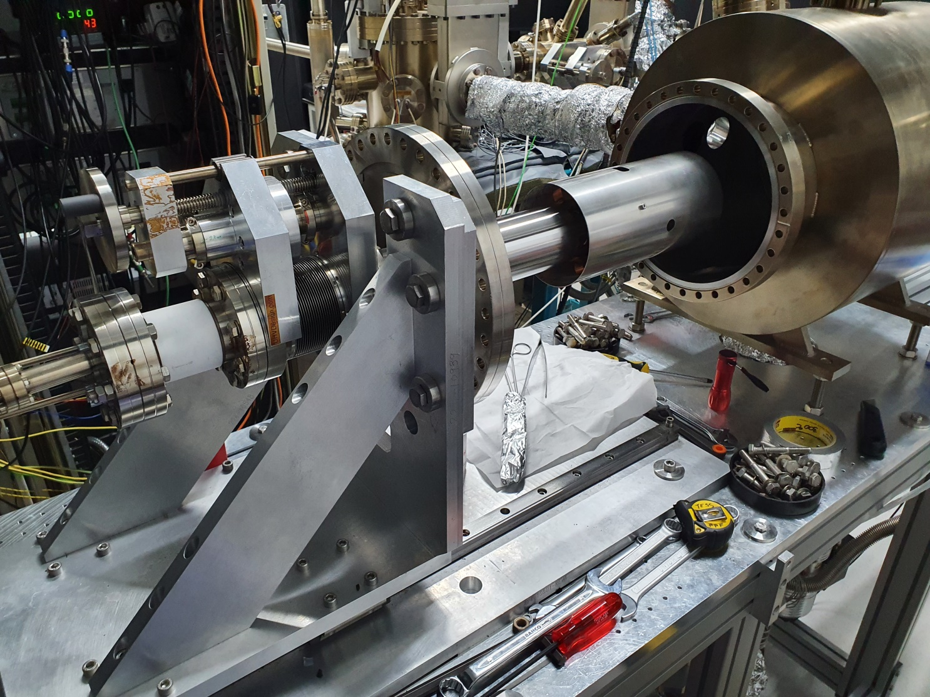
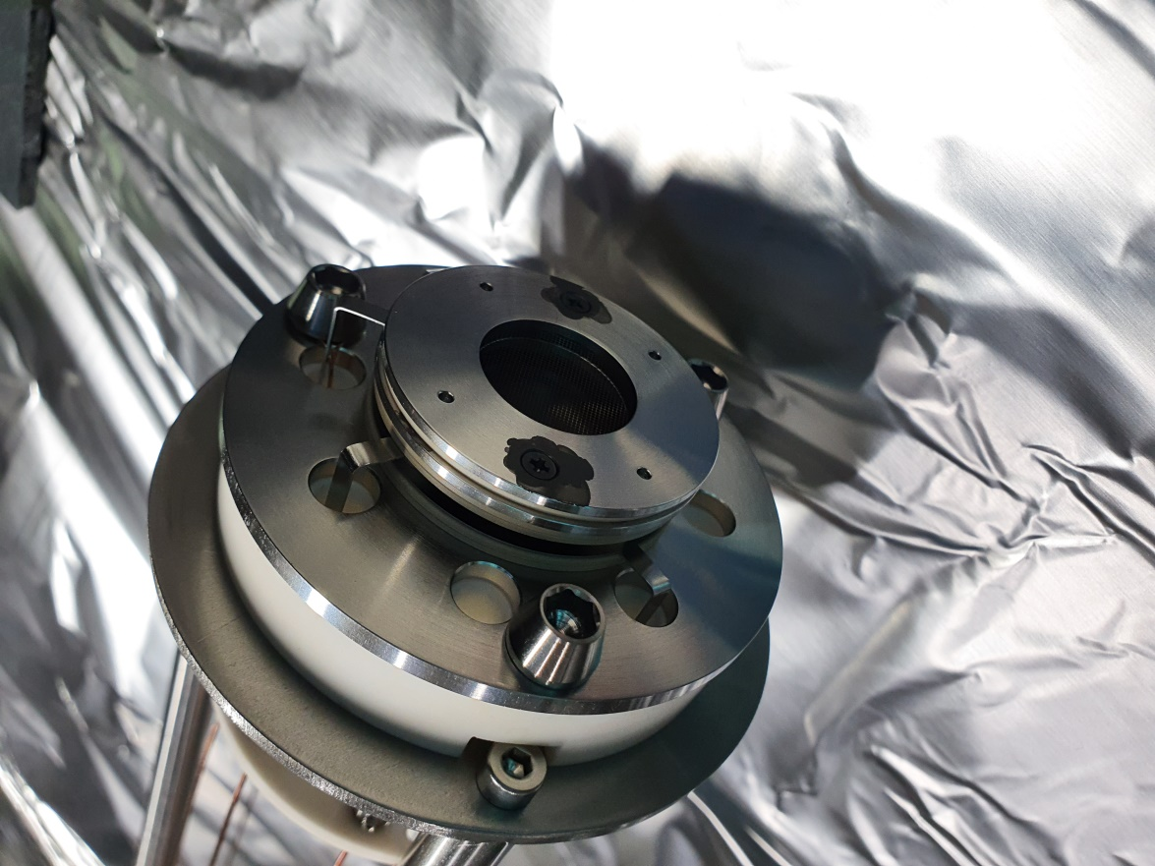
The TESS Instrument

Slide 4
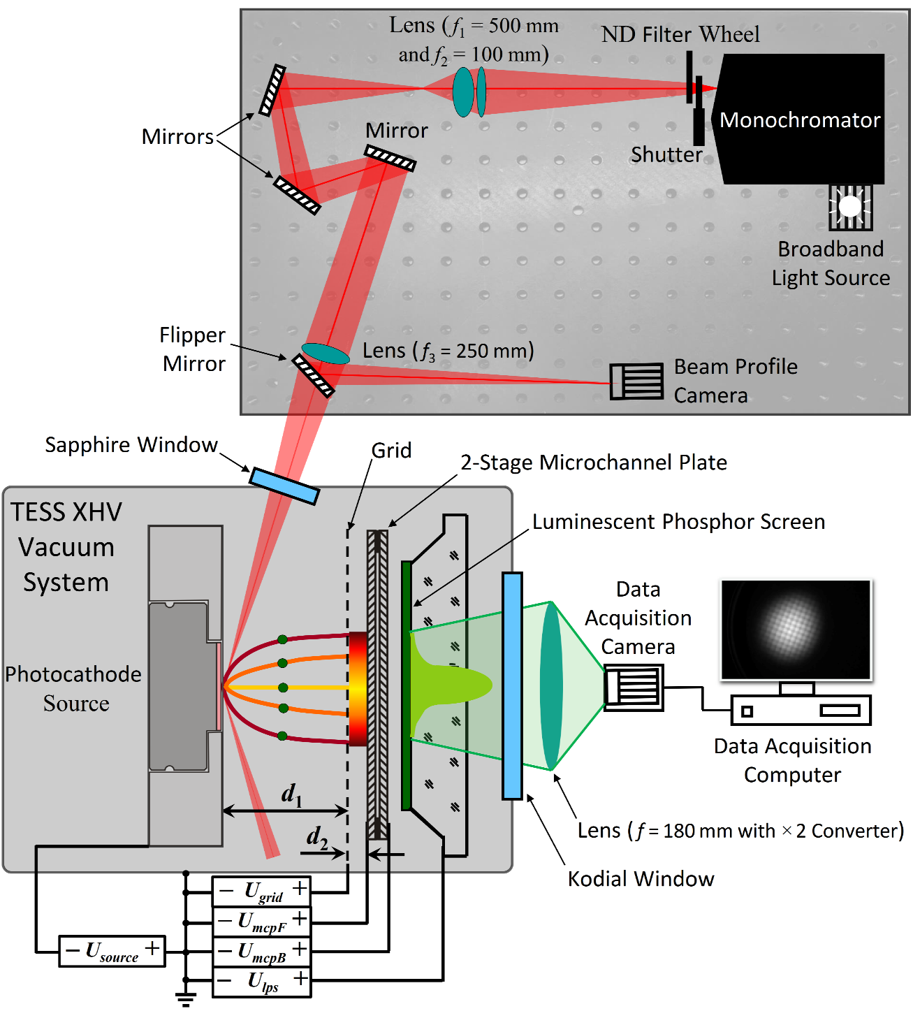
Brief TESS Overview
TESS Specifications
Wavelength | 200 nm to 2000 nm (operation typically 230 nm to 800 nm)
Monochromator Bandwidth | ± 1 nm
Light Spot Size | approx. 100 µm
Camera Exposure | Typically 1s to 120s
Cathode dimensions | 6 mm x 2 mm circular pucks
Chamber Pressure | < 5 x 10⁻¹¹ mbar
Aggregate error on each MTE measurement = 10 %
Optical Power Meter
The TESS instrument at Daresbury Laboratory measures the intrinsic transverse and longitudinal energy distributions of emitted electrons from chosen photocathode candidates.
These studies are important for optimized energy resolution.
*Not To Scale*

Slide 5
Degradation of polycrystalline Cu
Why polycrystalline copper?
It is a commonly used photocathode material
Easy to prepare, clean and characterise
Surprising lack of literature on degradation in UHV conditions

Slide 6
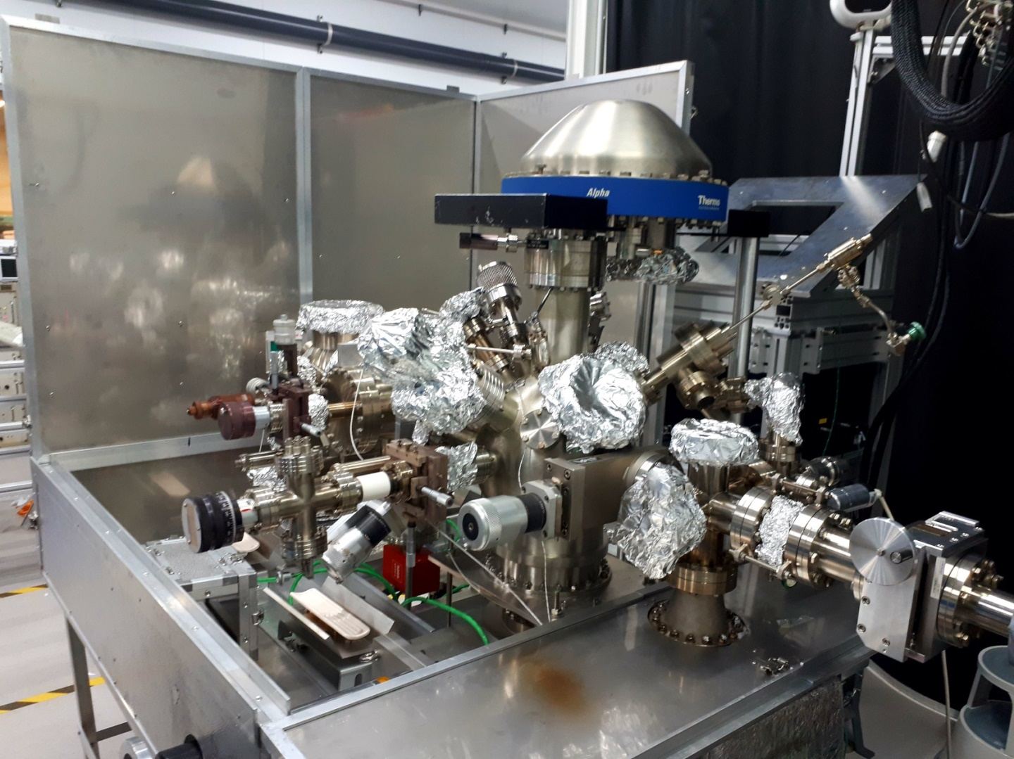
Degradation of the Cu polycrystalline Surface
A polycrystalline copper photocathode was prepared in Daresbury’s surface characterisation suite, the Multiprobe system*.
Sample transferred from Multiprobe to TESS via UHV suitcase (<1 x 10⁻¹⁰ mbar).
*T.C.Q, Noakes et al., CERN-ACC-2014-0039, EuCARD2-Mil-MS73-final

Slide 7
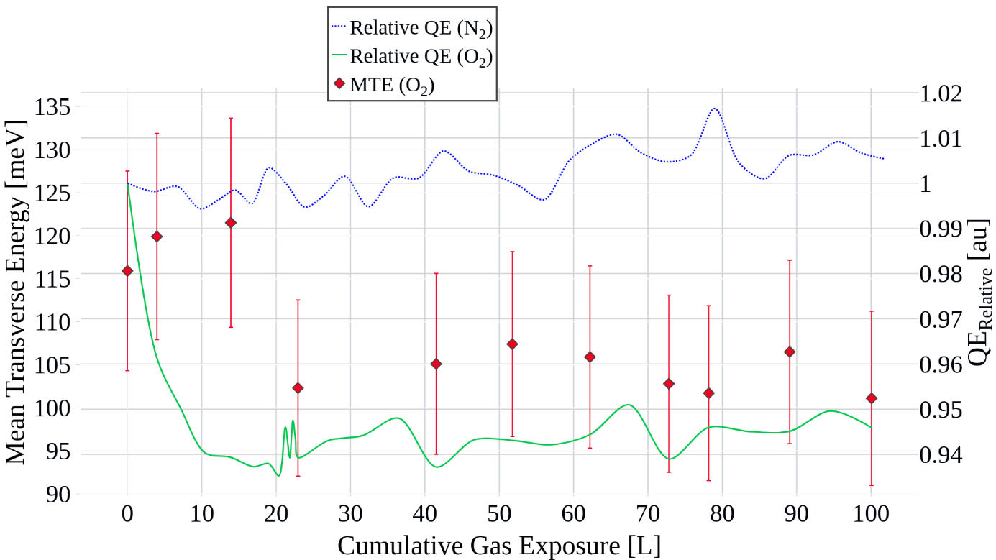
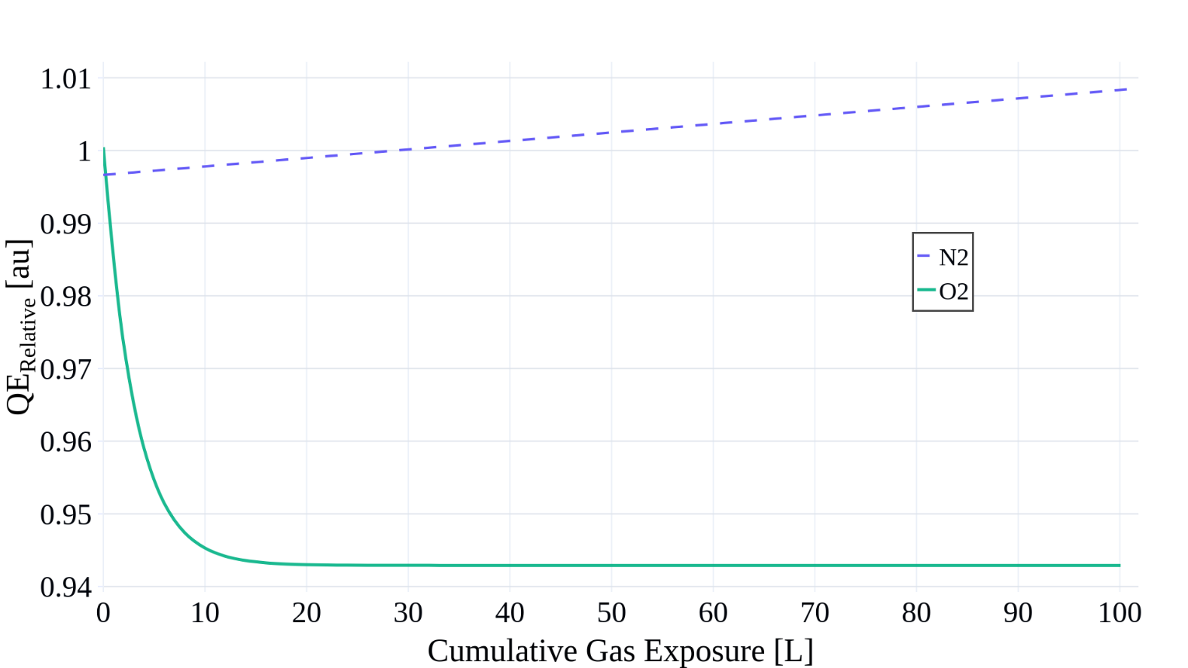
Cu (Poly) Degradation at 256 nm
Cathode subjected to a cumulative gas exposure of 100 L over a 5 hour experiment
O₂ is the gas species with the largest negative effect on QE
We see the relative QE plateau shortly after 10 L. This could be due to all active bonding sites being taken.

Slide 8
Cs implantation into Polycrystalline Cu
Why study Cs Implantation?
Attractive option to lower work function, with a possibly tuneable QE based off implantation depth and number of ions;
Easy to produce;
Potentially rejuvenate samples with additional implantation.

Slide 9
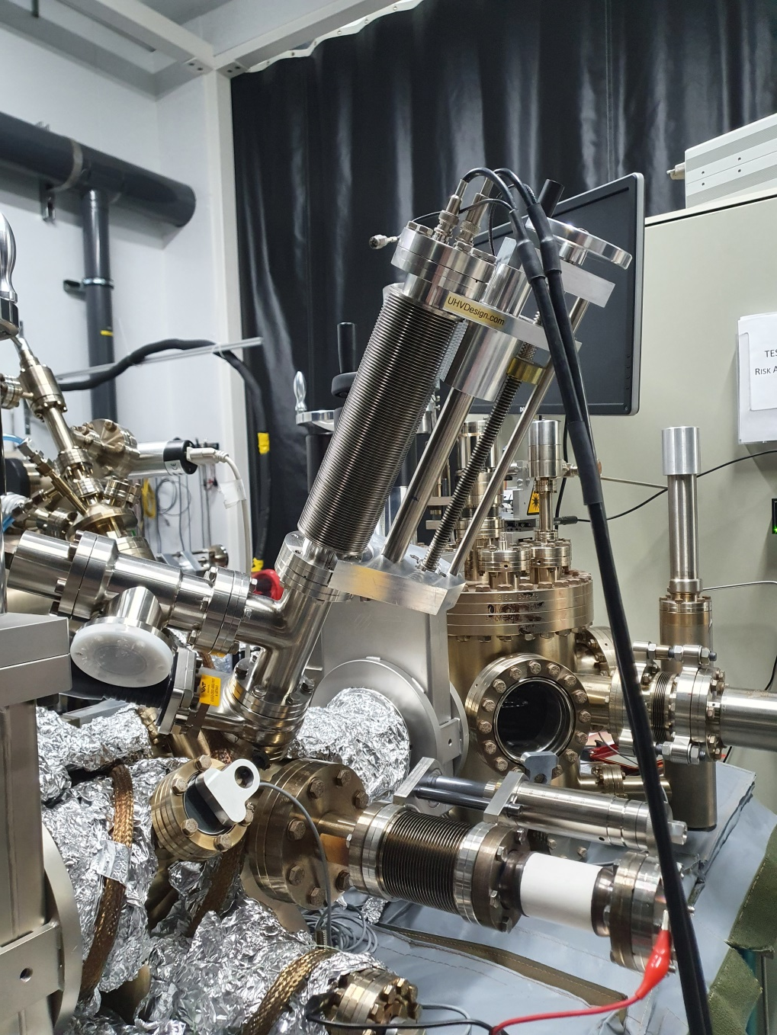
Experimental Setup
Implantation was performed in the cleaning chamber at a pressure of 1 x 10⁻⁹ mbar.
Cs ion source brought toward sample, calibrating with drain current.
2 implantation steps: first at 500 eV; second at 300 eV.
Cs Ion Source
Cs Ion Source
Gate Valve
Gate Valve
Callibration Plate
To Picoammeter
Sample on Transfer Arm
Callibration Plate

Slide 10
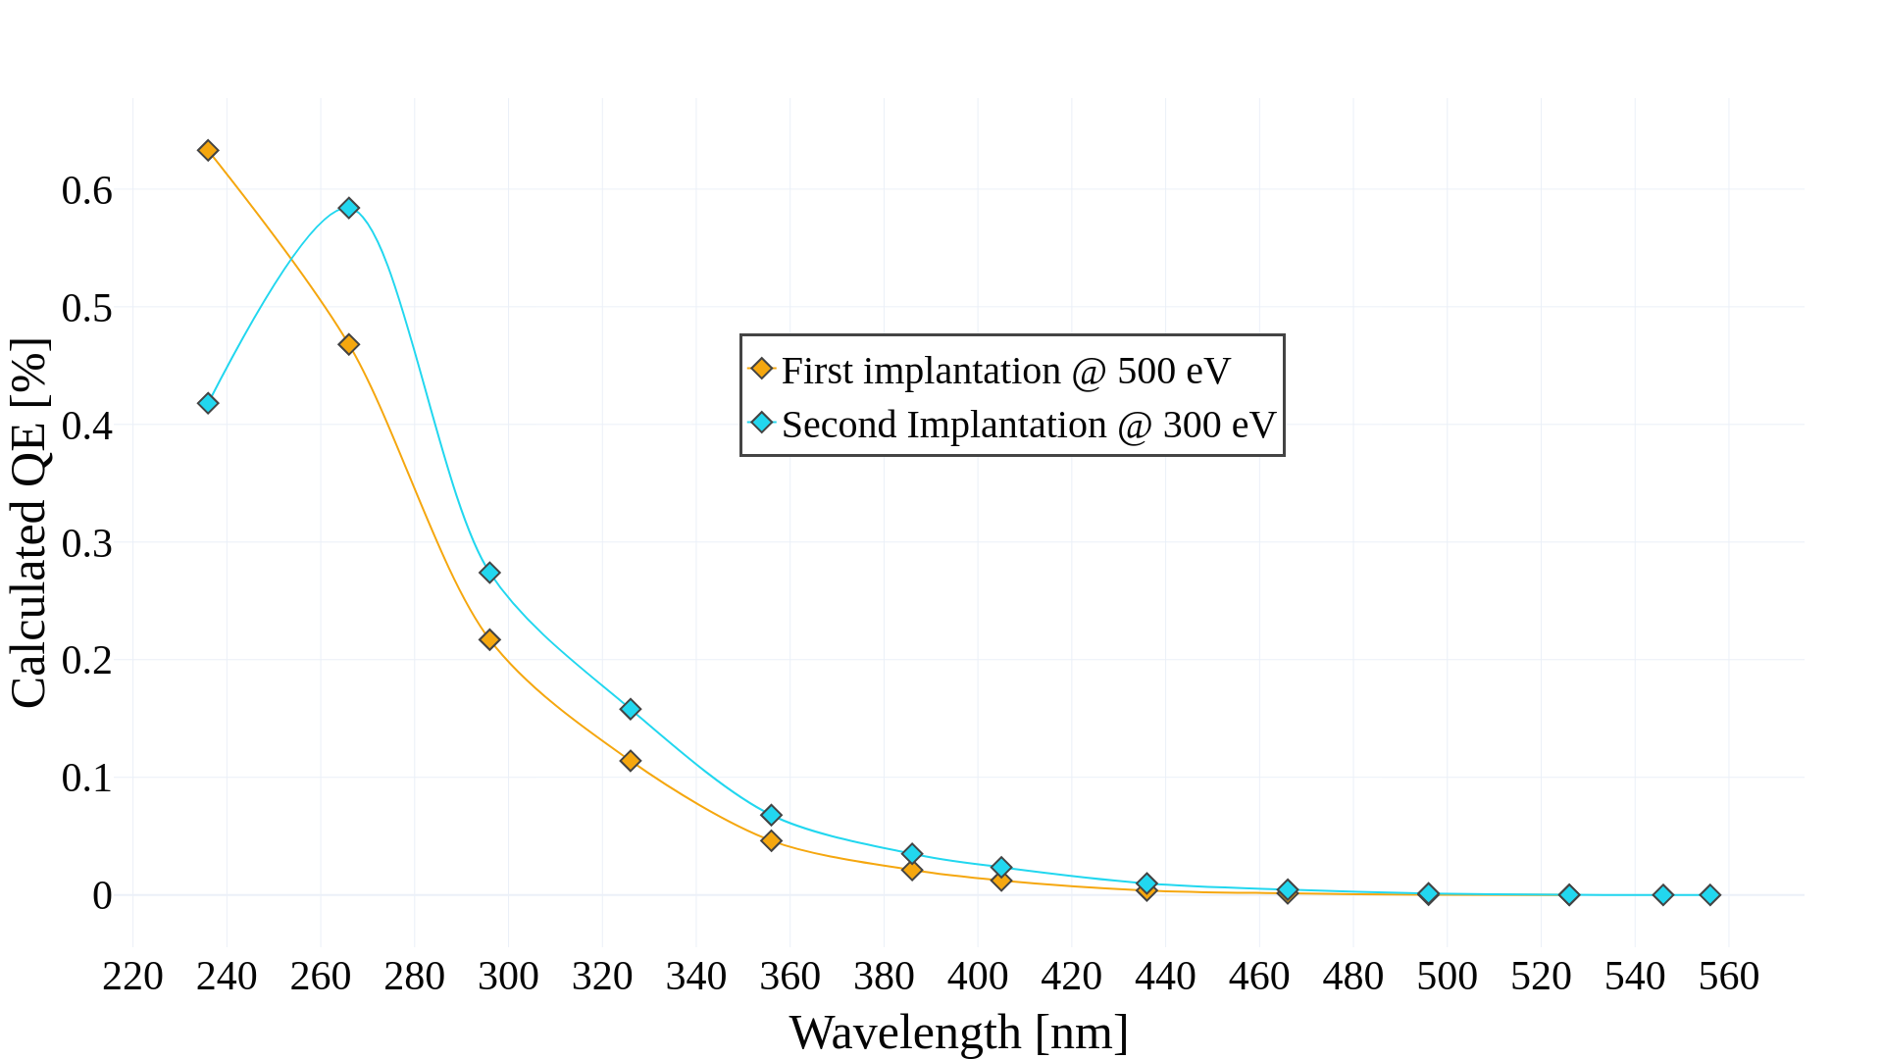
QE Values as a Function of Wavelength
Measured QE using a 405 nm laser gives a QE of 2.4E-2 %
Using the relative QE, we can calculate that at 266 nm the QE is approximately 5.8E-1 %
QE of a previously measured Cs-Cu sample at 266 nm with a UV laser had a QE of 3.1E-1 %

Slide 11
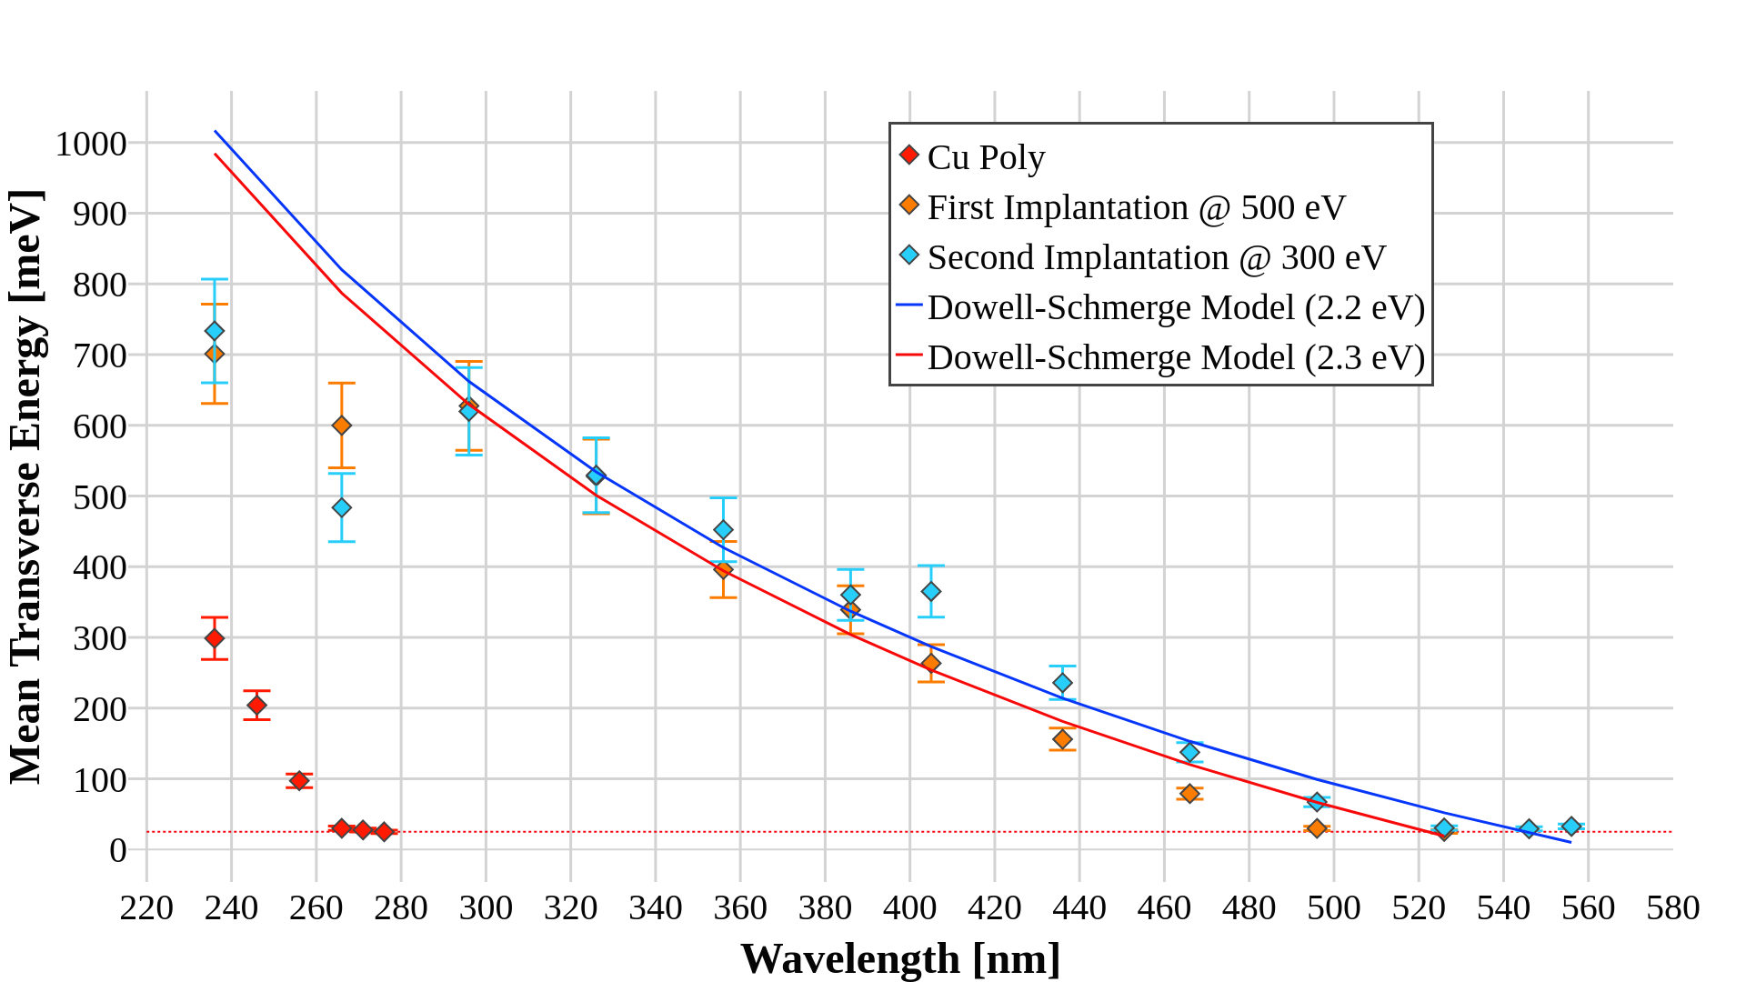
Implantation Step MTE
*
*
Reaches the thermal floor (25 meV) here!
*Herbert B. Michaelson, "The work function of the elements and its periodicity", Journal of Applied Physics 48, 4729-4733 (1977) DOI:10.1063/1.323539 and…
*S Cristofaro et al., 2020, Plasma Res. Express, 2, 035009, DOI:10.1088/2516-1067/abae81

Slide 12
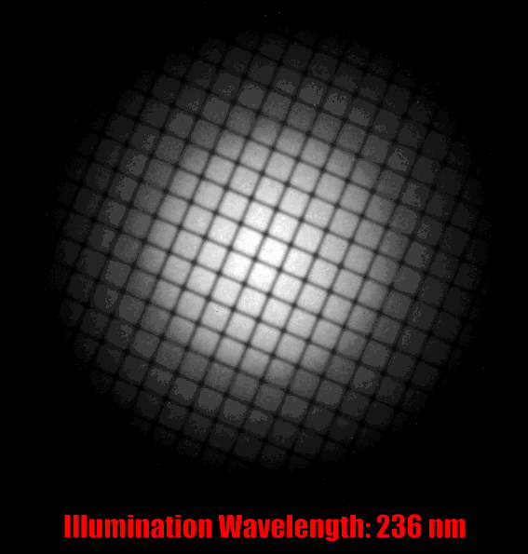
What we see on the screen
We see that at short wavelengths, where the Cu poly sample emits, there is a superposition of 2 spots.
This leads to the convolution of the measured MTE , which calls for a difference in analysis method.

Slide 13
First Implantation Second Implantation
At 266 nm we see differences in the superimposed spots

Slide 14
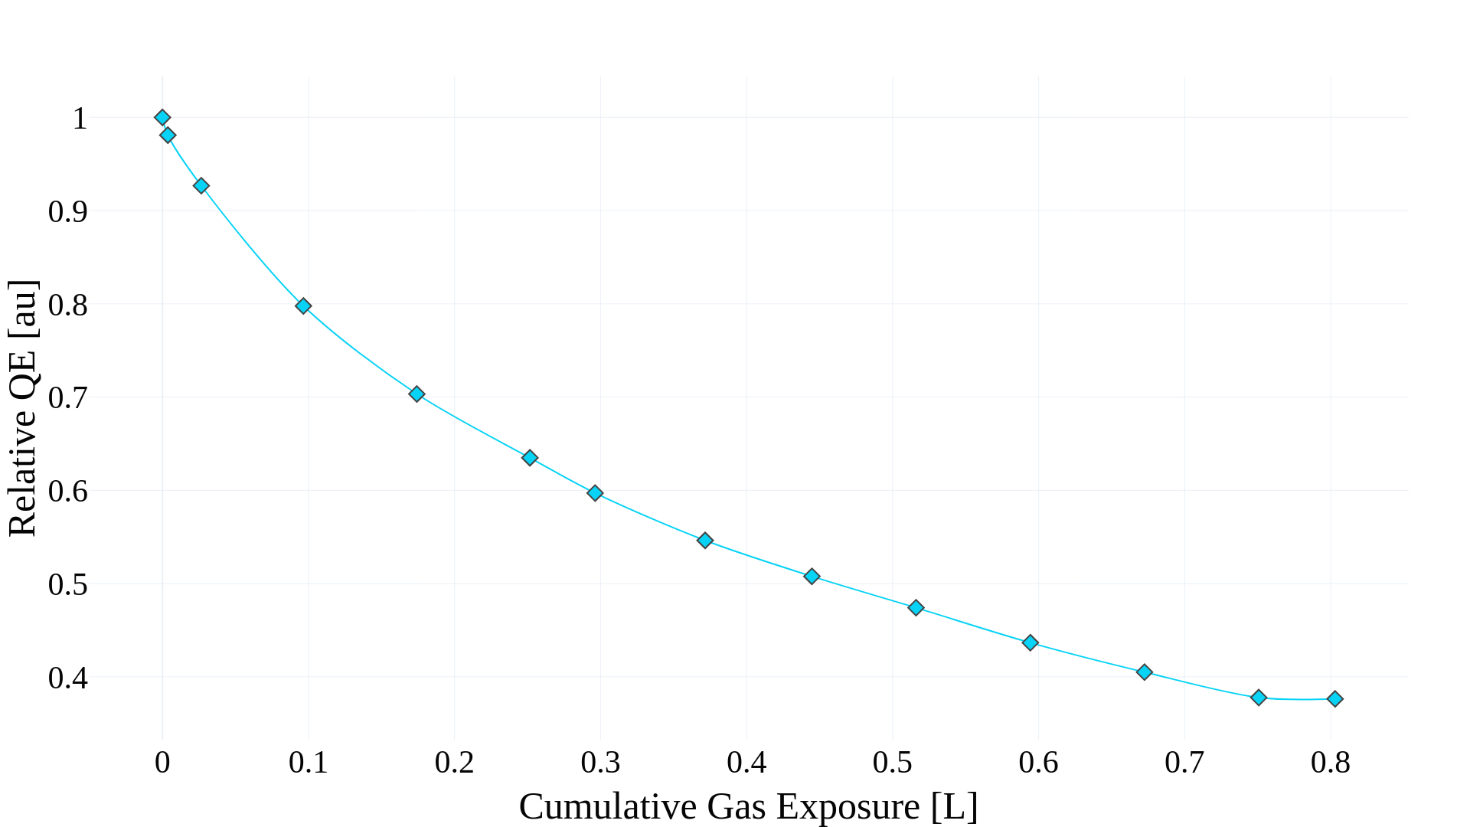
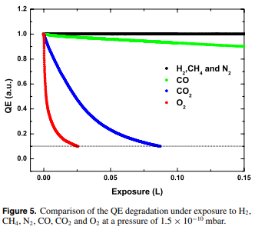
O₂ Degradation of Cs Implanted Cu
We see over a 60% drop in the QE in under 25 minutes.
This is slightly more robust than negative electron affinity GaAs*
*N.Chanlek et al., (2014), “The degradation of quantum efficiency in negative electron affinity GaAs photocathodes under gas exposure”, Journal of Physics D Applied Physics, 47. 055110. 10.1088/0022-3727/47/5/055110.

Slide 15
Further Work that can be done.
Further studies into Cs implanted Cu, optimizing implantation depth vs QE;
Replantation / rejuvenation experiments;
Medium Energy Ion Scattering (MEIS) studies.

Slide 16
Thank you for listening!
The Daresbury Lab Photocathode Team:
Dr. Andrew Vick Hugh Churn
Dr. Lee Jones Liam Soomary (Ph.D. Student)
Dr. Tim Noakes Chris Benjamin (Ph.D. Student)
Dr. Reza Valizadeh
Prof. Carsten Welsch
Lola (Site Overlord)
EWPAA 2022 - Milano

Slide 17
Additional Slides

Slide 18
Relative QE Calculation
The gain provided by the MCP was found to double for each increase of 41 V in difference between the MCP back and the MCP front:
Where ∆MCP is the voltage difference between the MCP back plate and the MCP front plate. The estimated relative QE for each wavelength is then calculated using the equation:
Where the Corrected Image Intensity is the intensity of the photoemission after background subtraction, t is the exposure time and (P $×$ T) is the power of the transmitted light falling on the cathode.
$$MCP Gain=2^{\frac{∆MCP}{41}}$$
$$Relative QE=\frac{Corrected Image Intensity}{t×\left(P×T\right)×MCP Gain}$$

