Slide 1

Review of recent photocathode advancements
L. Monaco – INFN LASA

Slide 2
Outline
Photocathodes required performance
Metals
Semiconductors
  Cs₂Te
  Alkali antimonide
Photocathode improvements
Photocathode diagnostic improvement in production systems for operation
News on photocathodes test facilities
The modern approach to photocathode developments and advancements

Slide 3
Photocathodes required performance

Slide 4
Photocathodes principal applications
Moderate currents
Low emittance
Ultrafast electron diffraction/microscopy
High brightness
Very low current
Short pulse duration
Polarized
High polarization
High QE
Electron beam for e-cooling
High average current (>100mA)
High bunch charge (1nC)
Low emittance
FEL sources
Semiconductors
Metals
Semiconductors
Metals
NEA Semiconductors
Semiconductors

Slide 5
Photocathode Requirements
High QE
  High QE relaxes requests on laser performance
  Near threshold operation for thermal emittance reduction may benefit
Stable QE with good spatial uniformity
  Reduced inhomogeneities improve photocathode emittance
Low thermal emittance (or MTE)
  Brightness improved
Robustness (vacuum condition)
  Up-time for machine operation
Low dark current
  Clean machine operation and reduce component activation
Long operative lifetime
  as long as possible depending on the applications…from wks to months
Reproducible recipe is a must to limit machine parameter changes!!

Slide 6
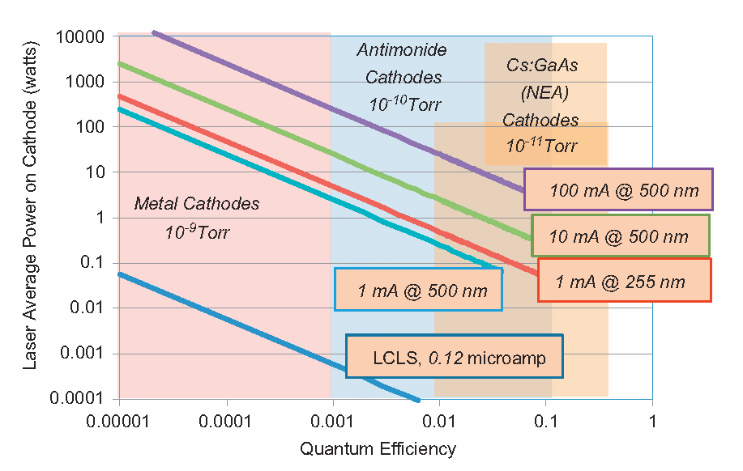
Photocathode families
D. Dowell et al., NIM A 622(2010) 685
Metals
  Low QE
  Very fast response time
  Long lifetime
Semiconductor
  High QE
  Fast response time
  Sensitive to vacuum
  conditions
Photocathode for polarized electrons
  Very sensitive to vacuum
  conditions

Slide 7
Metal Photocathodes

Slide 8
Metal Photocathode
These cathodes (Cu, Mg) are commonly used in normal conducting low repetition rate, high frequency, high gradient RF gun.
They are the photocathodes of the BNL/SLAC/UCLA S-band RF guns and of the LCLS gun.
SRF guns use either Nb or Pb deposited on the RF gun end plate for fixed cathodes. For exchangeble photocathodes, different materials are possible.
Pros
  Unlimited lifetime
  Low sensitivity to vacuum condition
  Very fast response time
  Low field emission
  Low emittance
Cons
  High work function
  Low QEs
  No polarization possible

Slide 9

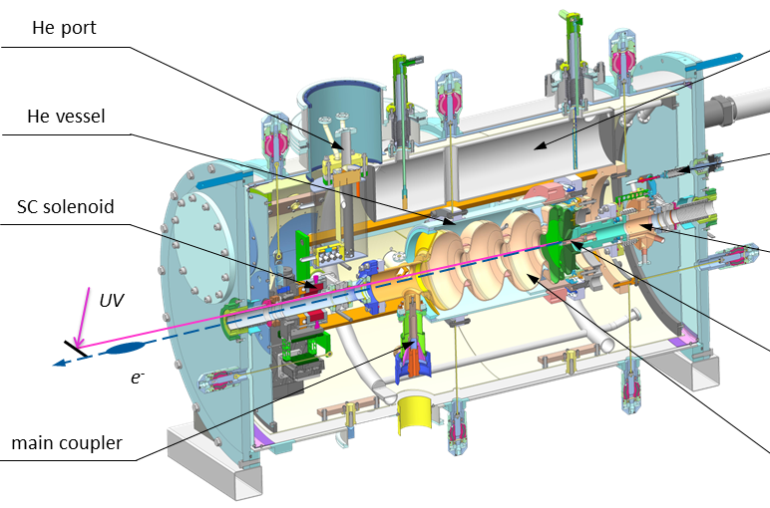
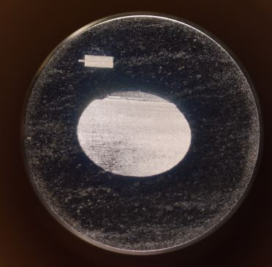
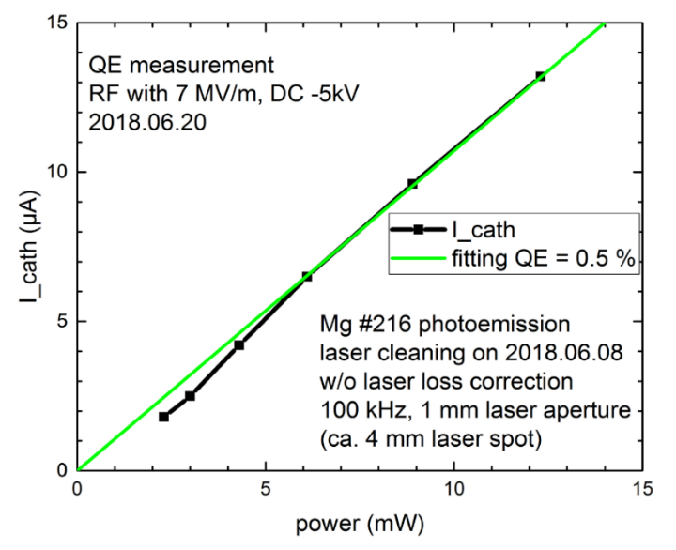
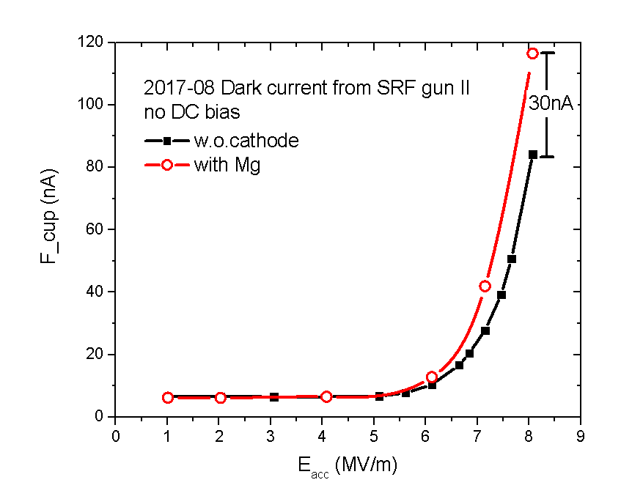
Metal photocathodes for HZDR SRF gun
Highlight:
2014 successful commissioning with Cu
2019-2020 stable operation with Mg ~ 1760 h beam time, ~ 57 C charge
2020-2021 user operation with Cs₂Te (see Cs₂Te section)
Mg cathode status: stable operation
high QE with UV laser, long life time
no multipacting problem
low dark current
repeatable (can be cleaned several times)
J.Teichert et al. PRAB 24, 033401 (2021)
Mg plug after laser cleaning
I_{dark} ~ 30 nA from Mg E_{cathode}=14 MV/m
QE_{258nm}~0.2%-0.5%
R. Xiang, Snowmass2021 Electron Source Workshop, Feb 2022

Slide 10



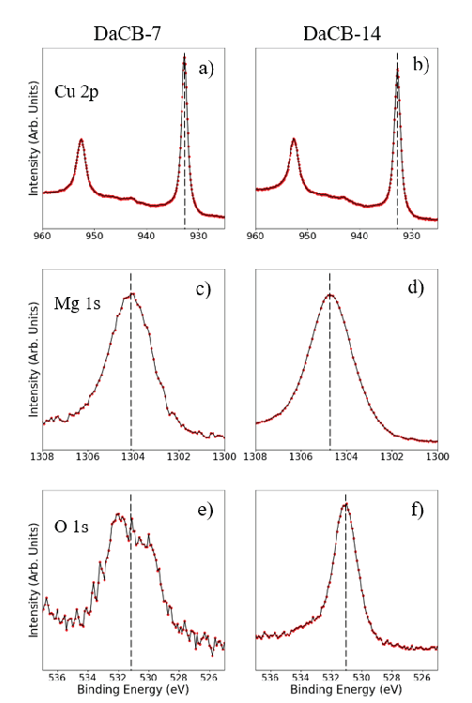
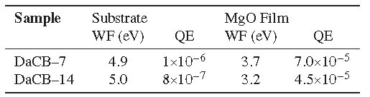
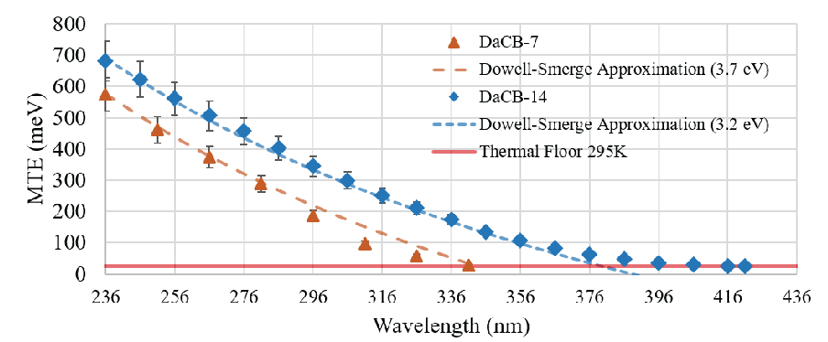
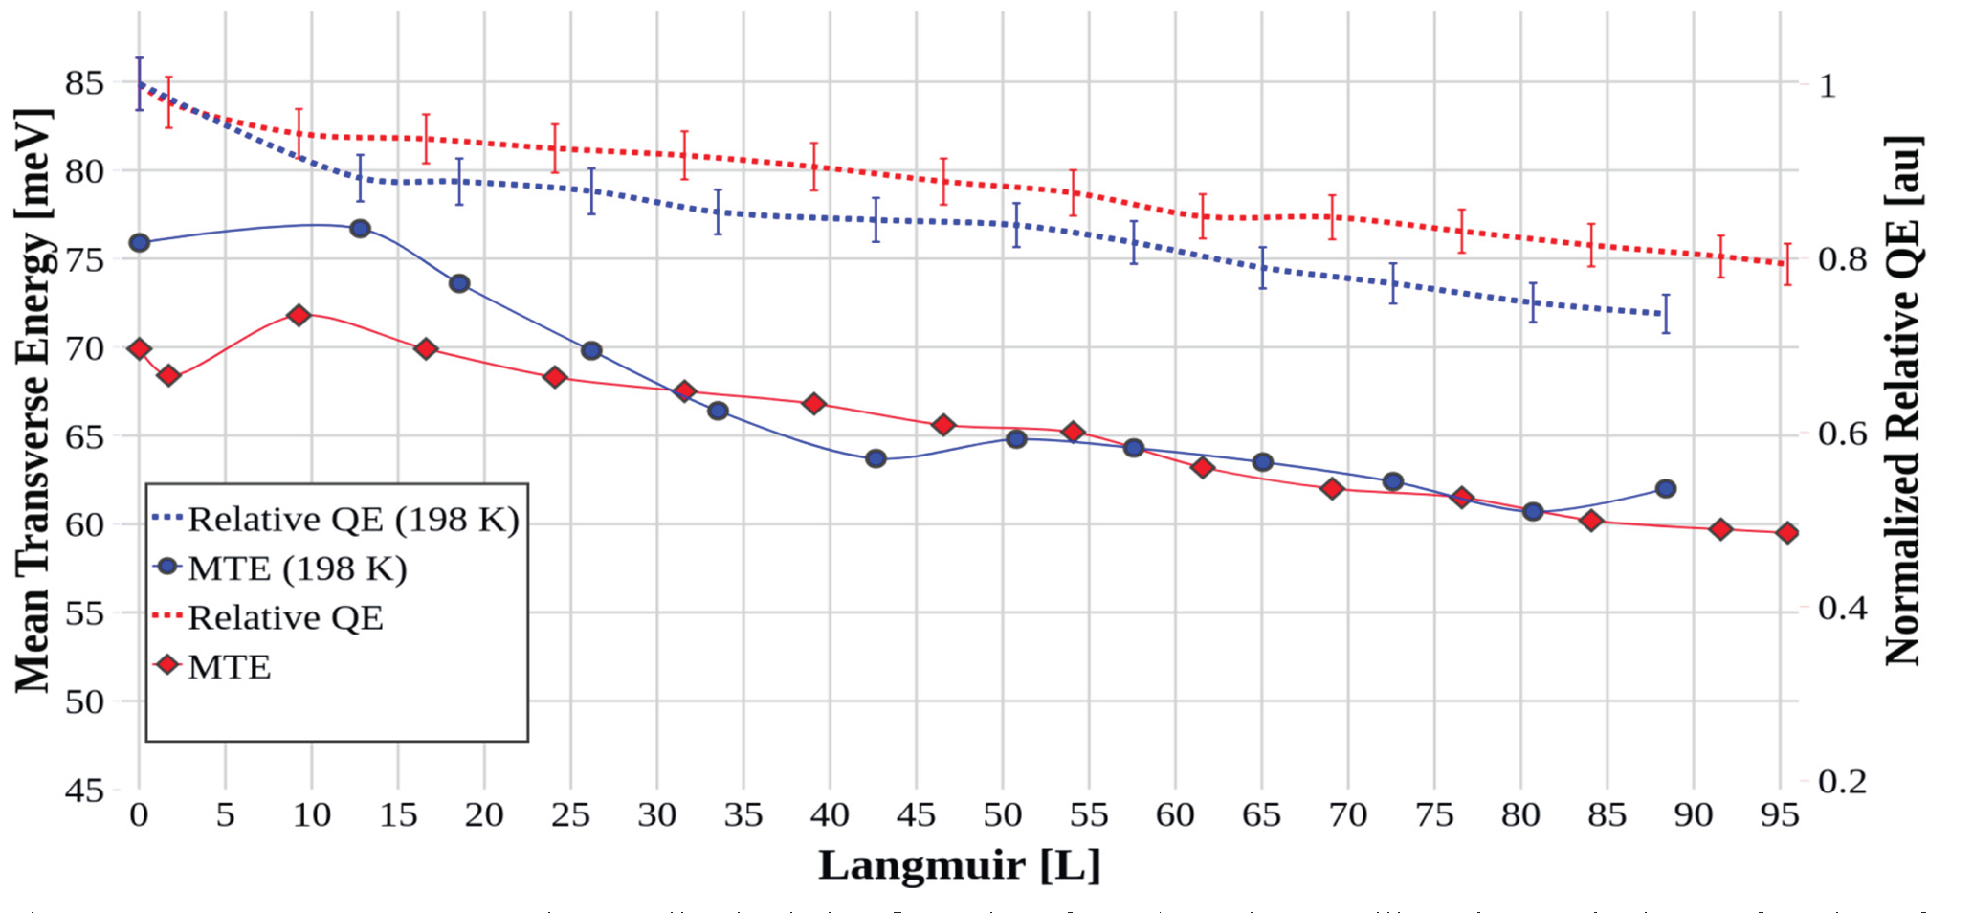
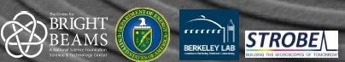
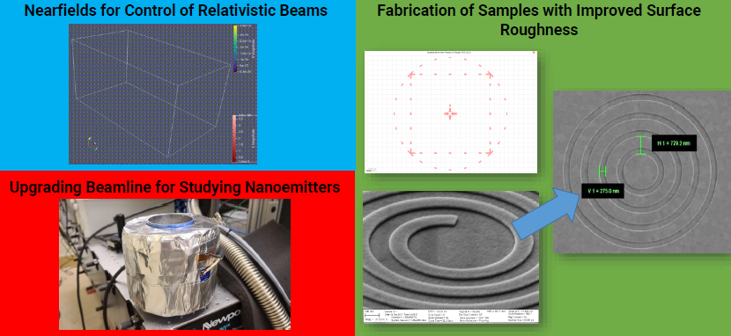
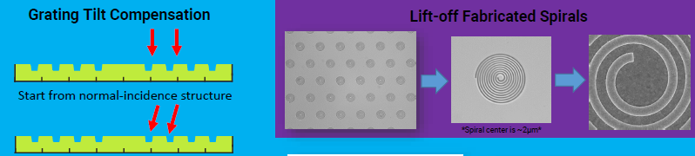
Study activities
MgO on polycrystalline Cu cathode
QE @ λ = 266nm (4.7 eV)
XPS
  work function lowering
  (increase of QE)
  increase of robustness
  measured MTE with TESS
C. Benjamin et al., MOPOMS025, IPAC2022
TESS
Ag - Polycrystalline vs single crystal
L. A .J. Soomary et al., THPOPT034, IPAC2022
  Ag polycrystalline shows a lower QE degradation w.r.t. single crystal Ag
  QE degrades faster under cryogenic condition
  -> at cold, higher sticking of O₂ to the surface
TESS
Femtosecond beam from flat surface
  Combine benefit of tip and flat emitters to get femtosecond, few electrons beam with high brightness.
C. M. Pierce et al., P3 workshop, November 2021

Slide 11
Semiconductor Photocathodes

Slide 12
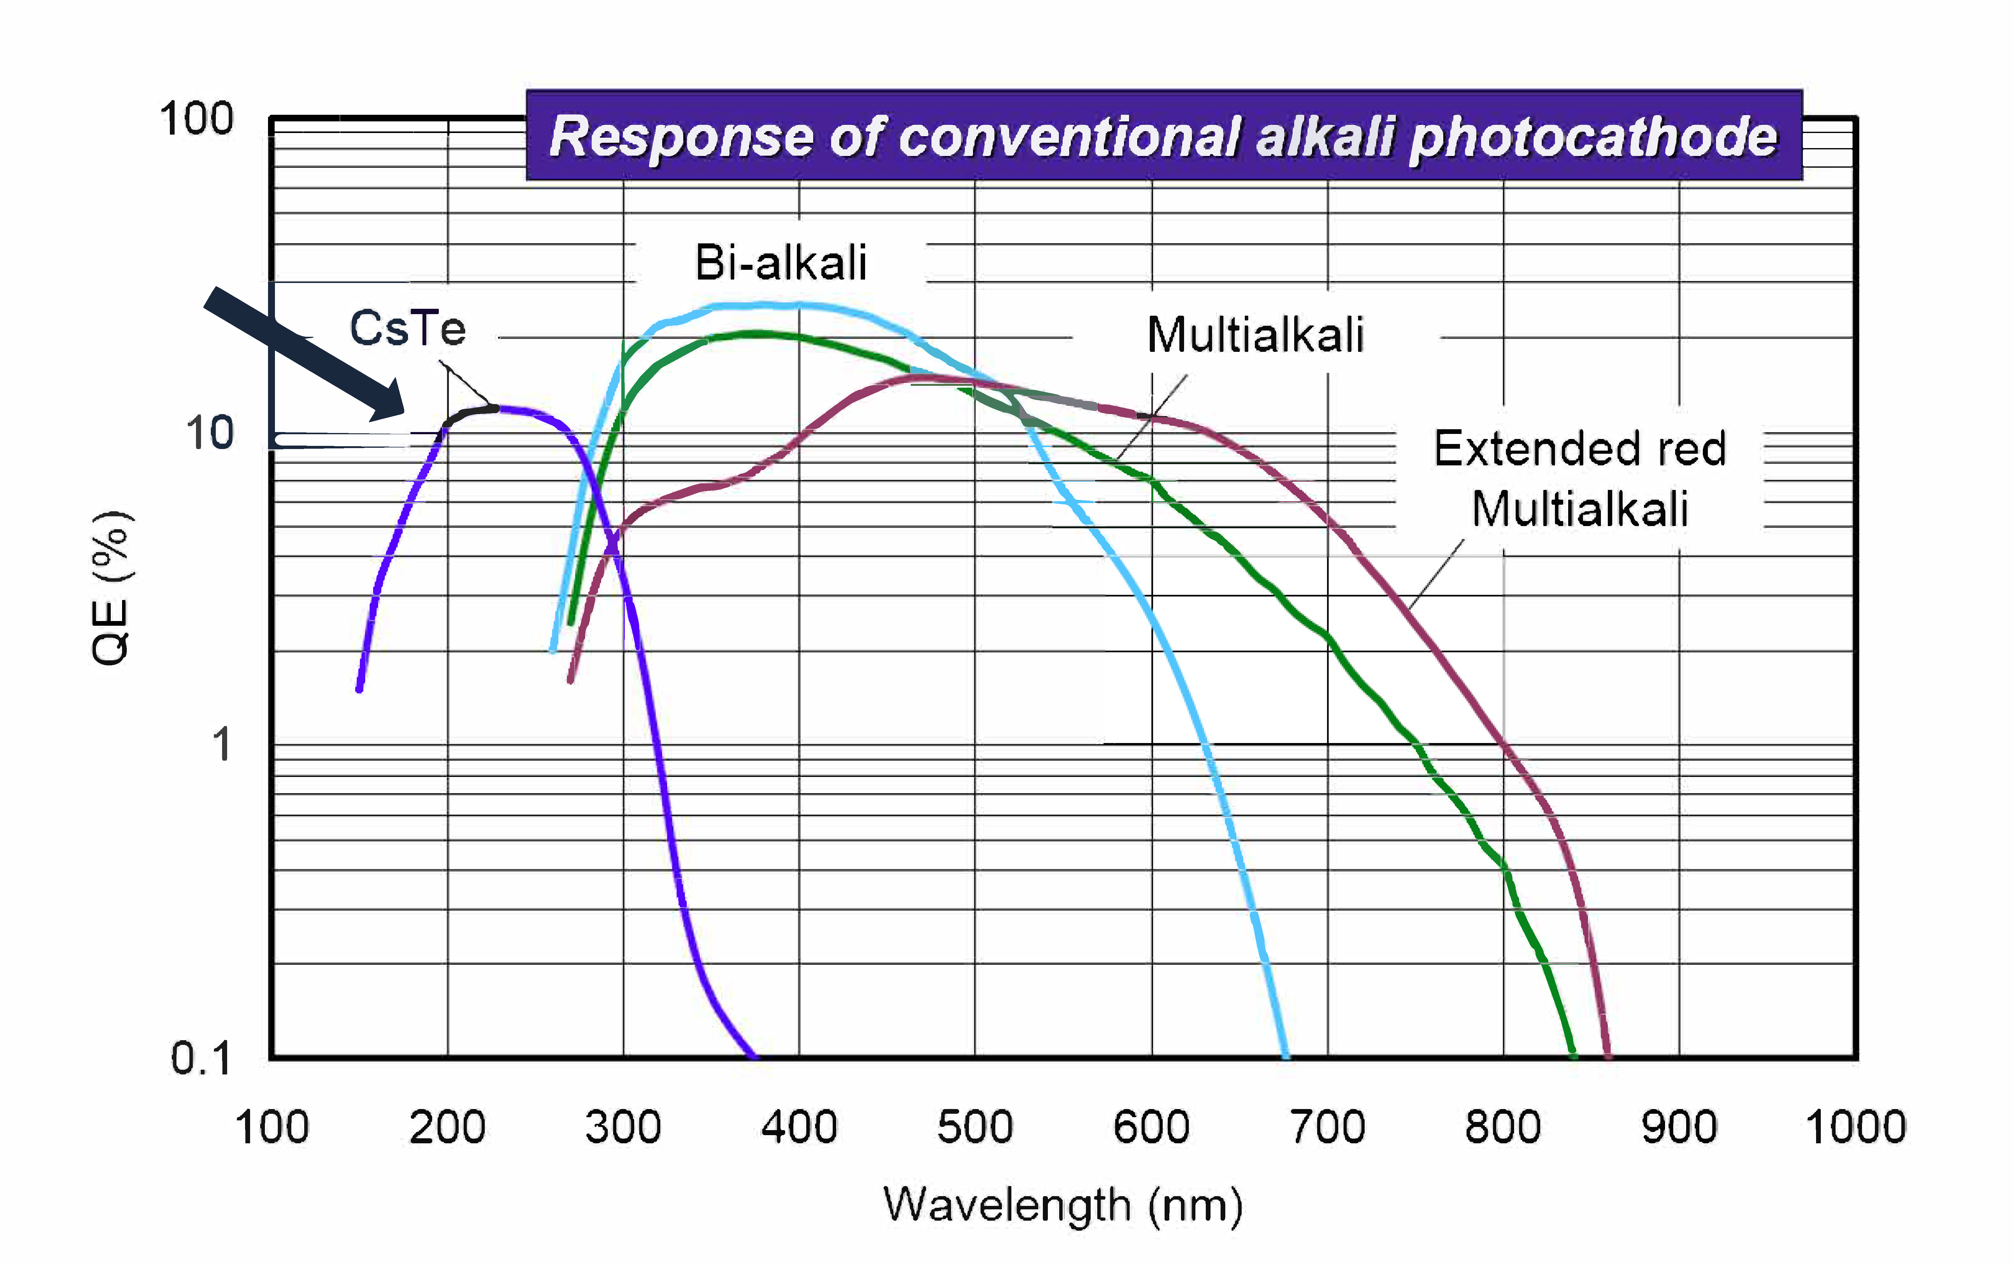
Introduction
High charge, long pulses and high repetition rate machines require high QE photocathodes given the limited average laser power to some tens of Watts.
Semiconductor photocathodes have high QE, but they are sensitive to gas exposition and require UHV conditions.
Their use in Gun requires also:
  QE uniformity
  Low dark current
  Long operative lifetime
  Stable operation along
  the train
  Fast response time
  Low thermal emittance
UV
10⁻⁹ - 10⁻¹⁰ mbar
Visible
10⁻¹⁰ - 10⁻¹¹ mbar
J. Smedley, Snowmass2021 Electron Source Workshop, Feb 2022

Slide 13
Alkali Telluride
C₂Te

Slide 14


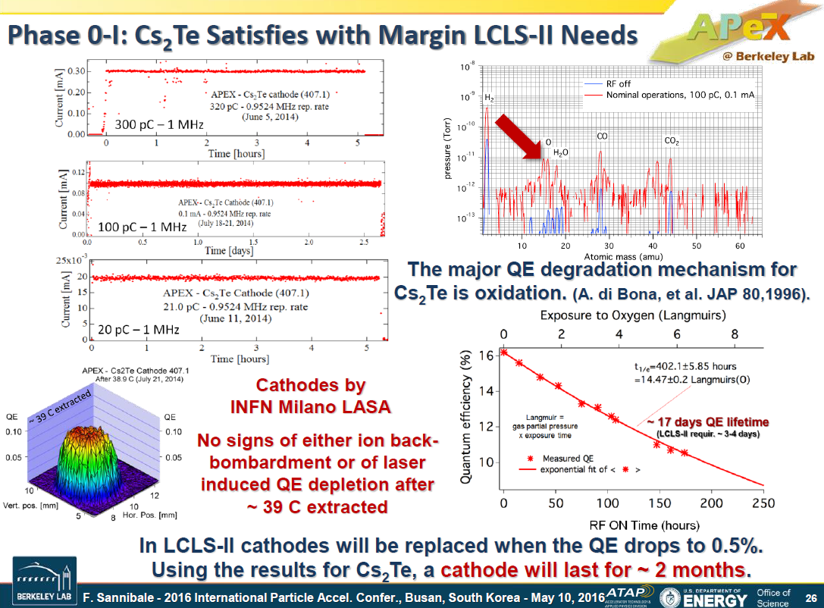


INFN LASA Cs₂Te Photocathodes
INFN LASA produce Cs₂Te photocathode since 90s and it’s a reference lab for this activity
With a continuos interplay between collaborators and R&D, we today growth cathodes that have few years of operative lifetime and are a reference for many accelerator complex for users.
More than 150 photocathodes delivered up to now!
Cs₂Te photocathodes have been demonstrated usable also
for CW operation.
Extracted charge: ~ 23 C
1063 days of oper. until now
Extracted charge: 32.2 C
1452 days of operation
D. Sertore, Snowmass2021 Electron Source Workshop, Feb 2022
F. Sannibale, TUOCA02, IPAC2016
S. Schreiber et al., TUP07, FEL2022

Slide 15
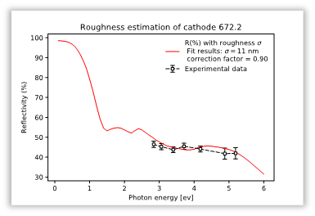
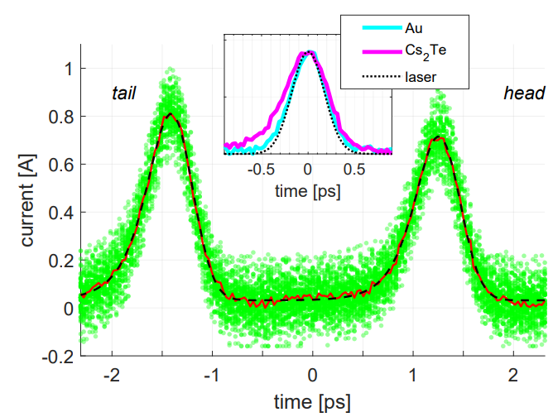
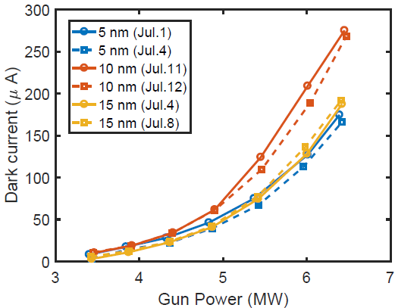
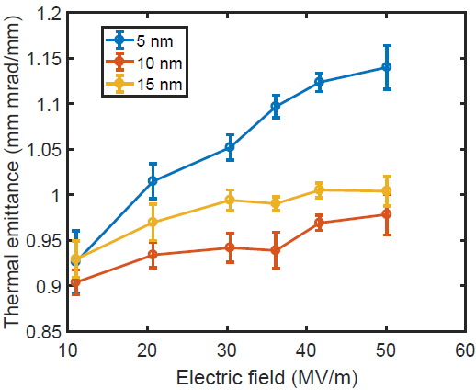
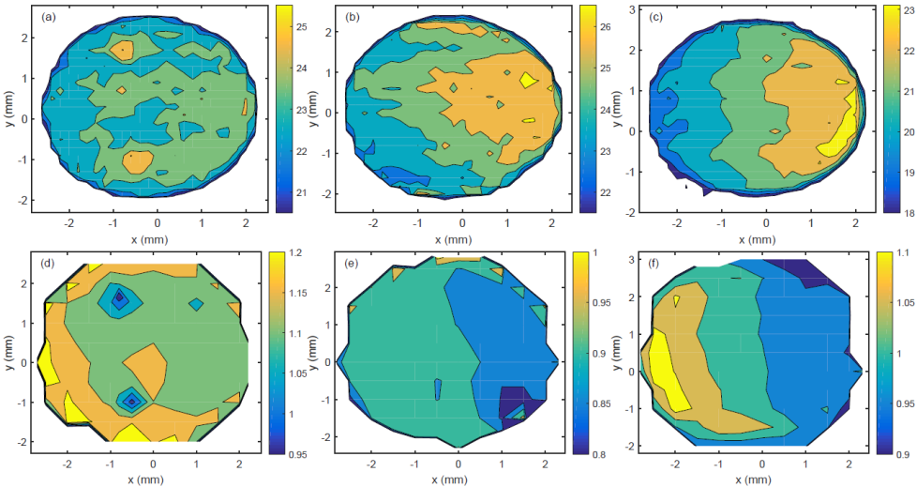

Photocathode Fundamental R&D
Deposition system is equipped with a “multiwave” diagnostics for the monitoring of optical parameters and QE during cathode growth
Measurements at PITZ and FLASH RF gun provide feedback to production process
R vs Cs Thickness
L. Monaco et al., WEA04, FEL2019
QE vs Cs Thickness and λ
Reflectivity during production
113.2 (5nm)
149.1 (10nm)
146.1 (15nm)
676.1 (5nm)
672.2 (10nm)
678.1 (15nm)
λ = 254 nm φ_{spot}=5 mm
Cs dep.
Te dep.
Response time
D. Sertore et al., THPOPT027, IPAC2022
Mo (R@λs)
Response time
Thermal emittance vs E
QE map (1st row) and thermal
emittance map (2nd row)
σ_{r}=11nm
σ_{r}=6nm
$$τ≈185 fs$$
σ_{r}=7nm
P. Huang et al., WEP062, FEL2019
G. Loisch et al., Appl. Phys. Lett. 120, 104102 (2022)

Slide 16
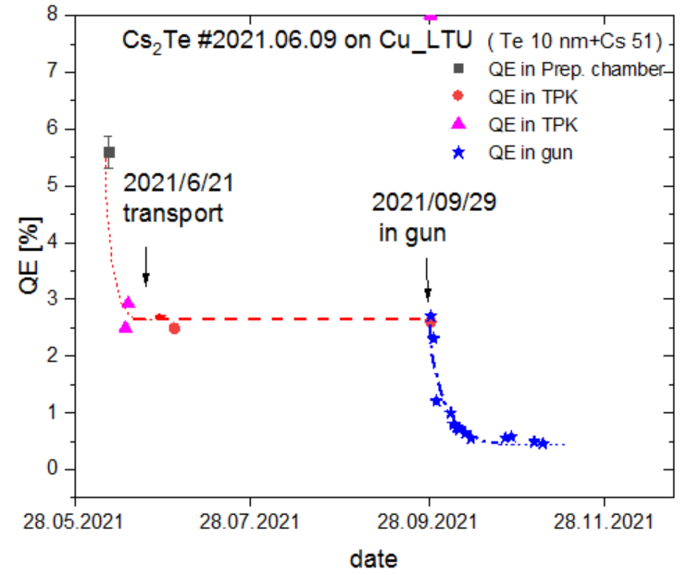
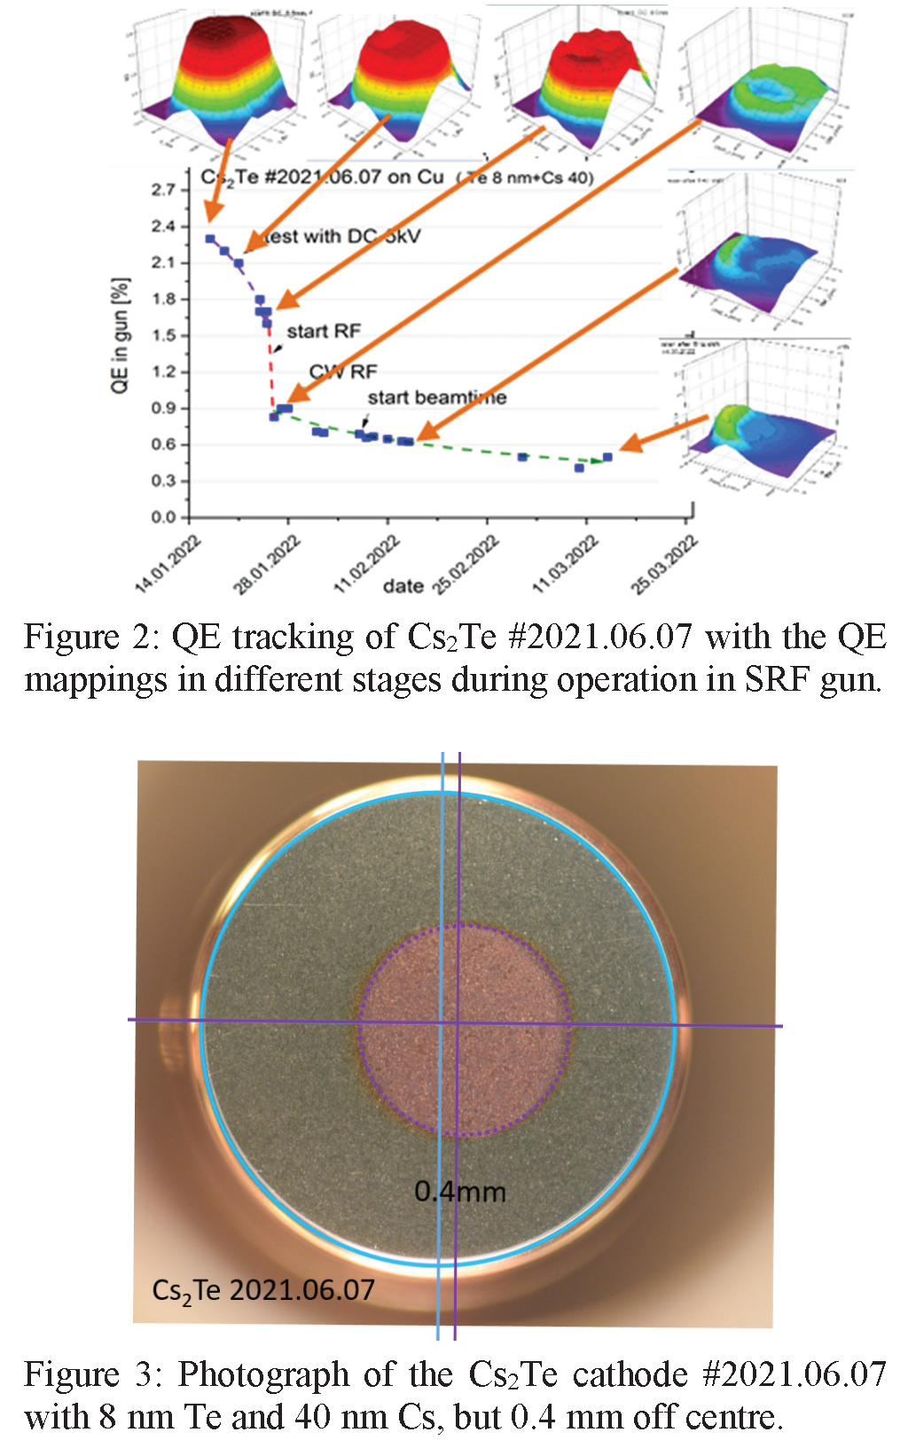
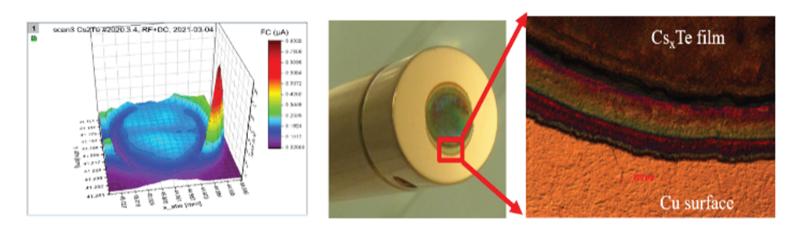
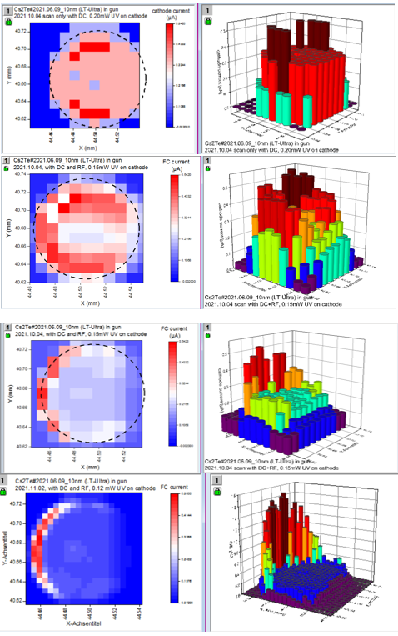
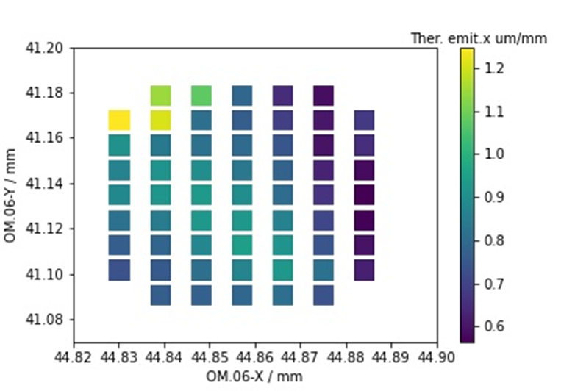
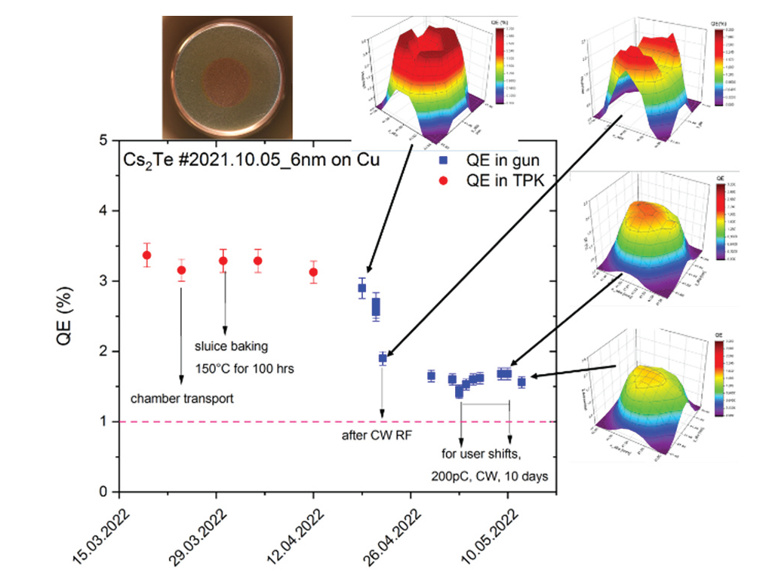
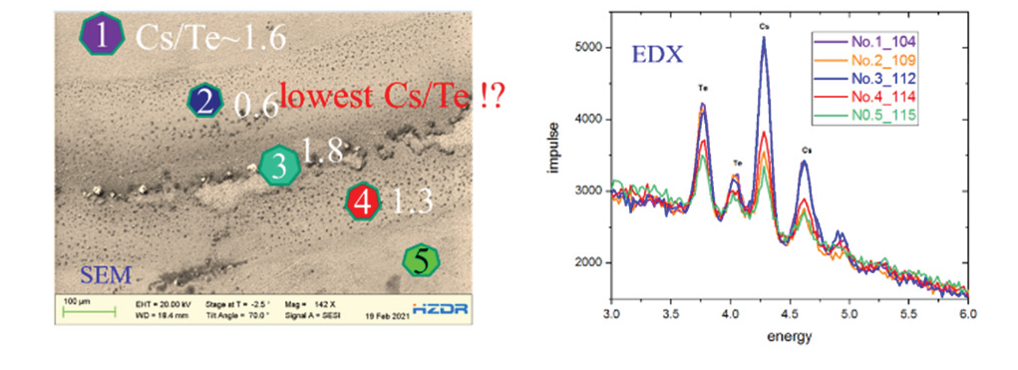
HZDR SRF Gun Cs₂Te on Cu operation
Switch from Mo substrate to copper substrate for improving thermal contact
2020.06-2022.02 extracted 91.3 C for 3064 h user beam (7 Cs₂Te)
Providing 200pC/2.3ps, 50-100kHz (CW)
2-3 months lifetime with QE 0.5%-1%
QE drops down due to transport, multipacting and beam operation
Up to now, 7 Cs₂Te cathodes have been operated in the SRF gun
Status: stable operation
thermal emittance 0.6-1.2 µm
SEM and EDX analysis after usage
R. Xiang et al., THPOPT022, IPAC2022
R. Xiang, Snowmass2021 Electron Source Workshop, Feb 2022

Slide 17






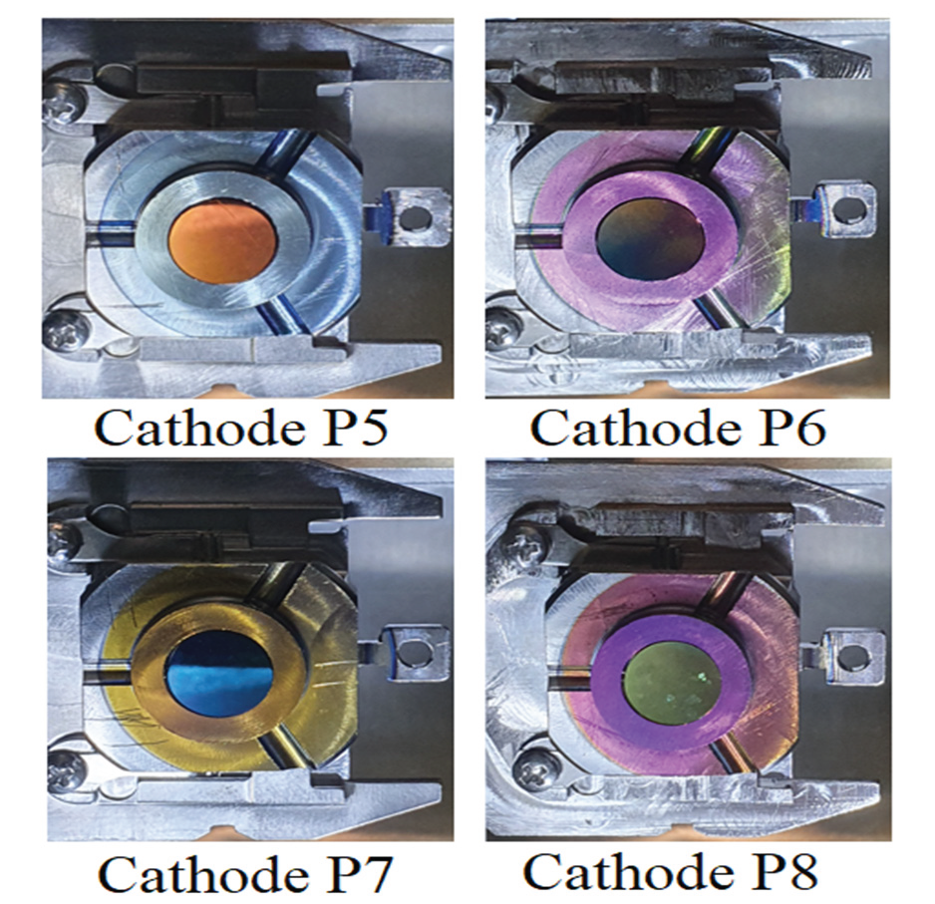
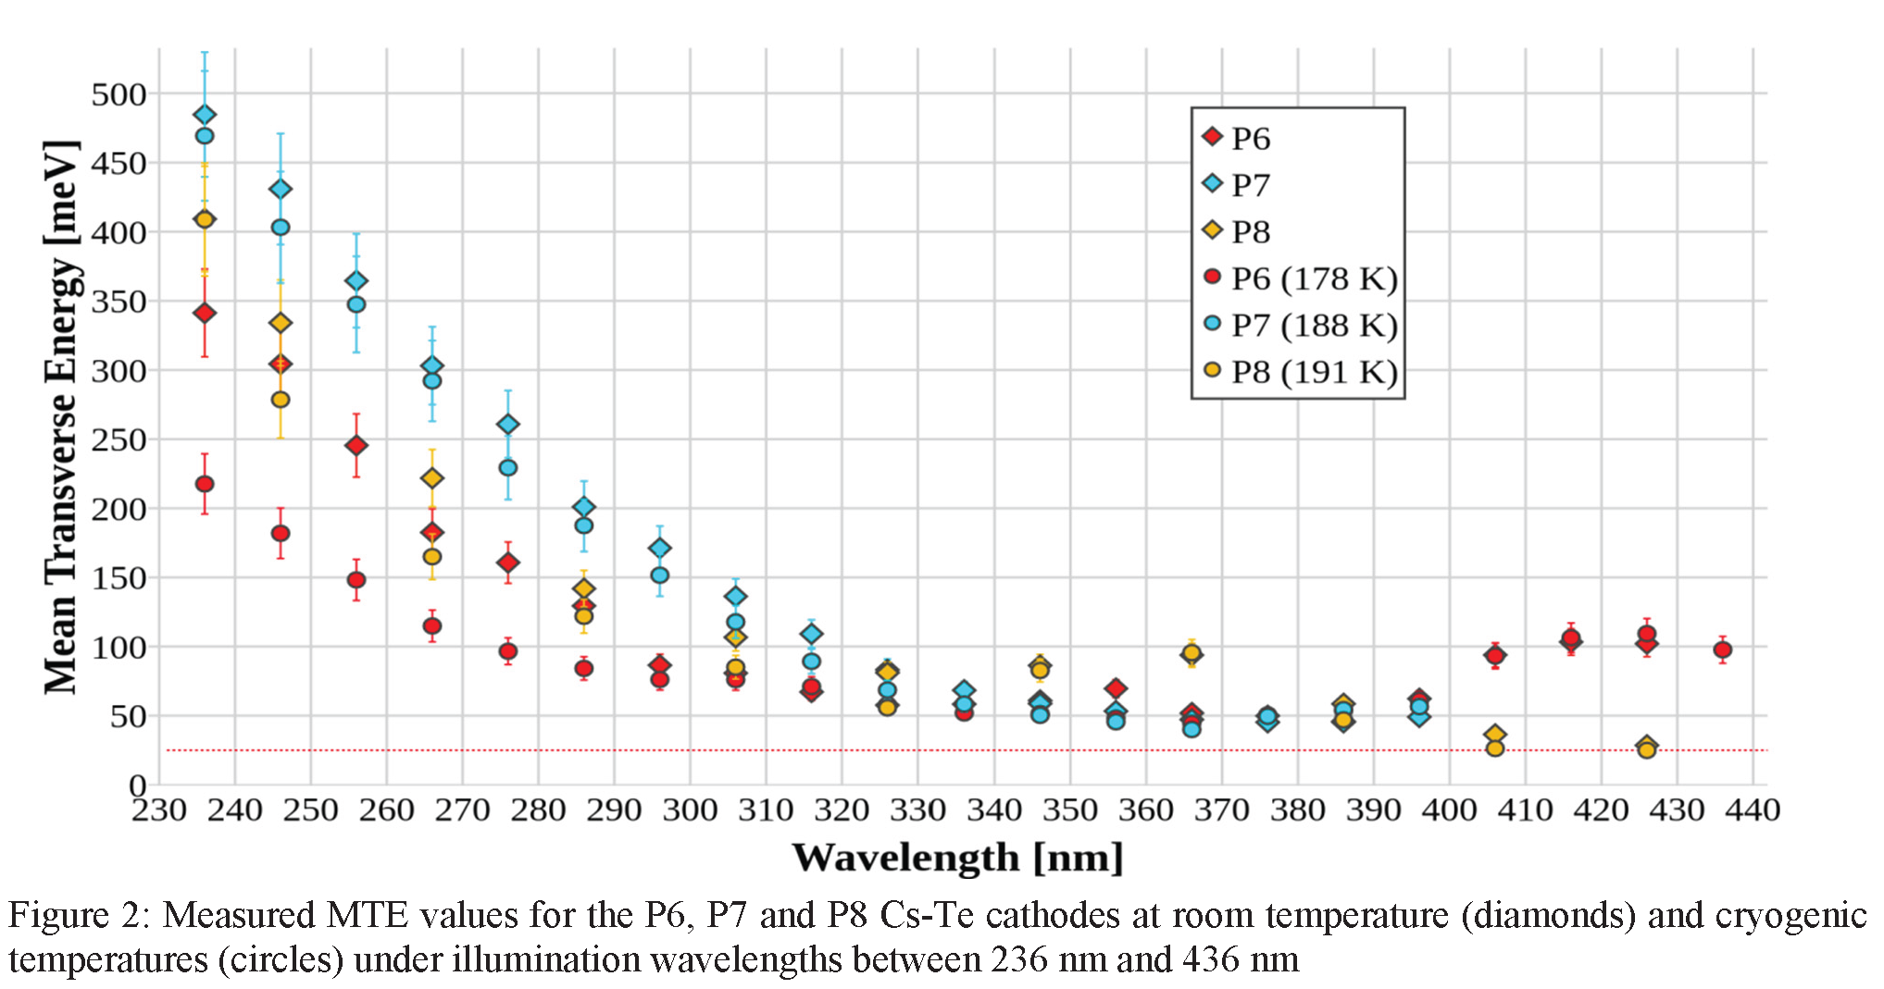
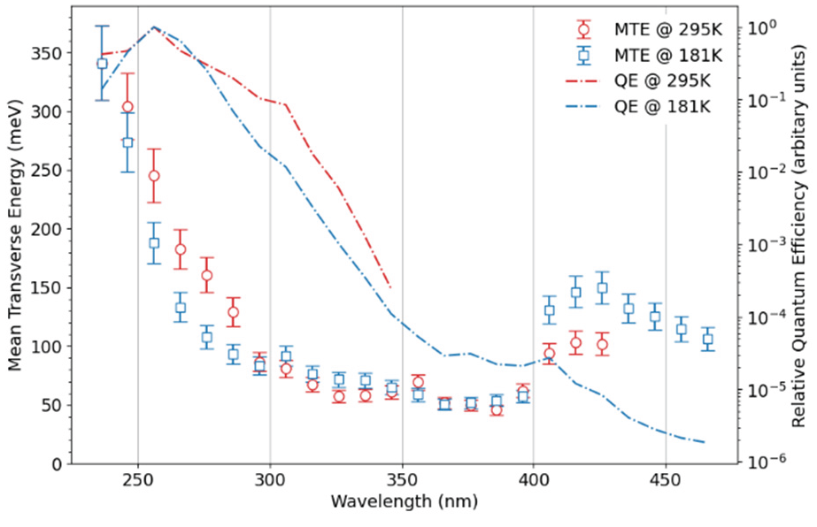
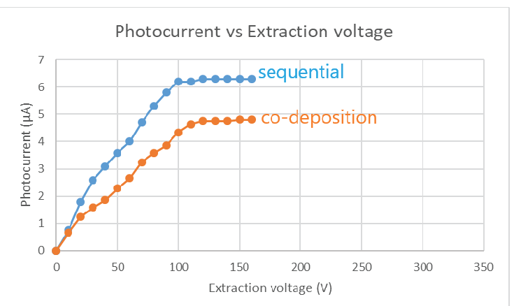
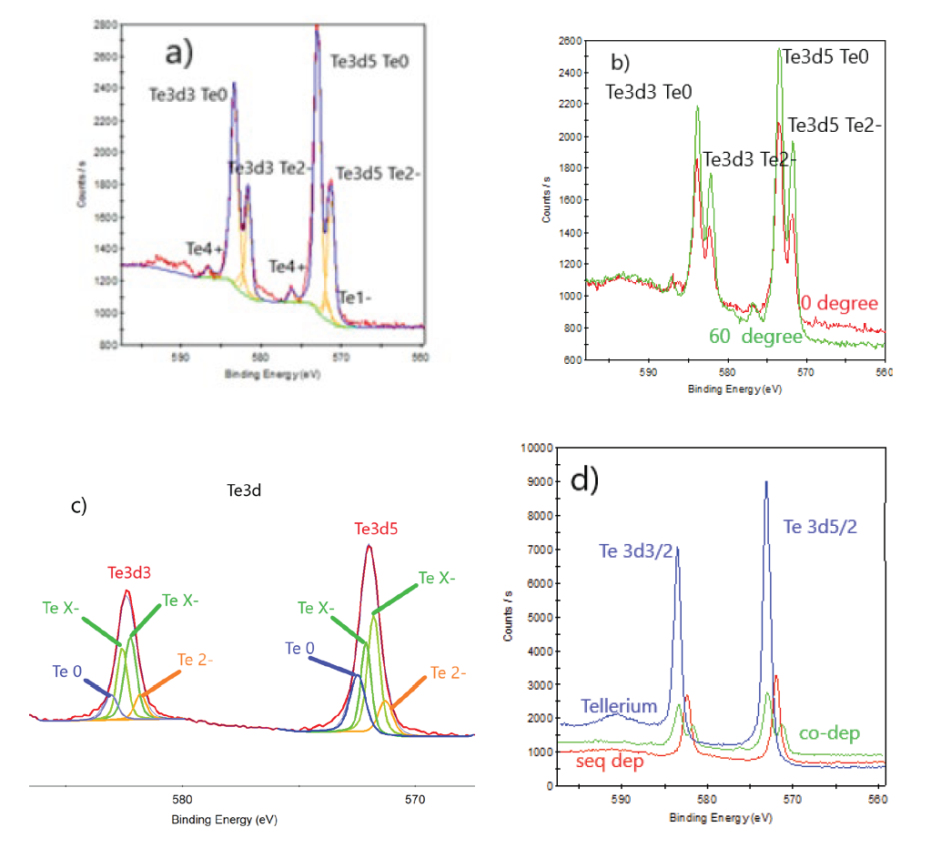
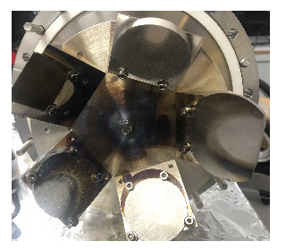
Cs₂Te co-evaporation towards production
Cs₂Te history:
Cu substrates prepared at Daresbury
Co-deposition at CERN
Delivery in UHV (1.10⁻¹⁰mbar)
Transfer in PPF (XHV 5.10⁻¹² mbar, p_{max} 1.10⁻⁹ mbar in transfer)
Cs₂Te diagnostic:
TEDC (Transverse Energy Distribution Curve) in TESS
λ = 236÷436nm (10nm step), T @ RT & cryogenic T
QE determined in TESS
XPS analysis -> evaluation of Cs/Te ratio, main peaks
TEDCs & XPS results
Films behave differently and this is confirmed by XPS results.
P6: large TEDC @ λs> 400nm, probably due to oxygen peak (XPS) that reduces the work function increasing MTE
L. A. J. Soomary et al., THPOPT033, IPAC2022
CLARA injector at STFC: S-band RF Gun, successfully operated with Cu cathodes
For FEL application, Alkali telluride (Cs₂Te) is chosen (Mo substrate)
Design of a new preparation facility for(also by ion beam deposition/implantation):
  metal, metal/oxide, caesium implanted on metal
  Alkali-Telluride and Alkali-Antimonide
Cs₂Te history:
Mo substrates (0.5mm thick)
Cleaning: acetone, methanol, deionized water in US bath, baking (p 10⁻⁹ mbar), ion beam spattering
Sequential deposition (1h for each) and Co-deposition (1h in total)
T 120 °C, 20nm Te (ion beam sputtering), Cs (source)
QE after deposition, XPS analysis
R. Valizadeh et al., MOPOMS027, IPAC2022

Slide 18
Alkali antimonide

Slide 19








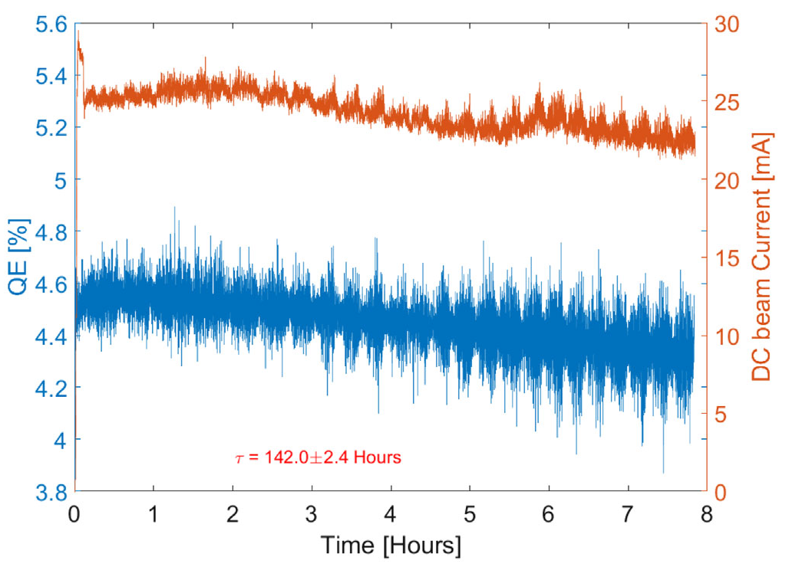
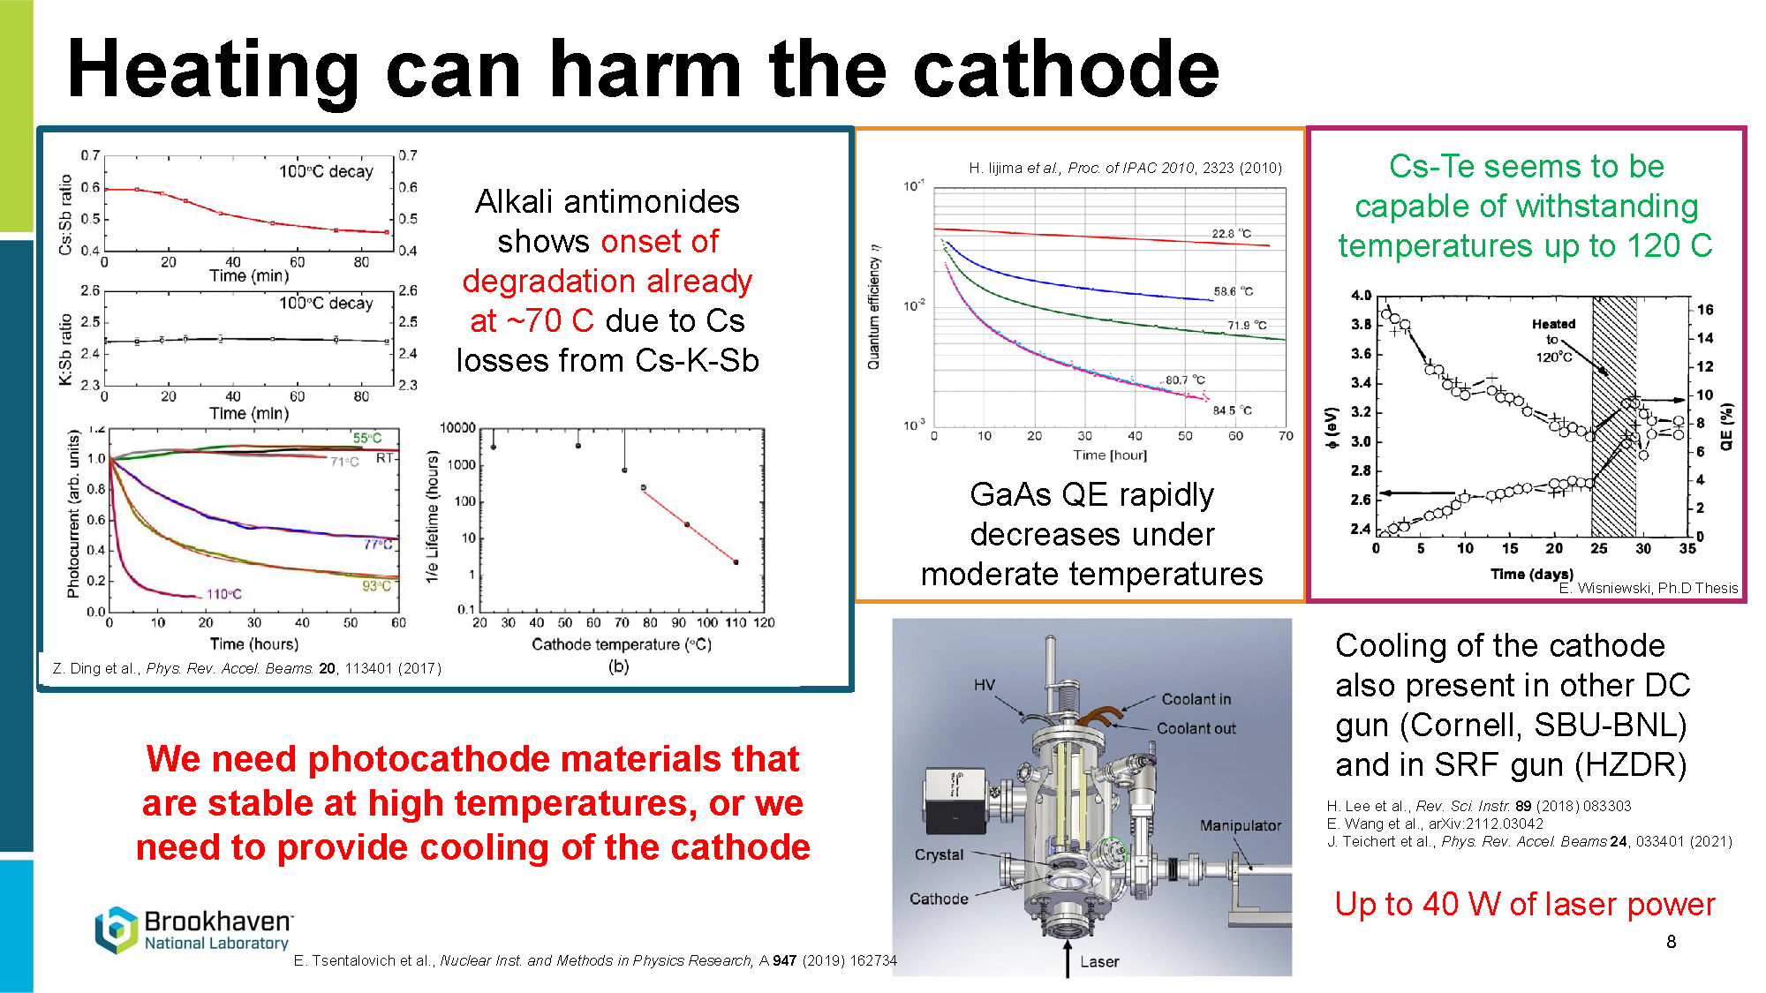
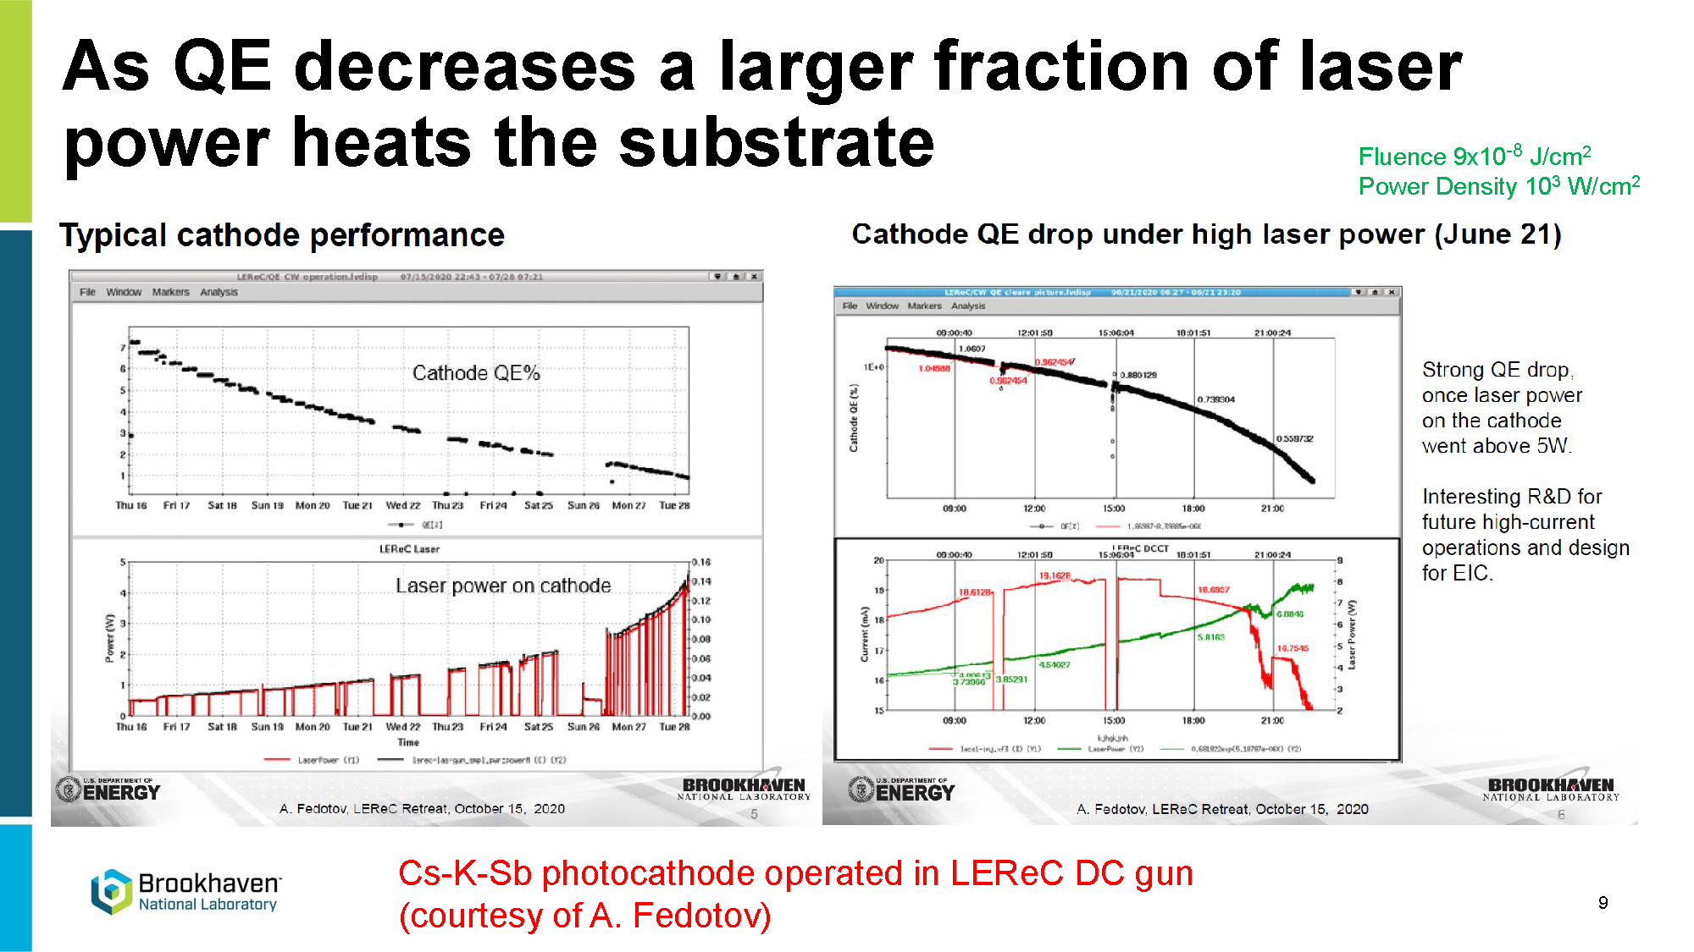
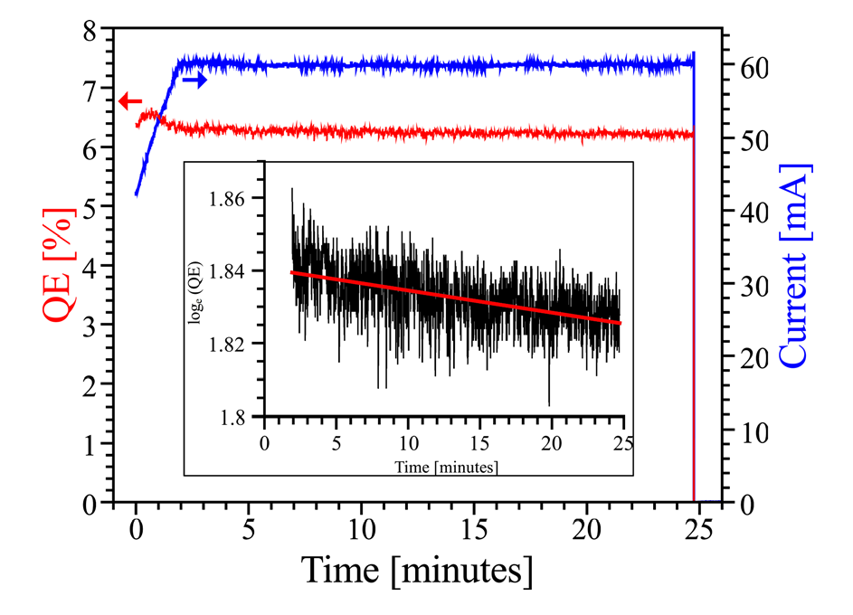
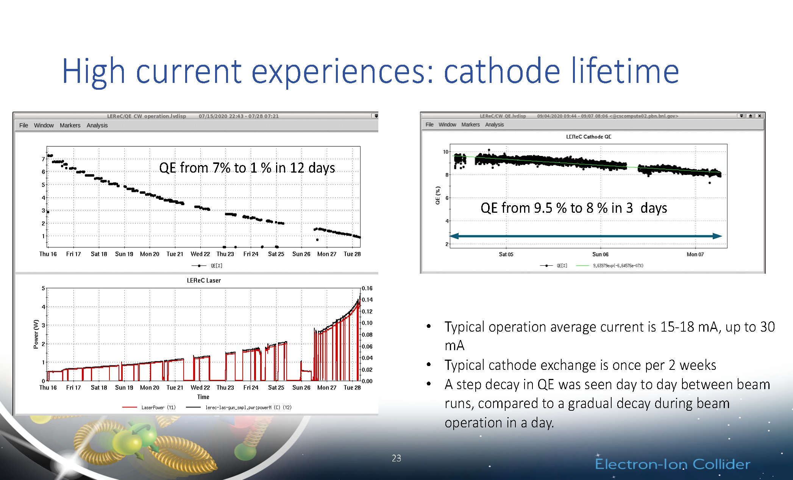
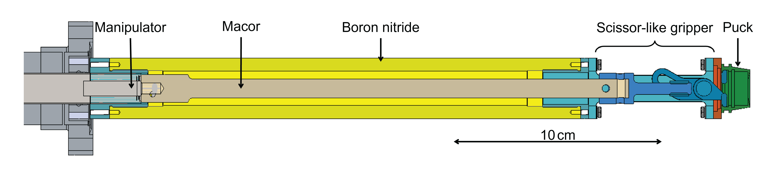
Lifetime at high average current operation
Demanding EIC requests for Electron beam e-cooling:
>100 mA, 1.5 nC bunch charge, 1.5 mm.mrad, > 3 days lifetime
LEReC result
Drawback (not only for High Average current):
Cs-K-Sb QE drop ~ 70 °C (Cs losses)
Cs-K-Sb QE drop P_{laser} >5W
Ion back bombardment
Solutions
new robust cathodes: multi-alkali (Na),
coating, epitaxial growth, graphene, etc.
cathode cooling
anode bias voltage/coating off-centered
Cs₂KSb (QE start: 4-8%)
25mA CW (9MHz), 50-80 pC/bunch
Lifetime: 142h (6 days)
L. Cultrera, Snowmass2021 Electron Source Workshop, Feb 2022
X. Gu et al., PRAB 23, 013401 (2020)
Cornell record current
MIST: K₂CsSb in puck, heating trasnferred by BN
CsK₂Sb
65mA CW, lifetime: 30h 1/e (1d)
E. Wang et al., Snowmass2021 Electron Source Workshop, Feb 2022
B. Dunham et al., Appl. Phys. Lett. 102, 034105 (2013)
D. Filippetto et al., arXiv:2207.08875v1 [physics.acc-ph] 18 Jul 2022
M. A. Dehn et al., THPOPT024, IPAC2022

Slide 20

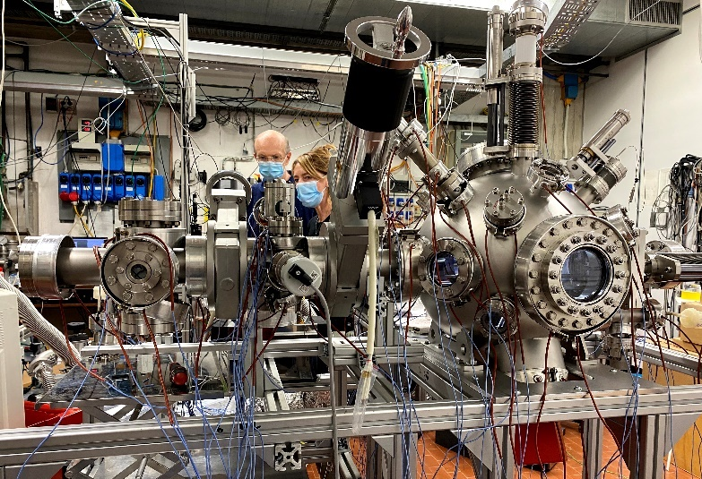
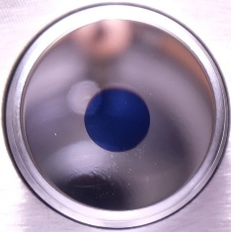
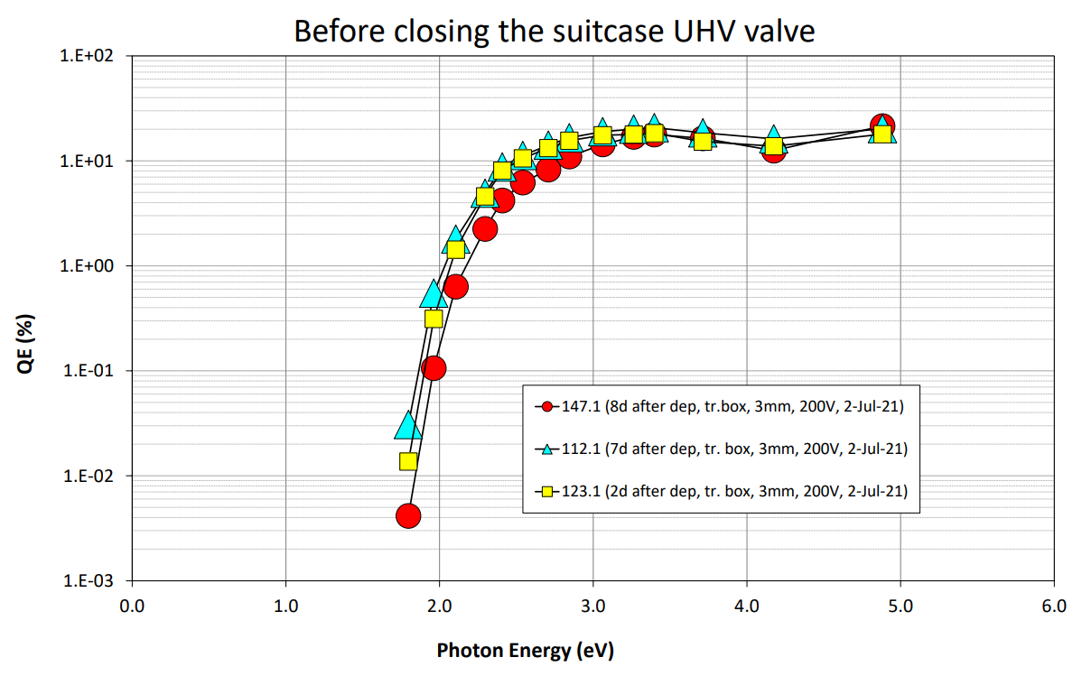
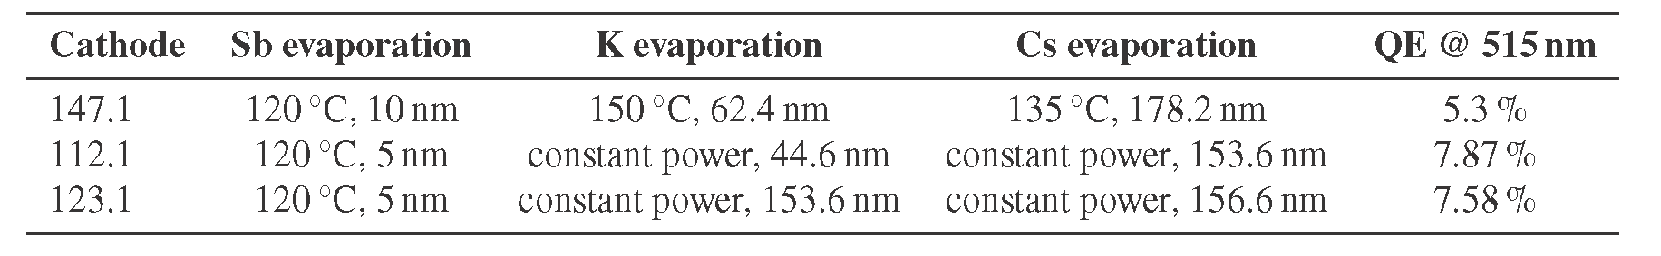

“Green” Photocathodes INFN - DESY
New deposition system for «green» cathodes
CW machine operation requests photocathode:
  sensitive to visible light to relax requests on lasers.
  smaller thermal emittances $ε_{th}$≈ 0.3 mm mrad to improve machine
  performances.
However, these materials requires XUHV (≈ 10⁻¹¹ mbar)
being more sensitive than Cs₂Te
In collaboration with DESY PITZ:
  we have developed a new deposition system suitable
  for «green» photocathodes.
First photocathode desposited in LASA system
Spectral response of first batch of «green» photocathodes
#123.1 QE@2.4 eV
~8% (At INFN)
~4% (In PITZ loadlock)
~5.6% (In PITZ gun)
  A deposition process was studied in the R&D system
  and transfer to growing these cathodes.
  The first K₂CsSb photocathodes have been produced in June ’21 and tested in July in the PITZ RF Gun.
  Successful transfer of the photocathodes to PITZ with limited QE degradation
D Setore et al., THPOPT027, IPAC2022
S. Mohanty et al., TUP04, FEL2022

Slide 21
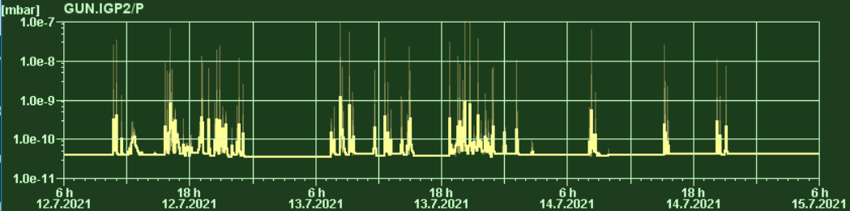
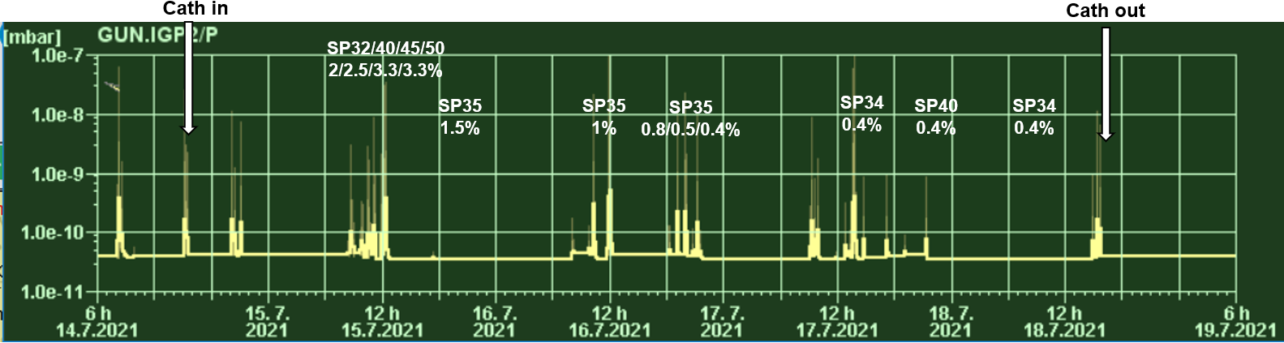
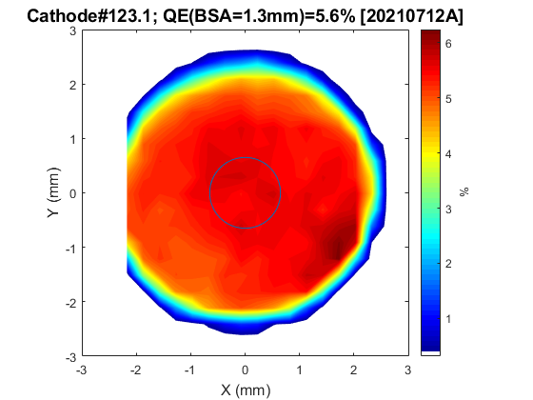
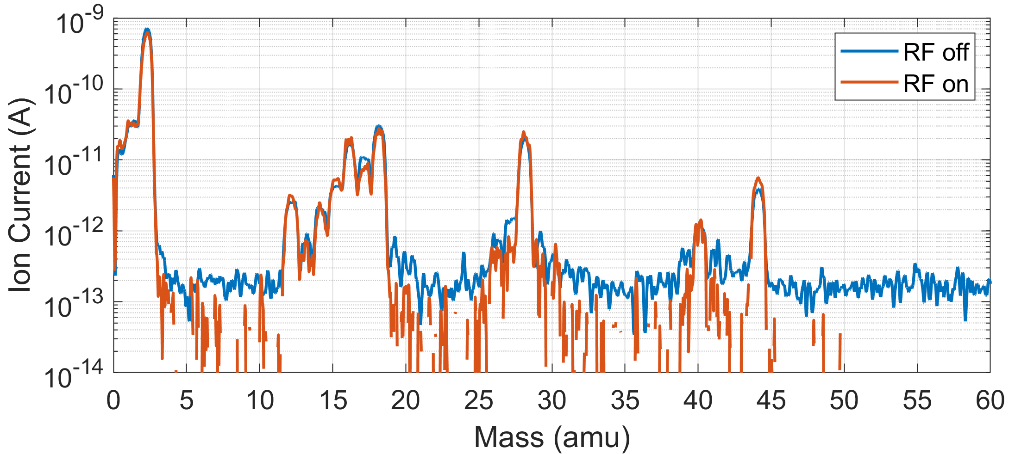
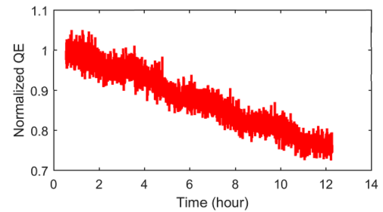
K₂CsSb photocathode in high gradients RF Gun
2 days <1% QE (T_{cath}~70℃ #123.1)
Cathode RF conditioning, QE, lifetime, vacuum
Cath in
Cath out
Cathode RF conditioning
  Below 30 MV/m, almost not necessary, up to 400 μs was tested without vac events
  Above 30-40 MV/m, much more vac events than Cs₂Te conditioning, degrades QE significantly
Cathode QE
  Fresh QE in gun is consistent
  with lab measurements
  QE decrease dominated
  by vac events during
  conditioning, QE also
  slowly decreases
  w/o vac events.
30/35 MV/m
5.6/5.5%
30/45 MV/m
0.8/1.2%
2 days <1% QE (T_{cath} ~50℃ #147.1)
Fresh QE map in gun
H₂
O⁺
CH₄
H₂O
CO
CO₂
Overnight run
No vac events
S. Mohanty et al., TUP04, FEL2022
QE slowly drops by 20% in 12 hours

Slide 22
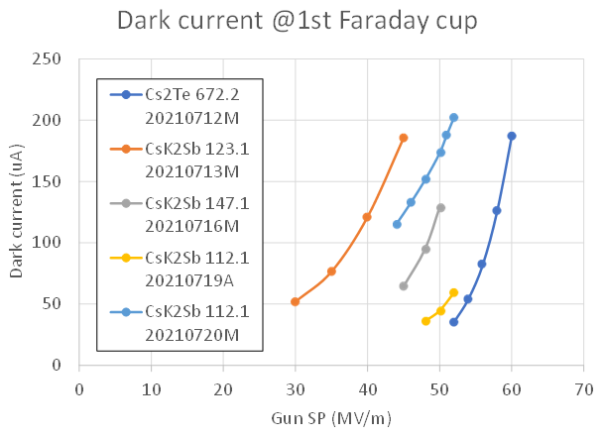
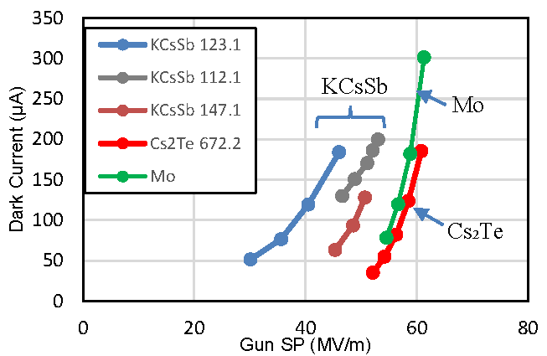


K₂CsSb photocathode in high gradient RF Gun
Dark current, cathode response time
Dark current vs gun gradient
Cathode response time measurement
  #147.1 CsK₂Sb, measured in green when QE dropped to 0.4%
  Two laser pulses with known optical delays shine the cathode to calibrate the beam temporal response at photoemission
  Preliminary data show that response time is below the resolution of 100 fs! Much shorter than high QE Cs₂Te cathode response time in UV (~200 fs)
  -> but…measurement to be repeated on a fresh cathode since QE degradation could indicate possibly changes in the surface chemistry of the film
Max dark current @ 0.8 m from cathode
CsK₂Sb
Cs₂Te
All cathodes have higher dark current than Cs₂Te one.
#112.1 dark current increased during cathode conditioning.
Higher dark current can be due to the different energy threshold of films:
E_{th} (KCsSb) = 1.9 eV < E_{th} (Cs₂Te) = 3.5 eV
F-N analysis, high dark current due to low emission threshold, not due to surface quality
Dark current imaging
Mo dark current similar to Cs₂Te one confirm that the major contribution of dark current comes from the film itself
 | beta | A (nm²)
Cs₂Te 672.2 | 126 | 15212
123.1 | 462 | 0.002
147.1 | 97 | 0.98
147.1 | 102 | 1.1
112.1 | 99 | 0.3
112.1 | 246 | 0.013
Response time
S. Mohanty et al., TUP04, FEL2022

Slide 23

K₂CsSb photocathode in high gradients RF Gun
Thermal emittance and 100 pC emittance
Thermal emittance vs QE & laser λ
    515 nm: 19 MV/m, 0.6 µm.rad/mm (2%, 0.8%, 1.5%)
    -> Consistent with APEX gun results
    515 nm: 29 MV/m, 0.7 µm.rad/mm (1.5%)
    -> limited at 30MV/m since high dark current
  257 nm: 19 MV/m, 1 µm.rad/mm (2.5%)
  -> Very similar to Cs₂Te cathode
100 pC emittance, CsK₂Sb vs Cs₂Te
  40 MV/m 1.6 cell L-band gun, ~20 MeV linac
  Emittance reduced by ~23%,
  4D brightness increased by ~60%
100 pC beam phase space
Measurement | Cs₂Te 1 µm.rad/mm | CsK₂Sb 0.7 µm.rad/mm | Unit
95% rms emit. | 0.36 | 0.28 | µm.rad
Gauss emit. | 0.33 | 0.25 | µm.rad
4D brightness | 760 | 1209 | pC/(µm.rad)²
Post-usage analysis and future plan
Photocathode spectral responses after RF gun operation
Lower QE at all λs for the three cathodes. Cathode 123.1 show a higher QEs w.r.t. cathode 147.1 and 112.1
  Low energy (photoemission threshold): E_{th} (147.1 and 112.1) increased from 1.79 eV to 2.08 eV; a shoulder appeared at the low photon energy for cathode 123.1 -> potential oxidation of cathode films
Spectral responses of KCsSb cthodes
Next steps will be:
CsK₂Sb recipe improvement and development of multi-alkali (Na)
New tests at PITZ
S. Mohanty et al., TUP04, FEL2022

Slide 24











Testing Alkali Antimonide
Photocathodes in High Gradient RF Injector
Na-K-Sb grown on molybdenum plug surface
at Cornell University
Initial QE of Na-K-Sb after growth: ~1.5% at 532nm. (10/8/21)
QE upon arriving at UCLA: ~8e-4 at 405nm. (10/20/2021)
Previous testing verified transportation by car, yet the cathodes experienced QE degradation during delayed transport.
QE remains above 0.2% at 266 nm and greater than 5e-4 at 400 nm for multiple weeks of operation.
Negligible change in QE after transfer from vacuum suitcase to the gun.
Maximum single shot bunch charge extracted: ~ 600pC.
Schottky scan fits for 400 nm and 266 nm yield a work function of 𝟐.𝟐 𝒆𝑽 for Na-K-Sb.
Difference in MTE between 266 nm and 400 nm agrees with workfunction and excess energy measurement from Schottky scans.
𝑀𝑇𝐸=𝐸_{𝑒𝑥𝑐} / 3
2 and 3 photon photoemission @ 800 nm
C. Pennington, P3 Workshop, November 2021

Slide 25
















Multi-alkali antimonide development
Na-K-Sb as alternative to Cs-K-Sb photocathode, since more robust at high temperature to be used in Sealab/bERLinPro SRF gun.
Cs-K-Sb
Na-K-Sb
6 Na-K-Sb produced and analyzed:
5 with Sb + co-deposition of alkali
1 with sequential deposition (WH04)
QE @ 515nm between 0.3 and 2.0%
QE stability of co-dep: film WH05 showed a fast decrease (Na excess?) while WH03 was stable after 1.5d
XPS (WP04 & WP05)
Na-K-Sb
Na-K-Sb
S. Mistry et al., THPOPT019, IPAC2022
Mo plug
Sb on Mo
Na-k-Sb on Mo
Different Chinese laboratories are making progress
on developing new production system for telluride and alkali antimonies.
They are exploring both sequential and co-evaporation.
For co-evaporation recipe, Sb is deposited in advance and then alkali metals are evaporated together
H. Xie, Micromachines 2021, 12, 1376
SARI first results:
K₂CsSb (Mo plug) :
co-dep, QE and R during dep
PKU: suitcase and plug carrier
SARI: transfer system and suitcase
IHEP: Bialkali deposition system

Slide 26









Multi-alkali brightness improvement
Molecular beam epitaxy of Cs₃Sb: a single crystalline visible light photocathode
Successfully deposited epitaxial Cs₃Sb (100) films on 3C SiC (100) substrates
XPS measurements well reproduce literature data on Cs₃Sb
Ultrathin samples (<10 nm) have >2% QE at 532 nm
We observe enhnaced QE at 650 nm on our best epitaxial sample
ARPES measurements unveil for the first time the Cs₃Sb band
structure
DFT band strucure calculations show good agreement with
measurements , but significant bandwidth discrepancy indicates
that strain and intrinsic instabilities of the Cs₃Sb structure may play a role.
C. T. Parzyck and A. Galdi et al., PRL 128, 114801 (2022)
P. Saha et al., Appl. Phys. Lett. 120, 194102 (2022)

Slide 27












Multi-alkali improvement - Graphene
Towards the use of 2D materials as unique protection layer
for bialkali photocathodes
Cs₂KSb grown on graphene layers
deposited on grid/substrate
Good quality graphene is important for optimal result
Achieved good QE through graphene layer
H. Yamaguchi, P3 Workshop, November 2021
L. Guo et al., THPOPT028, IPAC2022
Unexpected findings
QE enhancement of bialkali photocathodes by coating metal substrates with graphene
Graphene as reusable substrate for bialkali photocathodes
Progress towards long lifetime photocathodes with
protective layer
Cs₃Sb grown on Sb (10 nm)/Si substrate coated with graphene ML
Graphene layer prevent Sb to evaporate during thermal cycle
Successfully grown Cs₃Sb on this support
$$O1s and Sb3d5/2$$
$$Binding Energy shift ≈0.22 ev$$
$$O1s and Sb3d5/2$$
$$Metallic Sb peak$$
$$After the Cs deposition$$
J. K. Biswas, P3 Workshop, November 2021
$$RT$$
$$200°C$$
$$300°C$$
$$400°C$$
$$500°C$$
$$Sb on Si with Gr (550C heat clean)$$
$$600°C$$
Sb on Si substrate with Graphene layer
Sb on Si substrate with Graphene layer

Slide 28




Multi-alkali improvement – Surface Plasmon
The maximum efficiency of the typical K2CsSb film photocathode in absorbing the incident laser is approximately 30%
To improve absorption, it is proposed to use
Surface Plasmon Polaritons (SPP)
This structure produces a peak in laser light absorption
The SPP are introduced into a Monte Carlo model by
proper modification of the absorption process
Blu – KCsSb
Orange – Ag substrate
H. Xie, Micromachines 2021, 12, 1376
Z. Jiang et al., PRAB 24, 033402 (2021)

Slide 29
Photocathode diagnostics in production systems for operation

Slide 30
Importance of photocathode diagnostics in production system for operation
Diagnostics in system for photocathode production will provide:
Feedback on the quality of produced photocathodes -> possibility to improve films reliability
Post-usage analysis on photocathodes after operation in guns -> correlation between performance and photoemissive properties of films
Continuous improvement of recipes -> hints for corrections and new solutions
R&D activities….but done on real photocathodes to be used in operation (and not samples!)

Slide 31





News on diagnostics in production systems
INFN LASA - TRAMM
  A TRAnsverse Momentum Measurement
  device is being developed and it will be
  installed on the production systems
DESY - Blue Lab
  Build a characterization system based on AES and XPS
  Build on electron momentum spectrometer
ASTeC - Alkali-metal Photocathode Preparation Facility (APPF)
  This facility will produce photocathodes for Gun (CLARA)
  Multiprobe system (for QE and work function
  measurements) and in the Transverse Energy Spread
  Spectrometer (TESS) for MTE (or TEDC), CMA for AES.
  The system can use R&D sample (Omicron) and
  INFN Mo plug (for production)
D. Sertore et al., THPOPT026, IPAC2022
P. Juarez, P3 Workshop, November 2021
H. M. Churn et al., THPOPT044, IPAC2022

Slide 32
News on
Photocathode test facilities

Slide 33




News on Photocathode test facilities
Cornell - High ElectrRon Average Current for Lifetime ExperimentS (HERACLES)
  Dedicated beamline for robustness
  improvement of photocathodes
  at high current
  Photocathode produced at Cornell
  are transported by a UHV suitcase
  DC Gun: commissioned at 200 keV, 10 mA
  Cs₃Sb (first test): 8mA (av. curr.), no QE decrease (3hs run)
INFN LASA – Photocathode Stress Test Bench (BriXSinO)
  Dedicated system for Cs₂Te operative lifetime
  studies at High rep rate & current (in construction)
  LASA photocathode transported by UHV suitcase
  DC Gun: 100 kV, 5 mA; Laser system: 92.857 MHz
  (IR=1035nm, 4th=258.75nm), P (4th) 700mW
DESY PITZ – Test of “green” photocathodes in high gradient RF Gun
  PITZ upgrade for “green” photocathodes test in RF gun (new tests foreseen)
Beam Current (mA)
QE (%)
p (Torr)
M. B. Andorf et al., THPOMS036, IPAC2022
D. Sertore et al., THPOPT025, IPAC2022
BriXSinO layout (TDR)
Overview of StressTestBench

Slide 34
The modern approach to photocathode developments and advancements

Slide 35






Machine learning and AI
Novel Ultrabright Photocathodes Discovered from Machine
Learning and Density Functional Theory Driven Screening (32)
  Development of a generalizable photoemission model
  Machine learning for predicting the
  work function of photocathodes
  Screening for novel photocathode materials
Commercial available
E. R. Antoniuk, P3 Workshop, November 2021
Automated growth of photocathode films: from the basics of process
control towards artificial intelligence
  First implementation of automatic
  film growth process on Cs₃Sb
  Positive first results
  Extension to further materials (Cs₂Te)
  Implementation of AI instead of standard
  feedback on ratio QEs
V. Pavlenko, P3 Workshop, November 2021

Slide 36

How to improve photocathode performances
J. Smedley, Snowmass2021 Electron Source Workshop, Feb 2022

Slide 37
One example: Sealab- bERLinPro

Slide 38
Thanks for your attention!
A special thanks to Daniele Sertore for the work done on the preparation of this review

Slide 39
References
D. Filippetto et al., “Electron sources for accelerators”, arXiv:2207.08875v1 [physics.acc-ph] 18 Jul 2022
D.H. Dowell et al., “Cathode R&D for duture light sources”, NIM A 622(2010) 685
J. Teichert et al., “Successful user operation of a superconducting radio-frequency photoelectron gun with Mg cathodes”, PRAB 24, 033401 (2021)
R. Xiang, “Recent progress on advanced photocathodes for SC RF guns”, Snowmass2021 Electron Source Workshop, Feb 2022
C. Benjamin et al., “Photocathode performance characterization of ultra-thin MgO films on polyscrystalline copper”, MOPOMS025, IPAC2022
L. A .J. Soomary et al., “Controlled degradation of Ag photocathode by exposure to multiple gases”, THPOPT034, IPAC2022
C. M. Pierce et al., “Generating bright femtosecond electron beams from flat surfaces”, Photocathodes Physics for Photoinjectors Workshop, November 2021
J. Smedley, “Cathode characterization and fabrication”, Snowmass2021 Electron Source Workshop, Feb 2022
D. Sertore, “Overview of high QE photocathode R&D in Europe”, Snowmass2021 Electron Source Workshop, Feb 2022
F. Sannibale, “APEX phase-II commissioning results at Lawrence Berkeley National Laboratory”, TUOCA02, IPAC2016
S. Schreiber et al., “Photocathodes for the electron sources at FLASH and European XFEL”, TUP07, FEL2022
L. Monaco et al., “Growing and characterization of Cs₂Te photocathodes with different thicknesses at INFN LASA”, oral-WEA04, FEL2019
P. Huang et al., “Test of Cs₂Te thickness on cathode performance at PITZ”, WEP062, FEL2019
D. Sertore et al., “R&D on high QE photocathodes at INFN LASA”, THPOPT027, IPAC2022
G. Loisch et al., “Direct measurement of photocathode time response in a high-brightness photoinjector”, Appl. Phys. Lett. 120, 104102 (2022)
R. Xiang et al., “Study on QE evolution of Cs₂Te photocathodes in ELBE SRF Gun-II”, THPOPT022, IPAC2022
L. A. J. Soomary et al., “Performance characterization at Daresbury laboratory of Cs-Te photocathodes grown at CERN”, THPOPT033, IPAC2022
R. Valizadeh et al., “Synthesis of first Caesium Telluride photocathode at ASTeC using sequential and co-deposition method”, MOPOMS027, IPAC2022
L. Cultrera, “Robust Cathodes to produce high current electron beams”, Snowmass2021 Electron Source Workshop, Feb 2022
X. Gu et al., “Stable operation of a high-voltage high-current dc photoemission gun for the bunched electron cooler in RHIC”, PRAB 23, 013401 (2020)
B. Dunham et al., “Record high-average current from a high-brightness photonjector”, Appl. Phys. Lett. 102, 034105 (2013)
E. Wang et al., “Electron source requirements for Electron-ion collider”, Snowmass2021 Electron Source Workshop, Feb 2022
M. A. Dehn et al., “MIST – The MESA-Injactor source two”, THPOPT024, IPAC2022
D Setore et al., “R&D on high QE photocathodes at INFN LASA”, THPOPT027, IPAC2022
S. Mohanty et al., “Development and test results of multi-alkali antimonides photocathodes from the high gradient RF gun at PITZ”, TUP04, FEL2022
C. Pennington, “Testing Alkali Antimonide Photocathodes in High Gradient Injectors“, Photocathodes Physics for Photoinjectors Workshop, November 2021
S. Mistry et al., “Multi-alkali antimonide photocathode development for high brightness beams”, THPOPT019, IPAC2022
H. Xie, “Overview of the semiconductor photocathode research in China”, Micromachines 2021, 12, 1376. https://doi.org/10.3390/mi12111376
C. T. Parzyck. and A. Galdi et al., “Single-Crystal Alkali Antimonide photocathodes: high efficiency in the ultrathin limit”, PRL 128, 114801 (2022)
P.Saha et al., “Physically and chemically smooth cesium-antimonide photocathodes on single crystal strontium titanate substrates”, Appl. Phys. Lett. 120, 194102 (2022)
H. Yamaguchi, “Towards the use of 2D materials as unique protection layer for bialkali photocathodes”, Photocathodes Physics for Photoinjectors Workshop, November 2021
L. Guo et al., “Dependence of CsK₂Sb photocathode performance on the quality of graphene substrate film”, THPOPT028, IPAC2022
J. K. Biswas, “Progress towards long lifetime photocathodes with protective layer”, Photocathodes Physics for Photoinjectors Workshop, November 2021
Z. Jiang et al., “Monte Carlo simulations of electron photoemission from plasmon-enhanced bialkali photocathode”, PRAB 24, 033402 (2021)
D. Sertore et al., “Assembly and characterization of low-energy electron transverse momentum measurement device (TRAMM) at INFN LASA”, THPOPT026, IPAC2022
P. Juarez, “Photocathodes at FLASH and European XFEL”, Photocathodes Physics for Photoinjectors Workshop, November 2021
H. M. Churn et al., “The alkali-metal photocathode preparation facility at Daresbury laboratory: first Caesium Telluride deposition results”, THPOPT044, IPAC2022
M. B. Andorf et al., “HERACLES: a high average current electron beamline for lifetime testing of novel photocathodes”, THPOMS036, IPAC2022
D. Sertore et al., “Photocathode stress test bench at INFN LASA”, THPOPT025, IPAC2022
E. R. Antoniuk, “Novel ultrabright photocathodes discovered from machine learning and density functional theory driven screening”, Photocathodes Physics for Photoinjectors Workshop, November 2021
V. Pavlenko, “Automated growth of photocathode films: from the basics of process control towards artificial intelligence”, Photocathodes Physics for Photoinjectors Workshop, November 2021

