Slide 1

Quantum Model: a look at what happens in the Center of Mass reference system (kinematics)
Lab ref.
c.m. ref.
Recall some Basics

Slide 2
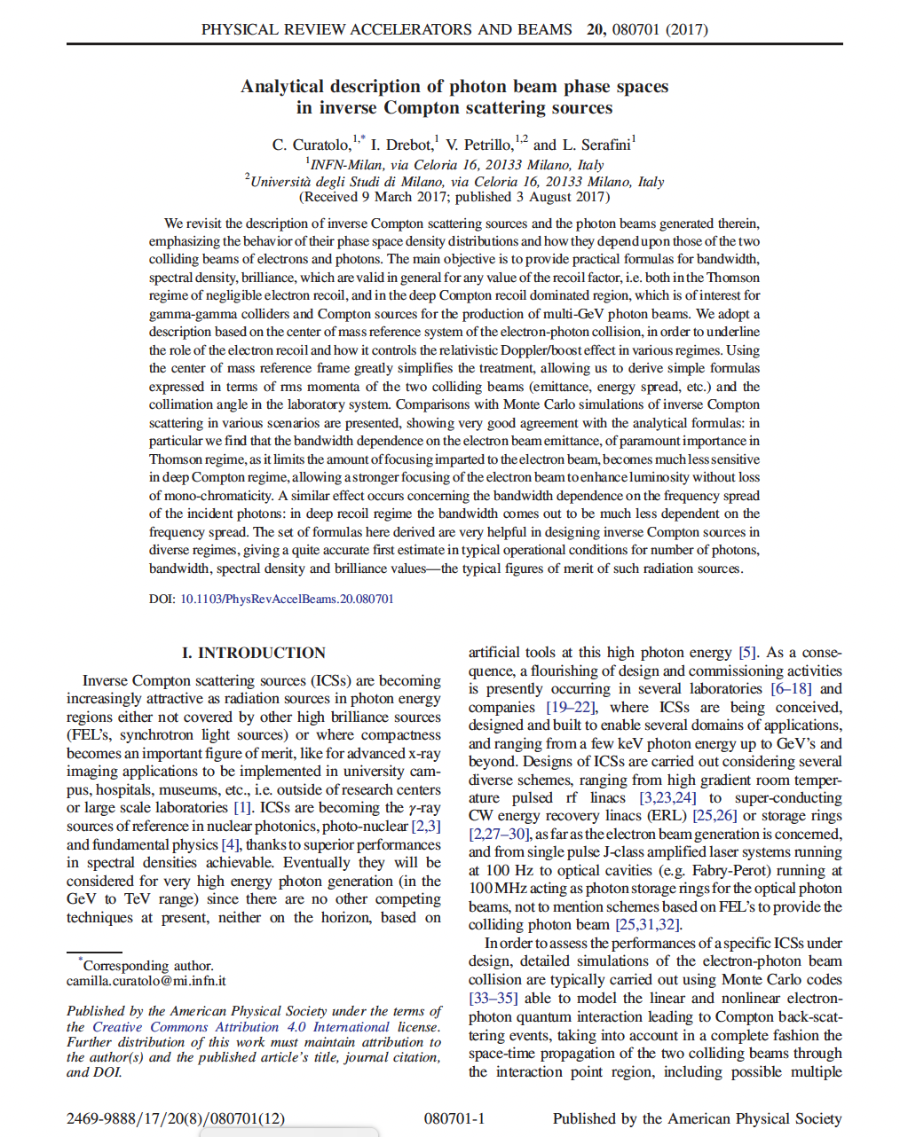

Slide 3
Invariant Mass, Lorentz transformation from Lab to c.m. ref. system

Slide 4
from
and
Holds before and after scattering (c.m ref. system!)
in the literature the recoil factor is
sometimes Δ, sometimes X

Slide 5
Δ=0 electron as relativ. mirror
Δ>>1 symmetric collider

Slide 6
before scattering
θ∗
θ∗ is scattering angle in c.m. frame
after scatt.

Slide 7
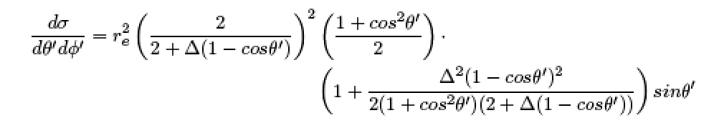
what is the probability of scattering at ?
Klein-Nishina differential cross-section

Slide 8
Recalling Compton differential cross-section
(2.11)
total cross-section

Slide 9
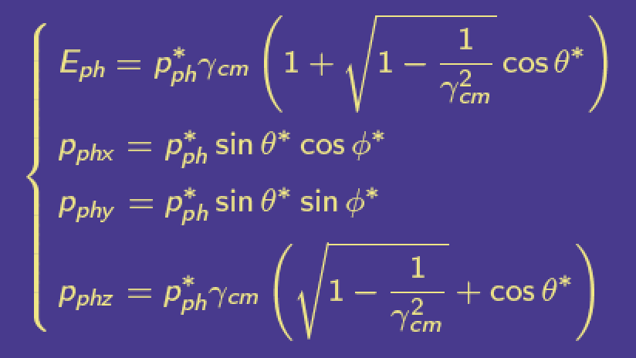
To transform to the Lab ref. system we need to compute
c.m. frame travels with e⁻ when Δ<<1, while
it slows down as 1/Sqrt(Δ) when Δ is large
Then apply a Lorentz transformation

Slide 10
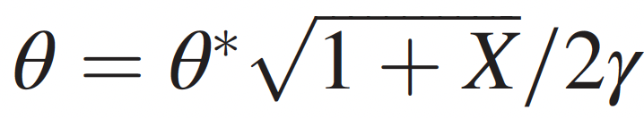
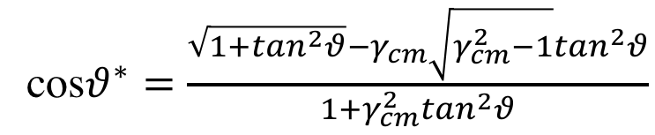
general solution
see below
cos$θ^{∗}=\frac{\sqrt{1+\tan^{2}θ}−{γ_{cm}\sqrt{γ_{cm}^{2}−1}tan}^{2}θ}{1+γ_{cm}^{2}\tan^{2}θ}$
notation warning hν_{x} = E_{ph}

Slide 11
-
head-on collision is
at α=π, i.e. f(α)=1
Deep Compton regime
(Δ>>1 recoil dominated)
Thomson regime Δ=0 no recoil
-

Slide 12
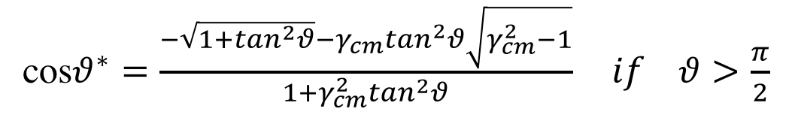
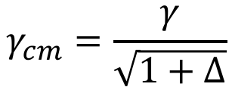
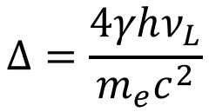
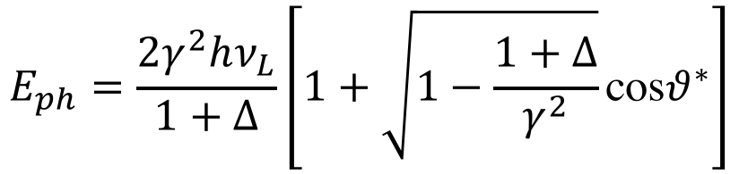
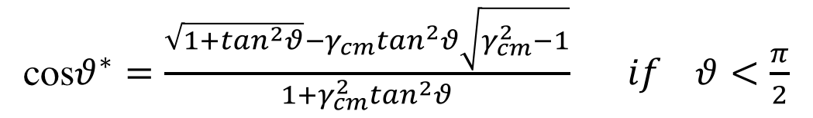
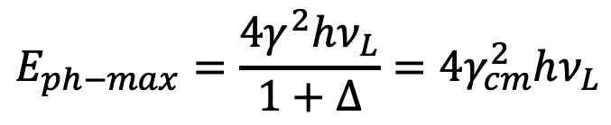
Recap
(exact analytical formula, no approximations)
$$Δ=\frac{4γhν_{L}}{m_{e}c^{2}}$$
$$γ_{cm}=\frac{γ}{\sqrt{1+Δ}}$$
$$E_{ph}=\frac{2γ^{2}hν_{L}}{1+Δ}\left[1+\sqrt{1−\frac{1+Δ}{γ^{2}}}\text{cos}θ^{∗}\right]$$
cos$θ^{∗}=\frac{\sqrt{1+\tan^{2}θ}−{γ_{cm}tan}^{2}θ\sqrt{γ_{cm}^{2}−1}}{1+γ_{cm}^{2}\tan^{2}θ} if θ<\frac{π}{2}$
cos$θ^{∗}=\frac{−\sqrt{1+\tan^{2}θ}−{γ_{cm}tan}^{2}θ\sqrt{γ_{cm}^{2}−1}}{1+γ_{cm}^{2}\tan^{2}θ} if θ>\frac{π}{2}$
$$E_{ph−max}=\frac{4γ^{2}hν_{L}}{1+Δ}=4γ_{cm}^{2}hν_{L}$$

Slide 13
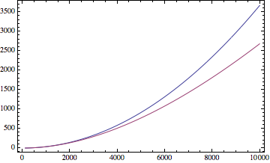
γ−γ Colliders
X/γ
[MeV]
Polarized
Positrons
FELs (pure γ²)
Nuclear
Photonics
Δ
Thomson
X-rays
1 GeV
T_{e} [MeV]
1 TeV
0.511
E_{cm} [MeV]
1.533

Slide 14
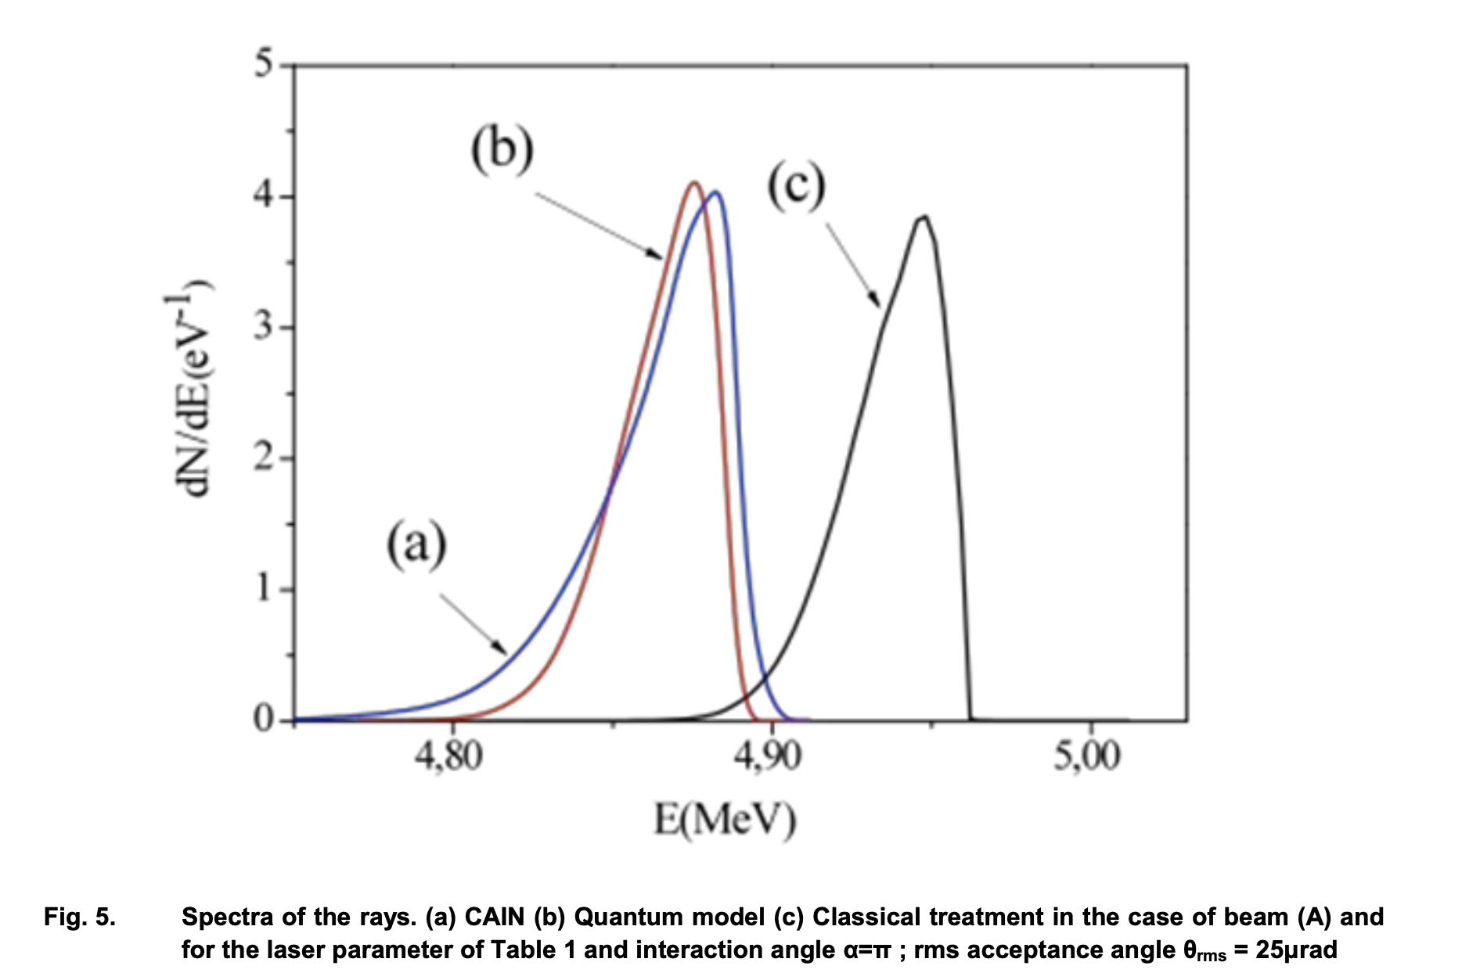
with
electron recoil
without
electron recoil

Slide 15





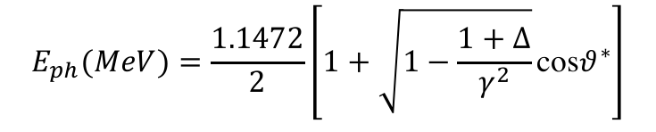

Recap
(exact analytical formula, example 250 MeV electrons against hν_{L}=1.2 eV photons)
$$E_{ph}(MeV)=\frac{1.1472}{2}\left[1+\sqrt{1−\frac{1+Δ}{γ^{2}}}\text{cos}θ^{∗}\right]$$
$$γ=490.$$
$$Δ=0.0046$$
$$γ_{cm}=488.88$$
$$E_{ph}(eV)$$
$$E_{ph}(eV)$$
$$θ$$
$$θ=1/γ$$

Slide 16


Recap
(exact analytical formula, example 250 MeV electrons against hν_{L}=1.2 eV photons)
$$E_{ph}(MeV)=\frac{1.1472}{2}\left[1+\sqrt{1−\frac{1+Δ}{γ^{2}}}\text{cos}θ^{∗}\right]$$
$$γ=490.$$
$$Δ=0.0046$$
$$γ_{cm}=488.88$$
$$E_{ph}(eV)$$
$$θ$$

Slide 17
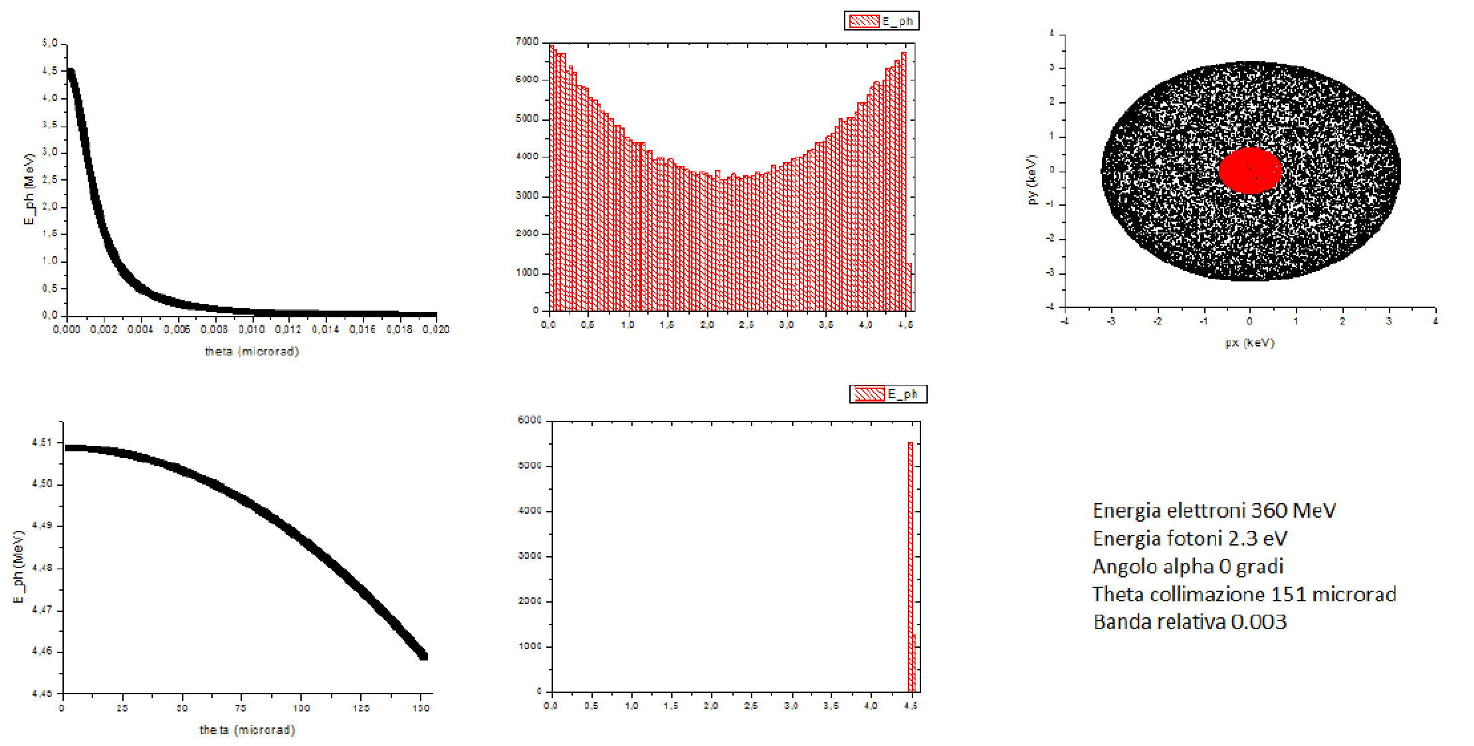
Single electron-photon spectra
What happens when we scatter beams of electron against beams of photons?

Slide 18
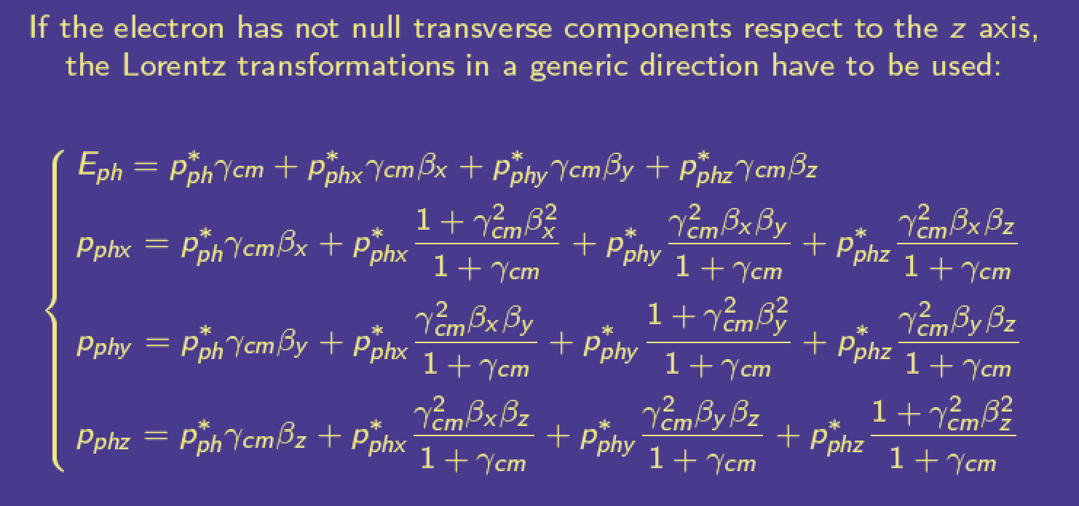
Electron beam emittance and energy spread spread out the c.m. propagation so to generate a “beam” of c.m. ref. frames
See C. Curatolo, PhD Thesis, Univ. of Milan, 2016 (and references therein)

Slide 19
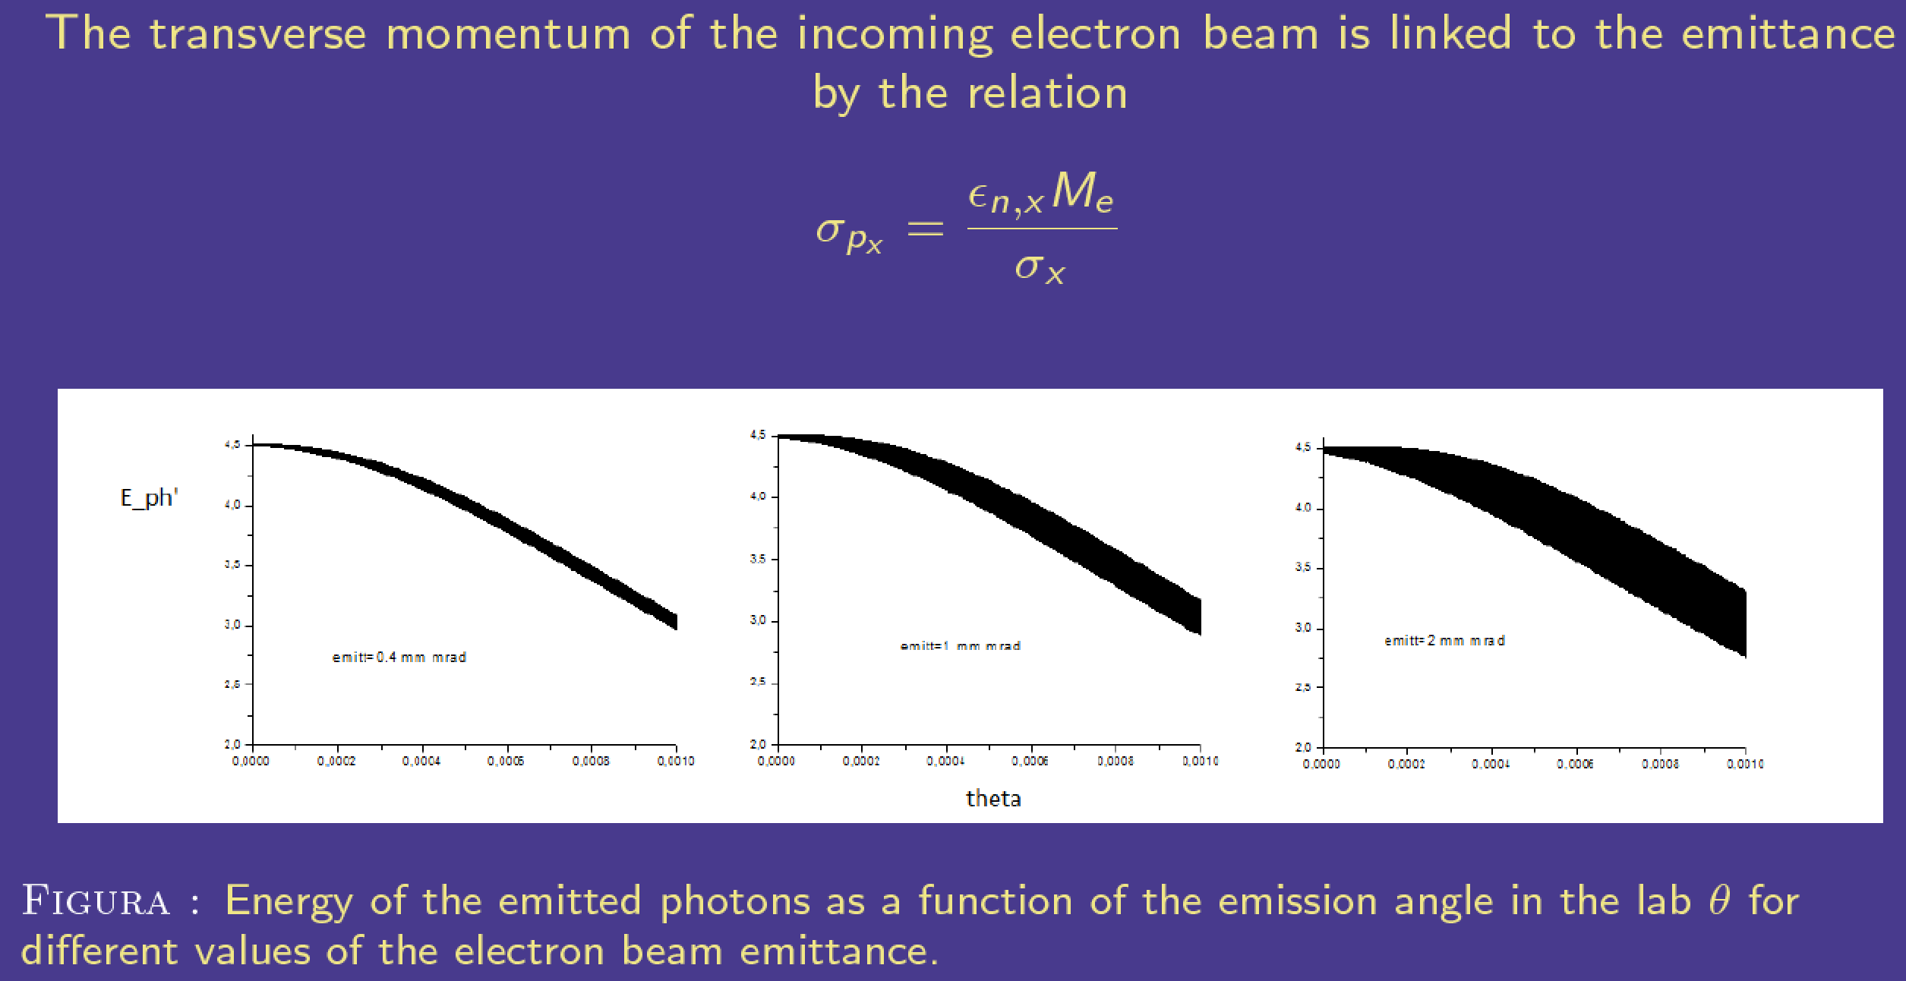
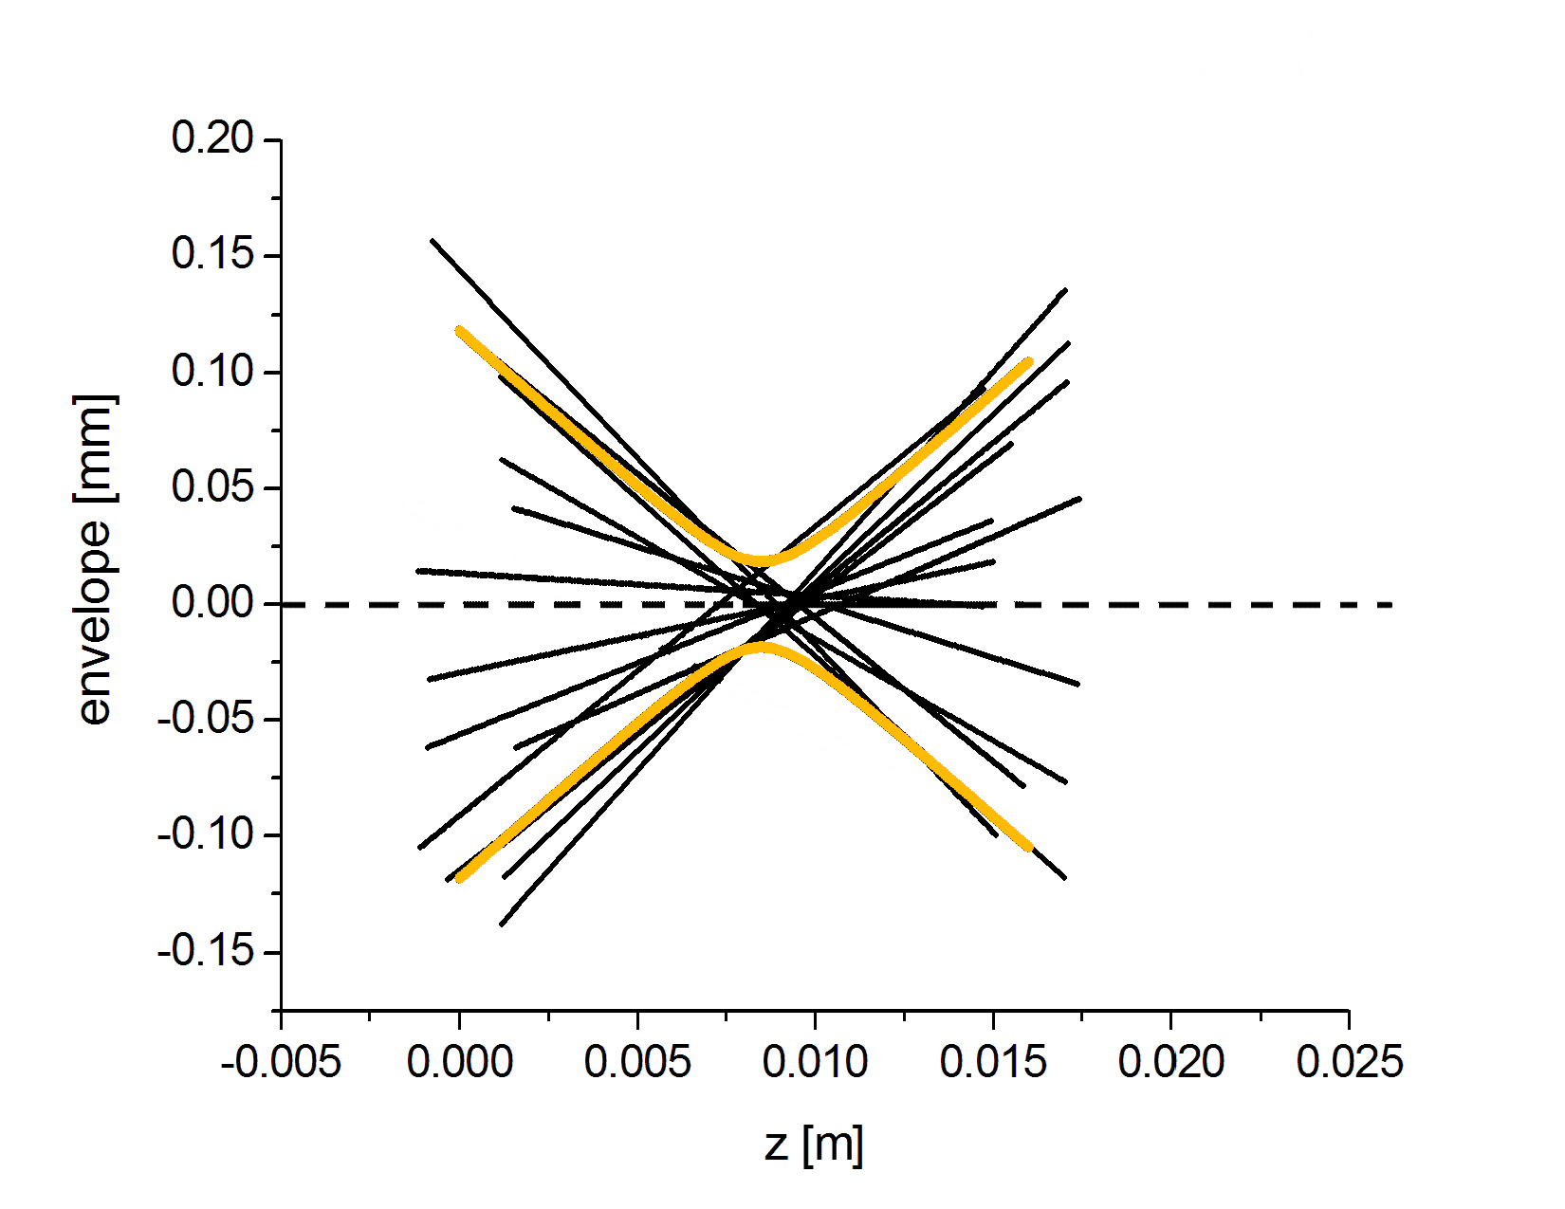
Electron-photon Collider Spectra

Slide 20
The Physics of Compton Inverse Scattering is quite straightforward
What are we missing by adopting the Quantum QED treatment of Compton back-scattering?
We re-construct the beam-beam back-scattering from single electron-photon scattering events by summing over the phase space density distributions of electrons and photons (treated incoherently!)
The coherent aspect (phase) of the laser e.m. field is lost...
Multi-photon absorption/scattering phenomena are not taken into account (dressed electron model in e.m. field)
Linear QED treatment is good for
low intensity (a₀<1) laser pulses
3 regimes: a) Elastic, Thomson b) Quasi-Elastic, Compton with Thomson cross-section c) Inelastic, Compton, recoil dominated
Courtesy V. Petrillo – Univ. of Milan

Slide 21
We need to build a very high luminosity collider,
that needs to maximize the Spectral Luminosity,
i.e. Luminosity per unit bandwidth
negligible diffraction
0 crossing angle
Scattered flux
Luminosity as in HEP collisions
  Many photons, electrons
  Focus tightly
  ELI-NP
f
electrons
laser
  cfr. LHC 10³⁴, Hi-Lumi LHC 10³⁵

Slide 22
Matching Laser Pulse Length and Focus Size
Laser pulse length matched to focus size (Rayleigh length).
Laser pulse too long for small focus size.
Laser pulse must be short compared to Rayleigh length so that whole pulse is focused simultaneously.
Laser may be shorter than Rayleigh length, but less than 0.5 ps is not practical, and could lead to non-linear effects that broaden the spectral line
courtesy of
D. Moncton

Slide 23
Electron Bunch Length Matched to Rayleigh Length
Electron pulse too long
Electron pulse matched
electrons
laser
electrons
laser
Poor efficiency at head and tail
courtesy of
D. Moncton

Slide 24
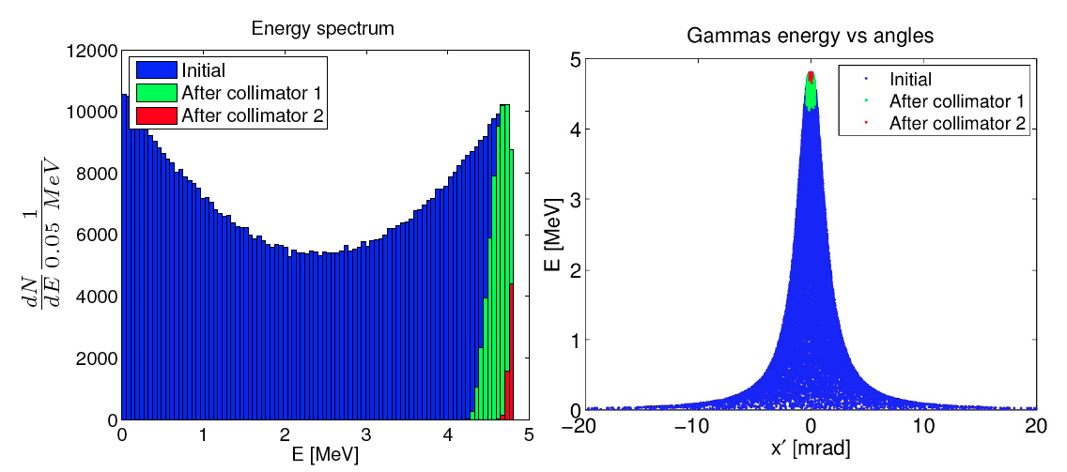
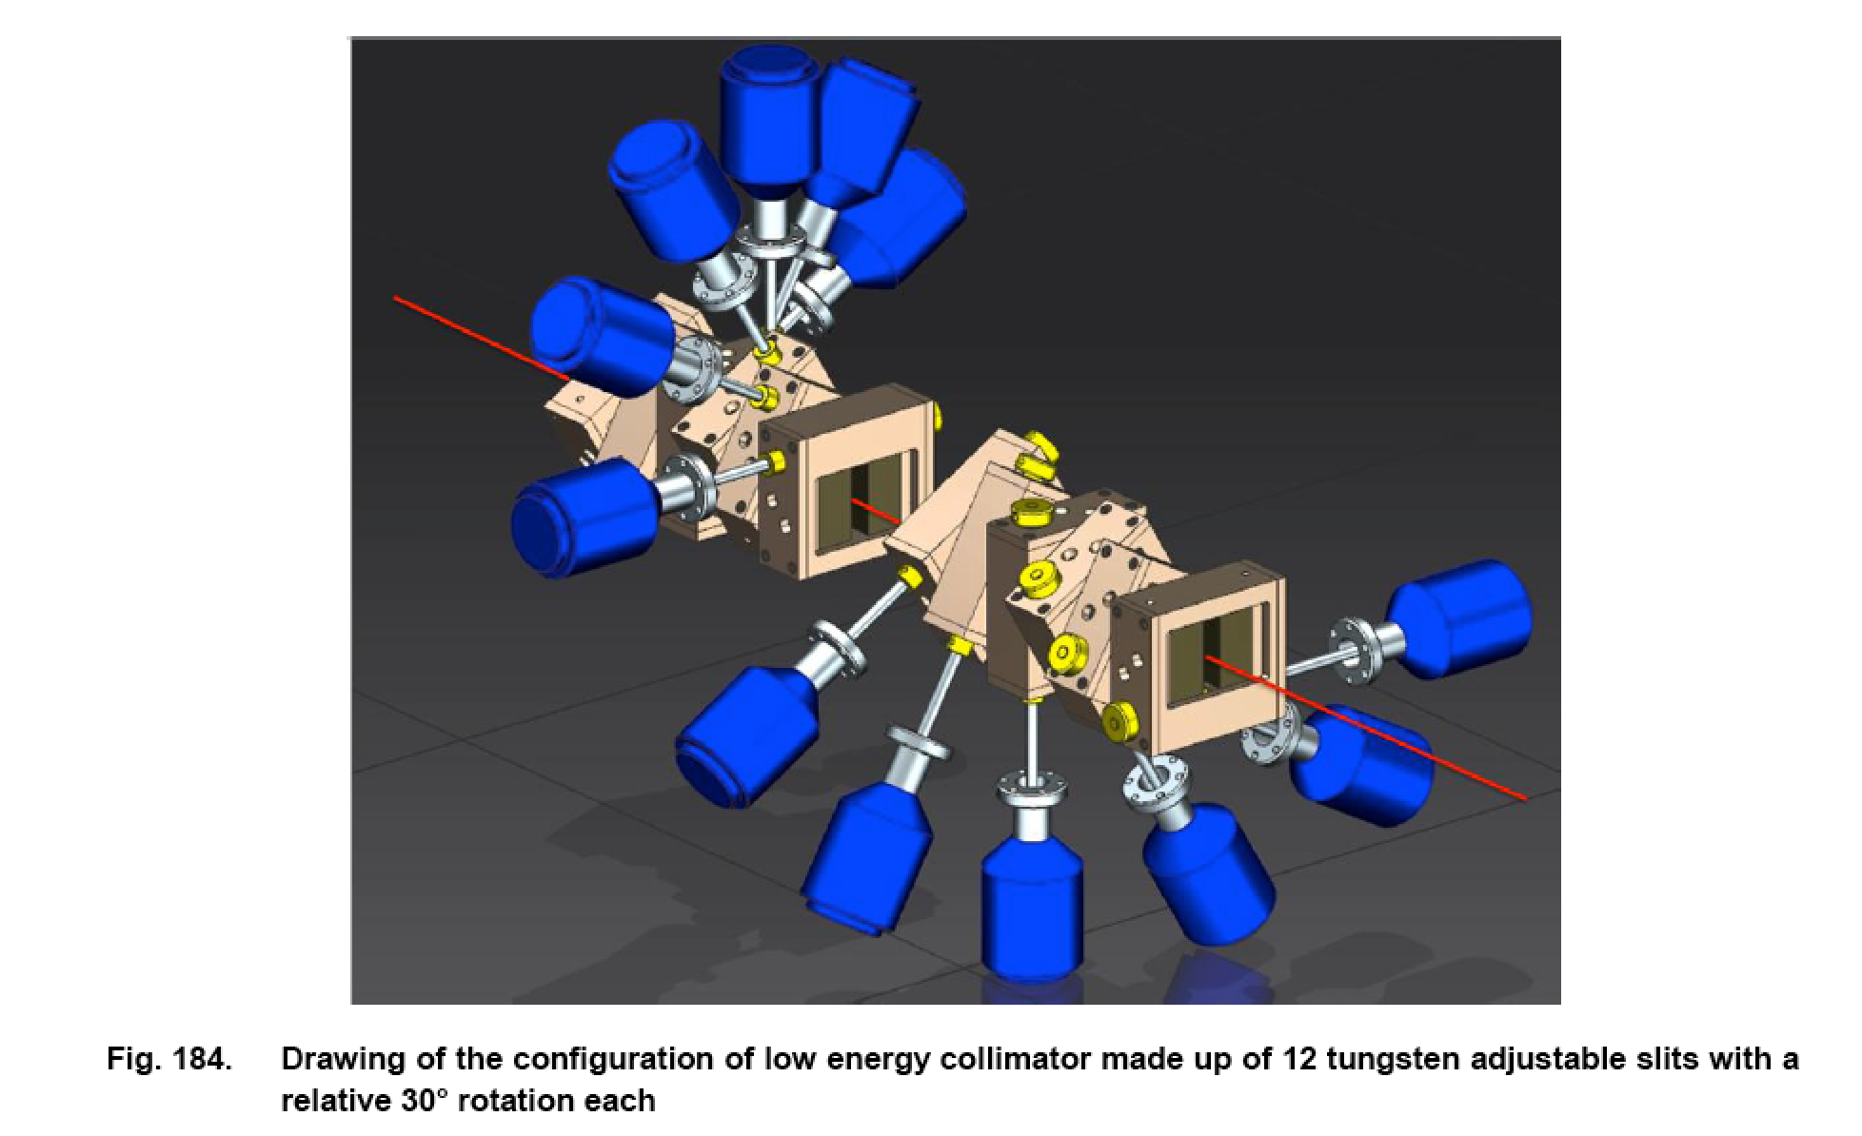
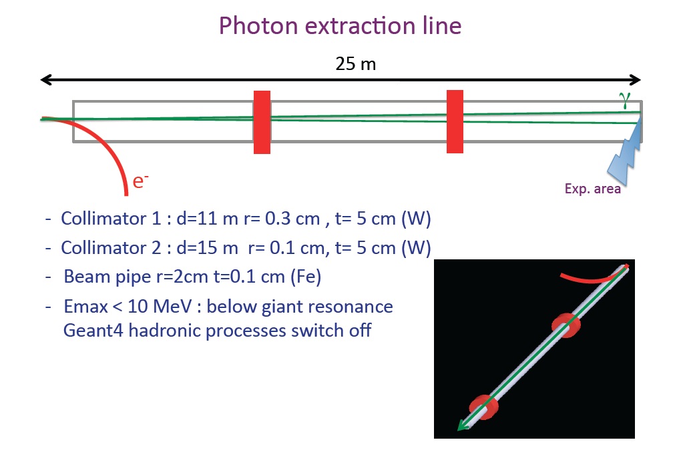
300 μrad
60 μrad
Courtesy M. Gambaccini

Slide 25
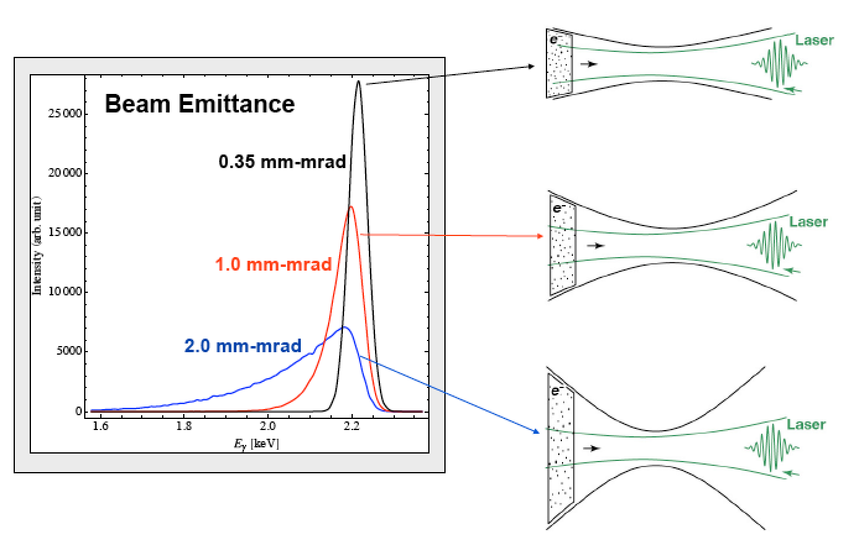
Courtesy C. Barty - LLNL

Slide 26
Spectral broadening due to ultra-focused beams:
Thomson Source classically described as a
Laser Syncrotron Light Source
X
e⁻
X
e⁻
focus
envelope
Scattering angle in Thomson limit (no recoil) is small, i.e. < 1/γ

Slide 27
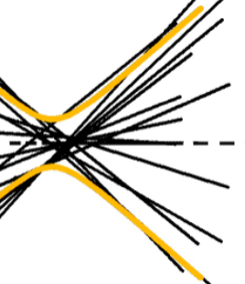
Spectral broadening due to ultra-focused beams:
Thomson Source classically described as a
Laser Syncrotron Light Source
focus
X
Limit to focusability due to max acceptable bandwidth

Slide 28
Bandwidth due to collection angle, laser and electron beam phase space distribution
;
;
etc
angular spread due to scattering angle and angular spread due to single electron incoming angle (emittance) are treated symmetrically

Slide 29
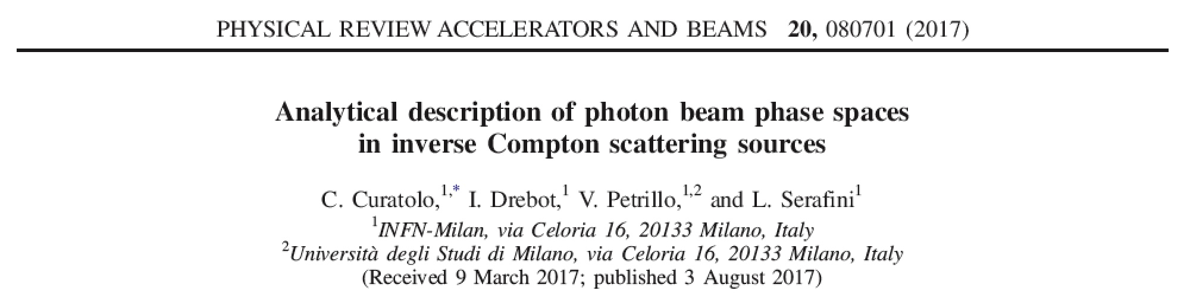
Petrillo-Serafini Formula* for
ICS photon beam bandwidth
electron beam phase space
collimation
laser beam phase space
laser collective effects

Slide 31
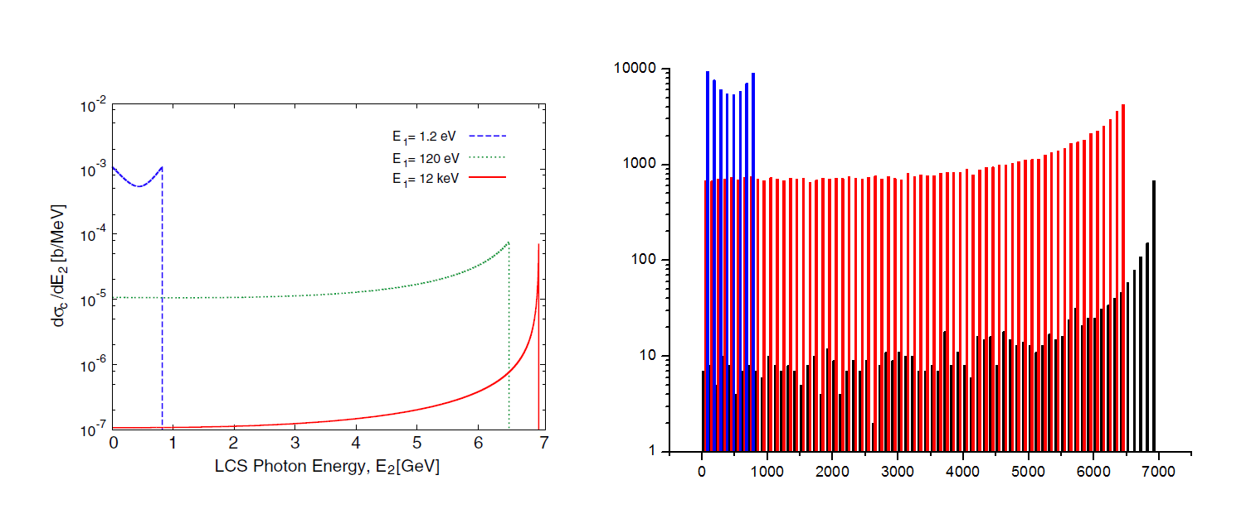
High Recoil of 12 keV photons scattering off
7 GeV electrons
Laser
UV/FEL
XFEL

Slide 34
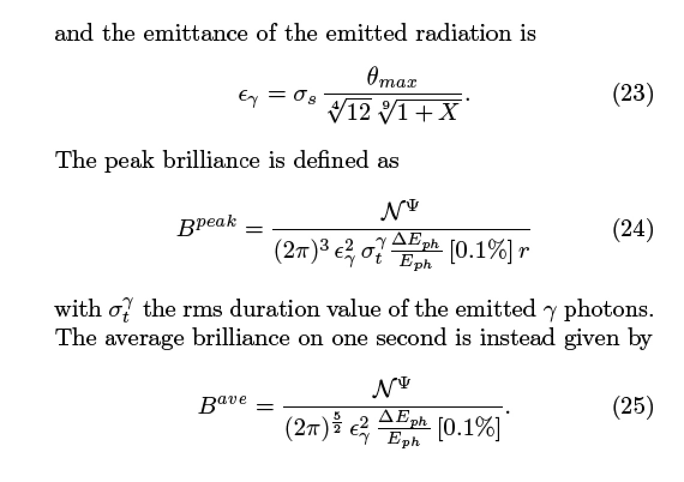

Slide 35
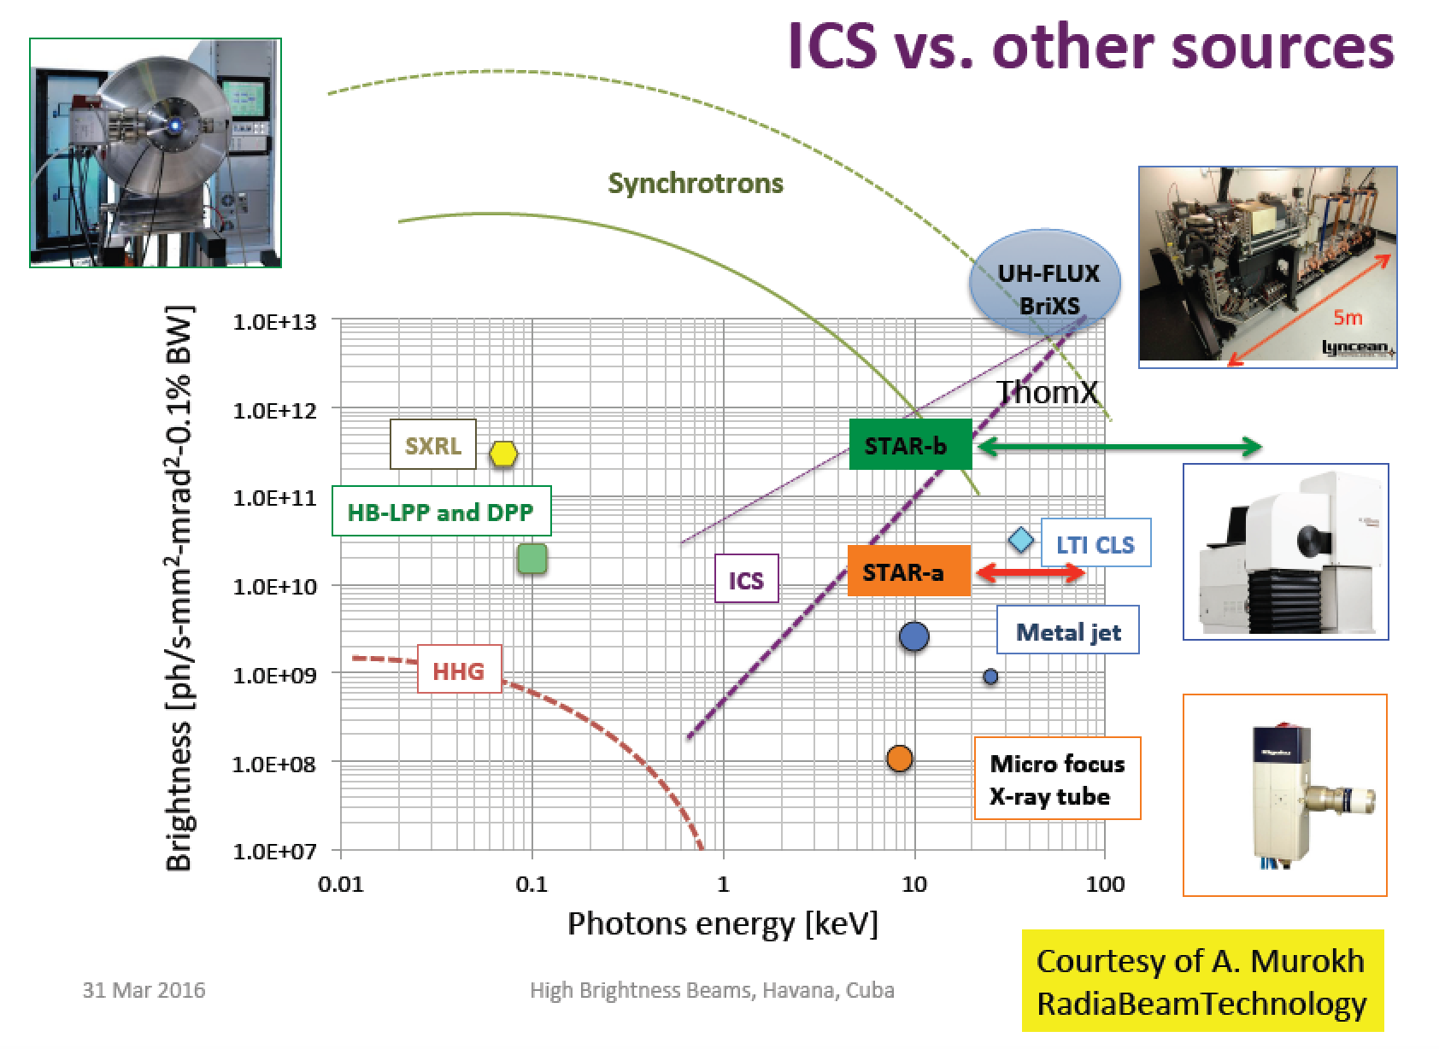
Rivaling with Synchr. Light Sources for energies above 50 keV

Slide 36
X-ray flux N_{X}^{bw} in photons/sec within rms bandwidth bw
Case A: head-on collision STAR-like
U_{L} energy of colliding laser pulse, Q electron bunch charge, f_{RF} rep rate of electron bunches, σ_{x} electron beam spot size at collision
Case B: BriXS-like with F-P optical cavity
P_{FP} power stored in Fabry-Perot cavity, <I_{e}> average electron beam current

Slide 37
Sorgenti di Radiazione Thomson/Compton e
Collisori Fotonici
Luca Serafini – INFN-Milan and University of Milan
Seminar Outline
Overview of Compton Sources and Applications
Linear Quantum Theory of Inverse Compton Scattering of Beams and Paradigms for Compton Sources
Sources of secondary beams using photons (electron-positron pairs, muon pairs): the large recoil regime towards ultra-low emittance muon beams

Slide 38
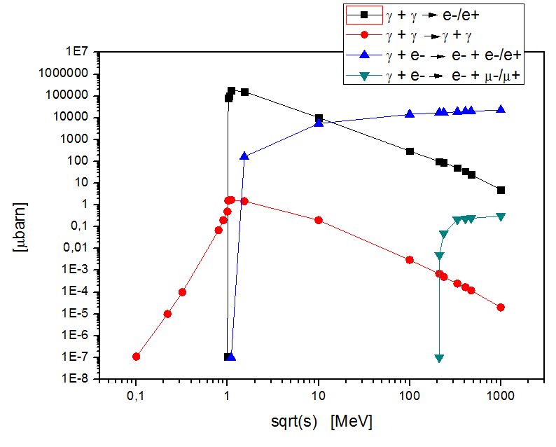
Total cross section of various γ−γ or e-γ interactions
Thomson cross sect. = 670 mbarn
Courtesy C. Curatolo

Slide 39
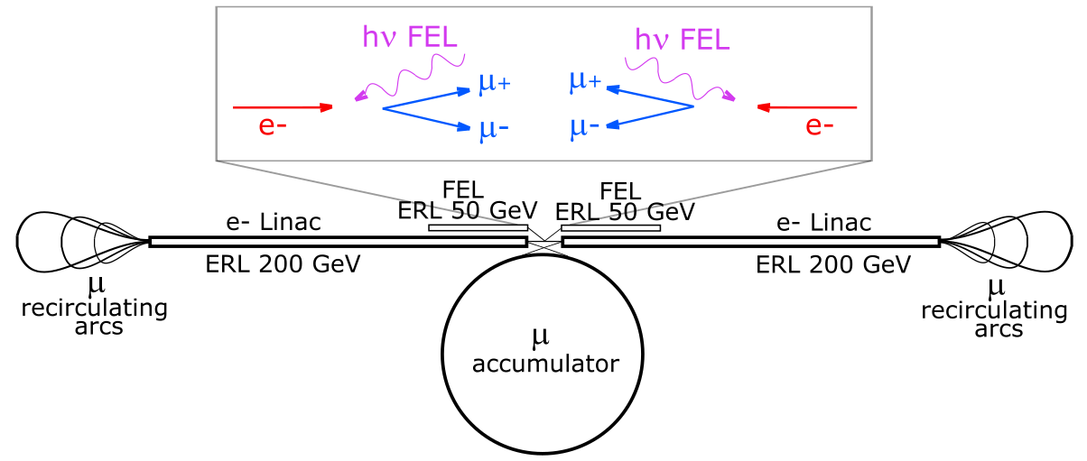
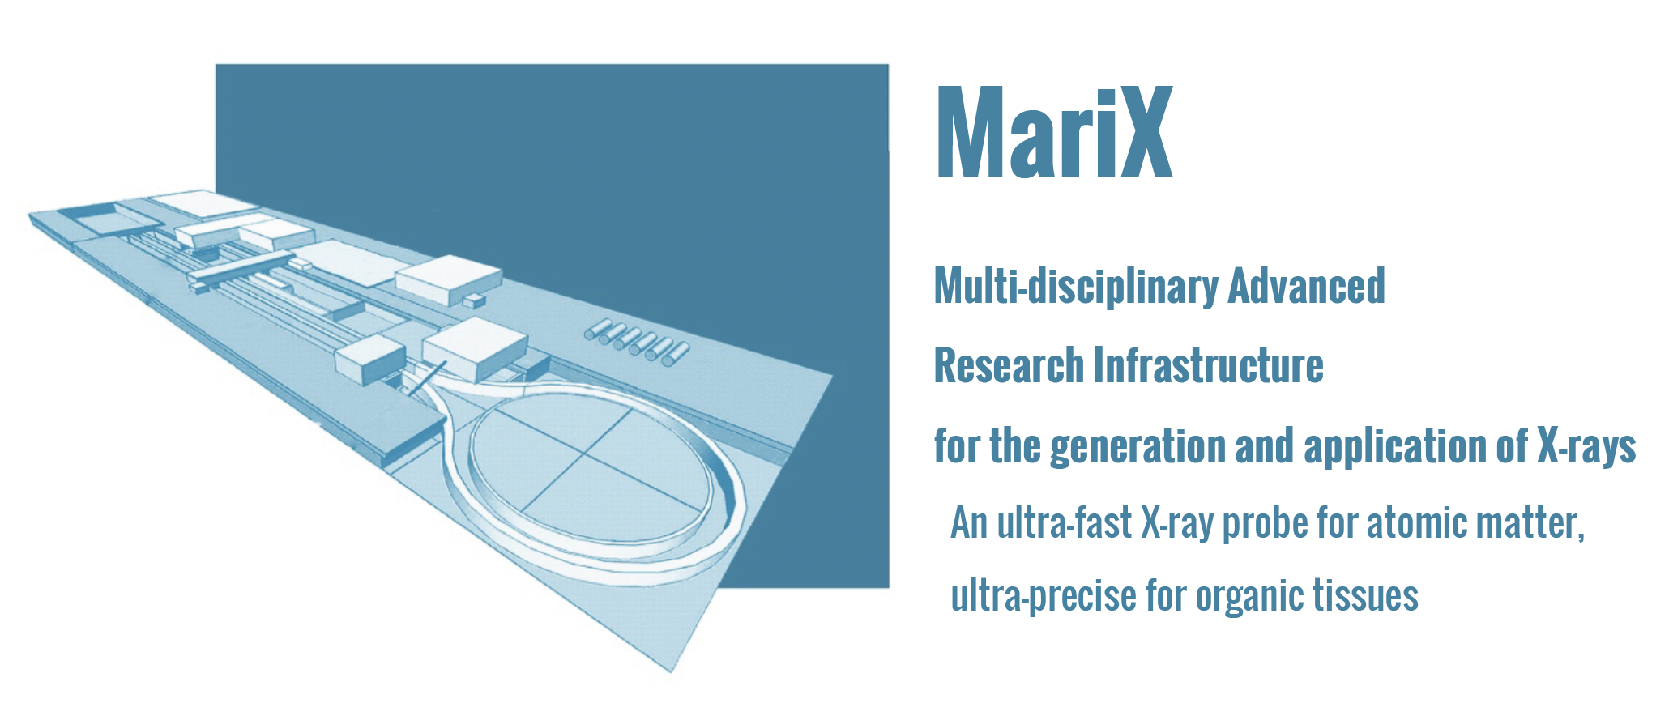
EXMP: Muon Beams
From Electron-Photon Collisions
Luca Serafini and Camilla Curatolo – INFN-Milano and LASA
Very recent idea (C. Curatolo and L. Serafini, arXiv:2106.03255v1 , 6 Jun 2021) on a new scheme of muon collider based on electron-photon collisions
Idea conceived from decades of expertise on Free Electron Lasers (MariX), High Brightness e⁻ beams (SPARC), secondary beams from electron-photon collisions (Inverse Compton Scattering sources of X and γ –rays, STAR, ELI-NP-GBS), exotic ideas with photons (HPC) -> leading to EXMP (Electron and X-rays to Muon Pairs)
INFN – CSN1 Meeting – Firenze Nov. 15th, 2021

Slide 40
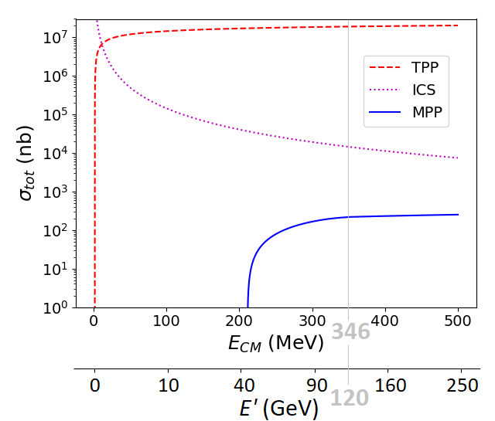

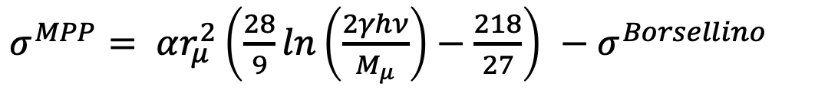
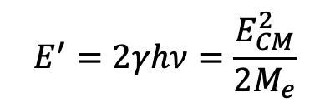
Total cross-section for MPP (muon pair production), Bethe-Heitler:
fraction of a μbarn at photon energies > 100 GeV onto electrons at rest
$$e^{−}+γ→e^{−}+{e^{+}}/{e^{−}}$$
$$e^{−}+γ→e^{−}+γ$$
$$e^{−}+γ→e^{−}+{μ^{+}}/{μ^{−}}$$
EXMP
$σ^{MPP}= αr_{μ}^{2}\left(\frac{28}{9}ln\left(\frac{2γhν}{M_{μ}}\right)−\frac{218}{27}\right)$ ${− σ}^{Borsellino}$
Bethe-Heitler
$$E_{CM}=2\sqrt{M_{e}γhν}$$
$$E^{′}=2γhν=\frac{E_{CM}^{2}}{2M_{e}}$$

Slide 41
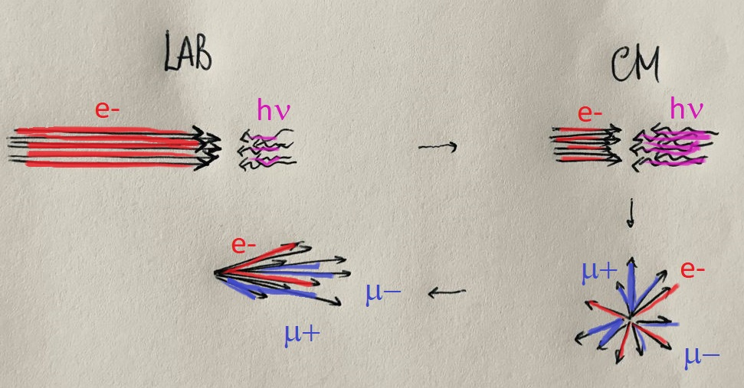

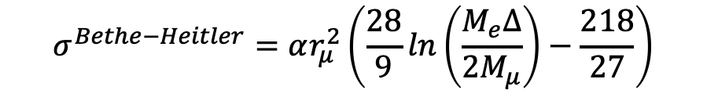
Highly Asymmetric Lorentz-boosted electron-photon collisions with large recoil factor are characterized by much higher phase space densities of secondary generated beams w.r.t. collisions operated with small recoil factor
${e^{−} recoil factor Δ=\frac{4γhν}{M_{e}} ; when Δ≫1 E}_{CM}=2\sqrt{M_{e}γhν}$ = $M_{e}\sqrt{∆}$
$$σ^{Bethe−Heitler}=αr_{μ}^{2}\left(\frac{28}{9}ln\left(\frac{M_{e}Δ}{{2M}_{μ}}\right)−\frac{218}{27}\right)$$
Inverse Kinematics
$$αr_{μ}^{2}=13.4 nbarn$$

Slide 42
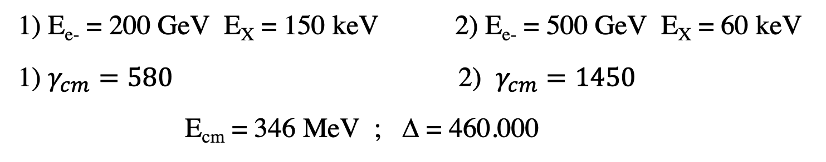
EXMP is based on a
Δ>>1 Asymmetric boosted primary collider
$$e^{−} recoil factor Δ=\frac{4γhν}{M_{e}}$$
$$E_{CM}=M_{e}\sqrt{∆}$$
$$γ_{cm}=\frac{γ}{\sqrt{1+Δ}}$$
2 operating points selected for EXMP
1) E_{e-} = 200 GeV E_{X} = 150 keV 2) E_{e-} = 500 GeV E_{X} = 60 keV
1) $γ_{cm}=580$ 2) $γ_{cm}=1450$
E_{cm} = 346 MeV ; Δ = 460.000

Slide 43
EXMP 500 GeV e⁻ vs. 60 keV hν_{FEL}
FEL-graded CW electron beam – 800 MHZ (SC-RF Perle cavities) @ 200 mA
Parameters of Primary Beams
Energy e-beam (GeV) | 500. | 500. | FEL photon energy (keV) | FEL photon energy (keV) | 60.
Bunch charge (pC) | 250. | 250. | Photons per pulse (10¹²) | Photons per pulse (10¹²) | 12.5
N_{e} (10⁹) | 1.6 | 1.6 | Repetition rate (MHz) | Repetition rate (MHz) | 800.
Repetition rate (MHz) CW | 800. | 800. | ε_{x,y} (pm.rad) | ε_{x,y} (pm.rad) | 1.5
Average Current (mA) | 2x200. | 2x200. | Focal spot size (rms, nm) | Focal spot size (rms, nm) | 10.
Nominal beam power (GW) | 2x100. | 2x100. | FEL beam power (MW) | FEL beam power (MW) | 2x100.
beam power recovery fraction | 99.95 % | 99.95 % | FEL-efficiency (tapering) | FEL-efficiency (tapering) | 1%
beam power loss (MW) | 2x50. | 2x50. | FEL e⁻ beam av. curr. (mA) | FEL e⁻ beam av. curr. (mA) | 200.
Bunch length (psec) | 0.2 | 0.2 | FEL e- beam energy (GeV) | FEL e- beam energy (GeV) | 50.
ε_{n}__{x,y} (mm.rad) | 0.4 | 0.4 | FEL e-beam power (GW) | FEL e-beam power (GW) | 2x10.
b_{x,y} (mm) | 0.23 | 0.23 | e⁻ beam power recovery fraction (after FEL) | e⁻ beam power recovery fraction (after FEL) | 99.9%
s_{x,y} (nm) | 10. | 10. | e⁻ beam power loss (MW) | e⁻ beam power loss (MW) | 2x10.
Total beam power loss (primary+FEL) (MW) |  |  |  |  | 320.
Peak Luminosity (cm⁻²s⁻¹) = 2 x 1.25.10⁴²

Slide 44
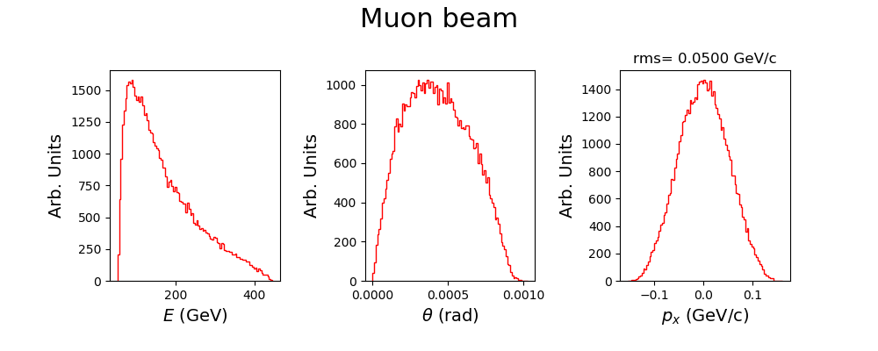
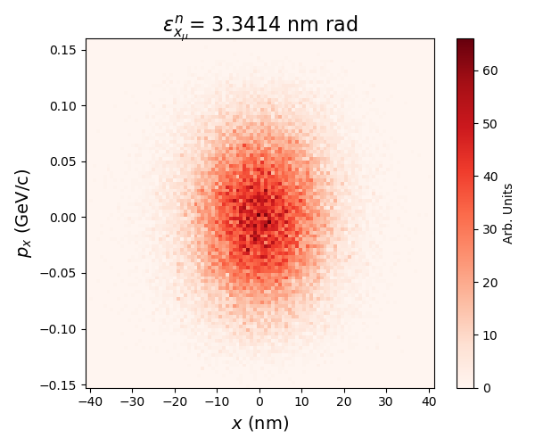
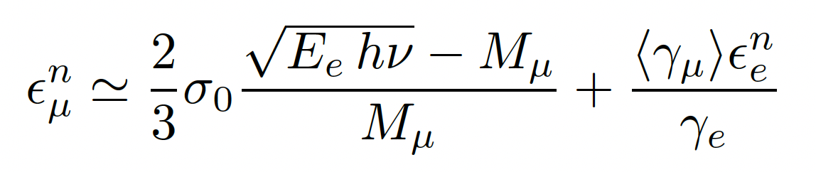
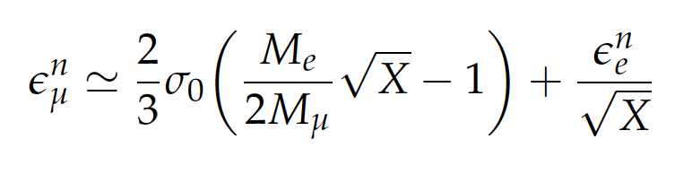
EXMP Simulations Results
(using Wizhard + ad-hoc script to populate phase spaces)
E_{e} = 500 GeV σ₀ = 10 nm $γ_{cm}=1450$ E_{cm} = 346 MeV
$$E_{peak}\sim M_{μ}γ_{cm}\sim 120 GeV$$
Analytical formula for the muon beam normalized rms transv. emittance that agrees with data within 20-30%
MAP emittance 25.*10³ nm.rad
after ionization cooling
LEMMA emittance 50. nm.rad

Slide 45
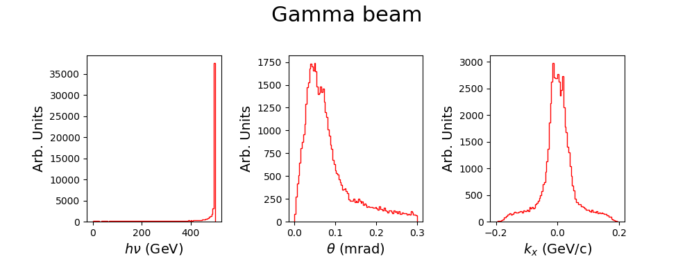
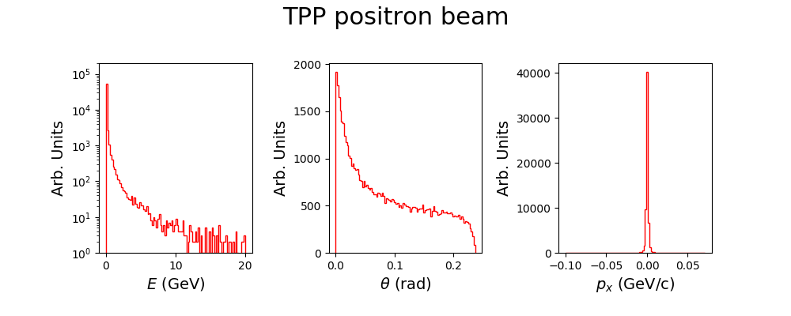

Slide 46
EXMP Simulations Results
(using Wizhard + ad-hoc script to populate phase spaces)
EXMP with 500 GeV electrons | vs. 60 keV FEL photons
E_{CM} | 346 MeV
TPP total cross section | 19 mbarn*
ICS total cross section | 14.7 μbarn
MPP total cross section | 216 nbarn*
N e₊₋ | 2x2.4 10¹⁶ (s⁻¹)
N_{ICS} | 2x1.9 10¹³ (s⁻¹)
N μ₊₋ | 2x2.7 10¹¹ (s⁻¹)

Slide 47
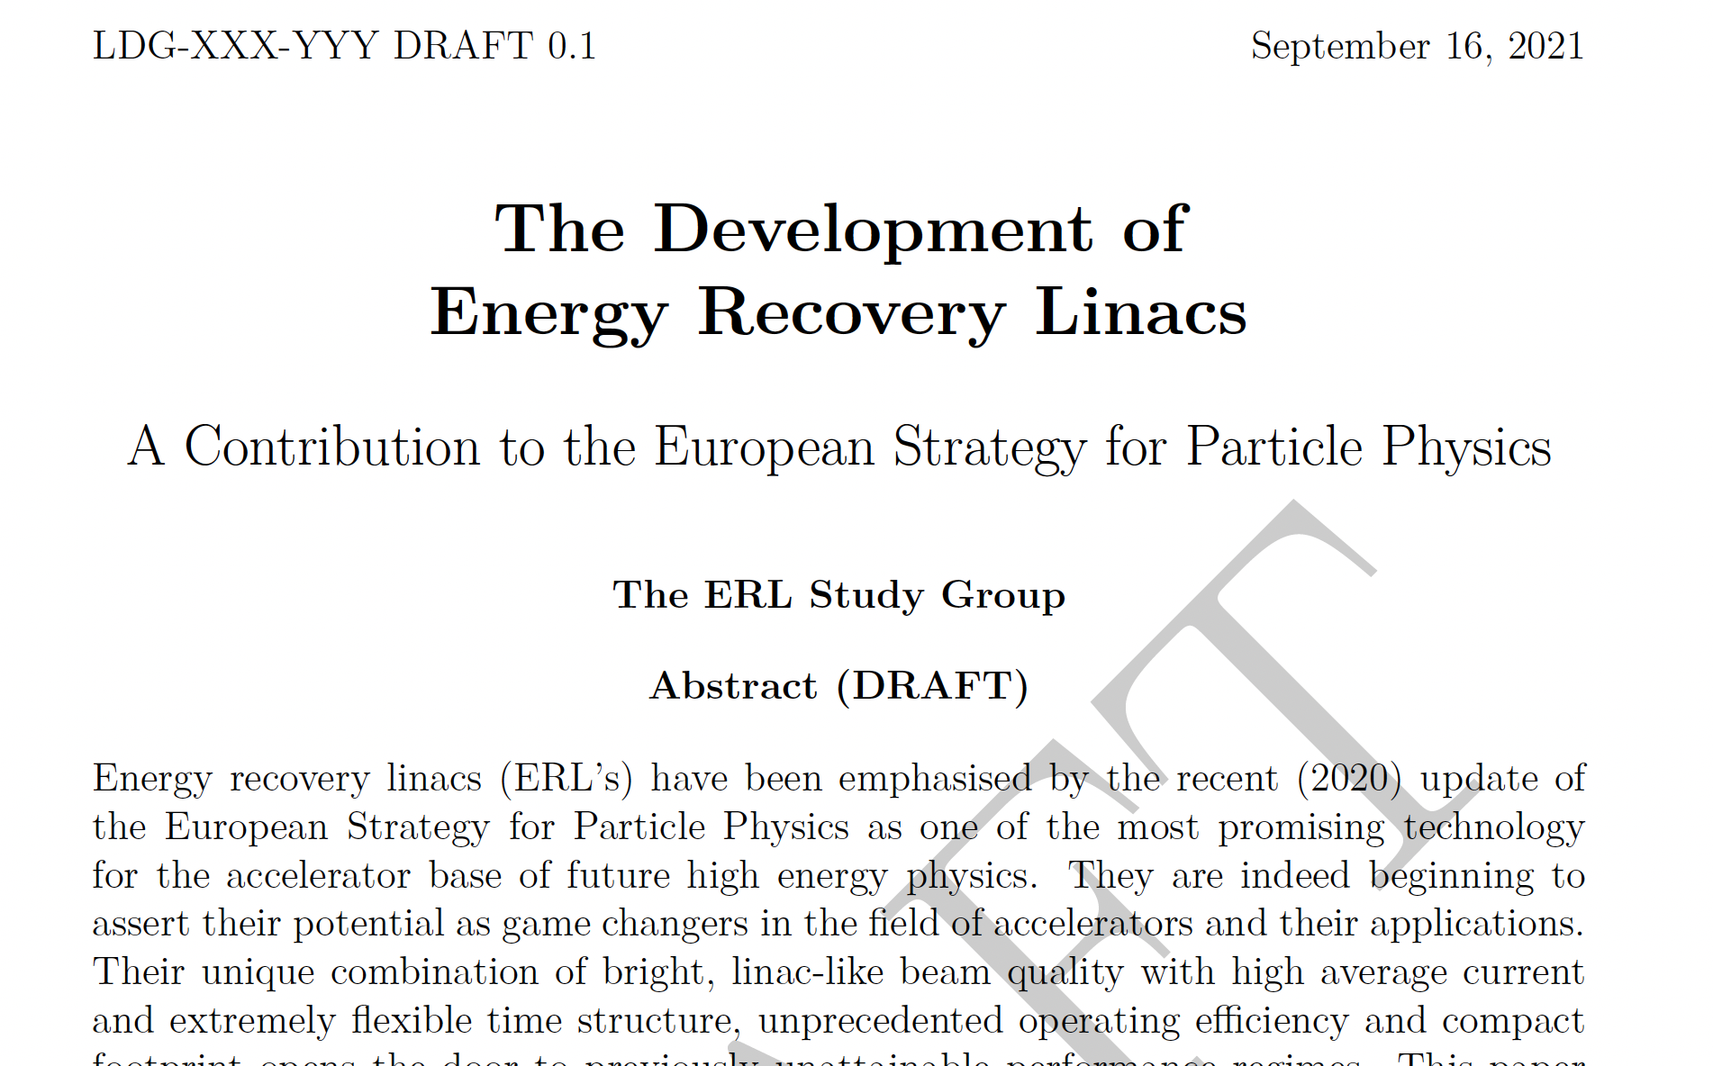
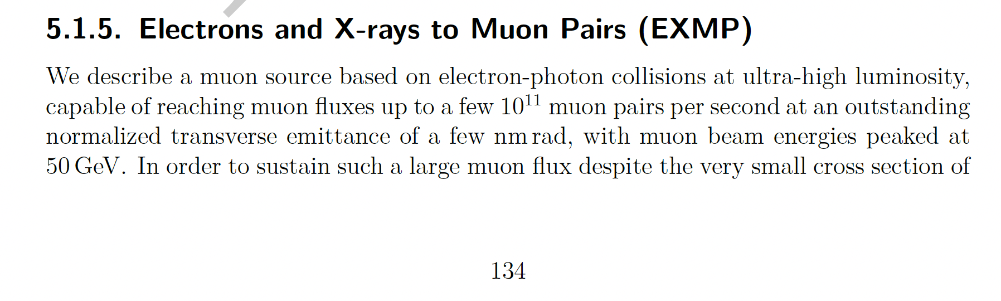

Slide 48
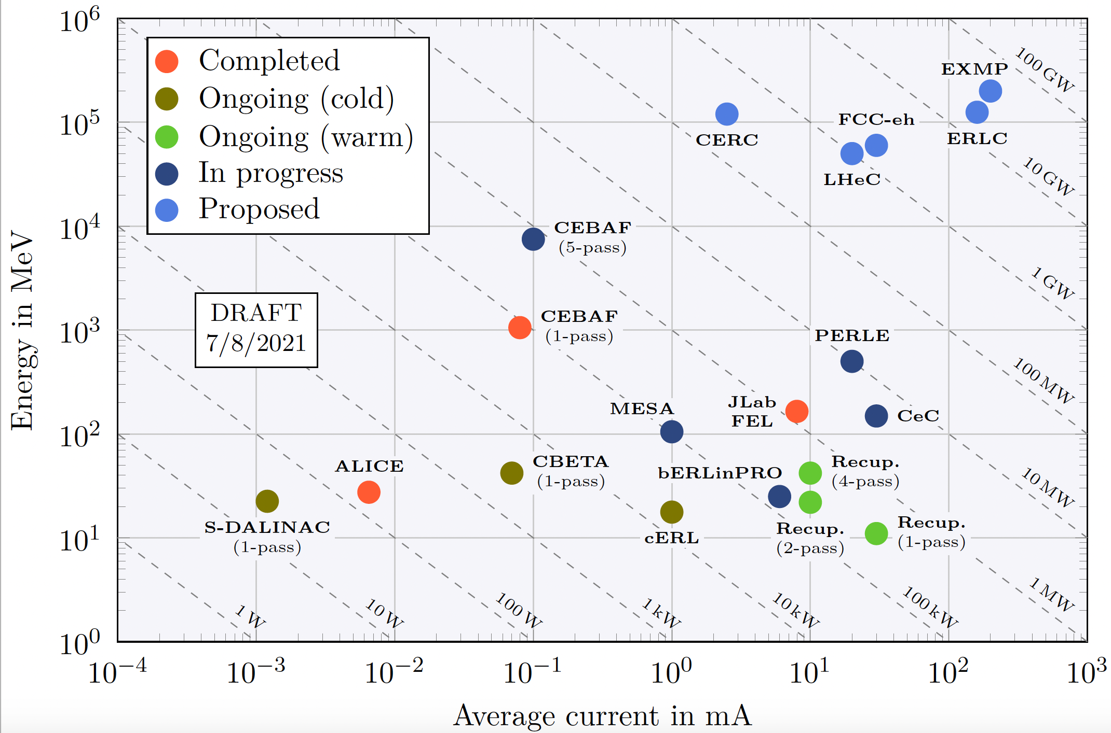

Slide 49
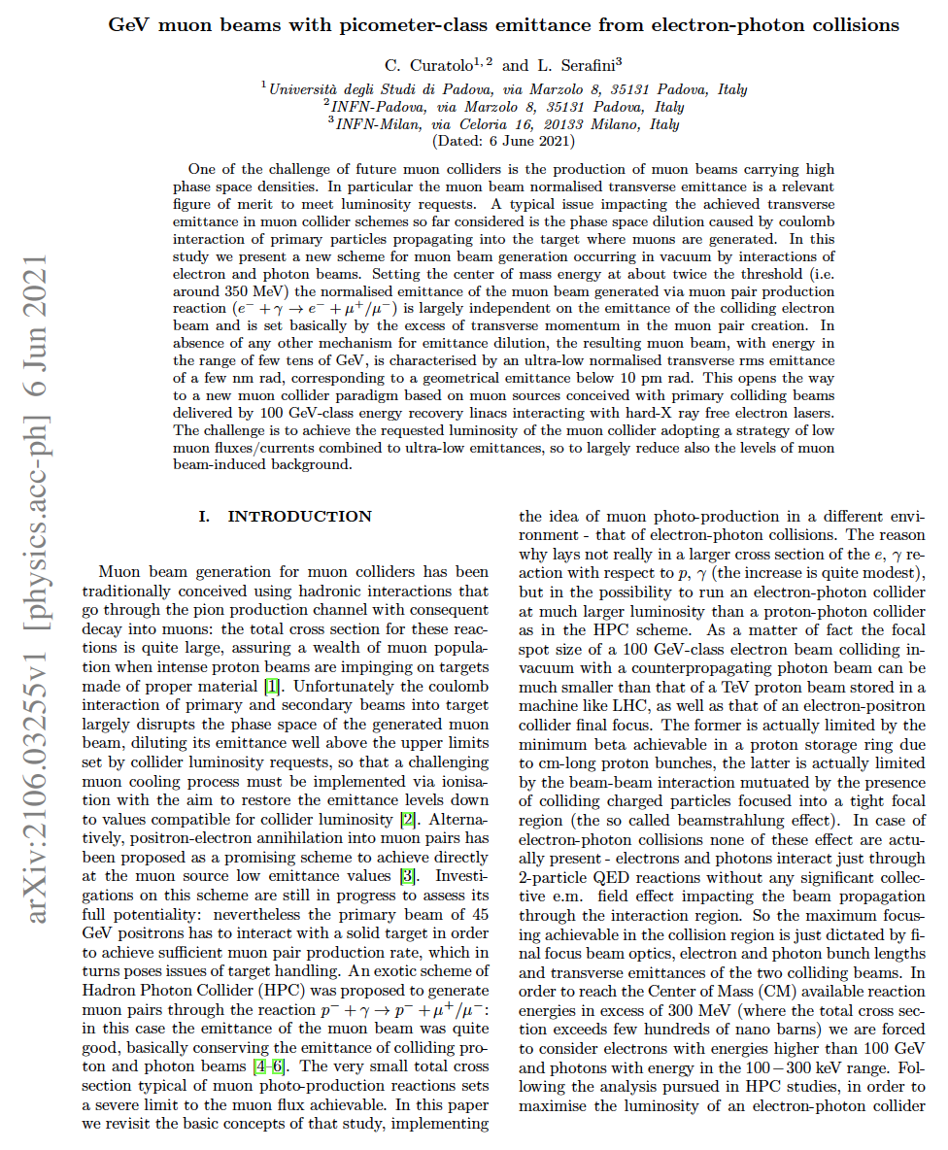
Many details/references can be found in

Slide 51
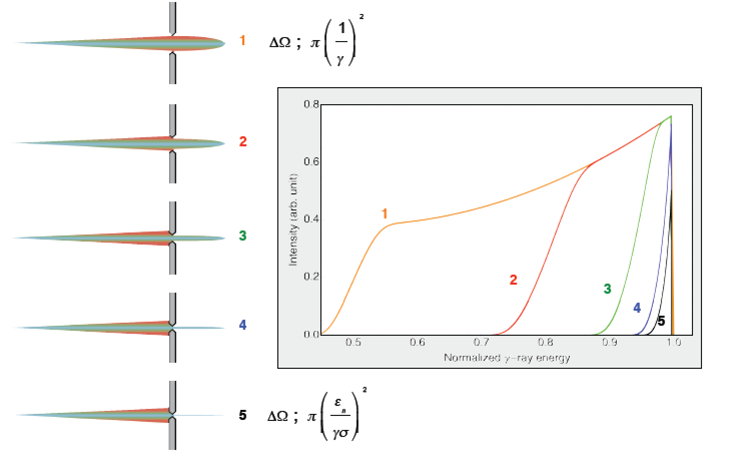
Courtesy C. Barty - LLNL

Slide 52
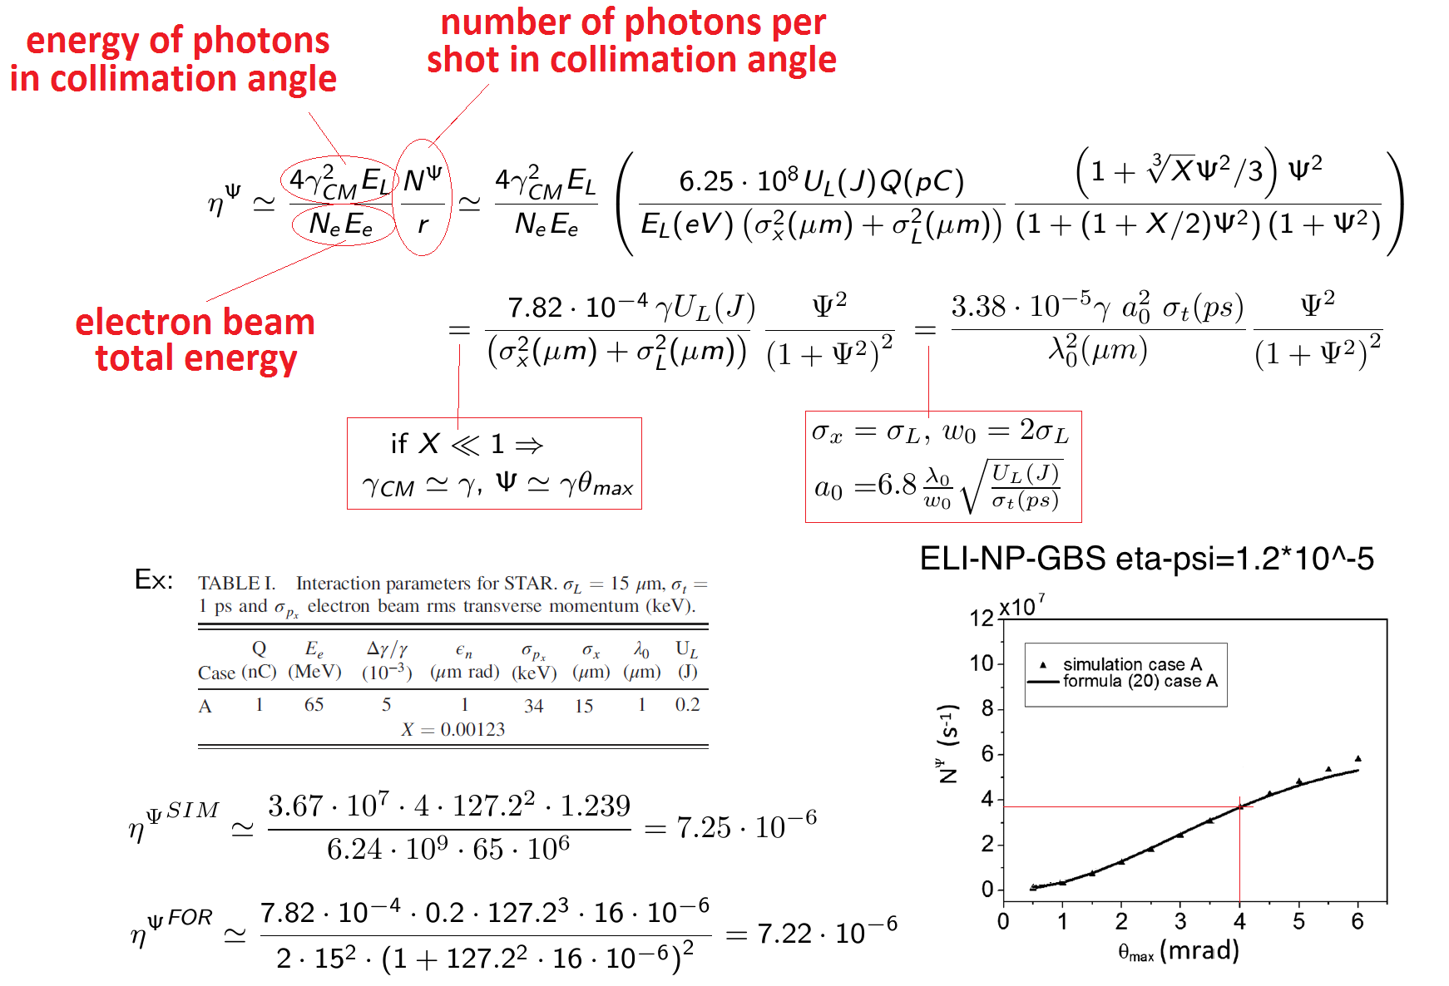
Efficiency of Compton Sources in converting
electron beam energy into radiation beam energy

Slide 56
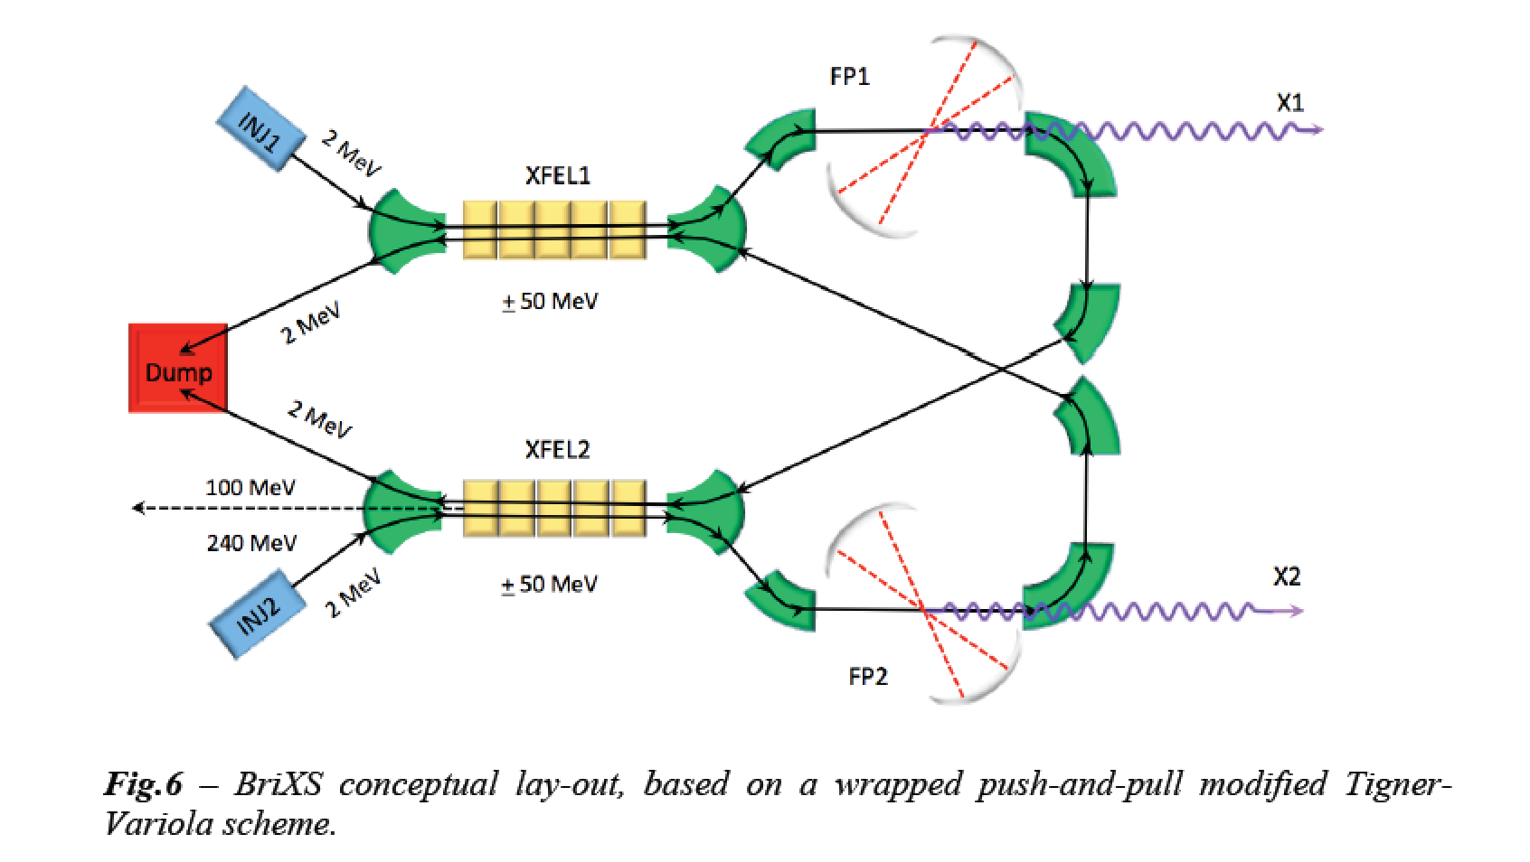
BriXS: BRIght and compact X-ray Source - Proposal at
INFN-Milan and Univ. of Milan (post EXPO-2015 initiative
submitted to regional and metropolitan area governments)

