Slide 1

Sorgenti di Radiazione Thomson/Compton e
Collisori Fotonici
Luca Serafini – INFN-Milan and University of Milan
luca.serafini@mi.infn.it
also thanks to V. Petrillo, F. Broggi, A. Bacci, A.R. Rossi, I. Drebot, C. Curatolo, M. Rossetti
Seminar Outline
Overview of Compton Sources and Applications
Linear Quantum Theory of Inverse Compton Scattering of Beams and Paradigms for Compton Sources
Sources of secondary beams using photons (electron-positron pairs, muon pairs): the large recoil regime towards ultra-low emittance muon beams

Slide 2
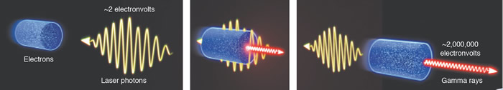
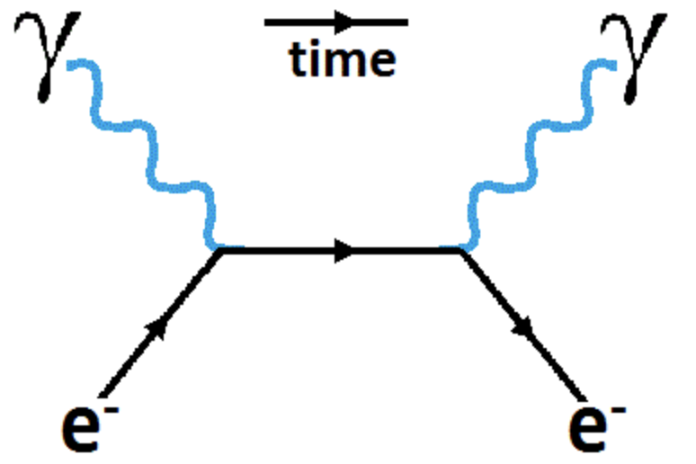
I.C.S. : Inverse Compton Scattering
Inverse Compton Scattering: why Inverse?
(direct) Compton Scattering is performed by an energetic photon (X-rays) interacting with an atomic electron (eV)
Inverse Compton Scattering is performed by an energetic electron (MeV-GeV) onto a visible (eV) photon (“inverse” refers to the reaction kinematics, not the dynamics)

Slide 3
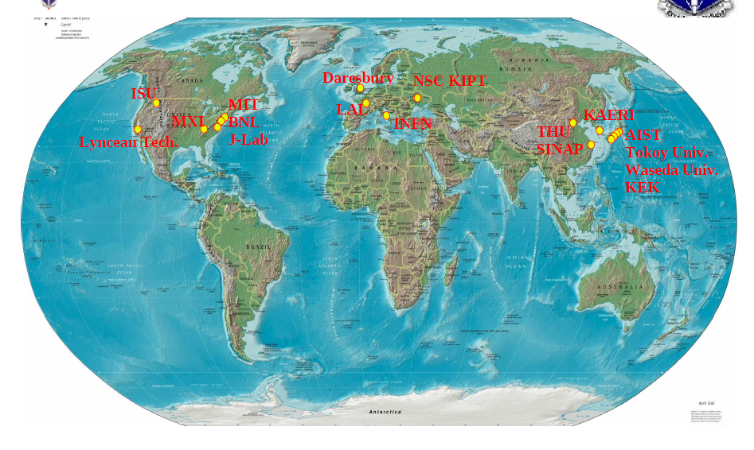
CALA
ELI-NP
HigS
STAR
ICS are the most effective “photon accelerators” (boost twice than FELs)
“4γ² boost effect”
Courtesy A. Variola

Slide 4
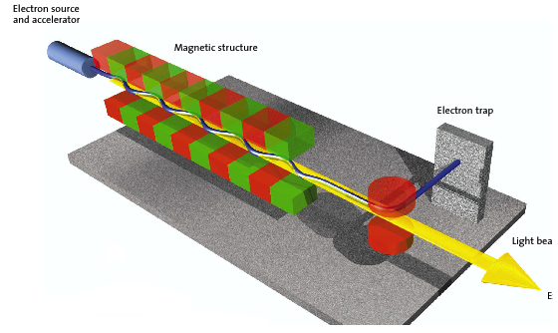
The Classical E.M. view (Maxwell eq.): Thomson Sources as synchrotron radiation sources with electro-magnetic undulator
FEL’s and Thomson/Compton Sources common mechanism:
collision between a relativistic electron and a (pseudo)electromagnetic wave
3 km
cm und. period λ_{u}
1-25 GeV
electrons
100-0.5 Å
photons
20-150 MeV electrons
0.8 μm laser λ
20-500 keV
photons
20 m

Slide 5
Classical model
Laser pulse
Relativistic electron
Courtesy V. Petrillo

Slide 6
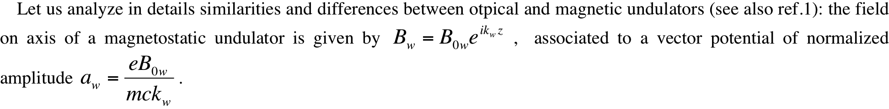
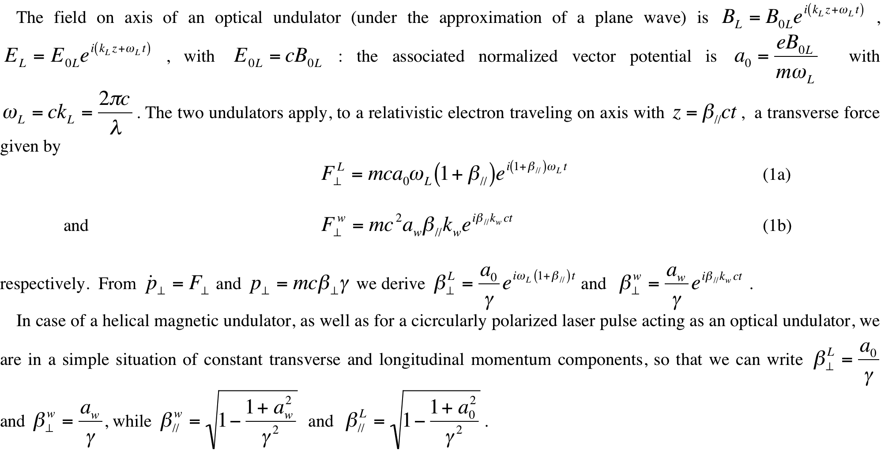

Slide 7
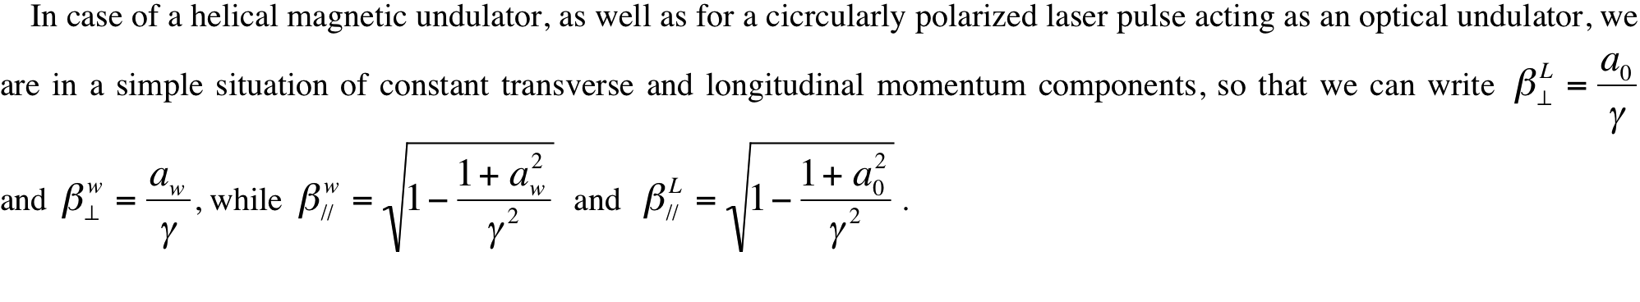
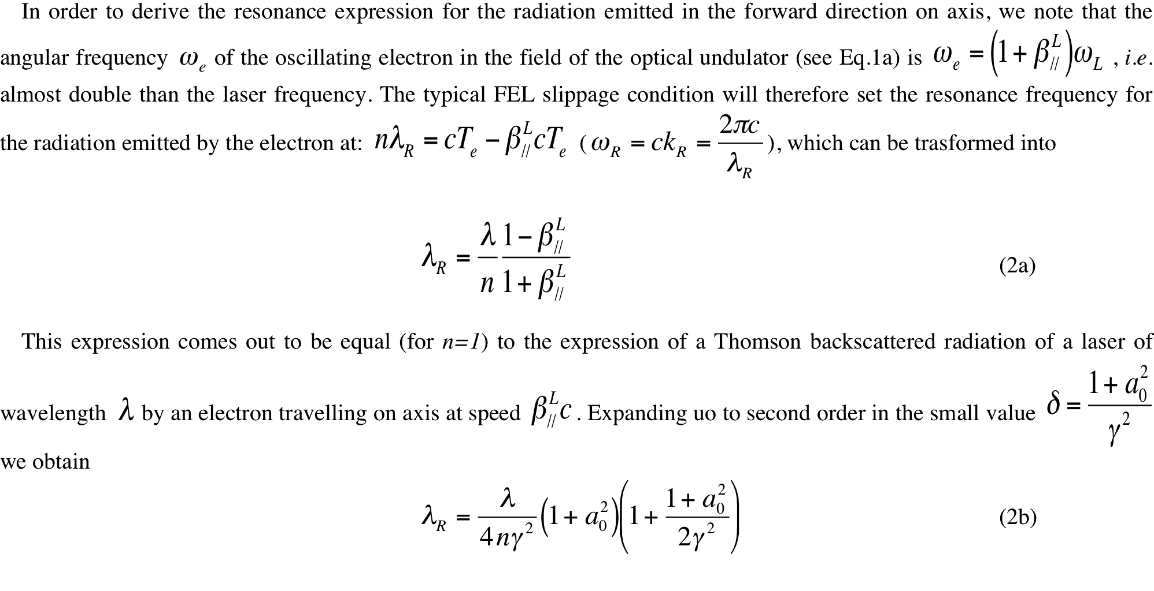

Slide 8
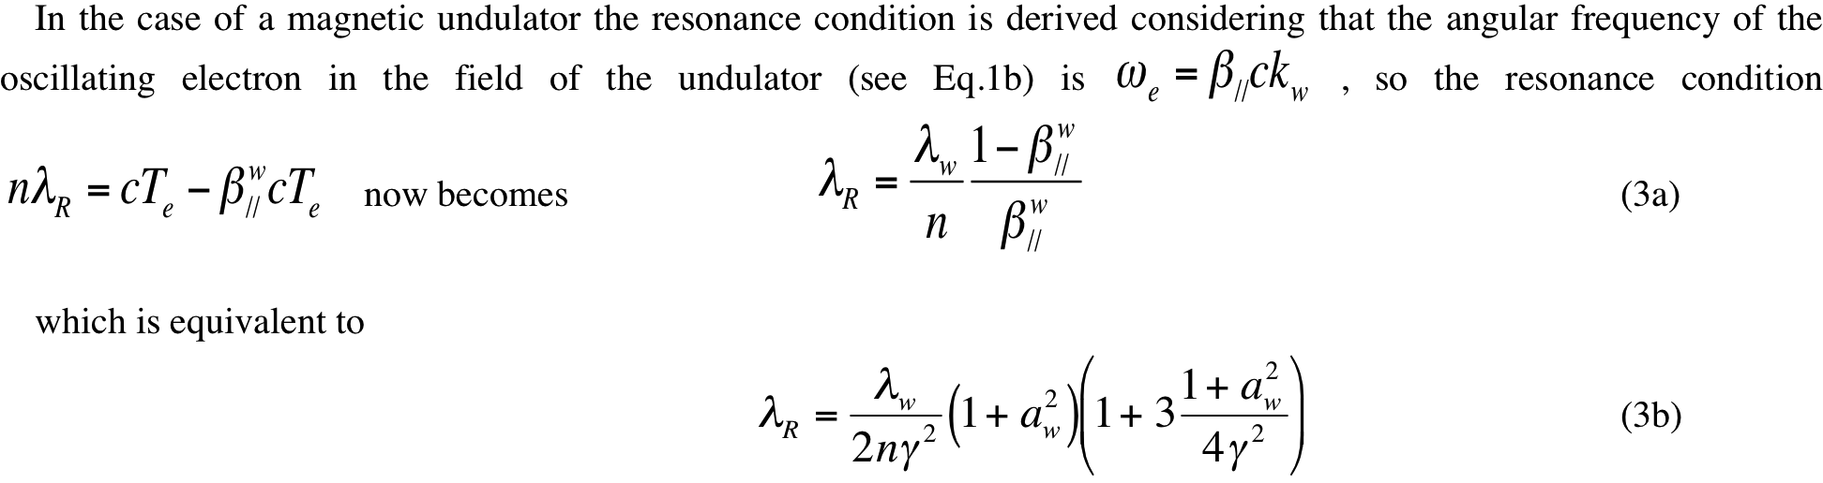
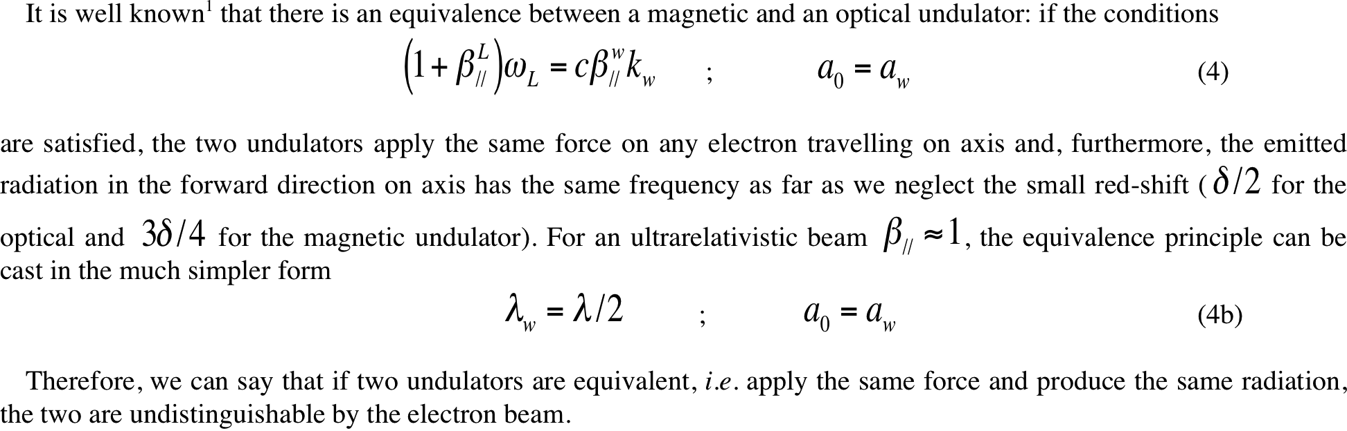

Slide 9
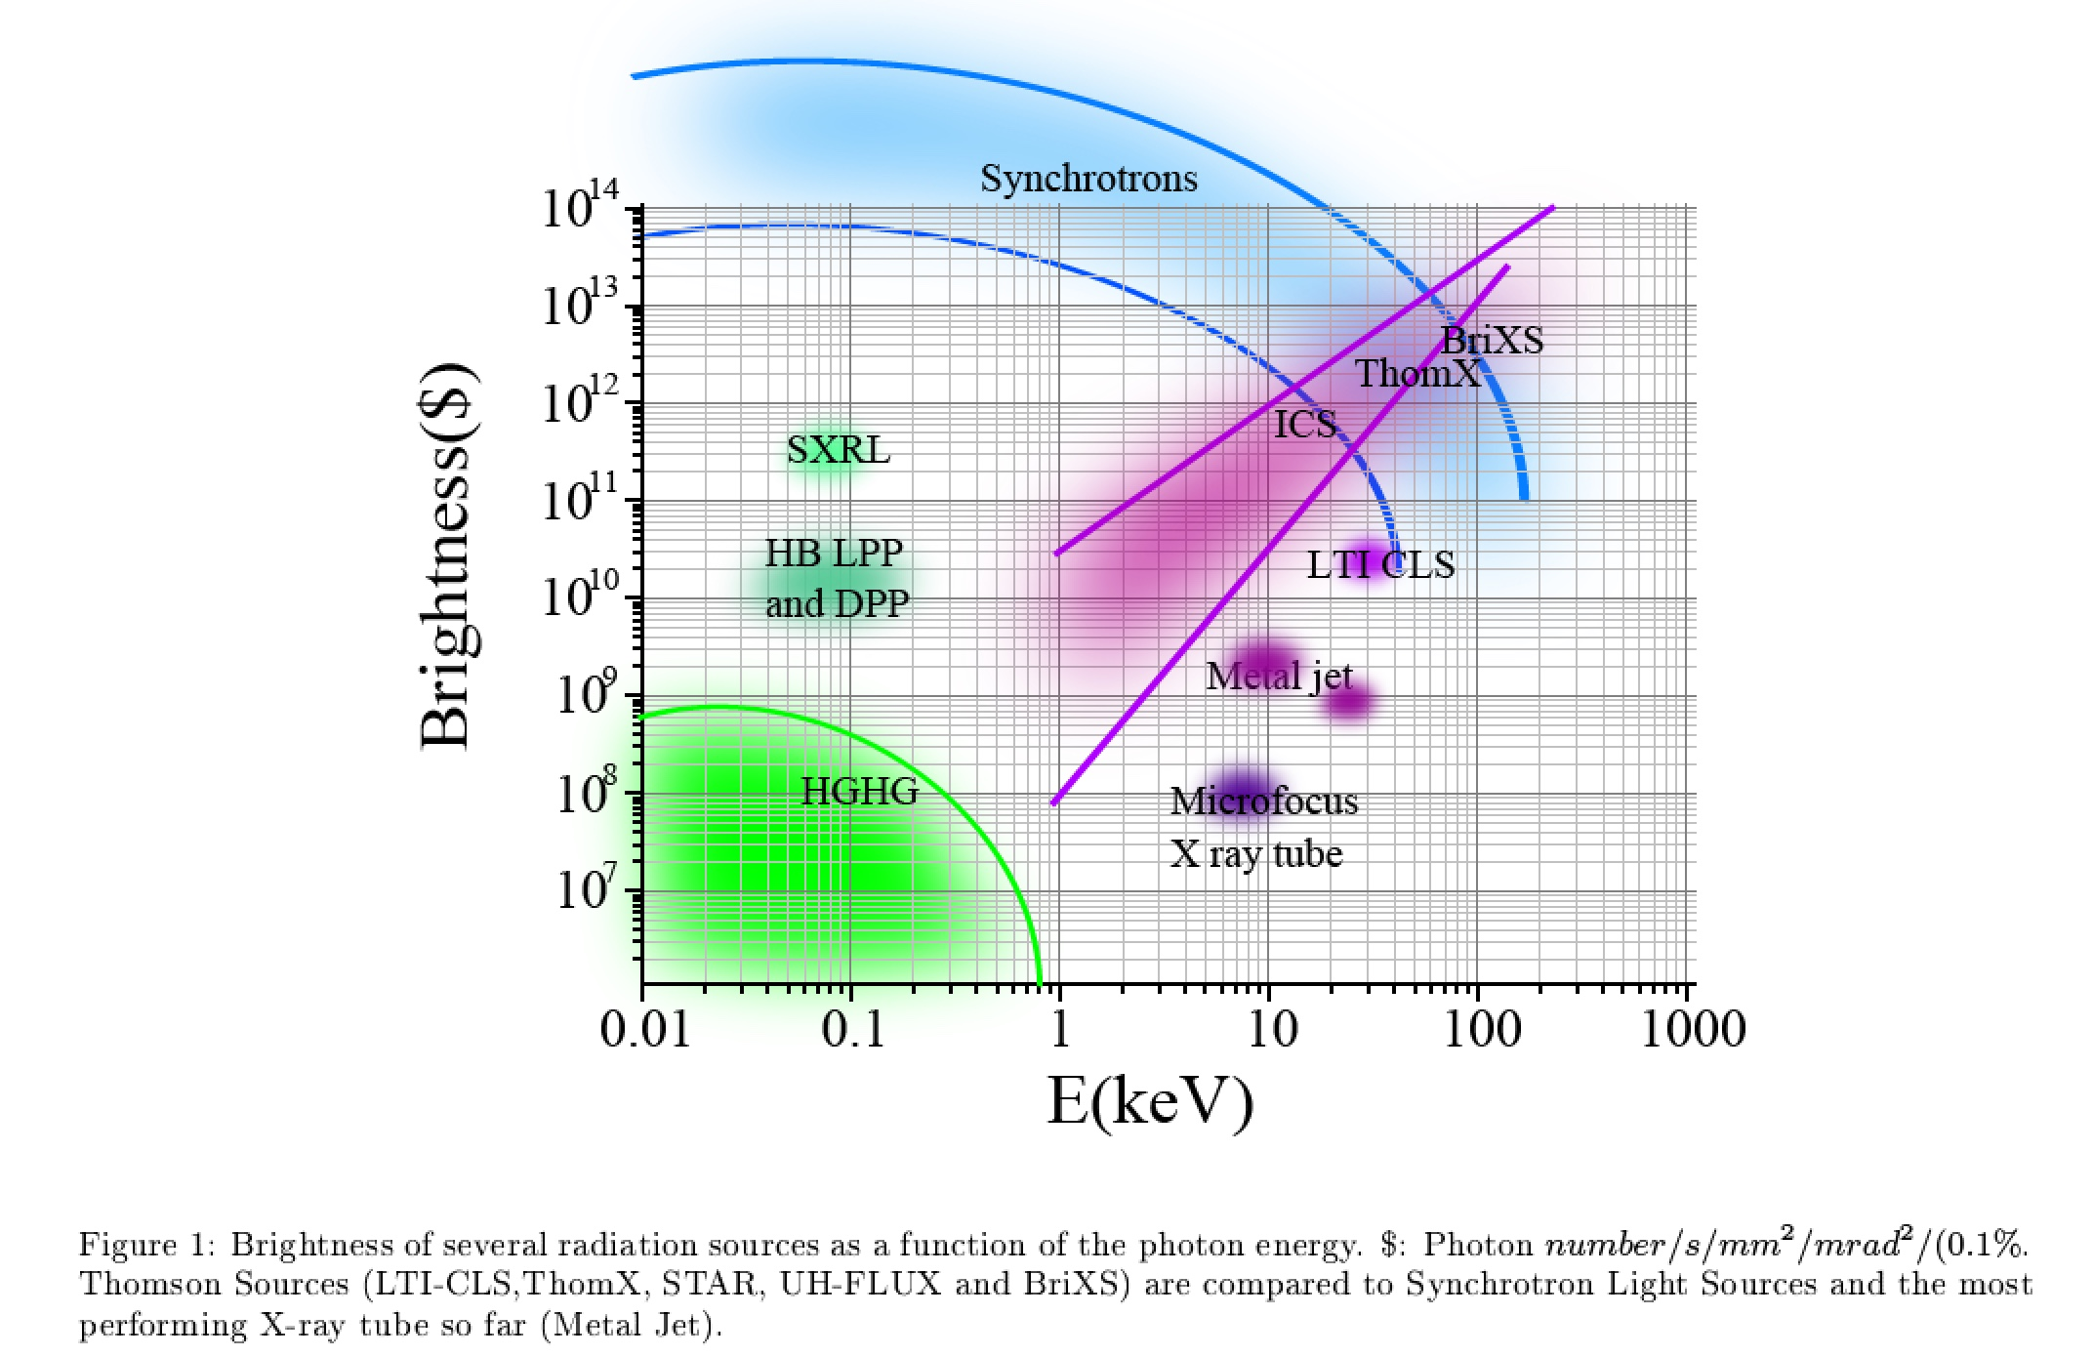
Inverse Compton Sources rivaling/overcoming
Synchrotron Light Sources at photon energies above 80-100 keV
ELI-NP-GBS
STAR
I.C.S.

Slide 10
Inverse Compton Sources, Overview, Theory, Main Technological Challenges – Photonic Colliders
New Generation of X/γ ray beams via electron-photon beam collisions for advanced applications in medicine/biology-material science/cultural heritage/national security and fundamental research in nuclear physics and high energy physics (e-γ, γ-γ colliders, pol. e⁺ beams, hadron. physics, etc)
Inverse Compton Sources (ICS) are e⁻/photon colliders aimed at producing secondary beams of photons
Several Test-Facilities world-wide: after a decade of machine test&development we are entering the era of User Facilities in X-ray imaging and γ-ray Nuclear Physics and Photonics

Slide 11
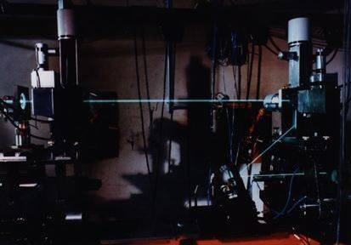
Inverse Compton Sources, Overview, Theory, Main Technological Challenges – Photonic Colliders
Hadronic Physics was the original motivation for Compton back-scattering experiments (cfr. Ladon at INFN-LNF, Graal at ESRF, etc): single photon per bunch collision at energies > 50 MeV with tagging (quite popular decades ago)
Recent Proposals (R.Hajima et al., PRAB 19, 020702, 2016 ) for high flux (5000 / s) GeV photons using FELs and 7 GeV e⁻ E.R.L.
Combination at this Lab (CERN, SPS and LHC) of TeV-class proton beams and (possible) X-ray FELs ⇒ TeV-class photons (the role in beam-beam collisions of beam phase space quality on TeV photon spectra and fluxes (100 / s))

Slide 12
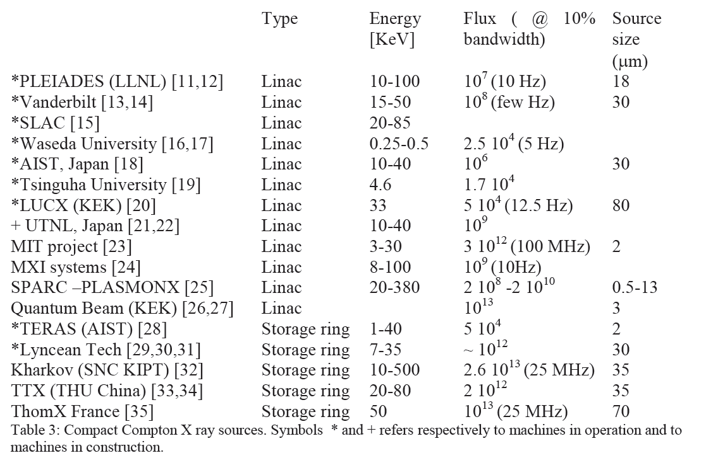
Existing and planned Thomson sources
STAR (Calabria) Linac 20-100 10¹¹ (100 Hz) 18
From THOMX Conceptual Design Report, A.Variola, A.Loulergue, F.Zomer, LAL RT 09/28, SOLEIL/SOU-RA-2678, 2010

Slide 13
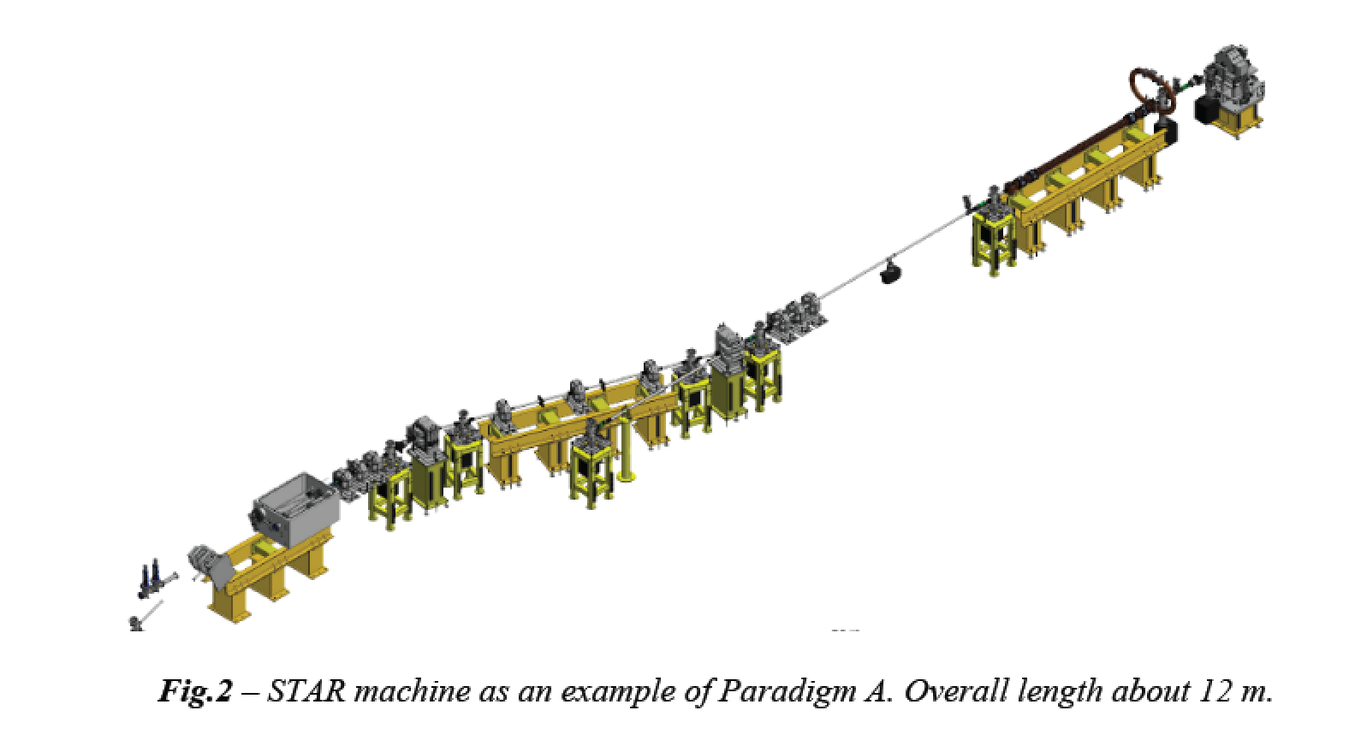
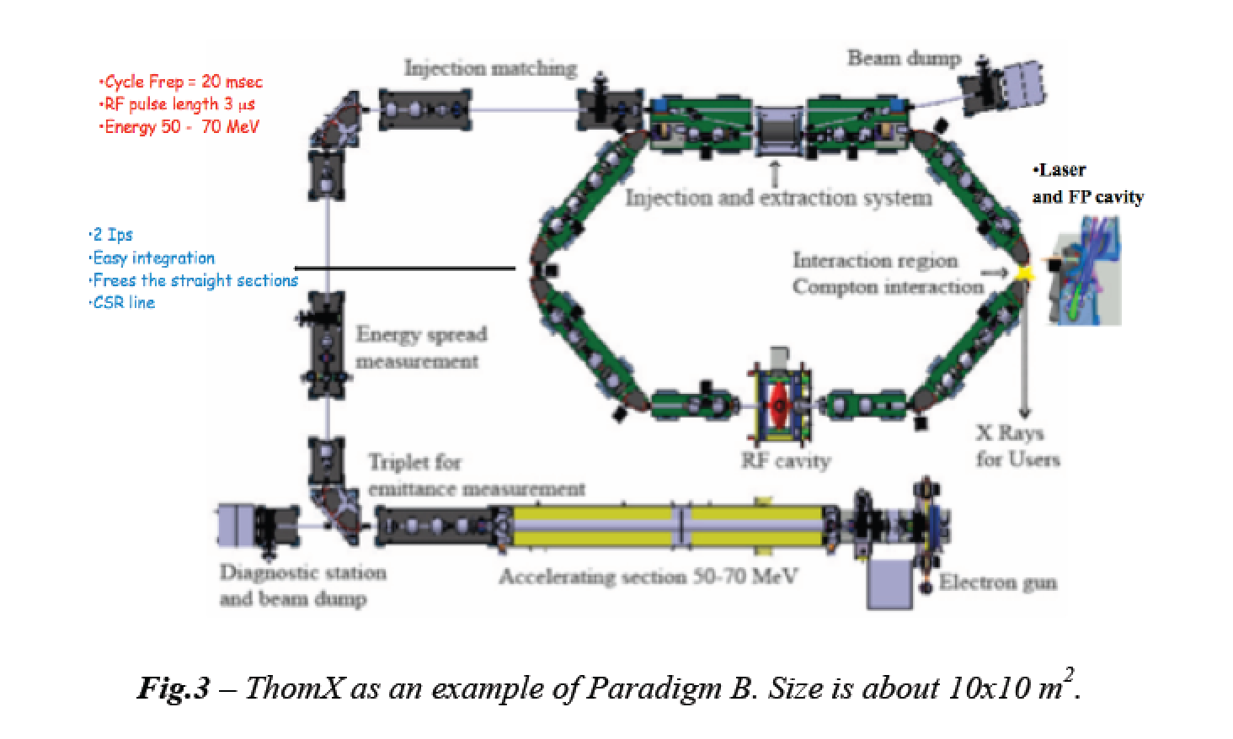
highly asymmetric compact*
electron-photon colliders
*10 m, 10 M$
secondary photon beams via large
lorentz boost of c.m. reference frame
MeV/GeV’s electrons
eV’s photons

Slide 14
MariX/BriXS Program at Universita’ degli Studi di Milano and INFN
Courtesy V. Petrillo

Slide 15
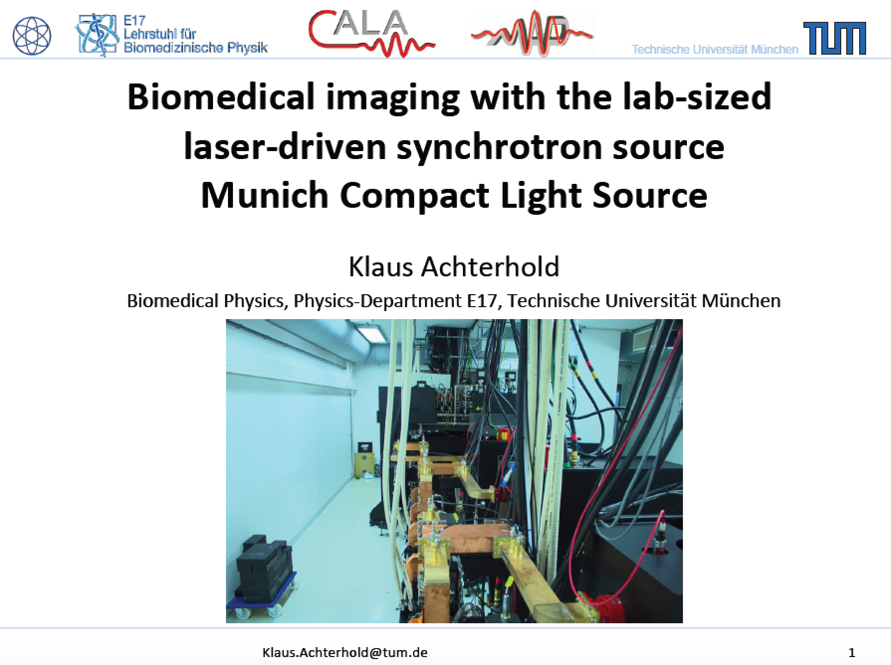
An ICS based X-ray User Facility in operation in Germany
Compact machine
10x10 m²
In operation since
early 2015

Slide 16
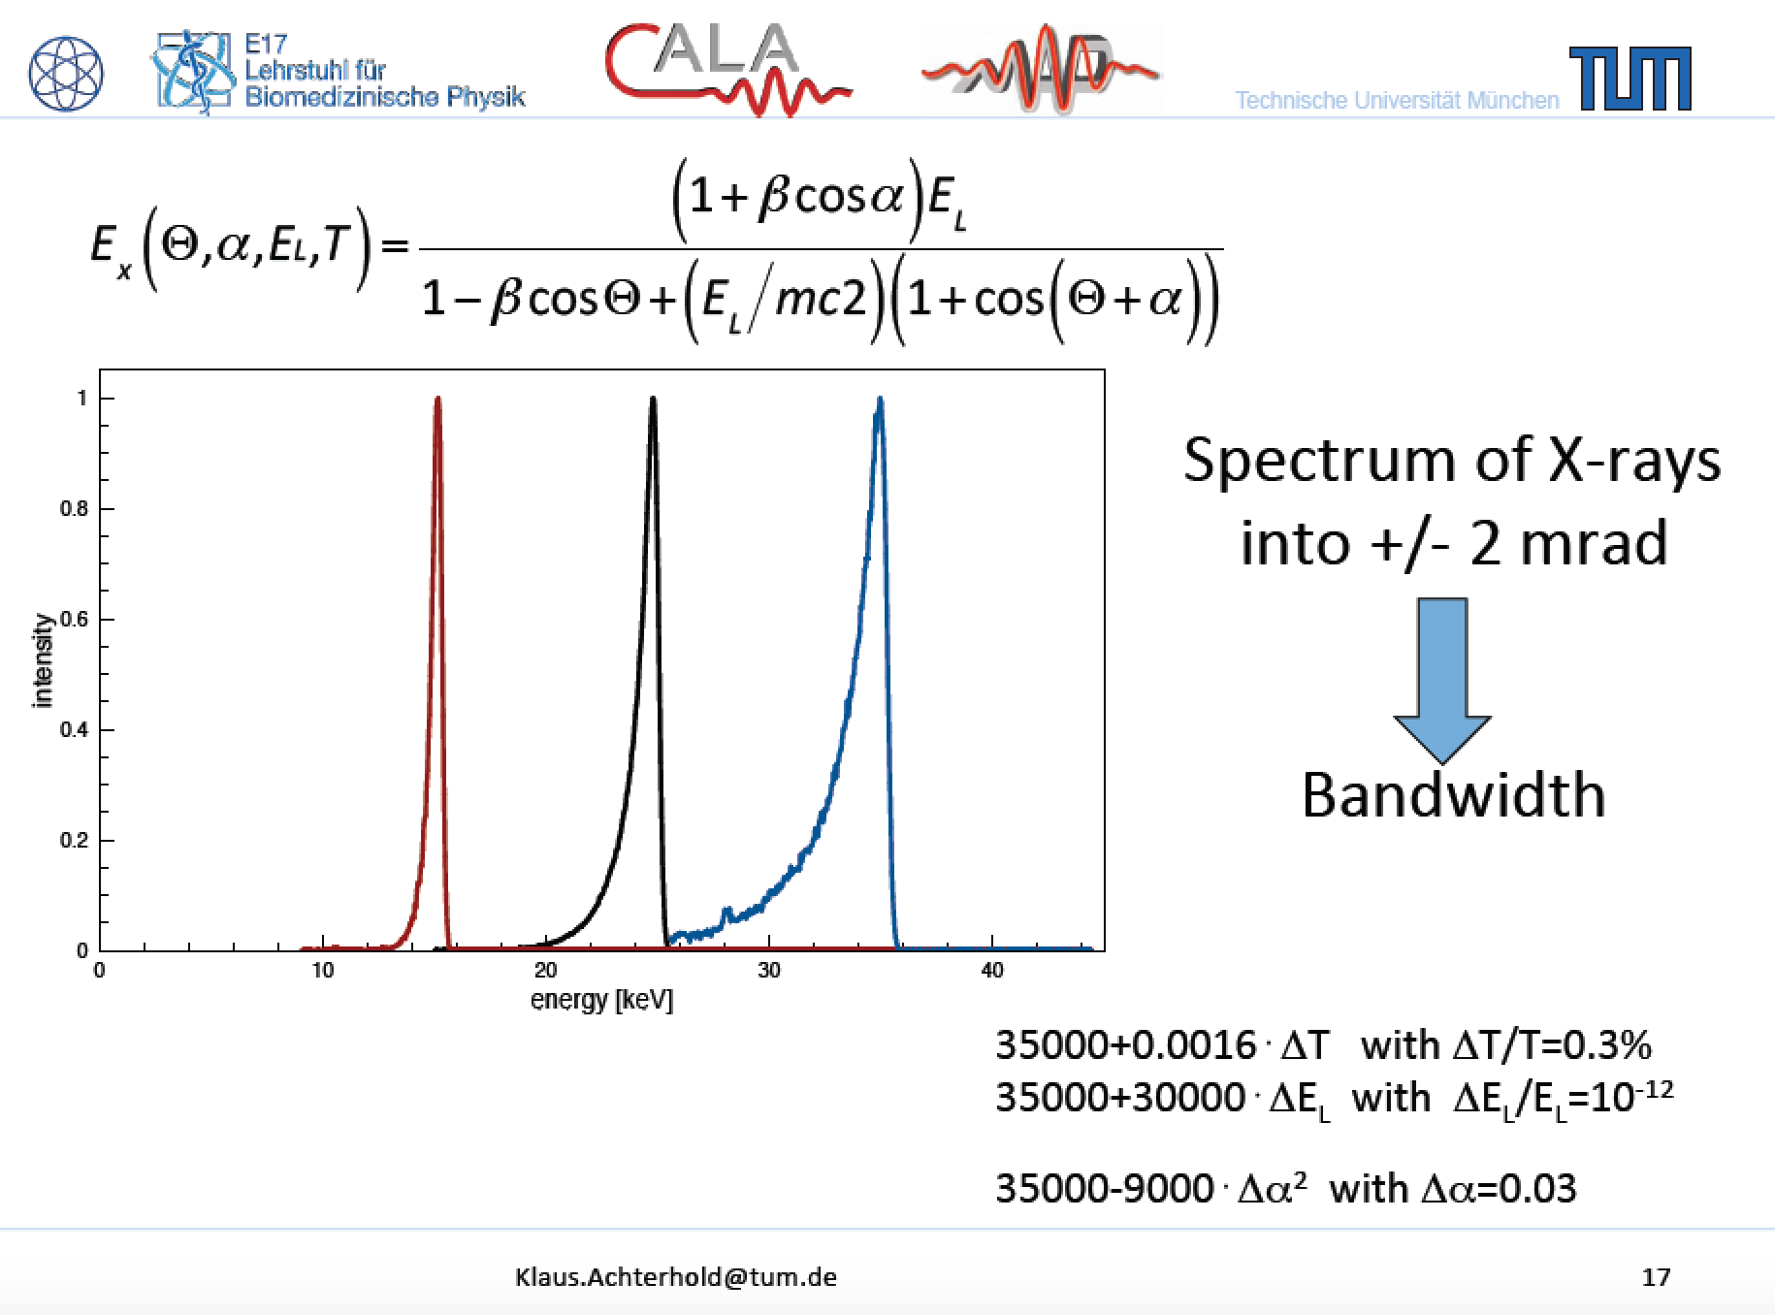
measured
Measured 5.10¹⁰ ph/sec with 20 mA

Slide 17
measured
Measured 5.10¹⁰ ph/sec with 20 mA

Slide 18
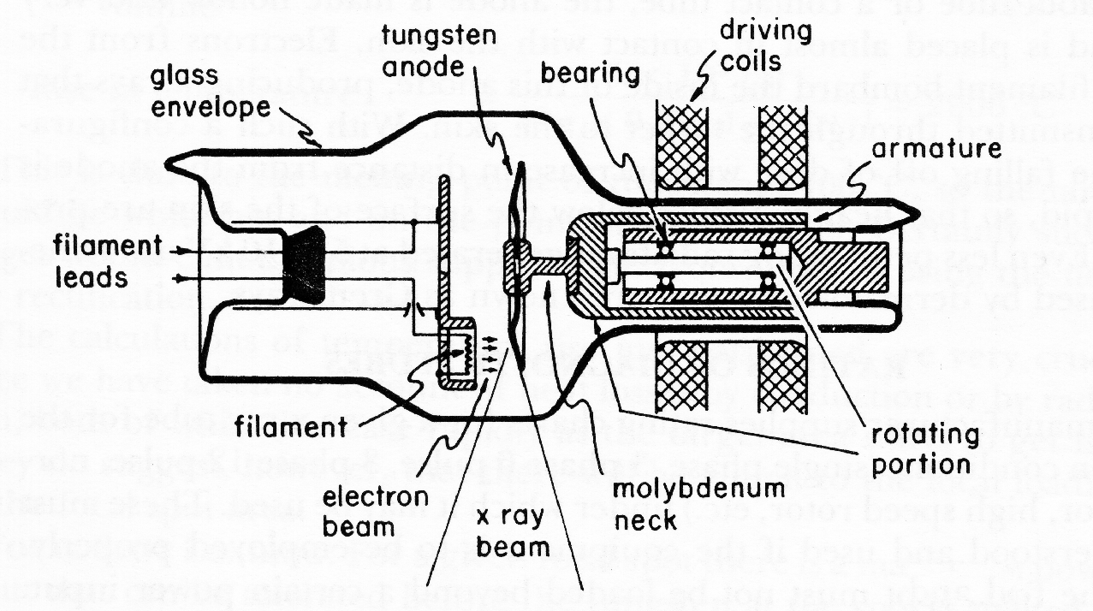
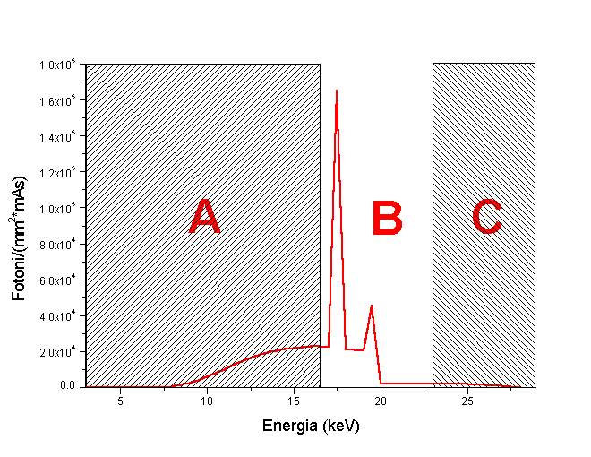
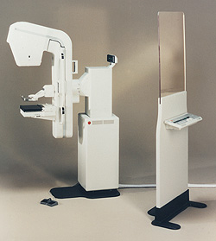
Great example of Radio-logical imaging applied to mass screening over population: mammography
Conventional X-ray tube for mammography
Spatial resolution ~100 μm
High Flux ~10⁷ γ/(mm²s) equivalent to ~5.10¹¹ γ/s over 20x20 cm² area.
Absent in
Thomson
Source
X-ray
spectrum!
65 cm
Low energy photons in the spectrum are absorbed by tissue, delivering radiation dose without bringing informations to detector. Risk of inducing secondary tumors increases without increasing the benefit of detecting early tumors

Slide 19
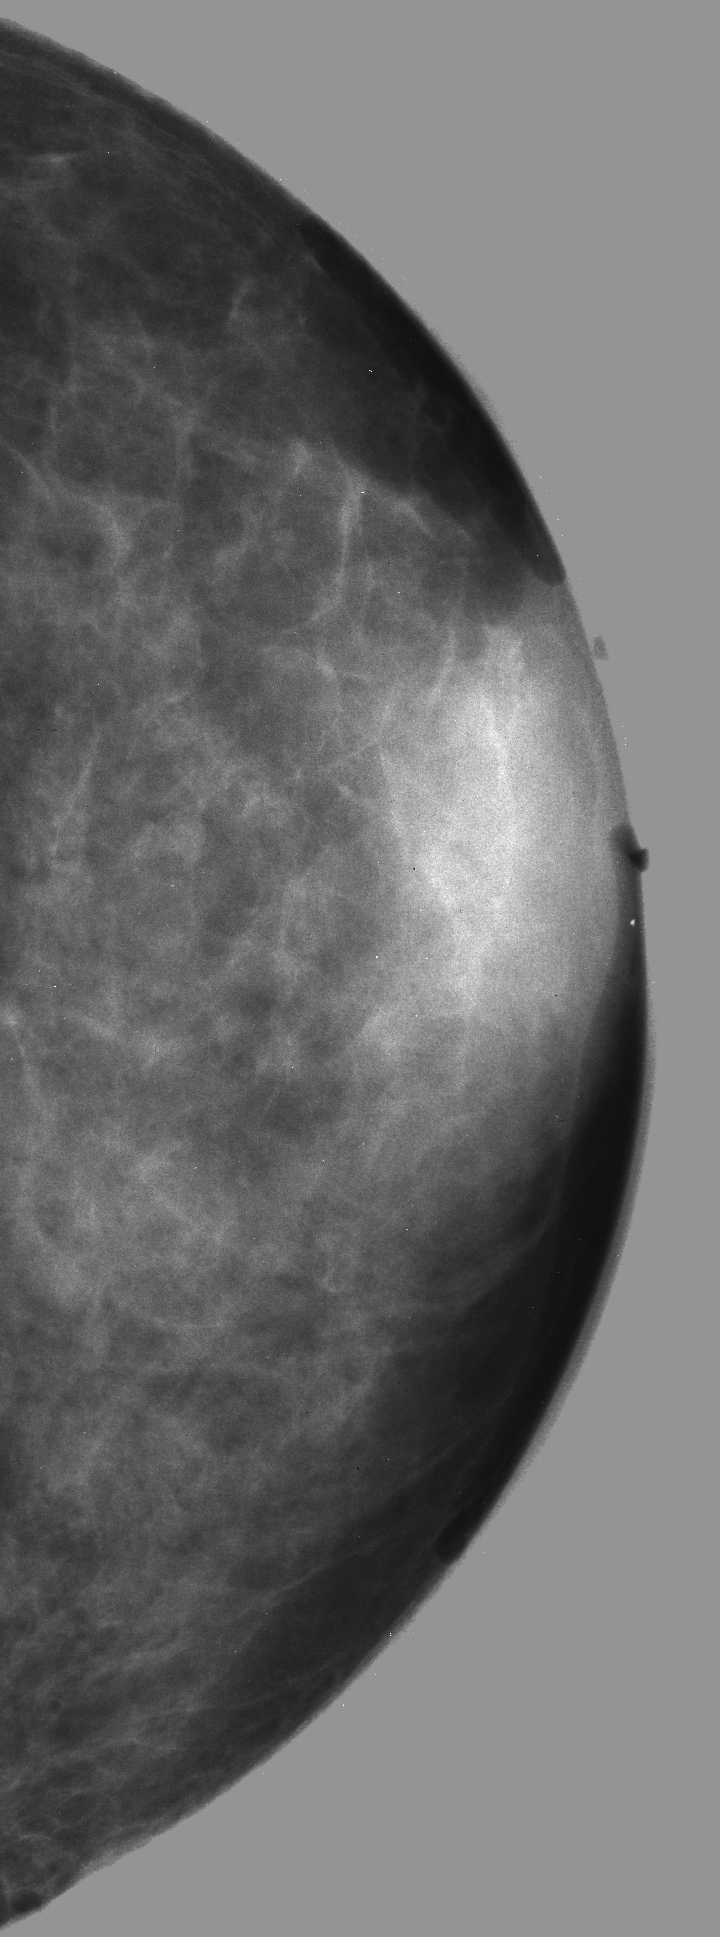
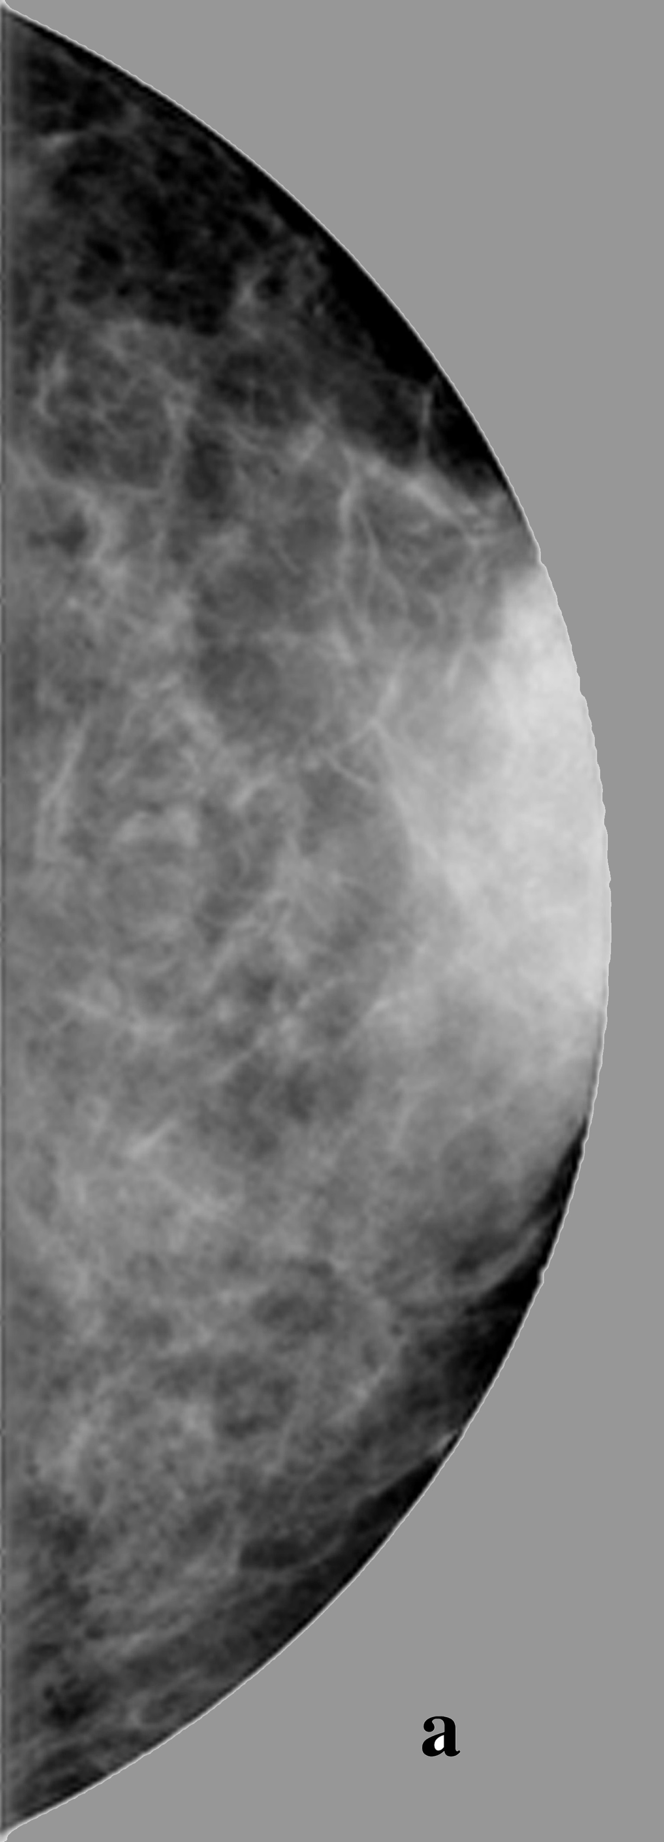

Mammography with Mono-chromatic X-rays at 20 keV has been proven
far superior in Signal-to-Noise-Ratio w.r.t. conventional mammographic tubes,
with a considerably lower radiation dose to the tissue
a) SR digital image
Energy 17 keV
Scan step 100 mm
MGD 1 mGy
Conventional
X-ray tube 26 kVp
MGD 1 mGy
b) SR digital image
Energy 20 keV
Scan step 100 mm
MGD 0.33 mGy
3 cm thick in vitro human breast tissue

Slide 20
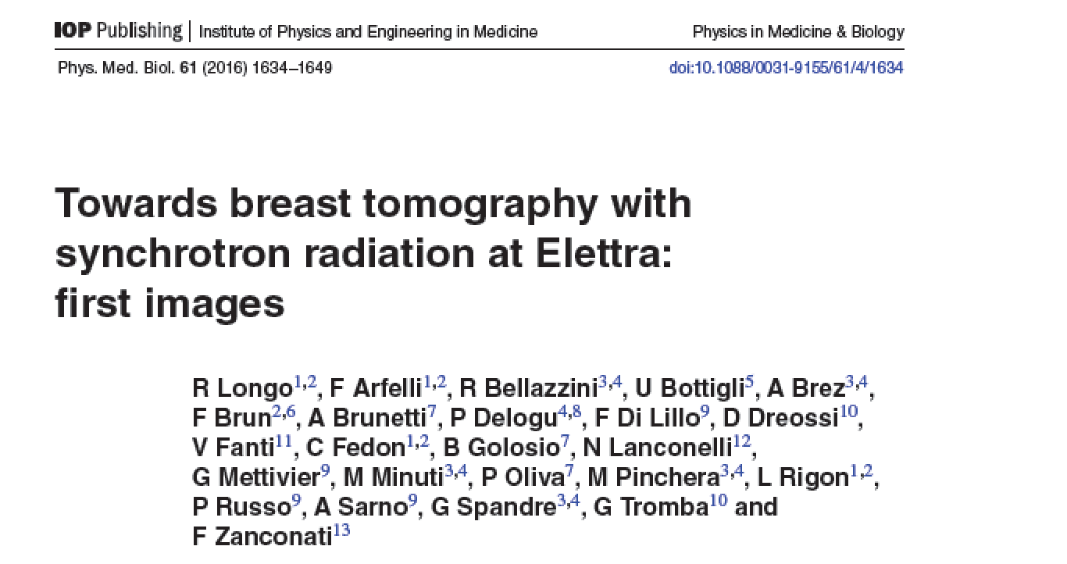
Compact Thomson X-ray Sources could be located inside hospitals to diagnose
and treat patients directly at the hospital site (unlike Synchrotrons…)

Slide 21
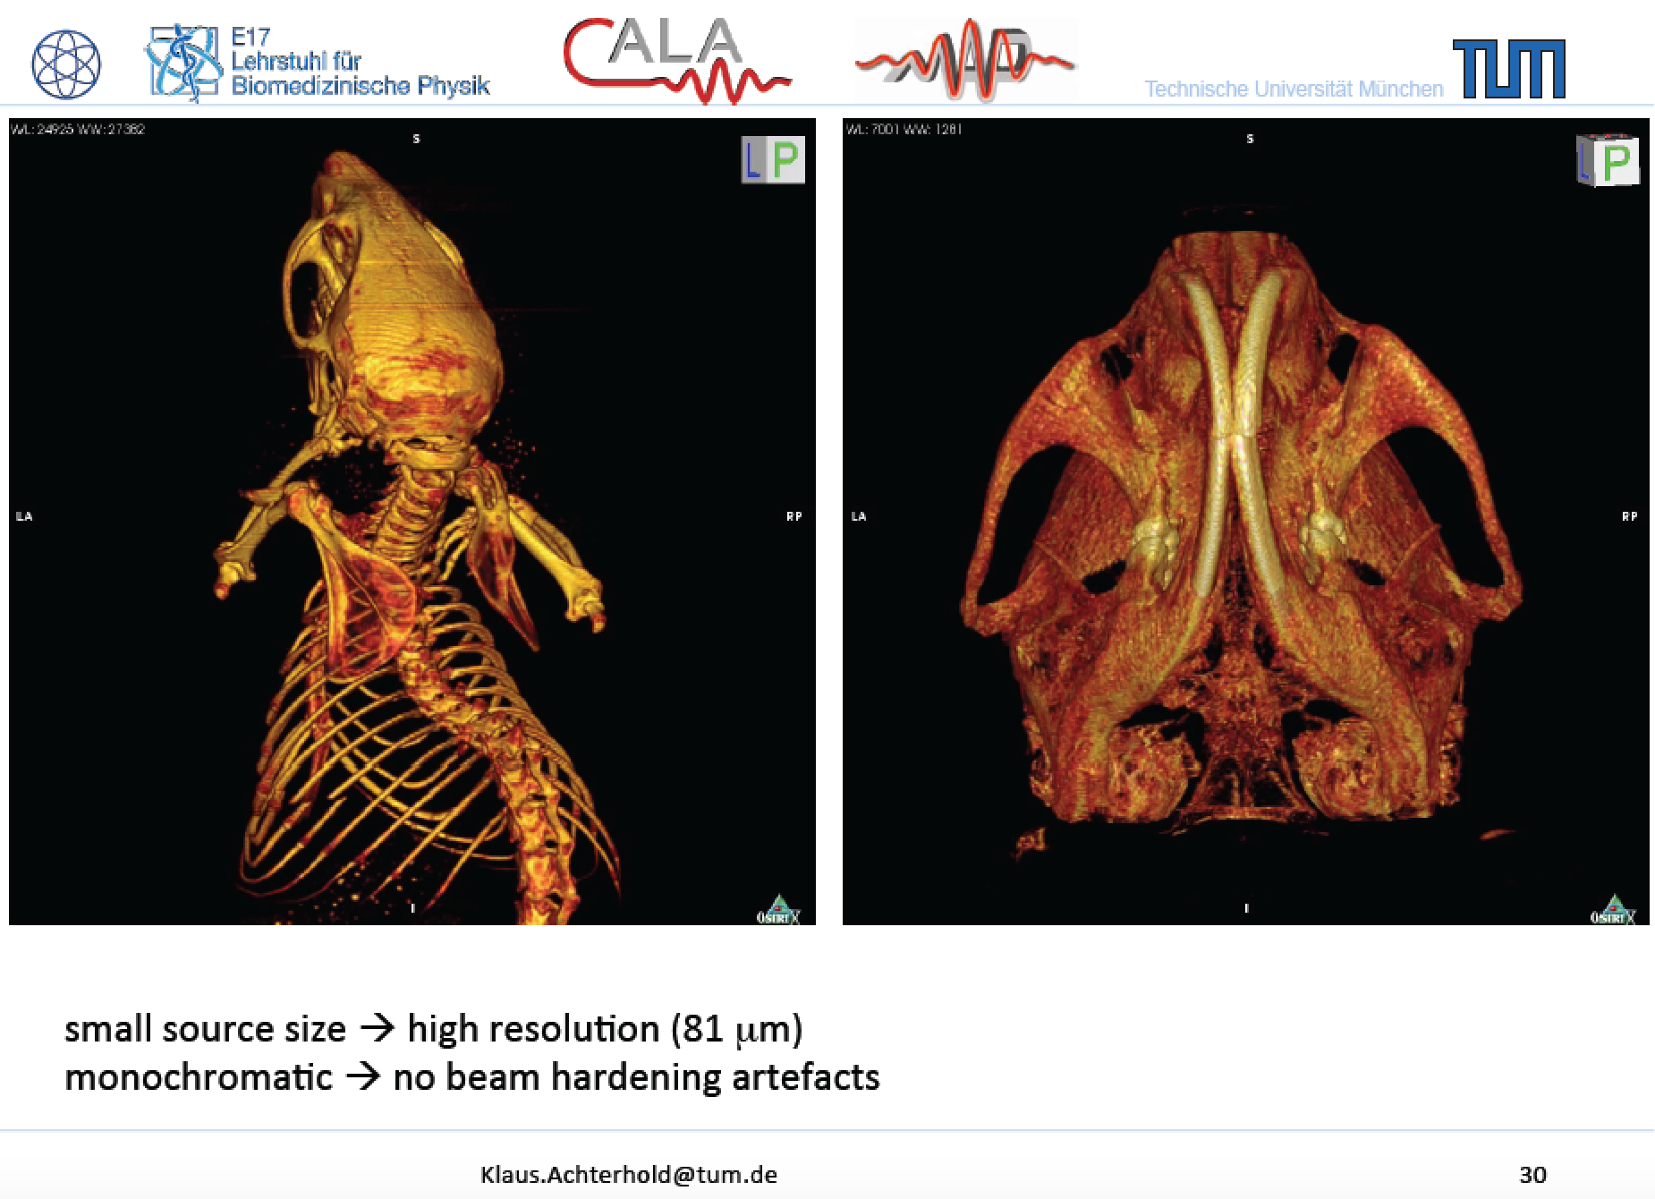
Phase Contrast Imaging made possible
by small round source spot size (< 20 μm)

Slide 22
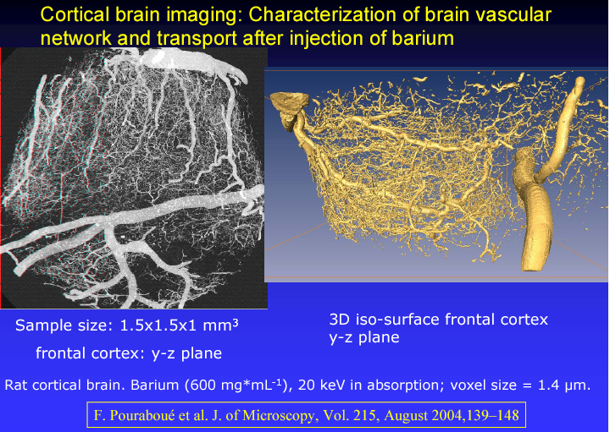
courtesy of A. Bravin (ESRF)
Bio-Medical Advanced Imaging with Mono-chromatic X-rays, demonstrated at
Synchrotrons, is possible also with High Flux Thomson X-ray Sources
in 20 keV-100 keV energy range

Slide 23
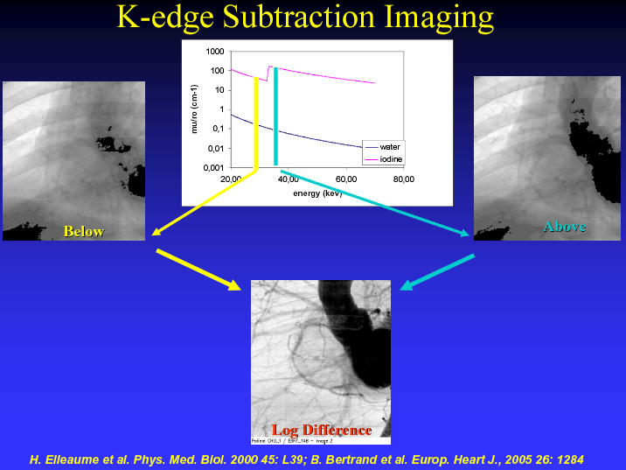
Bio-Medical Advanced Imaging with Digital Subtraction of Mono-chromatic
X-ray shots are also possible with High Flux Thomson X-ray Sources with
picosecond to millisecond time resolution

Slide 24
Advancing Thomson X Ray Sources for
Bio/Medical Imaging Applications and Matter Science

Slide 25
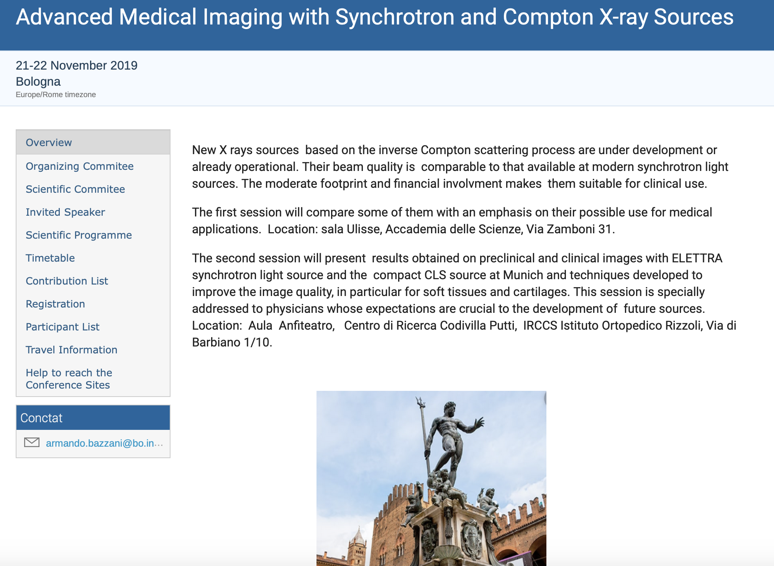

Slide 26

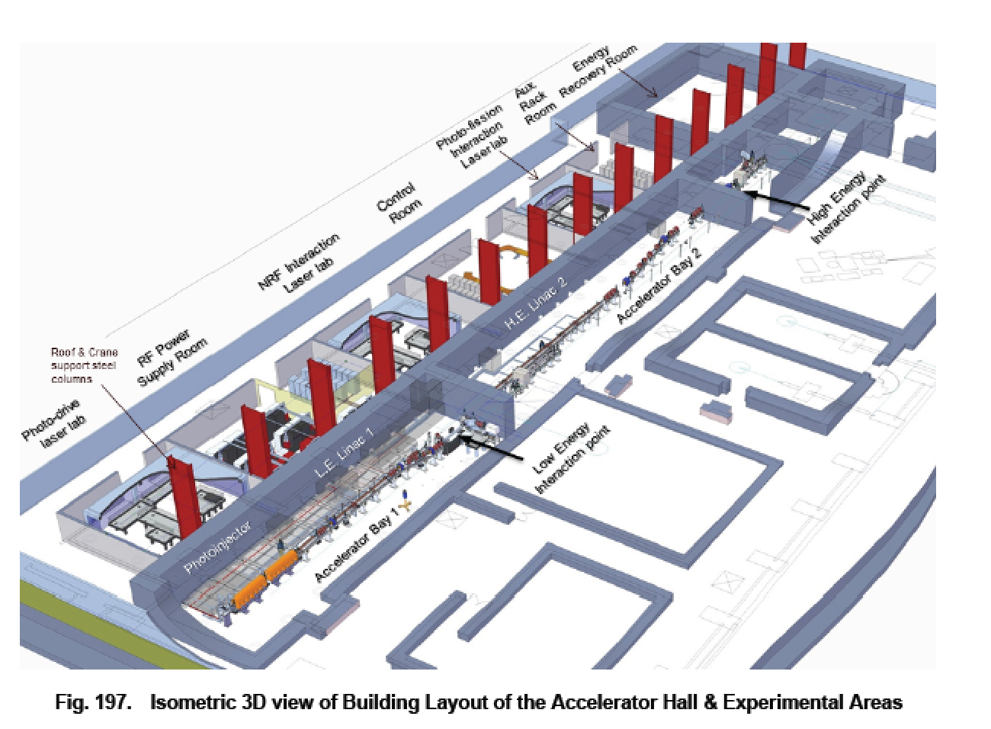
Accelerator and Equipments
in ELI-NP Building
100 m, 100 M$ scale
A γ-ray User Facility in construction in
Romania: ELI-NP-GammaBeamSystem

Slide 27
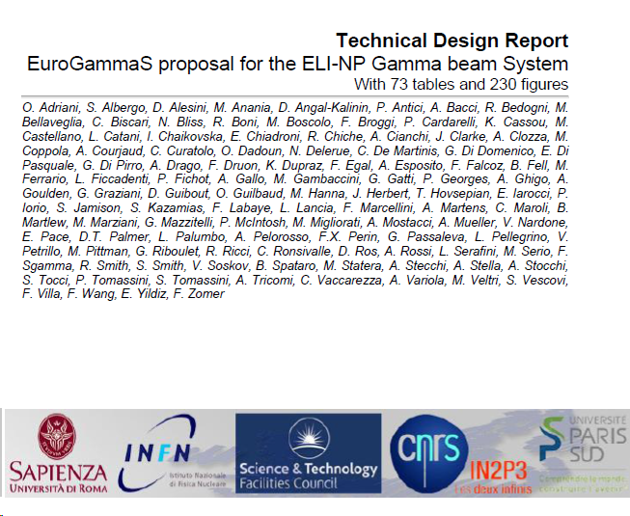
109 Authors, 327 pages
published today on ArXiv
http://arxiv.org/abs/1407.3669

Slide 28

Photonuclear Reactions
γ
What happens?
Seminario su Advanced Photon Sources - Dottorato Milano - June 2017

Slide 29
Courtesy C. Barty - LLNL

Slide 30
Photonuclear Reactions
Separation
threshold
~ 8 MeV
Absorption
γ
γ´
γ´
β
^{A´}Y
β
gs
^{A}X
Nuclear Resonance Fluorescence (NRF)
Photoactivation
Photodisintegration
(-activation)

Slide 31
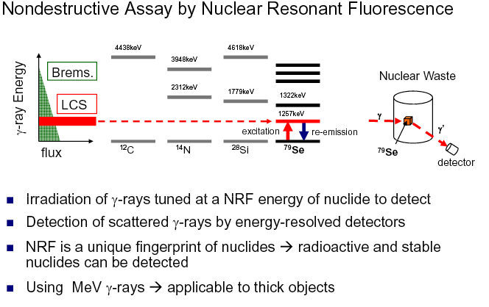
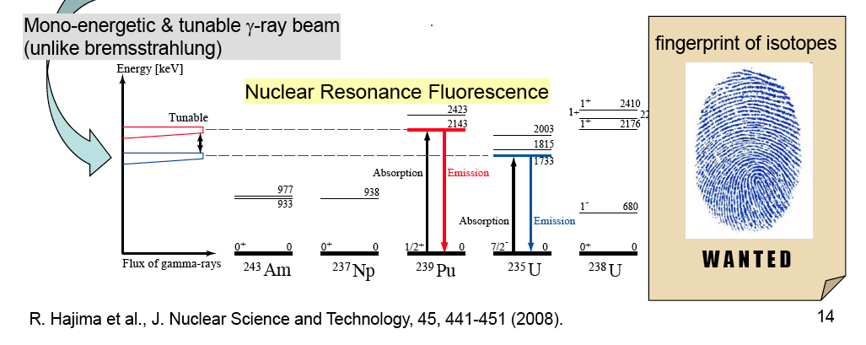

Slide 32
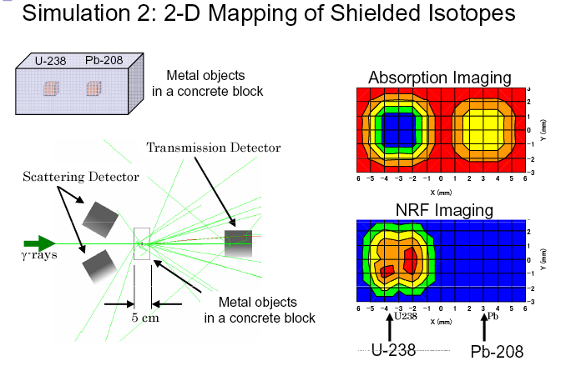

Slide 33
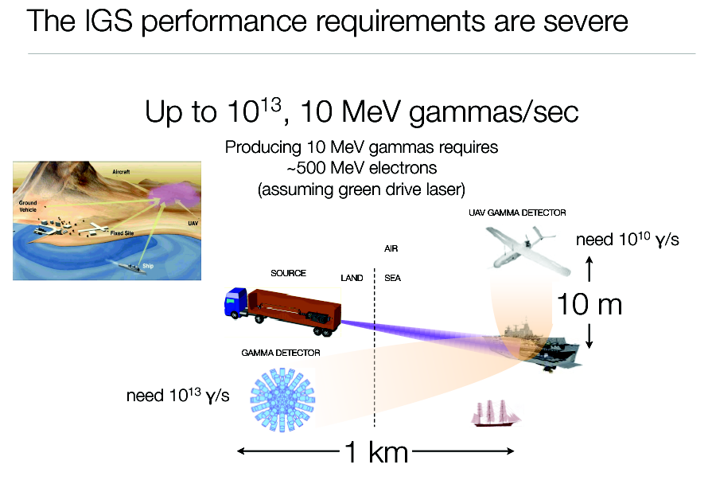
courtesy of G. Travish (UCLA)

Slide 34
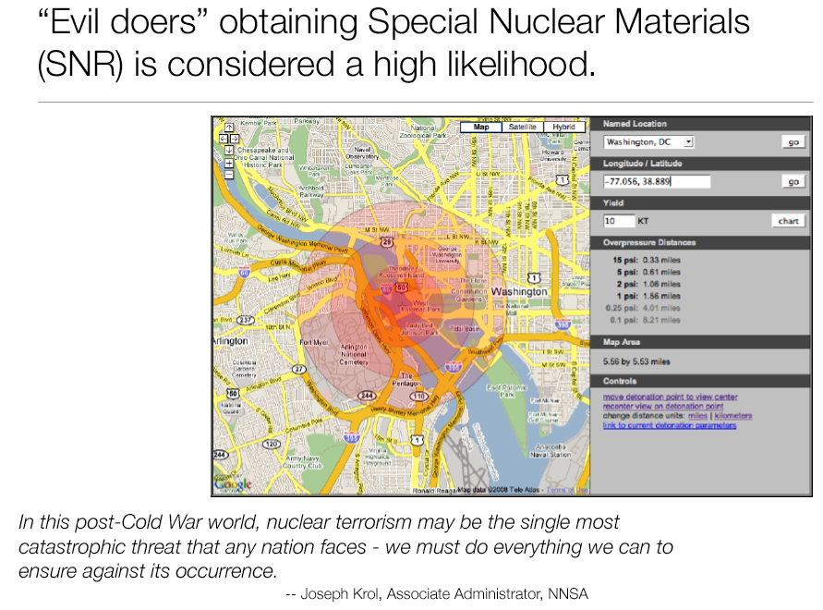
courtesy of G. Travish (UCLA)

Slide 35
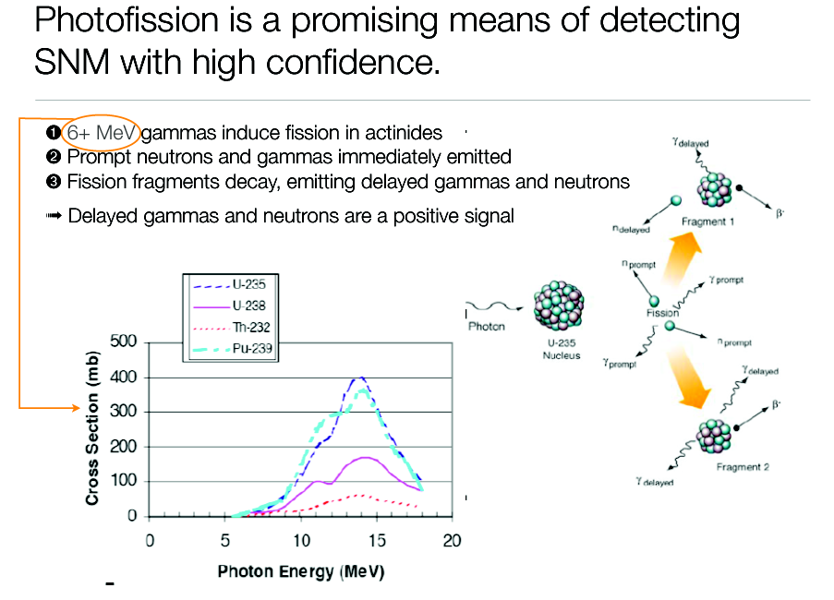
courtesy of G. Travish (UCLA)

Slide 36
Challenges of electron-(optical)photon colliders as X/γ beam Sources using Compton back-scattering
Need of high peak brightness/high average current electron beams (cmp. FEL’s drivers) fsec-class synchronized and μm-μrad-scale aligned to high peak/average power laser beams
Main goal for Nuclear Physics and Nuclear Photonics: Spectral Densities > 10⁴ N_{ph}/(s.eV) photon energy range 1-20 MeV, bandwidths 10⁻³ class
Main goal for Medical Applications with X-rays: tunability in the 20-120 keV range, good mono-chromaticity (1-10 %), high flux (10¹¹ min., 10¹² for radio-imaging, 10¹³ for radio-therapy)

Slide 37
Main goal for MeV-class γ − γ and TeV γ - nucleon colliders: Peak Brilliance > 10²¹ N_{ph}/(s.mm^{2.}mrad^{2.}0.1%) 10⁹<N_{ph}<10¹³ Source spot size μm-scale (low diffraction, few μrad) Tunability, Mono-chromaticity, Polarization (H,V,C)
Photon-Photon scattering (+ Breit-Wheeler: pair creation in vacuum) is becoming feasible with this new generation γ-beams: a γ-γ low energy collider

Slide 38
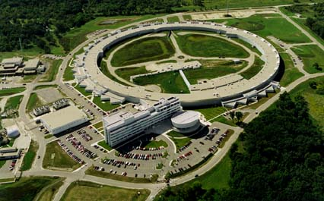
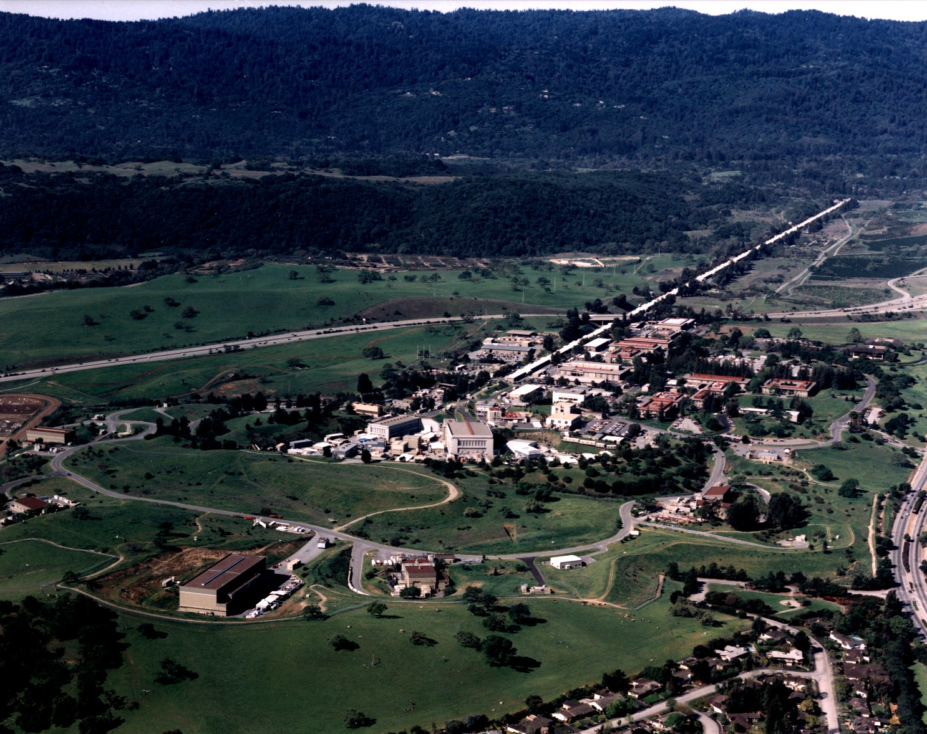
3rd-4th Generation Light Sources
Synchrotron light sources: < 50 keV, > 50 ps (100 m, 300 M$)
X-ray FEL (LCLS): energy ≤25 (50?) keV, 1-100 fs (1 km, 1 G$)
New approach: inverse Compton scattering (ICS) 20-200 keV , sub-ps, (10 m , 10 M$) – sometimes called Laser Synchrotron since a laser pulse substitutes the magnetic undulators

Slide 39
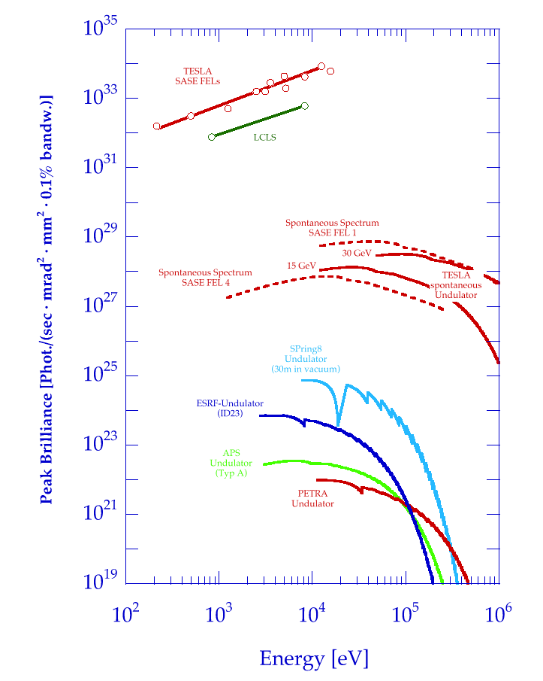
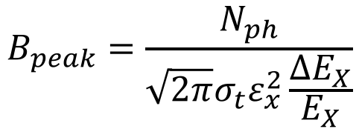
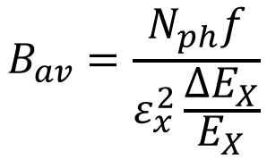
Brilliance of Lasers and X-ray sources
ELI
12.4
1.24
0.124
λ (nm)
BELLA
FLASH
$$B_{peak}=\frac{N_{ph}}{{\sqrt{2π}σ_{t}ε}_{x}^{2}\frac{ΔE_{X}}{E_{X}}}$$
Thomson/Compton Sources
$$B_{av}=\frac{N_{ph}f}{ε_{x}^{2}\frac{ΔE_{X}}{E_{X}}}$$

Slide 40
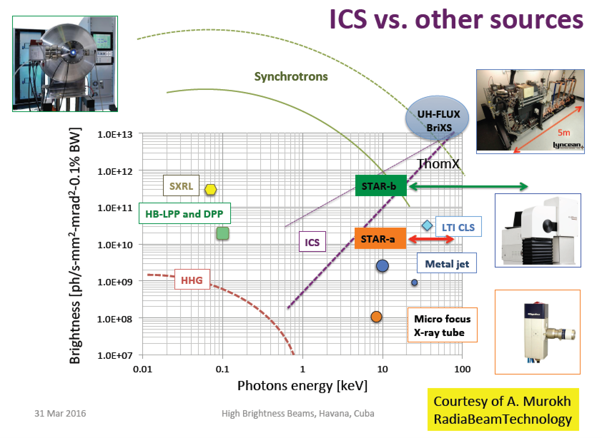

Rivaling with Synchr. Light Sources for energies above 50 keV
$$B_{av}=\frac{N_{ph}f}{ε_{x}^{2}\frac{ΔE_{X}}{E_{X}}}$$

Slide 41
highly asymmetric compact*
elecron-photon colliders
*10 m, 10 M$
secondary photon beams via large
lorentz boost of c.m. reference frame
MeV/GeV’s electrons
eV’s photons

Slide 42
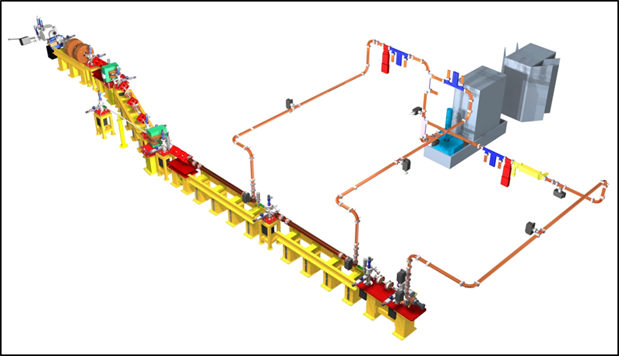
STAR – Southern europe Thomson source for Applied Research
is a good example of research infrastr. based on X-ray beam lines for a regional facility to be built in an developing region/country
10 m

Slide 43
STAR Hangar and Bunker

Slide 45
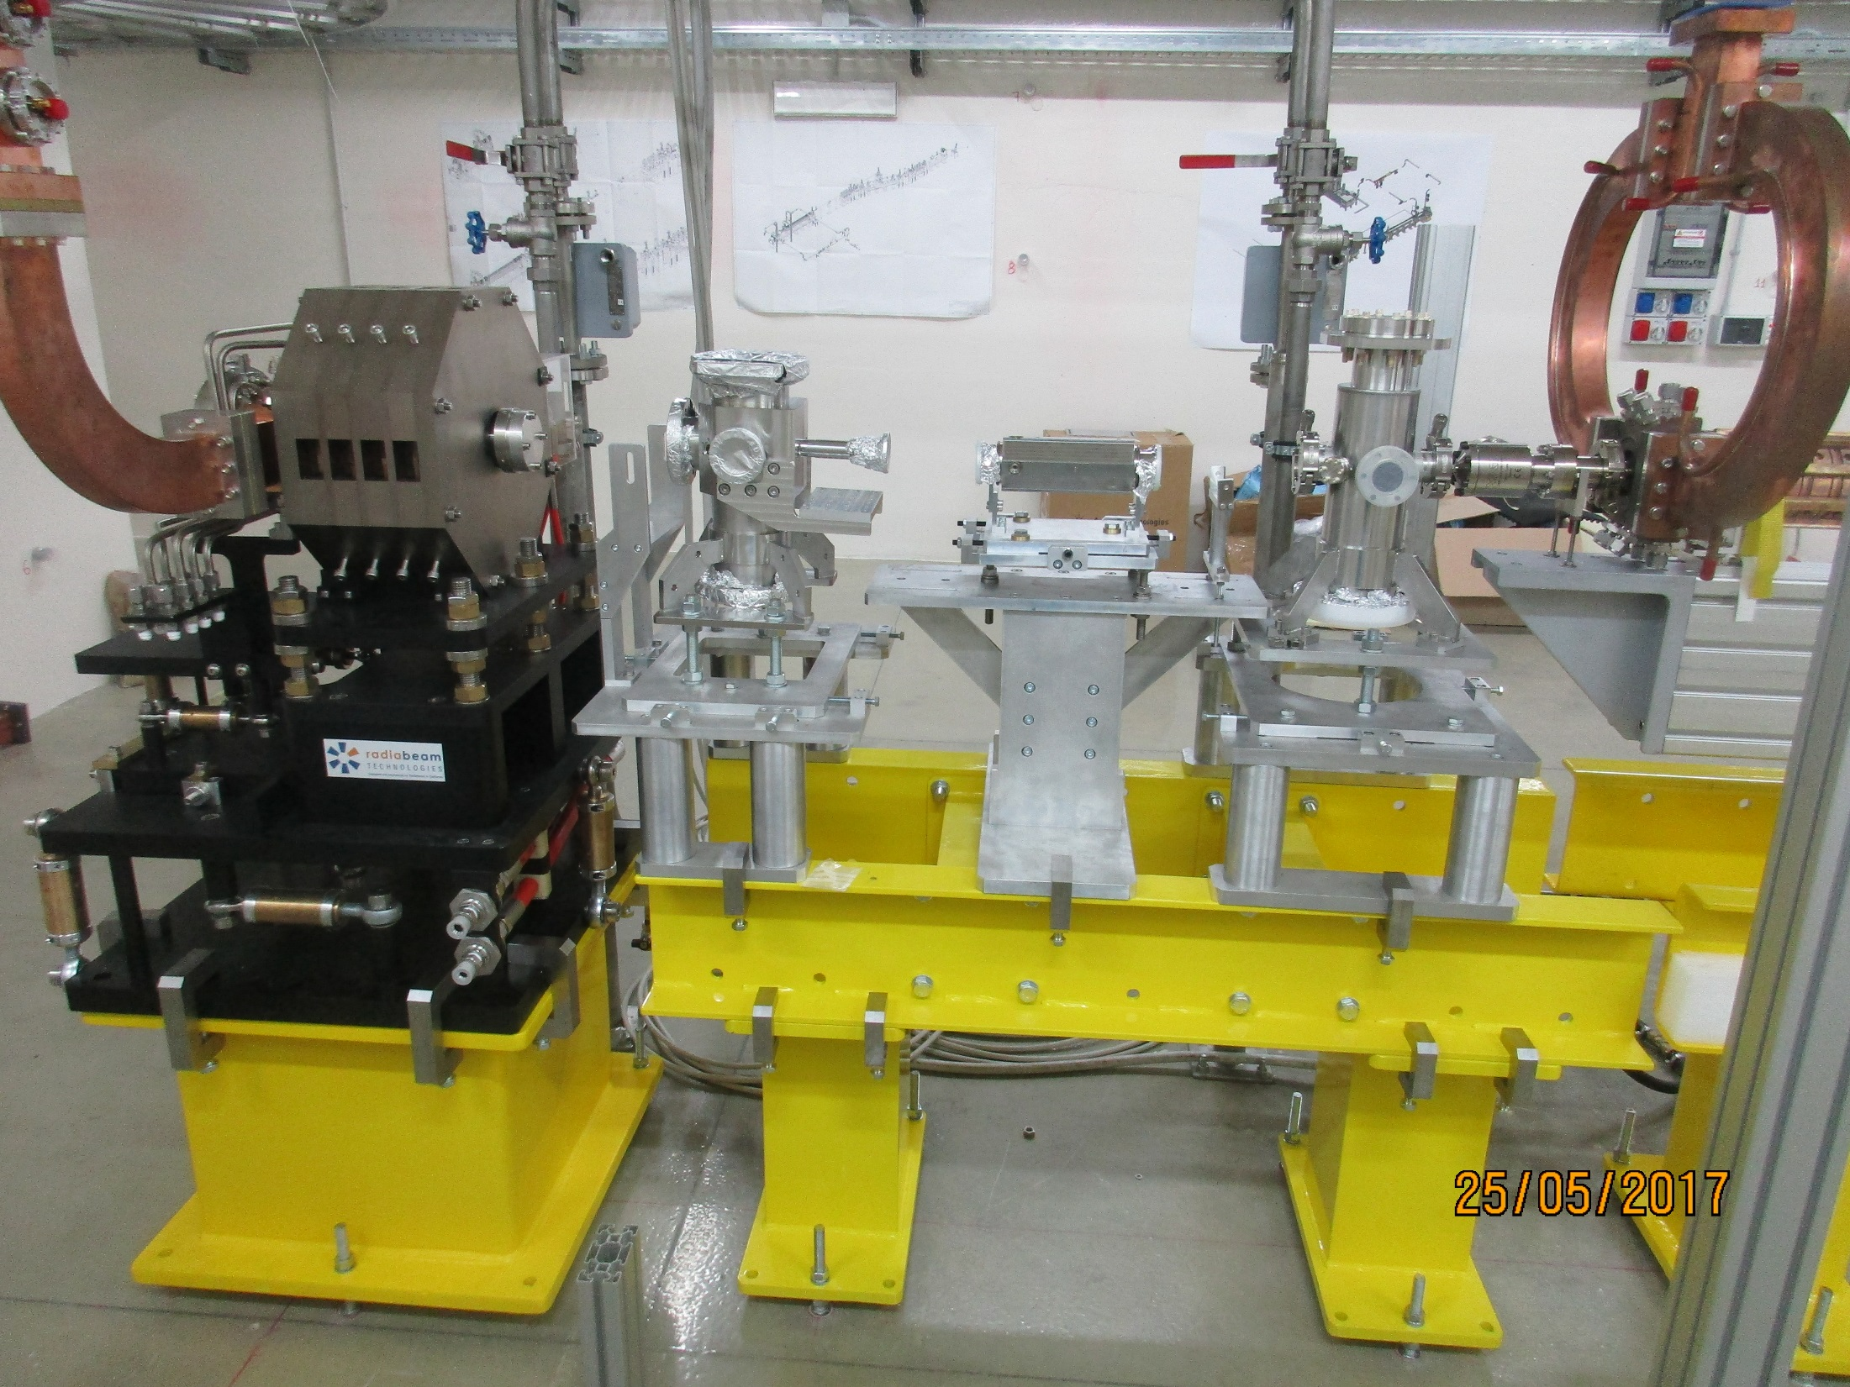

Slide 46
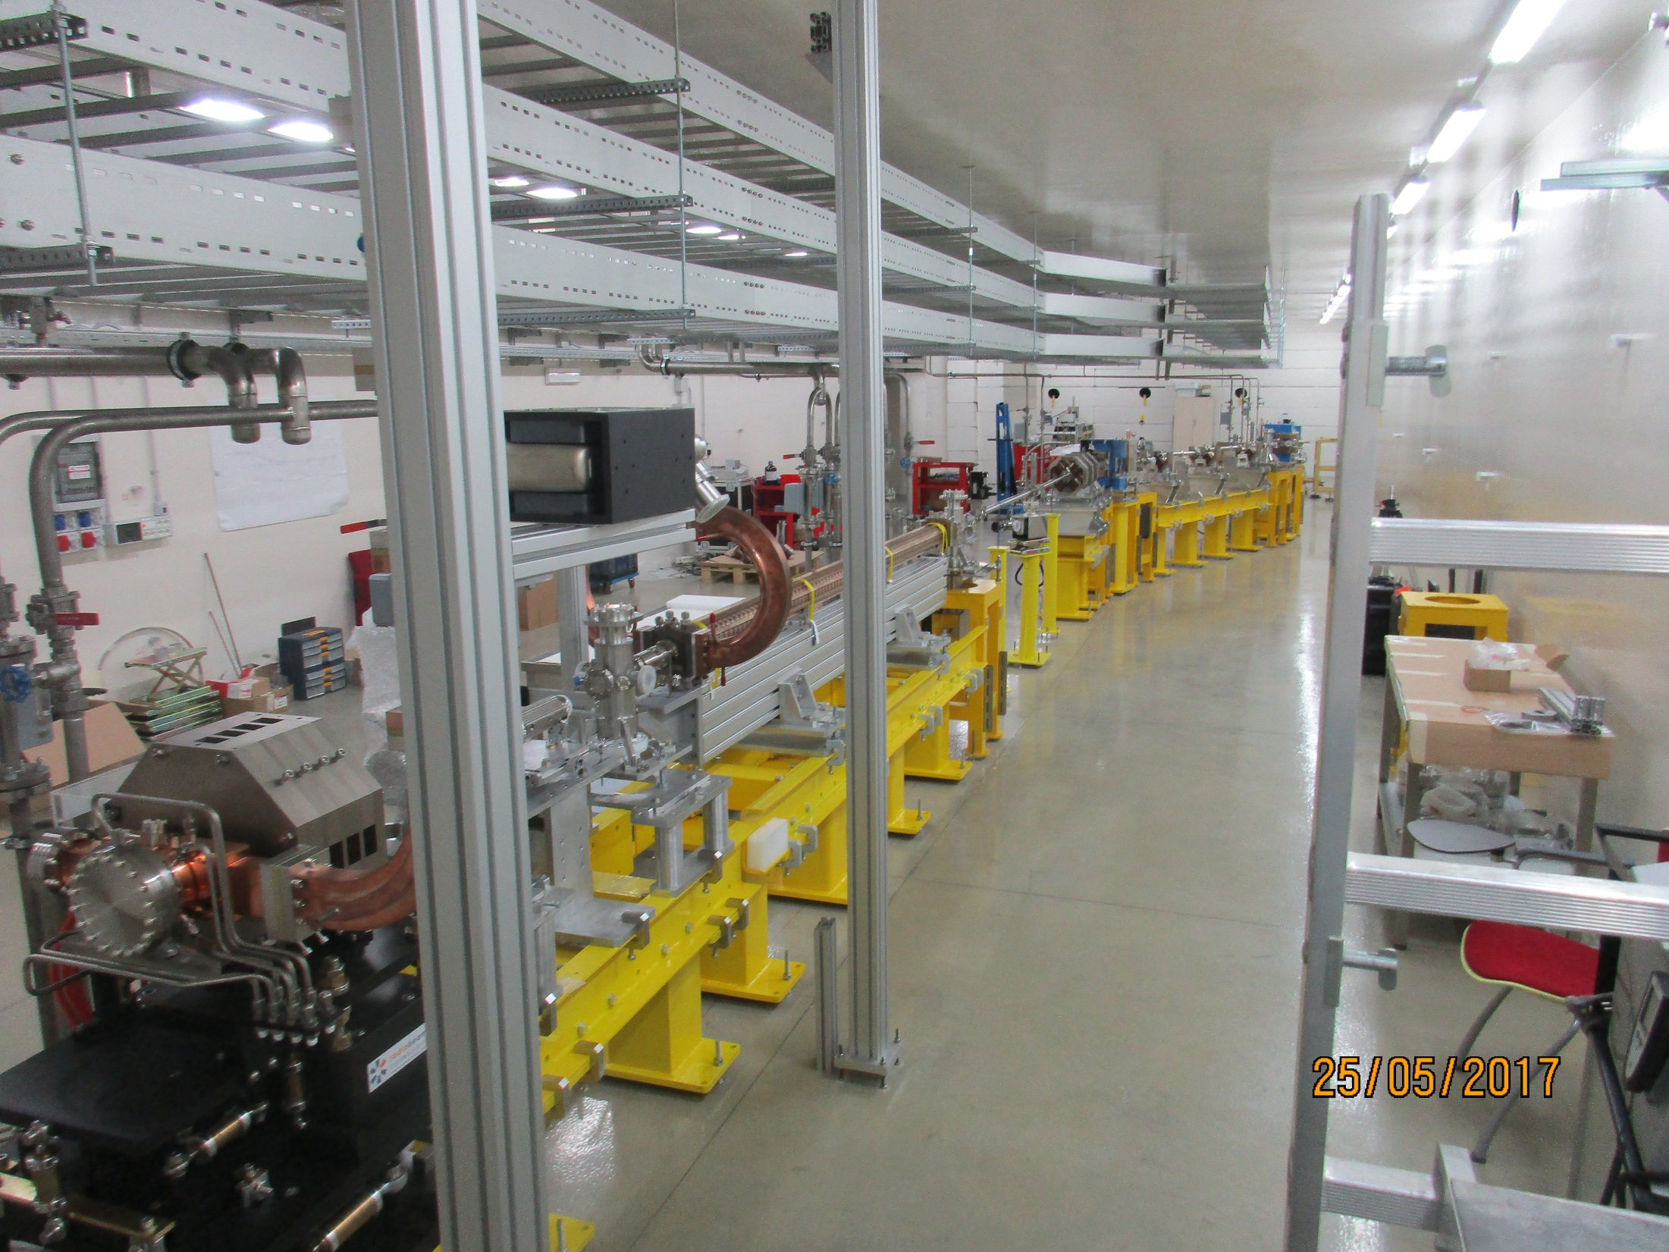

Slide 47
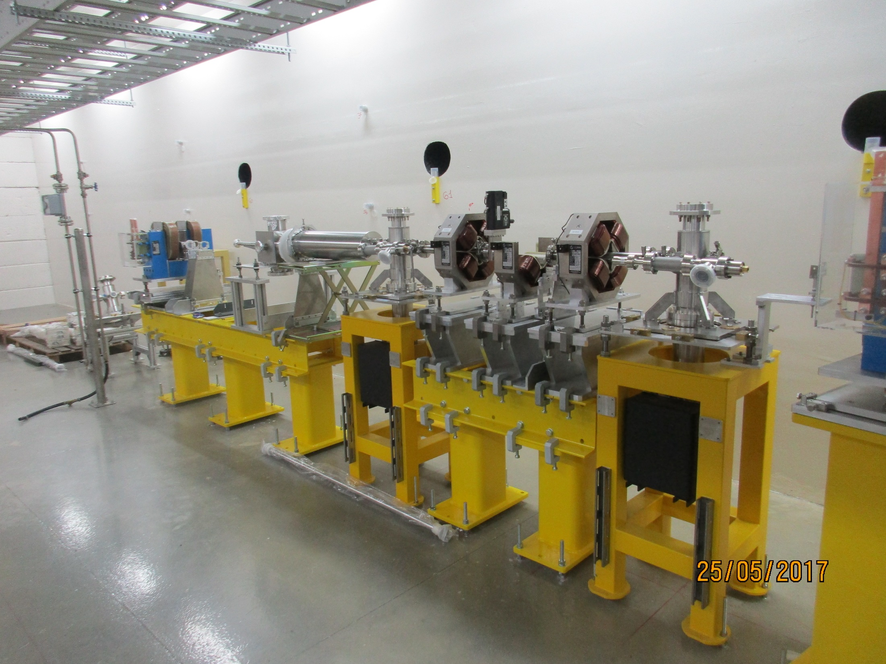

Slide 48

STAR X-ray beamlines
foreseen applications
2021 SILS Meeting – Bologna (online) - June 23rd, 2021

Slide 49
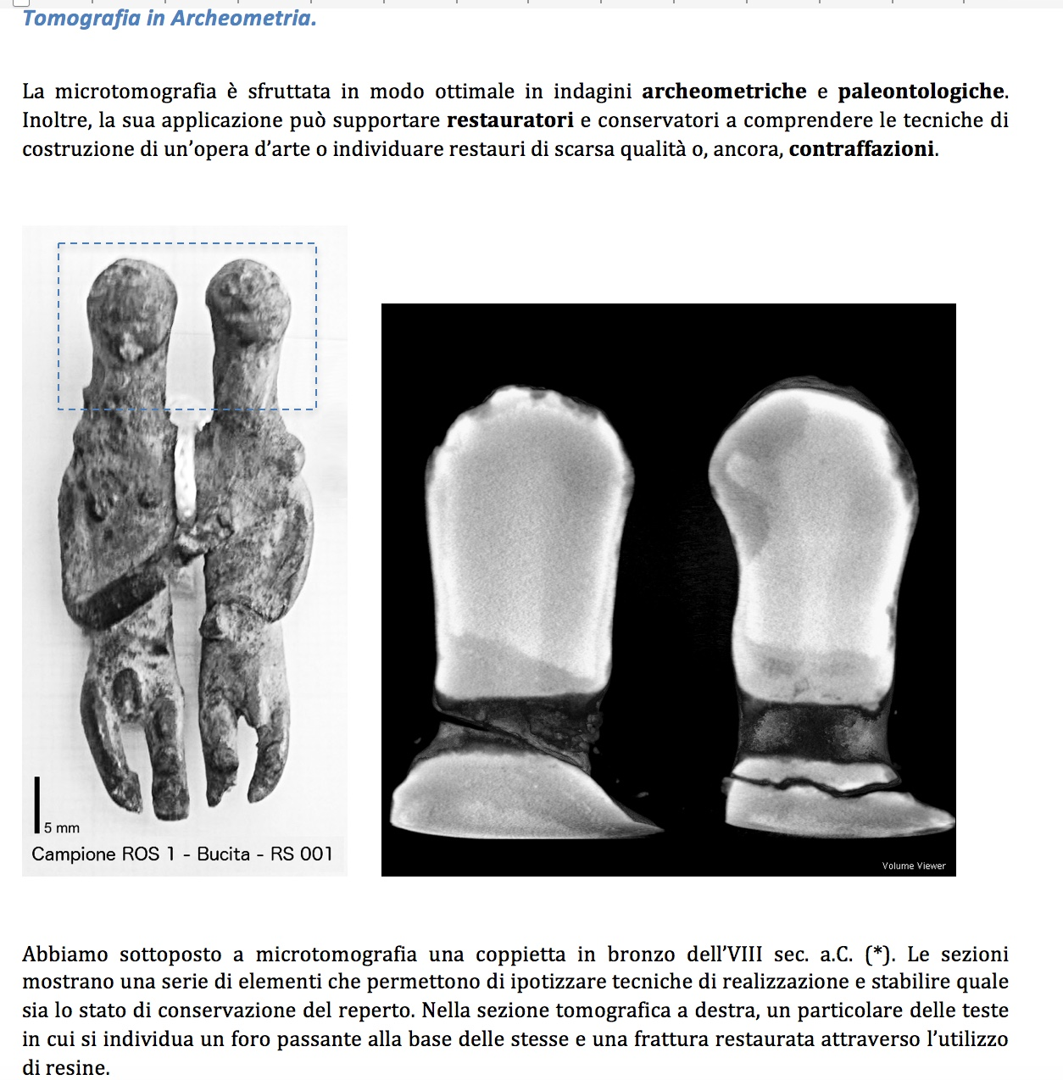
Courtesy R. Agostino

Slide 50
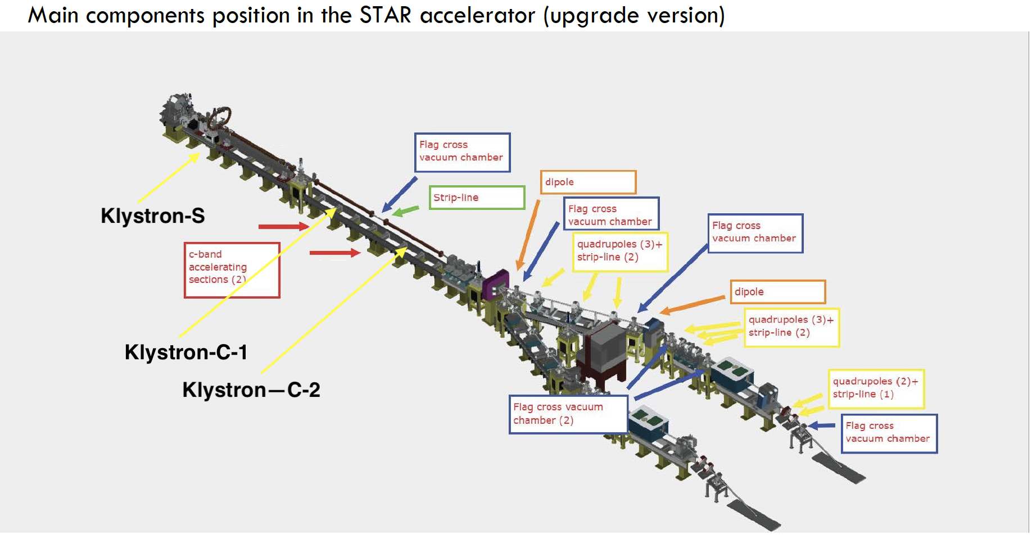
20-130 keV
100-350 keV
2021 SILS Meeting – Bologna (online) - June 23rd, 2021

Slide 51
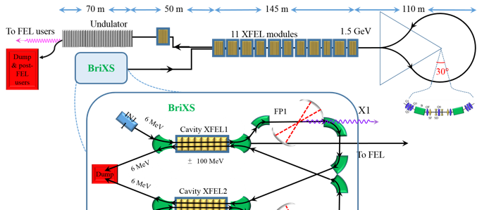
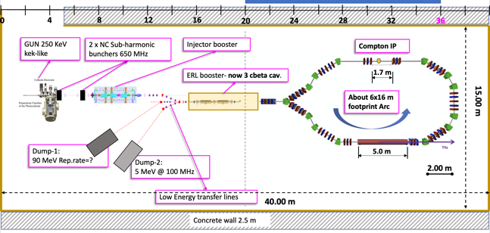
MariX-BriXS-BriXSinO
MariX with bubble arc compressor
3.2-3.8 GeV
3.-3.6 GeV
1.5-1.8 GeV
Dump& post FEL users
High flux ICS
200 kW e⁻ beam 50% efficiency
Two Way or ERL
BriXSinO with recirculation loop
Dump-1:
90 MeV 1 μA
kW-class
THz FEL
2021 SILS Meeting – Bologna (online) - June 23rd, 2021

Slide 52


30 m
15 m

Slide 53
Inverse Compton Sources rivaling in Average Brightness with Synchrotron Light Sources at photon energies above 80-100 keV
ELI-NP-GBS
STAR
I.C.S.

Slide 54
If the Physics of Linear Compton/Thomson
back-scattering is well known….
the Challenge of making a Compton Source running as an
electron-photon Collider with maximum Luminosity,
to achieve the requested Spectral Density, Brilliance,
narrow Bandwidth of the generated X/γ ray beam,
is a completely different issue/business !
Re-visiting the Physics of Compton back-scattering
with an eye to effects impacting the quality and behavior of
the photon (and electron) beam phase space distributions
Courtesy L. Palumbo

Slide 55

Photon / Particle Beams: diffraction, envelope, matching, co-propagation.
Example: TEM₀₀ Gaussian Laser mode (circ. pol. M²=1 diffr. limited)

Slide 56
LASER
PARTICLE BEAM

Slide 57
2 Approaches to describe the Physics of I.C.S.
A) (linear) Quantum B) Classical
A) Quantum: linear QED of electron-photon 2-body kinematics and Klein-Nishina cross section
Energy/Momentum Conservation - no multi-photon (non-linear, collective) effects
Effect of electron recoil on X/γ ray beam phase space quality (spectral density, bandwidth broadening) and on electron beam (emittance dilution in multiple scattering and incoherent energy spread due to scattering stochasticity)
B) Classical: synchrotron radiation with e.m. undulators
No Energy/Momentum Conservation – description of collective effects (laser coherent field, multi-photon absorption/emission, harmonics, red-shifts, etc)
Limitation of (linear) quantum description: does not take into
account the coherent organization of photons
in the e.m. field of the laser pulse (intensity field, no phase)

Slide 58
LINEAR (a₀<<1, single photon)
THOMSON BACK-SCATTERING
e⁻ (1 GeV); λ₀=1µm, E₀=1.24 eV λ_{T}=6 x10⁻⁸µm, E_{T}=20 MeV
e⁻ (200 MeV); λ₀=1µm, E₀=1.24 eV λ_{T}=1.56 x10⁻⁶µm, E_{T}=800 KeV
e⁻ (29 MeV); λ₀=0.8µm, E₀=1.5 eV λ_{T}=0.5 x10⁻⁴µm, E_{T}=20 KeV

Slide 59
From the electron orbits and the Liénard-Wiechert potentials in the far zone one can write the expression of the electric field [Jackson..]:
n
e_{z}
Courtesy V. Petrillo
Notes:
In the classical treatment, the double differential spectrum permits to evaluate the power emission and can be evaluated by means of a standard electrodynamical procedure based on the orbit calculation and on the Lienard-Wiekert potential in the far zone. The extension to the whole beam is made by summing the contribution of all the electrons.

Slide 60
From the motion equation of the electrons
If E and B=kxE are electric and magnetic field of
the incoming laser,
Courtesy V. Petrillo

Slide 61
Classical double differential spectrum
The double differential spectrum for one electron is:
And for all the beam:
Full treatement of linear and nonlin. TS for a plane-wave laser pulse with analytical expression of the distributions in P. Tomassini et al., Appl. Phys. B 80, 419 (2005).

Slide 63


Total intensity and Stokes parameter |E_{x}|²-|E_{y}|² on the screen at 1 m, γ=1200
n
e_{z}

Slide 66

Example
Quasi head-on collision of a 5 MeV electron
(θ_{e} = 50 mrad, φ_{e} = π/2) on a flat-top pulse of normalized ampliude a₀=1.5, λ = 1μm and T = 20 fs
P. Tomassini et al., Appl. Phys. B 80, 419 (2005)

Slide 67
FEL resonance condition
(magnetostatic undulator )
Example : for λ_{R}=1A, λ_{w}=2cm, E=7 GeV
Violation of Energy-Momentum Conservation !!
(electromagnetic undulator )
Example : for λ_{R}=1A, λ=0.8μm, E=25MeV
Example : for hν=10 MeV, λ=0.4μm, E=530 MeV
laser power
L. Serafini et al., Proceedings of the SPIE,
Volume 6634, article id. 66341G (2007)
laser spot size

Slide 68

with
electron recoil
without
electron recoil

Slide 69
Compton Inverse Scattering Physics is clear: recall some basics
Laboratory ref. system
3 regimes: a) Elastic, Thomson b) Quasi-Elastic, Compton with Thomson cross-section c) Inelastic, Compton, recoil dominated
Petrillo V. and al., NIM A 693 (2012)
Sun C. and Wu Y. K., PRSTAB 14 (2011) 044701
Courtesy V. Petrillo

Slide 70
Quantum Model: a look at what happens in the Center of Mass reference system (kinematics)
Lab ref.
c.m. ref.
Recall some Basics

Slide 71
Invariant Mass, Lorentz transformation from Lab to c.m. ref. system

Slide 72
from
and
Holds before and after scattering (c.m ref. system!)

Slide 73
Δ=0 electron as relativ. mirror
Δ>>1 symmetric collider

Slide 74
before scattering
after scatt.

Slide 75

what is the probability of scattering at ?
Klein-Nishina differential cross-section

Slide 76

To transform to the Lab ref. system we need to compute
Then apply a Lorentz transformation

Slide 77

general solution
see below
cos$θ^{∗}=\frac{\sqrt{1+\tan^{2}θ}−{γ_{cm}\sqrt{γ_{cm}^{2}−1}tan}^{2}θ}{1+γ_{cm}^{2}\tan^{2}θ}$
notation warning hν_{x} = E_{ph}

Slide 78


Slide 79
-
Deep Compton regime
(Δ>>1 recoil dominated)
Thomson regime Δ=0 no recoil
-

Slide 80






Recap
(exact analytical formula, no approximations)
$$Δ=\frac{4γhν_{L}}{m_{e}c^{2}}$$
$$γ_{cm}=\frac{γ}{\sqrt{1+Δ}}$$
$$E_{ph}=\frac{2γ^{2}hν_{L}}{1+Δ}\left[1+\sqrt{1−\frac{1+Δ}{γ^{2}}}\text{cos}θ^{∗}\right]$$
cos$θ^{∗}=\frac{\sqrt{1+\tan^{2}θ}−{γ_{cm}tan}^{2}θ\sqrt{γ_{cm}^{2}−1}}{1+γ_{cm}^{2}\tan^{2}θ} if θ<\frac{π}{2}$
cos$θ^{∗}=\frac{−\sqrt{1+\tan^{2}θ}−{γ_{cm}tan}^{2}θ\sqrt{γ_{cm}^{2}−1}}{1+γ_{cm}^{2}\tan^{2}θ} if θ>\frac{π}{2}$
$$E_{ph−max}=\frac{4γ^{2}hν_{L}}{1+Δ}=4γ_{cm}^{2}hν_{L}$$

Slide 81







Recap
(exact analytical formula, example 250 MeV electrons against hν_{L}=1.2 eV photons)
$$E_{ph}(MeV)=\frac{1.1472}{2}\left[1+\sqrt{1−\frac{1+Δ}{γ^{2}}}\text{cos}θ^{∗}\right]$$
$$γ=490.$$
$$Δ=0.0046$$
$$γ_{cm}=488.88$$
$$E_{ph}(eV)$$
$$E_{ph}(eV)$$
$$θ$$
$$θ=1/γ$$

Slide 82


Recap
(exact analytical formula, example 250 MeV electrons against hν_{L}=1.2 eV photons)
$$E_{ph}(MeV)=\frac{1.1472}{2}\left[1+\sqrt{1−\frac{1+Δ}{γ^{2}}}\text{cos}θ^{∗}\right]$$
$$γ=490.$$
$$Δ=0.0046$$
$$γ_{cm}=488.88$$
$$E_{ph}(eV)$$
$$θ$$

