Slide 1
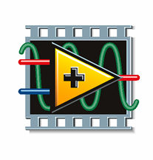
Readout With LabVIEW
Arun Veeramani
National Instruments

Slide 2
Virtual Instruments (VIs)
LabVIEW programs are called virtual instruments, or VIs
Appearance and operation imitate physical instruments, such as oscilloscopes and digital multimeters

Slide 3
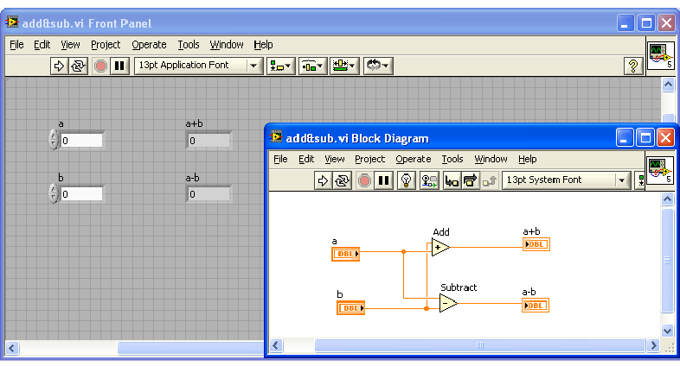
Parts of a VI
LabVIEW VIs contain three main components:
Front Panel
Block Diagram
Icon/Connector Panel

Slide 4
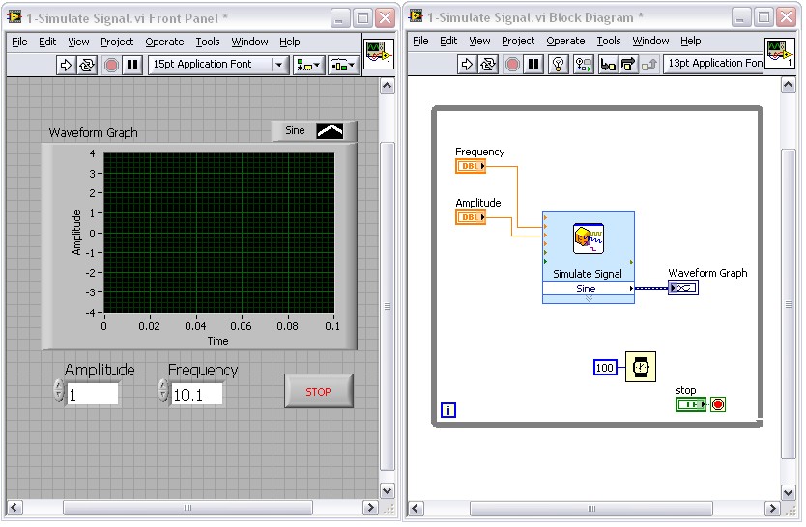
The LabVIEW Environment
“VI” = program or function
“Front Panel” = user interface
“Block Diagram” = code

Slide 5
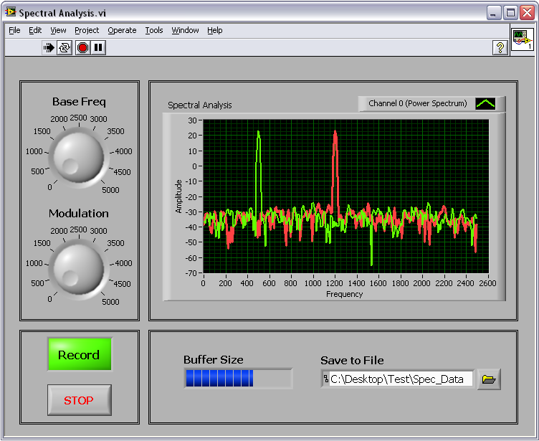
Front Panel-Controls & Indicators
Knobs/Dials
Graphs/Charts
Buttons
Digital Displays
Sliders
Thermometers
Customize and create your own

Slide 6
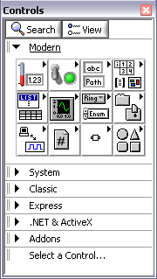
Front Panel
Controls Palette
Contains the controls and indicators you use to create the front panel
Access from the front panel by selecting View»Controls Palette
Toolbar

Slide 7
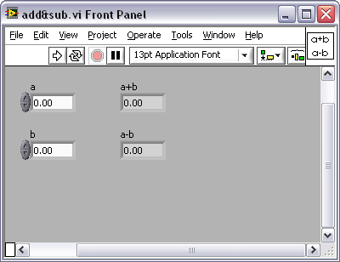
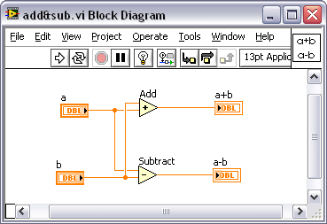
Block Diagram
Block diagram objects include the following:
  Terminals
  SubVIs
  Functions
  Constants
  Structures
  Wires

Slide 8
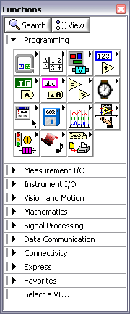
Block Diagram
Functions Palette
Contains the VIs, functions, and constants you use to create the block diagram
Toolbar

Slide 9
Searching for Controls, VIs & Functions
Find controls, function, and VIs using the Search button on the Controls and Functions palette

Slide 10
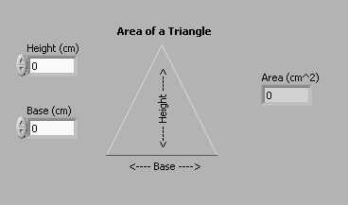
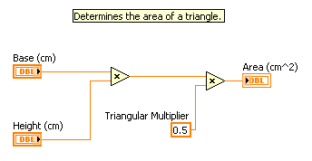
Block Diagram Terminals

Slide 11

Dataflow
LabVIEW follows a dataflow model for running VIs
A node executes only when data are available at all of its input terminals
A node supplies data to the output terminals only when the node finishes execution

Slide 12
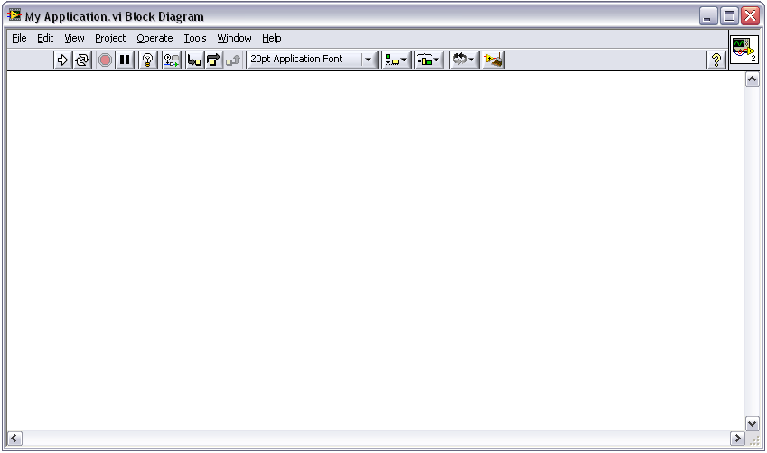
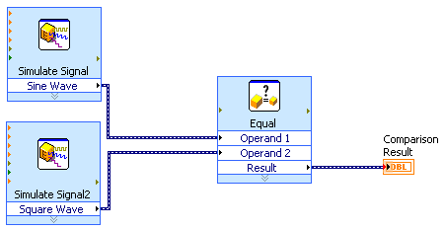
Dataflow Programming
Block Diagram
1
2
3
1
Both ‘Simulate Signal’ Express VIs execute simultaneously
2
Comparison waits until all inputs are present, then executes
3
Once executed, output from comparison continues through code

Slide 13
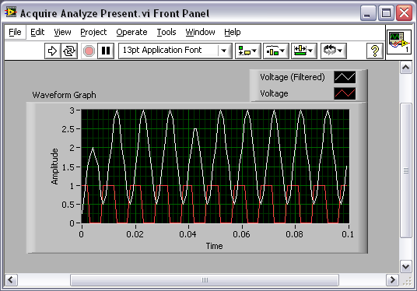
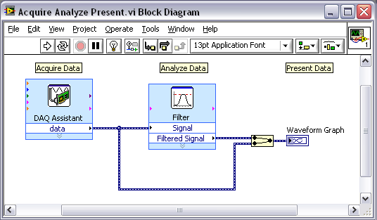
Building a Simple VI

Slide 14




Building a Simple VI – Acquire
Acquire Express VIs:
DAQ Assistant Express VI
Instrument I/O Assistant Express VI
Simulate Signal Express VI
Read from Measurement File Express VI

Slide 15





Building a Simple VI – Analyze
Analyze Express VIs:
Amplitude and Level Measurements Express VI
Statistics Express VI
Spectral Measurements Express VI
Tone Measurements Express VI
Filter Express VI

Slide 16
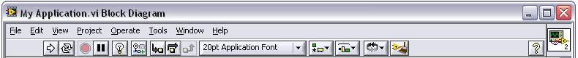
Built-in Programming Assistance
Highlight Execution
Block Diagram Cleanup
Context Help

Slide 17
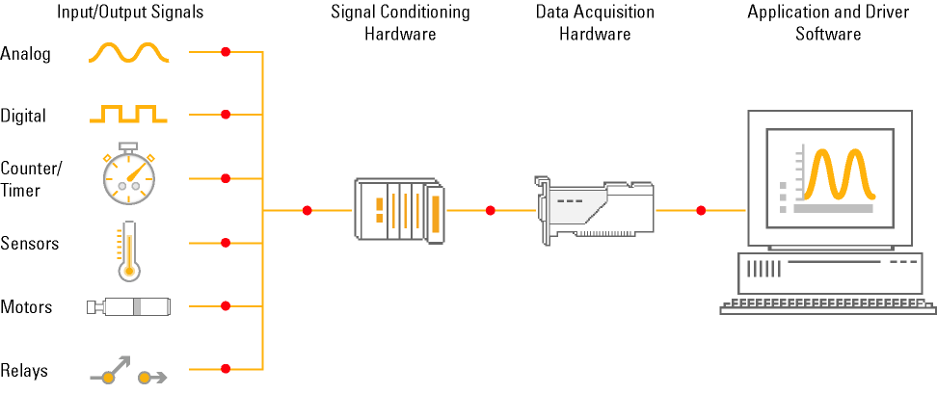
PC-Based Data Acquisition (DAQ)

Slide 18
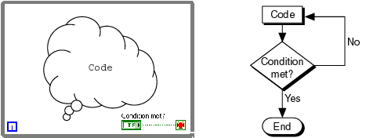
While Loops
Repeat (code);
Until Condition met;
End;
LabVIEW While Loop Flowchart Pseudo Code

Slide 19
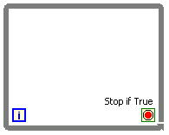
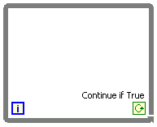
While Loops
Iteration terminal: returns number of times loop has executed; zero indexed
Conditional terminal: defines when the loop stops
Iteration Terminal
Conditional Terminal

Slide 20
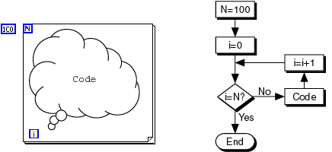
For Loops
N=100;
i=0;
Until i=N:
Repeat (code;i=i+1);
End;
LabVIEW For Loop Flowchart Pseudo Code

Slide 21
Timing a VI
Why do you need timing in a VI?
Control the frequency at which a loop executes
Provide the processor with time to complete other tasks, such as processing the user interface

Slide 22
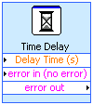


Timing a VI – Wait Functions
A wait function inside a loop allows the VI to sleep for a set amount of time
Allows the processor to address other tasks during the wait time
Uses the operating system millisecond clock

Slide 23




Timing Methods
  Wait VI – Constant time of execution
  Execute A, Execute B, sleep 10 ms
  Wait Until Next Multiple VI – Variable time of execution
  Execute A, Execute B, sleep until OS timer reaches next multiple of 20 ms

Slide 24
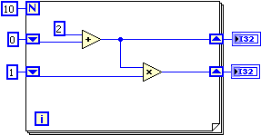
Iterative Data Transfer – Shift Registers
Right-click the border and select Add Shift Register from the shortcut menu
Right shift register stores data on completion of an iteration
Left shift register provides stored data at beginning of the next iteration

Slide 25
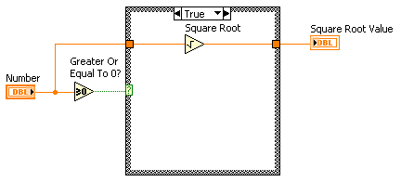
Case Structures
Have two or more subdiagrams or cases
Execute and displays only one case at a time
An input value determines which subdiagram to execute
Similar to case statements or if...then...else statements in text-based programming languages

Slide 26
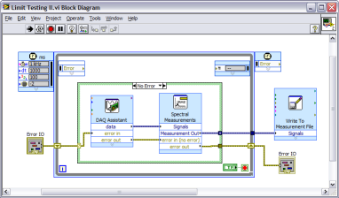
LabVIEW is a Programming Language
Graphical Programming
  Data types
  Structures (i.e. loops, case, event handling)
  Standard functions (i.e. File I/O)
Reuse external code
Compiles to machine code
Automatic multithreading
Notes:
LabVIEW is a graphical programming language. Like text-based languages, LabVIEW has common programming devices like data types (numbers, strings, arrays, etc.), structures (for loops, while loops, case structures, event handling) and functions (file I/O, comparisons, etc.).
Graphical programming is valuable for domain experts that don’t have a heavy background in text-based programming. Using function blocks, wires and loops in place of text strings, engineers and scientists can create a program that looks similar to their whiteboard drawings of an application instead of translating that high level design to specific text strings, avoiding errors in that translation from algorithm to code. This additional level of abstraction aides in program design, but in no way decreases application power. Like text-based languages, LabVIEW compiles to machine code when run and performs at similar speeds to applications written in text-based languages. In addition to including its own, optimized compiler for run-time, LabVIEW continually compiles your program during design to help you catch errors while you code.
Multicore processing is one of the most important trends in computing today, and LabVIEW has been inherently multithreaded for over 10 years. LabVIEW automatically looks for ways to break up your application into different pieces that can be processed simultaneously on multiple cores. That way, without any effort on your part, your applications can see improved execution speeds.

Slide 27
Parallelism
  Often, you need to program multiple tasks so that they execute at the same time
  In LabVIEW, tasks can run in parallel if they do not have a data dependency between them, and if they do not use the same shared resource

Slide 28
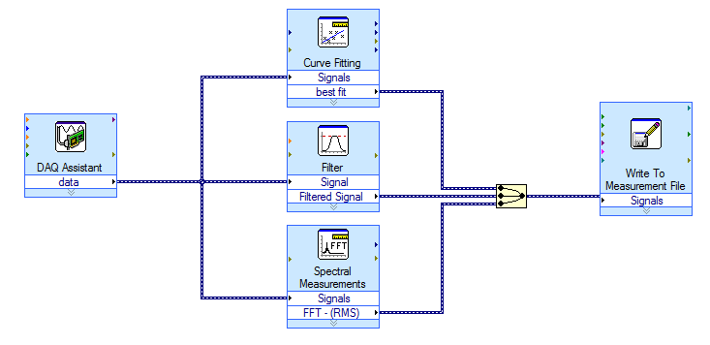
Automatic Multithreading in LabVIEW
LabVIEW automatically divides each application into multiple execution threads (introduced in 1998 with LabVIEW 5.0)
Parallel code paths will execute in unique threads
thread
thread
thread

Slide 29
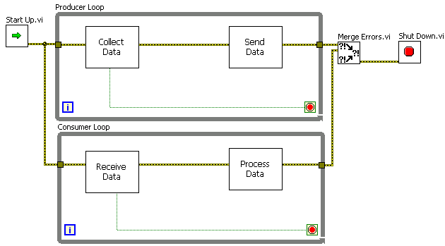
Multiple Loop Architectures

Slide 30
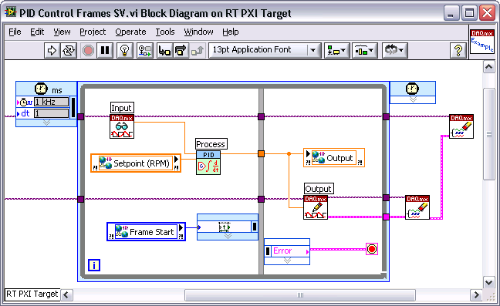
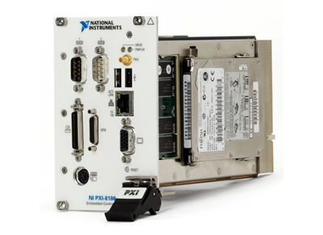
LabVIEW Real-Time Module
Rapidly develop deterministic applications with graphical programming
Easily architect distributed control and monitoring systems
Eliminate time spent integrating diverse I/O
Notes:
LabVIEW Real-Time extends LabVIEW graphical programming to create applications with deterministic, real-time performance. You can develop and debug your application using familiar LabVIEW graphical programming on a Windows PC, and then download that time-critical code to run embedded on RT Series hardware. Through LabVIEW Real-Time, National Instruments is extending the simplicity of LabVIEW graphical programming for widespread development and deployment of real-time applications without requiring in-depth knowledge of real-time techniques.

Slide 31
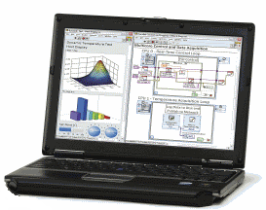
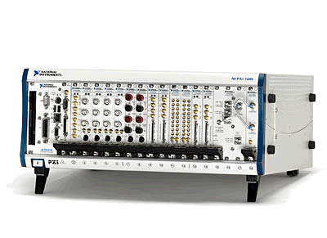


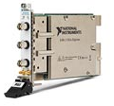
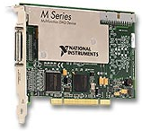
NI Real-Time Hypervisor for Linux
Windows PC
Hypervisor System*
*Must program
LabVIEW Real-Time
application from Windows
Supported Linux I/O
Supported RT I/O
Notes:
There are a few caveats that it is important for customers to know about before purchasing the Real-Time Hypervisor for Linux. The full name of the product is actually the NI Real-Time Hypervisor for Linux Early Access Program; the Early Access Program piece is meant to better convey the caveats to customers in place of the “pioneer” term used in the past. For more information on NI Early Access Programs, please see the eLearning module on that topic.
The first caveat that customers should know about is that the Real-Time Hypervisor for Linux software must be manually installed. Customers can order the Real-Time Hypervisor for Linux CD media directly by part number, and it will come with installation instructions. However, these instructions assume that the customer has experience working with Linux and compiling kernel modules, etc.
In addition, remember that the LabVIEW Real-Time Module is not supported on Linux. Therefore, customers must develop their LabVIEW Real-Time applications on a separate Windows PC, and then download and deploy those applications to the real-time side of a Real-Time Hypervisor for Linux system.

Slide 32
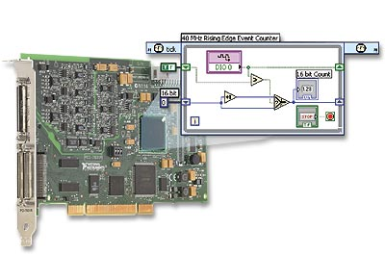
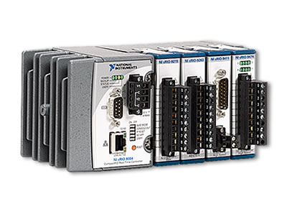
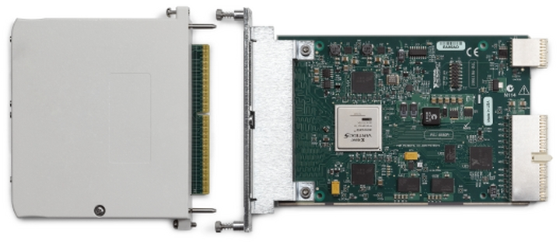

LabVIEW FPGA Module
Define custom FPGA I/O without VHDL programming
Achieve hardware deterministic response within 25ns
Execute tasks with true parallelism
R Series Intelligent DAQ
NI CompactRIO
NI FlexRIO
Notes:
The National Instruments LabVIEW FPGA Module extends LabVIEW graphical development to reconfigurable FPGAs on NI reconfigurable I/O (RIO) hardware. With the NI LabVIEW FPGA Module, you can create custom I/O measurement and control hardware without low-level hardware description languages or hardware board-level design. You can use this custom hardware for unique timing and triggering routines, ultrahigh-speed control, and interfacing to digital protocols.

Slide 33



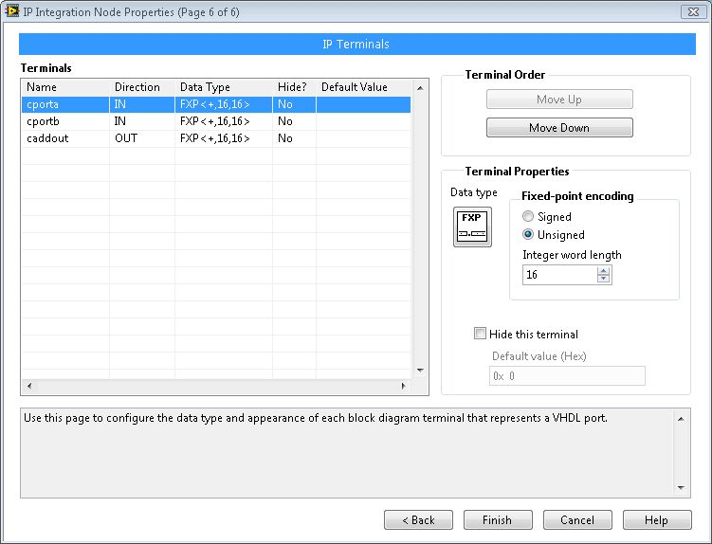


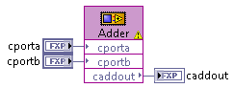
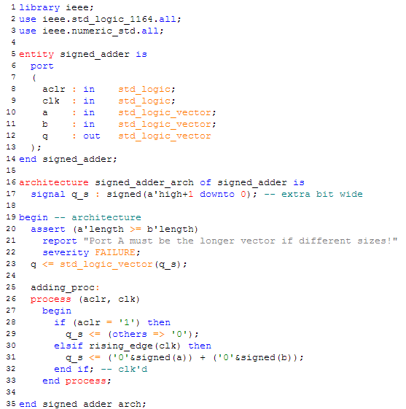
LabVIEW 2010 FPGA IP Integration Node
Use Core Generator
or Custom VHDL
Configure IP Integration Node and Generate Simulation Model
Use the IP Block Using Standard LabVIEW I/O Interfaces
Notes:
Generate Cores from Xilinx Core Generator or use any VHDL.
Configure the IP for use in LabVIEW invlovles telling LabVIEW

Slide 34
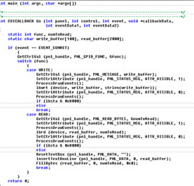
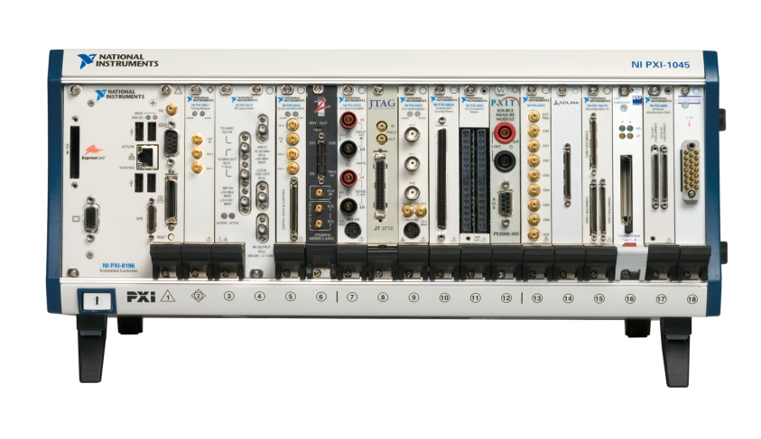
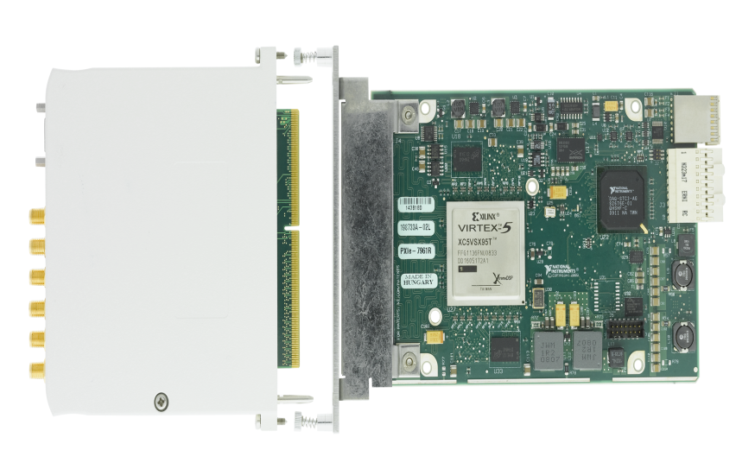
FPGA Interface C API for Linux
FPGA Interface
C API
Linux Target (RHEL or Scientific)
NI FPGA Device
Notes:
Notes

Slide 35
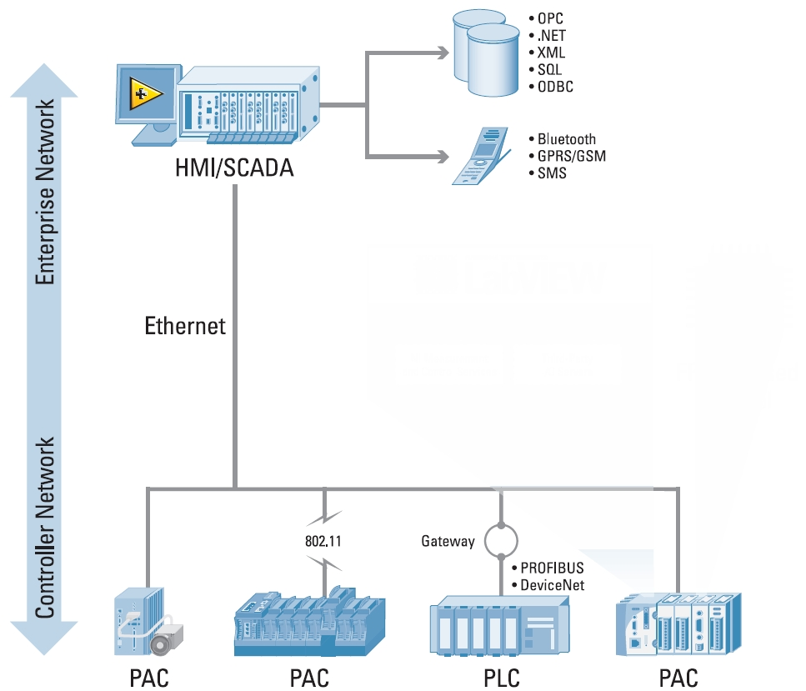
Open Architecture
Controls standards
  EPICS, TANGO, CORBA, TINE, C
Connectivity to different devices
  OPC, Modbus, TCP/IP, UDP, EtherCAT, Serial
Flexibility
  Windows, RTOS, FPGA

Slide 36
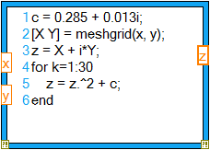
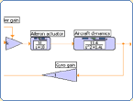
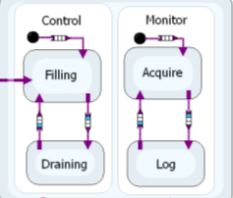
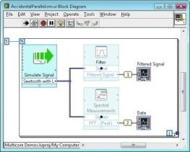
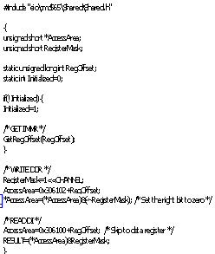
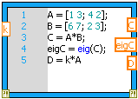


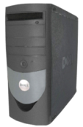
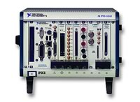






High-Level Design Models
Data Flow
C Code
Textual Math
Simulation
Statechart
Graphical System Design Platform
PC/Mac/Linux
PXI
CompactRIO
FlexRIO
Custom

Slide 37

LabVIEW Easily Connects to Hardware I/O
9000+ instrument drivers for instruments from over 300 vendors
PCI, PCIe, PXI, USB, Ethernet, serial, GPIB, and CAN devices
Modular data acquisition hardware from DC to the GHz range
Motion control stages
Cameras
Hundreds of PLCs
Notes:
What makes LabVIEW the superior choice for acquisition and control applications is its ability to integrate with hardware to acquire real-world data. LabVIEW delivers seamless connectivity with a wide range of measurement hardware. You can use LabVIEW to quickly configure and use almost any measurement device, from stand-alone instruments to USB data acquisition devices, motion controllers, image acquisition systems, and programmable logic controllers (PLCs).
If you use bench top instruments such as an Agilent Network Analyzer, or other standalone instruments to make measurements, there are over 6,000 instrument drivers from over 250 instrument providers available online that enable you to control these instruments from LabVIEW. You are also opening yourself to use a wide range National Instruments hardware products allow you to create solutions including rugged industrial monitoring applications, bench top data acquisition, Real-Time process control, prototyping embedded control systems, and handheld applications running on a PDA to name just a few.
Given the time constraints of today’s seminar we are going to focus on how to acquire, analyze and present data using LabVIEW. However it’s important to recognize that the capabilities of LabVIEW extend far beyond simple data acquisition to include areas such as PID control, vision inspection, Embedded design, rapid prototyping and so on.

Slide 38






NI DAQ Platforms
One application, multiple targets
Wireless
USB
PCI
CompactDAQ
PXI
Notes:
LabVIEW uses a single driver, NI DAQmx, to integrate with all NI DAQ platforms. Your code will execute the same on different DAQ systems, leaving channel selection and hardware bandwidth as the only variables. This means that you can distribute the same application you developed on your desktop to various other form-factors and buses depending on your application requirements.

Slide 39

CERN Collimator Alignment
550+ axes of motion
Across 27 km distance
The jaws have to be positioned with an accuracy which is a fraction of the beam size (200μm)
Synchronized to
  < 5ms drift over 15 minutes
  Maximum jitter in μs
Notes:
CERN
The European Organization for Nuclear Research, more commonly known as CERN, is the world’s largest particle physics laboratory. Located on the border between France and Switzerland, CERN was founded in 1954 and serves as a research organization where scientists gather to study the building blocks of matter and the forces that hold them together.
LHC Expected to Answer Fundamental Questions about the Universe
CERN relies on machines called particle accelerators to crash beams of ions or protons either together or into other targets. These collisions release enormous amounts of energy – enough to recreate the high-energy conditions that existed during the formation of the universe. The data collected from the particle collisions in the LHC will likely provide unprecedented information about how our universe came to be and help answer such questions as why particles have mass and what is the origin of dark matter.
The LHC, which is 27 km in circumference and is buried up to 150 m underground, is capable of producing head-on collisions between particle beams traveling at close to the speed of light. To produce these collisions, the LHC sends two beams of protons or other positively charged heavy ions around the circular tunnel in opposite directions. Superconducting magnets that operate in a superfluid helium bath at just 1.9 K (-271 ºC or -456 ºF) control the trajectory of LHC beams. The total energy in each beam at full power is 350 MJ, approximately the energy in a 400-ton train traveling at 150 km/h and enough energy to melt 500 kg of copper.

Slide 40
CERN – LHC Collimator Project
120 PXI systems running LabVIEW Real-Time
Communication
  PXI systems are connected through Ethernet
  Linux (Corba) host via a protocol called DIM (future FESA)
Synchronization
  Control systems are distributed over the 27 km tunnel
  Synchronization using PXI 10 MHz backplane clock
Embedded / FPGA
  Closed loop motor control systems with redundant feedback
  Softmotion algorithms running in a synchronized FPGA
Notes:
The Challenge:
Measuring and controlling, in real time, the position of bulk components to absorb energetic particles out of the nominal beam core with high reliability and accuracy at the world’s most powerful particle accelerator, the Large Hadron Collider (LHC).
The Solution:
Using LabVIEW, the LabVIEW Real-Time Module, the LabVIEW FPGA Module, and NI SoftMotion software with NI R Series reconfigurable I/O hardware for PXI to develop an FPGA-based motion control system capable of intercepting misguided or unstable particle beams.

Slide 41




Graphical System Design
LEGO® MINDSTORMS® NXT
“the smartest, coolest toy of the year”
CERN Large Hadron Collider
“the most powerful instrument on earth”
Notes:
The graphical system design approach can be applied to a range of applications…

Slide 42
THANK YOU!

Slide 43




Instrumentation Timeline
Compact PCI
GPIB
VXI
PXI
1965
1987
1995
1997
Photo Courtesy of Keithley
Notes:
To understand the history of instrumentation architectures let us examine a timeline depicting the introduction of several popular instrument architectures.
In 1965, the General Purpose Interface Bus (or GPIB) was developed to interface with popular bench-top instruments.
In 1987, VXI (which stands for VME eXtensions for Instrumentation) was introduced, ushering in the era of modular-based instruments.
In the early 90’s, PC plug-in instruments were developed to take advantage of the popular PCI bus found on standard desktop PC’s
in 1995, CompactPCI built on PC technology by introducing a rugged, modular architecture, thus paving the way for the introduction of PXI in 1997.

Slide 44
What is PXI?
PXI = PCI eXtensions for Instrumentation
Open specification governed by the PXI Systems Alliance (PXISA) and introduced in 1997
PC-based platform optimized for test, measurement, and control
PCI electrical-bus with the rugged, modular, Eurocard mechanical packaging of CompactPCI
Advanced timing and synchronization features
Notes:
Just highlight features at a really high level and quickly go through slide. Will go in more detail as PXI is explained and highlighted.
PXI - PCI eXtensions for Instrumentation
Open Spec that is governed by the PXI Systems Alliance – which I will talk about in a little bit
PXI is a rugged Compact PCI-based platform for test and measurement
Combines the PCI electrical-bus features with the rugged packaging of CompactPCI
Additional of specialized synchronization buses
High performance and low-cost deployment platform for a variety of applications ranging from manufacturing testing to military and aerospace.

Slide 45
PXI Specification
Mechanical
High-performance connectors
Eurocard mechanical packaging
Forced-air cooling by chassis
Optional module shielding
Environmental testing
Electromagnetic testing
Electrical
Industry-standard PC buses
System reference clocks
Star trigger buses
PXI trigger bus
Software
Microsoft Windows, RT, and Linux software frameworks
Software components that define HW configuration and capabilities
Virtual Instrument Software Architecture (VISA) implementation
View complete specification at pxisa.org
Notes:
The PXI specification defines requirements that make PXI systems well suited for harsh environments
Such as high performance connectors to ensure that the packaging is rugged
Along with cooling and environmental specifications to ensure operation in industrial environments.
The electrical features ensure that you will see the same performance features as defined by the desktop PCI specification. Except that you have even more peripheral slots per bus segment to gain access to an even higher variety of measurement devices.
The key difference is the addition of the timing and synchronization features: adding system reference clocks and PXI trigger buses to ensure that the cards will all begin taking measurements at a specific time.
To further simplify systems integration there are software requirements that enforced. These requirements include the use of standard operating system frameworks. Appropriate configuration information and software drivers for all peripheral devices are also required.
Remind people where they are able to get the full specification. Just highlight these and they can see the specification at pxisa.org

Slide 46
PXI Systems Alliance (PXISA)
Founded in 1998
PXISA goals:
  Maintain the PXI specification
  Ensure interoperability
  Promote the PXI standard
70+ members comprise the PXISA
PXISA web site (www.pxisa.org)
  Specifications
  Tutorials, application notes, and white papers
  Locate member companies and products
Notes:
The PXI Systems Alliance (PXISA) is an industry consortium that promotes and maintains the PXI standard.
This organization is chartered to:
Maintain the PXI specification
Ensure interoperability
Promote the PXI standard
Currently there are 60+ members and you can access a variety of important information from www.pxisa.org for free. This material consists of documented specifications to tutorials.

Slide 47



Modular PC-Based Architecture Provides Flexible Functionality
More than 1,500 PXI Products from More than 70 Vendors
DAQ and Control:
Multifunction I/O
FPGA/Reconfigurable I/O
Digital I/O
Analog Input/Output
Vision and Motion
Counter/Timers
Instruments:
Oscilloscopes
Digital Waveform Generator/Analyzers
Digital Multimeters
Signal Generators
Switching
RF Signal Generation and Analysis
Interfaces:
GPIB, USB, LAN
SCSI + Enet
Boundary Scan/JTAG
CAN + DeviceNet
RS232/RS485
VXI/VME
Notes:
This flexibility implies that single test system must contain multiple functionalities. To that end, PXI provides a platform with a breadth of functionality available, including analog and digital I/O, high-speed instrumentation, vision, motion, and various interfaces. PXI is built on the modular and scalable CompactPCI specification and the high-speed PCI bus architecture. As a result, PXI products maintain complete interoperability with CompactPCI, offering superior mechanical integrity, easy systems integration, and more expansion slots than desktop computers.
Industrial standard – 70+ companies are creating cards. If National Instruments doesn’t provide a card that are many other manufactures that are able to create cards. For example military and aerospace buses.

Slide 48

PXI: Then and Now
1998
2010
100% Interchangeable!

Slide 49

PXI Combines Standard Technologies
PXI Backplane
PCI bus
Timing and
Synchronization
Controller
Embedded PC or remote PC / laptop interface
Runs all standard software
Chassis
Peripheral Modules
Notes:
PXI systems are comprised of three basic components.
There is the chassis which houses all the cards and gives all of the cards access to the clock and bus to transfer information.
Within the chassis there is a controller which can be either a remote controller or an embedded controller. The controller will have the operating system used to setup and run the programs to communicate with the modules.
Modules are available for instrumentation, data acquisition, control, interfacing to buses, etc.

Slide 50


Embedded PXI System Controllers
General Purpose OSs
Windows, Linux, etc.
High performance
Integrated peripherals
  Gigabit Ethernet, USB 2.0, ExpressCard, etc.
Ethernet / LAN control of PXI
Real-Time OSs
LabVIEW Real-Time, VxWorks, etc.
Determinism and reliability
Headless operation
Notes:
For applications that require compact systems and therefore need a solution that eliminates the external PC. For these type of applications, you are able to use an embedded controller. This provides a complete system within the PXI chassis. PXI controllers are built using the standard PC components so it has all the same functionality: such as access to ethernet, USB, and ExpressCard slots. These controllers run the same operating systems as a desktop computer. Therefore you are able to run Windows, Real-Time, or Linux.
The Real-time operating systems are designed for applications requiring deterministic and reliable performance and are run under headless operation (i.e. no mouse, keyboard).

Slide 51


Remote PXI System Controllers
PC Control of PXI
Use latest high-performance PCs
Build multichassis PXI systems
Laptop Control of PXI
Control portable applications
Use with DC-powered chassis for mobile systems
Notes:
For situations where you want to use your desktop computer or possibily your laptop if you plan on moving your system to a variety of locations, you have the option of remote controllers. This enables you to get extended distance, since you might want to place the system in a dedicated area and then monitor it from another spot.
The links are high-throughput (up to 110 MB/s) and software-transparent. PC control of PXI enables use the latest desktops, servers, and workstations for applications that require the highest-performance processor, high-speed or long-duration streaming to disk. Both PCI Express and PCI controllers are available. PXI remote controllers can also be used to build multichassis PXI systems.
Laptop control of PXI enables control of portable applications and, when paired with a DC-powered chassis, enables mobile systems for applications such as in-vehicle data logging. Both ExpressCard and PCMCIA CardBus controller slot of your laptop.

Slide 52





PXI Chassis
3U, 6U, and 3U/6U combo
4 through 26 slots
Portable, benchtop, and rack mount
AC and DC power options
Application specific
    Ultra rugged, integrated signal conditioning, integrated LCD, etc.
Notes:
The chassis provides the rugged and modular packaging for the system. Chassis, ranging in size from 4-slots to 26-slots, are available for all different types of applications – portable, benchtop, and rack mount.
Chassis are available with all 3U slots, all 6U slots, or a combination of 3U and 6U slots
Chassis are also available with special features such as DC power supplies and integrated signal conditioning.
The chassis contains the high-performance PXI backplane, which includes the PCI bus and timing and triggering buses. Using these timing and triggering buses, users can develop systems for applications requiring precise synchronization.

Slide 53


PXI Includes Two Form Factors
3U (100mm x 160mm)
6U (233.35mm x 160mm)
Notes:
Key Talking Points:
Two different form factors 3U and 6U – The height is what makes them different
Chassis available to support both
Additionally, you can use all 3U modules in 6U slots with an adapter.
Choosing 3U
Placed into applications where you want a small system
Choosing 6U
Increased real estate for integrating more features on a single board. Large parts such as microprocessors and FPGAs require more space. You are able to place more on the card since you have more area.
Over 90% of modules are 3U

Slide 54


PXI and cPCI Module Interoperability
PXI and CompactPCI modules have complete compatibility
PXI adds timing and synchronization to the CompactPCI specification
Example: Agilent Technologies N6030A
15-bit, 500 MHz Wideband Arbitrary Waveform Generator
1.25 GS/s Sampling Rate
Photos Courtesy of Agilent
Notes:
There are many CompactPCI modules that are available. You are able to place them into PXI chassis however, most compactPCI modules don’t have the functionality built in to access the timing and sync capabilities.
PXI and CompactPCI modules have complete compatibility. CompactPCI modules can be installed in PXI systems and vice-versa. The PXI backplane adds timing and synchronization to the CompactPCI specification. However, for modules, connection of the timing and synchronization signals to the PXI backplane is optional.
Agilent N6030A Wideband Arbitrary Waveform Generator use ample front-panel space to provide connectivity to clocks and triggers outside of the backplane.

Slide 55
Trigger with PXI

Slide 56
Signal vs. Time-Based Synchronization
  Signal-based
    Clocks and triggers physically connected between systems
    Potentially the highest-precision synchronization
  Time-based
    Multiple systems synchronize to a common time reference
    Sync systems in large proximity i.e. World Wide
    Events, triggers and clocks can be generated based on this reference
    Signals can be timestamped and correlated in post-processing
Notes:
Signal-Based Synchronization can only be used with system in close proximity. They have to be physically connected.
Time-Based Synchronization can be used with large proximity (World Wide).
Used to generate Future Time Events.

Slide 57
Synchronization Technologies
Precision
10⁻¹² sec
On-chip
PXI
PXI Multichassis
10⁻⁹ sec
Signal-based
Time-based
IRIG-B
GPS
IEEE-1588
10⁻⁶ sec
10⁻³ sec
NTP
sec
TCP/IP Messages
<10⁻⁴m
10⁻²m
10⁰m
10¹m
10²m
10³m
10⁴m
10⁵m
Global
Proximity
Notes:
Let’s look at a comparision of signal-based and time-based where we have precision vs. proximity.

Slide 58

Timing and Synchronization Features of PXI
PXI Trigger Bus
  8 TTL
  Trigger, Clock, and Handshaking Signals
System Reference Clock
  10 MHz TTL
  Phase Lock Looping
  Equal-Length Traces
  < 1 ns Skew
Star Trigger Bus
  1 Per Slot
  Star Configuration
  Traces Matched in Propagation Delay
  < 1 ns Skew
Notes:
System Reference Clock
The PXI backplane provides a built-in common reference clock for synchronization of multiple modules in a measurement or control system. Each peripheral slot features a 10 MHz TTL clock, transmitted on equal-length traces, providing skew of < 1 ns between slots. The accuracy of the 10 MHz clock is chassis specific, but is typically less than 25 parts per million (ppm), making it a reliable clock for synchronization based on phase lock looping (PLL) methods. For example, multiple 100 MHz digitizers are easily synchronized by phase-lock-loop of their individual voltage-controlled crystal oscillator (VCXO) 100 MHz clocks to the 10 MHz system reference clock. The accuracy of the 10 MHz clock can be improved by installing a capable board into the star trigger slot (slot 2) of the chassis.
PXI Trigger Bus
PXI defines eight trigger bus lines for synchronization and communication between modules. Trigger, clock, and handshaking signals can be shared using the trigger bus lines. Triggers can be passed from one module to any number of modules, so you can distribute digital trigger signals from master to slave measurement devices. The trigger bus allows transmission of variable frequency sampling clocks, so multiple modules can directly share a sample clock or variable frequency time base. For example, four data acquisition (DAQ) modules using a 44.1 Ksps CD audio sampling rate can directly share a clock that is a multiple of 44.1 KHz over the trigger bus. However, for clock frequencies of approximately 20 MHz or greater, direct transmission of a clock with the trigger bus is not recommended due to signal degradation, and you should use a system reference clock instead.
Star Trigger Bus
The star trigger bus has an independent trigger line for each slot oriented in a star configuration from a special star trigger slot (defined as slot 2 in any PXI chassis). The PXI star line lengths are matched in propagation delay to within 1 ns from the star trigger slot. This feature addresses high-speed synchronization where you can distribute start/stop trigger signals from the master measurement module in the star trigger slot with low delay and skew. Alternately, a variable-frequency clock signal can be transmitted to modules over the star trigger bus with < 1 ns skew.

Slide 59


Integrating PCI Express into PXI
Notes:
PCI Express is a new bus that we can take advantage of. As applications require more throughput we need to be able to provide the hardware to achieve these rates. PCI Express is now implemented in PXI to be able to provide a solution for these high throughput applications.

Slide 60
PCI Express Advantages
High throughput (up to > 4 GB/s)
Software compatibility
Scalable bandwidth
Dedicated bandwidth per slot
Peer-to-peer communication
Long life (20+ years in mainstream market)
Notes:
The main advantages of PCI Express are the following:
Software compatibility – Don’t have to change the software
High throughput (up to > 4 GBytes/s) – serial interconnect
Scalable bandwidth
Dedicated bandwidth per slot – dedicated to each slot instead of being shared like PXI does
Peer-to-peer communication
Cards are able to talk to each other and bypass the controller. For example a digitizer talking to a FPGA
Long life (20+ years in mainstream market)
PCI and PCIe are used in many architectures – PCI has been around for 20 years and for 20 more years – Intel is using this throughout their chipsets
PXIe has the same setup of controller, modules, in a chassis.

Slide 61

Dedicated Bandwidth per Device
Notes:
Unlike PCI, which divides bandwidth between all devices on the bus, PCI Express provides each device with its own dedicated data pipeline. Thus, as multiple PCI Express devices are added to a system, the total bus throughput scales linearly.

Slide 62
Integrating PCI Express into the PXI Backplane
Up to 2 GB/s dedicated bandwidth per slot
Enhanced synchronization capabilities
  100 MHz differential clock, differential triggering
Backwards compatibility
  Complete software compatibility
  Hybrid slot definition - install modules with either PCI or PCI Express signaling in a single slot
Notes:
Differential triggering gives a cleaner signal so better accuracy
The next step is to integrate the PCI Express bus into the PXI backplane. The PXI Express backplane integrates PCI Express while still preserving compatibility with current PXI modules, users benefit from increasing bandwidth while maintaining backward compatibility with existing systems. PXI Express specifies hybrid slots to deliver signals for both PCI and PCI Express. With PCI Express electrical lines connecting the system slot controller to the hybrid slots of the backplane, PXI Express provides a high bandwidth path from the controller to backplane slots. Using an inexpensive PCI Express-to-PCI bridge, PXI Express provides PCI signaling to all PXI and PXI Express slots to ensure compatibility with PXI modules on the backplane. With the ability to support up to a x16 PCI Express link in addition to a x8 link, the system controller slot provides a total of 6 GB/s bandwidth to the PXI Express backplane, representing more than a 45X improvement in PXI backplane throughput.

Slide 63




Compatibility of PXI and Hybrid Slots
Power
Trigger Bus
Star Trigger
Clk. 10
x8 PCIe (up to 2 GB/s)
Differential Clk. 100 & Star Triggers
Reserved Pins
64/66 PCI
Local Bus
(typically unused)
32/33 PCI
(132 MB/s
per system)
Hybrid
PXI
Notes:
A PXI Express hybrid slot provides compatibility with PXI modules with PCI signaling and will support future PXI Express modules with PCI Express signaling. Additionally, a hybrid slot supports both PXI timing and synchronization features and PXI Express timing and synchronization features. The hybrid slot is defined in the PXI Express Specification.
One thing to notes is that for Hybrid PXI cards, there is a section that has been added. Older PXI cards may not have this connector to be able to fit into these slots. However, NI and many other manufacturers will rework it for you to work in these hybrid slots so you are able to use them from your PXI system to your PXI Express Systems

Slide 64
PXI
100 MHz
Differential CLK
PXI
PXI Express
PXI Express
Star
Trigger
10 MHz
CLK
PXI Express
System
Controller
PXI-1
Peripheral
PXI Express
Hybrid
Peripheral
PXI Express
Hybrid
Peripheral
PXI Express
System
Timing Slot
PXI Express
Hybrid
Peripheral
PXI Trigger Bus (8 TTL Triggers)
Notes:
PXI Express adds additional signals to the PXI-1 specification discussed in the first section. The diagram above is a PXI Express extension of the PXI diagram used in the “what is PXI” section. Note that all slots are PXI Express capable but the rightmost slot. All PXI-1 timing and triggering features but local bus are still distributed to every peripheral slot.
In this diagram, we’ll show PXI Express additions to PXI-1 timing and triggering features in orange.
The first addition is a 100MHz differential clock. As with other PXI Express timing and triggering features, the clock is only routed to PXI Express slots.

Slide 65
PXI
100 MHz
Differential CLK
PXI Express
Star
Trigger
SYNC100
10 MHz
CLK
PXI Express
System
Controller
PXI-1
Peripheral
PXI Express
Hybrid
Peripheral
PXI Express
Hybrid
Peripheral
PXI Express
System
Timing Slot
PXI Express
Hybrid
Peripheral
PXI Trigger Bus (8 TTL Triggers)
Notes:
Another addition in PXIe is the Sync100 signal…
Sync 100 is a pulse that syncs the 100 MHz and the 10 MHz so that they can be used at the same time in your chassis and they are aligned. Makes sure that the phase difference and drift is as small as possible.

Slide 66
PXI
100 MHz
Differential CLK
PXI Express
Star
Trigger
SYNC100
10 MHz
CLK
PXI Express
System
Controller
PXI-1
Peripheral
PXI Express
Hybrid
Peripheral
PXI Express
Hybrid
Peripheral
PXI Express
System
Timing Slot
PXI Express
Hybrid
Peripheral
Differential Star
Triggers
PXI Trigger Bus (8 TTL Triggers)
Notes:
To minimize skew between peripheral devices, the PXI-1 specification provides a point-to-point Star trigger for matched trace-length signaling from the system timing slot. PXI Express adds three Differential Star triggers to the specification to allow for higher frequency signaling with less jitter.

Slide 67



Czech Institute of Plasma Physics
Thomson scattering system
Synchronized high speed data acquisition
  92ch running at1GS/s
  Tight synchronization over 3 PXI chassis
  Skew < 500 ps
Notes:
The Czech IPP (http://www.ipp.cas.cz/) needed a highly synchronized high speed digitizer system for Thomson scattering measurements on a new tokamak.
They originally purchased 3 PXI chassis, full of digitizers, and using our 665x boards to achieve a tight synchronization with a skew below 500 ps (using NI-TClk).
Recently, IPP purchased an additional PXI chassis, for a total of 4 chassis and 60 digitizers (120 channels).
http://www.ipp.cas.cz/
11/07: First engagement: presented NI as a partner
12/07 NI R&D on site visit
03/08 Tender for MIMO based on IST-CFN spec. NI lost the bid
09/08 Second engagement: presented references ….
06/09 Tender for DAQ system based on Aquiris system
06/09: BPT analyzes other lost opportunities against Aquiris at the UKAEA and at Desy. BPT provides the technical answers and suggests the final price (30% off the US price list)
08/09 IPP assign the bid to NI
Radim Stefan, ASM, always on top of the opportunity

Slide 68


ESO E-ELT Primary Mirror (M1) Control
M1
42m DIAMETER
10nm CORRECTION
984 MIRRORS
2952 ACTUATORS
5904 SENSORS
3k x 6k MATRIX
1 MILLISECOND
Notes:
The European Southern Observatory (ESO) is working on the next generation of telescopes. The European Extremely Large Telescope (E-ELT) will have a primary mirror (M1) with a 42 m diameter. As it is not technically possible to manufacture such a large mirror in a single piece, M1 is actually composed of roughly 1,000 smaller hexagonal mirrors. These segmented mirrors have to be controlled very accurately to guarantee that they behave like a single mirror.
The control system is based on roughly 6,000 edge sensors (6 per mirror) and 3,000 position actuators (3 per mirror). The control loop has to be closed in less than 1 ms and relies on a 3,000 by 6,000 matrix vector multiplication.

Slide 69




M1 Control - Proposed System Setup
NI cRIO Node for Local Sensor / Actuator I/O
1 cRIO Node per Mirror
Synchronization via 1588
Supervisor
Supervisory Network
6 Distributed Mirror Controllers per Supervisor
Deterministic EtherCAT Network Ring
25-30 cRIO Nodes per eCAT Network Ring
NI PXI Distributed Mirror Controller
6 eCAT Network Rings per Distributed Mirror Controller
…
Notes:
The proposed NI architecture is based on cRIO expansion chassis (1 per mirror) using EtherCAT to provide the required 1 kHz sample rate. Several EtherCAT rings are combined with a single PXI RT controller. This setup is reproduced 6 times to take advantage of the six-fold symmetry of the primary mirror. The different controllers and EtherCAT rings are synchronized with 1588. The large matrix vector multiplication can be distributed over the 6 RT controllers or centralized in a supervisor machine.
Assumptions
Mechanical system consists of 984 hexagonal mirrors
5604 edge position sensors
3 actuators per mirror
2952 axes of control total
Sampling of sensors occurs at 1kHz loop rate (1ms sampling interval)
Sampling of sensors must be synchronized to 1-10 uS precision

Slide 70
PXI Express Summary
Continual extension of the PXI platform
Improves PXI platform performance
  Increased throughput
  Improved latency and synchronization
PXI Express maintains backwards compatibility with PXI
  Software compatibility
  Hardware compatibility with hybrid slots and hybrid systems

Slide 71
Multicore Programming

Slide 72

Moore’s Law
Driving the computer revolution over the last 20 years
Multicore Processors
Notes:
72

Slide 73

Deterministic Multithreading in LabVIEW Real-Time
Users can assign and lock code to specific cores
Notes:
In this last point of being able to manually assign threads, this is a great advancement. But also, if you are running on an OS, such as Windows, you are still susceptible to the OS running independent processes on a core that you’ve targeted for a critical routine.
To completely isolate a core and reserve it exclusively for your own target code, you can run LabVIEW RT which uses a real-time OS and is not susceptible to a over arching operating system. This means that you are able to focus entire core resources toward ensuring maximum performance and determinism to critical code elements of our application. And what’s really exciting is that its as easy as placing that code in a LabVIEW structure, like a Timed-loop and then assigning that loop to a core!
Then you can utilize multithreading in LabVIEW to give similar parallelism effects on the remaining core resources available.

Slide 74




Plasma Diagnostics & Control with NI LabVIEW RT
Max Planck Institute
Plasma control in nuclear fusion Tokamak with LabVIEW on an eight-core real-time system
“…with LabVIEW, we obtained a 20X processing speed-up on an octal-core processor machine over a single-core processor…”
Louis Giannone
Lead Project Researcher
Max Planck Institute
Notes:
74
The goal was to control the plasma in real time, which are in a state of constant flux and pressure. This plasma which is formed inside the tokamak should be controlled in real-time so that it does not touch the wall of the tokamak or lose its shape.
Computation in the loop for plasma control: PCA (Principal Component Analysis)
Coil measurement is done with PXI-based system

Slide 75

Nuclear Fusion Research, Max Planck
Magneto-Hydrodynamics Control Flow
Notes:
75
The loop is similar to any control loop where you acquire data, process and control the actuators. The need was to control the plasma position and shape with 11 currents on a 1ms time scale.

Slide 76



From 1 to 8 cores
Notes:
By providing a standard interface for describing parallel processing, the complexity of a multithreaded environment was abstracted to allow Matrix Vector Multiplication
Further optimization is possible and already on target!
A blade array with LabVIEW RT 8.5 is to be tested for performing tomographic inversion of soft X-ray measurements and solving the PDE in real time to improve the quality of the reconstructed magnetic equilibrium

Slide 77
System Improvements
Compute Time
3 to12 ms → 0.6 ms
Spatial resolution
39 x 69 grid → 64 x 128 grid
Model accuracy
PCA approximation → PDE solution
Notes:
PCA – Principal Component Analysis
PDE – Partial Differential Equation

Slide 78
DAQ & Control with FPGA

Slide 79
Factors Driving Need for Custom Hardware
Very tight control loops
Onboard signal processing
Specialized communication protocols
Custom flexible timing
Massively parallel processing
Notes:
Even with advancing bus performance and computation engines, there are instances when a modular, general system may require custom hardware…

Slide 80





FPGA Technology
Programmable
Interconnects
Logic
Blocks
I/O Blocks
Notes:
Objective: Discuss How FPGAs are structured and how they work
Before we begin talking about LabVIEW FPGA it is important to understand FPGA technology in general. A Field Programmable Gate array or FPGA is programmable chip composed of three basic components. <click> The logic blocks are where bits are crunched and processed to produce programmatic results. <click> These logic blocks are connected together with programmable interconnects which serve as a sort of micro switch matrix to route signals from one logic block to the next <click> the interconnects can also route signals to the I/O blocks which are connected to the pins on the chip for two-way communication to surrounding circuitry. FPGAs are really just a blank silicon canvas which can be programmed to be any type of custom digital hardware.

Slide 81



Field Programmable Gate Array (FPGA)
What it is
  A silicon chip with unconnected gates/processing resources
How it works
  Define behavior in software
  Compile and download to the hardware
Advantages
  Reconfigurable
  Reliability
  Parallel execution
Notes:
As with multi-core processors, programming FPGAs can require knowledge of another area. But technologies to provide the application expert a standard way of targeting either of these technologies opens the opportunity for their integration
Automation Developers Forum ni.com/forum

Slide 82

Simple Logic Example
E
F
LabVIEW FPGA Code
AB
CD
Implementing Logic on FPGA: F = {(A+B)CD} ⊕ E
Notes:
Software allows you to program with a high level graphical language

Slide 83



FPGA Programming: The Ultimate in Multicore, Multiprocessor Development
Notes:
83

Slide 84

Standard Embedded RIO Architecture
Processor
FPGA
I/O Modules

Slide 85

FlexRIO FPGA Modules for PXI
Virtex-5 FPGA
  LX30, LX50, LX85, LX110
Direct Access to FPGA I/O lines
  Full I/O pin performance
Adapter Module required!

Slide 86
NI FlexRIO
FlexRIO Adapter Module
Interchangeable I/O
Customizable by users
Adapter Module Development Kit
FlexRIO FPGA Module
Virtex-5 FPGA
Up to 132 channels
Up to 128 MB of DDR2 DRAM
Notes:
86

Slide 87


FlexRIO Adapter Module
Card Edge Connector
Defines I/O for LabVIEW FPGA
Self identification
Custom connectivity
Adapter Module Development Kit

Slide 88
Option 1: NI Developed Adapter Modules
Complete Integration with LabVIEW FPGA and NI-RIO
No HDL experience required
Notes:
88

Slide 89


Option 2: Custom Module Development
Xilinx Virtex 5 FPGA
…
CLIP
CLIP
CLIP
Socketed CLIP
PXI Bus
Custom Front-End
LabVIEW FPGA VI
Socketed CLIP
Socketed CLIP
DRAM Memory
DRAM Memory
Notes:
89

Slide 90
Option 2: Custom Module Development
Design Steps
  Circuit Design
  PCB Layout
  Mechanical Components
  Enclosure (provided by NI)
  VHDL Development
    CLIP Node Interface to LVFPGA

Slide 91
CLIP Node in LabVIEW FPGA
FlexRIO FPGA
Adapter Module
User CLIP
User CLIP
User CLIP
Socketed CLIP
LabVIEW FPGA VI
PXI Bus
Socketed CLIP
Socketed CLIP
DRAM
DRAM
Notes:
Component Level IP (CLIP) Node
Access FPGA pins directly from CLIP HDL
Execute HDL in multiple clock domains
Exercise specific features of the FPGA
Run HDL code in parallel with LabVIEW code
91

Slide 92
CERN Collimator Alignment
550+ axes of motion
Across 27 km distance
The jaws have to be positioned with an accuracy which is a fraction of the beam size (200μm)
Synchronized to
  < 5ms drift over 15 minutes
  Maximum jitter in μs
Notes:
CERN
The European Organization for Nuclear Research, more commonly known as CERN, is the world’s largest particle physics laboratory. Located on the border between France and Switzerland, CERN was founded in 1954 and serves as a research organization where scientists gather to study the building blocks of matter and the forces that hold them together.
LHC Expected to Answer Fundamental Questions about the Universe
CERN relies on machines called particle accelerators to crash beams of ions or protons either together or into other targets. These collisions release enormous amounts of energy – enough to recreate the high-energy conditions that existed during the formation of the universe. The data collected from the particle collisions in the LHC will likely provide unprecedented information about how our universe came to be and help answer such questions as why particles have mass and what is the origin of dark matter.
The LHC, which is 27 km in circumference and is buried up to 150 m underground, is capable of producing head-on collisions between particle beams traveling at close to the speed of light. To produce these collisions, the LHC sends two beams of protons or other positively charged heavy ions around the circular tunnel in opposite directions. Superconducting magnets that operate in a superfluid helium bath at just 1.9 K (-271 ºC or -456 ºF) control the trajectory of LHC beams. The total energy in each beam at full power is 350 MJ, approximately the energy in a 400-ton train traveling at 150 km/h and enough energy to melt 500 kg of copper.

Slide 93
CERN – LHC Collimator Project
120 PXI systems running LabVIEW Real-Time
Communication
  PXI systems are connected through Ethernet
  Linux (Corba) host via a protocol called DIM (future FESA)
Synchronization
  Control systems are distributed over the 27 km tunnel
  Synchronization using PXI 10 MHz backplane clock
Embedded / FPGA
  Closed loop motor control systems with redundant feedback
  Softmotion algorithms running in a synchronized FPGA
Notes:
The Challenge:
Measuring and controlling, in real time, the position of bulk components to absorb energetic particles out of the nominal beam core with high reliability and accuracy at the world’s most powerful particle accelerator, the Large Hadron Collider (LHC).
The Solution:
Using LabVIEW, the LabVIEW Real-Time Module, the LabVIEW FPGA Module, and NI SoftMotion software with NI R Series reconfigurable I/O hardware for PXI to develop an FPGA-based motion control system capable of intercepting misguided or unstable particle beams.

Slide 94
Questions

