Slide 1
Introduction to
Detector Readout
International School of Trigger and Data Acquisition
February, 9 - 16, 2011
"Sapienza" University, Rome, Italy
Niko Neufeld, CERN-PH

Slide 2
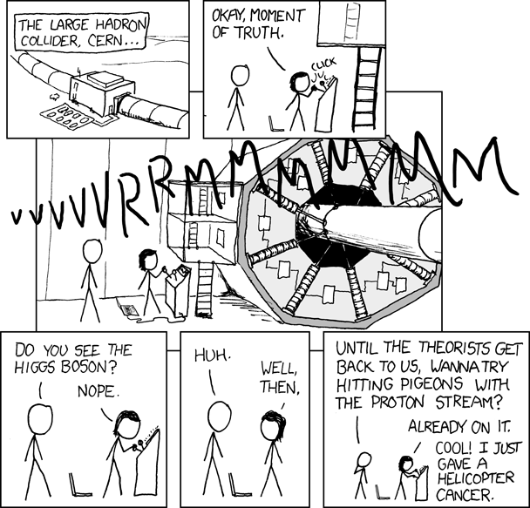
Seeing the data
Notes:
What does “see” mean? How do we visualize particles, which are as small as an electron, which have actually no internal structure, no size!

Slide 3
Contents
Lecture 1: Mostly electronics, some triggering
Lecture 5: High Levl Trigger
Topics are related, no 100% separation between the 3

Slide 4
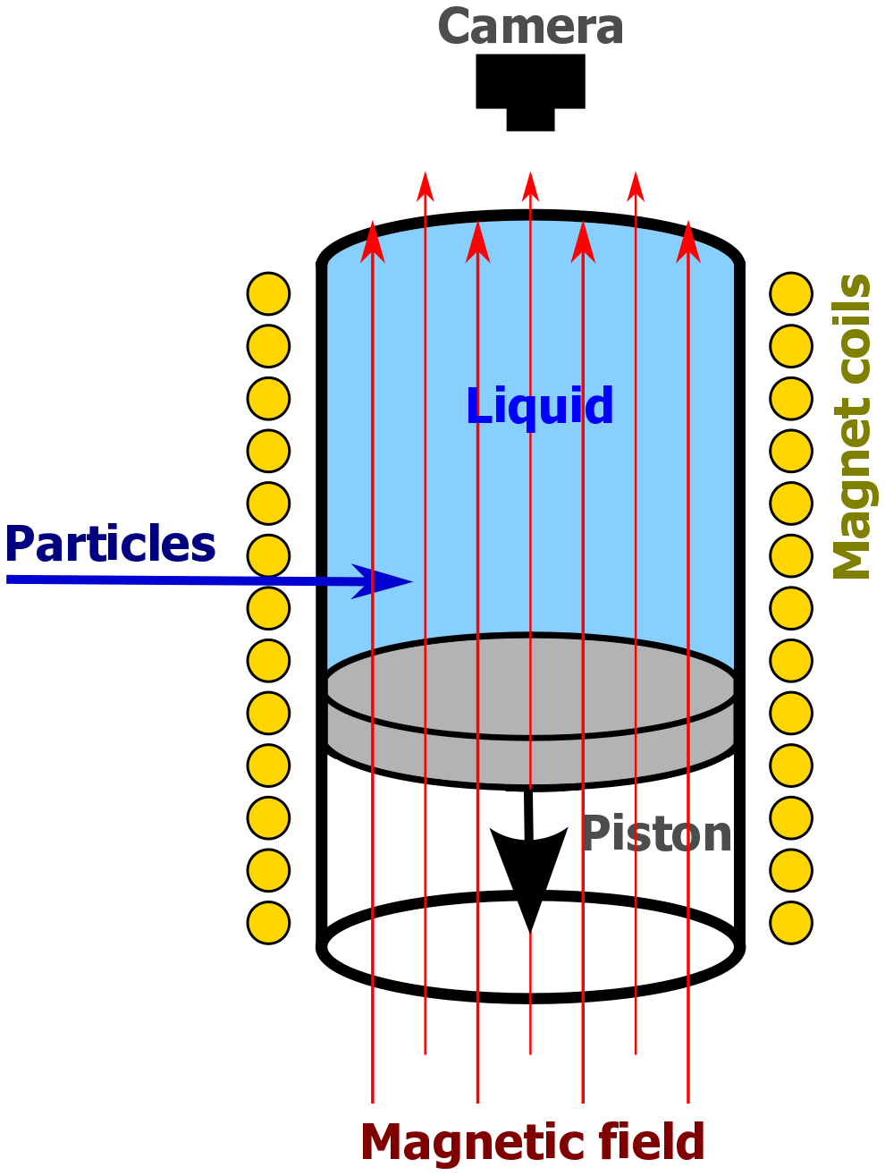
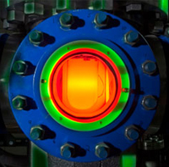
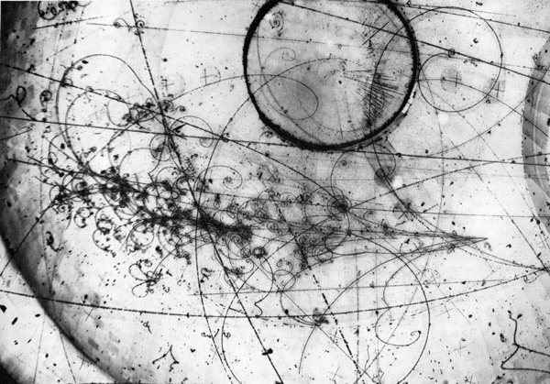
Once upon a time…
from Wikipedia
Notes:
COUPP experiment – searching for WIMPs with a bubble-chamber!

Slide 5
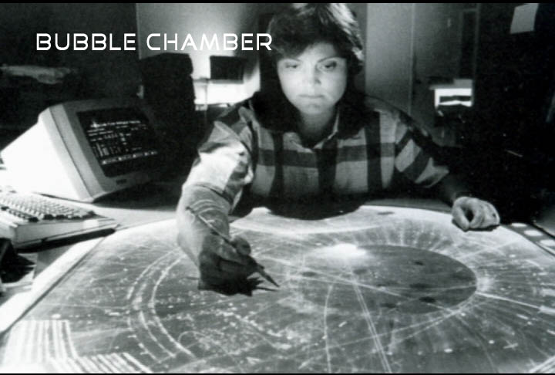
...experiment-data were read

Slide 6
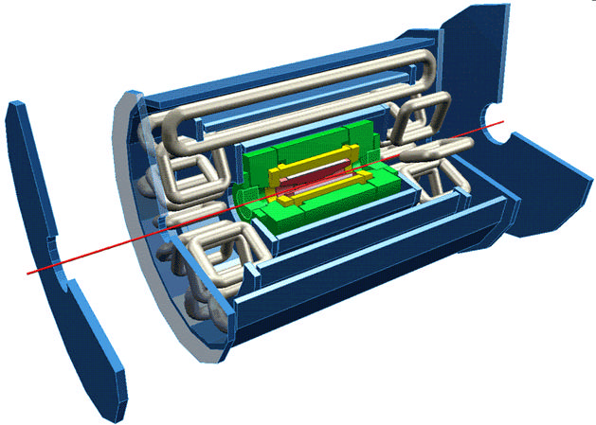
“Reading” in ATLAS?
Electromagnetic Calorimetry
Muon chambers
Beam pipe
Tracking (in solenoid field)
Hadronic Calorimetry

Slide 7
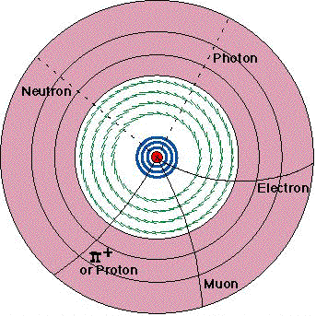
Tracking
Separate tracks by charge and momentum
Position measurement layer by layer
  Inner layers: silicon pixel and strips → presence of hit determines position
  Outer layers: “straw” drift chambers → need time of hit to determine position
Notes:
Si Tracking position to ~10 μm accuracy in rφ (through segmentation) timing to 25 ns accuracy to separate bunch crossings
Straw Tracker position to 170 μm at r > 56 cm

Slide 8
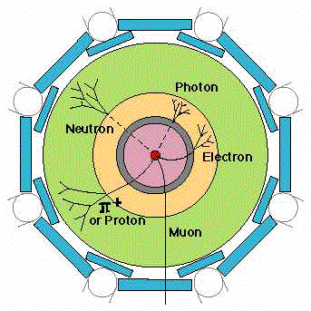
Calorimetry
Particles generate showers in calorimeters
  Electromagnetic Calorimeter (yellow): Absorbs and measures the energies of all electrons, photons
  Hadronic Calorimeter (green): Absorbs and measures the energies of hadrons, including protons and neutrons, pions and kaons
→ amplitude measurement required to find deposited charge
position information provided by segmentation of detector
Notes:
EM calorimeter energy via LAr ionization chambers position through segmentation
Hadron calorimeter energy via plastic scintillator tiles position through segmentation

Slide 9
Muon System
Track
Electrons formed along the track drift towards the central wire.
The first electron to reach the high-field region initiates the avalanche, which is used to derive the timing pulse.
Since the initiation of the avalanche is delayed by the transit time of the charge from the track to the wire, the detection time of the avalanche can be used to determine the radial position^{(*)}
→ need fast timing electronics
Δt
ATLAS Muon drift chambers have a radius of 3 cm and are between 1 and 6 m long
(*) Clearly this needs some start of time t=0 (e.g. the beam-crossing)
Notes:
This is also the principle of the straw tracker. Muon System signal via ionization chambers position through timing measurement

Slide 10
Many detectors – One problem
Although these various detector systems look very different, they all follow the same principles:
Sensors must determine
  presence of a particle
  magnitude of signal
  time of arrival
Some measurements depend on sensitivity, i.e. detection threshold, e.g.: silicon tracker, to detect presence of a particle in a given electrode
Others seek to determine a quantity very accurately, i.e. resolution, e.g. : calorimeter – magnitude of absorbed energy; muon chambers – time measurement yields position
All have in common that they are sensitive to:
signal magnitude
fluctuations

Slide 11
The “front-end” electronics`
Front-end electronics is the electronics directly connected to the detector (sensitive element)
Its purpose is to
  acquire an electrical signal from the detector (usually a short, small current pulse)
  tailor the response of the system to optimize
    the minimum detectable signal
    energy measurement (charge deposit)
    event rate
    time of arrival
    in-sensitivty to sensor pulse shape
  digitize the signal and store it for further treatment
incident radiation
Digitization
Amplifier
digitization
pre-amplifier
Detector
detector
DSP
DSP
DAQ
Buffering
DAQ
Shaping
buffering
shaping
Interface
Triggering
Interface
triggering
Multiplexing
multiplexing
ETC.
etc.

Slide 12
Electronics in a nutshell

Slide 13

Physicists stop reading here
It is well known that
“Only technical details are missing”
Werner Heisenberg, 1958
A physicist is someone who learned Electrodynamics from Jackson

Slide 14
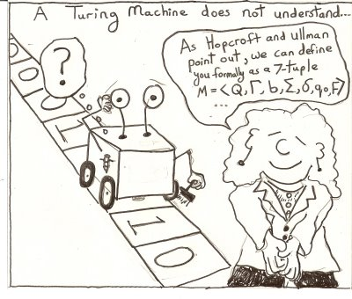
Computer scientists live digital
So why bother with this gruesome (analogue) electronics stuff?
The problem is that Turing machines are so bad with I/O and it is important to understand the constraints of data acquisition and triggering

Slide 15
The bare minimum
From Maxwell’s equations derive
Ohm’s law and power
The IV characteristic of a capacitance
Impedance
where: Q = charge (Coulomb),
C = Capacitance (Farad), U = V = Voltage (Volt), P = Power (Watt), I = Current (Ampere), ω = frequency

Slide 16
The read-out chain
Detector / Sensor
Amplifier
Filter
Shaper
Range compression
clock (TTC)
Sampling
Digital filter
Zero suppression
Buffer
Feature extraction
Buffer
Format & Readout
to Data Acquisition System

Slide 17
The signal
The signal is usually a small current pulse varying in duration (from ~ 100 ps for a Si sensor to O(10) μs for inorganic scintillators)
There are many sources of signals. Magnitude of signal depends on deposited signal (energy / charge) and excitation energy
Signal | Physical effect | Excitation energy
Electrical pulse (direct) | Ionization | 30 eV for gases 1- 10 eV for semiconductors
Scintillation light | Excitation of optical states | 20 – 500 eV
Temperature | Excitation of lattice vibrations | meV

Slide 18
The read-out chain
Detector / Sensor
Amplifier
Filter
Shaper
Range compression
clock (TTC)
Sampling
Digital filter
Zero suppression
Buffer
Feature extraction
Buffer
Format & Readout
to Data Acquisition System

Slide 19
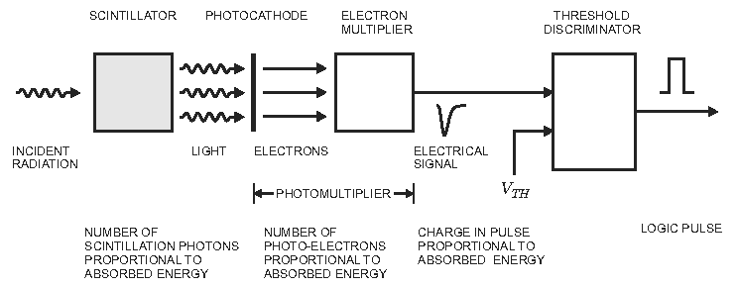
Example: Scintillator
from H. Spieler “Analog and Digital Electronics for Detectors”
Photomultiplier has high intrinsic gain (== amplification) → no pre-amplifier required
Pulse shape does not depend on signal charge → measurement is called pulse height analysis

Slide 20
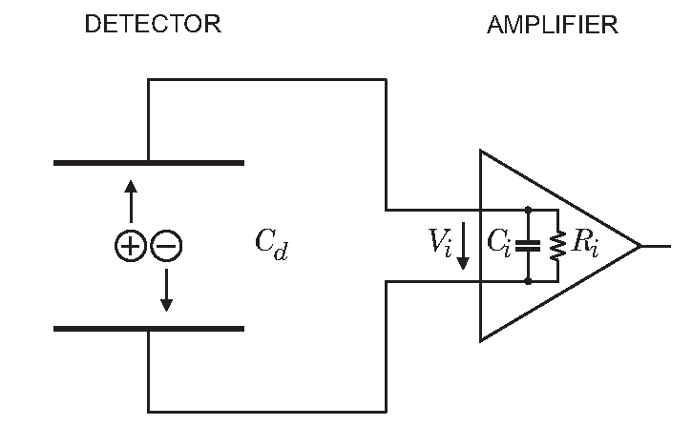
Acquiring a signal
Interesting signal is the deposited energy ➔ need to integrate the current pulse
  on the sensor capacitance
  using an integrating pre-amplifier
  using an integrating Analog Digital Converter (ADC)
The signal is usually very small ➔ need to amplify it
  with electronics
  by signal multiplication (e.g. photomultiplier)
Not so practical! Response depends
on sensor capacitance

Slide 21
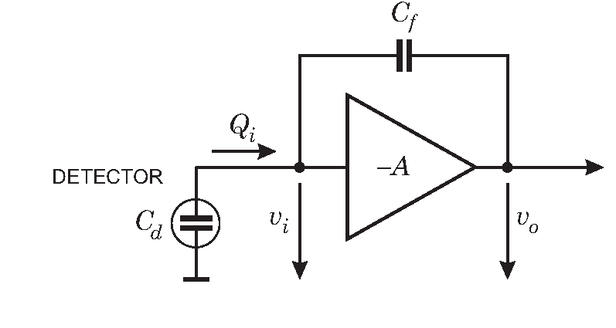
Charge sensitive amplification
Feedback amplifier with gain –A
Assume infinite input impedance (no current flows into the amplifier)
Input signal produces v_{i} at the input of the amplifier generating –Av_{i} on output
All charge must build up on feed back capacitance
Charge gain depends only on C_{f}
C_{f} x A needs to be large compared to C_{d}

Slide 22
Fluctuations and Noise
There are two limitations to the precision of signal magnitude measurements
  Fluctuations of the signal charge due to a an absorption event in the detector
  Baseline fluctuations in the electronics (“noise”)
Often one has both – they are independent from each other so their contributions add in quadrature:
Noise affects all measurements – must maximize signal to noise ration S/N ratio

Slide 23
Signal fluctuation
A signal consists of multiple elementary events (e.g. a charged particle creates one electron-hole pair in a Si-strip)
The number of elementary events fluctuates where F is the Fano factor (0.1 for Silicon)
r.m.s.

Slide 24
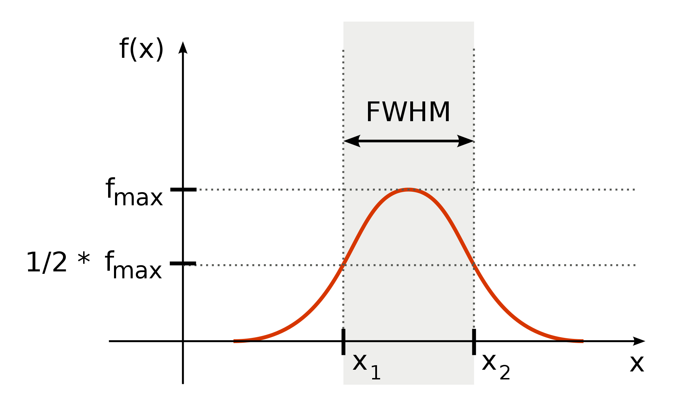
Full Width at Half Maximum (FWHM)
from Wikipedia
FWHM = 2.35 σ for a Gaussian distribution

Slide 25
Electronics Noise
Thermal noise
  created by velocity fluctuations of charge carriers in a conductor
  Noise power density per unit bandwidth is constant: white noise ➔
  larger bandwidth → larger noise (see also next slide)
Shot noise
  created by fluctuations in the number of charge carriers (e.g. tunneling events in a semi-conductor diode)
  proportional to the total average current

Slide 26
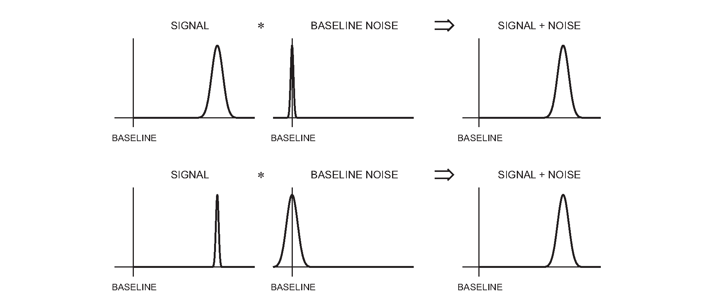
SNR / Signal over Noise
Need to optimize Signal over Noise Ratio (SNR)

Slide 27
Two important concepts
The bandwidth BW of an amplifier is the frequency range for which the output is at least half of the nominal amplification
The rise-time t_{r} of a signal is the time in which a signal goes from 10% to 90% of its peak-value
For a linear RC element (amplifier):
BW * t_{r} = 0.35
For fast rising signals (t_{r} small) need high bandwidth, but this will increase the noise (see before) → shape the pulse to make it “flatter”

Slide 28
SNR and detector capacitance
For a given signal charge Q_{s}:
V_{s} – Q_{s}/(C_{d} + C_{i})
Assume amplifier has an input noise voltage V_{n}, then
SNR =
SNR is inversely proportional to total capacitance on the input → thicker sensor gives more signal but also more noise

Slide 29
The read-out chain
Detector / Sensor
Pre-amplifier
Filter
Shaper
Range compression
clock (TTC)
Sampling
Digital filter
Zero suppression
Buffer
Feature extraction
Buffer
Format & Readout
to Data Acquisition System

Slide 30
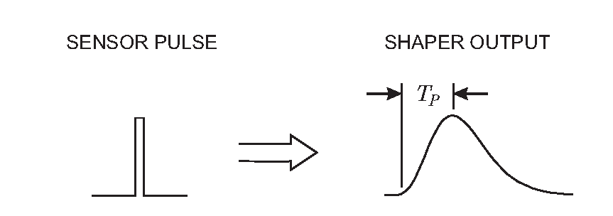
The pulse-shaper should “broaden”…
Sharp pulse is “broadened” – rounded around the peak
Reduces input bandwidth and hence noise

Slide 31
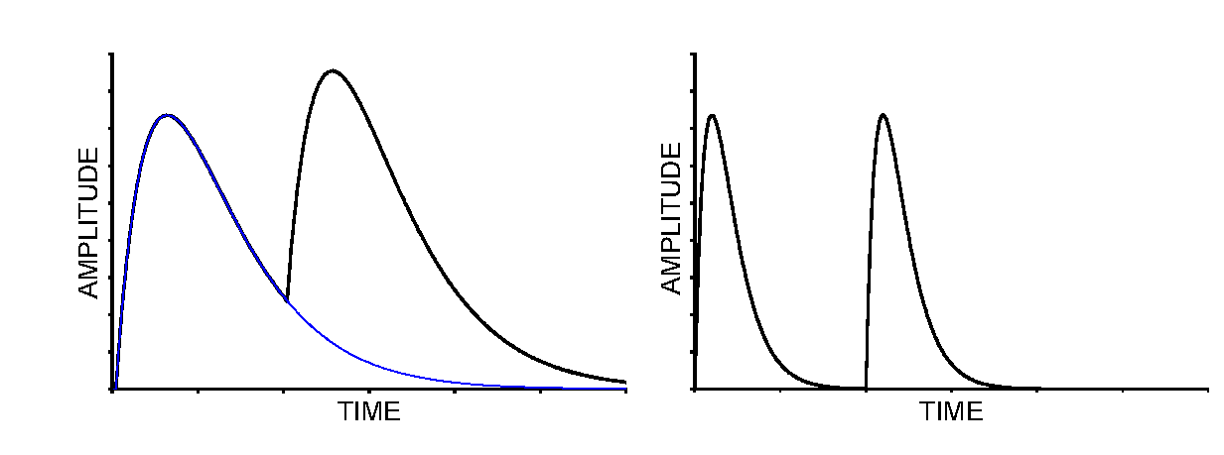
…but not too much
Broad pulses reduce the temporal spacing between consecutive pulses
Need to limit the effect of “pile-up” → pulses not too borad
As usual in life: a compromise, in this case made out of RC and CR filters

Slide 32
The read-out chain
Detector / Sensor
Pre-amplifier
Filter
Shaper
Range compression
clock (TTC)
Sampling
Digital filter
Zero suppression
Buffer
Feature extraction
Buffer
Format & Readout
to Data Acquisition System

Slide 33
Analog/Digital/binary
1) Analog memory
Mux
ADC
After amplification and shaping the signals must at some point be digitized to allow for DAQ and further processing by computers
Analog readout: analog buffering ; digitization after transmission off detector
Digital readout with analog buffer
Digital readout with digital buffer
Binary: discriminator right after shaping
  Binary tracking
  Drift time measurement
control
2) Analog memory
Mux
ADC
Mux
control
3) Digital memory
ADC
Mux
ADC
ADC
ADC

Slide 34
Analog to digital conversion
There is clearly a tendency to go digital as early as possible
  This is extensively done in consumer goods
The “cost” of the ADC determines which architecture is chosen
  Strongly depends on speed and resolution
Input frequencies must be limited to half the sampling frequency.
  Otherwise this will fold in as additional noise.
High resolution ADC also needs low jitter clock to maintain effective resolution

Slide 35
An important truth
A solution in detector-electronics can be:
  fast
  cheap
  low-power
Choose two of the above: you can’t have three
Cost means:
  Power consumption
  Silicon area
  Availability of radiation hard ADC

Slide 36
Measuring time

Slide 37
Time measurements
Time measurements are important in many HEP applications
  Identification of bunch crossing (LHC: 25ns)
  Distinguishing among individual collisions (events) in continuous beam like experiments (or very short bunch interval like CLIC: ~250ps)
  Drift time
    Position in drift tubes ( binary detectors with limited time resolution: ~1ns)
    Time projection chamber (both good time and amplitude)
    Time Of Flight (TOF) detectors (very high time resolution: 10-100ps)
Time walk: Time dependency on amplitude
  Low threshold (noise and pedestal limited)
  Constant fraction discrimination
    Works quite well but needs good analog delays (cable delay) which is not easy to integrate on chip.
  Amplitude compensation (done in DAQ CPU’s)
    Separate measurement of amplitude (expensive)
    Time measurements with two thresholds: 2 TDC channels
    Time over threshold (TOT): 1 TDC channel measuring both leading edge and pulse width
Time Over Threshold (TOT) can even be used as a poor mans ADC
  E.g. ATLAS Pixel
TH₂
TH₁
Constant fraction discriminator
1/k
delay
delay
D
R
delay
Vi
Th
TOT₁
TOT₁
T=T_{r} – f(TOT)

Slide 38
Time to digital conversion
Start
Stop
Counter
  Large dynamic range
  Good and cheap time references available as crystal oscillators
  Synchronous to system clock so good for time tagging
  Limited resolution: ~1ns
Charge integration (start – stop)
  Limited dynamic range
  High resolution: ~1-100 ps
  Sensitive analog circuit needing ADC for final conversion.
  Sensitive to temperature, etc. so often needs in-system calibration
  Can be combined with time counter for large dynamic range
Clock
Counter
Reset
Start-stop type
Clock
Counter
Hit
Register
Time tagging type
Start
Stop
ADC
Start
Stop

Slide 39
Getting the data out
Detector / Sensor
Pre-amplifier
Filter
Shaper
Range compression
clock (TTC)
Sampling
Digital filter
Zero suppression
Buffer
Feature extraction
Buffer
Format & Readout
to Data Acquisition System

Slide 40
After shaping and amplifying
As usual ☺ what you do depends on many factors:
Number of channels and channel density
Collision rate and channel occupancies
Triggering: levels, latencies, rates
Available technology and cost
What you can/want to do in custom made electronics and what you do in standard computers (computer farms)
Radiation levels
Power consumption and related cooling
Location of digitization
Given detector technology

Slide 41
Single integrator
Simple (only one sample per channel)
Slow rate (and high precision) experiments
Long dead time
Nuclear physics
Not appropriate for HEP
ADC
DAQ
Collect charge from event
Convert with ADC
Send data to DAQ

Slide 42
Double buffered
Use a second integrator while the first is readout and reset
Decreases dead time significantly
Still for low rates
ADC
DAQ

Slide 43
Multiple event buffers
Good for experiments with short spills and large spacing between spills (e.g. fixed target experiment at SPS)
Fill up event buffers during spill (high rate)
Readout between spills (low rate)
ADC can possibly be shared across channels
Buffering can also be done digitally (in RAM)
Shaping
Channel mux.
ADC
DAQ

Slide 44
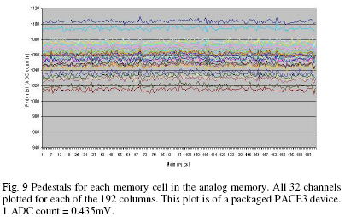
Analog buffers
Extensively used when ADC not available with sufficient speed and resolution or consuming too much power
Large array of storage capacitors with read and write switches (controlled digitally)
For good homogeneity of memory
  Voltage mode
  Charge mode with Charge integrator for reading
Examples:
  Sampling oscilloscopes
  HEP: CMS tracker, ATLAS calorimeter, LHCb trackers, etc.

Slide 45
Constantly sampled
Needed for high rate experiments with signal pileup
Shapers and not switched integrators
Allows digital signal processing in its traditional form (constantly sampled data stream)
Output rate may be far to high for what following DAQ system can handle
With local zero-suppression this may be an option for future high rate experiments (SLHC, CLIC)
Sampling clock
Shaping
ADC
DSP
(zero-sup.)
DAQ

Slide 46
Excursion: zero-suppression
Why spend bandwidth sending data that is zero for the majority of the time ?
Perform zero-suppression and only send data with non-zero content
  Identify the data with a channel number and/or a time-stamp
  We do not want to loose information of interest so this must be done with great care taking into account pedestals, baseline variations, common mode, noise, etc.
  Not worth it for occupancies above ~10%
Alternative: data compression
  Huffman encoding and alike
TANSTAFL (There Aint No Such Thing As A Free Lunch)
  Data rates fluctuates all the time and we have to fit this into links with a given bandwidth
  Not any more event synchronous
  Complicated buffer handling (overflows)
  Before an experiment is built and running it is very difficult to give reliable estimates of data rates needed ( background, new physics, etc.)

Slide 47
Synchronous readout
All channels are doing the same “thing” at the same time
Synchronous to a global clock (bunch crossing clock)
Data-rate on each link is identical and depends only on trigger -rate
On-detector buffers (de-randomizers) are of same size and there occupancy (“how full they are”) depends only on the trigger-rate
☹ Lots of bandwidth wasted for zero’s
  Price of links determine if one can afford this
☺ No problems if occupancy of detectors or noise higher than expected
  But there are other problems related to this: spill over, saturation of detector, etc.
On-detector
Off-detector
MUX
DAQ
Data
formatting
Zero-
suppression
Data buffering during trigger
Derandomizer buffer
Trigger
Global clock

Slide 48
Trigger & DAQ
(Sneak Preview)

Slide 49
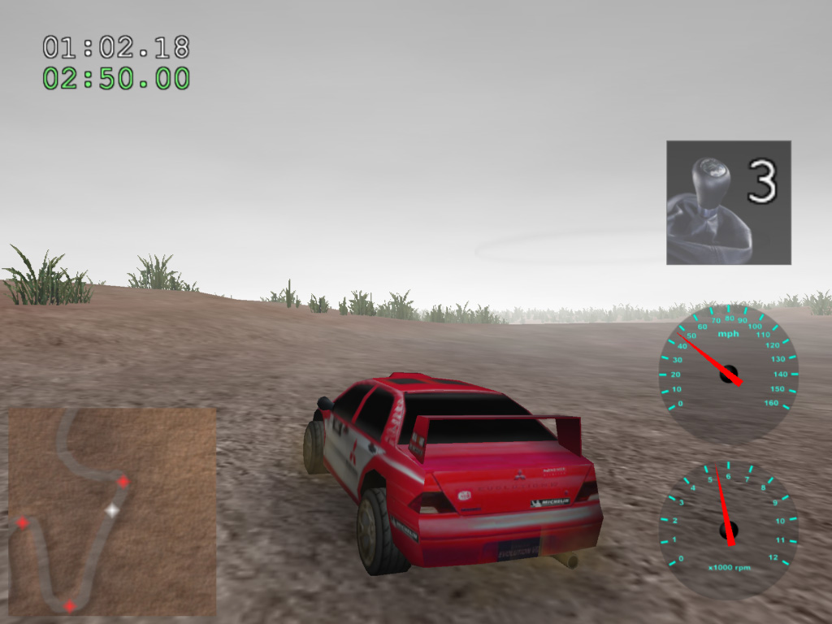
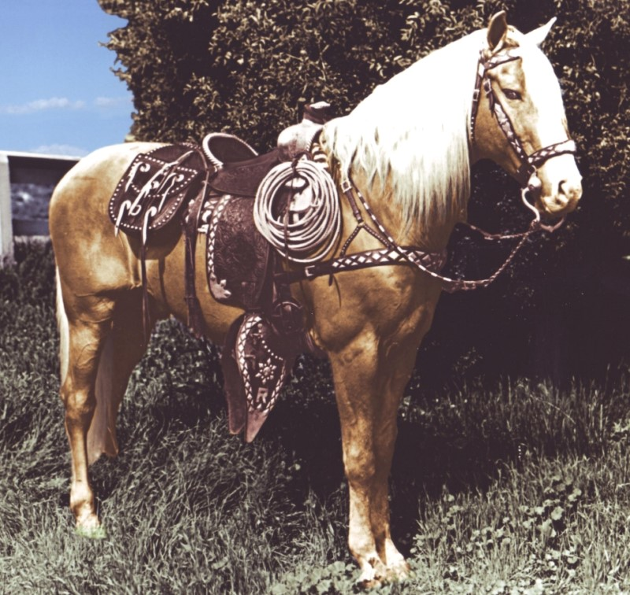
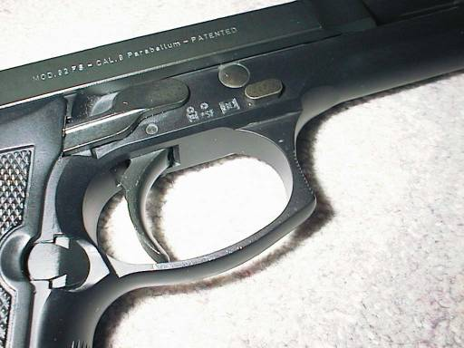
What is a trigger?
An open-source
3D rally game?
An important part
of a Beretta
The most famous
horse in
movie history?

Slide 50
What is a trigger?
Wikipedia: “A trigger is a system that uses simple criteria to rapidly decide which events in a particle detector to keep when only a small fraction of the total can be recorded. “

Slide 51
Trigger
Simple
Rapid
Selective
When only a small fraction can be recorded
Notes:
This is not a scientific precise definition, but it catches what most physicists think about, when they hear “trigger”
Simple: because you want to be able to understand what the trigger did to your measurement – a selection of data will influence the result!
Rapid: because the data you want to keep, might be lost if you wait to long to decide
Decide to keep: a trigger is a selection mechanism, depending on what you want and what your apparatus is
When only a small fraction can be recorded: most of the time we are a looking for rare event and consider all events, which create similar signals in our detectors as “background”, the cheap & dumb approach would be to record everything and then try to select in the analysis the good events. Even though sometimes this would be nice, in practice we do not have enough money to do that.

Slide 52
Trivial DAQ
External View
sensor
Physical View
sensor
CPU
ADC Card
disk
Logical View
Proces-
sing
ADC
storage

Slide 53
Trivial DAQ with a real trigger
Sensor
Trigger
Delay
Discriminator
ADC
Start
Proces-
sing
Interrupt
storage
What if a trigger is produced when the ADC or
processing is busy?

Slide 54
Trivial DAQ with a real trigger 2
Sensor
Trigger
Delay
Discriminator
Start
Busy Logic
ADC
and
not
Proces-
sing
Interrupt
Set
Q
Clear
Ready
storage
Deadtime (%) is the ratio between the time the DAQ
is busy and the total time.

Slide 55
Trivial DAQ with a real trigger 3
Sensor
Trigger
Discriminator
Delay
Start
Busy Logic
ADC
and
Full
FIFO
DataReady
Proces-
sing
storage
Buffers are introduced to de-randomize data,
to decouple the data production from the data
consumption. Better performance.

Slide 56
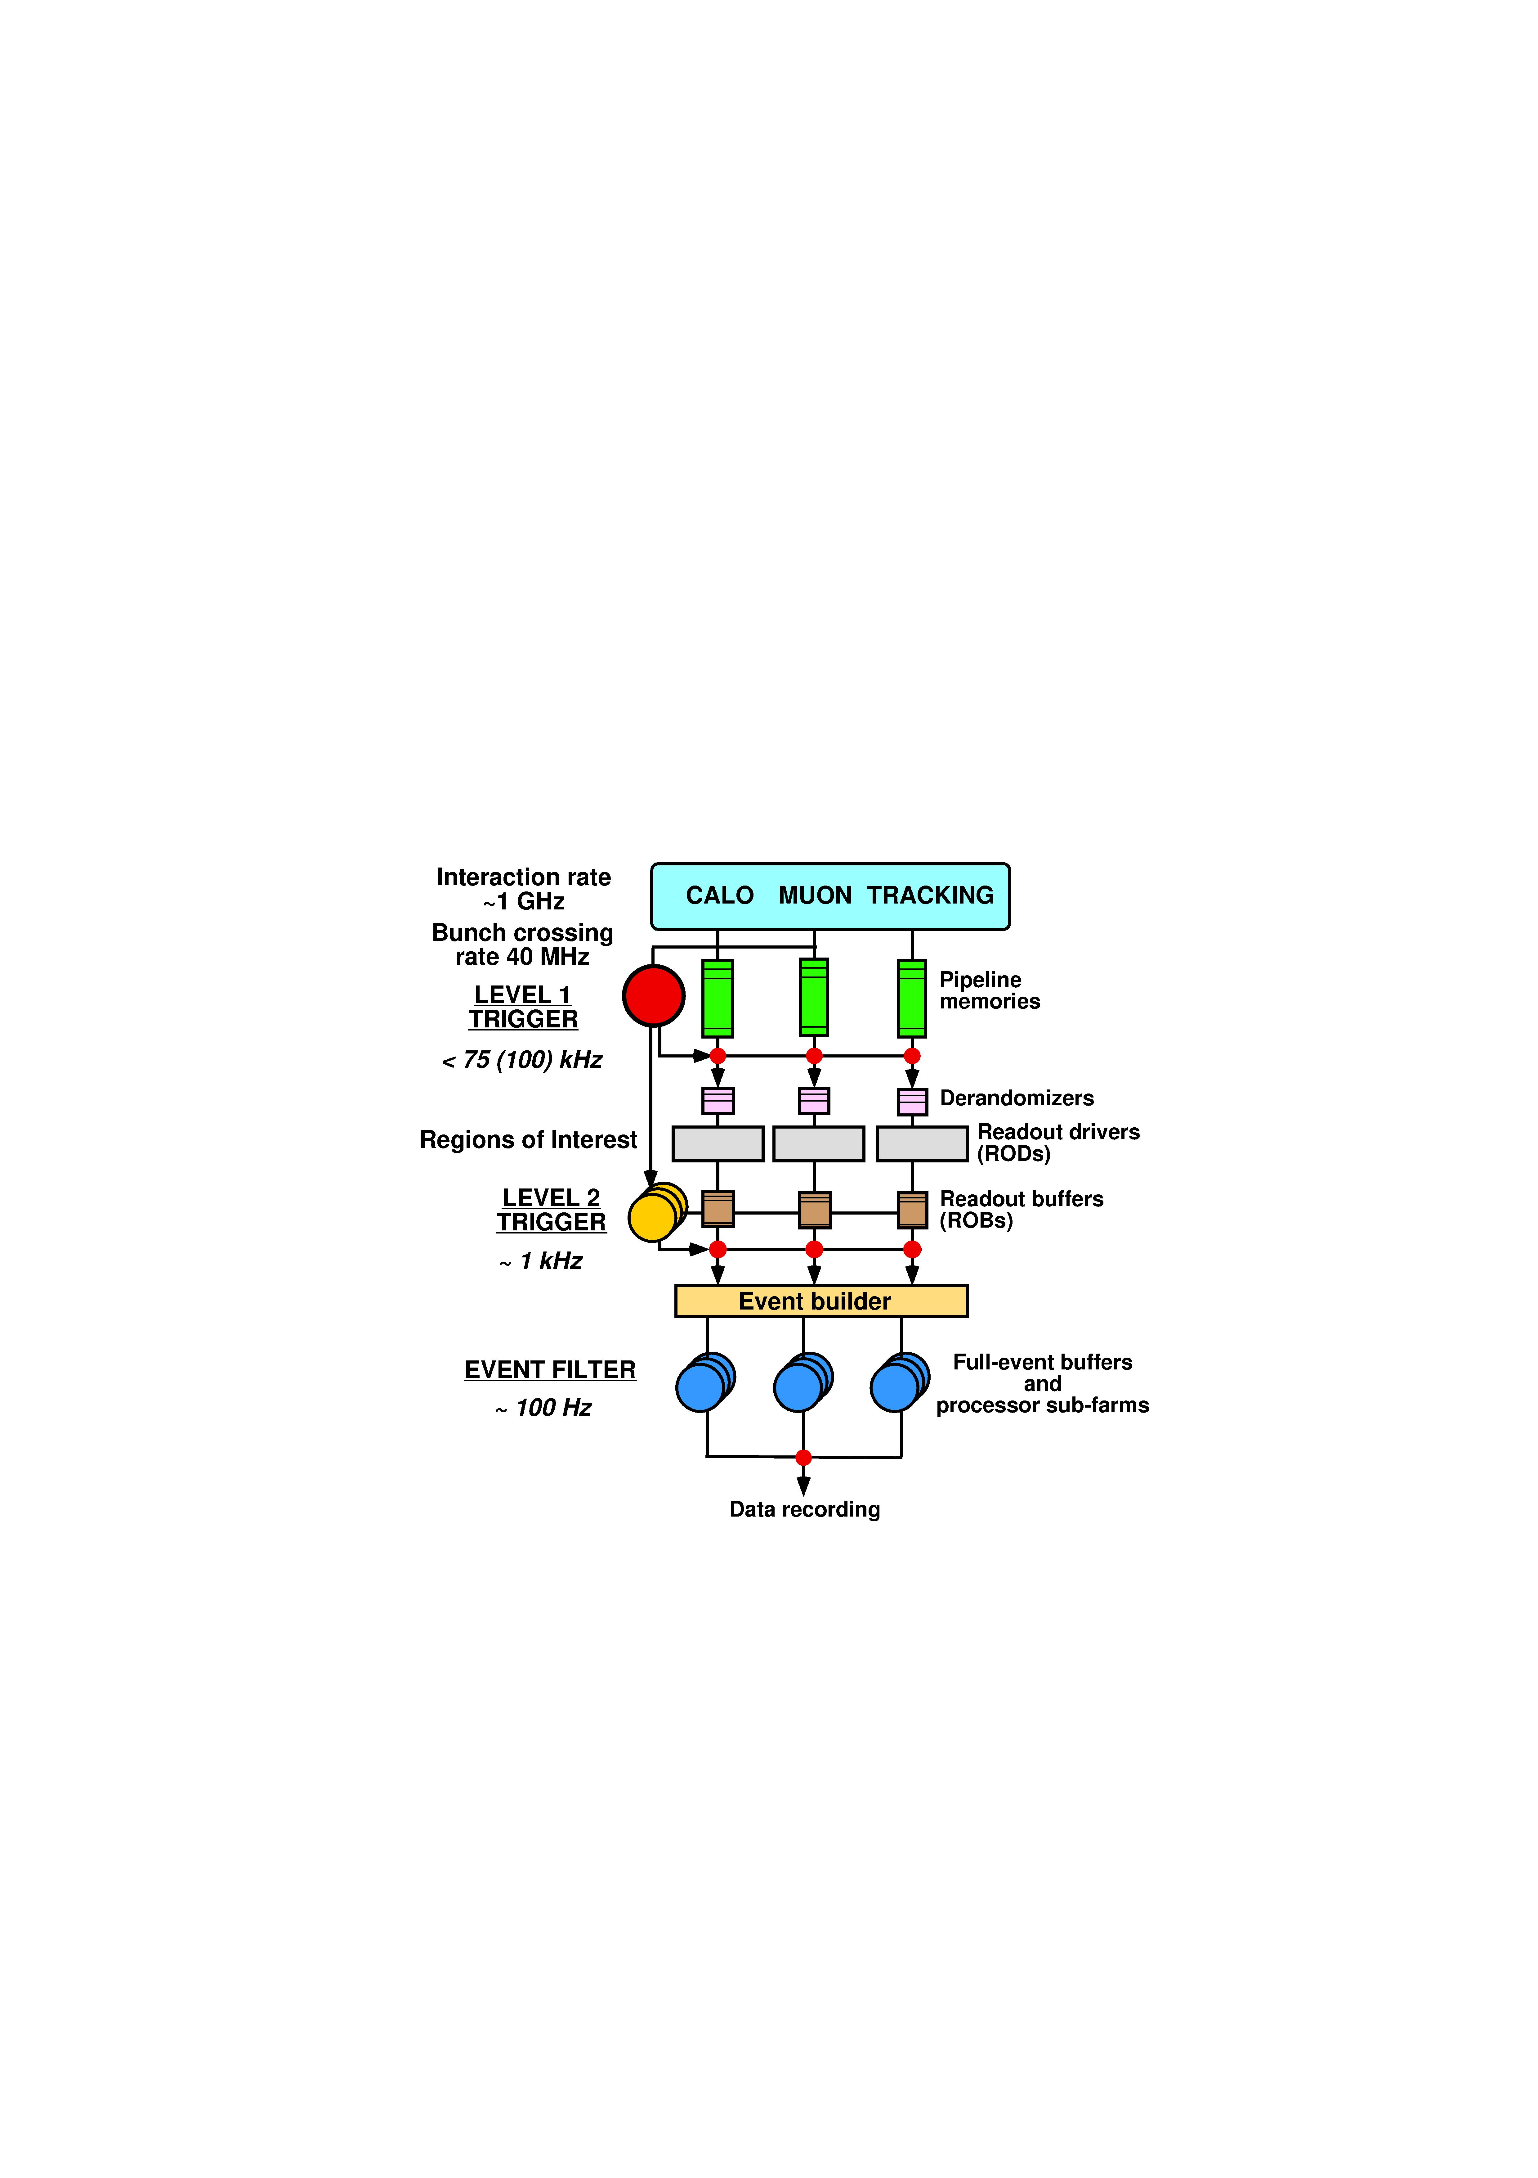
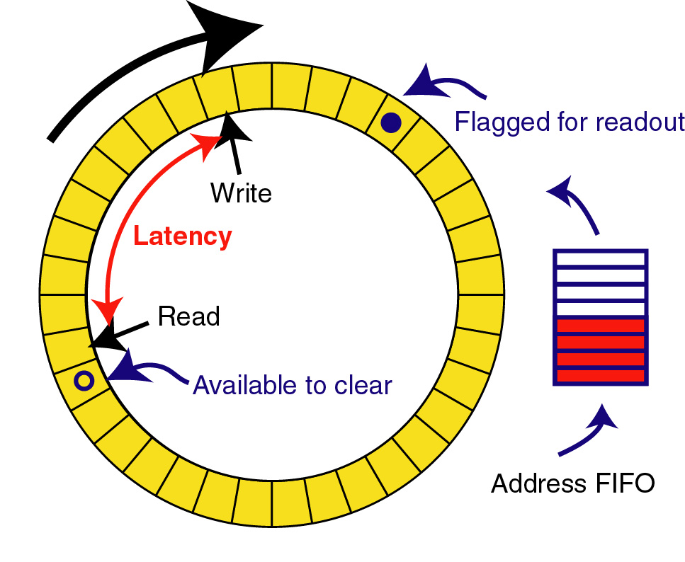
Triggered read-out
Trigger processing requires some data transmission and processing time to make decision so front-ends must buffer data during this time. This is called the trigger latency
For constant high rate experiments a “pipeline” buffer is needed in all front-end detector channels:
analog or digital
  Real clocked pipeline (high power, large area, bad for analog)
  Circular buffer
  Time tagged (zero suppressed latency buffer based on time information)
Shaping
Constant writing
Channel mux.
ADC
DAQ
Trigger

Slide 57
Trigger rate control
Trigger rate determined by physics parameters used in trigger system:
1 kHz – 1MHz
  The lower rate after the trigger allows sharing resources across channels (e.g. ADC and readout links)
Triggers will be of random nature i.e. follow a Poisson distribution → a burst of triggers can occur within a short time window so some kind of rate control/spacing is needed
  Minimum spacing between trigger accepts → dead-time
  Maximum number of triggers within a given time window
Derandomizer buffers needed in front-ends to handle this
  Size and readout speed of this determines effective trigger rate

Slide 58
Effect of de-randomizing
Sensor
Sensor
Trigger
Trigger
Delay
Discriminator
Delay
Discriminator
ADC
Start
and
Busy Logic
ADC
Start
Busy Logic
Full
and
not
FIFO
Proces-
sing
Interrupt
Set
Proces-
sing
DataReady
Ready
Clear
Q
storage
storage
The system is busy during the ADC conversion time + processing time until the data is written to the storage
The system is busy during the ADC conversion time if the FIFO is not full (assuming the storage can always follow!)

Slide 59
System optimisation: LHCb front-end buffer
Trigger latency
Fixed to 4 us in LHCb
Working point for LHCb
Max readout time: 900 ns
Derandomzier depth:
16 events
➔ 1 MHz maximum trigger accept rate

Slide 60
Asynchronous readout
Remove zeros on the detector itself
  Lower average bandwidth needed for readout links Especially interesting for low occupancy detectors
Each channel “lives a life of its own” with unpredictable buffer occupancies and data are sent whenever ready (asynchronous)
In case of buffer-overflow a truncation policy is needed → BIAS!!
  Detectors themselves do not have 100% detection efficiency either.
  Requires sufficiently large local buffers to assure that data is not lost too often (Channel occupancies can be quite non uniform across a detector with same front-end electronics)
DAQ must be able to handle this (buffering!)
Async. readout of detectors in LHC: ATLAS and CMS muon drift tube detectors, ATLAS and CMS pixel detectors, ATLAS SCT, several ALICE detectors as relatively low trigger rate (few kHz).
Off-detector
On-detector
Data
formatting
MUX
DAQ
Data
formatting
Zero-
suppression
Trigger
Data buffering
during trigger
Data
formatting
MUX
DAQ
Data
formatting
Zero-
suppression
Derandomizer buffer

Slide 61
To the DAQ
Large amount of data to bring out of detector
  Large quantity: ~100k in large experiment
  High speed: Gbits/s
Point to point unidirectional
Transmitter side has specific constraints
  Radiation
  Magnetic fields
  Power/cooling
  Minimum size and mass
  Must collect data from one or several front-end chips
Receiver side can be commercially available module/components (use of standard link protocols when ever possible)

Slide 62
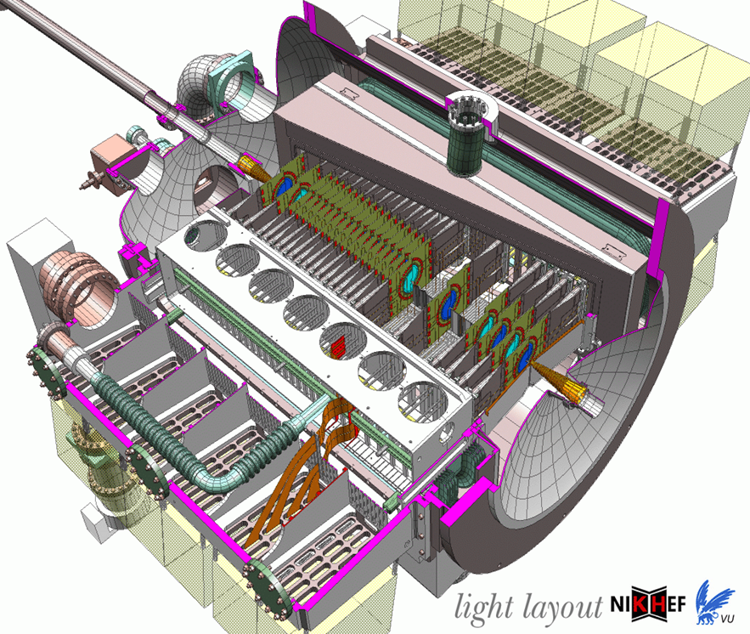
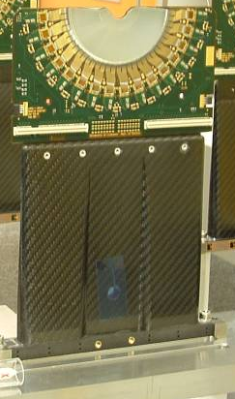
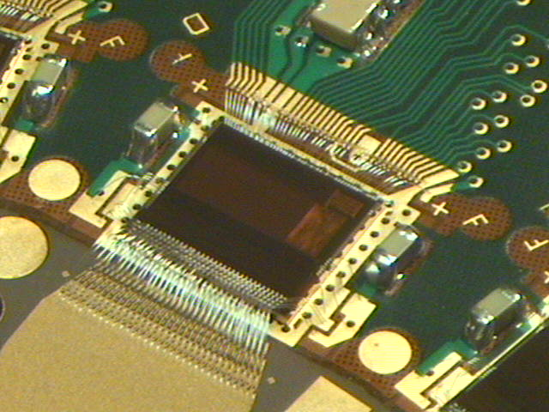
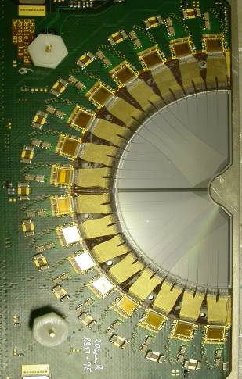
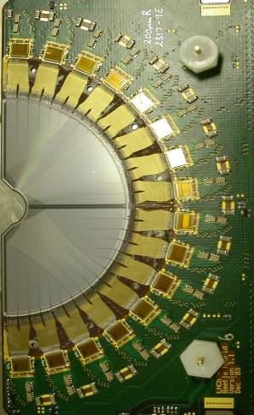
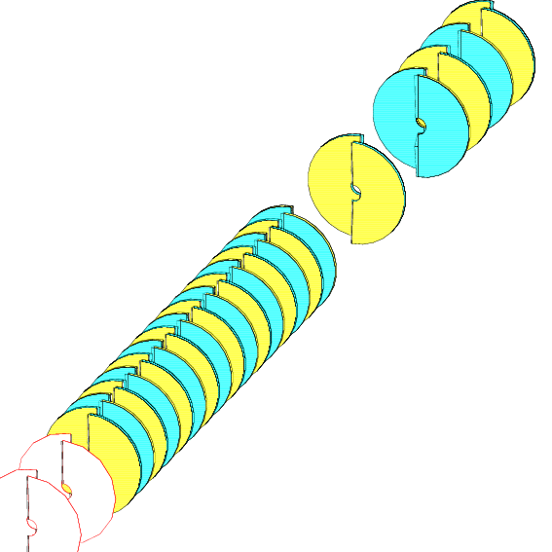
An example: the LHCb Vertex detector and its readout IC beetle
172k Channels
Strips in R and φ projection
(~10um vertex resolution)
Located 1cm from beam
Analog readout (via twisted pair cables over 60m)
Interaction
region
Beam
~1m

Slide 63
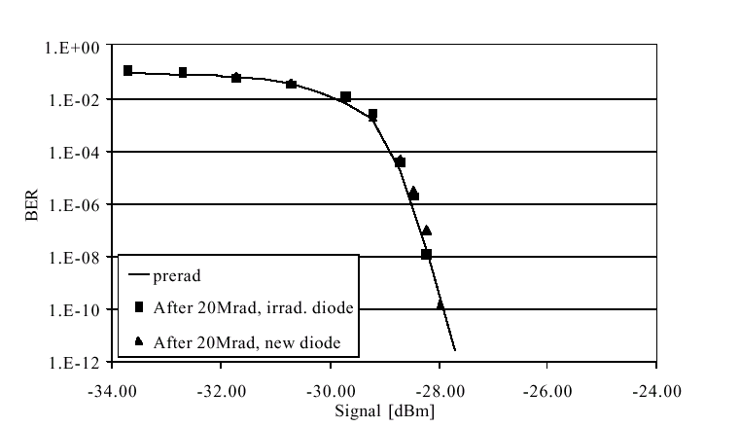
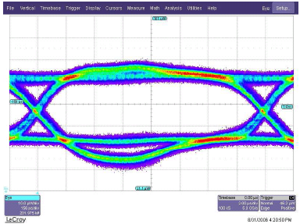
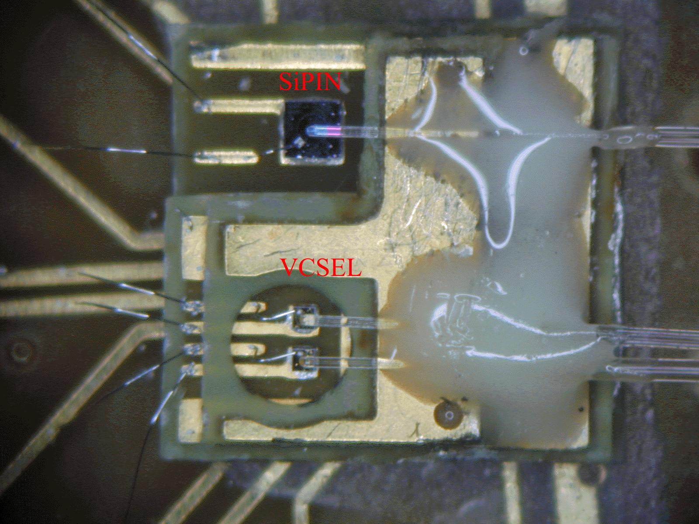
Digital optical links
High speed: 1Ghz - 10GHz – 40GHz
Extensively used in telecommunications (expensive) and in computing (“cheap”)
Encoding
  Inclusion of clock for receiver PLL’s
  DC balanced
  Special synchronization characters
  Error detection and or correction
Reliability and error rates strongly depending on received optical power and timing jitter
Multiple (16) serializers and deserializers directly available in modern high end FPGA’s.

Slide 64
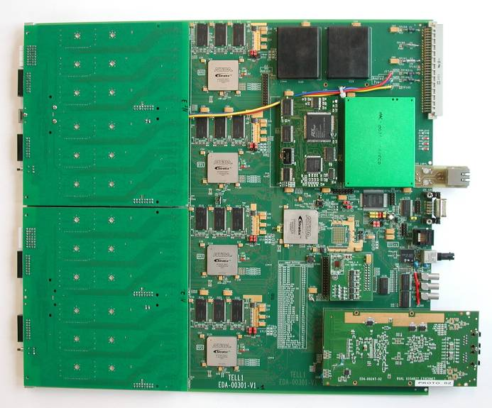
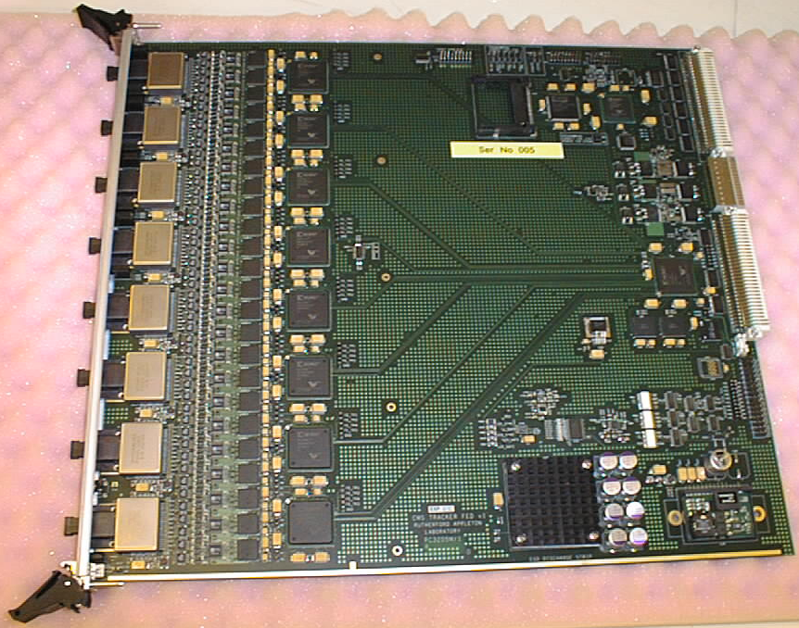
DAQ interfaces / Readout Boards
Front-end data reception
  Receive optical links from multiple front-ends: 24 - 96
  Located outside radiation
Event checking
  Verify that data received is correct
  Verify correct synchronization of front-ends
Extended digital signal processing to extract information of interest and minimize data volume
Event merging/building
  Build consistent data structures from the individual data sources so it can be efficiently sent to DAQ CPU farm and processed efficiently without wasting time reformatting data on CPU.
  Requires significant data buffering
High level of programmability needed
Send data to CPU farm at a rate that can be correctly handled by farm
  1 Gbits/s Ethernet (next is 10Gbits/s)
  In house link with PCI interface: S-link
Requires a lot of fast digital processing and data buffering: FPGA’s, DSP’s, embedded CPU
Use of ASIC’s not justified
Complicated modules that are only half made when the hardware is there: FPGA firmware (from HDL), DSP code, on-board CPU software, etc.

Slide 65
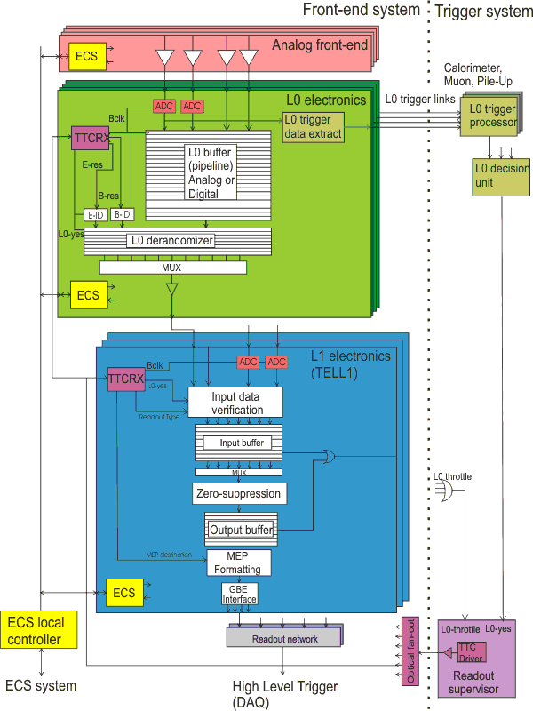
Readout Architecture (LHCb)
FEE = Front End Electronics
Example from LHCb

Slide 66
Summary
Detector read-out is mostly about electronics
Front-end electronics must fitthe detector (noise, sensitivity) and the overall read-out architecture (trigger)
This lecture is (hardly) the beginning…

Slide 67
Even more stuff

Slide 68
Further reading
H. Spieler, “Semiconductor Detector Systems”, Oxford Univ. Press, 2005
A. Sedra, K. Smith, “Microelectronic Circuits”, Oxford Univ. Press, 2009
W. R. Leo, “Techniques for Nuclear and Particle Physics Experiments”, Springer, 1994
O. Cobanoglu “Low-level front-end design”, this school
Wikipedia!

Slide 69
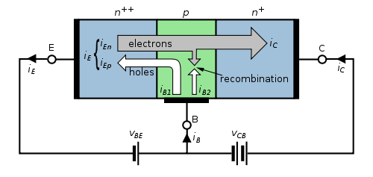
Transistors
Exampe: bi-polar transistor of the NPN type
C collector, E emitter, B Base
EB diode is in forward bias: holes flow towards np boundary and into n region
BC diode is in reverse bias: electrons flow AWAY from pn boundary
p layer must be thinner than diffusion length of electrons so that they can go through from E to N without much recombination
from Wikipedia

Slide 70
Multilevel triggering
First level triggering.
  Hardwired trigger system to make trigger decision with short latency.
  Constant latency buffers in the front-ends
Second level triggering in DAQ interface
  Processor based (standard CPU’s or dedicated custom/DSP/FPGA processing)
  FIFO buffers with each event getting accept/reject in sequential order
  Circular buffer using event ID to extracted accepted events
    Non accepted events stays and gets overwritten by new events
High level triggering in the DAQ systems made with farms of CPU’s: hundreds – thousands.
(separate lectures on this)
DAQ interface
Front-end
MUX
DAQ
Data
formatting
Zero-
suppression
Trigger L2
Trigger L1

Slide 71
ADC architectures
Flash
  A discriminator for each of the 2^{n} codes
  New sample every clock cycle
  Fast, large, lots of power, limited to ~8 bits
  Can be split into two sub-ranging Flash
  2x2^{n/2} discriminators: e.g. 16 instead of 256
  plus DAC
    Needs sample and hold during the two stage
    conversion process
Ramp
  Linear analog ramp and count clock cycles
  Takes 2^{n} clock cycles
  Slow, small, low power, can be made with large resolution
1
Linear to binary encoder
2
V_{in}
3
2^{n}
V_{ref}
S&H
Flash1
DAC
-
Flash2
V_{in}
Ramp
V_{in}
Start
Stop
V_{in}
1
Counter
I
Start
Clock

Slide 72
ADC architectures
Successive approximation
  Binary search via a DAC and single discriminator
  Takes n clock cycles
  Relatively slow, small, low power, medium to large resolution
Pipelined
  Determines “one bit” per clock cycle per stage
    Extreme type of sub ranging flask
  n stages
  In principle 1 bit per stage but to handle imperfections each stage normally made with ~2bits and n*2bits mapped into n bits via digital mapping function that “auto corrects” imperfections
  Makes a conversion each clock cycle
  Has a latency of n clock cycles
    Not a problem in our applications except for very fast triggering
  Now dominating ADC architecture in modern CMOS technologies and impressive improvements in the last 10 years: speed, bits, power, size
DAC voltage
V_{in}
Aprox reg.
DAC
ADC code
DAC code
100
010
011

Slide 73
ADC imperfections
Quantization (static)
  Bin size: Least significant bit (LSB) =V_{max}/2^{n}
  Quantization error: RMS error/resolution:
Integral non linearity (INL): Deviation from ideal conversion curve (static)
  Max: Maximum deviation from ideal
  RMS: Root mean square of deviations from ideal curve
Differential non linearity (DNL): Deviation of quantization steps (static)
  Min: Minimum value of quantization step
  Max: Maximum value of quantization step
  RMS: Root mean square of deviations from ideal quantization step
Missing codes (static)
  Some binary codes never present in digitized output
Monotonic (static)
  Non monotonic conversion can be quite unfortunate in some applications.
  A given output code can correspond to several input values.

Slide 74
(Large) Systems

Slide 75
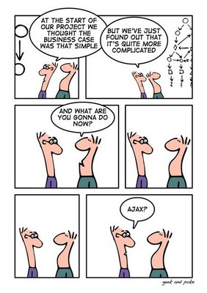
New problems
Going from single sensors to building detector read-out of the circuits we have seen, brings up a host of new problems:
  Power, Cooling
  Crosstalk
  Radiation (LHC)
Some can be tackled by (yet) more sophisticated technologies

Slide 76
Radiation effects
In modern experiments large amounts of electronics are located inside the detector where there may be a high level of radiation
  This is the case for 3 of the 4 LHC experiments (10 years running)
    Pixel detectors: 10 -100 Mrad
    Trackers: ~10Mrad
    Calorimeters: 0.1 – 1Mrad
    Muon detectors: ~10krad
    Cavern: 1 – 10krad
Normal commercial electronics will not survive within this environment
  One of the reasons why all the on-detector electronics in the LHC experiment are custom made
Special technologies and dedicated design approaches are needed to make electronics last in this unfriendly environment
Radiation effects on electronics can be divided into three major effects
  Total dose
  Displacement damage
  Single event upsets (for digital electronics only)
1 Rad == 10 mGy
1 Gy = 100 Rad

Slide 77
Total dose
Generated charges from traversing particles gets trapped within the insulators of the active devices and changes their behavior
For CMOS devices this happens in the thin gate oxide layer which have a major impact on the function of the MOS transistor
  Threshold shifts
  Leakage current
In deep submicron technologies
( <0.25um) the trapped charges are removed by tunneling currents through the very thin gate oxide
    Only limited threshold shifts
The leakage currents caused by end effects of the linear transistor (NMOS) can be cured by using enclosed transistors
  For CMOS technologies below
  the 130nm generation the use
  of enclosed NMOS devices does
  not seem necessary.
  But other effects may show up
No major effect on high speed
bipolar technologies

Slide 78
Displacement damage
Traversing hadrons provokes displacements of atoms in the silicon lattice.
Bipolar devices relies extensively on effects in the silicon lattice.
  Traps (band gap energy levels)
  Increased carrier recombination in base
Results in decreased gain of bipolar devices with a dependency on the dose rate.
No significant effect on MOS devices
Also seriously affects Lasers and PIN diodes used for optical links.

Slide 79
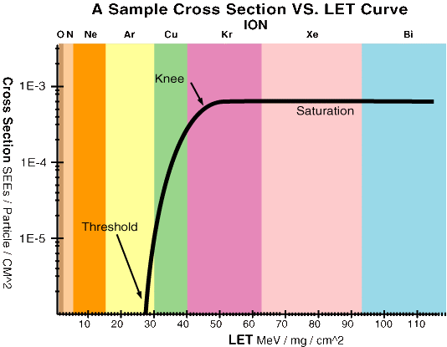
Single event upsets
Deposition of sufficient charge can make a memory cell or a flip-flop change value
As for SEL, sufficient charge can only be deposited via a nuclear interaction for traversing hadrons
The sensitivity to this is expressed as an efficient cross section for this to occur
This problem can be resolved at the circuit level or at the logic level
Make memory element so large and slow that deposited charge not enough to flip bit
Triple redundant (for registers)
Hamming coding (for memories)
  Single error correction, Double error detection
  Example Hamming codes: 5 bit additional for 8 bit data
    ham[0] = d[1] $ d[2] $ d[3] $ d[4];
    ham[1] = d[1] $ d[5] $ d[6] $ d[7];
    ham[2] = d[2] $ d[3] $ d[5] $ d[6] $ d[8];
    ham[3] = d[2] $ d[4] $ d[5] $ d[7] $ d[8] ;
    ham[4] = d[1] $ d[3] $ d[4] $ d[6] $ d[7] $ d[8];
    $ = XOR
  Overhead decreasing for larger words
  32bits only needs 7hamming bits
Example of SEU cross section

Slide 80
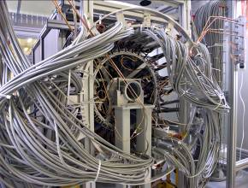
Powering
Delivering power to the front-end electronics highly embedded in the detectors has been seen to be a major challenge (underestimated).
The related cooling and power cabling infrastructure is a serious problem of the inner trackers as any additional material seriously degrades the physics performance of the whole experiment.
A large majority of the material in these detectors in LHC relates to the electronics, cooling and power and not to the silicon detector them selves (which was the initial belief)
How to improve
  Lower power consumption
  Improve power distribution

Slide 81
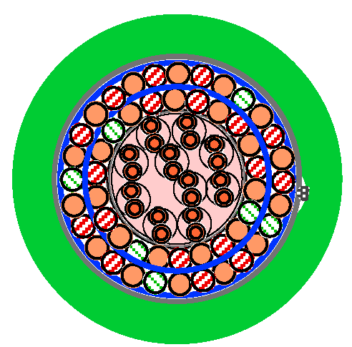
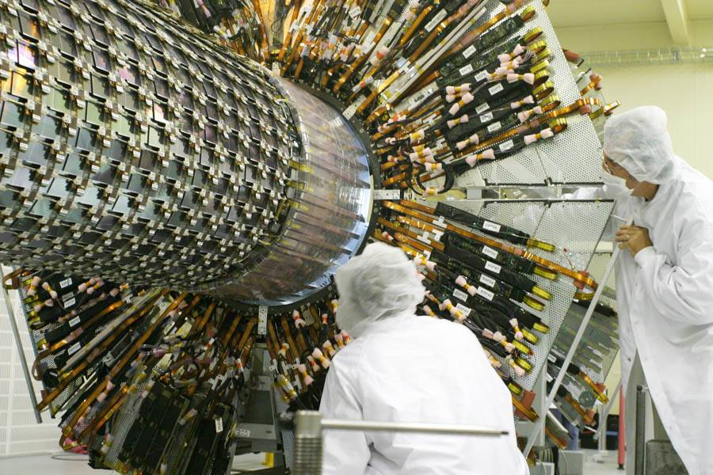
The problem as is
Total power: ~500kw (to be supplied and cooled)
  Trackers: ~ 60 kW
  Calorimeters: ~ 300 kW
  Muon: ~ 200 kW
  Must for large scale detectors be delivered over 50m – 100m distance
Direct supply of LV power from ~50m away
  Big fat copper cables needed
    Use aluminum cables for last 5-10m to reduce material budget
  Power supply quality at end will not be good with varying power consumption (just simple resistive losses)
    If power consumption constant then this could be OK
  Use remote sense to compensate
    This will have limited reaction speed
    May even become unstable for certain load configurations
  Power loss in cables will be significant for the
  voltages (2.5v) and currents needed: ~50% loss
  in cables (that needs to be cooled)
Use of local linear regulators
  Improves power quality at end load.
  Adds additional power loss: 1 – 2 v head room
  needed for regulator
  Increases power losses and total efficiency now
  only: ~25% (more cooling needed)
Voltage drop
Load
Remote sense

Slide 82
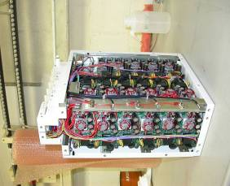
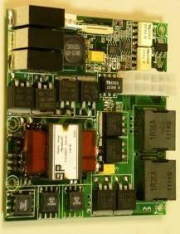
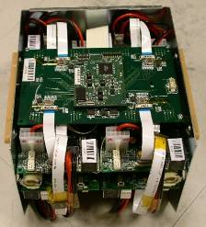
Use of DC-DC converters
For high power consumers (e.g. calorimeter) the use of local DC-DC converters are inevitable.
These must work in radiation and high magnetic fields
  This is not exactly what switched mode DC-DC converters like
  Magnetic coils and transformers saturated
  Power devices do not at all like radiation:
  SEU - > single event burnout -> smoke -> disaster
DC-DC converters for moderate radiation and moderate magnetic fields have been developed and used
  Some worries about the actual reliability of these for long term

