Slide 1
DAQ software
E. Pasqualucci
CERN and INFN Roma

Slide 2
Overview
Aim of this lecture is
Give an overview of a medium-size DAQ
Starting from the general picture given by W. Vandelli
Analyze its components
Using the concepts introduced by previous lectures
Introduce the main concepts of DAQ software
As “bricks” to build larger system
… with the help of some pseudo-code …
Give more technical basis
For the implementation of larger systems
See S. Ballestrero’s and C. Schwick’s lectures

Slide 3
Software components
Trigger management
Data read-out
Event framing and buffering
Data transmission
Event building and data storage
System control and monitoring
Data sampling and monitoring

Slide 4
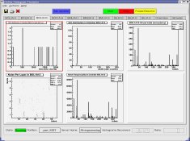
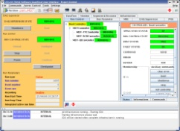
A multi-crate system
Trigger
Detector 1
Trigger
Detector N
C
P
U
Configuration
Trigger
A
D
C
A
D
C
T
D
C
T
D
C
C
P
U
Configuration
Trigger
A
D
C
A
D
C
T
D
C
T
D
C
. . .
Online monitoring
Trigger
Trigger
Readout
Readout
Run Control
Event Flow Manager
E
B
(1)
. . .
E
B
(M)

Slide 5
Data readout (a simple example)
Trigger
Detector
C
P
U
Trigger
A
D
C
A
D
C
T
D
C
T
D
C
Configuration
Trigger
Readout
Data digitized by VME modules (ADC and TDC)
Trigger signal received by a trigger module
I/O register or interrupt generator
Data read-out by a Single Board Computer (SBC)

Slide 6
Is a new event available?
How to know that new data are available?
Interrupt
An interrupt is sent by an hardware device
The interrupt is
Transformed into a software signal
Catched by a data acquisition program
Data readout starts
Polling
Some register in a module is continuously read out
Data readout happens when register “signals” new data
In a synchronous system
Trigger must also set a busy
The reader must reset the busy after read-out completion

Slide 7
Managing interrupts
irq_list.list_of_items[i].vector = 0x77;
irq_list.list_of_items[i].level = 5;
irq_list.list_of_items[i].type = VME_INT_ROAK;
signum = 42;
ret = VME_InterruptLink(&irq_list, &int_handle);
ret = VME_InterruptWait(int_handle, timeout, &ir_info);
ret = VME_InterruptRegisterSignal(int_handle, signum);
ret = VME_InterruptUnlink(int_handle);
From M. Joos’ lecture

Slide 8
Real time programming
Has to meet operational deadlines from events to system response
Mentioned by M. Joos and A. Veeramani
Implies taking control of typical OS tasks
For instance, task scheduling
Real time OS offer that features
Most important feature is predictability
Performance is less important than predictability!
It typically applies when requirements are
Reaction time to an interrupt within a certain time interval
Complete control of the interplay between applications

Slide 9
Is real-time needed?
Can be essential in some case
It is critical for accelerator control or plasma control
Wherever event reaction times are critical
And possibly complex calculation is needed
Not commonly used for data acquisition now
Large systems are normally asynchronous
Either events are buffered or de-randomized in the HW
Performance are usually improved by DMA readout (see M. Joos)
Or the main dataflow does not pass through the bus
In a small system dead time is normally small
Drawbacks
We loose complete dead time control
Event reaction time and process scheduling are left to the OS
Increase of latency due to event buffering
Affects the buffer size at event building level
Normally not a problem in modern DAQ systems

Slide 10
Polling modules
Loop reading a register containing the latched trigger
while (end_loop == 0)
{
uint16_t *pointer;
volatile uint16_t trigger;
pointer = (uint16_t *) (base + 0x80);
trigger = *pointer;
if (trigger & 0x200) // look for a bit in the trigger mask
{
... Read event ...
... Remove busy ...
}
else
sched_yield (); // if in a multi-process/thread environment
}

Slide 11
Polling or interrupt?
Which method is convenient?
It depends on the event rate
Interrupt
Is expensive in terms of response time
Typically (O (1 μs))
Convenient for events at low rate
Avoid continuous checks
A board can signal internal errors via interrupts
Polling
Convenient for events at high rate
When the probability of finding an event ready is high
Does not affect others if scheduler is properly released
Can be “calibrated” dynamically with event rate
If the input is de-randomized…

Slide 12
The simplest DAQ
Synchronous readout:
The trigger is
Auto-vetoed (a busy is asserted by trigger itself)
Explicitely re-enabled after data readout
Additional dead time is generated by the output
// VME interrupt is mapped to SYSUSR1
// (See M. Joos presentation)
static int event = FALSE;
const int event_available = SIGUSR1;
// Signal Handler
void sig_handler (int s)
{
if (s == event_available)
event = TRUE;
}
event_loop ()
{
while (end_loop == 0) {
if (event) {
size += read_data (*p);
write (fd, ptr, size);
busy_reset ();
event = FALSE;
}
}
}

Slide 13
Fragment buffering
Why buffering?
Create internal de-randomizers
See Wainer’s lectures
Optimize the usage of output channels
Disk
Network
Avoid back-pressure due to peaks in data rate
Warning!
Avoid copies as much as possible
Copying memory chunks is an expensive operation
Only move pointers!

Slide 14
A simple example…
Ring buffers emulate FIFO
A buffer is created in memory
Shared memory can be requested to the operating system
A “master” creates/destroys the memory and a semaphore
A “slave” attaches/detaches the memory
Packets (“events”) are
Written to the buffer by a writer
Read-out by a reader
Works in multi-process and multi-thread environment
See T. Akdogan’s lecture about threading
Essential point
Avoid multiple copies!
If possible, build events directly in buffer memory

Slide 15
Ring buffer
ceiling
tail
ceiling
tail
head
head
head
head
head
head
Writer:
Reserve a chunk of memory:
Add header to event size (including frame)
Protect pointers
Move the head
Write the packet header
Set the packet as FILLING
Unprotect pointers
Reader:
Release
Protect pointers
Move tail
Unprotect pointers
Reader:
Work on data
Reader:
Locate next available buffer:
Protect pointers
Get oldest event (if any)
Set event status to EMPTYING
Unprotect pointers
Writer:
Validate the event:
Protect the buffer
Set the packet as READY
(Move the head to correct value)
Unprotect the buffer
Writer:
Build the event fragment in memory:
Prepare event header
Write data to the buffer
Complete the event frame
The two processes/threads can run concurrently
Header protection is enough to insure event protection
A library can take care of buffer management
A simple API is important
We introduced
Shared memories provided by OS
Buffer protection (semaphores or mutexes)
Buffer and packed headers (managed by the library)
struct header
{
int head;
int tail;
int ceiling;
…
}

Slide 16
Event buffering example
Data collector
Data writer
int cid = CircOpen (NULL, Circ_key, size));
while (end_loop == 0) {
if (event) {
int maxsize = 512;
char *ptr; uint32_t *p; uint32_t *words;
int number = 0, size = 0;
while ((ptr = CircReserve (cid, number,
maxsize)) == (char *) -1)
sched_yield ();
p = (int *) ptr;
*p++ = crate_number; ++size;
*p++; words = p; ++size;
size += read_data (*p);
*words = size;
CircValidate (cid, number, ptr,
size * sizeof (uint32_t));
++number;
busy_reset ();
event = FALSE;
}
sched_yield ();
}
CircClose (cid);
int fd, cid;
fd = open (pathname, O_WRONLY | O_CREAT);
cid = CircOpen (NULL, key, 0));
while (end_loop == 0)
{
char *ptr;
if ((ptr = CircLocate (cid, &number,
&evtsize)) > (char *) 0)
{
write (fd, ptr, evtsize);
CircRelease (cid);
}
sched_yield ();
}
CircClose (cid);
close (fd);
Find next event
Write to the output and release the buffer
Open the buffer in master mode
Prepare the header
Set TRUE by a signal handler upon trigger arrival
Reserve the buffer (maximum event size)
Validate the buffer
Read data and put them directly into the buffer
Reset the busy
Release the scheduler
Release the scheduler
Close the buffer

Slide 17
By the way…
In these examples we were
Polling for events in a buffer
Polling for buffer descriptor pointers in a queue
We could have used
Signals to communicate that events were available
Handlers to catch signals and start buffer readout
If a buffer gets full
Because:
The output link throughput is too small
There is a large peak in data rate
The buffer gets “busy” and generates back-pressure
Thresholds must be set to accommodate events generated during busy transmission
These concepts are very general…

Slide 18
Event framing
Fragment header/trailer
You will see that during exercise number 4
Identify fragments and characteristics
Useful for subsequent DAQ processes
Event builder and online monitoring tasks
Fragment origin is easily identified
Can help in identifying sources of problems
Can (should) contain a trigger ID for event building
Can (should) contain a status word
Global event frame
Give global information on the event
Very important in networking
Though you do not see that
See networking lecture

Slide 19
Framing example
typedef struct
{
u_int startOfHeaderMarker;
u_int totalFragmentsize;
u_int headerSize;
u_int formatVersionNumber;
u_int sourceIdentifier;
u_int numberOfStatusElements;
} GenericHeader;
Event
Payload
Header
Status words

Slide 20
A more general buffer manager
Same basic idea
Use a pre-allocated memory pool to pass “events”
Paged memory
Can be used to minimize pointer arithmetic
Convenient if event sizes are comparable
At the price of some memory
Buffer descriptors
Built in an on-purpose pre-allocate memory
Pointers to descriptors are queued
Allows any number of input and output threads

Slide 21
A paged memory pool
Reserve memory
Create descriptor
Buffer release
Queue buffer pointer
Writer
Reader
Queue (or vector)

Slide 22
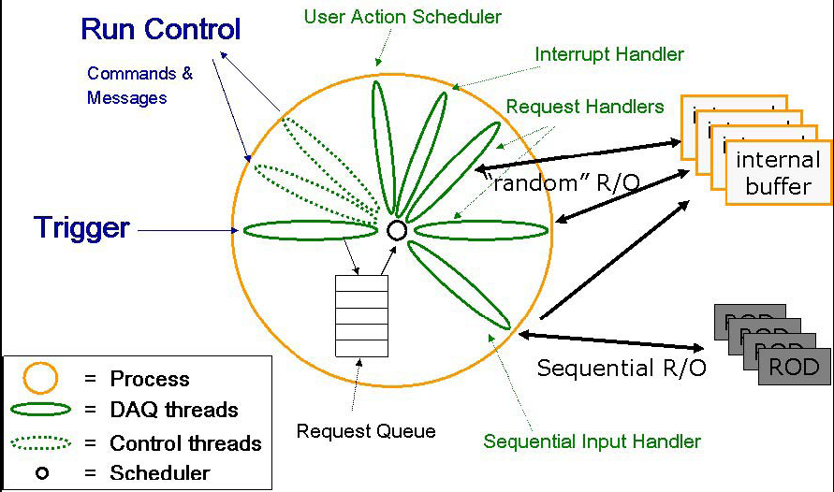
Generic readout application
Module
Input Handler

Slide 23
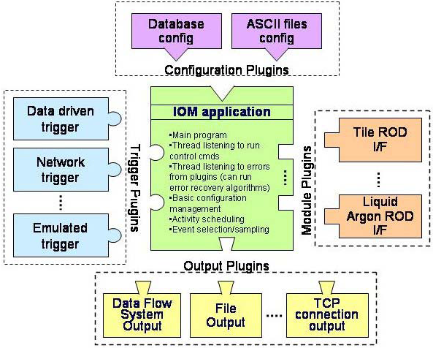
Configurable applications
Ambitious idea
Support all the systems with a single application
Through plug-in mechanism
Requires a configuration mechanism
You will (not) see an example in exercise 4

Slide 24
Some basic components
We introduced basic elements of IPC…
Signals and signal catching
Shared memories
Semaphores (or mutexes)
Message queues
…and some standard DAQ concepts
Trigger, busy, back-pressure
Synchronous vs asynchronous systems
Polling vs interrupts
Real time programming
Event framing
Memory management

Slide 25
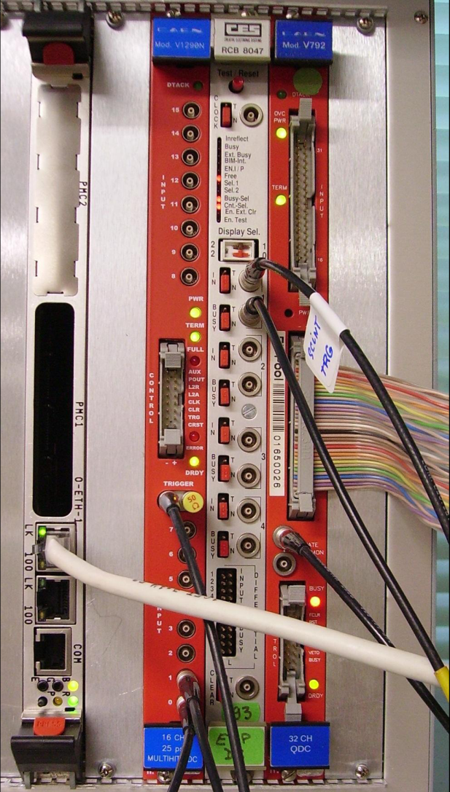
What will you find in the lab?
Theory at work…
Exercise 4
Simple DAQ with
VME crate controller
CORBO module
Upon trigger reception
Sets busy
Sends a VME interrupt
Latch the trigger in a register
QDC
TDC

Slide 26
Event building
Large detectors
Sub-detectors data are collected independently
Readout network
Fast data links
Events assembled by event builders
From corresponding fragments
Custom devices used
In FEE
In low-level triggers
COTS used
In high-level triggers
In event builder network
DAQ system
data flow & control
distributed & asynchronous
Detector Frontend
Level 1
Trigger
Readout
Systems
Event
Builder Networks
Controls
Manager
Filter
Systems
Computing Services

Slide 27
Data networks and protocols
Data transmission
Fragments need to be sent to the event builders
One or more…
Usually done via switched networks
User-level protocols
Provide an abstract layer for data transmission
… so you can ignore the hardware you are using …
… and the optimizations made in the OS (well, that’s not always true) …
See the lecture and exercise on networking
Most commonly used
TCP/IP suite
UDP (User Datagram Protocol)
Connection-less
TCP (Transmission Control Protocol)
Connection-based protocol
Implements acknowledgment and re-transmission

Slide 28
TCP client/server example
struct sockaddr_in sinhim;
sinhim.sin_family = AF_INET;
sinhim.sin_addr.s_addr = inet_addr (this_host);
sinhim.sin_port = htons (port);
if (fd = socket (AF_INET, SOCK_STREAM, 0) < 0)
{ ; // Error ! }
if (connect (fd, (struct sockaddr *)&sinhim,
sizeof (sinhim)) < 0)
{ ; // Error ! }
while (running) {
memcpy ((char *) &wait, (char *) &timeout,
sizeof (struct timeval));
if ((nsel = select (nfds, 0, &wfds,
0, &wait)) < 0)
{ ; // Error ! }
else if (nsel) {
if ((BIT_ISSET (destination, wfds))) {
count = write (destination, buf, buflen);
// test count…
// > 0 (has everything been sent ?)
// == 0 (error)
// < 0 we had an interrupt or
// peer closed connection
}
}
}
close (fd);
struct sockaddr_in sinme;
sinme.sin_family = AF_INET;
sinme.sin_addr.s_addr = INADDR_ANY;
sinme.sin_port = htons(ask_var->port);
fd = socket (AF_INET, SOCK_STREAM, 0);
bind (fd0, (struct sockaddr *) &sinme,
sizeof(sinme));
listen (fd0, 5);
while (n < ns) { // we expect ns connections
int val = sizeof(this->sinhim);
if ((fd = accept (fd0,
(struct sockaddr *) &sinhim, &val)) >0) {
FD_SET (fd, &fds);
++ns;
}
}
while (running) {
if ((nsel = select( nfds, (fd_set *) &fds,
0, 0, &wait)) [
count = read (fd, buf_ptr, buflen);
if (count == 0) {
close (fd);
// set FD bit to 0
}
}
}
close (fd0);

Slide 29
Data transmission optimization
When you “send” data they are copied to a system buffer
Data are sent in fixed-size chunks
At system level
Each endpoint has a buffer to store data that is transmitted over the network until the application is busy
TCP stops to send data when available buffer size is 0
Back-pressure
With UDP we get data loss
If buffer space is too small:
Increase system buffer (in general possible up to 8 MB)
Too large buffers can lead to performance problems
You will play in lab. 9 with
Data transmission
Event builders

Slide 30
Controlling the data flow
Throughput optimization
Avoid dead-time due to back-pressure
By avoiding fixed sequences of data destinations
Requires knowledge of the EB input buffer state
EB architectures
Push
Events are sent as soon as data are available to the sender
The sender knows where to send data
The simplest algorithm for distribution is the round-robin
Pull
Events are required by a given destination processes
Needs an event manager
Though in principle we could build a pull system without manager

Slide 31
Pull example
Trigger
Sender
Sender
Sender
Event Manager
Builder network

Slide 32
Push example
Trigger
Sender
Sender
Sender
Event Manager
Builder network

Slide 33
System monitoring
Two main aspects
System operational monitoring
Sharing variables through the system
Data monitoring
Sampling data for monitoring processes
Sharing histogram through the system
Histogram browsing

Slide 34
Event sampling examples
Spying from buffers
Sampling on input or output
Writer
Spy
Writer
Reader
Reader
To monitoring
process
To monitoring
process
Sampling is always on the “best effort” basis and cannot affect data taking

Slide 35
Histogram and variable distribution
Histo
Service
Sampler
Monitoring process
DAQ process
Info Service

Slide 36
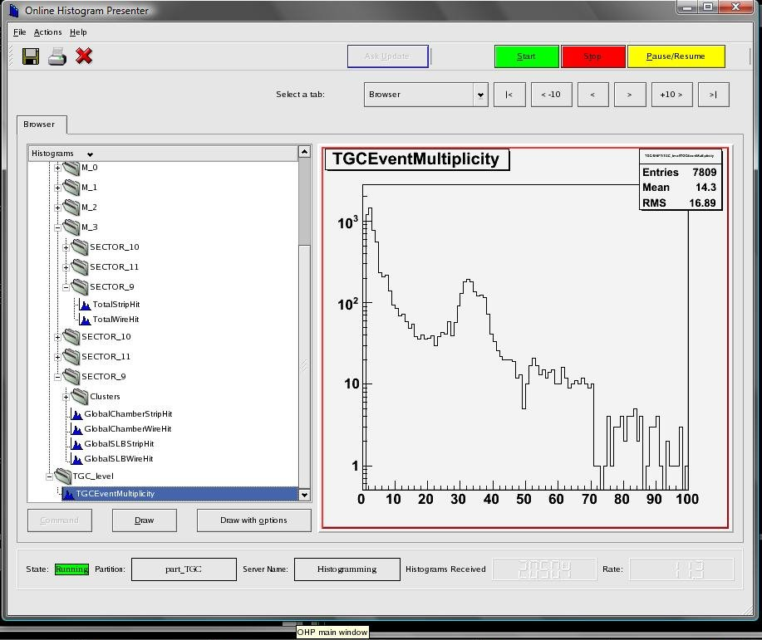
Histogram browser

Slide 37
Controlling the system
Each DAQ component must have
A set of well defined states
A set of rules to pass from one state to another
Finite State Machine
A central process controls the system
Run control
Implements the state machine
Triggers state changes and takes track of components’ states
Trees of controllers can be used to improve scalability
A GUI interfaces the user to the Run control
…and various system services…

Slide 38
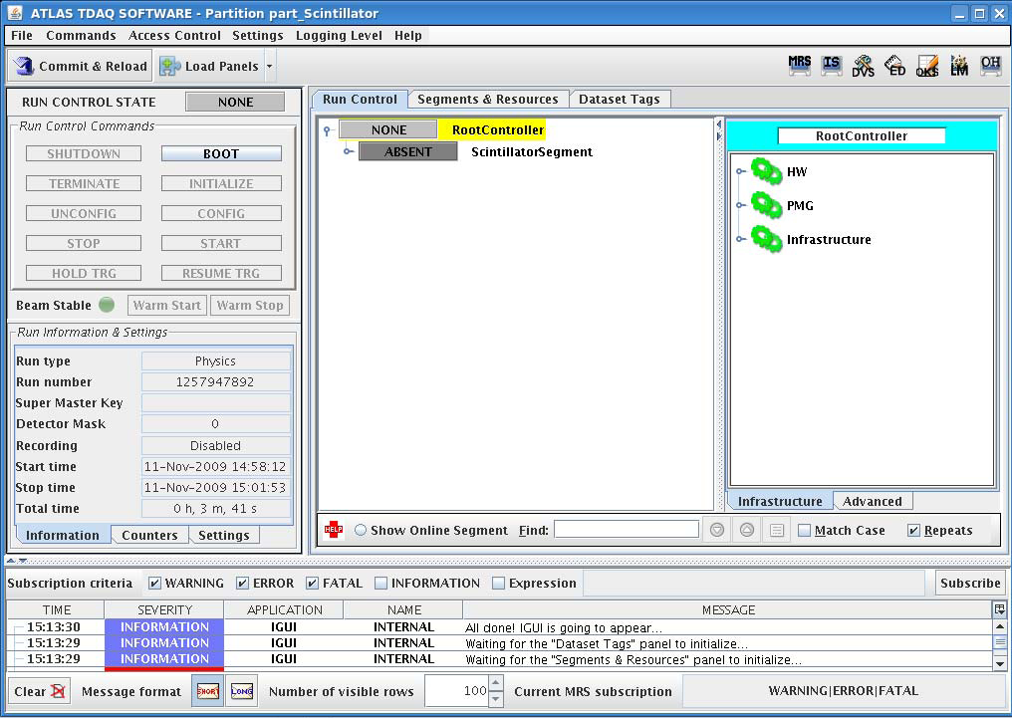
GUI example
From exercise 4…
… and Atlas!

Slide 39
Finite State Machines
Models of the behaviors of a system or a complex object, with a limited number of defined conditions or modes
Finite state machines consist of 4 main elements:
States which define behavior and may produce actions
State transitions which are movements from one state to another
Rules or conditions which must be met to allow a state transition
Input events which are either externally or internally generated, which may possibly trigger rules and lead to state transitions
Recover
NONE
ERROR
Boot
Reset
BOOTED
Configure
Unconfigure
CONFIGURED
Start
Stop
RUNNING

Slide 40
Propagating transitions
Each component or sub-system is modeled as a FSM
The state transition of a component is completed only if all its sub-components completed their own transition
State transitions are triggered by commands sent through a message system
Subsystem Control
Final Process
NONE
ERROR
BOOTED
NONE
ERROR
BOOTED
Run Control
NONE
ERROR
CONFIGURED
BOOTED
CONFIGURED
BOOTED
BOOTED
BOOTED
CONFIGURED
CONFIGURED
RUNNING
CONFIGURED
CONFIGURED
RUNNING
RUNNING

Slide 41
FSM implementation
State concept map on object state concept
OO programming is convenient to implements SM
State transition
Usually implemented as callbacks
In response to messages
Remember:
Each state MUST be well-defined
Variables defining the state must have the same values
Independently of the state transition
You will be required to implement a state machine
In exercise 10

Slide 42
Message system
Networked IPC
I will not describe it
You see a message system at work in exercise 12
Many possible implementations
From simple TCP packets…
… through (rather exotic) SNMP …
(that’s the way many printers are configured…)
Very convenient for “economic” implementation
Used in the KLOE experiment
… to Object Request Browsers (ORB)
Used f.i. by ATLAS

Slide 43
A final remark
There is no absolute truth
Different systems require different optimizations
Different requirements imply different design
System parameters must drive the SW design
As for DAQ HW design (see W. Vandelli’s talk)
Examples:
An EB may use dynamic buffering
Though it is expensive
If bandwidth is limited by network throughput
React to signals or poll
Depends on expected event rate
Event framing is important
But must no be exaggerated

Slide 44
Thanks for your attention!

