Slide 1
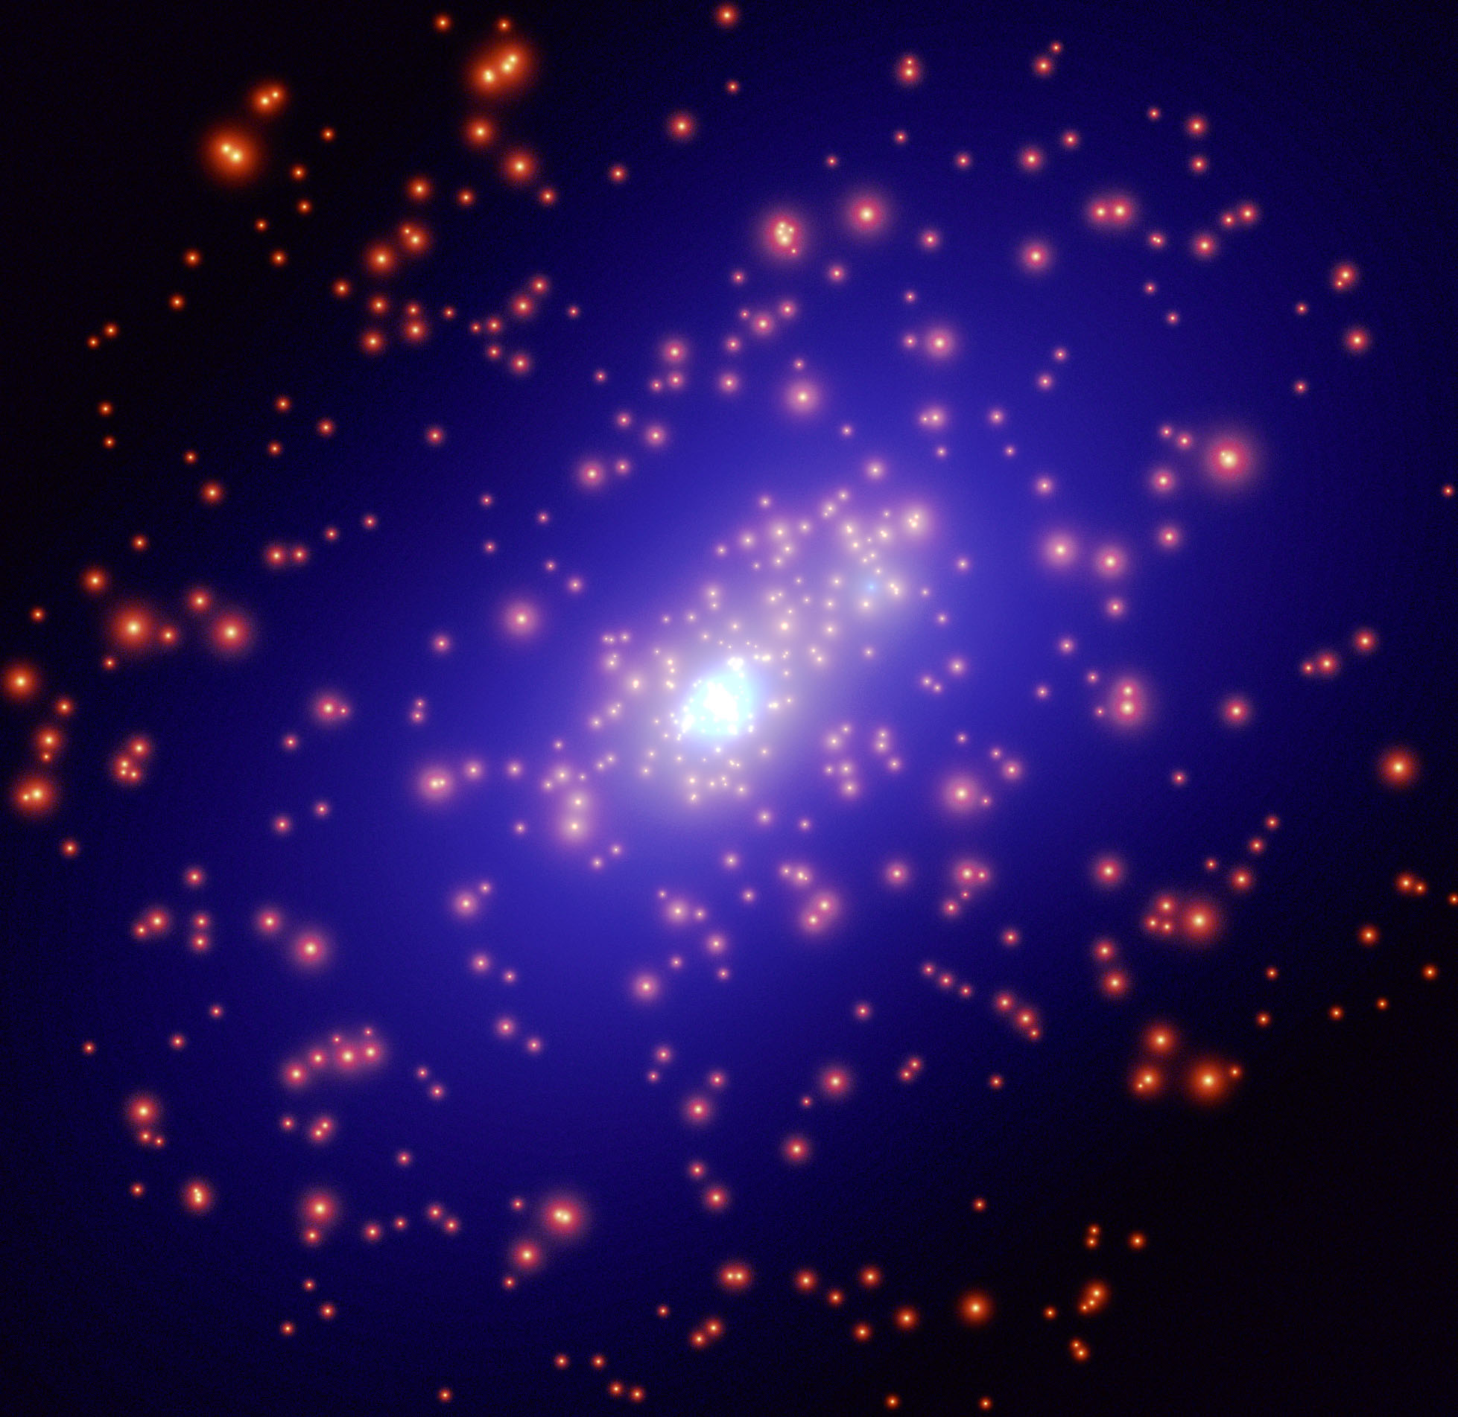
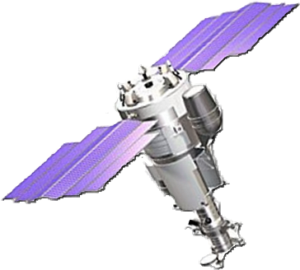
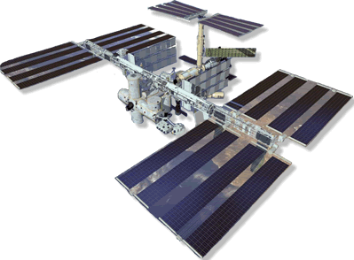
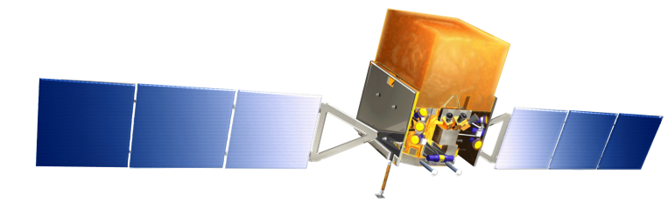
Antimatter and Dark Matter Search in Space
Piergiorgio Picozza
INFN and University of Rome Tor Vergata
LC10 Workshop
Laboratori Nazionali di Frascati, INFN
30 November - 3 December 2010

Slide 2
Astrophysics and Cosmology compelling Issues
Apparent absence of cosmological Antimatter
Nature of the Dark Matter that pervades the Universe

Slide 3
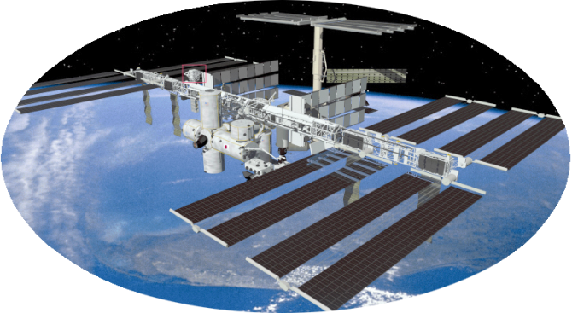
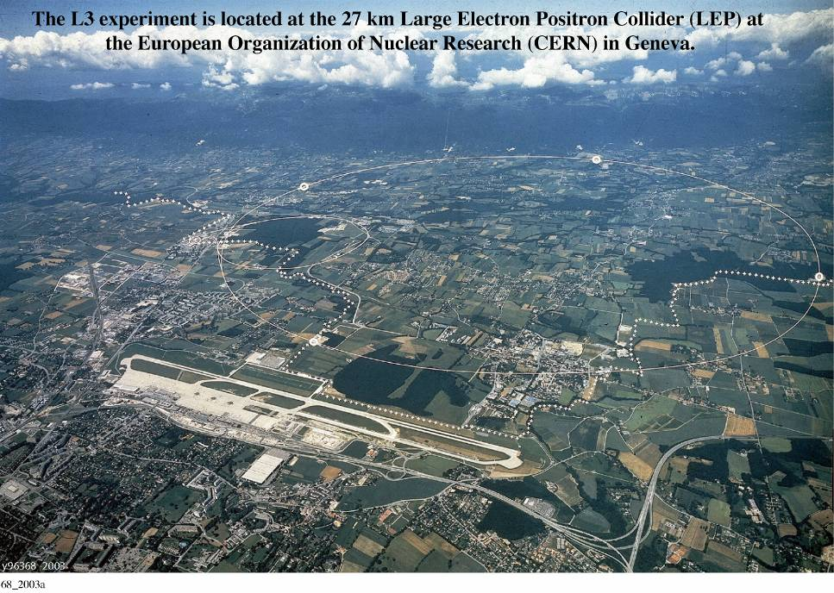
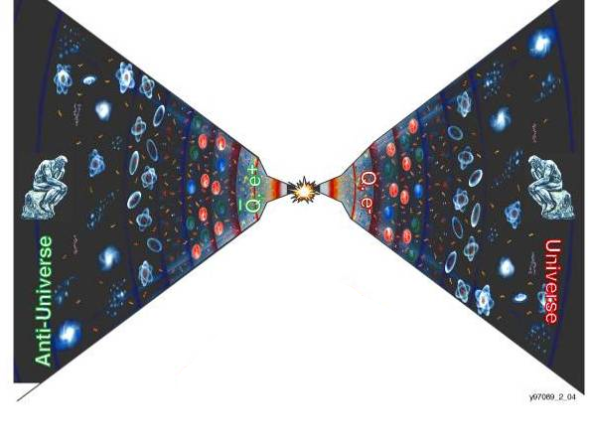
Search for the existence of Antimatter in the Universe
PAMELA AMS
in Space
AMS
Search for the existence of anti Universe
Search for the origin of the Universe
Accelerators
The Big Bang origin of the Universe requires
matter and antimatter
to be equally abundant at the very hot beginning

Slide 4
Gamma Evidence for Cosmic Antimatter?
Steigman 1976, De Rujula 1996, Dolgov 2007
Osservation in the 100 MeV gamma range
Leading process:
p p π⁰+ ………
γγ
Other processes:
p p π^{+………} μ^{+………} e^{+………} γ 1-10 MeV
e⁺e⁻ γ γ 0.511 MeV

Slide 5
Cosmic Diffuse Gamma Spectrum
P. Sreekumar et al, astroph/9709257

Slide 6
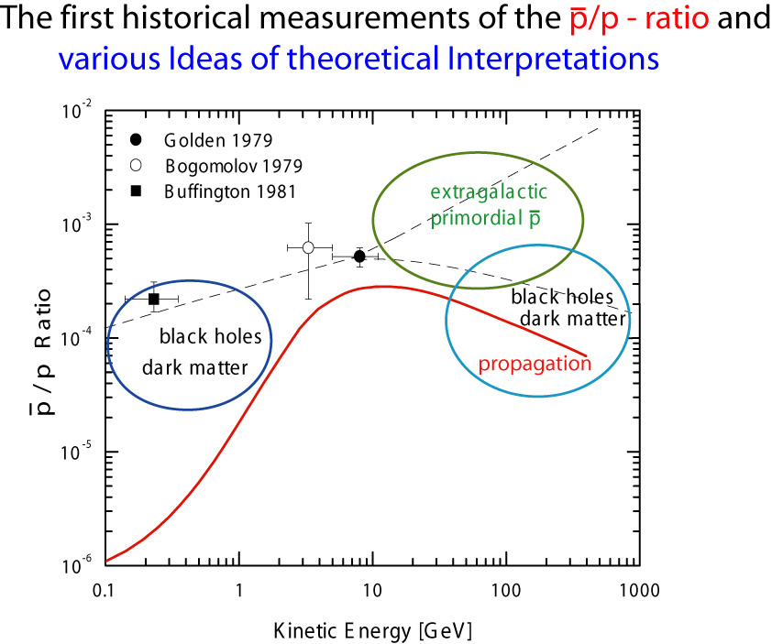
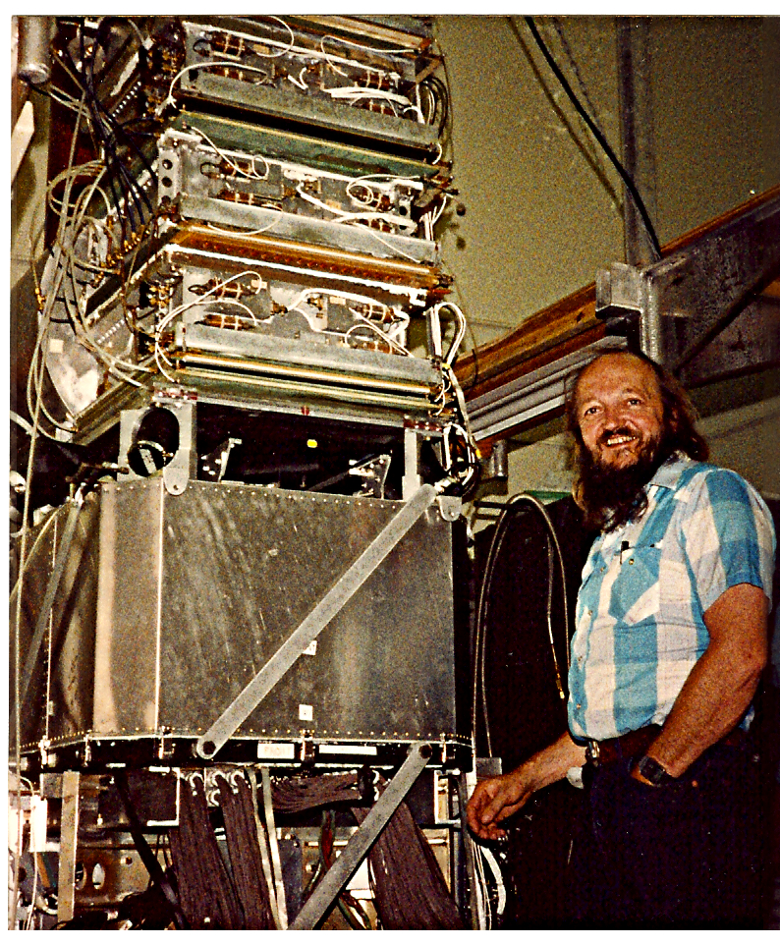
Robert L. Golden
R.

Slide 7
Antimatter Direct Search
High energy antiparticles
and antinuclei

Slide 8
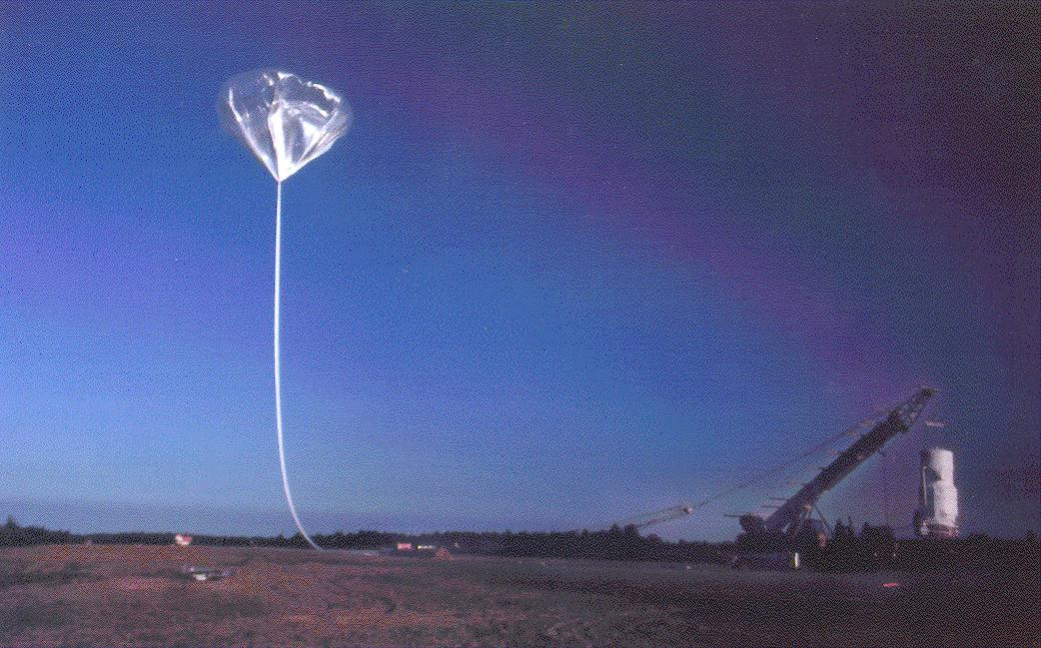
Antimatter Search
Wizard Collaboration
MASS – 1,2 (89,91)
TrampSI (93)
CAPRICE (94, 97, 98)
BESS (93, 95, 97, 98, 2000)
Heat (94, 95, 2000)
IMAX (96)
BESS LDF (2004, 2007)
AMS-01 (1998)

Slide 9
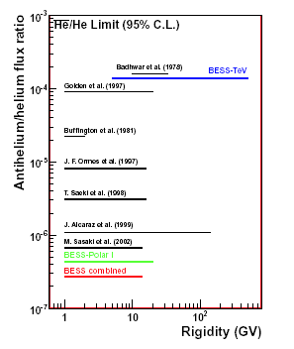
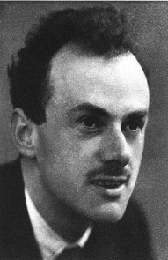
Antimatter
“We must regard it rather an accident that
the Earth and presumably the whole Solar System contains a preponderance of negative electrons
and positive protons. It is quite possible that
for some of the stars it is the other way about”
P. Dirac, Nobel lecture (1933)‏

Slide 10

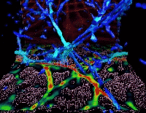
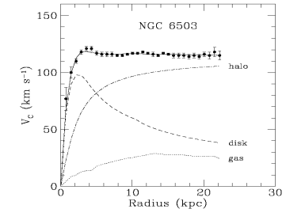
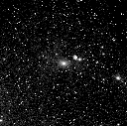
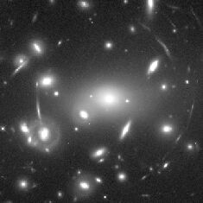
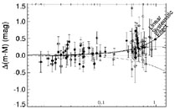
Dark Matter
Evidence for the existence of an unseen, “dark”, component in the energy density of the Universe comes from several independent observations at different length scales:
Rotation curves of galaxies
CMB
Large Scale Structure
Galaxy clusters
Lensing
SN Ia
Bertone, Hooper & Silk, hep-ph/0404175. Bergstrom, hep-ph/0002126. Jungman et al, hep-ph/9506380

Slide 11
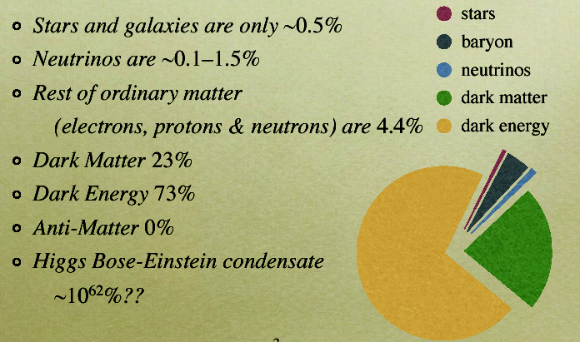
THE UNIVERSE ENERGY BUDGET

Slide 12
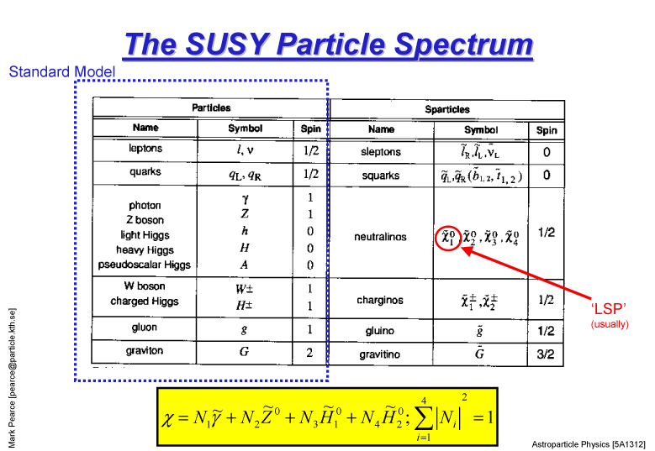

Slide 13
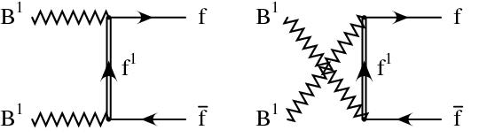
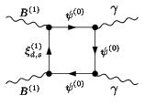
Another possible scenario:
KK Dark Matter
Lightest Kaluza-Klein Particle (LKP): B⁽¹⁾
Bosonic Dark Matter:
fermionic final states no longer helicity suppressed.
e+e⁻ final states directly produced.
As in the neutralino case
there are 1-loop
processes that produces monoenergetic
γ γ in the final state.

Slide 14






DM annihilations
DM particles are stable. They can annihilate in pairs.
Primary annihilation channels
Decay
Final states
σ_{a}= <σv>

Slide 15
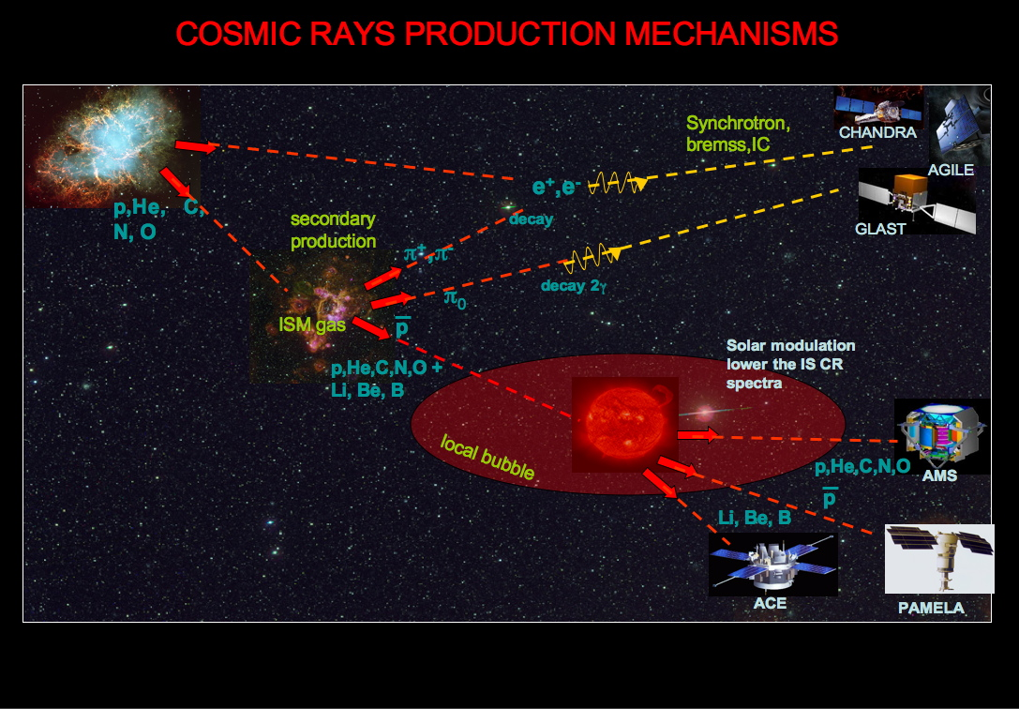
e⁻

Slide 16
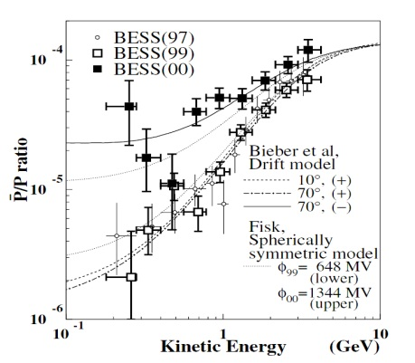
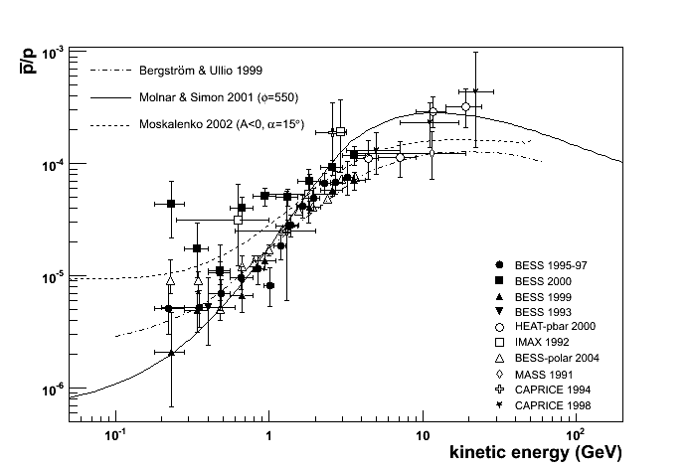
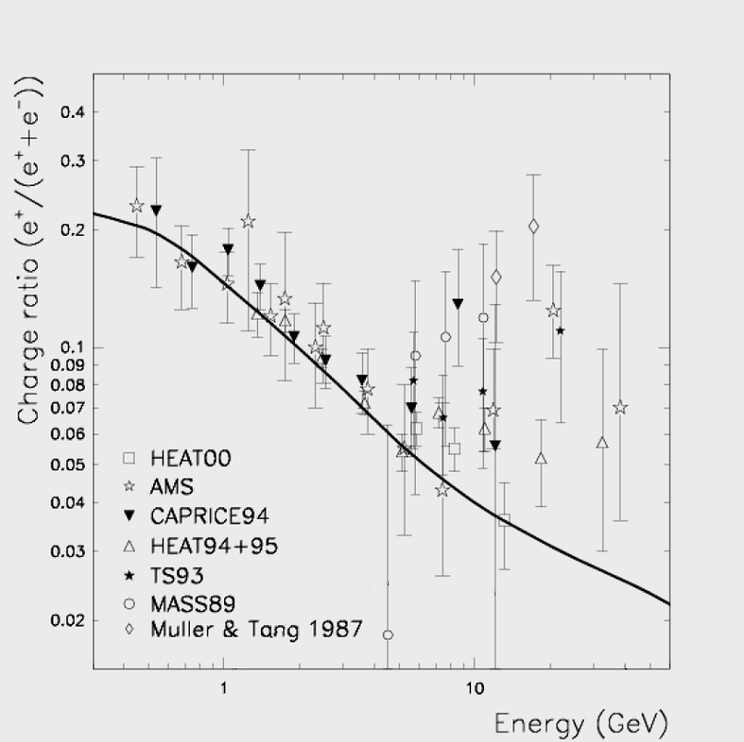
Cosmic Ray Antimatter
Charge-dependent solar modulation
Solar polarity reversal 1999/2000
Asaoka Y. Et al. 2002
Pre-PAMELA status
Antiprotons
Positrons
Moskalenko & Strong 1998
Positron excess?
?
¯
?
+
CR + ISM → p-bar + …
kinematic threshold:
5.6 GeV for the reaction
CR + ISM → π± + x → μ± + x → e± + x
CR + ISM → π⁰ + x → γγ → e±

Slide 17
What did we need?
Measurements at higher energies
Better knowledge of background
High statistics
Continuous monitoring of solar modulation
Long Duration Flights

Slide 18
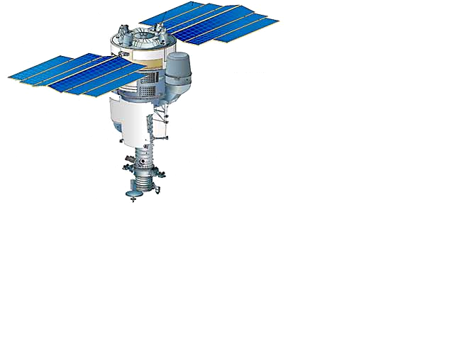
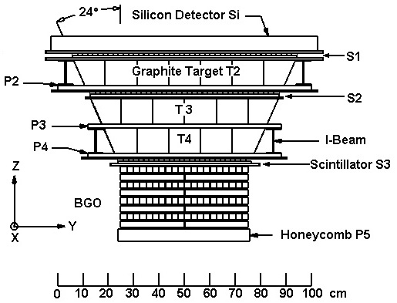
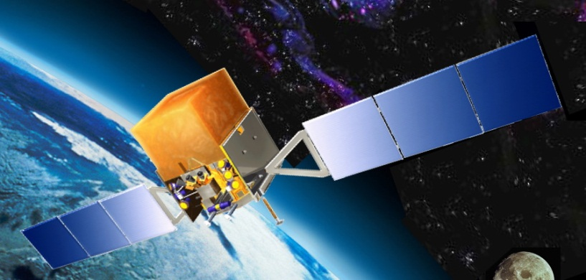
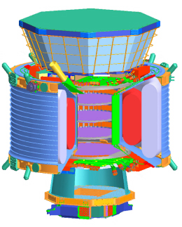
Antimatter and Dark Matter
Space Missions
PAMELA
15-06-2006
ATIC
2002 - 2007
AMS-02
Feb. 2011
Fermi/GLAST
11-6-2008

Slide 19
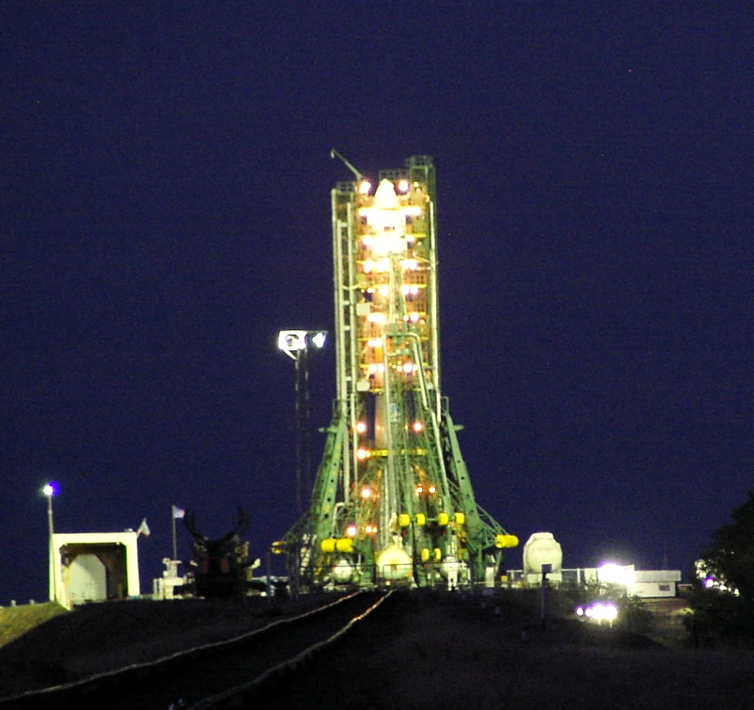
PAMELA
Payload for Antimatter Matter Exploration and Light Nuclei Astrophysics

Slide 20







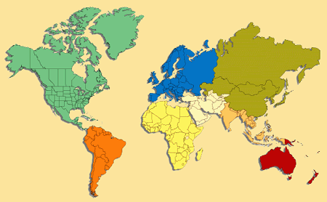





PAMELA Collaboration
Italy:
Bari
Florence
Frascati
Naples
Rome
Trieste
CNR, Florence
Russia:
Moscow
St. Petersburg
Germany:
Sweden:
Siegen
KTH, Stockholm

Slide 21
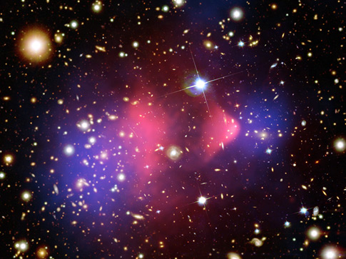
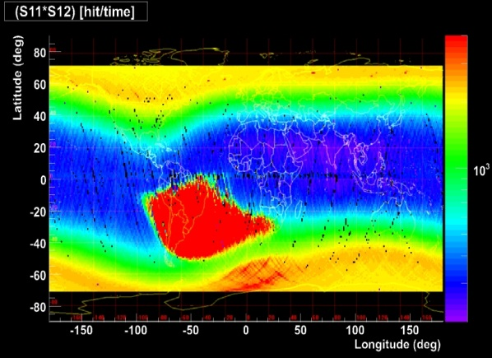
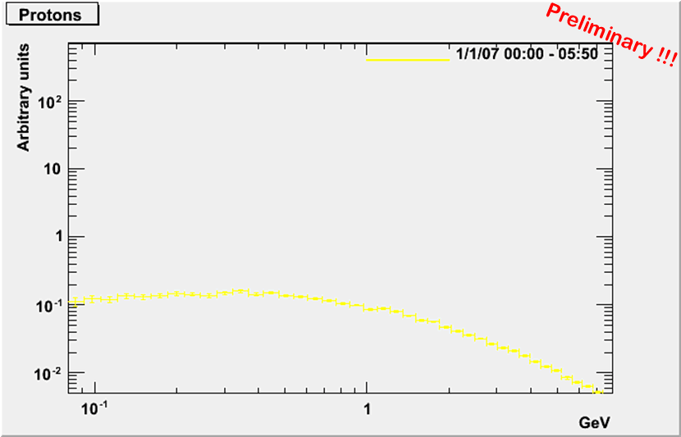
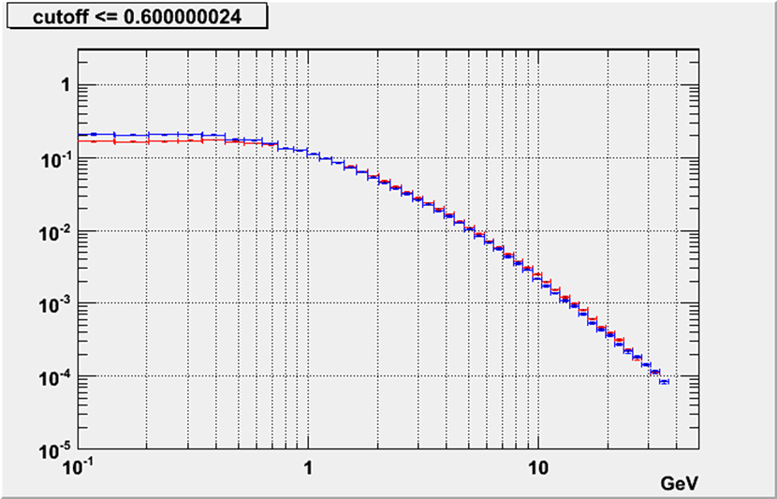
The Physics of PAMELA
Search for dark matter annihilation
Search for antihelium (primordial antimatter)‏
Search for new Matter in the Universe (Strangelets?)
Study of cosmic-ray propagation
Study of solar physics and solar modulation
Study of terrestrial magnetosphere
Study of high energy electron spectrum (local sources?)

Slide 22
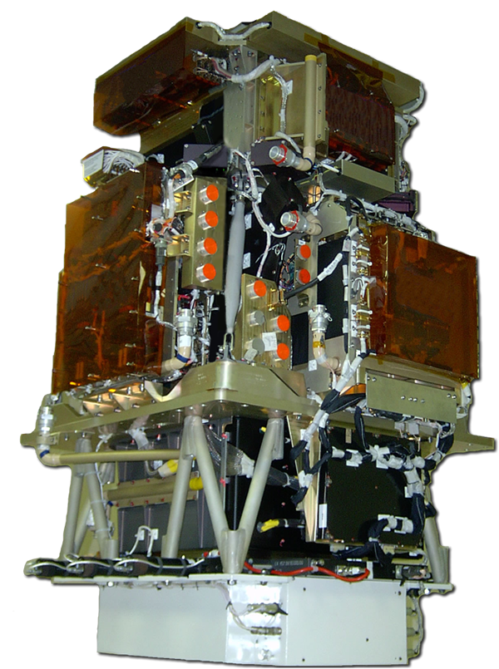
PAMELA Instrument
GF ~21.5 cm²sr
Mass: 470 kg
Size: 130x70x70 cm³

Slide 23
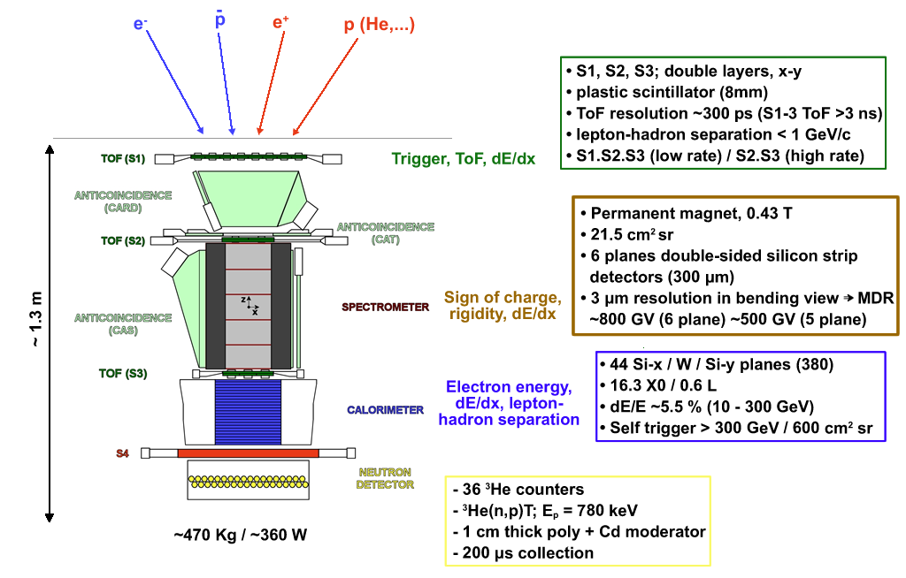
MDR 1.2 TeV

Slide 24
Design Performance
Energy range
Antiprotons 80 MeV - 190 GeV
Positrons 50 MeV – 300 GeV
Electrons up to 600 GeV
Protons up to 1 TeV
Helium up to 400 GeV/n
Electrons+positrons up to 2 TeV (from calorimeter)
Light Nuclei (Li/Be/B/C) up to 200 GeV/n
AntiNuclei search sensitivity of 3x10⁻⁸ in He/He
Notes:
24

Slide 25
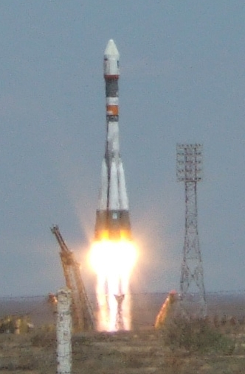
PAMELA
Launch
15/06/06
16 Gigabytes trasmitted daily to Ground
NTsOMZ Moscow

Slide 26
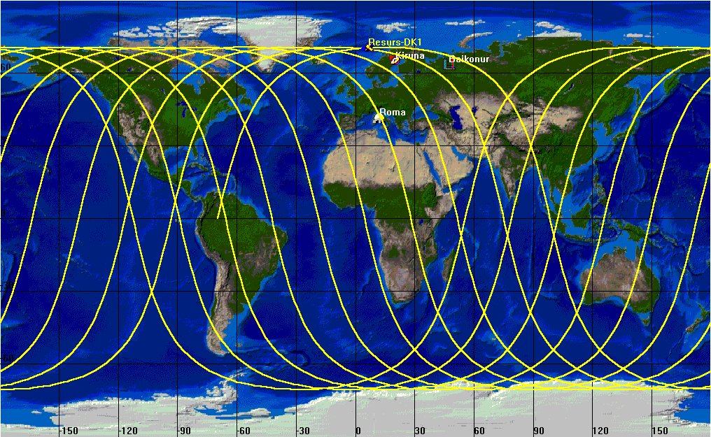
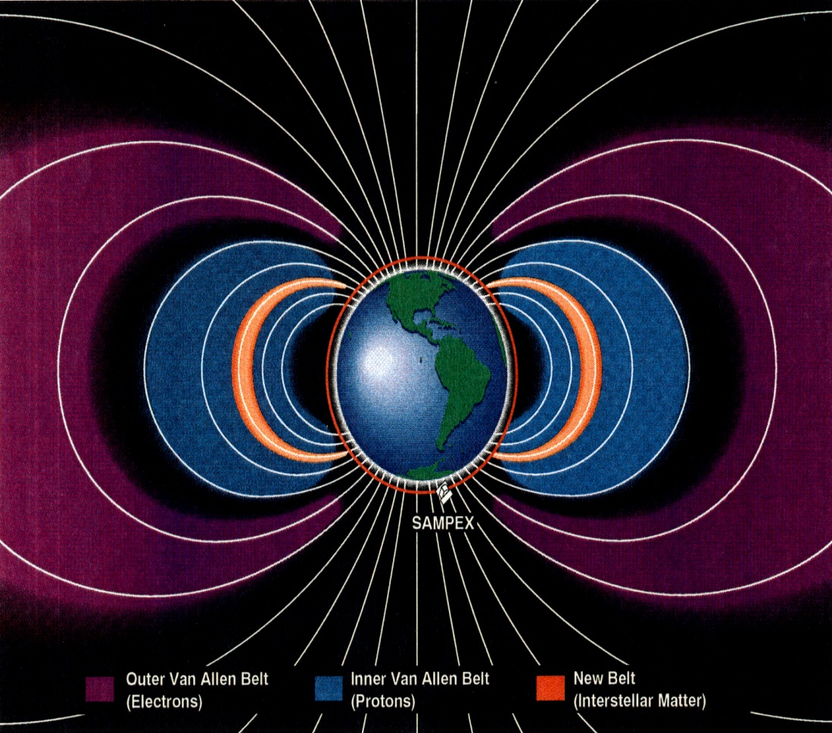
Orbit Characteristics
350 km
SAA
70^{ο}
610 km
Low-earth elliptical orbit
350 – 610 km
Quasi-polar (70º inclination)
SAA crossed

Slide 27
Particle ID with PAMELA

Slide 28
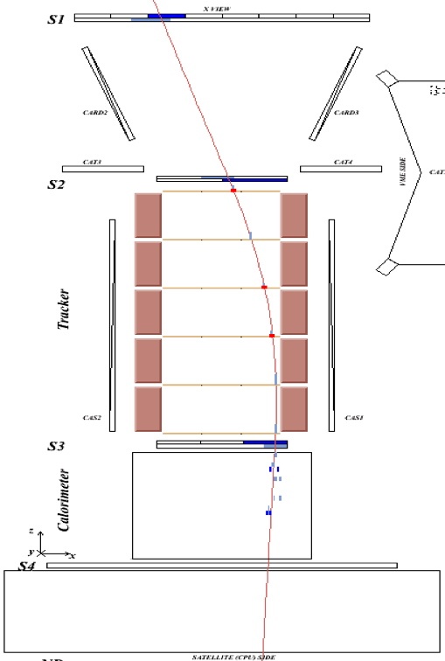
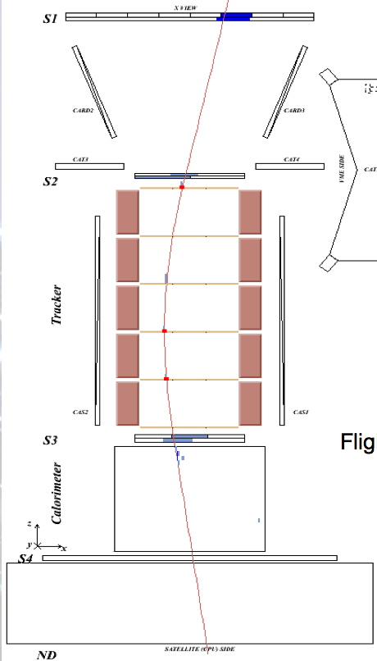
Flight data:
0.171 GV positron
Flight data:
0.169 GV electron

Slide 29
Flight data: 0.632 GeV/c
antiproton annihilation

Slide 30
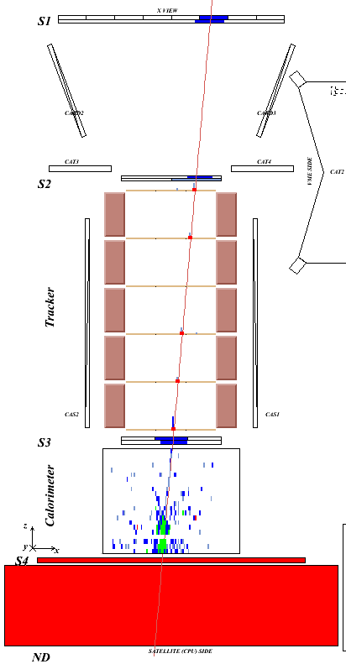
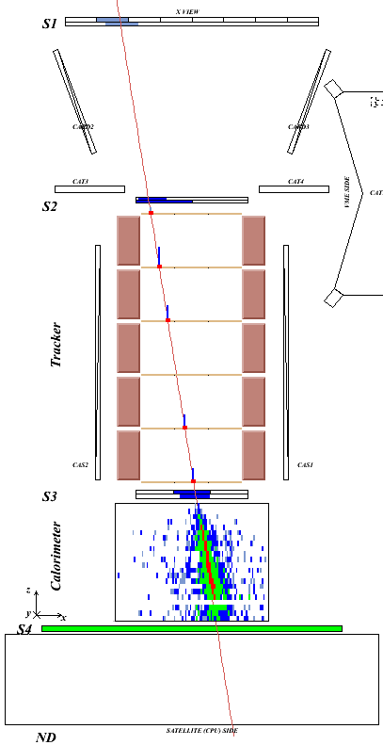
Antiproton / Positron Identification
Time-of-flight: trigger, albedo rejection, mass determination (up to 1 GeV)
Bending in spectrometer: sign of charge
Ionisation energy loss (dE/dx):
magnitude of charge
Interaction pattern in calorimeter: electron-like or proton-like, electron energy
Antiproton
(NB: e⁻/p ~ 10²)
Positron
(NB: p/e⁺ ~10³⁻⁴)

Slide 31
PAMELA
  1632 Days in Orbit
  ~ 17 TByte of raw data trasmitted

Slide 32
Antiparticles with PAMELA

Slide 33
Antiprotons

Slide 34
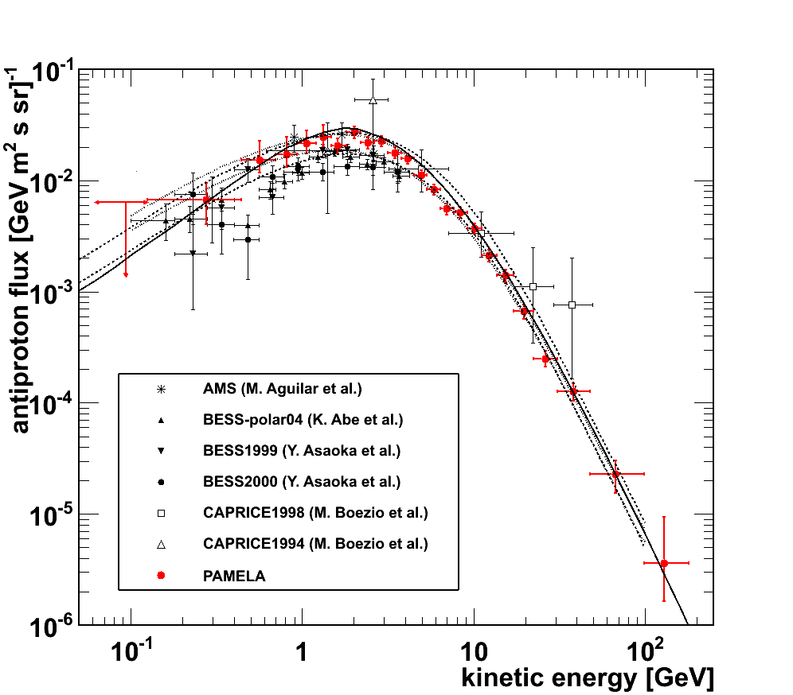
Antiproton Flux
(0.06 GeV - 180 GeV)
Donato et al. (ApJ 563 (2001) 172)
Systematics
errors included
Ptuskin et al. (ApJ 642 (2006) 902)
Adriani et al., Phys. Rev. Lett. 105, 121101 (2010)

Slide 35
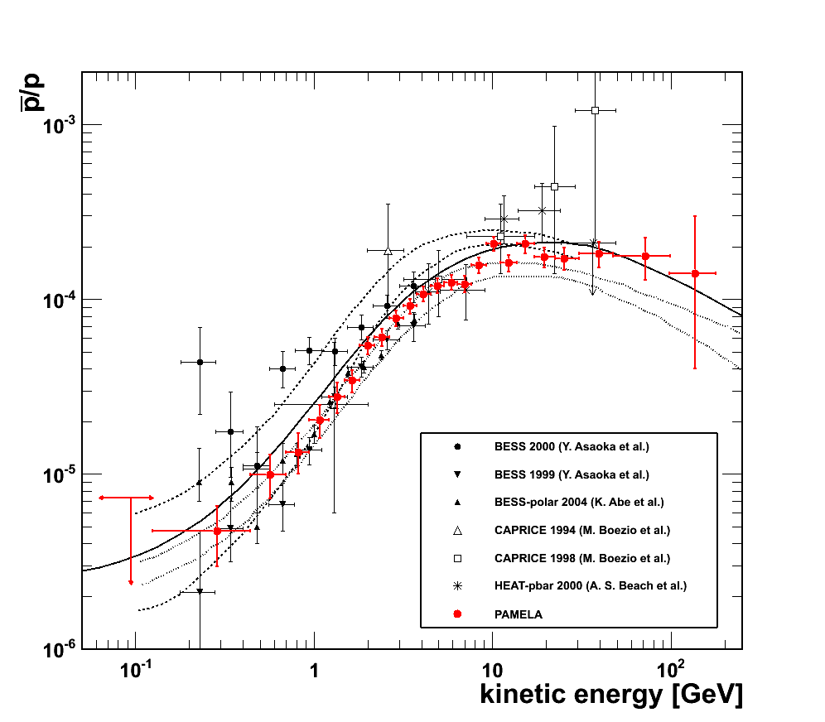
Antiproton to proton ratio
(0.06 GeV - 180 GeV)
Simon et al. (ApJ 499 (1998) 250)
Ptuskin et al. (ApJ 642 (2006) 902)
Donato et al. (PRL 102 (2009) 071301)
Systematics
errors included
Adriani et al., Phys. Rev. Lett. 105, 121101 (2010)

Slide 36
Wino Dark Matter in a non-thermal Universe
G. Kane, R. Lu, and S. Watson arXiv:0906.4765v3 [astro-ph.HE)

Slide 37
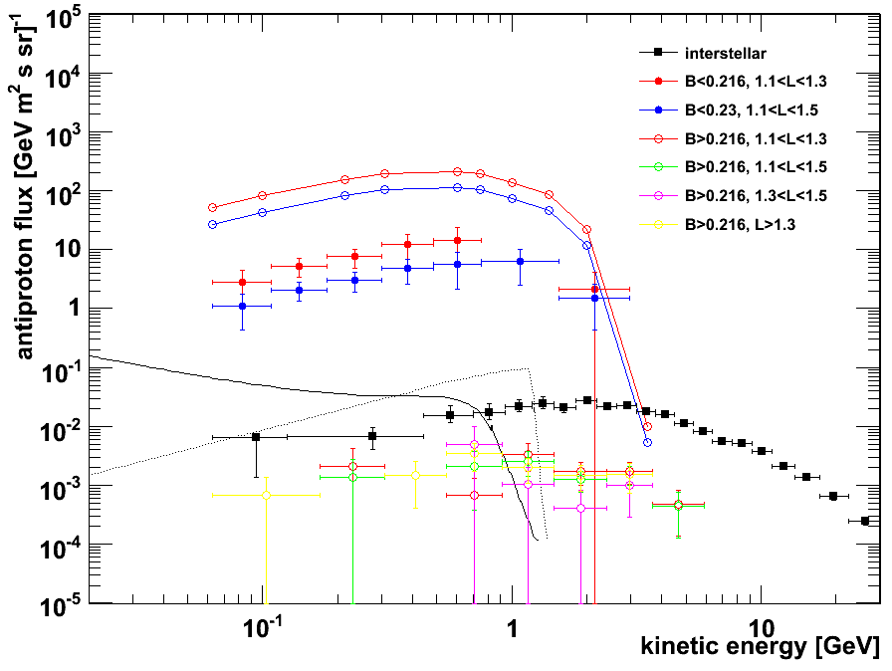
Trapped antiprotons in SAA

Slide 38
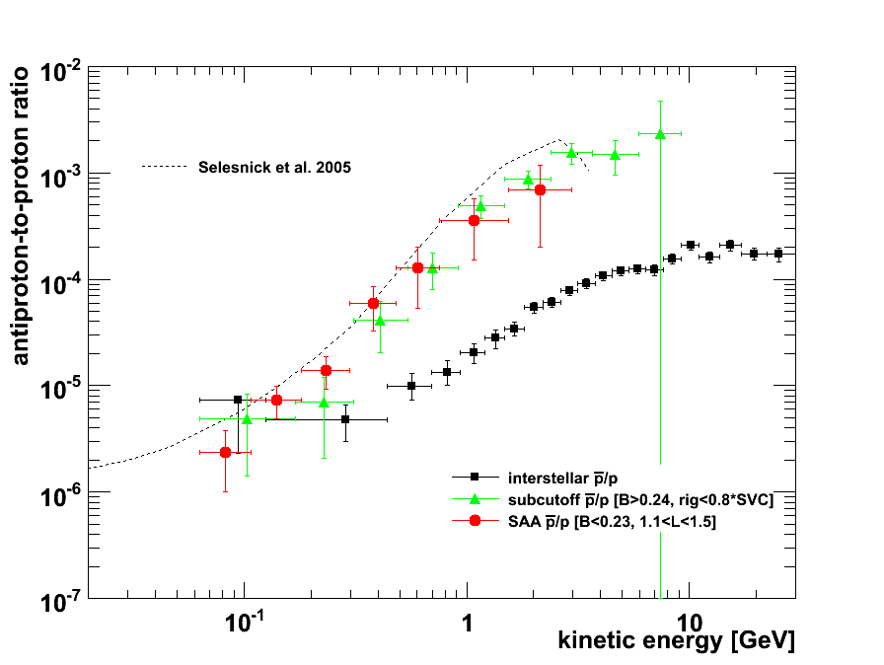
Trapped antiprotons in SAA
PAMELA
Trapped
GCR

Slide 39
Positrons and Electrons

Slide 40
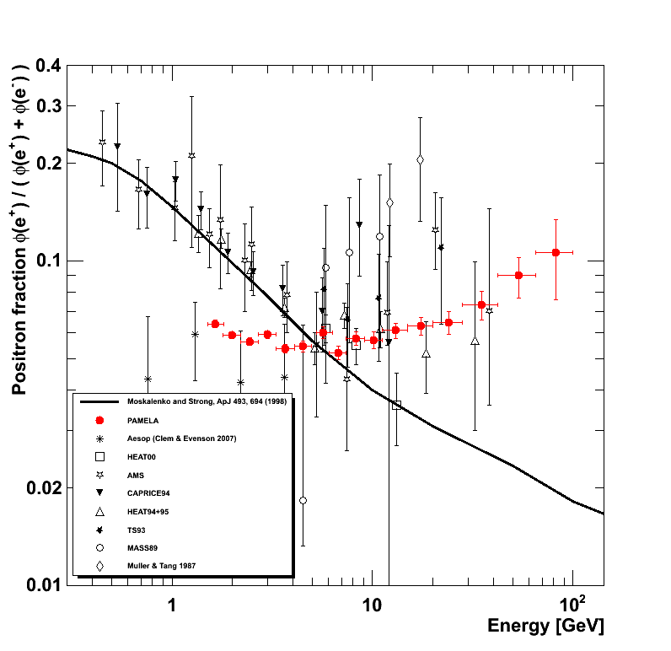
Positron to Electron Fraction
Secondary production Moskalenko & Strong 98
Adriani et al, Astropart. Phys. 34 (2010) 1 arXiv:1001.3522 [astro-ph.HE]

Slide 41
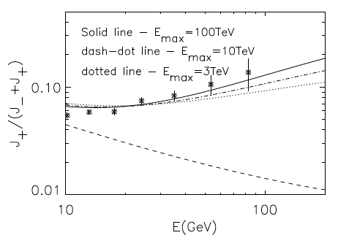


A Challenging Puzzle for CR Physics
P.Blasi, PRL 103 (2009) 051104; arXiv:0903.2794
Y. Fujita arxiv .0904.5298
Positrons (and electrons) produced as secondaries in the sources (e.g. SNR) where CRs are accelerated.
But also other secondaries are produced: significant increase expected in the p/p and B/C ratios.
D. Hooper, P. Blasi, and P. Serpico, JCAP 0901:025,2009; arXiv:0810.1527
Contribution from diffuse mature &nearby young pulsars.
I. Cholis et al., Phys. Rev. D 80 (2009) 123518; arXiv:0811.3641v1
Contribution from DM annihilation.

Slide 42

A Challenging Puzzle for Dark Matter Interpretation

Slide 44


Slide 45


All electron spectrum
ATIC
GLAST
HESS

Slide 46



All three ATIC flights are consistent
Preliminary
Preliminary
ATIC 1
ATIC 2
ATIC 4
ATIC 1+2+4
ATIC 1+2
“Source on/source off” significance of bump for ATIC1+2 is about 3.8 sigma
J Chang et al. Nature 456, 362 (2008)
ATIC-4 with 10 BGO layers has improved e , p separation. (~4x lower background)
“Bump” is seen in all three flights.
Significance for ATIC1+2+4 is 5.1 sigma

Slide 47


Example: DM I. Cholis et al. arXiv:0811.3641v1
I. Cholis et al. arXiv:0811.3641v1
See Neal Weiner’s talk

Slide 48
Fermi (e⁺+ e⁻)
M. Ackermann et al. astro-ph 1008.3999

Slide 49
Fermi (e⁺+ e⁻)
D. Grasso astro-ph 0912.3887

Slide 50

Fermi (e⁺+ e⁻) and PAMELA ratio
Bergstrom et al. astro-ph 0905.0333v1

Slide 51


Slide 52

Proton and Helium spectra
p
He

Slide 53


Solar Modulation of galactic cosmic rays
Study of charge sign dependent effects
Asaoka Y. et al. 2002, Phys. Rev. Lett. 88, 051101),
Bieber, J.W., et al. Physi-cal Review Letters, 84, 674, 1999.
J. Clem et al. 30th ICRC 2007
U.W. Langner, M.S. Potgieter, Advances in Space Research 34 (2004)
Pamela
AMS-01
Caprice / Mass /TS93
BESS

Slide 54

Time Dependence of PAMELA Proton Flux
Preliminary

Slide 55

Time Dependence of PAMELA Electron (e⁻) Flux
Preliminary

Slide 56




Charge dependent solar modulation
Preliminary!!
¯
+
¯
Pamela
2006
(Preliminary!)
+
A > 0
Positive particles
A < 0

Slide 57




AMS-02 on ISS
In Orbit Feb. 2011
TRD
Tracker
Vacuum
Case
MAGNET
He Vessel
RICH

Slide 58







The Completed AMS Detector on ISS
Transition Radiation Detector (TRD)
Time of Flight Detector (TOF)
Magnet
Silicon Tracker
Electromagnetic Calorimeter (ECAL)
Ring Image Cerenkov Counter (RICH)
Size: 3m x 3m x 3m
Weight: 7 tons

Slide 59
AMS-02 new configuration

Slide 60




Unique
Feature
of
AMS
positrons
antiprotons
Combining searches in different channels could
give (much) higher sensitiviy to SUSY DM signals
anti deuterons
gamma rays

Slide 61


The Next Future

Slide 62

Future

Slide 63
Perspectives

Slide 64

Gamma Space Experiments
AGILE
23-04-2007
Fermi/GLAST
11-6-2008

Slide 66
AGILE 2.5 yr gamma ray map

Slide 67

FERMI Catalog (11 months, 1451 sources)
http://fermi.gsfc.nasa.gov/ssc/data/access/lat/1yr_catalog/
arXiv:1002.2280

Slide 68

Dark Matter Fermi astro-ph 0912.0973

Slide 69
Thanks!
http:// pamela.roma2.infn.it

Slide 70

AGILE discovery of strong gamma-ray flares from the Crab Nebula
M. Tavani (on behalf AGILE Team)

Slide 71

AGILE gamma-ray flux lightcurve of the Crab, E > 100 MeV
20-22 September 2010

Slide 72
the facts:
AGILE discovery of strong transient gamma-ray emission above 100 MeV from the Crab Nebula (Astron. Teleg. N. 2855, 22 Sept. 2010).
confirmation by Fermi-LAT (ATEL 2866).
many other Telegrams, data with Swift, Integral, low-resolution optical telescopes.
Hubble Telescope and Chandra observations at the highest resolution

Slide 73
Contamination ?
  pre- and post-flare X-ray imaging and radio data esclude the presence of a blazar or other sources within 10-20 arcminutes.
  AGILE and Fermi-LAT gamma-ray positioning consistent with the Crab Nebula coordinates (error box diameter: 10-20 arcminutes).

Slide 74
What could it be ?
  PSR
    33 ms pulsed gamma-ray signal intensity increase (but no evidence of pulsed profile changes during the post-AGILE flare, or pulsar glitch)
    neutron star gamma-ray flare (never observed before)
  NEBULA
    Relativistic PSR wind interaction in the gaseous nebula, magnetohydrodynamic shocks, formation of giant “wisps” and transient gamma-ray emission

Slide 75

Chandra imaging of the inner nebula of the Crab showing the toroidal emission, wisps, jets

Slide 76

suspects…
Wisps, shocked gas and energetic electrons in compressed magn. field
(variable on timescales of days/weeks/months)
“jet” base, shocked gas and energetic electrons in compressed magn. field

Slide 77
Yesterday’s situation
Hubble and Chandra observations will tell
First observations scheduled on Tuesday, Sept. 28, 2010

Slide 78


Spectral properties
SPECTRAL PROPERTIES
nebular (unpulsed)
total pulsed emission

Slide 79
Spectral properties
SPECTRAL PROPERTIES
flare level
normal pulsed level
nebular (unpulsed)
total pulsed emission

Slide 80

Chandra image, 28 Sept. 2010 (Tennant et al. ATEL 2882)
South East “jet” base, possibly enhanced (!?)

Slide 81
Conclusions
very exciting results, the Crab Nebula produces ~day-long gamma-ray flares !
nebular origin, not clear yet if it is the South East “jet” base
confirmation of relativistic shock mechanisms of particle acceleration
connection with previous pulsar activity (glitches ?) to be established

Slide 82
Chandra imaging of the inner nebula of the Crab showing the toroidal emission, wisps, jets

Slide 83
Chandra image, 28 Sept. 2010 (Tennant et al. ATEL 2882)

