Slide 1
Report
Lecce team

Slide 2
Outline
Some studies on pDNN
Some expected limits
Next steps
Lecce team

Slide 3
Some studies on pDNN
INPUT:
MC16a MC samples, CxAOD tag: 33-08, UFO-pFlow, BTagging201903
pDNN: version (see later)
No Data
Radion, ggF/DY, merged regime
Studies:
Interpolation capability
From the light version to the configuration in ATL-COM-PHYS-2018-1549
Adding MllJ
Stability with statistics
Lecce team

Slide 4
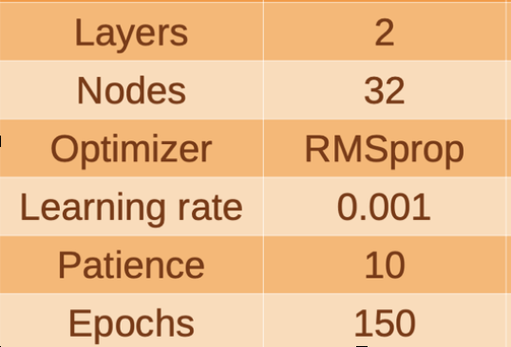
Some studies on pDNN
pDNN configuration: light version
Input variables:
Lepton 1, 2: m, pt, eta, phi
Leptonic Z: m, pt
Fatjet: m, d2, pt, eta, phi
Event: (Njet)
Special for pDNN: Signal Mass
Variable scaling: mean to 0; rms to 1
Training:
Background: Z+jet and Diboson, weighted to equalise stat. (No use of MC weights)
Signal: Sum (over masses) of all samples reweighed to match stat of sum of backgrounds
Mass (GeV): 500, 600, 700, 800, 1000, 1200, 1400, 1500, 1600, 1800, 2000, 2400, 2600, 3000, 3500, 4000, 4500, 5000, 6000
20% dropout
20% of the training set as validation sample (for the early stopping after 10 epochs without any decrease in the validation loss)
Some results presented in https://indico.cern.ch/event/1037488/contributions/4356646/attachments/2242794/3803014/LecceActivities.pdf
Lecce team

Slide 5
Some studies on pDNN
pDNN configuration: light version
Interpolation capability of the pDNN:
pDNN tested on a signal sample not used in the training
Lecce team

Slide 6
Interpolation capability
Lecce team

Slide 7
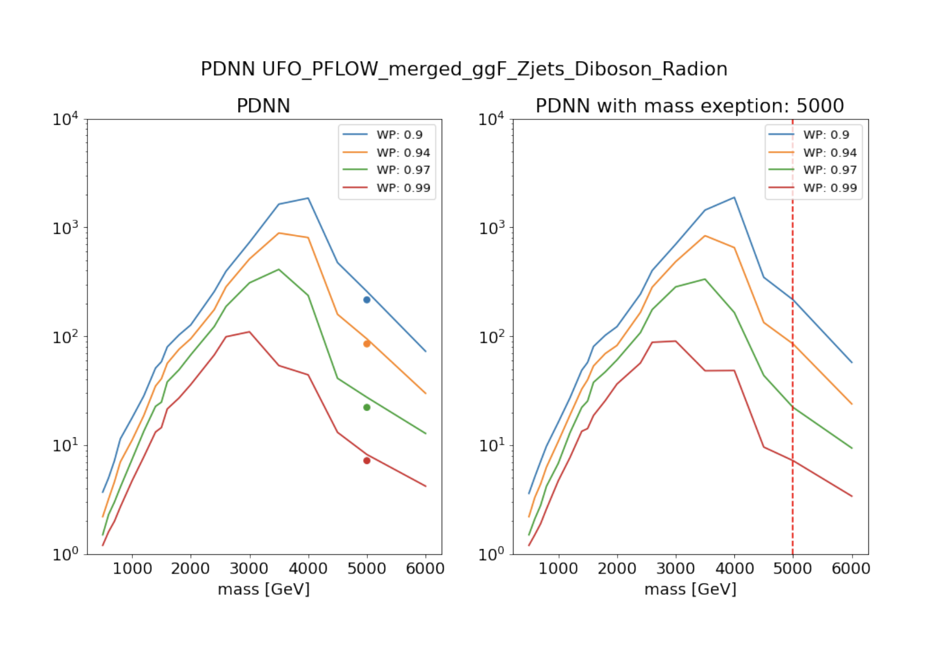
Interpolation capability
Mass = 5TeV NON in the training set
Mass = 5TeV IN the training set
Hypo under test
Hypo under test
Lecce team

Slide 8
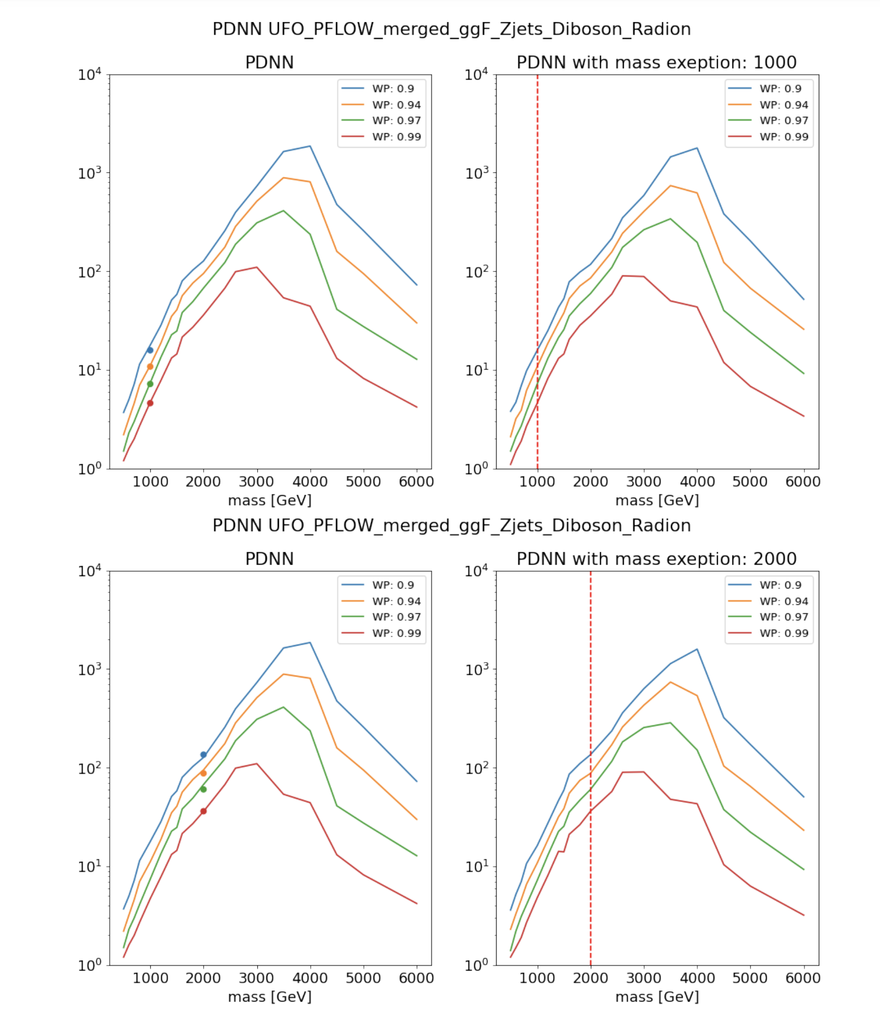
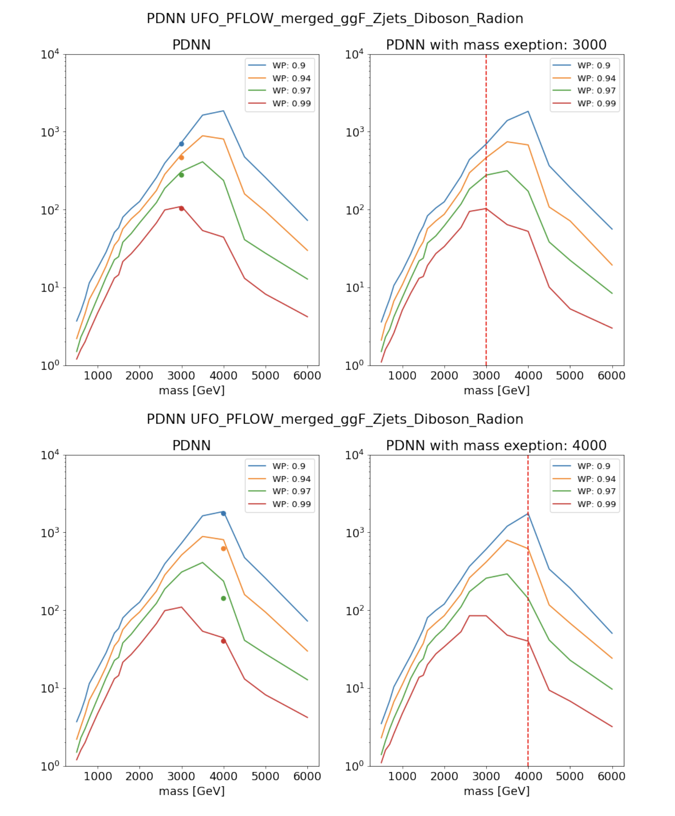
Interpolation capability
Lecce team

Slide 9
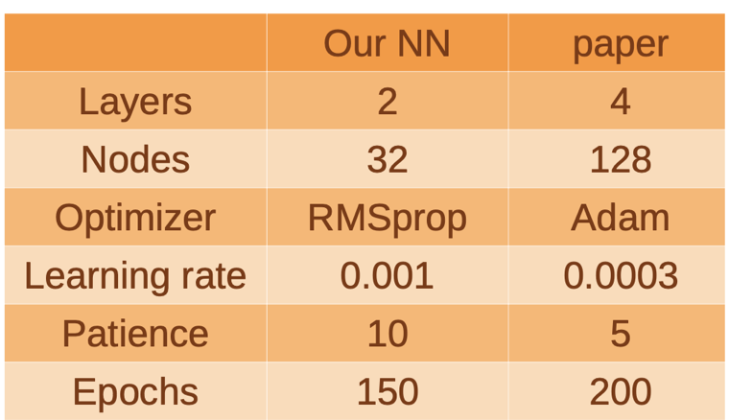
Some studies on pDNN
pDNN configuration: light version
Comparing with pDNN documented in ATL-COM-PHYS-2018-1549 (internal note of Eur. Phys. J. C (2020) 80:1165)
Differences
Lecce team

Slide 10
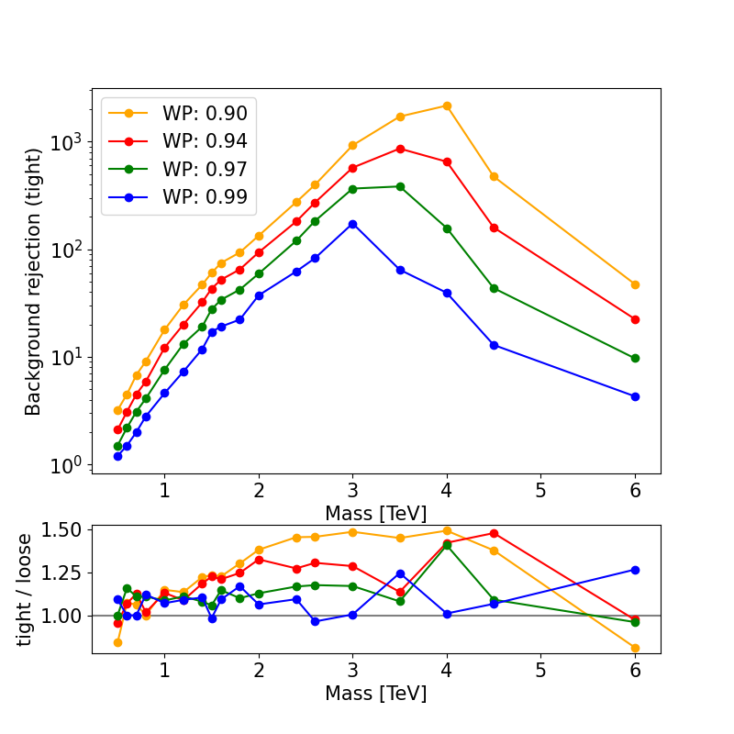
Some studies on pDNN
Light vs ATL-COM-PHYS-2018-1549
CxAOD tag: 33-08, UFO-pFlow, BTagging201903
Lecce team

Slide 11
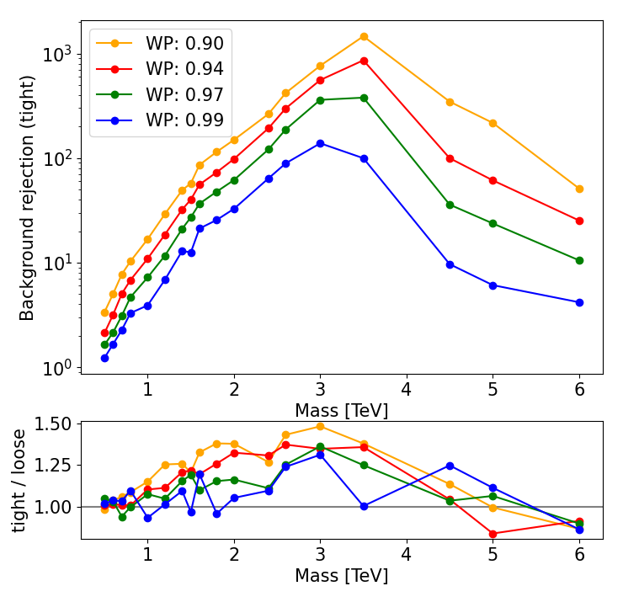
Some studies on pDNN
Light vs ATL-COM-PHYS-2018-1549
CxAOD tag: 33-22, UFO-pFlow, BTagging201903
Lecce team

Slide 12
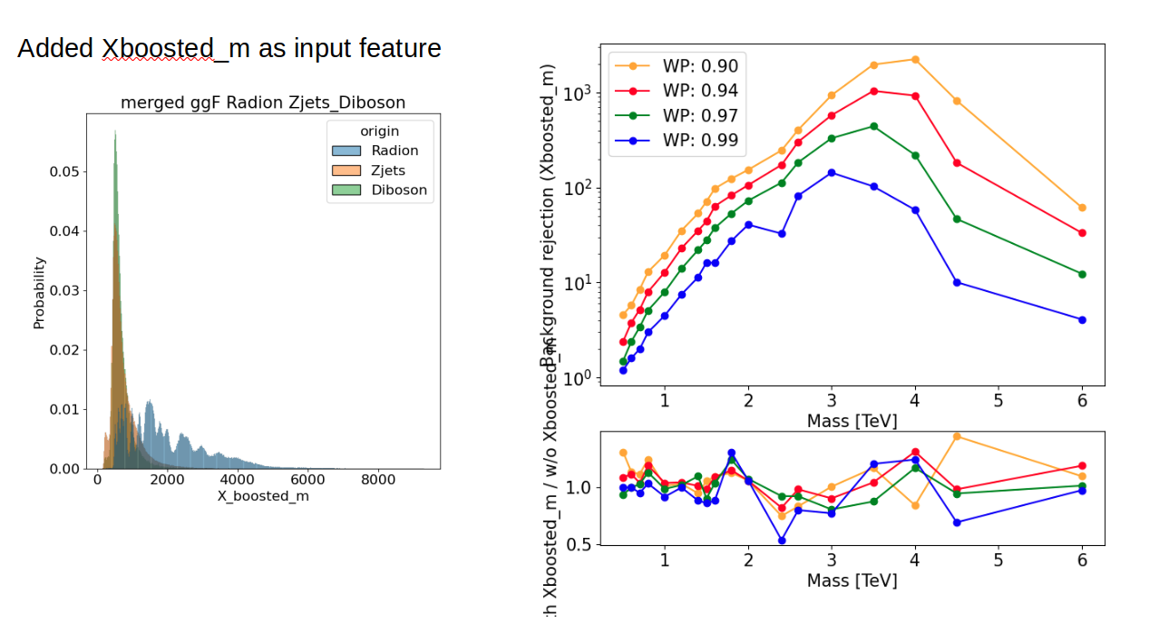
Some studies on pDNN
pDNN configuration: ATL-COM-PHYS-2018-1549
Adding MllJ as input variable
No apparent gain => input variables contain the information in MllJ
Lecce team

Slide 13
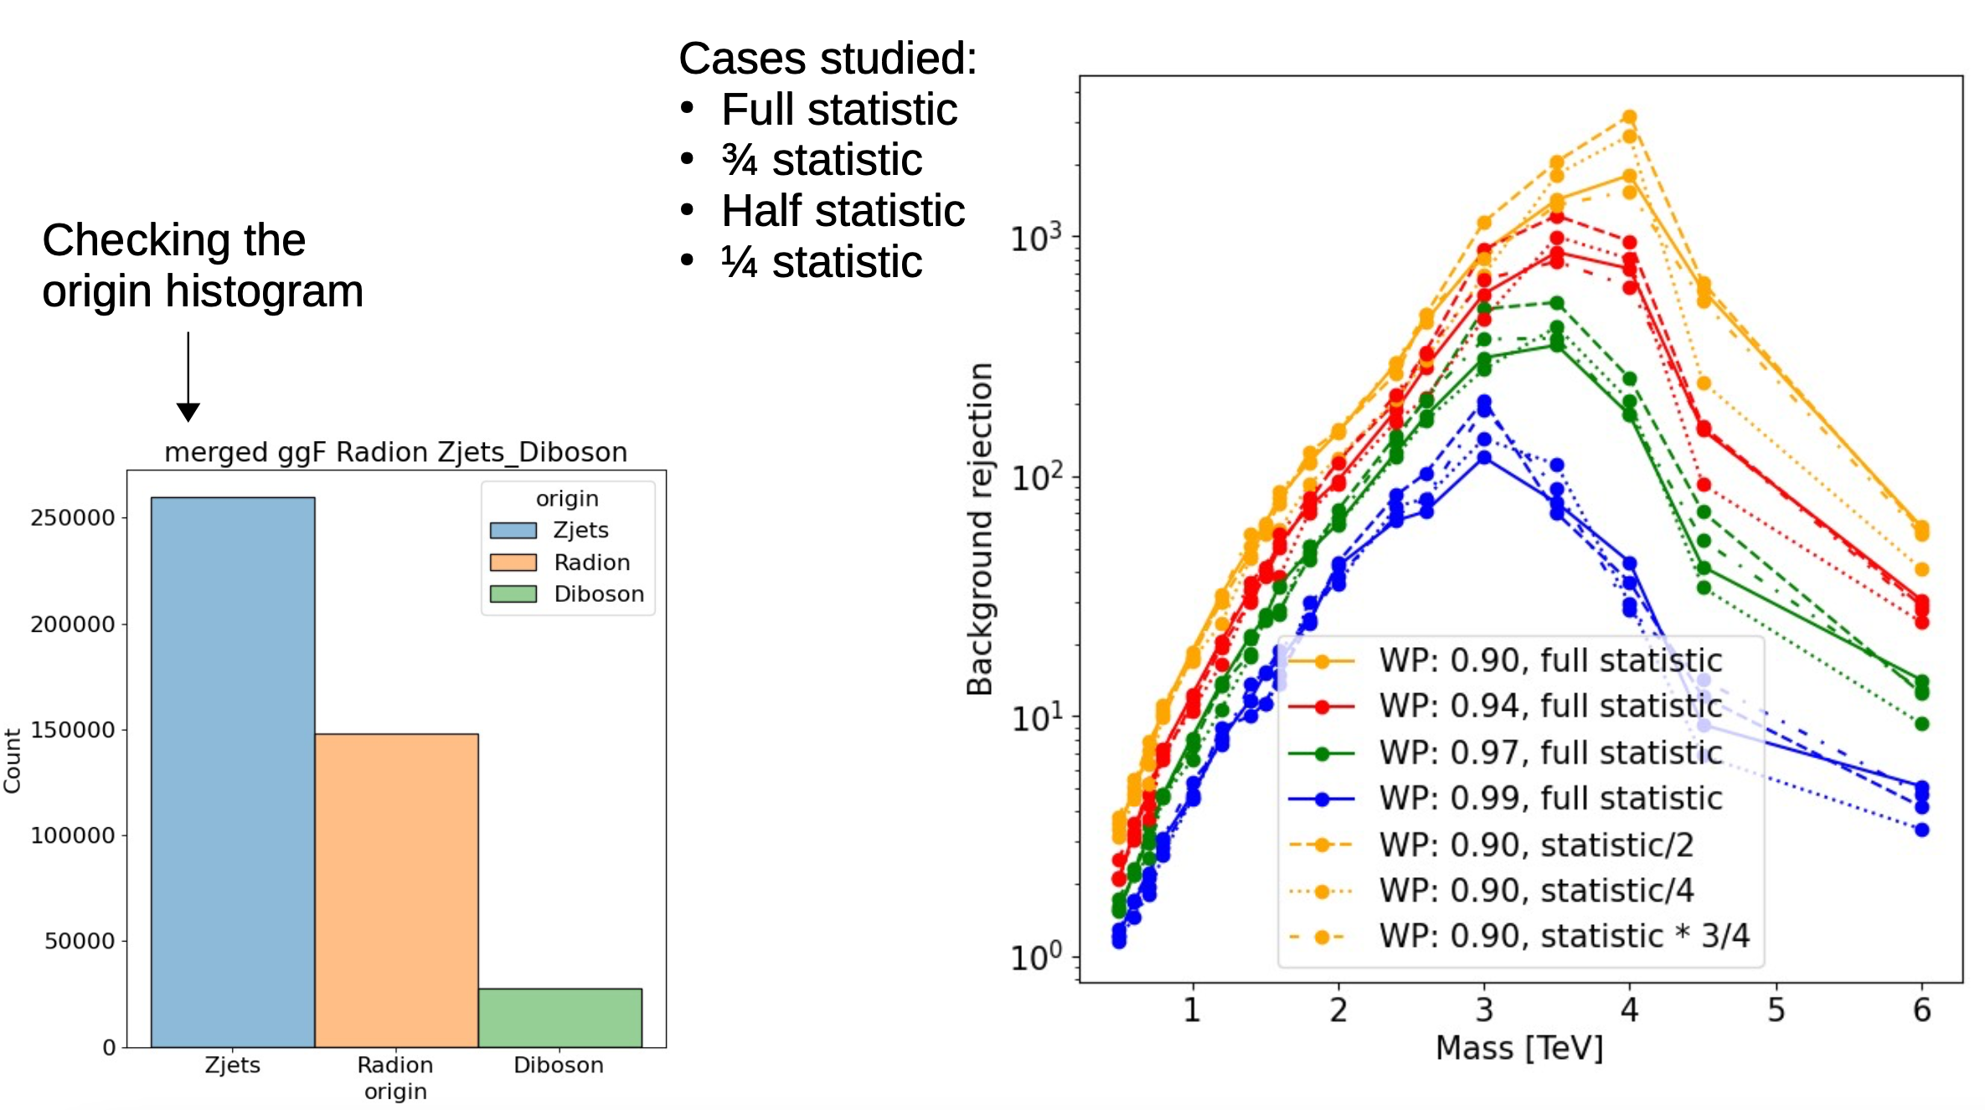
Some studies on pDNN
pDNN configuration: ATL-COM-PHYS-2018-1549:
Stability of the pDNN performance with statistics Full, 3/4, 1/2, 1/4
Relative sample size with 1/2 stat
Lecce team

Slide 14
First comparison of limits from RF
MC16a MC samples, CxAOD tag: 33-08, UFO-pFlow
pDNN: light version
Data = fake, no systematic variations
Radion, ggF/DY, merged regime
4 Signal Regions: MergedLP_Untag/Tag, MergedHP_Untag/Tag
Lecce team

Slide 15
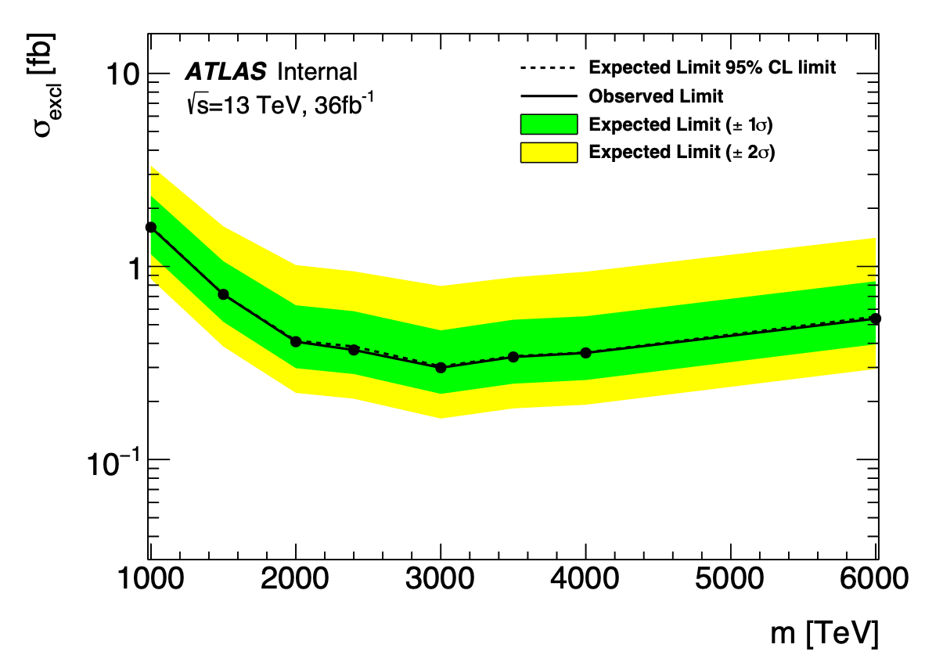
First comparison of limits from RF
MllJ
Cross Section Limit
mass=1000.000000, obs[fb]=1.595659, exp[fb]=1.605636
mass=1500.000000, obs[fb]=0.716886, exp[fb]=0.716932
mass=2000.000000, obs[fb]=0.407849, exp[fb]=0.412634
mass=2400.000000, obs[fb]=0.369438, exp[fb]=0.384979
mass=3000.000000, obs[fb]=0.299021, exp[fb]=0.303847
mass=3500.000000, obs[fb]=0.339803, exp[fb]=0.343007
mass=4000.000000, obs[fb]=0.356745, exp[fb]=0.358377
mass=6000.000000, obs[fb]=0.537053, exp[fb]=0.549133
Lecce team

Slide 16
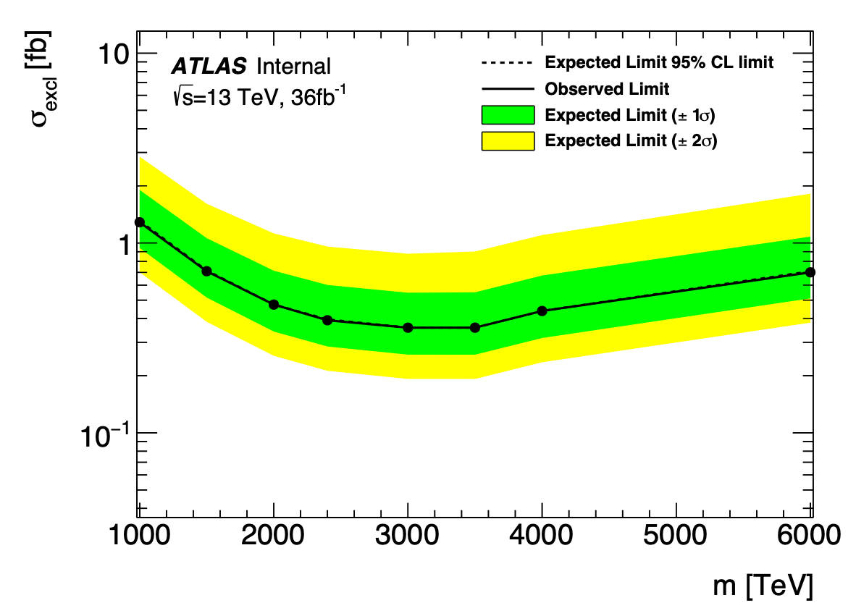
First comparison of limits from RF
pDNN score 200 bin
Cross Section Limit
mass=1000.000000, obs[fb]=1.285975, exp[fb]=1.307315
mass=1500.000000, obs[fb]=0.710017, exp[fb]=0.716263
mass=2000.000000, obs[fb]=0.473827, exp[fb]=0.474285
mass=2400.000000, obs[fb]=0.391747, exp[fb]=0.395557
mass=3000.000000, obs[fb]=0.358052, exp[fb]=0.358318
mass=3500.000000, obs[fb]=0.358118, exp[fb]=0.358055
mass=4000.000000, obs[fb]=0.438339, exp[fb]=0.438441
mass=6000.000000, obs[fb]=0.700799, exp[fb]=0.709310
Lecce team

Slide 17
First comparison of limits from RF
MllJ
pDNN score 200 bin
Cross Section Limit
mass=1000.000000, exp[fb]=1.605636
mass=1500.000000, exp[fb]=0.716932
mass=2000.000000, exp[fb]=0.412634
mass=2400.000000, exp[fb]=0.384979
mass=3000.000000, exp[fb]=0.303847
mass=3500.000000, exp[fb]=0.343007
mass=4000.000000, exp[fb]=0.358377
mass=6000.000000, exp[fb]=0.549133
Cross Section Limit
mass=1000.000000, exp[fb]=1.307315
mass=1500.000000, exp[fb]=0.716263
mass=2000.000000, exp[fb]=0.474285
mass=2400.000000, exp[fb]=0.395557
mass=3000.000000, exp[fb]=0.358318
mass=3500.000000, exp[fb]=0.358055
mass=4000.000000, exp[fb]=0.438441
mass=6000.000000, exp[fb]=0.709310
Lecce team

Slide 18
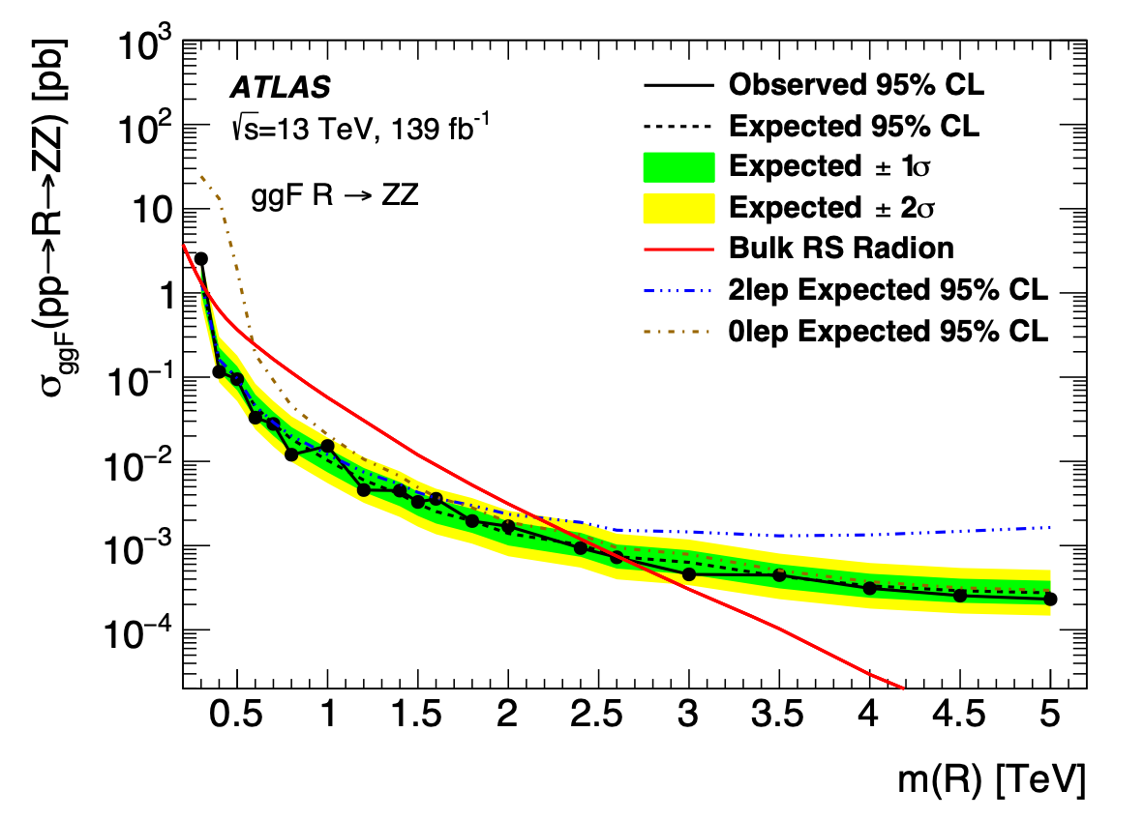
Comparison with published paper
MllJ
MllJ
139 ifb
36 ifb
No systematic errors
https://atlas.web.cern.ch/Atlas/GROUPS/PHYSICS/PAPERS/HDBS-2018-10/figaux_07a.pdf
~10 fb @ 1TeV
~1 fb @ 4TeV
~2 fb @ 1TeV
~0.4 fb @ 4TeV
Lecce team

Slide 19
Next steps
Ready to move to r33-22
Moving to pDNN optimisation
Trying to follow ATL-COM-PHYS-2020-766, HH -> bbττ
TO DO:
Training set preparation:
Equalize (by reweighting) the stat. of signal samples;
Equalize (by reweighting) the stat. of total signal sample to total background
Consider all physics backgrounds processes (with their MC weights)
Scale input variables (median to zero, interquartile range to 1) taking into account the training weights
Technical optimisations:
Hyperparameter optimization on random realizations
k-fold cross validation splitting events in even/odd → remove high variance realizations
Reconsider input variables
Lecce team

Slide 20
Backup

Slide 21
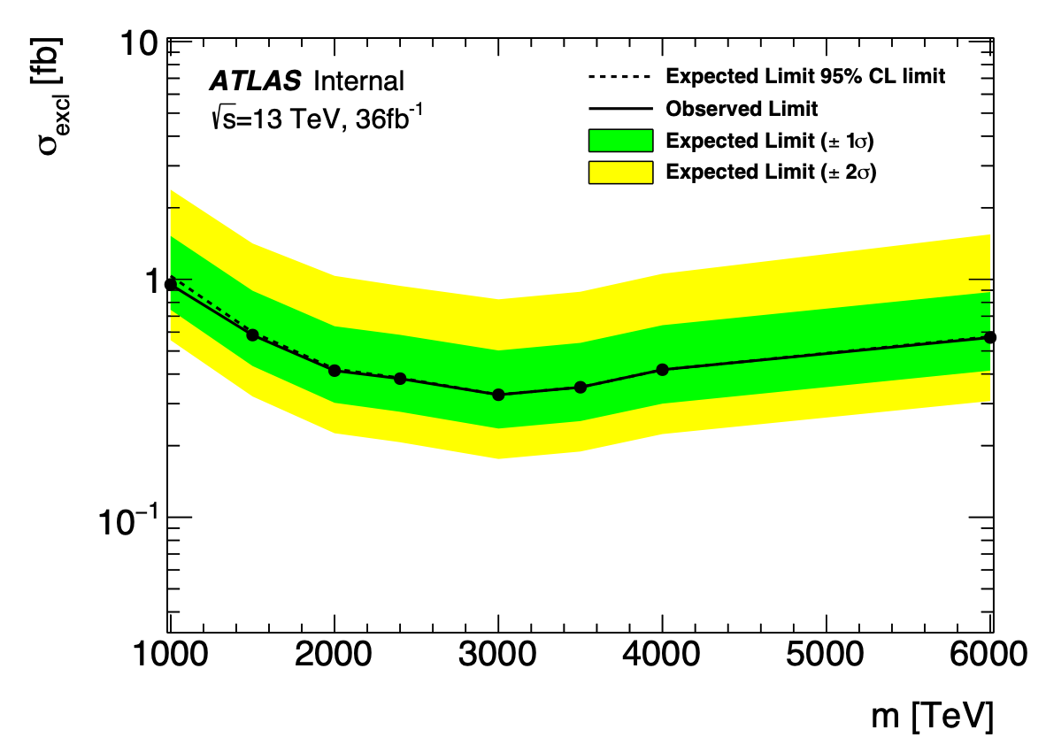
First comparison of limits from RF
pDNN score
1000 bins
Cross Section Limit
mass=1000.000000, obs[fb]=0.950482, exp[fb]=1.033647
mass=1500.000000, obs[fb]=0.583156, exp[fb]=0.599691
mass=2000.000000, obs[fb]=0.413288, exp[fb]=0.420130
mass=2400.000000, obs[fb]=0.382443, exp[fb]=0.385068
mass=3000.000000, obs[fb]=0.327206, exp[fb]=0.327483
mass=3500.000000, obs[fb]=0.351858, exp[fb]=0.352043
mass=4000.000000, obs[fb]=0.417012, exp[fb]=0.416731
mass=6000.000000, obs[fb]=0.569377, exp[fb]=0.574183
Lecce team

Slide 22
RS_ZZ_GGF_Merged
Atlas link with auxiliary plots HDBS-2018-10
Eur. Phys. J. C (2020) 80:1165
10149 MC
Total 14+26+769+2716 = 3524 = 1.34 * expected according to Eur. Phys. J. C (2020) 80:1165
Region: L2_MergHP_GGF_ZZ_Tag_SR
Diboson Integral=5.941466 +/- 0.370521
Radion Integral=0.000000 +/- 0.000000
Wjets Integral=0.000040 +/- 0.000008
Zjets Integral=7.874548 +/- 1.580589
stop Integral=0.116039 +/- 0.023291
ttbar Integral=0.187731 +/- 0.037682
SumMC Integral=14.119825
Postfit Integral=14.119824 + 0.319207 - 0.319214
Data Integral=14.119779
Prefit integral=14.119824
Region: L2_MergHP_GGF_ZZ_Untag_SR
Diboson Integral=112.358536 +/- 7.006886
Radion Integral=0.000000 +/- 0.000000
Wjets Integral=0.000040 +/- 0.000008
Zjets Integral=653.897095 +/- 131.251007
stop Integral=0.723407 +/- 0.145203
ttbar Integral=2.416062 +/- 0.484955
SumMC Integral=769.395142
Postfit Integral=769.395142 + 5.543274 - 5.543335
Data Integral=769.291199
Prefit integral=769.395142
0.51
0.81
Region: L2_MergLP_GGF_ZZ_Tag_SR
Diboson Integral=3.666073 +/- 0.228623
Radion Integral=0.000000 +/- 0.000000
Wjets Integral=0.000040 +/- 0.000008
Zjets Integral=21.808302 +/- 4.377388
stop Integral=0.141827 +/- 0.028468
ttbar Integral=0.368419 +/- 0.073949
SumMC Integral=25.984659
Postfit Integral=25.984661 + 0.359983 - 0.359983
Data Integral=25.864803
Prefit integral=25.984661
Region: L2_MergLP_GGF_ZZ_Untag_SR
Diboson Integral=98.287056 +/- 6.129363
Radion Integral=0.000000 +/- 0.000000
Wjets Integral=0.563510 +/- 0.113108
Zjets Integral=2606.893555 +/- 523.258789
stop Integral=1.392521 +/- 0.279508
ttbar Integral=8.703288 +/- 1.746934
SumMC Integral=2715.840088
Postfit Integral=2715.839844 + 3.307373 - 3.307617
Data Integral=2715.784424
Prefit integral=2715.839844
0.91
1.4
0.62
1.7
3.3
0.63
1.7
Lecce team

Slide 23
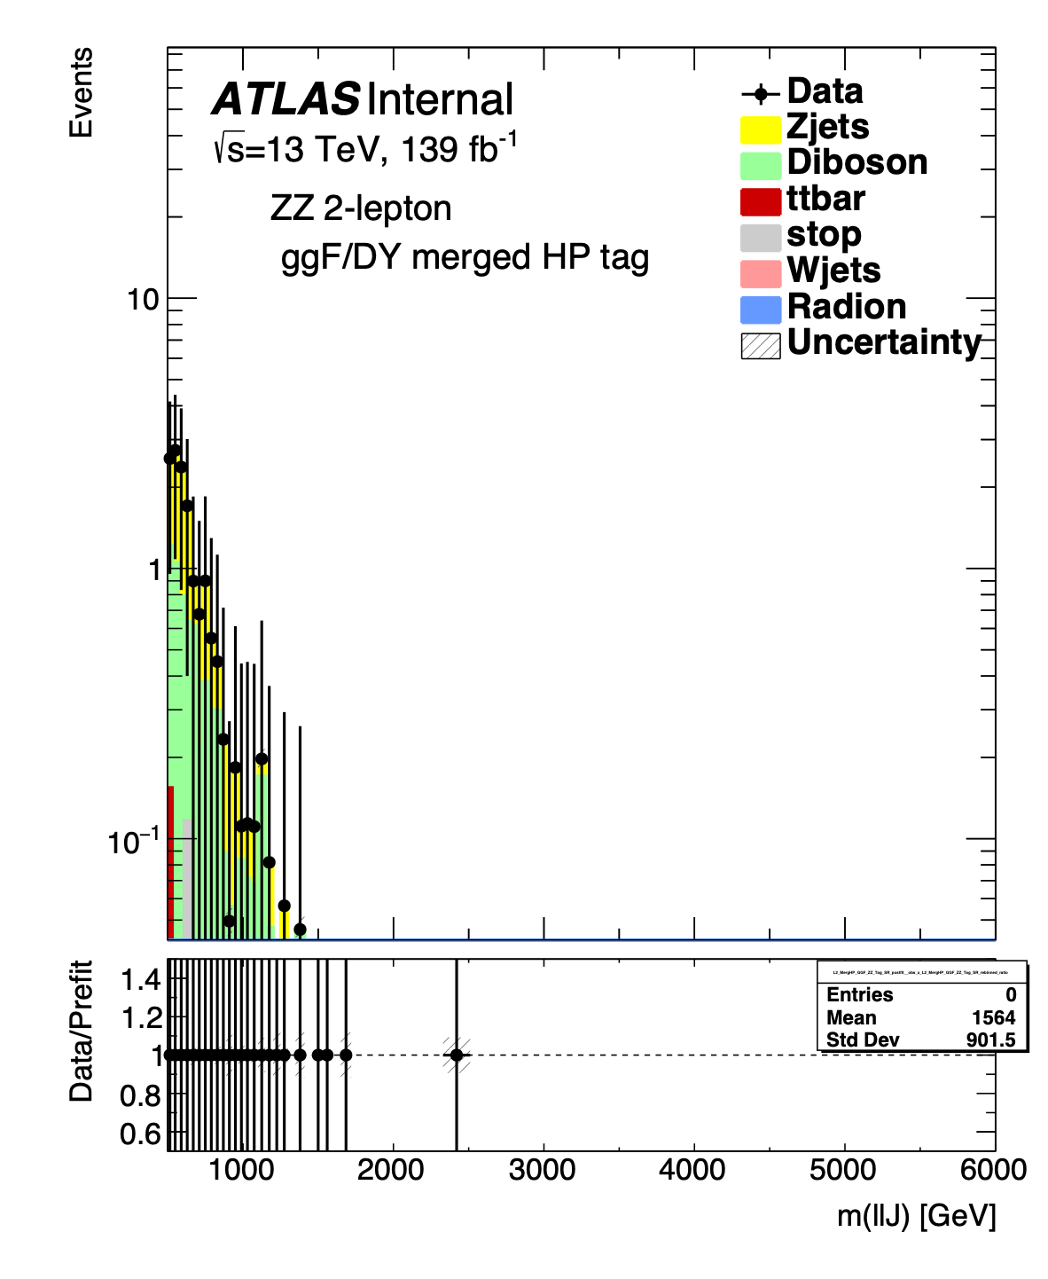
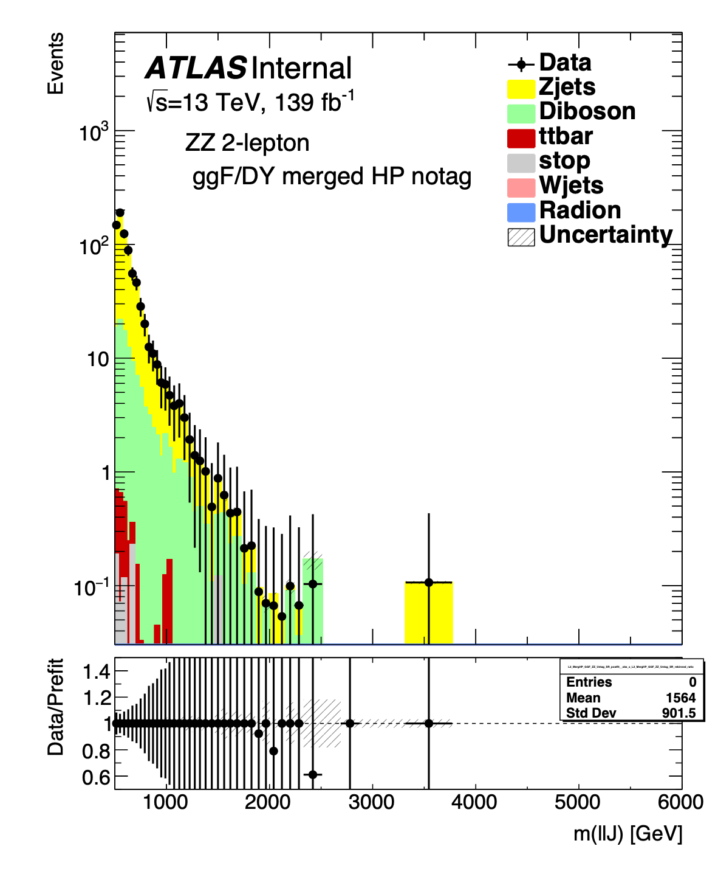
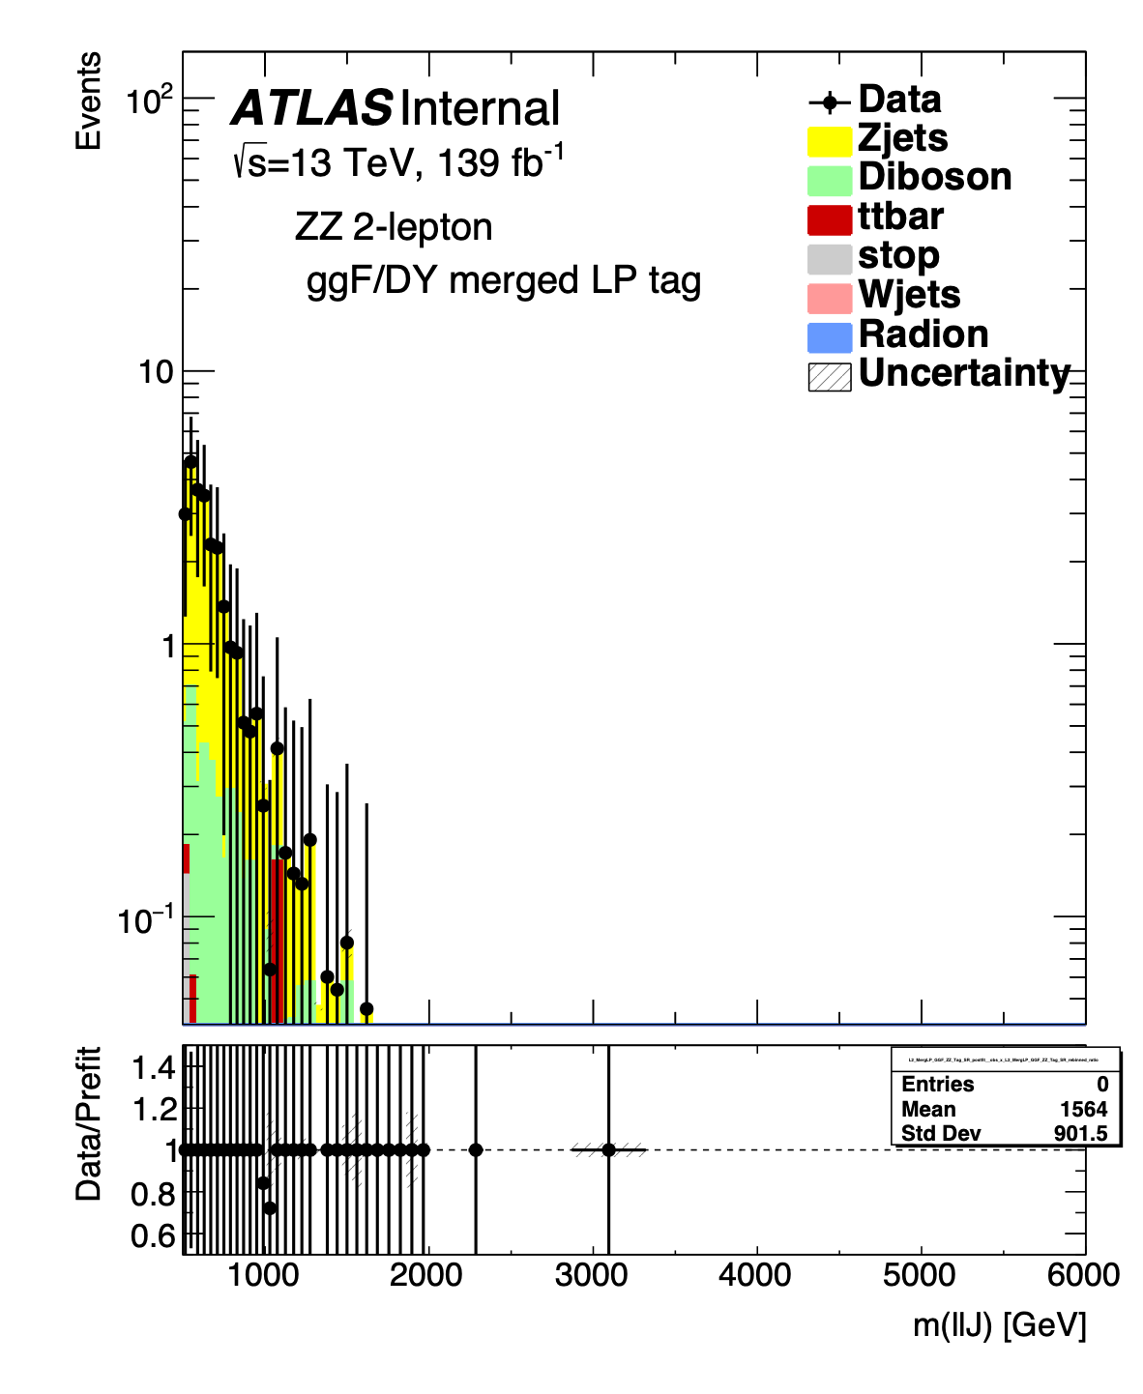
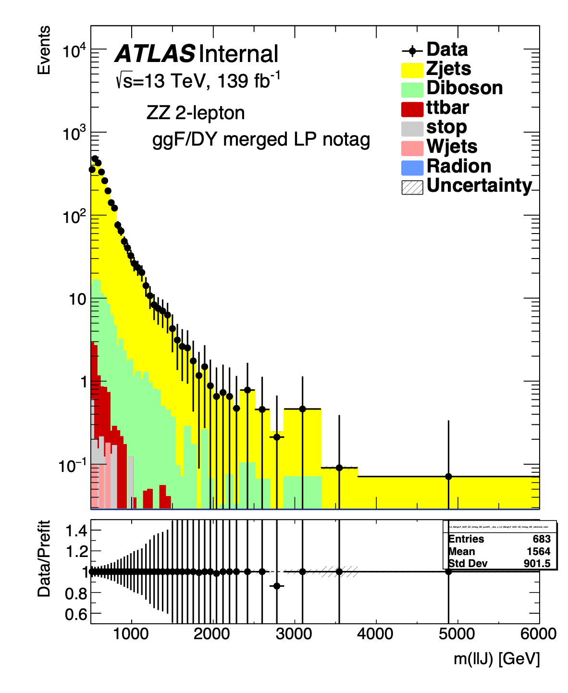
RS_ZZ_GGF_Merged
python RS_ZZ_GGF_Merged_HP_Tag.py 2MergSR 1000 Radion
basedirectory="/nfs/kloe/einstein4/HDBS/PDNNTestAGS/ntuples" # as before but from Lecce
“Radion_1000":451147 instead of 309993 (from original Rob macro)
./runPreFit.py ../runSS/output/ZZSignalRegionsGGF/ws/ExampleVV_Radion_1000_test.root
Lecce team

Slide 24
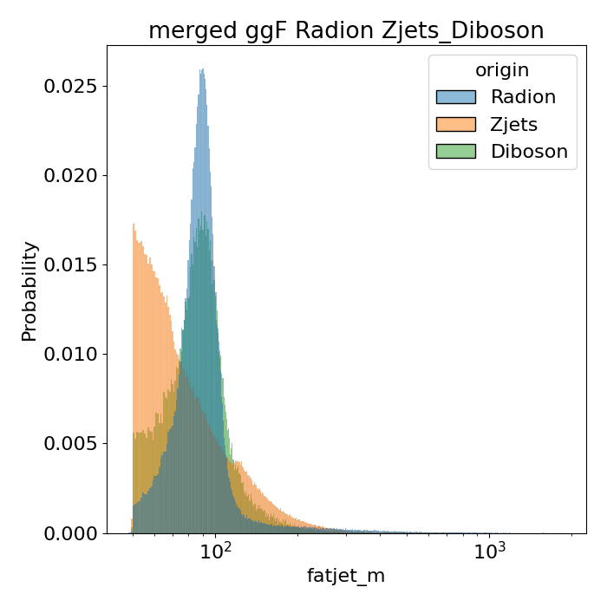
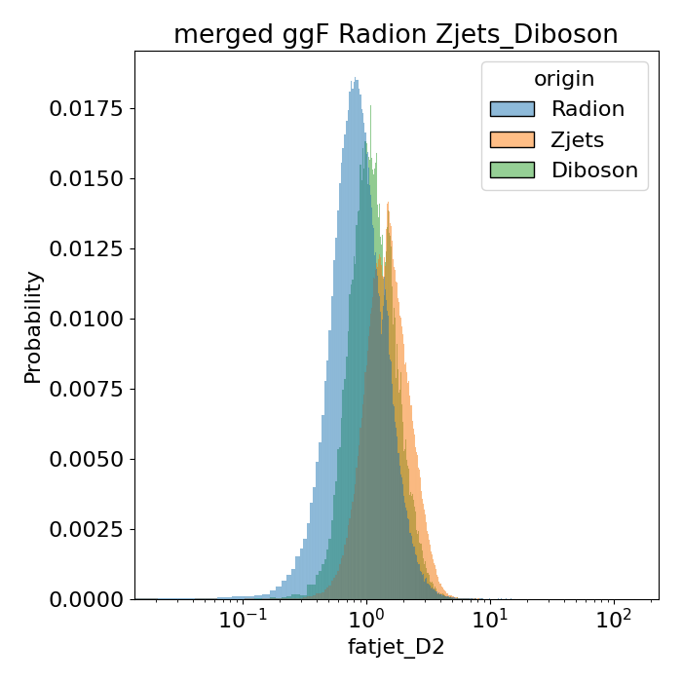
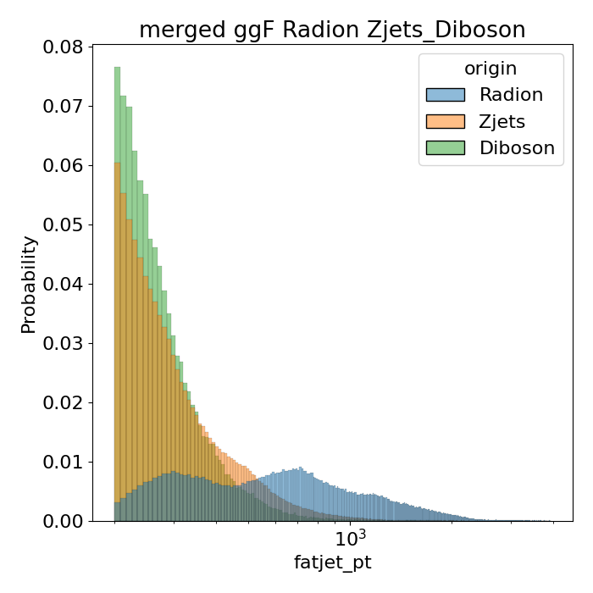
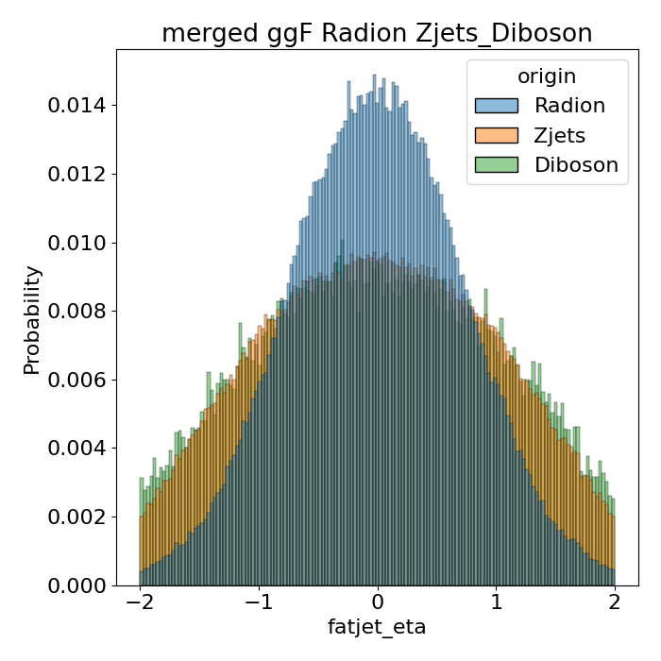
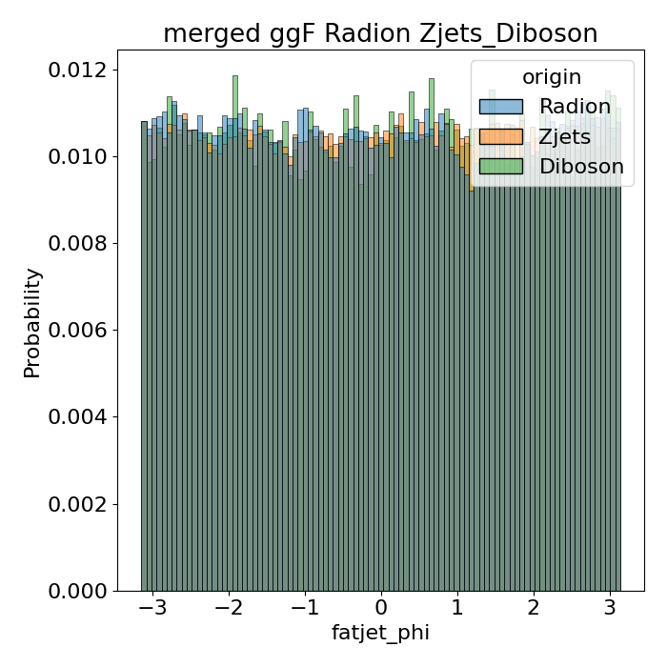
Variabili attualmente utilizzate
Fatjet: m, d2, pt, eta, phi
Stefania Spagnolo
Monday Dec 6th, 2021

Slide 25
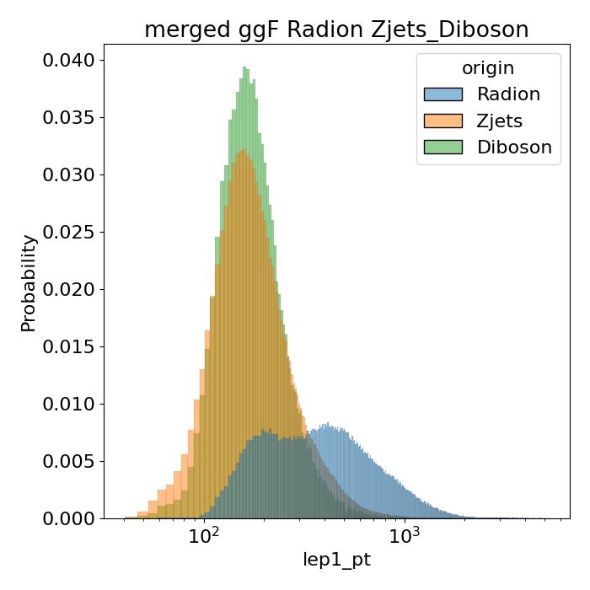
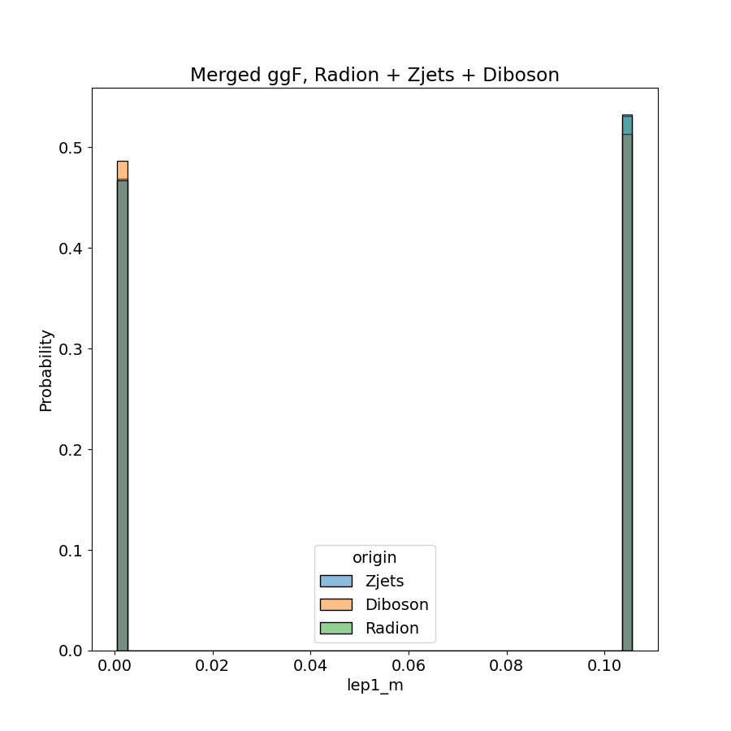
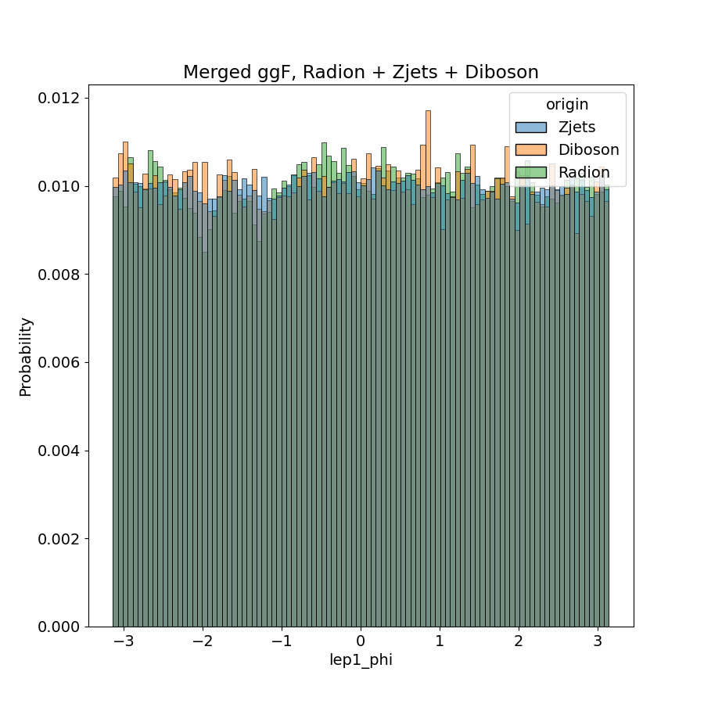
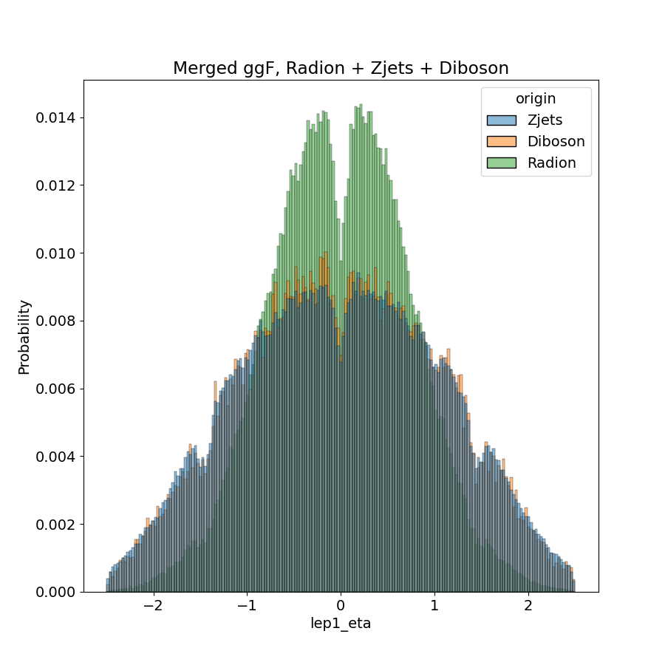
Variabili attualmente utilizzate
Lepton 1: m, pt, eta, phi
Stefania Spagnolo
Monday Dec 6th, 2021

Slide 26
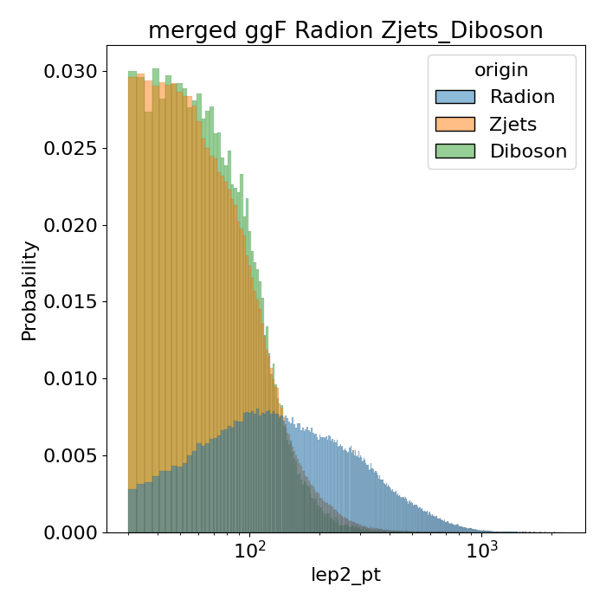
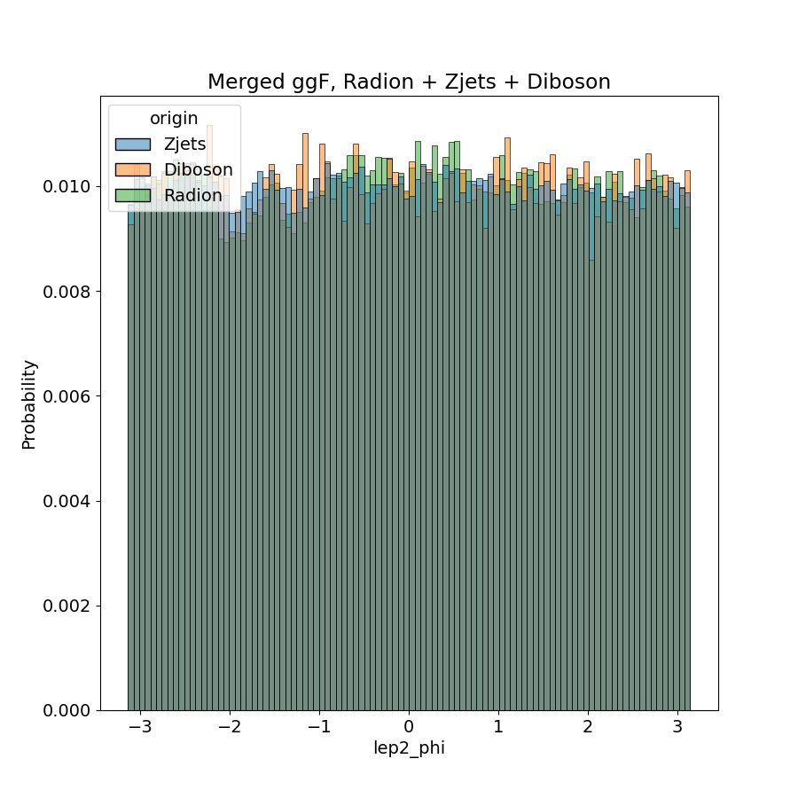
Variabili attualmente utilizzate
Lepton 2: m, pt, eta, phi
Stefania Spagnolo
Monday Dec 6th, 2021

Slide 27
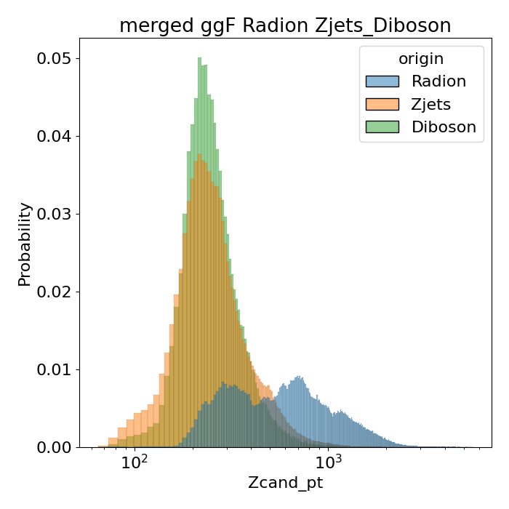
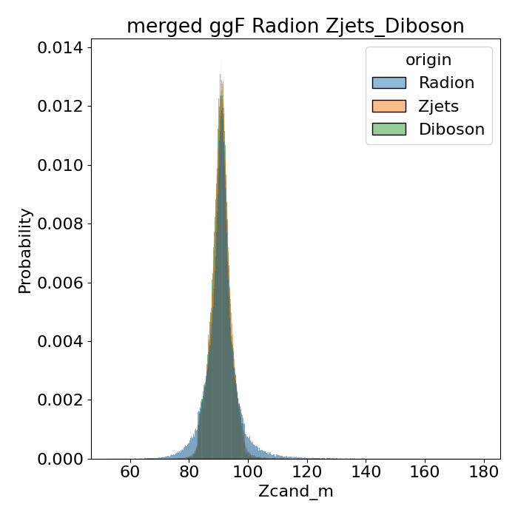
Variabili attualmente utilizzate
Leptonic Z: m, pt
Stefania Spagnolo
Monday Dec 6th, 2021

Slide 28
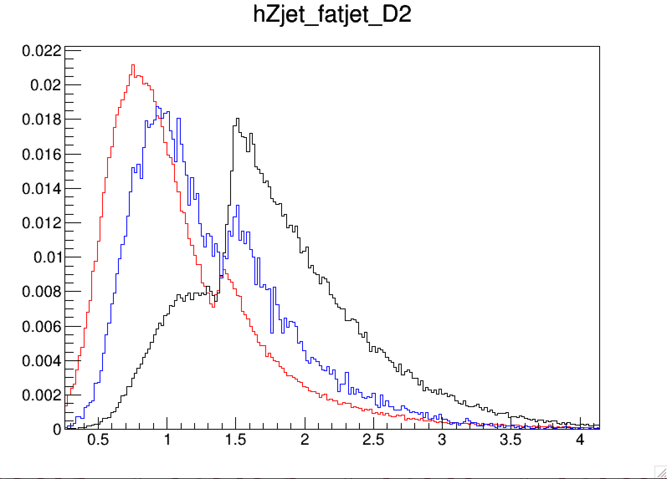
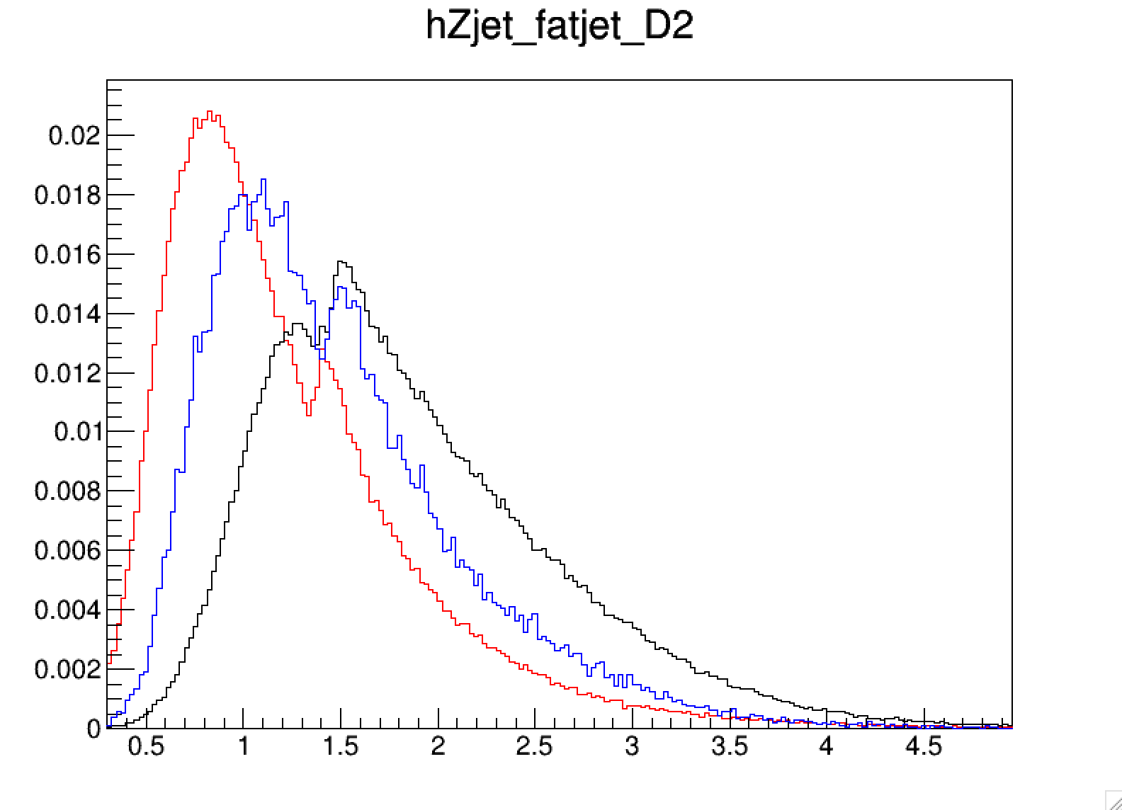
Pass_MergHP_GGF_ZZ_Tag_SR == 1 || Pass_MergHP_GGF_ZZ_Untag_SR == 1 || Pass_MergHP_GGF_WZ_SR == 1 || Pass_MergLP_GGF_ZZ_Tag_SR == 1 || Pass_MergLP_GGF_ZZ_Untag_SR == 1 || Pass_MergHP_GGF_ZZ_Tag_ZCR == 1 || Pass_MergHP_GGF_WZ_ZCR == 1 || Pass_MergHP_GGF_ZZ_Untag_ZCR == 1 || Pass_MergLP_GGF_ZZ_Tag_ZCR == 1 || Pass_MergLP_GGF_ZZ_Untag_ZCR == 1 || Pass_MergLP_GGF_WZ_SR == 1 || Pass_MergLP_GGF_WZ_ZCR == 1
Signal Regions only
Signal+Control Regions
Z+jets
Z+jets
Di-Boson
Di-Boson
Radion
Radion
Stefania Spagnolo
Monday Dec 6th, 2021

