Slide 1
Italian activity in the
High field Magnet program for FCC-hh
Stefania farinon

Slide 2

THE MILANO-GENOVA INFN TEAM
The Milan and Genoa sections of INFN have been close collaborators since the project for the design, construction and testing of a pulsed curved dipole for the SIS300 at GSI (started in 2005), especially thanks to the friendship between Giovanni Volpini and Pasquale Fabbricatore.
The collaboration continued with the European project EuroCircol, intended as the first step towards the development of the 16 T Nb₃Sn dipoles for the FCC.
We are presently collaborating on several projects:
  FalconD (part of the High Field Magnet Program)
  SIG – Superconducting Ion Gantry
  HITRIplus – Heavy Ion Therapy Research Integration
  I.FAST – Innovation Fostering in Accelerator Science and Technology
  Milano LASA
    Lucio Rossi
    Massimo Sorbi
    Marco Statera
    Marco Prioli
    Ernesto De Matteis
    Samuele Mariotto
    Riccardo Valente
    Stefano Sorti (AdR)
  Sezione di Genova
    Stefania Farinon
    Riccardo Musenich
    Andrea Bersani
    Barbara Caiffi
    Alessandra Pampaloni
    Filippo Levi (PhD)
    Sergio Burioli (PhD)
    Andrea Gagno (PhD)
    Michela Bracco (AdR)
  Collaboration with CERN
    Amalia Ballarino
    Friedrich Lackner
    Diego Perini
    Davide Tommasini

Slide 3


Eurocircol
Started in June 2015
Ended in December 2019

Slide 4

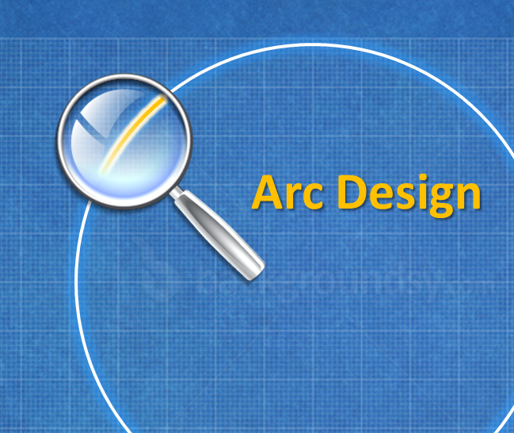
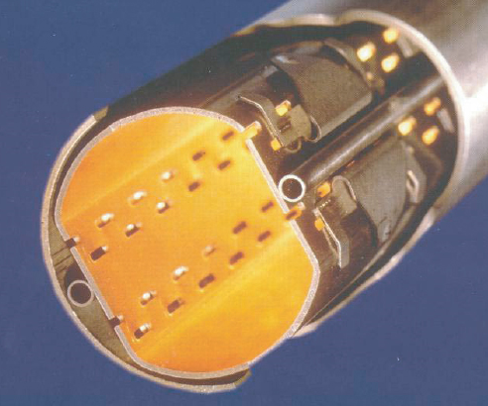
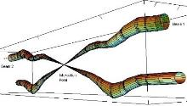
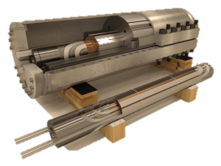
EuroCirCol project
The EuroCirCol project focused on the key design questions which determine the feasibility of a 100 TeV hadron collider in a 100 km long tunnel
It consisted of 5 WPs:
Our group was involved in WP5, led by D.Tommasini, for the development of the 16 T dipole magnet design:
  Study and assess different dipole design options
  Develop a cost model for the dipole
  Develop EM and mechanical design
  Devise a quench protection concept
WP1 - Management
WP2 - Arc design
WP3 – EIR design
WP4 - Cryo Beam Vacuum
WP5 – High field magnet
From M.Benedikt presentation at EuroCirCol kick-off meeting
https://indico.cern.ch/event/389991/contributions/931909/

Slide 5
Participants person months
Partner | WP1 | WP2 | WP3 | WP4 | WP5 | Total PM | Total Cost | EU Funding
CERN | 128 | 90 | 42 | 84 | 80 | 424 | € 3,587,500 | € 138,000
TUT |  |  |  |  | 40 | 40 | € 325,188 | € 166,000
CEA |  | 108 |  |  | 36 | 144 | € 1,018,770 | € 514,000
CNRS |  | 64 |  |  |  | 64 | € 508,667 | € 213,000
KIT |  |  |  | 15 |  | 15 | € 124,500 | € 63,000
TUD |  | 84 |  |  |  | 84 | € 553,905 | € 278,000
INFN |  |  | 30 | 94 | 36 | 160 | € 836,938 | € 422,000
UT |  |  |  |  | 38 | 38 | € 219,185 | € 110,000
ALBA |  |  |  | 100 |  | 100 | € 332,858 | € 169,000
CIEMAT |  |  |  | 54 | 48 | 102 | € 383,250 | € 193,000
STFC |  |  | 48 | 96 |  | 144 | € 595,665 | € 299,000
UNILIV | 22 |  |  |  |  | 22 | € 256,844 | € 192,000
UOXF |  |  | 88 |  |  | 88 | € 760,691 | € 242,000
KEK |  | 12 |  |  | 12 | 24 | € 158,445 | € 0
EPFL |  |  | 36 |  |  | 36 | € 360,000 | € 0
UNIGE |  |  |  |  | 24 | 24 | € 176,730 | € 0
SUM | 150 | 358 | 244 | 443 | 314 | 1509 | € 10,199,135 | € 2,999,000
aa
EU funding to INFN for WP5:
137 k€
From M.Benedikt presentation at EuroCirCol kick-off meeting
https://indico.cern.ch/event/389991/contributions/931909/

Slide 6
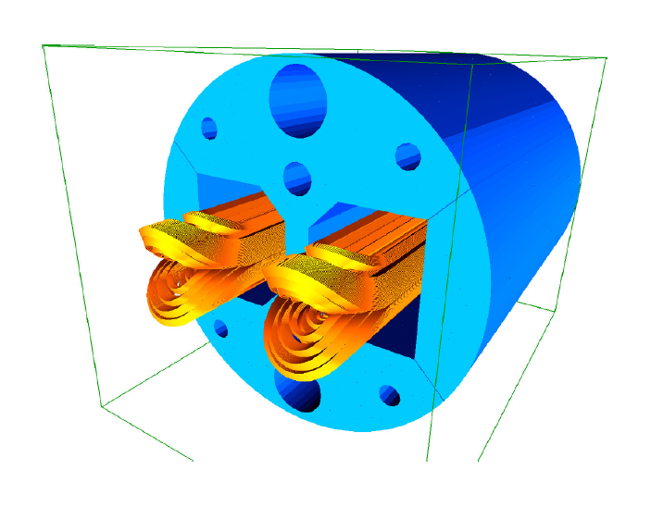
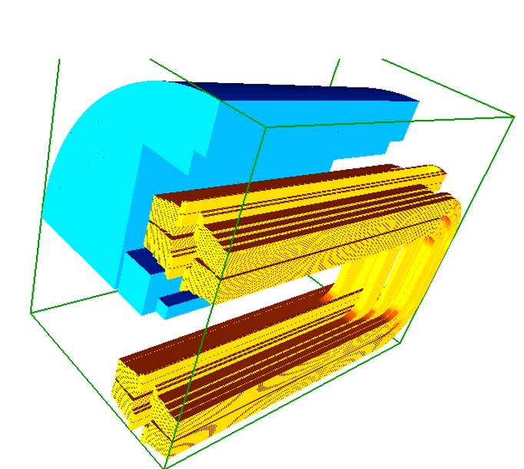
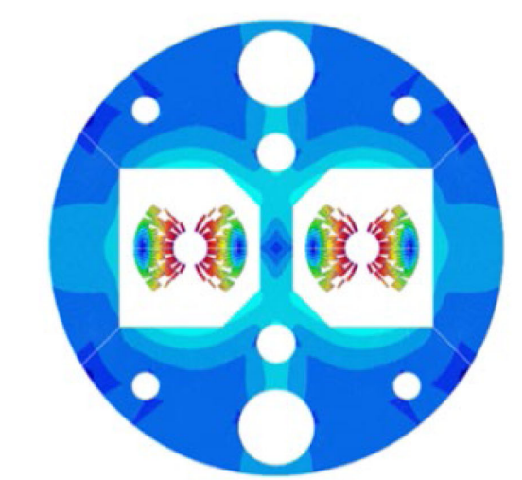
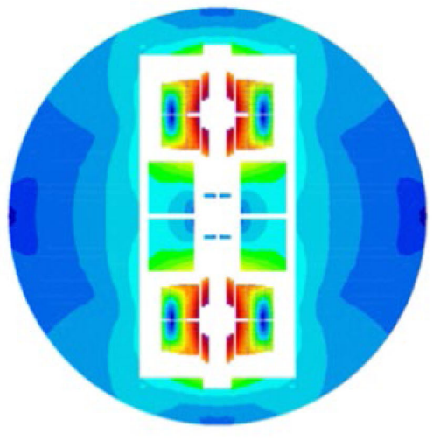


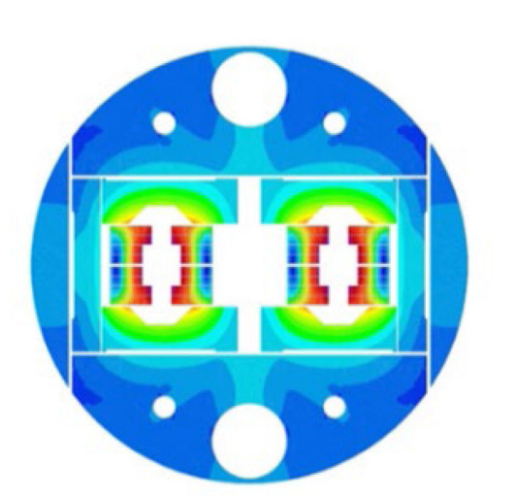
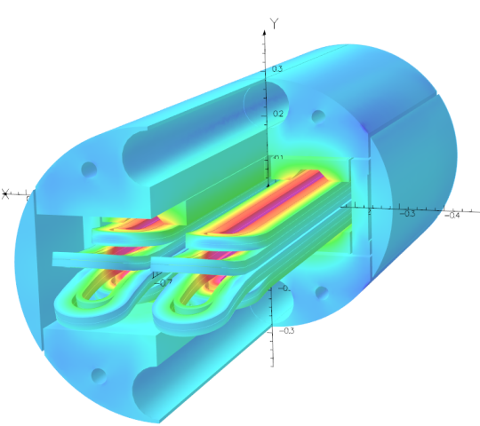
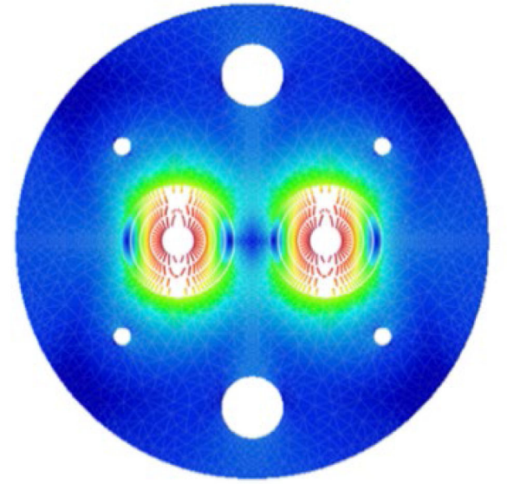

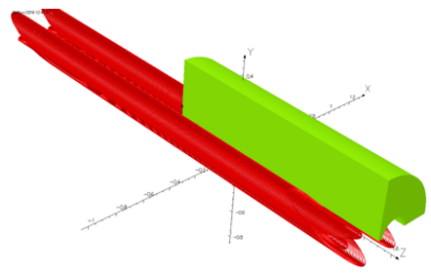

EuroCirCol WP5 strategy
The EuroCirCol WP5 strategy was grounded on the exploration of different design options for the 16 T Nb₃Sn dipoles based on the same parameter space:
  Cosine theta
  block coil
  common coil
  CCT
contribution external to EuroCirCol

Slide 7
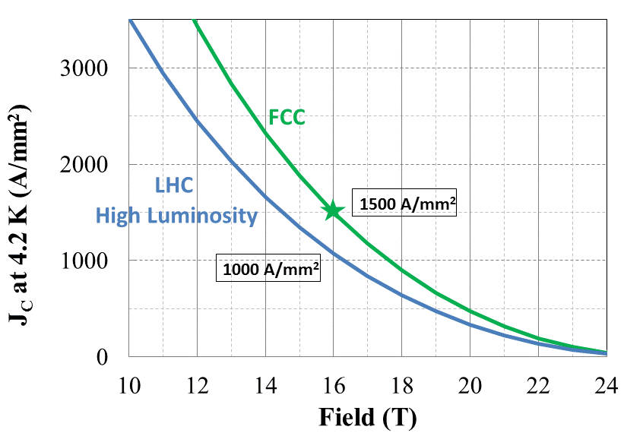
Common assumptions for the WP5 designs
To have a fair comparison of the 4 options, a common set of parameters was set:
Parameter | Value
bore inner diameter | 50 mm
beam distance | 250 mm
bore nominal field | 16 T
operating temperature | 1.9 K
field harmonics geo/sat | ≤ 3/10 units
J_{C} @ 4.2 K, 16 T | 1500 A/mm²
Operation on the loadline | 86%
outer yoke diameter | 660 mm
min/max strand diameter | 0.7/1.1 mm
max. Number of strand in cable | 40
insulation thickness | 0.15 mm
Min. Cu/nonCu ratio | 0.8
stress limit on coil ambient/cold | 150/200 MPa
Max hot spot temperature | 350 K
    We initially tried to fit the FCC-hh dipoles in the same tunnel as the LHC (beam distance 194 mm), but because of the huge cross-talk, it was not possible to correct b2 better than 40 units
    In 2015, J_{C}(4.2K,16T)=1500 A/mm² was the target current density for the FCC dipole, which is still
    far enough away to be achieved
    in actual conductor development
    Preliminary studies on Nb₃Sn cables seemed to indicate that 200 MPa could be withstood at cold without major degradation. More recently, it has been assessed that 150 MPa regardless of temperature is a safer upper limit (this raises doubts about the absolute technical feasibility of reaching 16 T with this type of magnets)

Slide 8
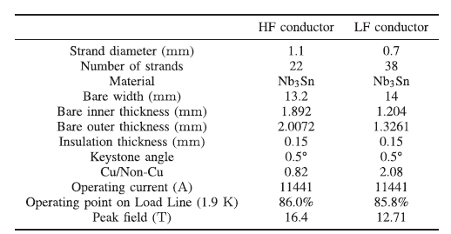
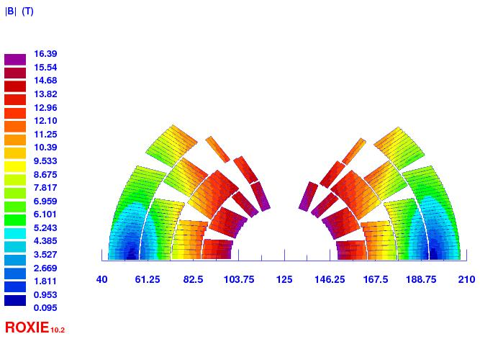
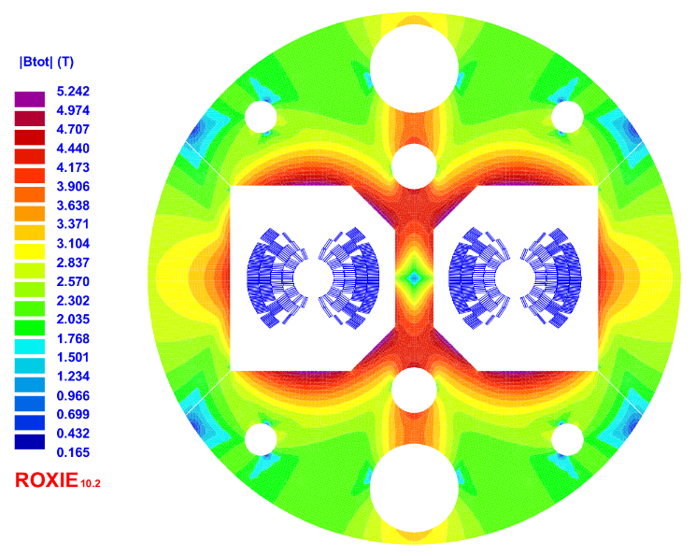
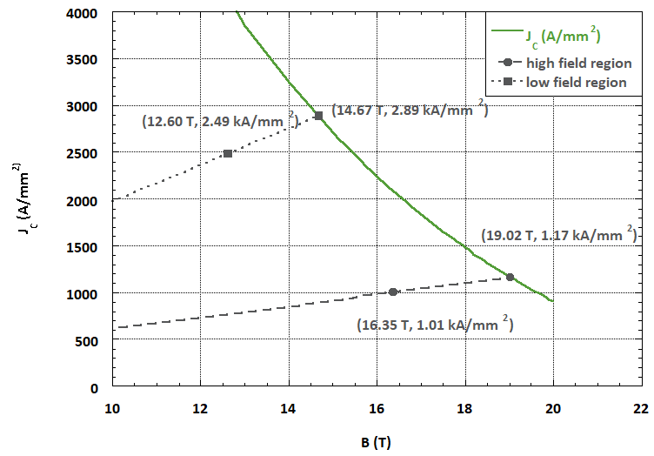
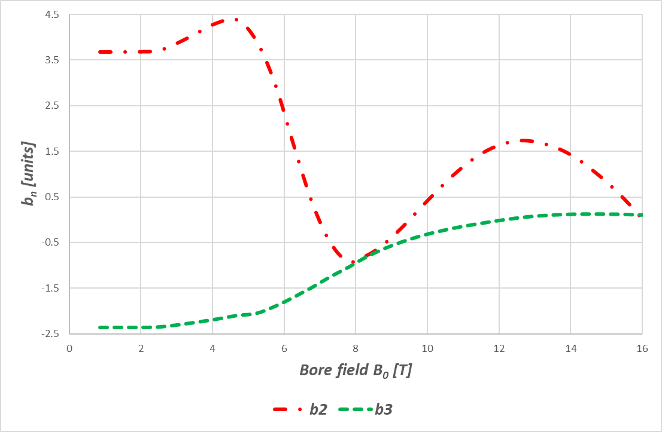
The INFN cosϑ option – electromagnetic design
the magnet is in 4 layers, 2 double pancakes, with 2 different kinds of cables:
to satisfy the field quality requirements, the cross-talk has been corrected shaping the iron yoke and designing a-symmetric coils
The margin on the load line is 14% for both high and low field region

Slide 9
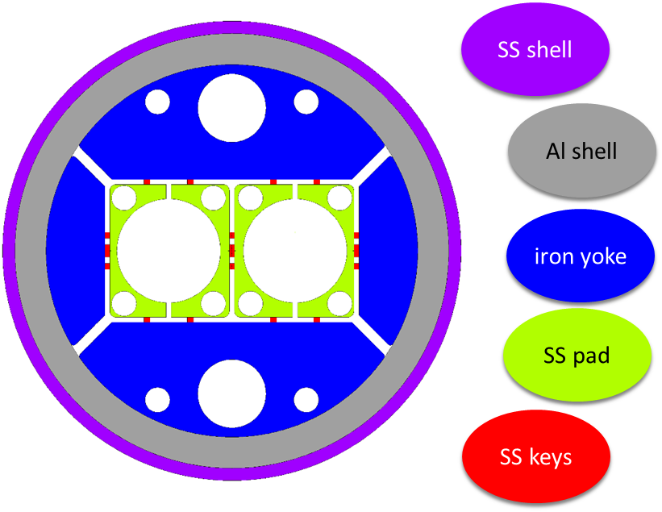
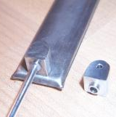
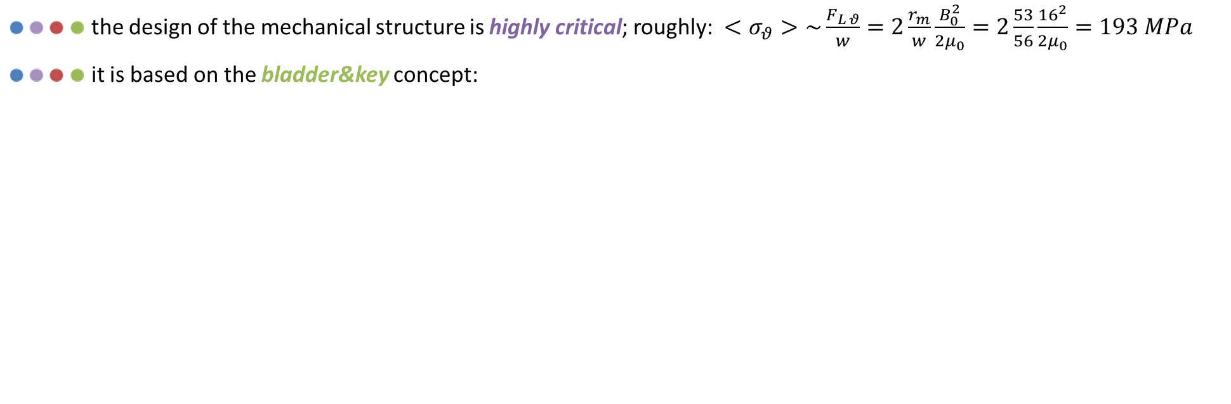
The INFN cosϑ option – mechanical design
the design of the mechanical structure is highly critical; roughly: $<σ_{θ}>\sim \frac{F_{L θ}}{w}=2\frac{r_{m}}{w}\frac{B_{0}^{2}}{2μ_{0}}=2\frac{53}{56}\frac{{16}^{2}}{2μ_{0}}=193 MPa$
it is based on the bladder&key concept:
  around half of the preload at room temperature is provided by assembling SS keys with interference using water pressurized bladders
  the other half is provided by cooling the Al shell
  SS shell may or may not be present

Slide 10
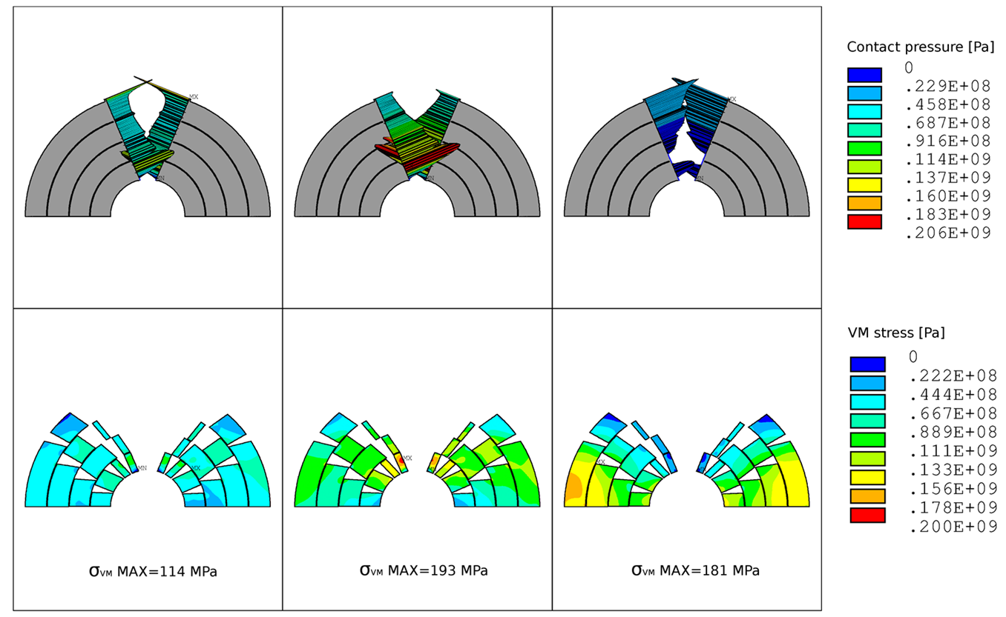
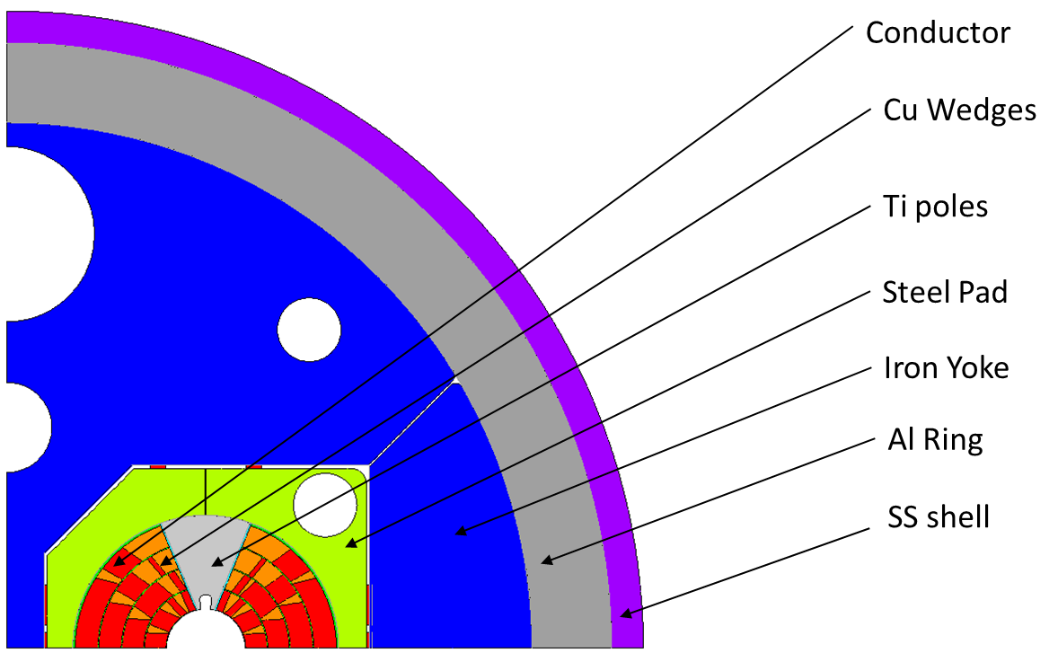
The INFN cosϑ option – mechanical design
peak stresses in the winding are lower but very close to 200 MPa
the EuroCirCol design requirements (set in 2015) are met, but today's knowledge suggests that the reasonable limit for conductors developed so far should be set at 150 MPa
Assembly
Cool down
Energization

Slide 11
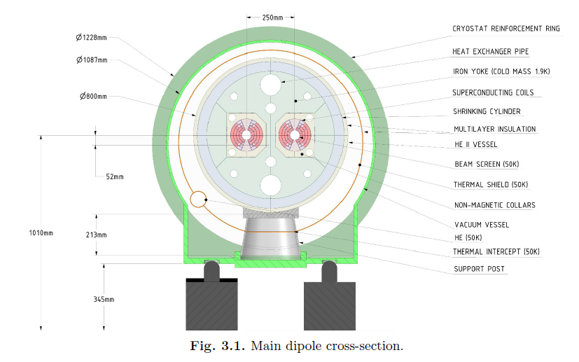
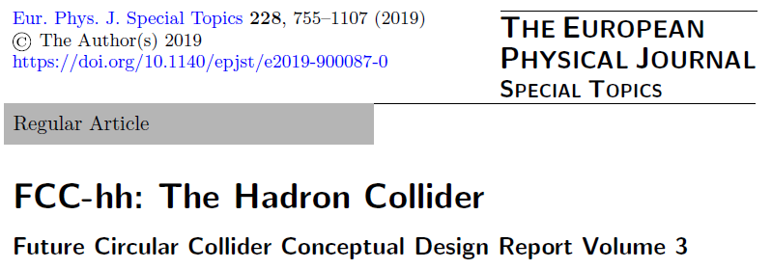
Conceptual Design Report
The INFN cosϑ option has been chosen as baseline design for the Conceptual Design Report published in 2019
the other configurations could not be definitively discarded on a design basis alone

Slide 12


falcond
Started in June 2018
Currently to be completed by June 2023

Slide 13
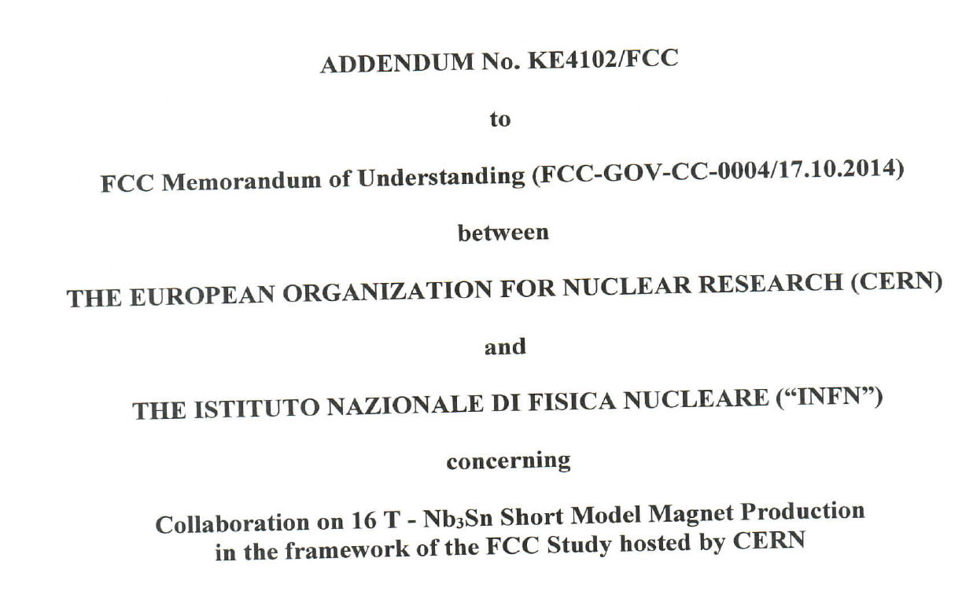
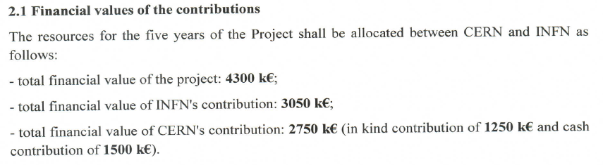
The birth of FalconD project
Future Accelerator post-LHC Cos-theta Optimised Nb₃Sn Dipole
The natural continuation of the EuroCirCol experience, was the fabrication of a demonstrator
An agreement CERN-INFN was signed on Sept. 20th 2018
  Addendum No. KE4102/FCC to FCC Memorandum of Understanding FCC-GOV-0004/17.10.2014
  Collaboration on 16 T –Nb₃Sn Short Model Magnet Production
  in the framework of the FCC Study hosted by CERN
  Develop a single aperture 16 T 4-layer cosϑ demonstrator
  2 practice and 2 + 1 spare Nb₃Sn coils
In 2019 an international tender was launched, and the corresponding industrial contract was awarded to ASG
Superconductors in June 2020 (1.5 M€)
  ASG is responsible for the construction of the coils
  The mechanical assembly is planned to be performed by INFN at the LASA Laboratory

Slide 14
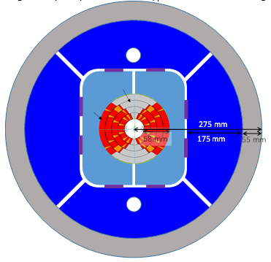
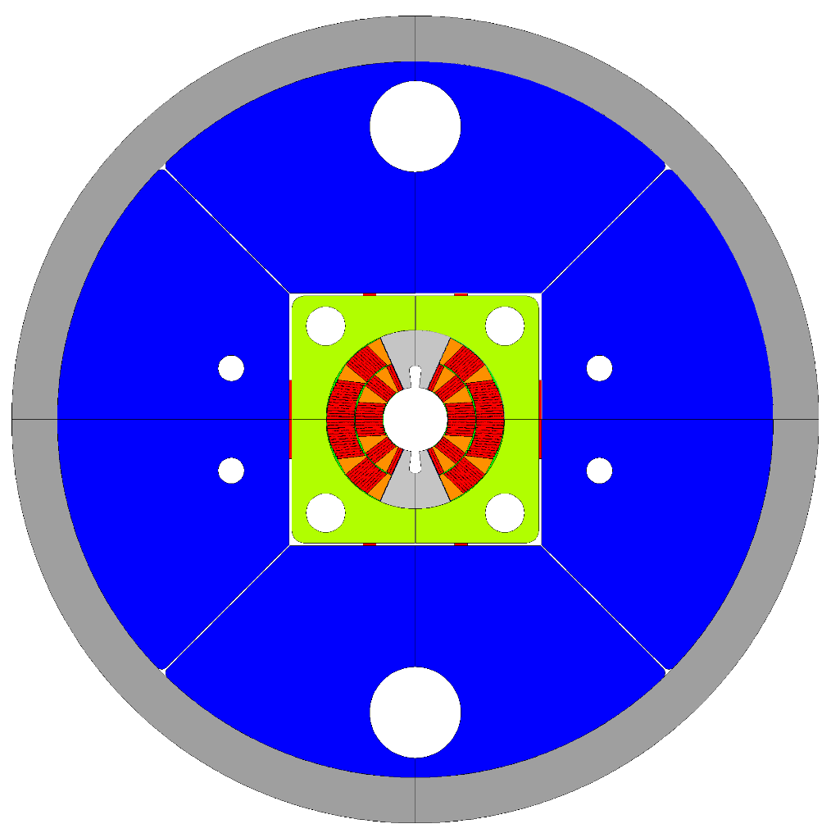
Kick-off meeting at ASG – July 2020
Technical specification design:
Compared to the original Technical Specification (2018), several changes had already been agreed with CERN at the time of the kick-off meeting (July 2020), because
  a 4 layer 16 T dipole is an extremely challenging magnet, a step too far beyond the state of the art
  current conductors do not have the performance required to reach 16 T − J_{C}(4.2K,16T)=1500 A/mm²
  a 2 layer dipole in the range 12−14 T would already be a significant advancement with respect to the state of the art
FalconD characteristics ( Addendum to be updated):
  2 layers
  design magnetic field: 12 T (ultimate field of mech. structure/prot. system: 14 T)
  40 strand Rutherford cable Φ=1 mm
  bladder&key mechanical structure confirmed
  stress in conductors < 150 MPa in any conditions
  max outer dimension 650 mm (to make cold test at LASA feasible)
due to several reasons (overbooking of the engineering department at ASG, Covid19 pandemic limitations, unavailability of the conductor from CERN) the project did not progress until the end of 2021
Kick-off meeting design:

Slide 15
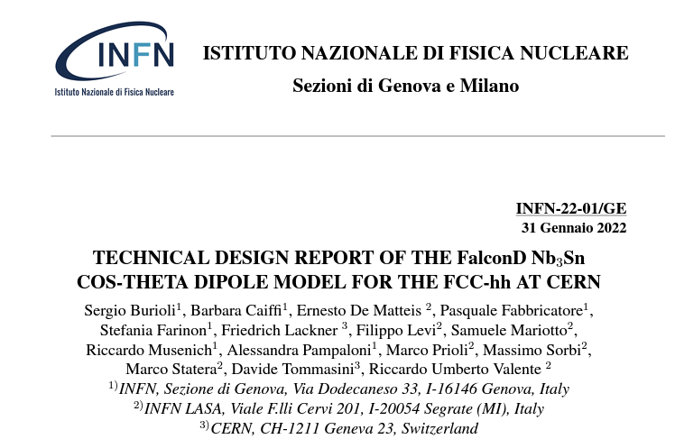
the Technical Design Report
only design activities were able to progress, and on October 15th 2021 the FalconD Technical Design Report was submitted to the CERN Collaboration
the TDR was the 1st Deliverable of the CERN/INFN agreement
in January this year, the TDR was approved by the
HFM CERN/INFN Steering Committee
after approval, the TDR was published as INFN Technical
Note and can be downloaded from
http://www.lnf.infn.it/sis/preprint/getfilepdf.php?filename=INFN-22-01-GE.pdf

Slide 16
the tdr design

Slide 17
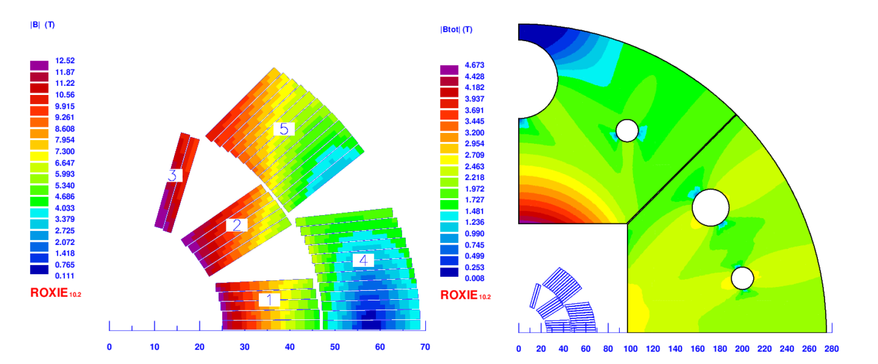
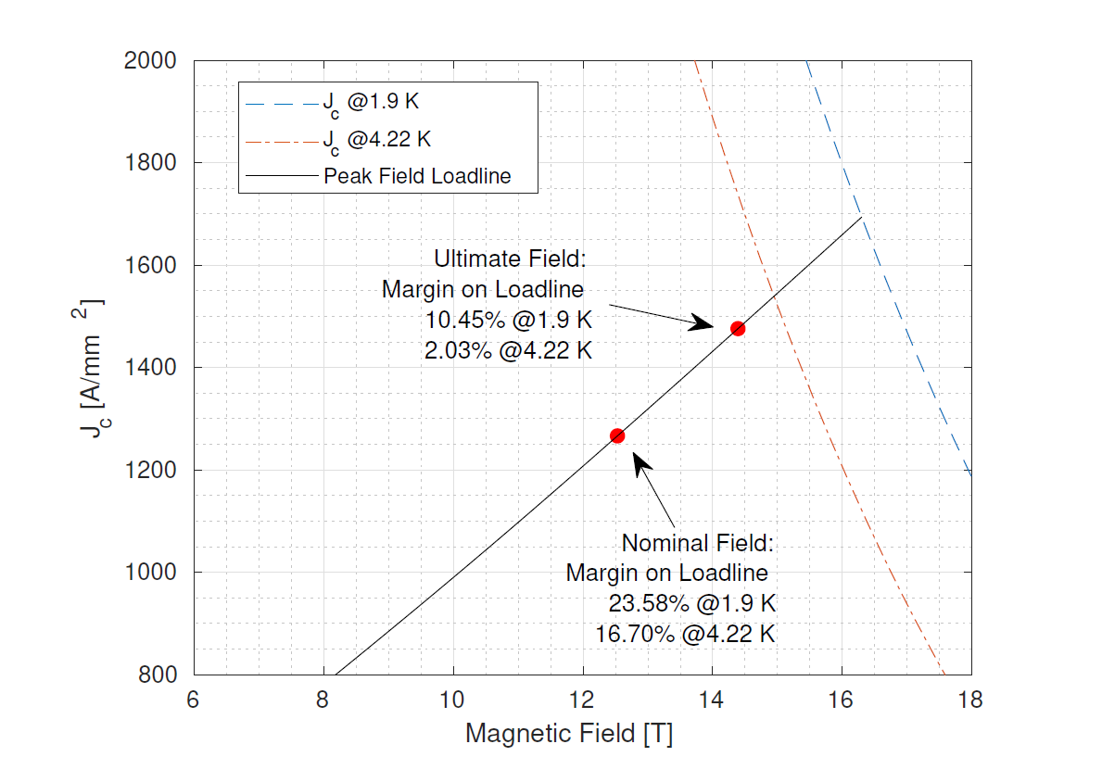
Electromagnetic design
The magnet is designed to reach a bore field of 12 T with two layers of keystoned Rutherford cable wound using the double pancake technique.
In each quadrant there are 3 blocks in the first layer and 2 blocks in the second one, for a total of 36 turns.
The main goal of the project is to achieve the target field by prioritizing technical feasibility rather than absolute field quality (minimum bending radius around
10 mm and minimum copper wedge size around 1 mm).
Field quality is not at accelerator level,
as it is a secondary goal to achieving
the nominal field.
The margin on the loadline @ 12 T, 1.9 K
is 23.6%, which is consistent with other
magnets of the same type (MQXF).
Courtesy of R.Valente (INFN LASA)

Slide 18

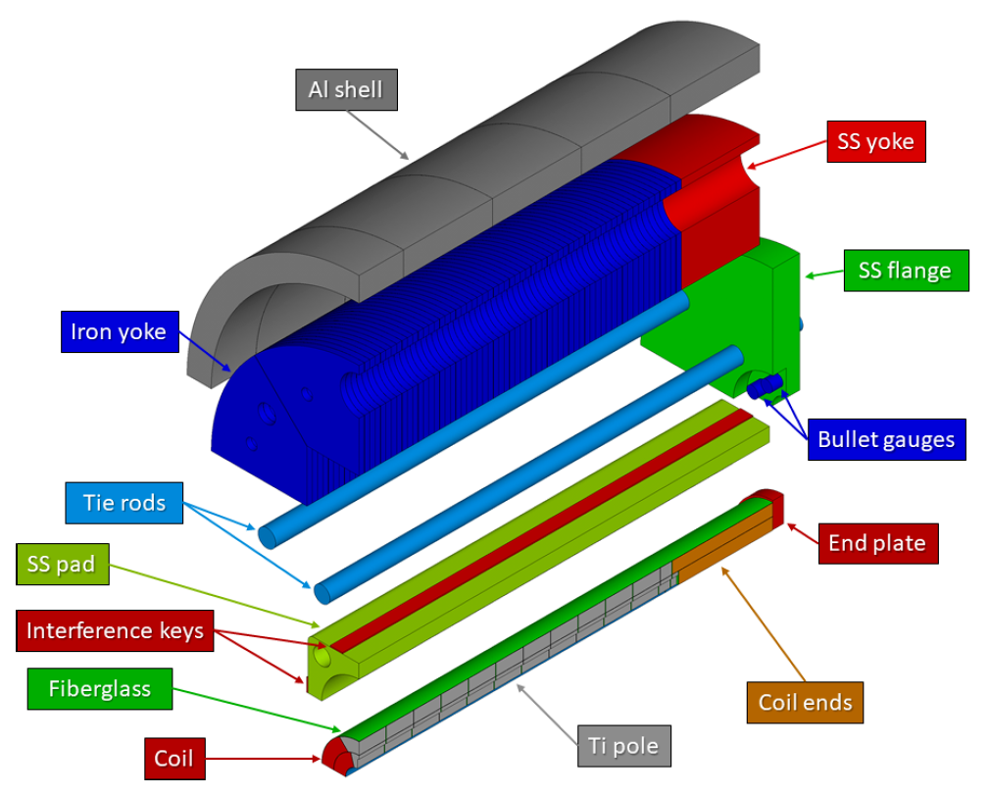
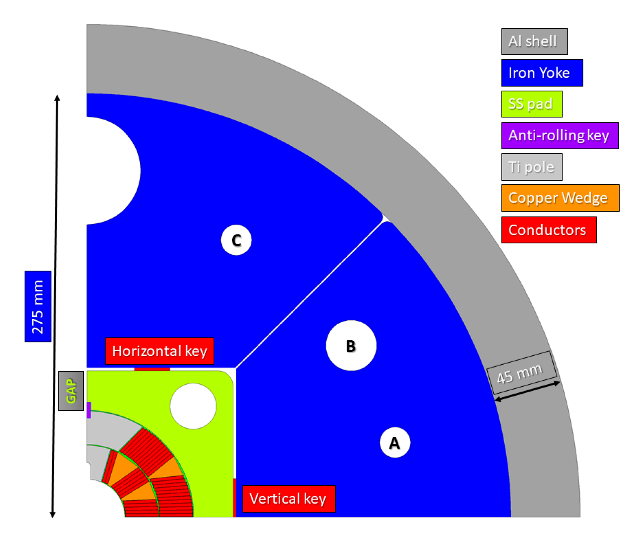
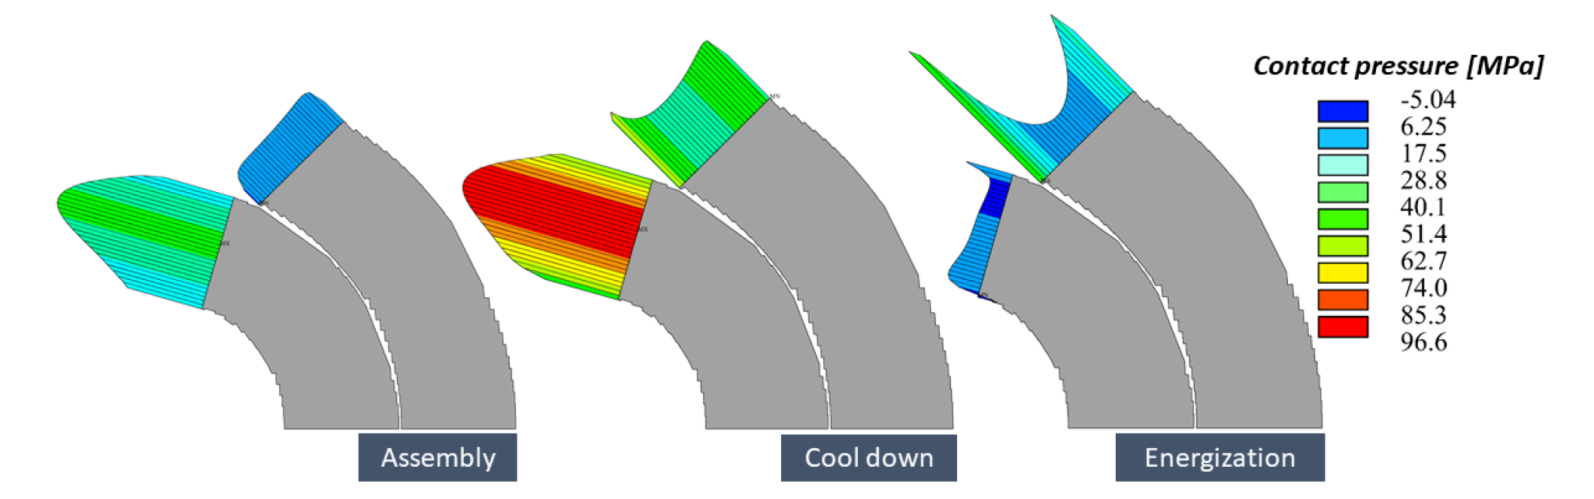
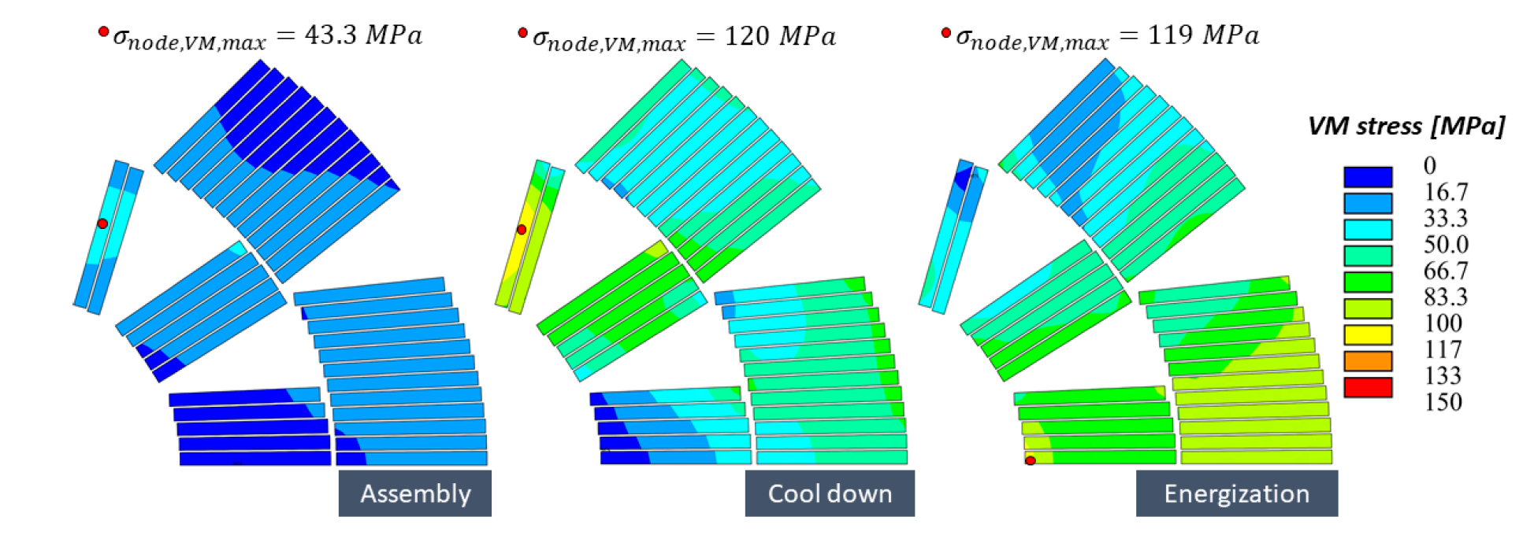
Mechanical design
as already mentioned, the mechanical structure adopts the bladder&key concept
the vertical keys preload the coil by imposing a mild ovalization that counterbalance the effect of the Lorentz forces
the goal is to ensure contact pressure between coil and collar pole in any conditions while keeping the stress in the conductors below 150 MPa
Courtesy of A.Pampaloni&F.Levi (INFN Genova)

Slide 19
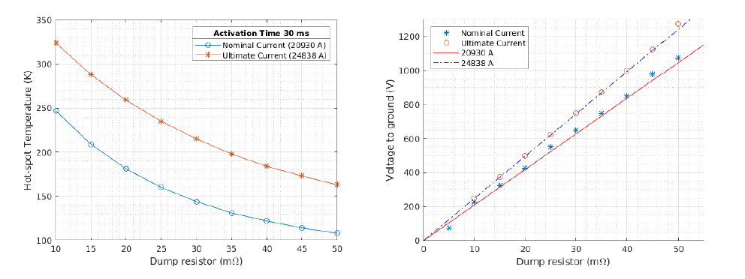
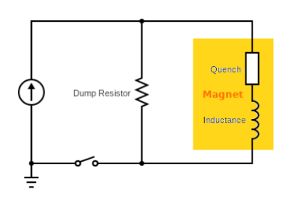
Quench protection
The magnet can be protected by energy extraction only, without using quench heaters (with considerable construction simplification).
At 12 T the optimized dump resistor of 25 mΩ gives hot spot temperature of 160 K and max. voltage to ground 525 V
Courtesy of R.Valente (INFN LASA)

Slide 20
advancements since the TDR drafting

Slide 21
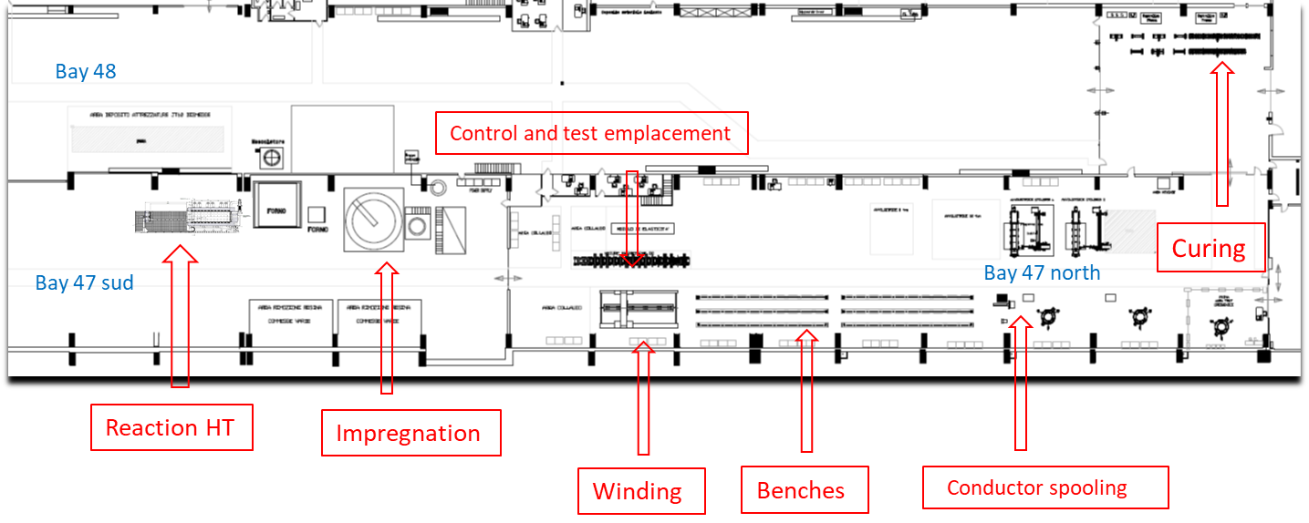
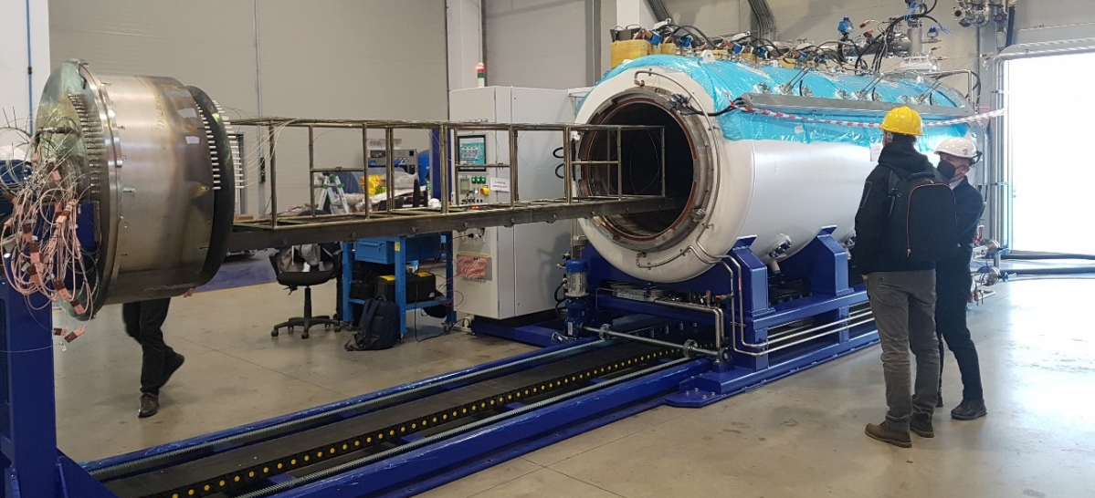
Advancements @ ASG Superconductors
the manufacturing layout in the ASG premises has been set up
the construction of the furnace for the thermal treatment of Nb3Sn was completed by HTS-Furnaces Mozzanica-BG and the furnace was installed at ASG in January this year

Slide 22
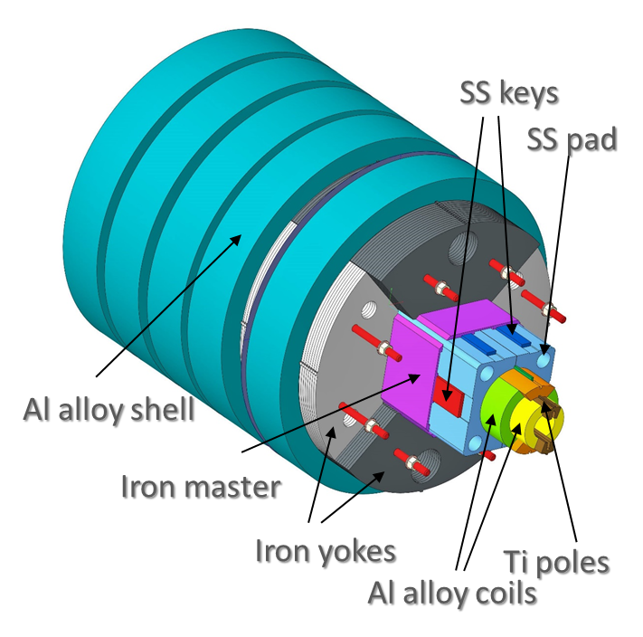
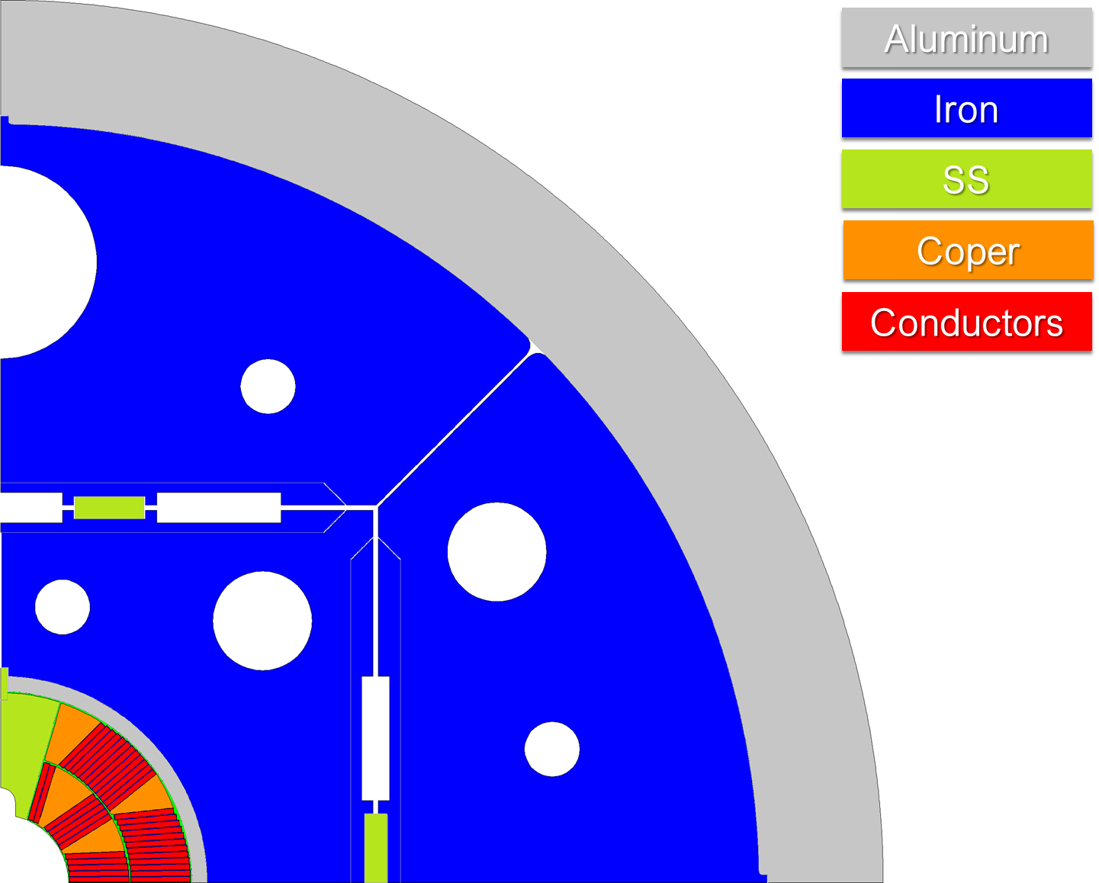
Advancements @ INFN
We started an activity to assemble a mock-up of the FalconD magnet. The reasons are:
  Consolidate the mechanical FE analysis to predict magnet the stress/strain conditions (straight part only) during the B&K assembly and cooling (at 77 K)
  Study the influence of mechanical tolerances on the mechanical system
  Determine the most convenient assembly sequence
we are working on a new
design that brings the iron
yoke closer to the coils,
which helps to reduce
current and increase the
margin
Courtesy of R.Cereseto (INFN Genova)
Courtesy of A.Pampaloni&F.Levi (INFN Genova)

Slide 23
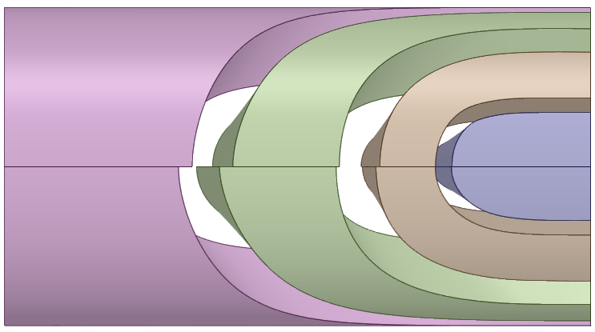
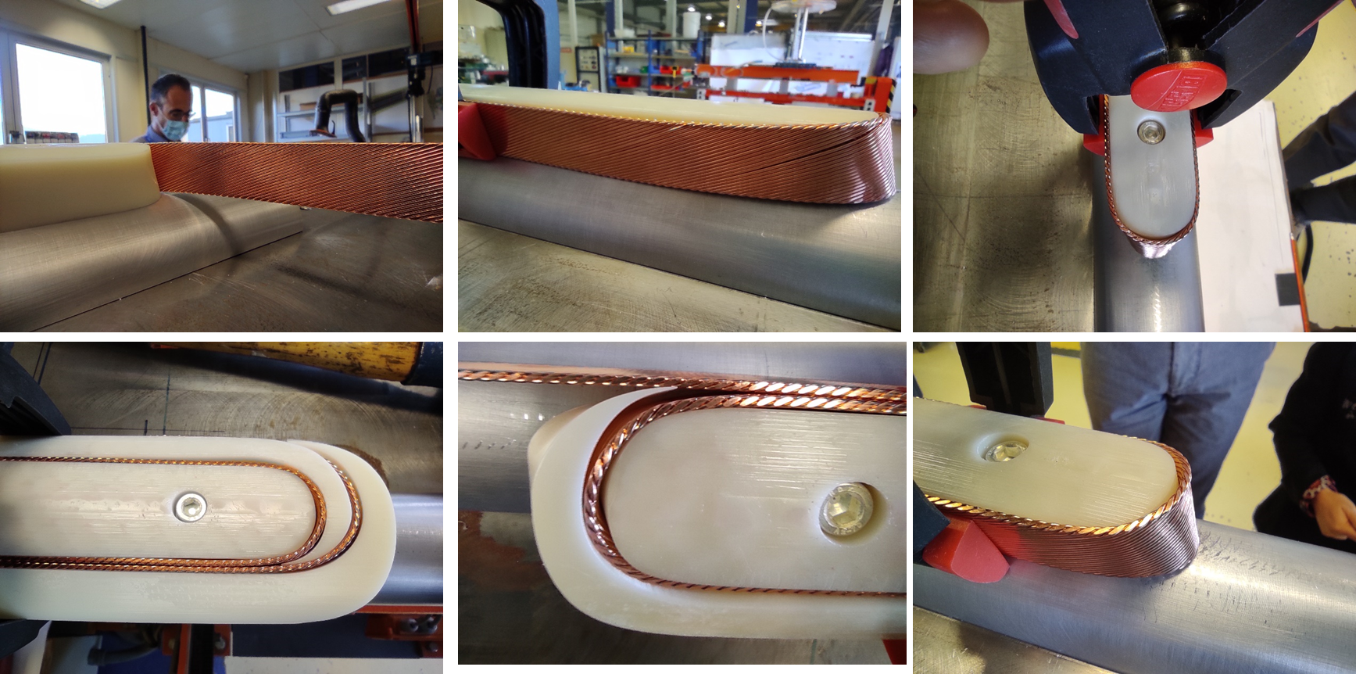
Winding trials @ CERN
in October 2021 a first run of winding trial was performed with machined Al mandrel and polymer wedges and spacers
the results were not entirely good but encouraging (non-insulated Cu cable, very low tension due to the soft material of the wedges and spacers)
in spite the non-optimal test conditions, we understood in which direction to act to improve the windability of the ends of the coil. New end spacers have already been designed for next winding test (transition is smoother and longer)
new winding trials are planned by the end
of March using machined Al wedges
and spacers
Old version
New version

Slide 24
Preliminary schedule
a new program has been agreed upon between CERN and INFN that includes the construction and testing of the FalconD dipole by the end of 2024
the Addendum will soon be modified accordingly

Slide 25
thanks for your attention

