Slide 1
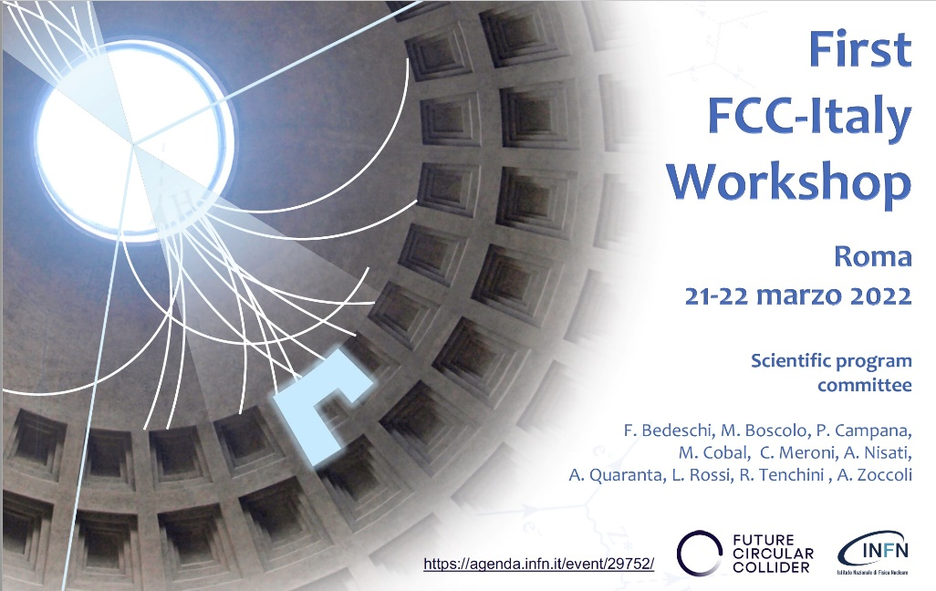
FCC Accelerator Technology and R&D:
Opportunities for collaborations
R. Losito, CERN

Slide 2
Goals of the Technology and R&D activity
Support the establishment of a consistent baseline configuration for the Feasibility Study in 2025.
In particular, address technologies and components that have a significant impact on cost and feasibility.
Support studies to improve sustainability and ORAMS (Operability, Reliability, Availability, Maintenability and Safety)
See next Slide (T. Raubenheimer, Technical Coordination meeting of 10 January 2022).

Slide 3
Technical R&D
The Technical R&D program will cover Baseline and Options R&D
The goal is to have all of the critical prototyping completed before a construction start in 2028. These include items that are:
Long-lead, therefore must be started early, e.g. SRF
Technically challenging, therefore early prototyping is required, e.g. IR magnets
Large quantity/cost, therefore value engineering is needed, e.g. arc cell
Broad impact on downstream systems, therefore results are needed to support other calculations/designs/costing, e.g. tapering design or MPS systems
Alternatives that could have significant impact on performance or cost
There are a few Technical R&D items that could have large impact on the Design Study such as tapering, HTS magnets, and 600 MHz RF design.
Courtesy T. Raubenheimer

Slide 4
RadioFrequency

Slide 5

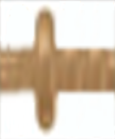
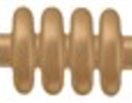
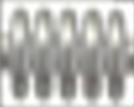
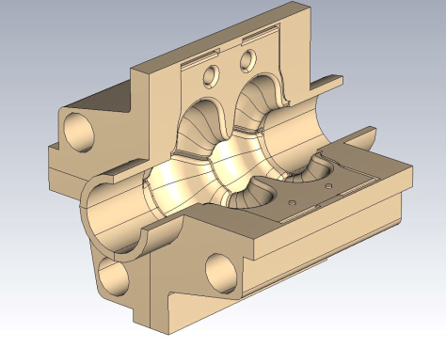
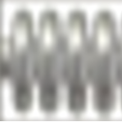
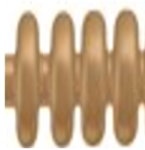

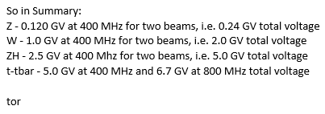
FCC_ee: cavities numbers (incl. booster)
Courtesy O. Brunner
time (operation years)
1 cell ELL_400 (Nb/Cu)
104 cav / 26 CM
Baseline
(CDR)
ELL_Large mono_cells > 10 MV/m
ELL_Large multi_cells: FCC phase 3 (need large infrastructure)
Bulk Nb Ell_800: mature technology
4 cells ELL_400 (Nb/Cu)
408 cav / 102 CM
5 cells ELL_800 (bulk Nb)
852 cav / 213 CM
2 cells SWELL_600 (Nb/Cu)
668 cav
SWELL_1.3: demonstrate E_{acc}
SWELL_600: ~ 16MV/m, + HOM power extraction (in CTD)
SWELL_600 for high energy ? (instead of 4 cells)
ELL_600 Nb/Cu competitive to bulk Nb?
SWELL_600
4 cells ELL_600 (bulk Nb or Nb/Cu)
1150 cav
2 cells ELL_600 (Nb/Cu)
668 cav
ELL_600: impact on Z-H performance? (reduced beam current?)
ELL _600 MHz: ~ bulk Nb performance
ELL_600
4 cells ELL_600 (bulk Nb or Nb/Cu)
1150 cav
---- large numbers of cavities favours Nb/Cu technology ---
---- + 20 % at 400 MHz compare to CDR !! ---

Slide 6
Options and goals by program
Courtesy O. Brunner
Cavity Studies & Beam Dynamics
  complete baseline and SWELL_600 studies
  define optimum overall scenarios (machine, booster and injector) -> e.g. 500 MHz would be compatible for 3 GHz injector (in fact 2.9985 GHz)
WOW (Wide Open Waveguide):
  qualify & optimize surface preparation & coating on complex shapes (incl. dev of related simulation tools)
ELL_1.3 GHz: demonstrate Q₀ > 10¹⁰ at > 20 MV/m, 2 K
  qualify & optimize substrate fabrication (bulk Cu, electro_deposition, internal welding), surface preparation & coating
ELL_400 MHz: demonstrate > 10 MV/m
  qualify & optimize large substrate fabrication, preparation and coating – large series (~LHC program)
SWELL_1.3 GHz: demonstrate competitive E_{acc} (to be specified) --- (Slotted Waveguide ELLipltical)
  qualify prep, coating, mechanical design, assembly and RF test procedures
SWELL_600 MHz: demonstrate full concept
  qualify E_{acc} performance (vertical test)
  demonstrate concept: mechanical design: vacuum, assembly, cooling, tuning, fpc
  integrate SWELL in CTD
FPC:
  develop, build and test new generation of couplers for LHC cavities @ 400 MHz, ~500 kW CW (document design consideration for 1 MW FPC)
  develop, build and test FPC for the SWELL_600 (600 kW CW, 50 mm course), for installation on CTD mid 2025
TS HE klystron:
  finalize full RF design of 400 MHz, 1.2 MW, 80% tube -> investigate fabrication possibilities (THALES) plus testing possibilities (e.g. CEA Saclay)
  investigate partnership with EIC for the fabrication of a TS HEK ~ 595 MHz, 600 kW: the expected BW of ~ 20 MHz shall cover EIC & FCC frequencies
CTD:
  develop & built a CTD compatible with the SWELL_600 demonstration program
  prepare for RF test in SM18 bunker 7, equipped with 2 IOT(~ 100 kW) or 600 MHz TS HEK –> 2026 – to be discussed

Slide 7

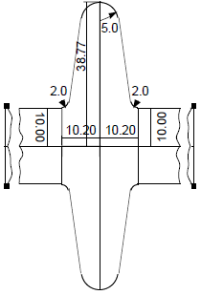
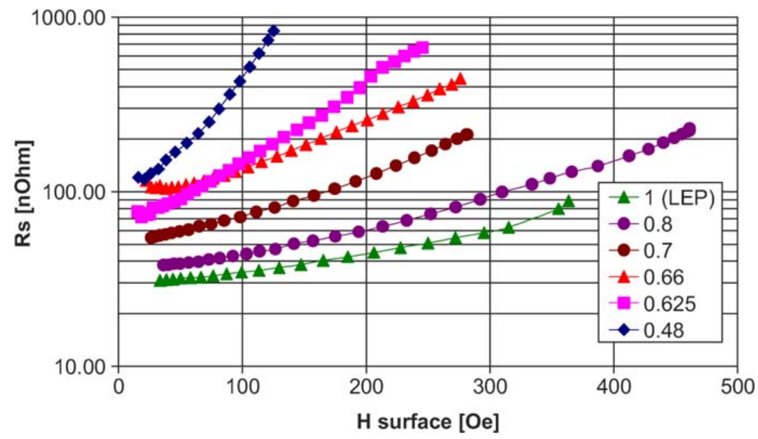
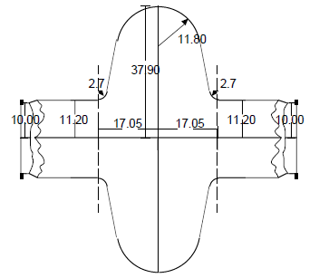
Energetic condensation of Nb films
Courtesy G. Rosaz
Tackle the Q-slope Problematic
S.Calatroni, 20years of experience with the Nb/Cu technology for superconducting cavities and perspectives for future developments, Physica C 441 (2006) 95-101

Slide 8
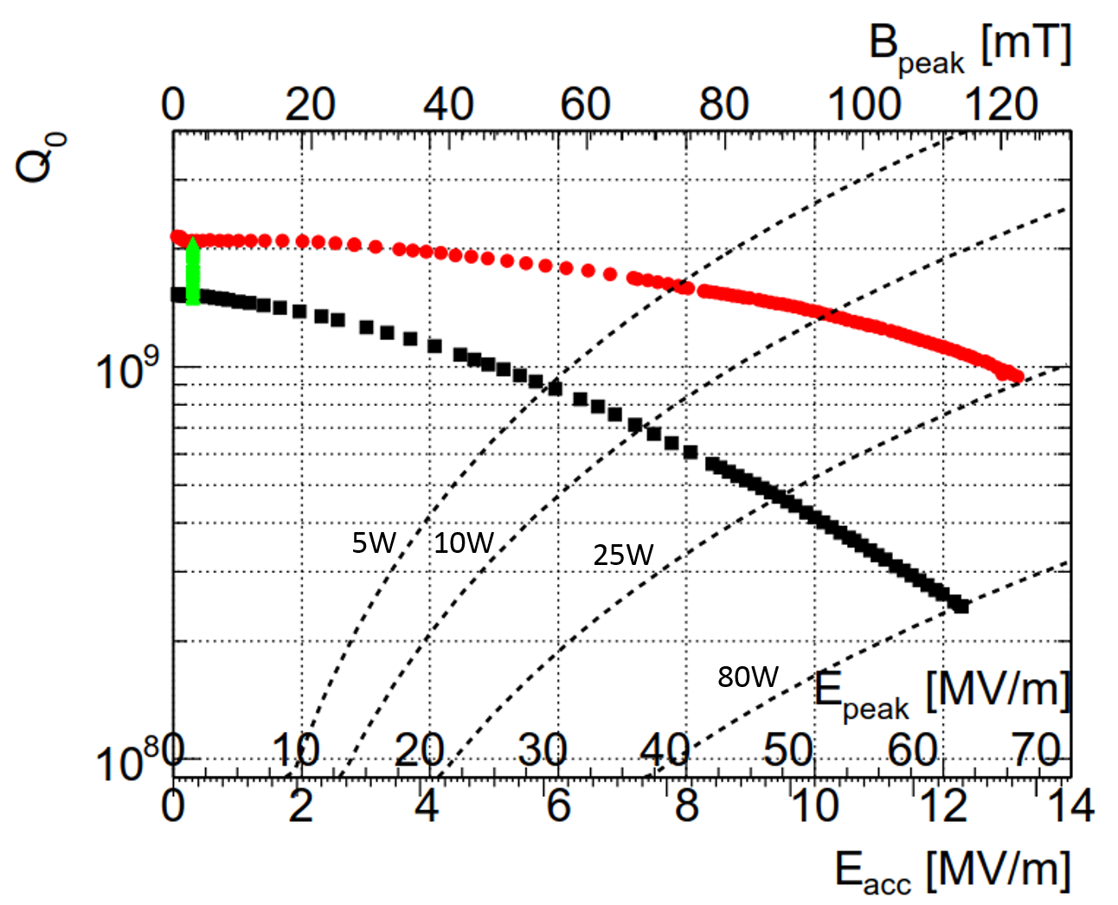
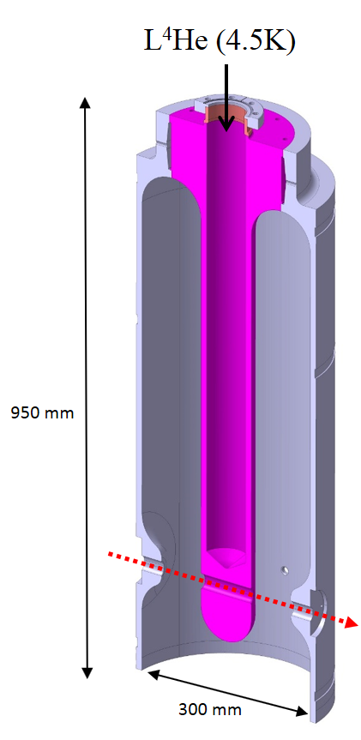
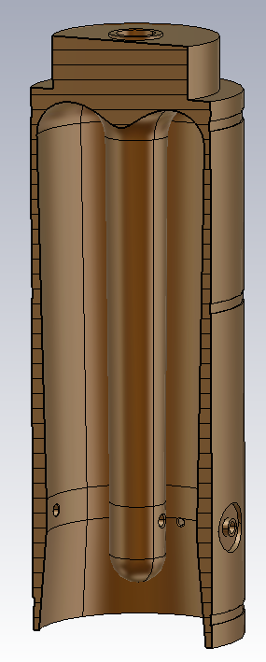
Seamless substrates
Courtesy G. Rosaz
HIE-ISOLDE experience
Original design
Seamless design
950 mm
Highest field ever reached by a Nb/Cu cavity
(~30MV/m in elliptical shape)
300 mm

Slide 9
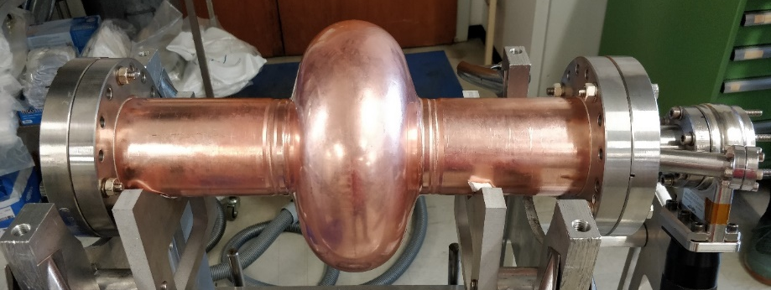
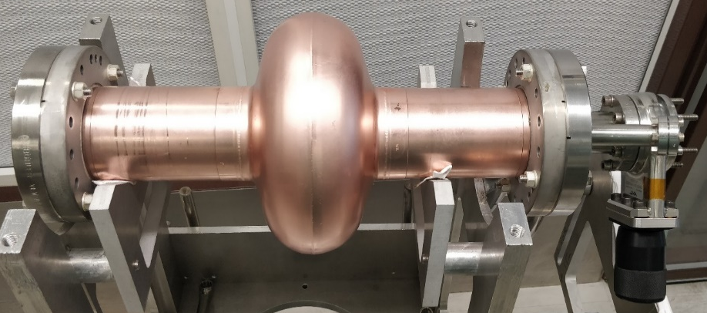
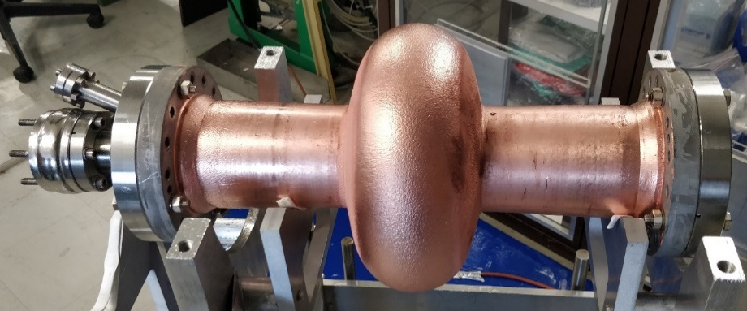
Seamless substrates
Courtesy G. Rosaz
HIE-ISOLDE experience
→ Transfer to 1.3GHz
bulk machined seamless cavity
Use Bulk machined cavity as “gold standard”
Compare seamless bulk vs spun/welded cavities
Compare seamless vs electroformed cavities
Focus on “scalable” techniques and “machine-compatible”
Cf S. Atieh talk (FCC week 2021)
Welded cavity
Electroformed seamless cavity
Highest field ever reached by a Nb/Cu cavity
(~30MV/m in elliptical shape)
https://indico.cern.ch/event/817780/contributions/3716458/

Slide 10
Nb/Cu performance
Courtesy G. Rosaz
1.3GHz Cavities
Electropolished surface
3rd Coating
R_{BCS} further improved
Residual drastically reduced (~6nOhms)
Q-slope suppressed
Q>1.10¹⁰ at 15MV/m
  (max field limited by radioprotection safety limits)
Even a bulk machined cavity requires minimum of material removal

Slide 11
RF Performance
With both 400 MHz (single cell) and 800 MHz, the respective accelerating voltage (10 MV/m and 20 MV/m) is (almost) state of the art.
4x400 MHz need a further step.
R&D is focusing on improving Q₀, reproducibility and reliability.
Alternative solutions (new film materials, new methodologies) may help in reducing production and operation cost.

Slide 12
Options and goals by program
Cavity Studies & Beam Dynamics
  complete baseline and SWELL_600 studies
  define optimum overall scenarios (machine, booster and injector) -> e.g. 500 MHz would be compatible for 3 GHz injector (in fact 2.9985 GHz)
WOW (Wide Open Waveguide):
  qualify & optimize surface preparation & coating on complex shapes (incl. dev of related simulation tools)
ELL_1.3 GHz: demonstrate Q₀ > 10¹⁰ at > 20 MV/m, 2 K
  qualify & optimize substrate fabrication (bulk Cu, electro_deposition, internal welding), surface preparation & coating
ELL_400 MHz: demonstrate > 10 MV/m
  qualify & optimize large substrate fabrication, preparation and coating – large series (~LHC program)
SWELL_1.3 GHz: demonstrate competitive E_{acc} (to be specified) --- (Slotted Waveguide ELLipltical)
  qualify prep, coating, mechanical design, assembly and RF test procedures
SWELL_600 MHz: demonstrate full concept
  qualify E_{acc} performance (vertical test)
  demonstrate concept: mechanical design: vacuum, assembly, cooling, tuning, fpc
  integrate SWELL in CTD
FPC:
  develop, build and test new generation of couplers for LHC cavities @ 400 MHz, ~500 kW CW (document design consideration for 1 MW FPC)
  develop, build and test FPC for the SWELL_600 (600 kW CW, 50 mm course), for installation on CTD mid 2025
TS HE klystron:
  finalize full RF design of 400 MHz, 1.2 MW, 80% tube -> investigate fabrication possibilities (THALES) plus testing possibilities (e.g. CEA Saclay)
  investigate partnership with EIC for the fabrication of a TS HEK ~ 595 MHz, 600 kW: the expected BW of ~ 20 MHz shall cover EIC & FCC frequencies
CTD:
  develop & built a CTD compatible with the SWELL_600 demonstration program
  prepare for RF test in SM18 bunker 7, equipped with 2 IOT(~ 100 kW) or 600 MHz TS HEK –> 2026 – to be discussed

Slide 13
MAGNETS

Slide 14
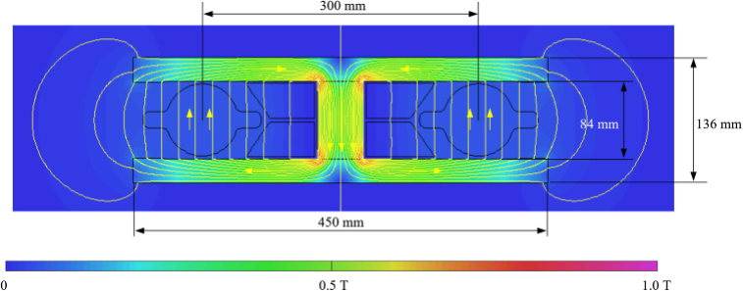
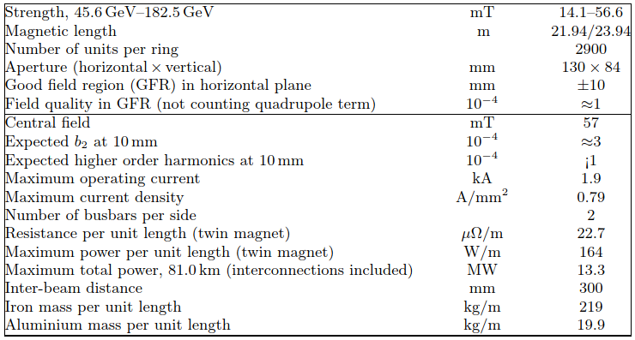
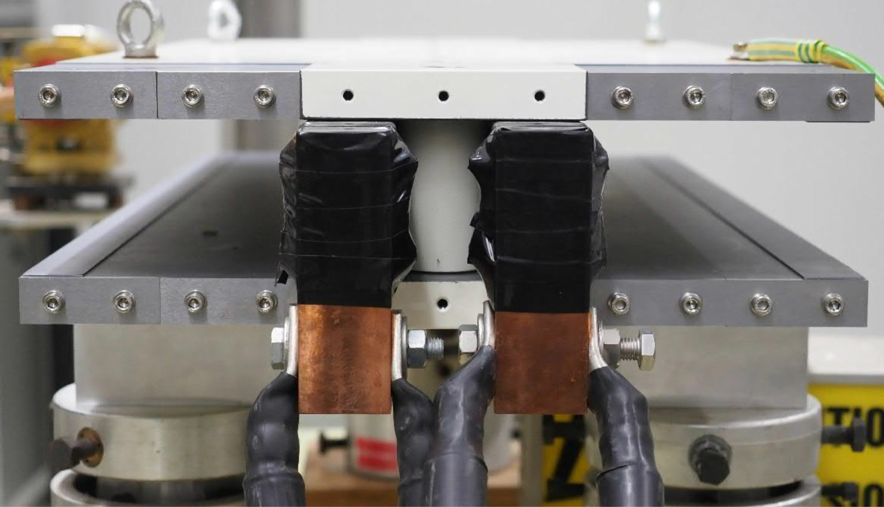
Dipole
Courtesy J. Bauche
  Twin aperture design, magnetically coupled [1], [2], [3]
  Simple, pure, cost effective, low field operation
  Low power consumption (50% w.r.t. separate magnets)
  300 mm inter-beam distance shared between vacuum chamber size, SR absorbers, busbars and yoke return leg
  DC operation, compatible with solid iron yoke construction, but alternatives are possible
  Twin air-cooled aluminium busbar considered in CDR to be reviewed (SR in mid-plane)
Magnetic model cross-section (CDR), B₀ max = 57 mT
Prototype 1m-long, single busbar “coil”, measurements reported in [4]
Parameters (CDR) [1]

Slide 15
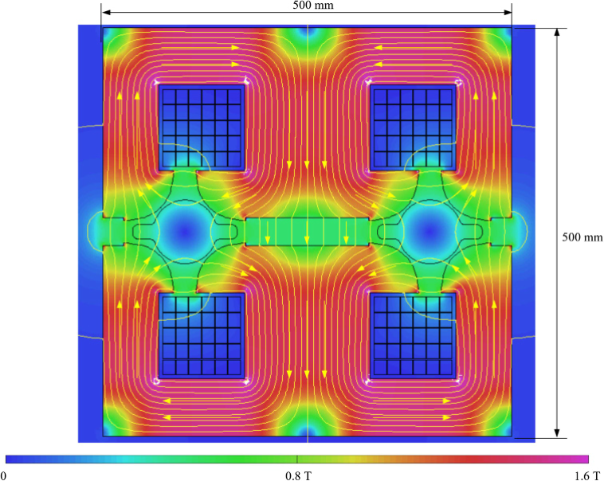
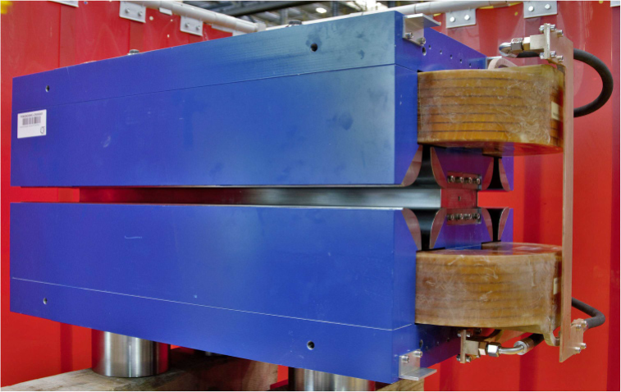
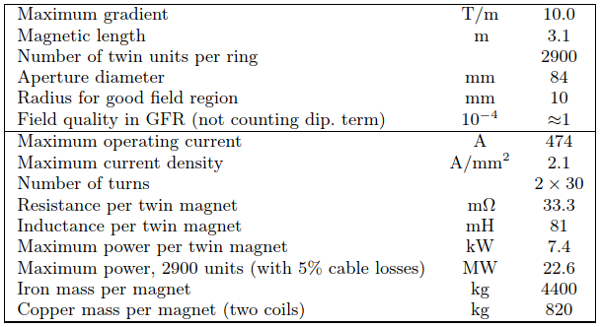
Quadrupole
Courtesy J. Bauche
  Twin aperture design, magnetically coupled [1], [2], [3]
  Only 2 racetrack coils for 8 poles, out of mid-plane (SR)
  Top-bottom assembly via non-magnetic central spacer
  Equilibrium of parallel flux distribution between horizontal and vertical field lines controlled by central gap height (adjustable with end shims on prototype)
  Magnetic axis shift along powering cycle observed on prototype [4], to be addressed
Magnetic model (CDR), G₀ max = 10 T/m, B_{pole tip} 0.42 T
Prototype 1m-long
Parameters (CDR) [1]

Slide 16
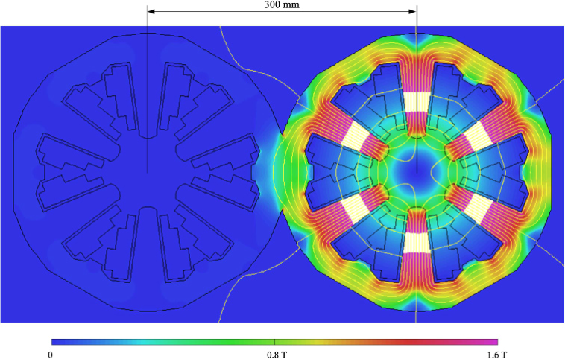
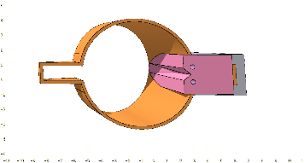
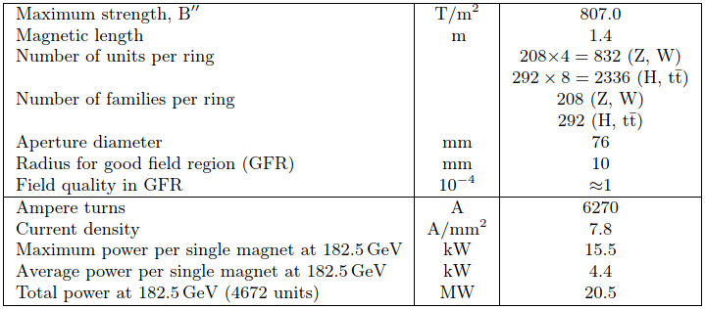
Sextupole
Courtesy J. Bauche
  Classical design as first approach for CDR
  Fits in 300 mm inter-beam distance, compatible with individual magnets for each beam
  Crowded cross section, current and flux densities at upper values, to reach the high gradient
  Vacuum chamber winglets and SR absorbers integration issue with coils on mid-plane
  → Cross section needs reworking to accommodate additional space for the vacuum chambers and relax the current and flux densities
  Option: yoke geometry with 120° periodicity
Magnetic model (CDR), S₀ max = 807 T/m², B_{pole tip} 1.17 T
Parameters (CDR) [1]

Slide 17
Opportunities for collaboration
Courtesy J. Bauche
  Development of large-scale manufacturing techniques for production of:
    Solid iron yokes
    Laminated yokes
    Extruded and coated copper and aluminum busbars
    Impregnated coils
    Objectives:
    Identification of suitable cost-effective techniques for high precision magnet yoke production with high repeatability (incl. automated processes for machining, measurements, assembly and welding)
    Elaboration of a production plan with schedule and spending profile
  Design and prototyping of sextupole magnet for the collider
    Objectives:
    Rework the design to match the updated specifications
    Produce and measure a prototype magnet to validate the performance (field intensity and quality)

Slide 18
References
M. Benedikt et al., “Future circular collider conceptual design report, vol. 2: The lepton collider (FCC-ee),” Eur. Phys. J. ST., vol. 228, no. 2, 2019. (https://doi.org/10.1140/epjst/e2019-900045-4)
A. Milanese, “Efﬁcient twin aperture magnets for the future circular e+/e- collider,” Phys. Rev. Accel. Beams, vol. 19, 2016, Art. no. 112401.
A. Milanese and M. Bohdanowicz, “Twin aperture bending magnets and quadrupoles for FCC-ee,” IEEE Trans. Appl. Supercond., vol. 28, no. 3, Apr. 2018, Art. no. 4000904.
A. Milanese, C. Petrone, J. Bauche, “Magnetic Measurements of the First Short Models of Twin Aperture Magnets for FCC-ee,” IEEE Trans. Appl. Supercond., vol. 30, 2020, Art. no. 4003905.

Slide 19
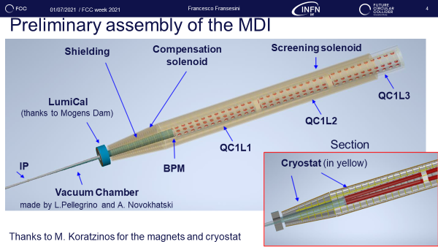
Interaction region magnets
Mechanical integration already being studied By INFN-LNF
Final focus quadrupoles are supposed to be of the type Canted Cosine Theta.
A conceptual design and even a prototype exist, full engineering model with realistic constraints (e.g.cryostat) still to be developed

Slide 20



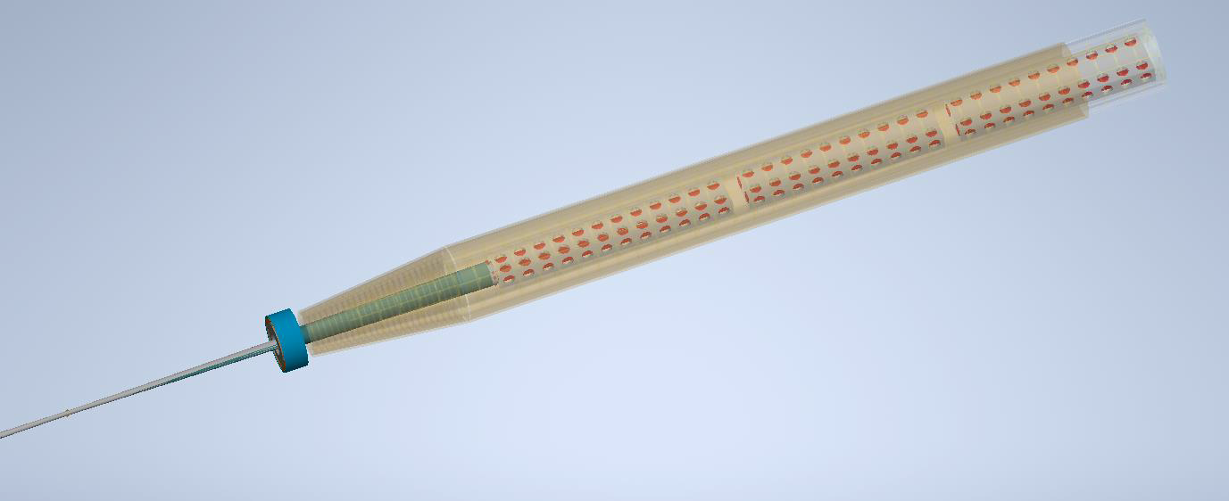



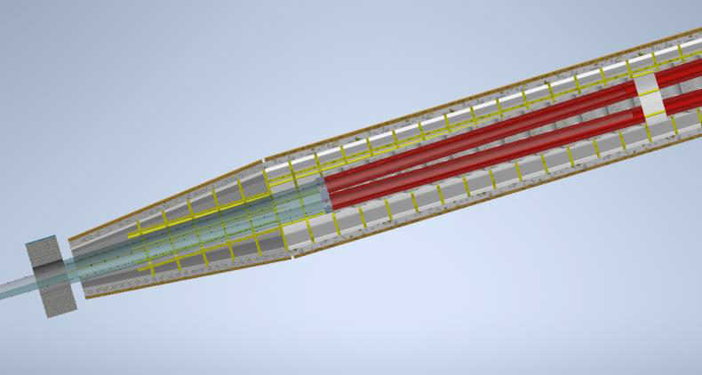

_{01/07/2021 / FCC week 2021} Francesco Fransesini 4
Preliminary assembly of the MDI
Courtesy F. Fransesini
Shielding ^{Compensation}
Screening solenoid
solenoid
QC1L3
LumiCal
(thanks to Mogens Dam)
QC1L2
Section
_{BPM} Cryostat (in yellow)
QC1L1
IP
Vacuum Chamber
made by L.Pellegrino and A. Novokhatski
Thanks to M. Koratzinos for the magnets and cryostat

Slide 21
Arc Half cell Mock-up

Slide 22
Large quantity/cost
A mock-up of an Arc Half-Cell will be built, to provide
  Confidence in design and construction methodology
  A testbed for Integration and alignment
  A playground to prove that we can remotely maintain (and operate?) with massive use of Robotics, Digital Twins, AI etc…

Slide 23
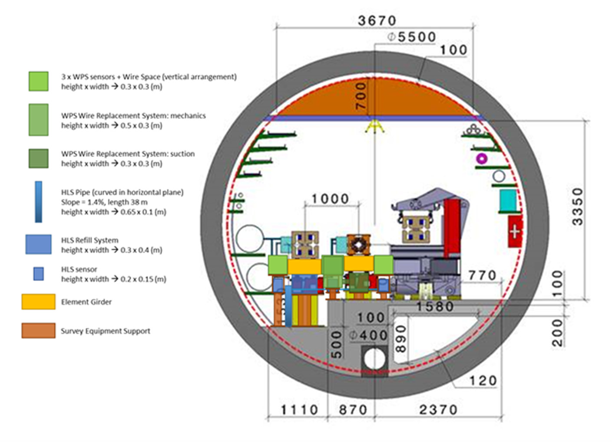
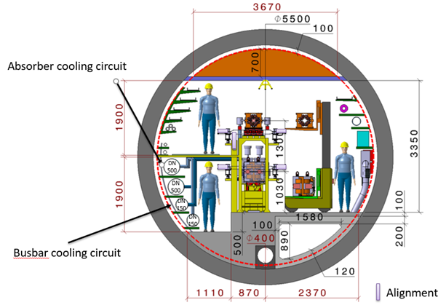
Two Options, one baseline

Slide 24
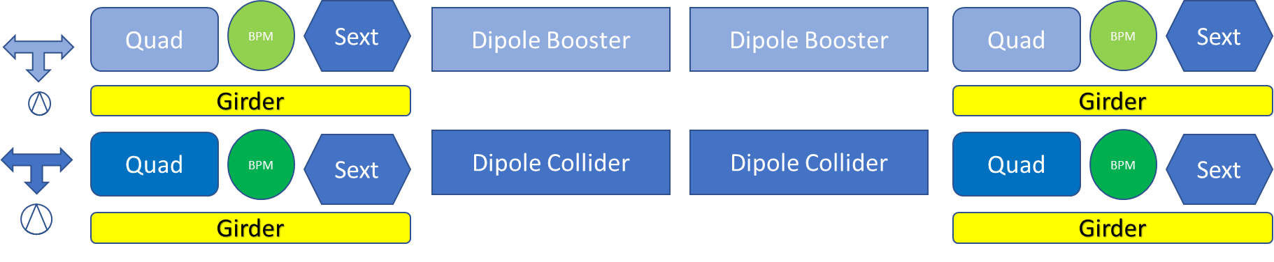
Mock-up layout

Slide 25
Alignment
Alignment is one of the critical activities to be performed all along the lifecycle of the FCC
We need a real step forward to come to realistic scenarios: using current techniques a team can normally align ~25 elements/week
With two accelerators of 91 km we would need years with a reasonable number of teams
New concepts are needed, automation has to be pushed, cost has to remain within reach

Slide 26

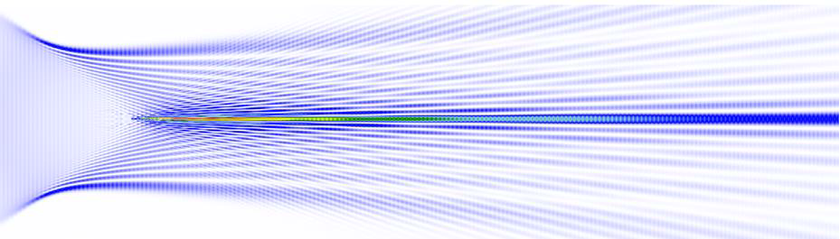
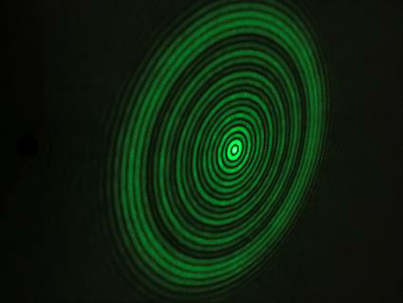
HOW IT WORKS
•The SLB consists of a central part with surrounding fringes.
•After the generator, only the central part is a continuous line.
European patent application filed 2nd May 2018.

Slide 27
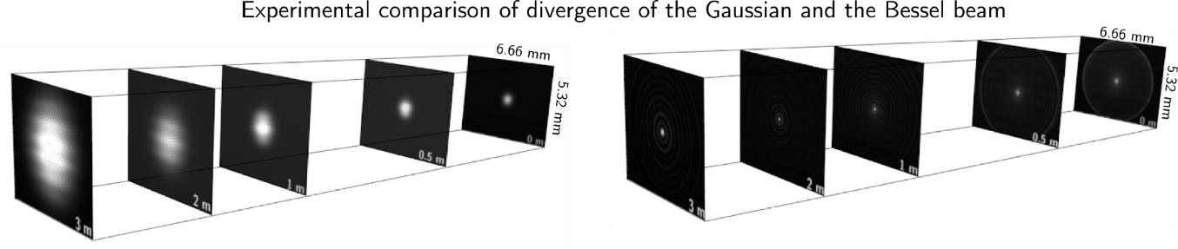
ADVANTAGES
Size at 3 m Size at 100 m
Gaussian 0.8 mm 240 mm
SLB 0.01 mm 1.2mm

Slide 28
Other Opportunities
The detailed design of FCC-ee is just at the beginning, many opportunities will appear in the next years
  Beam Instrumentation
  Dumps & Collimators
  Injection/extraction
  Mitigation of Radiation to Electronics
Opportunities may exist as well in
  Organization topics, e.g. quality & project management
  Engineering support, e.g. creating and implementing a vision for the design and operation of a machine that will run in 20 years from now: Digital twins, remote control and maintenance, spare management etc…

