Slide 1
HAPSPIDE
WP3 Simulation
18/01/2022

Slide 2
WP3 Simulations – Status and short term plans
  Technology CAD (TCAD) approach (Sentaurus Synopsys TCAD),
  aiming at accurate description of:
  - the charge transport within a-Si:H material;
  - the device electrical response (DC, transient simulations).

Slide 3
Study of LIFETIMES and MOBILITY models
  Interplay between carriers lifetimes and mobility models on carrier densities computation (e.g. simulation findings to be compared with measurements).

Slide 4
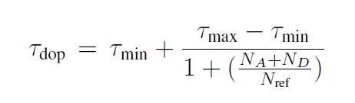
Study of carriers LIFETIMES models
  Activation of the carriers lifetimes dependencies… (Scharfetter)

Slide 5
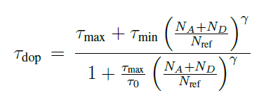
Study of carriers LIFETIMES models
  Advanced carriers lifetimes models (Nakagawa)
  No significant differences with respect to standard Scharfetter’s model.

Slide 6
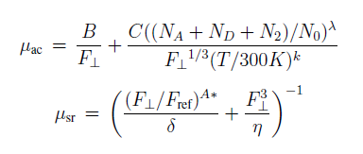
Analyses of carriers LIFETIMES + MOBILITIES (TCAD embedded) models
  LOMBARDI’s model
  High electric field carriers -> scattering by acoustic surface phonons and surface roughness

Slide 7
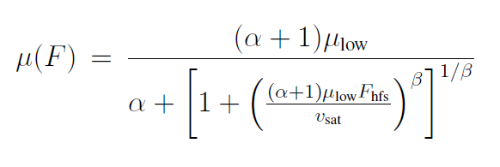
Analyses of carriers LIFETIMES + MOBILITIES (TCAD embedded) models
  CANALI’s model
  High-Field Saturation Models

Slide 8
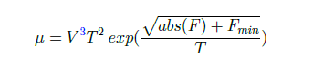
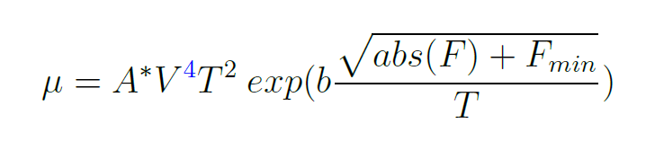
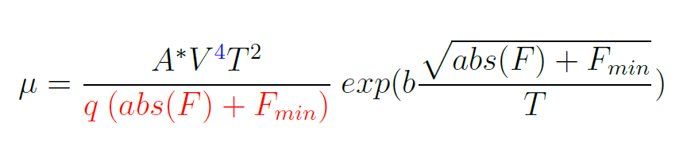
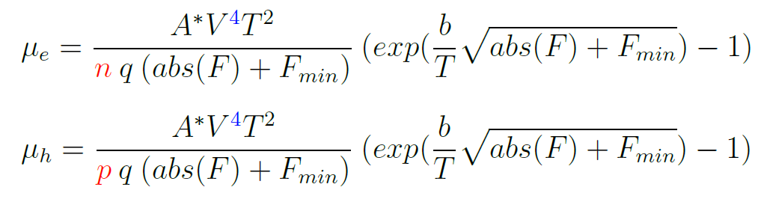
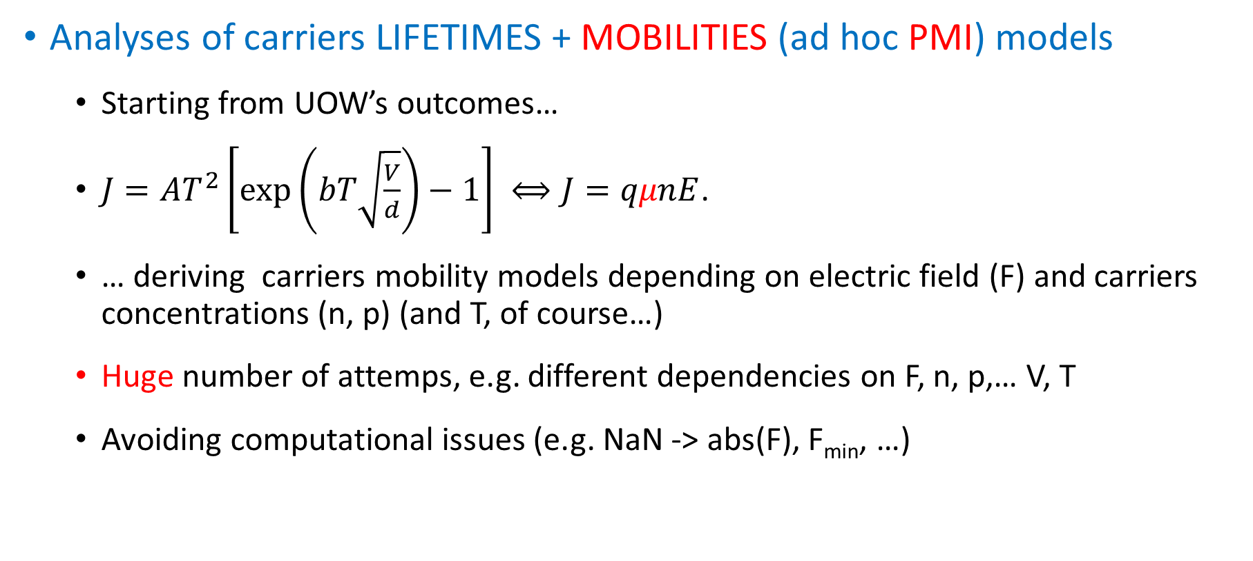
Analyses of carriers LIFETIMES + MOBILITIES (ad hoc PMI) models
  Starting from UOW’s outcomes…
  $J=AT^{2}\left[\exp\left(bT\sqrt{\frac{V}{d}}\right)−1\right] ⟺J=qμnE$.
  … deriving carriers mobility models depending on electric field (F) and carriers concentrations (n, p) (and T, of course…)
  Huge number of attemps, e.g. different dependencies on F, n, p,… V, T
  Avoiding computational issues (e.g. NaN -> abs(F), F_{min}, …)
Physical Model Interface, add-on, e.g. ad hoc, external models to be compiled and embedded within the software
…

Slide 9
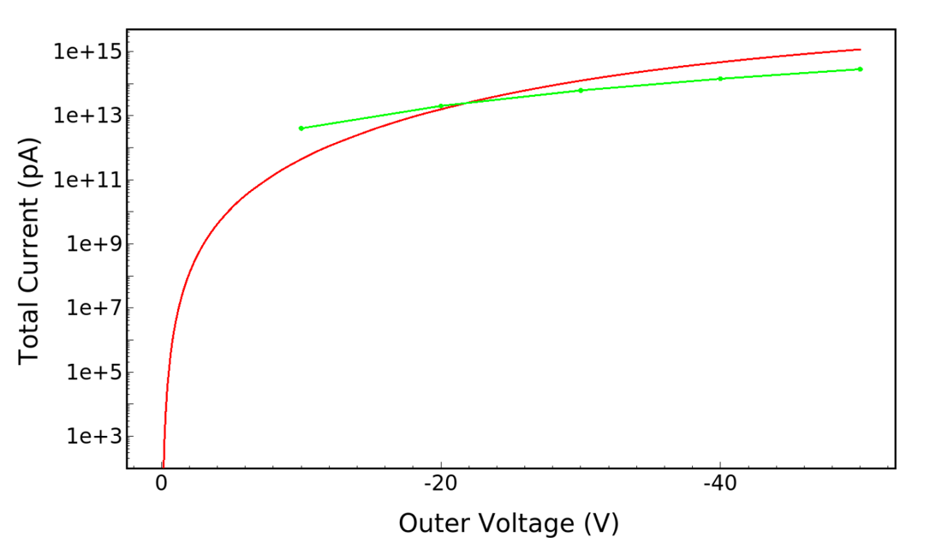
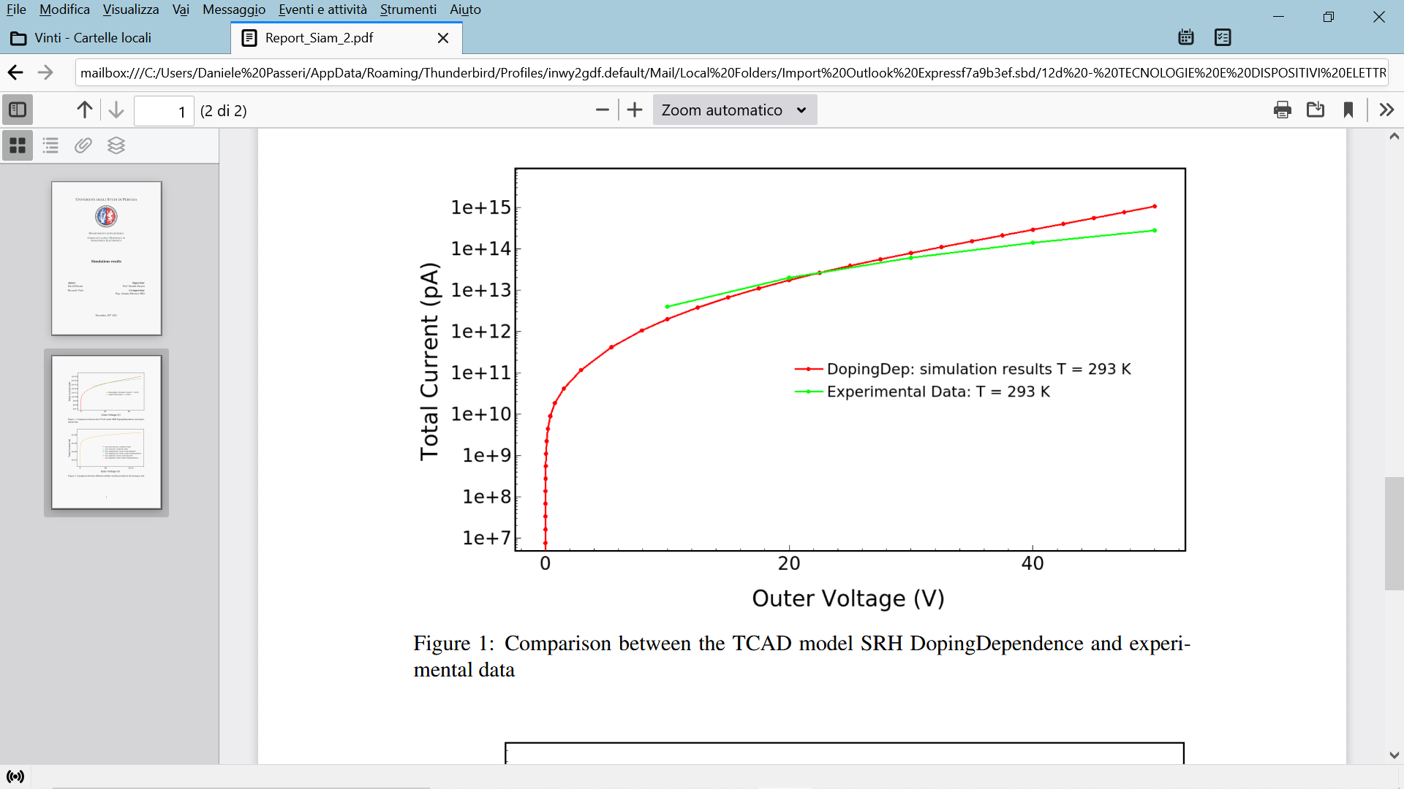
Analyses of carriers LIFETIMES + MOBILITIES (PMI ad hoc) models
  Some encouraging results
PRELIMINARY!

Slide 10
Study of LIFETIMES and MOBILITY models
  Double Check of the interplay between carriers lifetimes and mobility models.
  Effect of T.
  Are we able to model the charge transport within a-Si:H using available or even devising new models developed for mono-crystallin Silicon?
Introduction of innovative materials (from TCAD perspective)
  Transparent Contact Oxides (TCO) -> transport modeling within oxides.
  Electrons/Holes selective Contacts -> selective mobility for e, h.

Slide 11
BACKUP
18/01/2022

Slide 12
Analyses of carriers LIFETIMES + MOBILITIES (PMI ad hoc) models
  P.S. during countless attempts… effect of forward biasing ?!?

Slide 13
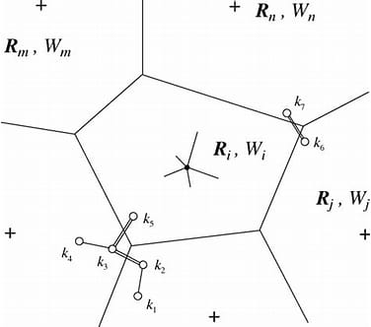
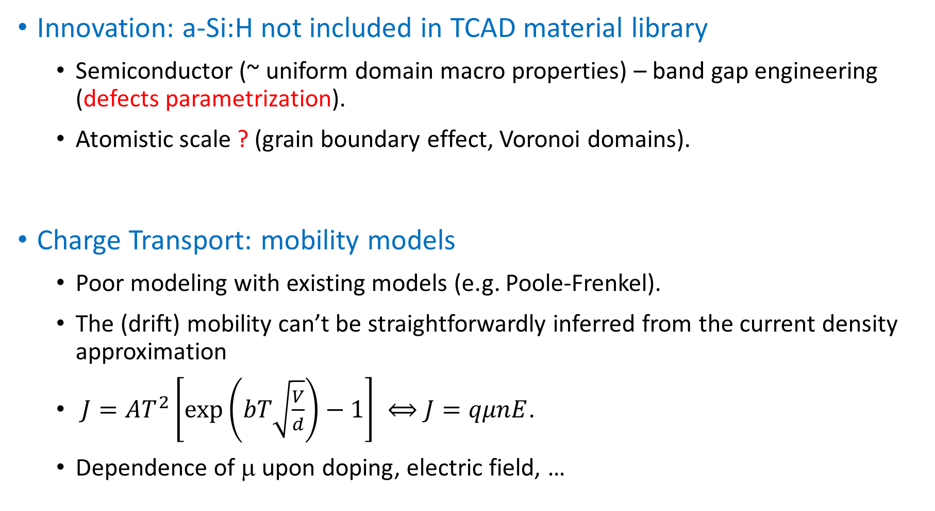
Innovation: a-Si:H not included in TCAD material library
  Semiconductor (~ uniform domain macro properties) – band gap engineering (defects parametrization).
  Atomistic scale ? (grain boundary effect, Voronoi domains).
Charge Transport: mobility models
  Poor modeling with existing models (e.g. Poole-Frenkel).
  The (drift) mobility can’t be straightforwardly inferred from the current density approximation
  $J=AT^{2}\left[\exp\left(bT\sqrt{\frac{V}{d}}\right)−1\right] ⟺J=qμnE$.
  Dependence of μ upon doping, electric field, …

Slide 14
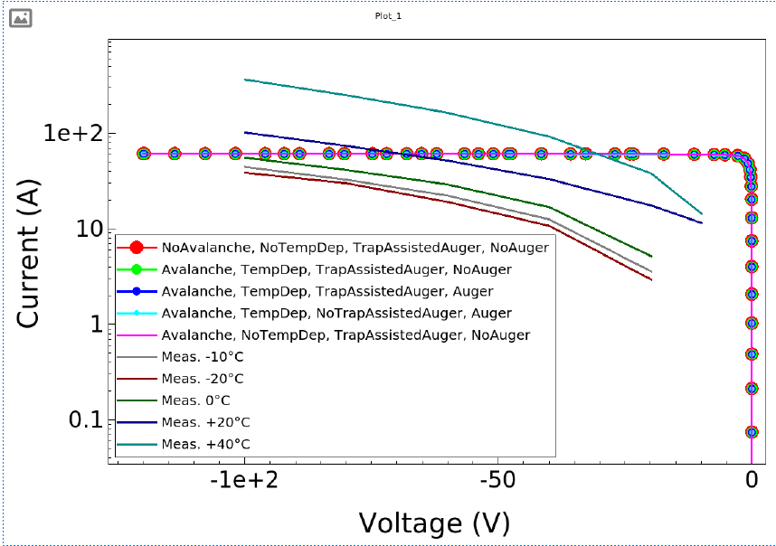
Simulations vs. measurements @mobility/lifetimes models
  Current activities/starting point.

