Slide 1
LAPPD
Elements of interest within ATHENA
Backup of SiPMs (hopefully not)
Alternative for the pfRICH: with LAPPDs also ToF information with the same sensors
Alternative to the standard commercial MCP-PMTs for the DIRC
EIC_NET PID meeting, January 31, 2022

Slide 2
LAPPD
The LAPPD ‘for free’ from INCOM received at the beginning of January
Ongoing effort to be in the position of starting the studies (pre-preliminary, at present)
Starting interactions with GE as soon as we are ready to start
A few slides from Deb to share with you the pre-preliminary
On collaborative aspects
A first meeting with NISER (Bedanga Mohanty et al.) : they are purchasing an LAPPD and preparing the lab for characterization studies
Monthly meetings with them agreed upon
A meeting organized by Alexander Kiselev to form an LAPPD Consortium
EIC, but not only (similar to Si Consortium, AC-LGAD Consortium)
A workshop to launch the initiative ~ mid March 2022
EIC_NET PID meeting, January 31, 2022

Slide 3
dRICH with pressurized Ar
At the moment, looking for pre-conceptual ideas
2 meetings with BNL engineers and Elke
June 7, 2021 (Elke, Silvia, Michael Gaffney, Mario Cubillo)
Also Francesco Noto invited, he did not attend
January 10, 2022 (Elke, Silvia, Paul Orfin, Cody Taylor)
Outcome after the first meeting: not in the right direction
10 cm thick Al plate forming the entrance windows!
Or similar options with stain steels …
Second meeting, moving towards the right direction
EIC_NET PID meeting, January 31, 2022

Slide 4
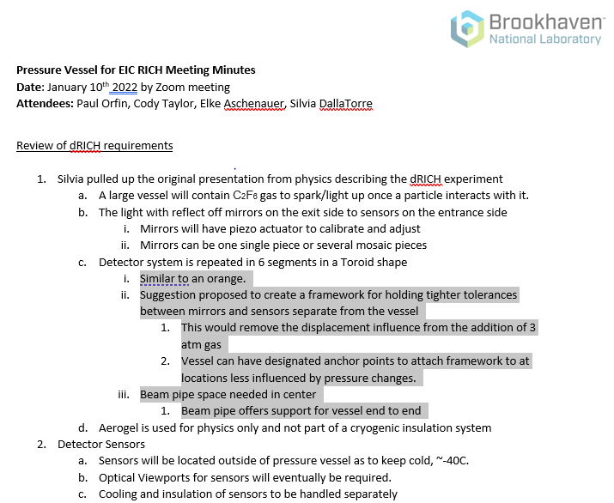
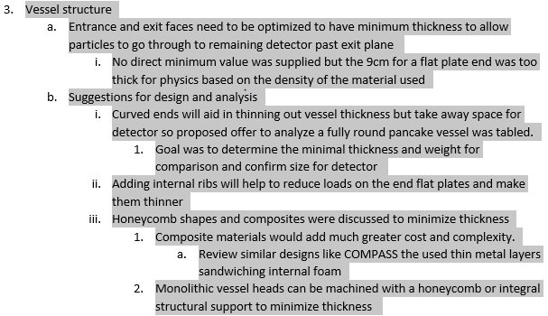
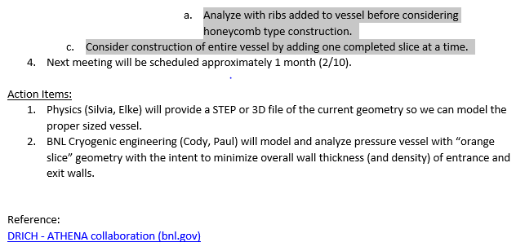
Minutes of the January 10, 2022 meeting
EIC_NET PID meeting, January 31, 2022

