Slide 1


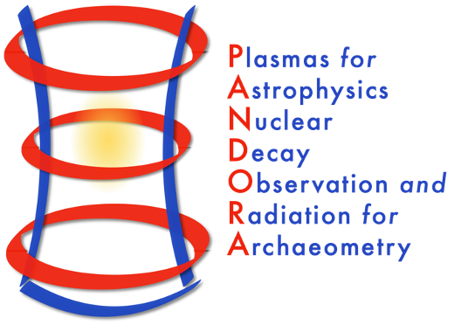
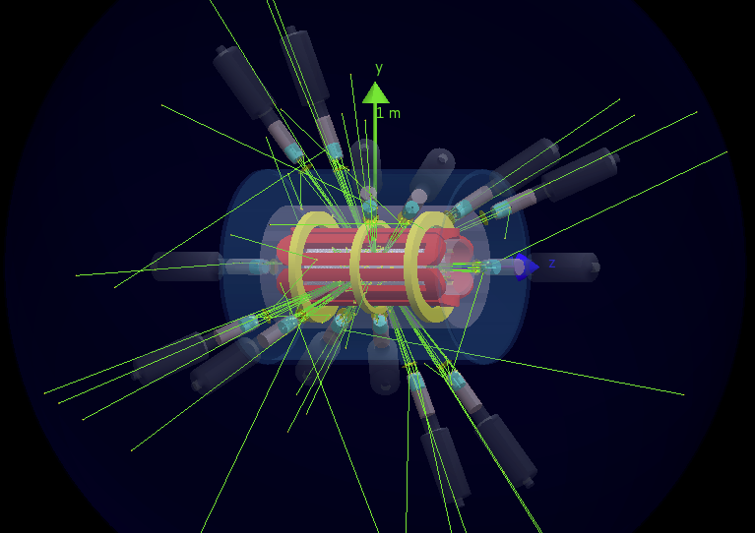
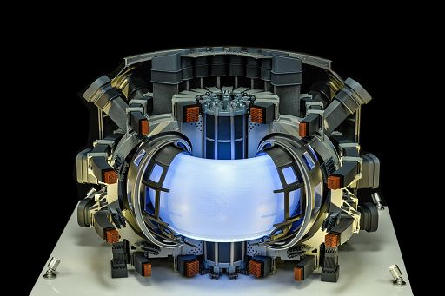

David Mascali on behalf of LNS and LNL Ion sources groups
Laboratori Nazionali del Sud
Interf.
RF/μW
Services
X-ray
optical
Plasma Diagnostics
Plasma Physics and R&D on ion sources
Plasma Modelling: confinement and heating
Sources and Accelerators:
RF systems, innovative resonators, innovative accelerators
Fundamental or Applied Research

Slide 2
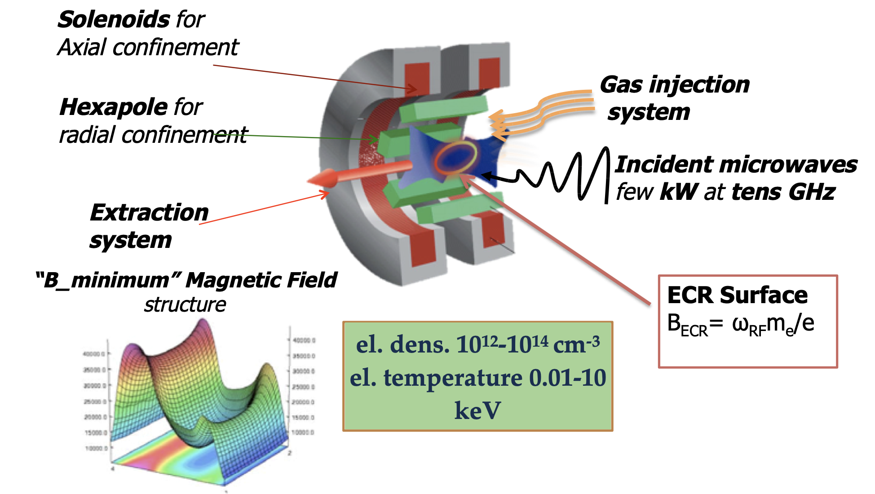
ECR Ion Sources Setup

Slide 3
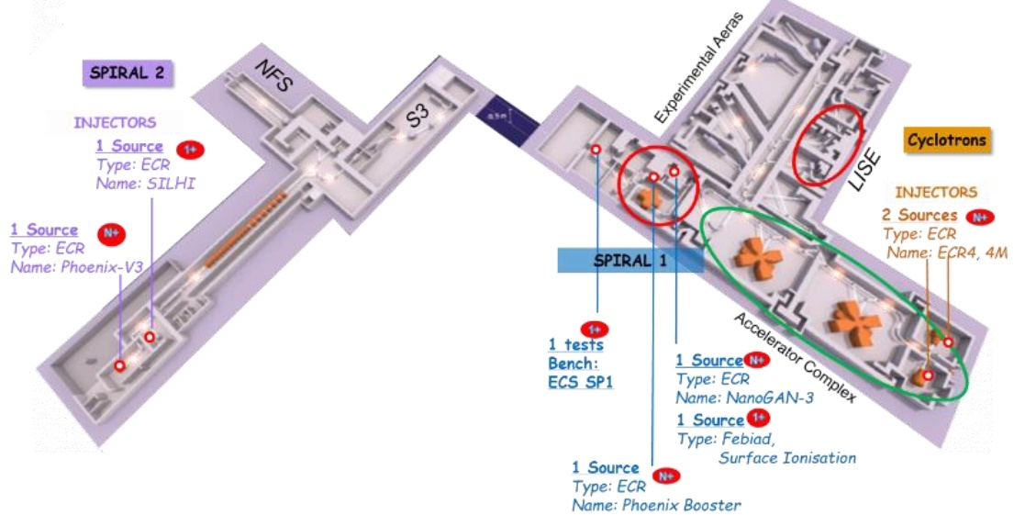
GANIL
  NUCLEAR PHYSICS WITH STABLE BEAMS
  RIBs PRODUCTION
    NEUTRONS PRODUCTION
Courtesy of L. Manoury
GSI
  PRODUCTION OF SUPER HEAVY ELEMENTS WITH UNILAC
  NUCLEAR STRUCTURE OF EXOTIC NUCLEI
    HIGH ENERGY EXPERIMENTS
    ATOMIC PHYSICS
Courtesy of F. Maimone

Slide 4
Plasma Modelling: confinement and heating
2006-2009
2011
2012-2013
2014-2016
2017-2020
2020 - …
L Celona, et al, Observations of the frequency tuning effect in the CAPRICE ion source Review of Scientific Instruments 79 (2), 023305
D Mascali, et al. Towards a better comprehension of plasma formation and heating in high performances electron cyclotron resonance ion sources
Review of Scientific Instruments 83 (2), 02A336

Slide 5
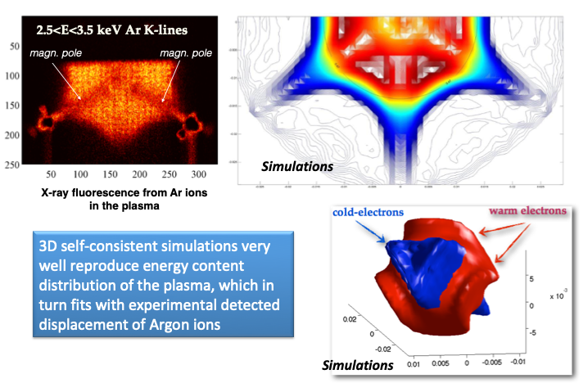
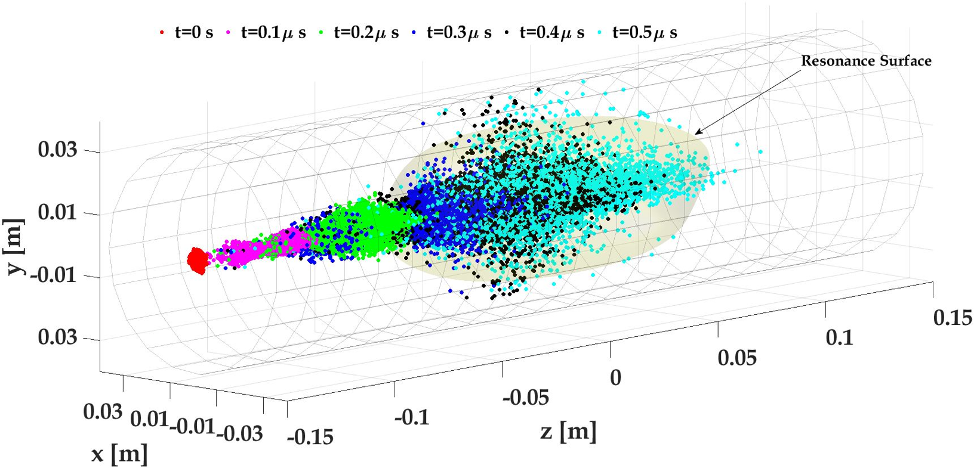
Experimental Benchmarks from theory and simulations: how to self-consistently model the ECR plasma and beyond → charge breeding for ISOL facilities
Plasma Modelling: confinement and heating
2006-2009
2011
2012-2013
2014-2016
Contribution to Charge Breeding in ISOL facilities
2017-2020
Stopping power studies in plasmas
2020 - …
An ion bunch propagating inside an ECR plasma

Slide 6
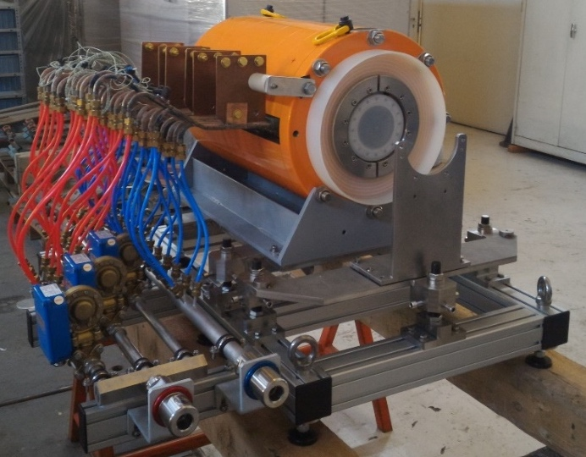


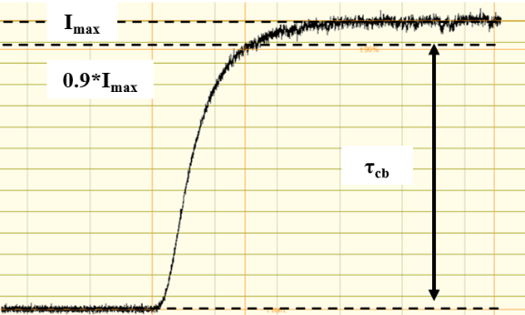
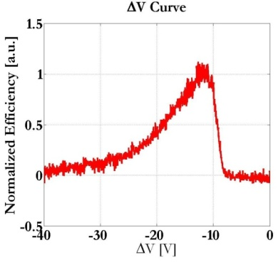



Charge Breeding scheme in ISOL facilities
E₁₊=1*V keV
V_{CB} = +(V + ΔV) kV
Focusing
Deceleration
Interaction with the ECR plasma
ΔV
τ_{CB} (half life)
<q+> (energy)
Efficiency (Intensity)
UPGRADED VERSION OF PHOENIX FROM LPSC
$$ε_{q^{+}}=\frac{I_{q_{}^{+}}}{q∗I_{1^{+}}}$$
ΔV<0
$$ε_{tot}=\sum_{i}{ε_{q_{i}^{+}}}$$
Fundamental parameter!
plasma
Courtesy of A. Galatà

Slide 7
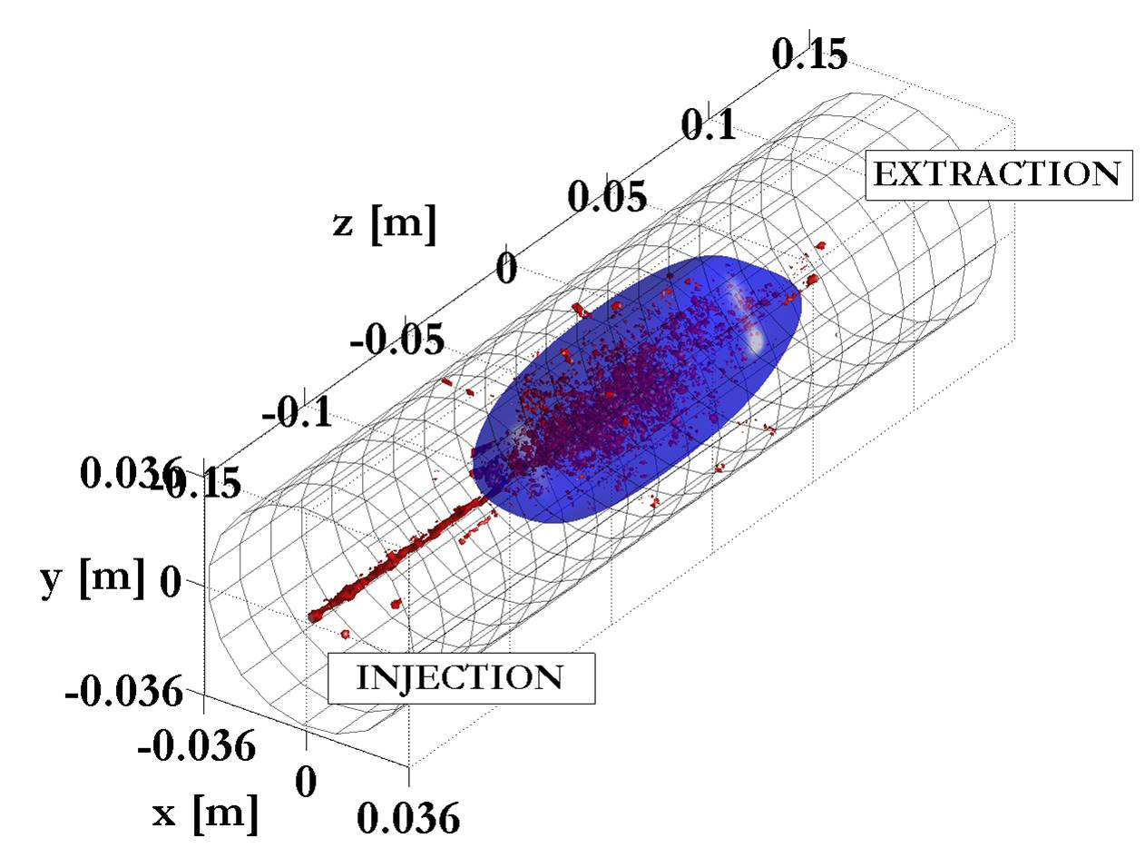
Modelling of Charge Breeding in ECR Ion Sources
There is the unique possibility to reproduce energy deposition and collective effects during beam-plasma interaction
Local Energy Release

Slide 8
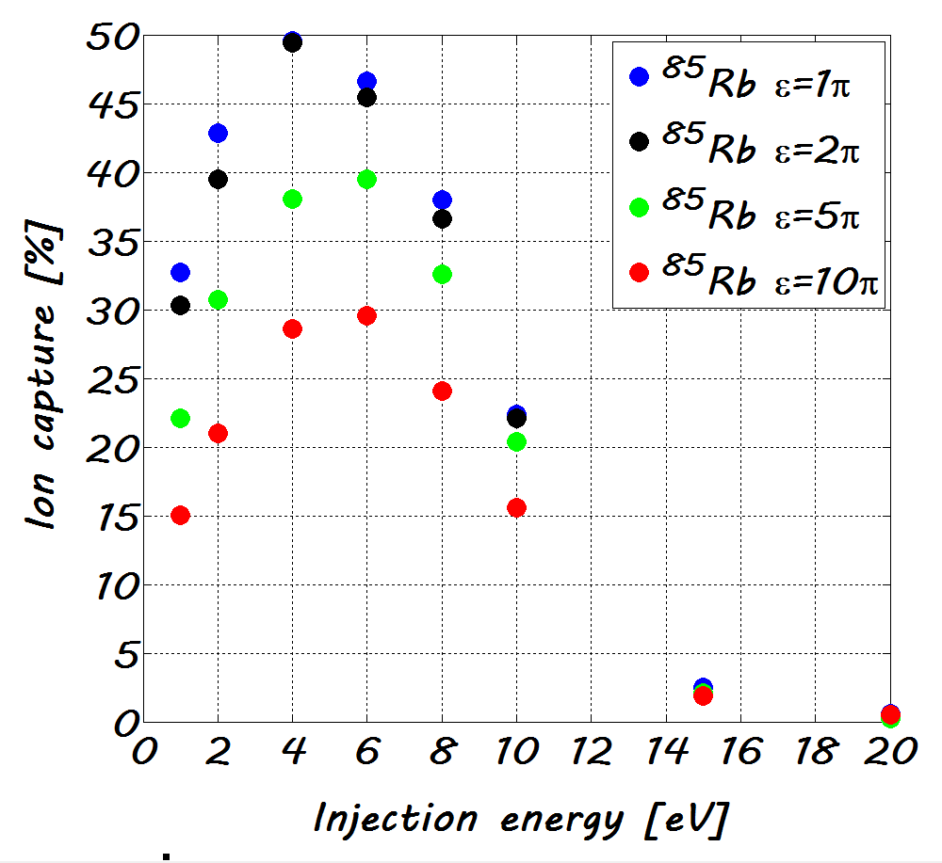
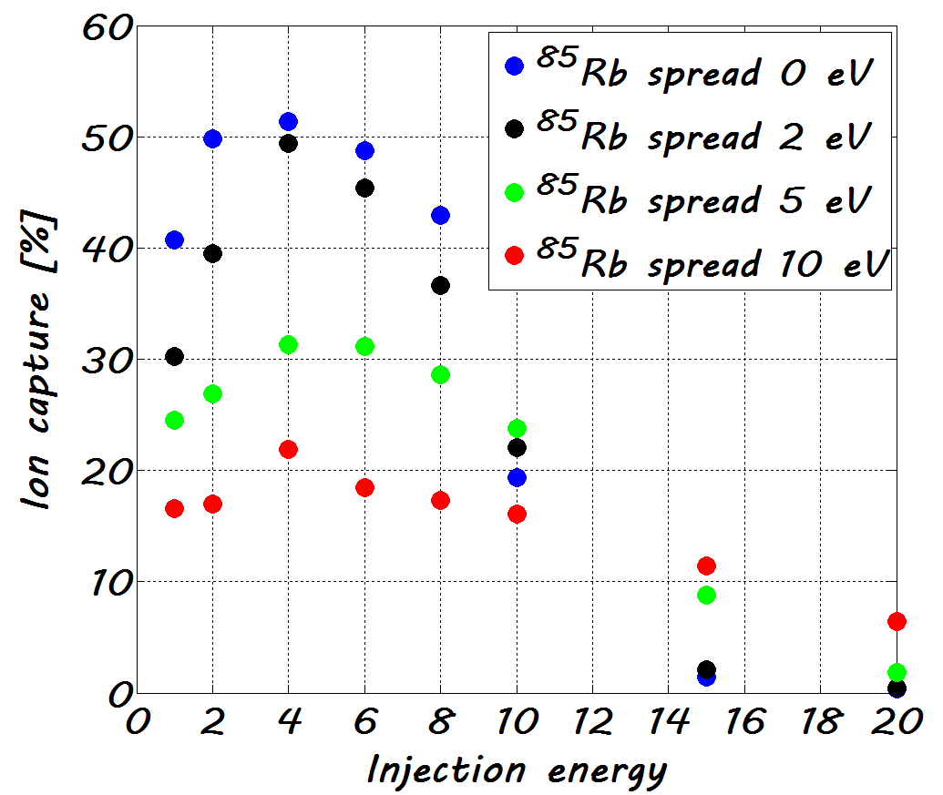
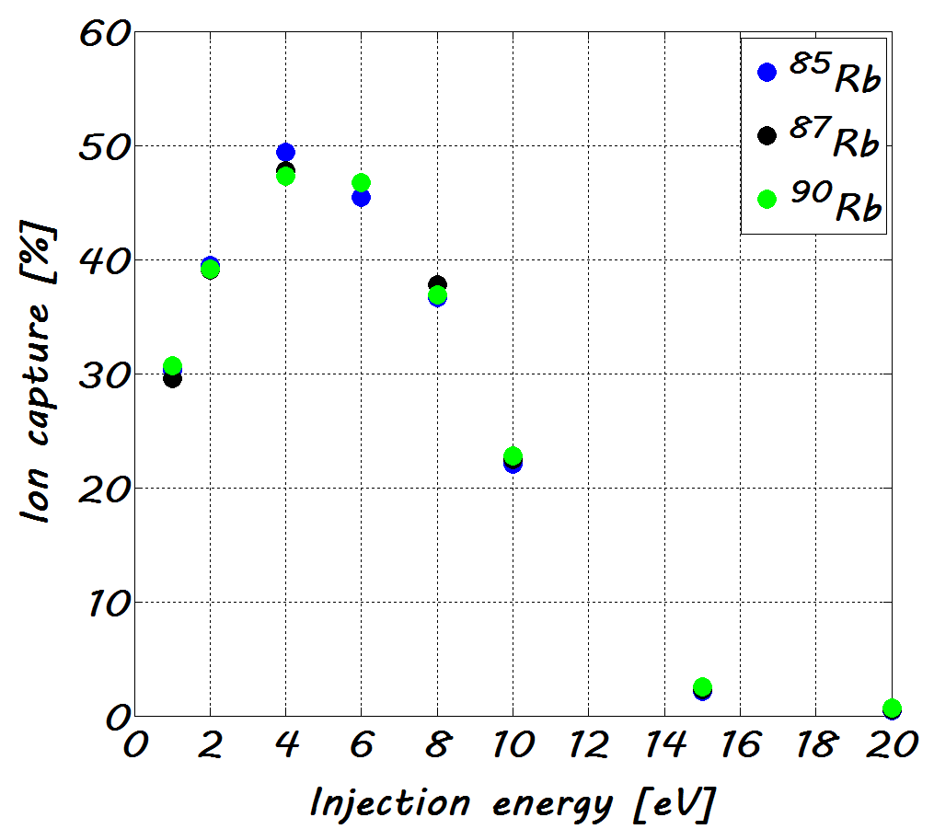
ECR-CB MODELING
CHARACTERISTICS OF THE INJECTED BEAM
Efficiency Vs emittance
Efficiency Vs E spread
Efficiency Vs ion mass
IMPORTANT INFORMATION FOR THE BLIND TUNING OF THE CB

Slide 9
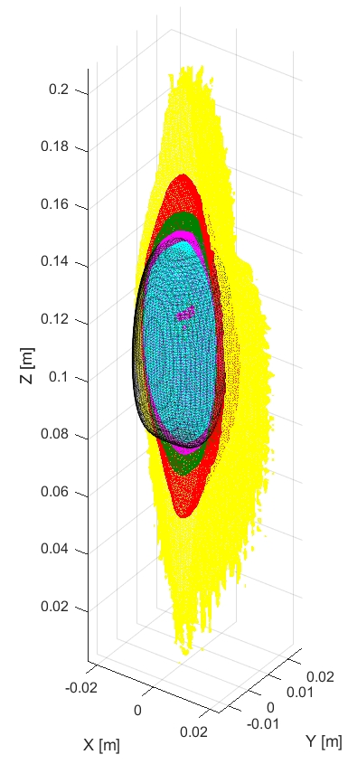
Plasma Modelling: confinement and heating
Stepwise ionization: from electron energy-density 3D maps to charge state distribution
2006-2009
O¹⁺
2011
O²⁺
2012-2013
O³⁺
O⁵⁺
2014-2016
O4⁺
2017-2020
ECR RESONANCE
2020 - …
2022 - …

Slide 10
Interf.
RF/μW
X-ray
optical
Plasma Diagnostics
Plasma Physics and R&D on ion sources

Slide 11
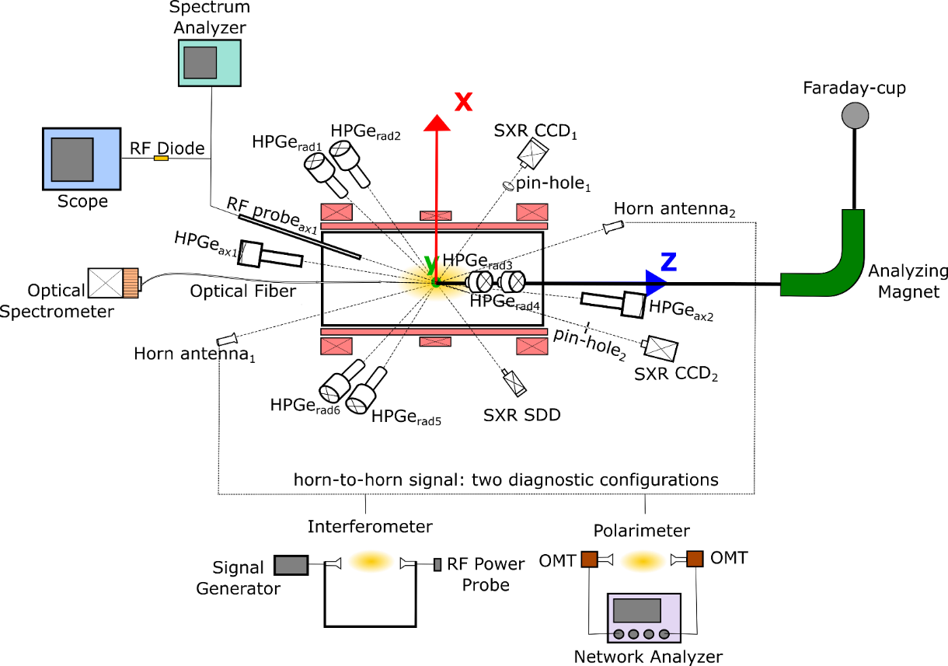
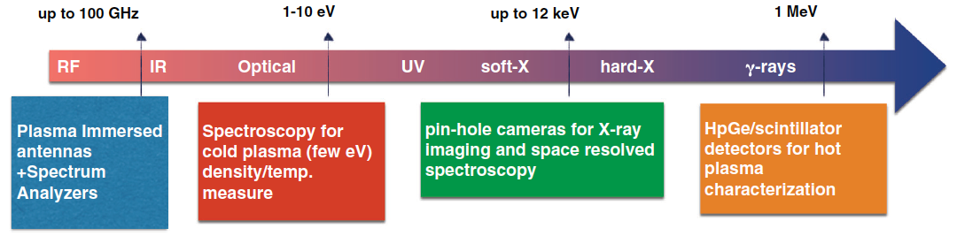
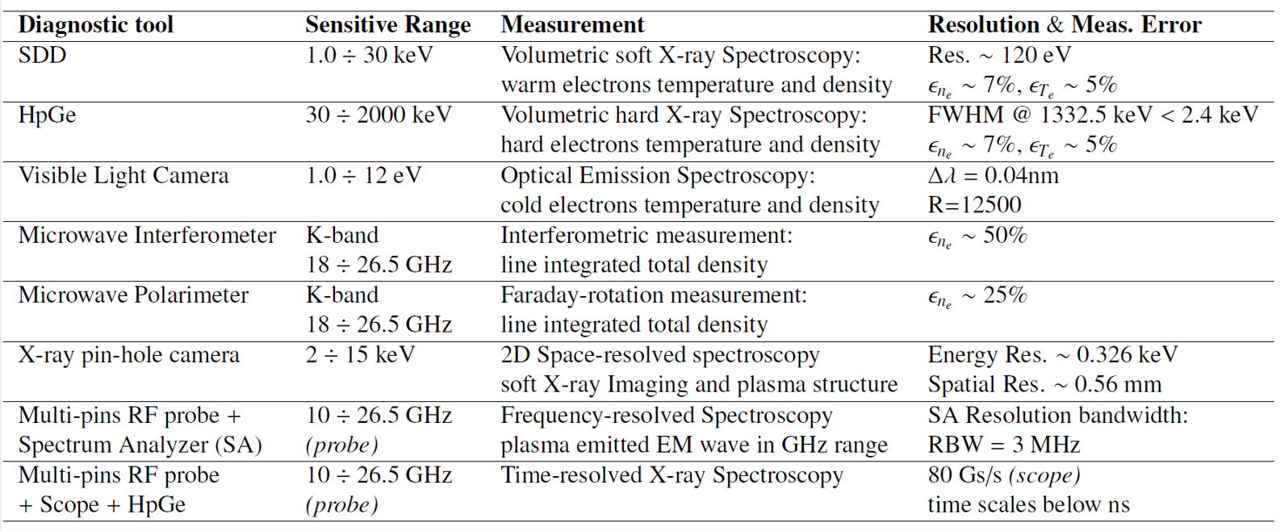
PANDORA
Online plasma multidiagnostic
One of the most advanced multidiagnostics systems in ion sources field
Modelling + Diagnostics: a “gymnasium” for young students (MsD, PhD, etc.) training and formation:
8 PhD thesis (Physics and Engineering)
10 MsD thesis in Physics
>20 Bachelor thesis in Physics, Chemistry, Engineering
Course of Accelerator Physcs at Catania University Phys. & Astron. Dpt. (D. Mascali contract Prof. + Torrisi, Mauro, Naselli)

Slide 12
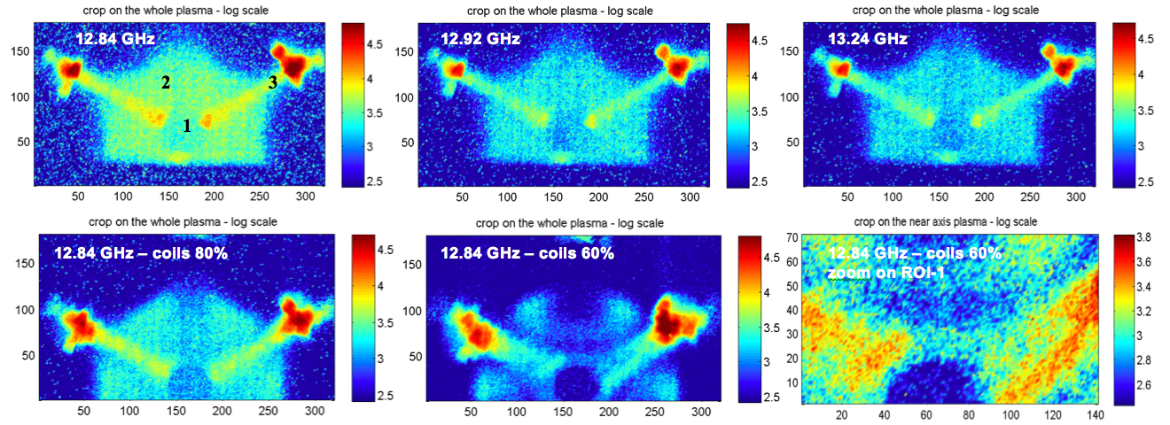
Exp.@ GSI – 2013, presented at ICIS’13-Tokyo and published on D. Mascali et al. Rev. Sci. Instrum. 2014
2010-2014
2015-2016
2017-2020
2020 - …
Exp. @ Atomki – 2014, presented at ICIS’15-New York, and published on D. Mascali et al. Rev. Sci. Instrum. 2016 and R. Racz, Plasma Sour. Sci. & Tech. 2017

Slide 13
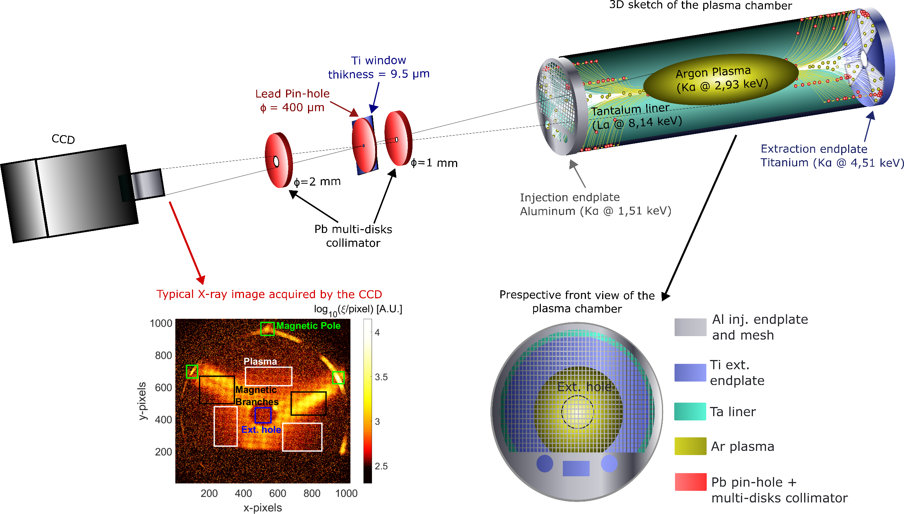
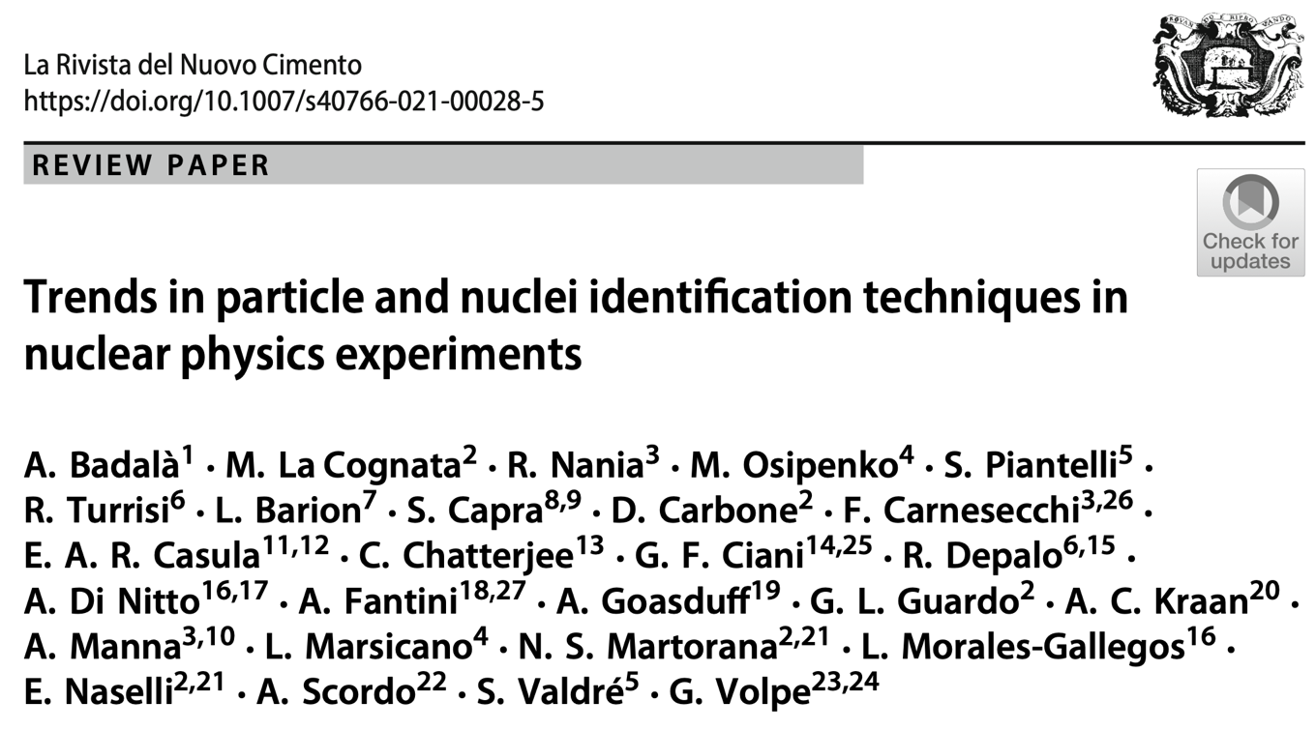
ATOMKI 2018 --> Experiment aiming at studying TCFH and its impact on plasma turbulence. A milestone for the understanding of plasma sability in compact traps.
2012-2014
Spatially-resolved X-ray Spectroscopy
2015-2016
2017-2020
2020 - …

Slide 14

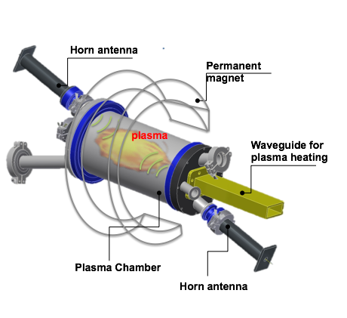
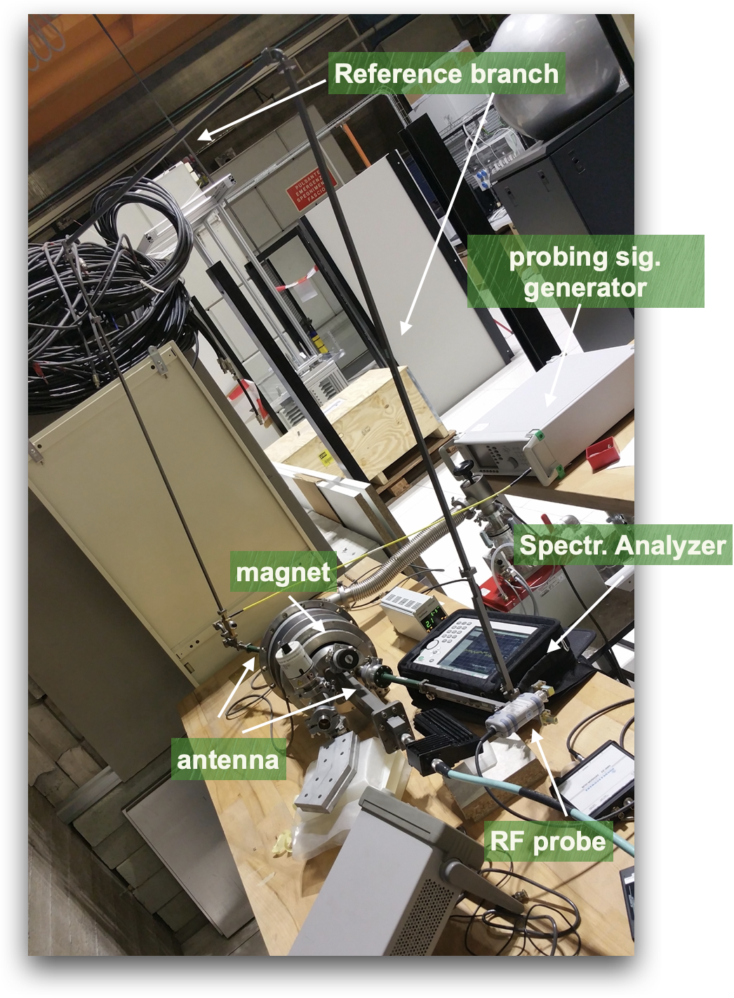
VESPRI@CSN5: The first interferopolarimeter worldwide for compact ECR traps and ion sources
2010-2014
2015-2016
2017-2020
2020 - …

Slide 15

LNS 2017: experiment with Max Planck Institute – IPP partners
ATOMKI 2018 --> Experiment coordinated aiming at studying TCFH and its impact on plasma turbulence. A milestone for the understanding of plasma sability in compact traps.
FIRST COMPLETE OPERATION IN MULTIDIAGNOSTICS MODE!! During the PANDORA Feasibility study, approved by CSN5 (Nat. Resp.) the overall multidiagnostics method was set-up
2012-2014
2015-2016
2017-2020
2020 - …

Slide 16
C4) Improving Ion Beam services (ERIBS)
Participants: JYU (coordination), ATOMKI, CNRS (IPHC, LPSC), GANIL, GSI, INFN (LNL-LNS), UMCG.
ERIBS (European Research Infrastructure - Beam Services) aims at providing high-level ion beam services for the EURO-LABS research infrastructures by focusing on improvements in two key categories:
  ion beam variety and production efficiency;
  short and long-term ion beam stability.
Interf.
RF/μW
X-ray
optical
Plasma Diagnostics
Plasma Physics and R&D on ion sources
Plasma Modelling: confinement and heating
Sources and Accelerators:
RF systems, innovative resonators, innovative accelerators

Slide 17
Interf.
RF/μW
Services
X-ray
optical
Plasma Diagnostics
Plasma Physics and R&D on ion sources
Plasma Modelling: confinement and heating
Sources and Accelerators:
RF systems, innovative resonators, innovative accelerators

Slide 18
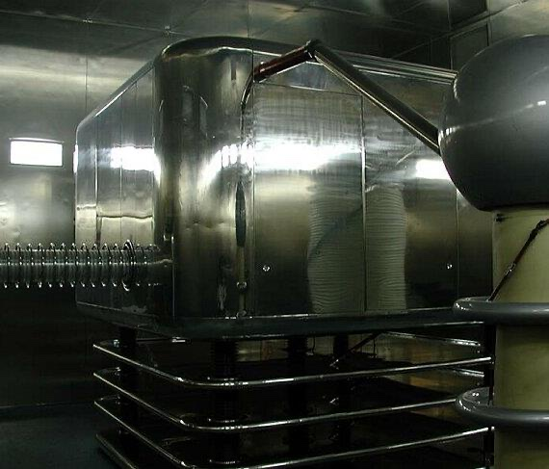
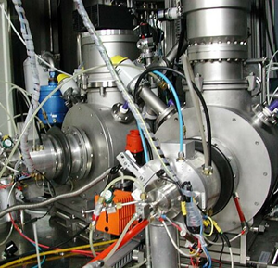
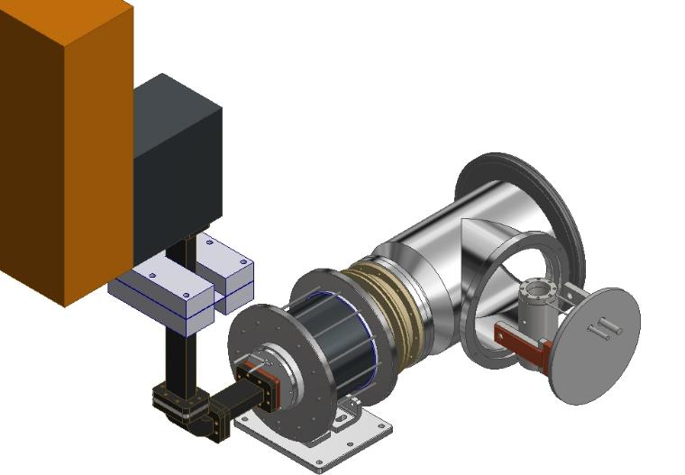

450 kV Tandem injection
Since November’22 extraordinary maintenance has been planned
for all the subsystems present on the platform
In the early summer is planned to restart with R&D activity after a revamping of the Nestor source for production of noble gas to provide He⁻ beam by charge exchange Li vapours
under study He⁺ and ²²Ne
ion implanted on pyrolytic graphite

Slide 19
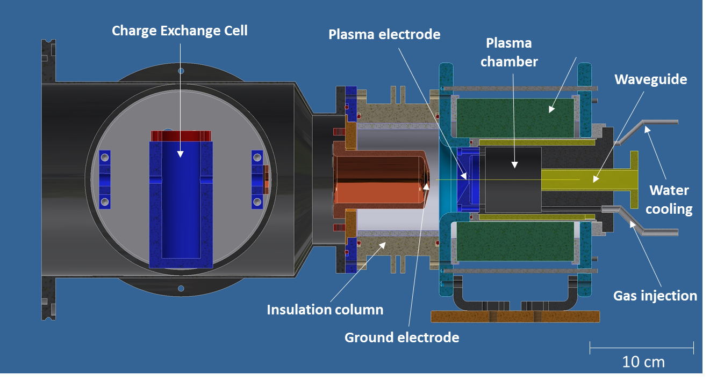
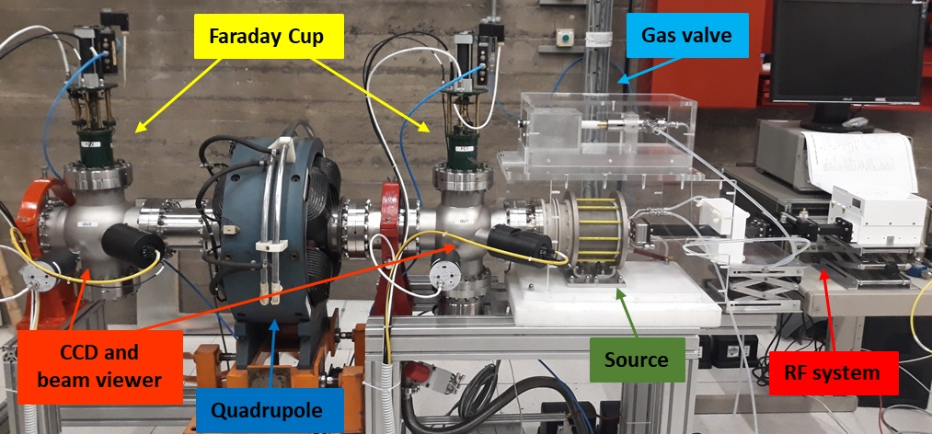
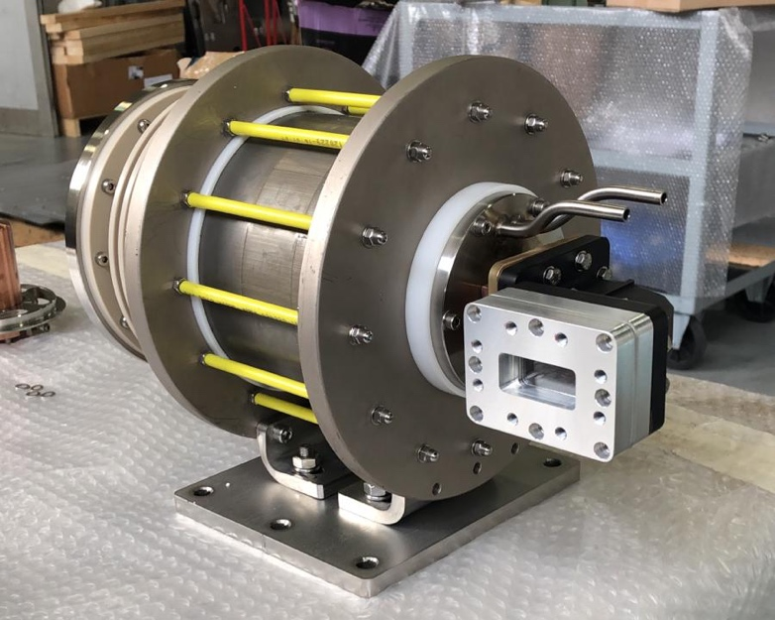
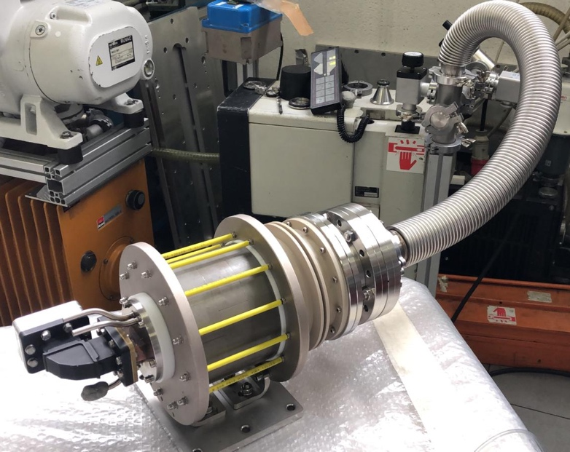
New Sources for LNS beams portfolio (2017-2020): NESTOR for the TANDEM (noble gases, e.g. He- beams) and ULISSE for the CS (protons)
NESTOR
30 cm
ULISSE is an ultracompact microwave discharge source producing protons for hadrontherapy (to be installed after the CS upgrade)

Slide 20
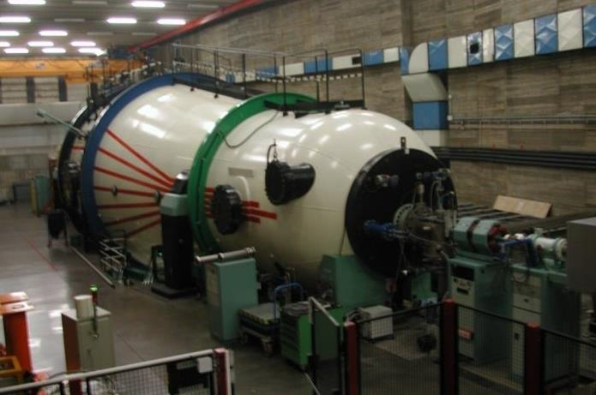
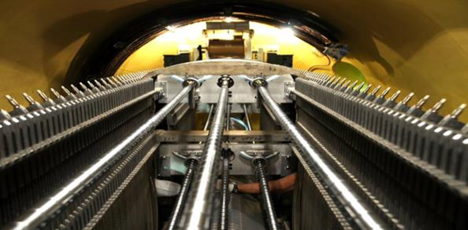
Tandem Beam Menu
²⁸Si, ²⁹Si
³²S, ³⁴S
³⁵Cl, ³⁷Cl
⁴⁰Ca
⁵⁸Ni, ⁶⁰Ni
⁶³Cu, ⁶⁵Cu
⁷⁰Ge
⁷⁹Br
⁹³Nb
¹¹⁶Sn, ¹²⁰Sn
¹²⁷I
¹⁹⁷Au
¹H, ²H
⁶Li, ⁷Li
⁹Be, ¹⁰Be
¹⁰B, ¹¹B
¹²C, ¹³C
¹⁴N
¹⁶O, ¹⁷O, ¹⁸O
¹⁹F
²³Na
²⁴Mg, ²⁵Mg
²⁷Al
Maximum High Voltage ≈ 13.5MV
Pelletron charging system
HV stability ≈ 10⁻⁴
Noble gases development in progress

Slide 21
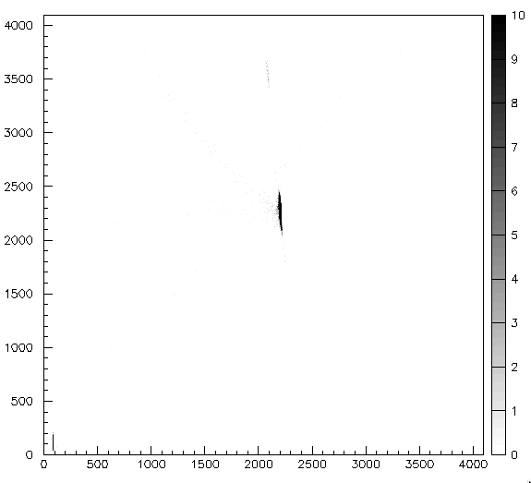

Long half-life isotopes in batch-mode
¹⁰Be (T_{1/2} = 1.39×10⁶ y) Tandem beam has been produced in batch-mode, in collaboration with PSI (Zurich)
@ 47 MeV
I≈10 nA for a few days
Contamination of ¹⁰B≈0.1%
ΔE(ch)
¹⁰B≈0.1%
¹⁰Be
Batch-mode beam development is foreseen for the next years
Next possible beam: ²⁶Al (T_{1/2}=7.17×10⁵ y)
E (ch)

Slide 22
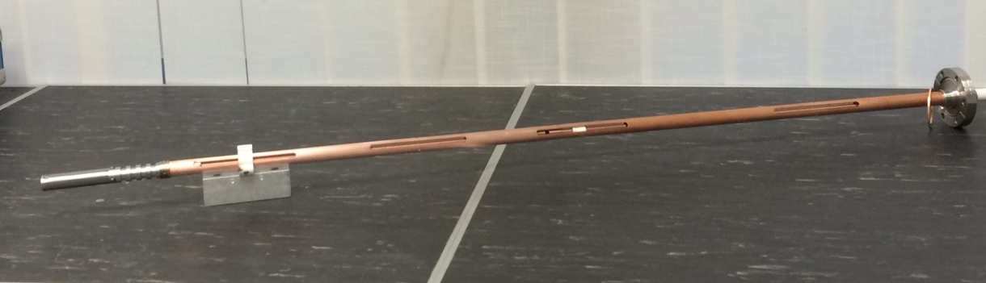
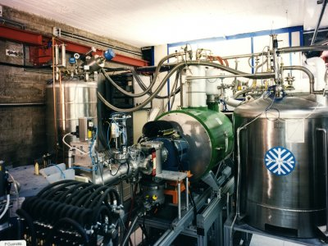
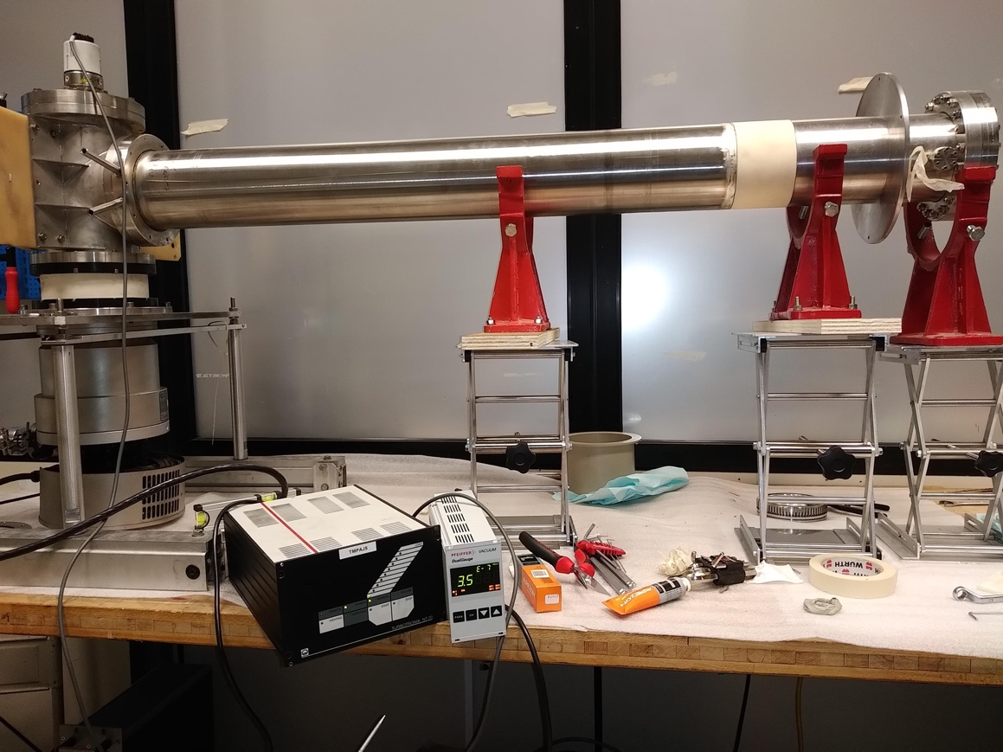

Upgrade of existing sources SERSE and CAESAR (2017-2020): rare isotopes for international collaborations
SERSE REVAMPING
New plasma chamber and insulations: commissioning ok in view of CS upgraded;
Control system: renewed 100%;
New gas-injection-system, minimizing "beam-switch-time” for rare gases and isotopes (also useful for ASIF irradiation facility);
Commissioning phase-1 in 2020: around 330 μA O6+ output current at 30 kV (CS-upgraded requirement: 400 uA at 30 kV)
Now a cost-benefit analysis is ongoing to manage major maintenance issues on the cryo-systems
Vaporizing ovens
CAESAR upgrade
The SERSE ECR ion source
Rare isotopes of Ca, Zn, Sn beams

Slide 23
Cyclotron Beams Menu
^{A}X E (AMeV)
H₂⁺ 62,80
H₃⁺ 30,35,45
²D⁺ 35,62,80
⁴He 25,62,80
He-H 10, 21
⁹Be 45
¹¹B 55
¹²C 23,62,80
¹³C 45,55
¹⁴N 62,80
¹⁶O 21,25,55,62,80
¹⁸O 15,55
¹⁹F 35,40,50
²⁰Ne 20,40,45,62
²⁴Mg 50
²⁷Al 40
³⁶Ar 16,38
⁴⁰Ar 15,20,40
^{A}X E (AMeV)
⁴⁰Ca 10,25,40,45
^{42,48}Ca 10,45
⁵⁸Ni 16,23,25,30,35,40,45
^{62,64}Ni 25,35
^{68,70}Zn 40
⁷⁴Ge 40
^{78,86}Kr 10
⁸⁴Kr 10,15,20,25
⁹³Nb 15,17,23,30,38
¹⁰⁷Ag 40
¹¹²Sn 15.5,35,43.5
¹¹⁶Sn 23,30,38
¹²⁴Sn 15,25,30,35
¹²⁹Xe 20,21,23,35
¹⁹⁷Au 10,15,20,21,23
²⁰⁸Pb 10

Slide 24
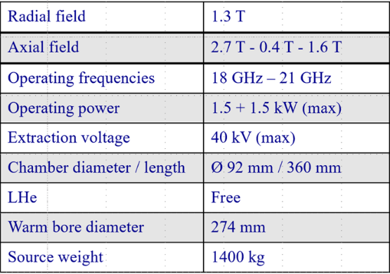
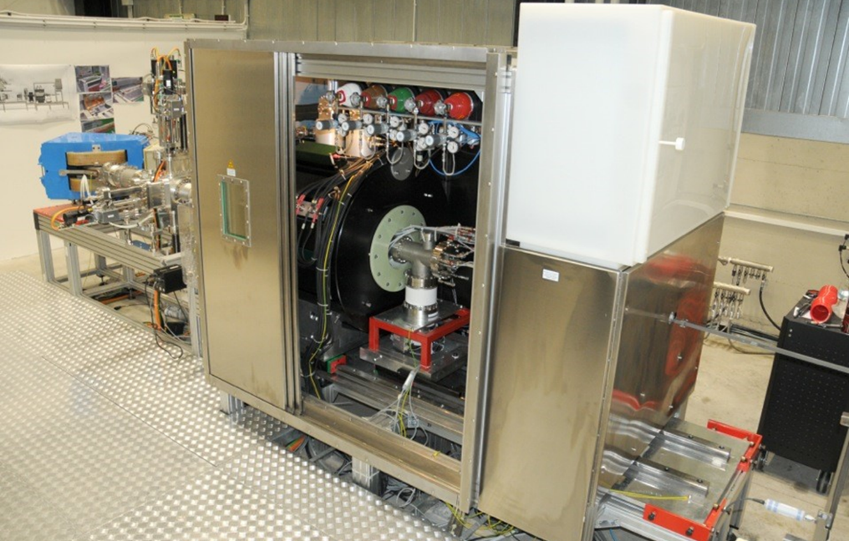
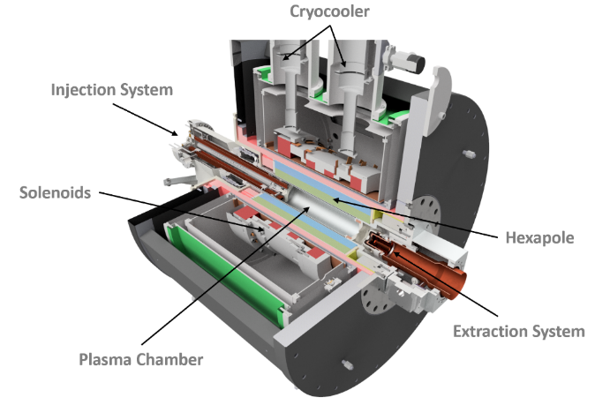
AISHa@LNS
low space occupation
low maintenance time
highly charged ion beams with low ripple
high stability and high reproducibility
Courtesy of L. Celona, S. Gammino, O. Leonardi

Slide 25
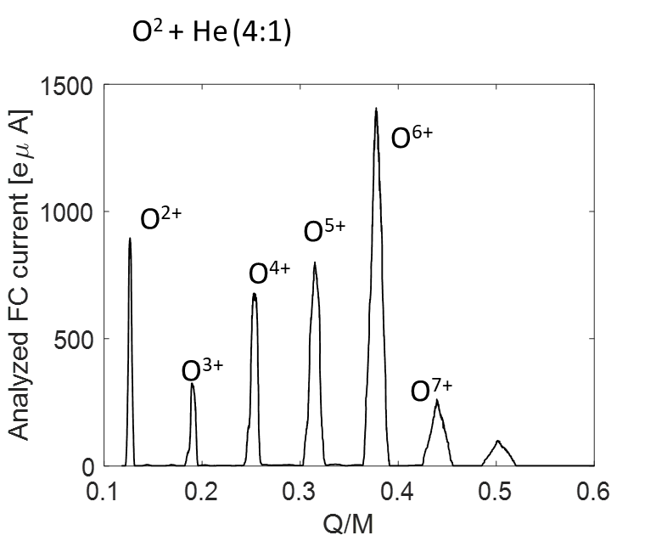
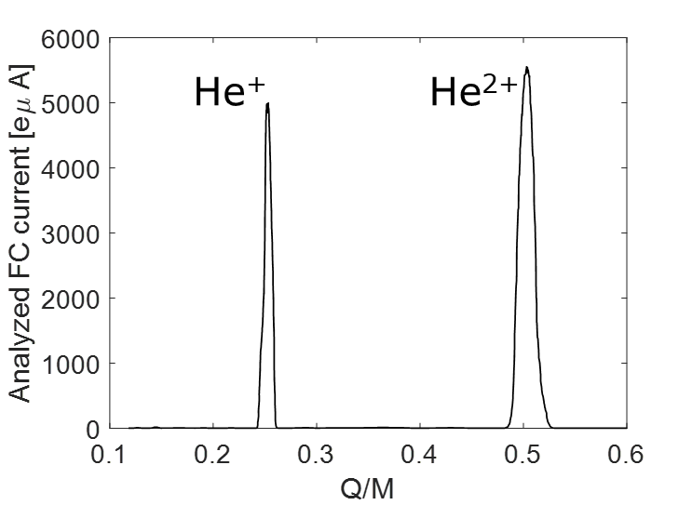
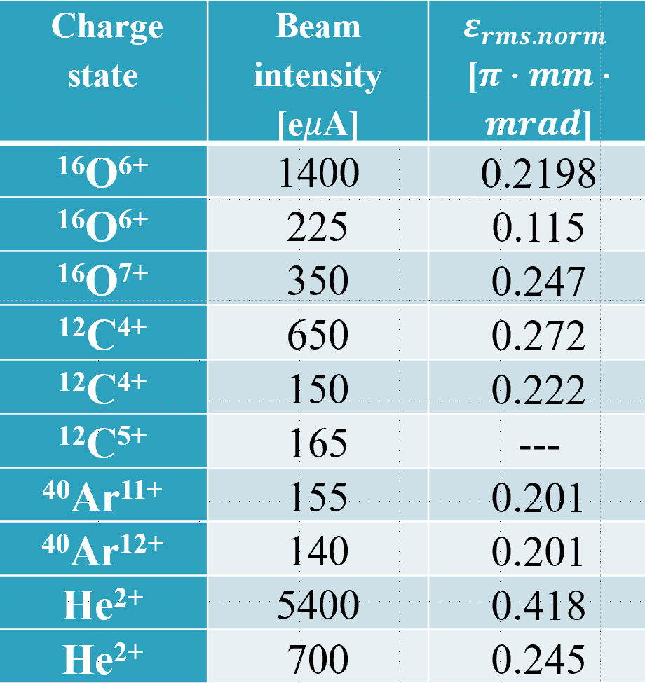
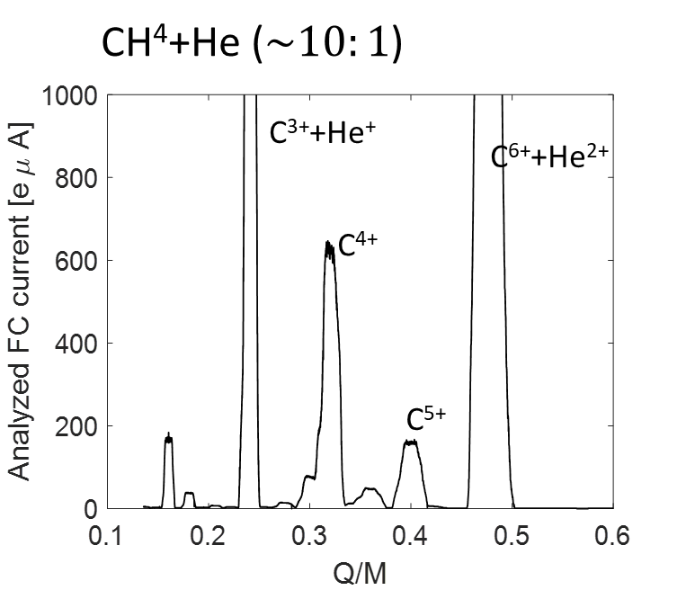
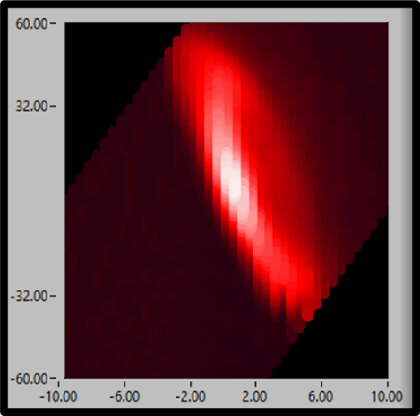
AISHa Performances
O⁶⁺ emittance 0.5emA
Courtesy: L. Celona, S. Gammino, O. Leonardi

Slide 26
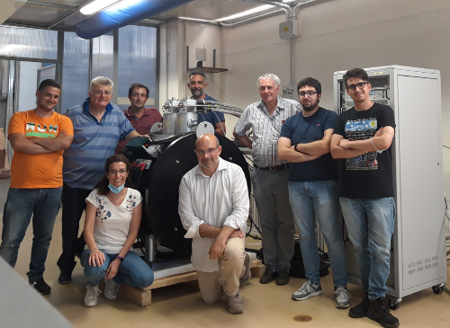
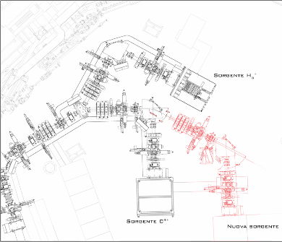
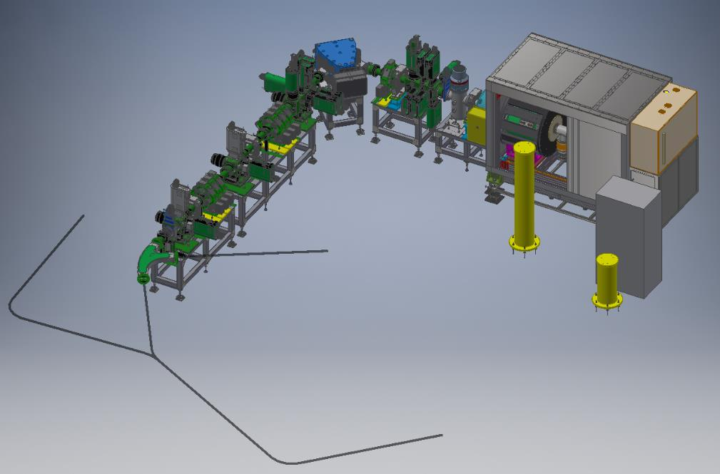


AISHa @ CNAO
INSpiRIT
INnovative accelerator facility with Sources Ions for
Research and radiation hardness studies
with IndusTrial and clinical applications
  Helium, Lithium, Oxygen and Iron for new clinical protocols and biological/material experiments for space radiation research
  Source and ancillary equipment are being preassembled in INFN-PV.
  The first deployment into synchro room is foreseen on 12 May 22, other displacements will be done in several time slots allocated for synchro ordinary maintenance
  Commissioning is planned to start in late summer and will envisage night shifts as already carried out for O1 and O2.
Courtesy: L. Celona, S. Gammino, O. Leonardi

Slide 27
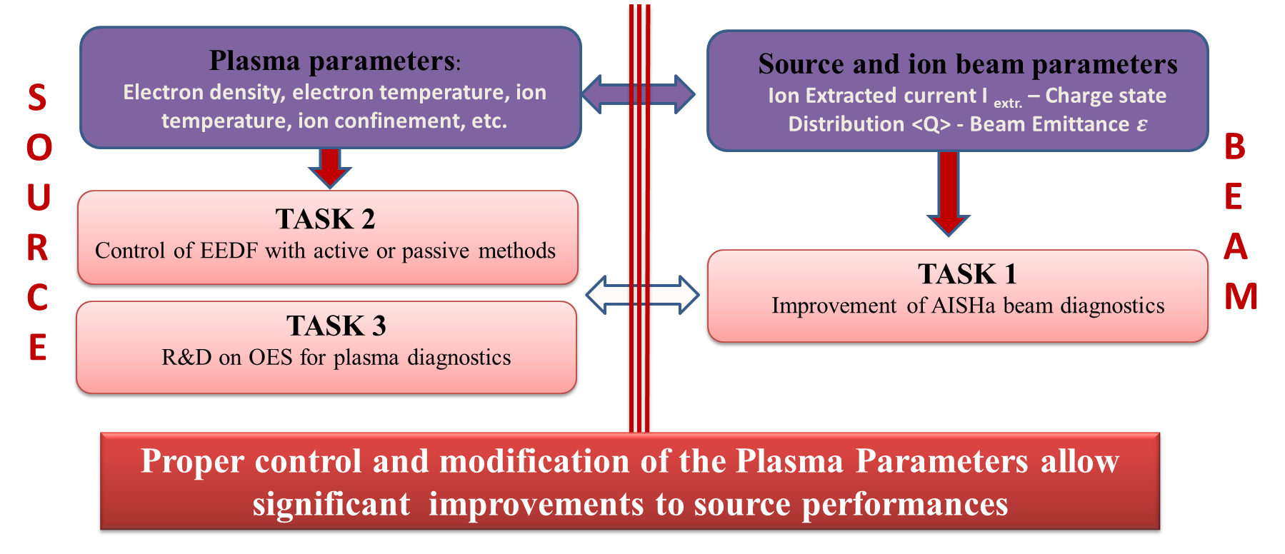
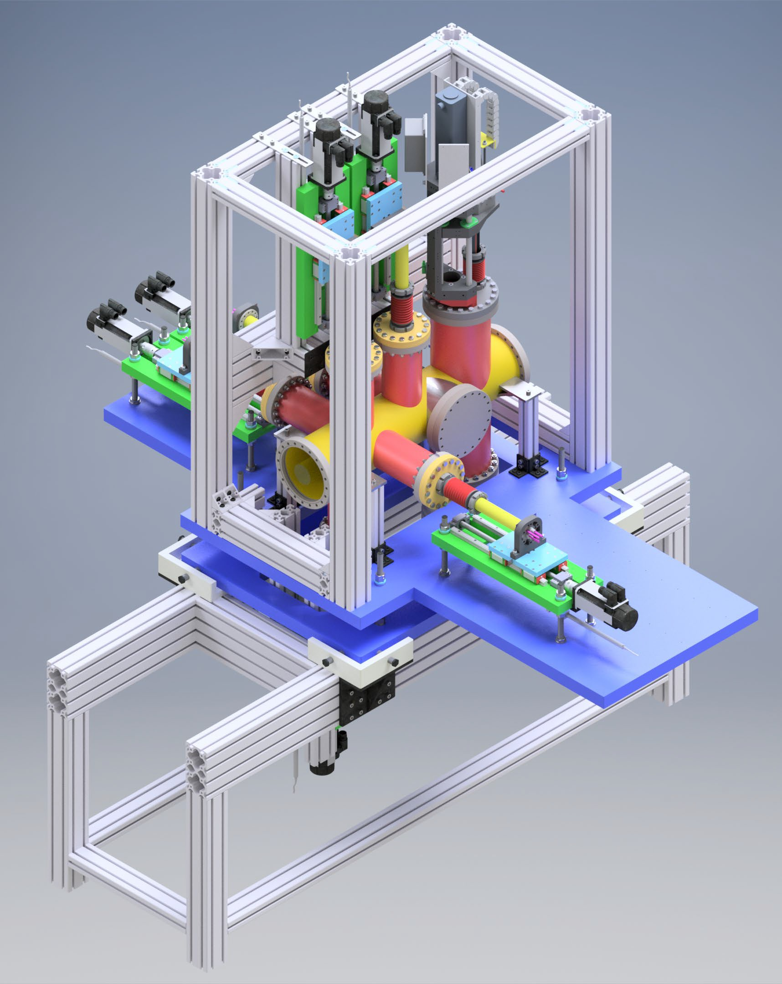
R&D activities-IONS (CSN5)
Task1: Beam diagnostics
  Connection between Plasma Parameters (n_{e}, T_{e}, T_{i}, τ_{i}) and Ion beam parameters (extracted current, Charge state distribution, beam emittance and shape) for the different working conditions;
  Modification of plasma losses current by using active (multi splitted camera) and passive methods (wall covering) to improve source performances;
  Development of the Optical Emission Spectroscopy as a diagnostic tool
New beam viewer and emittance measurement unit
Courtesy of G. Castro, L. Celona, O. Leonardi, F. Odorici, L. Malferrari, R. Reitano, L. Neri, S. Gammino

Slide 28
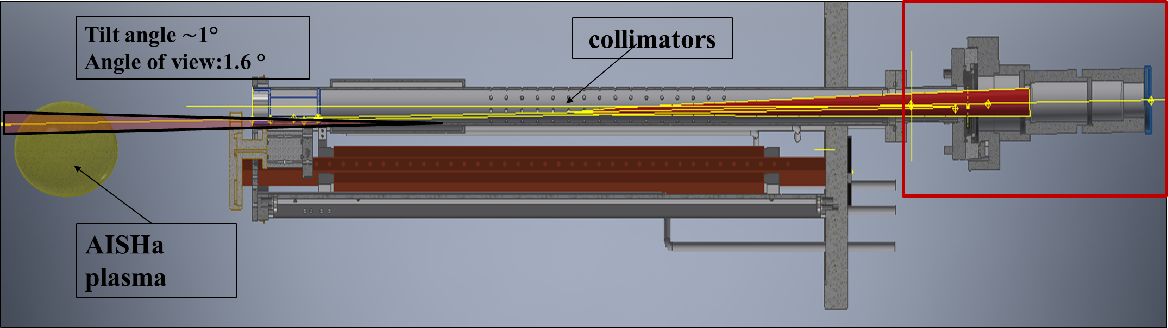

R&D activities-IONS
Task3: Optical Emission Spectroscopy
Once plasma parameters of ECRIS are evaluated by OES,
it is possible to create a 0 dimensional model to predict beam parameters.
A typical OES
spectrum
Optical coupling system from AISHa plasma (H.V) to Horiba spectrometer

Slide 29



R&D activities-IONS
Task2: Active plasma chamber
Courtesy of G. Castro, L. Celona, O. Leonardi, F. Odorici, L. Malferrari, R. Reitano, L. Neri, S. Gammino

Slide 30


ESS high intensity proton source
Pulse rise and fall time using LEBT chopper (Prototype tested on BETSI)
Flexible magnetic system design
(OPERA, Comsol)
Reduction of electric field (Comsol)
2011 Strat of the design at LNS
2015 Start of the construction at LNS
25/05/2017 ESS visit for requirement verification
12/09/2017 ESS visit for requirement verification
17/11/2017 End of the commissioning at LNS
01/02/2018 Delivered and assembled in Lund
Microwave to plasma coupling (3D Full wave simulation code)
Beam extraction
(Axcel)
Defocusing chopper (Comsol, TraceWin)
Improvements starting from IFMIF design (in collaboration with CEA)
Stationary and time dependent beam transport in space charge compensation regime (Particle in cell simulation code)
Courtesy of L. Neri, L. Celona, S. Gammino

Slide 31





ESS high intensity proton source
Intra-pulse stability < ±2%
Pulse to pulse stability < ± 3.5%
Minimum proton current range 67-74 mA
Doppler shift measurement

Slide 32








High Stability Microwave Discharge Ion Source
MDIS
915 G @ 0 mm
simulation
Goal 1: In-depth study of the largest dataset ever collected on this type of source (55000 source configurations)
Goal 2: Ion source simulation tool development (from plasma formation to beam extract)
HSMDIS
simulation
simulation
ɛ = 0.177 pi.mm.mrad
Courtesy of LNS+LNL Team: L. Neri, L. Celona, O. Leonardi, G. Castro, A. Miraglia, S. Gammino, F. Grespan, M. Comunian, L. Bellan, C. Baltador, G. Russo, S. Boscarino, A. Coco

Slide 33
Interf.
RF/μW
X-ray
optical
Plasma Diagnostics
Plasma Physics and R&D on ion sources
Plasma Modelling: confinement and heating
Fundamental Research
Sources and Accelerators:
RF systems, innovative resonators, innovative accelerators

Slide 34



PANDORA: Plasmas for Astrophysics, Nuclear Decays Observation and Radiation for Archaeometry → A New ECRIT – ECR Ion Trap for β-decay measurements in plasmas
MAIN GOAL: Make β−decay measurements in plasmas of astrophysical interest: many isotopes can change their lifetime of several order of magnitude when ionized!!
COSMO-CHRONOMETER
reproduction of the two s-only isotopes ¹³⁴Ba, ¹³⁶Ba in suitable proportions
Bound-state β-decay
PANDORA Phase-1 → 3 isotopes from a list of more than 120 of astrophysical interest!!
Solving the puzzle about the the exact contribution of s-processing to ⁹⁴Mo: β-decay or binary stars
Experiments driving feasibility study carried out in the frame of an international partnership:
ATOMKI – Debrecen (Hungary) → multi-diagnostics setups
LPSC-Grenoble (France) → radio-isotopes injection
Max Planck Institute – Inst. Plasma Physics (Germany) → Optical Spectroscopy of magnetoplasmas
GANIL (France) → theoretical studies on multi-ionisation
University Jyvaskyla (Finland) → Ion Cyclotron Heating studies
GSI – Darmstadt (Germany) → Vaporizing ovens
INAF: the spectropolarimeter SARG was moved from TNG-Canary Island to LNS
>45 Researchers and Technologists INFN involved in 2020-2021 with > 20 FTE, 2 Nat. Labs and 3 Sections; >60 Researchers in total, including international partners

Slide 35

The Paper for Universe has been published in Jan. 2022. It includes 70 co-authors from 34 departments/laboratories in Italy and Europe

Slide 36

PANDORA: an interdisciplinary facility to be installed at LNS
PANDORA consists of:
Superconducting Magnetic Plasma Trap: it contains a plasma made of multiply charged radioisotopes
HpGe Array: it consists of 14 detectors to measure the γ rays emitted after β-decays
Plasma Diagnostics System: it consists of RF, optical and X ray spectrometers allowing direct correlation of β-decay rate to plasma density and temperature
It could “add unique research capability” [CVI-report 2019] in Astrophysics and Nuclear Astrophysics in laboratory
for the first time, β-decay measurements in plasmas;
plasma opacity measurements in conditions similar to kilonovae ejecta;
an unprecedented setup for applications: it will be the biggest B-minimum magnetic trap with potentiality as ion source; as testbench for magnetic fusion; as radiation source for Archeometry.
Huge impact on nuclear physics and stellar nucleosynthesis
Heavy elements production in n-star merging
New ion and radiation sources for science and technology

Slide 37

Notes:
Qui descrivo con un pizzico in più di dettaglio il setup sperimentale e la questione della vita media attesa in plasma per il Lu, a titolo di esempio

Slide 38
PANDORA Timescale – GANTT “master”
Phase-2 (in-flight injection, etc.)
TBD in details

Slide 39
David Mascali on behalf of LNS and LNL Ion sources groups
Laboratori Nazionali del Sud
Interf.
RF/μW
X-ray
optical
Plasma Diagnostics
Plasma Physics and R&D on ion sources
Plasma Modelling: confinement and heating
Sources and Accelerators:
RF systems, innovative resonators, innovative accelerators

Slide 40



INFN-DTT @ LNS
Sub-task:
ICH Antenna Conceptual Design
R&D on plasma heating and diagnostics applied to Ion Heating, interferopolarimetry and X-ray measurements in the Divertor Tokamak Test
Sub-task:
Soft X-ray diagnostics (imaging and tomography)
Sub-task:
Interferopolarimetry

Slide 41



INFN-DTT @ LNS: ICH-antenna
Divertor Tokamak Test Design of the IC-Antenna

Slide 42






New μ-waves resonators: IRIS
Innovative Resonator Ion
Source
IRIS 1.0
IRIS refined
Conventional (CAESAR@LNS) plasma chamber
IRIS with slotted twisted waveguide
New microwave launching system with slotted/twisted waveguides
IRIS: italian patent pending n. 102020000001756
International patent pending N. PCT/IB2021/050696 // (E0130645) BRE-sz

Slide 43





New μ-waves resonators: IRIS
Innovative Resonator Ion
Source
IRIS is conceived for A.M. realization (3D printing). Twisted WGs have been already realized and vacuum/e.m. tested
Refined 3D printing and postprocessing has produced lab measurements close to simulations!

Slide 44



New Accelerators Schemes: On-chip solutions for ultracompact electron/proton accelerators
Italian patent pending n. 102021000021158 “Metodo per progettare una struttura accelerante dielettrica che supporta un modo TE210-like perturbato” by Istituto Nazionale Di Fisica Nucleare E Politecnico Di Milano
TM₀₁
~ GeV m⁻¹
o
Accelerator
‘in-a-shoebox’
beam
TE₁₀
Courtesy of G. Torrisi, G. Mauro

Slide 45
David Mascali on behalf of LNS and LNL Ion sources groups
Laboratori Nazionali del Sud
Thanks for your attention!!

