Slide 1

Paolo Michelato
SRF cavities for large international projects
ESS and PIP-II
Daniele Sertore
INFN Milano – LASA

Slide 2
Presentation Layout
INFN LASA SRF Group Expertise
  Cavity design
  Prototypes
  2 K Vertical Test
  Path to large project contribution
European Spallation Source
  Challenges
  Status of the contribution
Proton Improvement Plan – II
  Key features
  R&D program
  View into the future

Slide 3
INFN LASA
SRF expertise

Slide 4
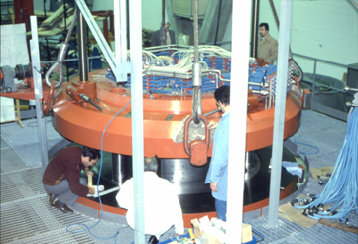


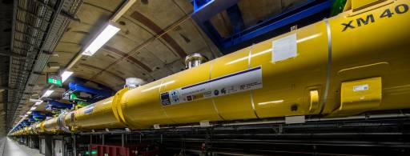
Path towards INFN LASA SRF experties
The First Superconducting Cyclotron in Europe in
the ‘80s, now at LNS, was realized at LASA
TESLA and the TESLA Collaboration (90’s …)
  TESLA, a TeV-scale electron-positron collider, was the
  first accelerator based on SRF. As a funder of the collaboration, INFN LASA contributed to bring SRF to be reliable and usable for acceleration application
European XFEL (from 2000’s …)
  A 17.6 GeV SRF based accelerator
  feeding a X-Ray Free Electron Laser.
  This project has succesfully
  demonstrated the possibility of
  application of SRF to large projects,
  paving the way to further challenging
  accelerators (LCLS-II, SHINE, ESS, PIP-II,
  ILC, FCC-ee, CEPC, etc.)

Slide 5
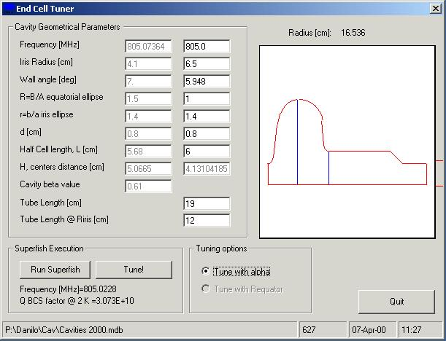
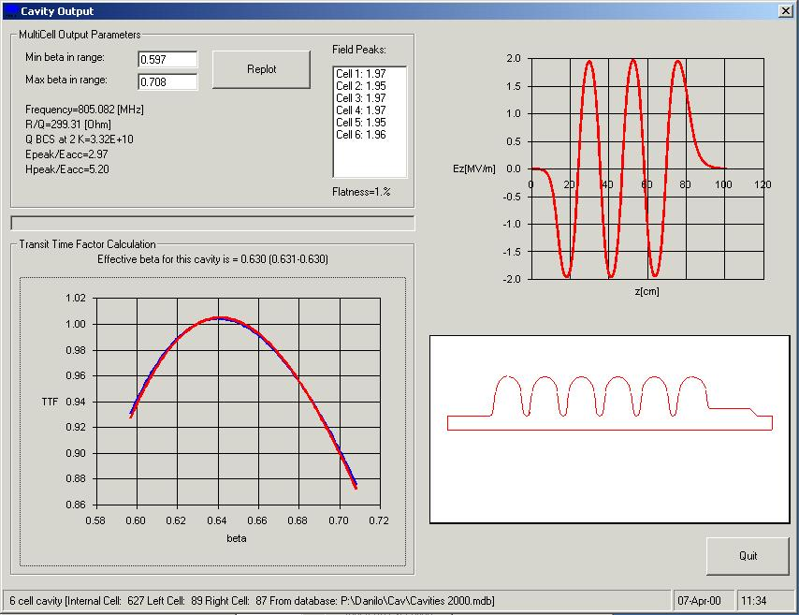
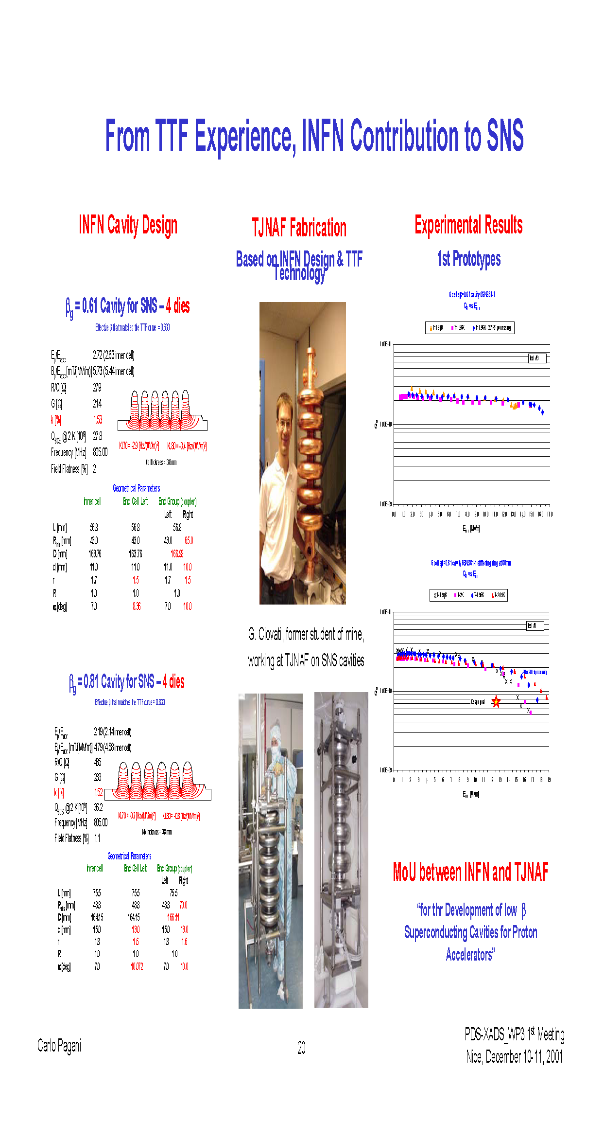

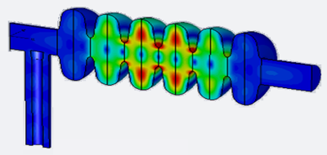
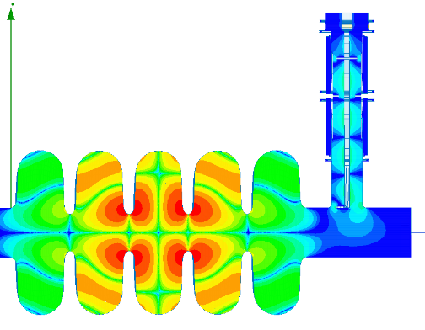


Cavity – Electromagnetic Design
Half Cell Parameters
Full parametric model in terms of 7 geometrical parameters
We built a 2D parametric tool for the analysis of the cavity shape on the electromagnetic parameters based on SUPERFISH
A multicell cavity is then built to minimize Field Flatness error, compute β and TTF as well as final performances
The 2D model constitutes the basis for further 3D simulations (HFSS, CST) for HOMs, multipacting, field emission considerations
BuildCavity
PIP-II LB Cavity: Example of EM analyses performed: Dipole HOM at 1678 MHz showing partial reflections in the FPC
ESS MB Cavity: Example of EM analyses performed: Dipole HOM at 1742.47 MHz

Slide 6
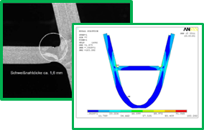
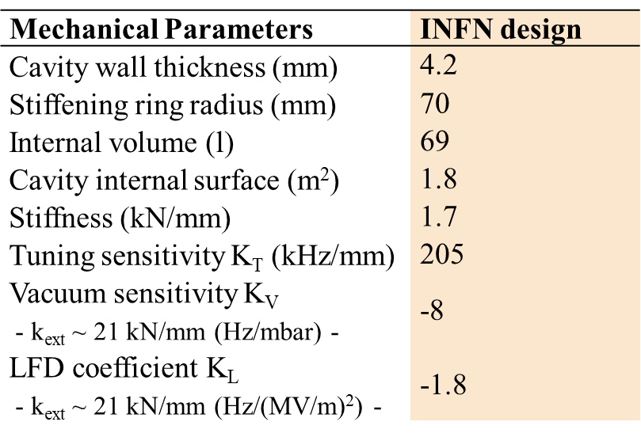
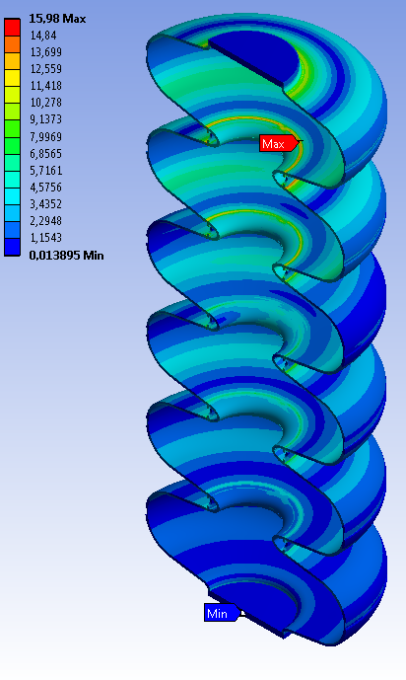
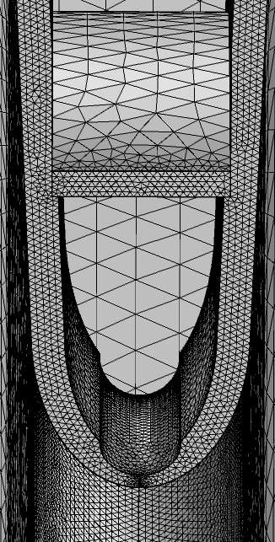
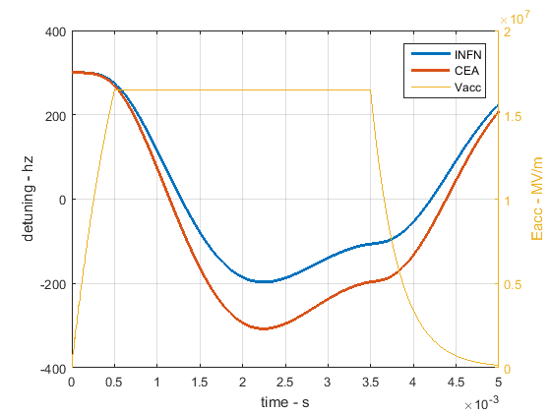
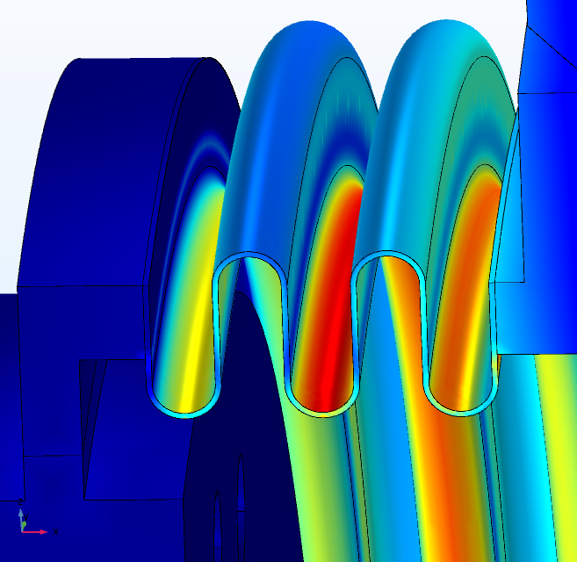
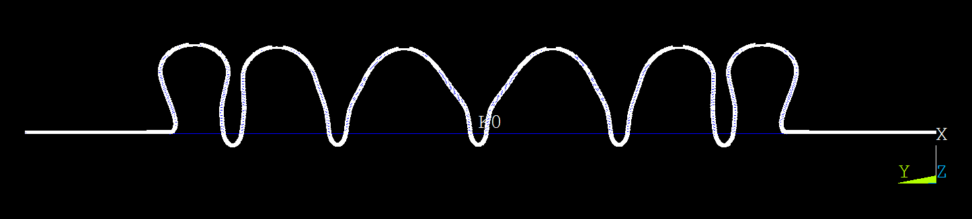
Cavity – Mechanical Design
The EM design is transferred to mechanical analysis (loop) for estimating critical parameters as:
  Ring radius
  Stiffness
  Tuning sensitivity
  Vacuum sensitivity
  Lorentz Force Detuning (LFD)
  PED, ASME compliance
Developed specific tool
LFD
Dynamical analyses: natural modes

Slide 7
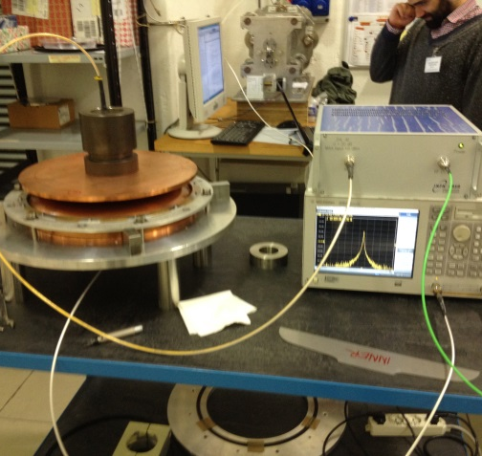
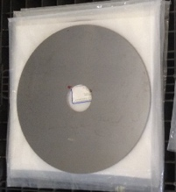



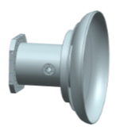

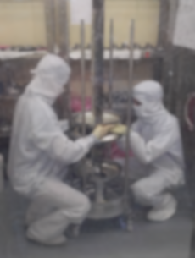
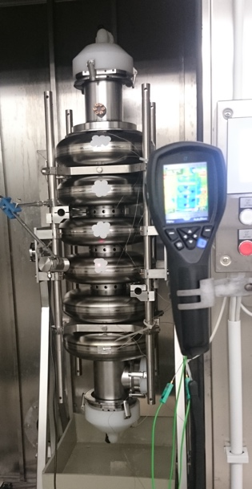
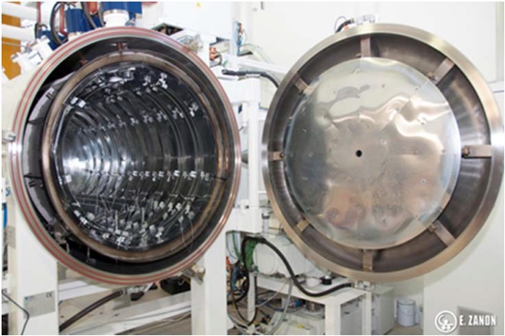
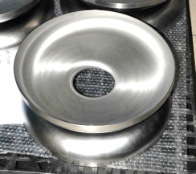
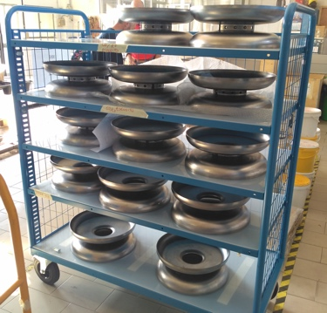
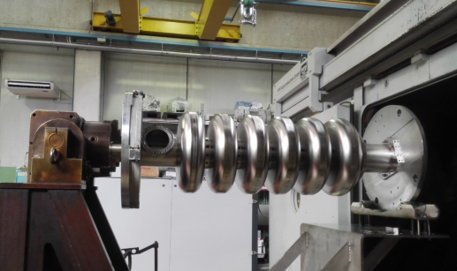
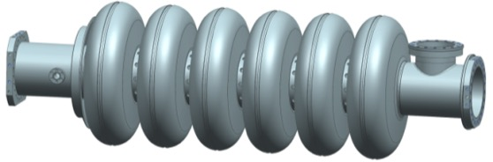
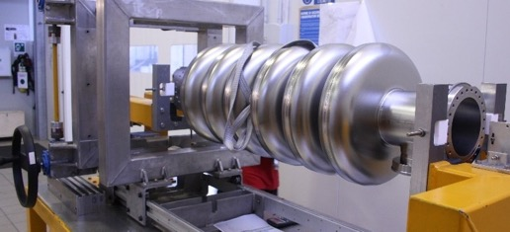
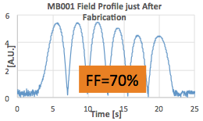
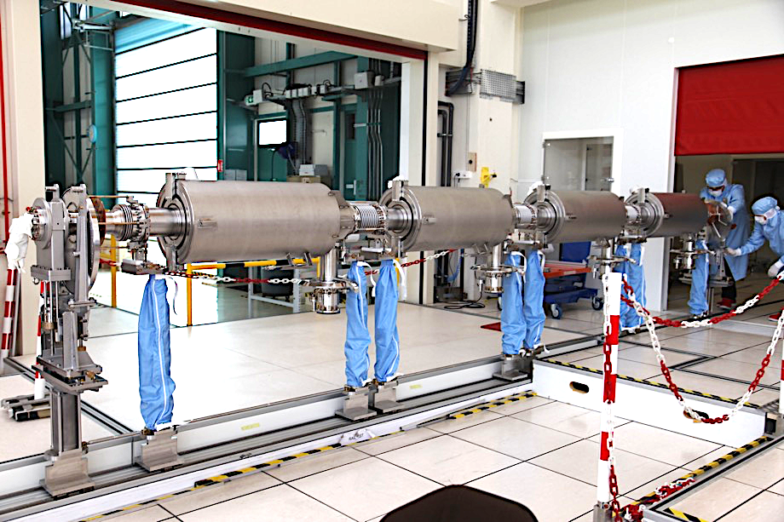




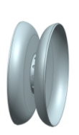
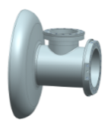
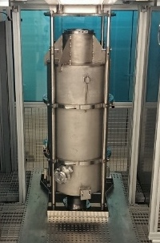
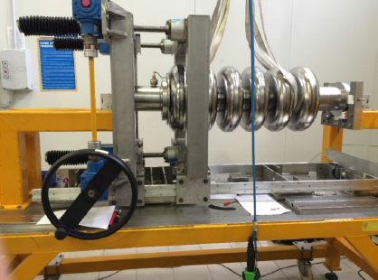
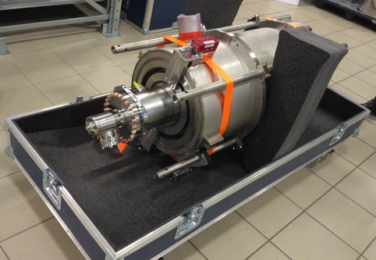
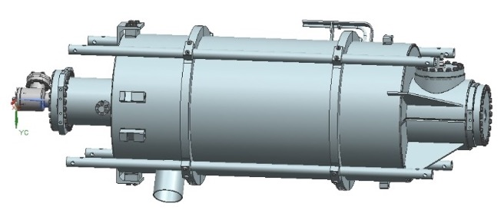
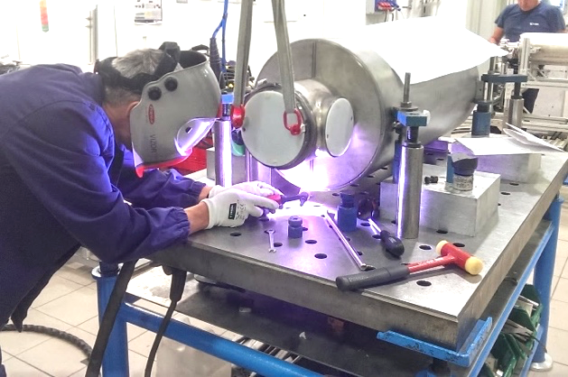
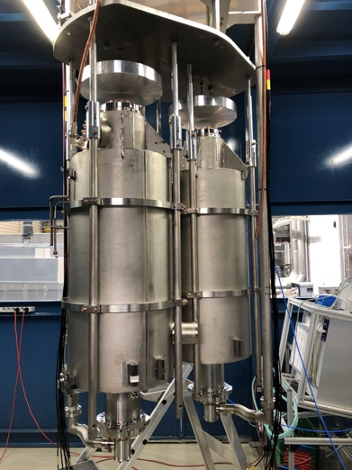
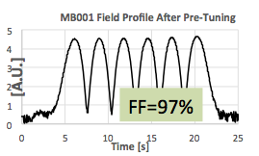
Cavity - Towards production -> Prototypes
A key element of our expertise consists also in the transfer of the
EM and mechanical design to production:
  RF procedures from sheets to cavity
  Define production cycle to guarantee final length and frequency
  Define appropriate treatment (BCP, EP, etc.)
  Mechanical and RF measurement and control plan
  Test of defined scheme on prototypes
  2 K RF test for final acceptance
RF Measurements
Nb sheets and raw materials
Subcomponents preparation
Cavity EBW
Bulk BCP
180 μm
Annealing
de Hydrog.
Al1
EC
PC
IC
PC
EC
EGP
PD
ID
CD
EGC
Al2
Tuning
CEA
Al3
Al5
Cavity tuning machine
DESY
Final Check and delivery
Accessories installation
Final BCP:
20 μm + HPR
Cavity integration
(He tank)
Al4

Slide 8
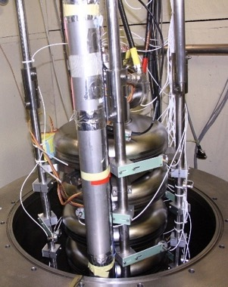
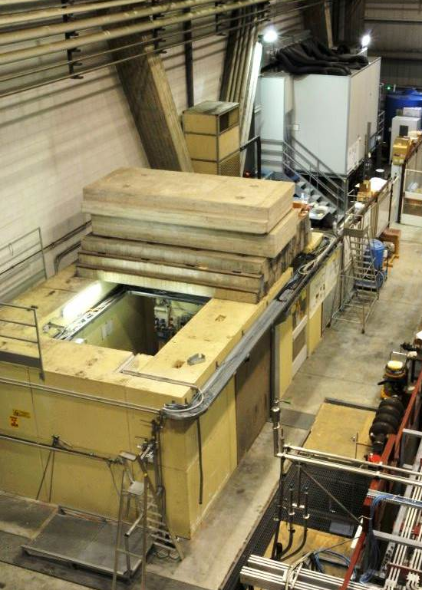
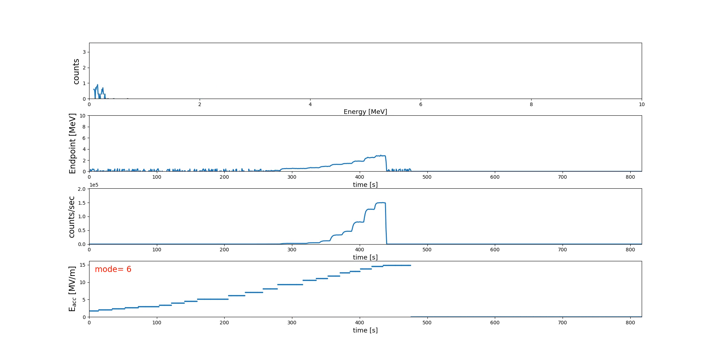
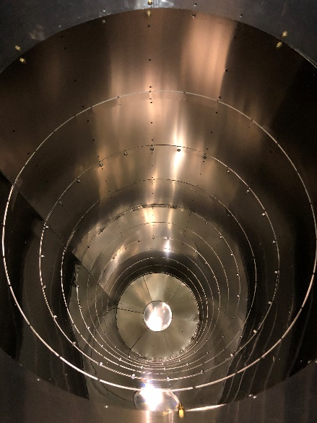
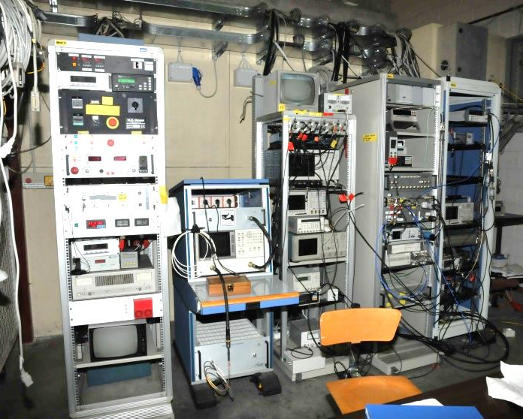
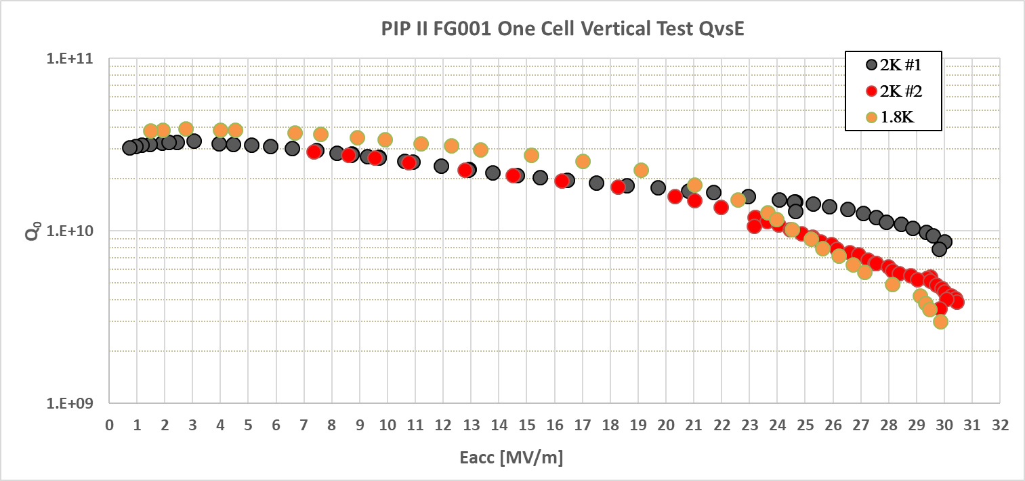
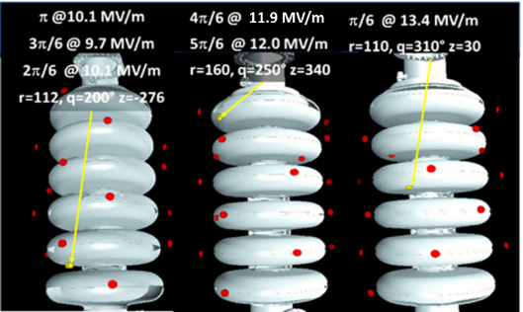
Cavity – Cold test @ LASA
Clean Room and UPW
  Ultra Pure Water plant
  ISO4/7 clean room, HPR system
  Qualified Slow Pumping Slow Venting system
Cryostat: φ 700 mm, 4.5 m length, losses ~ 1 W @ 2 K
Residual magnetic field: < 8 mGauss (single shield).
Single μmetal external shield and, second cryogenic shield (Cryoperm)
installed.
Sub-cooling system:
  Cooling power: ∼ 70 W @ 2 K
  Lowest temperature 1.5 K.
  Direct filling at 2 K
RF capability: 500 to 3900 MHz
Dedicated inserts with several diagnostics:
  second sound detectors for quench localization
  cryogenic photodiodes
  fast thermometry
  flux gate
X-ray counter and X-ray NaI spectrometer
Real-time Scintillator
Internal Magnetic Shield
Second Sound
Q₀ = 4 10¹⁰
8

Slide 9
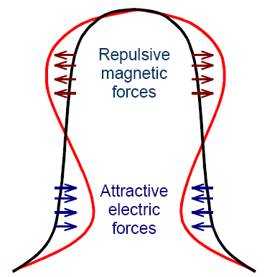
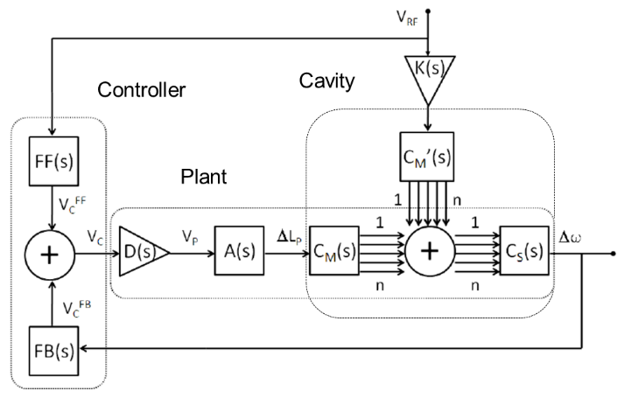
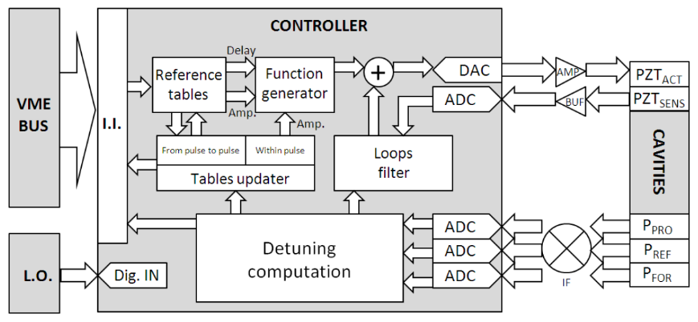
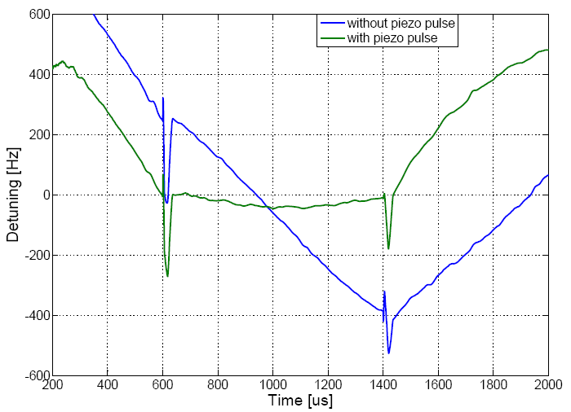
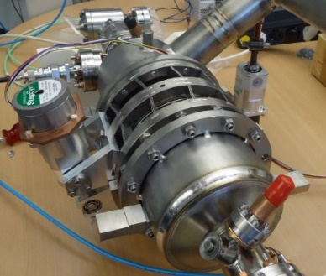
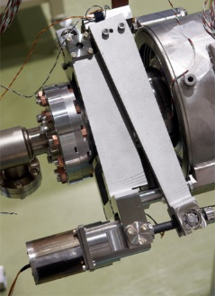
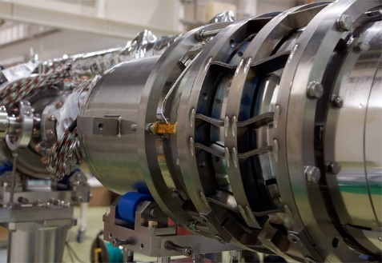


Tuners and Blade Tuner
Cavity Detuning:
Each SRF cavity must be equipped with a cryogenic tuning device, Cold Tuner, to set the cavity resonant frequency to the project value during operation. Tuners must also compensate detuning.
Among detuning sources:
  Lorentz forces on cavity walls induced by electromagnetic fields
  Microphonics and stochastic noise, strongly correlated to helium bath pressure fluctuations
Tuners control static frequency value (slow action, scale of second to minutes) and suppress dynamic detuning (fast action, scale of milliseconds).
At INFN LASA we designed, developed and experimentally qualified tuners and their control systems for many international projects
Slater’s theorem:
detuning rises with the square of field
Lorentz Force detuning
Required power rises with the square of detuning!
INFN Blade Tuner for
E-XFEL, DESY, Germany
E-XFEL Main Linac Tuner
INFN Blade Tuner at S1-Global KEK, Japan
INFN Tuner for the ADS cryomodule at IPN-Orsay, France
INFN Tuner for the ILC cryomodule at Fermilab, USA
Piezoelectric actuators for fast tuning, E-XFEL, DESY

Slide 10






Cryomodule: TESLA →XFEL→ILC design criteria
High filling factor
  maximize real estate gradient/cavity gradient
    long cryomodules/cryo-units, short connections
Moderate cost per unit length
  simple design, based on reliable technologies
  low static heat losses in operation
Effective cold mass alignment strategy
  room temperature alignment preserved at cold
Effective/reproducible assembling procedure
  clean room assembly just for the cavity string
  minimize time consuming operations (cost /reliability)
Module 1
Module 2
Module 3

Slide 11









Eu-XFEL 3.9 GHz: cavities and cryomodule results
INFN LASA In-Kind contribution:
  10+10 Cavities, recipe (BCP), PED compliant
  Ancillaries: Blade Tuners, magnetic shields,
  He-tank, etc.
  Cryomodule: cold mass, thermal shielding, etc.
String Assembly (DESY)
Blade Tuner
RF Curvature Linearization by AH1
3.9 GHz Blade Tuner
3.9 GHz cavities on LASA VT insert
X (i.e. E)
Off
On
September 23, 2015
3.9 GHz cavity ancillaries
Y (i.e. t)

Slide 12
Photocathodes for High Brightness Photoinjectors
INFN LASA is providing high QE Cs₂Te photocathodes since ‘90s (more than 150 photocathode produced) to different labs for high brightness RF electron gun operation, representing the state of the art in this field.
  DESY (FLASH, PITZ, REGAE)
  E-XFEL
  APEX (LBNL)
  FAST (FNAL)
  LBNL for the LCLS II commissioning
Preparation Chamber at LASA
VT installation

Slide 13

European Spallation Source

Slide 14






INFN LASA Contribution to ESS
352.21 MHz
704.42 MHz
2.4 m
4.6 m
3.8 m
39 m
56 m
77 m
179 m
Target
Source
LEBT
RFQ
MEBT
DTL
Spokes
Medium β
High β
HEBT & Contingency
75 keV
3.6 MeV
90 MeV
216 MeV
571 MeV
2000 MeV
LASA contribution
ESS Parameters
Max Energy | 2 GeV
Average beam power | 5 MW
Peak beam power | 125 MW
Peak beam current | 62.5 mA
Pulse length | 2.86 ms
Repetition rate | 14 Hz
Energy from SC sections | 96 %
INFN LASA In-Kind contribution for 11.6 M€.
  Fabrication of 36 cavities in the industry, including treatments, tuning and He tank integration.
  Built to Print strategy.
  Cavities delivered ready for the cold test.
    Analogous strategy as for the XFEL successful experience
  Cold test in a qualified infrastructure (DESY).
  Delivery at CEA ready for the cryomodule assembly.
Series cavities production at the industry:
    First cavity cold tested in November 2018
    Cold test at DESY and then CEA delivery
    Delivery rate foreseen: 2 cavities every 3 weeks
10²⁰
Reactor Sources
Spallation Sources
J-PARC
ESS
HIFAR
HFIR
ILL
LANSCE
ISIS
SNS
CSNS
10¹⁵
MTR
HFBR
MARIA
ORPHEE
IPNS
SALAM
HANARO
NRX
NRU
NIST
ZING-P’
Dhruva
FRM-II
CARR
PIK
SAFARI-1
JRR-3
ETERR-2
OPAL
LVR
RSG
SINQ
IBR-II
HOR
JEEP II
KENS
X-10
WNR
Effective thermal neutron flux n/cm²-s
ZING-P
10¹⁰
CP-2
CP-1
10⁵
Berkeley 37-inch cyclotron
Particle driven pulsed
350 mCi Ra-Be source
Particle driven steady state
Pulsed reactor
1
Chadwick
Fission reactors
1930
1940
1950
1960
1970
1980
1990
2000
2010
2020
2030
Year
(Updated from Neutron Scattering, K. Skold and D. L. Price, eds., Academic Press, 1986)

Slide 15






ESS Medium beta cavities: from design to series
INFN R&D on ESS prototypes
  INFN design, plug compatible with ESS cryomodule.
  Built prototypes at industry with same procedures as
  for series.
  Test QA/QC plan for future series production
  Final handling and test done in the qualified
  infrastructure at LASA.
  Successful result well above specification
Dumb-Bells
Cell shape design
ESS specs
  E_{acc} >16.7 MV/m
  Q₀> 5⋅10⁹
HOM analyses
Cavity tuning
ESS Medium Beta cavity prototype MB001 qualification at 2.0 K
Cold test @ LASA

Slide 16







INFN-LASA ESS cavities production workflow
Eddy current
Scanning (DESY)
OTIC
Ningxia
Rejected
Ettore Zanon
INFN LASA
Accepted
R300
Sheets
Semifinished parts
Special
diagnostic
Rs vs. T, etc.
Series
Vertical TEST @
DESY
Vertical TEST @
LASA
Cryomodule test at ESS
CEA
Cavities Assembly in criomodules
Not qualified
Qualified

Slide 17
MB Cavity 5-Acceptance Levels
Nb sheets and raw materials
Subcomponents preparation
Cavity EBW
Bulk BCP
180 μm
Annealing
de Hydrog.
Al1
EC
PC
IC
PC
EC
EGP
PD
ID
CD
EGC
Tuning
Al2
Al3
CEA
Al5
DESY
Final Check and delivery
Accessories installation
Final BCP:
20 μm + HPR
Cavity integration
(He tank)
Al4

Slide 18





QA/QC and document flow
INFN Alfresco CMS
NCR
INFN Experts Check
Industry
Cavity Production Data
Database:
Parameter Analysis
Process Control
Managing System
Quality Control
INFN Managing system
Cavity
with Tank
NCR
Cold RF Test
Cavity Assembly
NCR
NCR
Cavity Acceptance
Cavity
with Tank
Module
Q₀ vs E_{acc}
RF at Cold
Incoming
RF check
Document and data management developed in the framework of and LNS collaboration

Slide 19





ESS Medium Beta Status
ECS @ DESY
Niobium
  About 4 tons of Nb purchased,
  eddy current scanned at DESY
  and delivered to vendor
Series cavities
  All 38 cavities mechanical finished
  28 cavities (7 modules) delivered to
  CEA for module integration
  8 (+2) cavities still to be qualified
  4 new cavities production in progress,
  mitigation against possible further
  delays
28 cavities at CEA
ESS Acceptance Goal
E_{acc} = 16.7 MV/m
Q₀ = 5·10⁹
3 x goal
4 x goal
Q₀ at E_{acc} target

Slide 20

Plan for the completion of delivery
  8 (+2) cavities are not yet qualified to ESS specifications. COVID’19 and vendor change of ownership had impact on cavity perfomances. They are limited by the maximum achievabale field, while Q₀ at low field is inline with the qualified cavities.
  Actions:
    Optimization of the cleaning process
    with High Pressure Rinsing
      Recover M006 (already integrated at CEA)
    ElectroPolishing instead of standard BCP
      Recover naked M024
      Integration into He-tank in progress:
      final test scheduled beginning of May
    Innovative rotational BCP, collaboration
    with Argonne National Laboratory
      M028 is back from ANL
      test scheduled in the second half of May

Slide 21


Cavity M024 - Recovery

Slide 22

Proton Improvement Plan - II

Slide 23







PIP-II scope
Main Inj/Recycler
Transfer Line
SRF Linac
Booster
An 800-MeV superconducting H⁻ Linac; CW-compatible
Beam transport of 800-MeV H⁻ from the SRF Linac to the Booster
Modifications to the Booster, Main Injector, and Recycler Ring to enable >1MW power on LBNF target
Associated conventional facilities

Slide 24






















PIP-II Superconducting RF CW Linac, 2mA, 800 MeV
Consists of Five Types of Cryomodules
Elliptical
HB650 X 4
24 Cavities
650 MHz
Cryoplant
Elliptical
LB650 X 9
36 Cavities
650 MHz
Single Spoke
SSR2 X 7
35 Cavities
325 MHz
Single Spoke
SSR1 X 2
16 Cavities
325 MHz
CDS
HWR
8 Cavities
162.5 MHz
833 MeV
H- Ion source
516 MeV
177 MeV
RFQ
32 MeV
10 MeV
PIP-II Linac is technically complex, state of the art superconducting RF accelerator.
The world’s highest energy and highest power CW proton linac.
2.1 MeV

Slide 25



PIPII – Challenges
PIP-II LB650 cavities are among the key scientifical challenges of the project, requiring:
an unprecedented quality factor Q₀ for
these resonators.
Besides accelerating mode and passband,
High-Order Modes risks have been assessed
so that neither instabilities nor additional
cryogenic losses are posing critical issues.
PIP-II operational scenario is an uncharted
territory in terms of detuning control, and
this requires deep understanding of Lorentz
Force detuning, pressure sensitivity and
mechanical leading parameters as rigidities,
yield limits, stresses.
Extensive finite element analysis to evaluate
the challenging potential mutual compliancy
to both PED and ASME codes, a first-time for
an accelerator project.
Last mode in 2nd monopole passband, +8 MHz
away from 9th ML
R/Q of modes in the β range
FEM mesh and internal stress analyses
LFD frequency shift (blue) and pressure coefficient (red) as a function of external cavity stiffness for a cold cavity.

Slide 26









R&D phase, 2019-2022
Overview of High-Q activity at INFN
Pre-production cavities, Nb order placed | Jan 19
Pre-production cavities, order placed | Jan 19
Acceptance of pre-production cavities at vendor | Mar 20
BCAV#2 tuned for frequency and field-flatness | May 20
Transport and acceptance of BCAV#1 at FNAL | Jun 20
BCAV#2 surface treated with novel EP | Jul 21
BCAV#2 qualified at cold at LASA | Oct 21
JCAV#1 qualified as jacketed at VTS FNAL | Dec 21
JCAV#1 qualified as dressed in HTC FNAL | Apr 22
BCAV#2 jacketing at INFN | Apr 22
Dressed cavity Final Design Review close-out | May 22
JCAV#2 qualified at LASA | Jul 22
High-Q single-cell qualified at LASA | Sep 22
A total of 7 LB650 prototype cavities produced (single and multi cell),
3 already shared with Fermilab for a joint development effort:
Two cavities already cold tested at both FNAL and LASA,
project goal met for single-cell
Two INFN Bare LB650 Cavities (BCAV) used for qualification and review
Electro-polishing (EP) surface treatment developed jointly with industry and proved with novel diagnostic tools developed at LASA
Test bench for EP and BCP fluid-dynamics simulation validation through PIV camera in collaboration with Politecnico di Milano.
Real-time cavity thickness measurement during EP with US probes
PIV on
n-matched cavity
Thickness removal during EP
LB650 single-cell during Electro-Polishing
Simulated (sx) vs. Measured (dx) velocity field during etching

Slide 27




R&D phase, 2019-2022
INFN cold test infrastructure at LASA is being upgraded in view of the LB650 cavities vertical tests in order to align to state-of-the-art vertical cold test facilities.
Residual magnetic field:
Cylindrical Cryoperm inner shield realized and installed to reduce the average remnant field in the cavity equator region.
Extension of cryogenic plant performances:
Faster cool-down rate, now limited to about 1-1.5 K/min, via a different distribution of helium cold gas flow around the cavity.
Higher cryogenic power, up to 70 W at 32 mbar (2 K), thanks to an increased primary pumping skid throughput.
Sub-atmospheric refilling system installed to extend cavity testing time by means of counter-flow heat-exchanger followed by a Joule-Thomson expander.
Heat-Exchanger as designed, with its process lines
Refurbished pumping skid for higher cryo power at 2 K
New inner Cryoperm magnetic shiled
2 K cryogenic system now installed with B61-EZ-002 ready for VT at LASA

Slide 28


INFN High-Q activities
B61-EZ-002 installed on vertical insert al LASA
A total of 7 PIP-II LB650 cavities produced,
3 shared with Fermilab for a joint R&D effort.
Single Cell:
B61S-EZ-001 with high-Q recipe treated at FNAL
  180 μm bulk EP + 900 ˚C HT + N-Doping + final EP
  Test at Fermilab-VTS, project goals met
B61S-EZ-002 with baseline recipe qualified at LASA
  200 μm bulk EP + 800 ˚C HT + final EP + 120 ˚C
  High-Q treatment and re-test coming in 2022
B61S-EZ-003 to be prepared by INFN in 2022
  Target recipe is mid-T baking (300 ˚C)
5-cell cavities:
B61-EZ-001 successfully qualified at Fermilab VTS both
naked and jacketed at Fermilab
  Accepted for title transfer by Fermilab
B61-EZ-002 successful VT at LASA in October:
  150 μm bulk EP + 800 ˚C HT + final cold EP + 300 ˚C HT
  now targeted for jacketing in industry from April 2022.
B61-EZ-002 @ LASA
Tested at LASA without fast cool down and magnetic field correction

Slide 29

Production phase, 2021-2025
Major contracts, mainly: cavity material, manufacturing and cold-testing. Expected to be issued by 2022
Two pre-series cavities to be qualified both as naked and as jacketed. Subsequent cavities will reach cold-testing infrastructure as ready for string assembly
First Site Acceptance Review to take place under INFN responsibility at partner testing infrastructure after qualification cold-test. Final Site Acceptance Review to take place at string assembly site.
Production cavities targeted to be delivered at string assembly site in 9 batches from spring 2024 to
fall 2025
INFN-Fermilab Project Planning Document (PPD) signed.
It accounts for:
  Compliance to the PIP-II Tech. Review Plan
  Scope of Work, Deliverable, Milestones
  Project schedule
Quality Assurance Plan, Risk Management Plan documents finalized and soon released

Slide 30

Latest News
“Proceed to CD-3”

Slide 31
Conclusion
INFN LASA has a long experience on cavity design, fabrication and qualification of SC cavities, ancillaries and cryomodules.
We shared with DESY the production of the 800 cavities for European-XFEL cavity production with European companies, 100 cryomodules and tuners.
Afterwards, we have been in charge of the design, production and test of the
20 cavities for the 3.9 GHz module for European-XFEL together with cryomodule and tuners.
We are now involved in the ESS project as responsible for the Italian In-Kind contribution to the Medium Beta Section of the Superconducting Linac with 36 cavities.
We are also starting our activities towards the production of the 38 Low Beta cavities for the PIP-II accelerator at FNAL.

Slide 32
Thank you for your attention!

