Slide 1
TCAD simulation with charge injection
Rui Qiao; WenXi Peng; Ke Gong

Slide 2
Background
Charge sharing study for DAMPE sensor
Method | Charge sharing ratio
In-orbit calibration | ~0.5%
TCAD capacitance simulation & SPICE network simulation | 0.28%
Analytic calculation | 0.37%
TCAD charge injection | ???

Slide 3
Specification of sensor simulation
Name | Value
Thickness Implant pitch Readout pitch | 320 um 121 um 242 um
Bias resistance | 40 Mohm
Bias voltage Depletion voltage | 80 V 50 V
Width Num of implant pitch Num of readout pitch Length | 605 um 5 3 1 um
Bulk concentration Implant concentration | 6.5e11 cm⁻³ 1e19 cm⁻³

Slide 4
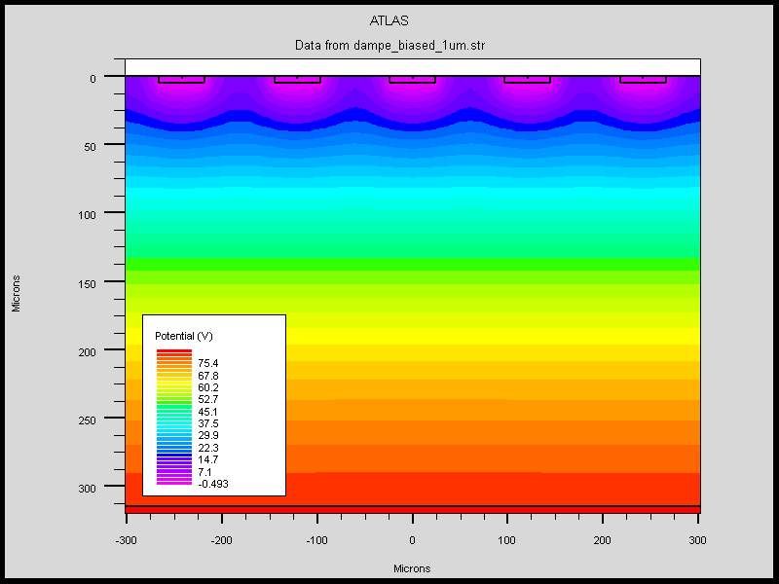
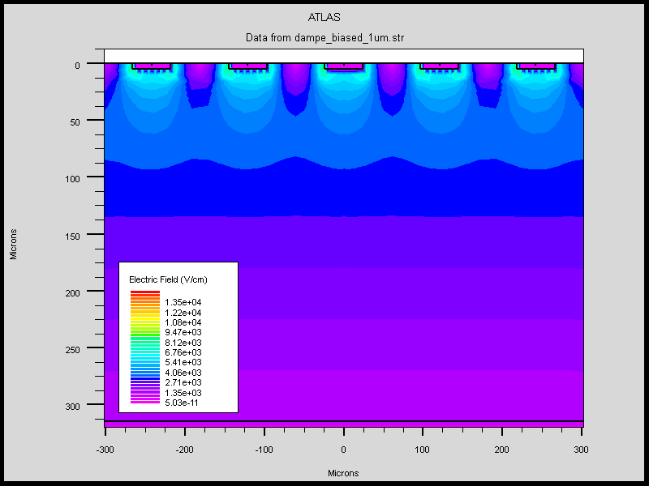
Before charge injection
Potential
Electric Field

Slide 5
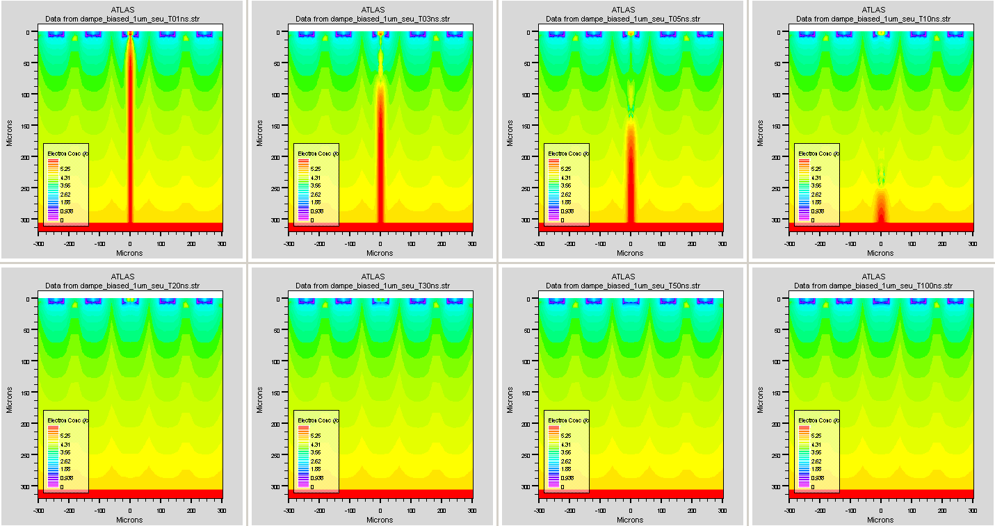
Charge injection: the drift of electrons
1ns
3ns
5ns
10ns
20ns
30ns
50ns
100ns

Slide 6
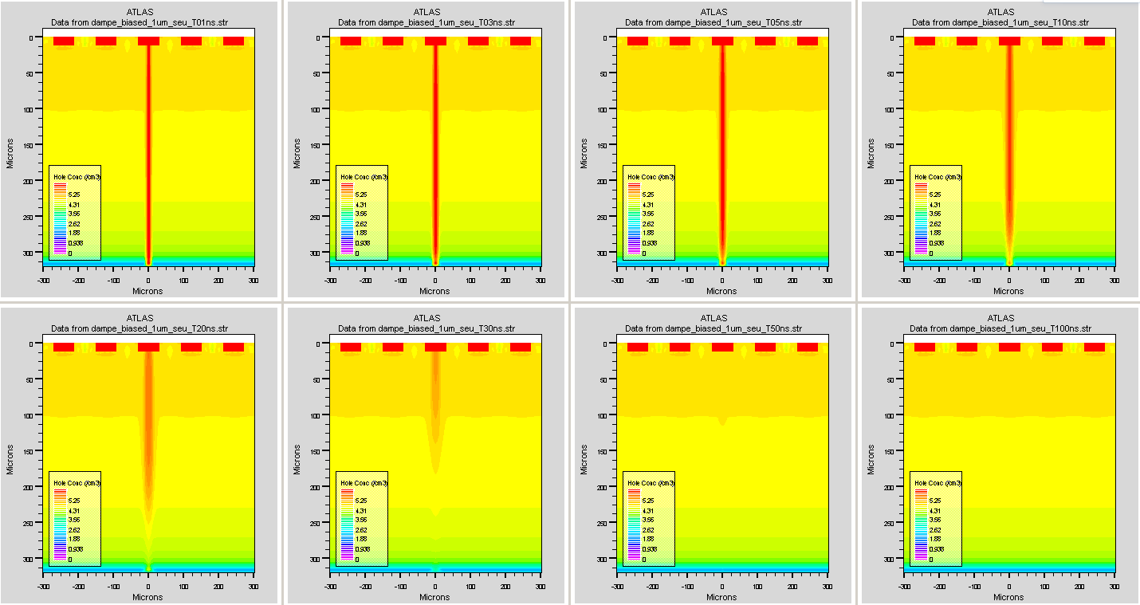
Charge injection: the drift of holes
1ns
3ns
5ns
10ns
20ns
30ns
50ns
100ns

Slide 7
The transient current
AC pad not hit
AC pad floating
DC pad not hit
Most
Electrons
Collected
DC pad hit
Most
Holes
Collected
AC pad hit

Slide 8
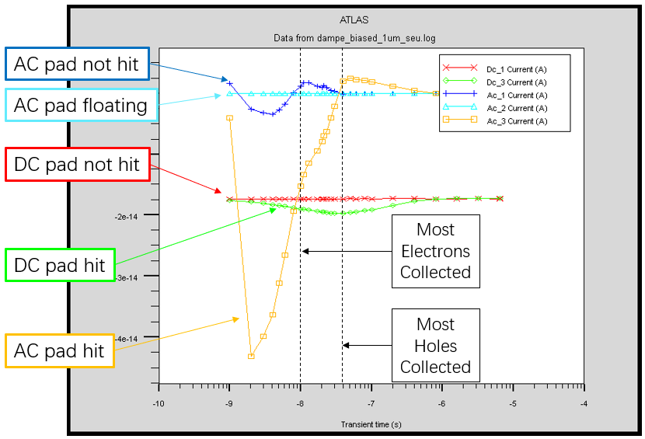
The three periods of transient current
Period ID | Time interval (ns) | Description | AC Transient Current
 |  |  | Hit | Not Hit
1 | 0 ~ 10 | Electrons and holes drifting | Pos | Pos
2 | 10 ~ 40 | Holes drifting | Pos | Neg
3 | > 40 | Charge release through bias resistor | Neg | Zero

Slide 9
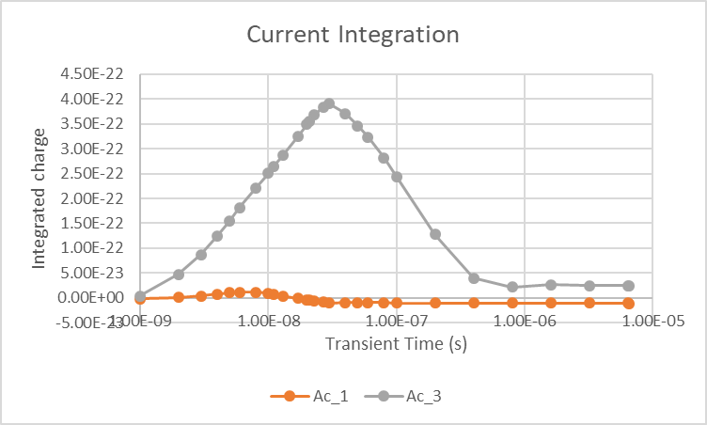
Integration of transient current
The charge-sensitive ASIC will integrate the transient current.
My integration show a negative integrated current of the not hit AC strip (AC_1 on the graph)!

Slide 10
Conclusion
The TCAD simulate charge injection, and the transient current of different electrodes.
There are three periods in the transient current, corresponding to the drifting of electrons, holes and after drifting. The hit ac strip has a negative current int P#3 , while the not hit ac strip has a negative current int P#2.
The TCAD charge injection shows a different diagram compared to capacitor networks. The charge sharing ratio is negative!

