Slide 1
How to interpret TCAD simulation results?
Rui Qiao; WenXi Peng; Ke Gong

Slide 2
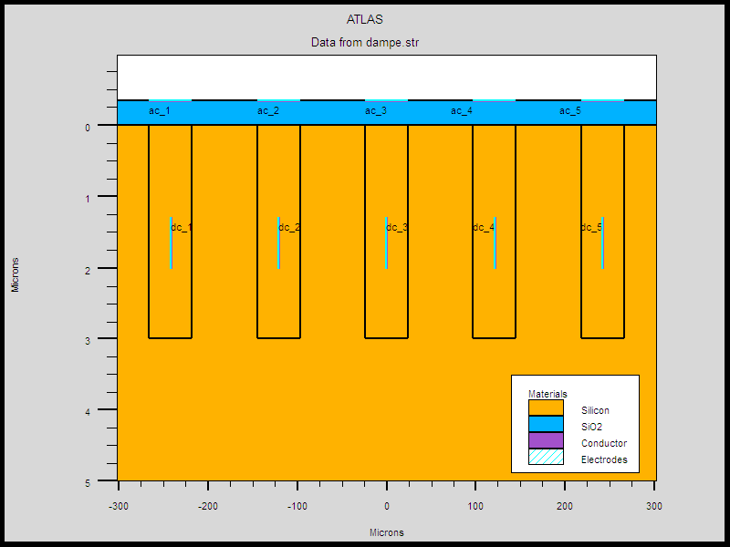
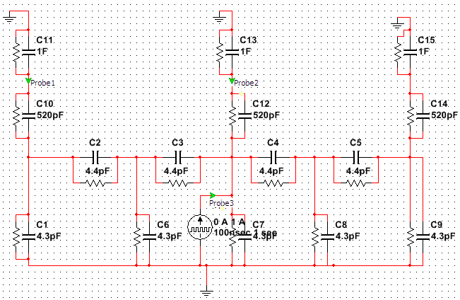
Background
step1
TCAD: DAMPE model
step2
TCAD: Capacitance sim.
Bulk capacitance
Interstrip capacitance
Coupling capacitance
step3
SPICE: Charge sharing sim.
Notes:
来源：G:\keyan\科研任务\211212_硅微条模拟\MyTCAD\220107——DAMPE 5个注入条\

Slide 3
Confusion to interpret TCAD capacitance: DC1 -> DC3
Option1: calculate DC1->DC3 directly.
Option2: calculate DC1->DC2, DC2->DC3，then build a network.
Cap?

Slide 4
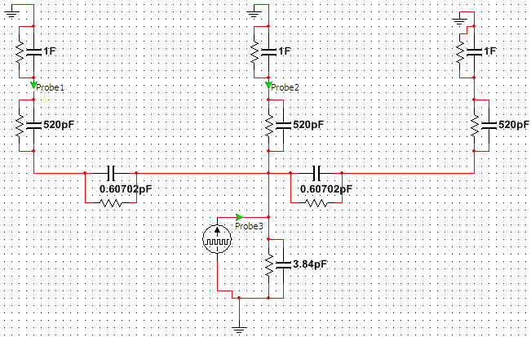
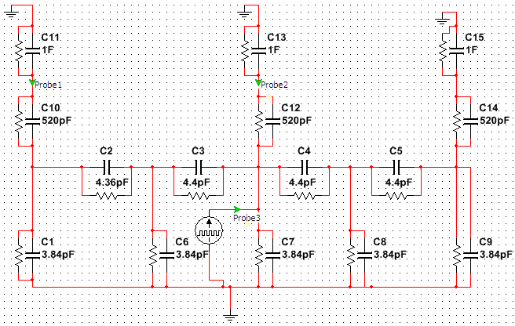
The two options on DAMPE
Opt1: direct cap. DC1->DC3
Charge Sharing Ratio: 0.12%
Opt2: indirect cap. DC1->DC2, DC2->DC3
Charge Sharing Ratio: 0.29%
The charge sharing ratio is different between these two option
Notes:
来源：G:\keyan\科研任务\211212_硅微条模拟\MyTCAD\220117——DAMPE 13个注入条\

Slide 5
Conclusion
Confused to interpret TCAD capacitance with more than 1 interstrip. This is critical before simulate FOOT (readout 1/3) and AMS (readout ½ and ¼).
Prepare to use the TCAD charge injection to verify.

