Slide 1
First JUNO data challenge
Xiaomei Zhang

Slide 2
Purposes
Check DMS and its HTTP TPC supports
Check functionality and performance of transfer services
Network status between data centers
Simulate raw data transfers in DCI parts

Slide 3
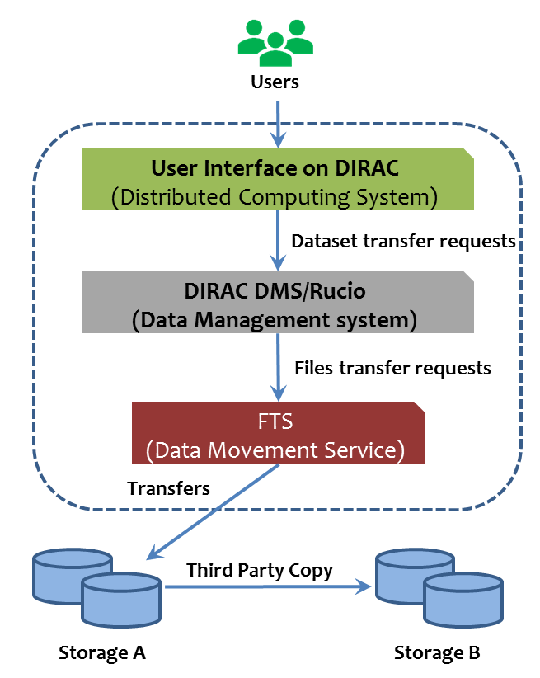
Data management system
Data Management System – DIRAC DMS and Rucio
Accept dataset transfer requests
Send file transfer requests to FTS
Both DIRAC DMS and Rucio joined
Data Movement Service -- FTS
Manage data transfers
Optimize parallel number
Four SEs
IHEP-JUNOEOS
CNAF-STORM
IN2P3-DCACHE
JINR-EOS
3

Slide 4
TPC used
HTTP TPC are used in three SEs
IHEP-JUNOEOS, CNAF-STORM, IN2P3-DCACHE
XROOTD TPC is used for JINR-EOS
IHEP-JUNOEOS <-> JINR-EOS

Slide 5
Network
IHEP <-> Europe
10Gb/s public network, shared with other experiments
Plan to upgrade to 100Gb/s this year
IN2P3 <-> CNAF
100Gb/s

Slide 6
Tests
Data and files
4000*5GB files=20TB, 10000*500MB files= 5TB
Transfer tests
IHEP-EOS-> IN2P3-DCACHE, CNAF-STORM, JINR-EOS
Both separated and in parallel
Both 5GB and 500M

Slide 7
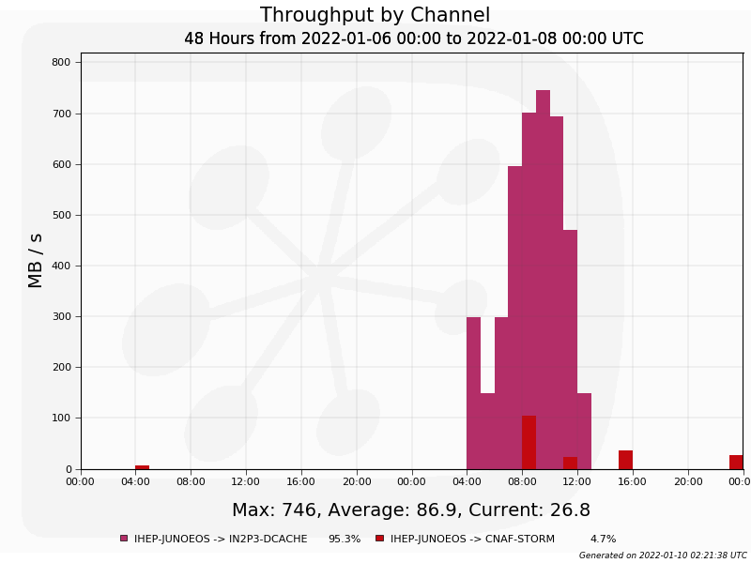
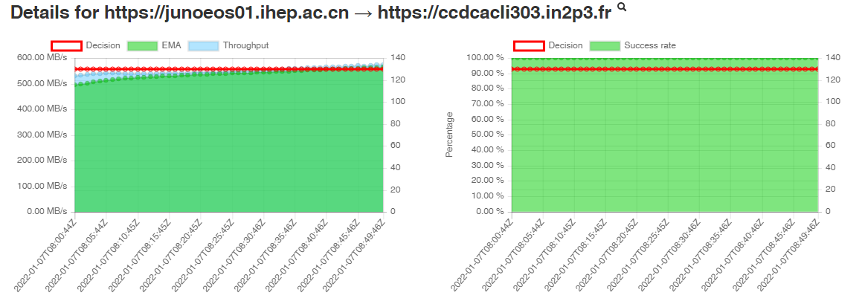
Tests using Dirac DMS (1)
Quality is good, and maximum speed can almost fulfill the network bandwidth
100% success rate
500MB/s with network control
~800MB/s without network control
Transfer status can be seen both from network, DIRAC and FTS3 monitoring
DIRAC
FTS

Slide 8
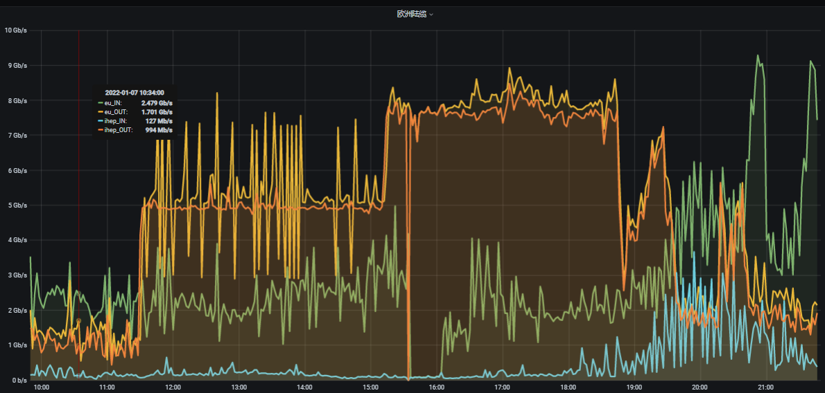
Test with Dirac DMS (2)
FTS
Network
5Gb/s with 5Gb/s network control
>8Gb/s with10Gb/s
8Gb/s
5Gb/s

Slide 9
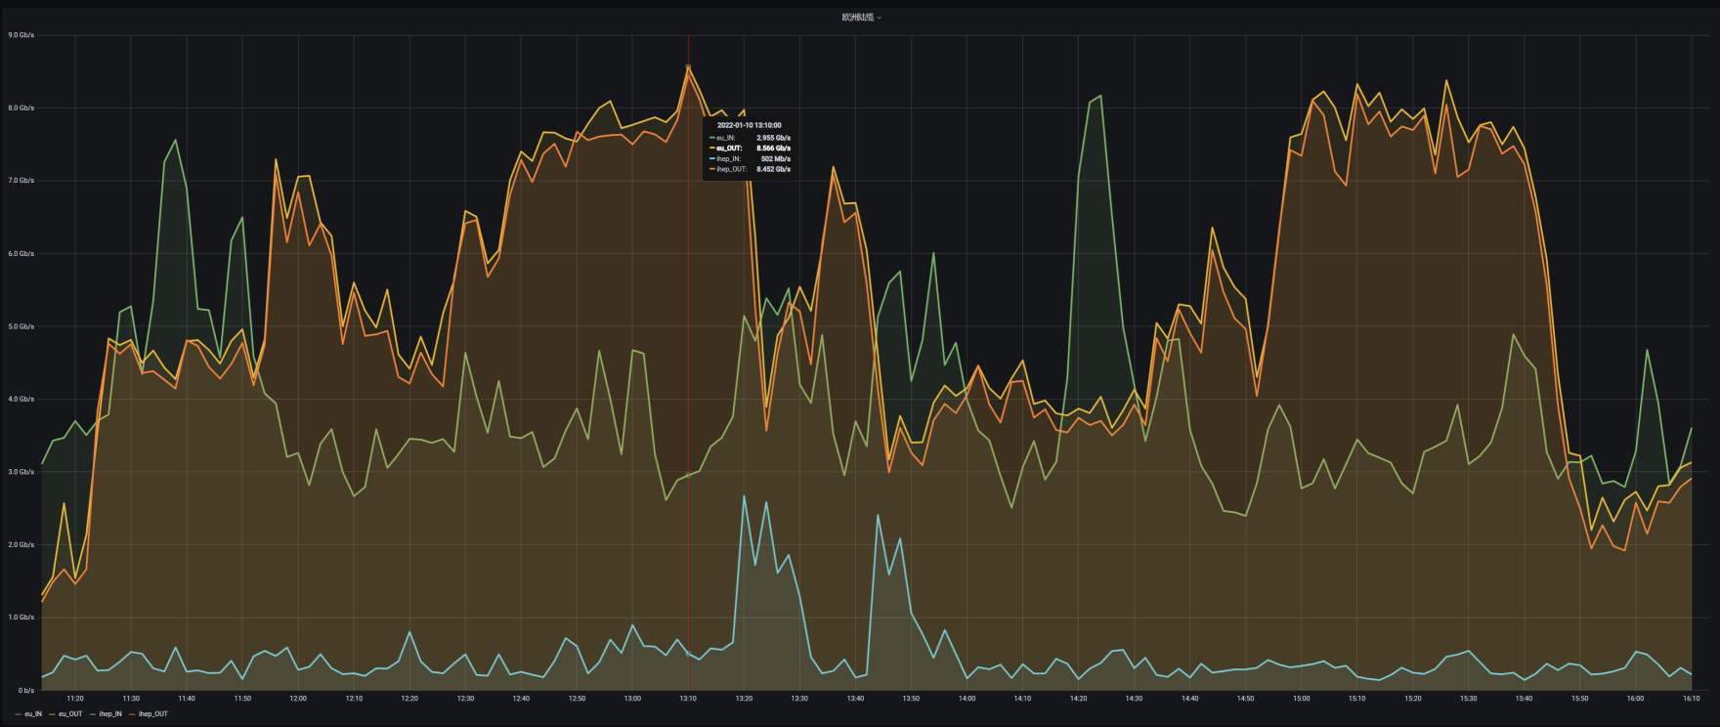
Tests with Rucio
Rucio has 100% success rate good
Maximum speed can almost fulfill the network bandwidth, reaching 8Gb/s
8Gbps
IHEP Network Monitoing

Slide 10
Speed rate control and optimization
Setting of submission and transfer rate
Submission rate in DMS
Have similar Controls with bulk size both in DIRAC and Rucio
100 bulk size means one submission with 100 files
20 threads for submissions
Each second can have 2000 files submission
Transfer rate in FTS3
16 streams * 130 active = 2080 parallel transferring
With current speed, no pressure found in both DMS and FTS3
Transfer system can have ability to increase the transfer speed if the network bandwidth increase to 100Gb/s

Slide 11
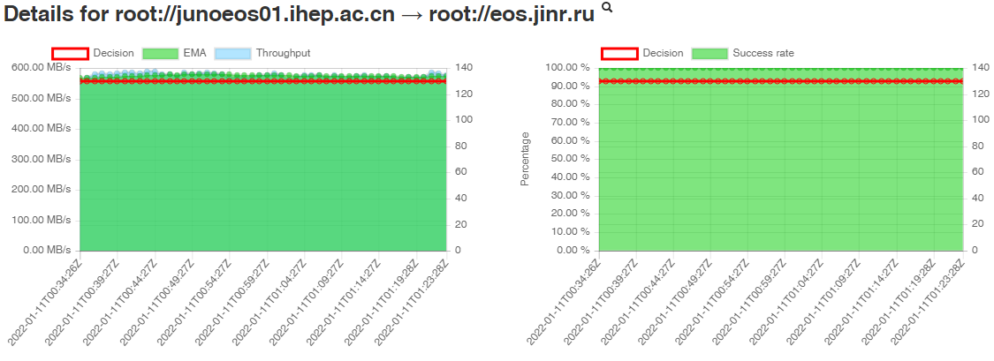
Single channel tests (1)
IHEP -> IN2P3, JINR

Slide 12
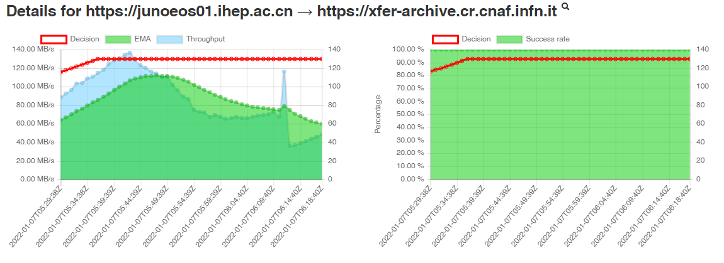
Single channel tests (2)
IHEP -> CNAF

Slide 13
Findings
500MB-5GB files are not much differences to the transfer speed
Transfers in parallel from IHEP to three sites, we see competition for network bandwidth
In a longer transfers covering two days, speed fluctuations was seen

Slide 14
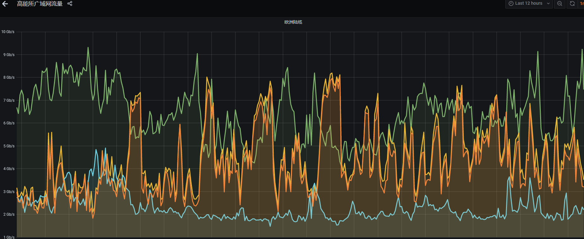
Network fluctuation

Slide 15
Summary and Plans
The transfer services and SEs are working well with HTTP TPC
The network from IHEP to Europe is good to meet requirements of JUNO
DMS can provide a transfer which almost fulfill a public network bandwidth, showing very good transfer ability and quality

Slide 16
Thank you!

