Slide 1
JUNO
Giuseppe Andronico
On behalf of the JUNO collaboration
INFN, Sez CT

Slide 2
JUNO
Jiangmen Underground Neutrino Observatory
Massive:
~20 kton Liquid Scintillator (LS) Underground:
~700 m overburden
High resolution:
3% / √E (MeV)
Precision energy scale: < 1%
Supernovae neutrinos
Atmospheric neutrinos
Solar neutrinos
Geoneutrinos
Nucleon decay
Multimessenger
Rich physics portfolio:
Determine Mass Hierarchy
JUNO Yellow Book (YB):
J. Phys. G 43, 030401 (2016)
Precision measurement of 3 oscillation parameters

Slide 3
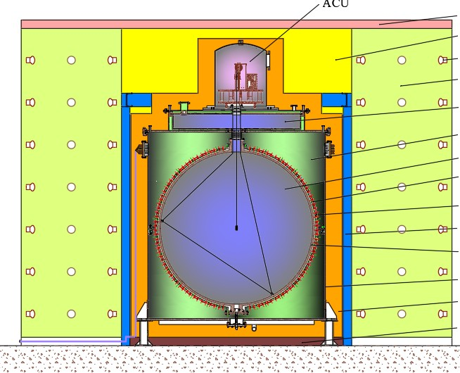
TAO
Taishan Antineutrino Observatory
Measure reactor spectrum with high E resolution
•
•
Enhance the JUNO sensitivity in the MH by looking at fine structures of the source spectrum
•
•
Not only a JUNO reference detector
Benchmark measurement to test the nuclear database
•
•
•
Sterile neutrino
Nuclear physics
Reactor monitoring and safeguard

Slide 4
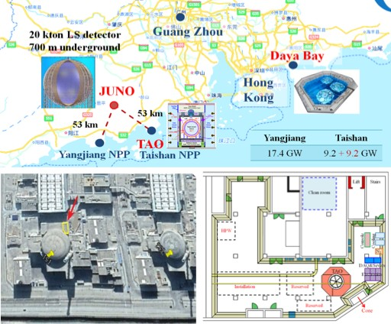
Experimental site
•
•
•
•
•
53 km far from the JUNO site
Taishan NPP
EPR Reactor (4.6 GW) power
~30 m far from Taishan core 1
Just outside the reactor containment building

Slide 5
Distributed Computing Infrastructure design

Slide 6
Service status
JUNO Distributed Computing system was built on DIRAC
Handles heterogeneous and distributed resources
Provides workload management (WM) and data management (DM)
Exploring optimal redundancy
Besides DIRAC, other WLCG services have been used
Storage Element (SE)
CVMFS
VOMS
FTS3
DIRAC and all these services are working well
Services under test before integration
Third Party Copy
RUCIO

Slide 7
Data centers and roles
Kaiping
Data taking, event filtering
 | Main storage | Partial secondary storage | Secondary storage |  | Secondary storage
 | Data quality
 | First reconstruction | Secondary reconstruction | Secondary reconstruction |  | Secondary reconstruction
 | Analysis | Analysis | Analysis | Analysis | Analysis
 | Simulation | Simulation | Simulation | Simulation | Simulation

Slide 8
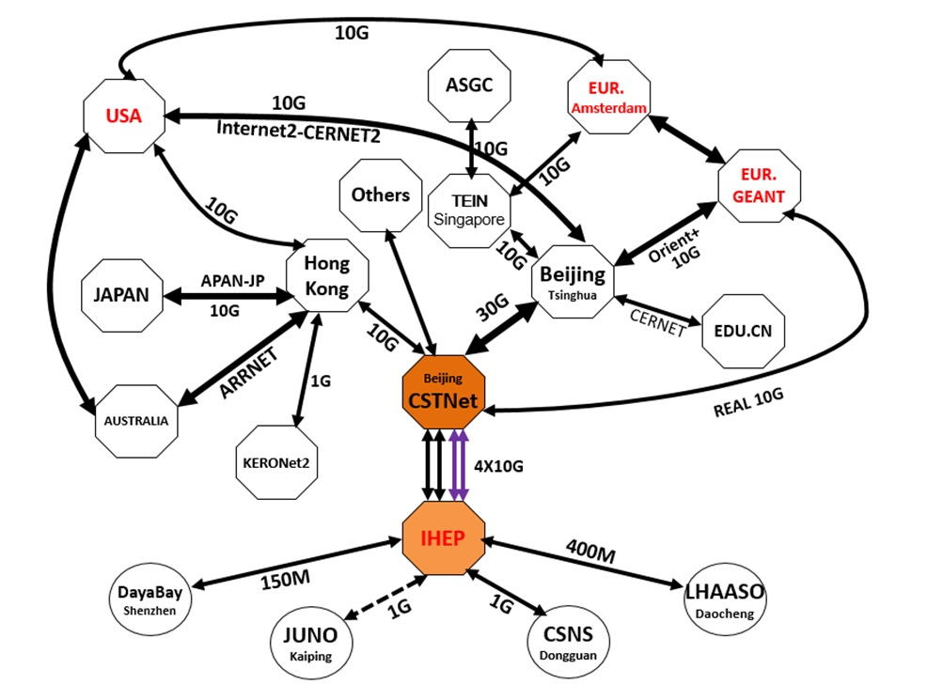
Data networks: China

Slide 9
Data networks: world
ORIENTplus 10Gbs
Real 10G
INTERNET2
GEANT
TEIN3

Slide 10
Data flows proposal
IHEP will receive data from experimental site and store them in master repository. At IHEP will run fast calibration and prompt reconstruction
IHEP main repository will be automatically replicated at CNAF
From CNAF data will be copied also to JINR
CC-IN2P3 will maintain a partial copy of the data at CNAF with the chance to access data physically at CNAF
JINR data will be accessed from MSU resources
Flows are bidirectional: data produced in European data centers (secondary reconstruction, analysis, simulations,…) will be replicated in the other European data centers and at IHEP
JUNO is officially part of LHCONE

Slide 11
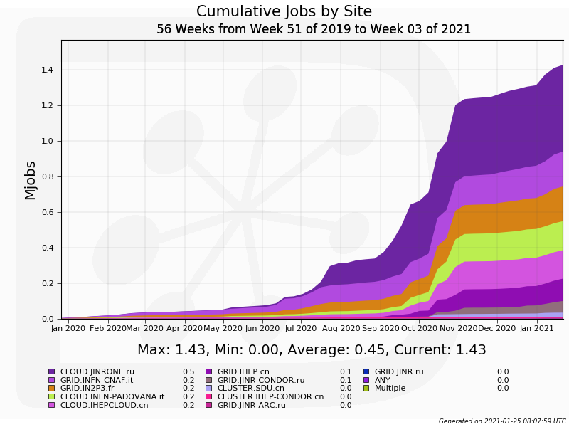
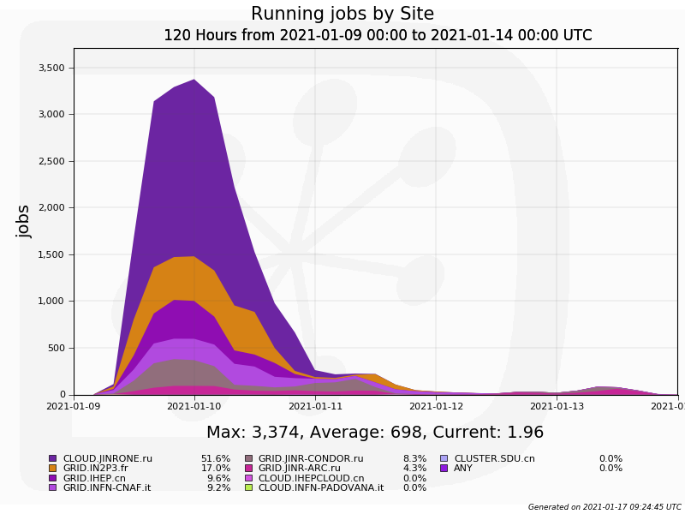
Workload Management System
WMS for jobs submission, scheduling, running and monitoring
Production system /JSUB
DIRAC WMS
Site LRMS (CE)
Status
Total running job: 1.43M, 4 sites are joined plus 2 sites at the moment not yet in MoU, 5 times larger than 2019
Peak-time jobs: 3374, 30% more than last year

Slide 12
Thank you!!!
Any question?

Slide 13
Backup slides

Slide 14
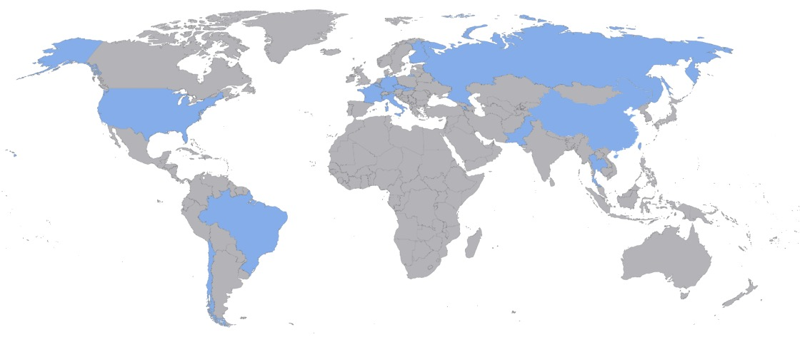
JUNO collaboration
Country | Institute | Country | Institute | Country | Institute
Armenia | Yerevan Physics Institute | China | IMP-CAS | Germany | FZJ-IKP
Belgium | Universite libre de Bruxelles | China | SYSU | Germany | U. Mainz
Brazil | PUC | China | Tsinghua U. | Germany | U. Tuebingen
Brazil | UEL | China | UCAS | Italy | INFN Catania
Chile | PCUC | China | USTC | Italy | INFN di Frascati
Chile | UTFSM | China | U. of South China | Italy | INFN-Ferrara
China | BISEE | China | Wu Yi U. | Italy | INFN-Milano
China | Beijing Normal U. | China | Wuhan U. | Italy | INFN-Milano Bicocca
China | CAGS | China | Xi'an JT U. | Italy | INFN-Padova
China | ChongQing University | China | Xiamen University | Italy | INFN-Perugia
China | CIAE | China | Zhengzhou U. | Italy | INFN-Roma 3
China | DGUT | China | NUDT | Latvia | IECS
China | ECUST | China | CUG-Beijing | Pakistan | PINSTECH (PAEC)
China | Guangxi U. | China | ECUT-Nanchang City | Russia | INR Moscow
China | Harbin Institute of Technology | Croatia | PDZ/RBI | Russia | JINR
China | IHEP | Czech | Charles U. | Russia | MSU
China | Jilin U. | Finland | University of Jyvaskyla | Slovakia | FMPICU
China | Jinan U. | France | LAL Orsay | Taiwan-China | National Chiao-Tung U.
China | Nanjing U. | France | CENBG Bordeaux | Taiwan-China | National Taiwan U.
China | Nankai U. | France | CPPM Marseille | Taiwan-China | National United U.
China | NCEPU | France | IPHC Strasbourg | Thailand | NARIT
China | Pekin U. | France | Subatech Nantes | Thailand | PPRLCU
China | Shandong U. | Germany | FZJ-ZEA | Thailand | SUT
China | Shanghai JT U. | Germany | RWTH Aachen U. | USA | UMD1
China | IGG-Beijing | Germany | TUM | USA | UMD2
China | IGG-Wuhan | Germany | U. Hamburg | USA | UC Irvine
78 members

Slide 15
Computing model
A lot of partner spread all over the world, requiring to access data for analysis
Rersources are provided from partners involved in WLCG too
Based on HEP – WLCG experience, relying on a grid-like infrastructure:
Estimated data volume and the needed resources
Evaluated networks
Identified data centers
Designed data flows and roles
Defined a first version of a distributed grid infrastructure

Slide 16
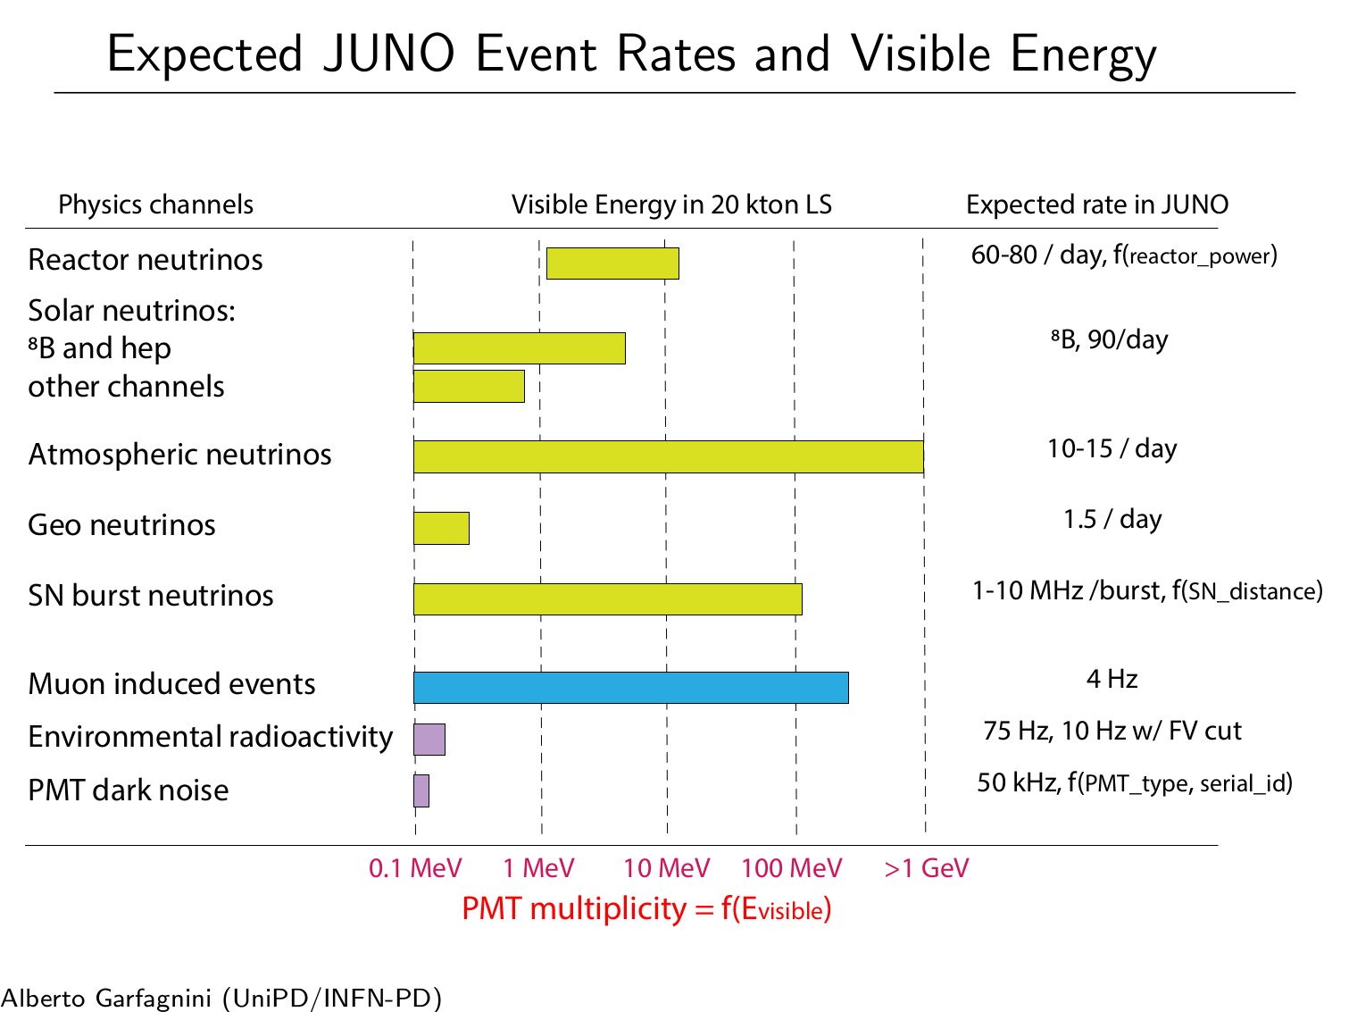
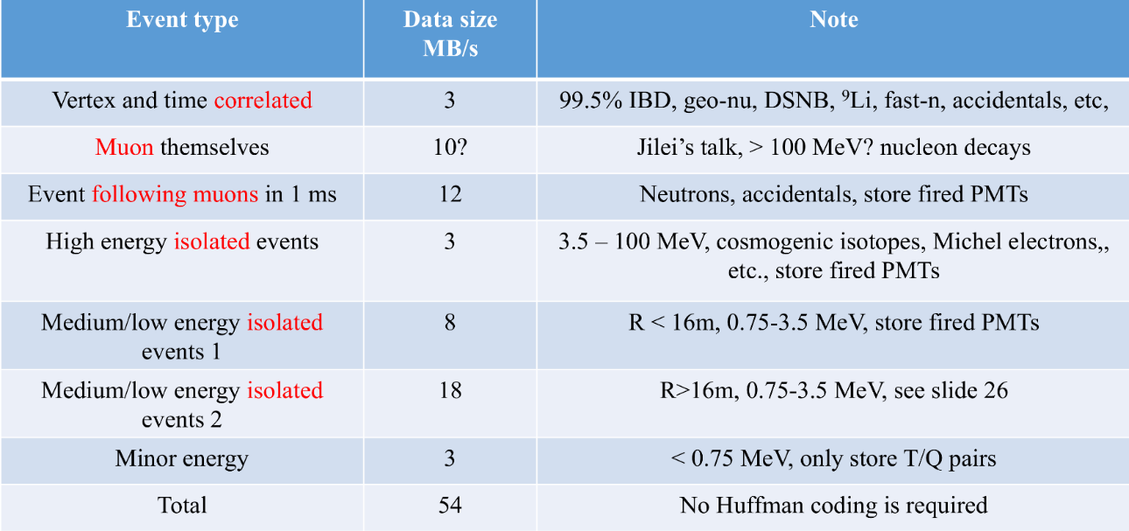
Data volume
Generic view
Data output from electronic: ≈ 1 EB/year
Given the expected number of events per day we estimate to cut data output at 2 PB/year.

Slide 17
Data centers
IHEP
CC-IN2P3 (France)
CNAF (Italy)
MSU (Russia)
JINR (Russia)
Kaiping (JUNO) | 1 Gb/s
Generic | 20 Gb/s IPv4 20 Gb/s IPv6 | 10 Gb/s | 20 Gb/s | 10 Gb/s | 10 Gb/s
LHCOne | yes | Yes | 100 Gb/s | Yes | 10 Gb/s
DC Storage (PB) | 5+15 | 70+30 | 80+33 | n.a. | 11+12
DC Computing (core) | 18,000 | 38,000 | 40,000 | n.a. | 17,000
Storage (disk) | 2000 TB | 44 TB | 620 TB | 60 TB | 600 TB
Cores | 2500 | 210 | 400 | 32 | 2000

