Slide 1
Planned integration of control system to Work Units
Daniel Piso Fernández
Hardware and Integration Group Leader
www.europeanspallationsource.se
17 January, 2017

Slide 2
ICS Organization 2016-12
Sub-project manager TBD
Henrik Carling
Division head
Wojtek Fabianowski in-kind manager
Systems engineering specialist
(Henrik Carling act)
Controls infrastructure
Anna Gillberg
Team assistant
Annika Nordt Safety and protection
Daniel Piso
Hardware and integration
Hector Novella
Deputy project manager
Susanne Regnell
Controls Software
Timo Korhonen Chief engineer
Ben Folsom
PhD student
Start 2017-02-01
Angel Monera
FPGA Engineer
David Brodrick
Integrator
Benedetto Gallese
Integrator
Alessio Curri ICS administrator
Start 2017-02-01
Denis Paulic
PLC Engineer
Javier Cerejo PhD Student
François Bellorini
Integrator
Emanuele Laface
Accelerator physicist
Benjamin Bertrand
Software engineer
Manuel Zaera-Sanz
PLC Engineer
2017-01-02
Start 2017-01-09
Claudio Rosati
Software engineer
Joao Martins
Integrator
Jeong Han Lee Integrator
Jan-Åke Persson
Senior software engineer
Morteza Mansouri
Safety Engineer
Julen Etxeberria
Junior controls engineer
Nick Levchenko
Integrator
Karin Rathsman Senior scientist
Start 2017-02-01
Juan Esteban Müller
Software scientist
Riccard Andersson PhD student
Simone Farina Embedded systems egineer
Start 2017-01-02
Ricardo Fernandes Senior software engineer
Tomasz Brys
Integrator
End 2016-12-31
Leandro Fernandez Senior software engineer
End 2017-02
Stuart Birch Senior safety engineer
Niklas Claesson
Integrator
Krisztián Löki
Integrator
Thilo Friedrich
PhD student
Remy Mudingay Infrastructure engineer
Yong Kian Sin IEC61508 engineer
Alexander Söderqvist
Integrator
Oliver Talevski
Embedded engineer
Fredrik Luthander
Software engineer
Viktor Fred
Electrical engineer
Szandra Kövecses
Technical coordinator
Open positions (2)
Jonny Svärd
Software engineer
Consultants
Open positions (3)
Open positions (3)
Employee
Consultant
Temporary employee
Consultant off-site
Position under consideration

Slide 3
Points of Contact at ICS
Nick Levchenko – Controls Integrator Warm Linac
Wojtek Fabianowski – IK Project Manager
Annika Nordt – Safety and Protection Group Leader
Daniel Piso – Hardware and Integration Group Leader

Slide 4
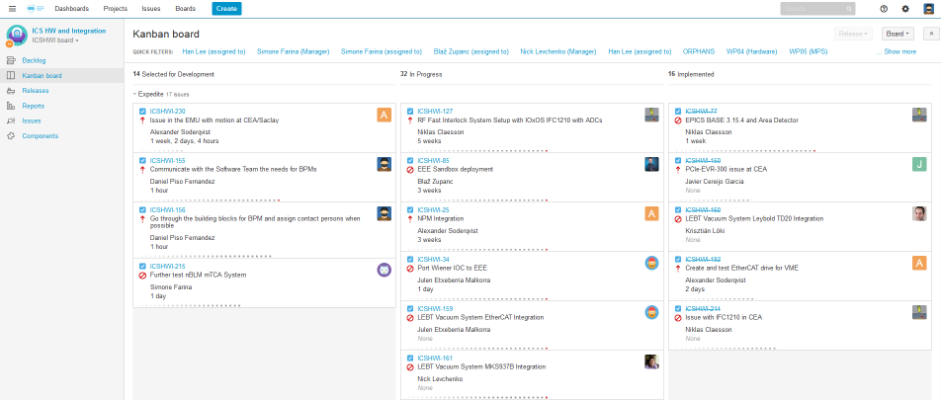
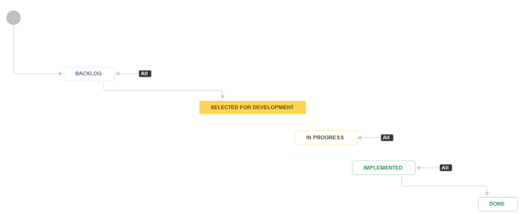
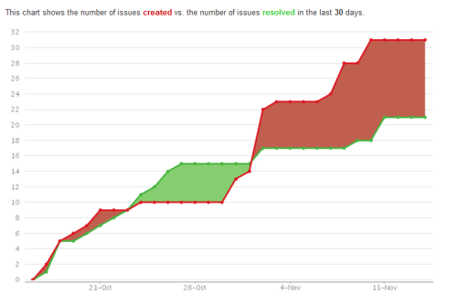
Organizational setup
The team, as the rest of ICS is organize in a classical matrix structure
It provides resources to 6 workpackages representing about 40% of the project value
The matrix allows flexibility in assigning resources and managing prioritization
At least in theory, everyone is available for any task!
The long term goal is to set up metrics (KPIs) to measure and improve the efficiency of the team and the processes related to integration

Slide 5
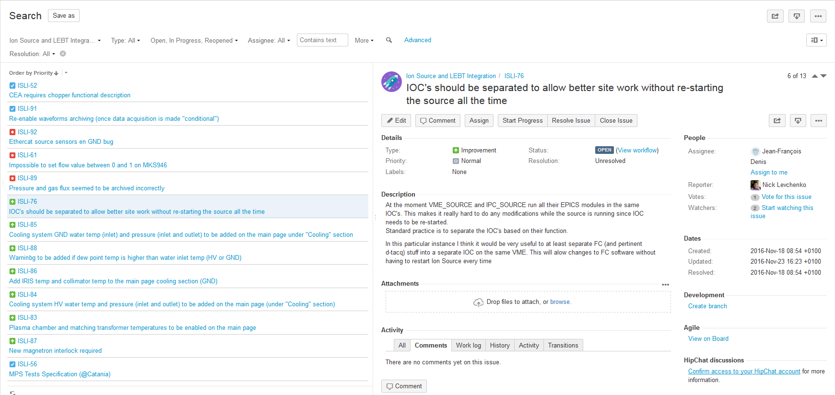
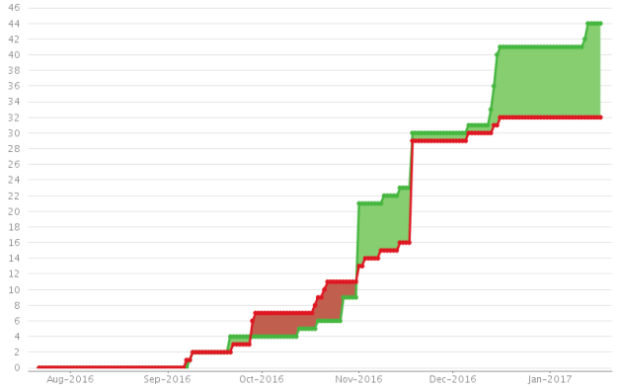
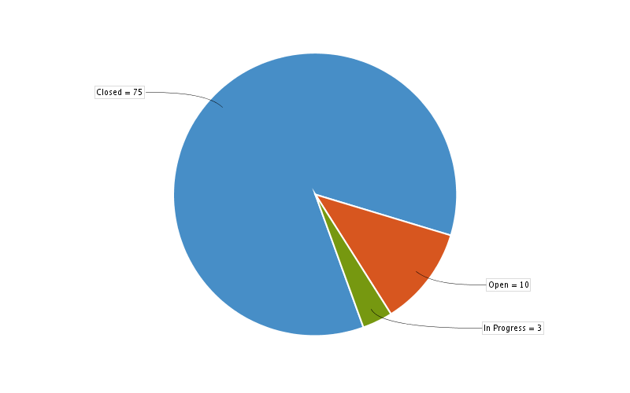
Issues
This chart shows the number of issues created vs. the number of issues resolved in the last 180 days.
Next Steps
Clearing Jira issues log (mostly GUI improvements and fixes)
Finishing PBI integration
Support
Issues
GUI improvements and fixes
Waveforms archiving

Slide 6
PS & LEBT
Status
IIK 14.10.2/3 Controls for PS&LEBT and RFQ by CEA
Kick-off meeting on 2017-01-27
We have been able to enable commissioning
Next Steps
Keep on refining and implement WP3 requests
Migrate fully to mTCA
System Lifecycle Documentation
Collaborate with WP3 in order to implement high-level software (Logbook, Jupyterhub, etc.) to improve commissioning.
Discussion and planning about PS#2

Slide 7
RFQ
Status
IIK 14.10.2/3 Controls for PS&LEBT and RFQ by CEA (signed)
Kick-off meeting on 2017-01-27
Next Steps
At some point we need to release the CEA team from PS&LEBT to focus on RFQ

Slide 8
MEBT
Status
IIK 14.10.4 MEBT Controls Integration by ESS Bilbao (signed)
Kick-off meeting to be held in the next few weeks
Activities have already been started
2016-11-30 - 2016-12-01 (Bilbao) - MEBT Workshop
Next Steps
Provide all the hardware needed for the development
Keep collaboration with the team in Bilbao in order to do better specification from ESS
System Life Cycle Documentation

Slide 9
DTL
Status
There have been conversations
ICS is really interested on getting the help of the controls team in Legnaro
Next Steps
Meeting in Legnaro 2017-02-03

Slide 10
Challenges for 2017
Finalize the development of the basic standard building blocks technology.
Improve the supply chain
Putting in place the mechanism for bigger scale and more agile procurement
Stock
Prepare the organization for installation
Fully unroll design lifecycle management

Slide 11
Questions

Slide 12
Backup Slides

Slide 13
Some installation tips
ESS is setting up all processes and procedures to support the installation phase (including a ESS installation manager)
ISC (Installation Support Coordination) group, with members from main areas (central services and sub-projects) is in place to help organizing, coordinating and getting
IK partners will have to be responsible to request access to site, hotel, ES&H training (ISC will support); also to adhere to all norms

Slide 14
Level 1 Milestones to be removed
Milestone | Date
1G20152570 Temporary Control room operational | 2017-05-31
1G20154730 Controls ready for Integrated testing ISrc - LEBT | 2017-11-30
1G20154740 Controls ready for Integrated testing ISrc - LEBT - RFQ - MEBT | 2018-04-03
1G20154750 Controls ready for Integrated testing ISrc - LEBT - RFQ - MEBT - DTL1 | 2018-08-13
1G20154760 Controls ready for Integrated testing ISrc - LEBT - RFQ - MEBT - DTL1- DTL2-4 | 2019-01-31
1G20154770 Controls ready for Integrated testing NCFE- DTL5 - SPK - MB to Dump | 2019-02-28
1G20161360 Controls ready for Integrated testing NCFE- DTL5 - SPK - MB to Target | 2019-04-01
1G20152960 Main Control room operational (ICS) | 2019-06-03
1G111190 Handover completed - construction project end (ICS) | 2019-11-18

Slide 15
Level 1 Milestones to be added
Milestone | Date
ICS components ready for initial operations independently | 2018-12-31
ICS ready for Accelerator ready for BOT | 2019-06-23
ICS ready for Target ready for BOT | 2020-03-31
ICS ready for NSS ready for TBL | 2020-10-15

