Slide 1
RATS
WP3: Room availability for storage and
assembly – RATS
RATS stands for: Receiving Acceptance Testing Storage areas
Facility | Size (m²)
ACCSYS WP3 front end RATS, total | (480 main working area + 30 storage) 510 2970
Dsffs< f
Presented by: Frank Hellström, WP3 Liaison Officer

Slide 2
RATS
Facility | Size (m²)/comment
ISRC & LEBT MEBT RFQ DTL receiving & storage & assembly for IS, LEBT, MEBT, RFQ and DTL | Requested 50 (main work area) + 20 (storage) Requested 50 + 10 Requested 120 Requested 130 + 80 combined area for all front end equipment

Slide 3
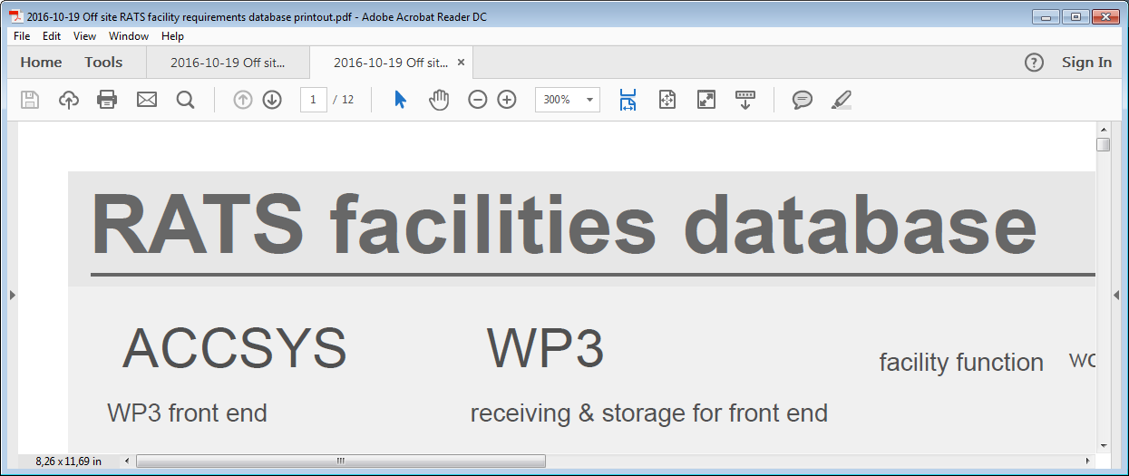
RATS

Slide 4
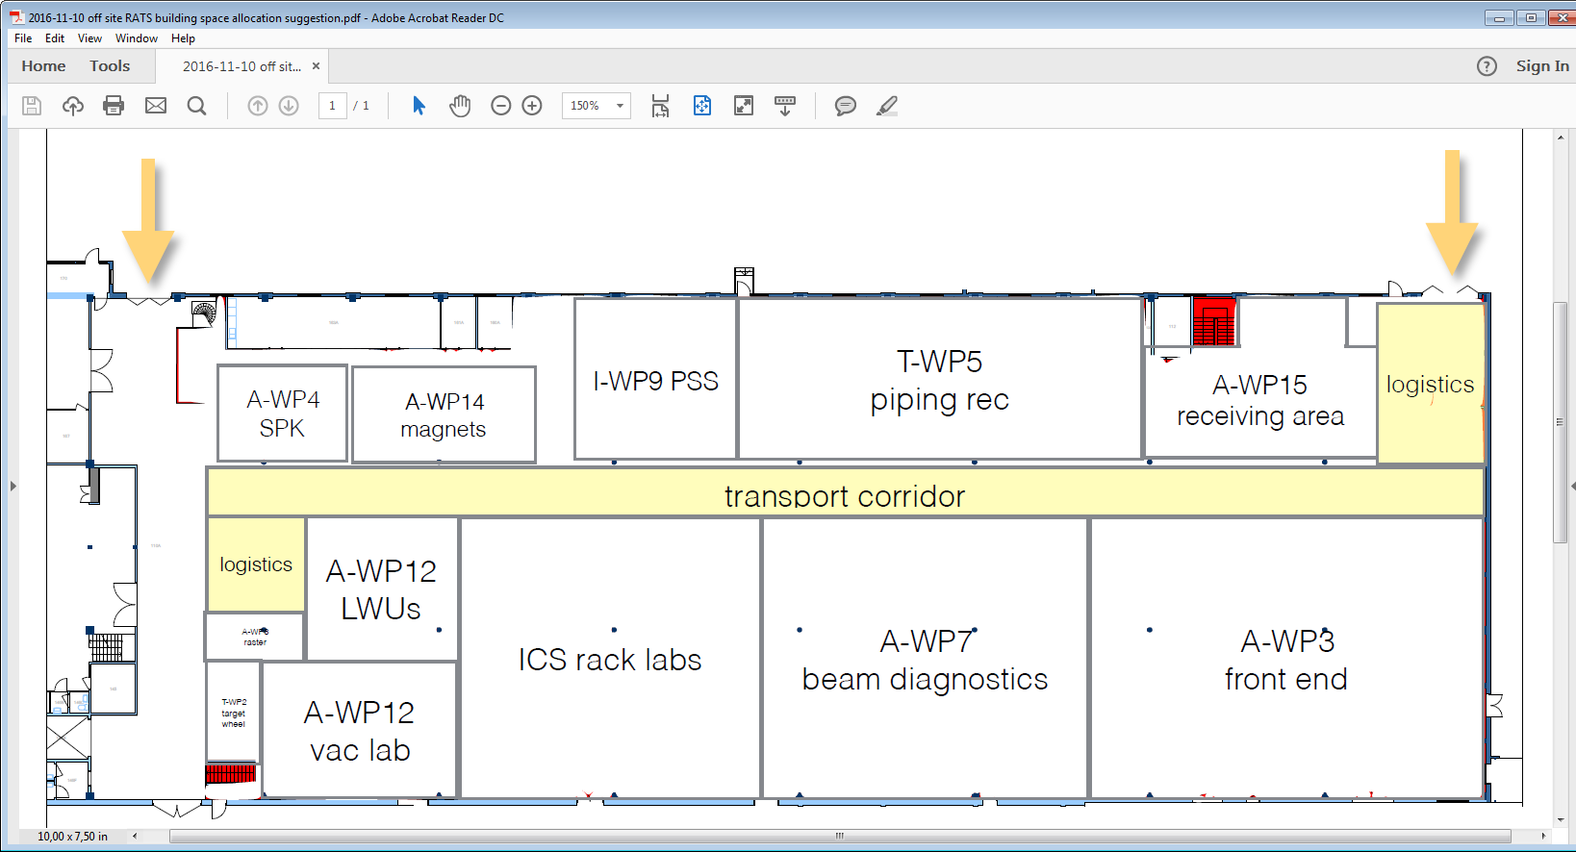
RATS
Facility layout and suggested floor plan

Slide 5
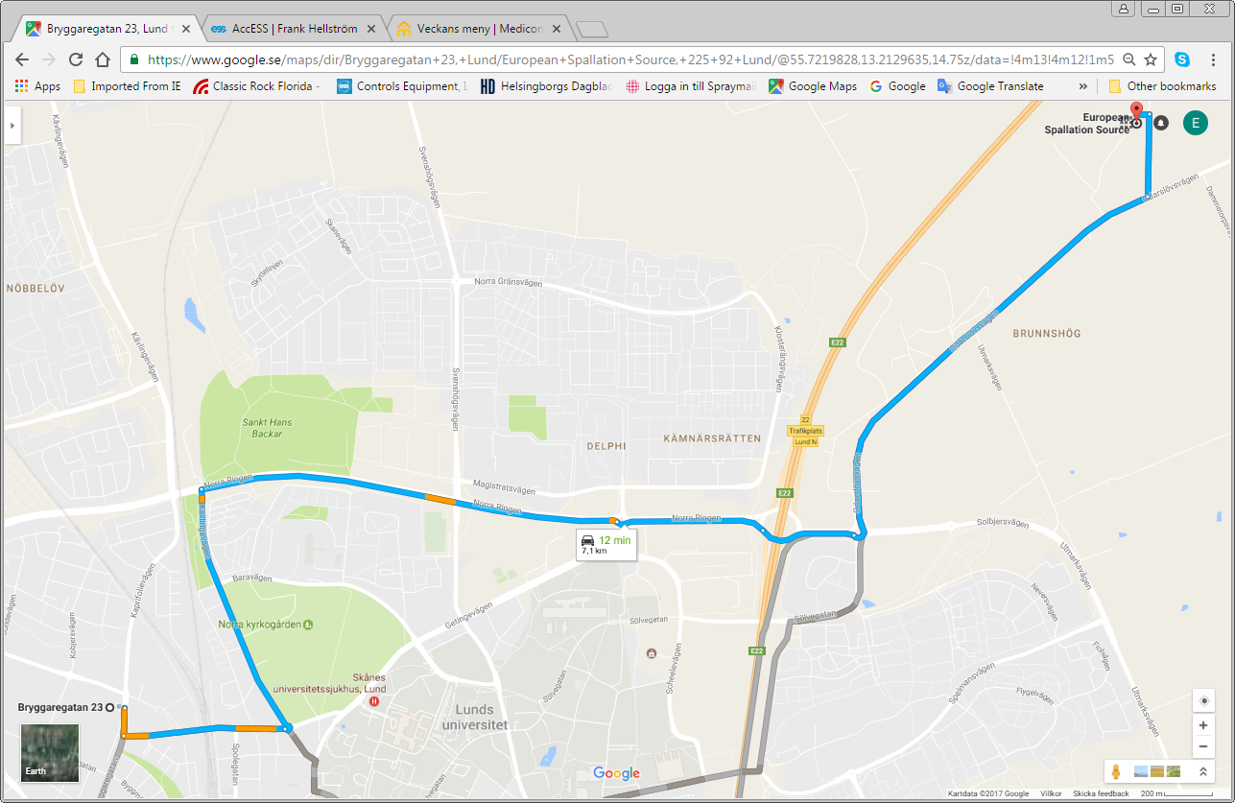
RATS, location in LUND

Slide 6
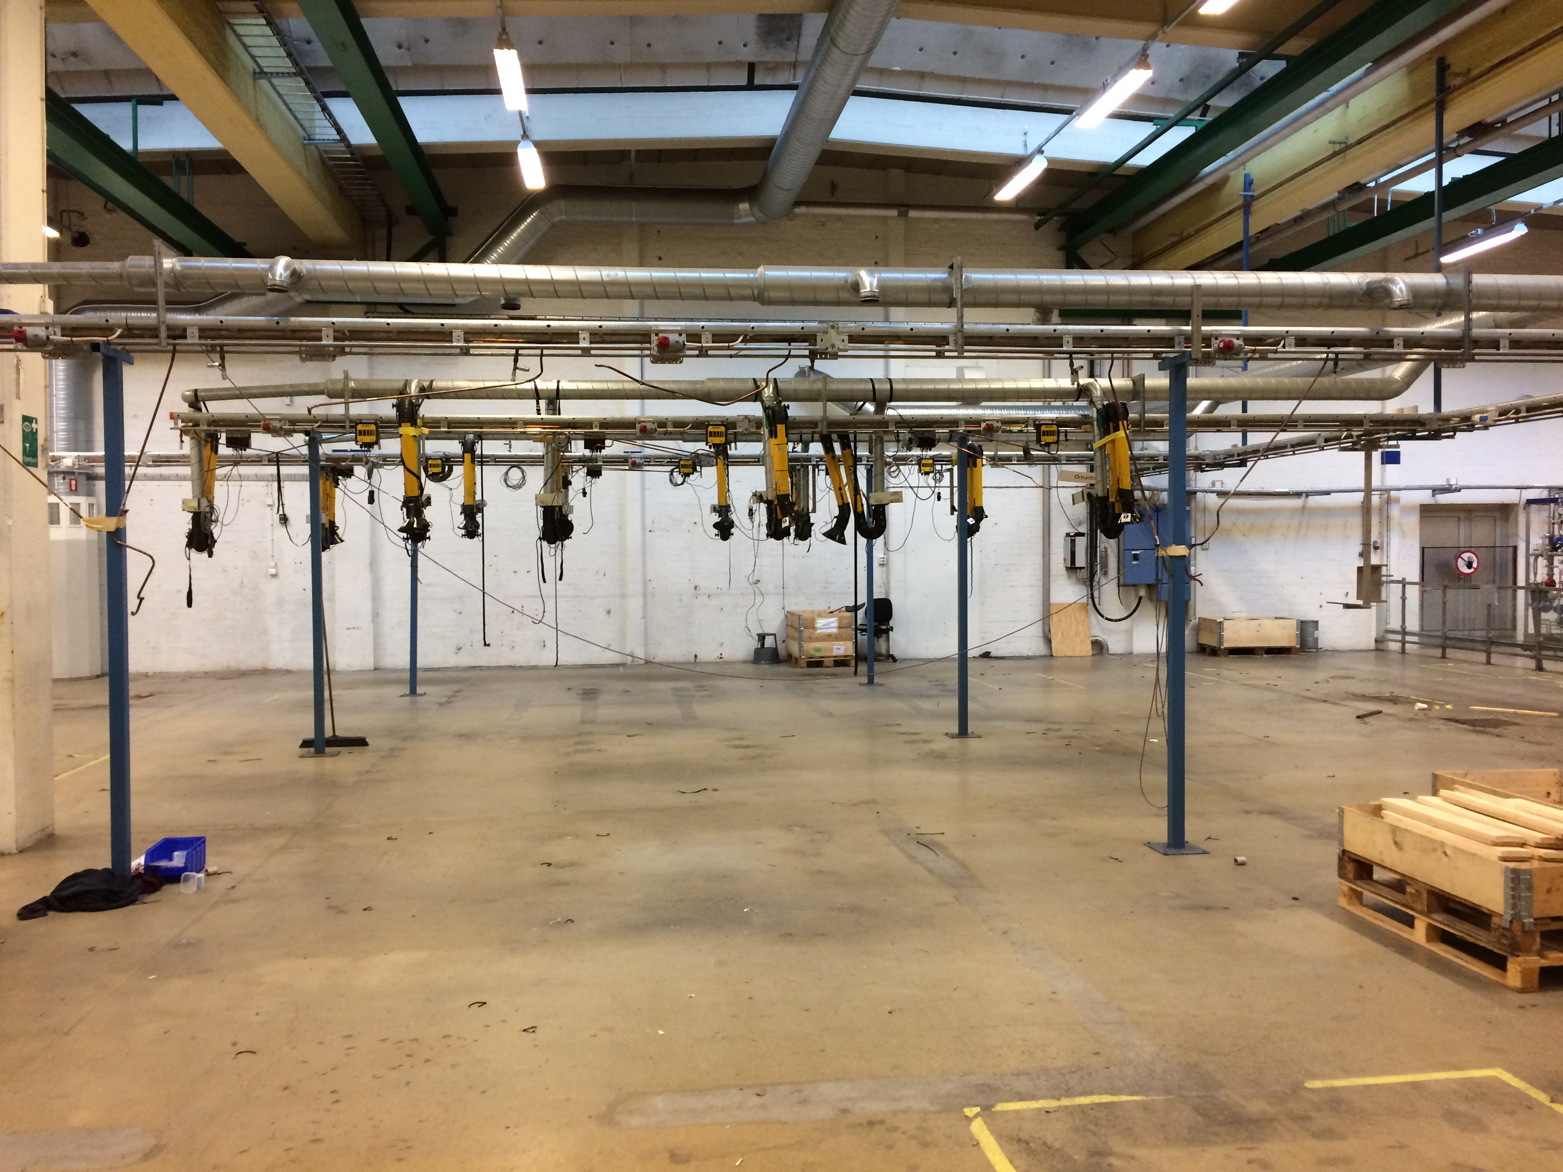
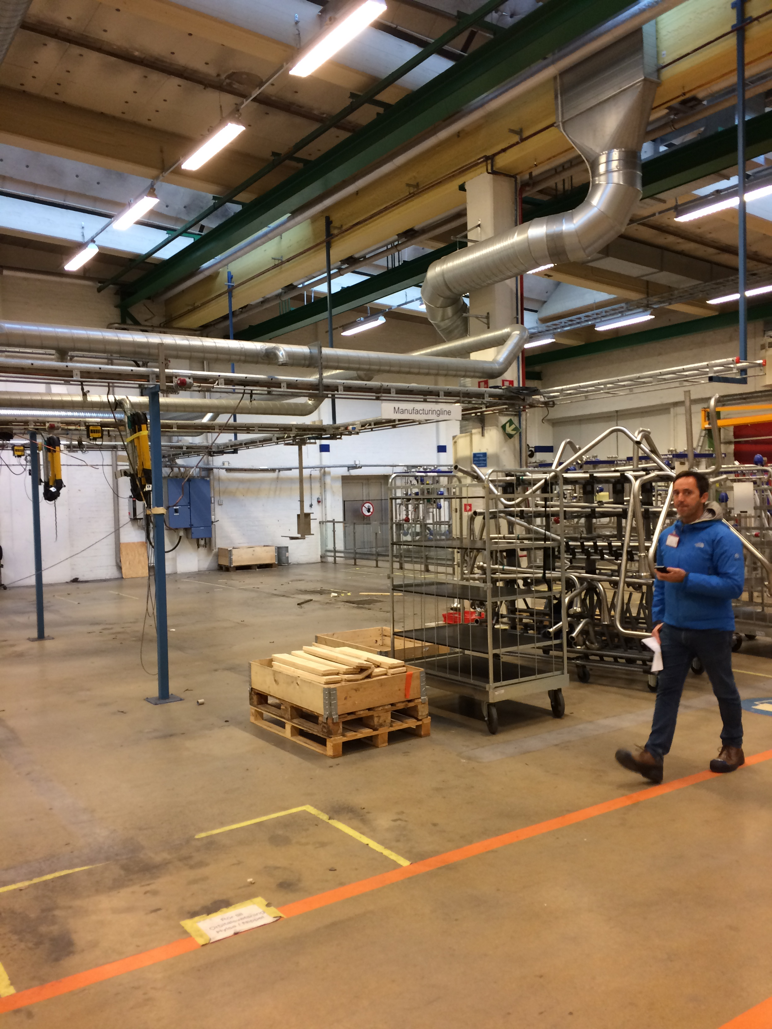
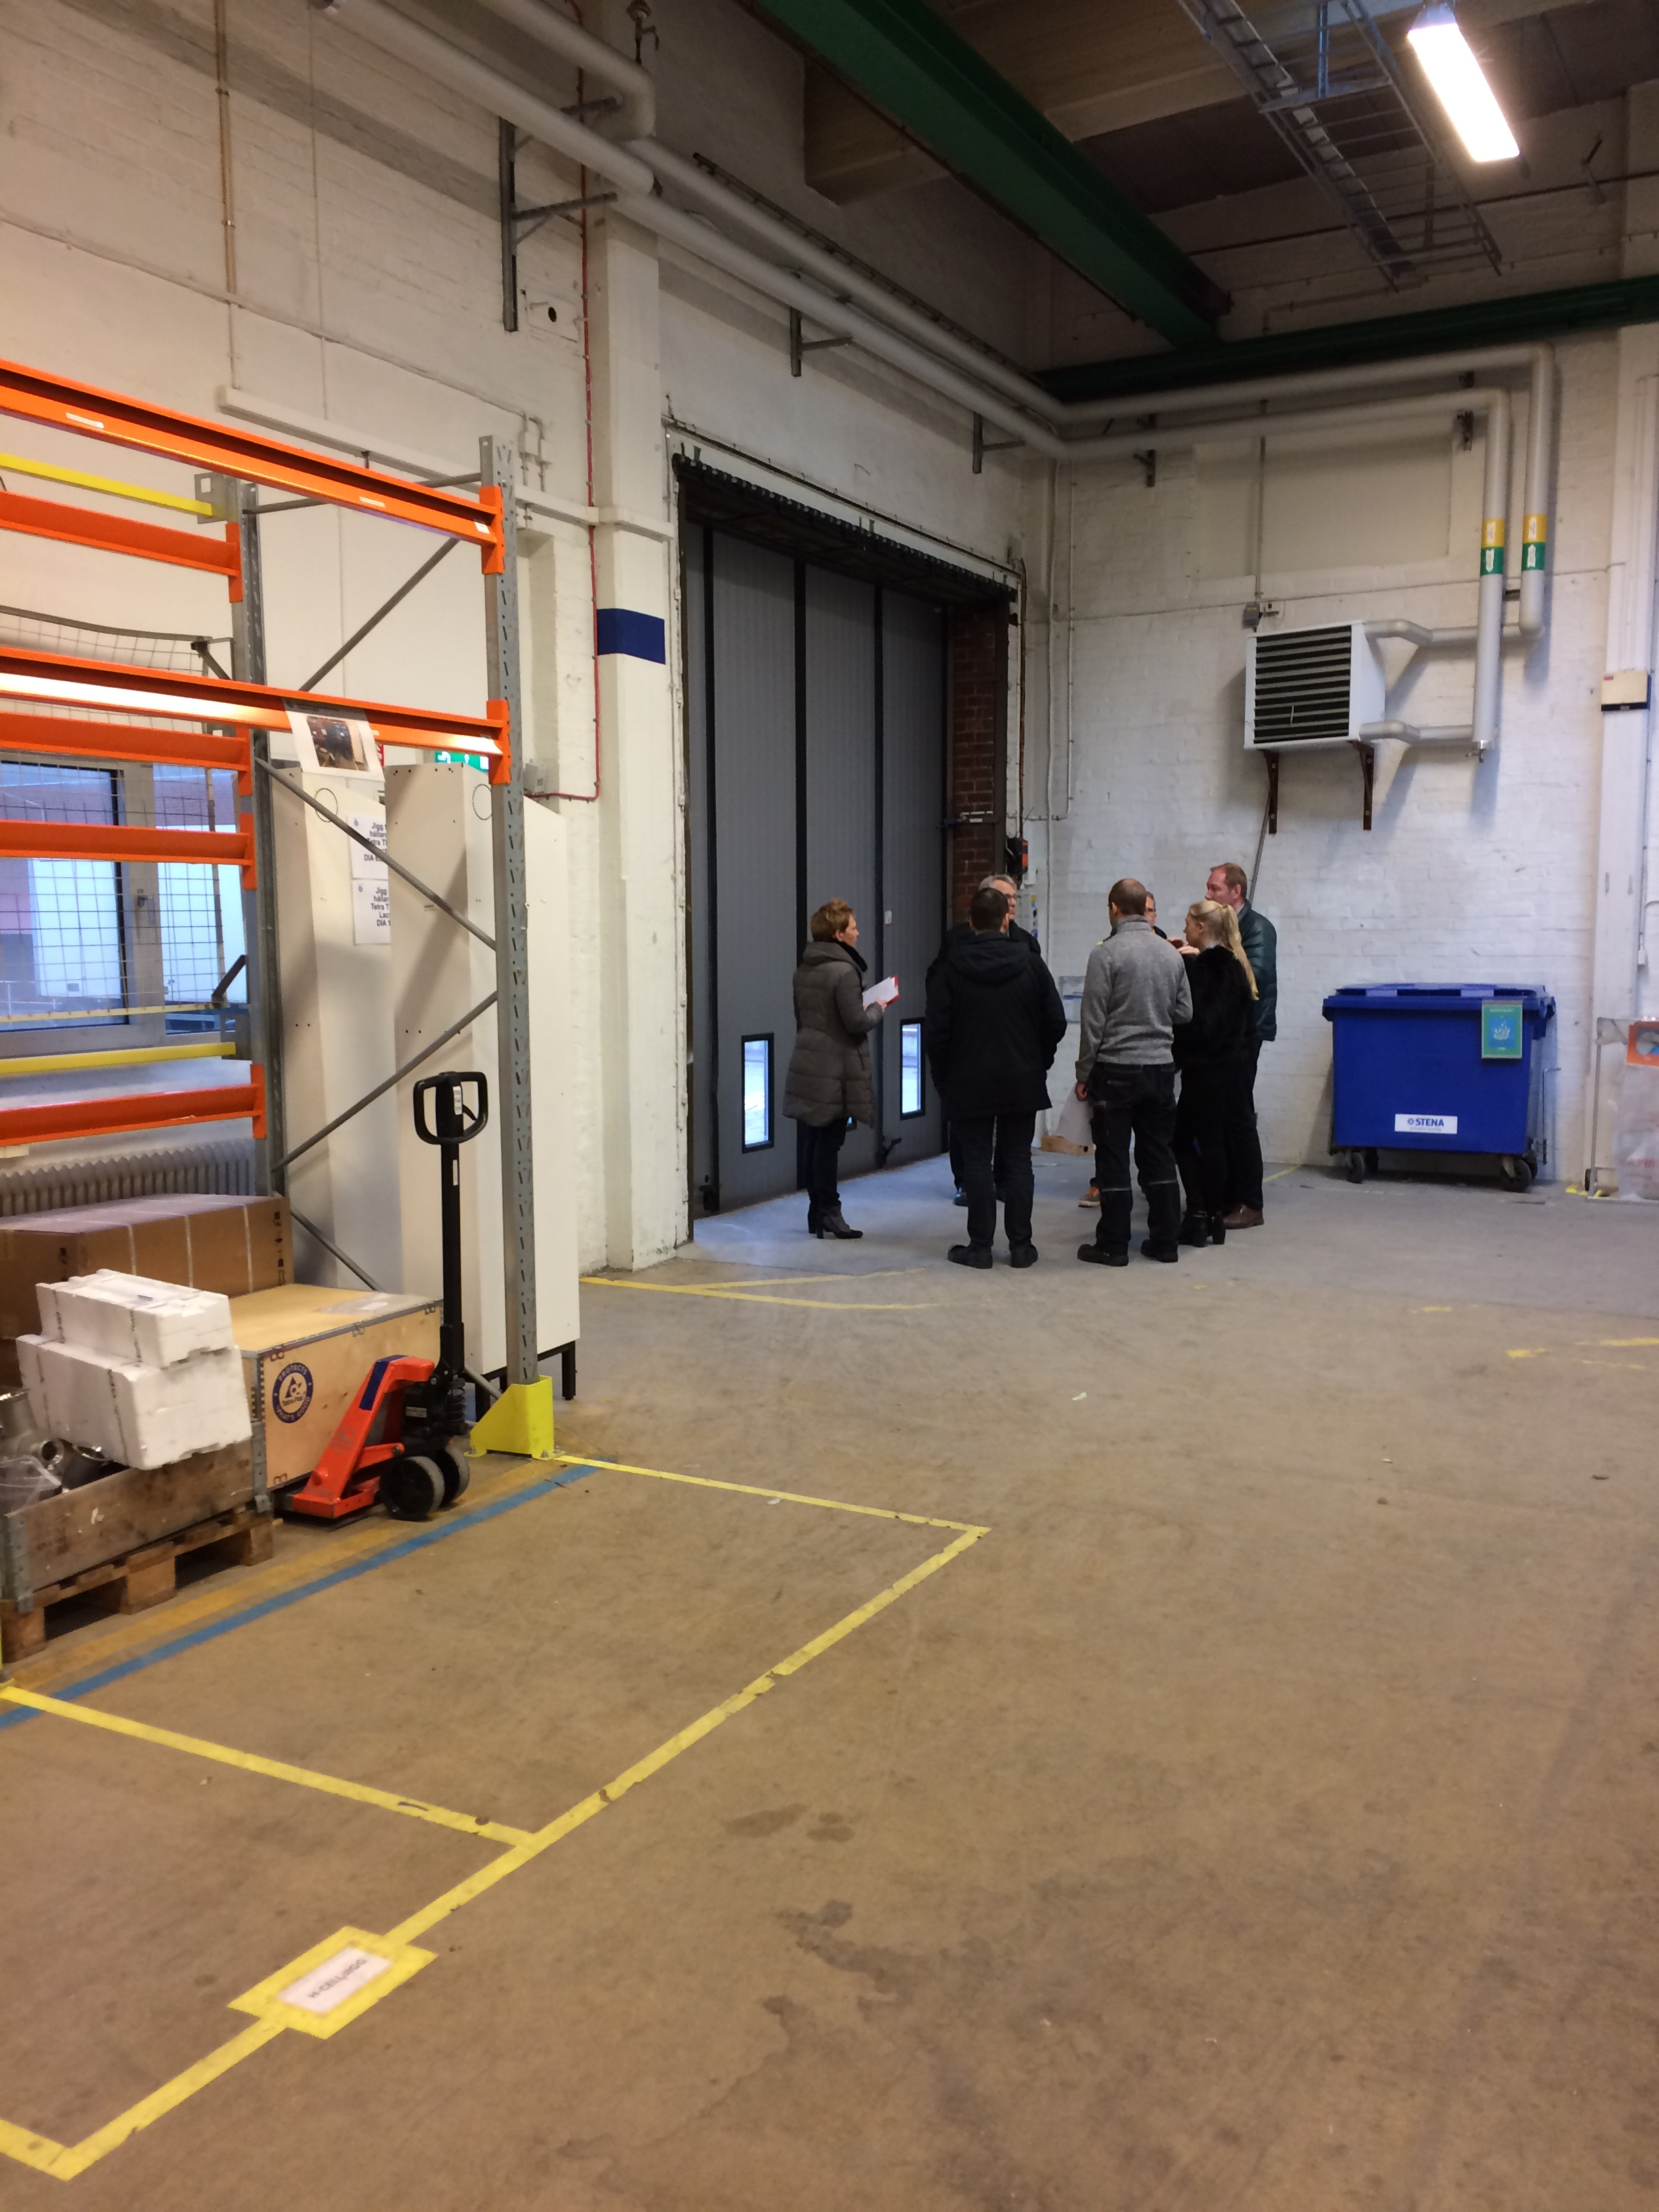
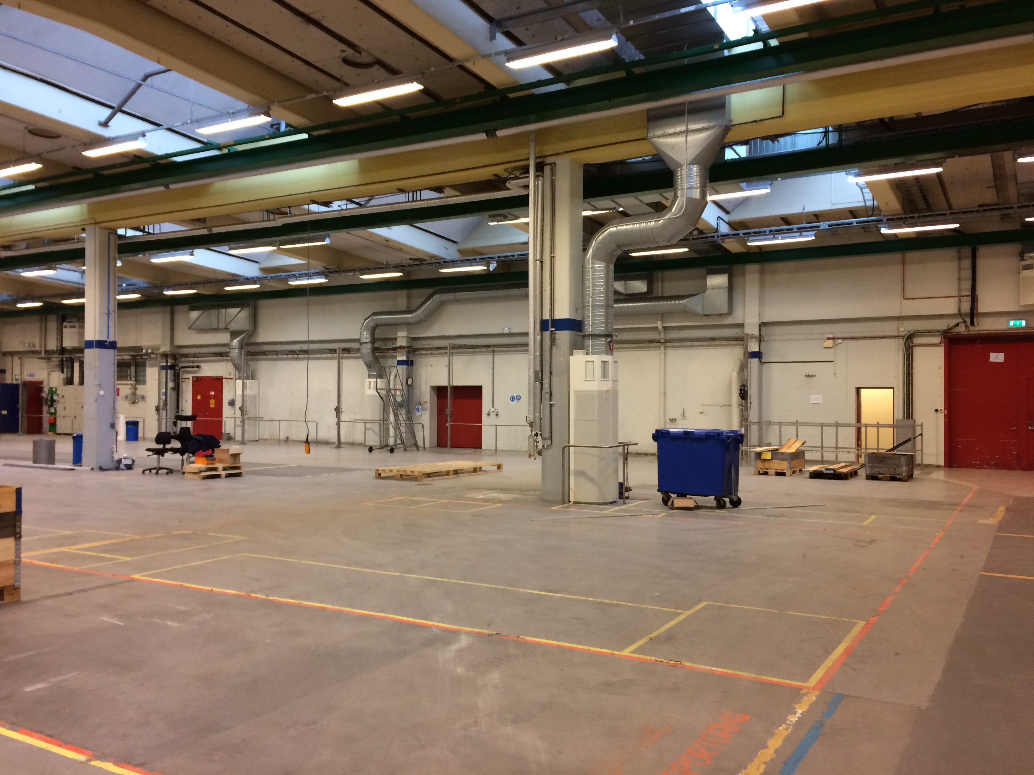
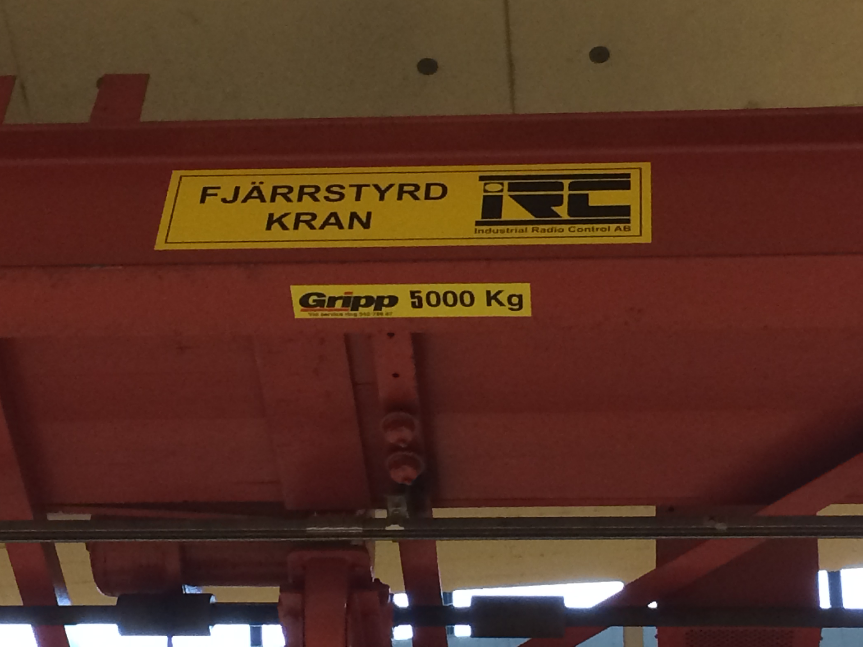
RATS, pictures

Slide 7
RATS
Thank you!

