Slide 1
HERD Technical document – PSD

Slide 2
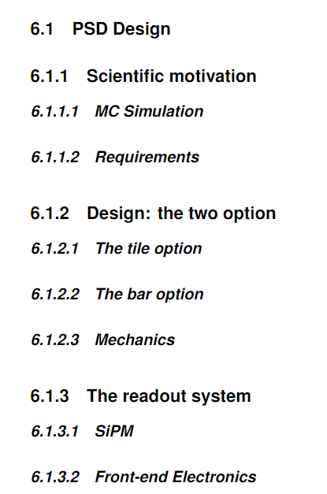
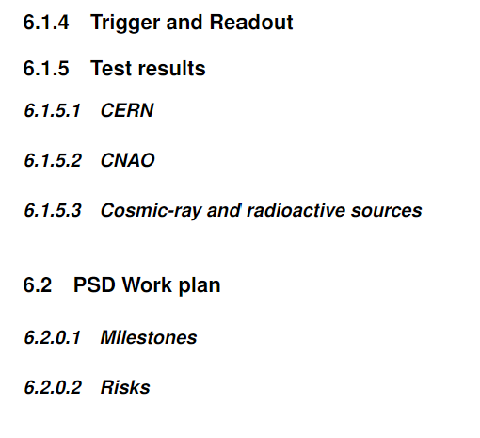
We need to contribute to the HERD Technical document by the end of January 2022 (two weeks from now!) with the chapter related to the PSD
Here you can find the link to a copy of Overleaf Project https://www.overleaf.com/2944376295qdgtyxwtgdwc
We should edit the PSD.tex file and keep all the images in the folder PSDFolder
Tentative index

Slide 3
Scientific Motivation
Description the role of the PSD in HERD and fix the requirements
Task assigned to: Antonio
Design
Description of the two options (layout, dimension, mechanics, …)
Task assigned to: Felicia + (tile integration)
Readout System
Description of the SiPM choice ( size, number of cell, gain, noise, …) and brief description of the front-end chip (Beta chip) for the PSD application
Task assigned to: Fabio
Trigger
Description of the trigger logic to be used for different roles of PSD (probably to be moved to the trigger session)
Task assigned to: Fabio

Slide 4
Test results
Description of all the test activates done in these years both in our labs and at CERN and CNAO. We need to focus to few robust results among the great amount of data that we have
Task assigned to: Leandro and Corrado and Paolo
PSD Work Plan
Future plan and milestones. Here we should define the path up to the next year (end 2023) end of Phase B
Task assigned to: Fabio Ivan Antonio Paolo

