Slide 1
About the response of FOOT calorimeter to different ions

Slide 2
What is expected
Calorimeter response should be proportional to the total kinetic energy
For the same degree of containment, two ions with different Z, but with the same total kinetic energy, should release the same amount of energy in the crystals, modulus some corrections due to possible differences in the fraction of “invisible” energy (Q-values of nuclear reactions: very small correction usually)
Further differences in measured energy might depend on other effects (for example: Birk’s law due to different quenching, etc.)
Are the instrumental effects enough to explain the observed dependence on Z?

Slide 3
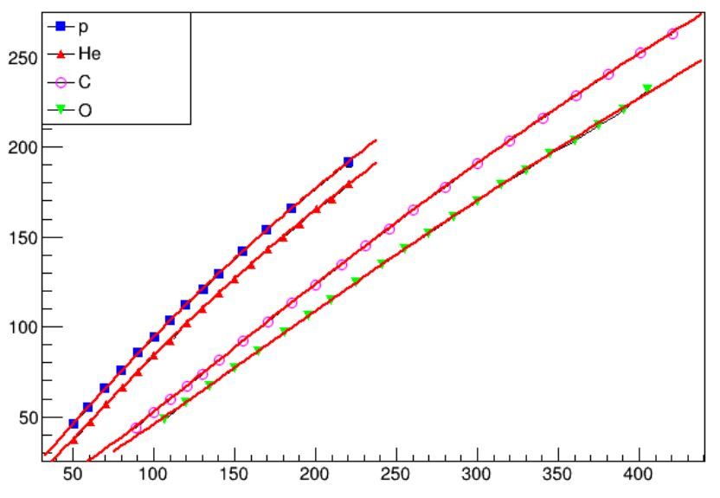
From the HIT results:
Let’s take ¹²C and ¹⁶O @100 MeV/u
(same β of ions)
Using the fit shown at Phys. Meeting of July 27:
Q/u(¹²C) = 50.7; Q/u(¹⁶O) = 46.3
Q(¹²C) = 607.95; Q(¹⁶O) = 740.18
Q(¹⁶0)/Q(¹²C) ~ 1.22
But they have different total kinetic energy:
E_{tot}(¹²C) ~ 1200 MeV
E_{tot}(¹⁶O) ~ 1600 MeV
And the ratio should be E_{tot}(¹⁶0)/ E_{tot}(¹²C) ~ 1.33
→ ¹⁶O is losing something with respect to ¹²C
Notice that from the point of view of containment, ¹⁶O should be better than ¹²C (for equal β the lower the mass the longer is the range)
ADC/u
ADC(E) = ax² / (1 + bx + cx²)
E (MeV/u)
Opposite exercise: take the same total kinetic energy
For E_{tot} ~1600 MeV calibration results yield
Q(¹²C) = 884.6; Q(¹⁶O) = 740.1 → Q(¹⁶0)/Q(¹²C) ~ 0.84 instead of 1

Slide 4
MC Exercise
Simplified simulation of crystal calibration:
1 Crystal module at 1 m from nozzle
No other detectors in between excecpt Start Counter
¹²C and ¹⁶O projectiles at the same total kinetic energy 1.6 GeV: E/A(¹²C) = 133.3 MeV/u; E/A(¹⁶O) = 100 MeV/u
No detector effects (light collection, etc.)
No saturation effects

Slide 5
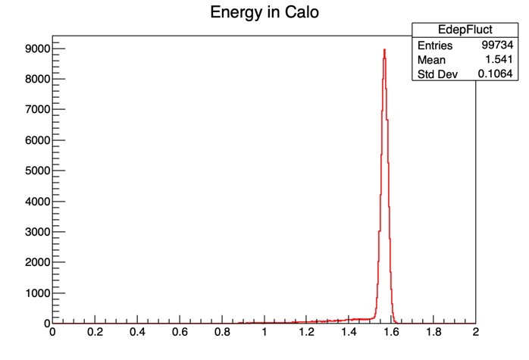
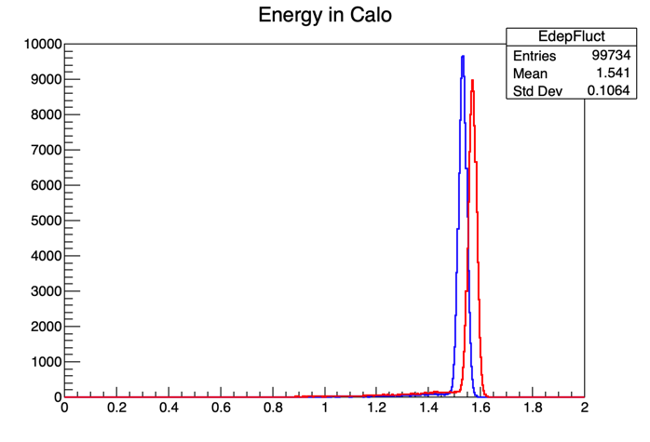
Results
(an hypothetical 1% gaussian fluctuation has been folded)
¹²C
¹⁶O
¹²C
E_{peak} ~ 1.57 GeV
<E> ~ 1.54 GeV
E_{peak} ~ 1.53 GeV
<E> ~ 1.52 GeV
E_{peak}(¹⁶0)/ E_{peak}(¹²C) ~ 0.97
→ larger than data (0.84), but still <1
Why<1?

Slide 6
Possible explanations
Energy deposited by hadrons+e.m.: ¹⁶O → 99.1%; ¹²C → 98.2%
Invisible energy: ¹⁶O → 0.5%; ¹²C → 0.8%
Escaping particles: ¹⁶O → 0.4%; ¹²C → 0.9%
These factors do not explain differences.
Other hypothesis:
different energy loss in the path from source to calorimeter?
MC simulation repeated taking away air

Slide 7
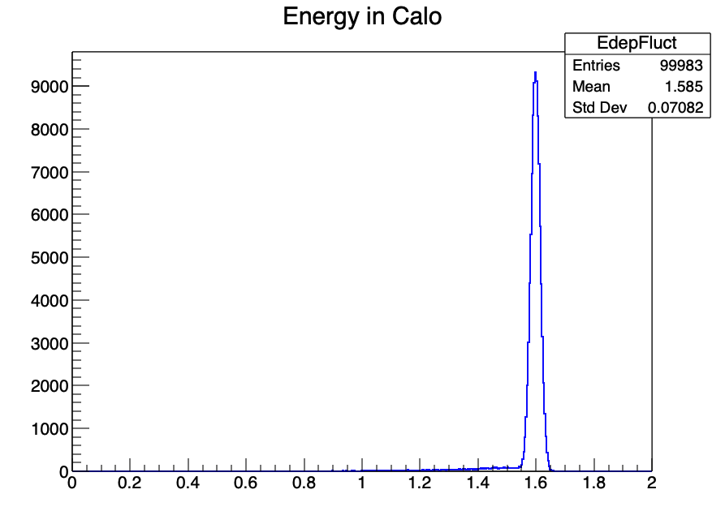
New Results (no Air)
¹²C
¹⁶O
E_{peak} ~ 1.6 GeV
<E> ~ 1.57 GeV
E_{peak} ~ 1.6 GeV
<E> ~ 1.59 GeV
Now they are ~coincident → Energy Loss in Air (and other materials) upstream the calorimeter may be significant for calibration

Slide 8
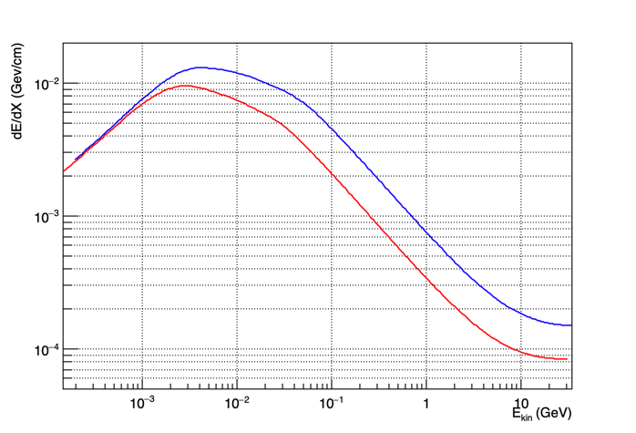
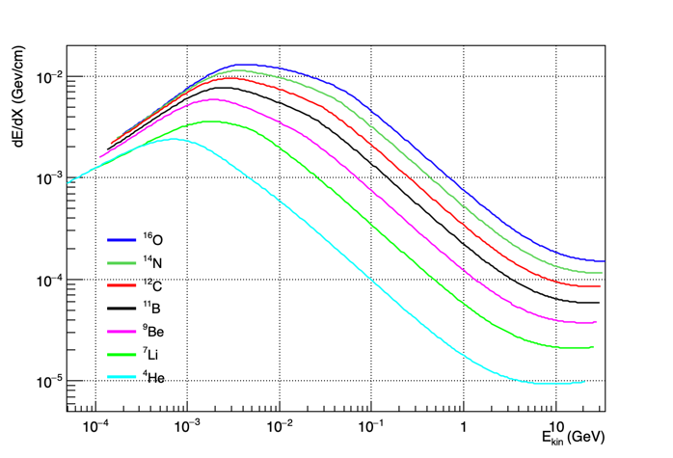
Energy loss in Air
For E_{tot} (0 cm) = 1.6 GeV
dE/dx(¹⁶O) = 0.053 GeV/m
dE/dx(¹²C) = 0.024 GeV/m
E_{tot}(¹⁶O @100 cm) = 1.547 GeV
E_{tot}(¹²C @100 cm) = 1.576 GeV
¹⁶O
¹²C
At least part of the difference in response to different Z is due to energy loss in the path to calorimeter

Slide 9
In the FOOT detector
Energy loss in Air and all detectors has to be considered to interpret correctly the calorimeter response
For instance for E/A = 200 MeV/u:
dE/dx (GeV/cm)
 | Air | Silicon | Scintillator
¹²C | 0.00018 | 0.304 | 0.165
¹⁶O | 0.00033 | 0.541 | 0.292
Considering 100 cm of Air, 0.6 cm of Scintillator (TW) and 0.09 cm of Si (6 single layers of MSD):
dE/dx(¹²C@200 MeV/u) = 144 MeV → E_{tot} (0 cm) = 2.4 GeV; E_{tot}(@Calo) = 2.256 GeV
dE/dx(¹⁶O@200 MeV/u) = 257 MeV → E_{tot} (0 cm) = 3.2 GeV; E_{tot}(@Calo) = 3.082 GeV
Ratio (0 cm)= 1.33 → Ratio(@Calo) = 1.37

Slide 10
Simplified analytical expression
For a (Z,A) ion with kinetic energy/nucleon E, neglecting logarithmic term, shell corrections, etc.:
$$\frac{dE}{dx}\sim k\frac{Z^{2}}{β^{2}}\sim k\frac{Z^{2}{(E+m)}^{2}}{E^{2}+2 m E}$$
m: nucleon mass; E^{kin}_{tot} = A E; M_{tot} = A m
GeV/cm | Air | Silicon | Scintillator
k | 1.637 10⁻⁶ | 0.00271 | 0.00146
k is ~Z,E independent in most of useful β range accessed by FOOT
$$E\left(@Calo\right)=A E −(k_{Air}{Δx}_{Air}+k_{Scint}{Δx}_{Scint}+k_{Si}{Δx}_{Si})\frac{Z^{2}{(E+m)}^{2}}{E^{2}+2 m E}$$
$$Δx:thickness of material$$

