Slide 1


MC Simulation for HIT2022 campaign
G.B. S.M., INFN-Milano
7 Sept. 2022

Slide 2
Following what preliminarily shown at Phys. Meeting of July 27
https://agenda.infn.it/event/29380/contributions/149246/attachments/95373/131036/MCUpdateNew_jul2022.pdf
A first high statistics production is now ready for ⁴He physics runs
Campaign is HIT2022_MC in Shoe Newgeom branch (Please update)
Run 100, 140, 200, 220 with 10⁷ primaries for each run; plus empty target for each run number (with reduced statistics: 10⁶ primaries/run)

Slide 3
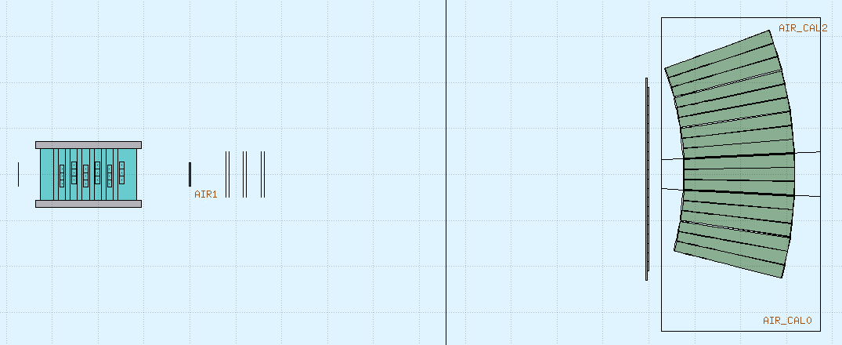
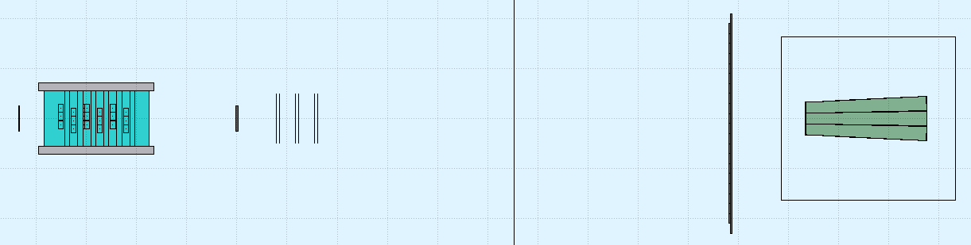
Recall of geometry - 1
125.55 cm
43.45 cm
10.9º
C target
5 mmm (1.83 g/cm³)
28 cm
8.5º
11.6 cm
z=0
98.45 cm
Of course at present everything is perfectly aligned
~1.6º

Slide 4
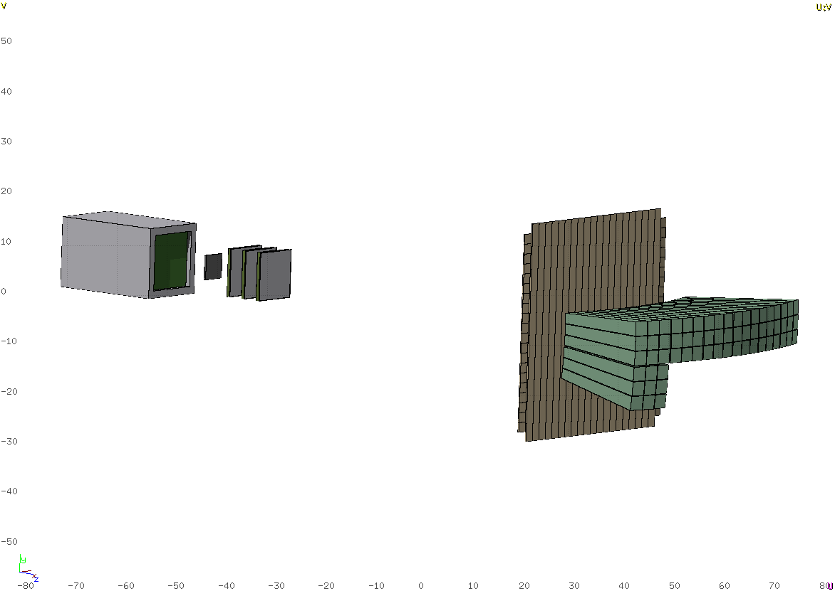
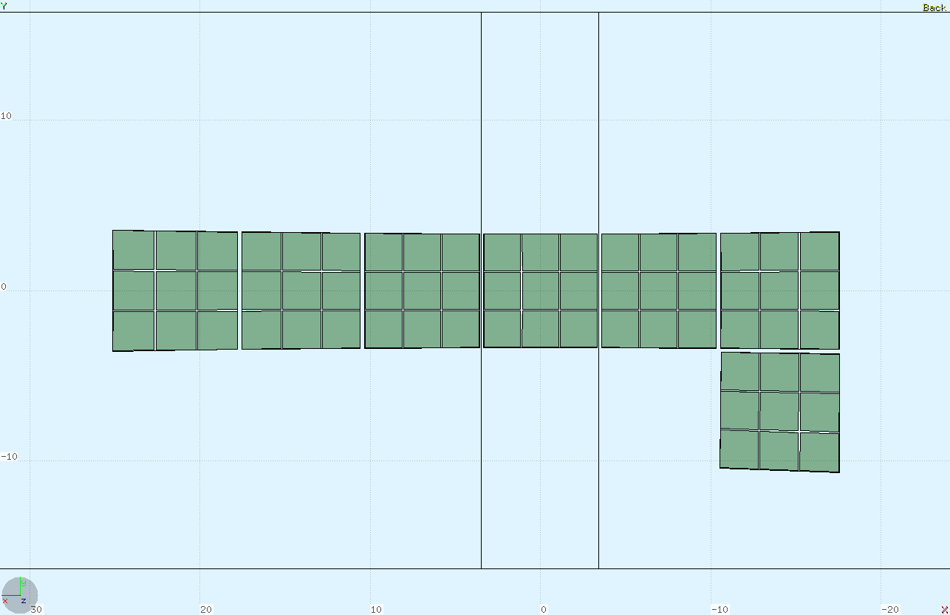
Recall of geometry - 2
63 crystals
180 Regions
Region mapping of crystals
WARNING: both spacing between modules and crystal alignement is ideal and probably not corresponding to actual layout: to be studied using exp. data

Slide 5
Setup updated on newgeom branch of shoe
Basic calo geometry imported from calo_2022 branch
libs/src/TACAparGeo.cxx
libs/src/TACAparGeo.hxx
Reconstruction/level0/macro/BuildCaGeoFile.C)
Please update
it produces TACAdetector.geo to be placed in
geomaps/HIT2022_MC
Campaign: HIT2022_MC
Target: C 5 mm
Run: 100, 140, 200, 220 according to the energies of physics runs
For each run the size of the beam (σ_{x} = σ_{y}) is the one obtained from the profile measured using MSD
Warning: Master Branch not yet aligned

Slide 6
Available files
In tier3: /gpfs_data/local/foot/Simulation/HIT2022_MC
^{Run 100}
4He_C_100_1_shoereg.root 5 10⁶ primaries
4He_C_100_2_shoereg.root 5 10⁶ primaries
4He_C_100_empty_shoereg.root 10⁶ primaries
E=100.19 MeV/u
σ_{x} = σ_{y} = 0.311 cm
Secondary particles include:
- e⁺/e⁻ 500 keV cut (except BGO)
- photons 500 keV cut
^{Run 140}
4He_C_140_1_shoereg.root 5 10⁶ primaries
4He_C_140_2_shoereg.root 5 10⁶ primaries
4He_C_140_empty_shoereg.root 10⁶ primaries
E=140.14 MeV/u
σ_{x} = σ_{y} = 0.253 cm
Neutrons for E<20 MeV have been produced using the multi-group (fixed width energy bins)
^{Run 200}
4He_C_200_1_shoereg.root 5 10⁶ primaries
4He_C_200_2_shoereg.root 5 10⁶ primaries
4He_C_200_empty_shoereg.root 10⁶ primaries
E=200.375 MeV/u
σ_{x} = σ_{y} = 0.216 cm
^{Run 220}
4He_C_220_1_shoereg.root 5 10⁶ primaries
4He_C_220_2_shoereg.root 5 10⁶ primaries
4He_C_220_empty_shoereg.root 10⁶ primaries
E=220.5 MeV/u
σ_{x} = σ_{y} = 0.180 cm

Slide 7
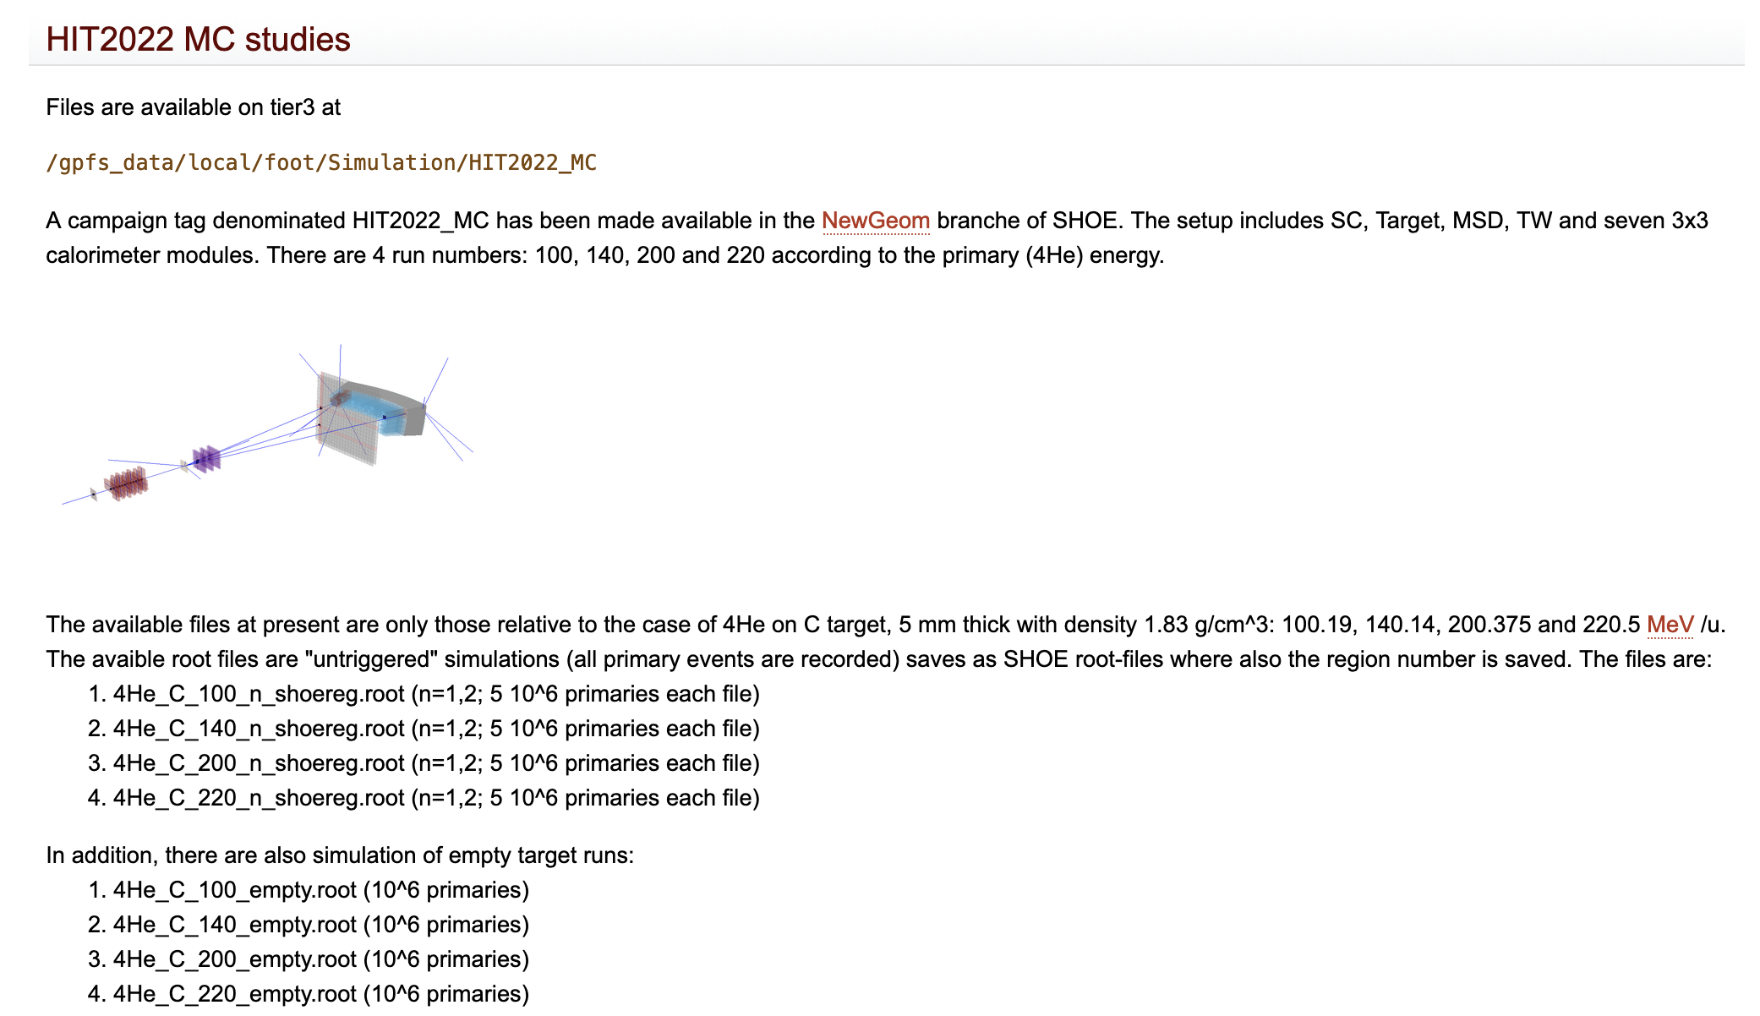
Wiki page of available simulation file updated
http://arpg-serv.ing2.uniroma1.it/twiki/bin/view/Main/FOOTAvailableSimulation

Slide 8
Some numbers from MC truth – 220 MeV/u
⁴He primary interaction
for 5 10⁶ primaries, 5 mm C target
No. of interactions in Air: 81665 (1.6%)
No. of interactions in STC: 17478 (0.3%)
No. of interactions in BMN: 21769 (0.4%)
No. of interactions in TGT: 447705 (9.0%)
No. of interactions in MSD: 82931 (1.7%)
No. of interactions in TWL: 251587 (5.0%)
No. of interactions in CAL: 1943616
No. of primaries interacting before target is 16178 (0.3%)
10⁶ primaries empty target
No. of interactions in Air: 19464 (1.9%)
No. of interactions in STC: 3450 (0.3%)
No. of interactions in BMN: 4384 (0.4%)
No. of interactions in MSD: 20835 (2.0%)
No. of interactions in TWL: 63591 (6.4%)
No. of interactions in CAL: 406117
Warning:
from now on, all analyses have been performed
using only ½ of the available statistics

Slide 9
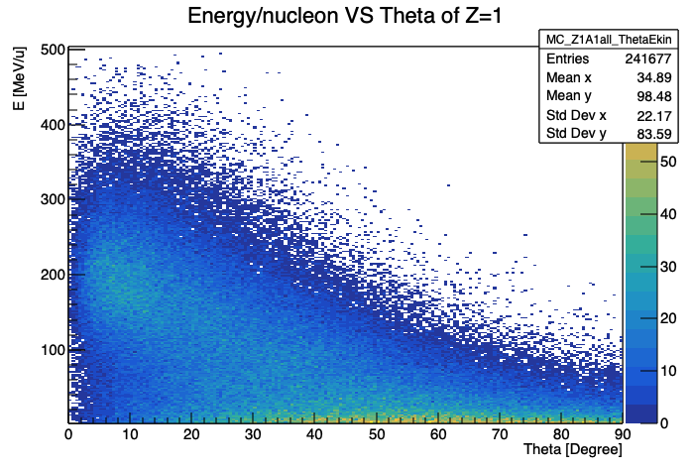
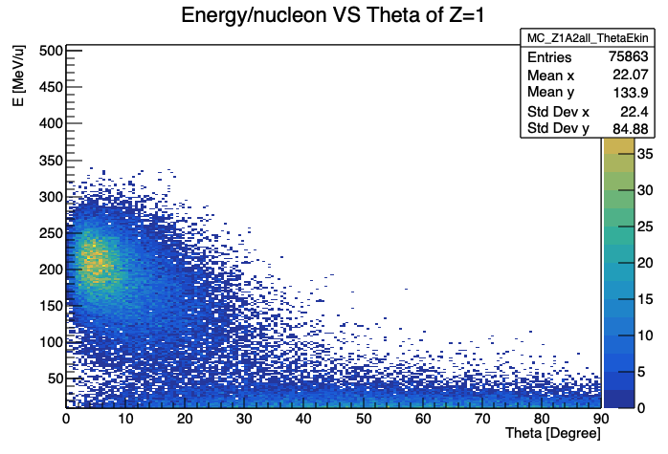
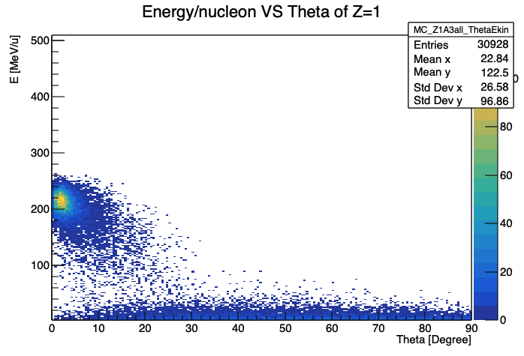

Some numbers from MC truth – 220 MeV/u
Secondaries produced in Target
p
d
Reasonable selection cuts in TW acceptance:
50 MeV/u, ~11º
t
³He
Target fragmentation

Slide 10
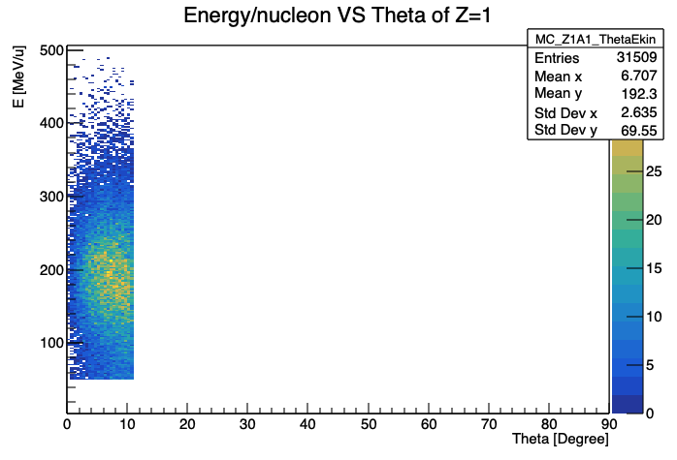
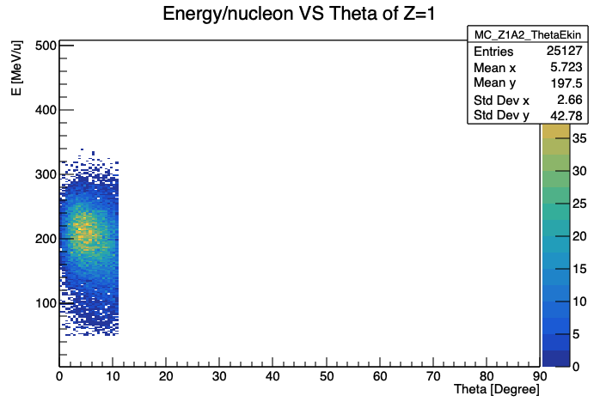
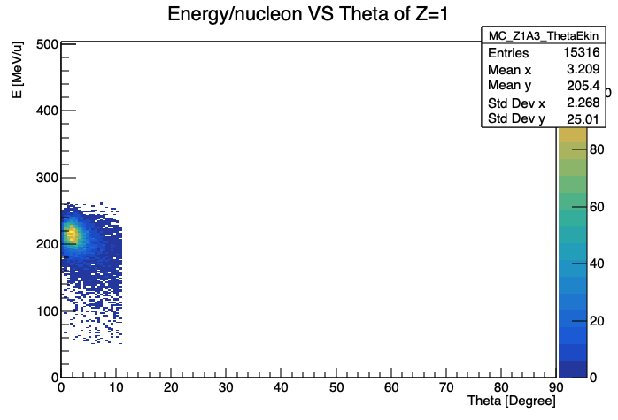

Some numbers from MC truth – 220 MeV/u
Secondaries produced in Target
p
d
18% of these
in 6 modules calo
24% of these
in 6 modules calo
Reasonable selection cuts in TW acceptance:
50 MeV/u, ~11º
t
³He
52% of these
in 6 modules calo
52% of these
in 6 modules calo

Slide 11
Some numbers from MC truth – 140 MeV/u
⁴He primary interaction
for 5 10⁶ primaries, 5 mm C target
No. of interactions in Air: 22607 (0.5%)
No. of interactions in STC: 4399 (~0.1%)
No. of interactions in BMN: 4221 (~0.1%)
No. of interactions in TGT: 123183 (2.4%)
No. of interactions in MSD: 17397 (0.3%)
No. of interactions in TWL: 94227 (1.9%)
No. of interactions in CAL: 1039732
No. of primaries interacting before target is 15914 (0.3%)
10⁶ primaries empty target
No. of interactions in Air: 4412 (0.4%)
No. of interactions in STC: 866 (~0.1%)
No. of interactions in BMN: 829 (~0.1%)
No. of interactions in MSD: 3530 (0.4%)
No. of interactions in TWL: 19084 (2.0%)
No. of interactions in CAL: 225265

Slide 12
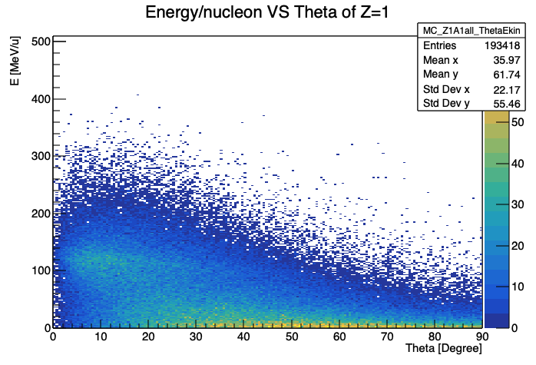
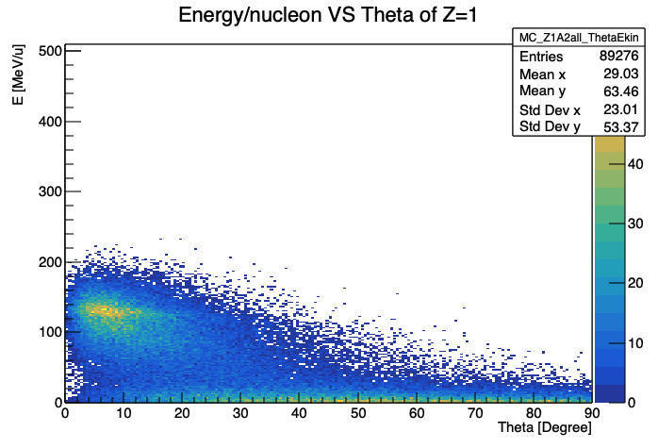
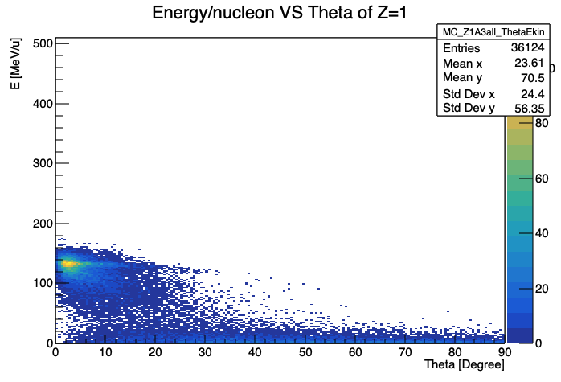

Some numbers from MC truth – 140 MeV/u
Secondaries produced in Target
p
d
Reasonable selection cuts in TW acceptance:
50 MeV/u, ~11º
t
³He

Slide 13
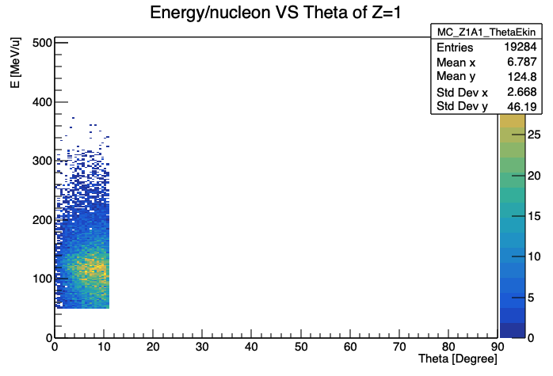
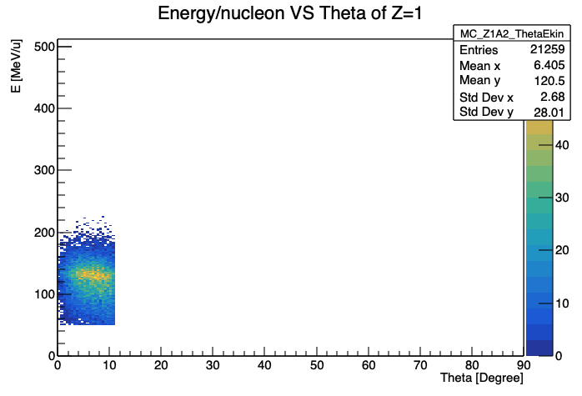
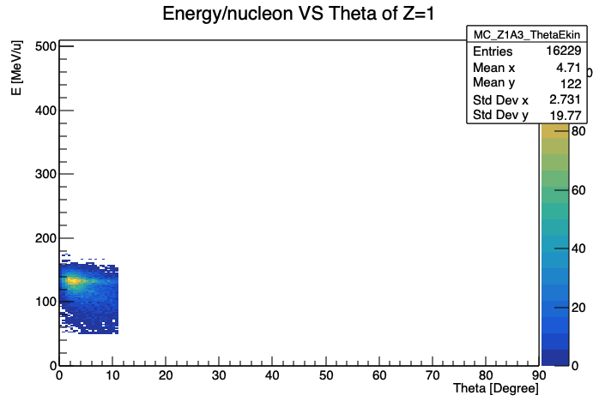

Some numbers from MC truth – 140 MeV/u
Secondaries produced in Target
p
d
18% of these
in 6 modules calo
20% of these
in 6 modules calo
Reasonable selection cuts in TW acceptance:
50 MeV/u, ~11º
t
³He
35% of these
in 6 modules calo
35% of these
in 6 modules calo

Slide 14
Some numbers from MC truth – 100 MeV/u
⁴He primary interaction
for 5 10⁶ primaries, 5 mm C target
No. of interactions in Air: 26527 (0.5%)
No. of interactions in STC: 5063 (0.1%)
No. of interactions in BMN: 4857 (0.1%)
No. of interactions in TGT: 138874 (2.8%)
No. of interactions in MSD: 19873 (0.4%)
No. of interactions in TWL: 112779 (2.3%)
No. of interactions in CAL: 585140
No. of primaries interacting before target is 16240 (0.3%)
10⁶ primaries empty target
No. of interactions in Air: 5061 (0.5%)
No. of interactions in STC: 987 (0.1%)
No. of interactions in BMN: 993 (0.1%)
No. of interactions in MSD: 3945 (0.4%)
No. of interactions in TWL: 22319 (2.2%)
No. of interactions in CAL: 225265

Slide 15
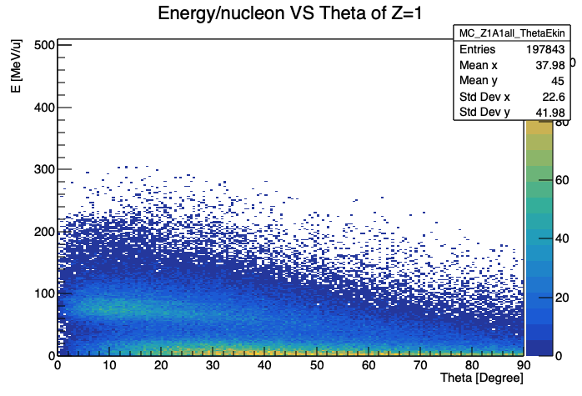
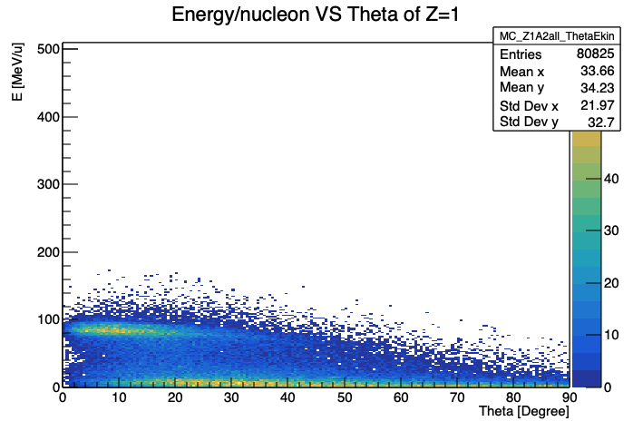
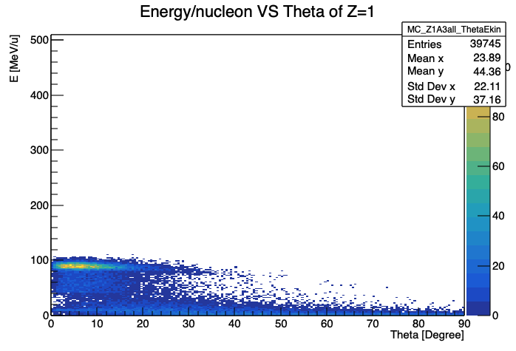

Some numbers from MC truth – 100 MeV/u
Secondaries produced in Target
p
d
Reasonable selection cuts in TW acceptance:
50 MeV/u, ~11º
t
³He

Slide 16
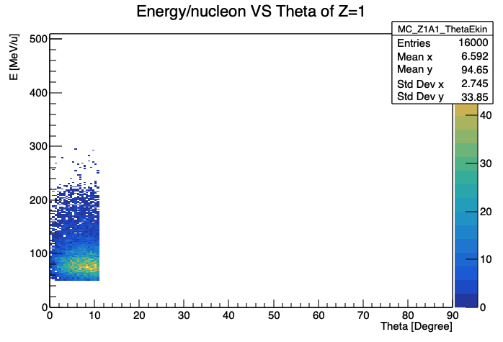
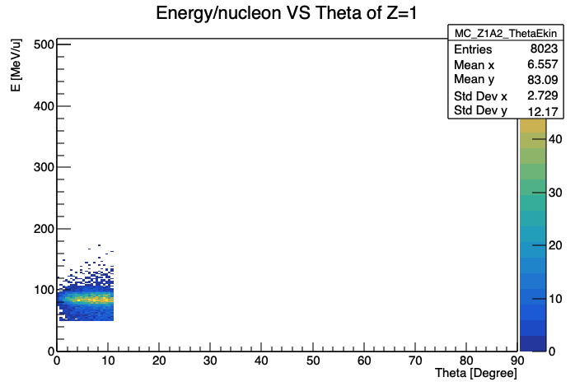
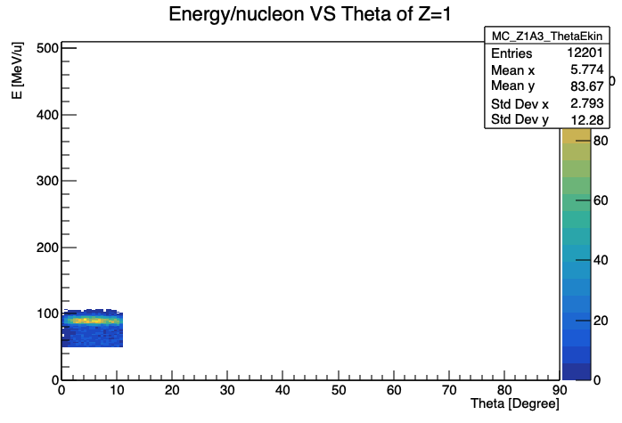

Some numbers from MC truth – 100 MeV/u
Secondaries produced in Target
p
d
19% of these
in 6 modules calo
19% of these
in 6 modules calo
Reasonable selection cuts in TW acceptance:
50 MeV/u, ~11º
t
³He
25% of these
in 6 modules calo
26% of these
in 6 modules calo

Slide 17
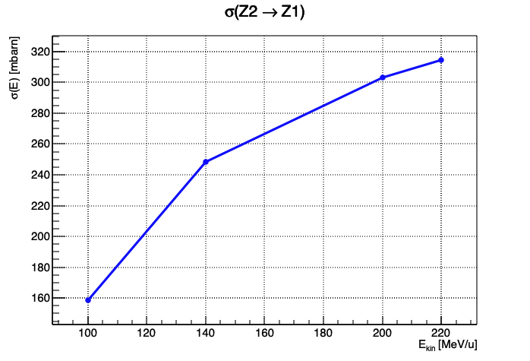
Some numbers from MC truth
Expected Cross Section behaviour:
Notice:
This is for the given selection cuts:
E>50 MeV/u, θ < 11º

Slide 18
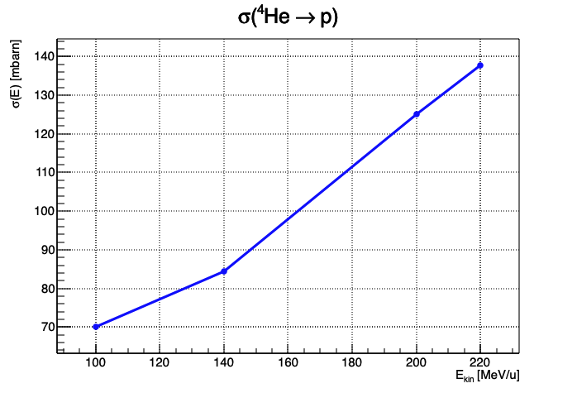
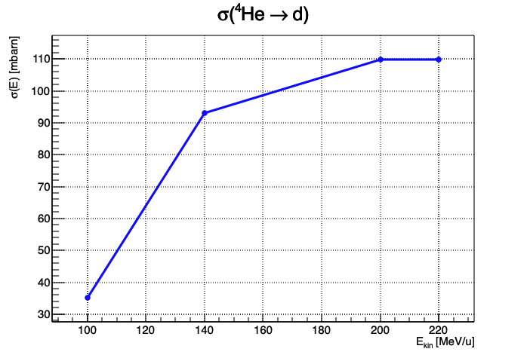
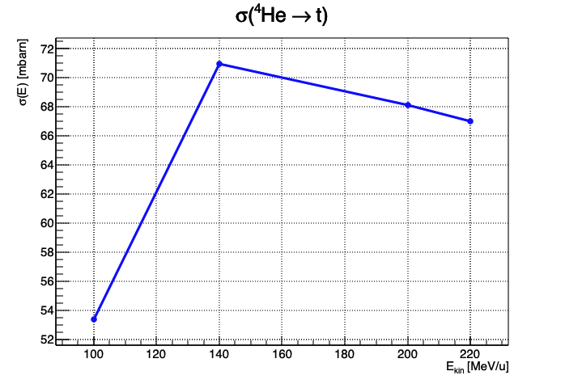
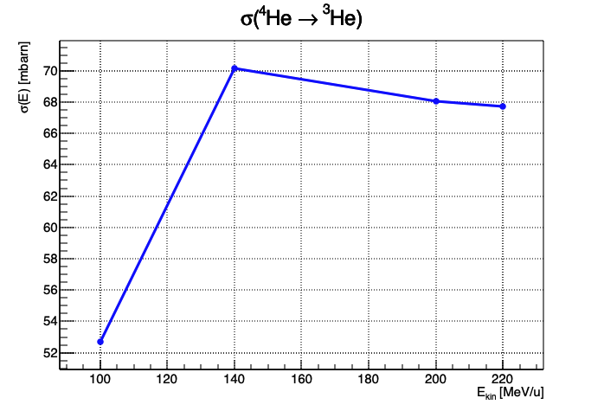
Some numbers from MC truth
Expected Cross Section behaviour:
for the given selection cuts:
E>50 MeV/u, θ < 11º
Notice:
the behaviour of these curves as a function of E is strongly affected by the chosen cuts

Slide 19
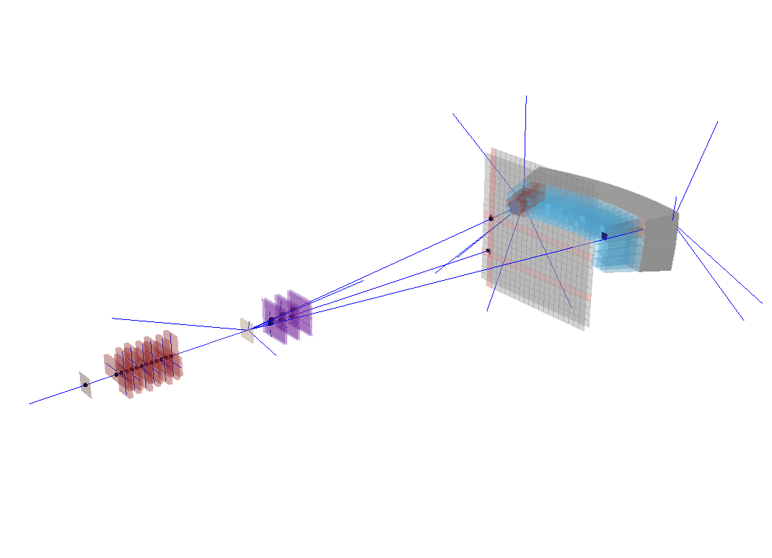
Slightly beyond MC truth: using MSD tracks
Looking for matches:
between BM track and MSD tracks intercepts at z=0 (target)
Between TW points and MSD tracks intercepts at z(TW)
Software Warning:
→ Quite often MSD tracks compare twice in the same event! (same track parameters, same MSD clusters)
Some additional logics was needed to get rid of double tracks…

Slide 20
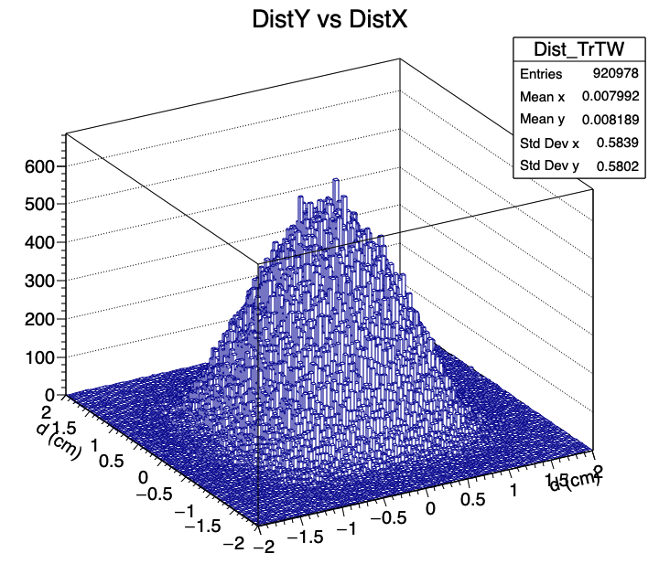
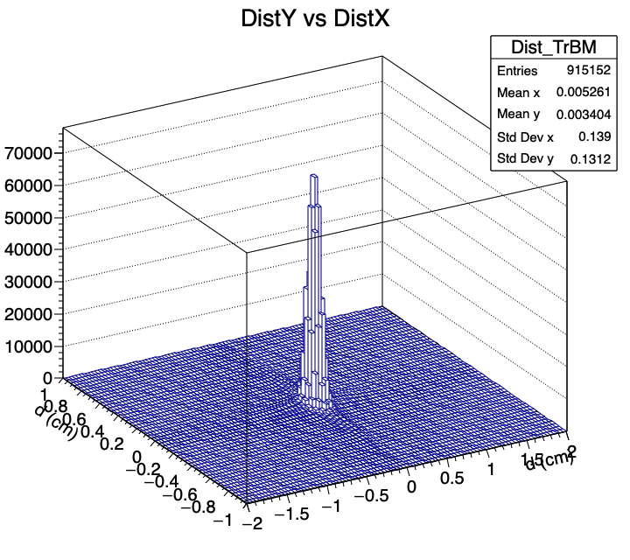
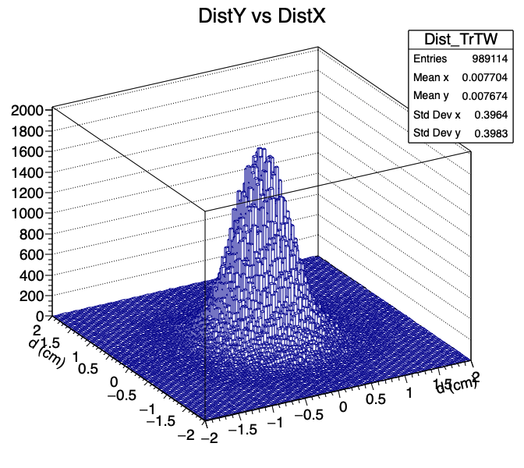
using MSD tracks
100 MeV/u
σ_{x}, σ_{y} ~ 0.58 cm
Distance of intercepts of MSD tracks and BM track at z=0
Distance of intercepts of MSD tracks at TW and TW point
200 MeV/u
σ_{x}, σ_{y} ~ 0.4 cm
σ_{x}, σ_{y} ~ 0.14 cm
Dependence on energy mostly due to Multiple Scattering in Silicon
Our definition of good match:
with BM track (d_{x} && d_{y})<0.5 cm
with TW point (d_{x} && d_{y})<1.5 cm

Slide 21
Matching Results
Considering 10⁶ events:
 | 100 MeV/u | 140 MeV/u | 200 MeV/u | 220 MeV/u
TW points | 973762 | 979893 | 974931 | 999696
MSD tracks | 931714 | 981500 | 1002896 | 1000079
MSD - BM track matching | 88.2% | 93.3% | 95.2% | ~100%
TW points matching a MSD track | 95.7% | 96.9% | 99.0% | ~100%

Slide 22
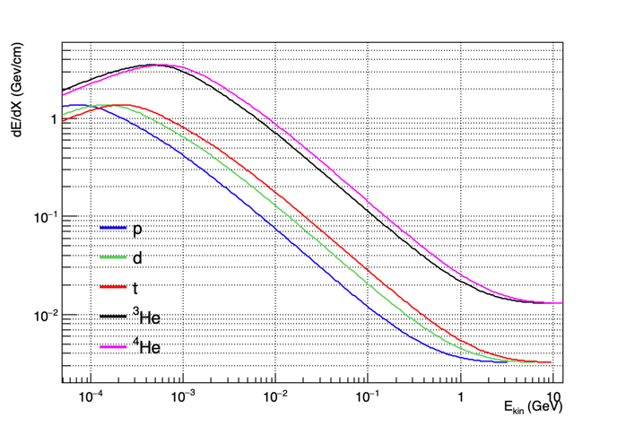
Not to be forgotten…
This is energy loss in C
The ratio between the different curves is maintained when changing material
Total kinetic energy

Slide 23
Conclusions
A first high statistics production is now ready for HIT2022_MC in Shoe Newgeom branch for ⁴He physics runs
This simulation can be used to perform a careful study of energy and angular cuts necessary to provide a significant evaluation of cross sections
Furthermore, it can be used for a study of reinteractions and of energy loss of tracks in the path from target to TW and Calo. This could be important, in particular for the lower energies.
Correspondence between data and MC as far as positioning, alignement etc. should be checked as soon as possible. Surely the Calo geometry is too much regular with respect to actual detector: → the calculation of acceptance in Calo could be not so easy…
There could be some details to be fixed in rec. software (see the case of repeated MSD tracks)

