Slide 1
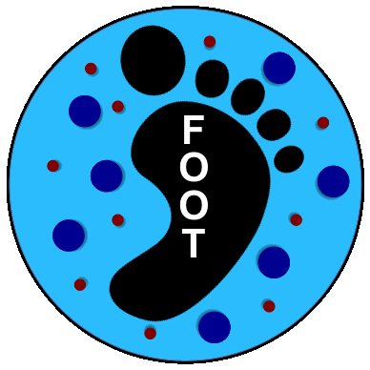
Update of MC Simulation for HIT2022 data taking
G.B. S.M., INFN-Milano
July 2022

Slide 2
Extension of Calorimeter
Thanks to E. Lopez Torres we have now the possibility of producing the geometry for the CALO configuration with 7 modules in alternative to the 5 module configuration (prepared by L. Scavarda) presented at the last Collab. Meeting.
The updated files have been uploaded in the newgeom branch of SHOE libs/src/TACAparGeo.cxx
libs/src/TACAparGeo.hxx
Reconstruction/level0/macro/BuildCaGeoFile.C)
it produces TACAdetector.geo to be placed in
geomaps/HIT2022_MC

Slide 3
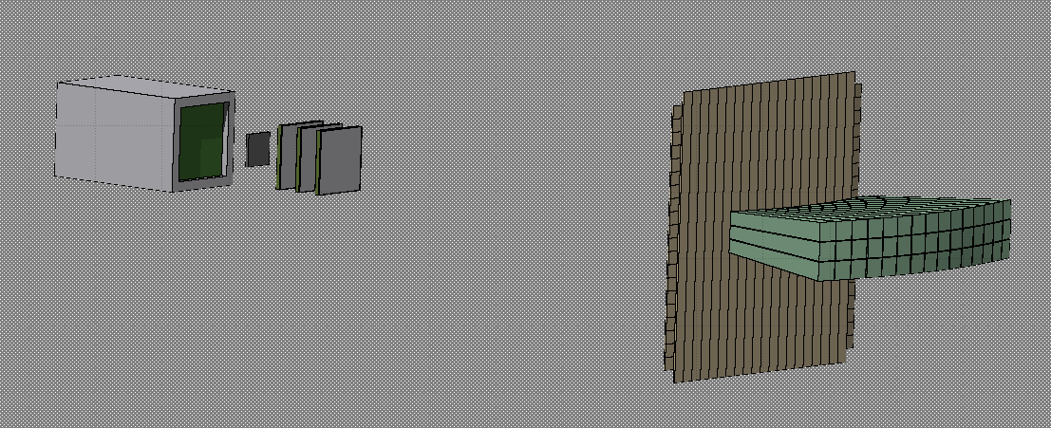
5 Module Setup version
At this time positioning is still provisional
45 crystals
159 Regions
~100 cm
~1.7º
Lateral View
~11º
~100 cm
~8.2º
12 cm

Slide 4
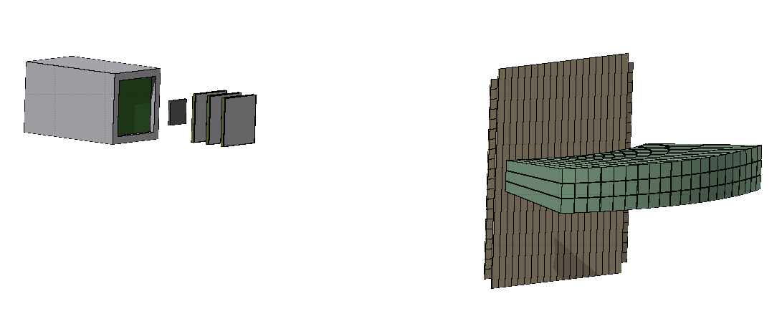
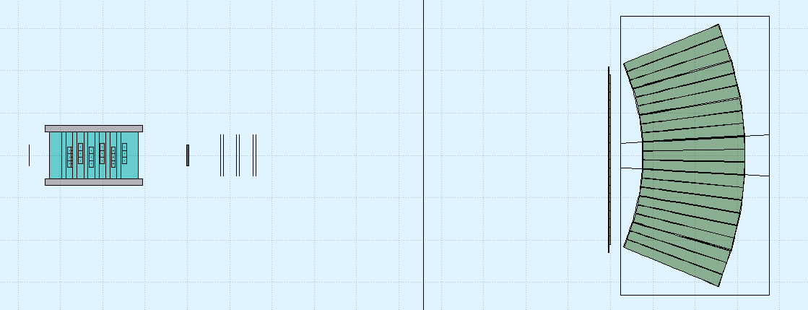
7 Module Setup version
63 crystals
180 Regions
~11º
With 7 modules in this view the CALO covers the whole angular acceptance of TW
Lateral view remains unchanged
12 cm

Slide 5
Preliminary Simulation now available for quick tests
With both configurations, 5 10⁶ events (untriggered) 200 MeV/u on C target 5 mm
in Tier3:
/gpfs_data/local/foot/Simulation/HIT2022_MC/5Mod/4He_C_200_5mod_shoereg.root
/gpfs_data/local/foot/Simulation/HIT2022_MC/7Mod/4He_C_200_7mod_shoereg.root
Notice: in both 5Mod and 7Mod directories you can find also the specific FOOT.reg and TACAdetector.geo files to be inserted in geomaps/HIT2022_MC
The idea is to update newgeom branch definitively when we shall have confirmation of the setup actually available

Slide 6
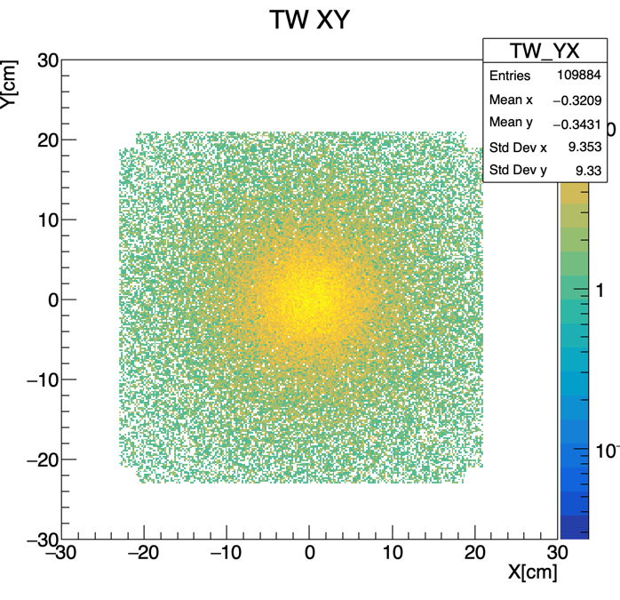
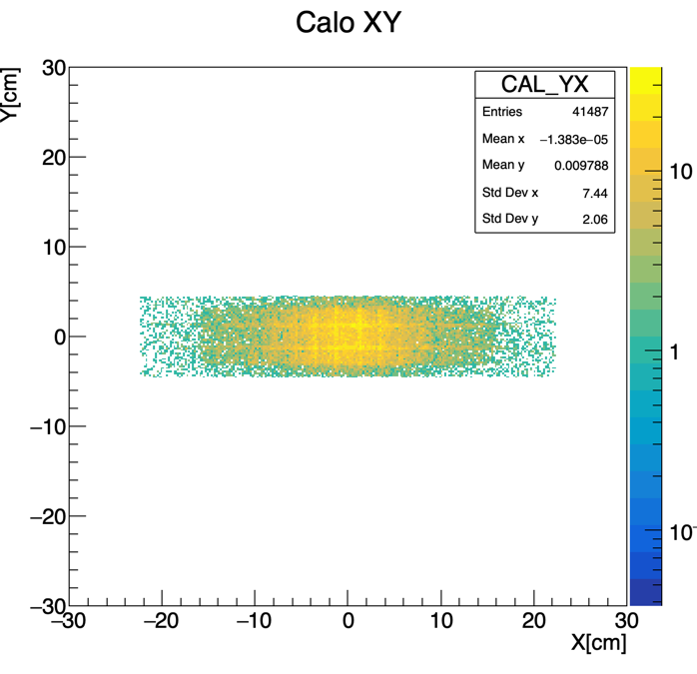
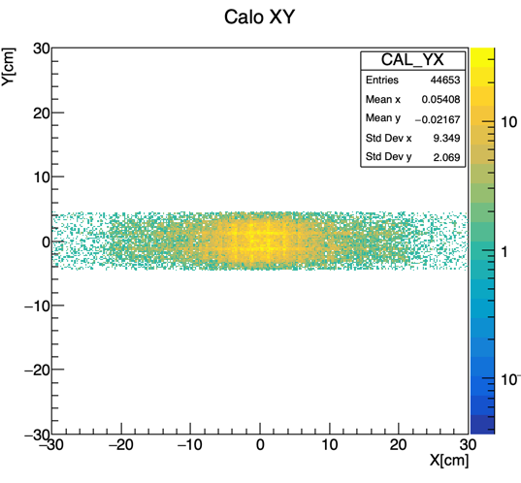
Acceptance of the Calorimeter
Only tracks produced in target
XY impact point in TW
XY impact point in CAL
5 modules
7 modules
~8 % increase in the number of tracks hitting the calorimeter

Slide 7
Some statistics: (7 Modules, 5 10⁶ primaries, 200 MeV/u, 5 mm C)
No. of interactions in Air: 25918
No. of interactions in STC: 4023
No. of interactions in BMN: 3770
No. of interactions in TGT: 114125
No. of interactions in MSD: 15934
No. of interactions in TWL: 85309
No. of interactions in CAL: 1715060 No. of primaries interacting before target is 22442
Selection cuts: E_cut = 0.10 Theta_cut = 11.00
Target Material = C; A_target = 1.201070e+01 rho_target = 1.830000e+00 thickness = 5.000000e-01
N_prim = 4.979231e+06 Ntg = 4.587792e-05
N(Z1) with cuts = 64997.00 sigma(Z1) with cuts = 284.63 +/- 1.12 mb
N(Z2) with cuts = 20994.00 sigma(Z2) with cuts = 91.93 +/- 0.63 mb
No. of events with Z=2 in TW: 9886
in which the no. of Z=2 events with 1 hit per bar is: 9825
in which the no. of Z=2 events with >1 hit per bar in only 1 layer is: 60
in which the no. of Z=2 events with >1 hit per bar in both layers is: 1
in practice no variation with respect to the 5 modules config: dominated by straight through primaries

