Slide 1
28nm analog front-end design
Matteo Fratus for the BG/PV group
FALAPHEL meeting, Gen 17 2022

Slide 2
Front-end design
Two different preamplifiers are being investigated, with different feedback network topology
Same forward gain stage (regulated cascode):
460nA
1.4uA
1.78uA

Slide 3
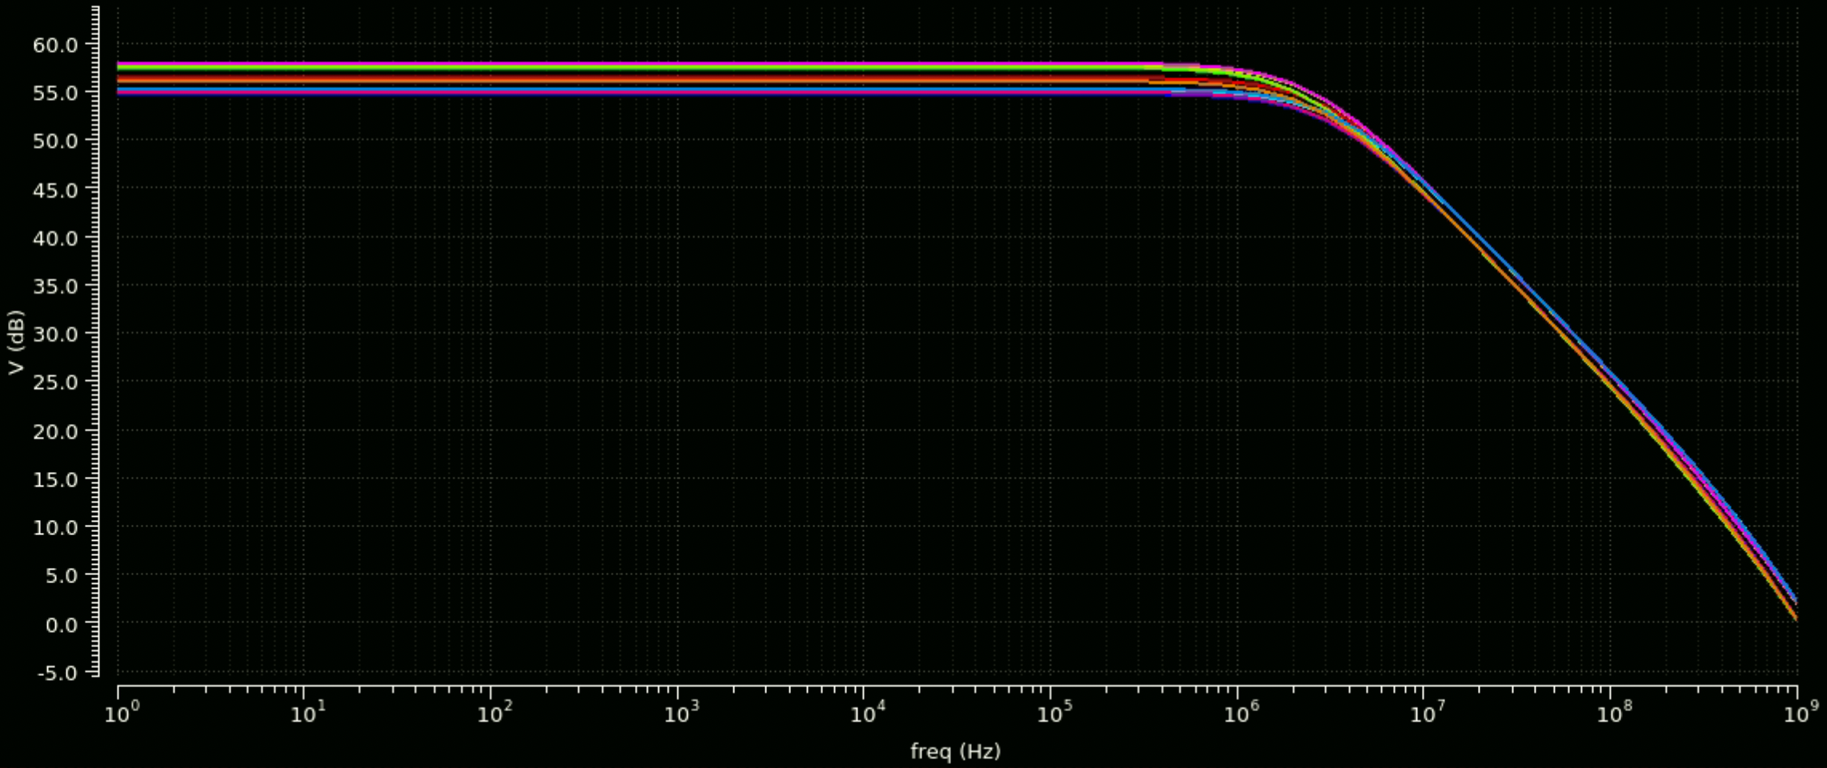
Forward gain stage
Open loop gain (different corners)
A_{V0} ≈ 58 dB, f₀ ≈ 2 MHz

Slide 4
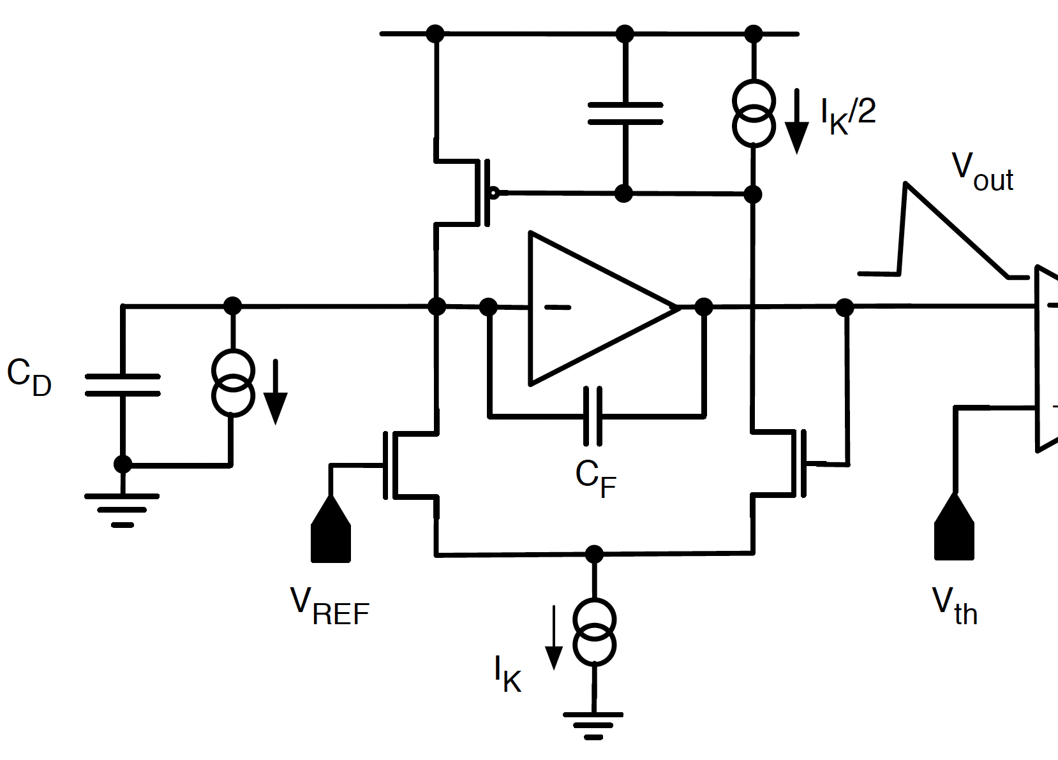
Krummenacher feedback
The first feedback topology being investigated is the classical Krummenacher network

Slide 5
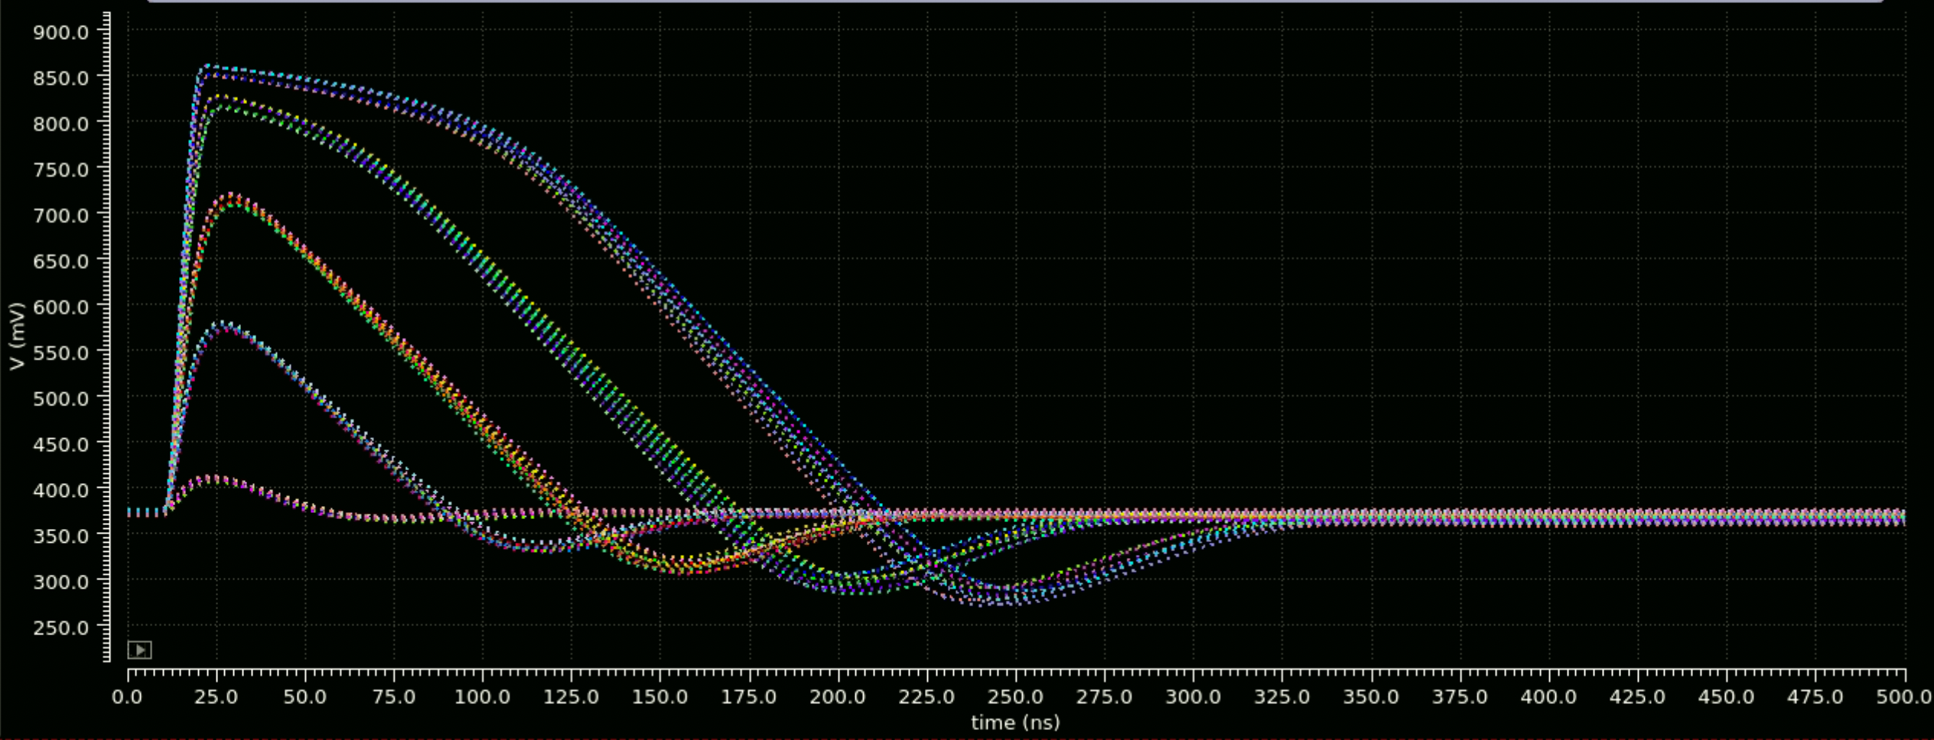
Krummenacher feedback
Premp output (different corners) for Qin ranging from 1ke- to 30ke-

Slide 6
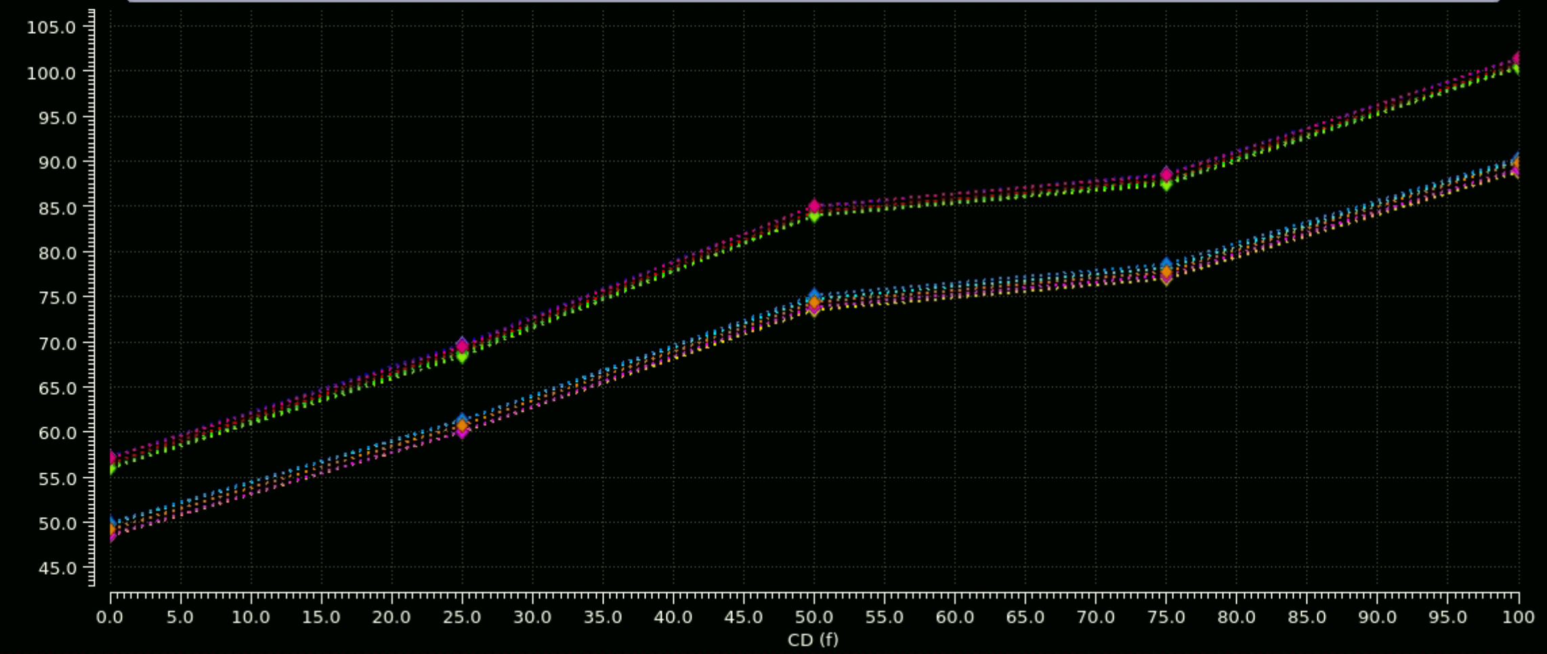
Krummenacher feedback
Room T
-20C
Equivalent noise charge (ENC) as a function of detector capacitance
Very similar results wrt RD53 Linear AFE

Slide 7
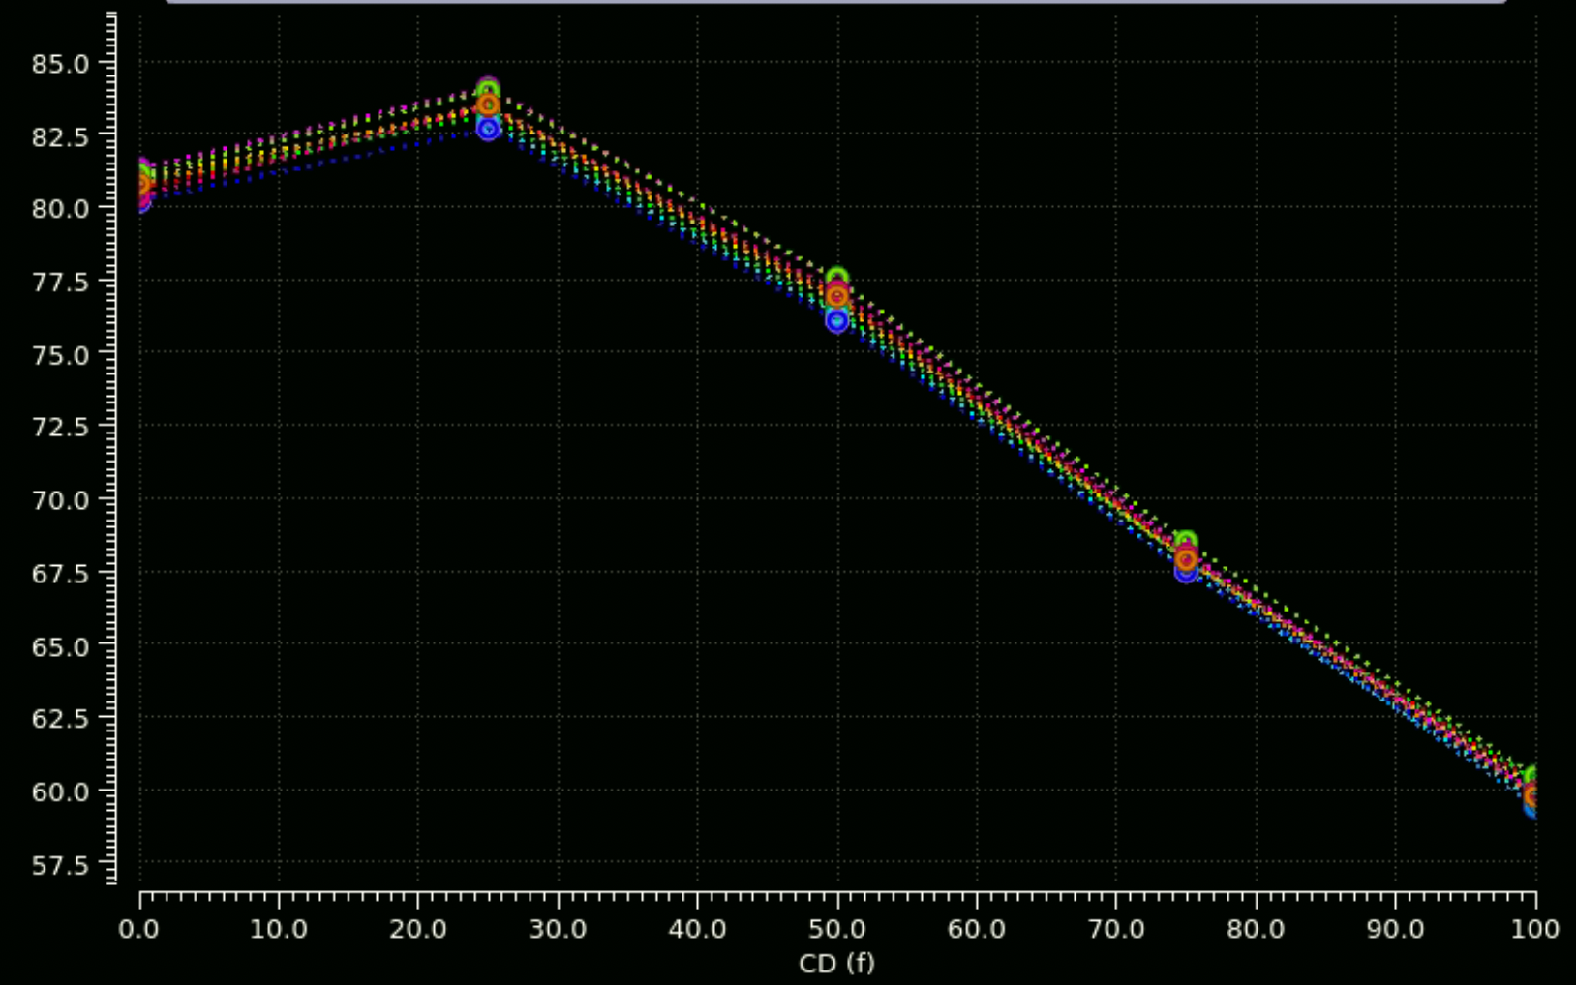
Krummenacher feedback
Phase margin as a function of detector capacitance (different corners)

Slide 8
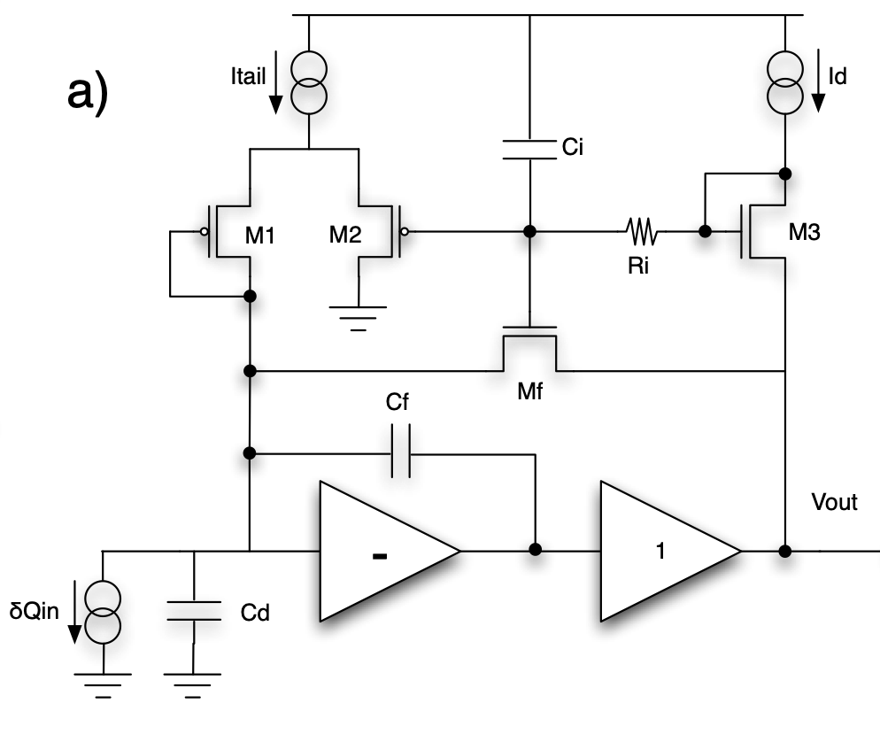
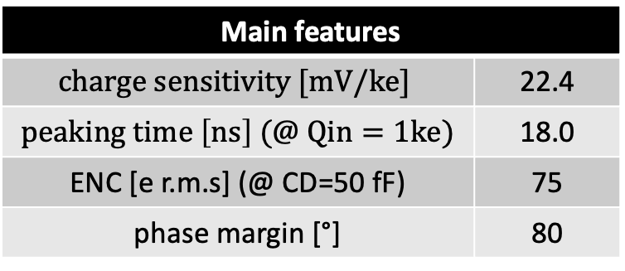
IFCP65 feedback
Feedback topology used in IFCP65 chip (Fermilab/BG_PV)
Mf acts as a 1/gm resistor for small signals
Constant current source for large signals
M1 provides a DC path for the detector leakage current
Ri + Ci ensures low frequency operation of the leakage compensation circuit
Main features
$$charge sensitivity [mV/ke]$$ | 22.4
$peaking time \left[ns\right] (@ Qin=1ke)$ | 18.0
ENC [e r.m.s] (@ CD=50 fF) | 75
phase margin [°] | 80

Slide 9
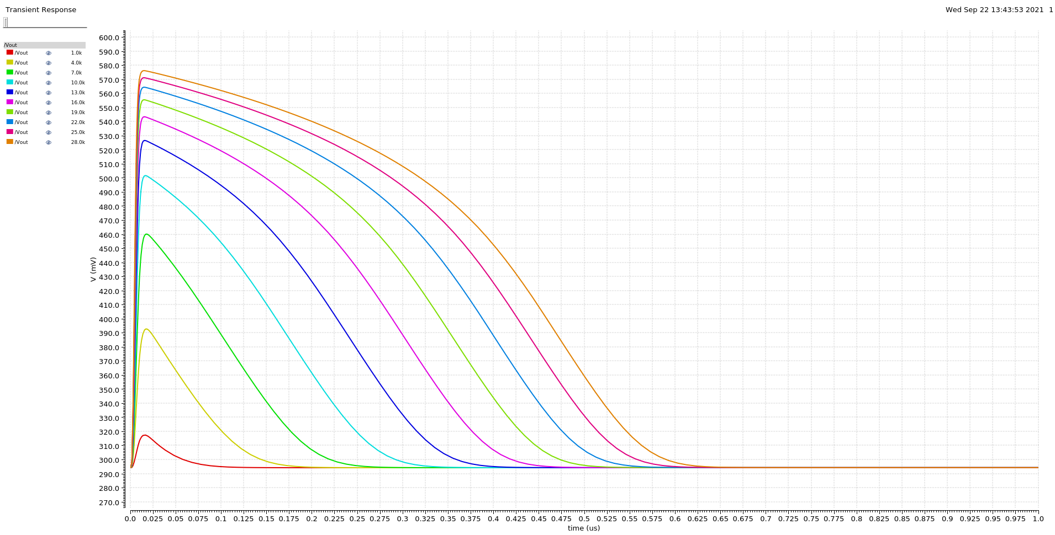
IFCP65 feedback
Premp output (TT corner) for Qin ranging from 1ke- to 28ke-
Significant baseline shift with detector leakage → not suitable for DC coupled comparators

Slide 10
Comparator design
Different architectures are being investigated

Slide 11
Time-walk and overdrive
Time-walk and overdrive data for a set of architectures (~500 el. input, ~25 mV/ke- charge sensitivity)
Schematic-level simulations (ideal preamp with 20 ns peaking time)
Parasitic capacitance (Cp) added at ”main nodes” of the comparators

Slide 12
Conclusions
Two different preamps (different feedback networks) are begin investigated
  Very compact preamp forward gain stage
  Krummenacher feedback: very stable baseline, optimized baseline dispersion → suitable for DC coupling
  IFCP feedback: very compact design, non negligible baseline shift with detector leakage → suitable for AC coupling
IFCP-like FE layout activity started
Different comparator architectures being investigated:
  Classical and Traff-based architecture most promising
  Classical architecture more sensitive to parasitics
  Traff architecture: current in the comparator output branch not well under control
New architecture (clocked, auto-zero) being investigated → In-pixel flash ADC (2 bit)
Planned submission by the end of May (CERN?)

