Slide 1
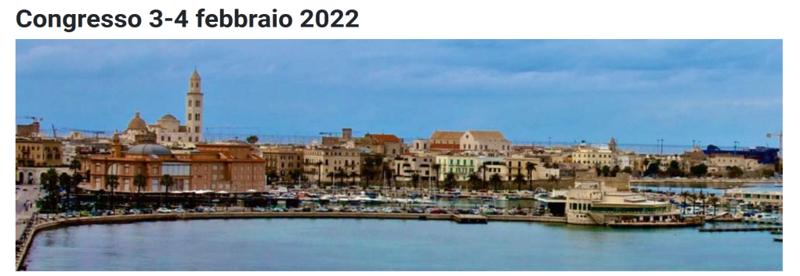


Detector developments for future experiments
Alessandra Pastore (INFN Bari)
on behalf of many others

Slide 2
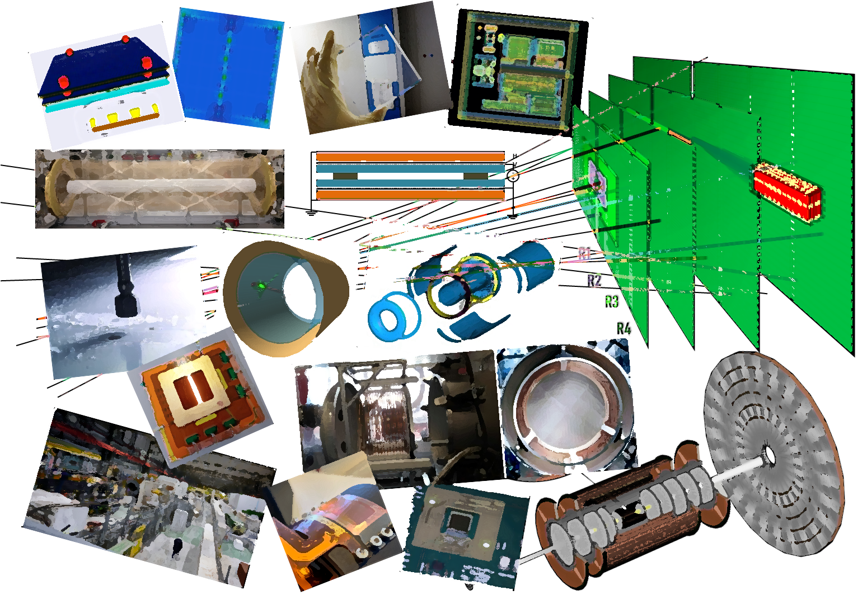
Designing our future ….
- Future detector developments: global perspectives
- Research and developments @ INFN Bari
- Summary and outlooks

Slide 3


The 2021 ECFA European Detector R&D roadmap
May 2020 → EPPSU mandate to ECFA
develop a roadmap for detector R&D efforts in Europe, with a bottom-up approach
coordination between several communities (ECFA, APPEC, NuPECC, LEAPS, LENS, ESA)
https://cds.cern.ch/record/2784893
Solid state
PID and Photon
Liquid
Quantum
Gaseous
Calorimetry
Training
Electronics
Integration

Slide 4
Detector R&D roadmap: focus on INFN Bari
several R&D activities started or ready to start locally
focus on future experiments (medium-long term)
well integrated into the ECFA roadmap
https://cds.cern.ch/record/2784893
Solid state
PID and Photon
Liquid
Quantum
not covered
by this talk
Gaseous
Calorimetry
Training
Electronics
not covered by this talk
Integration

Slide 5
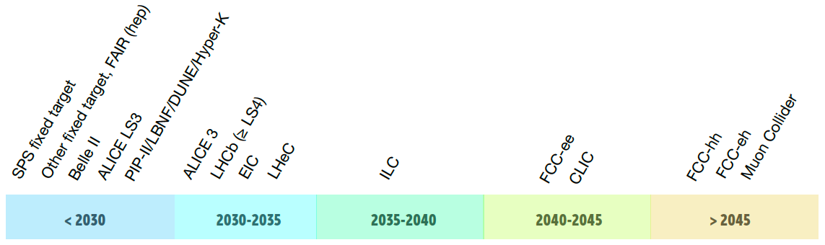
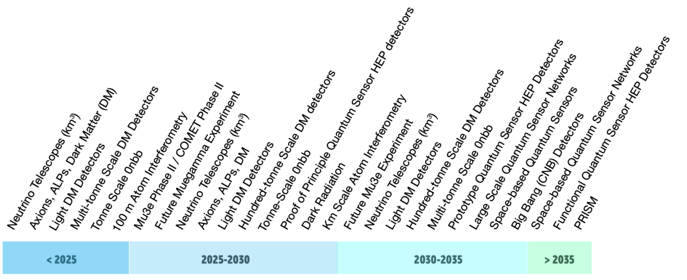
Detector R&D roadmap: focus on INFN Bari
An indication of the earliest feasible start dates is given
https://cds.cern.ch/record/2784893
Large Accelerator Based Facility/Experiment
Smaller Accelerator and Non-Accelerator Based Experiments (not exhaustive)

Slide 6
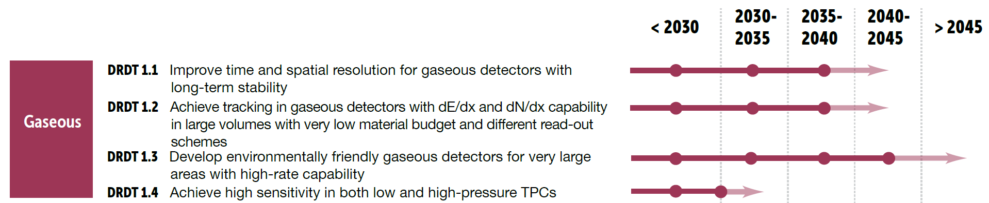





R&D @ INFN Bari on Gaseous detectors
focus on:

Slide 7
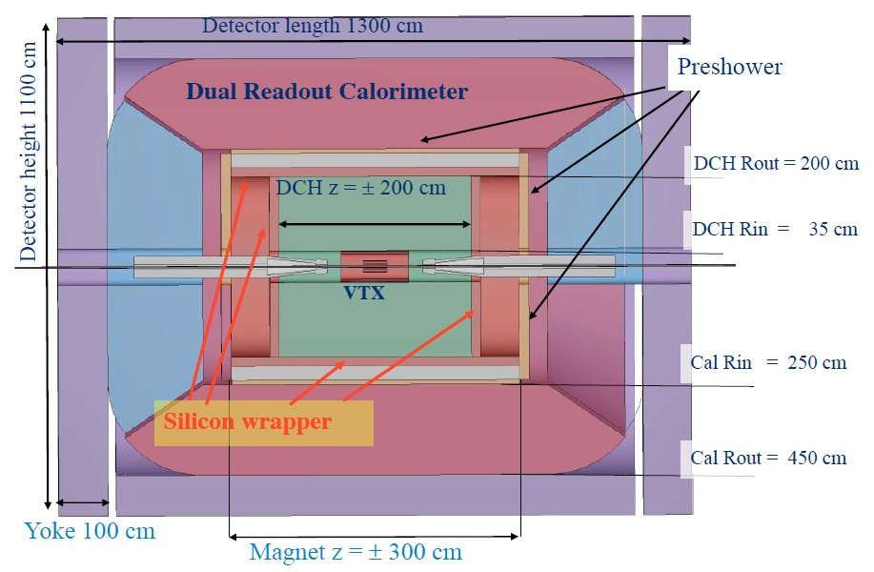
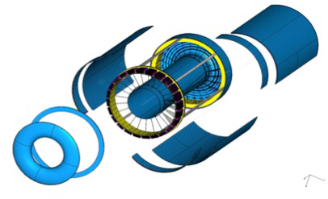
R&D @ INFN Bari on Gaseous detectors
FCC-ee
at CERN
The IDEA detector at e⁺e⁻ colliders
CEPC
at IHEP-China
Innovative Detector for Electron-Positron Accelerators
electron-positron collisions in a wide energy range
measure the Higgs boson σ_{prod} and most of its properties with precisions far beyond achievable at the LHC
Central tracker:
silicon pixel vertex detector
large-volume ultra-light drift chamber
silicon strip detectors in both barrel and forward regions
IDEA-Bari
Ultra – light cylindrical DC:
4 m long, r = 35-200 cm,
112 layers, 343968 wires in total
90% He – 10% i-C4H10 gas mix
ε_{trk} ~ 1 @ θ > 260 mrad
New concept of construction material reduced to ≈ 10⁻³ X0 (barrel)
and to a few x 10⁻² X0 (end-cap)

Slide 8
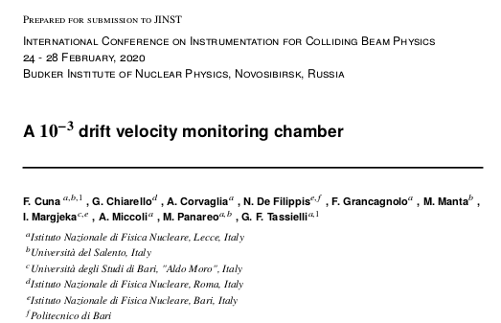
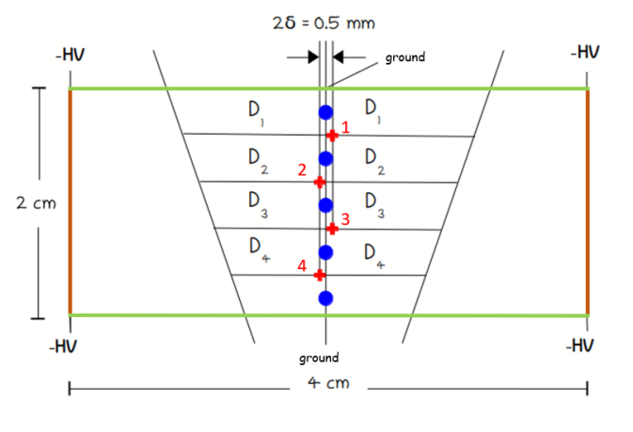
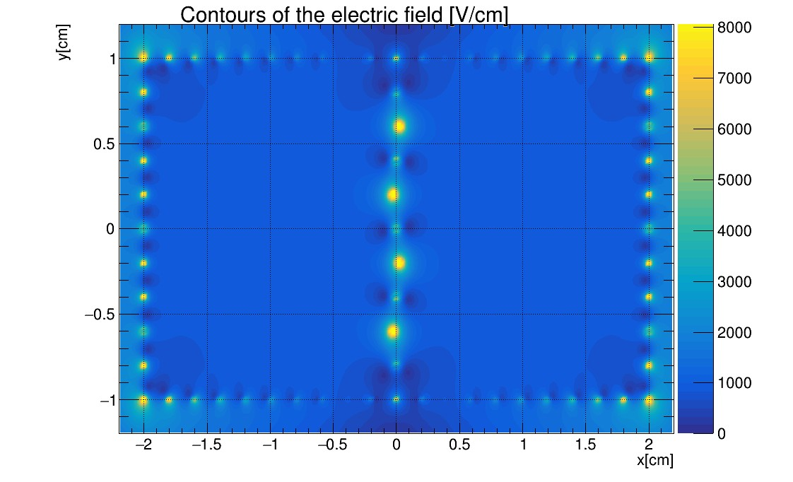
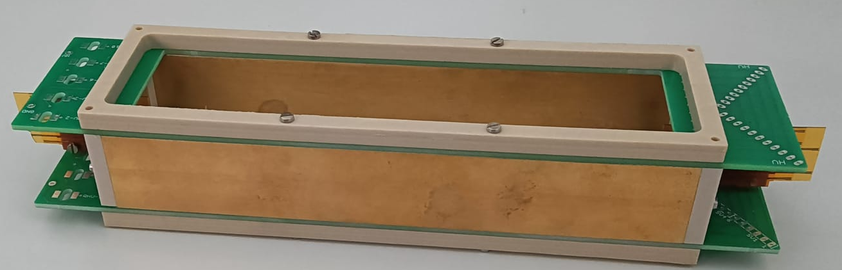
R&D @ INFN Bari on Gaseous detectors
IDEA-Bari:
Focus on the ultra-light drift chamber project
Design, test and characterization of a small chamber as drift velocity monitoring device
Geant4 simulation of the drift chamber
test beam activity at CERN to test the “cluster counting” technique for PID
Design, test and characterization of a small chamber for monitoring the drift velocity
continuous monitoring of the quality of gas →
install a small drift chamber that allows to measure electron v_{drift} variations at the 10⁻³ level, in < 1 min
Electric field configuration with
V_{g} = −350V , V_{s} = 925V
Simulation studies with
Garfield++
Detector to be installed and tested in the INFN Bari lab

Slide 9
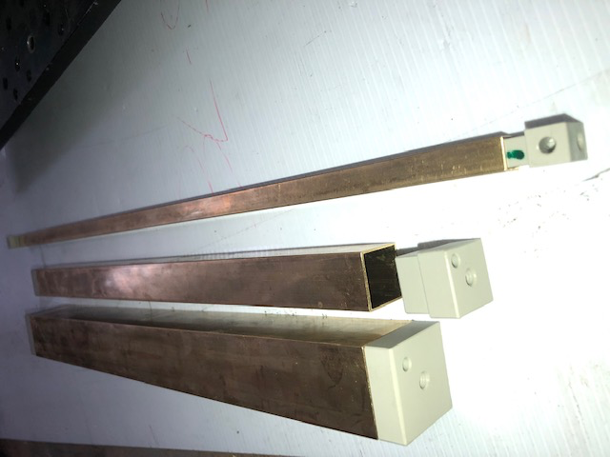
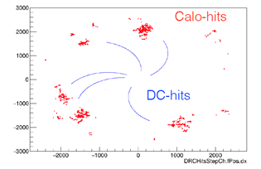
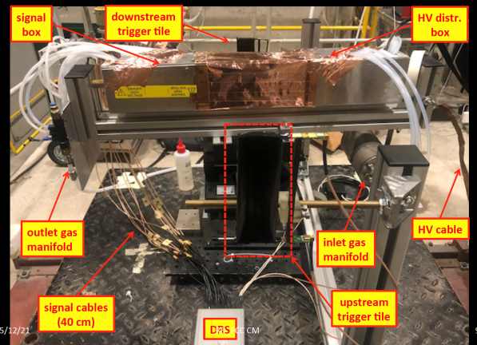
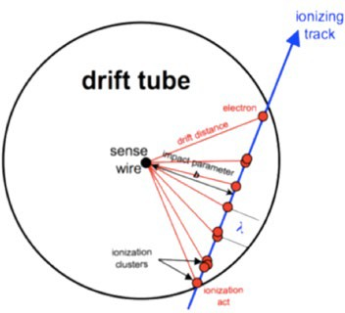
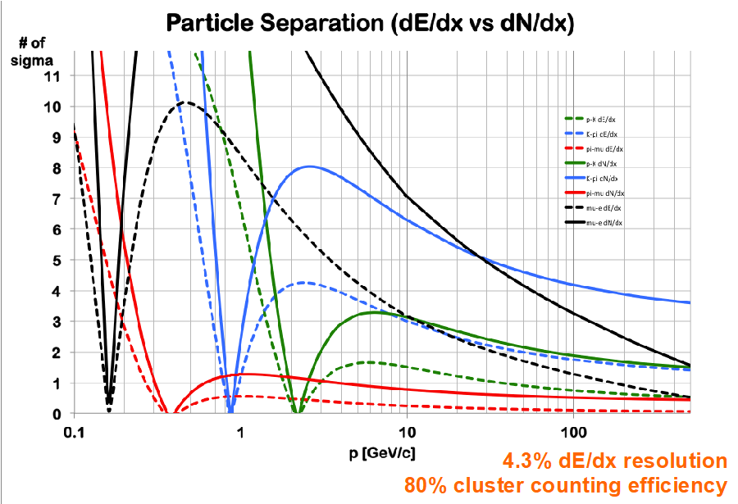


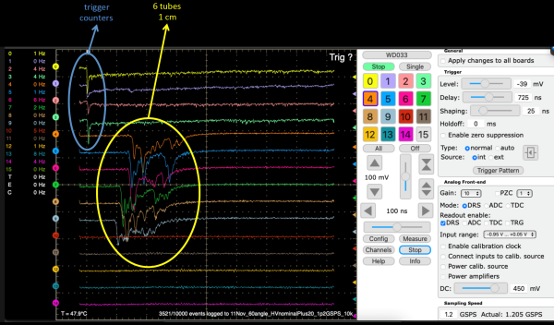
R&D @ INFN Bari on Gaseous detectors
Geant4 simulation of the drift chamber
DC simulated at a good level of geometry
details, including detailed description of the endcaps
hit creation and track reconstruction code available
full simulation for the IDEA detector going to be ported in the FCC framework
“cluster counting” technique for PID
Test beam at CERN/H8 in 2021 to test the technique:
Need to demonstrate the ability to count clusters
Establish the limiting parameters for an efficient cluster counting(cluster density , space charge, gas gain saturation)
In optimal configuration, measure the relativistic rise as a function of βγ, both in dE/dx and in dN_{cl}/dx, by scanning the muon momentum from the lowest to the highest value
dN/dx
dE/dx

Slide 10

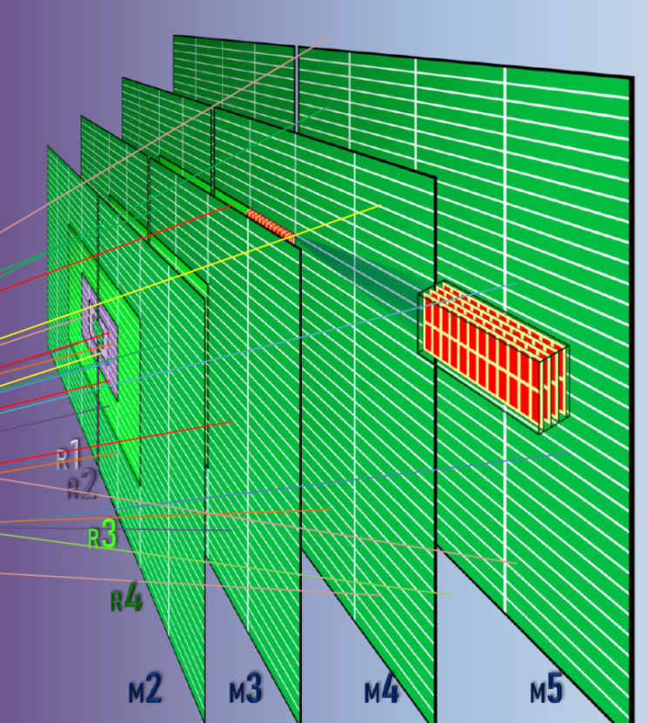
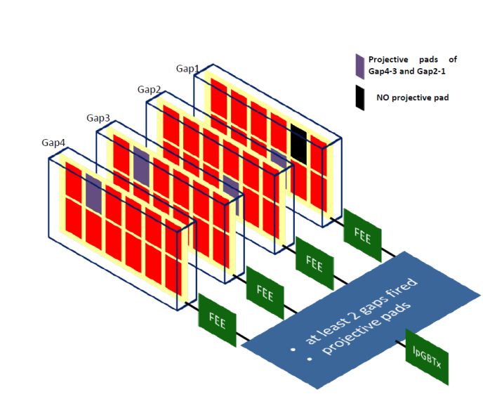
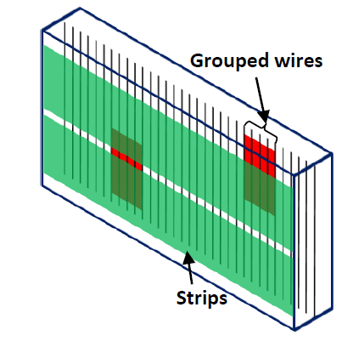
R&D @ INFN Bari on Gaseous detectors
LHCb Upgrade II (≥ LS4), FTDR to be published in March 2022
Future Muon Detector: Bari Group is actively involved in
simulation and optimization studies of the Muon Detector design
R&D on new generation RPCs with eco-friendly gas mixtures
new FE electronics (INFN Bari Electronics Service )
Baseline option: MWPC + μRWELL (R1-R2)
RPCs or SCI-Tiles in R4 (exp. rate several kHz/cm²)
new RO scheme
for the baseline option

Slide 11
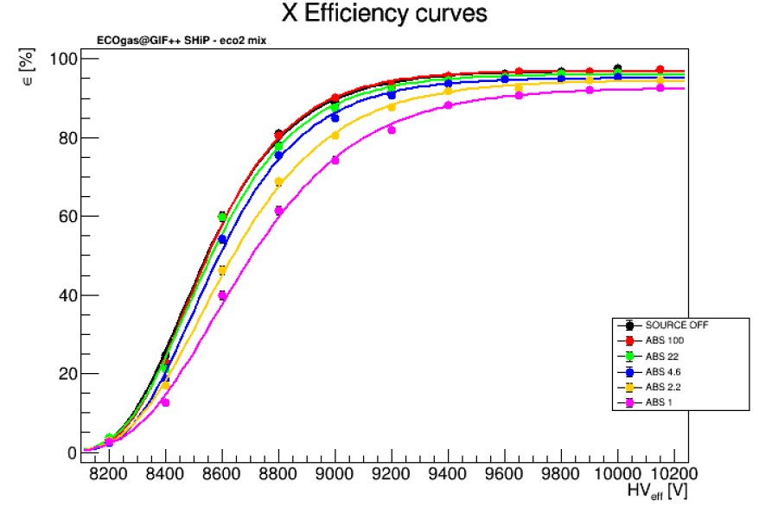
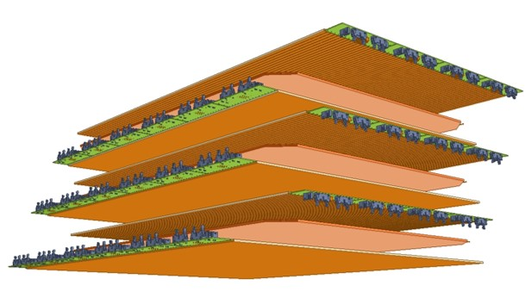

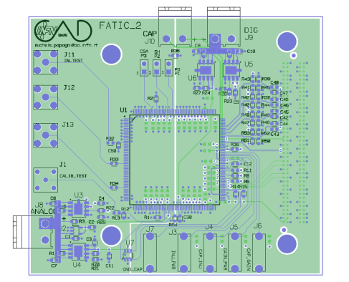
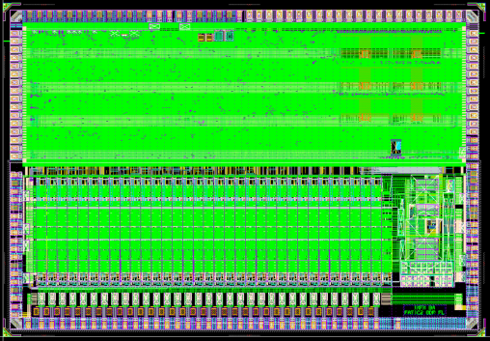
R&D @ INFN Bari on Gaseous detectors
R&D on new generation RPCs with eco-friendly gas mixtures
preliminary,
eco2 gas mix
see Piet’s talk
on 03.02.22
Performance studies on RPCs with different gap and electrodes thickness, operated with eco-friendly gas mixtures on-going in Bari and at CERN GIF++
prototype of a RPC-triplet
(INFN Bari Mechanics Service)
new FE electronics (INFN Bari Electronics Service)
Development of a new version of
the FATIC2 chip to meet LHCb requirements for μRWELL, MWPC and RPC options

Slide 12

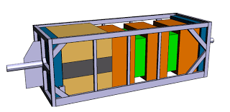
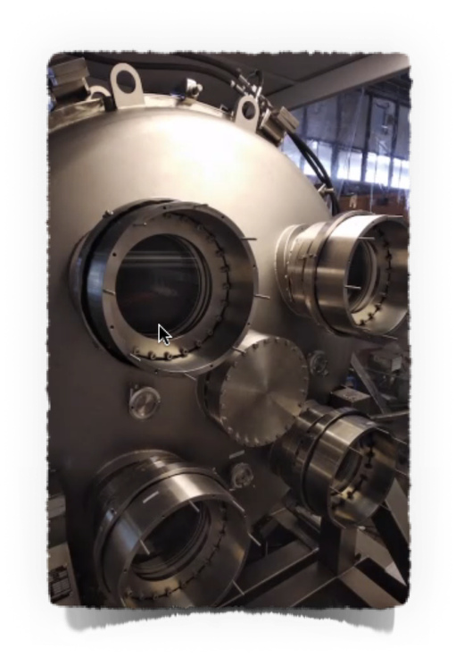
R&D @ INFN Bari on Gaseous detectors
ND280 upgrade for T2K phase II and Hyper-K
Group activities:
- Electric field simulation inside the field cages
- Construction of new generation TPCs with micro-pattern
gas detector readout
- Gas system design, implementation and maintenance
Goal of this new detector: increase the phase space coverage of the current ND280 up to 4π → increase the ND280 constraint on x-section models in order to improve oscillation analyses
AIDA-INNOVA (WP 7.4)
Group activities:
- Simulation and construction of a High-pressure TPC prototype with
hybrid readout (optical+MPGD)
- Study different gas mixtures as a target for neutrino interactions
Goal of this new detector: increase our knowledge on neutrino x-section models (extremely important for the next generation of neutrino oscillation experiments, as HK)

Slide 13
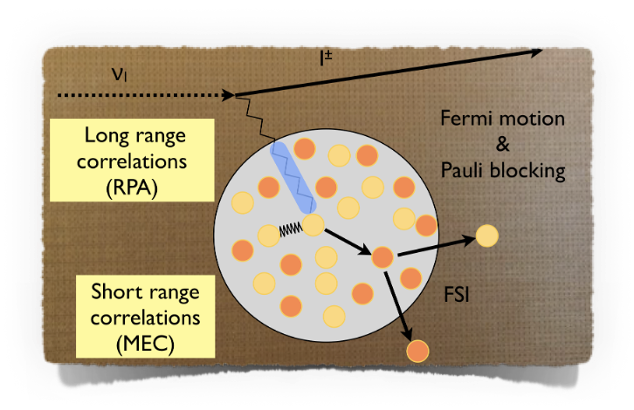

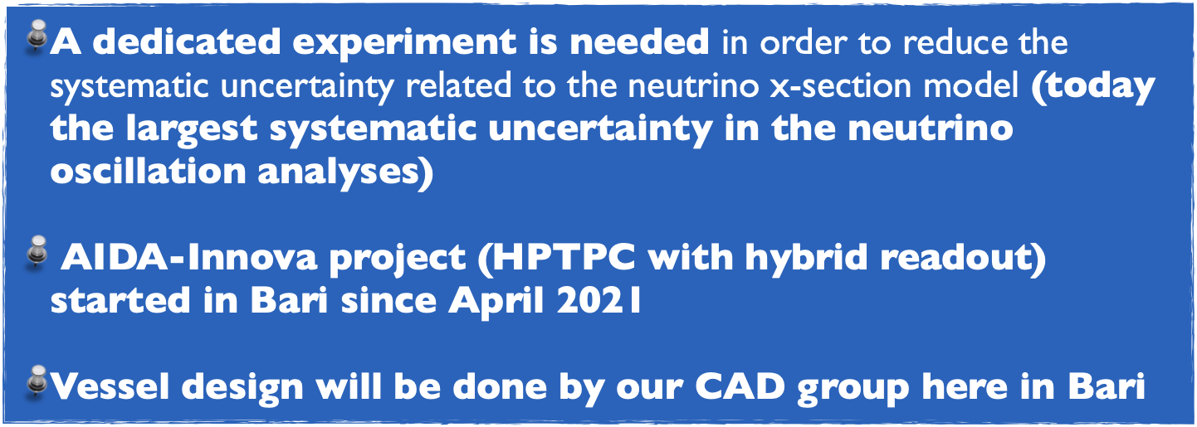
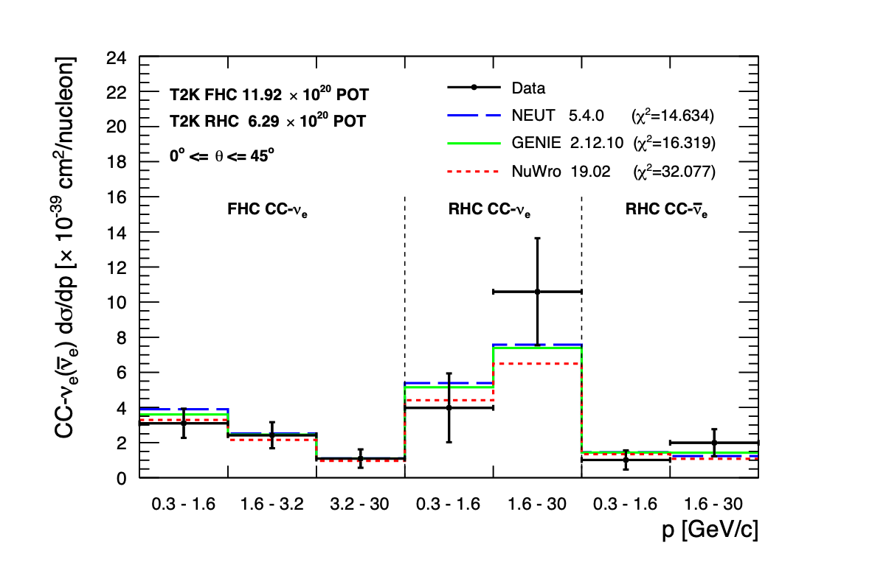
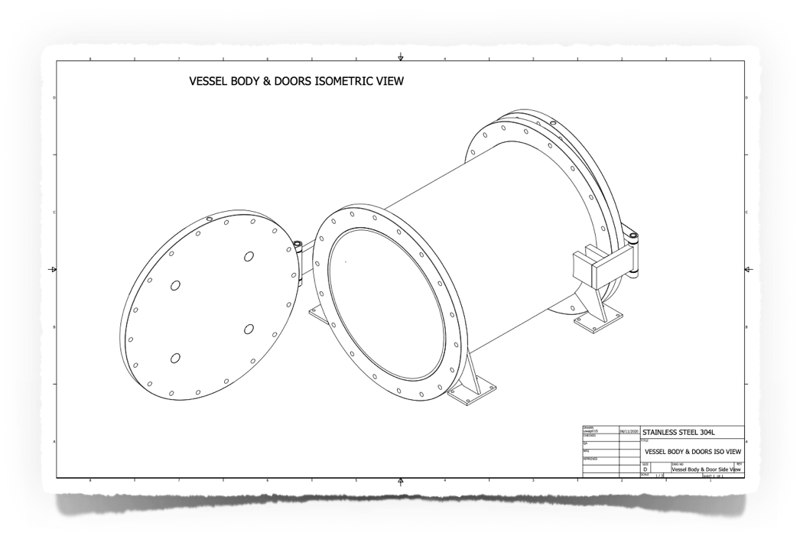
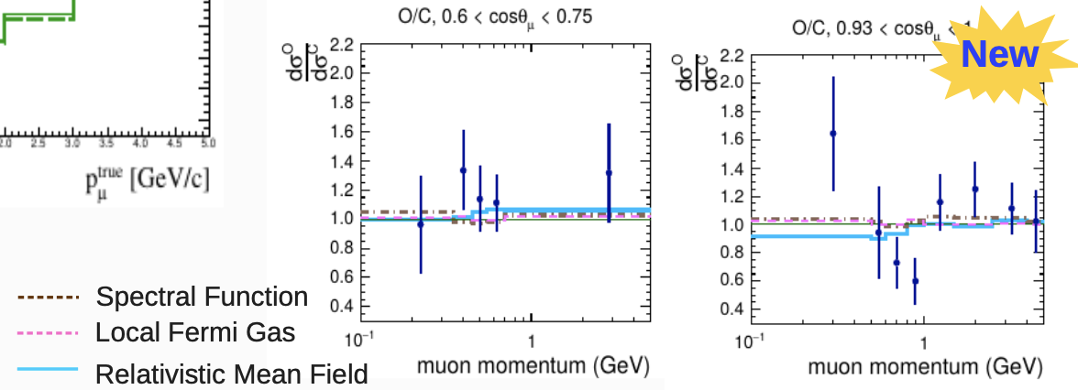

R&D @ INFN Bari on Gaseous detectors
AIDA-INNOVA (WP 7.4)
At low energies the main kind of interactions are CCQE-like
Other neutrino interactions with production of pions in the final state are important as well
There are large discrepancies between different theoretical models
Neutrino x-sec are not completely understood at low energies

Slide 14
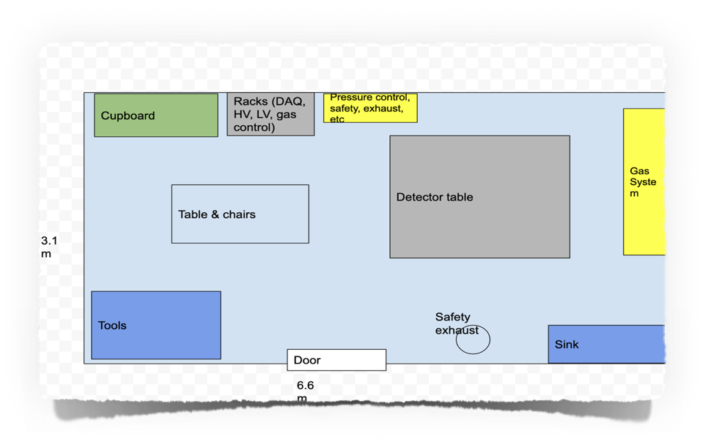
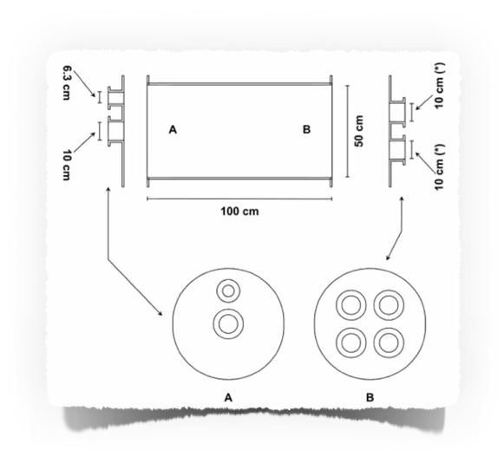
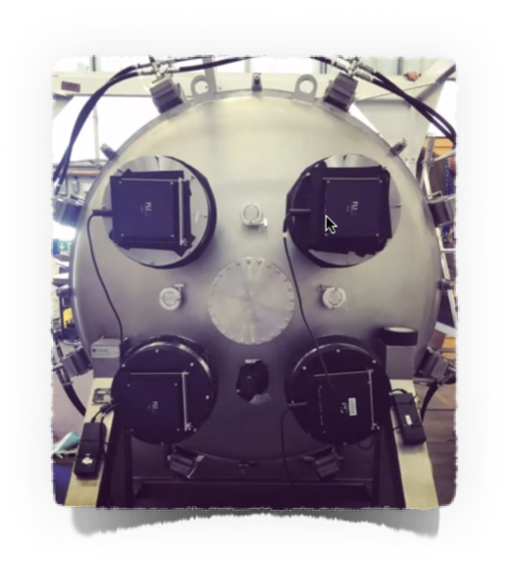
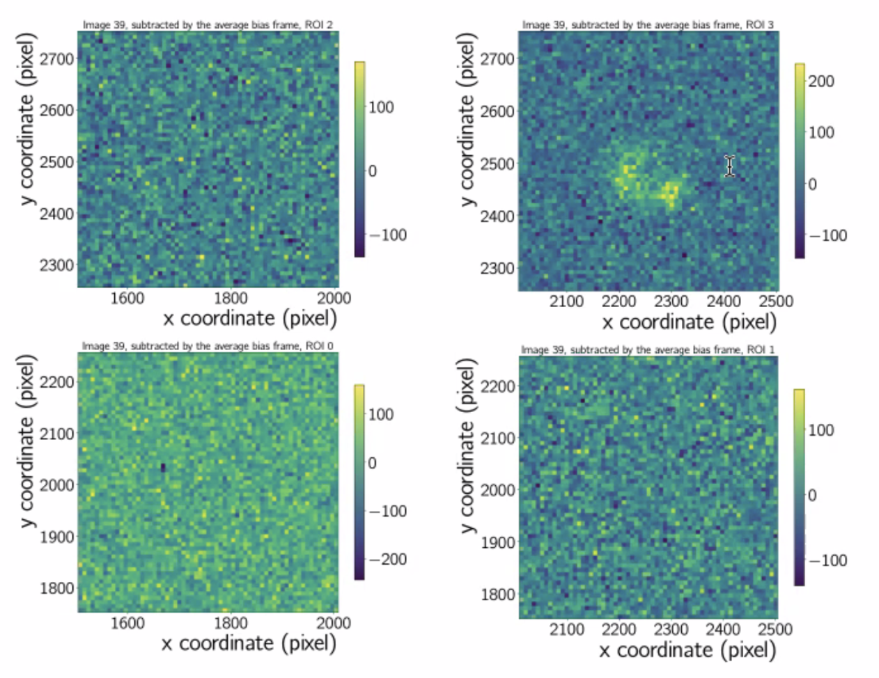


R&D @ INFN Bari on Gaseous detectors
AIDA-INNOVA (WP 7.4)
Ideal schedule
High-pressure Lab. in our department
High pressure flowmeter will be installed in late spring
Design and construction of the prototype
will be done in Bari by using CAD design and Mechanical workshop (this year)
Test and data taking with the prototype (2023-2024)
different pressure values, different gas and different readout techniques can be checked
Some optical readout possibility already tested in UK:
A FLI Proline PL09000 CCD camera is mounted on the window flange
A Nikon f/1.2 50 mm focal length lens is used to focus on the amplification region from the cathode side.
The camera images an area of 71 × 71 cm² and provides a granularity of 3056 x 3056 pixels → effective readout segment sizes of 230 μm length possible
Triple-GEM or resistive MicroMegas can be used as MPGD readout

Slide 15

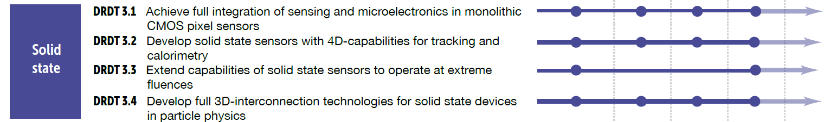



R&D @ INFN Bari on Solid State detectors
focus on:
& related projects ..
ALICE 3

Slide 16
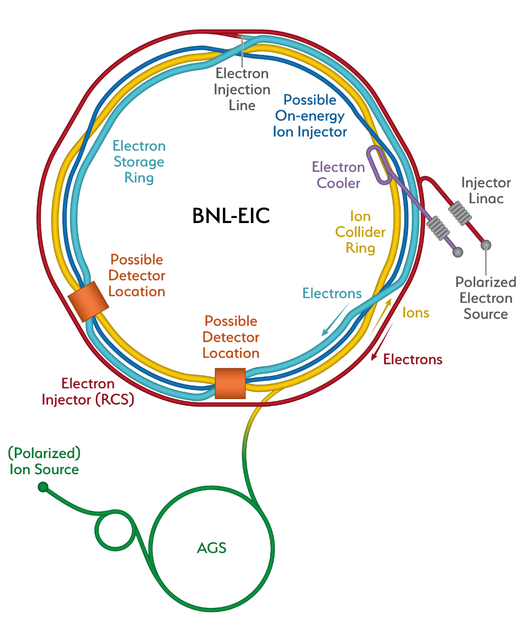
R&D @ INFN Bari on Solid State detectors
The Electron-Ion Collider (EIC) in US:
a new, innovative, large-scale particle accelerator facility planned for construction at BNL in the 2020s
The EIC will study protons, neutrons and atomic nuclei with the most powerful electron microscope, in terms of versatility, resolving power and intensity, ever built.
The resolution and intensity is achieved by colliding high-energy electrons with high-energy protons or (a range of different) ion beams
Center of Mass Energies 20 GeV – 140 GeV
Maximum Luminosity 10³³-10³⁴ cm⁻²s⁻¹
Hadron Beam Polarization 70%
Electron Beam Polarization 70%
Ion Species Range p to Uranium
Number of interaction regions up to two

Slide 17
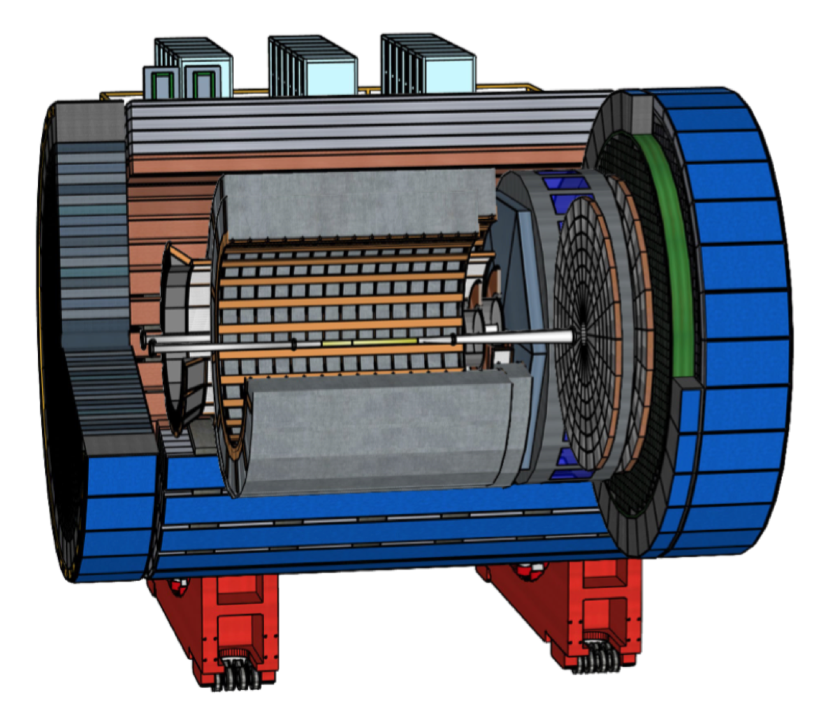
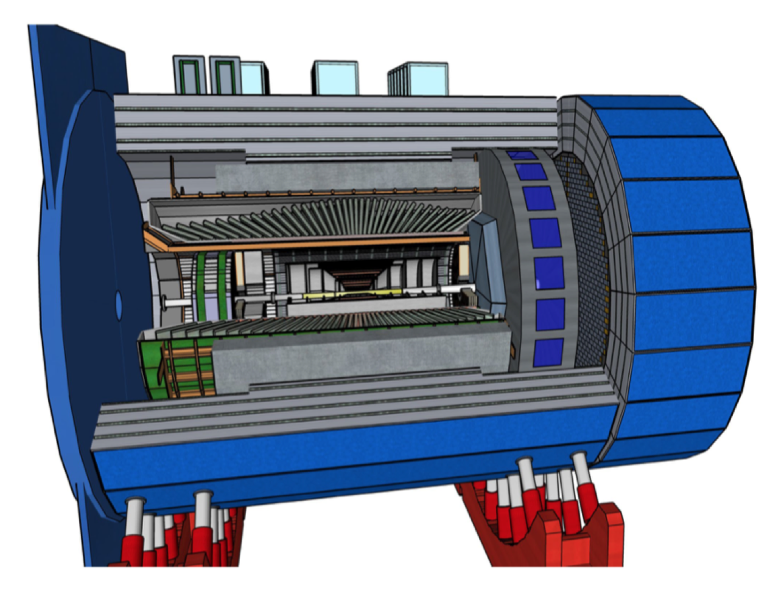

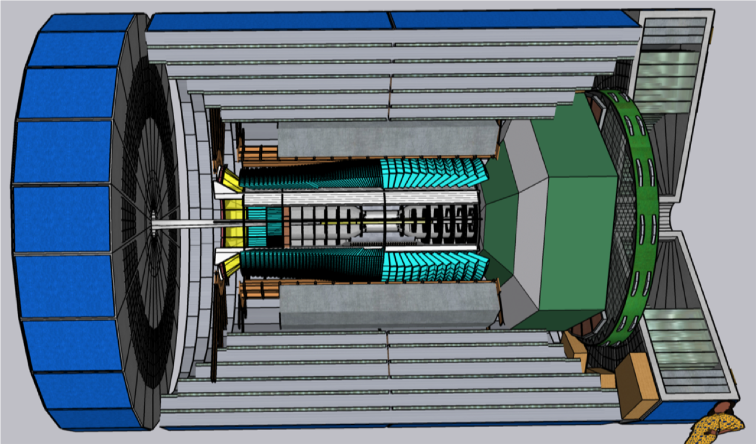

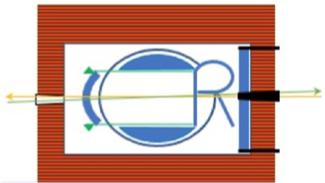
R&D @ INFN Bari on Solid State detectors
Main steps in the recent EIC path
July 2018: endorsement by US NAS (National Academy of Science)
January 2020: CD0 (mission need approval) and site selection (BNL)
February 2021: EIC CDR: https://doi.org/10.2172/1765663
March 2021 Yellow Report released: https://arxiv.org/abs/2103.05419
March 2021: Call for detector proposals: https://www.bnl.gov/eic/CFC.php
June 2021: CD-1 (completion of Definition Phase and the conceptual design)
December 2021: proposals sent to DoE (ATHENA, ECCE, CORE): feedback expected in March 2022
INFN contribution
ATHENA is general purpose for IP6 with new 3T solenoidal magnet (and large bore diameter)
ECCE is general purpose detector for IP6 re-using 1.4 T Babar magnet (bore diameter 2.8)
CORE is a more "compact" proposal, potentially for IP8 (3T solenoid as well)

Slide 18
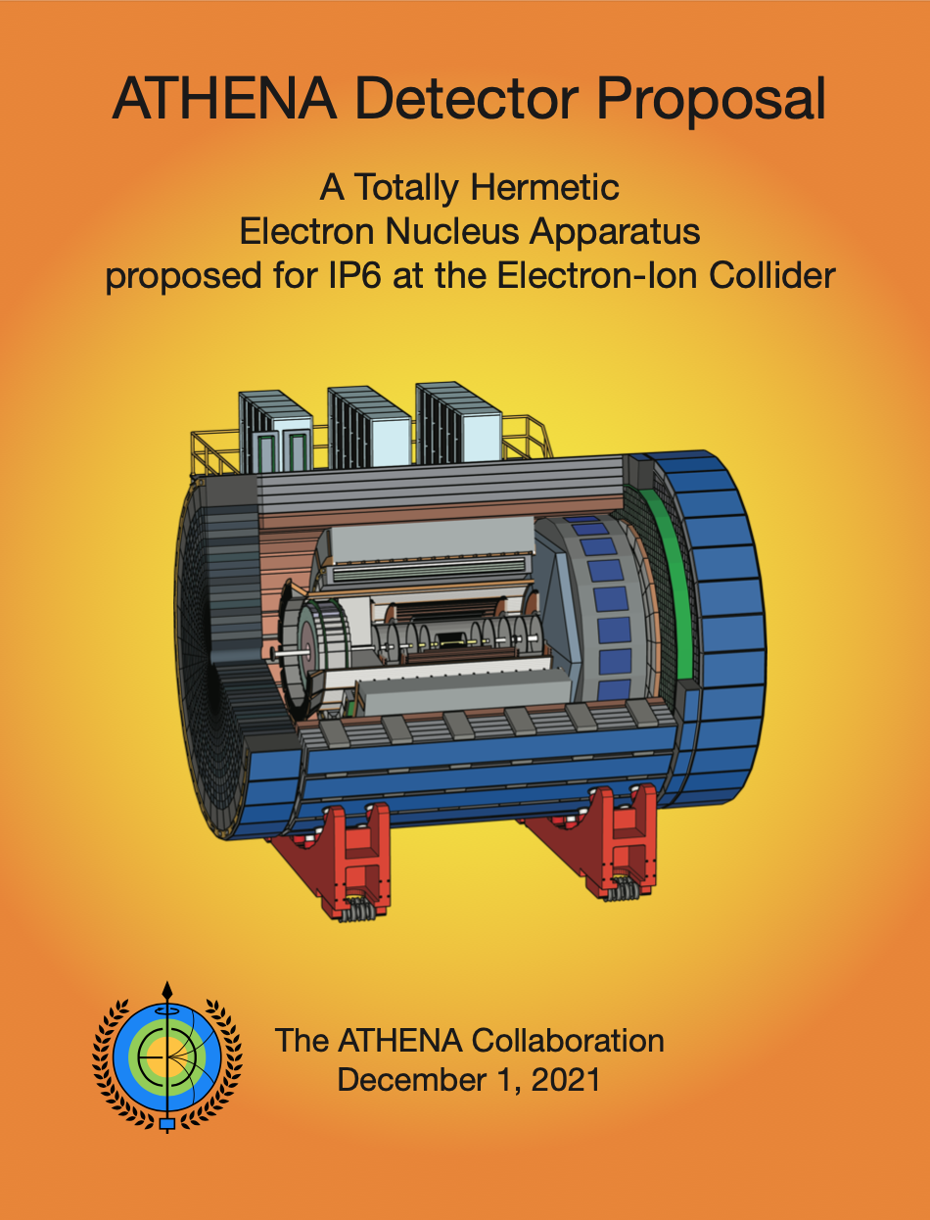
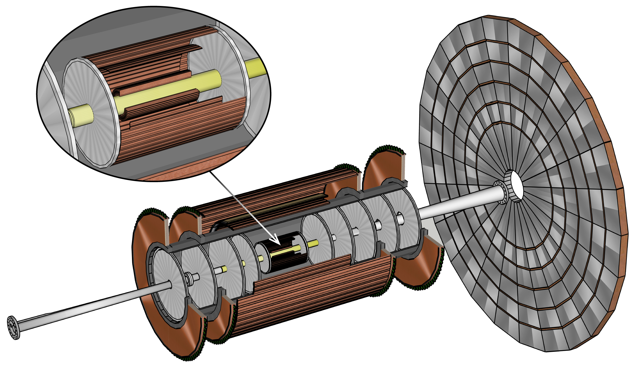
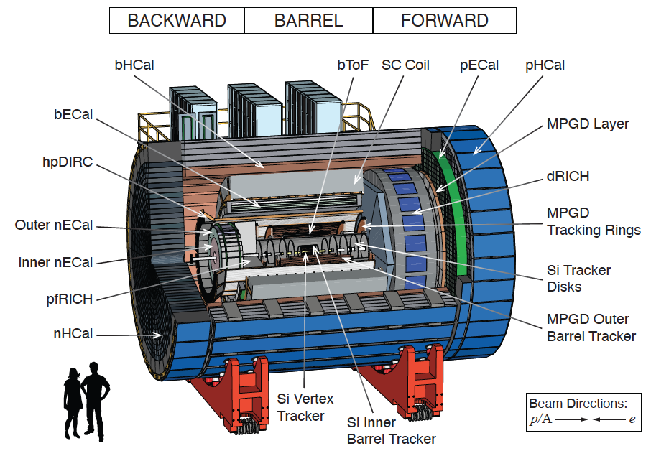
R&D @ INFN Bari on Solid State detectors
EIC-Bari:
Tracking system in ATHENA@EIC
Non-symmetric configuration
optimized for low material budget
in the backward direction

Slide 19
R&D @ INFN Bari on Solid State detectors
EIC-Bari:
Tracking system in ATHENA@EIC
Si Vertex Tracker: 3 layers
  first layer @ R~33 mm
  material 0.05% X₀ per layer
Si inner barrel Tracker: 2 layers
  material 0.55% X₀ per layer
FW and BW Si Tracker disks
  material 0.24% X₀ per disk
existing experience from eRD16/eRD18/eRD25 US projects
targeting the 65 nm MAPS technology (10 μm pitch, < 20 mW cm⁻²) being developed for ALICE ITS3
  → R&D synergies EIC/ALICE (for INFN in Bari and Trieste)
      Tracking WG coordination for YR (2020) and ATHENA proposal (2021): INFN Bari
      EIC Silicon Consortium leadership representatives: INFN Bari and Trieste
see talk by D. Colella

Slide 20
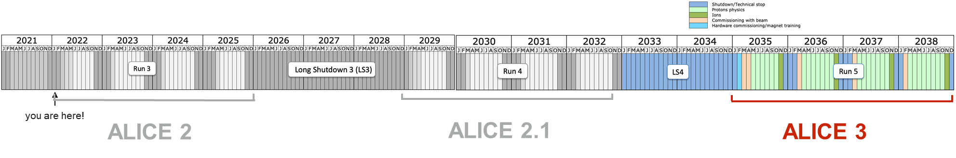
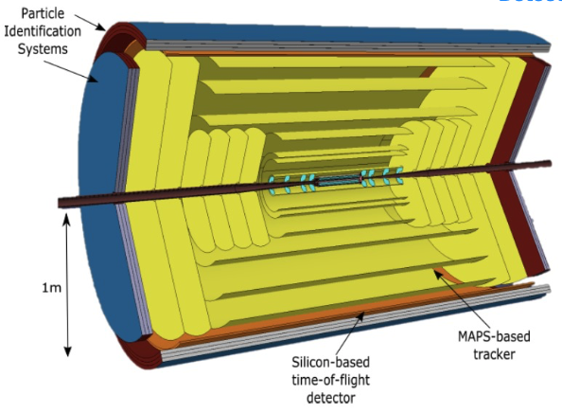
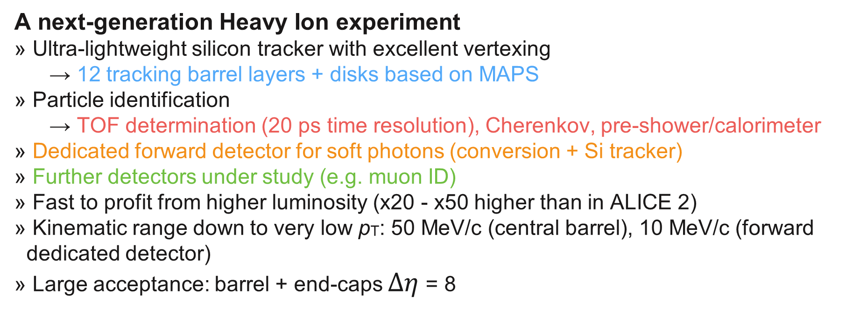
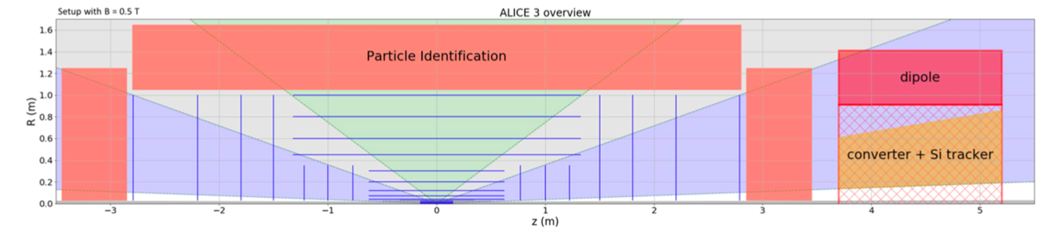
R&D @ INFN Bari on Solid State detectors
ALICE3 : a rich heavy ion programme at the HL-LHC
EoI 2019, LoI under preparation
ALICE 3
see talk by D. Colella

Slide 21
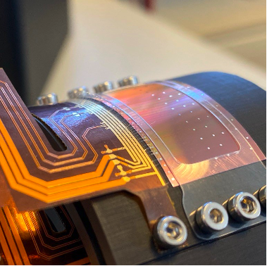
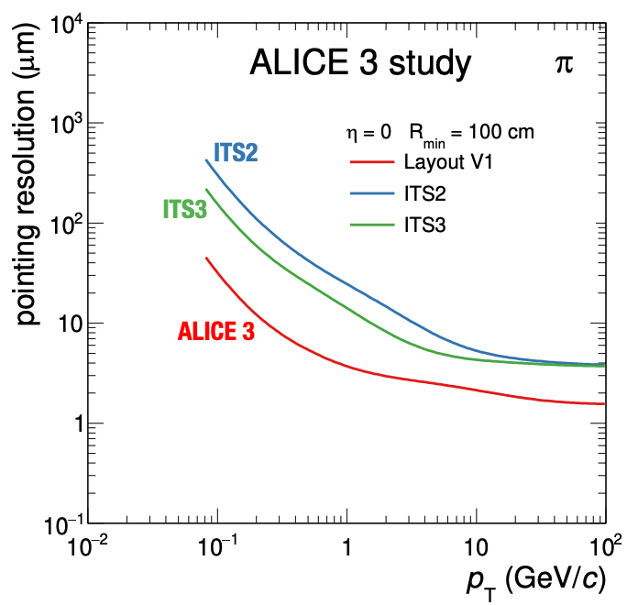



R&D @ INFN Bari on Solid State detectors
ALICE3-Bari:
Inner and Outer Silicon Trackers
ALICE 3
Flexible MAPS
Inner tracker
→ ultra-thin layout: flexible wafer-scale sensors (MAPS/ITS3)
→ minimal distance from IP requires retractable detector
→ position resolution O(1 𝜇𝑚) requires small pixel pitch
Outer tracker
→ large areas to instrument O(100 m²): develop cost-effective sensors
→ low material budget requires low-weight support and services
see talk by
D. Colella
IRIS tracker - Open
IRIS tracker - Closed

Slide 22



R&D @ INFN Bari on Solid State detectors
Medium size Gamma-ray telescopes based on Si strip/pad detectors
see talk by
R. Pillera
Next MeV-GeV satellite generation:
  Enable Compton regime reconstruction
ASTROGAM M5-Esa call (2016-2018) (INFN PI):
  nearly 56 m² of double-sided Si strip detectors (DSSDs)
  4 towers, 56 layers of 5×5 DSSDs
    5600 DSSDs
  Each DSSD wafer has a cross section of 9.5×9.5 cm², a thickness of 500 µm and a pitch of 240 µm (384 strips per side)
AMEGO Probe mission NASA call (2019-2021) (NASA PI):
  4 towers, 60 layers of 4×4 DSSDs
    4800 DSSDs
  DSSD wafers 9.5 cm wide, 500 µm thick and pitch of 500 µm (190 strips per side)
DSSDs wire-bonded on both sides to form 2-D views
  Bonding machines should be able to work on large area planes, as the strips in both direction need to be connected
  Non-trivial ladder mechanic support to avoid wire bonding paths
marionicola.mazziotta@ba.infn.it

Slide 23

R&D @ INFN Bari on Solid State detectors
Recent NASA MIDEX call

Slide 24

R&D @ INFN Bari on PID and Photon detectors
focus on:
ALICE 3

Slide 25



R&D @ INFN Bari on PID and Photon detectors
ALICE3-Bari:
Aerogel – RICH barrel to complement TOF PID
ALICE 3
Increase radius of TOF layer(s) by 22 cm to insert 2 cm of aerogel Cherenkov radiator + 20 cm expansion gap
Implement single-photon detection in TOF layer (using SPADs or SiPM) for Cherenkov radiation, sensitivity in the visible range is necessary
Exploit both information from Cherenkov angle and Cherenkov photons timing to complement TOF PID.
detector
design
options

Slide 26





R&D @ INFN Bari on PID and Photon detectors
ALICE3-Bari
Detector simulation
and performances
studies
ALICE 3
for N_{pe} = 25
e
pp coll. – Ring evts
μ
π
GEANT4
K
p
Detector challenges:
sinergy with EIC - dRICH (dual RICH)
tiles of 100x100x20 mm³
Main requirements for SiPM/ SPAD:
Single photon sensitivity in the visible range (PDE ~ 40-50%)
Fill factor > 80-90%
Pixel ~ 3x3 mm² (up to 5x5 mm²)
Area coverage ~ 30 m² → CMOS SPADS under investigation
25 m² of aerogel required factor 10 increase wrt existing and planned RICH systems

Slide 27





R&D @ INFN Bari on PID and Photon detectors
Nanodiamond photocathodes
for MPGD-based single photon detectors at future EIC
Main key requirements for hadron ID@EIC with RICH:
compact geometry and high space resolution
→ reduced pad size
radiation hardness
→ need for a robust photocatode
R&D ongoing on
ThickGEM-based counters
for single photon detection

Slide 28

R&D @ INFN Bari on PID and Photon detectors
Nanodiamond photocathodes for MPGD-based single photon detectors at future EIC

Slide 29





R&D @ INFN Bari on PID and Photon detectors
Multi-PMT for the Hyper-K multi-purpose Water-Cherenkov detector
Group activity:
multi-PMTs design with the INFN Bari CAD group
simulations of the mechanical stress of multi-PMT under pressure
Goal of this new detector: improve performances on vertex resolution and
directional sensitivity with respect to the current SK PMTs
Advantages of a mPMT technology
Superior photon counting → improved sensitivity for low energy events!
Improved angular acceptance
Local coincidence
Photodetectors and electronics in a pressure resistant vessel → reduce risk of
broken photo detectors
∼ ns time resolution
High rate tolerance and low background
Increased granularity → improved sensitivity for multi-ring events!

Slide 30


R&D @ INFN Bari on Calorimetry detectors
focus on:
Calorimetry
Gaseous

Slide 31

R&D @ INFN Bari on Calorimetry detectors
The multi-TeV Muon Collider concept :
a unique next-generation lepton-collider facility at the high-energy frontier
Muon Collider can be used both as direct exploration and precision machine
critical technologies required to produce, capture, accelerate and store intense beams of μ
μ production options: MAP vs LEMMA
MAP
US Muon Accelerator Program, 2011
Proton driver scheme, producing µ (𝟏𝟎^{𝟏𝟑}-𝟏𝟎^{𝟏𝟒}𝝁/𝒔𝒆𝒄)
- as tertiary particles, at low energy
- with large emittance -> quick cooling and confinement
LEMMA (INFN proposal)
Low Emittance Muon Accelerator, 2013
Positron driver scheme, producing µ (𝟏𝟎^{𝟏1}𝝁 pairs/𝒔𝒆𝒄)
- from e+e- collisions , at mean energy ∼ 22 GeV
- with small emittance -> no cooling or confinement
arXiv: 1901.06150 J.P. Delahaye et al.

Slide 32

R&D @ INFN Bari on Calorimetry detectors
HCAL
VTX &
tracking
Simulation studies to define the design of the detector on going
Geometry, event simulation and reconstruction are currently implemented in the CLIC's software ILCSoft
ECAL
μID
shielding
nozzles
superconducting solenoid
Muon Collider-Bari
HCAL design: proposal of a sampling of absorber + MPGD (as active layer)
  Standalone simulation in GEANT4 for quick studies with particle guns
  Simulation studies (full apparatus) with physics channels as benchmark for determining its final design
Participation to test beam activities to assess the LEMMA option, mostly focused on the study of the emittance and ee → µµ cross section measurements
Design study and optimisation of the Muon Collider target zone (ν Factory, HARP data used in MAP)

Slide 33




R&D @ INFN Bari on Calorimetry detectors
Muon Collider-Bari
A MPGD-based HCAL
radiation hard technology (BIB)
high granularity and fast response (S/N)
design and/or technology optimisation to improve jet reconstruction while suppressing the BIB
R&D supported by a RD51 (GRANT P. Verwilligen)
First studies performed in standalone GEANT4 environment with simple geometry:
10 layers
  2cm of Fe (absorber)
  5 mm of Ar (active gap)
10x10 cm² transverse surface
preliminary

Slide 34


R&D @ INFN Bari on Calorimetry detectors
Full characterization of high spatial resolution triple GEM, as a first candidate to build a small calo-cell prototype
Preliminary test in Bari lab
Test beam at CERN NA, Fall 2021: ongoing analysis, preliminary results available (efficiencies > 95%, spatial resolution~75 μm)
  Further goal reached: GE2/1 CMS detectors successfully tested and operated with final CMS electronics (VFAT3 chips + OptoHybrid) and DAQ
  + custom compact back-end based on commercial FPGA (CVP-13)
  Also provided a test of integration and performance of GEM detectors in view of LEMMA TB (2023) to measure the e+e-→μ+μ- cross section and
  muon beam emittance at μ production threshold (Bari participation: muon spectrometer with triple-GEM)
GE2/1

Slide 35
Conclusion and outlook
2021 set a globally agreed roadmap for the future of particle physics
a variety of ideas, design studies and R&D activities carried on locally, dedicated to future experiments
focus on some of them, but many others on-going (to be described soon…)
a lot of work, and a lot of fun in our near future !
Last but not least, a big thanks to all of you,
who have directly and undirectly contributed to this talk

Slide 36
Backup

Slide 37


Slide 38



Slide 39


Slide 40

The IDEA detector at e⁺e⁻ colliders
Moreover (internal news)…
→ "First FCC-Italy workshop" che si terra' a Roma il 21 e 22 Marzo
→ For first time, PJAS LHC/FCC both Collaboration at 50% .
→ 1/04/22 Reham Aly at 50%/50% CMS-FCC

Slide 41


Slide 42

EIC Project in US
EIC timeline
Extremely intense work carried out between March and December 2021 towards preparation of detector proposals by the three proto-Collaborations (INFN is in ATHENA)

Slide 43

Status and plans for Si-tracker R&D
ALICE ITS3 as a solution for EIC
The ALICE ITS3 project aims at developing a new generation MAPS sensor at the 65 nm CMOS node with extremely low mass for the LHC Run 4 (HL-LHC)
ITS3 sensor (from the EIC point of view)
Specifications meet or even exceed the EIC requirements
Satisfactory granularity (now targeting 20μm pixel pitch) and power consumption (<20mW/cm²)
Also, integration time, fake hit rate and time resolution better than required at the EIC
Sensor design optimized for high yield, stitched sensor to reach wafer-scale size (up to 28 x 10 cm²)
Development schedule well aligned with EIC timeline
ITS3 Specifications

Slide 44


ATHENA vertex & tracking
Tracking requirements for physics @ EIC
PWG requirements in the YR:
https://arxiv.org/abs/2103.05419

Slide 45

ATHENA@EIC vertex & tracking
Basic performance from full simulation
Tracking performance meets or exceeds the momentum resolution requirements stated in the EIC YR, except for the most backward region (needs combination with eCAL, further reduction of material budget etc)

Slide 46







Slide 47





ARICH simulation parameters
AEROGEL
Last generation hydrophobic aerogel from Chiba University with excellent optical properties in the refractive index range 1.03-1.05
Considered only Rayleigh scattering for the moment, forward scattering has smaller impact on angle resolution and will be added later
PHOTO-DETECTOR
SiPM HPK 13360 3050CS, 3.x3 mm² pixel
Dark count rate ~ 50 kHz/mm²
Assumed 50 ps time resolution
ALICE 3
Rayleigh scattering
$$T=A e^{−CL/λ^{4}}$$
A=1
C=0.00435 μm⁴/cm
L= 2 cm
Giacomo Volpe

Slide 48



Slide 49
Proton targets @ Muon Collider (E.Radicioni, M.G.Catanesi)
In continuita’ con gli studi effettuati per MAP nell’ambito dell’esperimento HARP , siamo interessati nel ….
  Design study and optimisation (materials, energy, phase space, π cross-sections) of the Neutrino Factory/Muon Collider target zone (WP4 )
  Long Term possible activities
    Test facility at CERN (development of beam monitor detectors)
    Additional high precision Hadron production measurements if needed
Target and Energy optimisation with HARP data used in MAP

