Slide 1
IHEP SCD simulation
Rui Qiao; WenXi Peng; Ke Gong

Slide 2
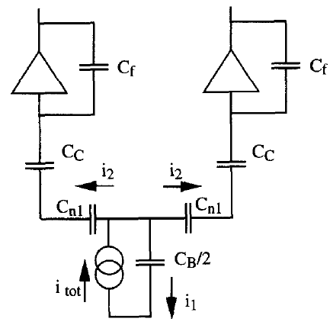
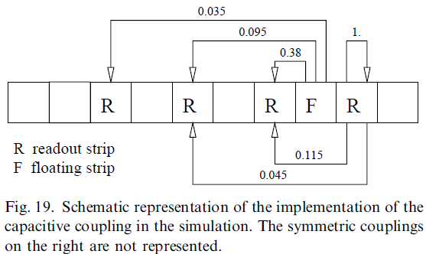
background
SCD should measure Z=1~26， large dynamic range.
Two requirements:
Large dynamic range of ASIC (VA140)
Optimize charge sharing in detector
charge sharing ratios of AGILE
From G. Barbiellini, NIMA 490 (2002) 146
charge sharing

Slide 3
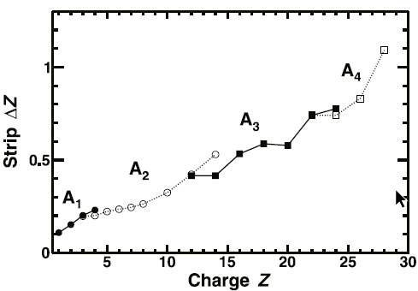
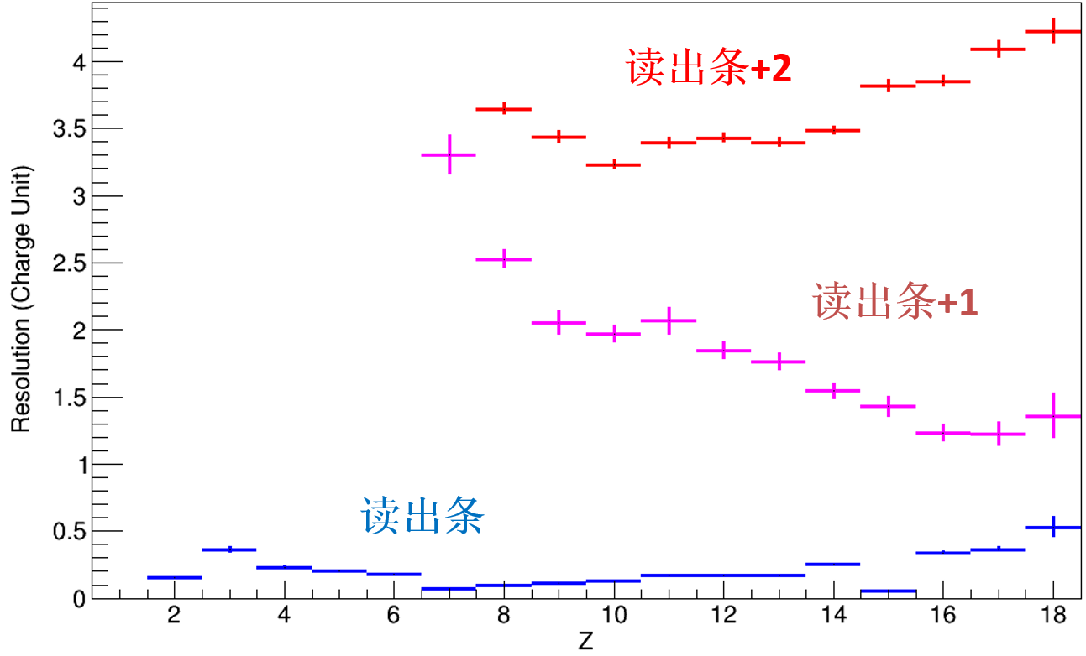
The charge sharing of AMS & DAMPE
$$\sqrt{A_{1}}$$
$$\sqrt{A_{2}}$$
 | Ratio A1->A2
AMS | ~40%
DAMPE @beamtest | <4%
$$\sqrt{A_{3}}$$
$$\sqrt{A_{3}}$$
$$\sqrt{A_{2}}$$
$$\sqrt{A_{1}}$$
AMS
DAMPE
Notes:
来源：G:\keyan\科研任务\211212_硅微条模拟\211212_硅微条模拟-软件比较.pptx

Slide 4
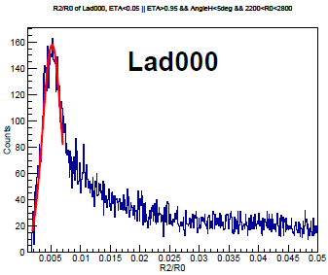
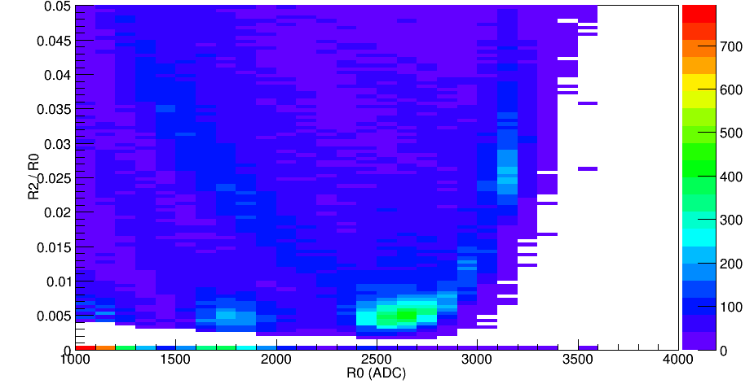
The in-flight calibration of DAMPE charge sharing ratio: A1->A2
Parameter | Selection
Angle (perpendicular strip) | <5 deg
Angle (along strip) | <15 deg
Impact Position | ETA<0.05 || ETA>0.95
Heavy ions | A1> 2200 ADC
No Saturation | A1< 2800 ADC
Z=8
A2/A1
A2/A1
Z=5
Z=6
Z=7
Ratio of A1->A2 is ~0.5%
A1 (ADC)
Notes:
来源：G:\keyan\科研任务\180115_轻粒子电荷\180301_用重核刻度更远的电荷分配系数\4 AnaLonger_调整策略后的2年的信号谱\TH2I_R2R0_vsR0_Lad000.png
G:\keyan\科研任务\180115_轻粒子电荷\180301_用重核刻度更远的电荷分配系数\5 FitLonger_调整策略后的2年的信号谱\TH1I_R2_R0.pdf

Slide 5
Problems to solve…
The charge sharing (0.5%) of DAMPE is too weak. When strip A1 encounter saturation (~3000 ADC)， the amplitude of strip A2 is too small (~15 ADC).
We need to design a SCD with larger charge sharing ratios.

Slide 6
Simulation tools
Name | Source | 运行环境
Sentaurus TCAD | Commercial | Windows
Silvaco TCAD
Allpix | Open-source；CERN | Linux；C++
KDetSim
TRACS |  | Linux；GUI
WeightField | Open-source；INFN
The four open-source simulation tools cannot simulate the capacitive charge sharing.
The commercial TCAD can simulate the capacitance.

Slide 7
The TCAD simulation
Parameters | Values
 | DAMPE | IHEP HERD(20um) | IHEP HERD(60um)
Thickness (um) | 320
implant Pitch (um) | 121 | 80
Readout pitch (um) | 242 | 160
implant width (um) | 48 | 20 | 60
Al width (um) | 56 | 28 | 68
concentration | 50V full depletion
Sio2 thickness | 520 pF coupling
Implant thickness (um) | 4.4 pF interstrip cap.

Slide 8
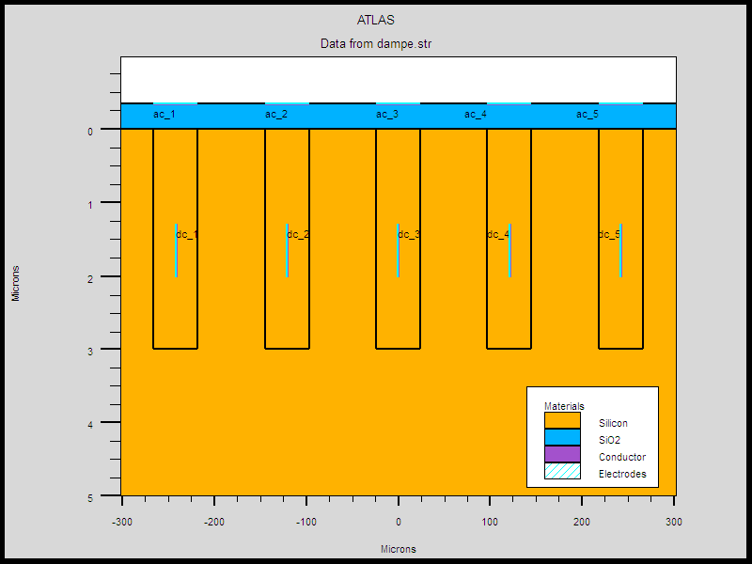
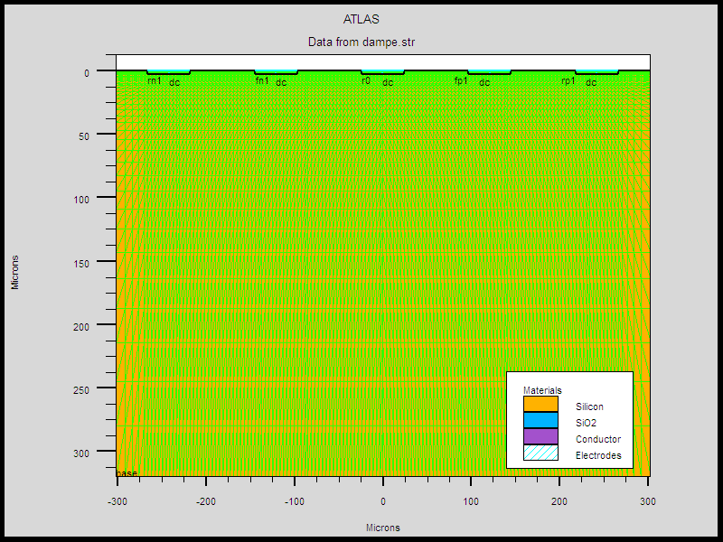
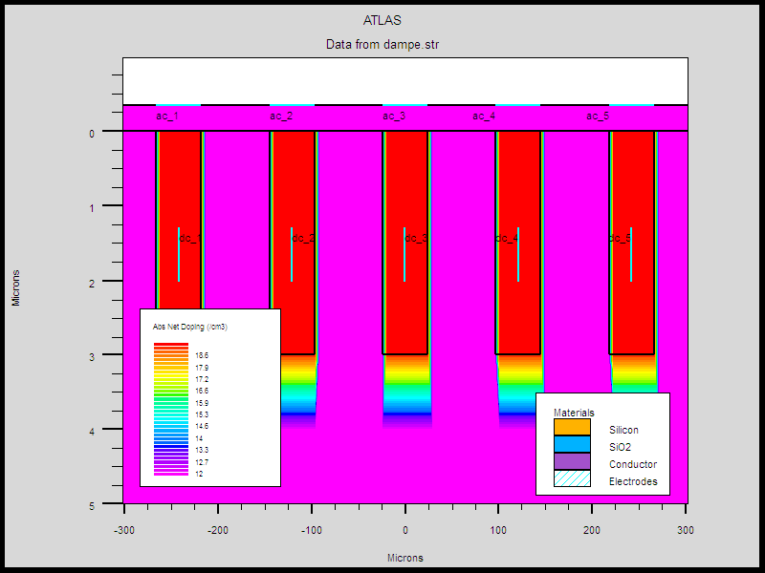
The TCAD simulation
electrode
doping
DAMPE design with 5 strips
Thickness 320um
Implant pitch 121um
Implant width 48um
Al width 56um
Notes:
来源：G:\keyan\科研任务\211212_硅微条模拟\MyTCAD\220107——DAMPE 5个注入条\

Slide 9
Simulation Results
Det_Name | Interstrip cap. (pF) | Coupling cap. (pF) | Backplane cap. (pF)
DAMPE_Exp | 4.4 | 520 | 4.3
DAMPE_Sim | 4.4 | 517 | 3.9
HERD_20um | 3.3 | 255 | 2.5
HERD_60um | 8.8 | 651 | 2.6
Full depletion: 50V
Result: CV curve
Red: interstrip cap.
Green: backplane cap.
Notes:
来源：G:\keyan\科研任务\211212_硅微条模拟\MyTCAD\220110——HERD\电容值统计.xlsx

Slide 10
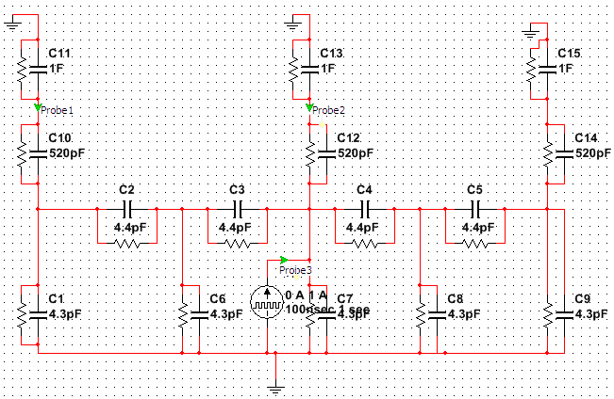
Spice simulation
The TCAD capacitances are inserted into SPICE.
Pulse current source generate charges
Probes measure amplitutde of A1 & A2
Det_Name | Charge sharing ratio: A1->A2
DAMPE_Exp | 0.28%
DAMPE_Inflight | ~0.5%
HERD_20um | 0.47%
HERD_60um | 0.58%
Spice simulation of DAMPE charge sharing.

Slide 11
Conclusion
Capacitive charge sharing is reported by AGLIE, AMS-02, DAMPE
When strip A1 is saturated, we should use strip A2/A3 for reconstruction.
The DAMPE charge sharing ration A2/A1 is small (0.4%), compared to AMS-02(~40%) and AGILE(10%). We should optimize SCD with larger charge sharing ratio.
TCAD+SPICE simulation was implemented for DAMPE & IHEP SCD. The ratio is still <1%.

Slide 12
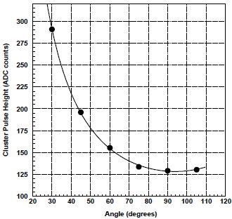
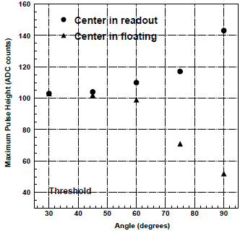
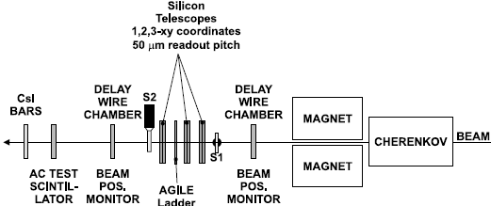
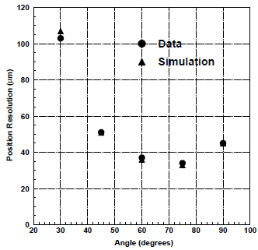
Backup: AGILE
Notes:
G. Barbiellini, NIMA 490 (2002) 146

Slide 13
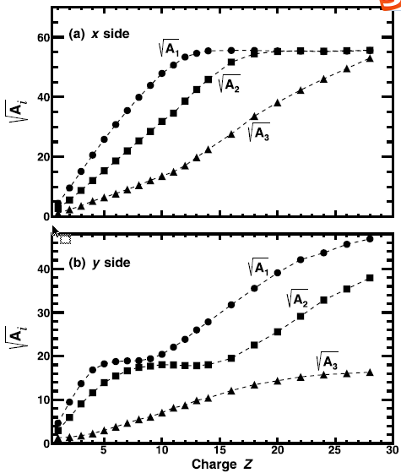
Backup: AMS-02
Not hitting readout strip, but d~0.3
Not normal incidence, but 10deg.

