Slide 1
Simulating Microgels
PhD Seminar, Roma, 15 / 02 / 2022

Slide 2
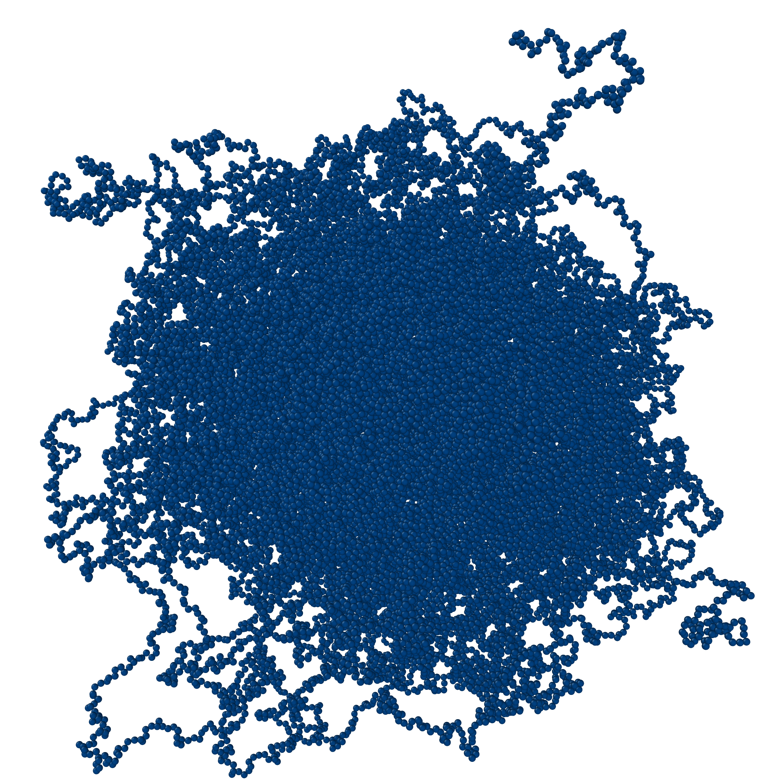
Overview
Introduction
In Silico Synthesis
Study Cases

Slide 3
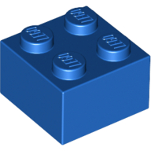
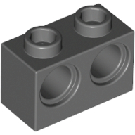
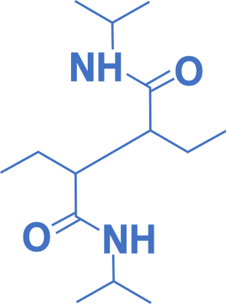
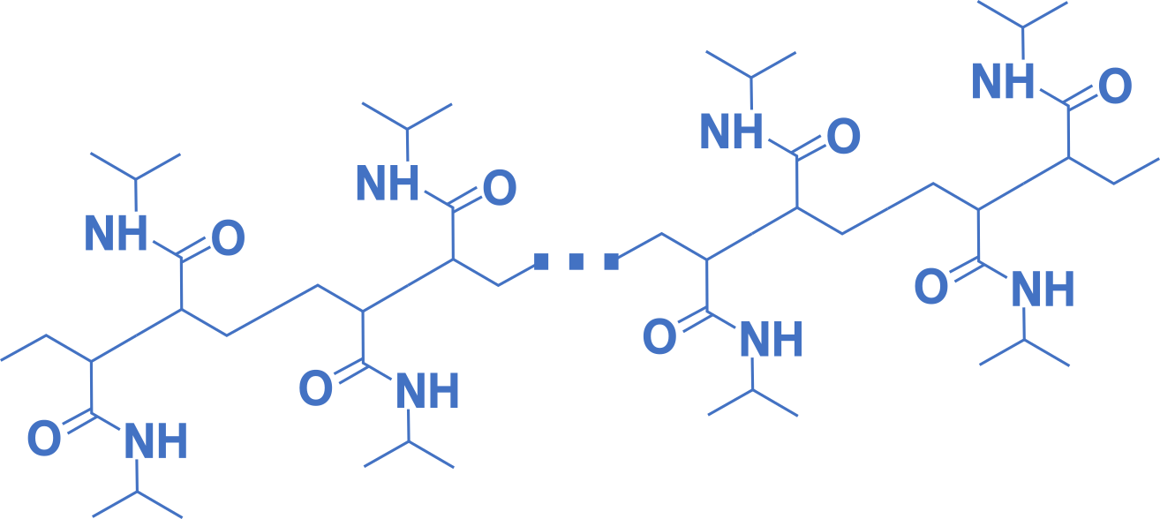
Microgels
Colloidal particles
Brownian motion
Easily measured
Progress in synthesis
Polymeric network
Soft
Flexible
Responsive to external stimuli
Temperature, pH, …
Nicoletta Gnan, Lorenzo Rovigatti, Maxime Bergman, and Emanuela Zaccarelli. Macromolecules 2017 50 (21), 8777-8786

Slide 4
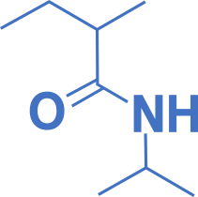
Microgels
Colloidal particles
Brownian motion
Easily measured
Progress in synthesis
Polymeric network
Soft
Flexible
Responsive to external stimuli
Temperature, pH, …
Nicoletta Gnan, Lorenzo Rovigatti, Maxime Bergman, and Emanuela Zaccarelli. Macromolecules 2017 50 (21), 8777-8786

Slide 5
Temperature-Responsive Snowflake-shaped Microgel
Wolff, H.J.M.; Linkhorst, J.; Göttlich, T.; Savinsky, J.; Krüger, A.J.D.; de Laporte, L.; Wessling, M. Lab Chip, 2020,20, 285-295

Slide 6
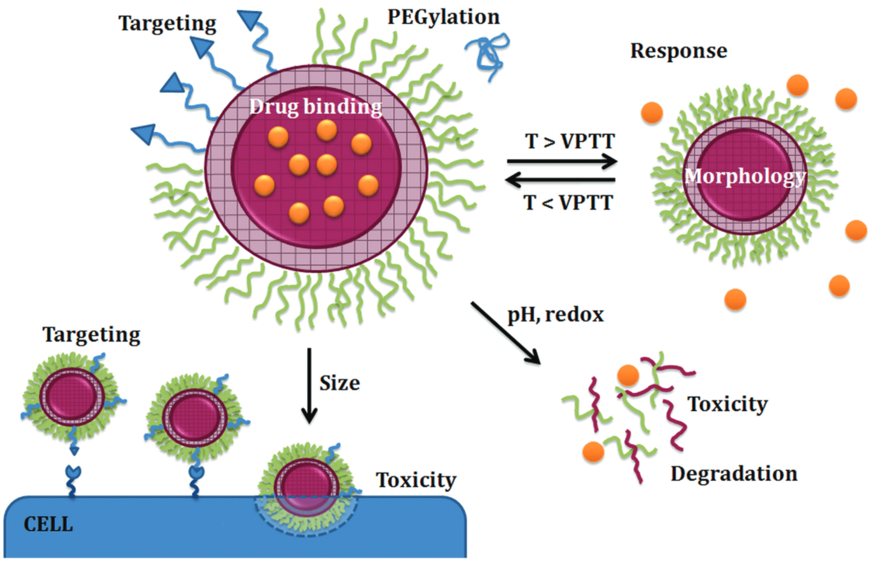
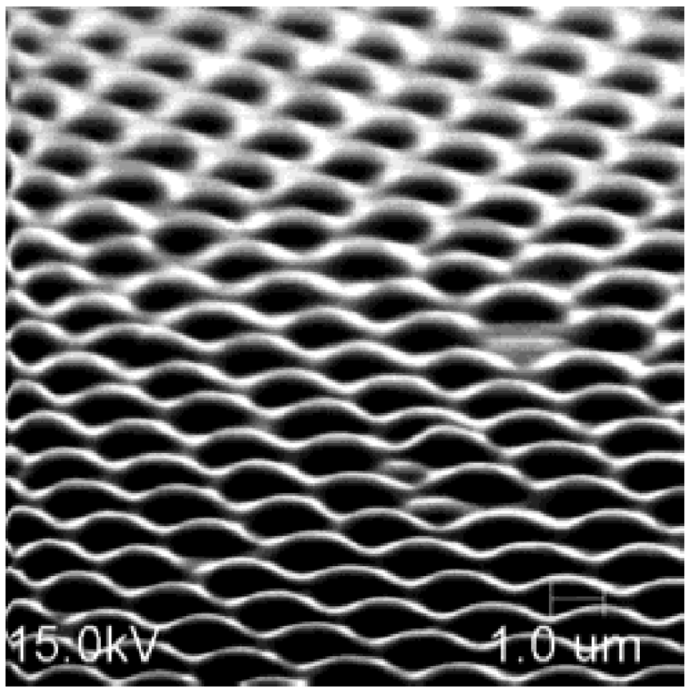
Applications
Smeets, N.M.B. and Hoare, T. (2013), J. Polym. Sci. Part A: Polym. Chem., 51: 3027-3043.
Jongseong Kim, Michael J. Serpe, and L. Andrew Lyon. Journal of the American Chemical Society 2004 126 (31), 9512-9513
Notes:
chitosan Methotrexate disodium
foveated vision, chemical sensing, and beam steering fingerprint

Slide 7
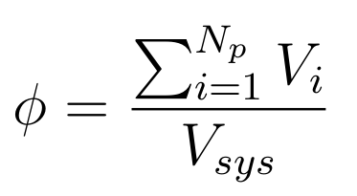
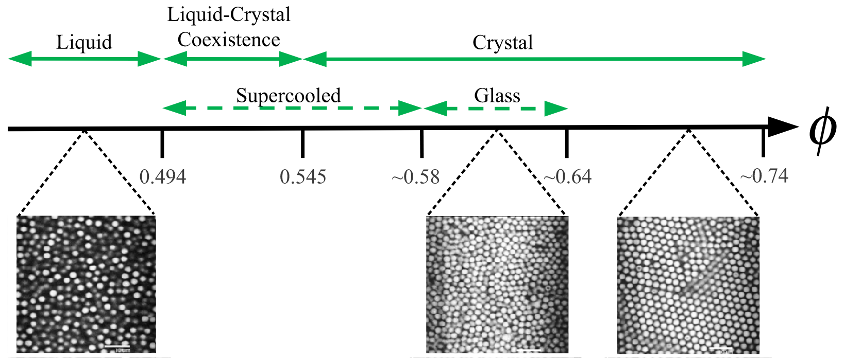
Applications
Gary L Hunter and Eric R Weeks 2012 Rep. Prog. Phys. 75 066501
Notes:
chitosan Methotrexate disodium
foveated vision, chemical sensing, and beam steering fingerprint

Slide 8
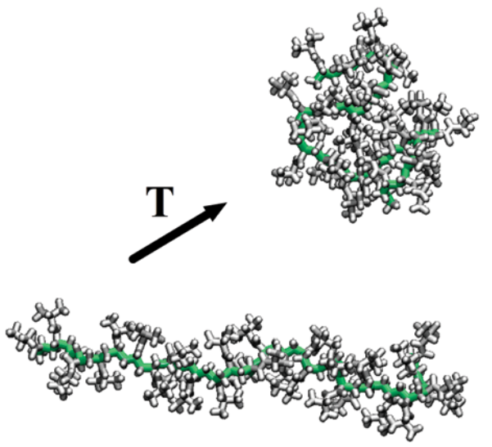
Simulation Detail Levels
All-atom
Monomer-resolved
Single Particle
L. Rovigatti, N. Gnan, L. Tavagnacco, A. J. Moreno and E. Zaccarelli, Soft Matter, 2019, 15, 1108–1119
LH Alvarez, A Eisold, RA Gumerov, M Strauch, AA Rudov, P Lenssen, D Merhof, II Potemkin, U Simon, D Wöll. Nano Lett. 2019, 19, 12, 8862–8867

Slide 9
In Silico Synthesis
Molecular Dynamics (MD)
N. Gnan, L. Rovigatti, M. Bergman and E. Zaccarelli. Macromolecules, 2017, 50, 8777.

Slide 10
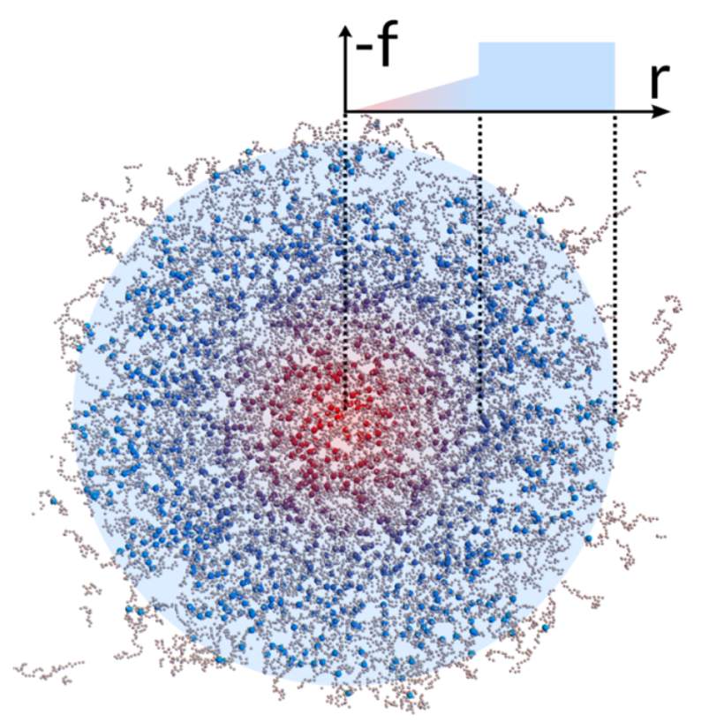
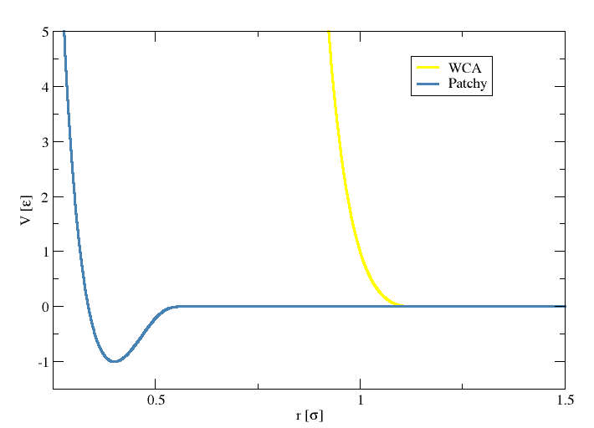
In Silico - 1st Step
Bivalente and tetravalent monomers in spherical flask at low T*
N. Gnan, L. Rovigatti, M. Bergman and E. Zaccarelli. Macromolecules, 2017, 50, 8777.
A Ninarello, J J. Crassous, D Paloli, F Camerin, F Gnan, F Rovigatti, P Schurtenberger, and E Zaccarelli. Macromolecules 2019, 52, 20, 7584–7592

Slide 11
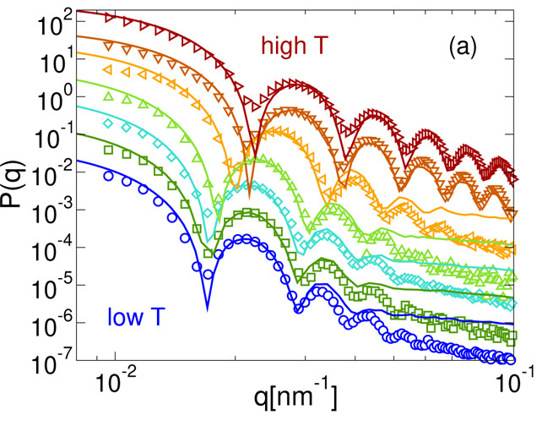
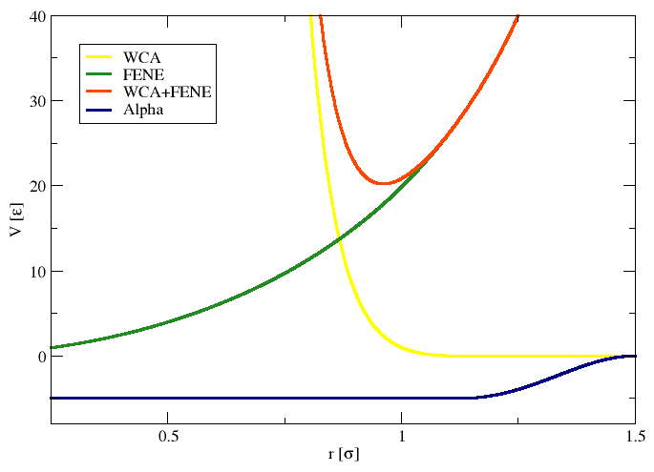
In Silico - 2nd Step
Kremer-Grest interactions + Solvent/Temperature
N. Gnan, L. Rovigatti, M. Bergman and E. Zaccarelli. Macromolecules, 2017, 50, 8777.
A Ninarello, J J. Crassous, D Paloli, F Camerin, F Gnan, F Rovigatti, P Schurtenberger, and E Zaccarelli. Macromolecules 2019, 52, 20, 7584–7592

Slide 12
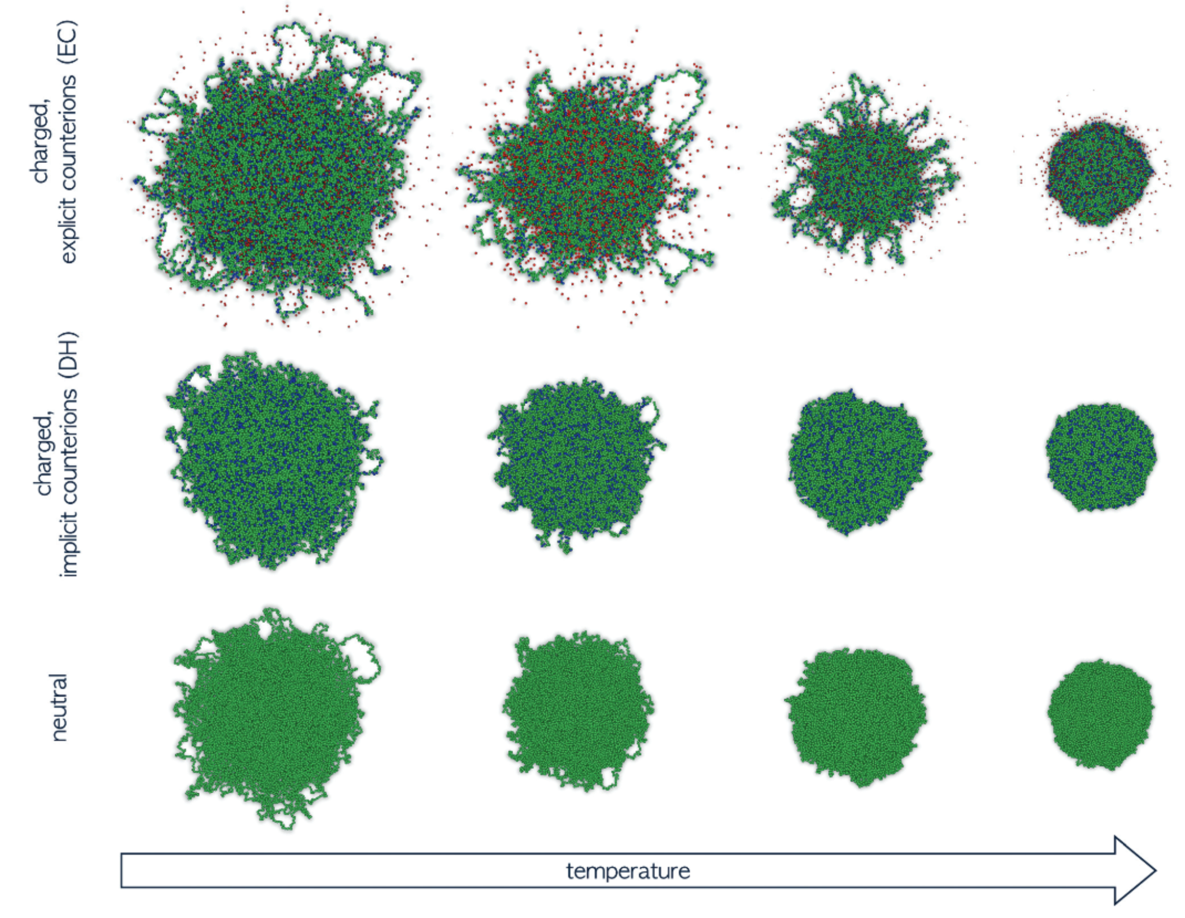
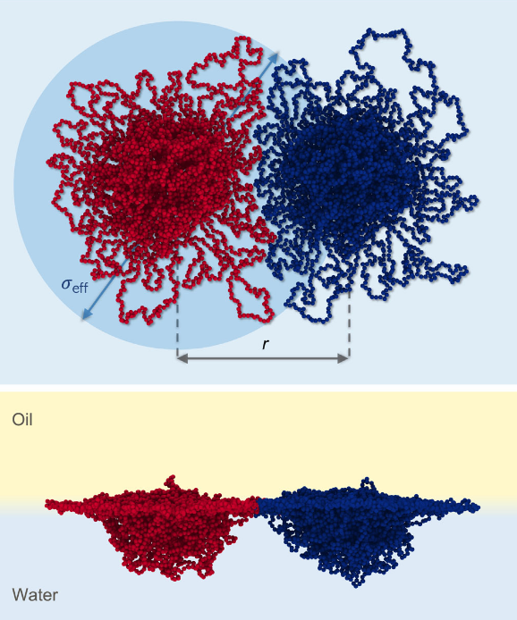
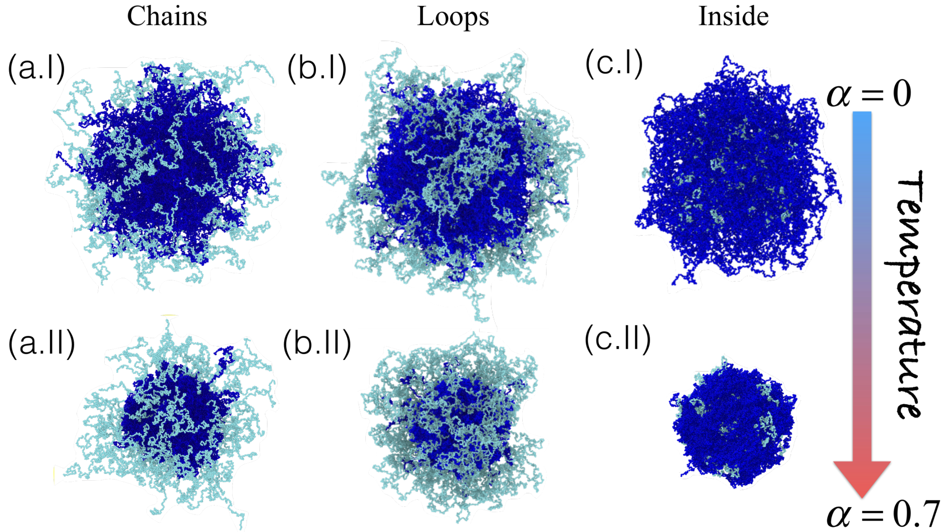
Study Cases
G Del Monte, A Ninarello, F Camerin, L Rovigatti, N Gnan, E Zaccarelli. Soft Matter, 2019,15, 8113-8128
R Rivas-Barbosa, J Ruiz-Franco, M A Lara-Peña, J Cardellini, A Licea-Claverie, F Camerin, E Zaccarelli, M Laurati. Macromolecules. Accepted
F Camerin, N Gnan, J Ruiz-Franco, A Ninarello, L Rovigatti, E Zaccarelli Physical Review X 10 (3), 031012
Notes:
Debye–Hu ̈ckel

Slide 13
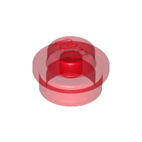
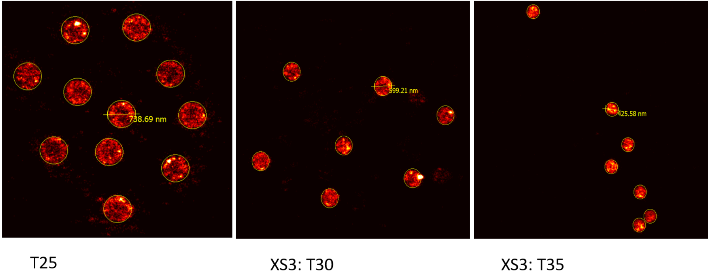
Experimental Conditions
Synthesis
APMA added 4 minutes after initiator
Fluorophores distribution outside the core
Super-Resolution Microscopy Measurements
Density profiles from the 2D projection of the fluorophores positions
Notes:
abbe diffraction limit

Slide 14
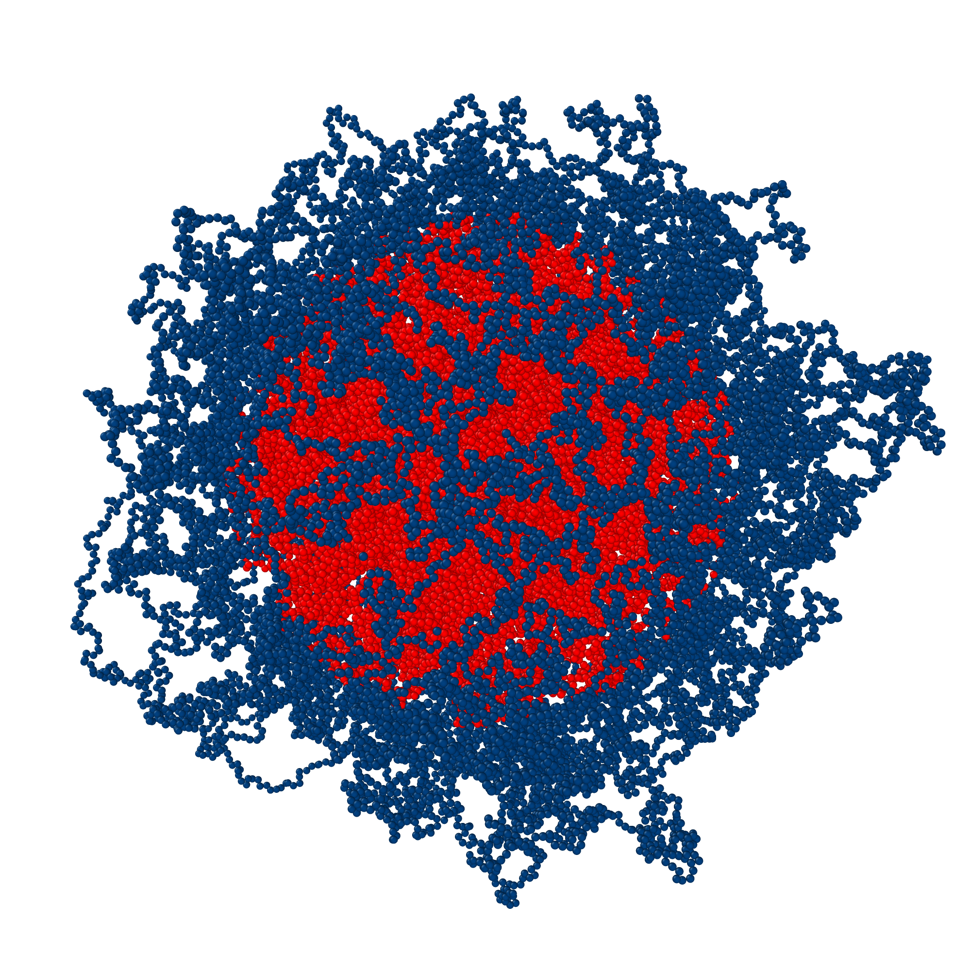
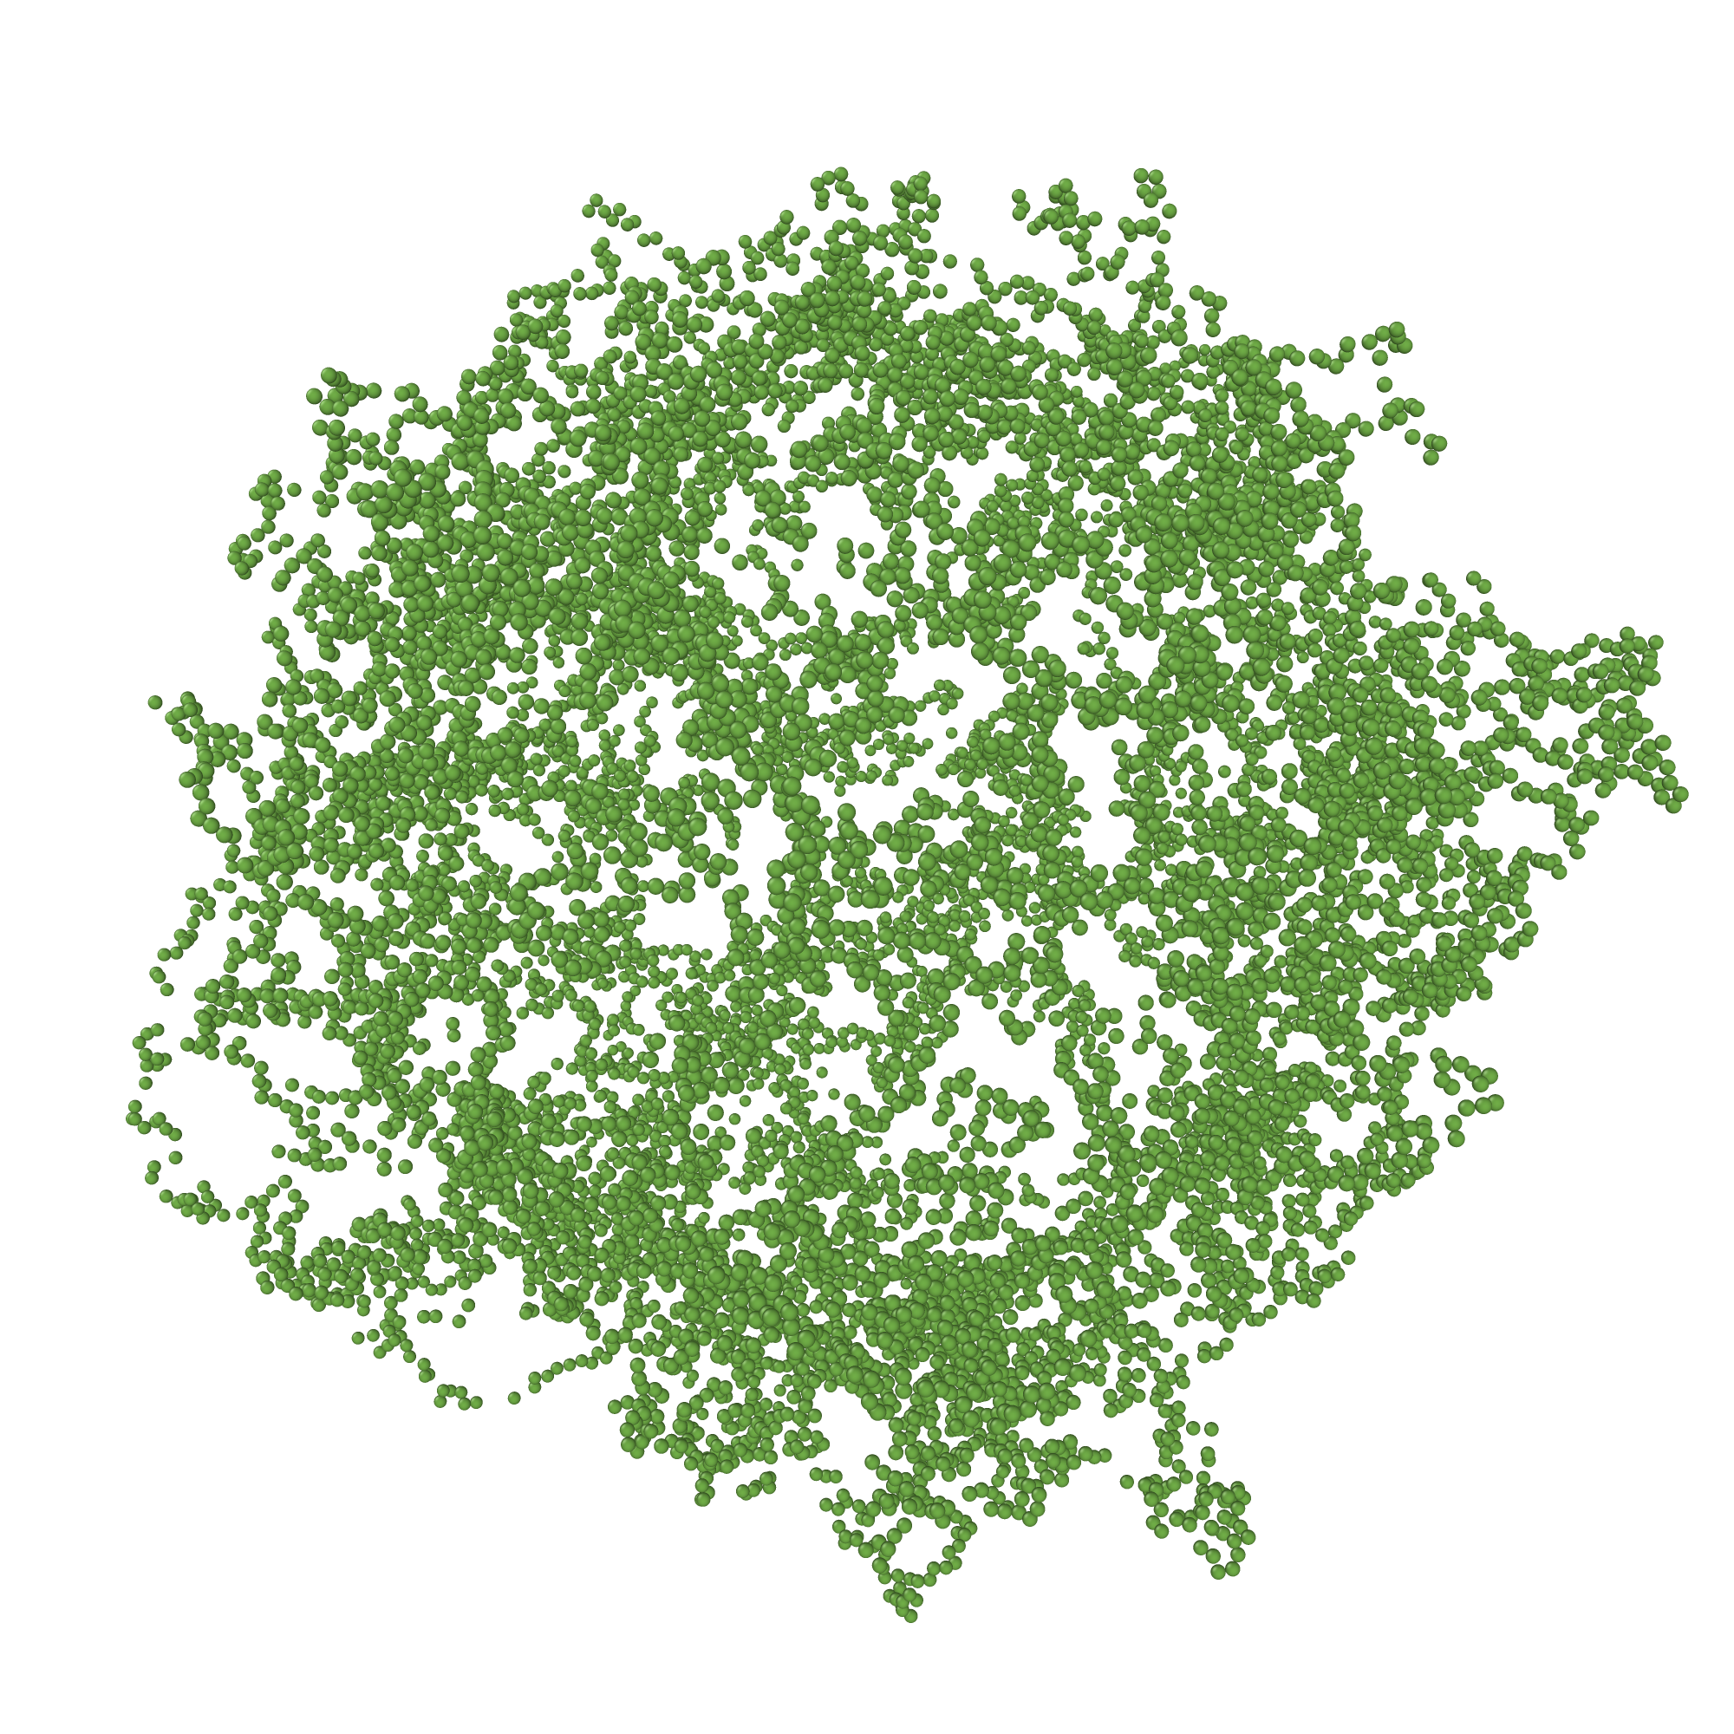
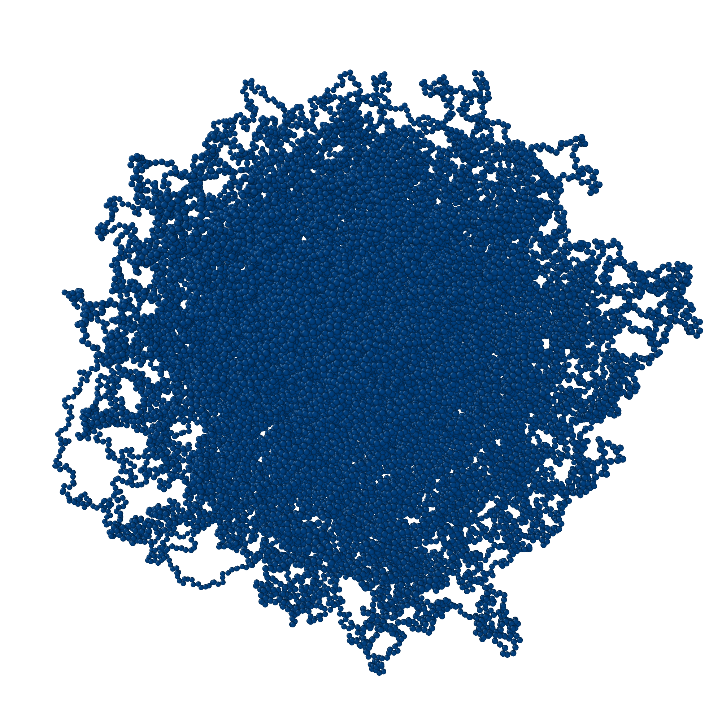
Fluorophore Emulation
Define the core-shell interface as function of the radius of gyration k*Rg
Choose r core-shell percentage distribution of fluorophores
Tune k and r parameters to fit measured profiles at all temperatures

Slide 15
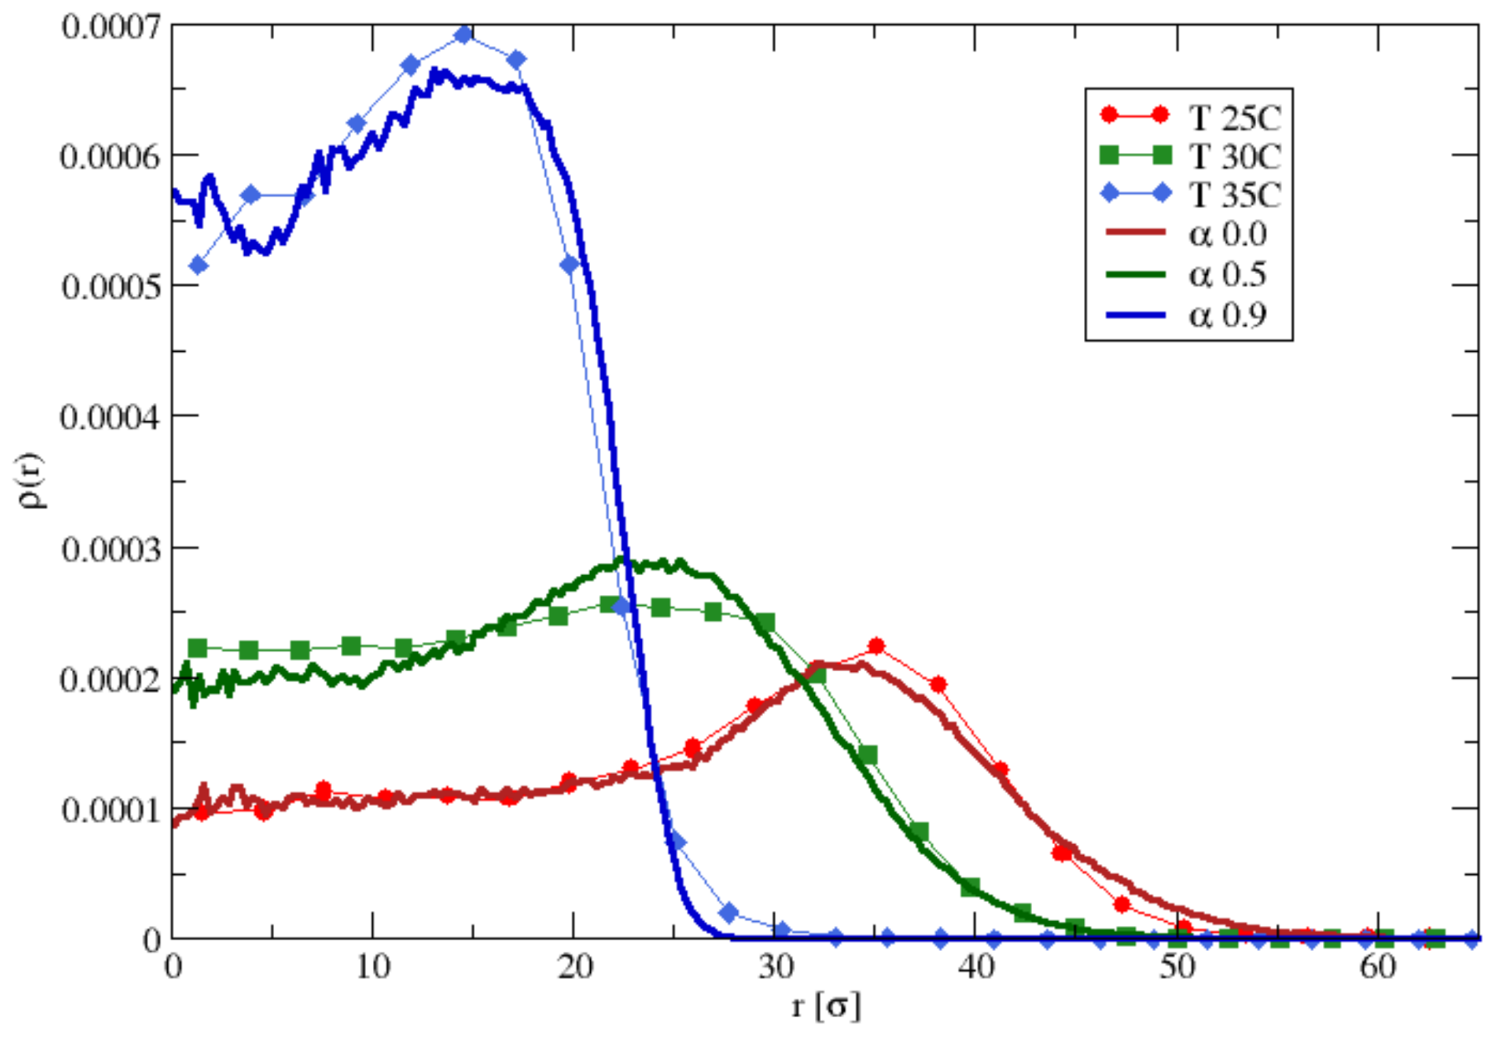
Comparing with Experiments

Slide 16
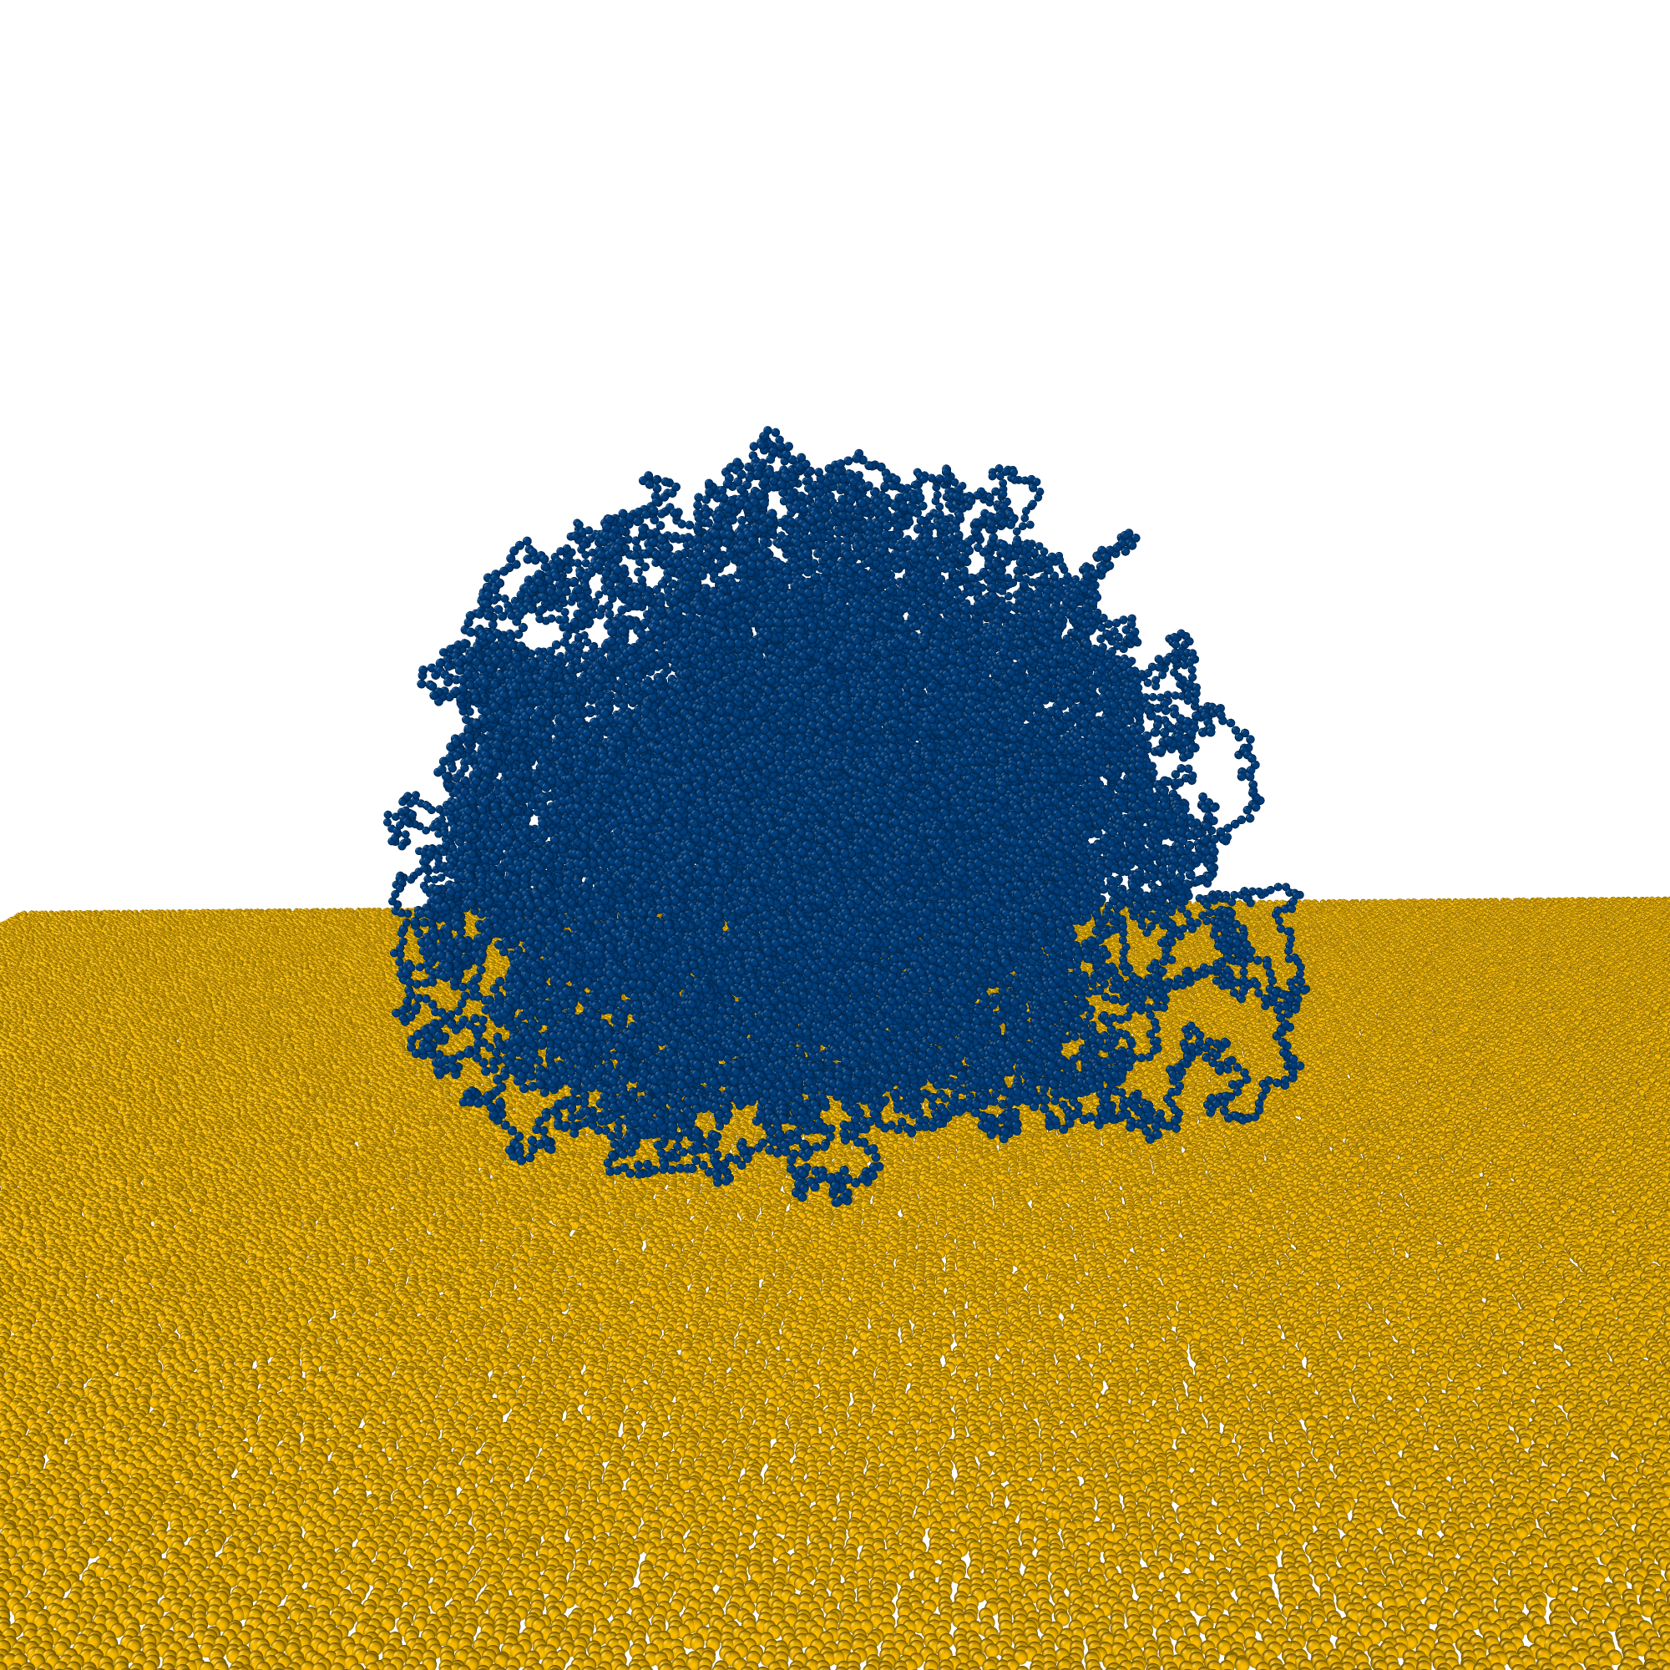
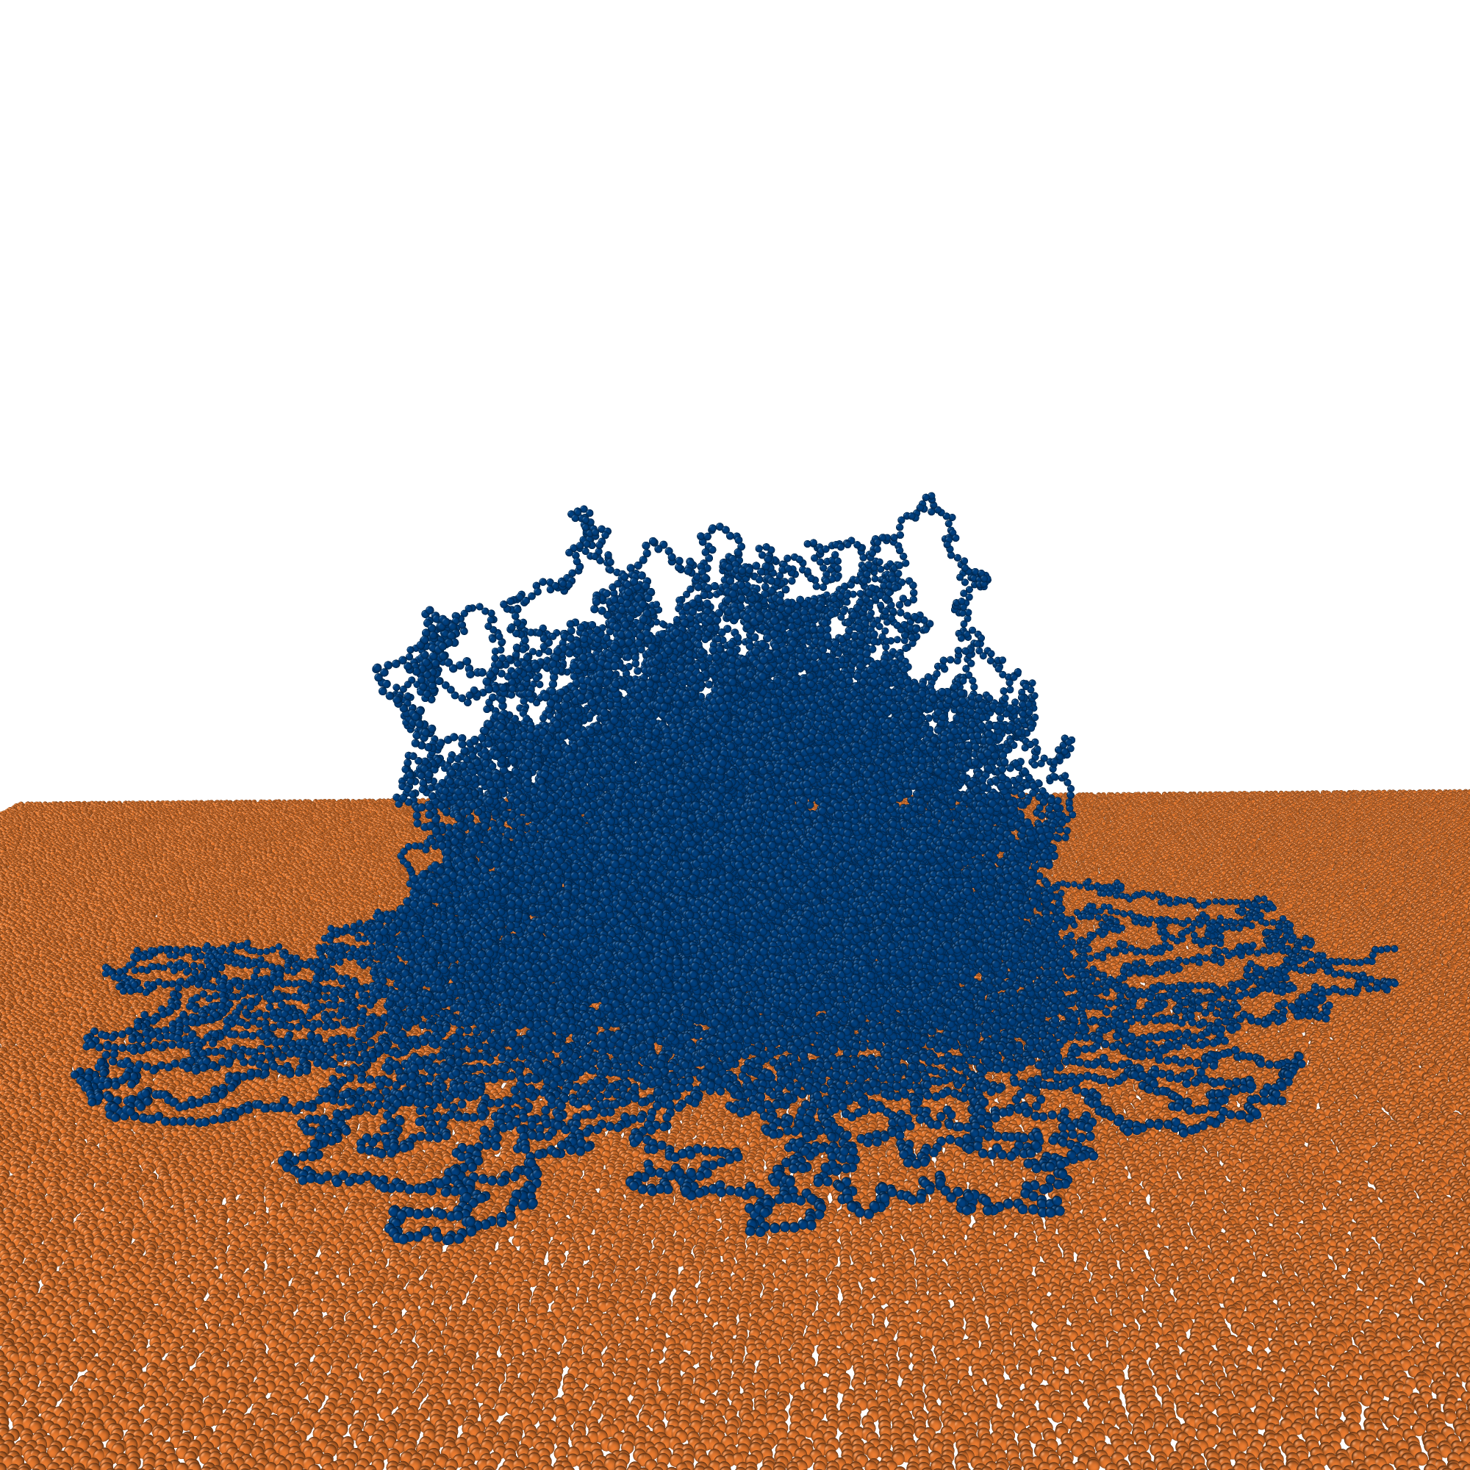
Hydrophilic/phobic Surfaces

Slide 17
Summary
Microgels are tiny, lego-like, cross-linked, responsive particles
Broad range of applications
Realistic monomer-resolved microgel simulations now available

Slide 18
Thank you
The SuperCol project has received funding from the European Union’s Horizon 2020 research and innovation programme under the Marie Skłodowska-Curie grant agreement No. 860914

