Slide 1
Bunch length measurements with coherent radiation detected via Schottky diodes in the sub-THz
Krakow, 14/12/2021
Alessandro Curcio
National Synchrotron Radiation Center SOLARIS

Slide 2
Introduction
Correspondence between coherent radiation and bunch profile
Past experiments with coherent diffraction radiation detected by Schottky diodes
Past experiments with coherent Cherenkov diffraction radiation detected by Schottky diodes
Expectations for Solaris
Conclusions

Slide 3

Coherent Diffraction Radiation from a metallic disk
Spectral angular distribution of the energy emitted by a single particle (incoherent)
Spectral angular distribution of the energy emitted by a beam of particles (coherent)
For a gaussian bunch, the ratio between two signals detected at two different frequencies can be related to the rms bunch length
Ratio between two signals
Theoretical expectation for the signal ratio due to a gaussian bunch

Slide 4
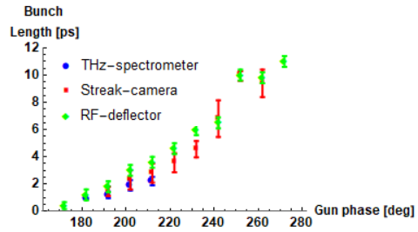
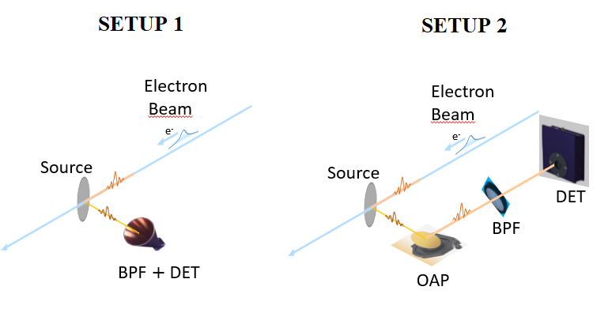
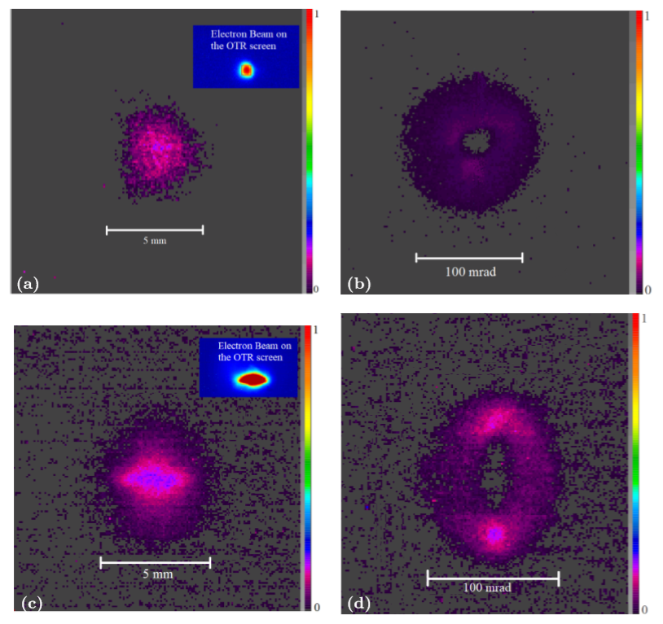
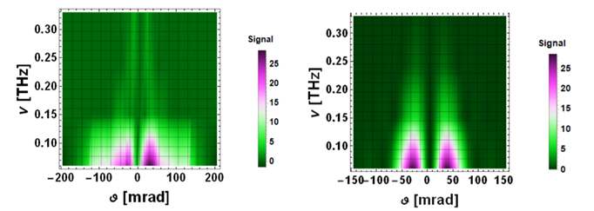
Measurements at Cern Linear Electron Accelerator for Research (CLEAR)
Spectrally and angularly characterized CTR source, by means of band-pass filtered Schottky diodes
Source characterized both in near and far-field
by means of a THz camera, angular distribution/polarization shaping by different beam focusing at the radiator plane
See Ref. Curcio, A., et al. "A beam-based (sub-)THz source at the CERN Linear Electron Accelerator for Research" Physical Review Accelerators and Beams (2019).

Slide 5
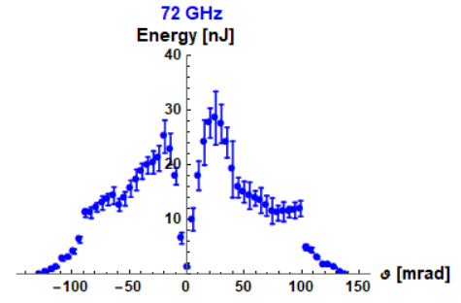
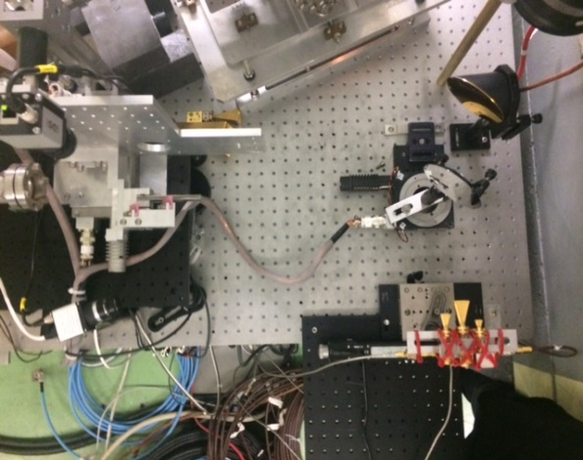
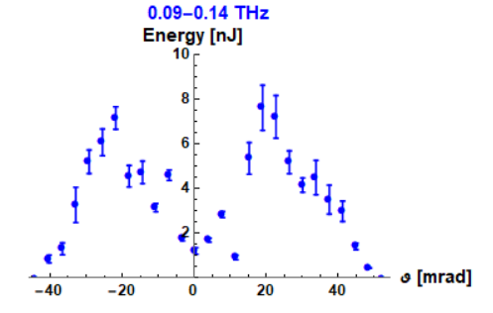
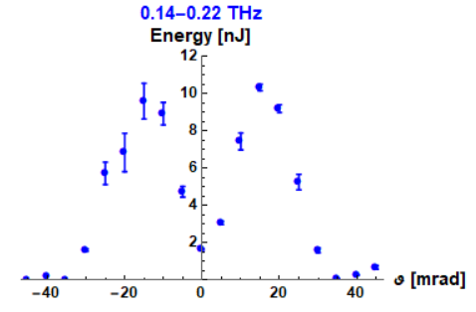
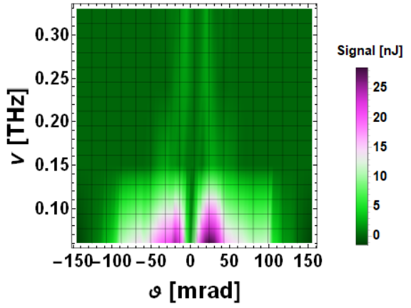
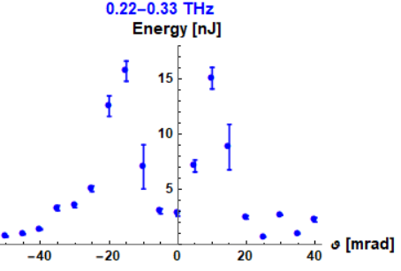
Spectral-angular distribution of CTR detected with Schottky diodes
Complete reconstruction for a bunch length 1.5 ps, 40 pC

Slide 6
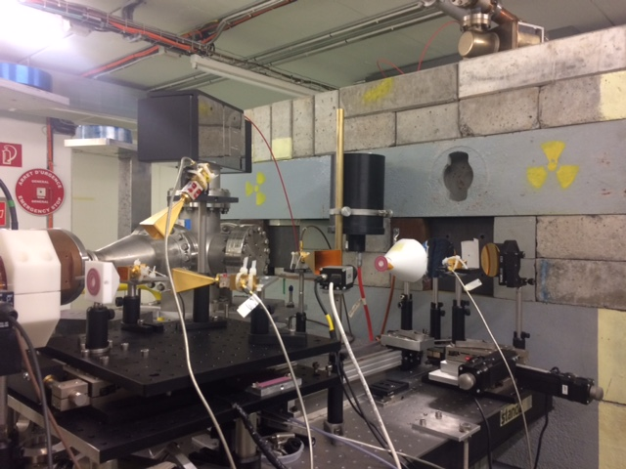
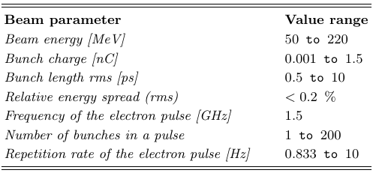
Similar measurements but with Coherent Cherenkov-Diffraction Radiation

Slide 7
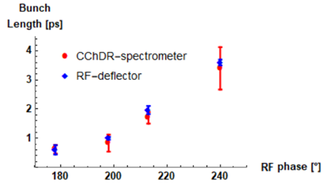
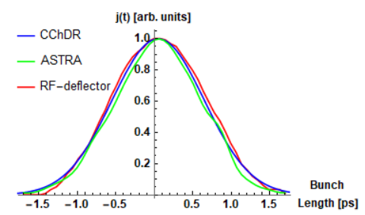
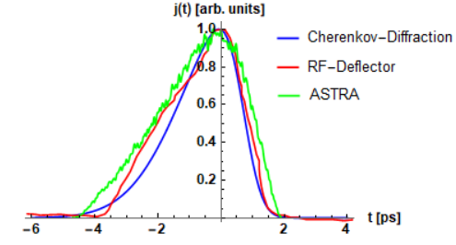
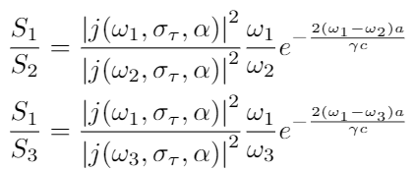
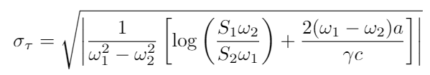

Not only gaussian bunches, if with more than two diodes
Using two diodes (84 GHz and 113.5 GHz)
Using three diodes (60 GHz, 84 GHz and 113.5 GHz)
Measurement made by exploiting a one-parameter formula for a gaussian bunch (100 pC)
Measurement made by exploiting a two-
parameter system for a skew-gaussian bunch (300 pC)
See Ref. Curcio, A., et al. "Noninvasive bunch length measurements exploiting Cherenkov diffraction radiation." Physical Review Accelerators and Beams 23.2 (2020): 022802.

Slide 8
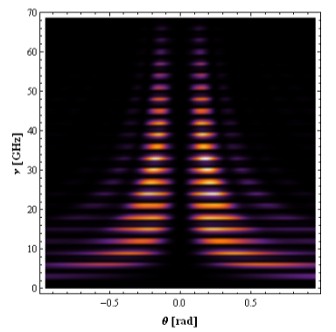
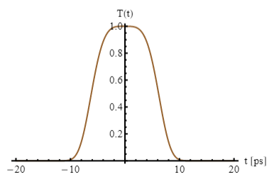
Theoretical expectations for the Solaris LINAC
Reconstructed (matching between simulation and measurements) longitudinal profile of the electron bunches of the SOLARIS injector LINAC.
Calculation of the Coherent Diffraction Radiation expected from the bunch profile shown in Fig. 2. The frequency modulation is due to the fact that the time structure of the Solaris bunches is modulated at 3 GHz from the gun.
Radiator parameters: 5 cm outer radius,5 mm inner radius, hollow metallic disk.
See Refs.
-. Curcio, A., et al. "Liouville theory for fully analytic studies of longitudinal beam dynamics and bunch profile reconstruction in dispersive lines." Nuclear Instruments and Methods in Physics Research Section A: Accelerators, Spectrometers, Detectors and Associated Equipment 986 (2021): 164755.
- Curcio, A. et al. “BUNCH LENGTH CHARACTERIZATIONS FOR THE SOLARIS INJECTOR LINAC” doi:10.18429/JACoW-IPAC2021-TUPAB277

Slide 9
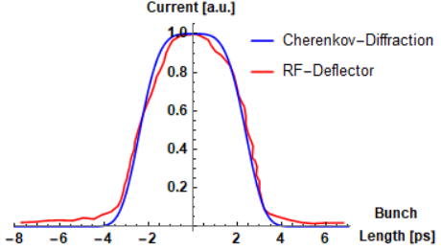


Past measurements on super gaussian bunches (ChDR at CLEAR)
Equation solved for retrieving the bunch length/profile
Expression of the form factor at given frequency

Slide 10
Conclusions
Spectral measurements of coherent radiation make it possible to retrieve the bunch length
Schottky diodes have been used in the past for retrieving the bunch length (and profile)
The diagnostics has been benchmarked to more standard ones (RF deflector, streak camera)
The proposed method is not the most precise, but it is simple and cost effective
The Solaris LINAC case has been already theoretically studied and tests are ongoing

