Slide 1

Present and future

Slide 2
Why ACTIS?
2
Requirements for MariX FEL:
High rep. rate (1 MHz)
E_{FEL}= 2-5 keV 3 GeV linac
Linac > 1 km
Gun
Bubble Arc-Compressor
Gun
Reduced costs
Reduced environmental impact
< 500 m
Acc. SC modules
Magnetic compression
Undulators
Notes:
To understand the reasons behind the birth of ACTIS we have to introduce a machine that was studied in the last years in Milano, the MariX FEL
A light source characterized by high rep rate and high photon energy. The high rep rate desired by users requires working in CW mode and adopting superconducting cavities.
Also high photon energy was required and this implied t build a 3 GeV linear machine.
whose lattice is composed of a long series of cryomodules and magnetic compression stages between them.
The total length of a machine like this is higher than 1 km, MariX was designed to fit into the new University of Milan Scientific Campus ad its dimensions should not exceed 500 m.
For this reason we adopted a new geometry (*****) of the machine by folding its lattice and exploiting the long cryogenic booster to accelerate twice the beam. This can be done adopting standing wave RF in the accelerating cavities. The compression happens in a long arc compressor bubble shaped that U-turns the e-beam.
***
and enables the machine to achieve low cost

Slide 3
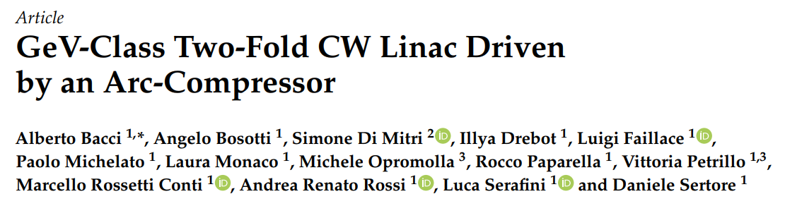
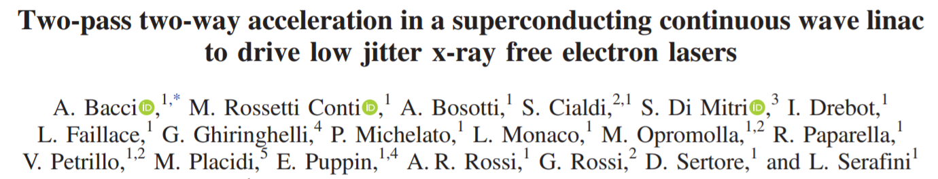
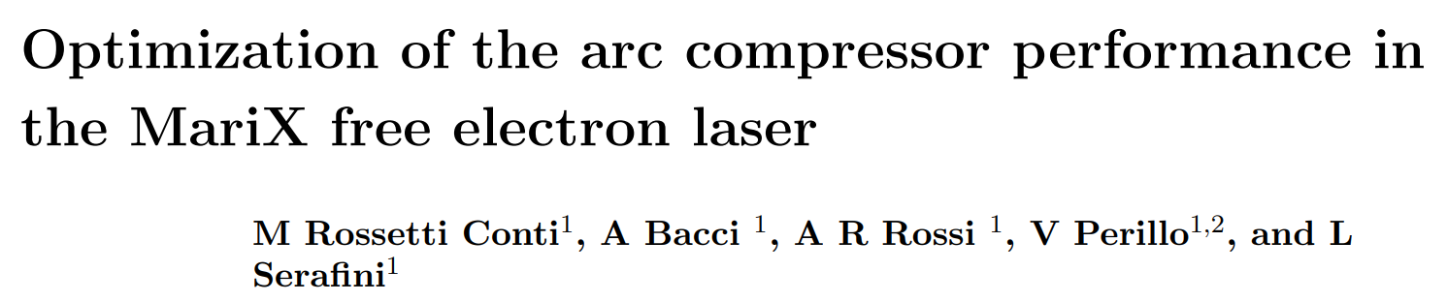
Arcs in MariX
3
MariX
Gun
< 500 m
Instruments, 3 (Sep. ‘19)
NO EXPERIMENTAL DEMONSTRATION
PRAB, 22 (Nov. ‘19)
J. Phys.: Conf. Ser., 1569 (2020)
Notes:
This kind of devices have been studied previously by Di Mitri who also collaborated in MariX Project.
Despite the theory of arc compressors is solid, an experimental demonstration have still to be provided.
The aim of the project is to demonstrate that arcs can be used as efficient magnetic compressors.

Slide 4

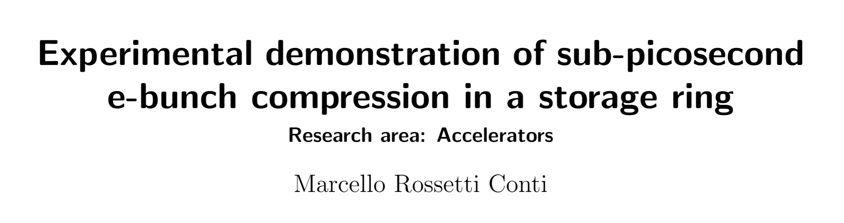
Grant awarded
4
- Call N. 21188/2019
Grant start: February 2020
Notes:
I proposed ACTIS at a call for young researchers and won a grant that started in February 2020
And Solaris was proposed as the perfect site to test the behavior of Arc Compressors

Slide 5
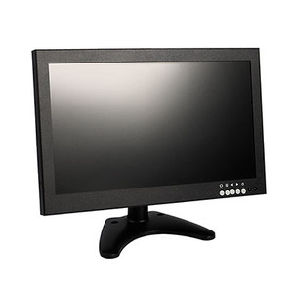
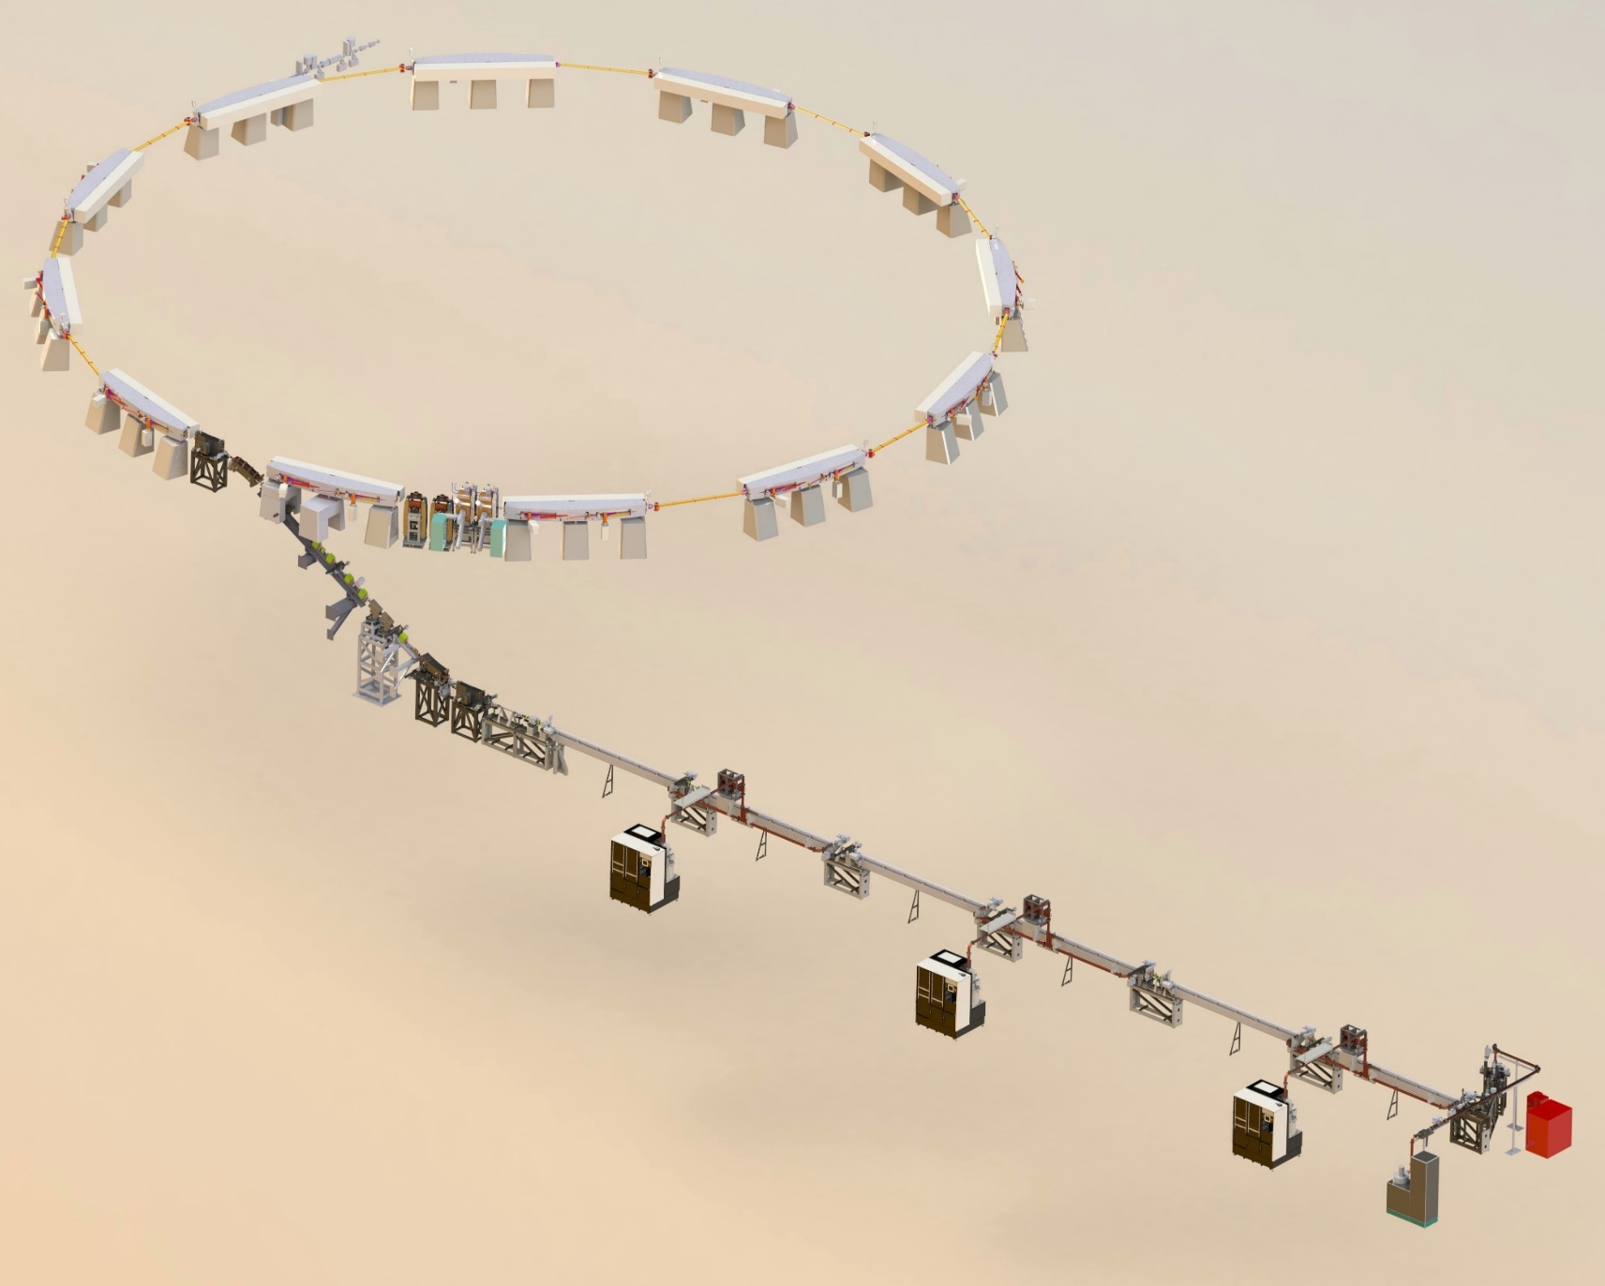
Solaris, the animation
5
Synchrotron Radiation (SR) SX-NIR
Coherent Synchrotron Radiation (CSR) FIR-THz
1 ps
15 ps
Coherent Transition Radiation (CTR)
Notes:
In fact @ Solaris a ring composed by 12 double band achromats is injected by a long linac and is able to produce MariX like e-bunches.
The linac will be used to chirp the beam (introduce a longitudinal energy correlation) *** and inject it into the ring when it will be compressed during one turn of it.
Beam lenght measurements will be performed with two separate detectors that have been studied …
one @ the end of the linac and one after the the 12Th DBA

Slide 6
Collaboration
6
Proposing Institution.
Strongly interested in the physics of MariX Arc Compressor.
INFN Milano
Provides the machine, the local expertise, experience in SR detection.
Solaris Synchrotron
Experience in arc compressors beam dynamics, and synchrotron machines.
Elettra - S.T. S.C.p.a.
INFN Frascati
SPARC_LAB collaboration on coherent THz radiation detection.
Notes:
The ACTIS collaboration is composed by 4 main actors:

Slide 7
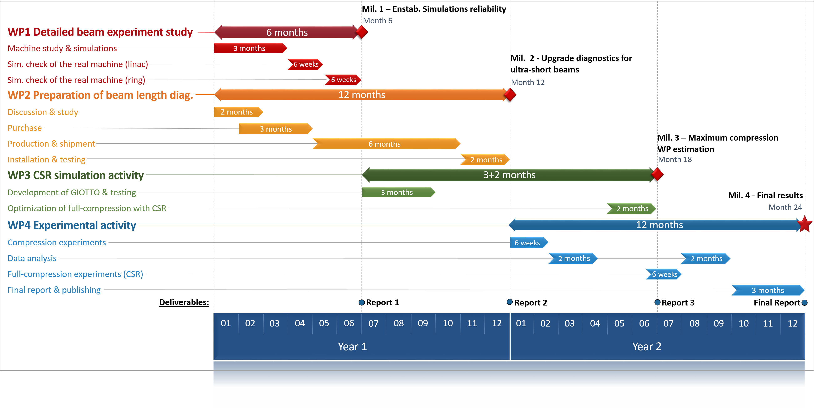
Work packages and time schedule
Notes:
This gantt chart was proposed 2 years ago and shows the 4 main activities of this project
Thi first is a simulative activity aimed to build reliable simulations of the machine
The second was dedicated to the design and procurement of the beam length detectors and their components
The third is a development activity of a code we use as optimizer of beam dynamics and will help to individuate the correct working point
The forth is the experimenal activity.
Without COVID we would have been here

Slide 8
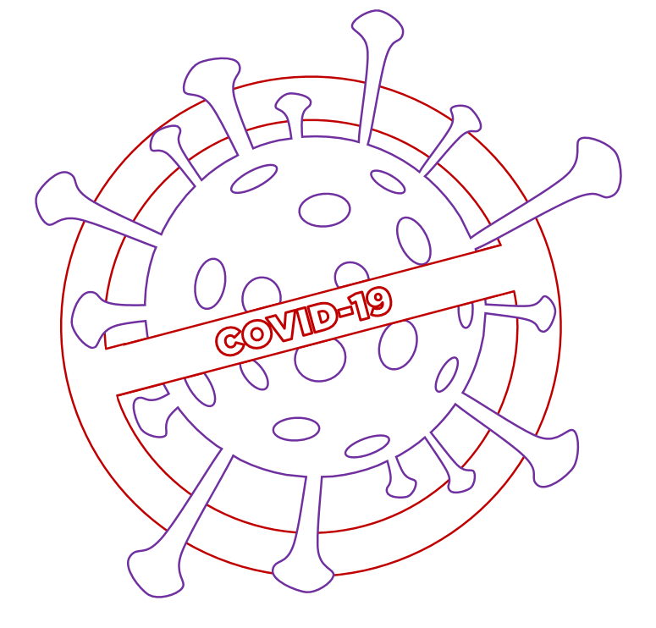
Pandemic legacy
8
Several activities were delayed
5 orders delayed (3 completed)
Missions completely cancelled.
Simulations become more extensive than expected.
ACTIS activities where extended up to 12/2022
Notes:
But the reality is that several activities have been delayed.
2 of five material orders (for detectors and computational activity) have yet to be completed.
Missions as we know have been cancelled several times.
I underestimated the workload of the simulative activity mainly because I thought that simulations of the machine were previously available at Solaris.
And I did not budget the time required for the creation of a model of the low energy machine.
However, considering the special situation the experiment have been extended to all 2022.

Slide 9

Detectors
Notes:
I will now move on to description of the beam length detectors sudied in the context of this experiment

Slide 10



Sub-THz detector
Sellers:
1
2
Breadboard
Parab. Mirror + Mountings
(Thanks to E. Chiadroni)
OTR from Frascati
Schottky diodes (2 freq.)
1-axis movement
1
OTR
To dump
e-beam
1
Sub- THz
2
Slit
1
Schottky
diodes
Parabolic mirror
Collimated beam
A. Curcio et al., “Beam-based sub-THz source at the CERN linac electron accelerator for research facility” PRAB 22, 020402 (2019)

Slide 11



THz detector
3-axis kinematics
Breadboard
Parab. Mirror + kinematics + Mountings
(Thanks to E. Chiadron)
Filter Wheel
Custom THz BP filters
Pyroelectric sensor + Focusing
Assembled 3-axis movement
1
Pyroelectric detector
1
1
3
Band-pass filter wheel
2
1
Sellers:
1
2
Focused
THz
Bending magnet
3
CSR - THz
Parabolic mirror

Slide 12


Situation
Workstation
Ad hoc THz BP filters
Design completed
Awaiting final quotation
Mirrors & mechanics
Orders Requests
sent
Pyroelectric sensor
Schottky diodes (2 frequencies)
bureaucracy almost completed
Notes:
Here we see a recap of the orders state.
Everithing have been delayed by the situation but computational resources have arrived together with half of the instrumentation for the detectors.
The last two orders are proceeding and I hope will be concluded in the near future.

Slide 13
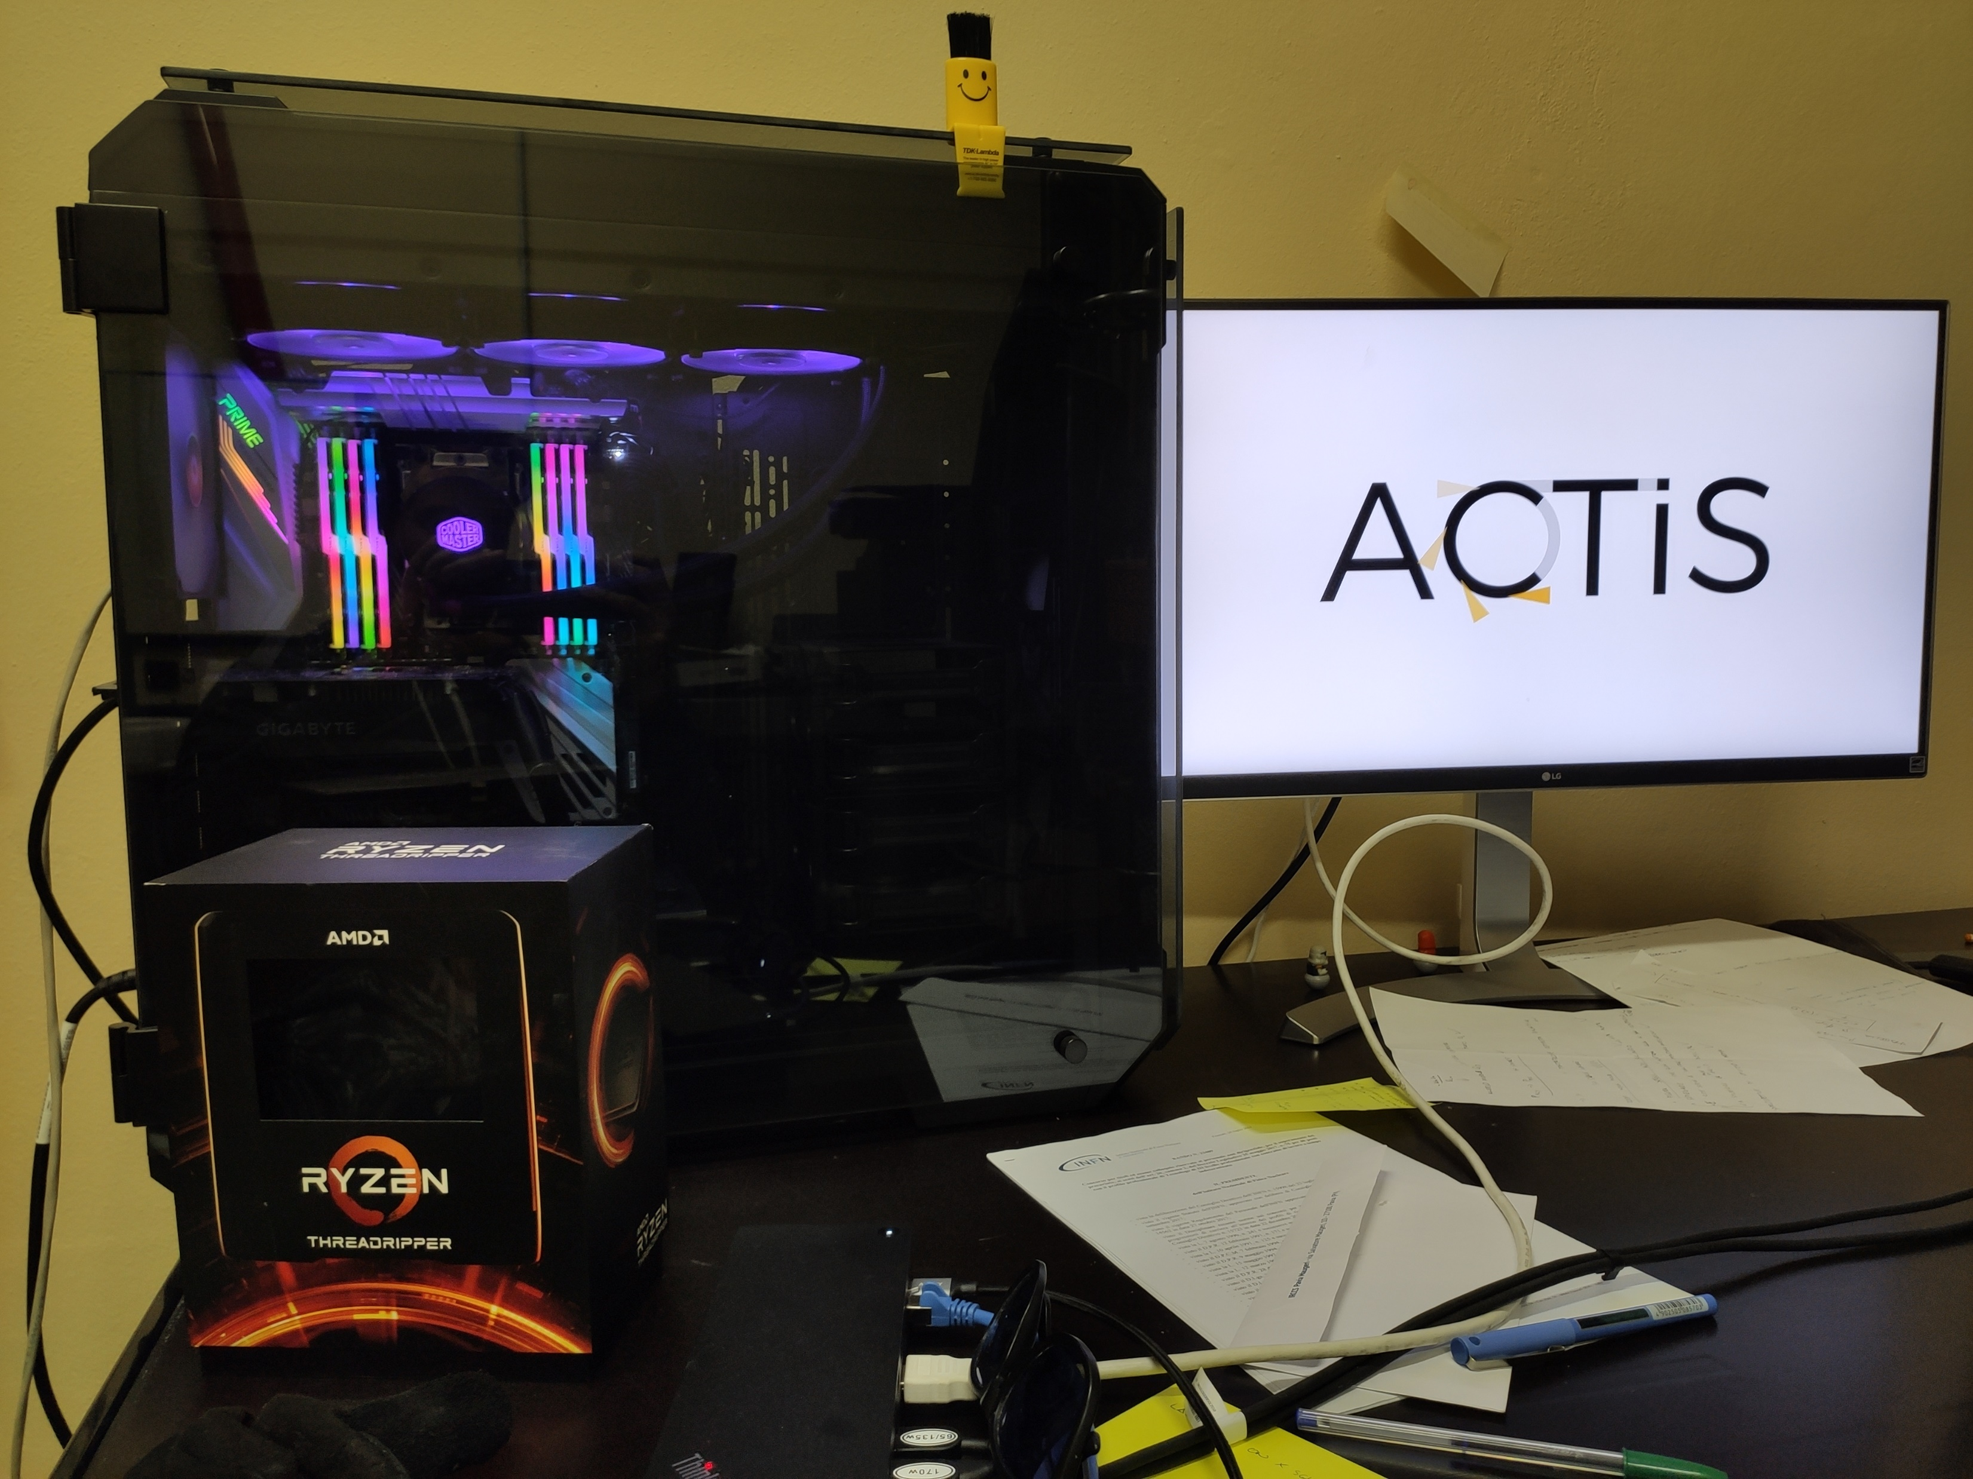
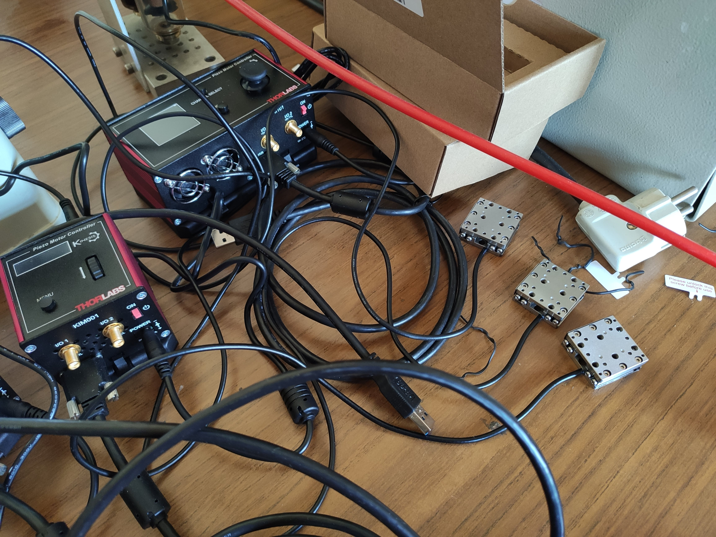
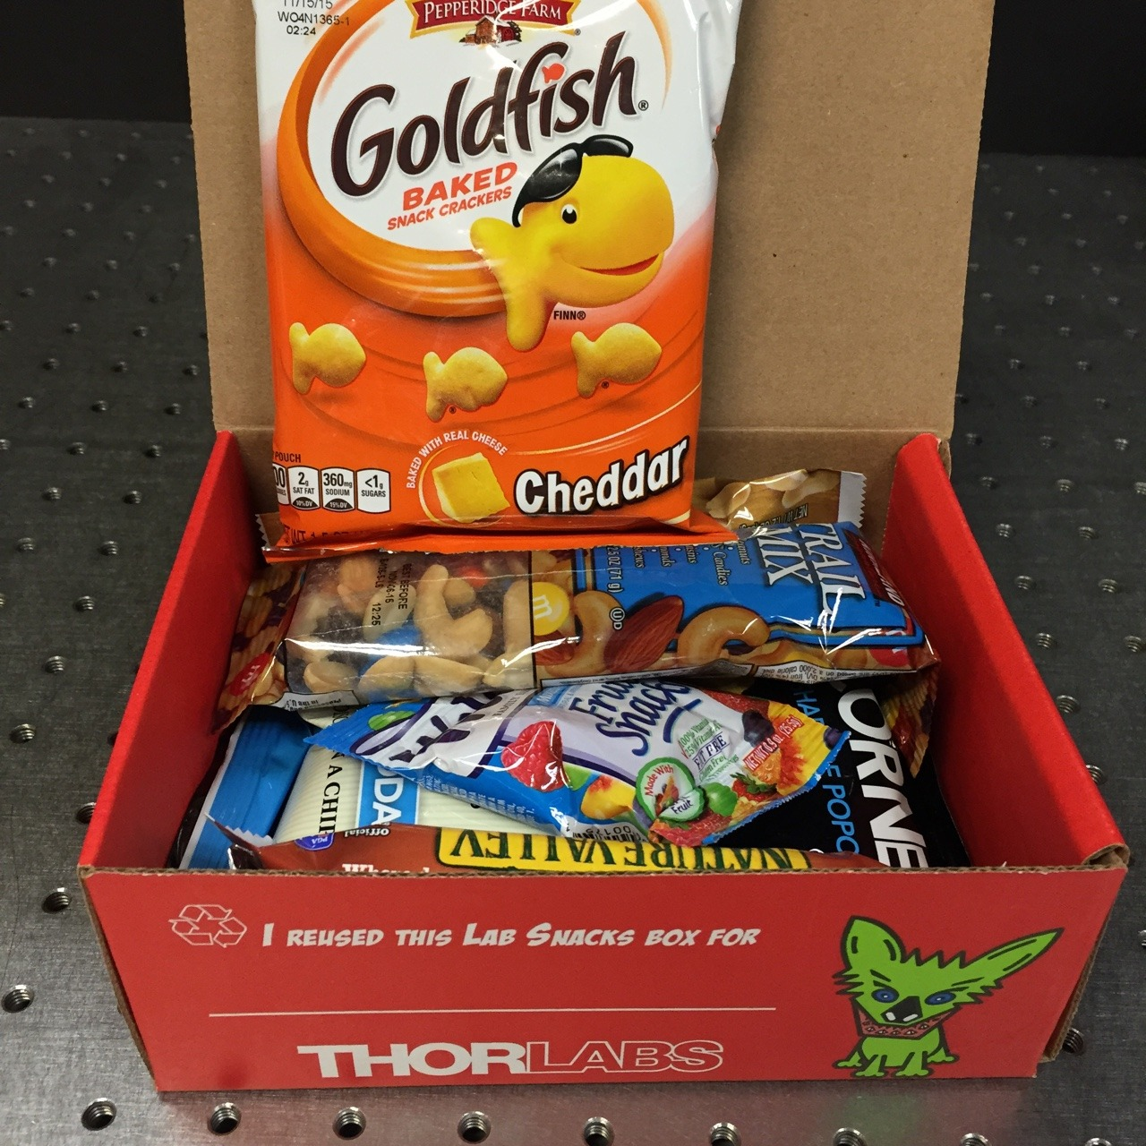
It’s real!
Notes:
Here I’m showing some of the goods that have arrived:
- the Multicore Workstation
Some of the kinematics for the THz detector
And the most surprising one: Lab snacks from THORLABS! Below that you can see one of the breadboards.

Slide 14

Simulations
Notes:
I will now summarize what have been done to build a machine model taking into account Space-charge

Slide 15
Codes
Complete simulation of the full machine.
ASTRA (A Space-Charge Tracking Algorithm), Desy
Low energy beamline
ELEGANT (Electron Generation And Tracking), APS, Argonne National Laboratory
High energy beamline
Integration with ASTRA
Multi objective opt.
Fast solutions explorer
Statistic mode (jitters)
Developed features:
Multi-position optimization
Rotated frames handling
Calculation of dispersion
GIOTTO (Genetic Interface for OpTimizing Tracking with Optics),
INFN, Milano
Notes:
We’ll use GIOTTO, a multi objective GA developed in our group to perform Genetic a optimization of BD thanks to its ability to drive Astra.

Slide 16
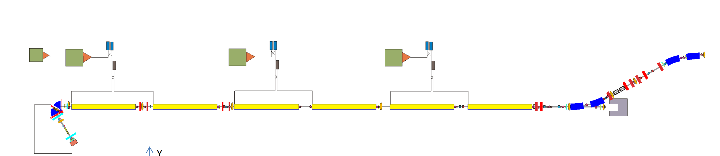
Starting point
Bunch
I tried to build a reliable simulation of the Linac with ASTRA.
Starting point:
An elegant lattice of the linac and one of the ring.
A simulation from elegant @ 95 MeV with an ideal input bunch.
Notes:
The “Linac Report v 7.7” considers a different gun max field (125 MV/m instead of 80, +56%).

Slide 17
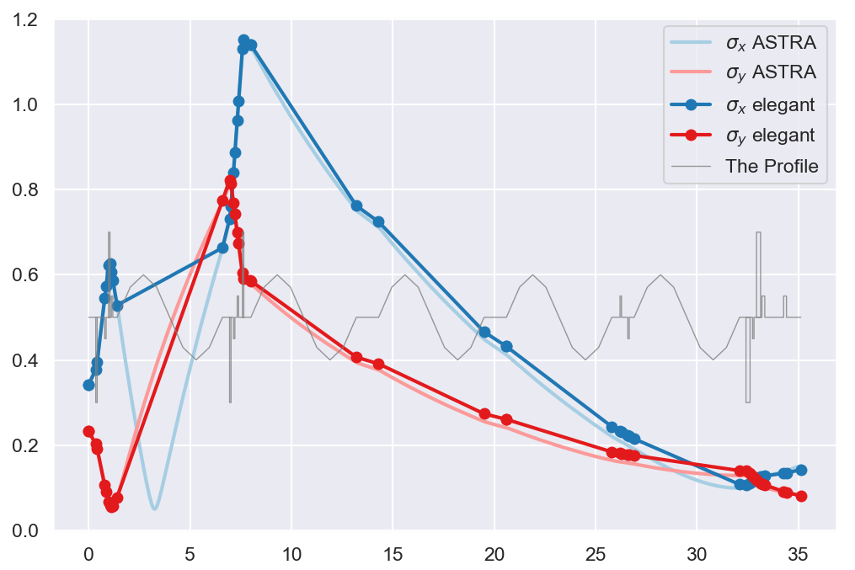
Comparison
Lattice alignment after tuning quadrupoles bores radii and using original cavity field:
σ_{x/y} [mm]
Z [m]
Notes:
In fact I started from this bunch to sync. the Astra results with elegant ones

Slide 18
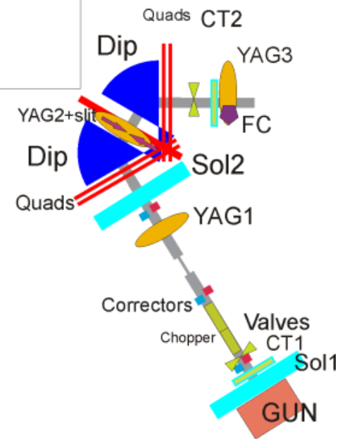
Injector
Thermionic RF-Gun
½ + ½ +1 cells structure in π/2 mode
RF
Short - Solenoids
S-band TW
Beam Chopper
15 cm long stripline pair
Energy filter
120° total bending

Slide 19
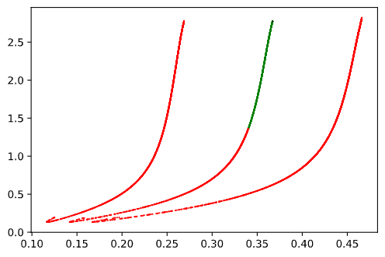
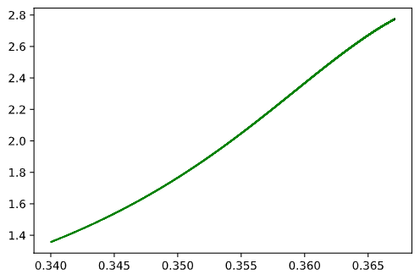
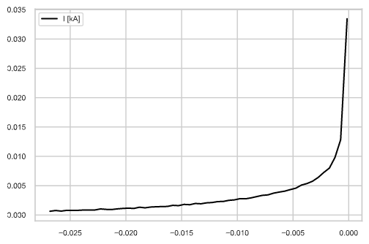
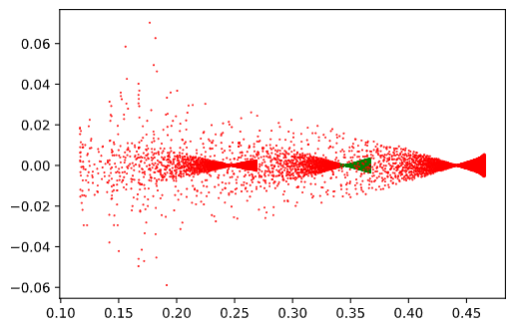
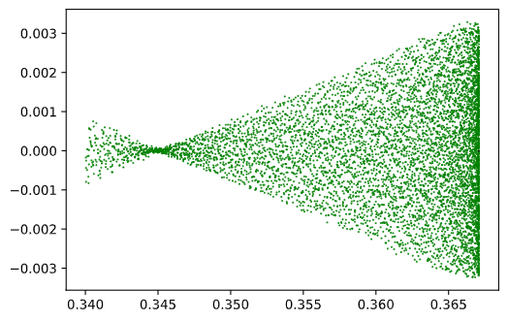
Cut after gun
Slice Current (500 µm bins, 54 slices)
E [MeV]
E [MeV]
Beam Cut (7.1 %)
σ_{x} = 0.910 mm
σ_{s} = 8.68 mm
ε_{n,x} = 5.2 mm mrad
<E> = 2.34 MeV, E_{sp} = 197KeV
Q = 106 pC / 6.78 kMP
I [kA]
z [m]
z [m]
X [m]
X [m]
Dz [m]
z [m]
z [m]

Slide 20
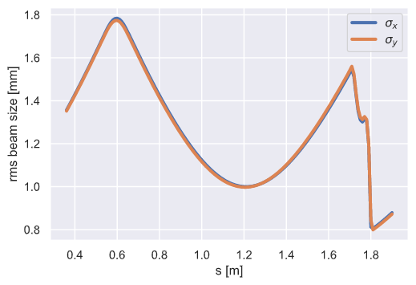
Chopper slit
Aperture radius: 2 mm
Survived: 71% (75 pC)

Slide 21
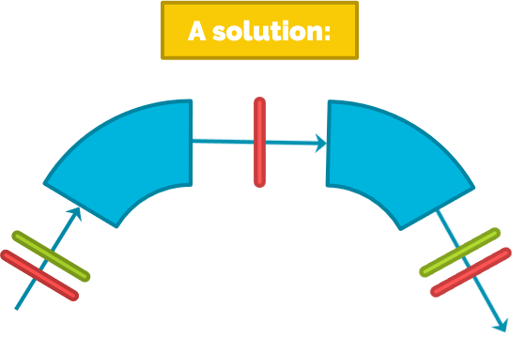
Filter simulation
It is difficult to deal with back-propagating bunches in Astra
Development of GIOTTO and Postprocessor to better deal with rotated bunches.
We requested an ad hoc modification of ASTRA to
K. Floettmann.
Notes:
The beam enters oblique way

Slide 22
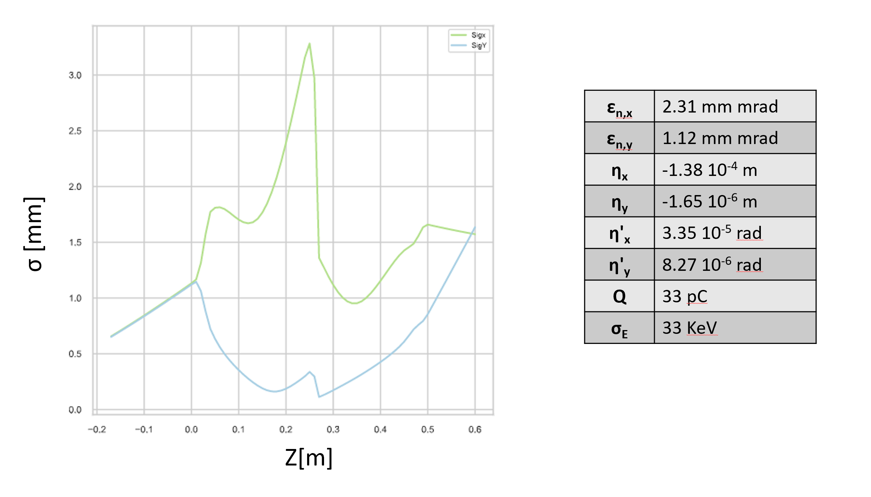
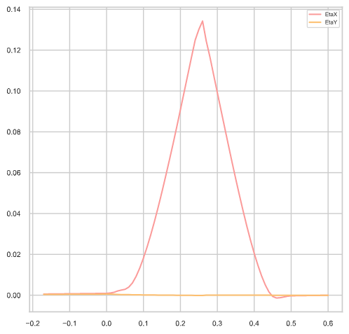
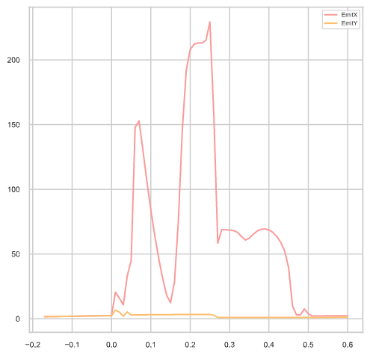
Filter dynamics
After correction of the horizontal offset of quads and aperture.
ε [mm mrad]
Z[m]
Z[m]

Slide 23
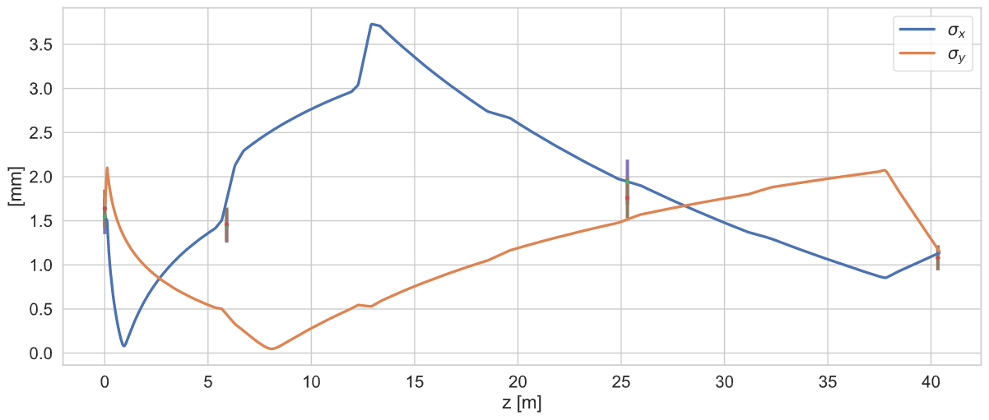
Booster size match
UNIT 1
UNIT 2
UNIT 3
RF
RF
RF
RF
RF
RF
Line: 35.12 m
I will have to match beam spotsizes measured along the line in several points
ε_{n,x} | 3.3 mm mrad
ε_{n,y} | 3.0 mm mrad
Giotto is now capable of doing it (multi-markers optimization)
Elegant line is correctly aligned to Astra elements (Cavities and quad bores)
Emittance is spoiled by high transverse dimensions.
Transverse dynamics after filter is difficult to control.
Notes:
The setting obtained is the following, emittance is spoiled by chromatic aberrations induced by the big transverse dimension in part of the booster.
However, I am confident that this solution can be improved with some more work.

Slide 24
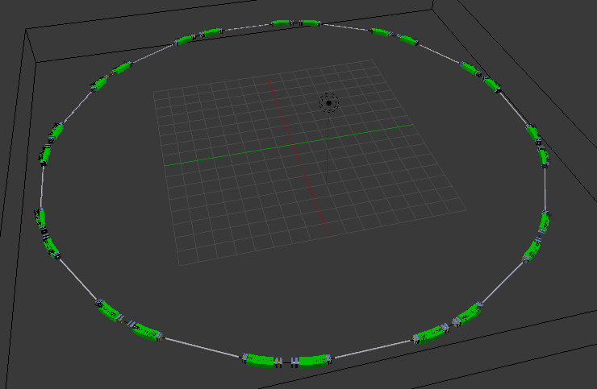
Ring model
24
Courtesy of I. Drebot
Notes:
After we will move on the elengant transport into the ring. The lattice is available and here you can see its 3D-geometry created by Illya Drebot.
The TL have still to be added.

Slide 25
What Next?
Notes:
To end this presentation, I would like to share what I think should be the next steps.

Slide 26
Simulations
26
Final refining of linac optimization.
In elegant transport beam into the transfer line - matching to the ring DBA.
Transport into 12 DBA (1 ring turn).
Simulate beam chirp & verify compression.

Slide 27
Detectors
27
Wait for last two orders.
Assemble and align the detectors in Frascati. (with E. Chiadroni)
Shipment of detectors to Solaris
Compression experiments should be performed in second half of ‘22

Slide 28
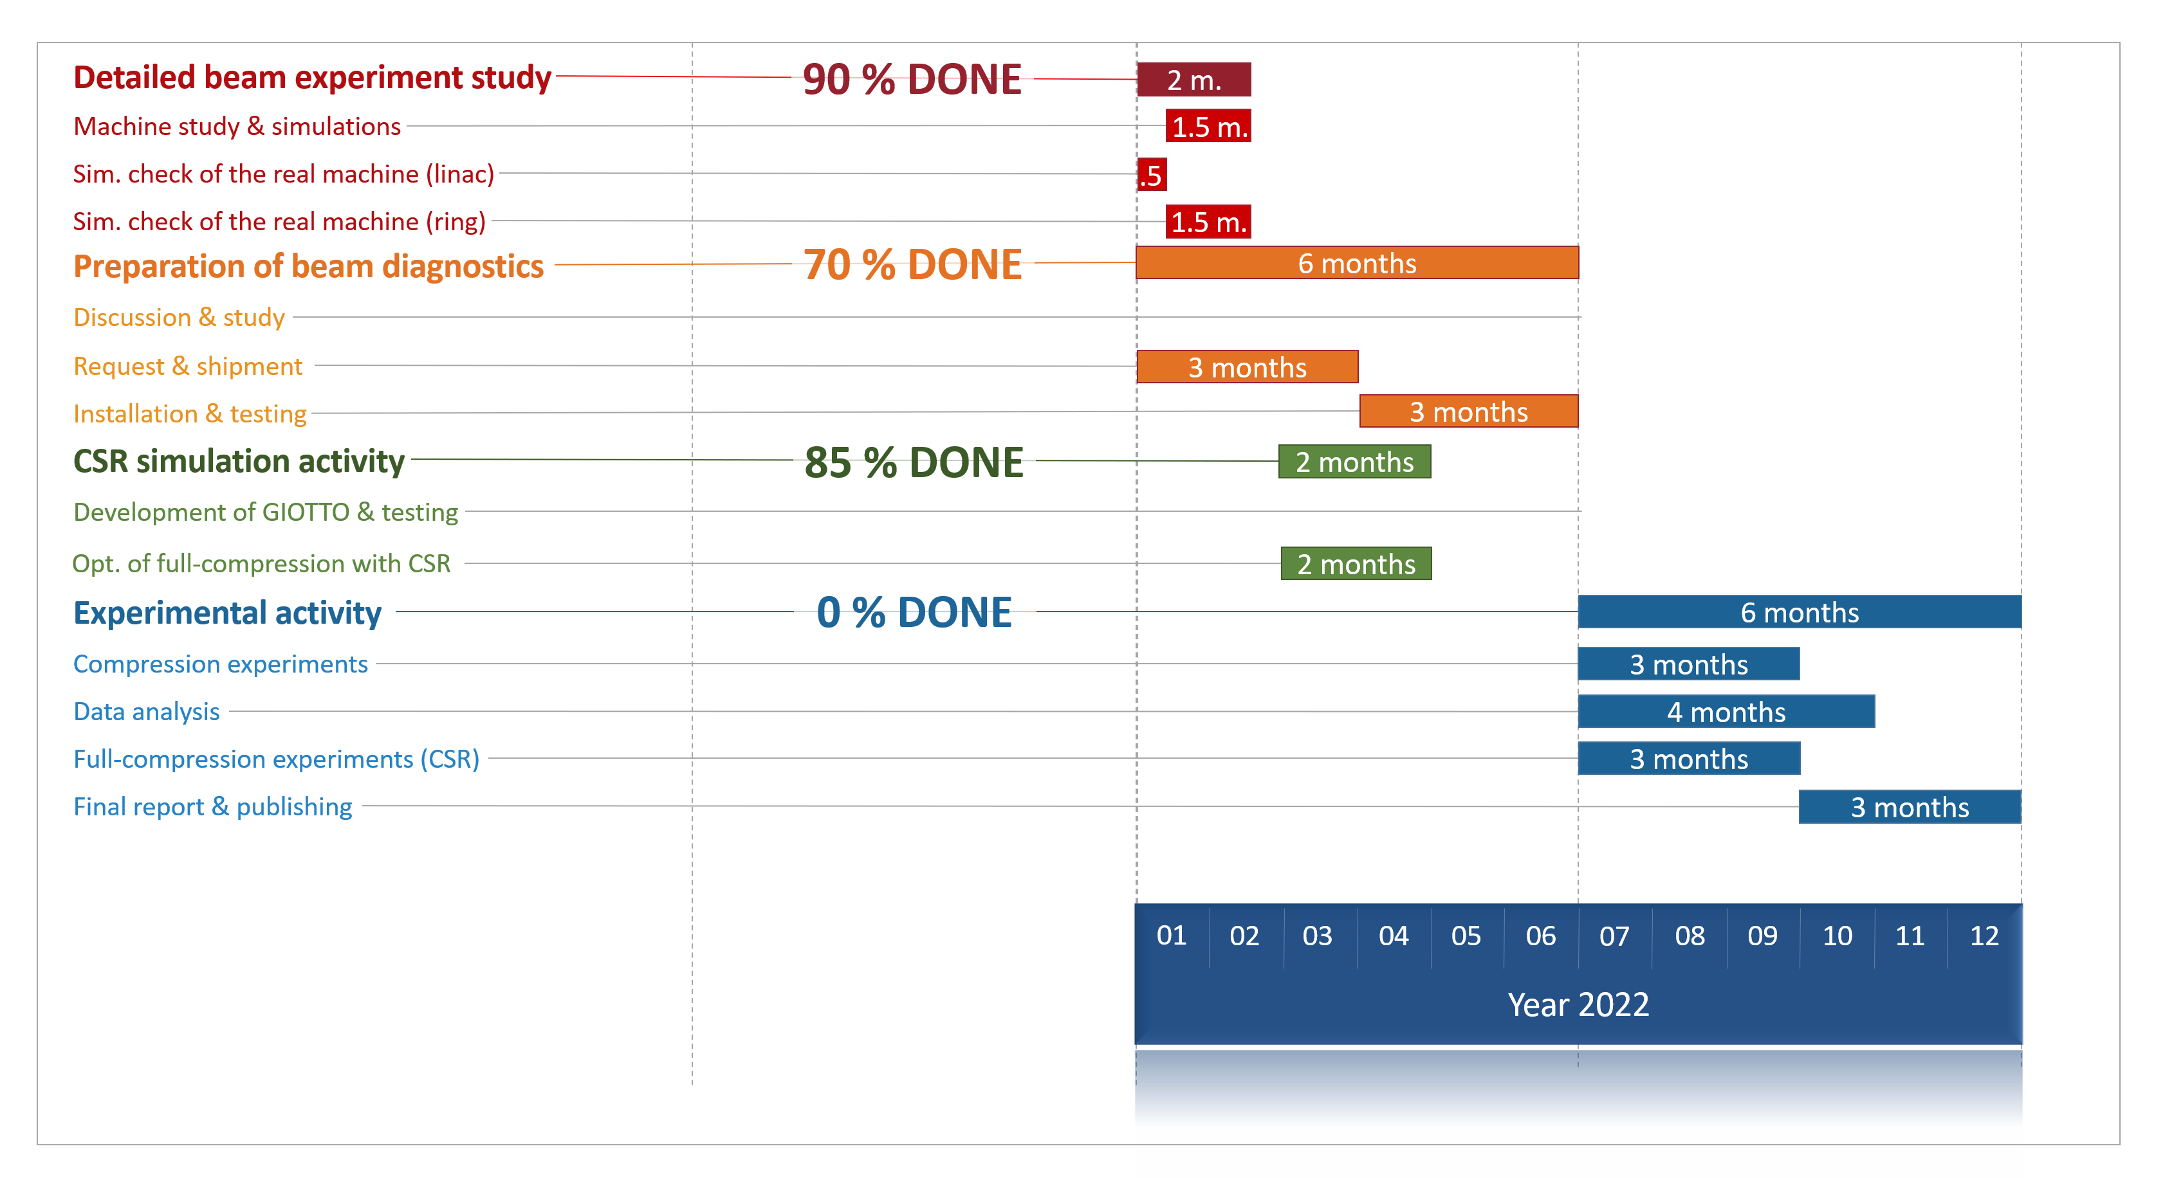

A possible ‘22
Notes:
This gantt is showing how the remaining activities could be organized in time
The machine model will be completed in the first 2 months. And the WP for maximum compression will be investigate in the following two months.
I suppose the apparat preparation will be completed in the first half of the here to move of the compression experiments in the first half.

Slide 29
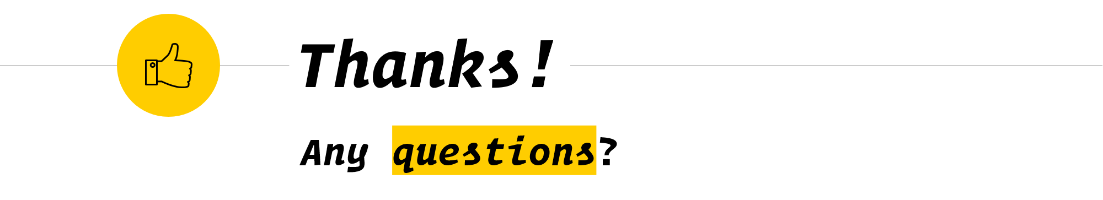
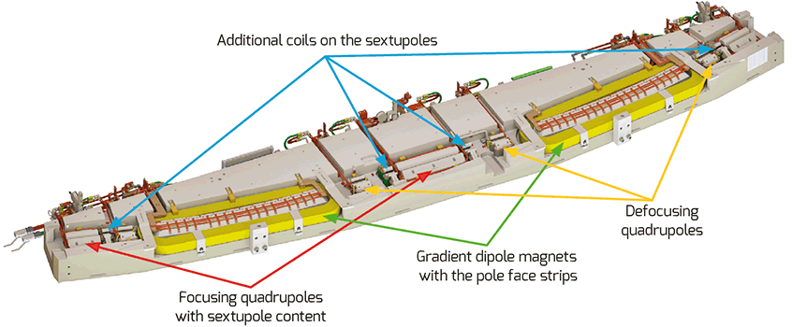
SOLARIS DBA

Slide 30
Bonus material

Slide 31
Credits
Special thanks to all the people who made and released these resources for free:
Presentation template inspired by SlidesCarnival
Icons from Flaticon

Slide 32
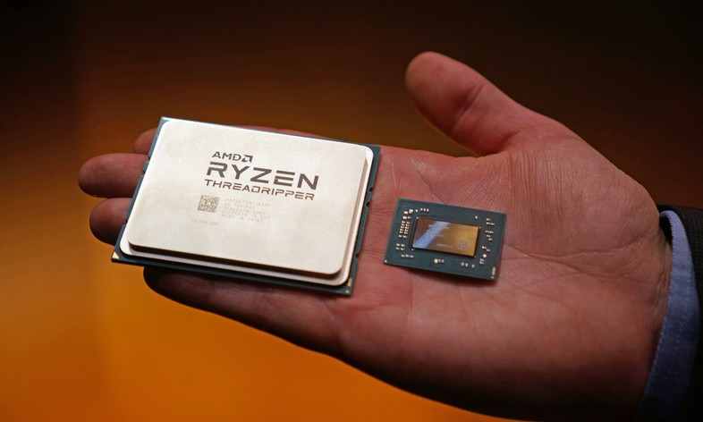
Workstation
I studied an optimal configuration of the machine given funds (8 k€) and requirements (High number of CPUs) fast and big Memory and Hard Drives.
Tower Workstation
After almost 6 months (Jul)
SHOULD ARRIVE BY DAYS!
AMD Ryzen Threadripper 3990x (4.0 k$)
64 Cores, 128 Thread (Clock 2.9GHz / 4.3GHz)
G-Skill 256 GB RAM DDR4 3200 MHz
Asked 5 companies for quotations of the setup
Computer Specialist (not on mepa)
E4
DPS Informatica
Bologna Computer SNC (minor price)
Virtual Logic

Slide 33

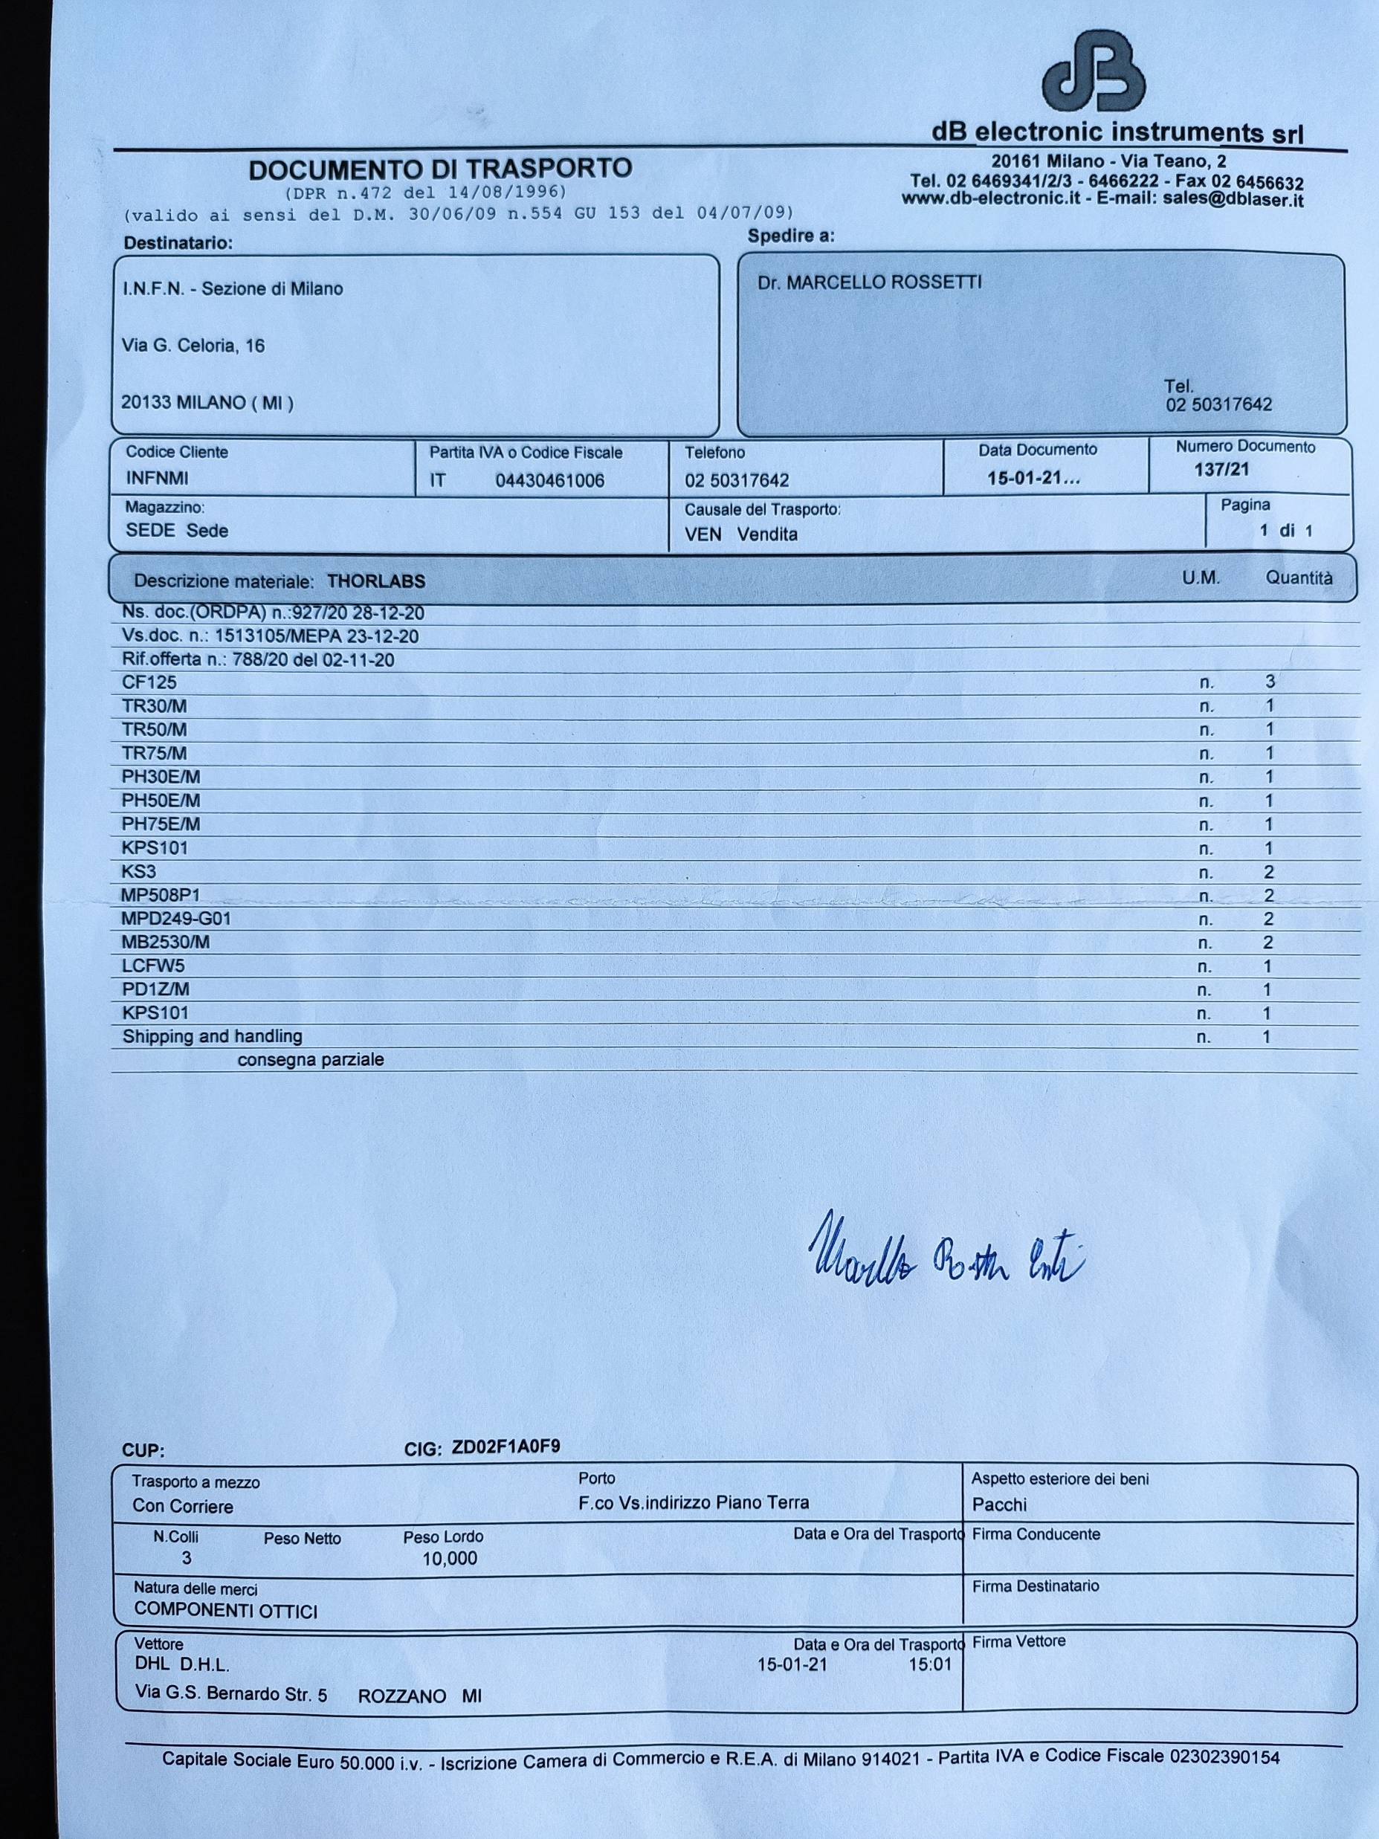
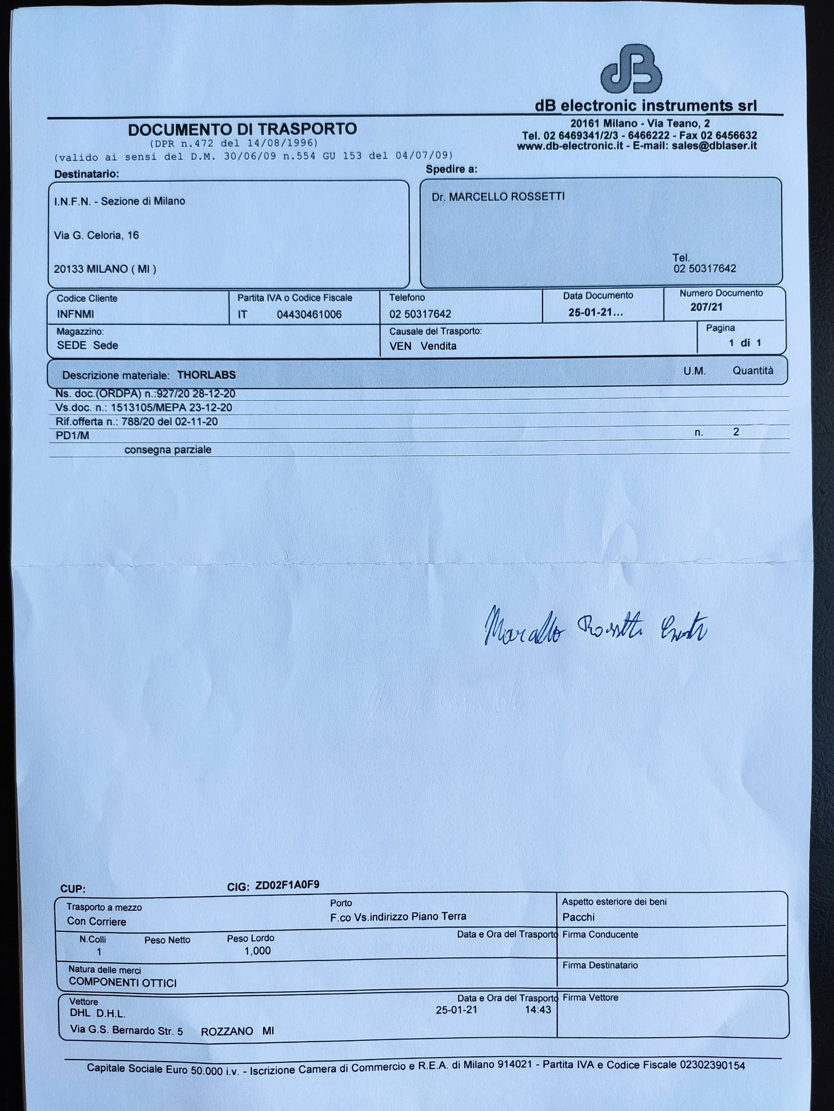
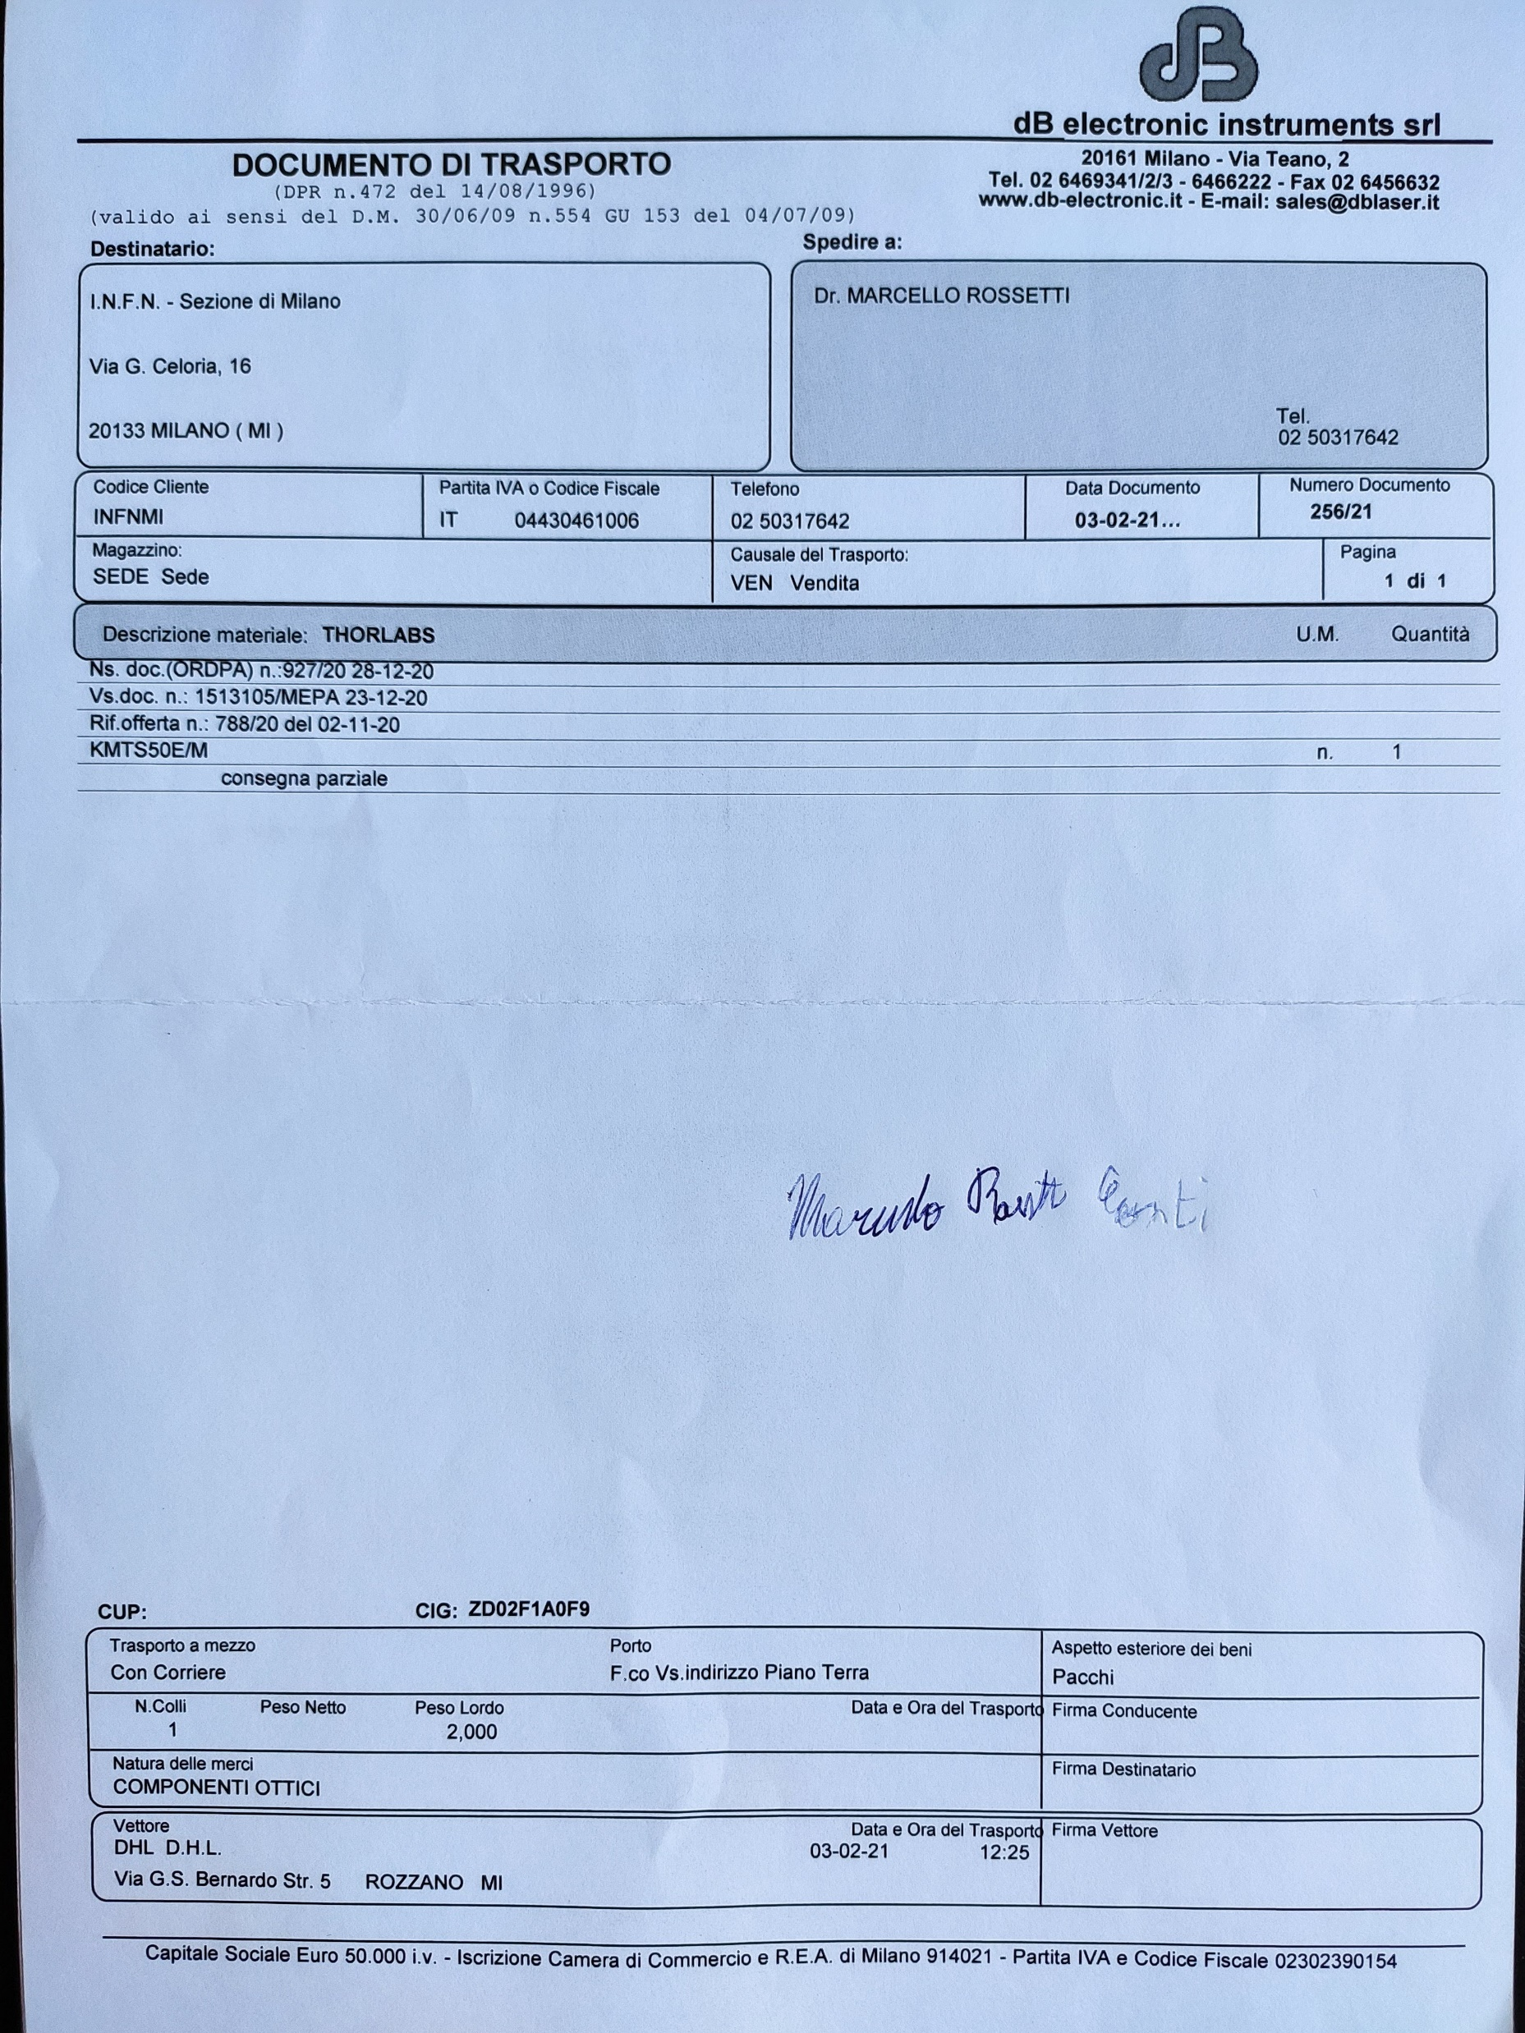
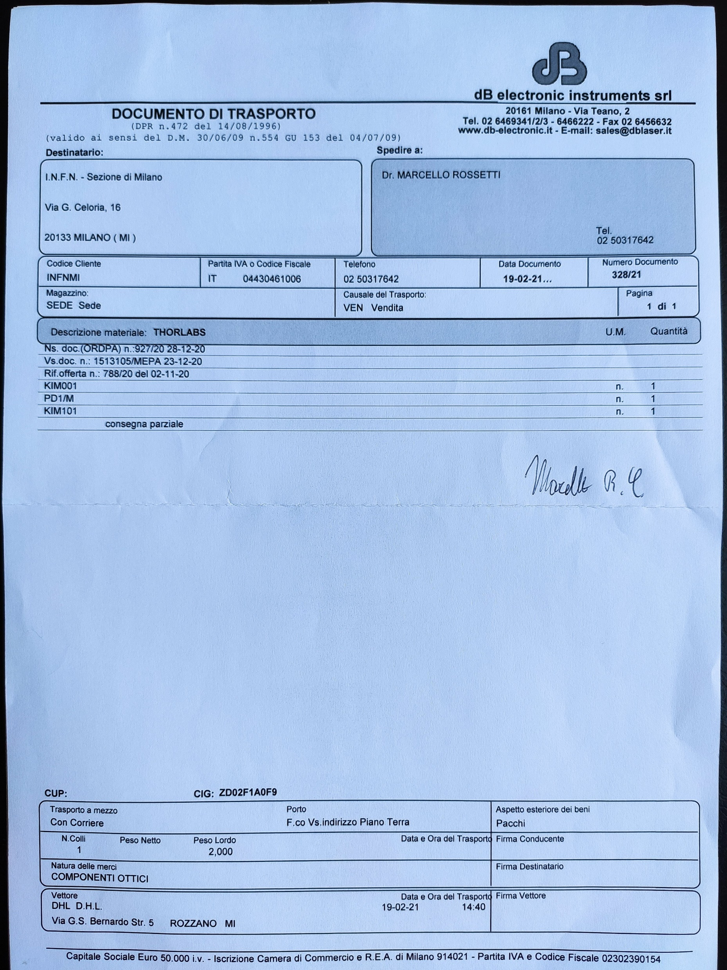
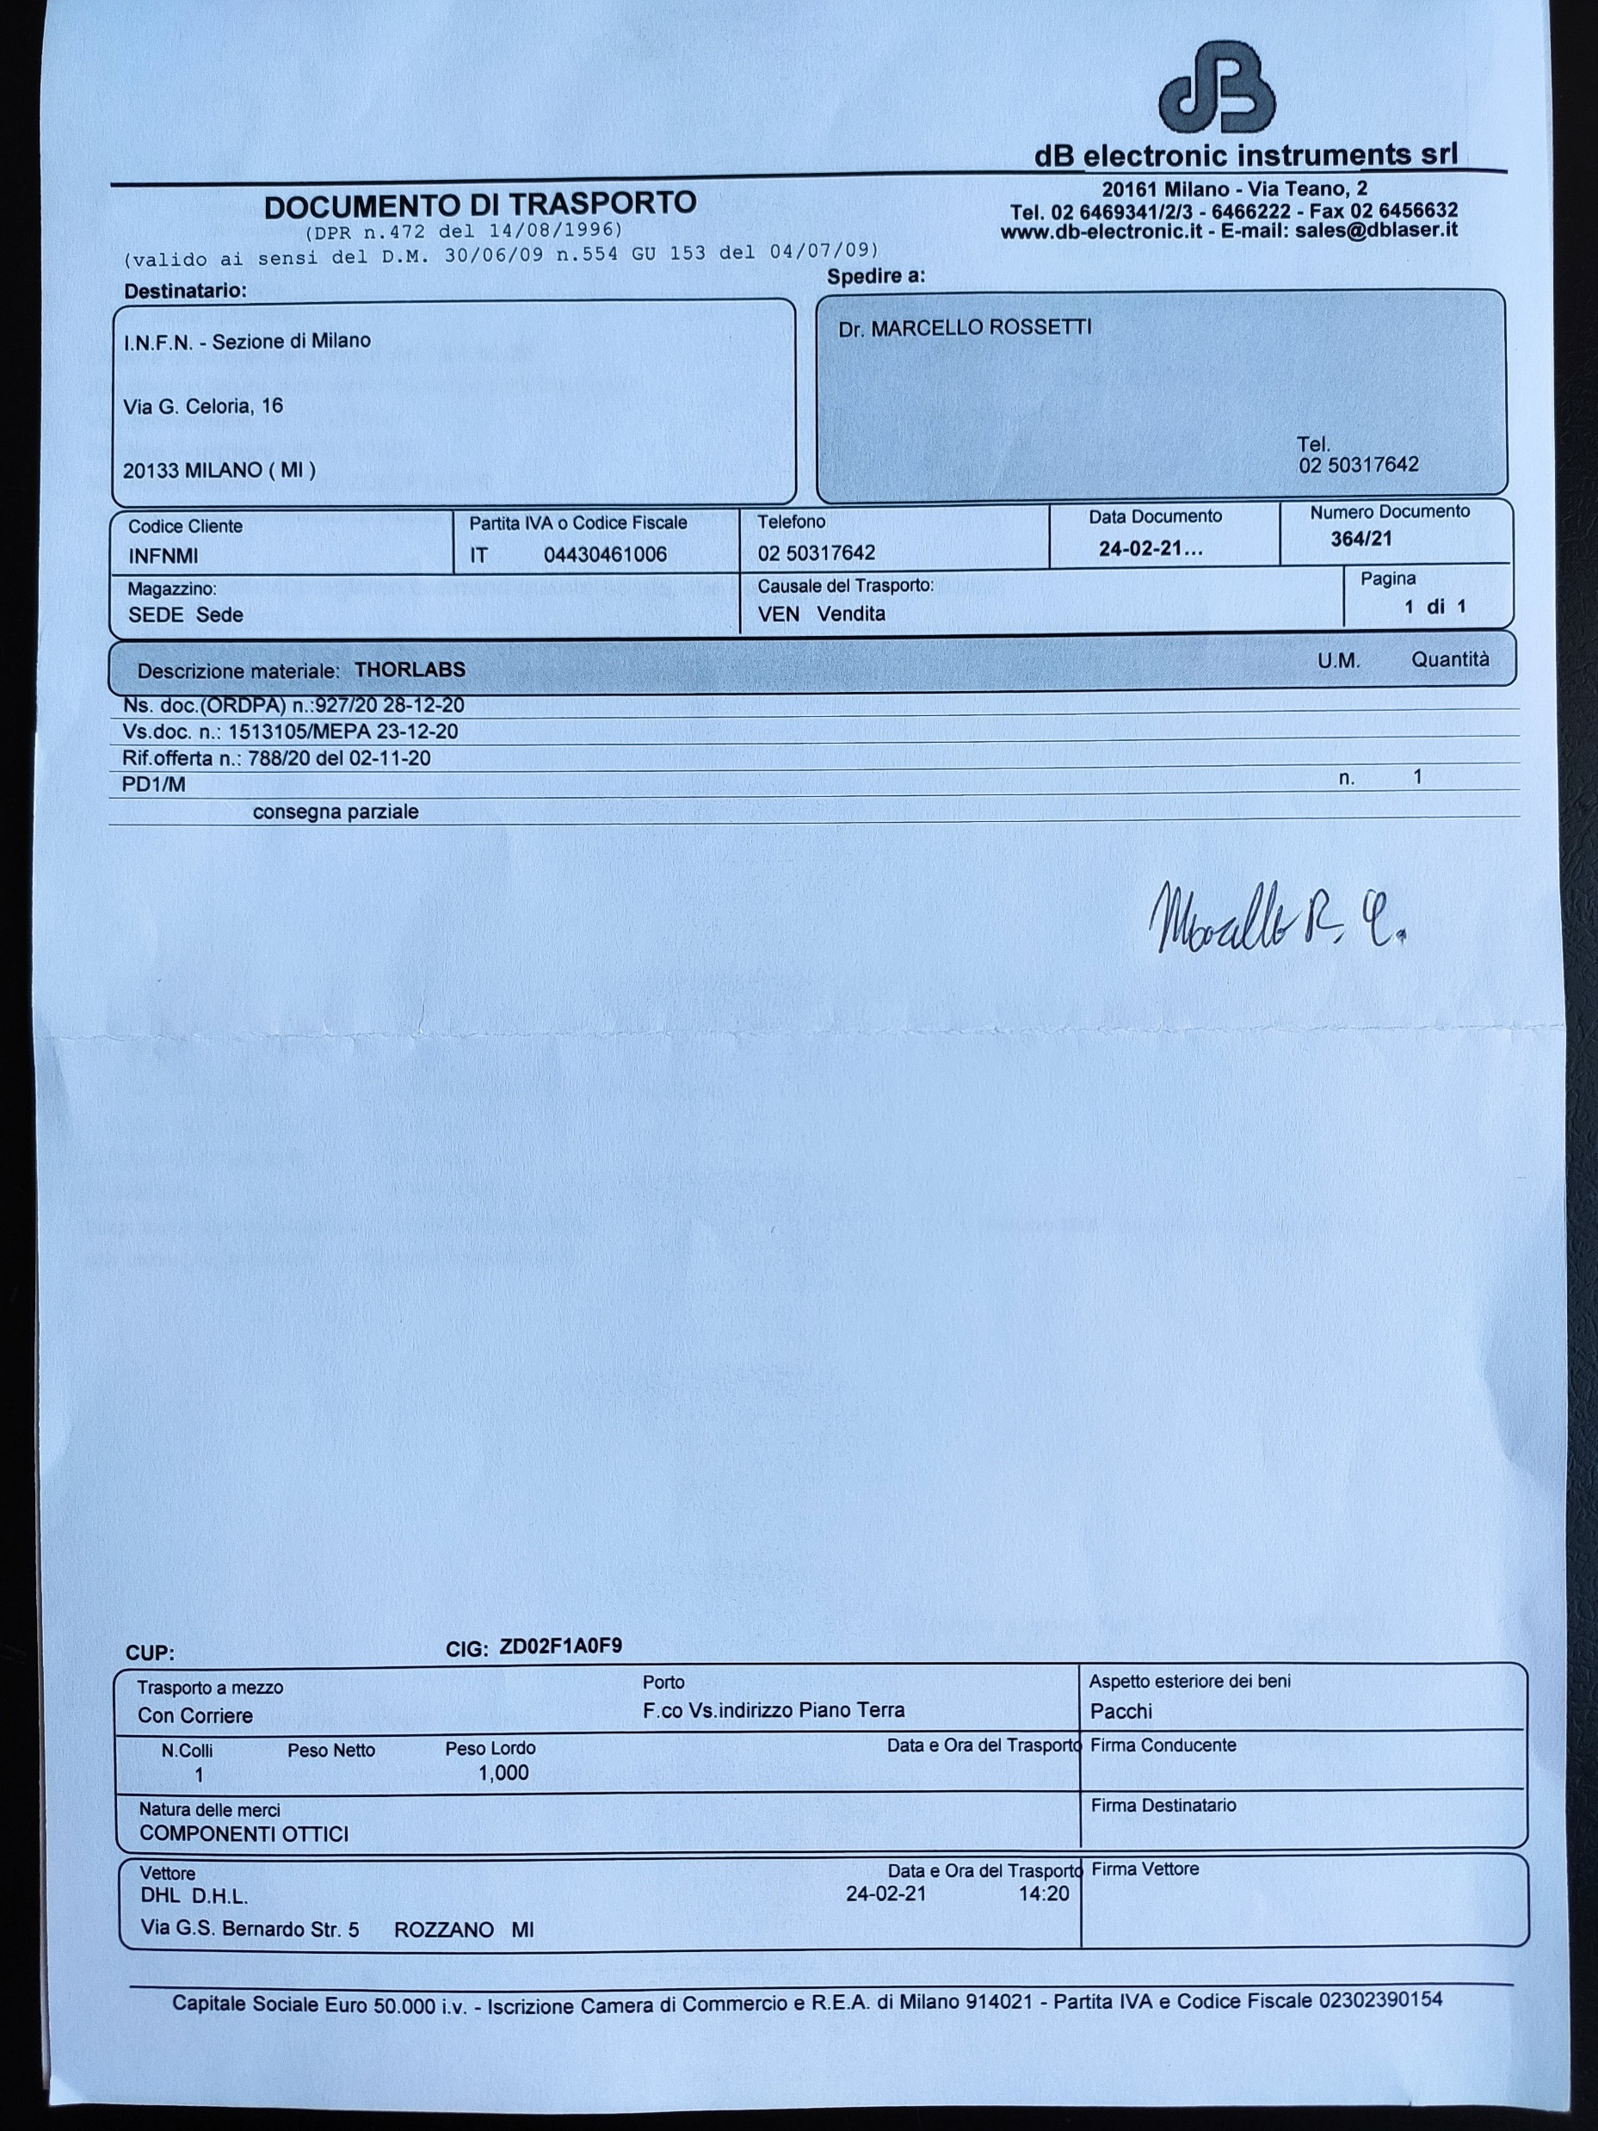
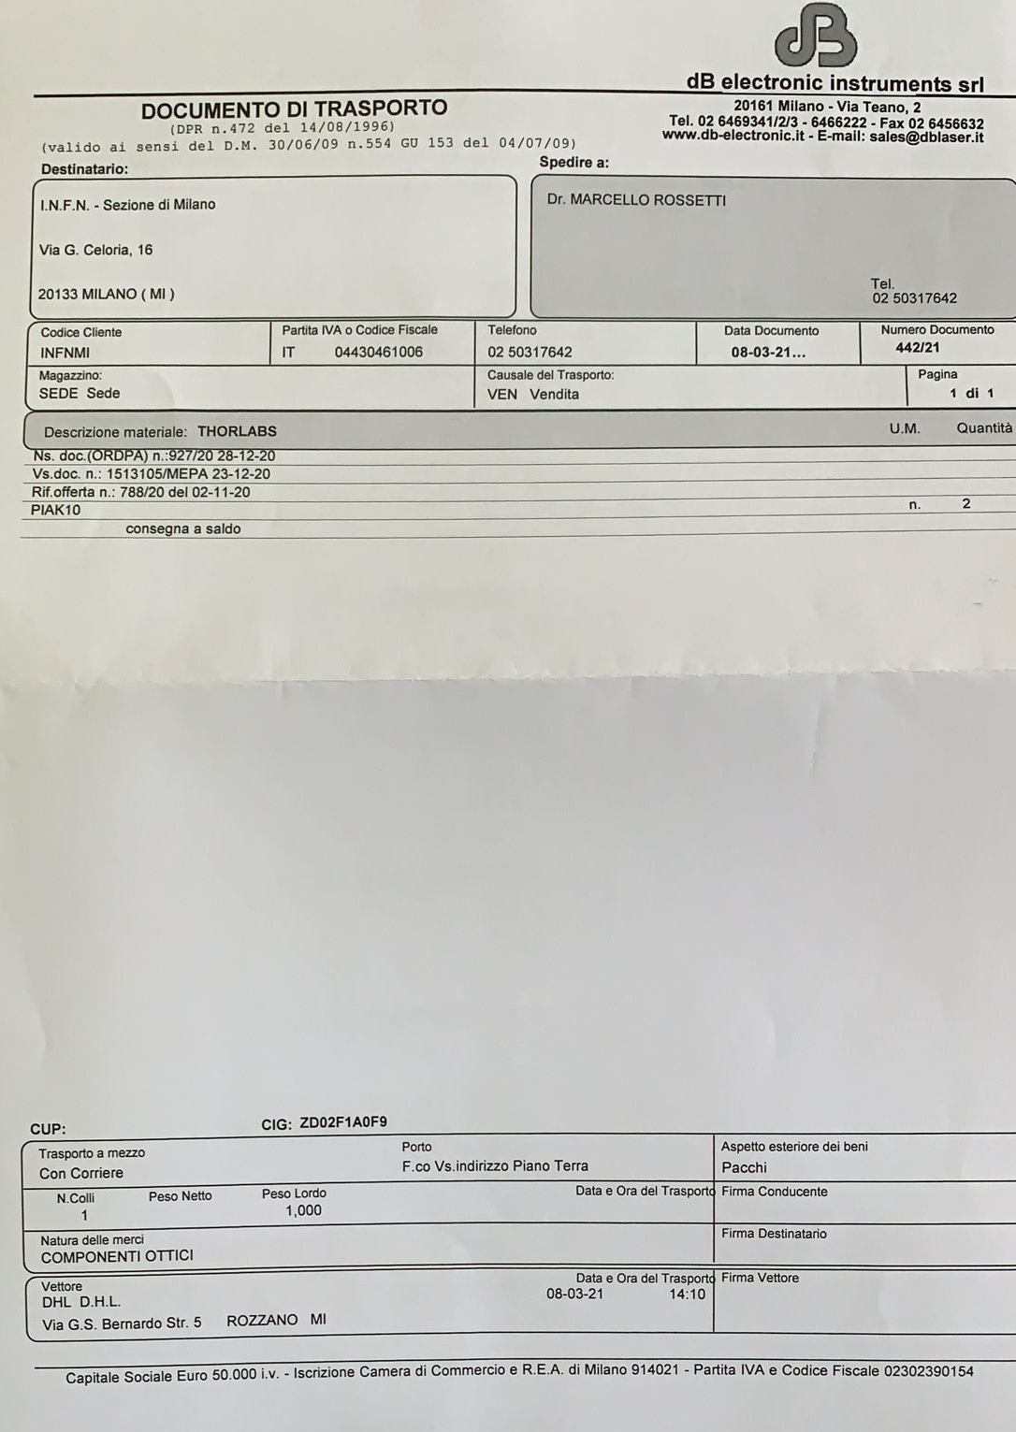
Orders!
Thorlabs order is the first one concluded!
Wrong destination (Milan instead of LNF)
The order was scattered in 6 tranches with 6 receipts
One element was wrong
The motorized pieces had to be tested in Milan by me
Everything has been repackaged and shipped to LNF

Slide 34
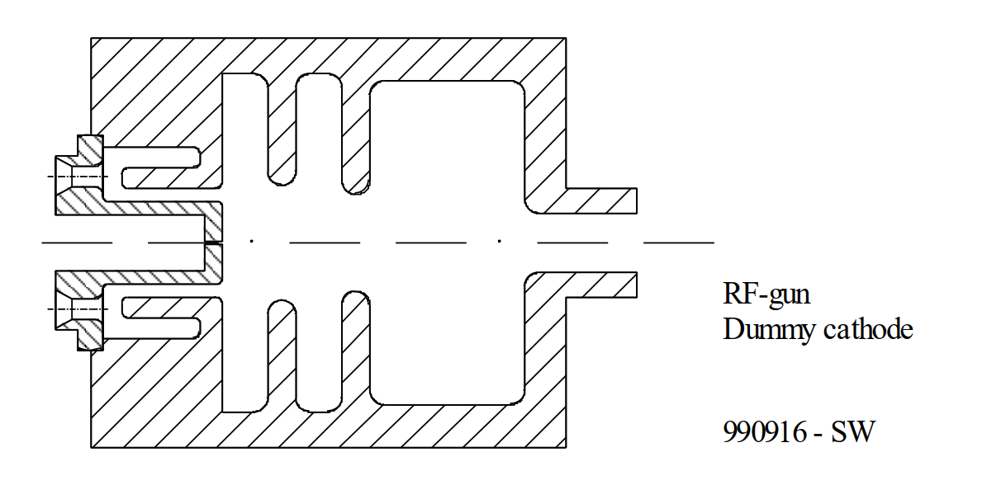
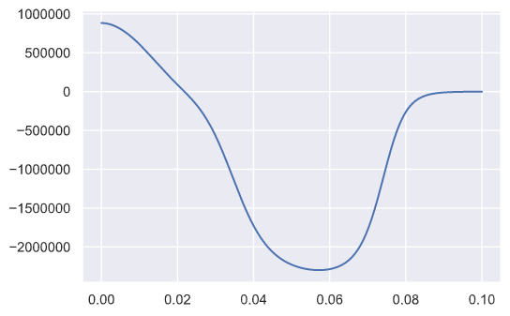
Gun simulation
E
Z [m]
@ the cathode
Laser: Flat Top
Q = 1.5 nC / 10⁵ MacroP
1000 K / 0.1 eV Therm. emit
σ_{r} = 0.75 mm

Slide 35
Chopper effect
100 ns (10 Macro-bunch)
10 ns, 100 MHz
1 ns
1 ns
1 ns
1 ns
1 ns
1 ns
1 ns
1 ns
…
9x
9x
9x
9x
9x
9x
9x
9x
333 ps
Selects 1 macro-bunch every 10 ns (100 MHz operation)
Gate of 100 ns

Slide 36
Filter test
Reference orbit
Why took so long? (5 months intead of 2)
Total charge was too high (discussion with Curcio)
Aperture radius had to be increased (asked the real value to Adriana)
The plane of the final quadrupoles intersects the trajectory (Astra modified by Klaus F.)
Space charge needs a very big 3-d mesh (beam is long and dispersion enlarges hor. dimension a lot). Slow down
Beam centroid strongly off-center when the beam is dispersed
leading to offsets in the quads and aperture (other dispersion).
When dispersion closed the beam divergence was too big for safe travel through quad bore.
Bends
Slit
X [m]
Quads
Solenoid
Start
Z [m]

Slide 37
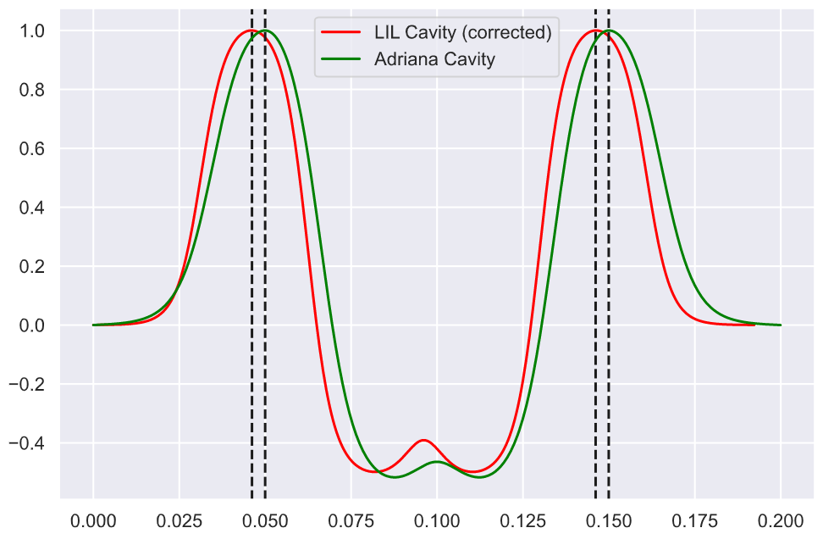
Cavity studies
LIL TW Cavity
Freq: S-band 2998.55 MHz
Cell L: 99.981 mm
Total: 156 cells - 5.2 m
L-Field [A.U.]
PSI TW Cavity
Freq: S-band 2998.55 MHz
Cell L: 99.959 mm
Total: 156 cells - 5.2 m
Z [m]

