Slide 1
Update on the RICH simulations
Chandradoy

Slide 2
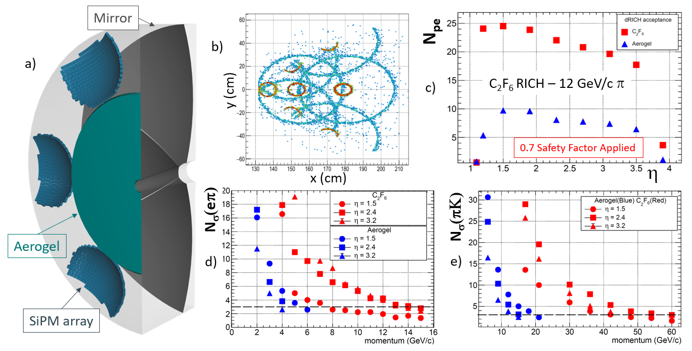

Slide 3
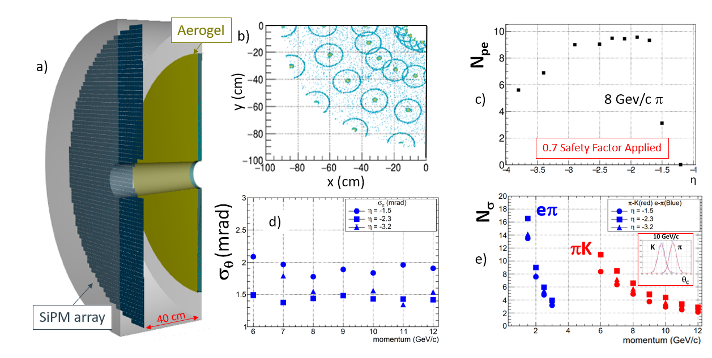

Slide 4
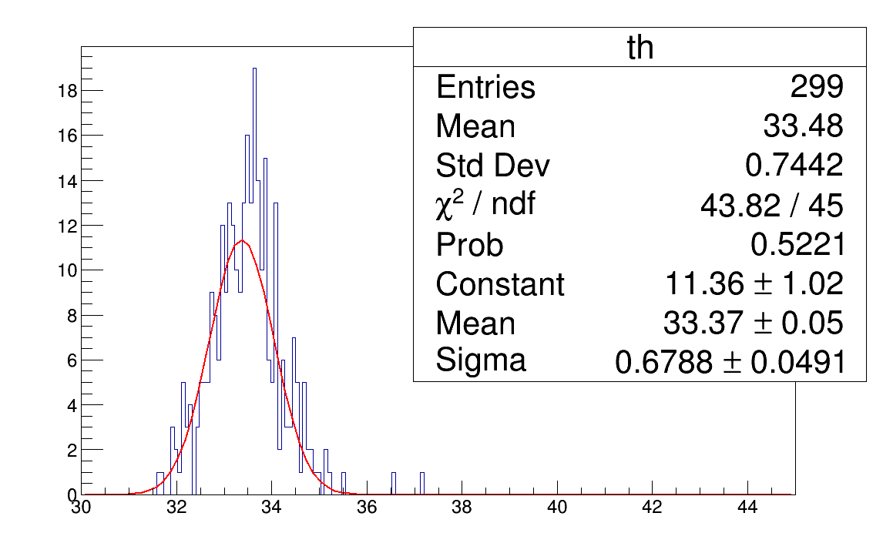
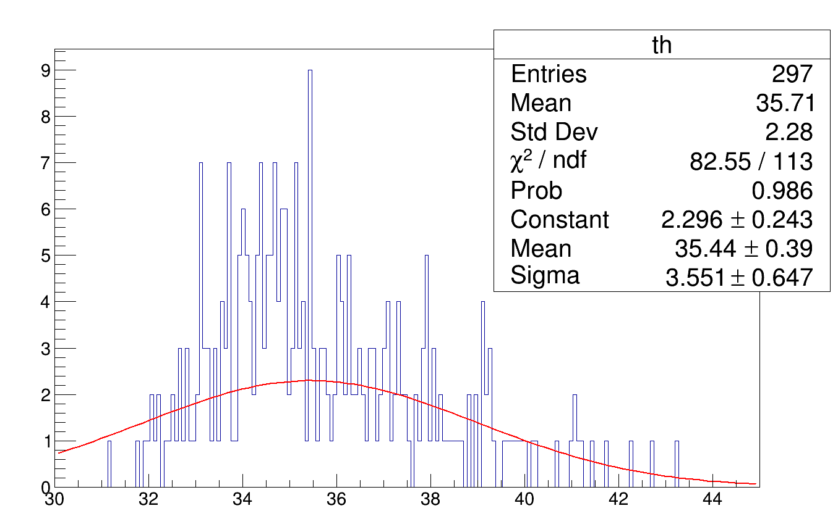
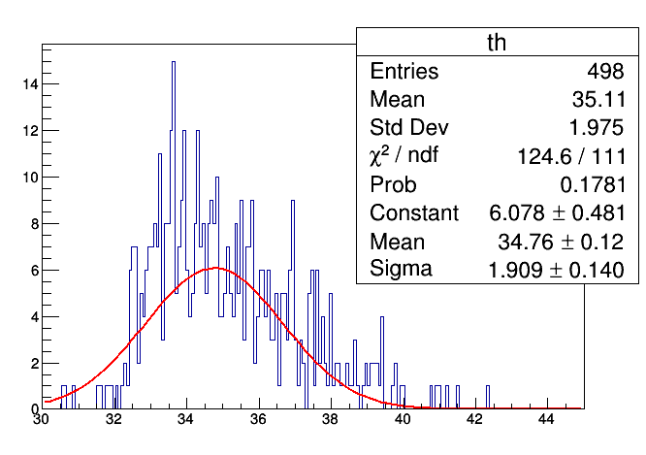
B ON
B OFF
Eta 1.2; 7 GeV pion
Single photon resolution ~ 10 mrad!
Factor 3 worse than expected. Similar studies made in eta 1.5 (Where we have Geant4 studies from satndalone)
Same effect!
Studies will be made to cure possible bugs or whatever. Things can improve than current situation!
Eta 1.5; 7 GeV pion
B OFF res ~ 0.4 mrad

Slide 5
Ongoing tasks: 1. Text for the supplementary materials is getting prepared. (Will be discussed this evening!)
2. Plots to be shown in the supplementary material was discussed with Alexander. Will be discussed in PID WG meeting.
3. A recent observation shows in dRICH we see worsen resolution in ring theta than expected in B field. Yesterday I cross-checked October 11th Results. They seem correct. Step by step verifications on going.
Questions: 1. When is the deadline for the sup. Materials? 2. Will it be standalone for each detector modules? Or we will follow something similar to Oleg’s Calorimeter reference.

