Slide 1


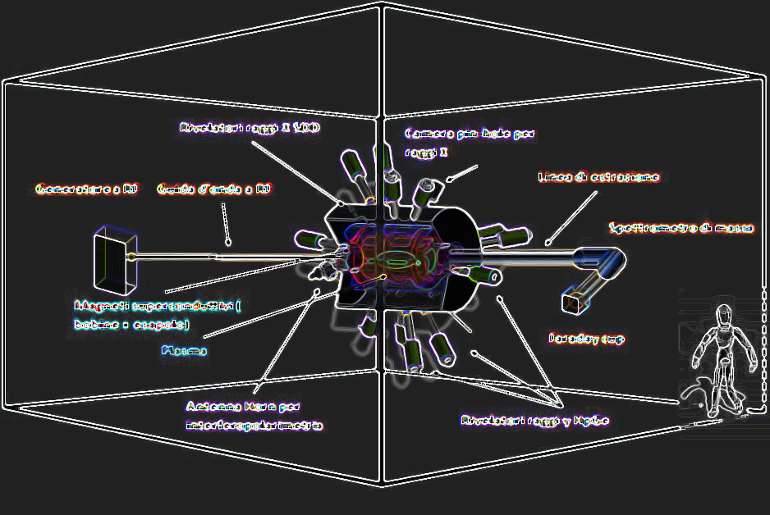

Closing Remarks:
A brief report of the meeting
David Mascali (LNS-INFN)
on behalf of the PANDORA collaboration

Slide 2


PANDORA Timescale – GANTT “master”
David Mascali - PANDORA Collaboration Meeting – 16-17 Dec 2021
2020 2021 2022 2023 2024 2025
Trap’s design, procurement, installation and commissioning
X-ray and interferopolarimetry upgrades
OES → plasma opacity preliminary studies
GAMMA-PANDORA agreement:
HpGe det. @ LNS
Space-time characterization of the whole EEDF
PANDORA plasma characterization
PANDORA Phase-1 experimental run

Slide 3
Meeting Summary-1
MAIN SUBSYSTEMS UPDATES:
    Trap requirements were defined and procurement officially started in 2021: Competitive Dialogue will last Jan.-Apr. 2022 to choice the BEST TECH. SOLUTION (talk by G. Mauro, L. Celona)
    PANDORA-GAMMA Coll. Agreement signed in Oct. 2021 → know-how/expertise transfer started with joint actitivies between LNS-LNL. HpGe lab realization ongoing @LNS. GALILEO detectors will move to LNS in early 2023 till late 2025. Data acquisition system has to be discussed and properly defined (talks by D. Santonocito, A. Gausduff)
    RF system has been designed consisting in 3 high power Kly+possible use of TWT for MFHeating. 2 KLY already procured with MW ancillaries (talk by G. Torrisi)
    PANDORA is a pilot-project within INFN for implementing Proj. Management tools and “philosophy”: PBS, WBS and RBS already defined. RAM to be completed in details in the coming months. It is a flexible tool to manage complexity and risks (talk by V. Bonanno)
    Isotopes procurement: detailed estimates based on measurability plots have been done. Procurement of commercial or non commercial isotopes has still to be discussed with more details, also including radioprotection issues (talk by A. Galatà)

Slide 4
Meeting Summary-2
MODELS & THEORY
    More advanced stellar models (both including MHD and nuclear data input) are promising for explaining nucleosynthesis elemental abundances in stars. We have an unprecedented occasion to make a detailed investigation of most significant physics cases still needing new nuclear inputs, in particular β-decays data never measured in plasma up to now (talk by S. Palmerini, M. Busso)
    New fully quantum-mechanical models are proving to be exceptional tools to investigate β-decays with unprecedented precision: 134Cs data are already in publication, new simulations will run in 2022 for the other PANDORA relevant isotopes (talks by S. Taioli, S. Simonucci)
    It is extremely interesting to investigate β-decay dependence on the density and temperature, exploring nLTE (laboratory plasma) vs LTE (stellar) plasma, in order to focalize which thermodinamical conditions are accessible by PANDORA, then rescalable to stellar scenarios (talk by A. Mengoni)
    Starting from β-decay calculations, attempts are ongoing to make a kind of «virtual experiment», including the in-plasma distribution of density and temperature, in order to provide convolved expected decay rates in the PANDORA plasma (talk by B. Mishra)
    Investigations about self-consistent plasma modelling via Particle-In-Cell simulations is now progressing including stepwise ionization, charge exchange processes, and ions-electrons interplay mediated by self-generated electrostatic fields (talk-#2 by A. Galatà)

Slide 5
Meeting Summary-3
PLASMA DIAGNOSTICS
    X-ray diagnostics have been developed both to provide as volumetric as space resolved information, also including spectroscopy, reaching 0.5 mm spatial resolution along with 300 eV energy resolution. In 2022 shuttering systems will enable space-time characterization in sofr X-ray domain (talk by R. Racz)
    Algorithm for PhC analysis of X-ray pin-hole camera systems has been now completed, providing exceptionally high Signal-Over-Noise ratios (including read-out noise removal) and the possibility to get HDR X-ray plasma images including spectroscopical information (talk by E. Naselli)
    Development of appropriate models to retrieve local reliable estimates of plasma parameters (namely, density and temperature) is ongoing. Preliminary data are already available and fits of models on available volumetric and space-resolved experimental data are in excellent agreement ( talk-#2 by B. Mishra)
    Microwave diagnostics: the upgrade of the VESPRI interferopolarimeter is ongoing (from 20 to 100 GHz operative frequency domain), and Microwave-Inverse-Profilometry seems to be a powerful tool to retrieve 1D profiles of the plasma density (talk-#2 and #3 by G. Torrisi)
    Incoherent Thomson Scattering has been proposed as a powerful tool to probe in a non-invasive way the density and temperature of PANDORA electrons in the range eV-3keV. The PANDORA density seem to be promising for having high sensitivity. Dedicated meeting needed to define accesses for the laser and diagnostics (talk by S. Tsikata)

Slide 6
Meeting Summary-4
MAIN SUBSYSTEMS: challenges and perspectives
    Active Plasma Chamber: segmented Al chamber has been designed, 3D model is almost ready, first tests are expected in 2022. The chamber is thought to change losses dynamics of the plasma compensating Simon currents (talk by F. Odorici)
    Progresses about the tentative of implementing ICRHeating in PANDORA were reported: antenna design and first plasma simulations are promising! To be checked the impact on ion confinement and stabilty (talk by A. Pidatella)
    Overview of GALILEO detectors to be used in PANDORA was given, also considering the main challenges: high rates (> 50 KHz) and huge dataflow. Solutions about advanced electronics have been reported ( talk by A. Gausduff)
    Progresses on the oven development at GSI have been presented. Diagnostics about stability of evaporation are really useful. Prototypes for PANDORA are ready and will be shipped to Catania in Feb. 2022. (talk by F. Maimone)

Slide 7
Meeting Summary-5
PLASMA OPACITIES in PANDORA
    Structure and dynamics of Kilonovae require more atomic data, which are now incomplete and uncertain. Laboratory data can corroborate observations and models, which are still partial. Quantitative estimations are still not fully available. (talk by D. Vescovi)
    AGB stars have magnetic fields for which dynamo theory has to be upgraded including B-field production in the radiative part (where nucleosynthesis is occurring). There, B-fields can also be unstable via Tayler instability. Numerical study has been carried out. (talk by A. Bonanno)
    According to preliminar calculations, PANDORA seems to be a suitable setup to study Kilonovae ejecta opacities at plasma densities of 10^12 cm^-3 – T=1-5 eV. FPT has been used for first characterization of needed plasma parameters, while synthetic spectra tell us most promising elements are e.g. Sr-Zr ( talk-#2 by A. Pidatella)
PANDORA Outreach
    Many Public Engagement activities involving PANDORA, also including thesis (MS and PhD) → PANDORA can be an exciting field of research for young physicists and engineers
    Website is coming soon! (talk by E. Naselli, A. Pidatella)

Slide 8
2022 Agenda
2022 rough Agenda, let’s organize meetings on:
    PUBLICATION POLICY:
      We agreed to start from two-steps approach:
        during construction phase we will have a hybrid mode: each team (diagnostics, theory, etc.) publish with a short-list maybe acknowledging the project as a broad context ; However, OVERVIEW/PERSPECTIVE/REVIEW paper will include anyway all the members.
        When the setup will be ready: all the collaboration members will be routinely included, with possible shortlists (responsible/spokesperson of a given experiment, etc .) before alphabetic order
        LET’S ESTABLISH AN EDITORIAL BOARD IN I-Quarter of 2022 (members coming from main WP and Partner institutions)
    Plasma diagnostics: let’s define technical needs (views, windows, acquisition system and integration, etc.) → doodle to the task members (by dec. 31, 2021), for a meeting in weeks 3-6 - 2022
    Overall data acquisition system/architecture: data reading/writing, storage, etc. → doodle by Jan. 31, 2021 → meeting in weeks 6-9 - 2022
    Organizational issues and management: Resp. Ass. Matrix to be completed
    Joint paper according to Maurizio “trigger” of meeting’s 1st day morning: two steps:
      one for Frontiers Special Issue (whislist, by Feb. 28, 2022),
      another one, for half of 2022, involving the whole collaboration (detailed feasibility of the whish list-cases)
    Meeting on isotopes procurement and radioprotection
      doodle by Jan. 15, 2022, meeting in March 2022

Slide 9
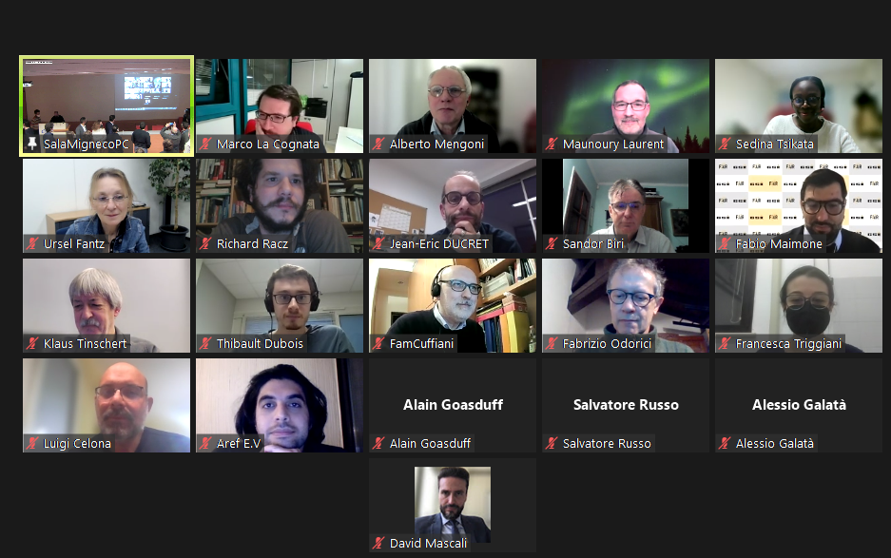
“hybrid” photo-taking process was… more or less successful!! THNK YOU ALL (Speakers and Attendees) FOR YOU PARTICIPATION AND CONTRIBUTIONS!!
Catania (and Zoom), 16-17 December 2021

