Slide 1
PANDORA: Outreach
E. Naselli, A. Pidatella (LNS-INFN)
on behalf of the PANDORA collaboration

Slide 2
PANDORA: Outreach
E. Naselli, A. Pidatella – PANDORA Collaboration Meeting – 16-17 Dec 2021
PANDORA: Outreach and Dissemination Activities
PANDORA joins to GIANTS
PANDORA at the celebratory event of the 70 years of INFN
European Research Night (ERN)
PANDORA: Outreach seminars, lectures and thesis activities
Mid-Range Plan in Nuclear Physics
PANDORA INFN-LNS Web page
PANDORA INFN-CSN3 Web page
Science3IP project
Editorial Activities,
celebratory event,
seminars and lectures
PANDORA Web pages, workshop and
outreach project

Slide 3
PANDORA: Outreach
E. Naselli, A. Pidatella – PANDORA Collaboration Meeting – 16-17 Dec 2021
PANDORA: Outreach and Dissemination Activities
PANDORA joins to GIANTS
PANDORA at the celebratory event of the 70 years of INFN
European Research Night (ERN)
PANDORA: Outreach seminars, lectures and thesis activities
Mid-Range Plan in Nuclear Physics
PANDORA INFN-LNS Web page
PANDORA INFN-CSN3 Web page
Science3IP project
Editorial Activities,
celebratory event,
seminars and lectures
PANDORA Web pages, workshop and
outreach project

Slide 4
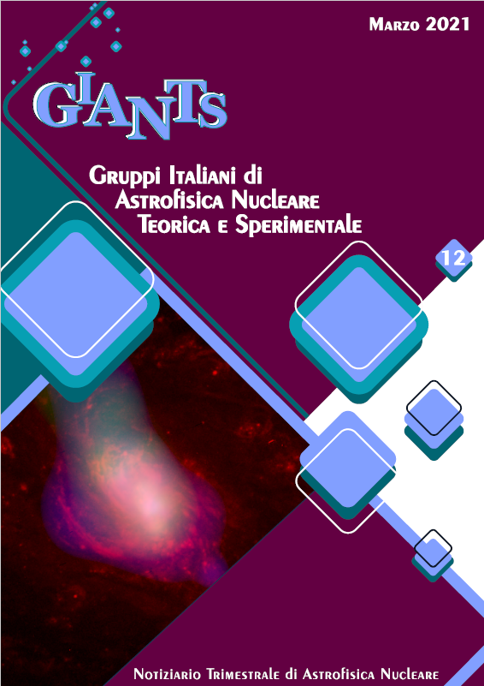
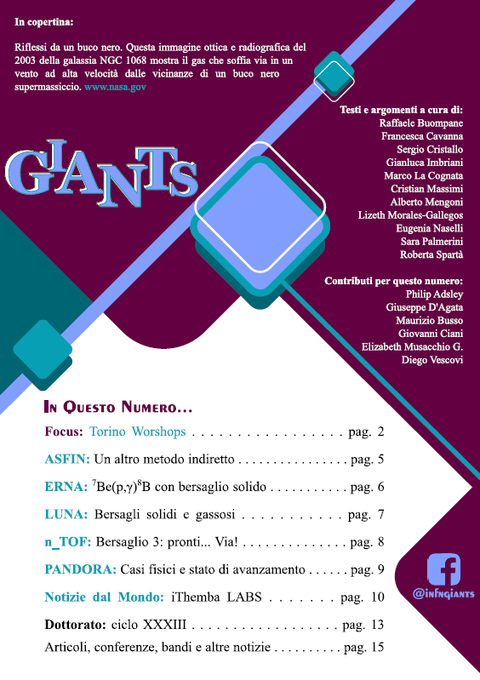
PANDORA: Outreach
E. Naselli, A. Pidatella – PANDORA Collaboration Meeting – 16-17 Dec 2021
PANDORA joins to GIANTS (Italian Groups of Theoretical and Experimental Nuclear Astrophysics)
GIANTS is involved in dissemination of nuclear astrophysics activities in a quarterly newsletter, in several outreach activities and in the organization of a biennial meeting.
It includes the 5 Nuclear Astrophysical Groups of INFN:
ASFIN, ERNA, LUNA, n_TOF and now also PANDORA!

Slide 5
PANDORA: Outreach
E. Naselli, A. Pidatella – PANDORA Collaboration Meeting – 16-17 Dec 2021
PANDORA joins to GIANTS (Italian Groups of Theoretical and Experimental Nuclear Astrophysics)
GIANTS is involved in dissemination of nuclear astrophysics activities in a quarterly newsletter, in several outreach activities and in the organization of a biennial meeting.
It includes the 5 Nuclear Astrophysical Groups of INFN:
ASFIN, ERNA, LUNA, n_TOF and now also PANDORA!
Focus: topic of specific interest in nuclear astrophysics
Focus
1-page for each experiment: updates on activities and results
World news: research in an International Laboratory
Other news: papers, events, prizes

Slide 6
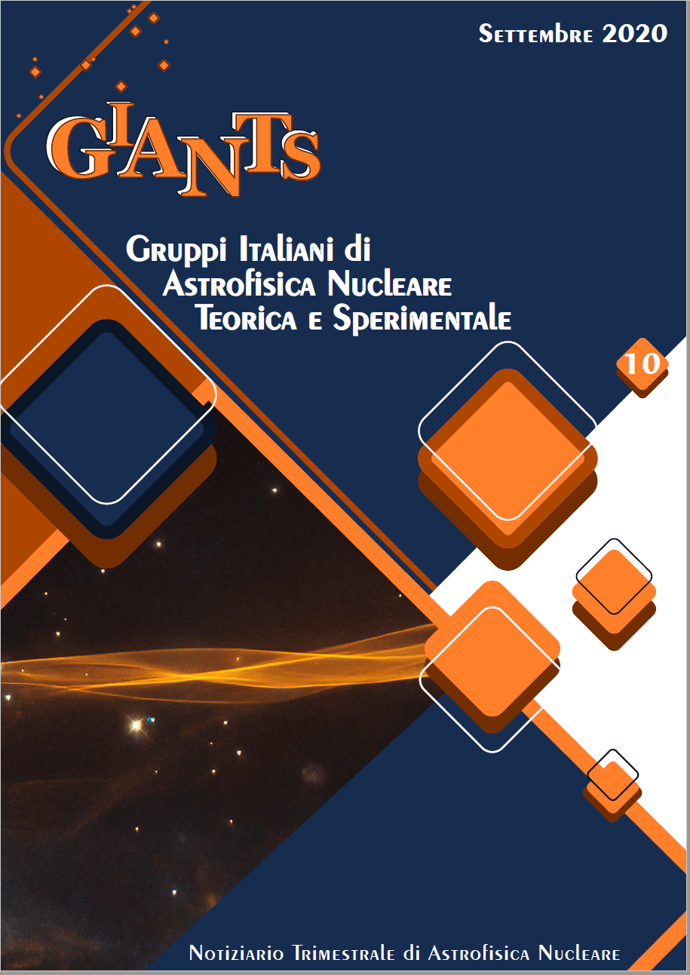
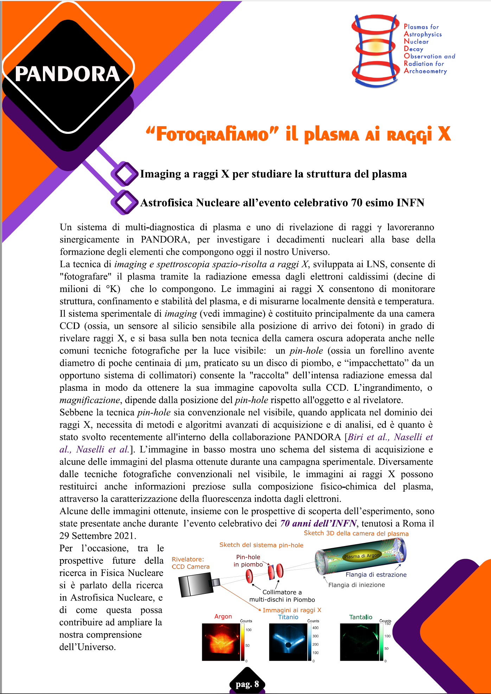
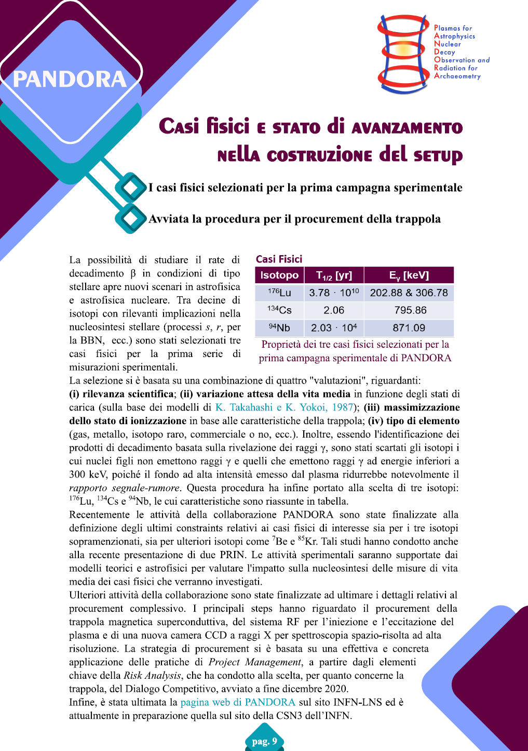
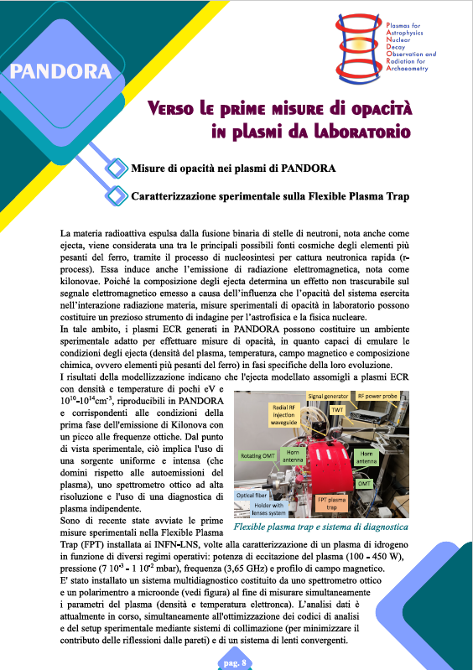
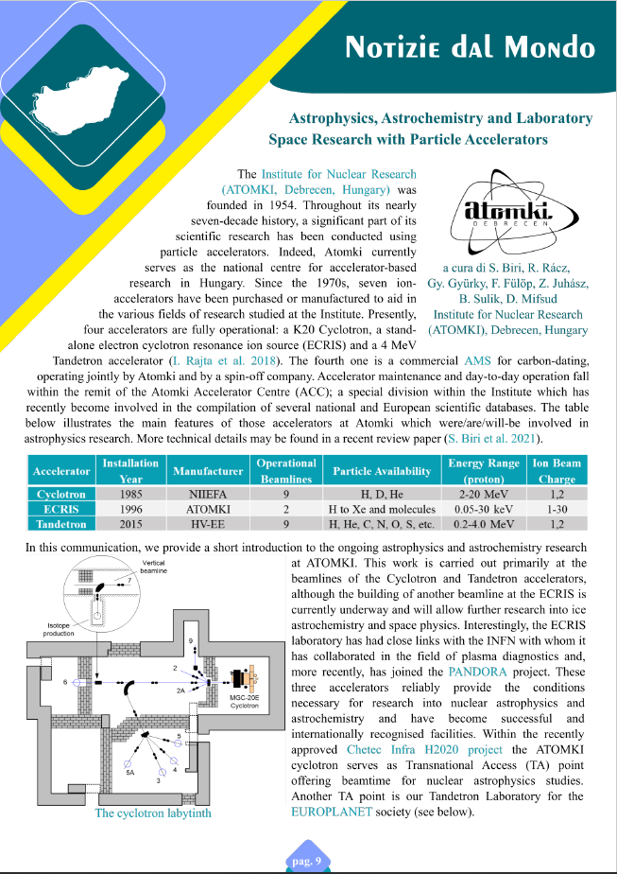
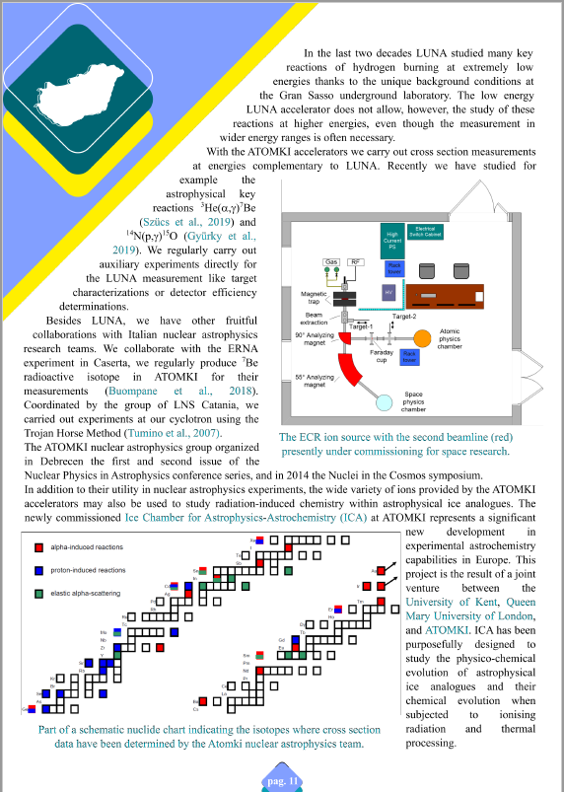
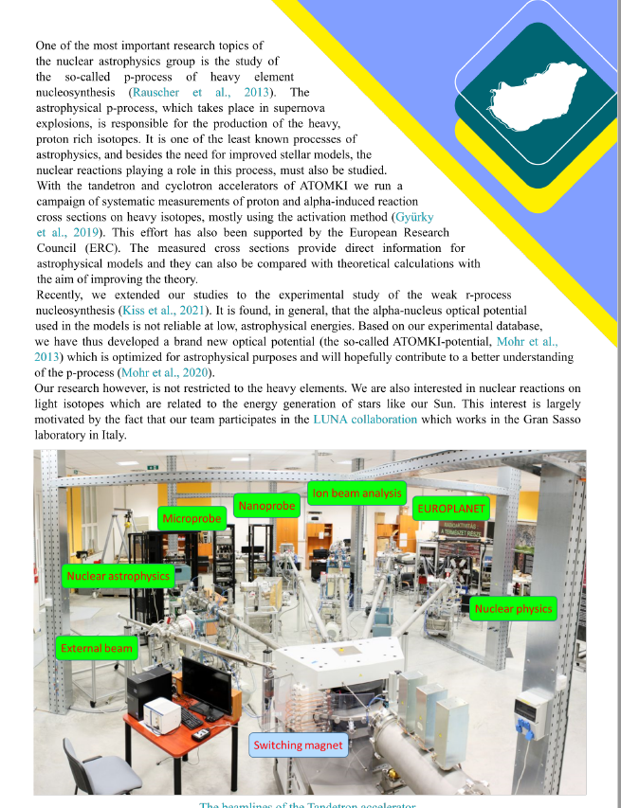
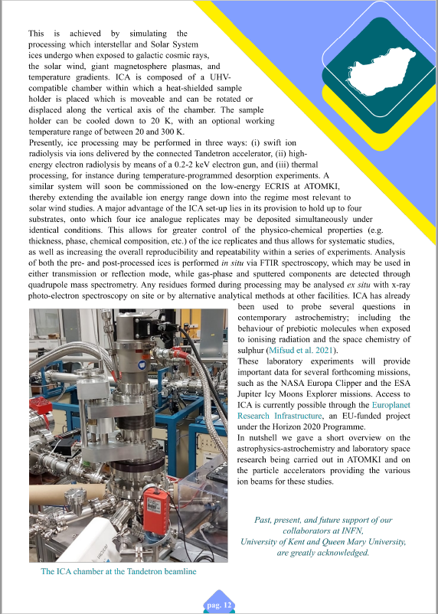
PANDORA: Outreach
E. Naselli, A. Pidatella – PANDORA Collaboration Meeting – 16-17 Dec 2021
PANDORA joins to GIANTS (Italian Groups of Theoretical and Experimental Nuclear Astrophysics)
GIANTS is involved in dissemination of nuclear astrophysics activities in a quarterly newsletter (from 2018), in several outreach activities and in the organization of a biennial meeting (from 1996).
It includes the 5 Nuclear Astrophysical Groups of INFN:
ASFIN, ERNA, LUNA, n_TOF and now also PANDORA!
From the first issue (February 2018) a total of 14 issues were published up to now!
We invite you to participate by sharing your laboratory's nuclear astrophysics activities with us…
Sep 2020
Focus on PANDORA
July 2021
World News on
ATOMKI Lab

Slide 7
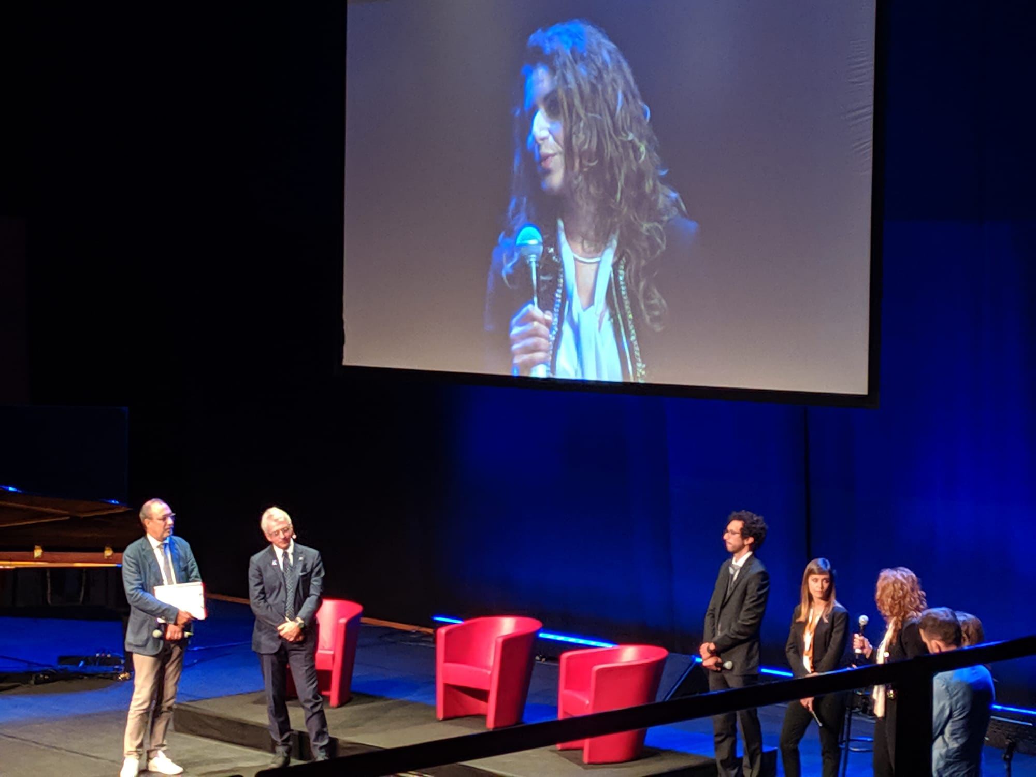
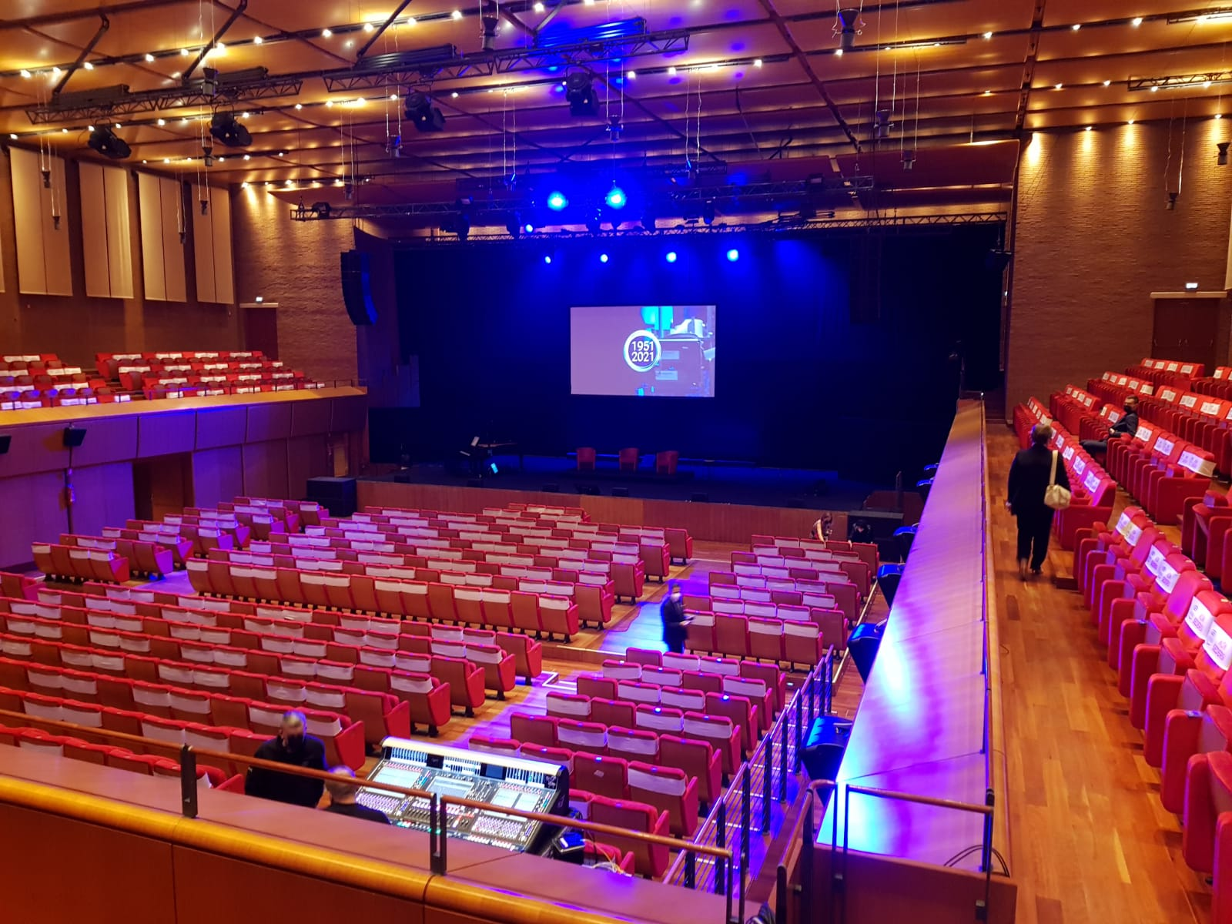
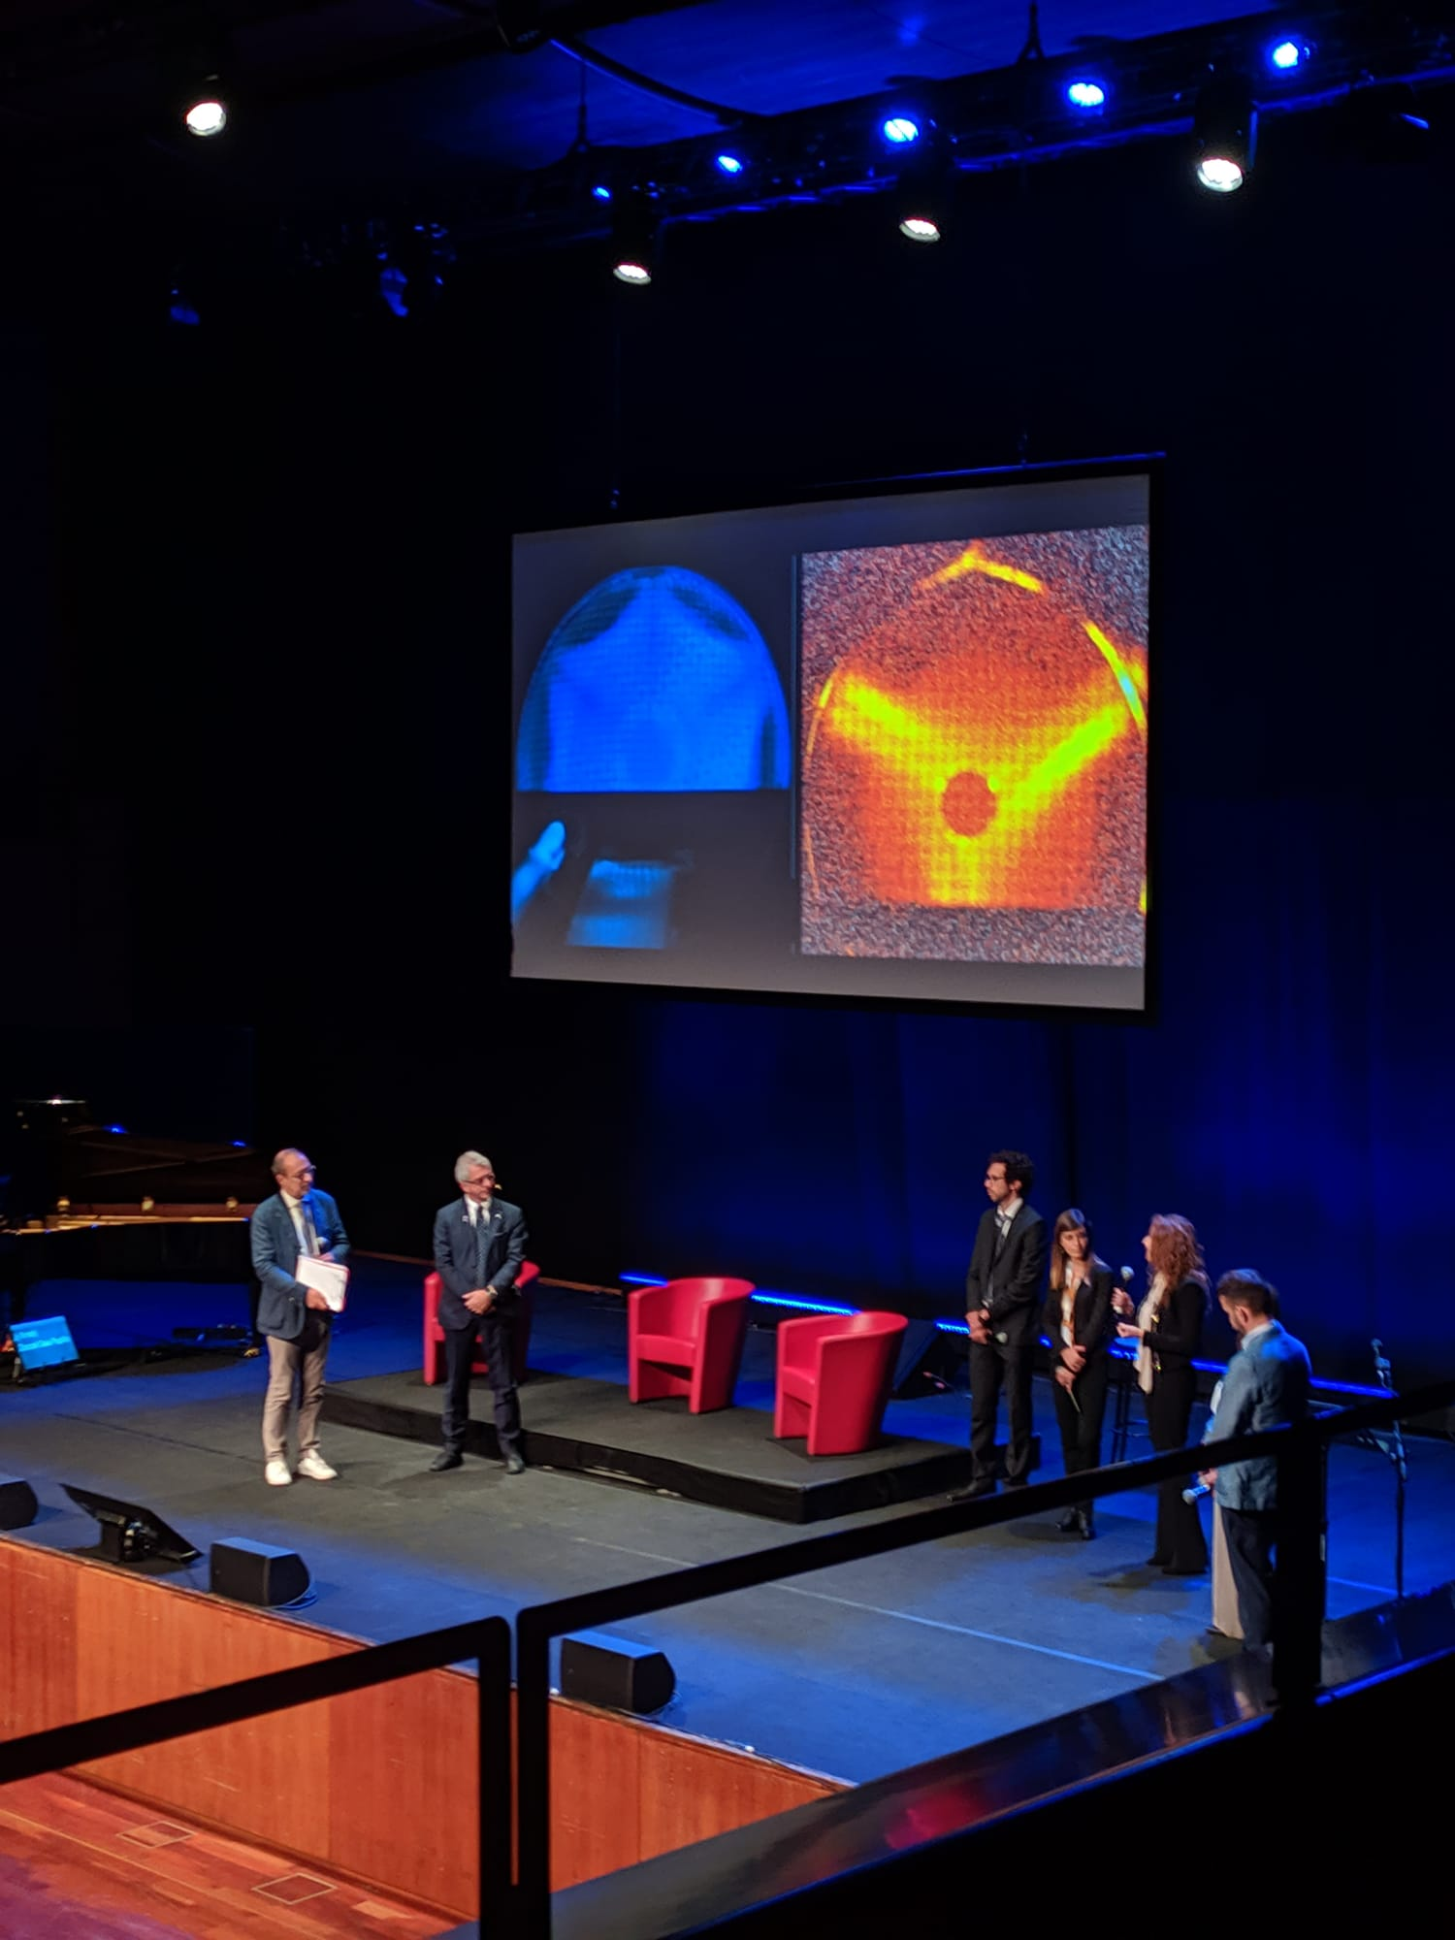
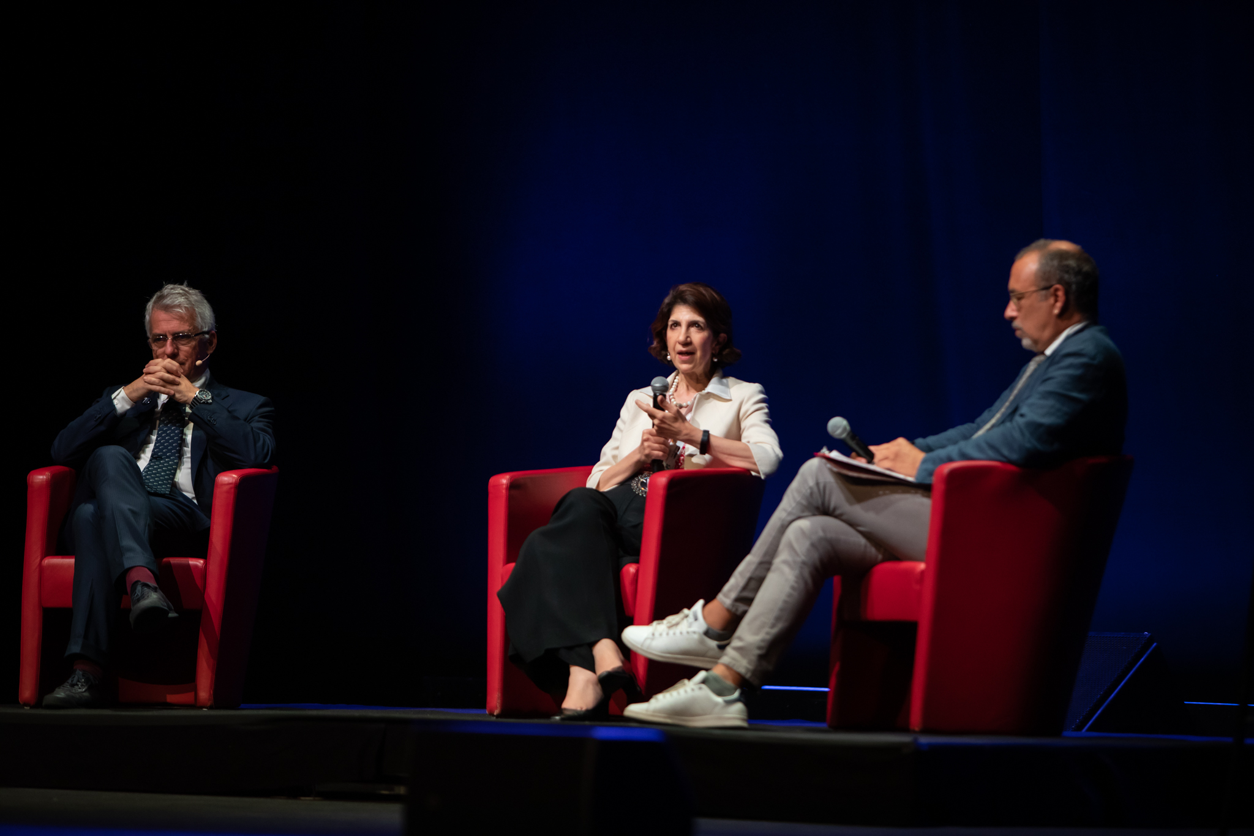
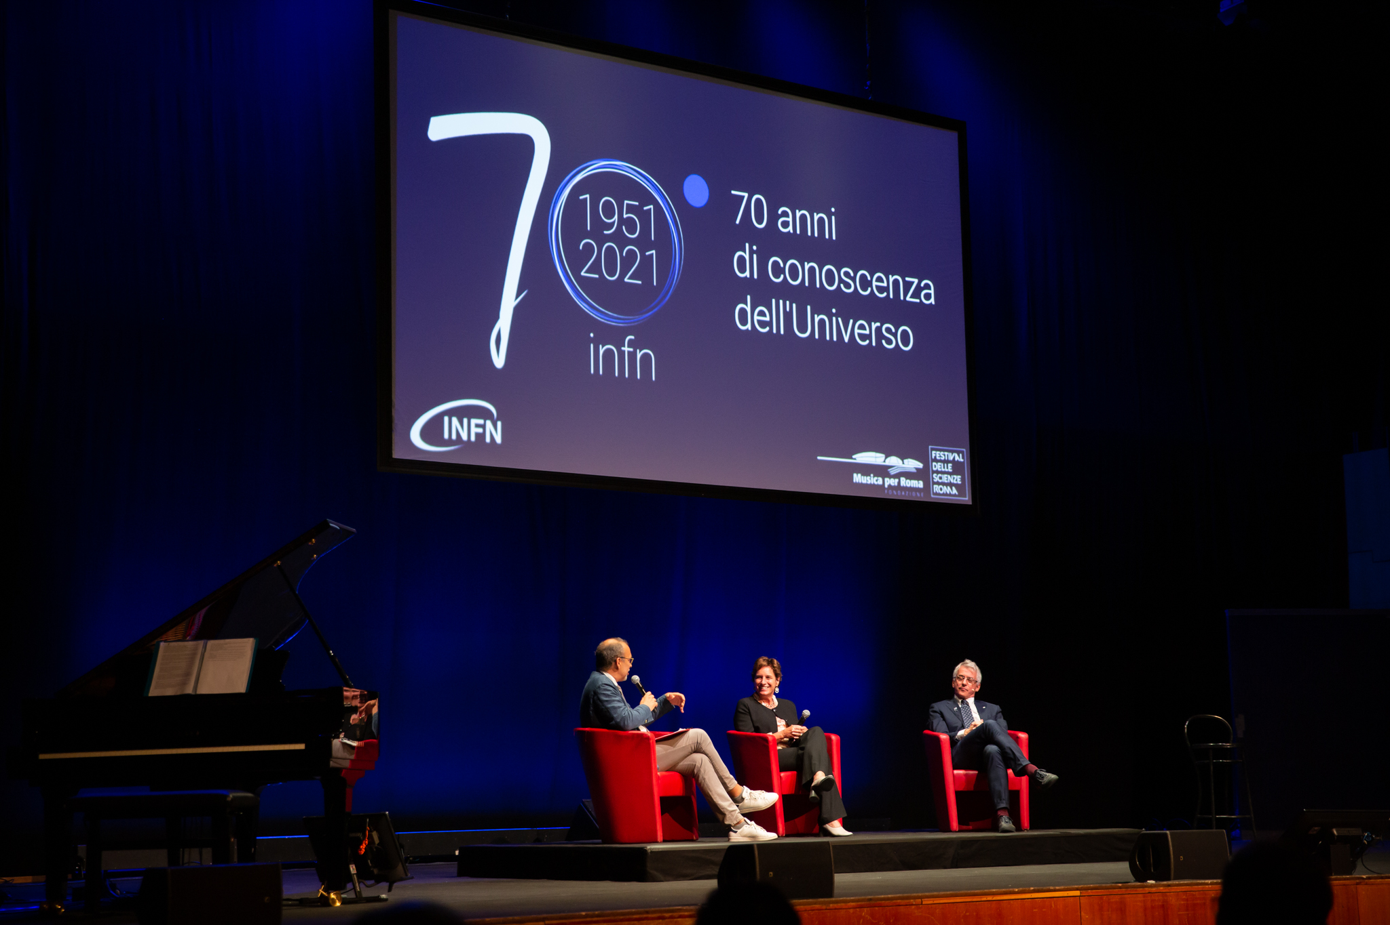
PANDORA: Outreach
E. Naselli, A. Pidatella – PANDORA Collaboration Meeting – 16-17 Dec 2021
The PANDORA activities were presented at the celebratory event of the 70 years of INFN “70 years of knowledge of the Universe”, Rome, 29 September 2021
The third and last session of the event was dedicated to the future of the INFN research: 5 young researchers were selected to talk about their personal experiences and the research they are involved in.
As representative of the National Scientific Committee 3 (Nuclear Physics) of the INFN a young researcher of the PANDORA group was selected
https://70.infn.it/evento/70-anni-di-conoscenza-delluniverso/
ITALIAN: https://www.youtube.com/watch?v=s2YvG1Ay3k0
ENGLISH: https://www.youtube.com/watch?v=zUzzvj8WQcU
Among the guests: the president of INFN A. Zoccoli, the Director General of CERN F. Giannotti, the Italian Minister of University and Research M.C. Messa, the former INFN presidents F. Ferroni and L. Maiani, the former Director of the LNGS-INFN L. Votano and in streaming the Nobel Prizes in Physics Barry Barish and Arthur McDonald.

Slide 8
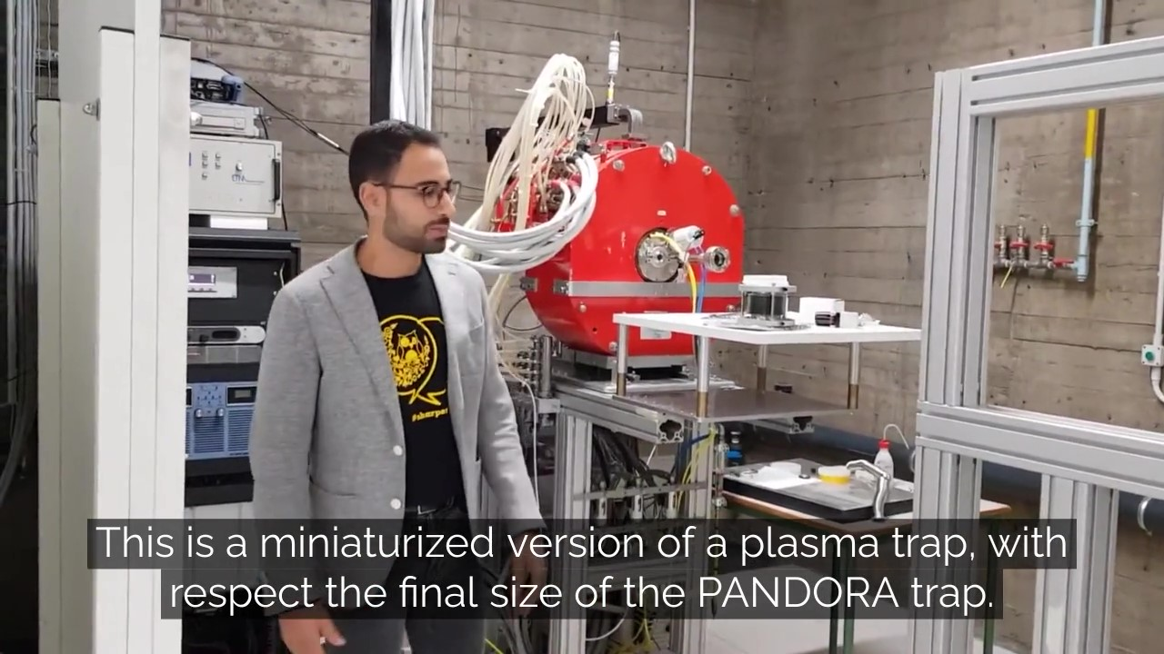
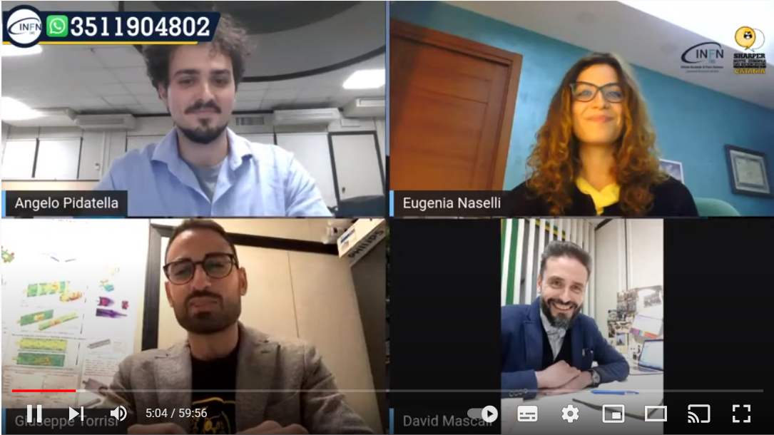
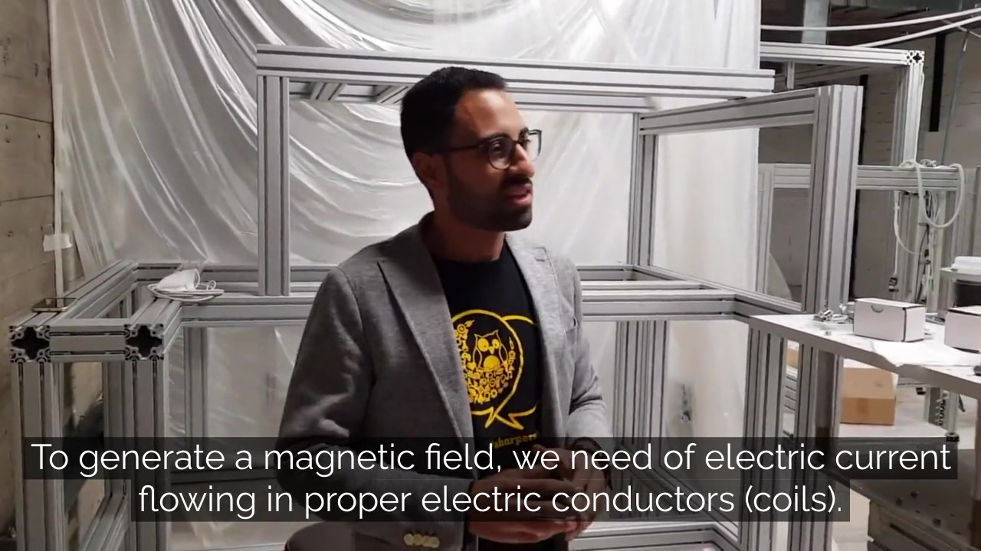
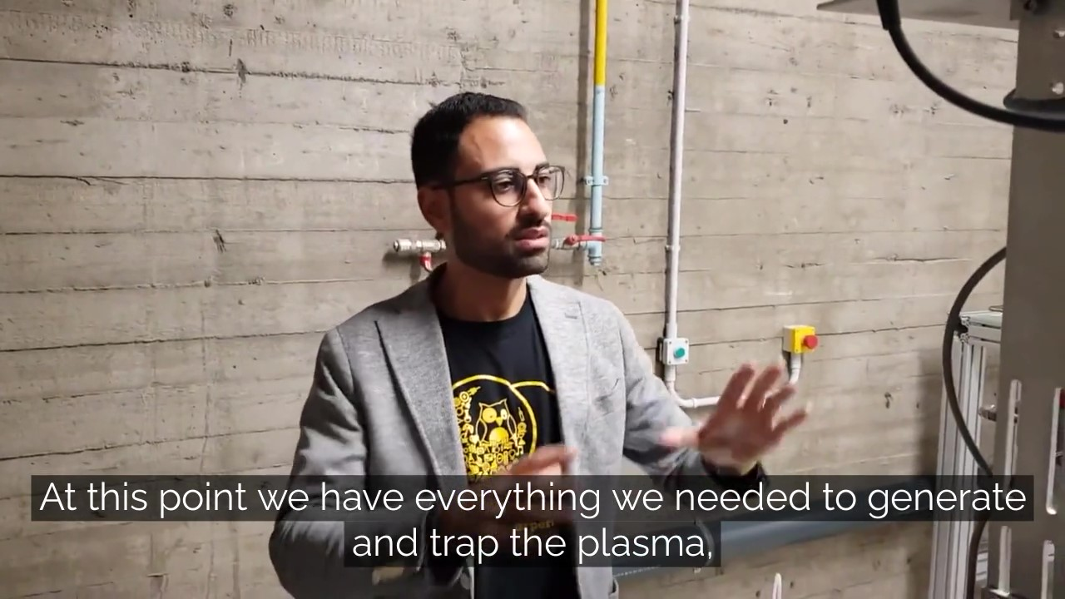
PANDORA: Outreach
E. Naselli, A. Pidatella – PANDORA Collaboration Meeting – 16-17 Dec 2021
PANDORA: European Research Night (ERN) 2020 @ LNS
Sharper Night 2020: pandemic limitations, no visit allowed @ LNS
Live-streaming on PANDORA facility and project
PANDORA overview, research and methods
FPT overview and connection to PANDORA
Multi-Diagnostics overview
Virtual visitors: 600
https://www.youtube.com/watch?v=k81q4PahP8s

Slide 9
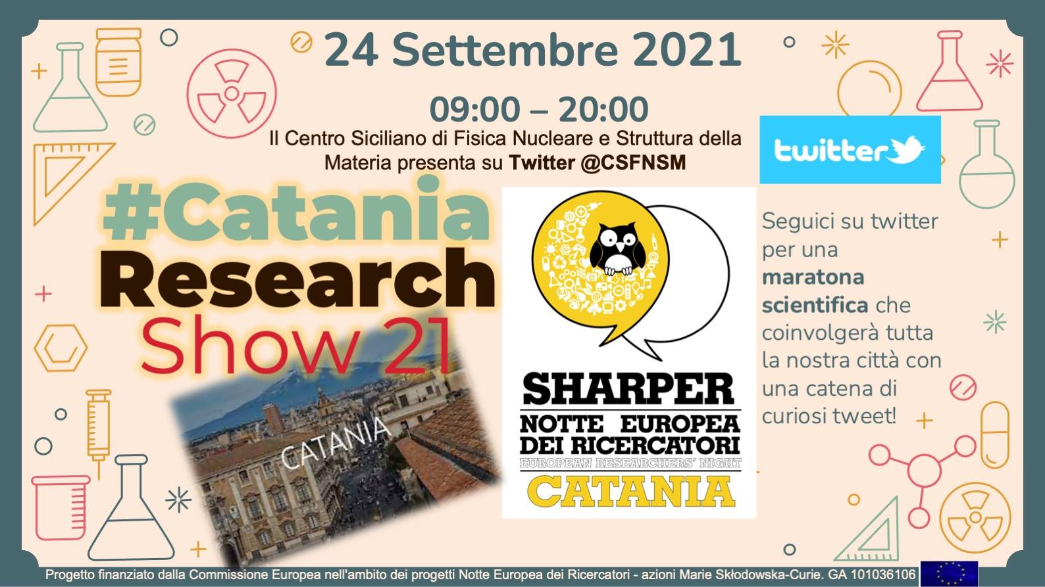
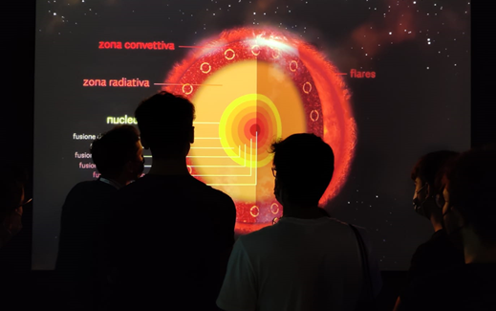
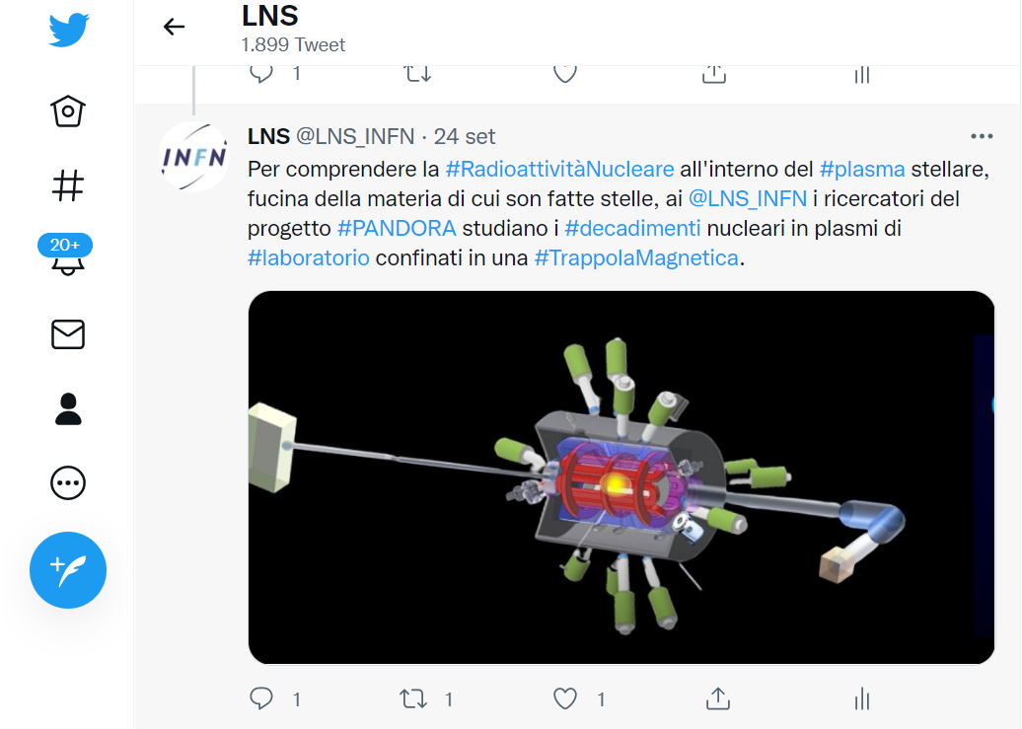
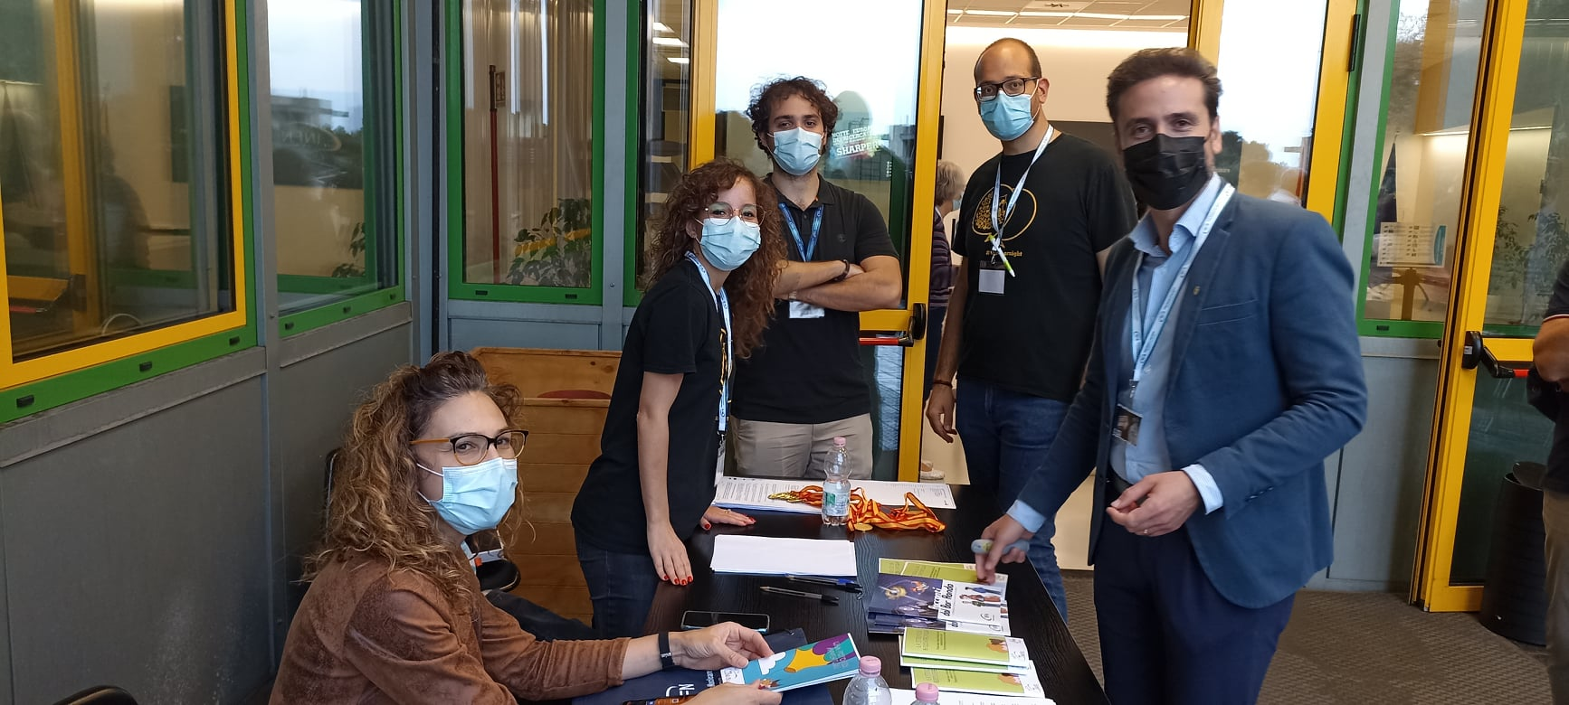
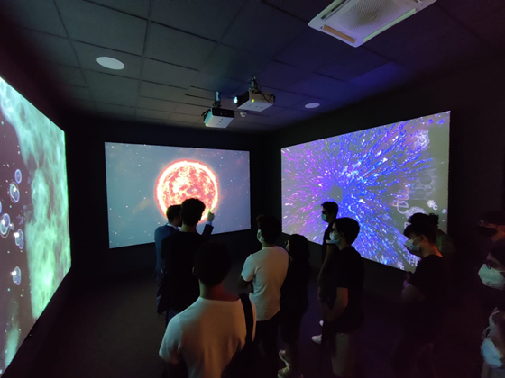
PANDORA: Outreach
E. Naselli, A. Pidatella – PANDORA Collaboration Meeting – 16-17 Dec 2021
Sharper Night 2021: pandemic limitations, BUT visit allowed @ LNS
LNS opens VISITOR CENTRE, 100 visitors
Also stands and seminars at the Dock (Km3NET) and Catania Downtown (Palazzo della Cultura)
PANDORA: ERN 2021 @ LNS

Slide 10
PANDORA: Outreach
E. Naselli, A. Pidatella – PANDORA Collaboration Meeting – 16-17 Dec 2021
PANDORA: Outreach Seminars and Lectures
2021 Nov – LNS Users Annual Meeting, INFN-LNS, D. Santonocito “PANDORA: status and perspectives”
2021 Sep – 107° Congress of the Italian Physical Society, G. L. Guardo and A. Pidatella “Indirect methods and innovative techniques for Nuclear Astrophysics”
2021 Apr – Colloquium, TRIUMF., D. Mascali “PANDORA: A new experimental setup for measuring in-plasma nuclear beta-decays of astrophysical interest”
2020 Feb – Invited Seminar, GANIL – Caen, France, D. Santonocito, “PANDORA – a new experimental setup for in-plasma β-decay measurements”
2019 Jun – NUSPIN 2019, Orsay, D. Santonocito “PANDORA: an experiment to measure nuclear beta decays of astrophysical interest in magnetized plasma”
2021 Nov – Invited Lecture at the Amirkabir University of Technology, Tehran – Iran, D. Mascali, "Electron Cyclotron Resonance I & II"
2020 Nov – Invited Lecture, New Dehli, India, D. Mascali “New Experiments in Astrophysics and Nuclear Physics using ECRIS”
2018 – Invited Lecture at INFN-Bo, Bologna, D. Mascali
2019 – PANDORA LNS group involved in the INFN dissemination program “Programma INFN per Docenti (PID) 2019” supported by INFN and MIUR. Lecture and laboratory for 20 high school teachers, Feb 2019, LNS-INFN, Catania.
Ongoing Thesis Activities
2 PhD in Physics: Bharat Mishra, Carmelo Sebastiano Gallo;
3 Master in Physics: Giulia Emma, Giorgio Finocchiaro, Matteo Bezmalinovich;

Slide 11
PANDORA: Outreach
E. Naselli, A. Pidatella – PANDORA Collaboration Meeting – 16-17 Dec 2021
PANDORA: Outreach and Dissemination Activities
PANDORA joins to GIANTS
PANDORA at the celebratory event of the 70 years of INFN
European Research Night (ERN)
PANDORA: Outreach seminars, lectures and thesis activities
Mid-Range Plan in Nuclear Physics
PANDORA INFN-LNS Web page
PANDORA INFN-CSN3 Web page
Science3IP project
Editorial Activities,
celebratory event,
seminars and lectures
PANDORA Web pages, workshop and
outreach project

Slide 12
PANDORA: Outreach
E. Naselli, A. Pidatella – PANDORA Collaboration Meeting – 16-17 Dec 2021
PANDORA: Mid-Range Plan in Nuclear Physics
LNS
Session
https://web.infn.it/nucphys-plan-italy/
Workshop dedicated to future nuclear physics research in Italy with particular emphasis on INFN laboratories
4 main scientific topics & groups: Nuclear Dynamics, Nuclear Structure,
Nuclear Astrophysics, Applied Physics
PANDORA: purposes and interests fit both in Nuclear Astrophysics and Applied Physics,
contribution also transversal to other topics
Contributions to the workshop and related «perspective white-book» are very welcome!

Slide 13
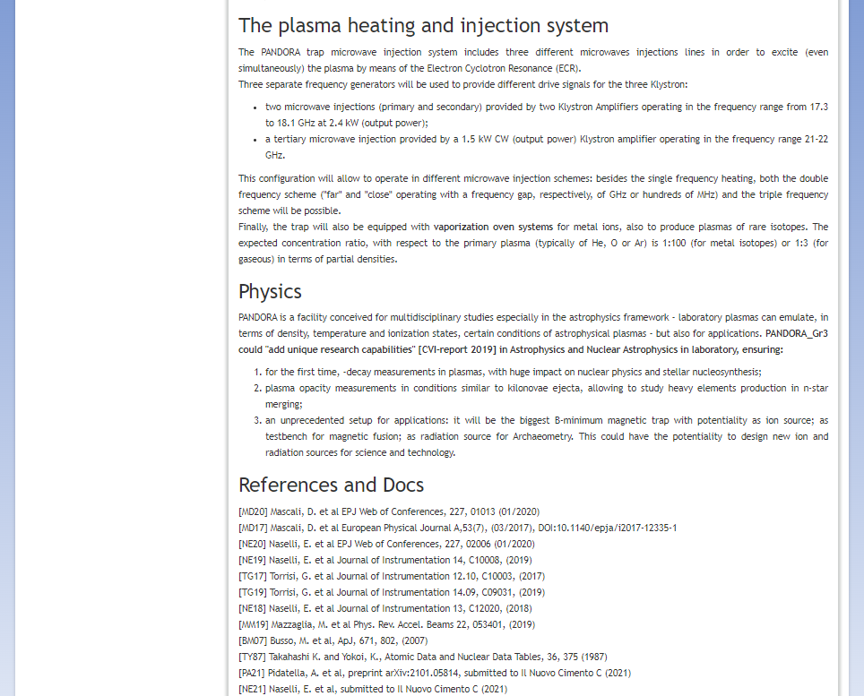
PANDORA: Outreach
E. Naselli, A. Pidatella – PANDORA Collaboration Meeting – 16-17 Dec 2021
PANDORA: INFN-LNS Web-Page
https://www.lns.infn.it/en/equipment/pandora.html

Slide 14
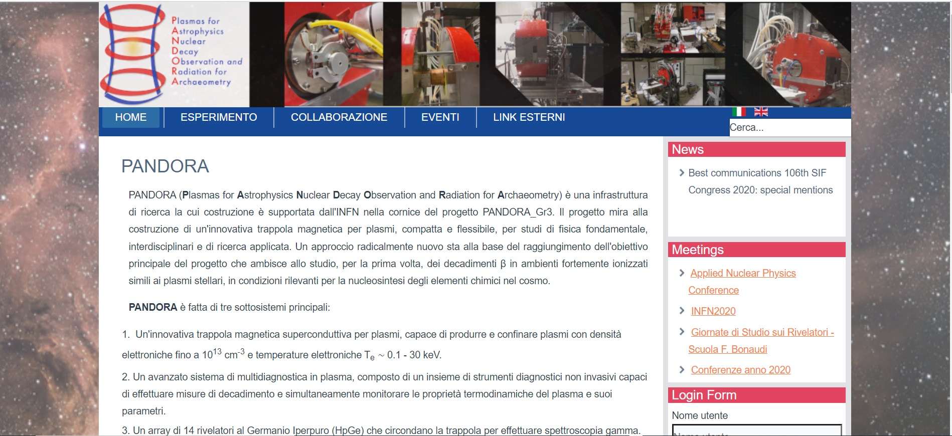
PANDORA: Outreach
E. Naselli, A. Pidatella – PANDORA Collaboration Meeting – 16-17 Dec 2021
PANDORA: INFN-CSN3 Web-Page – Work in Progress
Construction of PANDORA web page on CSN3 page
Beta-version soon on-line, both IT and EN version
Contribution/suggestions from collaboration members very welcome!
Members section: contact page, some info, etc…

Slide 15
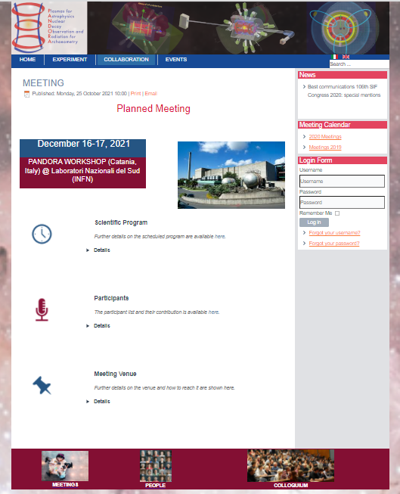
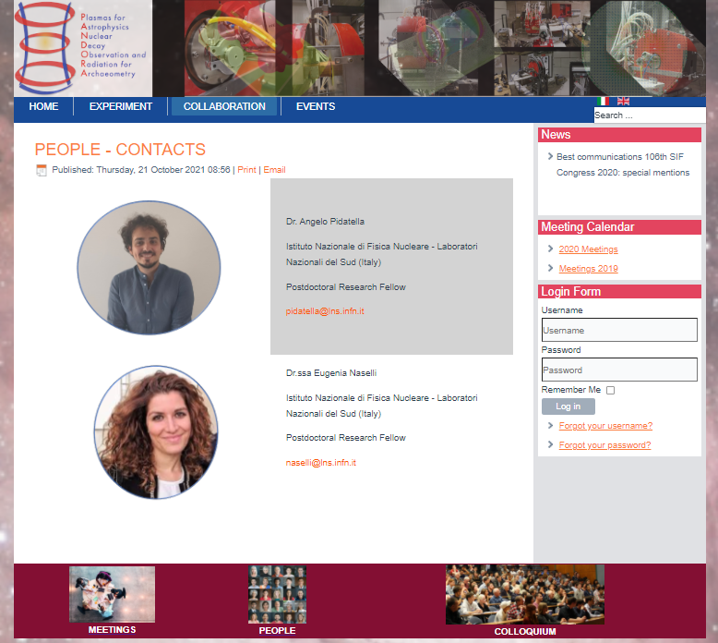
PANDORA: Outreach
E. Naselli, A. Pidatella – PANDORA Collaboration Meeting – 16-17 Dec 2021
PANDORA: INFN-CSN3 Web-Page – Work in Progress

Slide 16
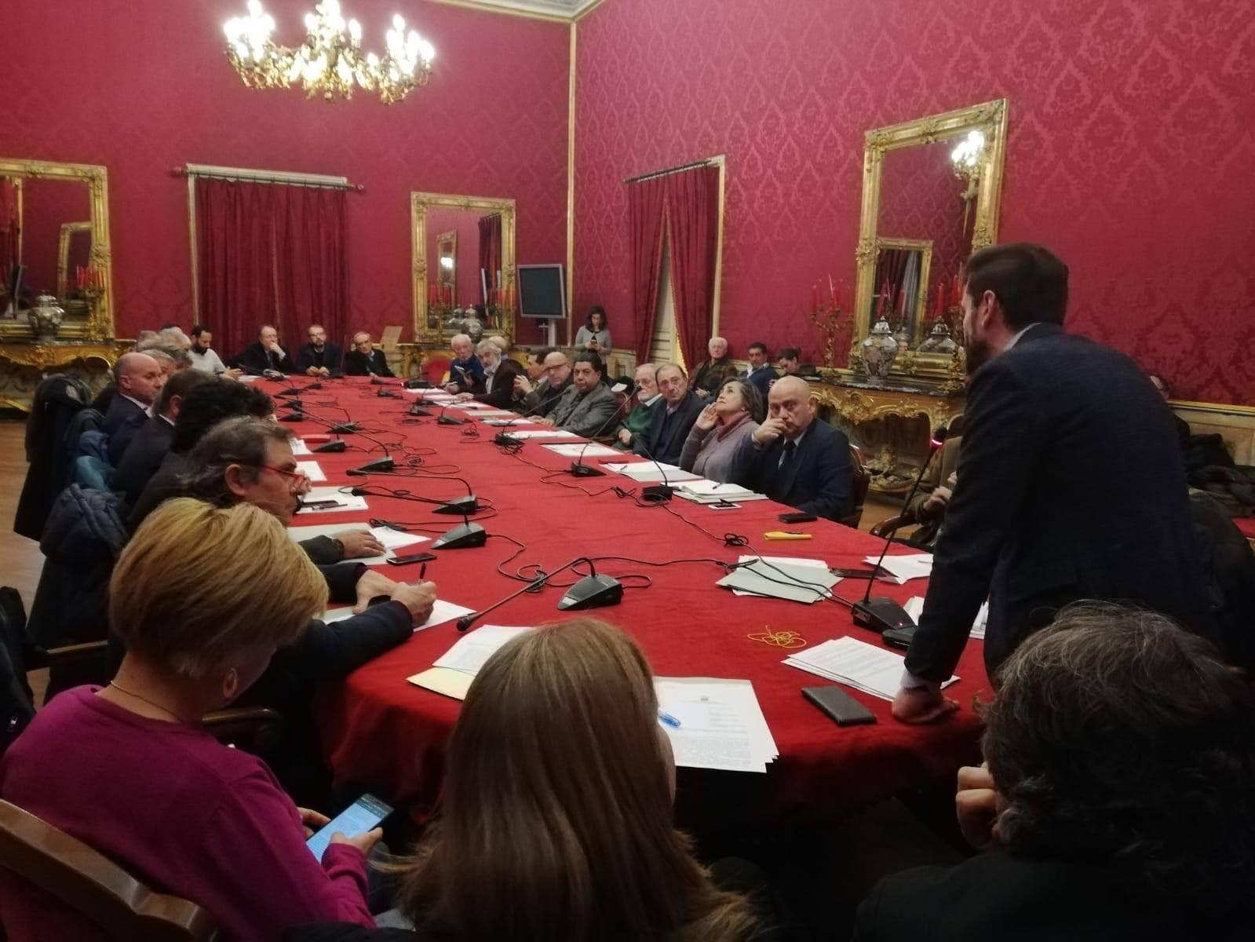
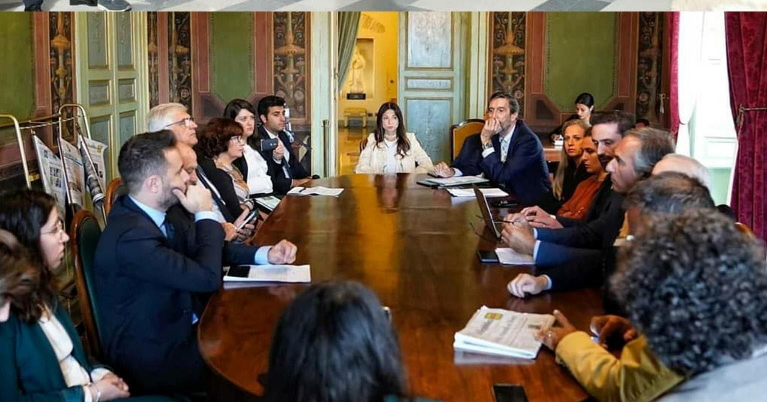
PANDORA: Outreach
E. Naselli, A. Pidatella – PANDORA Collaboration Meeting – 16-17 Dec 2021
PANDORA: Science 3IP
Science3IP – the Science trip to the Third Sector Organizations, Institutions and Politics
Science3IP is an innovative scientific outreach program aiming at connecting science and innovation with civil society and the political-institutional world, through synergy and networks between associations and research institutes;
Also aiming at making the target audience an active «tool» participating in the outreach program;
Encouraging brainstorming, views exchange and transverse cooperation between Research, Third Sector Organizations and local Political-Institutions.
PANDORA suits with the project supporting the research part of the outreach, transversally sharing knowledge on accelerator physics and related technologies to the civil society.
A bottom-up process could lead to ideas exchange also triggered by the political institutions to promote the diffusion of these knowledges and possible benefits for the civil society
Internationsl Partner involved: ATOMKI colleagues

Slide 17
Thanks for your attention
E. Naselli, A. Pidatella (LNS-INFN)
on behalf of the PANDORA collaboration

