Slide 1
PLASMA MODELING BY PIC SIMULATIONS
Alessio Galatà
Pandora Collaboration Meeting, LNS 16-17/12/2021

Slide 2
COMPLETE PLASMA DESCRIPTION
ELECTROMAGNETIC SIMULATIONS
SELF-CONSISTENT APPROACH
ELECTRON DYNAMICS
ENERGY GAIN DUE TO ECR
ENERGY REDISTRIBUTION DUE TO COLLISIONS
COLLISIONAL DIFFUSION
MICROWAVE ABSORPTION IN AN ANISTOTROPIC AND DISPERSIVE MEDIUM
IONS DYNAMICS INCLUDING CSD BUILD-UP AND CONFINING ELECTROSTATIC FIELD
OVERALL CHARGE NEUTRALITY
BUILD UP OF AN ELECTROSTATIC POTENTIAL RESPONSIBLE FOR CONFINEMENT
IONIZATION
CHARGE EXCHANGE
COLLISIONAL DIFFUSION
BUILD UP OF CSD

Slide 3
INFN SIMULATION TOOL
FULLY 3D TRACKING CODE FOR IONS AND ELECTRONS
PRECISE ELECTROMAGNETIC CALCULATIONS (COMSOL+MATLAB)
INCLUDES ELASTIC COULOMB COLLISIONS RESPONSIBLE FOR PARTICLES DIFFUSION
PLASMA FINE STRUCTURE IS AUTOMATICALLY OBTAINED
CAN CREATES DISTRIBUTION MAPS OF ANY PHYSICAL QUANTITY
ATOMIC PROCESS CAN BE EASILY IMPLEMENTED
BENCHMARKED WITH EXPERIMENTS
CAN DEMONSTRATES OBSERVED EXPRIMENTAL EVIDENCES (THE FREQUENCY TUNING EFFECT)
BUILD-UP OF CSD

Slide 4


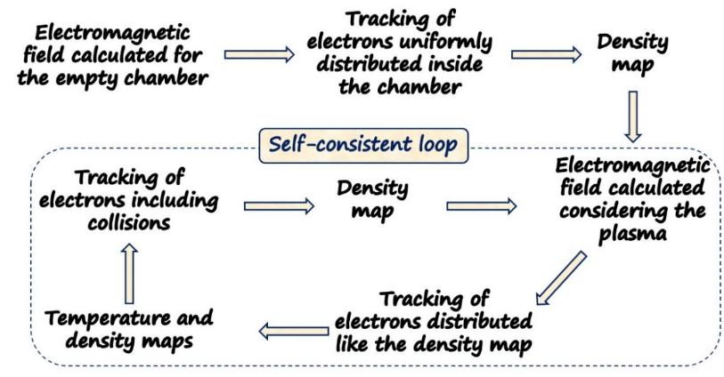
SELF CONSISTENT APPROACH
THE ELECTROMAGNETIC FIELD DISTRIBUTION AND THE PLASMA INFLUENCE EACH OTHER IN A CLOSED LOOP
TRACKING
T_{step}=10⁻¹² s
T_{span}=40 µs
N=40000 electrons
Elastica e-e collisions included

Slide 5
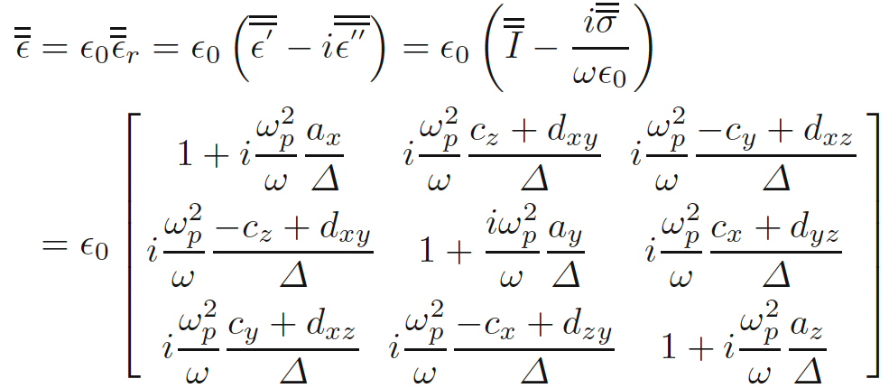
SELF CONSISTENT APPROACH
ELECTROMAGNETIC SIMULATIONS
COLD PLASMA ANISOTROPIC TENSOR FOR THE MAGNETIZED PLASMA COMPUTED IN MATLAB
non homogeneous dielectric permittivity Tensor depends on local electron density and magnetic field
ELECTROMAGNETIC FIELD IN ECRIS PLASMA
SOLUTION OF MAXWELL’S EQUATIONS IN COMSOL USING MUMPS DIRECT SOLVER
SOLUTION OF THE WAVE EQUATION WITH AN ADAPTATIVE MESH

Slide 6

SELF CONSISTENT APPROACH
ELECTROMAGNETIC SIMULATIONS
MAXWELL’EQUATIONS
CONSTITUTIVE RELATIONS
DERIVATION OF CONDUCTIVITY TENSOR
3D COLD PLASMA MODELING: PLASMA AS A DISPERSIVE MEDIUM WITH COLLISIONS
Random thermal motion neglected
( v_{φ} >>v_{th})
$$ω_{eff}≈\frac{ω}{1000}$$
where
COLLISION FREQUENCY ω_{eff} ACCOUNTS FOR THE COLLISION FRICTION, MODELS THE WAVE DAMPING AND RESOLVES THE SINGULARITY OF SOME ELEMENTS OF TENSOR

Slide 7
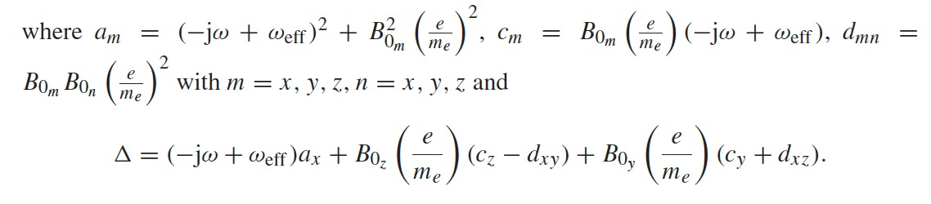
SELFCONSISTENT APPROACH
ELECTROMAGNETIC SIMULATIONS
NON-UNIFORM “LOCAL” DIELECTRIC TENSOR
NON-SYMMETRIC 3D MAGNETOSTATIC FIELD
ASSUMING A NON UNIFORM MAGNETOSTATIC FIELD THE DIELECTRIC TENSOR IS:
OFF-DIAGONAL ELEMENTS DUE TO 3D MAGNETIC FIELD

Slide 8
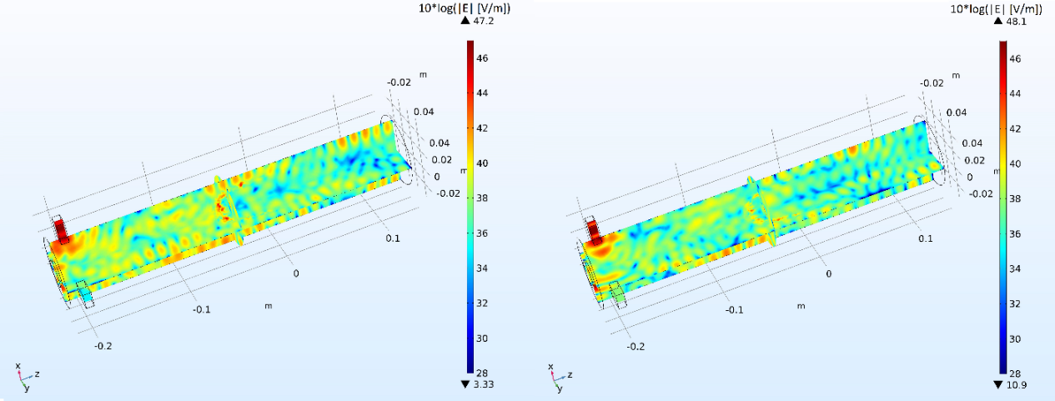
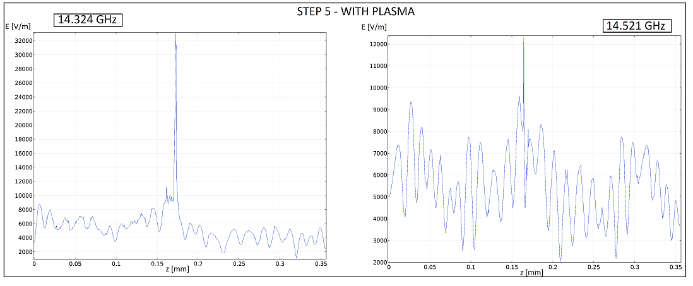
SELF CONSISTENT APPROACH
ELECTROMAGNETIC SIMULATIONS
14.324 GHz
14.521 GHz
ELECTROMAGNETIC FIELD AT THE END OF THE SELF-CONSISTENT LOOP
_{12 kV/m}
_{32 kV/m}
INTENSIFICATION OF THE ELECTRIC FIELD AT THE RESONANCE
ELECTRIC FIELD ON AXIS

Slide 9

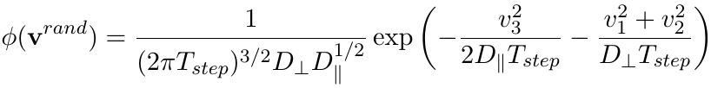
SELF CONSISTENT APPROACH
NUMERICAL IMPLEMENTATION
FORWARD DIFFERENCE METHOD
v(t+1)=v(t) + a*T_{step} → x(t+1)=x(t)+ v(t+1)*T_{step}
RELATIVISTIC BORIS METHOD (LEAPFROG)
EVENTUAL EXTERNAL EM FIELD
e-e COLLISIONS: LANGEVIN EUQATION
Δv_{Lang}= v(t+1)-v(t)= - ν_{s}v(t)*T_{step}+v^{rand}
DIFFUSION COEFFICIENTS
DIFFUSION
SLOWING DOWN
v(t+1)=v(t) - ν_{s}*v(t)*T_{step}+v^{rand} + q*[v(t)xB]

Slide 10
SELF CONSISTENT APPROACH
THE FOKKER PLANK EQUATION
DYNAMICAL FRICTION
PERP. DIFFUSION D⊥
PAR. DIFFUSION D//
INDEPENDENT VARIABLE

Slide 11
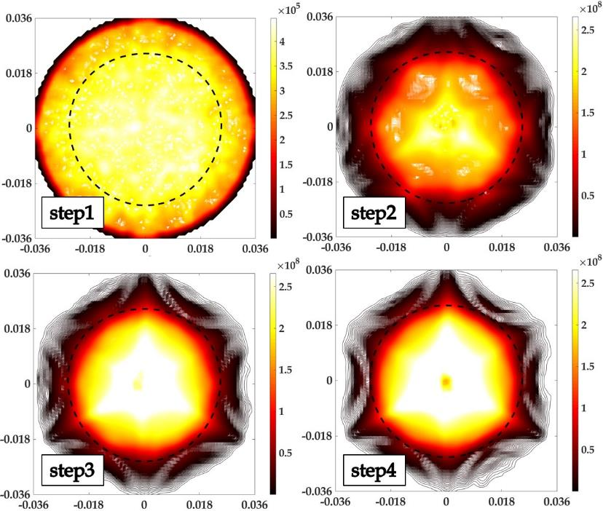
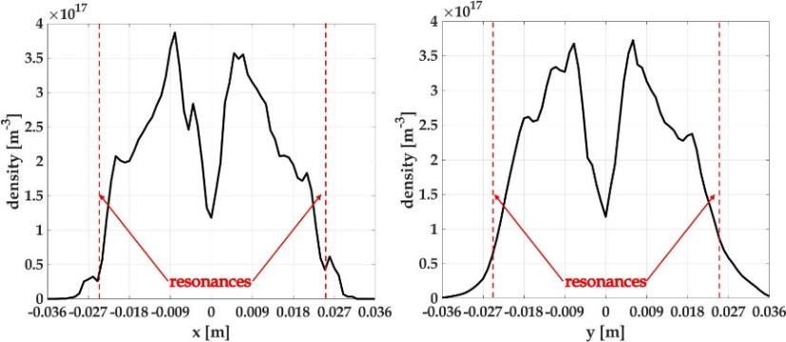
SELF CONSISTENT APPROACH
REALISTIC PLASMA DESCRIPTION
THE PLASMA CONCENTRATES INSIDE THE RESONANCE SURFACE
THE PLASMOID HALO STRUCTURE IS AUTOMATICALLY FORMED
THE PLASMOID HAS AN ITS OWN STRUCTURE
DENSITY DISTRIBUTION
RADIAL DENSITY DISTRIBUTION

Slide 12
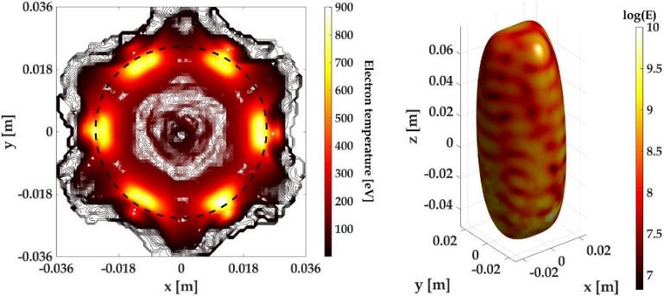
SELF CONSISTENT APPROACH
ENERGY DISTRIBUTION
AVERAGE ELECTRON ENERGY
MAXIMA LOCALIZED ON THE RESONANCE SURFACE
THE DISTRIBUTION REFLECTS THAT OF THE ELECTROMAGNETIC FIELD
SPATIAL DISYRIBUTION OF DIFFERENT ELECTRONS POPULATIONS

Slide 13
SELF CONSISTENT APPROACH
FREQUENCY TUNING
14.521 GHz
14.324 GHz
EVIDENCE OF THE INFLUENCE OF THE FREQUENCY ON THE PLASMA STRUCTURE

Slide 14
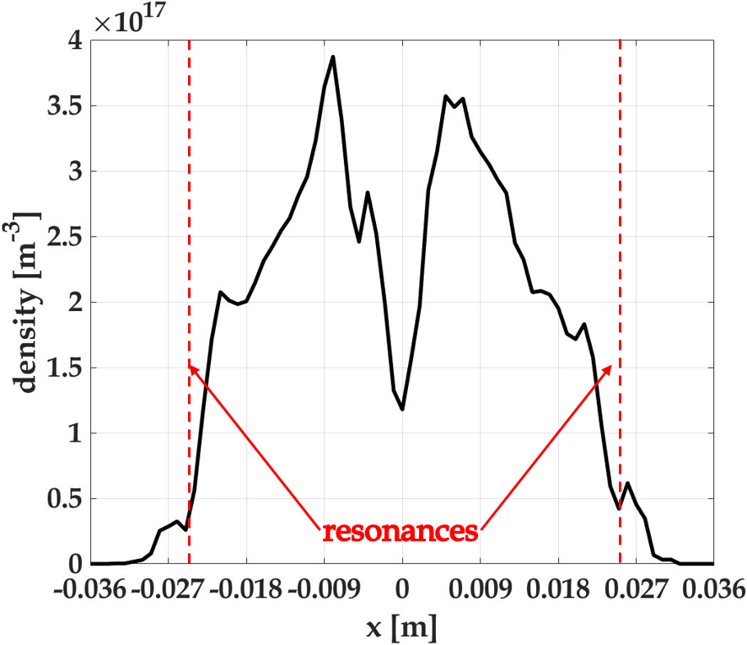
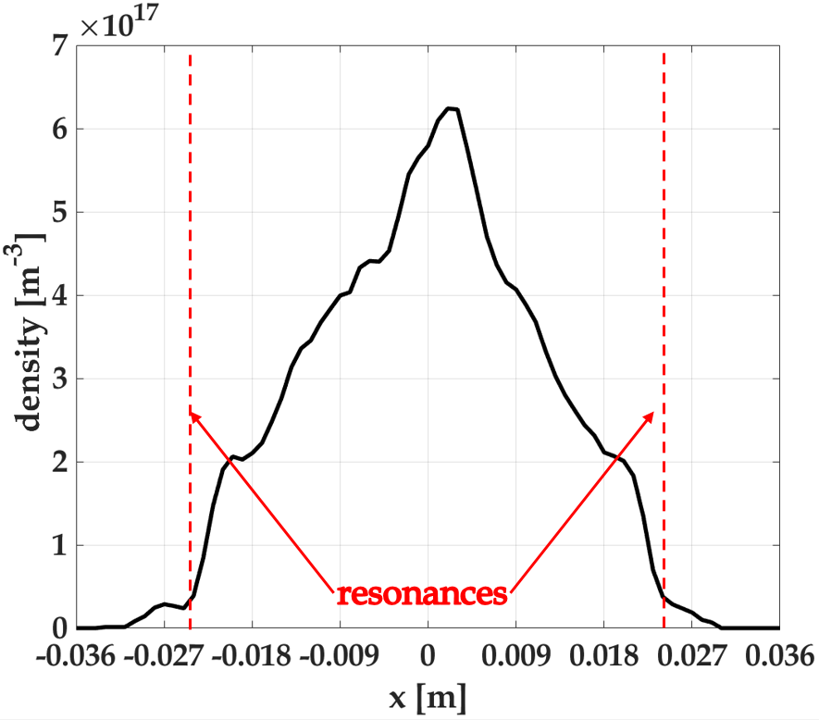
SELF CONSISTENT APPROACH
FREQUENCY TUNING: DENSITY PROFILES
14.521 GHz
14.324 GHz
THE FREQUENCY INFLUENCE THE ELECTRONS DISTRIBUTION INSIDE THE PLASMOID

Slide 15
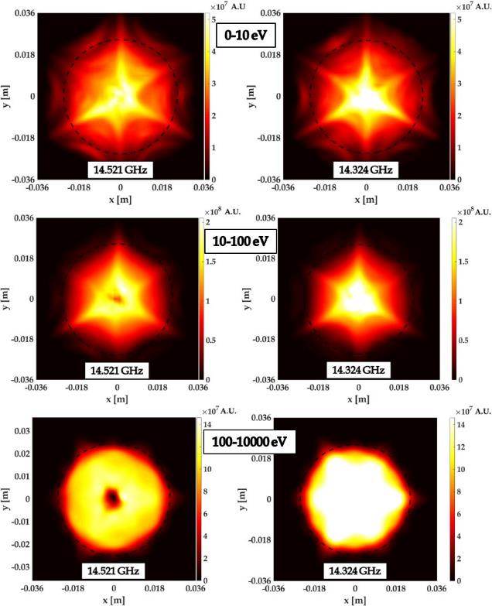
SELF CONSISTENT APPROACH
ENERGY DISTRIBUTION
IT IS POSSIBLE TO OBTAIN OCCUPATION MAPS IN ANY ENERGY RANGE!
THE FREQUENCY AFFECTS THE ELECTRONS DENSITY AND ENERGY DISTRIBUTIONS

Slide 16
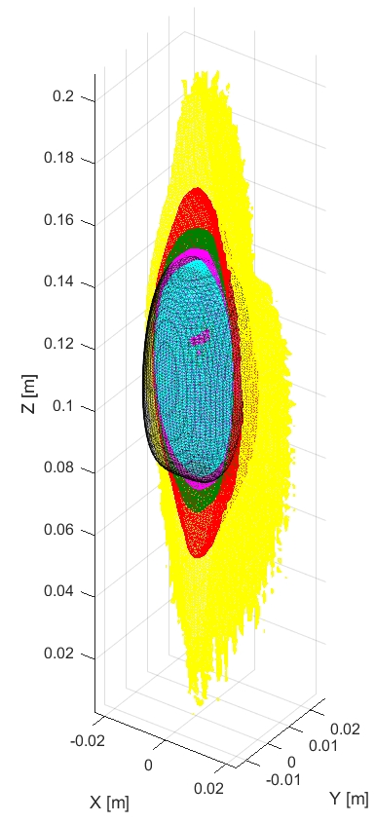
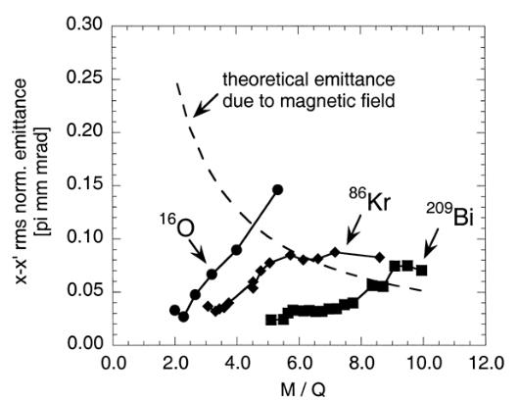
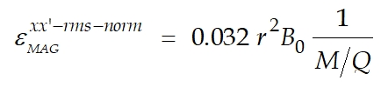
BUILD-UP OF CSD
PRELIMINARY RESULTS
CALCULATION OF OXYGEN CSD
ELECTRON DENSITY AND ENERGY FROM PREVIOUS SIMULATIONS
EACH CHARGE Z MOVES IN APLASMA MADE OF CHARGES 1…Z-1
ONLY IONIZATIONS UP TO 5+(NO CEX)
Tspan=10*<τ_{ioniz}(z)>
O¹⁺
O²⁺
O³⁺
O⁵⁺
O4⁺
RESULTS AGREE WITH THE EXPERIMENTAL EVIDENCE OF PROGRESSIVE IONS CONCENTRATION ON AXIS
ECR RESONANCE
MORE DETAILS ON THE COMPLETE APPROACH GIVEN BY B. MISHRA

Slide 17
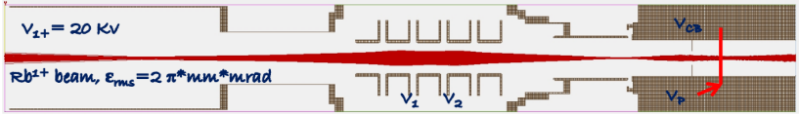


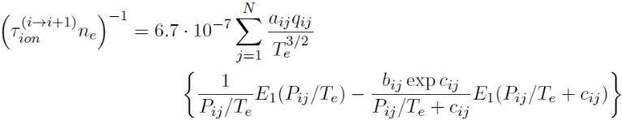
IONS DYNAMICS
1+BEAM INJECTION: CB TECHNIQUE
SIMULATION OF 1+ IONS INJECTION
PLASMA DISTRIBUTION FROM SC CALCULATIONS
COULOMB COLLISIONS THORUGH LANGEVIN EQUATION
IONIZATION WITH A MC APPROACH
E₁₊=1*V keV
V_{CB} = +(V + ΔV) kV
ΔV
LOTZ FORMULA
ECR SOURCE

Slide 18
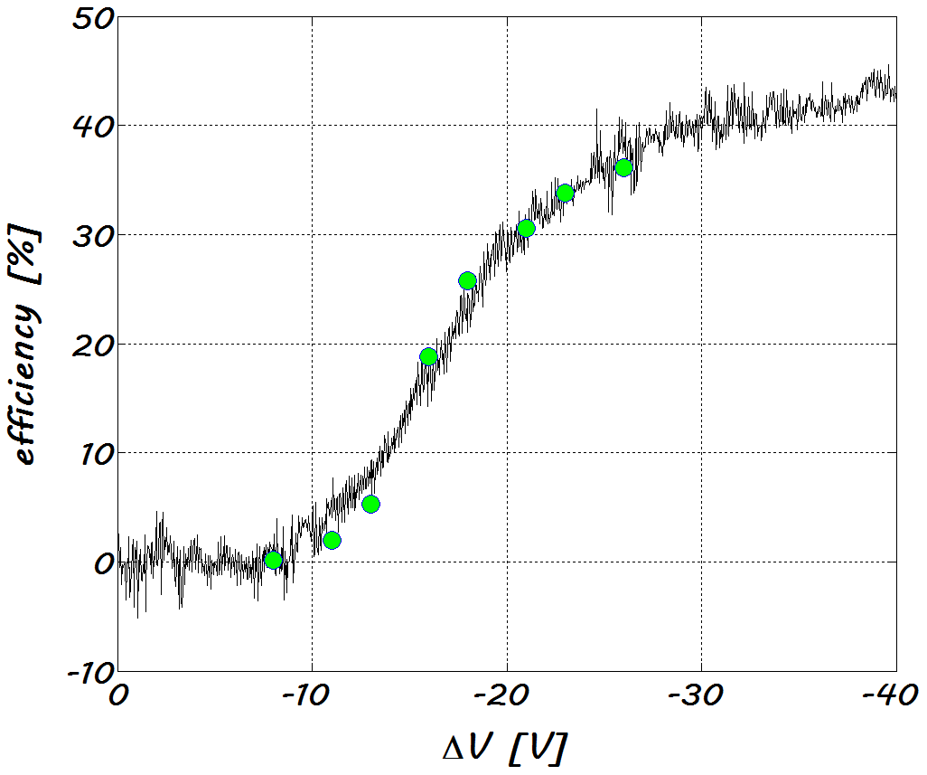
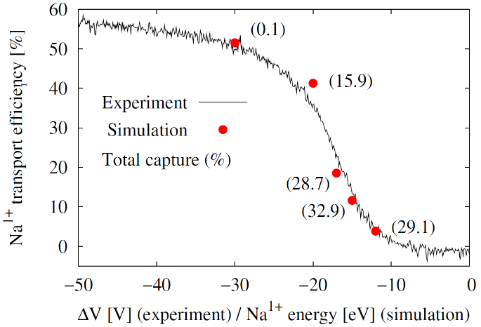
ECR-CB MODELING
AGREEMENT WITH EXPERIMENTS (CB @ LPSC)
Experiment
simulations
REPRODUCTION OF EFFICIENCY CURVES FOR HEAVY AND LIGHT IONS
Na
Rb

Slide 19
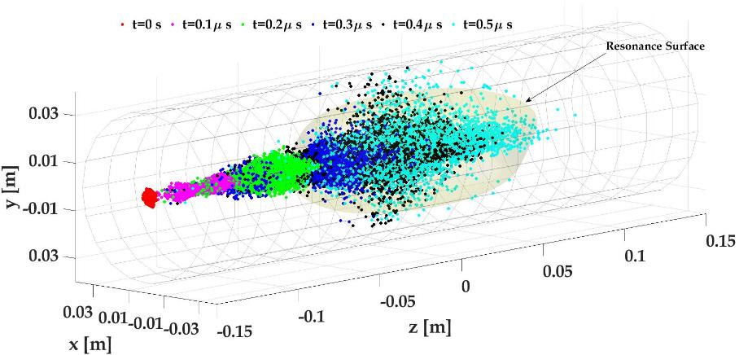
ECR-CB MODELING
DYNAMICS OF THE PROCESS
BALLISTIC OF THE PROCESS
IONS INJECTION AND CAPTURE
ENERGY RELEASED IN THE PLASMA

Slide 20
CONCLUSIONS
THE NUMERICAL CODE DEVELOPED WITHIN PANDORA IS ABLE TO DESCRIBE ELECTRONS MOTION
IS ABLE TO GIVE SPATIAL DISTRIBUTION OF RELEVANT QUANTITIES (DENSITY, ENERGY)
HAS BEEN BENCHMARKED WITH EXPERIMENTS
THE IMPLEMENTATION OF IONS’ CSD WILL GIVE A COMPLETE DESCRITPION OF THE ECR PLASMA
CAN BE CONSIDERED A PREDICTIVE TOOL FOR EVENTUAL VIRTUAL EXPERIMENTS
THE CODE IS READY FOR FUTURE UPGRADE OF THE FACILITY (CHARGE BREEDING)
NEXT STEP: HEATING BY MULTIPLE FREQUENCIES (WE ALREADY KNOW HOW TO DO IT!)

Slide 21
THANK YOU VERY MUCH FOR YOUR ATTENTION

