Slide 1



PANDORA Progress Meeting, Dec. 16 – 17, 2021
Incoherent Thomson scattering applied to the PANDORA experiment
Sedina Tsikata
CNRS, ICARE – Orléans, France
Laurent Maunoury and Jean-Eric Ducret
GANIL – Caen, France
sedina.tsikata@cnrs-orleans.fr

Slide 2
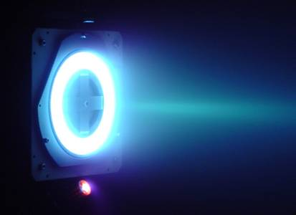
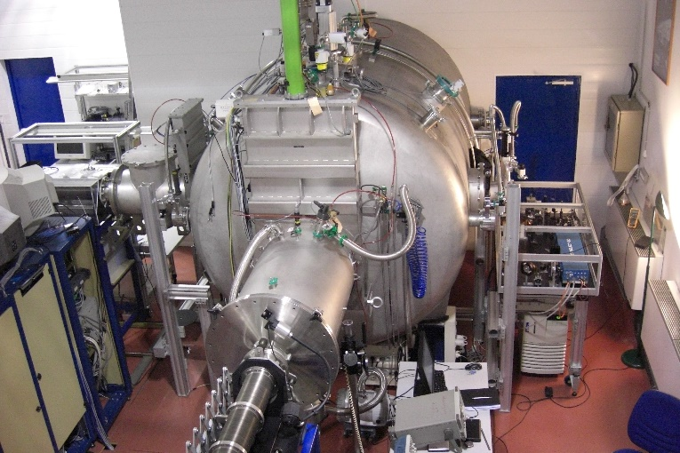
Context
ICARE: laboratory of the French National Center for Scientific Research (CNRS)
research in combustion, atmospheric chemistry, plasma propulsion and high speed flows
magnetized plasmas
- space propulsion, plasma-assisted deposition, ECR sources
turbulence, transport and self-organization
  - comparisons between experiments + theory + simulation
plasma diagnostic development
- specific open questions
my research
first experimental evidence for key drift instabilities in ExB geometry (electron cyclotron, ion-ion two stream)
Hall thruster (ICARE)
PIVOINE chamber with laser
scattering diagnostic PRAXIS
1

Slide 3
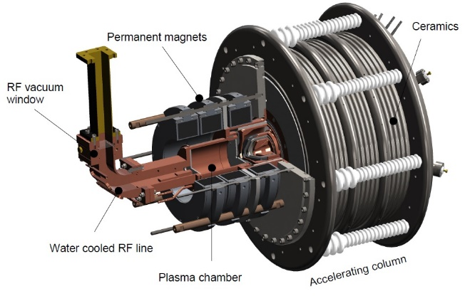
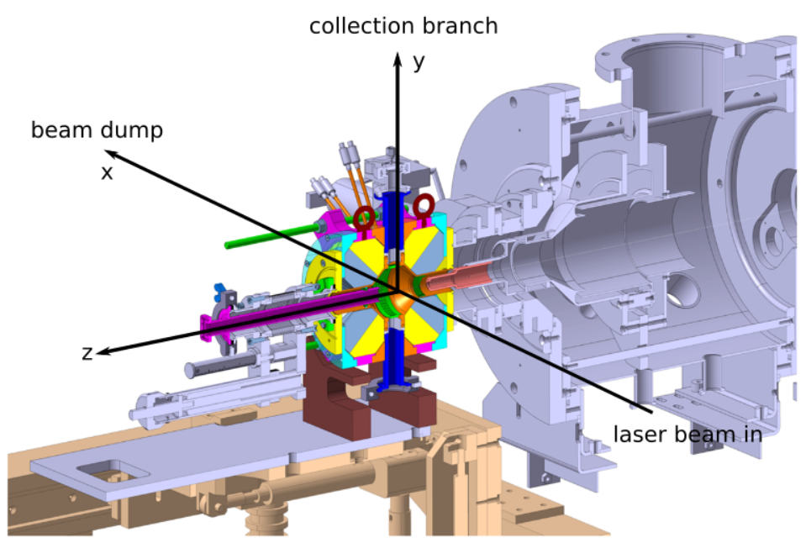
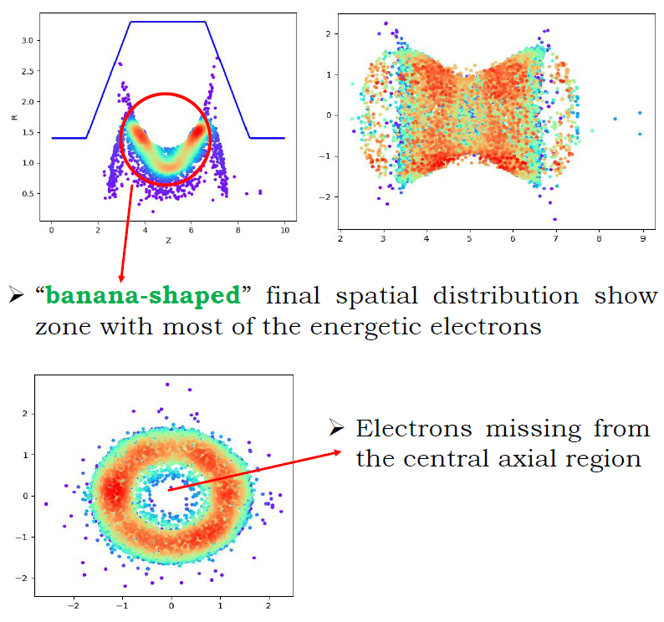
Context: investigations of ECR sources
from 2015: collaboration with O. Tüske, J. Schwindling, J. Fils on characterization of
model light ECR ion source (CEA Saclay)
2021: new collaboration with L. Maunoury and J-E. Ducret (GANIL) on characterization of 10 GHz PK-GANESA heavy ion ECR source
SILHI: H+, D+
A. Khandelwal
what is potential applicability of incoherent Thomson scattering to PANDORA?
2

Slide 4
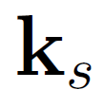

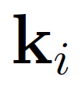

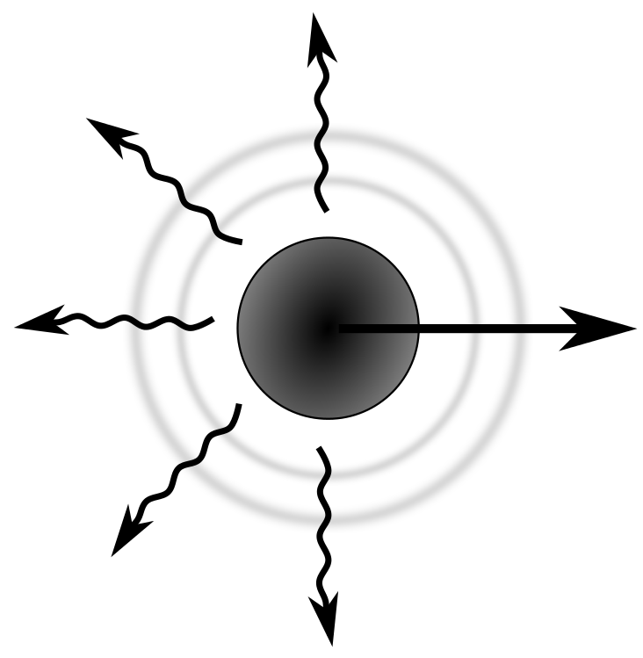
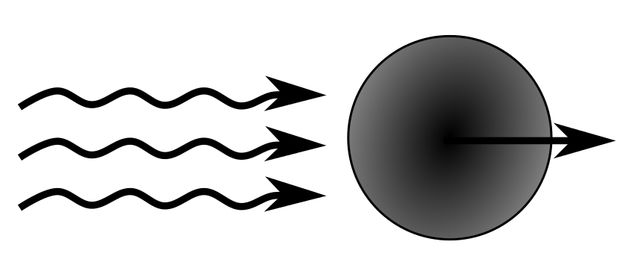
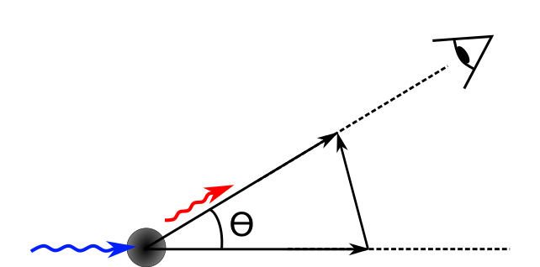
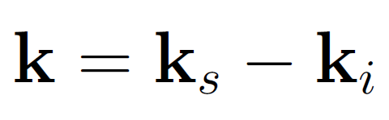

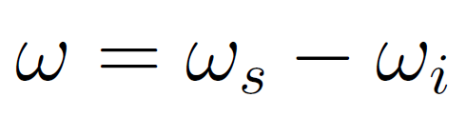



What is Thomson scattering?
expressed simply:
electromagnetic wave incident on free charged particle
radiation of an electromagnetic wave
the radiated field carries information on the particle uncorrelated and correlated behavior
observation direction
scattered wave vector
observation wave vector
incident wave vector
3

Slide 5
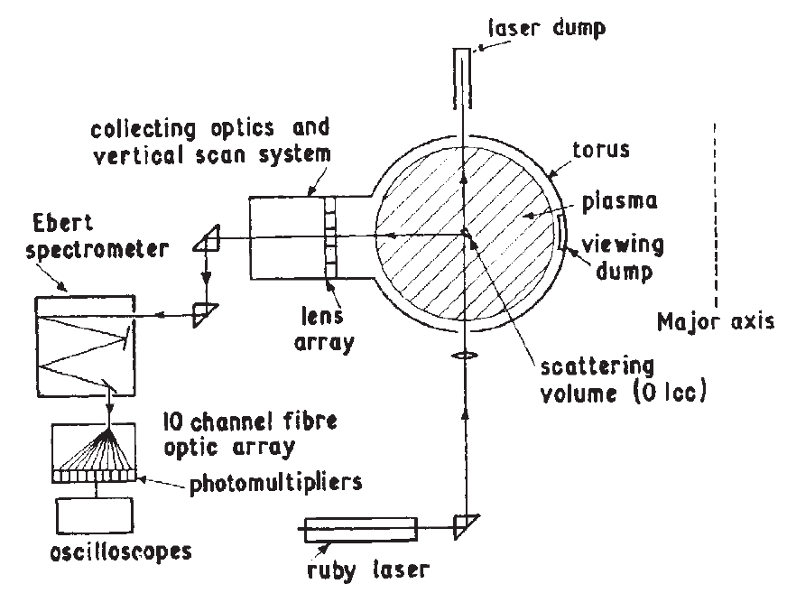
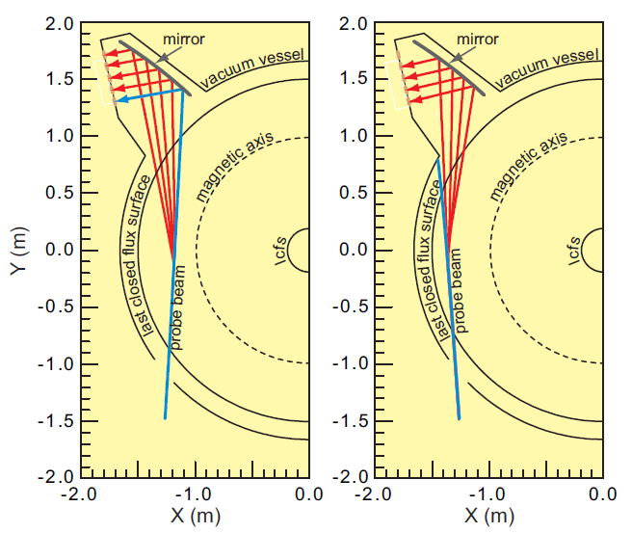
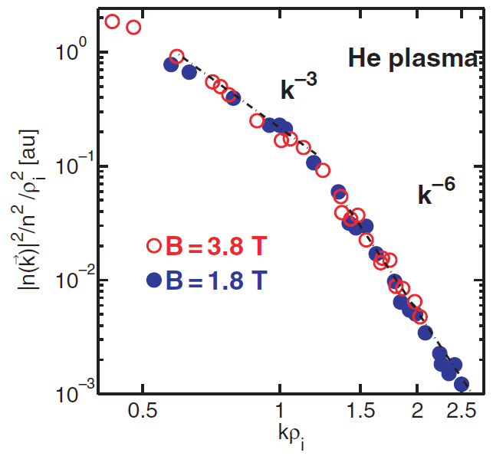
Examples of applications
NSTX implementation for study of modes driving anomalous electron transport (e.g. electron temperature gradients)
E. Mazzucato et al., Phys. Rev. Lett. 101, 075001 (2008)
Identification of key scaling laws on Tore Supra
P. Hennequin et al., Plasma Phys. Control. Fusion 46, B121 (2004)
First measurement of electron temperature
and density in T3 tokamak
Peacock et al., Nature 224, 448 (1969)
4

Slide 6
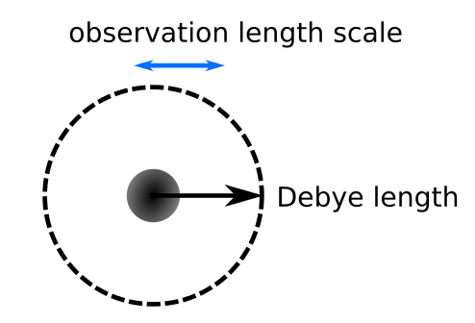
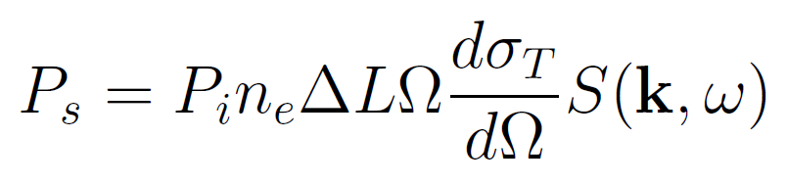

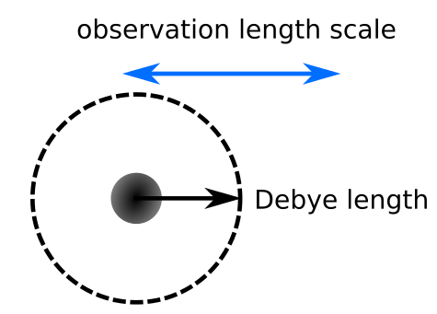
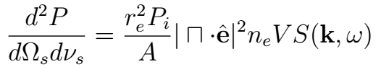
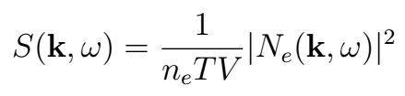

2 regimes of Thomson scattering
Incoherent Thomson scattering (ITS)
uncorrelated fluctuations
Coherent Thomson scattering (CTS)
correlated fluctuations
5

Slide 7
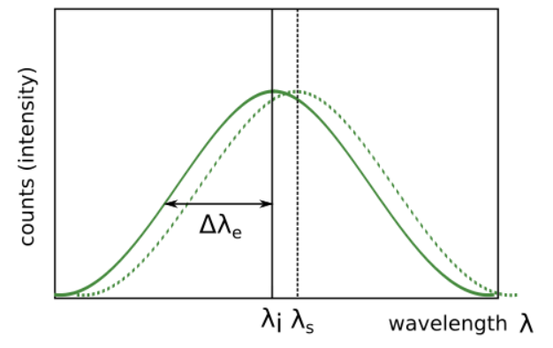
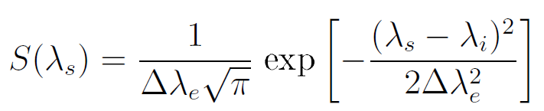
Incoherent Thomson scattering
scattered power
spectral density function / form factor
for Maxwellian electron velocity distribution
function along k
6

Slide 8
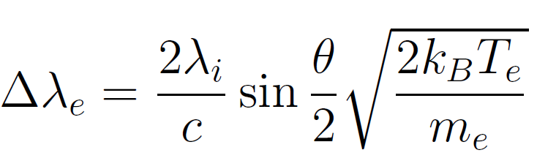


Incoherent Thomson scattering
technique provides direct access to:
electron temperature
electron density
electron drift velocity
more difficult to implement than probes, but no assumptions needed on plasma state
spectrum width proportional to
spectrum area proportional to
spectrum shift proportional to drift velocity
7

Slide 9
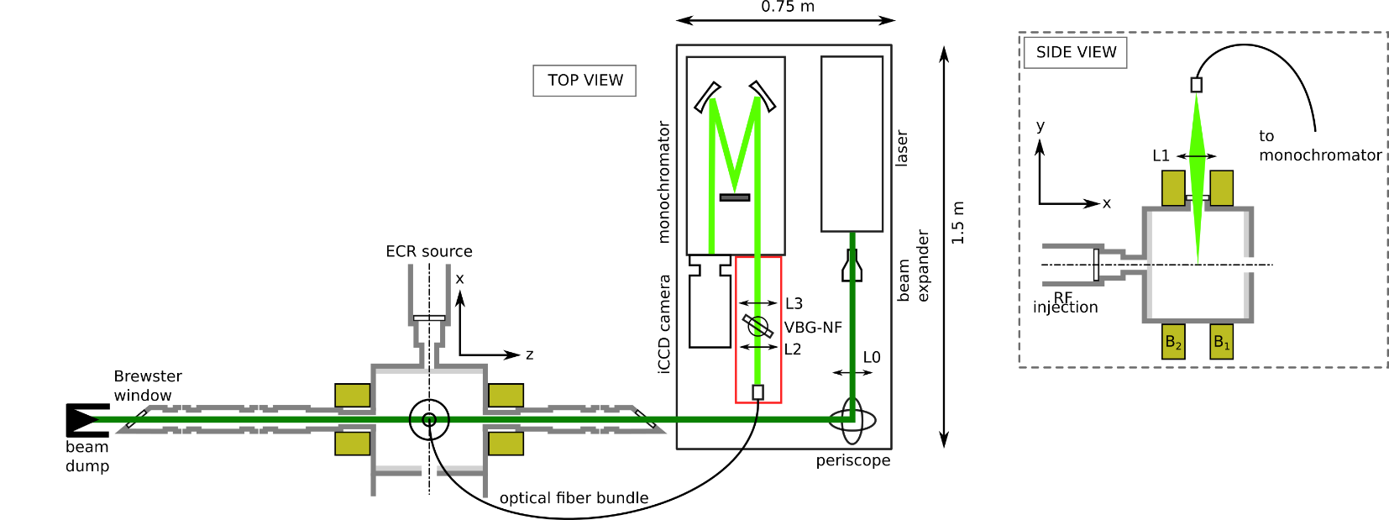
Incoherent Thomson scattering: implementation
THETIS - THomson scattering Experiments for low-Temperature Ion Sources
uses 532 nm, Nd:YAG pulsed laser
(10 Hz, PW 6 ns, 430 mJ/pulse)
unique sensitivity and
compactness
8

Slide 10
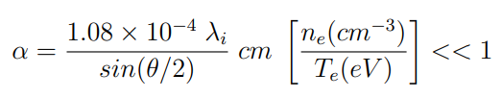
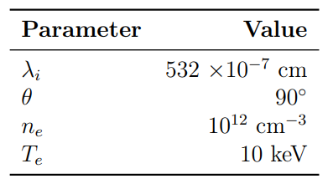

Diagnostic considerations
1. expected scattering parameter
incoherent regime
example values
values expected on PANDORA between 10⁻⁴ and 10⁻⁵ : incoherent regime
9

Slide 11


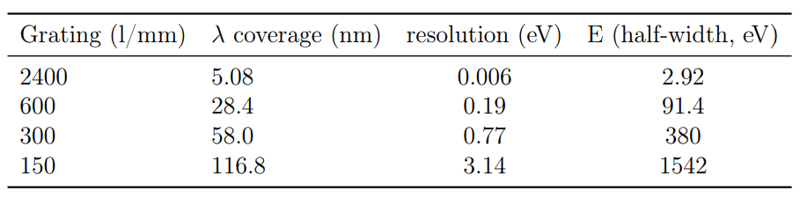
Diagnostic considerations
2. accessible electron temperature
equivalence between electron velocity and wavelength spread (half-width)
detection of the scattered light would use:
- Acton Standard Series SP-2756 Imaging Spectrograph
- PI-MAX 4: 1024f iCCD camera
equivalence between electron energy and velocity
installed
10

Slide 12
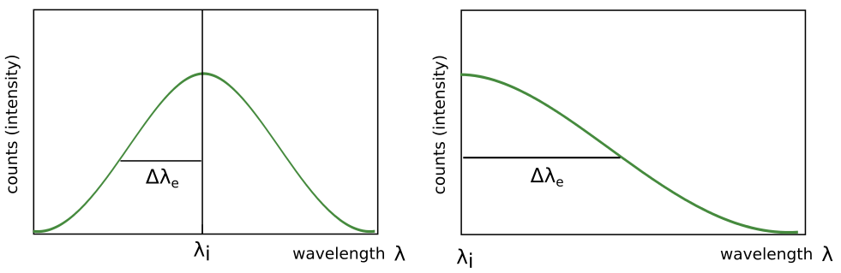
Diagnostic considerations
2. accessible electron temperature
energy range can be increased by shifting grating center
the electron energies accessible would range from < 1 eV to 3 keV
(note: deviations from Maxwellian EVDF are directly visible)
11

Slide 13
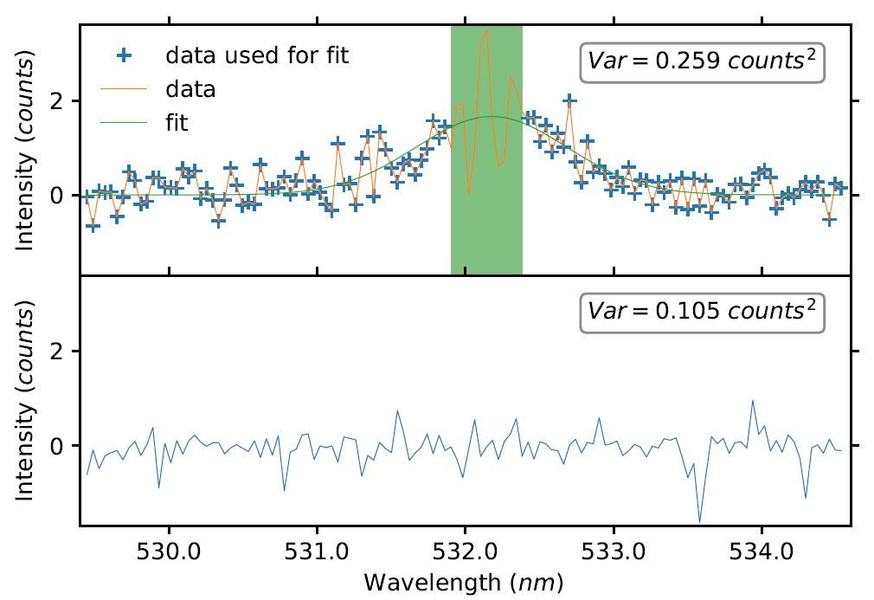
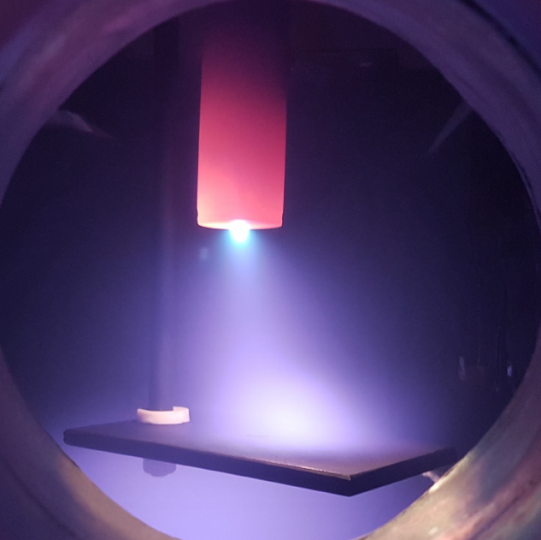
Diagnostic considerations
3. accessible electron density
The THETIS diagnostic has been optimized for low-temperature plasmas
demonstrated sensitivity: 10¹⁰ cm⁻³, lowest achieved so far
PANDORA: 10¹² – 10¹³ cm⁻³ : detection expected to be possible
caveat: detection of electron populations requires their presence in high enough numbers
ne = (1.8 ± 0.2) x 10¹⁰ /cm³
Te = (0.46 ± 0.08) eV
B. Vincent, S. Tsikata et al., PSST 27, 055002 (2018)
12

Slide 14
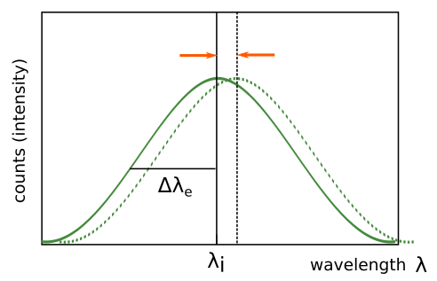
Diagnostic considerations
4. accessible electron drift velocity
so far, we have resolved global electron drifts as low as 10⁵ m/s
faster global drifts are easier to detect
caveat: depends on the particular conditions used (density, plasma emission, temperature)
13

Slide 15
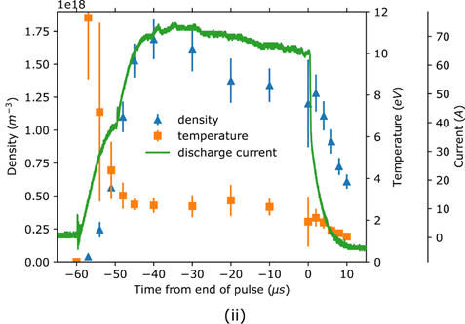
Diagnostic considerations
5. accessible temporal resolution
in very low-density plasmas (10¹⁰ cm⁻³), multiple laser shots required to gather sufficient photons
currently: 6000 shots, 10 Hz laser: 10 minute acquisition = averaged information
however: with a stable, pulsed source, µs resolution is accessible
so far, no plasma as dense as that of PANDORA has been studied: favorable conditions for measurement
S. Tsikata, B. Vincent, T. Minea et al., PSST 28, 03LT02 (2019)
14

Slide 16
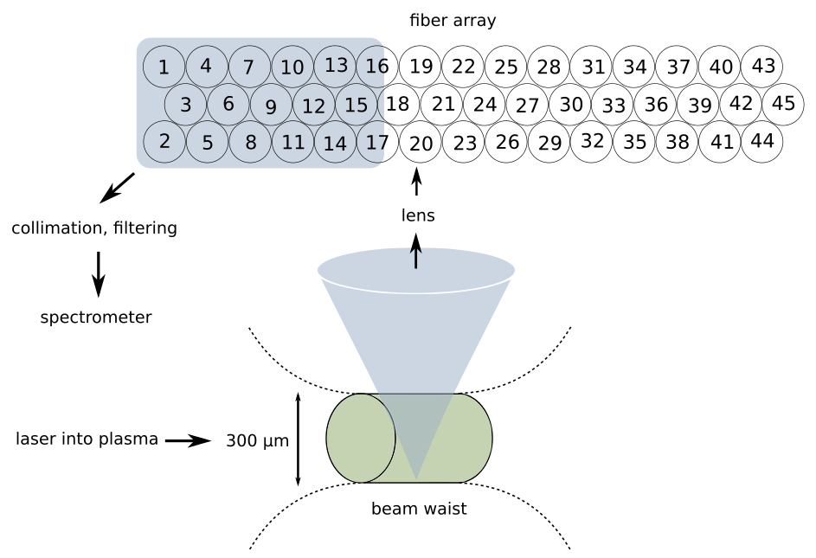
Diagnostic considerations
6. accessible spatial resolution
in current implementation, volumetric resolution is ~1 mm³
this is set by the laser beam dimensions in the plasma and the fibers imaged
15

Slide 17
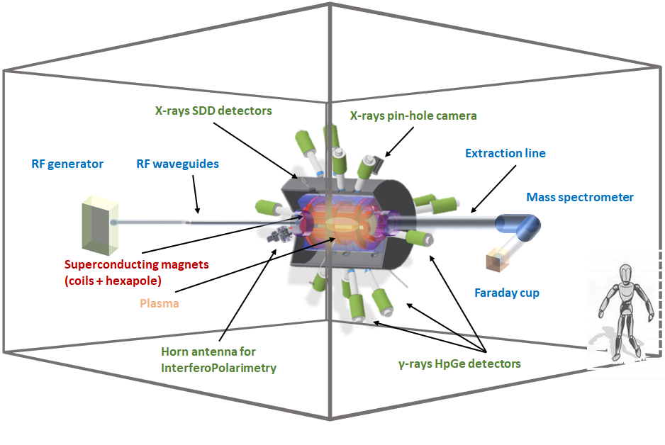
Implementation for PANDORA
this would require three access ports:
two ports diametrally opposed
one port permitting perpendicular light collection
might be a challenge to obtain
remote piloting of laser beam and light collection
3 axis motorized displacement of collection optics and laser beam
16

Slide 18
Discussion and conclusions
Thomson scattering is a powerful tool for characterizing plasmas:
  - recent advances = new info from low-density environments
information on electron energy distribution functions, density, and drift velocity in the incoherent scattering regime
the recently-developed incoherent Thomson scattering diagnostic THETIS appears potentially suited to measurements in PANDORA
- electron temperature: < 1 eV - 3 keV
- electron density: 10¹⁰ cm⁻³ and higher
- global electron drift velocity: 10⁵ m/s and above
a number of practical issues would need to be considered (optical access, compatibility with other features of the plasma device), also time available ☺
17

Slide 19
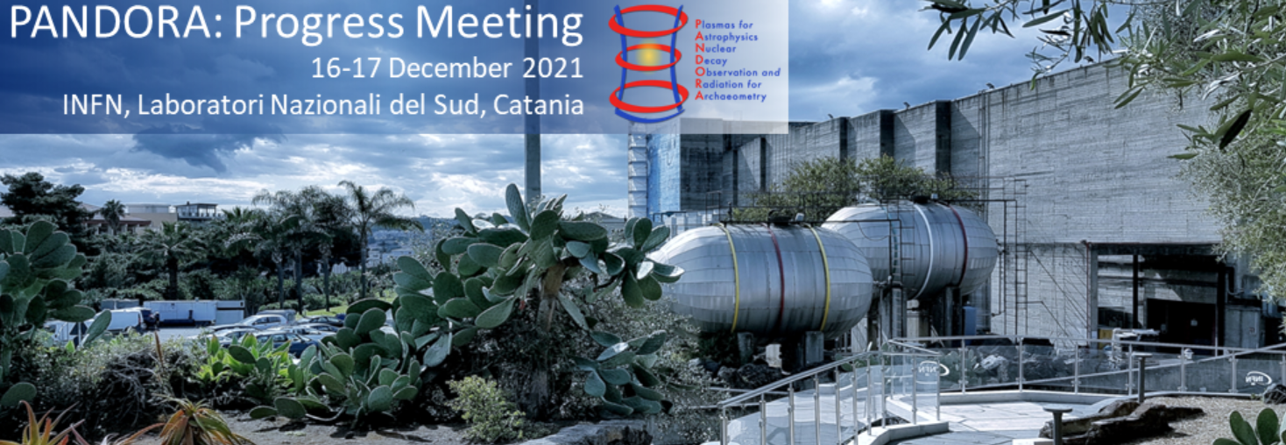
Thanks for your attention and the opportunity to present!
18

