Slide 1
X-ray diagnostics: SPhC algorithm for space-resolved spectroscopy
Eugenia Naselli (INFN-LNS)
on behalf of the PANDORA collaboration

Slide 2
X-ray imaging and space resolved spectroscopy of ECR plasmas in compact magnetic traps
Eugenia Naselli – PANDORA Collaboration Meeting – 16-17 Dec 2021
Outline
Motivations and Physical Background
→ Interdisciplinary, Fundamental and Applied Physics
Experimental Setup
→ X-ray pin-hole technique
Analytical Methods
→ Integrated X-ray Imaging
→ Single Photon Counting (SPhC) X-ray Imaging
Experimental Results
→ Plasma structure, dynamics of losses and confinement investigations
→ Quantitative elementar composition pixel-by-pixel → Perspective for locally plasma parameters (electron density, temperature) measurements
Perspectives and Conclusion

Slide 3
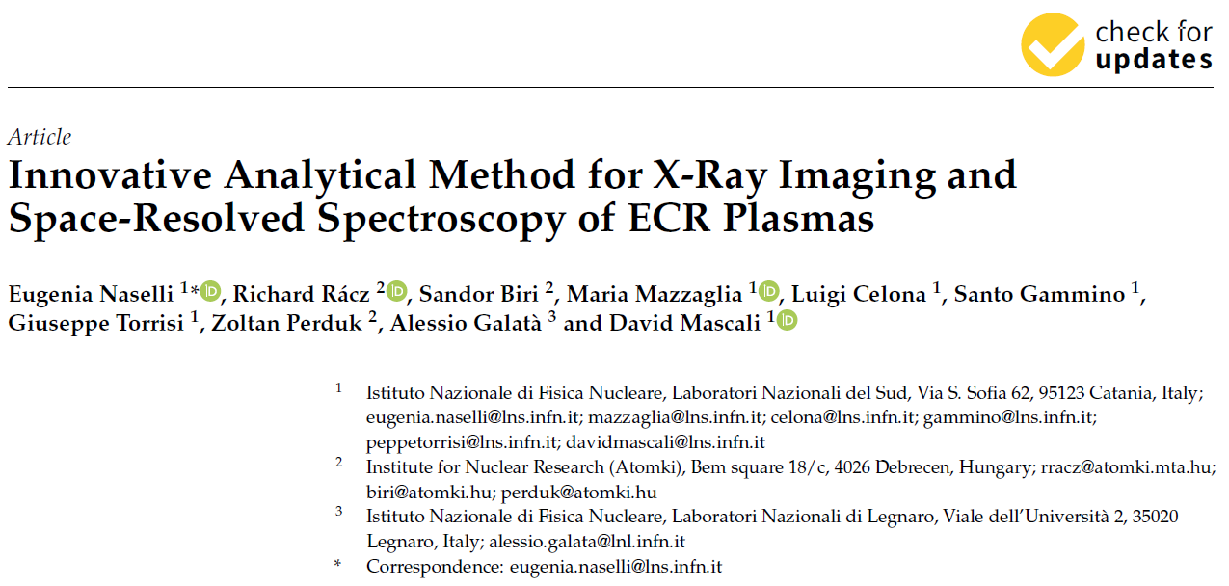
X-ray imaging and space resolved spectroscopy: Motivations and Physical Background
Eugenia Naselli – PANDORA Collaboration Meeting – 16-17 Dec 2021
Goal: to investigate ECR plasma proprieties (electron density and temperature, plasma structure, confinement and dynamics of losses) in compact trap
Method: ECR plasmas emit radiation from microwave to hard X-rays and this radiation can be used to investigate plasma parameters in different regimes;
Novelties: Development of an Innovative Analytical Method
for X-ray Imaging and Space-Resolved Spectroscopy to analyze Single-Photon-Counting image-frames;
Improvement of the whole setup TO PERFORM high
resolution X-ray imaging at HIGH POWER REGIMES;
Soft X-ray characterization is a very powerful method to study:
How plasma changes vs. pumping RF power and frequency, magnetic field and heating mode (single vs. multiple frequencies);
Plasma structure;
Confinement and losses dynamics in stable vs. turbulent regimes;
D. Mascali et al., EPJ Web Conf. 227 (2020) 01013

Slide 4
X-ray imaging and space resolved spectroscopy: Motivations and Physical Background
Eugenia Naselli – PANDORA Collaboration Meeting – 16-17 Dec 2021
Goal: to investigate ECR plasma proprieties (electron density and temperature, plasma structure, confinement and dynamics of losses) in compact trap
Method: ECR plasmas emit radiation from microwave to hard X-rays and this radiation can be used to investigate plasma parameters in different regimes;
Novelties: Development of an Innovative Analytical Method
for X-ray Imaging and Space-Resolved Spectroscopy to analyze Single-Photon-Counting image-frames;
Improvement of the whole setup TO PERFORM high
resolution X-ray imaging at HIGH POWER REGIMES;
Soft X-ray characterization is a very powerful method to study:
How plasma changes vs. pumping RF power and frequency, magnetic field and heating mode (single vs. multiple frequencies);
Plasma structure;
Confinement and losses dynamics in stable vs. turbulent regimes;
Motivation:
Interdisciplinary and Fundamental Physics: the PANDORA project;
Applied Physics: ECR plasmas are typically used in ECR Ion Sources (ECRISs);
The PANDORA (Plasmas for Astrophysics, Nuclear Decays Observation and Radiation for Archaeometry) project aims at measuring nuclear β-decays lifetimes of isotopes of astrophysical interest for the first time in a ECR magnetized-plasma
Laboratory-Magnetoplasmas in compact traps, can become ENVIROMENT for Nuclear Physics and Nuclear Astrophysics research;
The quality of the extracted ion beam depends on plasma properties in terms of high ion charge state production, beam intensity, beam stability (ripple);
D. Mascali et al., EPJ Web Conf. 227 (2020) 01013

Slide 5
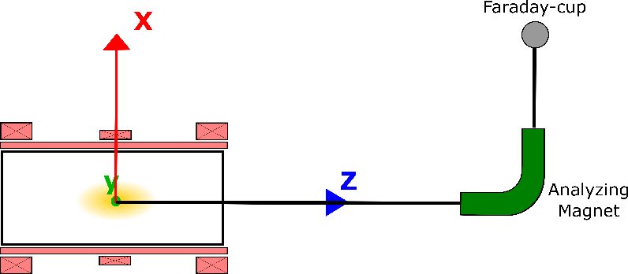
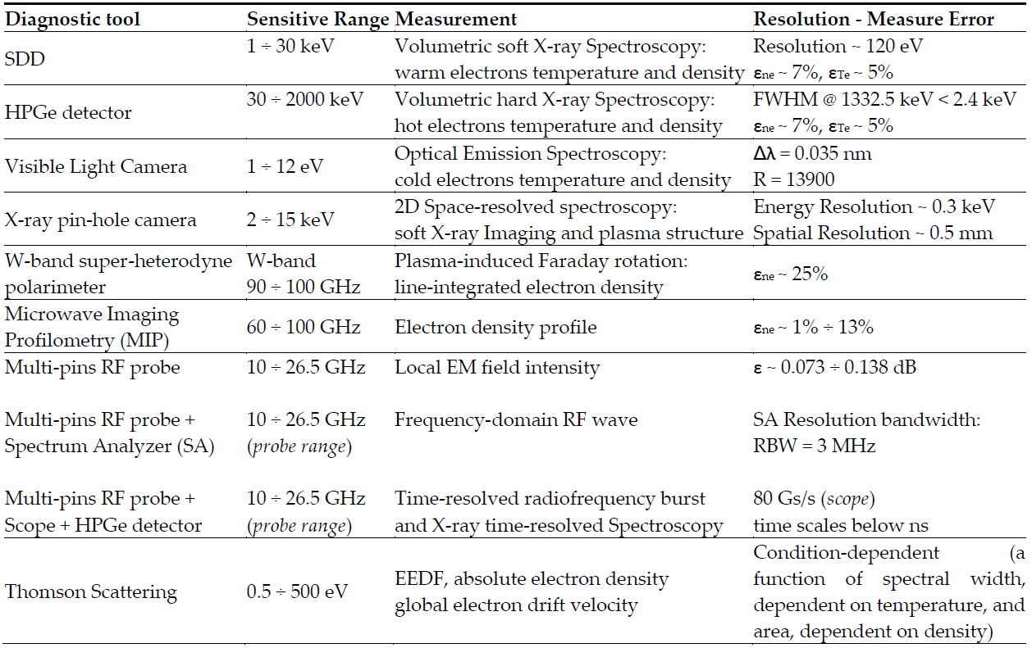
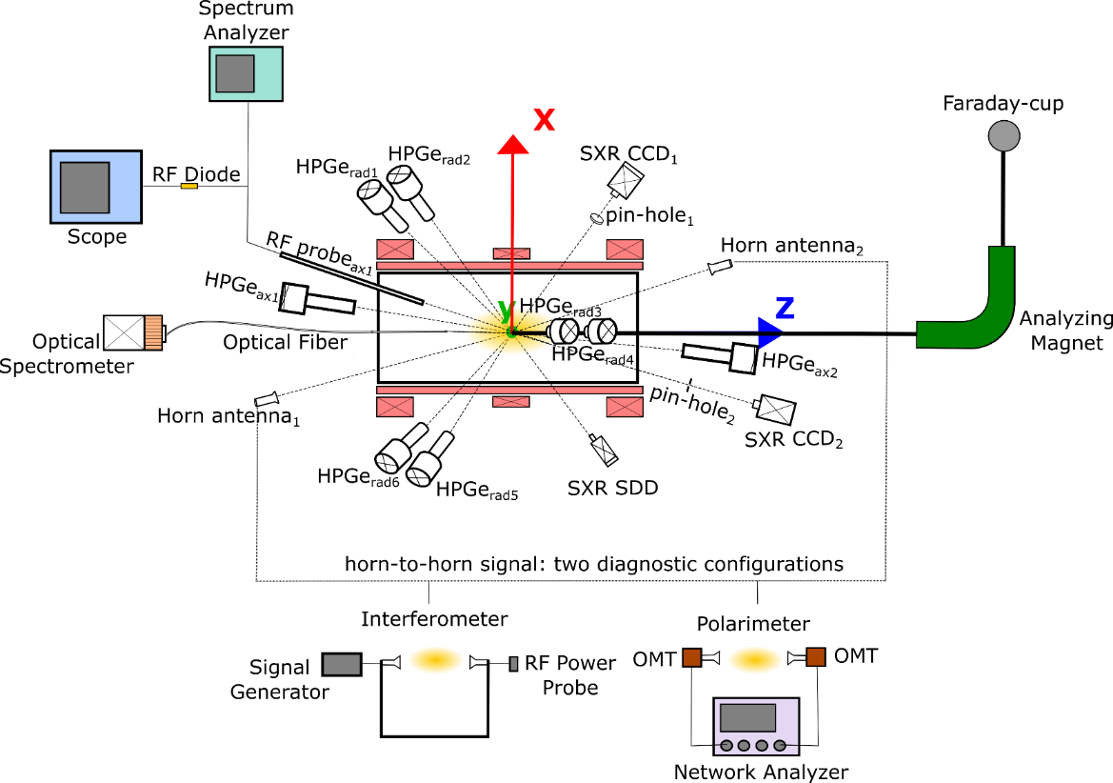
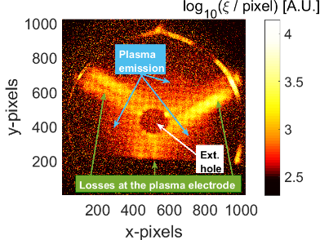
X-ray imaging and space resolved spectroscopy: Motivations and Physical Background – The PANDORA Multi-Diagnostics System
Eugenia Naselli – PANDORA Collaboration Meeting – 16-17 Dec 2021
Typical diagnostic in ECRIS
In the frame of the PANDORA project an innovative multi-diagnostic approach to correlate plasma parameters to nuclear activity has been proposed. This is based on several detectors and non-invasive techniques (Optical Emission Spectroscopy, RF systems, InterferoPolarimetry, time- and space-resolved X-ray spectroscopy),
allowing detailed investigations of magnetoplasma properties.
PANDORA plasma multidiagnostics systems
We here focus on High Resolution
Spectrally-resolved X-ray Imaging
E. Naselli et al., Journal of Instrumentation 14 (2019) C10008

Slide 6
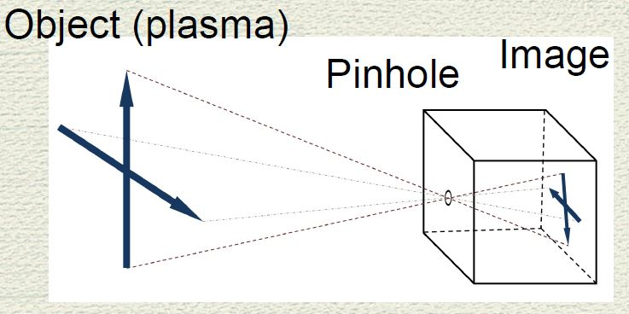
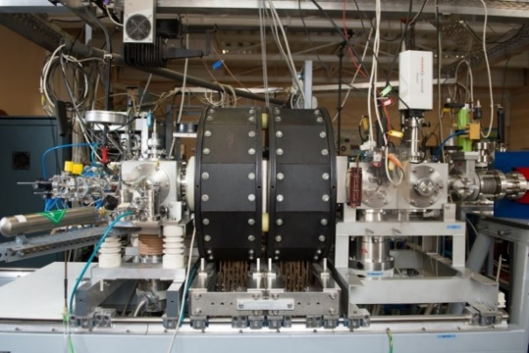
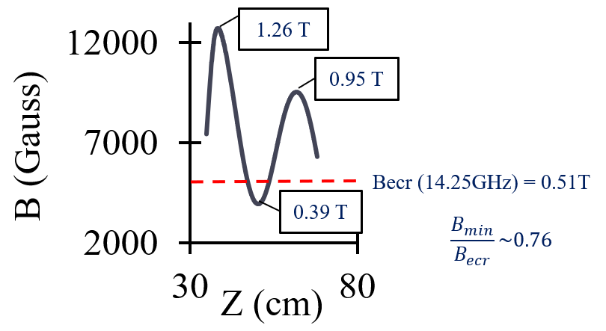
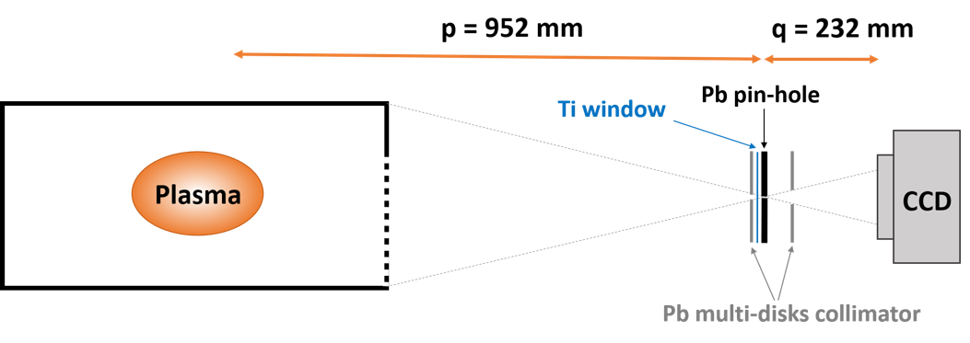
X-ray imaging and space resolved spectroscopy: The Experimental Setup – The pin-hole camera tool
Eugenia Naselli – PANDORA Collaboration Meeting – 16-17 Dec 2021
The Experimental Setup
Soft X-ray pin-hole camera tool
ECRIS at the ATOMKI Laboratory
The pin-hole technique allows to reproduce the plasma image
in a position-sensitive CCD detector
The diagnostic setup has been installed in a compact magnetic B-min plasma trap: the 14.25 GHz ECRIS at ATOMKI
14.25 GHz ECRIS
B-min magnetic field
Permanent magnet hexapole and room temperate coils
No post acceleration
Used for atomic physics, material science, ECR plasma physics
Plasma chamber
Length ~ 200 mm
Diameter ~ 56 mm
Holder with
pin-hole system
CCD camera
Sensitivity range ~ 2 ÷ 20 keV
Sensor Size: 13.3 mm x 13.3 mm (1024 x 1024 Pixels)
Pixel size: 13 µm x 13 µm
Lead Pin-hole (diameters 400 μm)
“X-ray measurements: status and next experiments”
R. Racz talk, Thursday 16th Dec, this Meeting
Energy Resolution ~ 300 eV
Spatial Resolution ~ 500 µm
R. Racz et al., Plasma Source Sci. Technol. 26 (2017) 075011
D. Mascali et al., Rev. Sci. Instrum. 87 (2016) 02A510

Slide 7
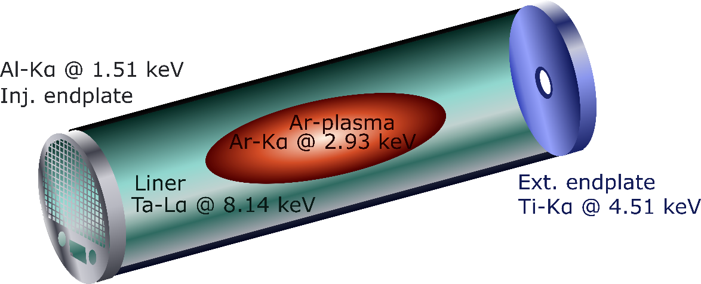
X-ray imaging and space resolved spectroscopy: The Experimental Setup – Advanced design of the plasma chamber walls
Eugenia Naselli – PANDORA Collaboration Meeting – 16-17 Dec 2021
The Experimental Setup
Advanced design of the plasma chamber walls
Fluorescence lines can be used to get info about where the electrons collide on the chamber walls
in order to have well separated component of the emitted X-ray:
→ Special design of plasma chamber for studying confinement dynamics (plasma vs losses X-radiation emission)
Perspective front-view in the FULL-FIELD X-ray pin-hole camera setup
Optical image by Optical Emission spectroscopy
Integrated Soft X-ray image
(50 sec of exposure time)
X-rays coming from Plasma are mostly due to ionized Kα Argon lines
X-rays coming from Magnetic Branches consist of mostly fluorescence from Ti
X-rays coming from Poles are mostly due to radial losses impinging on the Ta liner
S. Biri et al., Journal of Instrumentation 16 (2021) 02006

Slide 8
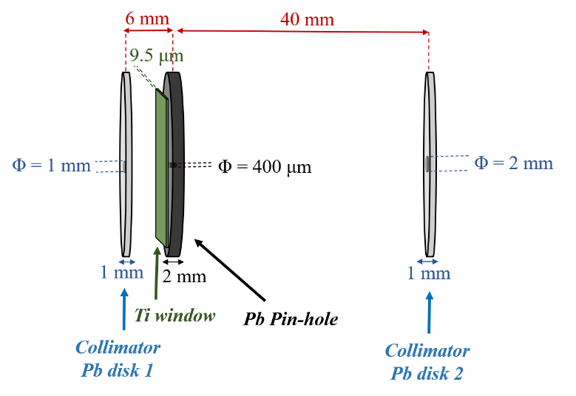
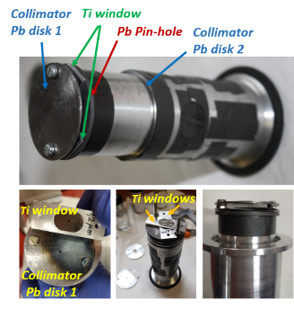
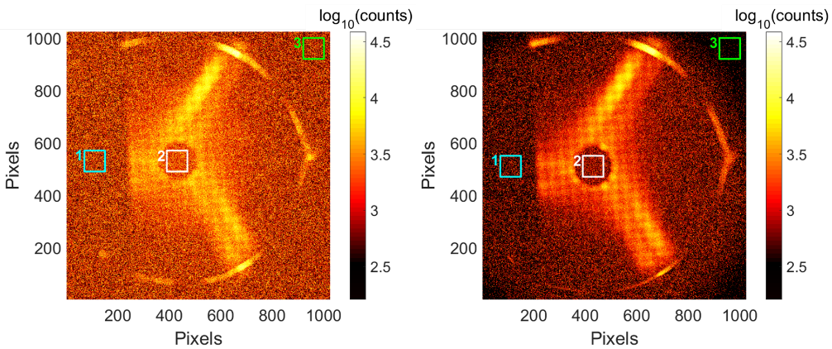
X-ray imaging and space resolved spectroscopy: The Experimental Setup – Lead multi-disks collimator
Eugenia Naselli – PANDORA Collaboration Meeting – 16-17 Dec 2021
The Experimental Setup
Advanced design of the plasma chamber walls
Lead multi-disks collimator
Fluorescence lines can be used to get info about where the electrons collide on the chamber walls
Lead multi-disks collimator properly designed to perform high resolution X-ray imaging at high energy (up to 200 W). It allows:
Reduce the noise
Improve the signal/noise ratio
Increase the resolution
in order to have well separated component of the emitted X-ray:
→ Special design of plasma chamber for studying confinement dynamics (plasma vs losses X-radiation emission)
Without the Collimator
With the Collimator
Perspective front-view in the FULL-FIELD X-ray pin-hole camera setup
Optical image by Optical Emission spectroscopy
Integrated Soft X-ray image
(50 sec of exposure time)
X-rays coming from Plasma are mostly due to ionized Kα Argon lines
X-rays coming from Magnetic Branches consist of mostly fluorescence from Ti
X-rays coming from Poles are mostly due to radial losses impinging on the Ta liner
S. Biri et al., Journal of Instrumentation 16 (2021) 02006

Slide 9
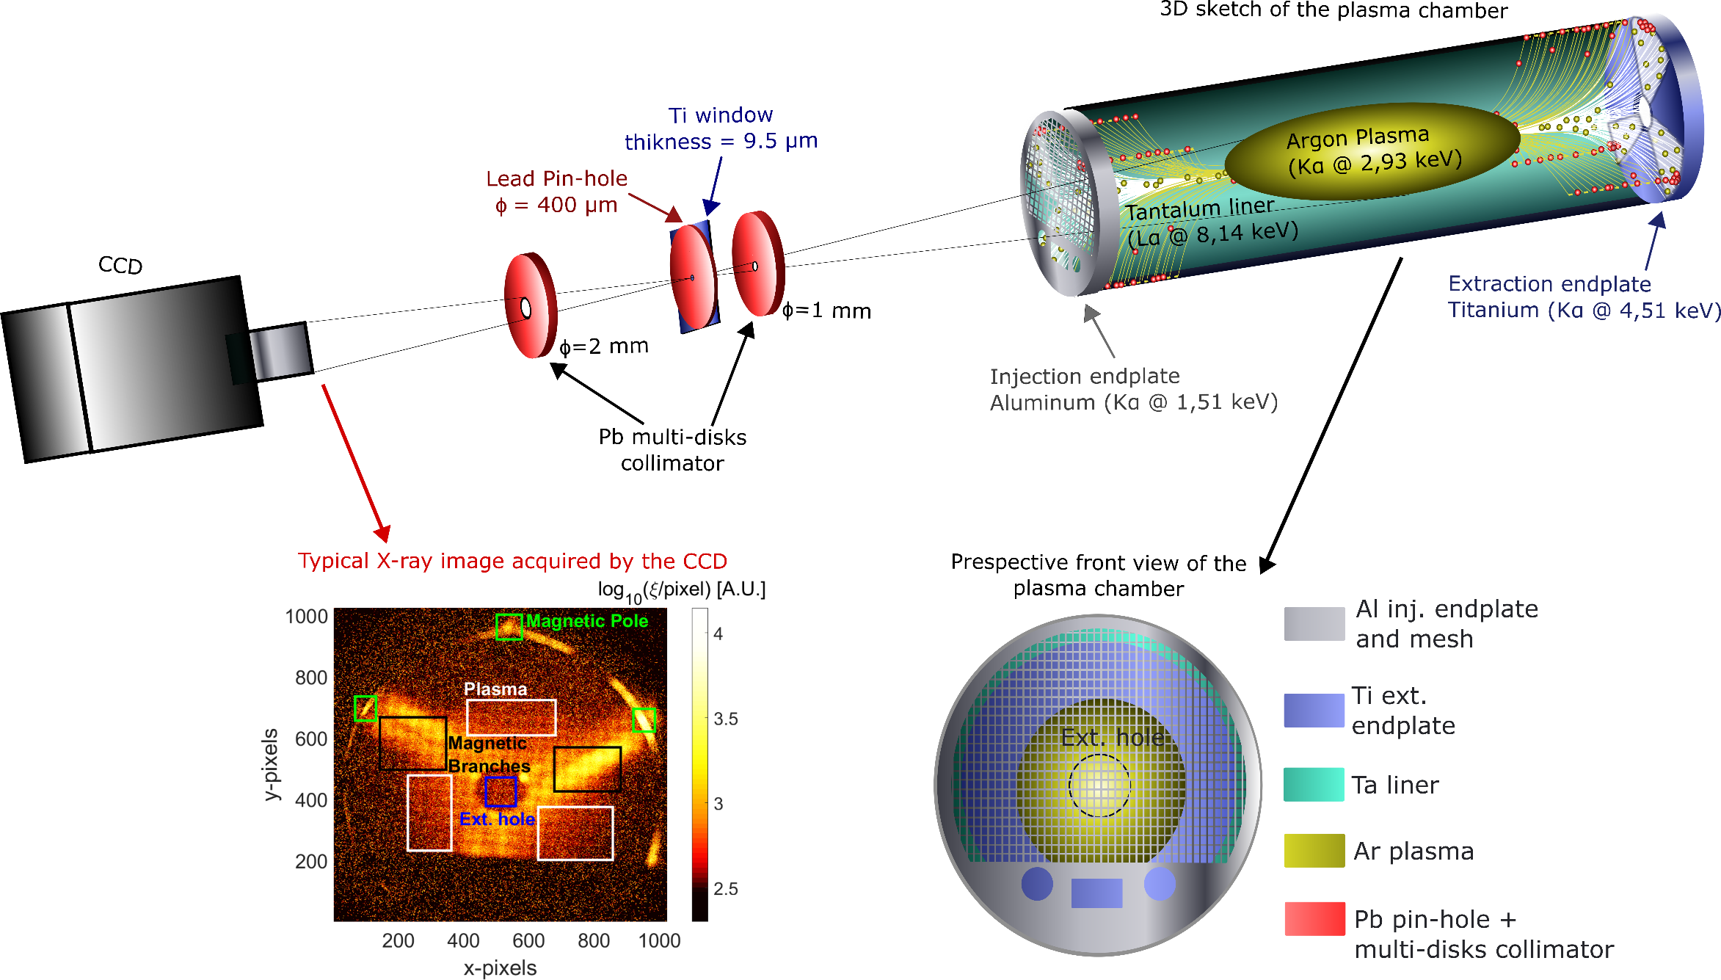
X-ray imaging and space resolved spectroscopy: The Experimental Setup – Lead multi-disks collimator
Eugenia Naselli – PANDORA Collaboration Meeting – 16-17 Dec 2021
The Experimental Setup

Slide 10
X-ray imaging and space resolved spectroscopy: The Analytical Methods
Eugenia Naselli – PANDORA Collaboration Meeting – 16-17 Dec 2021
Data Analysis
Integrated X-ray Imaging
Single Photon Counted (SPhC) X-ray Imaging
VERY FAST RESPONSE and ‘‘Easy’’ Analysis
for ‘‘Live’’ investigations
SLOW RESPONSE and ‘‘Advanced’’ Analysis
for quantitative and POWERFUL (local energy determination) investigations

Slide 11
X-ray imaging and space resolved spectroscopy: The Analytical Methods
Eugenia Naselli – PANDORA Collaboration Meeting – 16-17 Dec 2021
Integrated Soft X-ray image
(50 sec of exposure time)
Data Analysis
Data Analysis
Integrated X-ray Imaging
Single Photon Counted (SPhC) X-ray Imaging
VERY FAST RESPONSE and ‘‘Easy’’ Analysis
for ‘‘Live’’ investigations
SLOW RESPONSE and ‘‘Advanced’’ Analysis
for quantitative and POWERFUL (local energy determination) investigations
→ investigate the energy content (ξ)
→ in SPhC, each pixel becomes an independent spectrally-sensitive detector:
decoupling of photon number vs. energy
1 only image
Single frame exposure time ~ tens of seconds
Total measurement time ~ tens of seconds
→ VERY FAST RESPONSE and ‘‘ Easy ‘‘ analysis
‘‘LIVE’’ plasma structure and emission investigations
(vs. the operative parameter of the ECRIS).
Thousand of image-frames ~ 5000
Single frame exposure time ~ 50-500 milliseconds
Total measurement time: ~ 4 hours
→ SLOW RESPONSE and ‘‘Advanced‘‘ Analysis
POWERFUL Investigations: ‘‘SPATIALLY-RESOLVED SPECTROSCOPY’’
for quantitative characterization

Slide 12
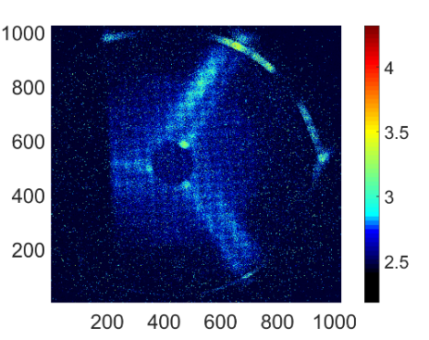
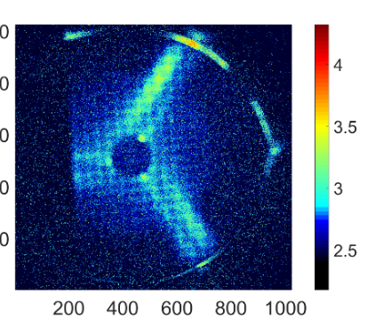
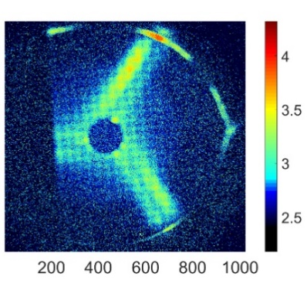
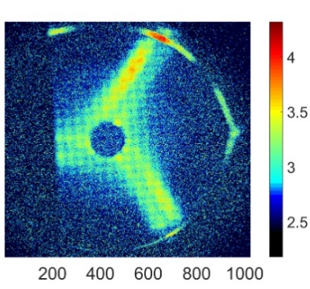
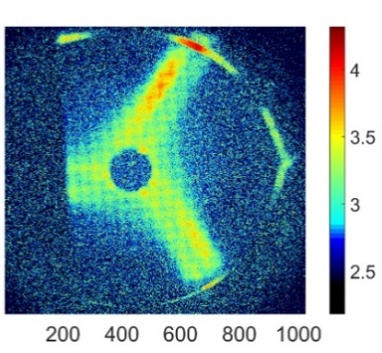
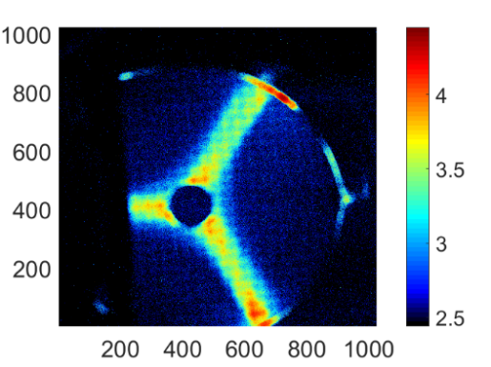
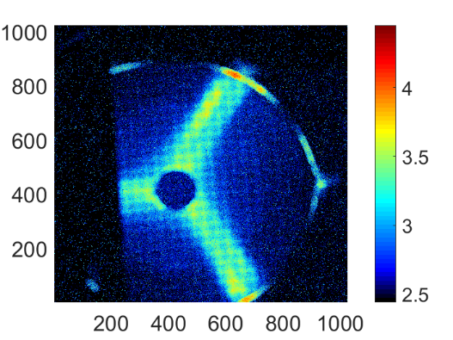
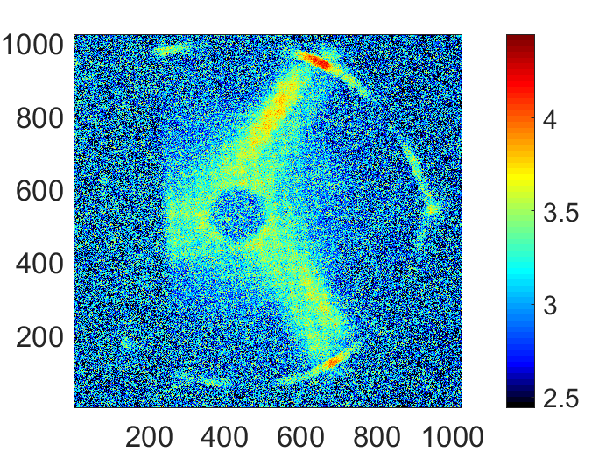
X-ray imaging and space resolved spectroscopy: The Experimental Results – The Integrated X-ray Imaging
Eugenia Naselli – PANDORA Collaboration Meeting – 16-17 Dec 2021
The Experimental Results: Integrated X-rays Imaging
Integrated X-ray Imaging vs. RF pumping power scaling
For a pumping RF power from 40W to 200W: changes to the ξ (energy content) of the plasma are clearly visible. By selecting specific ROIs in the images it is possible to quantitative investigate about the ξ of the emission.
RF frequency: 13.9 GHz
RF Power: 40 W
RF Power: 80 W
RF Power: 120 W
RF Power: 160 W
RF Power: 200 W
log₁₀ (ξ) [A.U.]
Integrated X-ray Imaging vs. RF magnetic field profile
RF frequency: 13.9 GHz @ 200W
Coil 60% Intensity
Coil 80% Intensity
Coil 100% Intensity
log₁₀ (ξ) [A.U.]
S. Biri et al., Journal of Instrumentation 16 (2021) 02006

Slide 13
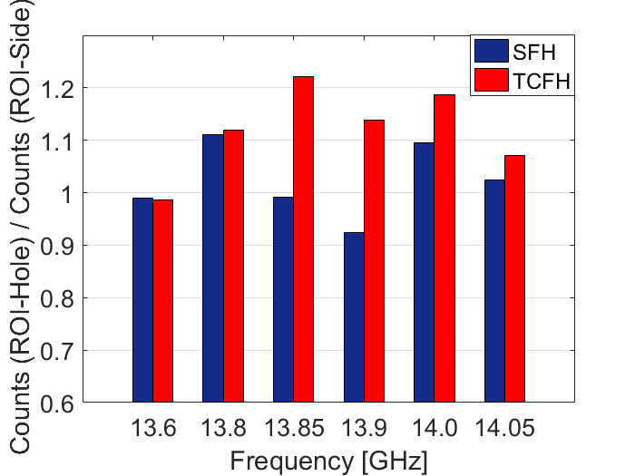
X-ray imaging and space resolved spectroscopy: The Experimental Results – The Integrated X-ray Imaging
Eugenia Naselli – PANDORA Collaboration Meeting – 16-17 Dec 2021
The Experimental Results: Integrated X-rays Imaging
Integrated X-ray Imaging vs. RF pumping power scaling
For a pumping RF power from 40W to 200W: changes to the ξ (energy content) of the plasma are clearly visible. By selecting specific ROIs in the images it is possible to quantitative investigate about the ξ of the emission.
RF frequency: 13.9 GHz
RF Power: 40 W
RF Power: 80 W
RF Power: 120 W
RF Power: 160 W
RF Power: 200 W
log₁₀ (ξ) [A.U.]
Confinement studies vs. plasma heating methods
Integrated X-ray Imaging vs. RF magnetic field profile
Counts ROI-Hole
RF frequency: 13.9 GHz @ 200W
Counts ROI-Side
Coil 60% Intensity
Coil 80% Intensity
Coil 100% Intensity
log₁₀ (ξ) [A.U.]
In two close frequency heating mode (TCFH) the plasma is rearranged to be denser in a central region of the plasma, compared to single frequency heating (SFH) mode
S. Biri et al., Journal of Instrumentation 16 (2021) 02006
D. Mascali et al., accepted to be published on Plasma Phys. Control. Fusion

Slide 14
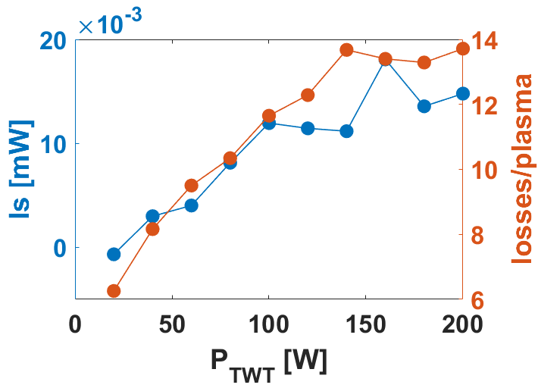
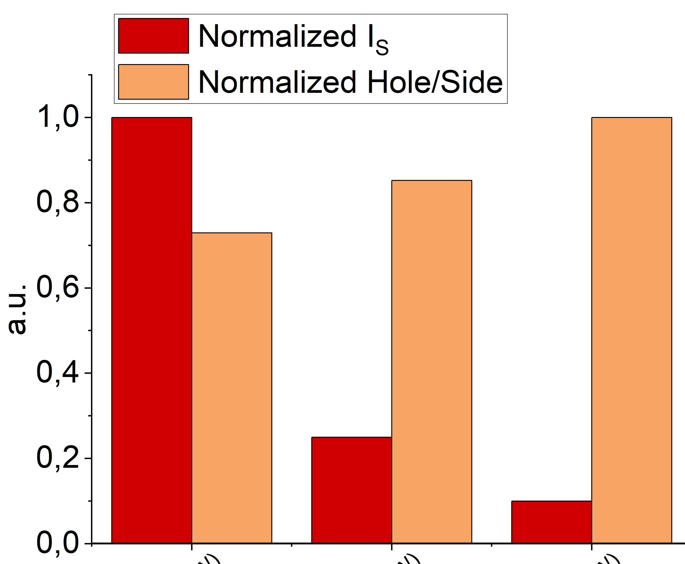
X-ray imaging and space resolved spectroscopy: The Experimental Results – The Integrated X-ray Imaging
Eugenia Naselli – PANDORA Collaboration Meeting – 16-17 Dec 2021
X-ray Imaging vs. RF pumping power
E. Naselli et al., Plasma Sources Sci. Technol. 28 (2019) 085021
Losses vs. Plasma
D. Mascali et al., accepted to be published on Plasma Phys. Control. Fusion
$\text{Plasma}\text{Core}$ vs. $\text{Plasma}\text{Side}$
Normalized I_{S}
Normalized Core/Side Plasma
‘‘Live’’ plasma structure and emission investigations
#1 #2 #3

Slide 15
X-ray imaging and space resolved spectroscopy: The Analytical Methods
Eugenia Naselli – PANDORA Collaboration Meeting – 16-17 Dec 2021
Data Analysis
Integrated X-ray Imaging
Single Photon Counted (SPhC) X-ray Imaging
CCD: Sensitive position detector
→ investigate the intensity
Each pixel becomes an indipendent spectrally-sensitive detector:
→ SPATIALLY-RESOLVED SPECTROSCOPY pixel-by-pixel
→ decoupling of photon number versus energy
very short exposure-time (tens milliseconds)
thousands of SPhC frames
→ the probability that two (or more) photons hit the same pixel during the exposure of a single image-frame is minimized;
→ single photon events carry the information on the energies of the incident photons

Slide 16
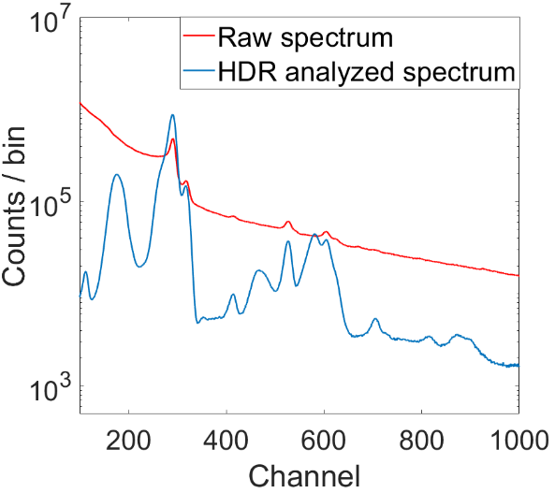
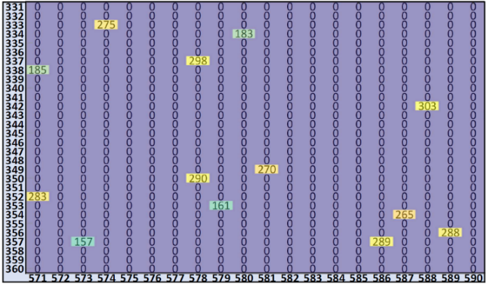
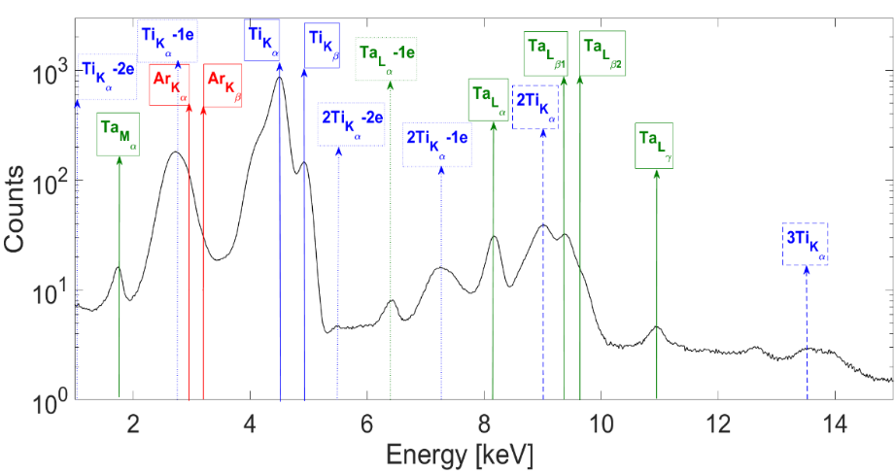
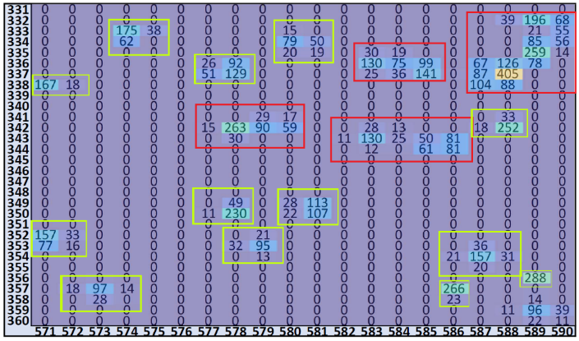
X-ray imaging and space resolved spectroscopy: The Analytical Methods – Algorithm for SPhC Analysis
Eugenia Naselli – PANDORA Collaboration Meeting – 16-17 Dec 2021
SPhC Analysis
Advanced Algorithm for SPhC Analysis
Raw Spectrum vs. Analyzed HDR Spectrum
by means of advanced algorithm!
The thousands of image-frames, allow gaining the statistics necessary for elaborating high quality X-ray fluorescence spectra and images
This comparison demonstrates that raw data are almost useless due to the really poor energy resolution, because the image is not in single photon counted mode
In the raw spectrum (red) it is not possible to distinguish any of the fluorescence characteristic peaks (Al, Ti, Ta, Ar).
Only by applying the advanced SPhC algorithm all characteristic fluorescence peaks become well distinguishable (blue spectrum) .
thousands of frames
Each frame has been analyzed by properly developed algorithm, starting from an imaging tool of MatLab, to select only true SPhC events and grouping the total charge
Frame-by-frame the algorithm filters out clusters with large size (> 5 pixels) due to multi-photons and sums the total charge of the single-photon clusters (≤ 5 pixels)
E. Naselli et al., accepted to be published on Condensed Matter
E. Naselli et al., Preprints 2021, 2021100433

Slide 17
X-ray imaging and space resolved spectroscopy: The Analytical Methods – Algorithm for SPhC Analysis
Eugenia Naselli – PANDORA Collaboration Meeting – 16-17 Dec 2021
SPhC Analysis
Advanced Algorithm for SPhC Analysis
Raw Spectrum vs. Analyzed HDR Spectrum
by means of advanced algorithm!
The thousands of image-frames allow gaining the statistics necessary for elaborating high quality X-ray fluorescence spectra and images
This comparison demonstrates that raw data are almost useless due to the really poor energy resolution, because the image is not in single photon counted mode
In the raw spectrum (red) it is not possible to distinguish any of the fluorescence characteristic peaks (Al, Ti, Ta, Ar).
Only by applying the advanced SPhC algorithm all characteristic fluorescence peaks become well distinguishable (blue spectrum) .
thousands of frames
Each frame has been analyzed by properly developed algorithm, starting from an imaging tool of MatLab, to select only true SPhC events and grouping the total charge
Frame-by-frame the algorithm filters out clusters with large size (> 5 pixels) due to multi-photons and sums the total charge of the single-photon clusters (≤ 5 pixels)
E. Naselli et al., accepted to be published on Condensed Matter
E. Naselli et al., Preprints 2021, 2021100433

Slide 18
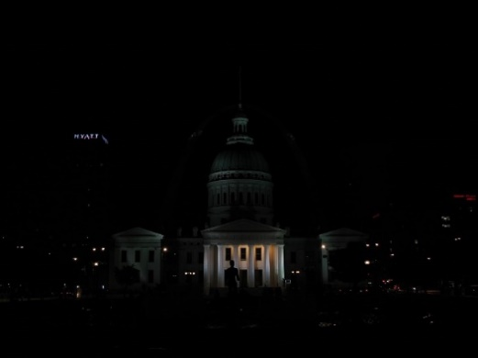
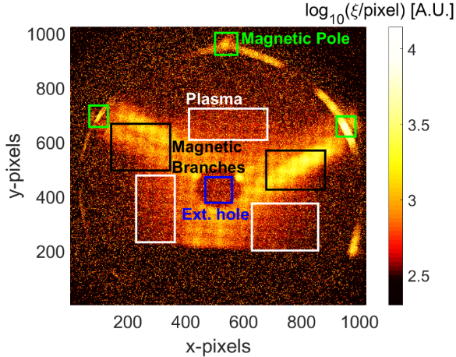
It is necessary to acquire the same image setting two or more different exposure time
X-ray imaging and space resolved spectroscopy: The Analytical Methods – Algorithm for SPhC and HDR Analysis
Eugenia Naselli – PANDORA Collaboration Meeting – 16-17 Dec 2021
High Dynamical Range (HDR) Analysis
when the ROIs intensities of an image vary of order of magnitude, it is very challenging to determine the exposure time:
#1
#2
#3
#4
HDR Image
advanced analysis in order to elaborate a weighted convolution image: the HDR image
Not HDR
HDR
 | Exp time [s] | N° frames
Plasma ROI | 0.5 | 4200
Pole ROI | 0.05 | 1000
when the ROIs intensities of an image vary of order of magnitude, it is very challenging to determine the exp. time
→ HDR analysis to elaborate the weighted convolution image starting from two different exp. times images
E. Naselli et al., accepted to be published on Condensed Matter
E. Naselli et al., Preprints 2021, 2021100433

Slide 19
It is necessary to acquire the same image setting two or more different exposure time
X-ray imaging and space resolved spectroscopy: The Analytical Methods – Algorithm for SPhC and HDR Analysis and Readout noise removal
Eugenia Naselli – PANDORA Collaboration Meeting – 16-17 Dec 2021
High Dynamical Range (HDR) Analysis
when the ROIs intensities of an image vary of order of magnitude, it is very challenging to determine the exposure time:
#1
#2
#3
#4
HDR Image
advanced analysis in order to elaborate a weighted convolution image: the HDR image
Not HDR
HDR
HDR without readout noise
when the ROIs intensities of an image vary of order of magnitude, it is very challenging to determine the exp. time
→ HDR analysis to elaborate the weighted convolution image starting from two different exp. times images
advanced algorithm to filter out intense read-out noise and elaborate high quality X-ray image with very high spatial resolution (Al mesh with wire diameter ~ 0.4 mm)
E. Naselli et al., accepted to be published on Condensed Matter
E. Naselli et al., Preprints 2021, 2021100433

Slide 20
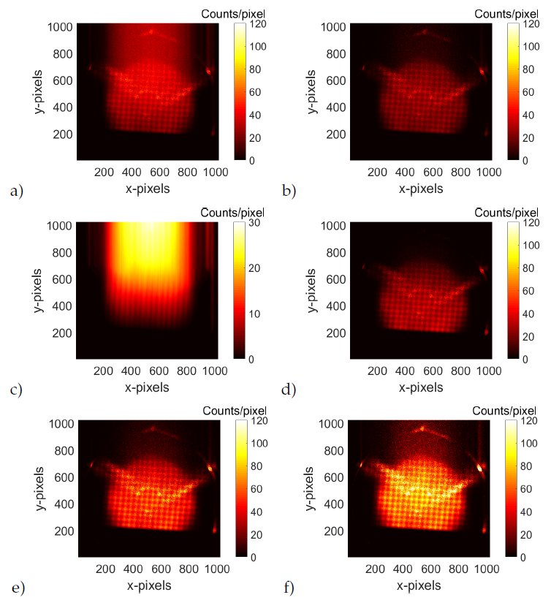
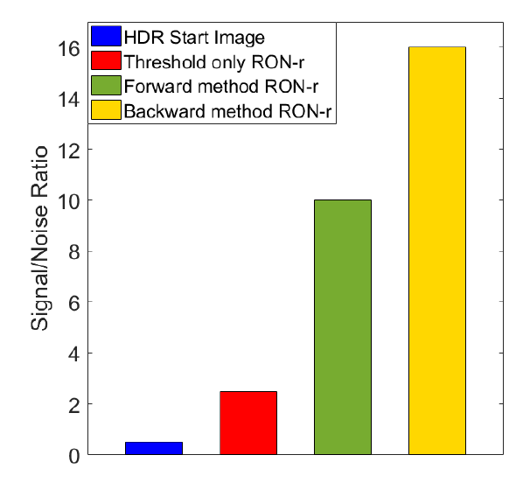
X-ray imaging and space resolved spectroscopy: The Analytical Methods – Algorithm for SPhC and HDR Analysis and Readout noise removal
Eugenia Naselli – PANDORA Collaboration Meeting – 16-17 Dec 2021
The algorithm consists in two steps:
1) we don’t just remove the readout-noise events,
2) but we are even able to place them in the correct pixel-dependent positions,
increasing the statistics, the resolution and the signal/noise ratio!

Slide 21
X-ray imaging and space resolved spectroscopy of ECR plasmas in compact magnetic traps
Eugenia Naselli – PANDORA Collaboration Meeting – 16-17 Dec 2021
Outline
Motivations and Physical Background
→ Interdisciplinary, Fundamental and Applied Physics
Experimental Setup
→ X-ray pin-hole technique
Analytical Methods
→ Integrated X-ray Imaging
→ Single Photon Counting (SPhC) X-ray Imaging
Experimental Results
→ Plasma structure, dynamics of losses and confinement investigations
→ Quantitative elementar composition pixel-by-pixel → Perspective for locally plasma parameters (electron density, temperature) measurements
Perspectives and Conclusion

Slide 22
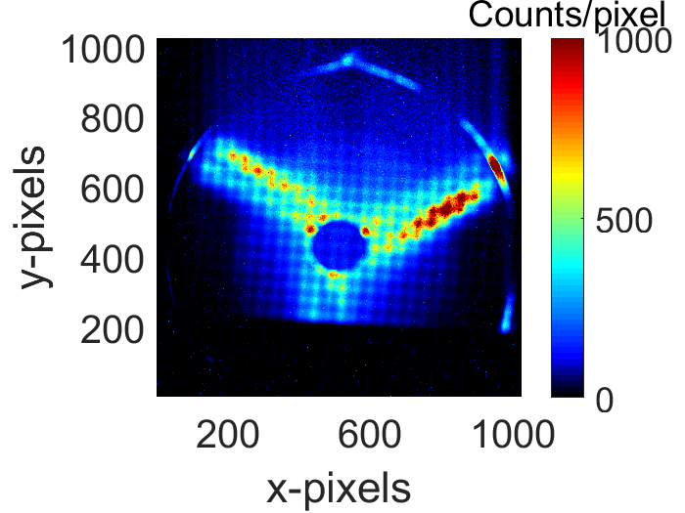
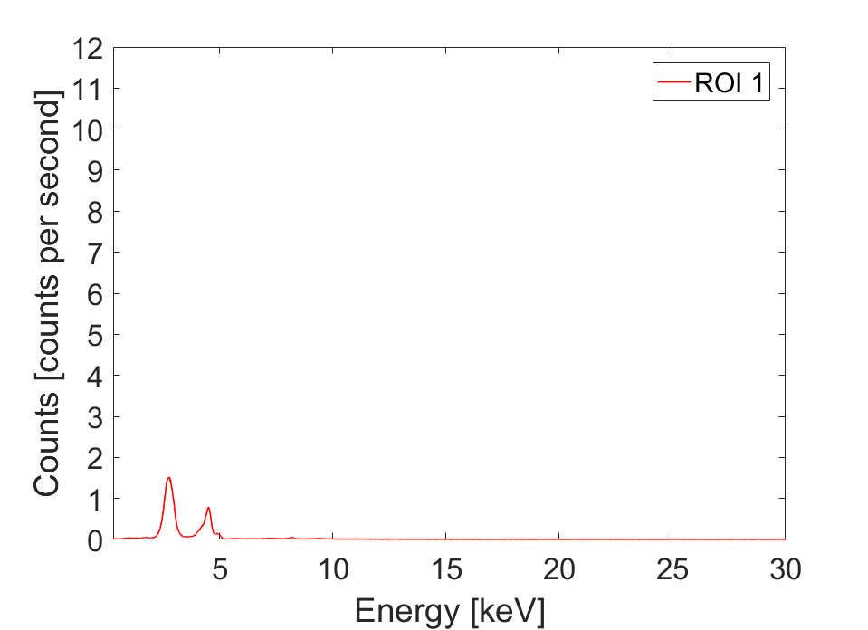
X-ray imaging and space resolved spectroscopy: The Experimental Results – SPhC Spectrally-resolved Imaging
Eugenia Naselli – PANDORA Collaboration Meeting – 16-17 Dec 2021
Experimental Results
The power of this technique consists in the possibility to perform, simultaneously, two complementary investigation:
HDR image
HDR spectra
SPhC Spectrally-resolved Imaging
Analyzed HDR Image
In SPhC mode, each pixel becomes an independent detector: we can analyze only a given collection of detectors, selecting only pixels in a given ROI of the HDR image
ROI1: Ar and Ti (Ti lower than Ar) and there is not Ta
1
Ar
Ti
Ta
Pixel-by-pixel quantitative elemental composition investigation
E. Naselli et al., accepted to be published on Journal of Instrumentation

Slide 23
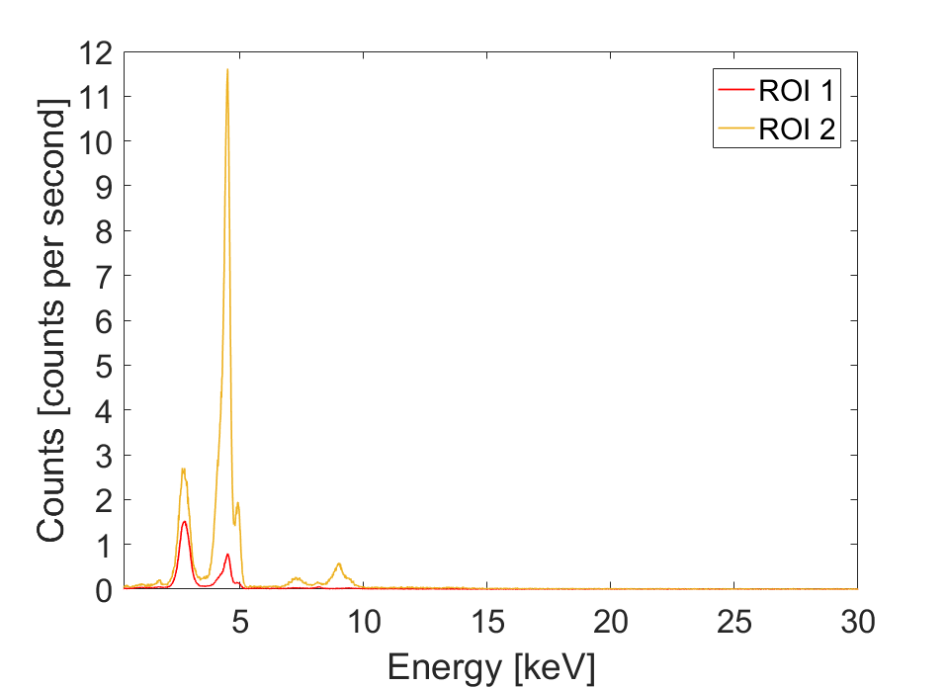
X-ray imaging and space resolved spectroscopy: The Experimental Results – SPhC Spectrally-resolved Imaging
Eugenia Naselli – PANDORA Collaboration Meeting – 16-17 Dec 2021
Experimental Results
The power of this technique consists in the possibility to perform, simultaneously, two complementary investigation:
HDR image
HDR spectra
SPhC Spectrally-resolved Imaging
Analyzed HDR Image
In SPhC mode, each pixel becomes an independent detector: we can analyze only a given collection of detectors, selecting only pixels in a given ROI of the HDR image
ROI1: Ar and Ti (Ti lower than Ar) and there is not Ta
ROI2: Ar increases and Ti is 1 order of magnitude higher than Ti in ROI1
2
1
Ti
Ar
Ta
Pixel-by-pixel quantitative elemental composition investigation
E. Naselli et al., accepted to be published on Journal of Instrumentation

Slide 24
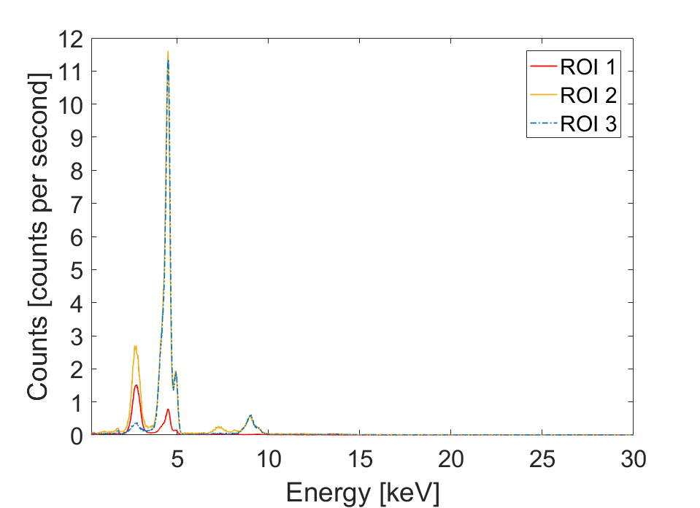
X-ray imaging and space resolved spectroscopy: The Experimental Results – SPhC Spectrally-resolved Imaging
Eugenia Naselli – PANDORA Collaboration Meeting – 16-17 Dec 2021
Experimental Results
The power of this technique consists in the possibility to perform, simultaneously, two complementary investigation:
HDR image
HDR spectra
SPhC Spectrally-resolved Imaging
Analyzed HDR Image
In SPhC mode, each pixel becomes an independent detector: we can analyze only a given collection of detectors, selecting only pixels in a given ROI of the HDR image
3
ROI1: Ar and Ti (Ti lower than Ar) and there is not Ta
ROI2: Ar increases and Ti is 1 order of magnitude higher than Ti in ROI1
ROI3: Ti is the same of Ti in ROI2, but Ar decreases
2
1
Ti
Ar
Ta
Pixel-by-pixel quantitative elemental composition investigation
E. Naselli et al., accepted to be published on Journal of Instrumentation

Slide 25
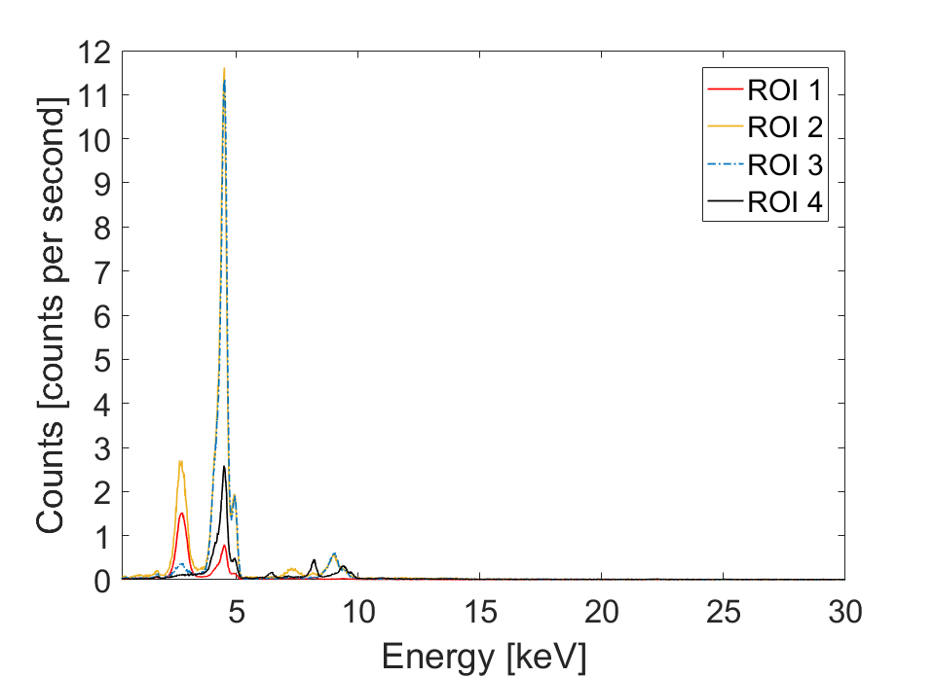
X-ray imaging and space resolved spectroscopy: The Experimental Results – SPhC Spectrally-resolved Imaging
Eugenia Naselli – PANDORA Collaboration Meeting – 16-17 Dec 2021
Experimental Results
The power of this technique consists in the possibility to perform, simultaneously, two complementary investigation:
HDR image
HDR spectra
SPhC Spectrally-resolved Imaging
Analyzed HDR Image
In SPhC mode, each pixel becomes an independent detector: we can analyze only a given collection of detectors, selecting only pixels in a given ROI of the HDR image
4
3
ROI1: Ar and Ti (Ti lower than Ar) and there is not Ta
ROI2: Ar increases and Ti is 1 order of magnitude higher than Ti in ROI1
ROI3: Ti is the same of Ti in ROI2, but Ar decreases
ROI4: Ar disappeares, Ti decreases and there is Ta
2
1
Ti
Analyzing each ROI-spectrum it is possible locally measure the plasma parameters (electron density, temperature)
Comparing experimental spectrum vs. theoretical one
Ar
Ta
Pixel-by-pixel quantitative elemental composition investigation
“Plasma parameters evaluation by X-ray diagnostics”
B. Mishra talk, Thursday 16th Dec, this Meeting
B. Mishra et al., Physics of Plasma 28 (2021) 102509
B. Mishra et al., Condensed Matter 6(4) (2021) 41
E. Naselli et al., accepted to be published on Journal of Instrumentation

Slide 26
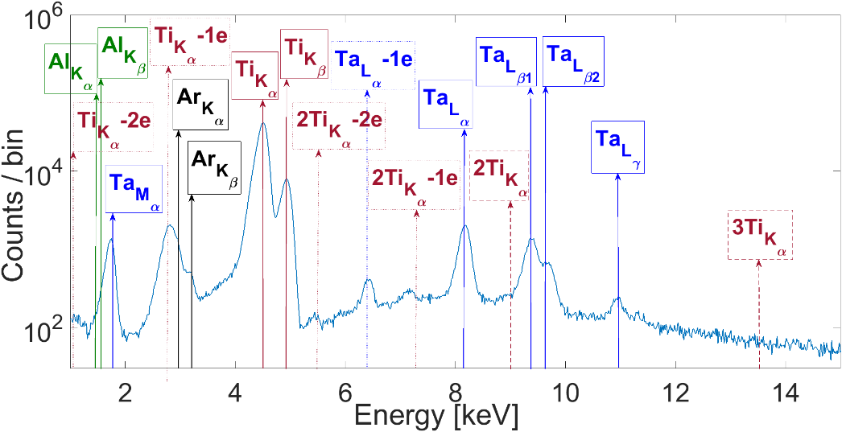
X-ray imaging and space resolved spectroscopy: The Experimental Results – SPhC Spatially-resolved Spectroscopy
Eugenia Naselli – PANDORA Collaboration Meeting – 16-17 Dec 2021
SPhC imaging for simultaneously SPECTRALLY and SPACE resolved analysis
SPhC Spatially-resolved Spectroscopy
Experimental Results
The power of this technique consists in the possibility to perform, simultaneously, two complementary investigation:
HDR image
HDR spectra
Analyzed HDR Spectrum
Since the data on the spectrum contains the spatial information,
the selection of a fluorescence peaks in the spectrum allows the imaging of the elemental distribution
E. Naselli et al., IL NUOVO CIMENTO 44C (2021) 64
E. Naselli et al., accepted to be published on Journal of Instrumentation
Ar
Ti
Ta
Energy Resolution ~ 230 eV at 8.1 keV (Ta-La fluorescence line)

Slide 27
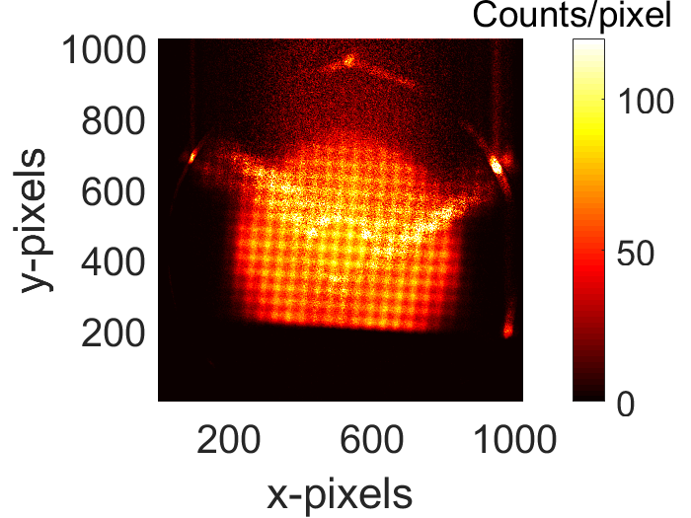
X-ray imaging and space resolved spectroscopy: The Experimental Results – SPhC Spatially-resolved Spectroscopy
Eugenia Naselli – PANDORA Collaboration Meeting – 16-17 Dec 2021
SPhC imaging for simultaneously SPECTRALLY and SPACE resolved analysis
SPhC Spatially-resolved Spectroscopy
Experimental Results
The power of this technique consists in the possibility to perform, simultaneously, two complementary investigation:
HDR image
HDR spectra
Analyzed HDR Spectrum
Since the data on the spectrum contains the spatial information,
the selection of a fluorescence peaks in the spectrum allows the imaging of the elemental distribution
E. Naselli et al., IL NUOVO CIMENTO 44C (2021) 64
E. Naselli et al., accepted to be published on Journal of Instrumentation
Ar
Ti
Ta
HDR Imaging
Plasma structure inspection
Argon

Slide 28
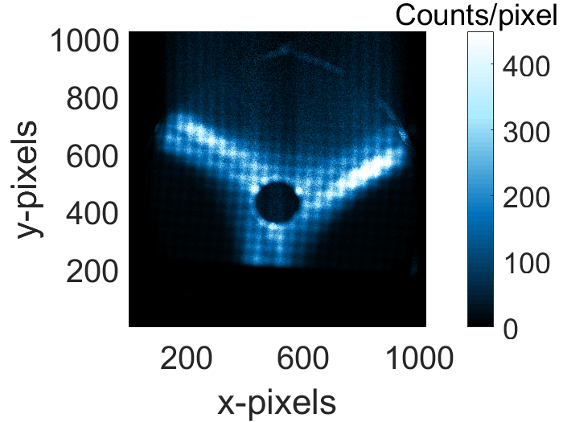
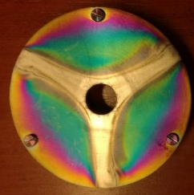
X-ray imaging and space resolved spectroscopy: The Experimental Results – SPhC Spatially-resolved Spectroscopy
Eugenia Naselli – PANDORA Collaboration Meeting – 16-17 Dec 2021
SPhC imaging for simultaneously SPECTRALLY and SPACE resolved analysis
SPhC Spatially-resolved Spectroscopy
Experimental Results
The power of this technique consists in the possibility to perform, simultaneously, two complementary investigation:
HDR image
HDR spectra
Analyzed HDR Spectrum
Since the data on the spectrum contains the spatial information,
the selection of a fluorescence peaks in the spectrum allows the imaging of the elemental distribution
E. Naselli et al., IL NUOVO CIMENTO 44C (2021) 64
E. Naselli et al., accepted to be published on Journal of Instrumentation
Ar
Ti
Ta
HDR Imaging
Plasma structure inspection
HDR Imaging
Axial losses inspection
Titanium Endplate
Argon
Titanium

Slide 29
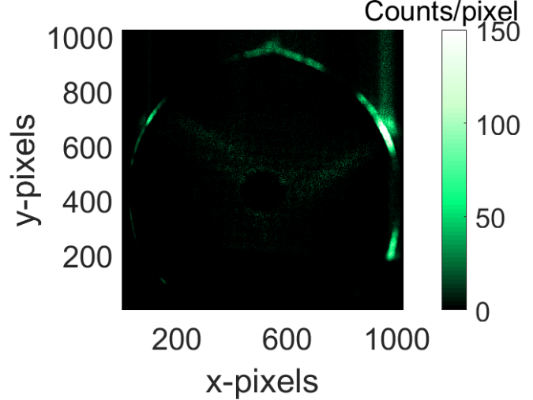
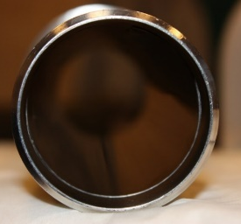
X-ray imaging and space resolved spectroscopy: The Experimental Results – SPhC Spatially-resolved Spectroscopy
Eugenia Naselli – PANDORA Collaboration Meeting – 16-17 Dec 2021
SPhC imaging for simultaneously SPECTRALLY and SPACE resolved analysis
SPhC Spatially-resolved Spectroscopy
Experimental Results
The power of this technique consists in the possibility to perform, simultaneously, two complementary investigation:
HDR image
HDR spectra
Analyzed HDR Spectrum
Since the data on the spectrum contains the spatial information,
the selection of a fluorescence peaks in the spectrum allows the imaging of the elemental distribution
E. Naselli et al., IL NUOVO CIMENTO 44C (2021) 64
E. Naselli et al., accepted to be published on Journal of Instrumentation
It is possible to distinguish the emission coming from Ar plasma only (selecting the fluorescence from Ar), compared to the
axial losses (Ti) or the radial losses (Ta),
selecting the fluorescence from Ti and Ta, respectively.
Ar
Ti
Ta
HDR Imaging
Plasma structure inspection
HDR Imaging
Axial losses inspection
HDR Imaging
Radial losses inspection
Titanium Endplate
Tantalum
Liner
Argon
Titanium
Tantalum

Slide 30
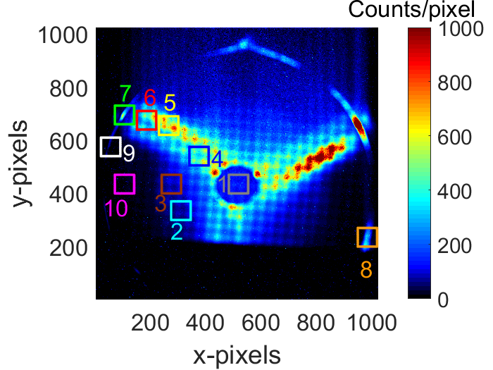
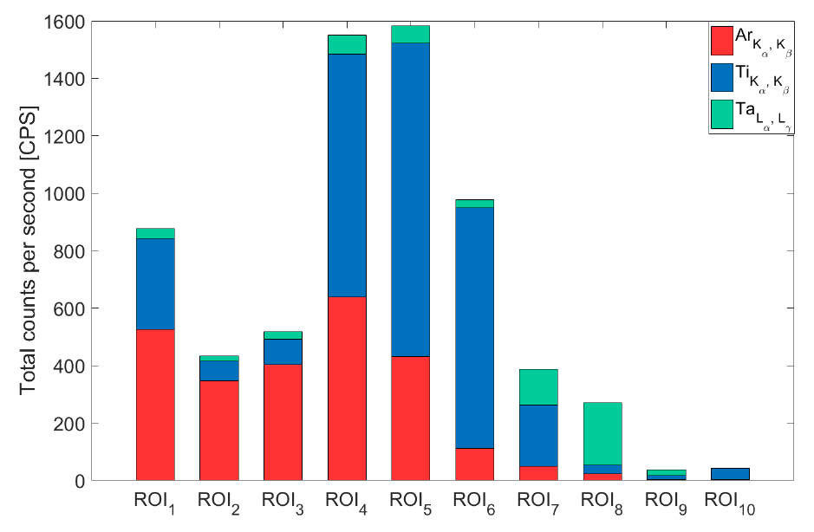
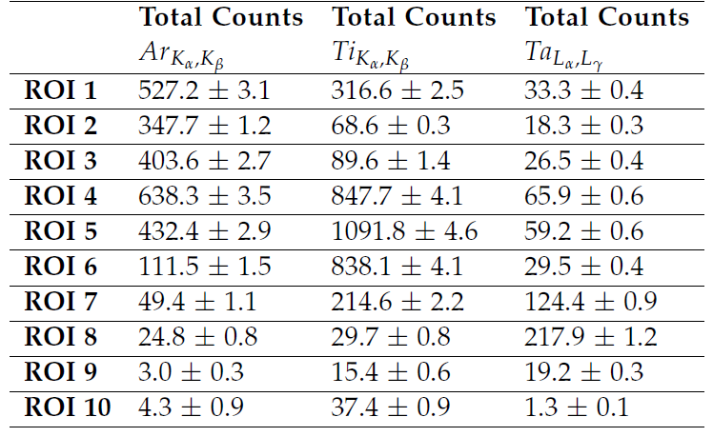
X-ray imaging and space resolved spectroscopy: The Experimental Results – SPhC Spatially-resolved Spectroscopy
Eugenia Naselli – PANDORA Collaboration Meeting – 16-17 Dec 2021
It is possible pixel-by-pixel to investigate the
balance between plasma emissions vs. losses emissions
High space and energy resoltutions:
Energy Resolution ~ 300 eV
Spatial Resolution ~ 500 µm
E. Naselli et al., IL NUOVO CIMENTO 44C (2021) 64
E. Naselli et al., accepted to be published on Journal of Instrumentation

Slide 31
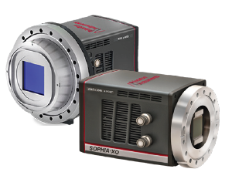
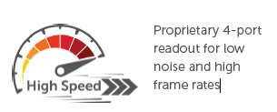
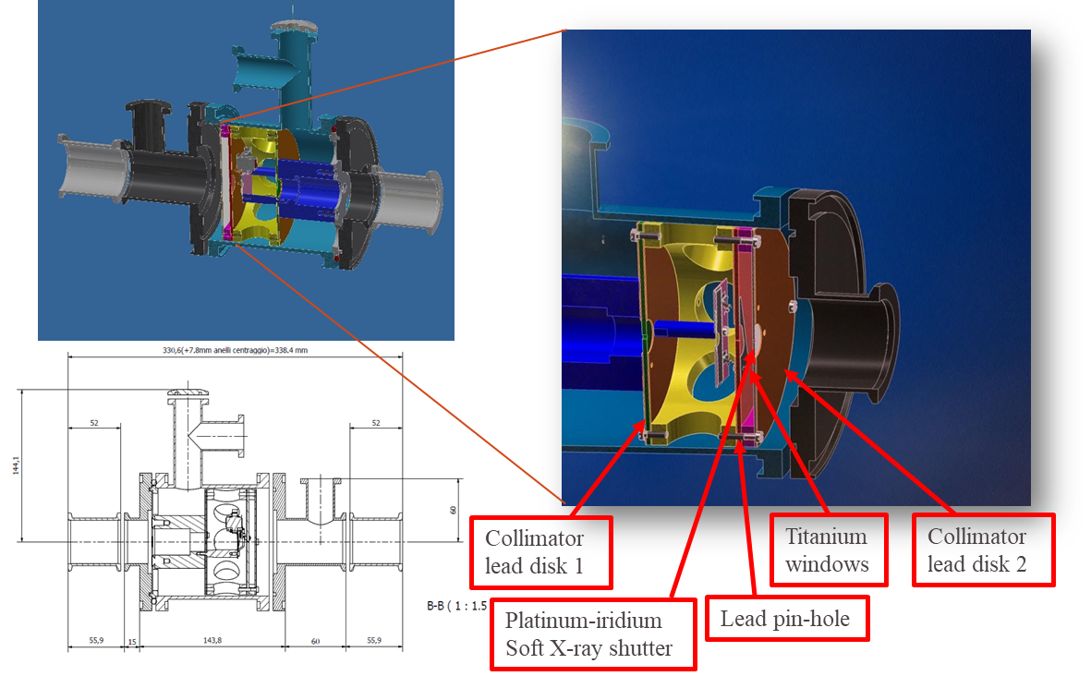
Improvement of the experimental setup: X-ray shutter and new high performances CCD camera
Eugenia Naselli – PANDORA Collaboration Meeting – 16-17 Dec 2021
Innovative soft X-ray Shutter:
Platinum-Iridium (PtIr) material;
6 mm aperture diameter;
Capable of blocking X-ray energy up to 30 keV;
Total opening time: 4.4 milliseconds
High Performances X-ray CCD (Sophia, Princeton):
> 95% QE (over ~ 5 eV to 30 keV range)
High spatial resolution: 4 megapixel, 2k x 2k format;
13.5 micron pixel;
High frame rates with up to 4-port readout: 8 MHz;
Cooling down to -90° using liquid or air;
Holder mechanical design to install in vacuum:
Pb multi-disk collimator + Pb pin-hole + Ti windows + X-ray PtIr Shutter

Slide 32
Improvement of the experimental setup: X-ray shutter and new high performances CCD camera
Eugenia Naselli – PANDORA Collaboration Meeting – 16-17 Dec 2021
Innovative soft X-ray Shutter:
Platinum-Iridium (PtIr) material;
6 mm aperture diameter;
Capable of blocking X-ray energy up to 30 keV;
Total opening time: 4.4 milliseconds
High Performances X-ray CCD (Sophia, Princeton):
> 95% QE (over ~ 5 eV to 30 keV range)
High spatial resolution: 4 megapixel, 2k x 2k format;
13.5 micron pixel;
High frame rates with up to 4-port readout: 8 MHz;
Cooling down to -90° using liquid or air;
Holder mechanical design to install in vacuum:
Pb multi-disk collimator + Pb pin-hole + Ti windows + X-ray PtIr Shutter
Future radial and axial measurements in space-time resolved mode:
the next challenge is to trigger simultaneously RF, soft X-ray (CCD), hard X-ray (HPGe) detectors to characterize very fast phenomena such as turbulent plasma regimes (timescale emissions: RF ~ ns, X-rays ~ ms) even in space-time resolved mode
Tentative Timetable:
Jan-Feb 2022: Installation and test with X-ray shutter, chiller and new CCD
at the Flexible Plasma Trap installed at INFN-LNS;
May-Dec 2022: Shipping to ATOMKI Laboratory (Debrecen, Hungary),
setup preparation, data taking and data analysis;

Slide 33
→ INTEGRATED X-ray IMAGING for ‘‘live’’ plasma structure and emission investigations (vs. ECRIS operative parameters); → SPhC X-ray IMAGING for simultaneously Spatially-Resolved Spectroscopy and Spectrally-Resolved Imaging;
X-ray imaging and space resolved spectroscopy: Conclusion
Eugenia Naselli – PANDORA Collaboration Meeting – 16-17 Dec 2021
Conclusion
Tool, analytical methods and preliminary results of a powerful system for making ECR plasma physics investigation:
In perspective, for the PANDORA purpose, it will be mandatory:
to locally characterize the plasma parameters;
to measure the plasma volume;
to master the plasma stability for days, weeks or even months;
to investigate plasma turbulent regimes of astrophysical interest in space-time resolved mode;
Plasma volume (const.)
Isotope activity
Density of the isotope in the plasma (const.)

Slide 34
Eugenia Naselli – PANDORA Collaboration Meeting – 16-17 Dec 2021
Lists of recent papers on X-ray imaging and space-resolved spectroscopy
E. Naselli et al., Preprints (2021), 2021100433 and accepted to be published on Condensed Matter “Innovative Analytical Method for X-Ray Imaging and Space-Resolved Spectroscopy of ECR Plasmas”
E. Naselli et al., accepted to be published on Journal of Instrumentation (2021) “Quantitative analysis of an ECR Ar plasma structure by X-ray spectroscopy at high spatial resolution”
D. Mascali et al., accepted to be published on Plasma Phys. Control. Fusion (2021) “Experimental study of single vs. two-close-frequency heating impact on confinement and losses dynamics in ECR Ion Sources plasmas by means of X-ray spectroscopy and imaging”
S. Biri et al., Journal of Instrumentation 16 (2021) 02006 “Innovative experimental setup for X-ray imaging to study energetic magnetized plasmas”
B. Mishra et al., Physics of Plasma 28 (2021) 102509 “A novel numerical tool to study electron energy distribution functions of spatially-anisotropic and non-homogeneous ECR plasmas”
E. Naselli et al., IL NUOVO CIMENTO 44C (2021) 64 “High resolution X-ray Imaging as a powerful diagnostics tool to investigate in-plasma nuclear β-decays”
B. Mishra et al., Condensed Matter 6(4) (2021) 41 “Probing Electron Properties in ECR Plasmas Using X-ray Bremsstrahlung and Fluorescence Emission”
B. Mishra et al. IL NUOVO CIMENTO 44C (2021) 60 “Anisotropic ion CSD in ECRIS: Mapping Kα emission and β-decay rates in PANDORA”
E. Naselli et al., EPJ Web Conf. 227 (2020) 02006 “Nuclear β-decays in plasmas: how to correlate plasma density and temperature to the activity”
D. Mascali et al., EPJ Web Conf. 227 (2020) 01013 “The PANDORA project: an experimental setup for measuring in-plasma β-decays of astrophysical interest”
E. Naselli et al., Plasma Sources Sci. Technol. 28 (2019) 085021 “Impact of the two-close-frequency heating on ECR Ion Sources plasmas radio emission and stability”
E. Naselli et al., Journal of Instrumentation 14 (2019) C10008 “Multidiagnostics setups for Magnetoplasmas devoted to Astrophysics and Nuclear Astrophysics Research in Compact Traps”
R. Miracoli et al., Journal of Instrumentation 14 (2019) C01016 “Characterization of ECR plasma by means of radial and axial X-ray diagnostics”
R. Rácz et al., Journal of Instrumentation 13 (2018) C12012 “Effect of the two-close-frequency heating to the extracted ion beam and to the X-ray flux emitted by the ECR plasma”
S. Biri, et al., Journal of Instrumentation 13 (2018) C11016 “Multi-diagnostic setup to investigate the two-close-frequency phenomena”
R. Racz et al., Plasma Source Sci. Technol. 26 (2017) 075011 “Electron cyclotron resonance ion source plasma characterization by energy dispersive X-ray imaging”
D. Mascali et al., Rev. Sci. Instrum. 87 (2016) 02A510 “Electron cyclotron resonance ion source plasma characterization by X-ray spectroscopy and X-ray imaging”

Slide 35
Thanks for your attention
Eugenia Naselli (INFN-LNS)
on behalf of the PANDORA collaboration

Slide 36
X-ray imaging and space resolved spectroscopy: Motivations and Physical Background – The PANDORA project
Eugenia Naselli – PANDORA Collaboration Meeting – 16-17 Dec 2021
Trap β-decaying radionuclides in ECR magnetoplasma, thus studying if and how the lifetimes is affected by the atomic charge state and by the plasma “environment” properties (density, temperature, ionisation states);
Electron Cyclotron Resonance (ECR) Heating
Coils
Plasma
Microwaves
Hexapole
Conceptual Design
B_{minimum} Magnetic Field
D. Mascali et al., EPJ Web Conf. 227 (2020) 01013
ECR magnetoplasma can be maintained in
MagnetoHydrodynamic Equilibrium for days, weeks or even months
It is mandatory to:
characterize the plasma parameters even in time/space-resolved way;
measure the plasma volume;
master the plasma stable regimes for days, weeks or even months
Plasma volume (const.)
Isotope activity
Density of the isotope in the plasma (const.)

Slide 37
X-ray imaging and space resolved spectroscopy: Perspective – Plasma turbulence regimes investigation
Eugenia Naselli – PANDORA Collaboration Meeting – 16-17 Dec 2021
Perspective
By means of X-ray imaging it is possible to investigate pixel-by-pixel the balance between plasma emissions vs. losses emissions;
It is known that losses emissions strongly depend on plasma instable regimes;
Plasma instabilities are characterized by a microwave counterpart which consists in fast and pulsed microwave bursts emitted in timescales of tens/hundreds of nanoseconds;
We have already characterized RF bursts by means of 80 Gs/s scope and RF plasma-immersed probe,
using the fast microwave burst as signal to trigger hard X-ray measurements by two HPGe detectors;
We discovered that hard X-ray emission is pulsed as well (timescales of milliseconds);
D. Mascali et al., to be submitted to Plasma Physics and Controlled Fusion (PPCF)
I. Izotov at al., Plasma Sources Sci. Technol. 27, 2018
A. G. Shalashov et al., Physics of Plasmas 24, 2017
E. Naselli et al., Plasma Source Science and Technology (PSST), 2019
I. Izotov at al., Plasma Sources Sci. Technol. 24, 2015
Microwave burst

Slide 38
X-ray imaging and space resolved spectroscopy: Perspective – Plasma turbulence regimes investigation
Eugenia Naselli – PANDORA Collaboration Meeting – 16-17 Dec 2021
Perspective
By means of X-ray imaging it is possible to investigate pixel-by-pixel the balance between plasma emissions vs. losses emissions;
It is known that losses emissions strongly depend on plasma instable regimes;
Plasma instabilities are characterized by a microwave counterpart which consists in fast and pulsed microwave bursts emitted in timescales of tens/hundreds of nanoseconds;
We have already characterized RF bursts by means of 80 Gs/s scope and RF plasma-immersed probe,
using the fast microwave burst as signal to trigger hard X-ray measurements by two HPGe detectors;
We discovered that hard X-ray emission is pulsed as well (timescales of milliseconds);
D. Mascali et al., to be submitted to Plasma Physics and Controlled Fusion (PPCF)
I. Izotov at al., Plasma Sources Sci. Technol. 27, 2018
A. G. Shalashov et al., Physics of Plasmas 24, 2017
E. Naselli et al., Plasma Source Science and Technology (PSST), 2019
I. Izotov at al., Plasma Sources Sci. Technol. 24, 2015
Microwave burst
Axial X-ray
Radial X-ray
RF emission
X-ray burst RF burst trigger signal
In perspective, our next challenge is to trigger simultaneously soft and hard X-ray measurements to characterize turbulent plasma regimes in microwave, soft and hard X-ray domains and even in time- and space-resolved way

Slide 39
X-ray imaging and space resolved spectroscopy: Perspective – Plasma turbulence regimes investigation
38
Eugenia Naselli – PANDORA Collaboration Meeting – 16-17 Dec 2021
Perspective
By means of X-ray imaging it is possible to investigate pixel-by-pixel the balance between plasma emissions vs. losses emissions;
It is known that losses emissions strongly depend on plasma instable regimes;
Plasma instabilities are characterized by a microwave counterpart which consists in fast and pulsed microwave bursts emitted in timescales of tens/hundreds of nanoseconds;
We have already characterized RF bursts by means of 80 Gs/s scope and RF plasma-immersed probe,
using the fast microwave burst as signal to trigger hard X-ray measurements by two HPGe detectors;
We discovered that hard X-ray emission is pulsed as well (timescales of milliseconds);
D. Mascali et al., to be submitted to Plasma Physics and Controlled Fusion (PPCF)
E. Naselli et al., Plasma Source Science and Technology (PSST), 2019
Microwave burst
Axial X-ray
Radial X-ray
RF emission
X-ray burst RF burst trigger signal
In perspective, our next challenge is to trigger simultaneously soft and hard X-ray measurements to characterize turbulent plasma regimes in microwave, soft and hard X-ray domains and even in time- and space-resolved way

