Slide 1
X-ray measurements: status and next experiments
We know and we would like to know
Richard Racz
rracz@atomki.hu
Institute for Nuclear Research (Atomki)
Hungary
PANDORA Progress Meeting, December 16, 2021

Slide 2
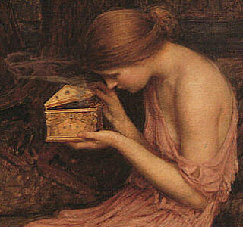
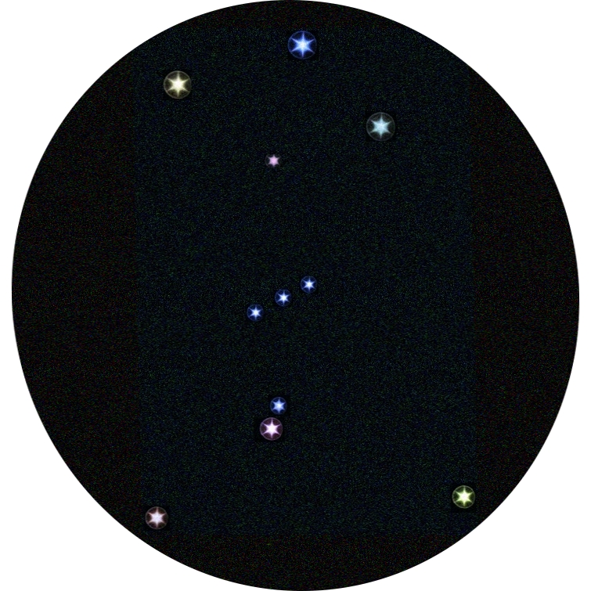
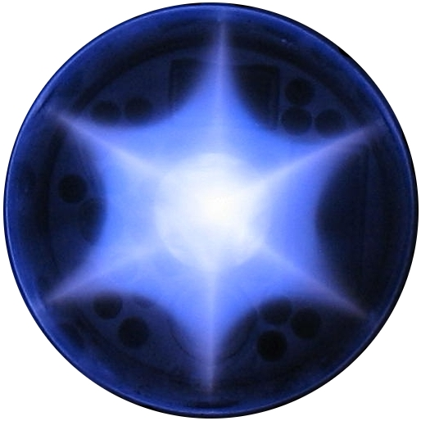
Outline
Plasma diagnostics for Pandora
ECR plasma
X-ray diagnostics
Volumetric soft X-ray
Volumetric hard X-ray
Spatially resolved soft
  Spectrally integrated
  Spectrally resolved (single photon counting)
Challenges
PANDORA Progress Meeting, December 16, 2021

Slide 3
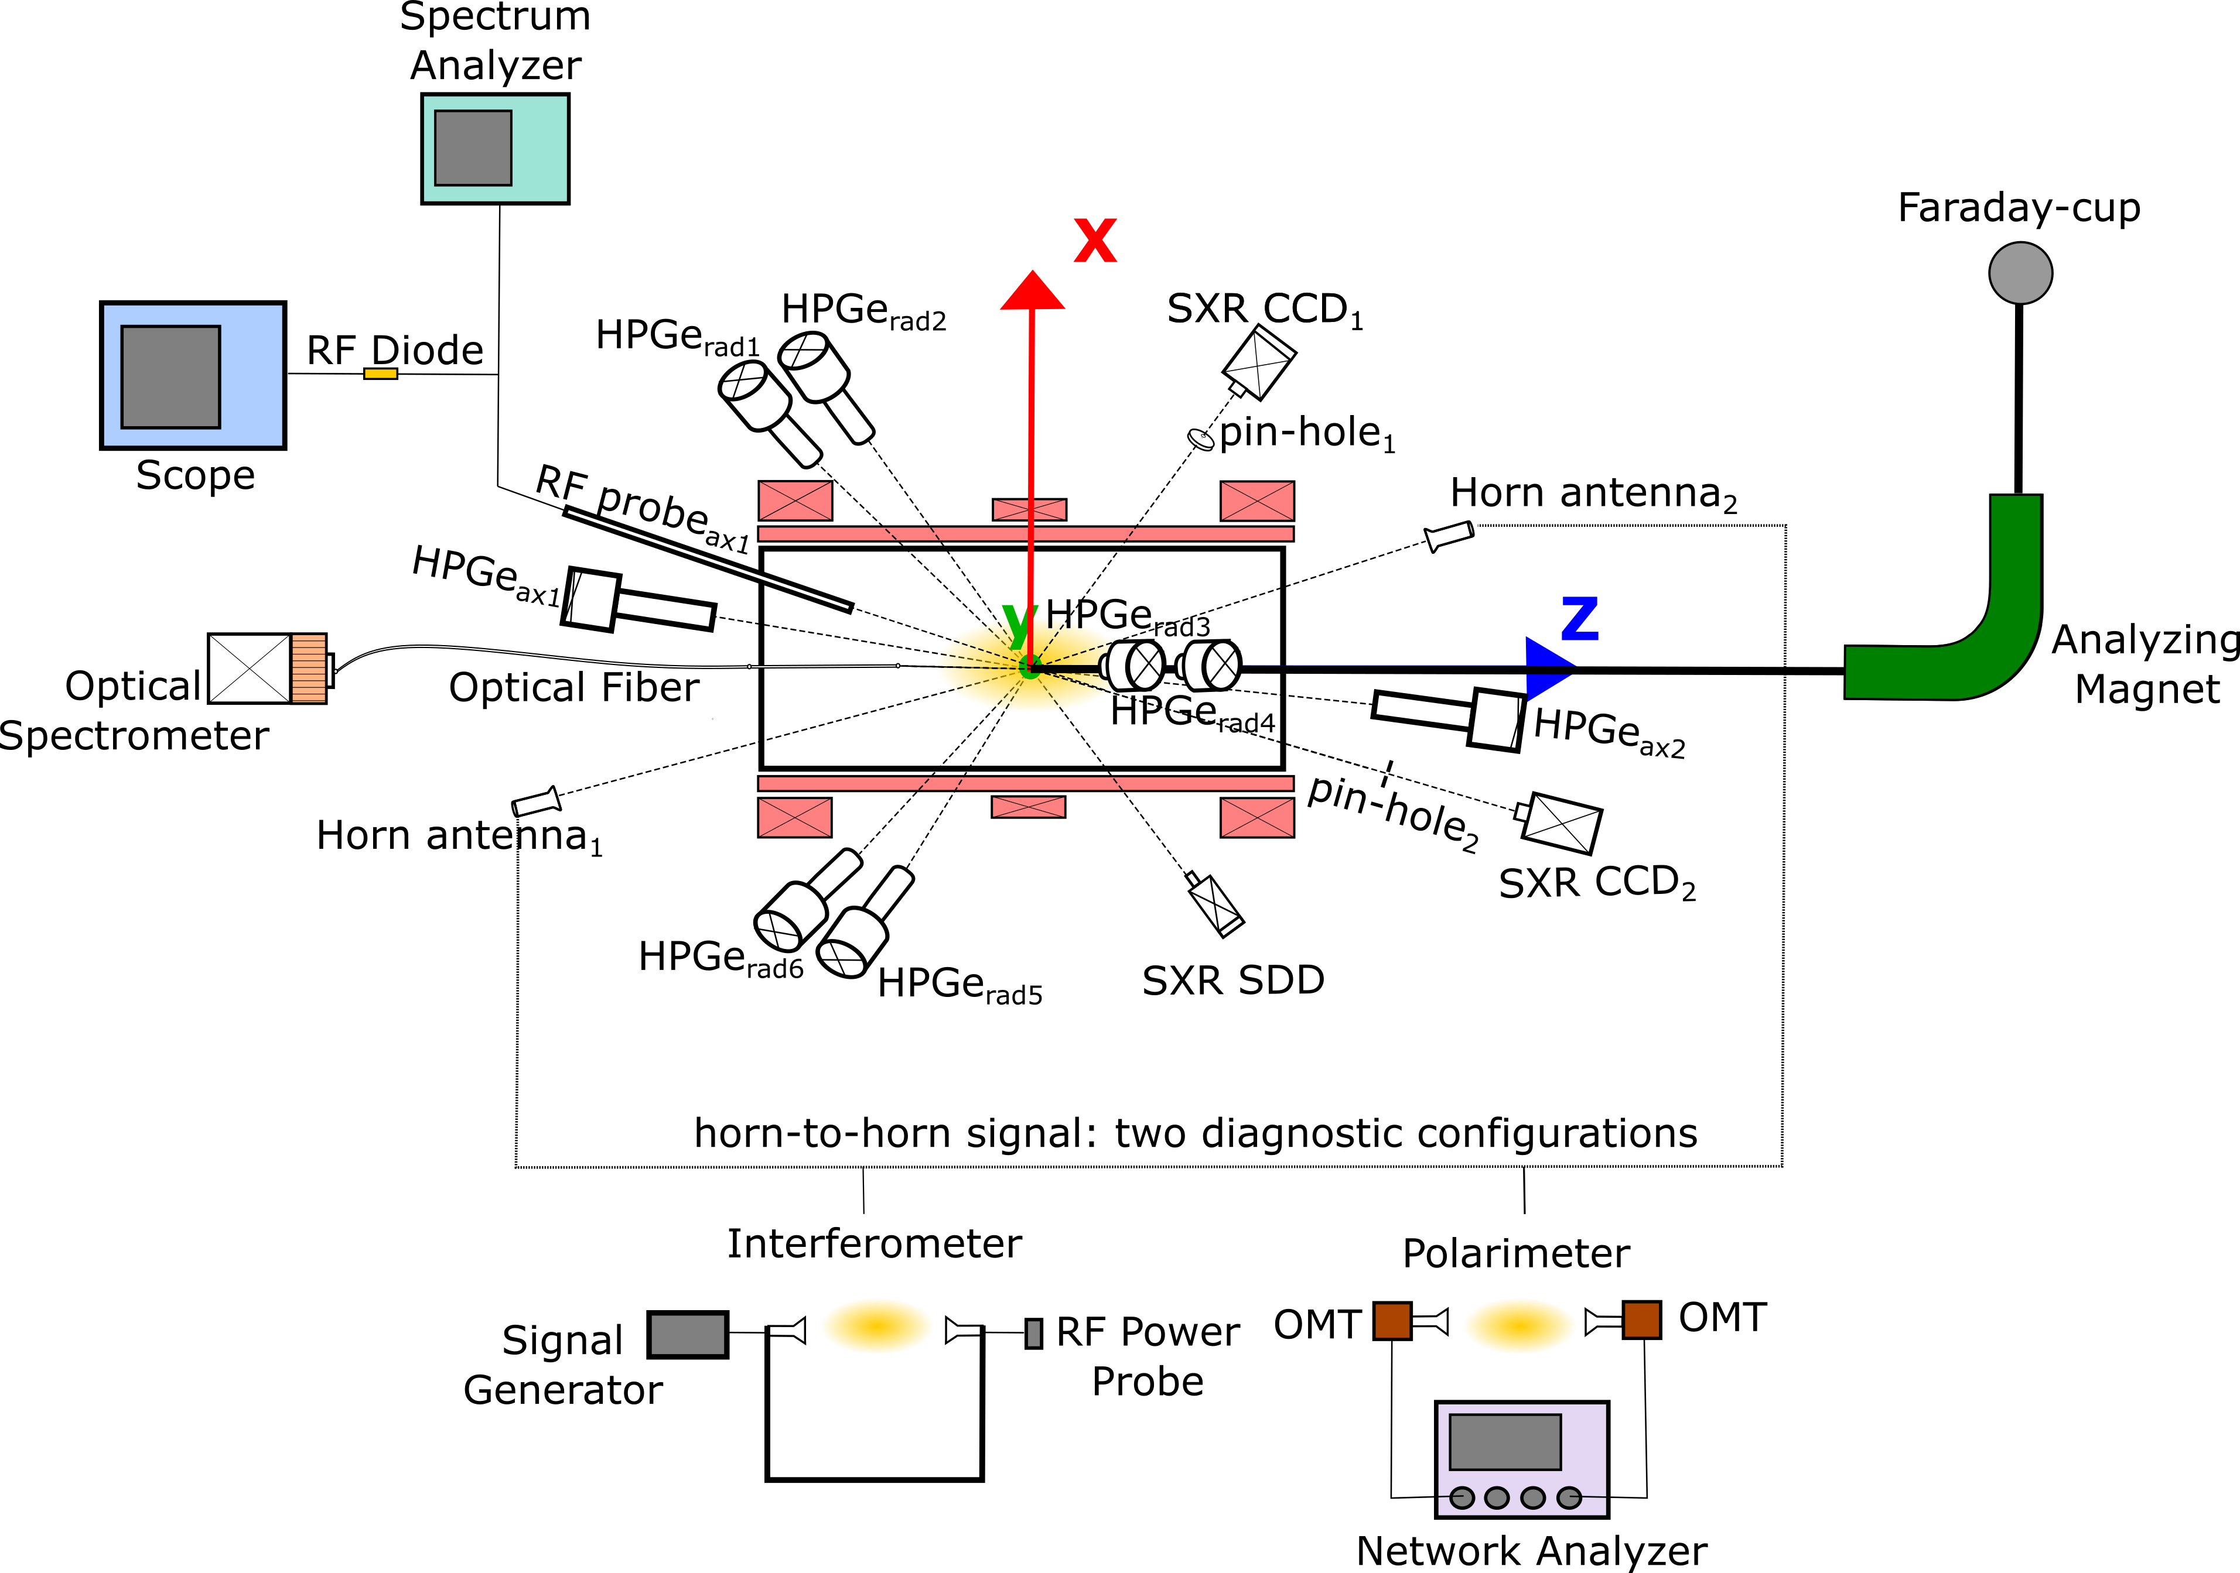
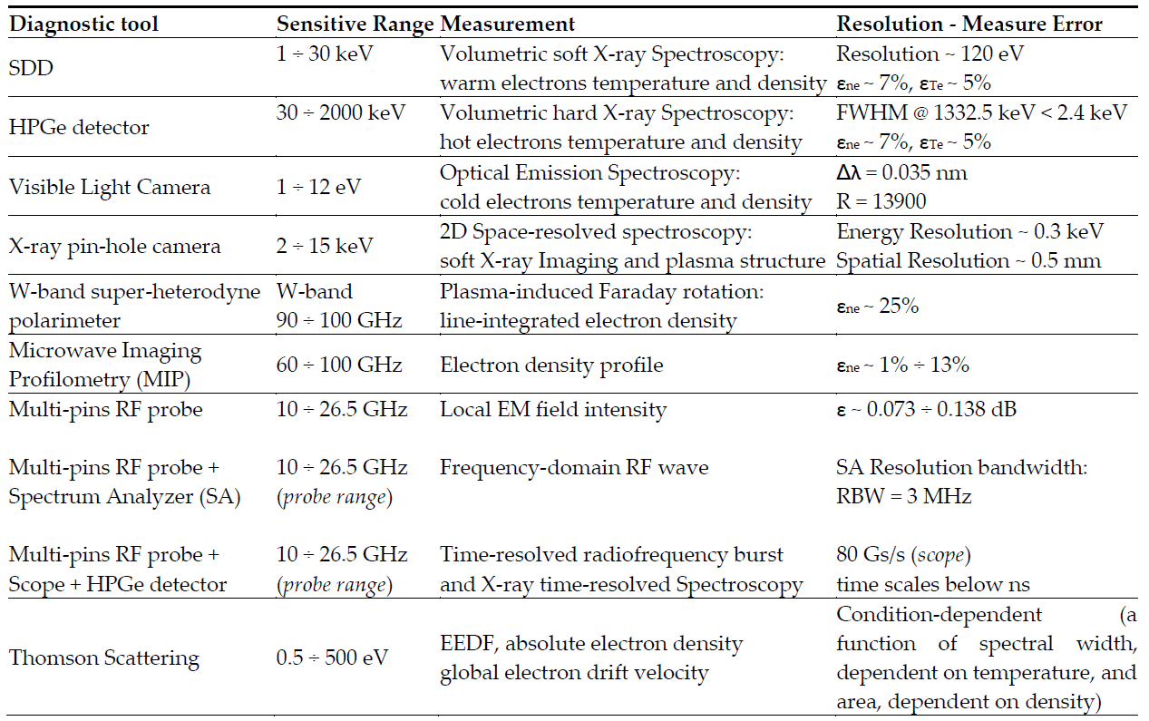
Pandora’s diagnostics
PANDORA Progress Meeting, December 16, 2021

Slide 4
ECR plasma
We need information on magnetized PLASMA heated by ECR mechanism
Gas
Ions
Plasma
Selective heating: Ion and electron temperature are strongly different
Strong anisotropy in velocity phase space
RF
vII
Ions
Electrons
Confined
Typical density ~ 10^11 – 10^13 1/cm^3
vI_
Cold
Multi component Can be hot
PANDORA Progress Meeting, December 16, 2021

Slide 5
EMV emissions by ECR plasma
Non-destructive way for plasma diagnostics
Intense source of:
Radio (plasma heating dynamics)
Infrared (molecular information)
Visible light (cold electrons, ion temperature)
Plasma
Ultraviolet (ionization processes)
X-ray (electrons responsible for step by step ionization)
PANDORA Progress Meeting, December 16, 2021

Slide 6
X-ray diagnostics
Volumetric soft
Warm electrons
E=1 keV – 20 keV
Spatially resolved soft
Warm electrons
E= 1 keV – 20 keV
Volumetric hard
Hot electrons
E=20 - 200 keV
Energy
Detector
SDD, Si-Pin
CCD
HPGe, NaI(TI)
Resolution
~ 150 eV
~ 300 eV
~ 1000 eV
Note
Long collimation
Pinhole stup
Thick collimator
PANDORA Progress Meeting, December 16, 2021

Slide 7
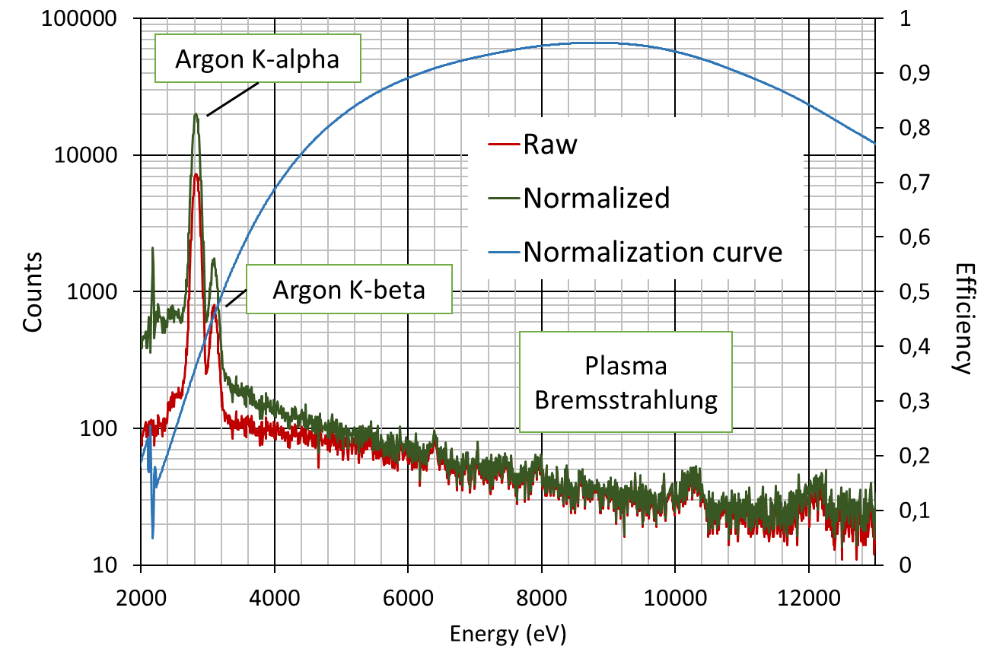
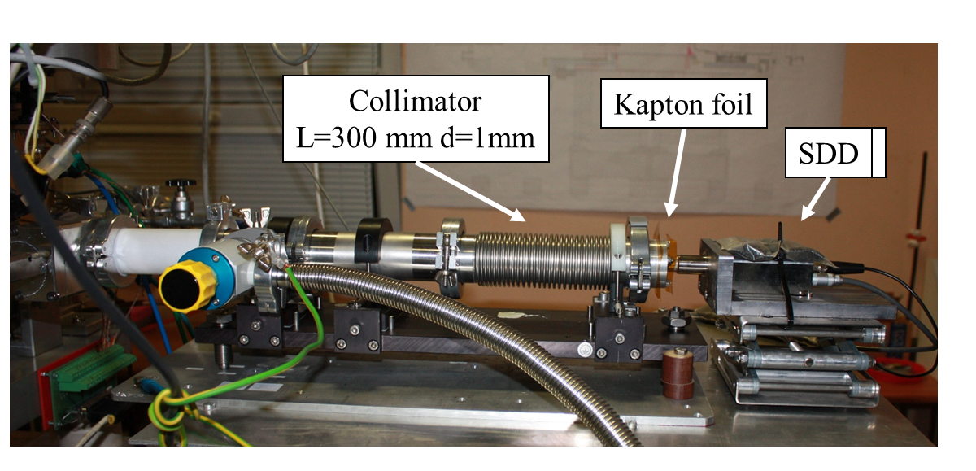
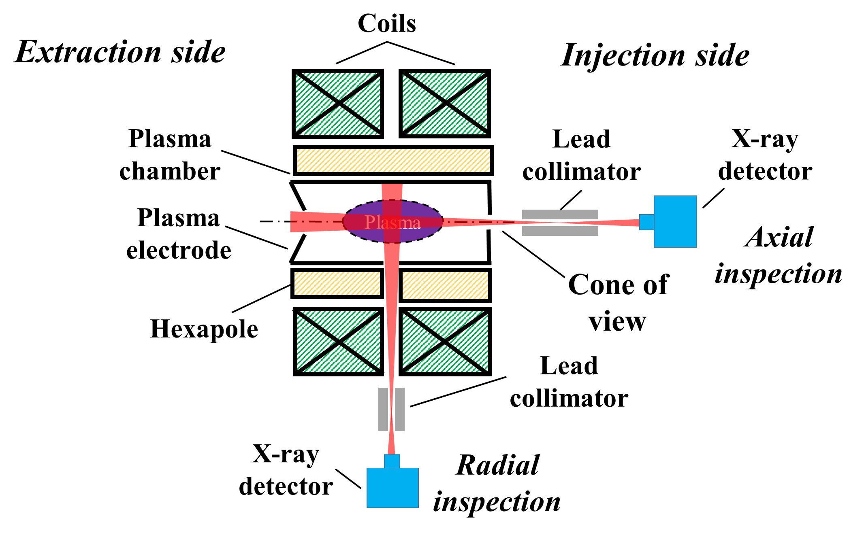
Volumetric Soft
Experimental setup:
Strong collimation
Bremsstrahlung
Characteristics lines
From the best fit:
Intersection: ~ density
Inverse slope ~ temperature
PANDORA Progress Meeting, December 16, 2021

Slide 8
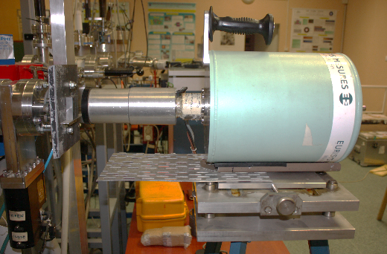
Volumetric Hard
Spectral temperature
Hot electron density
Experimental setup
Maximum energy can be ~ MeV
Lead collimator
HPGe detector
PANDORA Progress Meeting, December 16, 2021

Slide 9
Volumetric
Fine frequency tuning of heating RF
What we learnt:
Nonlinear changes in:
Average charge state
Electron density and temperature
Con not be explained by the scaling laws
But can be correlated with the nature of the resonant cavity
Mascali et al, RSI 87 (2016) 02A510
PANDORA Progress Meeting, December 16, 2021

Slide 10
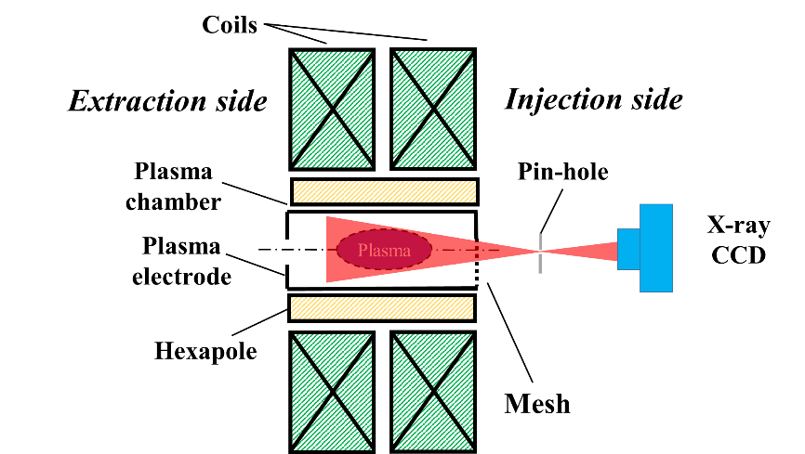
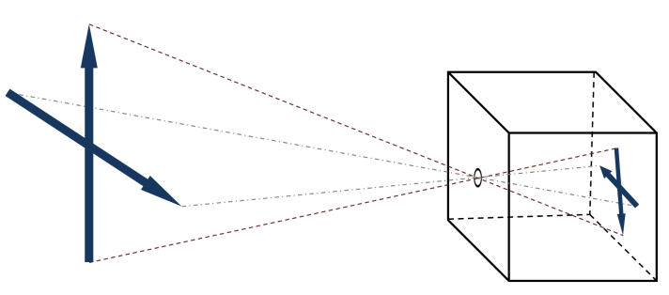
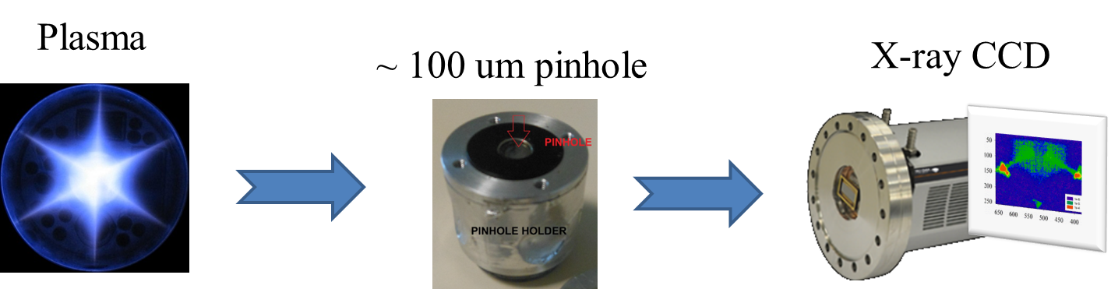
Spatially resolved soft
Experimental Setup: pinhole imaging
Object
Pinhole
Image
Exposition:
Spectrally integrated
Single photon counting
PANDORA Progress Meeting, December 16, 2021

Slide 11
Spatially Integrated soft
Long exposure time: several 10 s, to avoid the blooming of the CCD
One frame for one image
Individual pixels can be loaded by many X-ray photons → no spectral information
Spectrally integrated but spatially resolved structural information
Acquisition
0 | 0 | 0 | 1 | 0 | 0 | 0 | 0
1 | 0 | 0 | 0 | 0 | 1 | 0 | 0
0 | 1 | 0 | 1 | 0 | 1 | 0 | 0
0 | 1 | 0 | 1 | 0 | 0 | 0 | 0
0 | 0 | 1 | 1 | 0 | 0 | 0 | 0
1 | 0 | 1 | 0 | 0 | 0 | 0 | 0
0 | 0 | 0 | 0 | 1 | 0 | 1 | 0
0 | 1 | 0 | 0 | 0 | 0 | 0 | 0
0 | 0 | 0 | 2 | 0 | 0 | 0 | 0
2 | 0 | 0 | 0 | 0 | 2 | 0 | 0
0 | 2 | 0 | 2 | 0 | 2 | 0 | 0
0 | 2 | 0 | 2 | 0 | 0 | 0 | 0
0 | 0 | 2 | 2 | 0 | 0 | 0 | 0
2 | 0 | 2 | 0 | 0 | 0 | 0 | 0
0 | 0 | 0 | 0 | 2 | 0 | 2 | 0
0 | 2 | 0 | 0 | 0 | 0 | 0 | 0
0 | 0 | 0 | 3 | 0 | 0 | 0 | 0
3 | 0 | 0 | 0 | 0 | 3 | 0 | 0
0 | 3 | 0 | 3 | 0 | 3 | 0 | 0
0 | 3 | 0 | 3 | 0 | 0 | 0 | 0
0 | 0 | 3 | 3 | 0 | 0 | 0 | 0
3 | 0 | 3 | 0 | 0 | 0 | 0 | 0
0 | 0 | 0 | 0 | 3 | 0 | 3 | 0
0 | 3 | 0 | 0 | 0 | 0 | 0 | 0
0 | 0 | 0 | 4 | 0 | 0 | 0 | 0
4 | 0 | 0 | 0 | 0 | 4 | 0 | 0
0 | 4 | 0 | 4 | 0 | 4 | 0 | 0
0 | 4 | 0 | 4 | 0 | 0 | 0 | 0
0 | 0 | 4 | 4 | 0 | 0 | 0 | 0
4 | 0 | 4 | 0 | 0 | 0 | 0 | 0
0 | 0 | 0 | 0 | 4 | 0 | 4 | 0
0 | 4 | 0 | 0 | 0 | 0 | 0 | 0
0 | 0 | 0 | 5 | 0 | 0 | 0 | 0
5 | 0 | 0 | 0 | 0 | 5 | 0 | 0
0 | 5 | 0 | 5 | 0 | 5 | 0 | 0
0 | 5 | 0 | 5 | 0 | 0 | 0 | 0
0 | 0 | 5 | 5 | 0 | 0 | 0 | 0
5 | 0 | 5 | 0 | 0 | 0 | 0 | 0
0 | 0 | 0 | 0 | 5 | 0 | 5 | 0
0 | 5 | 0 | 0 | 0 | 0 | 0 | 0
0 | 0 | 0 | 6 | 0 | 0 | 0 | 0
6 | 0 | 0 | 0 | 0 | 6 | 0 | 0
0 | 6 | 0 | 6 | 0 | 6 | 0 | 0
0 | 6 | 0 | 6 | 0 | 0 | 0 | 0
0 | 0 | 6 | 6 | 0 | 0 | 0 | 0
6 | 0 | 6 | 0 | 0 | 0 | 0 | 0
0 | 0 | 0 | 0 | 6 | 0 | 6 | 0
0 | 6 | 0 | 0 | 0 | 0 | 0 | 0
0 | 0 | 0 | 7 | 0 | 0 | 0 | 0
7 | 0 | 0 | 0 | 0 | 7 | 0 | 0
0 | 7 | 0 | 7 | 0 |  | 0 | 0
0 | 7 | 0 | 7 | 0 | 0 | 0 | 0
0 | 0 | 7 | 7 | 0 | 0 | 0 | 0
7 | 0 | 7 | 0 | 0 | 0 | 0 | 0
0 | 0 | 0 | 0 | 7 | 0 | 7 | 0
0 | 7 | 0 | 0 | 0 | 0 | 0 | 0
0 | 0 | 0 | 8 | 0 | 0 | 0 | 0
8 | 0 | 0 | 0 | 0 | 8 | 0 | 0
0 | 8 | 0 | 8 | 0 | 0 | 0 | 0
0 | 8 | 0 | 8 | 0 | 0 | 0 | 0
0 | 0 | 8 | 8 | 0 | 0 | 0 | 0
8 | 0 | 8 | 0 | 0 | 0 | 0 | 0
0 | 0 | 0 | 0 | 8 | 0 | 8 | 0
0 | 8 | 0 | 0 | 0 | 0 | 0 | 0
0 | 0 | 0 | 9 | 0 | 0 | 0 | 0
9 | 0 | 0 | 0 | 0 | 9 | 0 | 0
0 | 9 | 0 | 9 | 0 | 9 | 0 | 0
0 | 9 | 0 | 9 | 0 | 0 | 0 | 0
0 | 0 | 9 | 9 | 0 | 0 | 0 | 0
9 | 0 | 9 | 0 | 0 | 0 | 0 | 0
0 | 0 | 0 | 0 | 9 | 0 | 9 | 0
0 | 9 | 0 | 0 | 0 | 0 | 0 | 0
0 | 0 | 0 | 10 | 0 | 0 | 0 | 0
10 | 0 | 0 | 0 | 0 | 9 | 0 | 0
0 | 10 | 0 | 10 | 0 | 10 | 0 | 0
0 | 10 | 0 | 10 | 0 | 0 | 0 | 0
0 | 0 | 10 | 10 | 0 | 0 | 0 | 0
10 | 0 | 10 | 0 | 0 | 0 | 0 | 0
0 | 0 | 0 | 0 | 10 | 0 | 10 | 0
0 | 10 | 0 | 0 | 0 | 0 | 0 | 0
0 | 0 | 0 | 11 | 0 | 0 | 0 | 0
11 | 0 | 0 | 0 | 0 | 11 | 0 | 0
0 | 11 | 0 | 11 | 0 | 11 | 0 | 0
0 | 11 | 0 | 11 | 0 | 0 | 0 | 0
0 | 0 | 11 | 11 | 0 | 0 | 0 | 0
11 | 0 | 11 | 0 | 0 | 0 | 0 | 0
0 | 0 | 0 | 0 | 11 | 0 | 11 | 0
0 | 11 | 0 | 0 | 0 | 0 | 0 | 0
0 | 0 | 0 | 17 | 0 | 0 | 0 | 0
42 | 0 | 0 | 0 | 0 | 73 | 0 | 0
0 | 50 | 0 | 40 | 0 | 30 | 0 | 0
0 | 72 | 0 | 11 | 0 | 0 | 0 | 0
0 | 0 | 56 | 47 | 0 | 0 | 0 | 0
17 | 0 | 60 | 0 | 0 | 0 | 0 | 0
0 | 0 | 0 | 0 | 43 | 0 | 72 | 0
0 | 50 | 0 | 0 | 0 | 0 | 0 | 0
PANDORA Progress Meeting, December 16, 2021

Slide 12
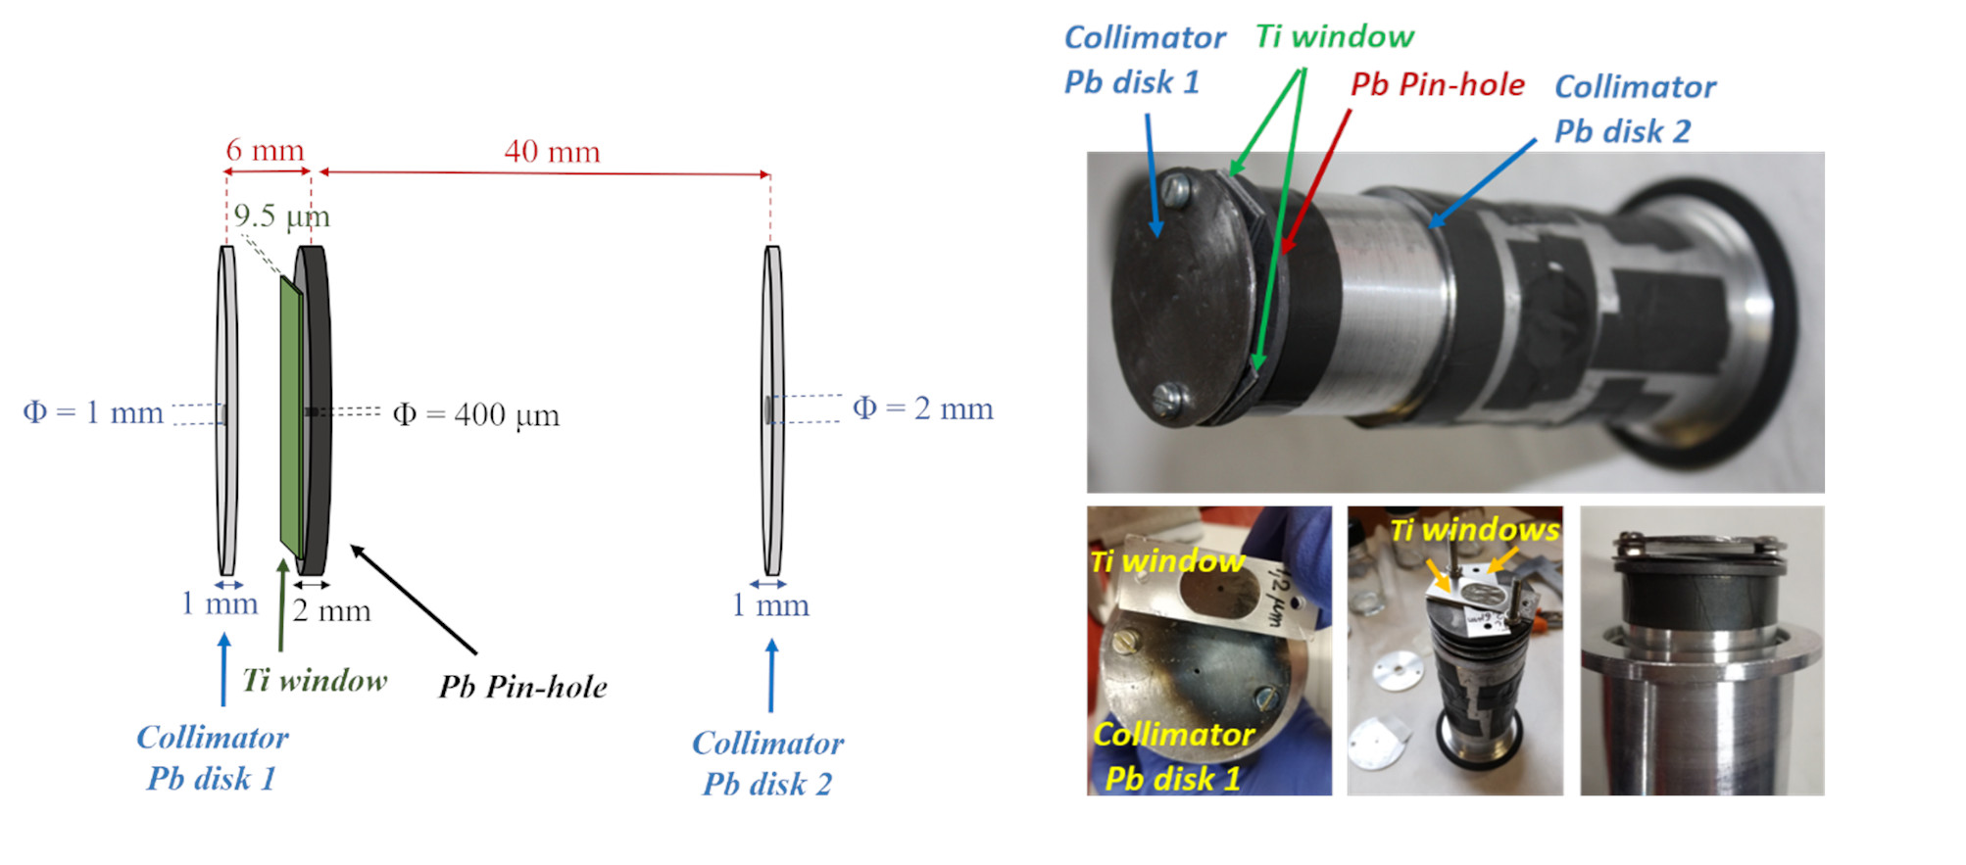
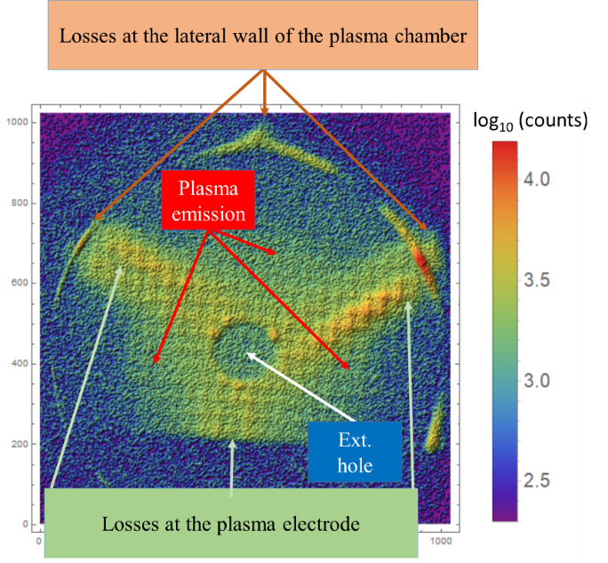
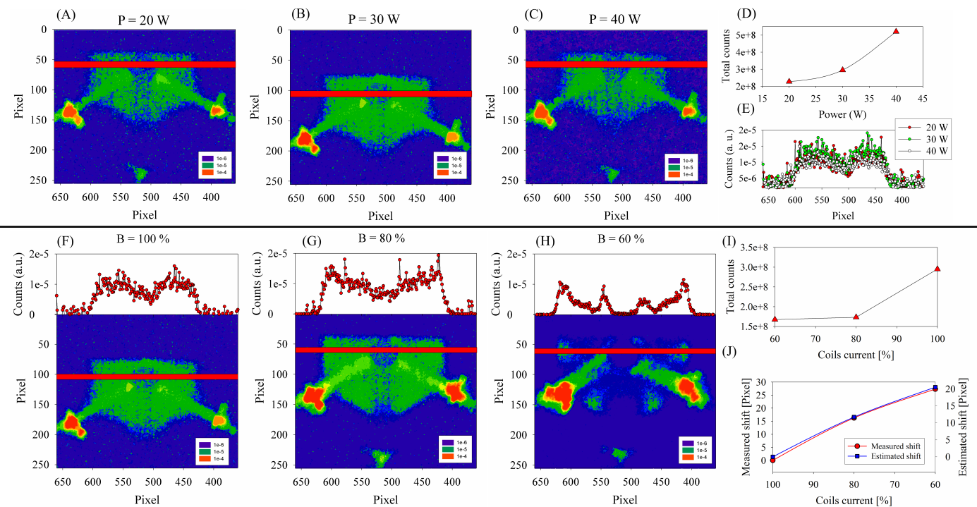
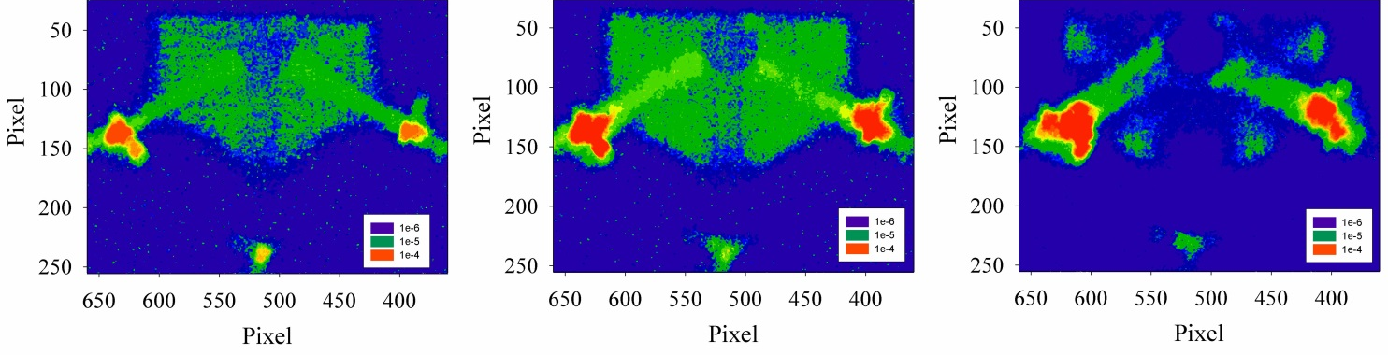
Spatially Integrated soft
Biri et al, JINST 16 (2021) P03003
Multilayer pinhole
Innovative imaging
Imaging at high mw power: not trivial
Multilayer pinhole
Plasma core volume characterization even at high power
Plasma losses detected
Plasma volume changes vs B
PANDORA Progress Meeting, December 16, 2021

Slide 13
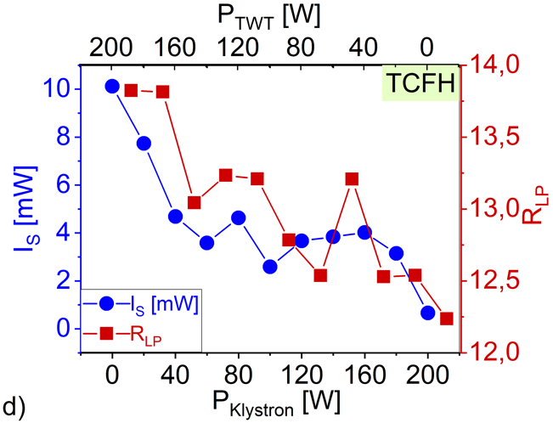
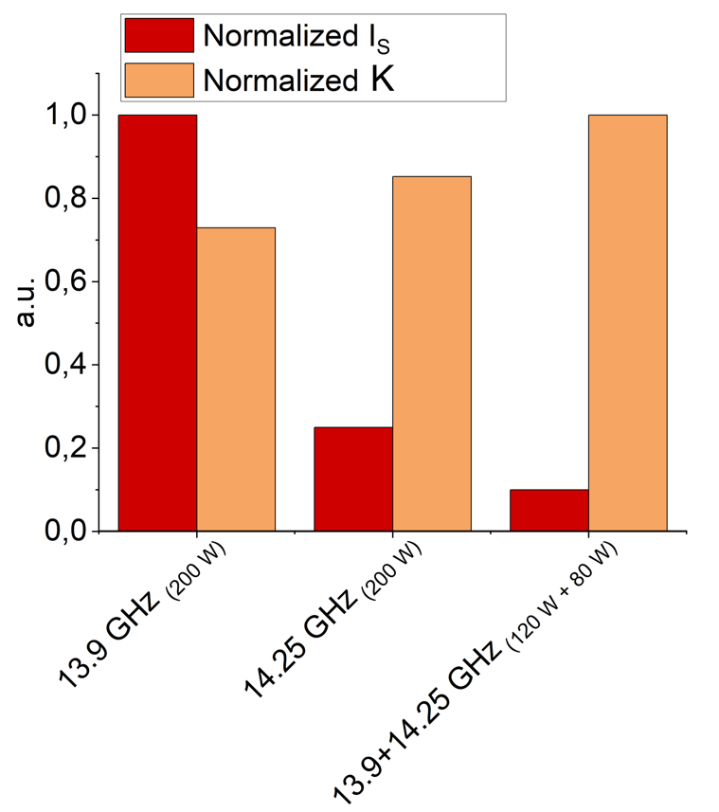
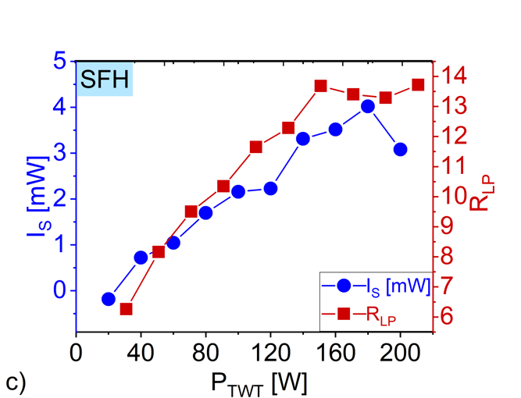
Plasma losses vs Instability
R_LP
K
Two parameters are indtroduced succesfully:
R_LP: ratio of plasma losses and plasma counts <-> correlation with instability strength
K: centralization, central over side counts ratio <-> anticorrelation with instability
Mascali et al, PPCF, just accepted for publication ☺
PANDORA Progress Meeting, December 16, 2021

Slide 14
Spatially resolved soft
0 | 0 | 0 | 1 | 0 | 0 | 0 | 0
0 | 0 | 0 | 0 | 0 | 1 | 0 | 0
0 | 1 | 0 | 0 | 0 | 1 | 0 | 0
0 | 1 | 0 | 1 | 0 | 0 | 0 | 0
0 | 0 | 1 | 1 | 0 | 0 | 0 | 0
0 | 0 | 1 | 0 | 0 | 0 | 0 | 0
0 | 0 | 0 | 0 | 1 | 0 | 1 | 0
0 | 0 | 0 | 0 | 0 | 0 | 0 | 0
0 | 0 | 0 | 17 | 0 | 0 | 0 | 0
1 | 0 | 0 | 0 | 0 | 25 | 0 | 0
0 | 47 | 0 | 25 | 0 | 1 | 0 | 0
0 | 9 | 0 | 1 | 0 | 0 | 0 | 0
0 | 0 | 30 | 20 | 0 | 0 | 0 | 0
1 | 0 | 1 | 0 | 0 | 0 | 0 | 0
0 | 0 | 0 | 0 | 1 | 0 | 1 | 0
0 | 1 | 0 | 0 | 0 | 0 | 0 | 0
0 | 0 | 0 | 1 | 0 | 0 | 0 | 0
0 | 0 | 0 | 0 | 0 | 1 | 0 | 0
0 | 1 | 0 | 0 | 0 | 1 | 0 | 0
0 | 1 | 0 | 1 | 0 | 0 | 0 | 0
0 | 0 | 1 | 1 | 0 | 0 | 0 | 0
0 | 0 | 1 | 0 | 0 | 0 | 0 | 0
0 | 0 | 0 | 0 | 1 | 0 | 1 | 0
0 | 0 | 0 | 0 | 0 | 0 | 0 | 0
0 | 0 | 0 | 1 | 0 | 0 | 0 | 0
0 | 0 | 0 | 0 | 0 | 1 | 0 | 0
0 | 1 | 0 | 0 | 0 | 1 | 0 | 0
0 | 1 | 0 | 1 | 0 | 0 | 0 | 0
0 | 0 | 1 | 1 | 0 | 0 | 0 | 0
0 | 0 | 1 | 0 | 0 | 0 | 0 | 0
0 | 0 | 0 | 0 | 1 | 0 | 1 | 0
0 | 0 | 0 | 0 | 0 | 0 | 0 | 0
0 | 0 | 0 | 1 | 0 | 0 | 0 | 0
0 | 0 | 0 | 0 | 0 | 1 | 0 | 0
0 | 1 | 0 | 0 | 0 | 1 | 0 | 0
0 | 1 | 0 | 1 | 0 | 0 | 0 | 0
0 | 0 | 1 | 1 | 0 | 0 | 0 | 0
0 | 0 | 1 | 0 | 0 | 0 | 0 | 0
0 | 0 | 0 | 0 | 1 | 0 | 1 | 0
0 | 0 | 0 | 0 | 0 | 0 | 0 | 0
0 | 0 | 0 | 1 | 0 | 0 | 0 | 0
0 | 0 | 0 | 0 | 0 | 1 | 0 | 0
0 | 1 | 0 | 0 | 0 | 1 | 0 | 0
0 | 1 | 0 | 1 | 0 | 0 | 0 | 0
0 | 0 | 1 | 1 | 0 | 0 | 0 | 0
0 | 0 | 1 | 0 | 0 | 0 | 0 | 0
0 | 0 | 0 | 0 | 1 | 0 | 1 | 0
0 | 0 | 0 | 0 | 0 | 0 | 0 | 0
0 | 0 | 0 | 1 | 0 | 0 | 0 | 0
0 | 0 | 0 | 0 | 0 | 1 | 0 | 0
0 | 1 | 0 | 0 | 0 | 1 | 0 | 0
0 | 1 | 0 | 1 | 0 | 0 | 0 | 0
0 | 0 | 1 | 1 | 0 | 0 | 0 | 0
0 | 0 | 1 | 0 | 0 | 0 | 0 | 0
0 | 0 | 0 | 0 | 1 | 0 | 1 | 0
0 | 0 | 0 | 0 | 0 | 0 | 0 | 0
0 | 0 | 0 | 1 | 0 | 0 | 0 | 0
0 | 0 | 0 | 0 | 0 | 1 | 0 | 0
0 | 1 | 0 | 0 | 0 | 1 | 0 | 0
0 | 1 | 0 | 1 | 0 | 0 | 0 | 0
0 | 0 | 1 | 1 | 0 | 0 | 0 | 0
0 | 0 | 1 | 0 | 0 | 0 | 0 | 0
0 | 0 | 0 | 0 | 1 | 0 | 1 | 0
0 | 0 | 0 | 0 | 0 | 0 | 0 | 0
0 | 0 | 0 | 1 | 0 | 0 | 0 | 0
0 | 0 | 0 | 0 | 0 | 1 | 0 | 0
0 | 1 | 0 | 0 | 0 | 1 | 0 | 0
0 | 1 | 0 | 1 | 0 | 0 | 0 | 0
0 | 0 | 1 | 1 | 0 | 0 | 0 | 0
0 | 0 | 1 | 0 | 0 | 0 | 0 | 0
0 | 0 | 0 | 0 | 1 | 0 | 1 | 0
0 | 0 | 0 | 0 | 0 | 0 | 0 | 0
0 | 0 | 0 | 1 | 0 | 0 | 0 | 0
0 | 0 | 0 | 0 | 0 | 1 | 0 | 0
0 | 1 | 0 | 0 | 0 | 1 | 0 | 0
0 | 1 | 0 | 1 | 0 | 0 | 0 | 0
0 | 0 | 1 | 1 | 0 | 0 | 0 | 0
0 | 0 | 1 | 0 | 0 | 0 | 0 | 0
0 | 0 | 0 | 0 | 1 | 0 | 1 | 0
0 | 0 | 0 | 0 | 0 | 0 | 0 | 0
0 | 0 | 0 | 1 | 0 | 0 | 0 | 0
0 | 0 | 0 | 0 | 0 | 1 | 0 | 0
0 | 1 | 0 | 0 | 0 | 1 | 0 | 0
0 | 1 | 0 | 1 | 0 | 0 | 0 | 0
0 | 0 | 1 | 1 | 0 | 0 | 0 | 0
0 | 0 | 1 | 0 | 0 | 0 | 0 | 0
0 | 0 | 0 | 0 | 1 | 0 | 1 | 0
0 | 0 | 0 | 0 | 0 | 0 | 0 | 0
0 | 0 | 0 | 1 | 0 | 0 | 0 | 0
0 | 0 | 0 | 0 | 0 | 1 | 0 | 0
0 | 1 | 0 | 0 | 0 | 1 | 0 | 0
0 | 1 | 0 | 1 | 0 | 0 | 0 | 0
0 | 0 | 1 | 1 | 0 | 0 | 0 | 0
0 | 0 | 1 | 0 | 0 | 0 | 0 | 0
0 | 0 | 0 | 0 | 1 | 0 | 1 | 0
0 | 0 | 0 | 0 | 0 | 0 | 0 | 0
0 | 0 | 0 | 1 | 0 | 0 | 0 | 0
0 | 0 | 0 | 0 | 0 | 1 | 0 | 0
0 | 1 | 0 | 0 | 0 | 1 | 0 | 0
0 | 1 | 0 | 1 | 0 | 0 | 0 | 0
0 | 0 | 1 | 1 | 0 | 0 | 0 | 0
0 | 0 | 1 | 0 | 0 | 0 | 0 | 0
0 | 0 | 0 | 0 | 1 | 0 | 1 | 0
0 | 0 | 0 | 0 | 0 | 0 | 0 | 0
0 | 0 | 0 | 1 | 0 | 0 | 0 | 0
0 | 0 | 0 | 0 | 0 | 1 | 0 | 0
0 | 1 | 0 | 0 | 0 | 1 | 0 | 0
0 | 1 | 0 | 1 | 0 | 0 | 0 | 0
0 | 0 | 1 | 1 | 0 | 0 | 0 | 0
0 | 0 | 1 | 0 | 0 | 0 | 0 | 0
0 | 0 | 0 | 0 | 1 | 0 | 1 | 0
0 | 0 | 0 | 0 | 0 | 0 | 0 | 0
0 | 0 | 0 | 1 | 0 | 0 | 0 | 0
0 | 0 | 0 | 0 | 0 | 1 | 0 | 0
0 | 1 | 0 | 0 | 0 | 1 | 0 | 0
0 | 1 | 0 | 1 | 0 | 0 | 0 | 0
0 | 0 | 1 | 1 | 0 | 0 | 0 | 0
0 | 0 | 1 | 0 | 0 | 0 | 0 | 0
0 | 0 | 0 | 0 | 1 | 0 | 1 | 0
0 | 0 | 0 | 0 | 0 | 0 | 0 | 0
0 | 0 | 0 | 1 | 0 | 0 | 0 | 0
0 | 0 | 0 | 0 | 0 | 1 | 0 | 0
0 | 1 | 0 | 0 | 0 | 1 | 0 | 0
0 | 1 | 0 | 1 | 0 | 0 | 0 | 0
0 | 0 | 1 | 1 | 0 | 0 | 0 | 0
0 | 0 | 1 | 0 | 0 | 0 | 0 | 0
0 | 0 | 0 | 0 | 1 | 0 | 1 | 0
0 | 0 | 0 | 0 | 0 | 0 | 0 | 0
0 | 0 | 0 | 1 | 0 | 0 | 0 | 0
0 | 0 | 0 | 0 | 0 | 1 | 0 | 0
0 | 1 | 0 | 0 | 0 | 1 | 0 | 0
0 | 1 | 0 | 1 | 0 | 0 | 0 | 0
0 | 0 | 1 | 1 | 0 | 0 | 0 | 0
0 | 0 | 1 | 0 | 0 | 0 | 0 | 0
0 | 0 | 0 | 0 | 1 | 0 | 1 | 0
0 | 0 | 0 | 0 | 0 | 0 | 0 | 0
0 | 0 | 0 | 1 | 0 | 0 | 0 | 0
0 | 0 | 0 | 0 | 0 | 1 | 0 | 0
0 | 1 | 0 | 0 | 0 | 1 | 0 | 0
0 | 1 | 0 | 1 | 0 | 0 | 0 | 0
0 | 0 | 1 | 1 | 0 | 0 | 0 | 0
0 | 0 | 1 | 0 | 0 | 0 | 0 | 0
0 | 0 | 0 | 0 | 1 | 0 | 1 | 0
0 | 0 | 0 | 0 | 0 | 0 | 0 | 0
0 | 0 | 0 | 1 | 0 | 0 | 0 | 0
0 | 0 | 0 | 0 | 0 | 1 | 0 | 0
0 | 1 | 0 | 0 | 0 | 1 | 0 | 0
0 | 1 | 0 | 1 | 0 | 0 | 0 | 0
0 | 0 | 1 | 1 | 0 | 0 | 0 | 0
0 | 0 | 1 | 0 | 0 | 0 | 0 | 0
0 | 0 | 0 | 0 | 1 | 0 | 1 | 0
0 | 0 | 0 | 0 | 0 | 0 | 0 | 0
Short exposure time (ms)
Thousands of frames for one image
Individual pixels as a single photon detector
Spectrally and spatially resolved information
Spectrally resolved
Single photon counting
PANDORA Progress Meeting, December 16, 2021

Slide 15
Spatially resolved soft – Low power
Superposition of the photon counted frames
Number of frames: 3500
Exposure time of one frame: 150 ms
Plasma parameters:
100 % coils current, P = 30W, f = 12.84 GHz, Ar plasma
ROIs: 1)Plasma region 2) extraction hole region, 3) extraction plate, 4) extraction plate, 5)lateral wall of the plasma chamber
5
Rácz et al, 26 (2017) 075011
Spectra of the whole image
PANDORA Progress Meeting, December 16, 2021

Slide 16
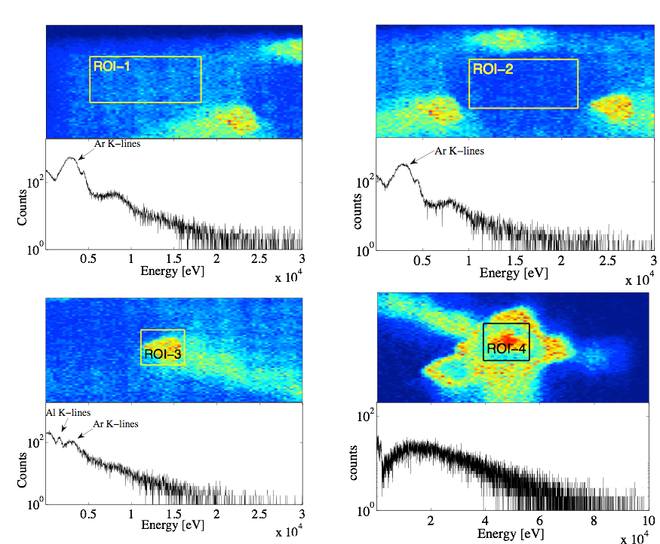
Spatially resolved soft – low power
Spectra of the selected ROIs
Superposition of the photon counted frames
Intense Argon K peak at ROI-1 and ROI-2 → corresponding to the Ar plasma
Aluminum K peak at ROI-4 → corresponds to the Al plasma electrode
ROI-3 shows the characteristics of both groups (ROI-1-2, and ROI-4) → axial inspection
ROI-5 shows K peaks of Fe/Co/Mn and Ni → lateral wall of the SS plasma chamber
5
5
Spectral comparison at different ROIs
PANDORA Progress Meeting, December 16, 2021

Slide 17
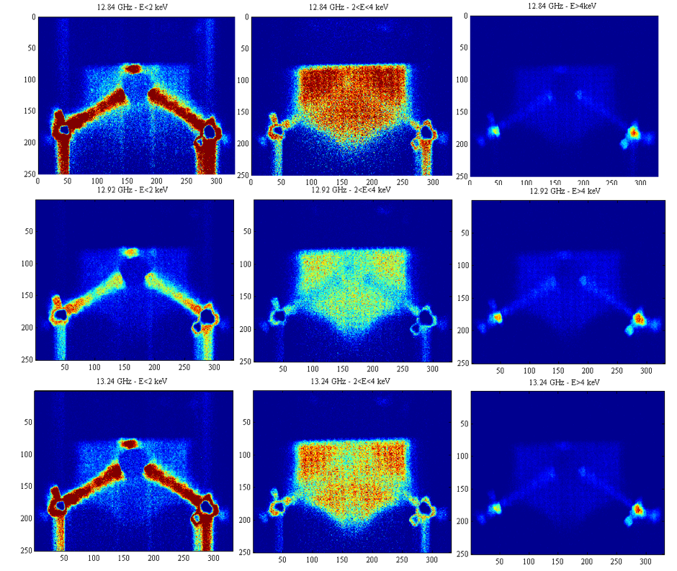
Spatially resolved soft – low power
Selecting only the pixels of the frames which are loaded by the photons having energy correspond to:
‚Low’ energy E < 2 keV
Argon K-alpha line 2 keV < E < 4 keV
‚High’ energy E > 4 keV
Low energy electrons lose mainly axially
Spatial distribution of the argon plasma; dense in magnetic gap position
High energy electrons lose mainly radially
PANDORA Progress Meeting, December 16, 2021

Slide 18
Spatially resolved soft - High Power
Sophisticated data processing is required:
  Clustering
  Grouping
  High Dynamic Range
  Read Out Noise
  Escape peaks
Local plasma parameters
  Simulation
  EEDF
  Cros sections
Next talk
Eugenia
After the next talk
Bharat
PANDORA Progress Meeting, December 16, 2021

Slide 19
What’s next - Challenges
To reach temporal resolution
  Periodic events
    Plasma build up process
    Instabilities
To reach better energy resolution: wavelength dispersive spectroscopy to online monitor the CSD in the plasma
PANDORA Progress Meeting, December 16, 2021

