Slide 1


Theoretical β-decay estimation of ionized atoms
Alberto Mengoni
ENEA and INFN Bologna
PANDORA meeting 2021, LNS & online, 16-17 December 2021

Slide 2
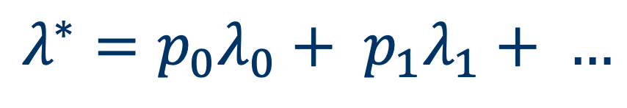
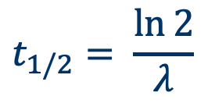
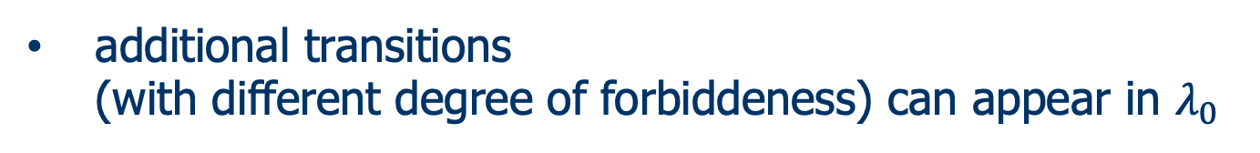

Beta decay rates
$$λ^{∗}=p_{0}λ_{0}+ p_{1}λ_{1}+ …$$
$$t_{1/2}= \frac{\ln{2}}{λ}$$
$λ_{i}$ can differ by orders of magnitude
additional transitions
(with different degree of forbiddeness) can appear in $λ_{0}$

Slide 3
Weak interaction rates (β⁻ decay)

Slide 4
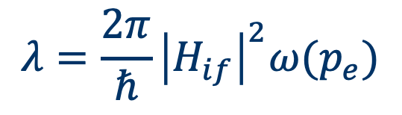
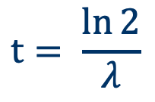
What about theory?
$$λ=\frac{2π}{ℏ}{\left|H_{if}\right|}^{2}ω(p_{e})$$
$$t= \frac{\ln{2}}{λ}$$
nuclear matrix elements
lepton phase volume
K Takahashi and K Yokoi , Nuclear Physics A404, 578 (1983)

Slide 5
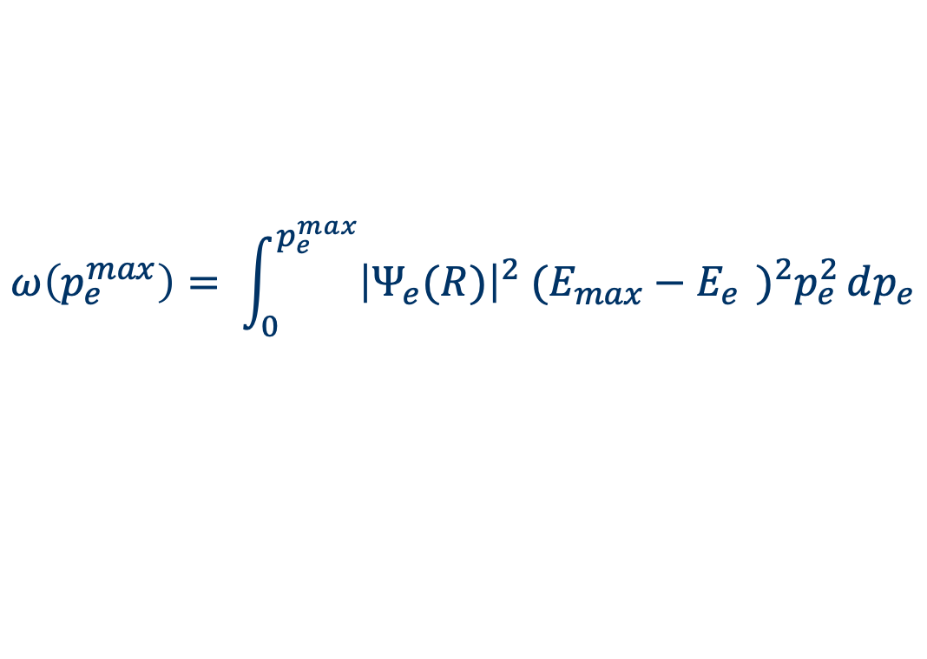
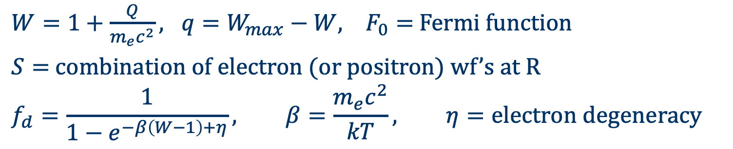
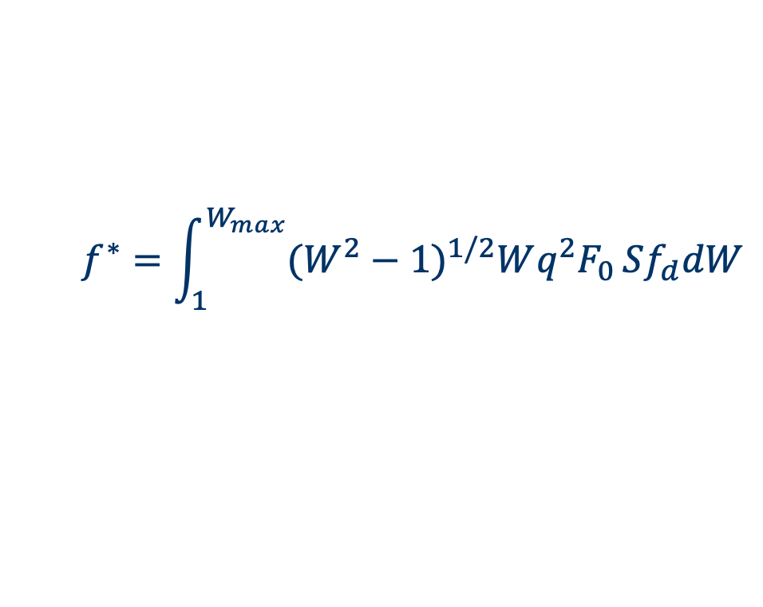
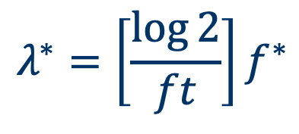
What about theory?
$$λ=\frac{2π}{ℏ}{\left|H_{if}\right|}^{2}ω(p_{e})$$
$$t= \frac{\ln{2}}{λ}$$
$$ω\left(p_{e}^{max}\right)= \int_{0}^{p_{e}^{max}}{{\left|Ψ_{e}(R)\right|}^{2} {(E_{max}−E_{e}^{})}^{2}p_{e}^{2}}dp_{e}$$
$$λ^{∗}=\left[\frac{\log{2}}{ft}\right]f^{∗}$$
$$f^{∗}=\int_{1}^{W_{max}}{{(W^{2}−1)}^{1/2}Wq^{2}F_{0}}Sf_{d}dW$$
$W=1+\frac{Q}{m_{e}c^{2}}, q=W_{max}−W, F_{0}=$ Fermi function
$S=$ combination of electron (or positron) wf’s at R
$$f_{d}=\frac{1}{1−e^{−β\left(W−1\right)+η}}, β=\frac{m_{e}c^{2}}{kT}, η=electron degeneracy$$
K Takahashi and K Yokoi , Nuclear Physics A404, 578 (1983)

Slide 6
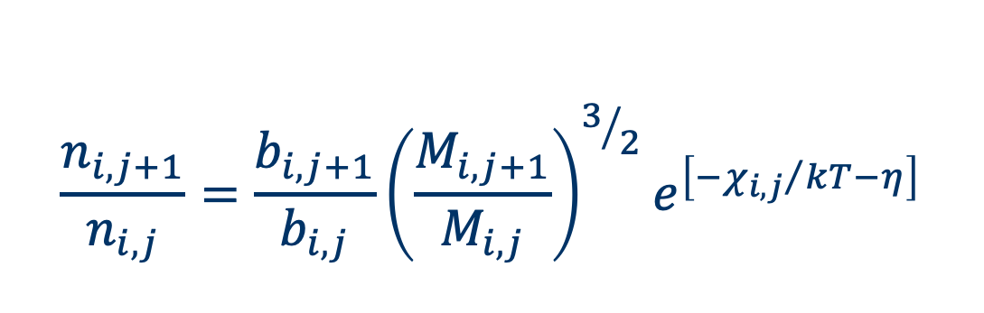
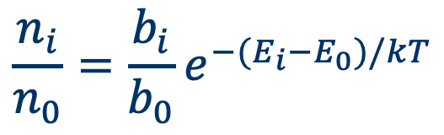
LTE
1. free electrons: maxwellian distribution of velocities f(v)dv
2. atomic excitations: Boltzmann distribution of atomic levels
$$\frac{n_{i}}{n_{0}}=\frac{b_{i}}{b_{0}}e^{−(E_{i}−E_{0})/kT}$$
3. Saha equations for ionized state populations
$$\frac{n_{i,j+1}}{n_{i,j}}=\frac{b_{i,j+1}}{b_{i,j}}{\left(\frac{M_{i,j+1}}{M_{i,j}}\right)}^{3/2}e^{\left[−{χ_{i,j}}/{kT}−η\right]}$$

Slide 7
LTE vs NLTE
dV₁,T₁
dV₂,T₂
T
LTE
each volume element, separately,
in thermodynamic equilibrium
at temperature T(r)
photons
r
however:
volume elements are not closed systems (interactions by photons)
LTE non-valid if absorption of photons disrupts equilibrium

Slide 8
LTE vs NLTE
1. free electrons: maxwellian distribution of velocities f(v)dv
2. atomic excitations: Boltzmann distribution of atomic levels
$$\frac{n_{i}}{n_{0}}=\frac{b_{i}}{b_{0}}e^{−(E_{i}−E_{0})/kT}$$
3. Saha equations for ionized state populations
$$\frac{n_{i,j+1}}{n_{i,j}}=\frac{b_{i,j+1}}{b_{i,j}}{\left(\frac{M_{i,j+1}}{M_{i,j}}\right)}^{3/2}e^{\left[−{χ_{i,j}}/{kT}−η\right]}$$

Slide 9
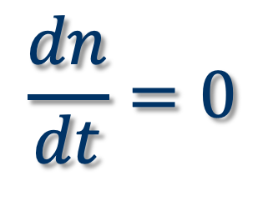
LTE vs NLTE
1. free electrons: maxwellian distribution of velocities f(v)dv
2. atomic excitations
$$\frac{dn}{dt}=0$$
3. Ion state populations

Slide 10
LTE vs NLTE
1. free electrons: maxwellian distribution of velocities f(v)dv
2. atomic excitations
$$\frac{dn}{dt}=0$$
$$\frac{dn}{dt}=0$$
3. Ion state populations

Slide 11
What about theory?
From LTE to NLTE
LTE
high densities & low temperatures
NLTE
low densities & high temperatures

Slide 12
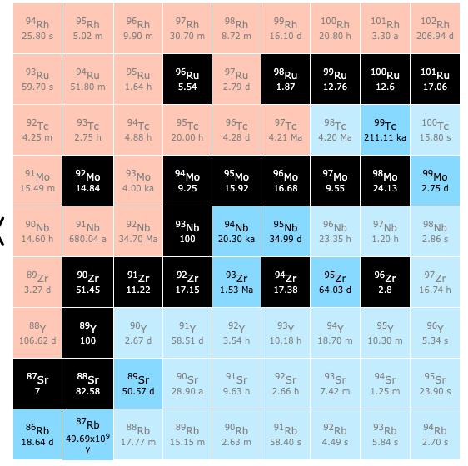
The ⁹⁴Nb(𝛽⁻) case

Slide 13
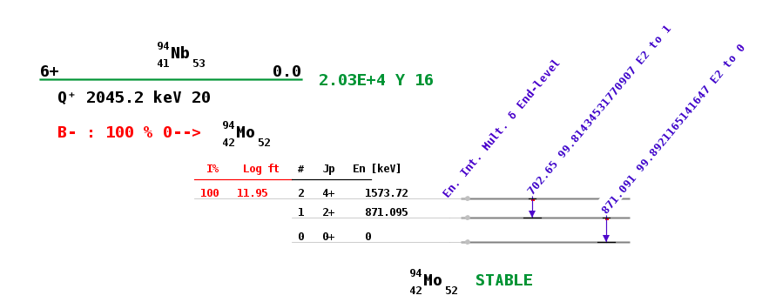
The ⁹⁴Nb(𝛽⁻) case
3+ 40.9

Slide 14
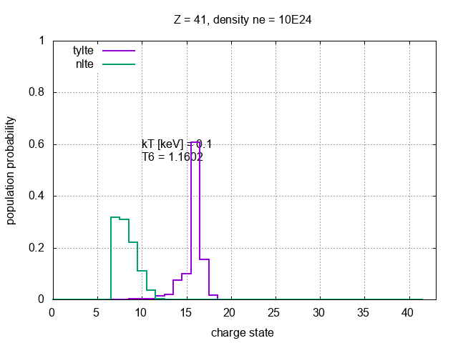
From LTE to NLTE
n_{e}=10²⁴ 1/cm³

Slide 15
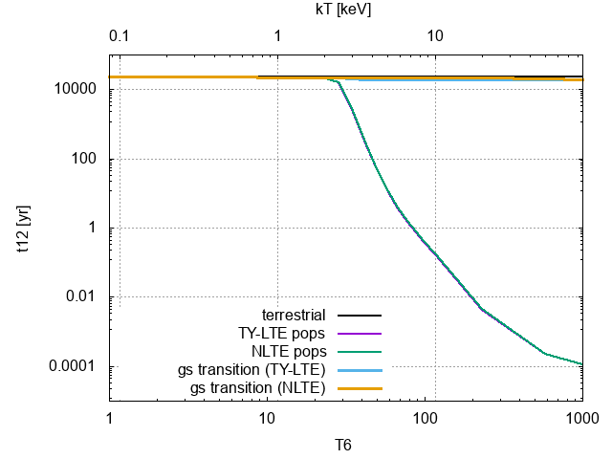
The ⁹⁴Nb(𝛽⁻) case
n_{e}=10²⁴ 1/cm³

Slide 16
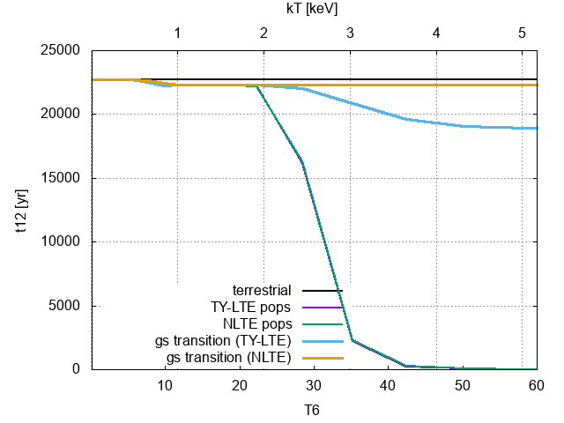
The ⁹⁴Nb(𝛽⁻) case
n_{e}=10²⁴ 1/cm³

Slide 17
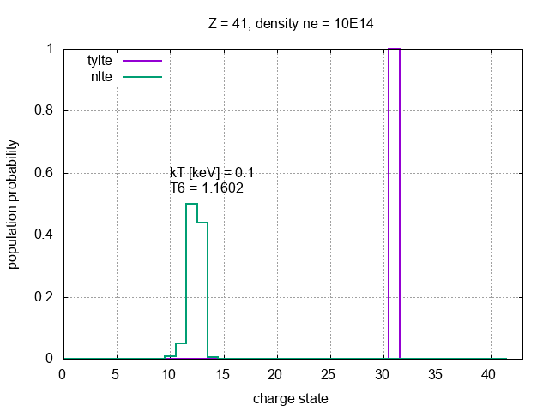
From LTE to NLTE
n_{e}=10¹⁴ 1/cm³

Slide 18
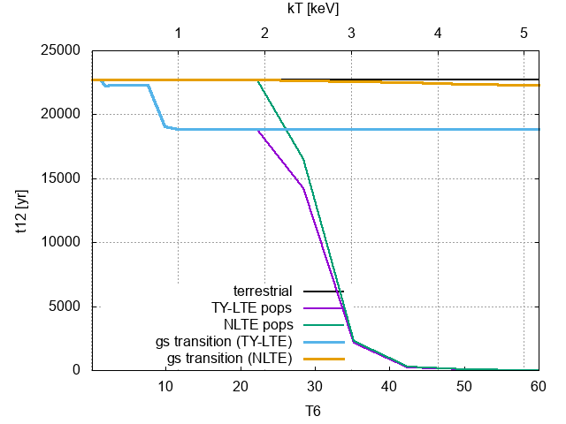
The ⁹⁴Nb(𝛽⁻) case
n_{e}=10¹⁴ 1/cm³

Slide 19
The ¹⁸⁷Re(𝛽⁻) case

Slide 20
The ¹⁸⁷Re(𝛽⁻) case

Slide 21
The ¹⁸⁷Re(𝛽⁻) case
BANG!
?
4.6 Ga
Now
s-only
Os
Os 184
0.02
Os 185
94 d
Os 186
1.58
Os 187
1.6
Os 188
13.3
Os 189
16.1
Os 190
26.4
Os 191
15.4 d
Os 192
41.0
Re
Re 183
71 d
Re 184
38 d
Re 185
37.4
Re 186
90.64 h
Re 187
62.6
Re 188
16.98 h
Re 189
24.3 h
Re 190
3.1 m
42.3x10⁹ a
W
W 182
26.3
W 183
14.3
W 184
30.67
W 185
75.1 d
W 186
28.6
W 187
23.8 h
W 188
69 d
s-process
r-only
r-process
(*) DD Clayton, ApJ 139 (1964) 637

Slide 22
¹⁸⁷Re(β⁻) decay
F Bosch, et al., PRL 77 (1996) 5190
The β-decay half-life of ¹⁸⁷Re is τ_{β} = 43.2 ± 1.3 Gyr.
Under stellar conditions, the ¹⁸⁷Os and ¹⁸⁷Re atoms can be partly or fully ionized.
The β-decay rate can then proceed through a transition to bound-electronic states in ¹⁸⁷Os.
The rate for this process can be orders of magnitude faster than the neutral-atom decay.
The bound-state β-decay half-life of fully-ionized ¹⁸⁷Re has been measured @ GSI.
The half-life of fully-ionized ¹⁸⁷Re turns out to be: τ_{β} = 32.9 ± 2.0 yr.

Slide 23
The ¹⁸⁷Re(𝛽⁻) case
WARNING
the results of the calculations shown in the next slides
need further checks and confirmation

Slide 24
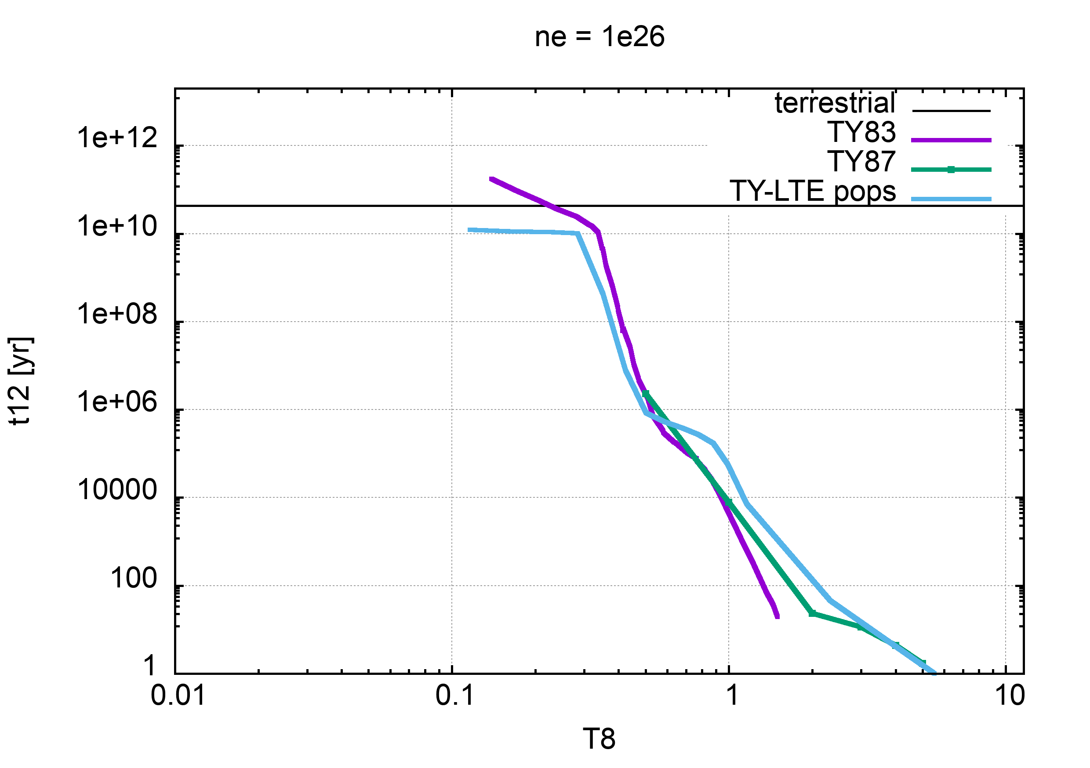
The ¹⁸⁷Re(𝛽⁻) case
n_{e}=10²⁶ 1/cm³
preliminary

Slide 25
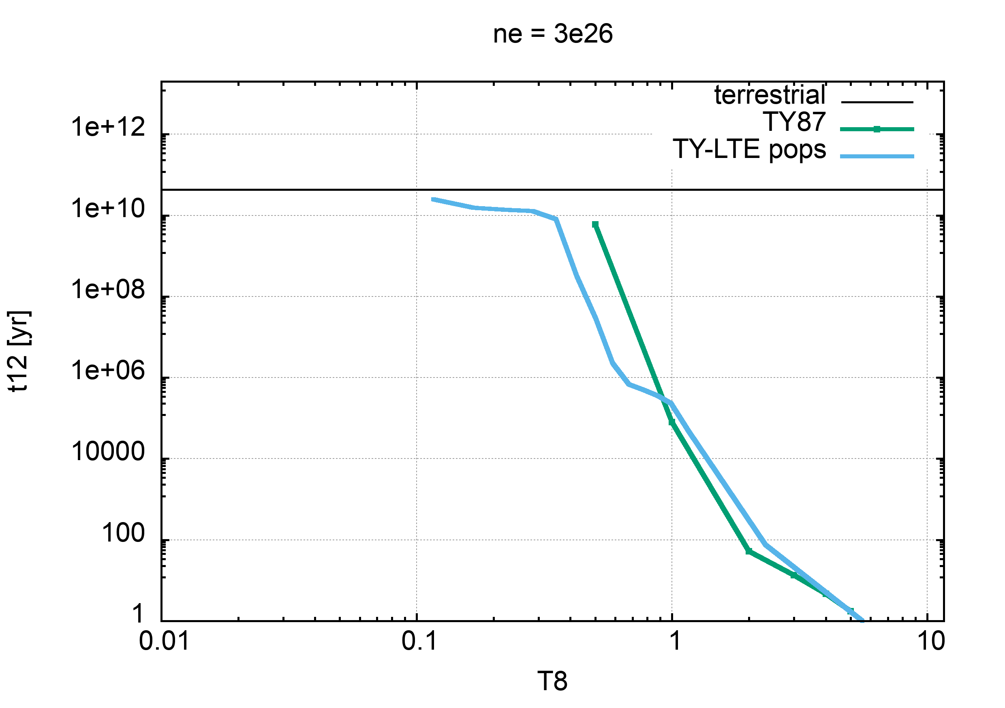
The ¹⁸⁷Re(𝛽⁻) case
n_{e}=3x10²⁶ 1/cm³
preliminary

Slide 26
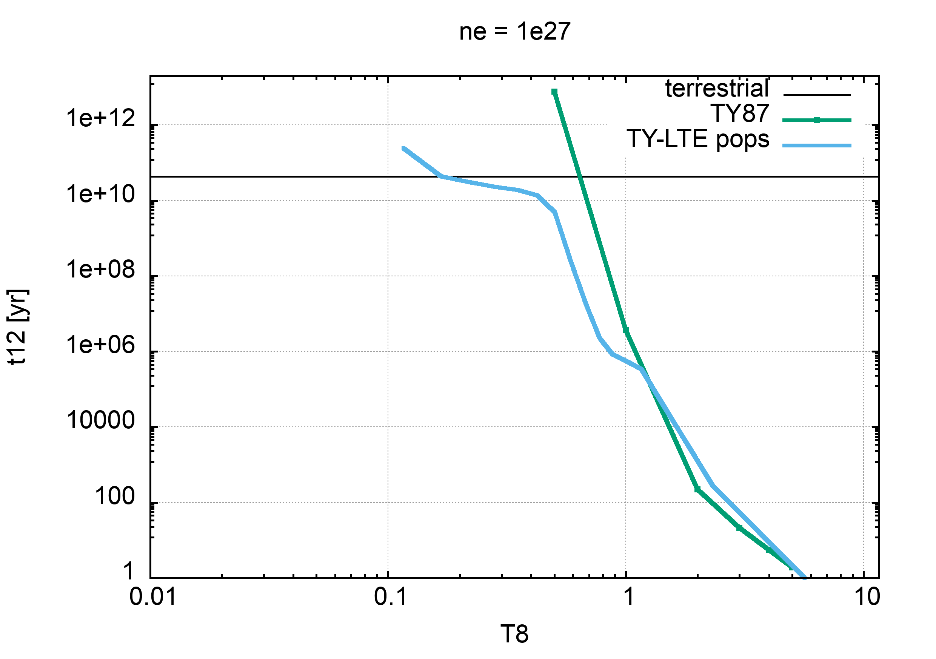
The ¹⁸⁷Re(𝛽⁻) case
n_{e}=10²⁷ 1/cm³
preliminary

Slide 27
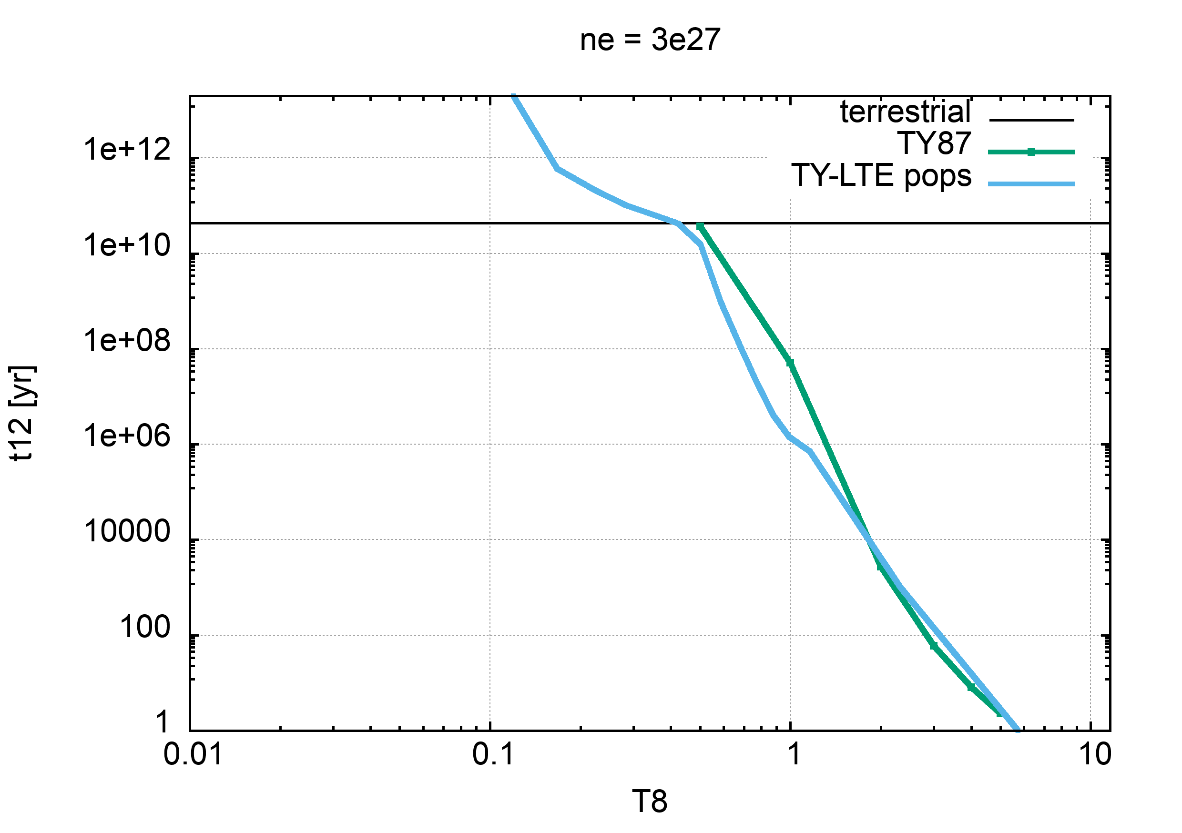
The ¹⁸⁷Re(𝛽⁻) case
n_{e}=3x10²⁷ 1/cm³
preliminary

Slide 28
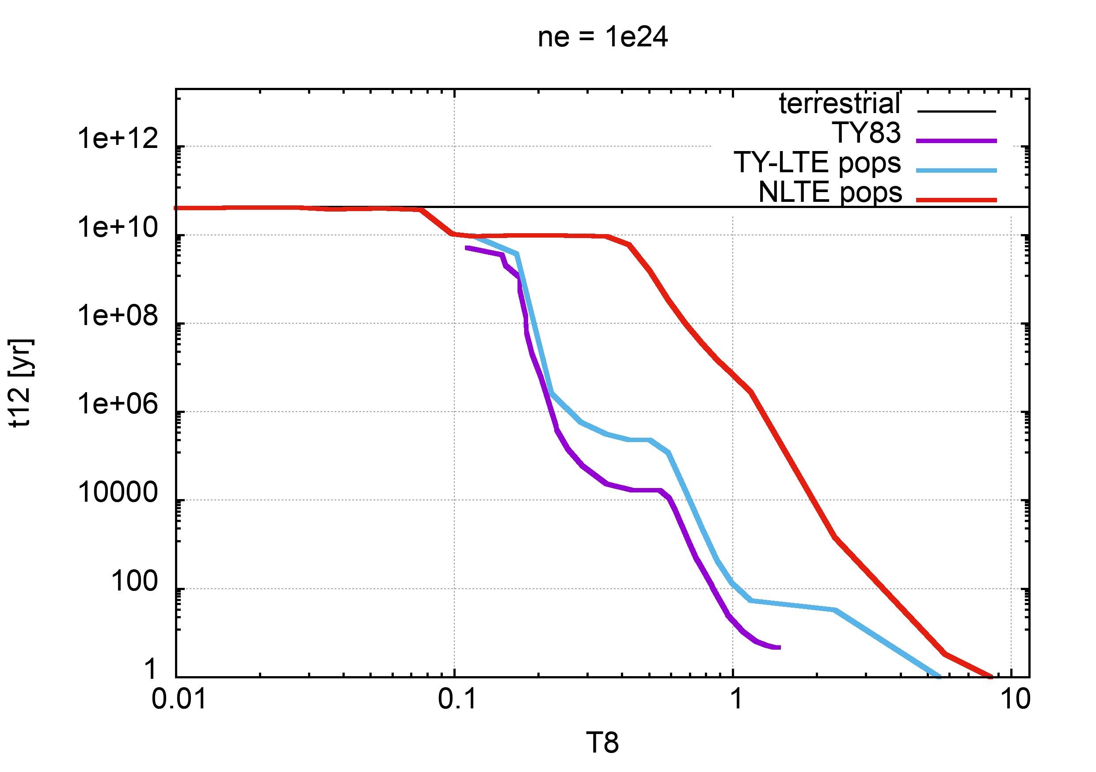
The ¹⁸⁷Re(𝛽⁻) case
n_{e}=10²⁴ 1/cm³
preliminary

Slide 29
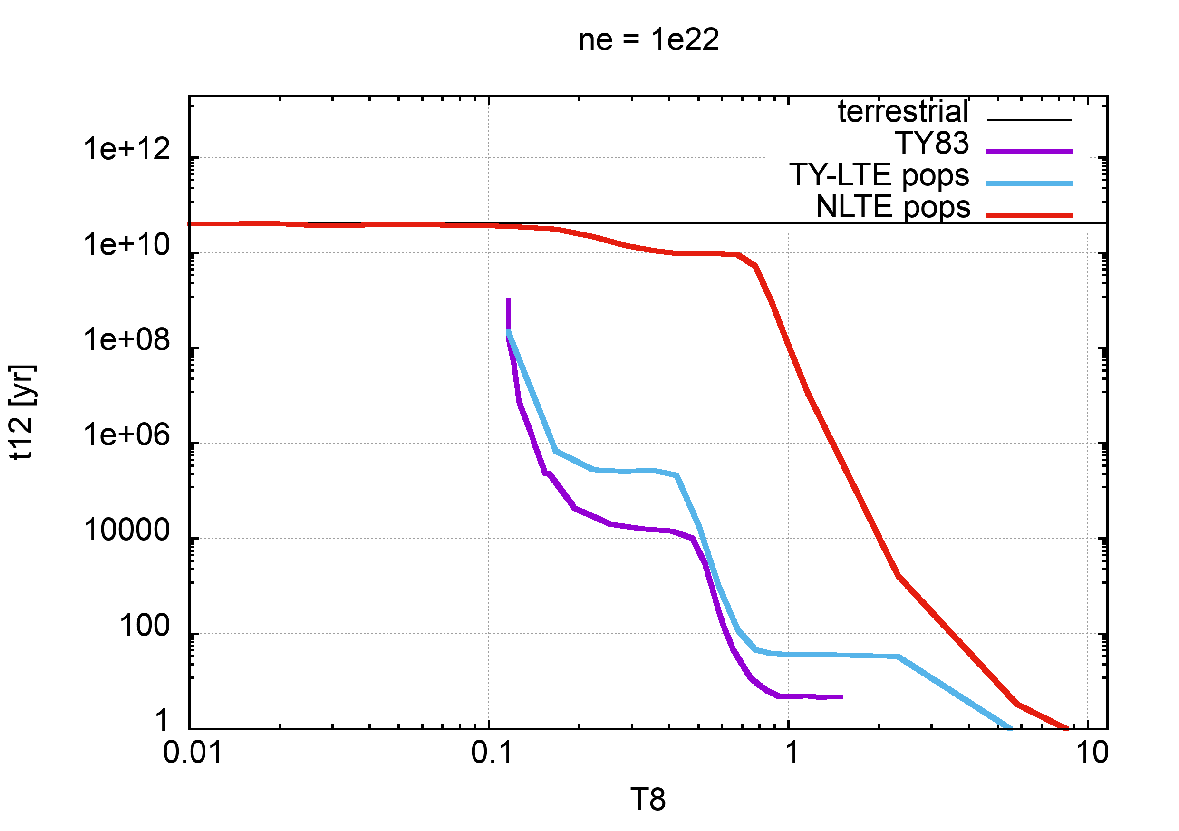
The ¹⁸⁷Re(𝛽⁻) case
n_{e}=10²² 1/cm³
preliminary

Slide 30
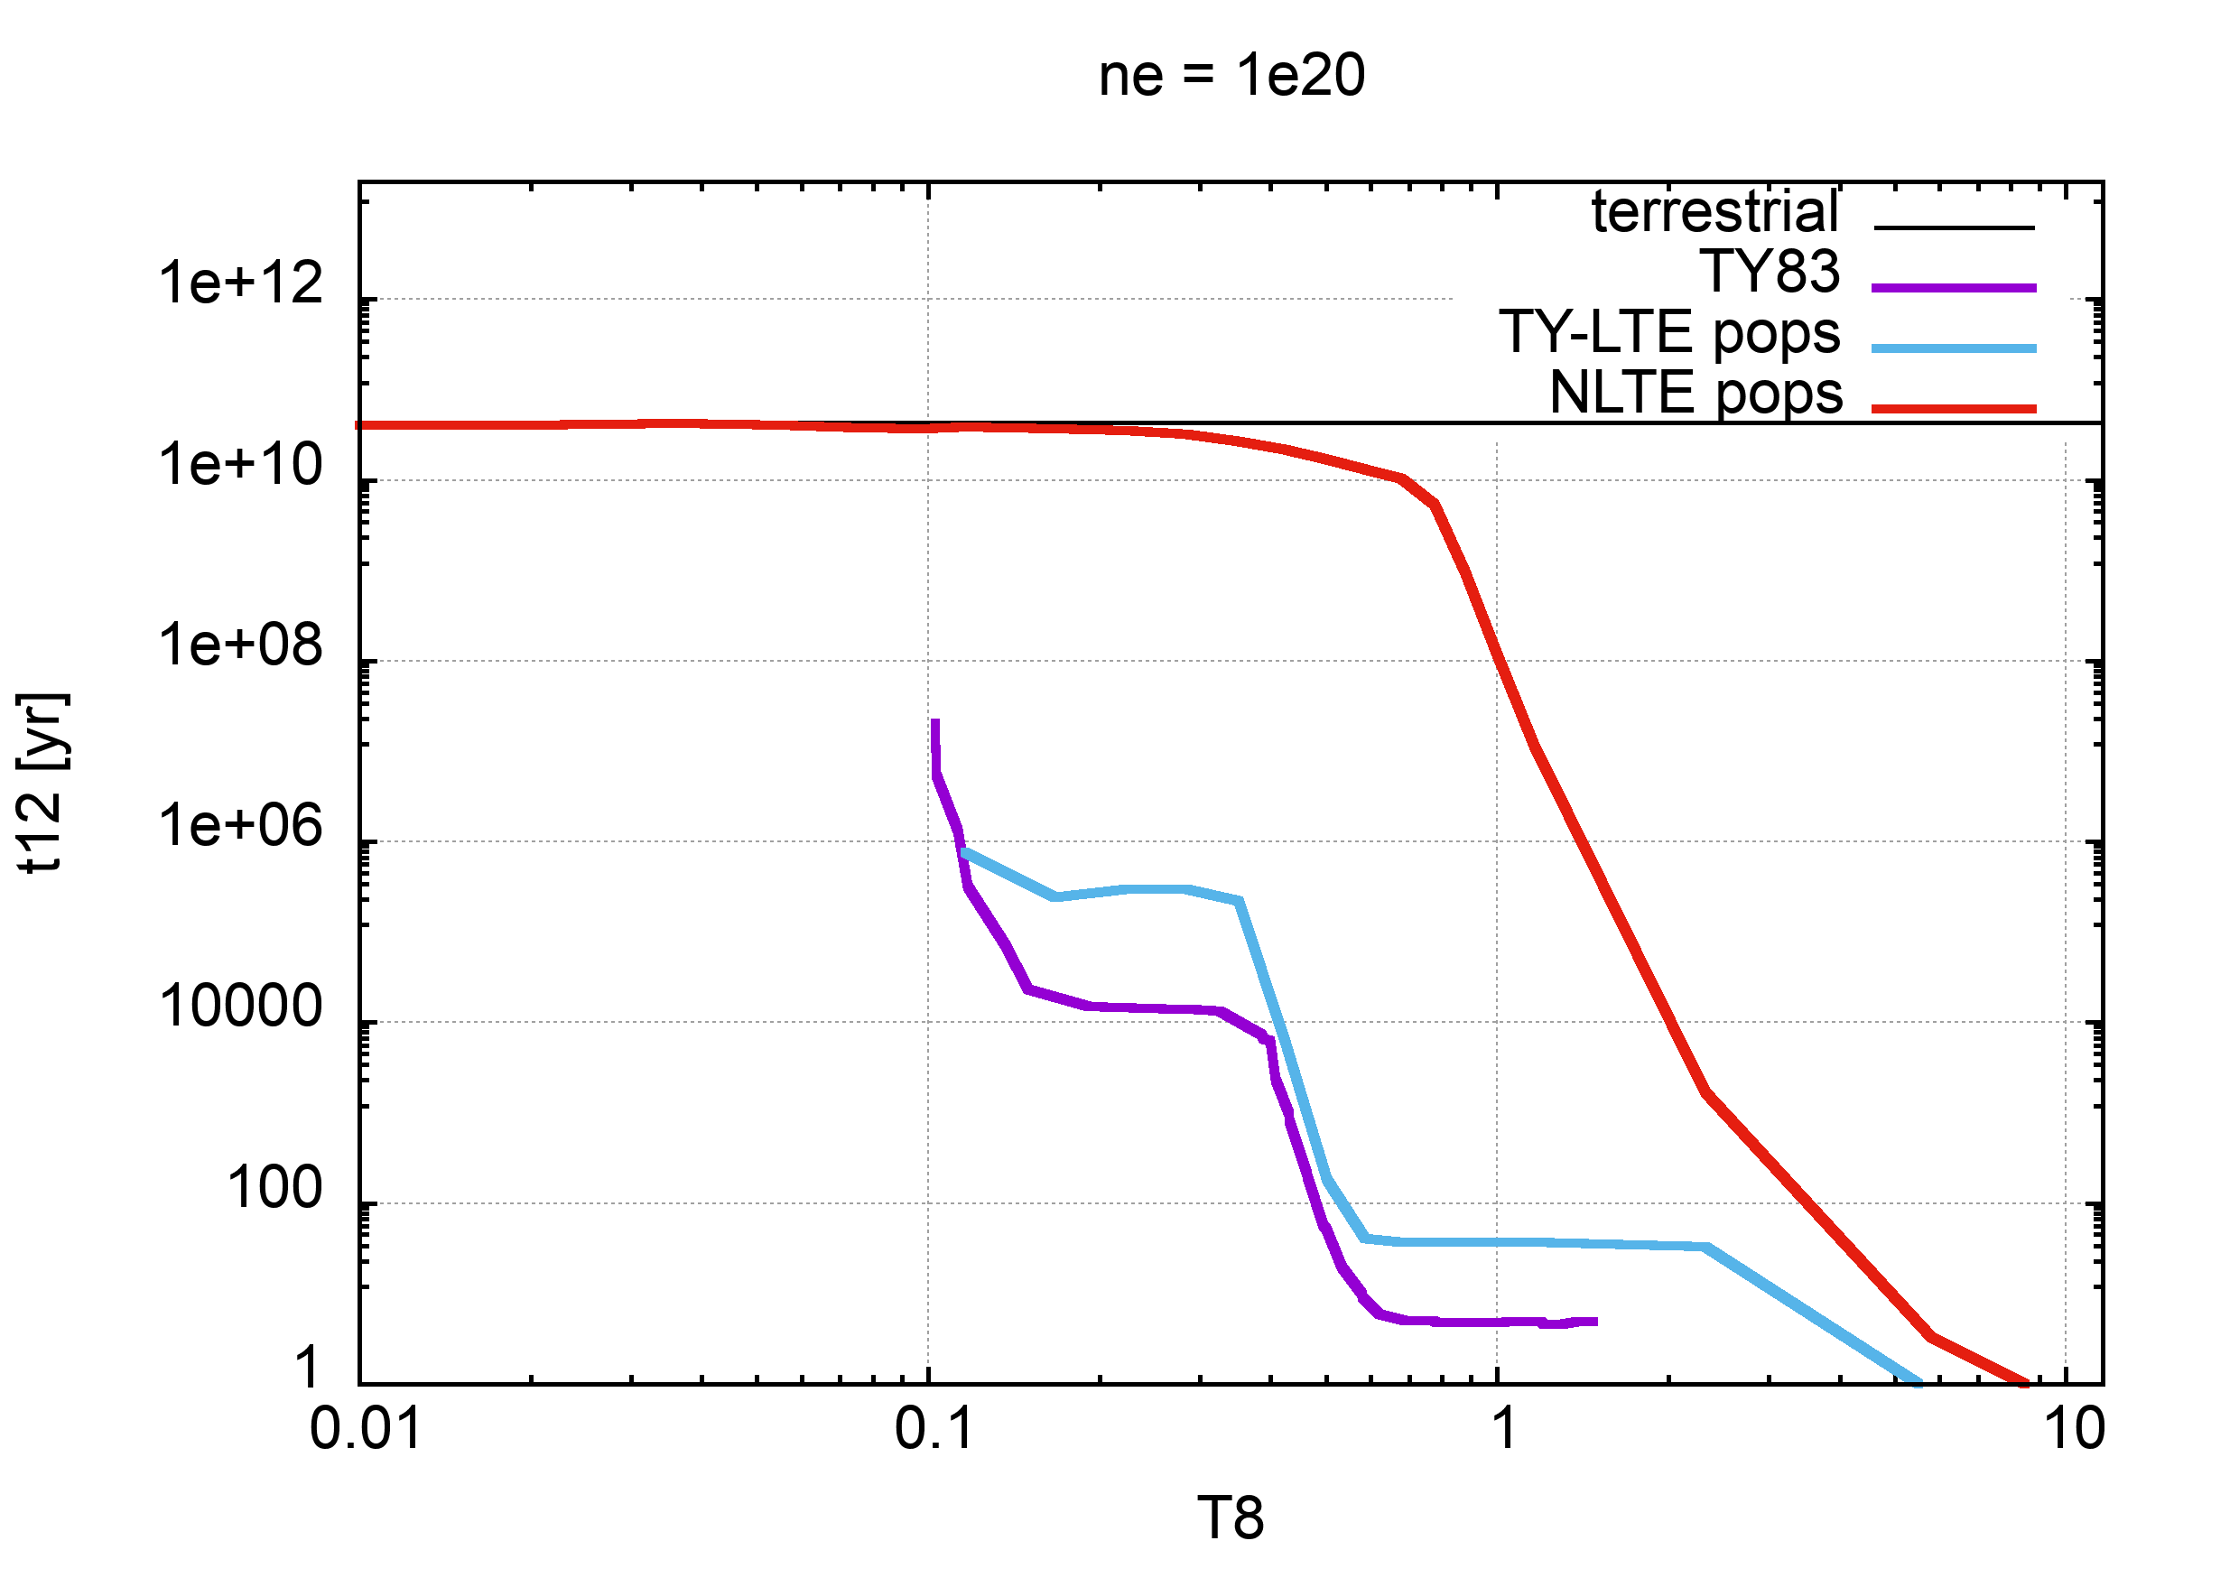
The ¹⁸⁷Re(𝛽⁻) case
n_{e}=10²⁰ 1/cm³
preliminary

Slide 31
Conclusions
The large effects of stellar conditions in β⁻ decays have
been measured in a few cases at storage rings
New perspectives on measurements of nuclear β-decays
in highly ionized atoms by the PANDORA experiment
at INFN-LNS

Slide 32
The End
alberto.mengoni@bo.infn.it

