Slide 1


Progresses on nucleosynthesis constraints: AGB stars and grains
S.Palmerini

Slide 2
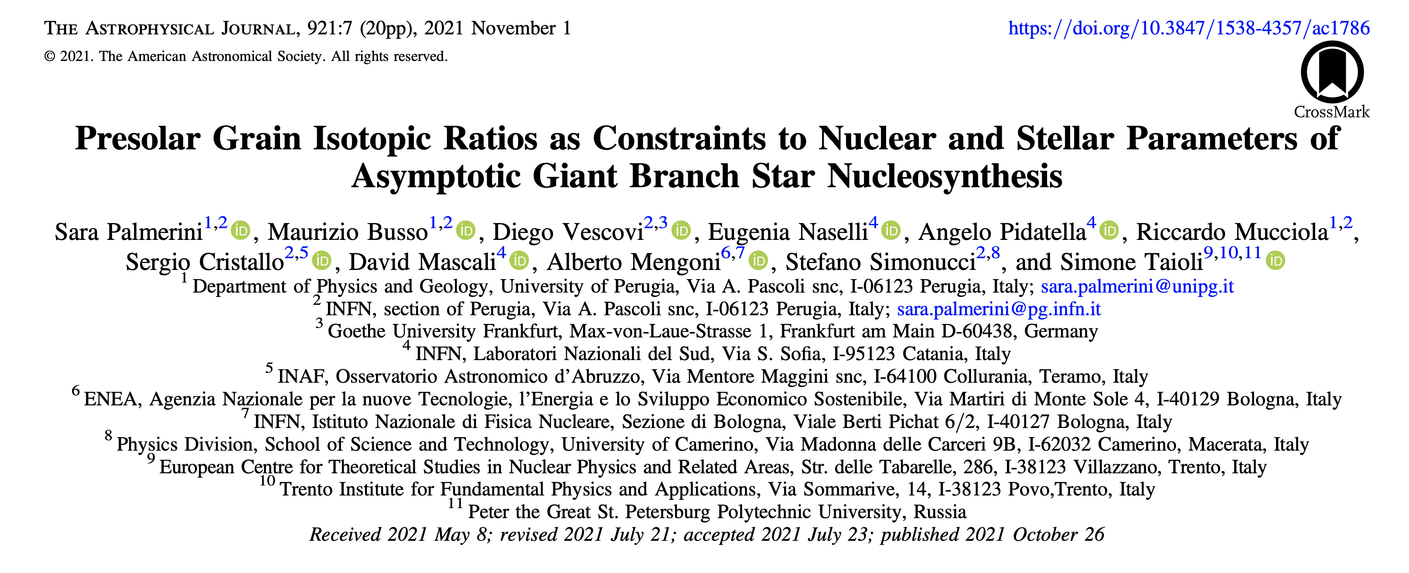

Slide 3
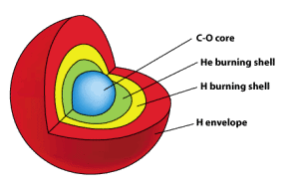

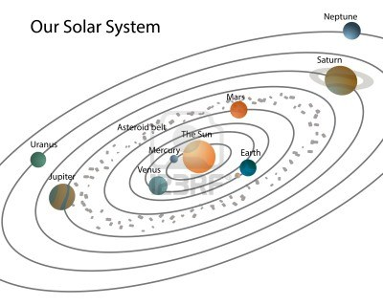
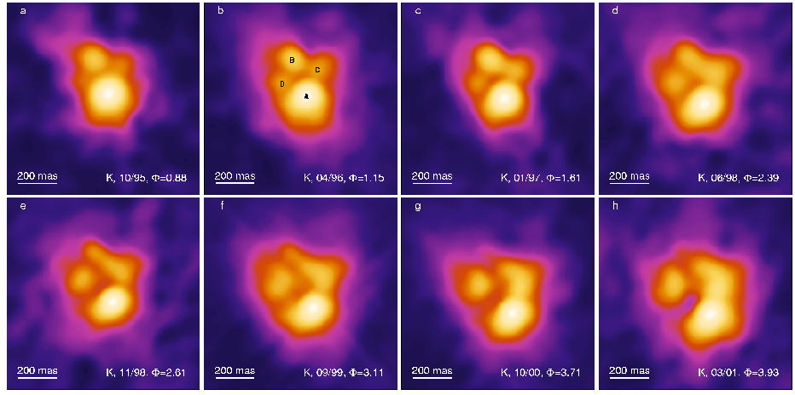
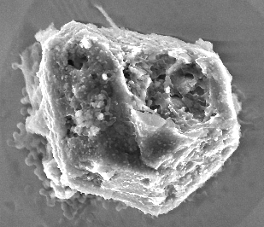

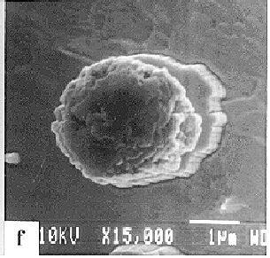
AGB stars, s-process and presolar grains: the story so far
Molecular Cloud
SiC presolar grains from AGB stars
Despite their low masses LMS are so numerous to contribute for 75% to the total mass return from stars to the ISM (Sedlmayr 1994);
C/O≥1
Presolar grains
Meteorite

Slide 4
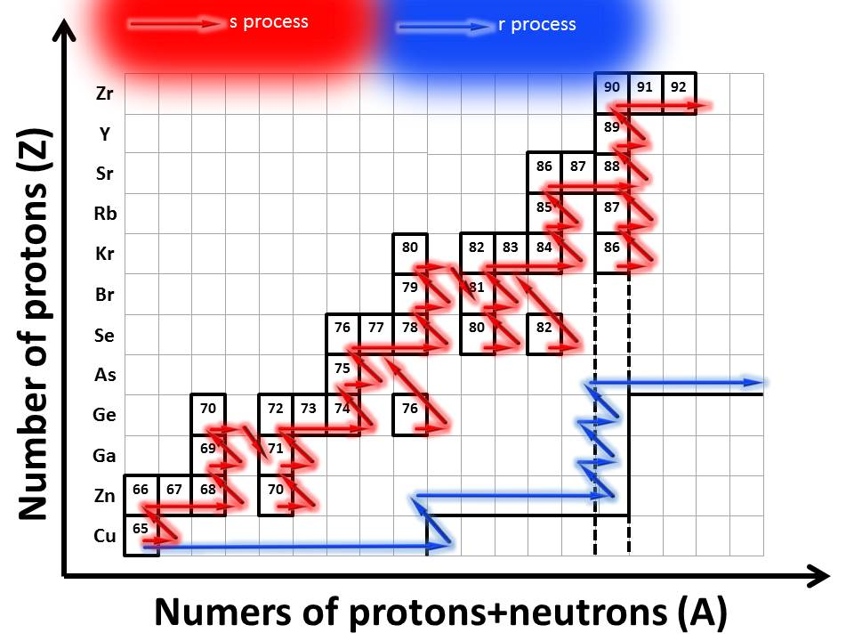
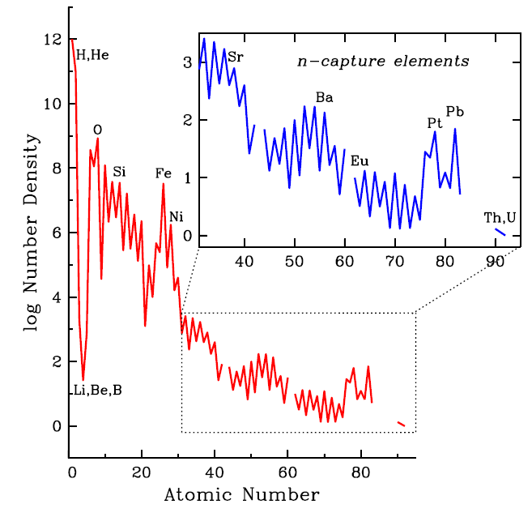
AGB stars, s-process and presolar grains:the story so far
Credits S. Cristallo
Convective envelope
TDU
Thermal pulse
H-burning shell
To the stellar surface
¹³C pocket
TDU
H-burning shell
protons
Thermal pulse
¹³C pocket
C-O (unburning) core
protons
He burning
20%¹²C 79%⁴He
¹³C(α,n)¹⁶O slow n capture (s-process)
¹²C(p,γ)¹³N(β⁺ ν)¹³C
¹³C(p,γ)¹⁴N* F producation
He burning
Time

Slide 5
The slow neutron-capture process
The s process is responsible for the production of about half the abundances of elements heavier than iron in the Galaxy.
s-process peaks
(close to magic numbers)
Credits S. Cristallo

Slide 6
The slow neutron-capture process
The s process is responsible for the production of about half the abundances of elements heavier than iron in the Galaxy.
s-process peaks
(close to magic numbers)
Credits S. Cristallo

Slide 7
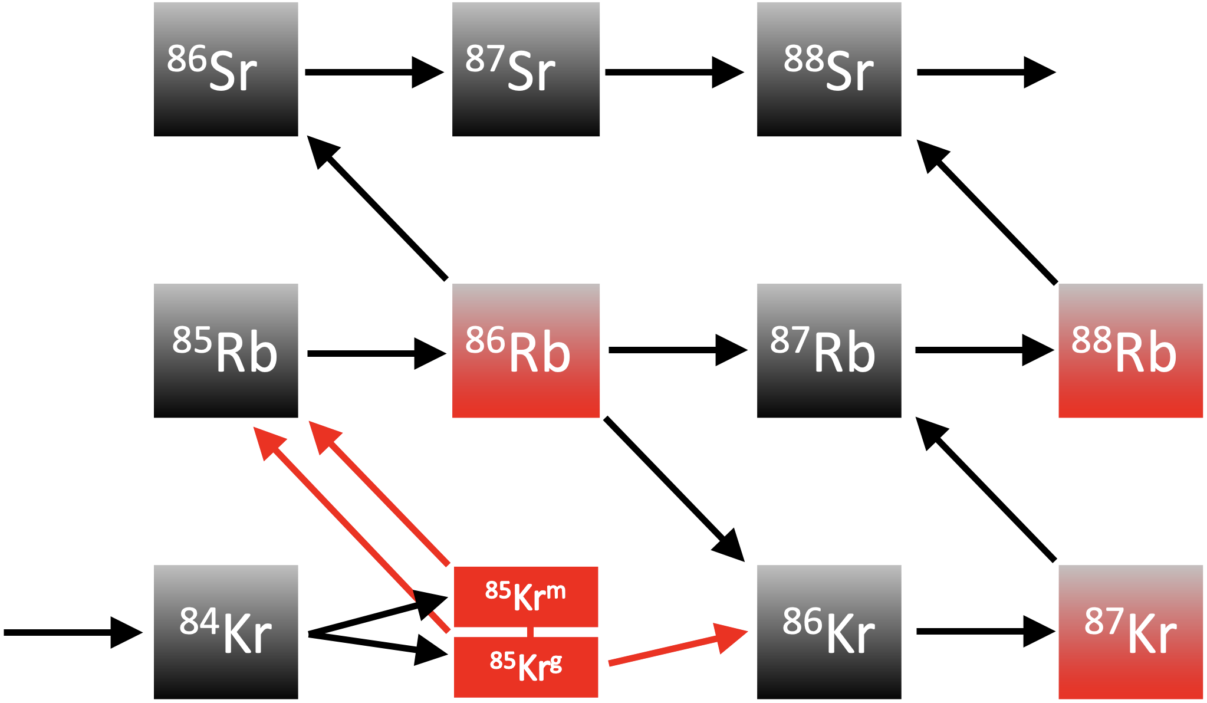
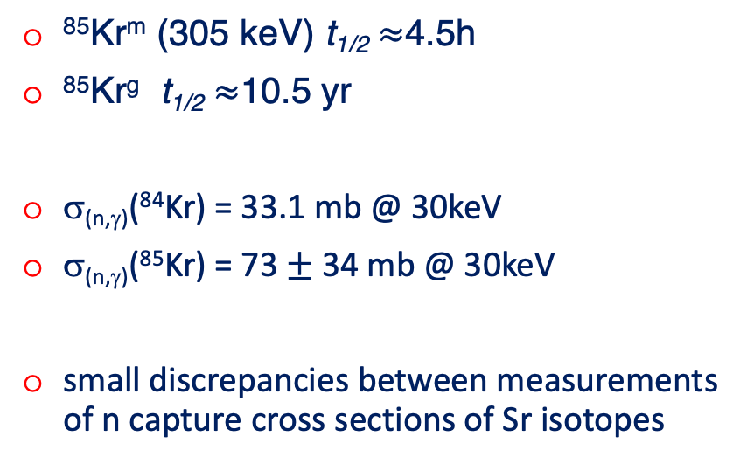
Main branching in the s-process nucleosynthesis path
…around N = 50; the ⁸⁵Kr branching is highlighted by the red arrows.
⁸⁵Kr^{m} (305 keV) t_{1/2} $≈$4.5h
⁸⁵Kr^{g} t_{1/2} $≈$10.5 yr
σ_{(n,γ)}(⁸⁴Kr) = 33.1 mb @ 30keV
σ_{(n,γ)}(⁸⁵Kr) = 73 $±$ 34 mb @ 30keV
small discrepancies between measurements of n capture cross sections of Sr isotopes

Slide 8
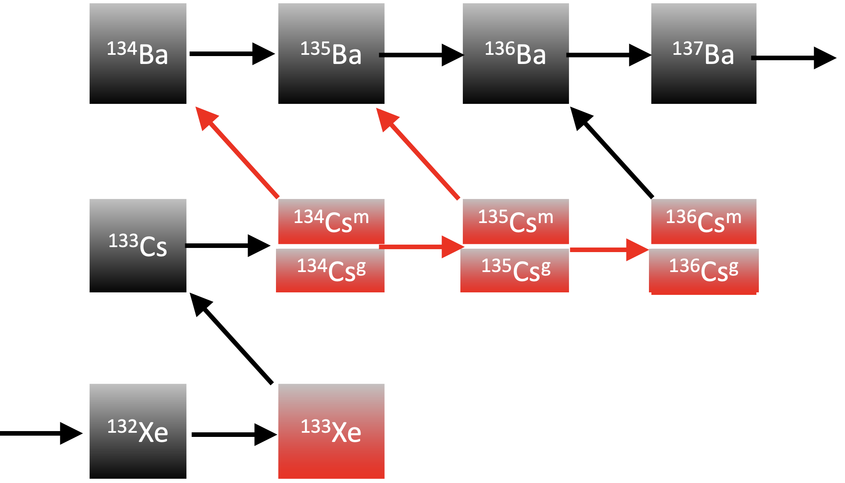
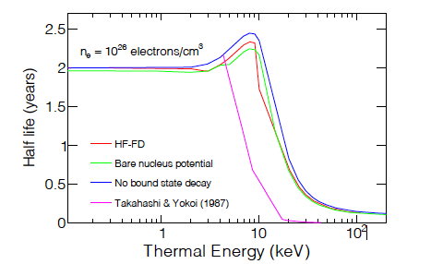

Main branching in the s-process nucleosynthesis path
…. around N = 82, the ¹³⁴Cs and ¹³⁵Cs branching points are highlighted by red arrows.
¹³⁴Cs (β⁻) t_{1/2} $≈$2 yr (lab.)
@ 3 10⁸K the decay rate of ¹³⁴Cs is enhanced by a factor of about 200. (TY 1987)
See the next talk by S. Taioli and S. Simonucci

Slide 9

Main Stream Sic Grains
PRESOLAR GRAIN DATABASE

Slide 10
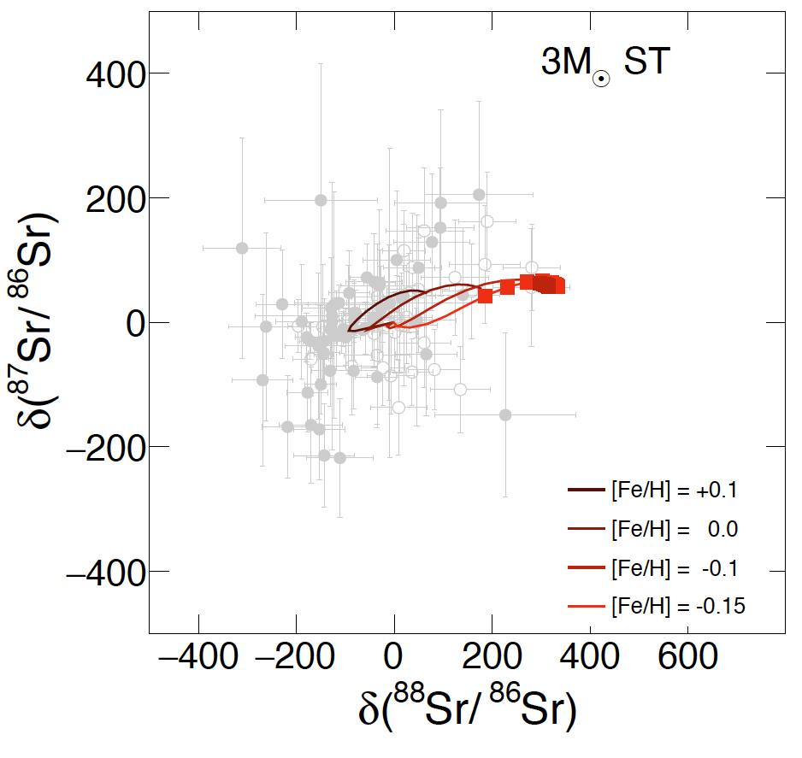
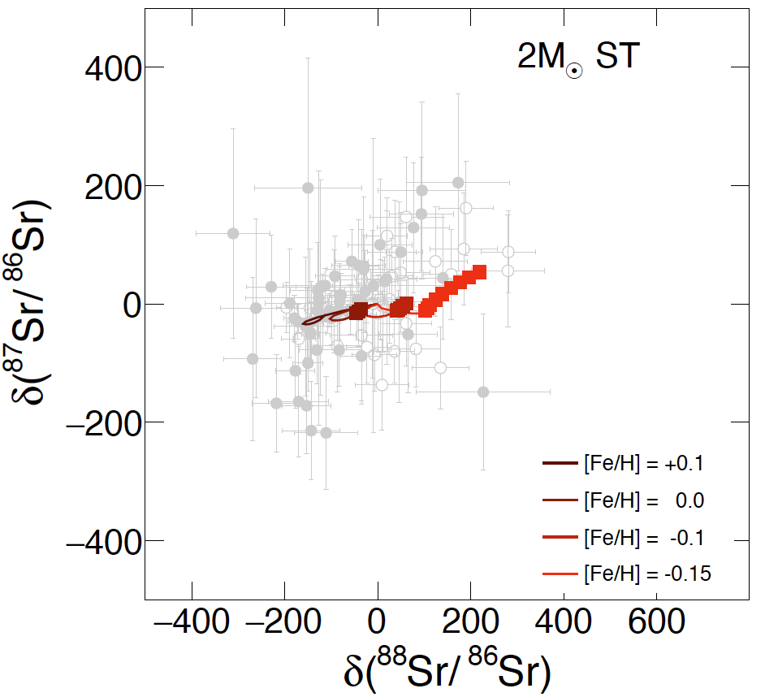
…around N = 50
ST nuclear input
(n,γ) MACS are from KADONIS 1.0
(n,γ) theoretical Hauser–Feshbach computations TALYS 2008 for unstable nuclei
rates for weak interactions from Takahashi & Yokoi (1987)

Slide 11
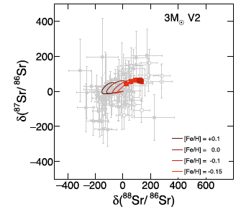
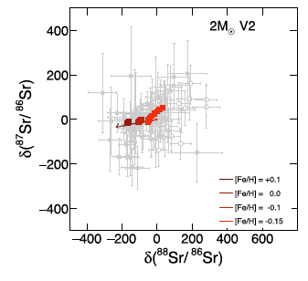
…around N = 50
V2 nuclear input
⁸⁵Kr b.r. = 0. 6, (60% of the n flux to the ⁸⁵Kr^{m}) K1
⁸⁵Kr b.r. = 0.4, (40% of the n flux to the ⁸⁵Kr^{m}) K0.3 -> more ⁸⁸Sr
Same effect occurs with the ⁸⁴Kr(n,γ) in K1 and a «new» ⁸⁵Kr^{m} decay rate
the ratio of Sr isotopes depends on their own cross sections, but also on those of ^{84,85}Kr, on the branching ratio to ⁸⁵Kr^{m}
→ We NEED new nuclear physics measurements on the chains departing
from ⁸⁴Kr , proceeding through ⁸⁵Kr^{m}, ⁸⁵Rb, ⁸⁶Rb and ^{86,87}Sr.

Slide 12
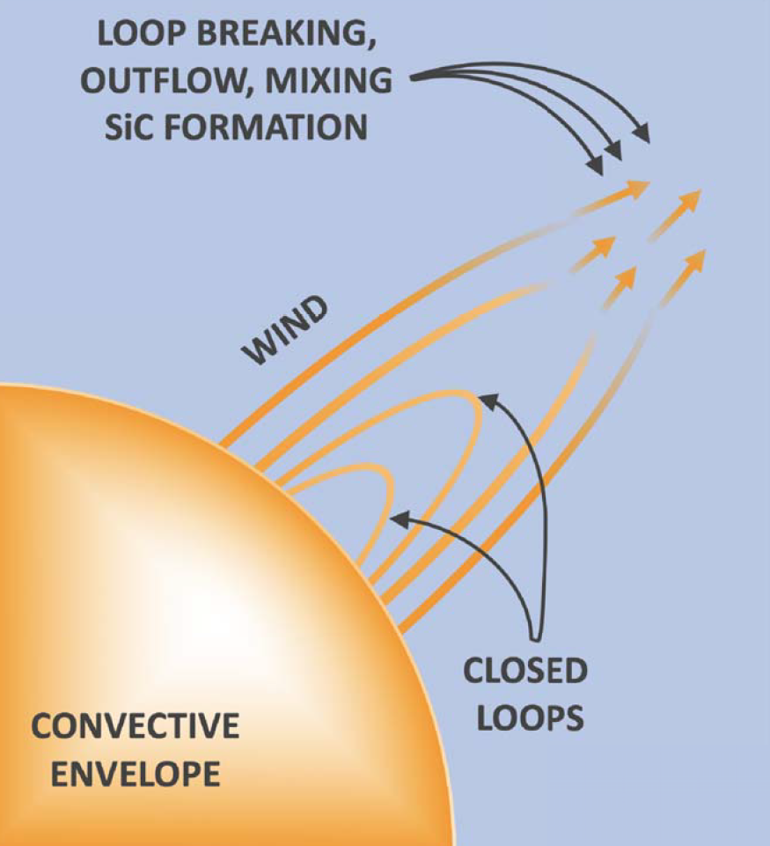
…but stellar physics can help too
The advection of magnetic bubble in the stellar envelope may allow the existence of C-rich domains, isolated by magnetic tension, even when the average envelop composition is still O-rich.
Busso et al. ApJ 908, 55 (2021)

Slide 13
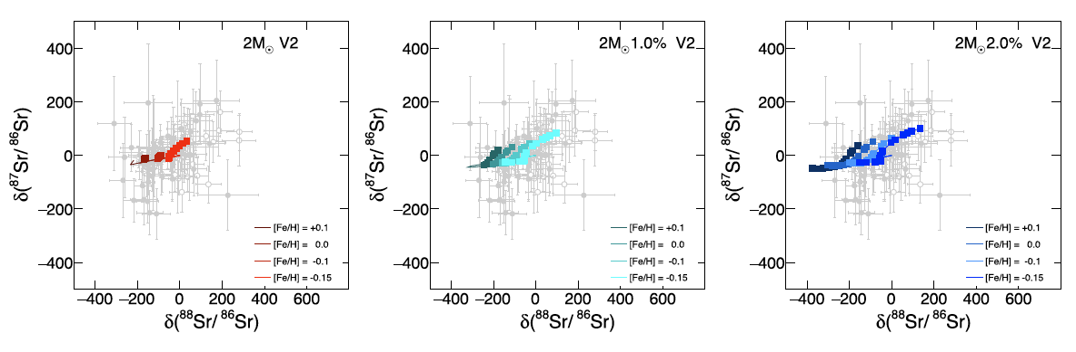
…around N = 50

Slide 14
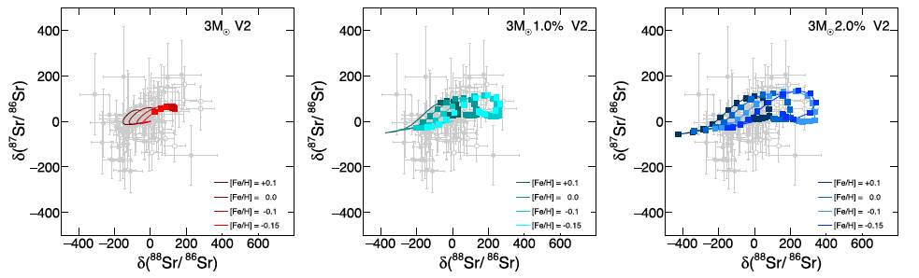
…around N = 50

Slide 15
…around N = 82
ST nuclear input
(n,γ) MACS are from KADONIS 1.0
(n,γ) theoretical Hauser–Feshbach computations TALYS 2008 for unstable nuclei
rates for weak interactions from Takahashi & Yokoi (1987)

Slide 16
…around N = 82
Ba isotopic ratios are sensitive to the (n,γ) cross sections (only theoretical values exist) and β−decay of ¹³⁴Cs and ¹³⁵Cs at T > 2 10⁸K.
V2 nuclear input
decay rate of ¹³⁴Cs enhanced by a factor of 8 respect to TY 1987 (see next talk)
Similar effects would be induced by variations in the ¹³⁵Cs neutron-capture cross section

Slide 17
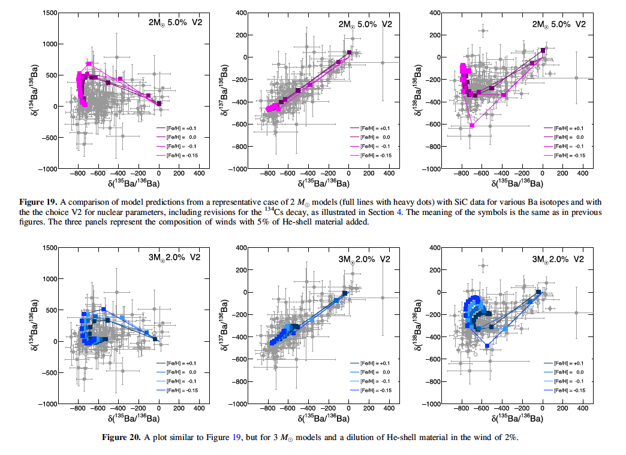
Effects of the magnetic wind and the new nuclear input around N = 82

Slide 18
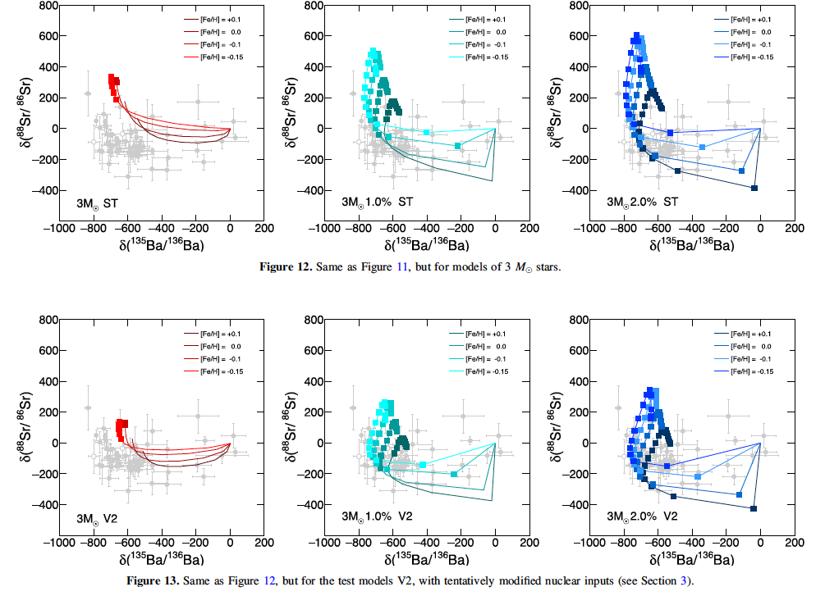
Light s and heavy s togheter

Slide 19
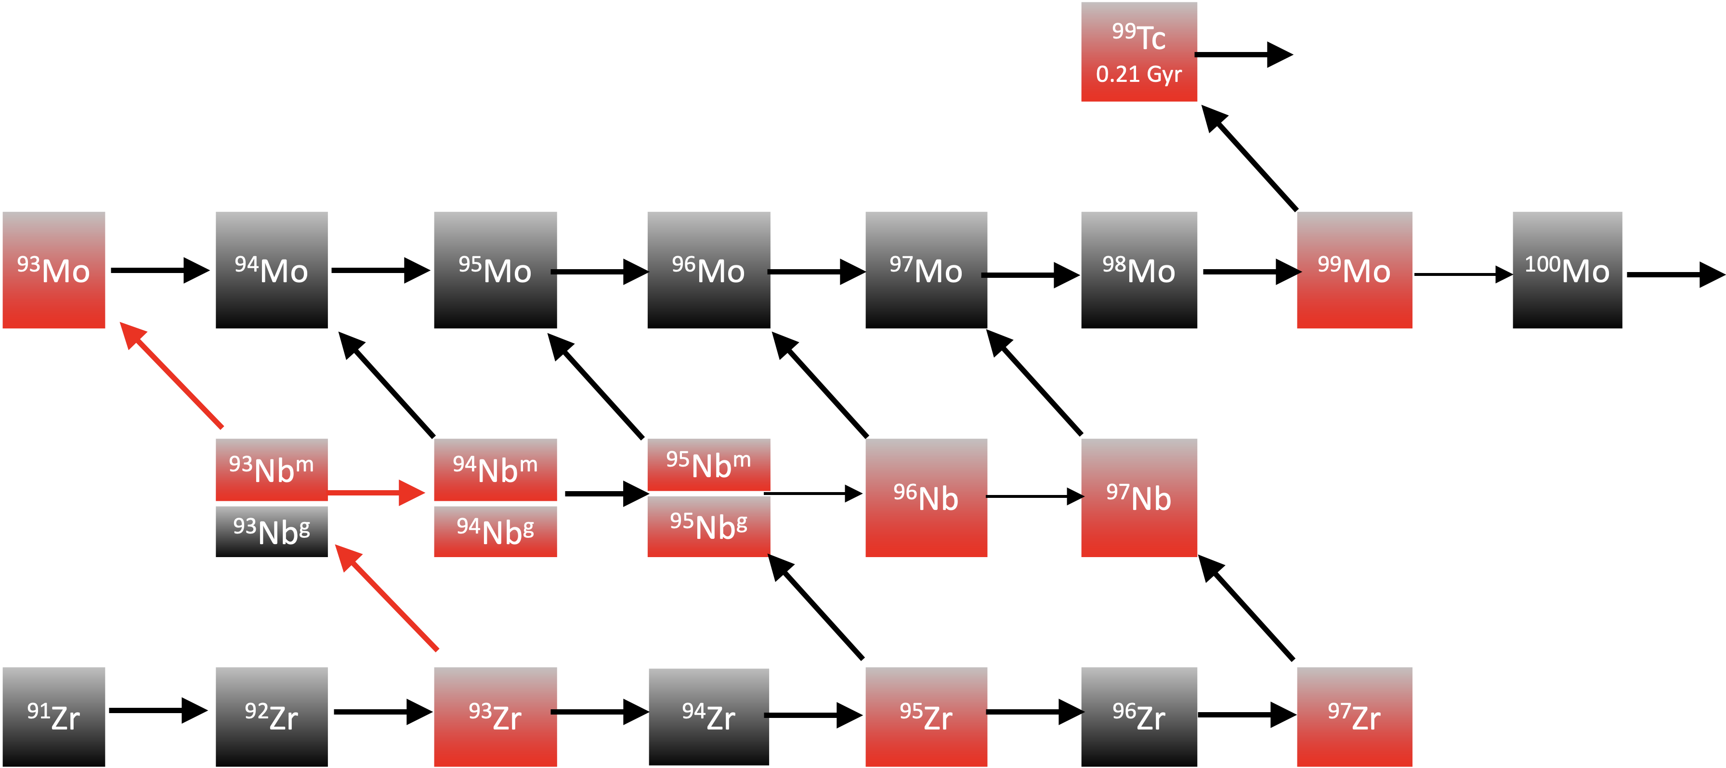
More branchings in the s-process nucleosynthesis path
…trough Zr, Nb and Mo isotope
σ_{(n,γ)}(^{91,92,93,94,96}Zr) measured
σ_{(n,γ)}(⁹⁵Zr) theoretical calculated (25-50% of uncertainties)
data by BNL are on average lareger by 30% (> ⁹⁶Zr and <⁹⁵Mo).
⁹³Nb branching (305 keV) t_{1/2} $≈$4.5h
⁹³Nb ^{g} t_{1/2} $≈$1.6 Gyr does not decrease with T

Slide 20
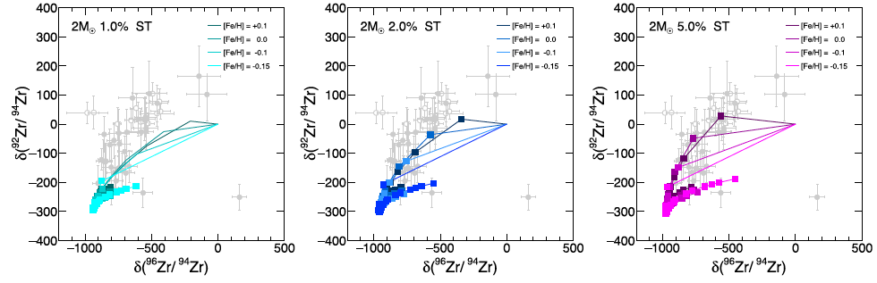
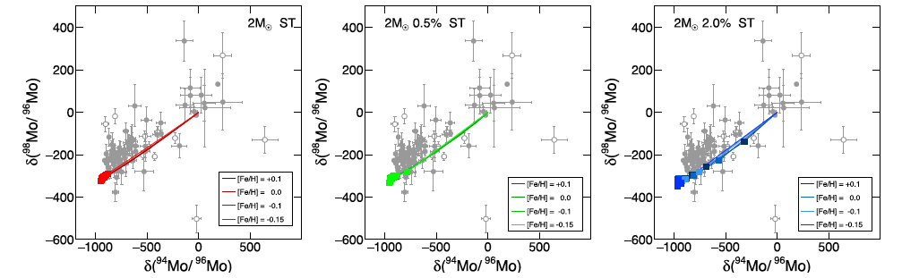
More branchings in the s-process nucleosynthesis path
…trough Zr, Nb and Mo isotope
Those are among the best fits to SiC grain abundances in literature but they could be improved by better nuclear physics data

Slide 21
Seminario Osservatorio Astronomico di Roma - Aula Gratton
Monday 20 December - 14:30
Speaker: Sara Palmerini (Università di Perugia)
Title: Presolar Grain Isotopic Ratios as Constraints to Nuclear and Stellar Parameters of Asymptotic Giant Branch Star Nucleosynthesis
Abstract:
Presolar grains that form in their dusty envelope provide the most valuable constraints to AGB star nucleosynthesis. Recent models show that magnetic flux-tube buoyancy can account for crucial properties of the star nucleosynthesis of low mass AGBs (M ≤3 Mo). Our model of AGB nucleosynthesis coupled with magnetic mixing works in to account for the isotopic admixtures of presolar grains form in both O- and C-rich environment.
In the first case the magnetic mixing will be shown to well reproduce for the large 18O depletion and 26Al enrichment found in group 2 oxide grains. In the other, the output of the nucleosynthesis models of AGBs with a 13C pocket generated by the magnetic buoyancy address the s-element isotopic mix recorded in MainStream SiC grains. In this framework, the suggestion that AGB stellar envelopes may preserve C-rich domains (condition needed for the formation of presolar SiC grains) even when their average composition is O-rich emerges. Despite the peculiarity of our models allows us to achieve fits to the presolar grain data of very high quality, improvements in the nuclear physics input are needed to permit a better agreements with measured isotopic ratios and also to help in deciding among remaining model ambiguities.
The seminar will be also given remotely using Google Meet. To connect use the following link:
meet.google.com/zev-pdvv-gku
Please follow the instructions below:
1) Mute your microphone and disable your webcam when joining
2) Q&A session at the end of the talk. Post your request to ask a question in the chat and the moderator will give you the floor

