Slide 1



Project Management approach in PANDORA (Gr3)
Vincenza Piera Bonanno (LNS-INFN)
on behalf of the PANDORA collaboration

Slide 2



Vincenza Piera Bonanno– PANDORA Collaboration Meeting – 16-17 Dec 2021
SUMMARY
The peculiarities of research projects like PANDORA_Gr3
Manage the Project Complexity: SCOPE & TIME BASELINE
Manage the Project Uncertainty: RA by using FMECA
Manage the Project Uncertainty: RESULTS, how the methodology helps the project leaders to make decisions
Conclusions: application in the next phases of the project

Slide 3
Vincenza Piera Bonanno– PANDORA Collaboration Meeting – 16-17 Dec 2021
1. The peculiarities of research projects like PANDORA_Gr3
STRONG COMPLEXITY
Baccarini , D, The concept of project complexity. International Journal of Project Management, 1996, 141, 201-204
#differentiation
#interdependency
“consisting of many varied interrelated parts”
INHERENT UNCERTAINTY
Williams, T M, The need for new paradigms for complex projects, International Journal of Project Management, 1999, 17, 5, 269-273
Structural
Epistemic <objectives> & <methods>
Turner, JR and Cochrane, RA, Goals and methods matrix, International Journal of Project Management, 1993,11,93-102
Prod. Develop.
Research
Eng.
Software
Develop.
PANDORA
ADOPTION OF PROJECT MANAGEMENT TECHNIQUES
# PROMOTED BY THE CSNIII
# PANDORA AS PILOT PROJECT
-
Methods well defined
+
+
-
Objectives well defined

Slide 4
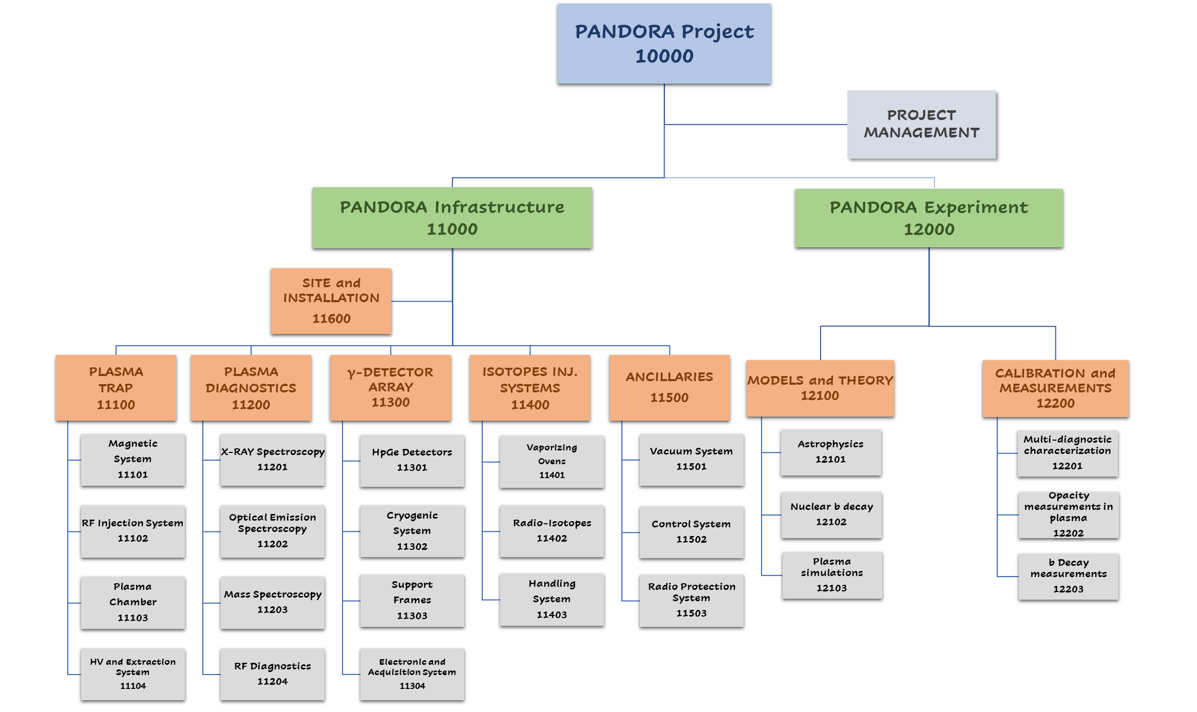
Vincenza Piera Bonanno– PANDORA Collaboration Meeting – 16-17 Dec 2021
2. Manage the Project Complexity: SCOPE BASELINE (1/3)
PBS
WBS
GANTT
Project Breakdown Structure → material and immaterial deliverables
Degree of decomposition (material deliverables)
Grouping criterion (immaterial deliverables)
Commons subsystems to the whole project
Transversal subsystems
Codification

Slide 5
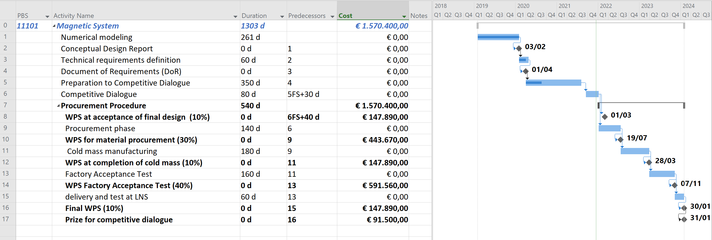


Vincenza Piera Bonanno– PANDORA Collaboration Meeting – 16-17 Dec 2021
2. Manage the Project Complexity: TIME BASELINE (2/3)
PBS
WBS
GANTT
Work Breakdown Structure → workflow of actions to accomplish the deliverables
Already done
Check points

Slide 6
Vincenza Piera Bonanno– PANDORA Collaboration Meeting – 16-17 Dec 2021
2. Manage the Project Complexity: TIME BASELINE (3/3)
PBS
WBS
GANTT
Work Breakdown Structure → workflow of actions to accomplish the deliverables
Already done
Check points
ACTIONS
DURATION
DEPENDENCIES
GANTT chart
MATERIAL RESOURCES
HUMAN RESOURCES

Slide 7
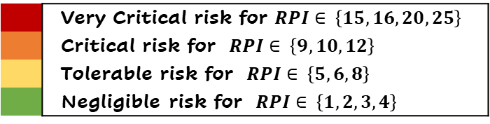
Vincenza Piera Bonanno– PANDORA Collaboration Meeting – 16-17 Dec 2021
3. Manage the Project Uncertainty: RA by using FMECA
RISK REGISTER
FMECA
RESULTS
SWOT
FMECA analysis Failure Modes, Effects and Criticalities Analysis
Risk Impact (RI) Scales
 | Very low/1 | Low/2 | Moderate/3 | High/4 | Very high/5
Cost | <10% cost increase | 10-20% cost increase | 20-30% cost increase | 30-40% cost increase | >40% cost increase
Schedule | <10% time increase | 10-20% time increase | 20-30% time increase | 30-40% time increase | >40% time increase
Technical | Performances are not exactly what was expected but this does not affect the project technical objectives | Performance below goal but within acceptable limits. Minor changes are required. | Performance below goal: moderate changes are required. | Performance unacceptable: does not meet some important project specifications. Meaningful changes are required. | Performance unacceptable: does not meet project specifications. The product is useless.
Research | Research outcomes are not exactly what was expected but this does not affect the project objectives. | Low impact on some research objectives related to secondary work packages | Moderate impact on the main project research objectives related to strategic work packages | High impact on the main project research objectives related to strategic work packages | The project research objectives have been radically changed.
Identify the risk (how it can occur)
Rate Risk Impact (RI) – see table RI scale
Risk Priority Index is automatically calculated (RPI =RI x RP).
Move on to the next relevant risk category and subcategory in the list.
Rate Risk Probability (RP) – see table RP scale
Risk Probability (RP) scales
Unlikely/1 | The event should not occur in the life of process and there is no previous experience about such kind of failure mode
Less than likely/2 | The event is unlikely, but someone has experienced this type of failure mode in the life of process
Moderate/3 | The event is likely to occur in this type of process
Likely/4 | The event has already occurred, and it is expected to occur many times
Highly likely/5 | The event will happen often
 | Very Critical risk for $RPI∈ \left\{15, 16, 20, 25\right\}$
 | Critical risk for $RPI∈ \left\{9, 10, 12\right\}$
 | Tolerable risk for $RPI∈ \left\{5, 6, 8\right\}$
 | Negligible risk for $RPI∈ \left\{1, 2, 3, 4\right\}$

Slide 8
Vincenza Piera Bonanno– PANDORA Collaboration Meeting – 16-17 Dec 2021
4. Manage the Project Uncertainty: Results
RISK REGISTER
FMECA
RESULTS
SWOT
Type | Category | Subcategory | ID Risk | Potential MODE(s) | CAUSE(s)/mechanism of failure | Risk IMPACT (RI) | Risk PROBABILITY (RP) | RPI value | RPI
A External |  |  | 1 | Underfunding 30% per year | Budget limit from Sponsor | Very High | Likely | 20 | Very Critical
B Internal | B.2 Operational | B.2.1 - Technical | 2 | Unachievable technical requirements: holes diameter reduction (10% at minimal diameter) or shape definition | Unfeasibility due to technological limits | Moderate | Likely | 12 | Critical
A External |  |  | 2 | Budget cut of 30% estimated | Budget limit from Sponsor | Very High | Less than likely | 10 | Critical
B Internal | B.2 Operational | B.2.2 Administrative/Legal | 1 | Noncompliance from suppliers during the procurement process | Insufficient or ineffective procurement management from the pool selection phase to the end of process | Moderate | Moderate | 9 | Critical
B Internal | B.2 Operational | B.2.1 - Technical | 1 | Unachievable technical requirements: < 50% number of holes at minimal diameter in the bulk cryostat | Unfeasibility due to technological limits | High | Less than likely | 8 | Tolerable
B Internal | B.2 Operational | B.2.3 - Organizational | 1 | Incomplete or ineffective execution of tests with diagnostic tools (e.g., optical spectrometer) | Insufficient collaboration with partners on research and development activities | Low | Likely | 8 | Tolerable
PROCUREMENT PROCEDURES
Schedule
Technical
Research
RE-DEFINITION PROJECT OBJ.
Schedule
Technical
Research

Slide 9
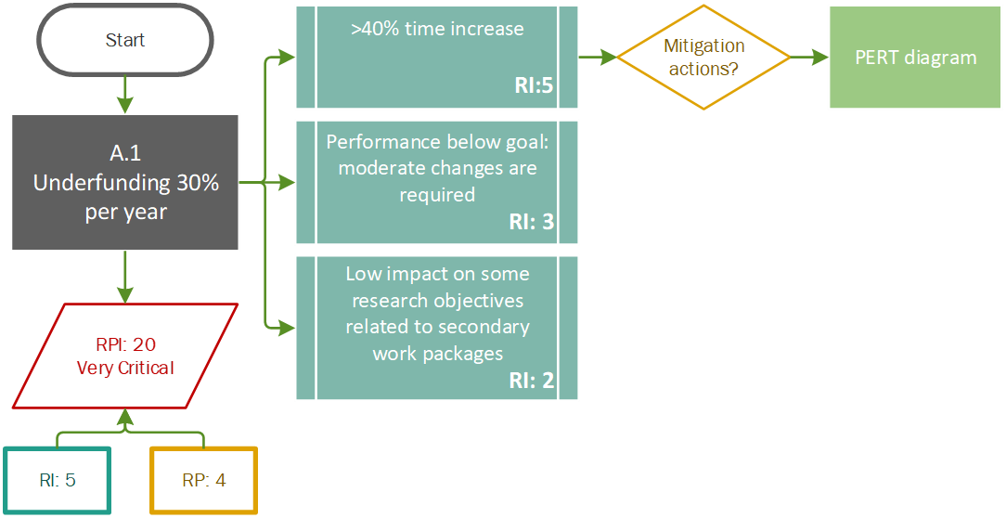
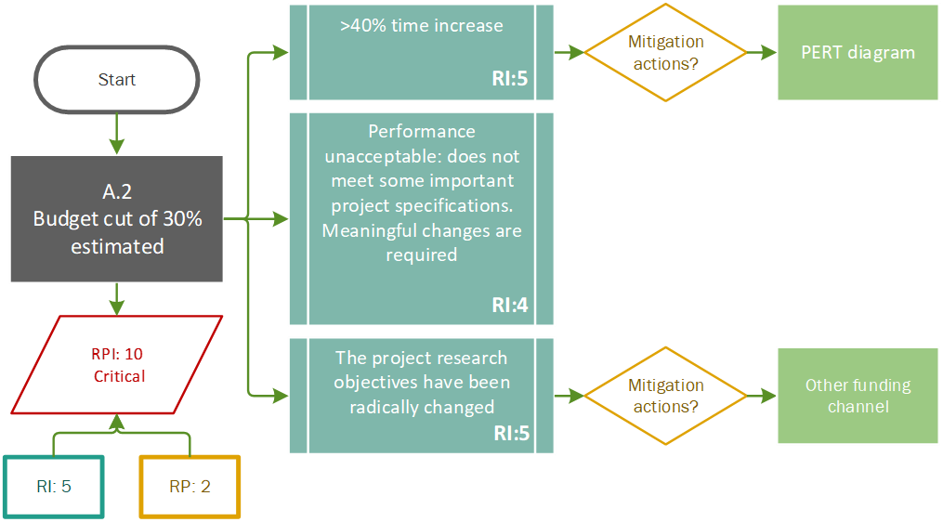
Vincenza Piera Bonanno– PANDORA Collaboration Meeting – 16-17 Dec 2021
4. Manage the Project Uncertainty: Results
RISK REGISTER
FMECA
RESULTS
SWOT
HOW METHODOLOGY CAN HELP PROJECT’S LEADER TO MAKE DECISIONS

Slide 10
Vincenza Piera Bonanno– PANDORA Collaboration Meeting – 16-17 Dec 2021
4. Manage the Project Uncertainty: Results
RISK REGISTER
FMECA
RESULTS
SWOT
Type | Category | Subcategory | ID Risk | Potential MODE(s) | CAUSE(s)/mechanism of failure | Risk IMPACT (RI) | Risk PROBABILITY (RP) | RPI value | RPI
A External |  |  | 1 | Underfunding 30% per year | Budget limit from Sponsor | Very High | Likely | 20 | Very Critical
B Internal | B.2 Operational | B.2.1 - Technical | 2 | Unachievable technical requirements: holes diameter reduction (10% at minimal diameter) or shape definition | Unfeasibility due to technological limits | Moderate | Likely | 12 | Critical
A External |  |  | 2 | Budget cut of 30% estimated | Budget limit from Sponsor | Very High | Less than likely | 10 | Critical
B Internal | B.2 Operational | B.2.2 Administrative/Legal | 1 | Noncompliance from suppliers during the procurement process | Insufficient or ineffective procurement management from the pool selection phase to the end of process | Moderate | Moderate | 9 | Critical
B Internal | B.2 Operational | B.2.1 - Technical | 1 | Unachievable technical requirements: < 50% number of holes at minimal diameter in the bulk cryostat | Unfeasibility due to technological limits | High | Less than likely | 8 | Tolerable
B Internal | B.2 Operational | B.2.3 - Organizational | 1 | Incomplete or ineffective execution of tests with diagnostic tools (e.g., optical spectrometer) | Insufficient collaboration with partners on research and development activities | Low | Likely | 8 | Tolerable
PROCUREMENT PROCEDURES
Schedule
Technical
Research
RE-DEFINITION PROJECT OBJ.
Schedule
Technical
Research
DATA TAKING ACTIVITIES
Schedule
Cost
Research
DATA TAKING ACTIVITIES
Schedule
Cost
Research

Slide 11
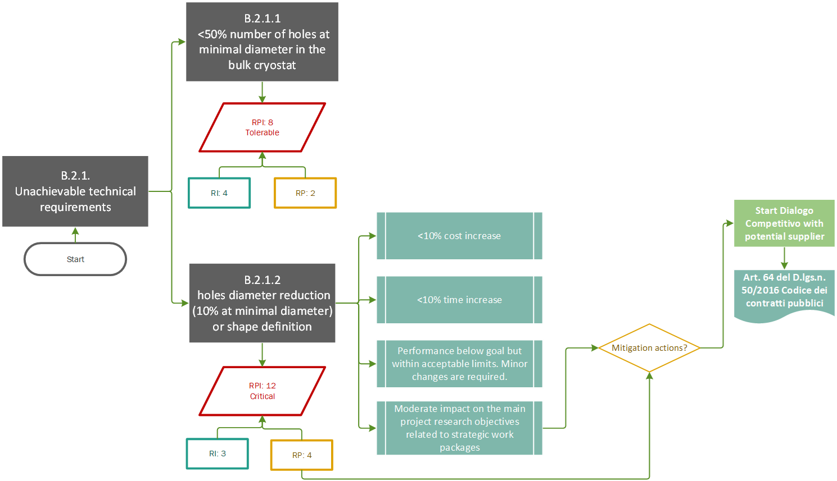
Vincenza Piera Bonanno– PANDORA Collaboration Meeting – 16-17 Dec 2021
4. Manage the Project Uncertainty: Results
RISK REGISTER
FMECA
RESULTS
SWOT
HOW METHODOLOGY CAN HELP PROJECT’S LEADER TO MAKE DECISIONS
# Answers to uncertainties (structural complexities of 11101)
# Manage interactions with potential suppliers
#Guarantee to achieve the best technical solution
# Negotiating tool (sponsor)

Slide 12

Vincenza Piera Bonanno– PANDORA Collaboration Meeting – 16-17 Dec 2021
5. Conclusions and perspectives
The adoption of PM techniques during the planning phase of the project proved to be useful in managing complexity and uncertainty.
The FMECA methodology supported the project’s leader to make decisions by translating the outcomes of assessment procedure in operative and strategical solutions: PERT, adoption of art.64 D.lgs. 50/2016.
The outcomes of the RA were strongly appreciated by the CSNIII – INFN. It proves that these methodologies are also negotiating tools.
Overall project TIME BASELINE
The PERT technique will be implemented.
From procedure (workflow of actions) → a more detailed RA for each deliverable
Not all risks can be predicted in this project phase (unpredictable elements) → the analysis must be updated (life cycle project).
The project management approach is a philosophy, not just a set of tools to be adopted. An integrated approach is required to accomplish the success of the project.

Slide 13
Vincenza Piera Bonanno– PANDORA Collaboration Meeting – 16-17 Dec 2021
Thank you for your attention!

Slide 14
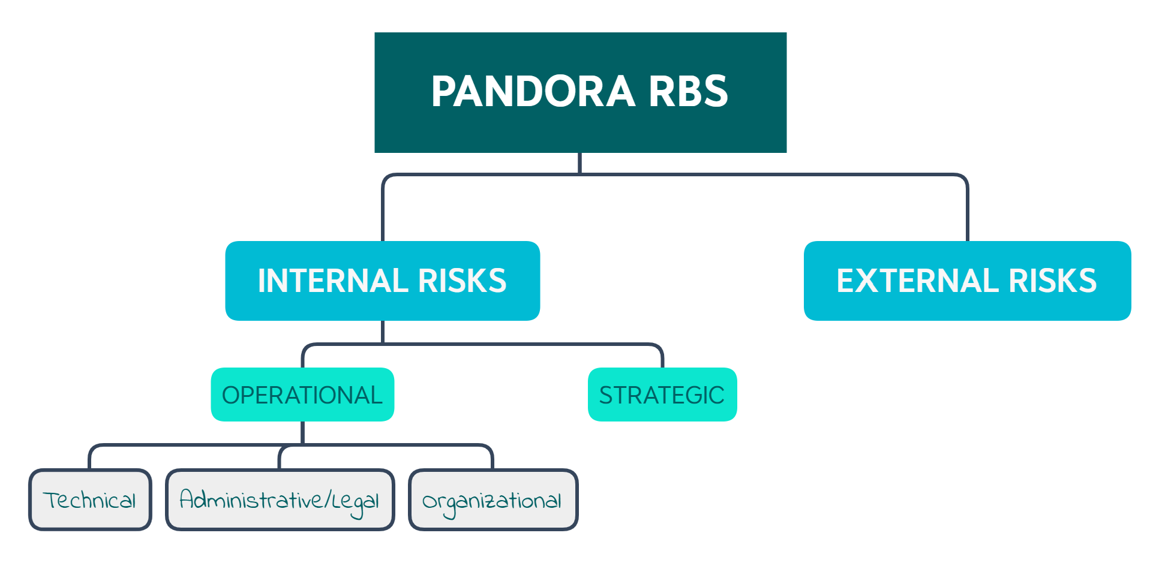
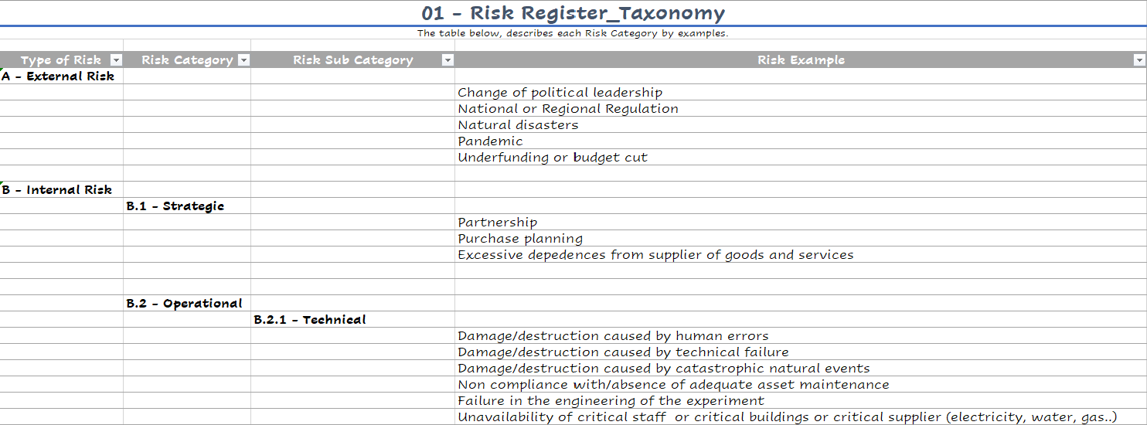
Vincenza Piera Bonanno– PANDORA Collaboration Meeting – 16-17 Dec 2021
3. Manage the Project Uncertainty: RA by using FMECA
RISK REGISTER
FMECA
RESULTS
SWOT
SWOT analysis is a strategic planning and management technique
Helpful to achieve
the proj. obj.
Harmful to achieve
the proj. obj.
SWOT
Strengths
Weaknesses
Opportunities
Threats
Internal origin
External origin

