Slide 1

Active Plasma Chamber: status and perspectives
Fabrizio Odorici – INFN Bologna
Outline:
Motivations for an active plasma chamber
General features
The prototype status:
        design for the AISHa ECRIS @ LNS
        construction & tests
Perspectives & schedule
PANDORA progress meeeting, december 16-17, 2021 @ LNS – F. Odorici (INFN-Bo)

Slide 2

Motivations for an Active Plasma Chamber
Problems that should be cured:
An efficient plasma magnetic trap should have small losses along radial (ions) and axial (electrons) components. However, imperfections in the magnetic trap produce plasma losses.
We would be able to enhance plasma charge state distribution towards highly charged ions
A combined solution:
We can divide the camber surface into segments and apply a given bias to each segment in order to reduce (& monitor) plasma losses
A inner chamber made of aluminum is able to enhance the Charge State Distribution towards highly charged ions. This because Al has a coefficient of secondary electron emission greater than 1 (electron donor) for a large energy range of impinging electrons
PANDORA progress meeeting, december 16-17, 2021 @ LNS – F. Odorici (INFN-Bo)

Slide 3
General features of the plasma chamber
The PANDORA plasma chamber consists of two parts
The MAIN chamber:
The INNER active chamber:
A stainless steel cylinder and two end-caps: 300 mm outer diameter, 700 mm length, 10 mm thickness. Strong structure with mechanical strength and rigidity to connect many devices through “holes”.
Aluminum elements: 30 tails (5 axial x 6 radial), 3 mm thickness. Each element has a variable bias.
60° radial segmentation
Axial segmentation
PANDORA progress meeeting, december 16-17, 2021 @ LNS – F. Odorici (INFN-Bo)
Axial bias disk

Slide 4
General features of the inner active chamber
Up to 30 aluminum segments (5 axial x 6 radial), 3 mm thickness:
  each segment anodized (electrochemical anodic oxide) on external surface and edges so that, electrically isolated from the neighbour.
  each segment polarized with individual bias by current-voltage measurement circuit (to reduce radial losses and to measure plasma leakage currents)
  active control of the bias voltages with automatic search for the best bias map, for any PANDORA working condition (pressure, RF, etc)
Aluminum gives a Secondary Electron emission Yield (SEY) greater than 1 for a large energy range (< 3.2 keV) of impinging electrons. The Al chamber permits to operate with lower pressure and RF power, thus limiting charge exchange process and recombination’s in the plasma, which is very important in order to produce highly charged ions.
F. Wang et al., Coating 2018, 8, 249
PANDORA progress meeeting, december 16-17, 2021 @ LNS – F. Odorici (INFN-Bo)

Slide 5
Additional benefits for an Active Plasma Chamber
Additional benefits:
The bias of segmented elements allow real-time monitoring of variation of plasma losses due to any unstable condition
The replacement of the inner chamber can be done in a relative «short» time, allowing to remove chamber contamination from radioactive isotopes (switch to a new physics case)
PANDORA progress meeeting, december 16-17, 2021 @ LNS – F. Odorici (INFN-Bo)

Slide 6
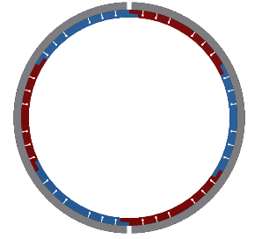
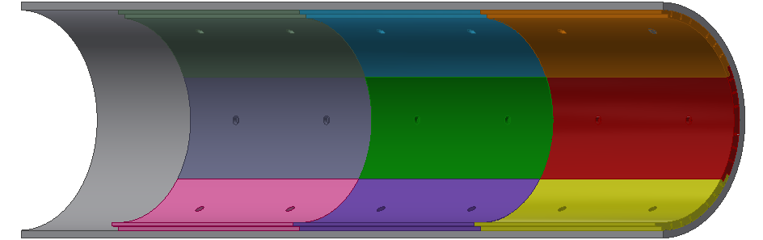
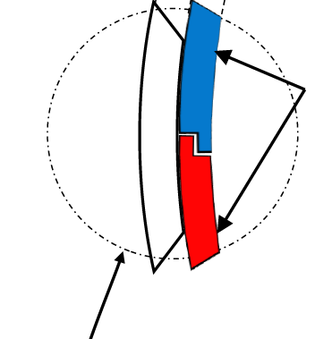
Prototype: design for the AISHa ECRIS @ LNS
Work is under IONS experiment (INFN 5th Scientific Commission)
Mechanical design of the active chamber to be compatible with the Advanced Ion Source for Hadrontherapy (AISHa), which is a compact ECRIS:
      > operating at 18 GHz (upgrade to 21 GHz, and final config. 18 + 21 GHz)
      > small chamber (diam. 92 mm, length 337 mm)
      Chamber segmentation: 4 axial x 6 radial tails
      Final 3D model (resp. LNS) by january 2022
Detail of tails
PANDORA progress meeeting, december 16-17, 2021 @ LNS – F. Odorici (INFN-Bo)

Slide 7
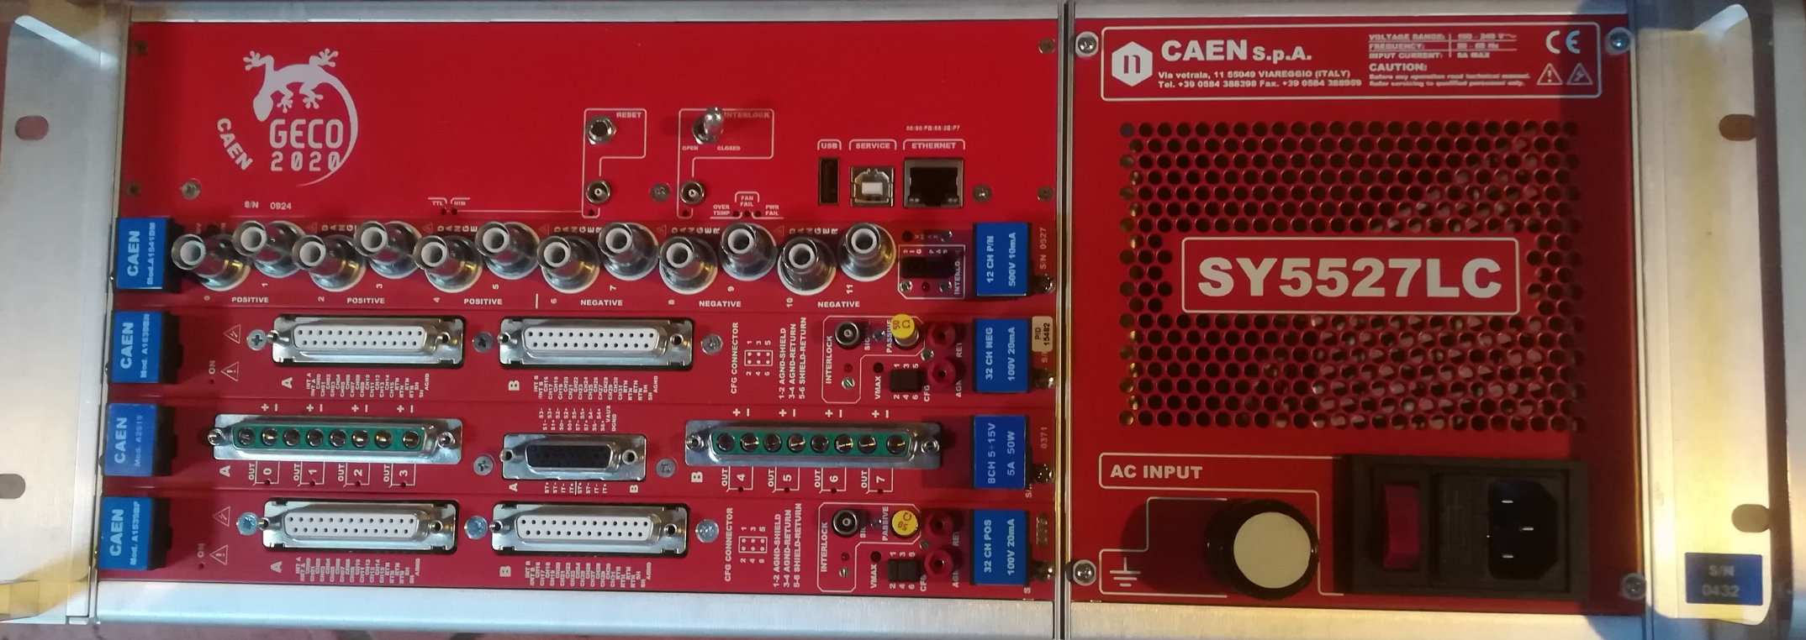
Prototype: construction and test
Executive drawings and construction will be made at Bologna (feb-june 2022)
2 test campaigns (jun-sep 2022) on AISHa @ LNS:
- Test mechanics vs temperature @ different RF power
- Measure plasma parameters with active bias in different configurations
Bias electronics based on CAEN modules A1539, ±100 V, 20 mA, 32 ch, into a crate SY5527 optically linked to the control room.
PANDORA progress meeeting, december 16-17, 2021 @ LNS – F. Odorici (INFN-Bo)

Slide 8
Perspectives & schedule
Wait for results from prototype tests on AISHa before final design for PANDORA
DATE | ACTIVITY | RESP. | COMMENTS
jan 2022 | Prototype of active chamber: 3D model | LNS | Integration with AISHa
feb 2022 | Prototype of active chamber: executive drawings | BO
jun 2022 | Prototype of active chamber: construction | BO
jun-sep 2022 | Prototype of active chamber: tests | LNS & BO
jan 2023 | PANDORA active chamber: 3D model | BO & LNS | Integration with Trap design
feb 2023 | PANDORA active chamber: executive drawings | BO
jun 2023 | PANDORA active chamber: construction | BO
jun 2023 - feb 2024 | PANDORA active chamber: integration & test | LNS & BO | HW-SW integration
PANDORA progress meeeting, december 16-17, 2021 @ LNS – F. Odorici (INFN-Bo)

Slide 9
PANDORA Timescale – GANTT “master”
David Mascali - PANDORA Progress Meeting – 16 Dec 2021
2020 2021 2022 2023 2024 2025
Trap’s design, procurement, installation and commissioning
Advanced Plasma Chamber
Prototype
3D design
Proto
constr&test
PANDORA advanced ch.
3D design, constr. & install.
GAMMA-PANDORA agreement:
HpGe det. @ LNS
We have to check compatibility of the two schedules …
PANDORA plasma characterization
PANDORA Phase-1 experimental run
PANDORA progress meeeting, december 16-17, 2021 @ LNS – F. Odorici (INFN-Bo)

Slide 10
Thank you for your attention!
PANDORA progress meeeting, december 16-17, 2021 @ LNS – F. Odorici (INFN-Bo)

