Slide 1


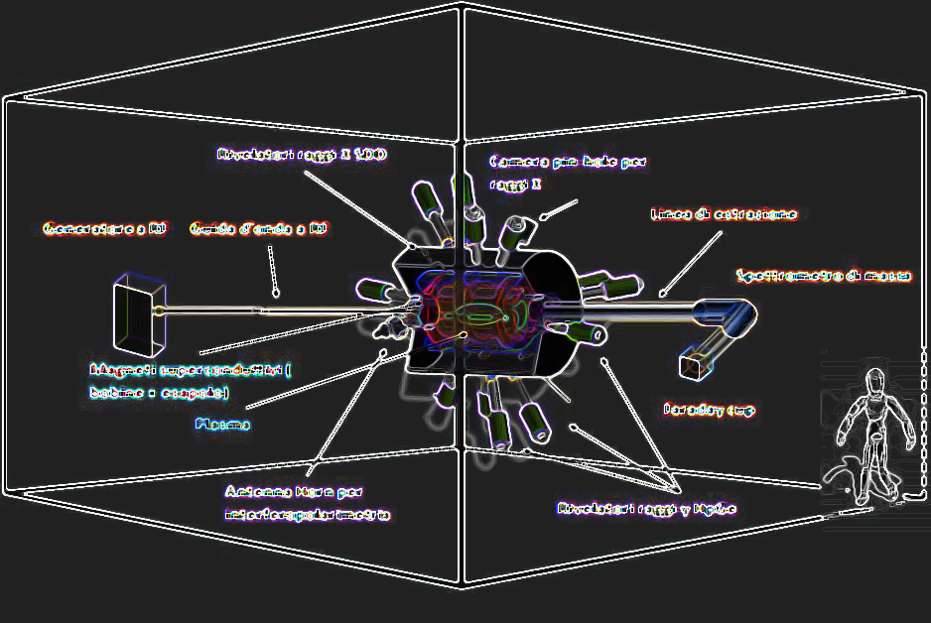

Intro & Overview
David Mascali (LNS-INFN)
on behalf of the PANDORA collaboration

Slide 2



Meeting at a glance
David Mascali - PANDORA Collaboration Meeting – 16-17 Dec 2021
Meeting organization and practical info
An informal occasion to update the whole collaboration, to foster discussion and further joint actions
We are happy about large participation: almost 60 registrations, 50-50 % participation in person/on-line
Hopefully the next meeting… 100% in person!
We have more than 20 speakers: time was allotted to have 5 mins discussion after each talk + the round table and the closing remarks (not a summarizing presentation but a final “recap”)
Stay in the Migneco Room until the end today, and also online, to get a “hybrid” mode meeting photo ;-)
Round-Table to discuss and address early 2022 agenda on WP organization, publication policy, etc.
We kindly recommend to mute microphones for people online, and use the “raise-the-hand” Zoom mode to make questions during the discussion time
People in the meeting room: please await the microphone to make your questions/comments otherwise the colleagues online could not hear you well
Social Dinner: transportation has been arranged from LNS (20:00) to the Restaurant (20:30, ZŌ-Restaurant, “Le Ciminiere”, Catania), with intermediate stop at Stesicoro’s Square (20:15)

Slide 3
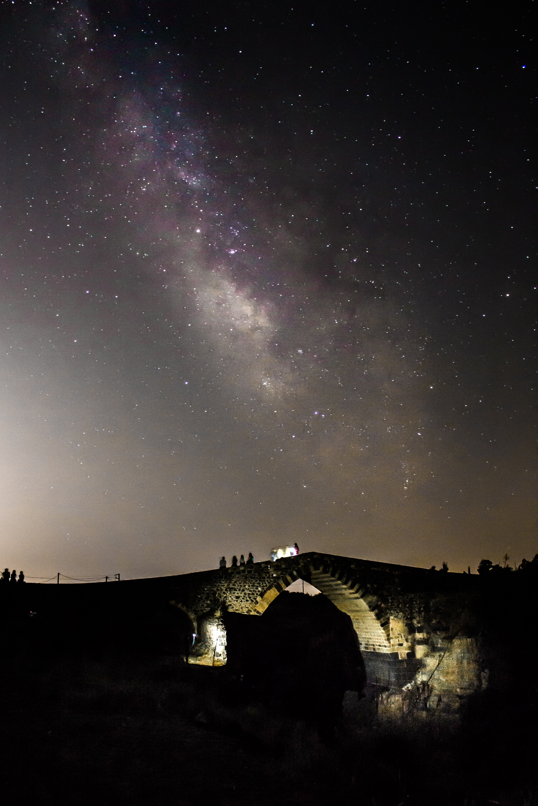
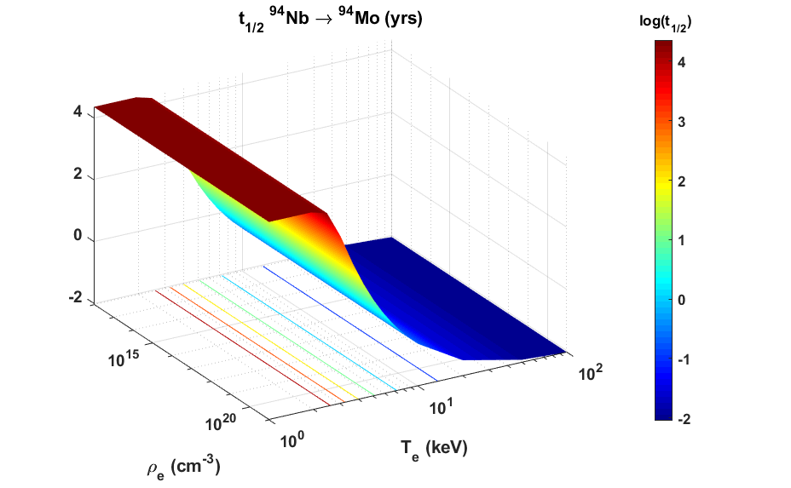
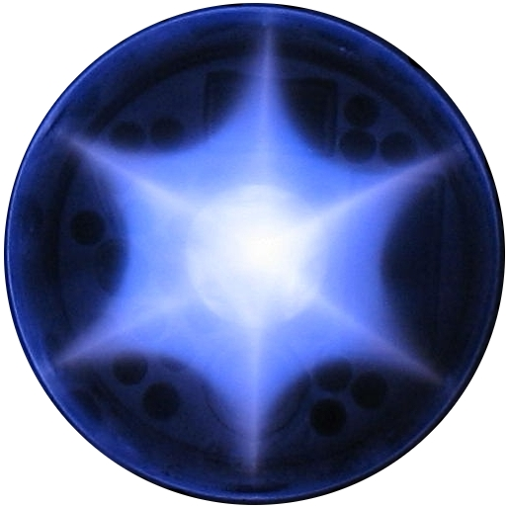
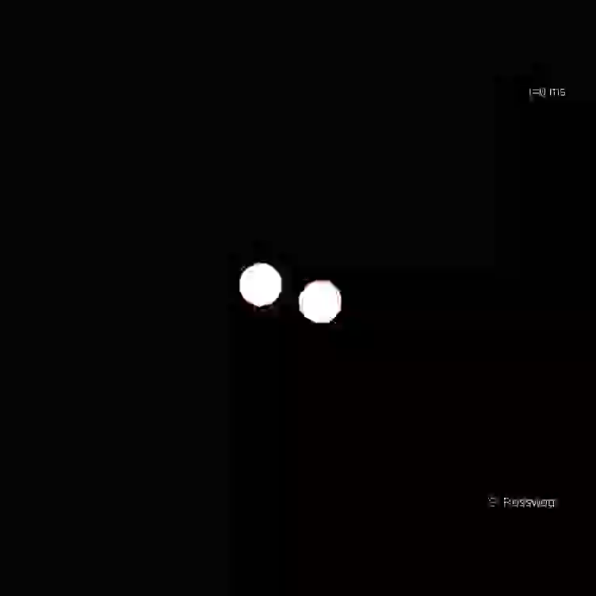
PANDORA main goal
David Mascali - PANDORA Collaboration Meeting – 16-17 Dec 2021
Investigating β-radioactivity in a «stellar» environment
From a laboratory ECR “Plasma star” to…
Additional Goal
Measuring plasma opacity relevant for compact binary ejecta (Kilonovae)
T_{e} = 0.1-100 keV in a lab. Magnetoplasma
Nucleosynthesis in stars
Variation with T_{e} stronger than with ρ_{e} so “stellar effect” can be modelled in ECR plasmas

Slide 4
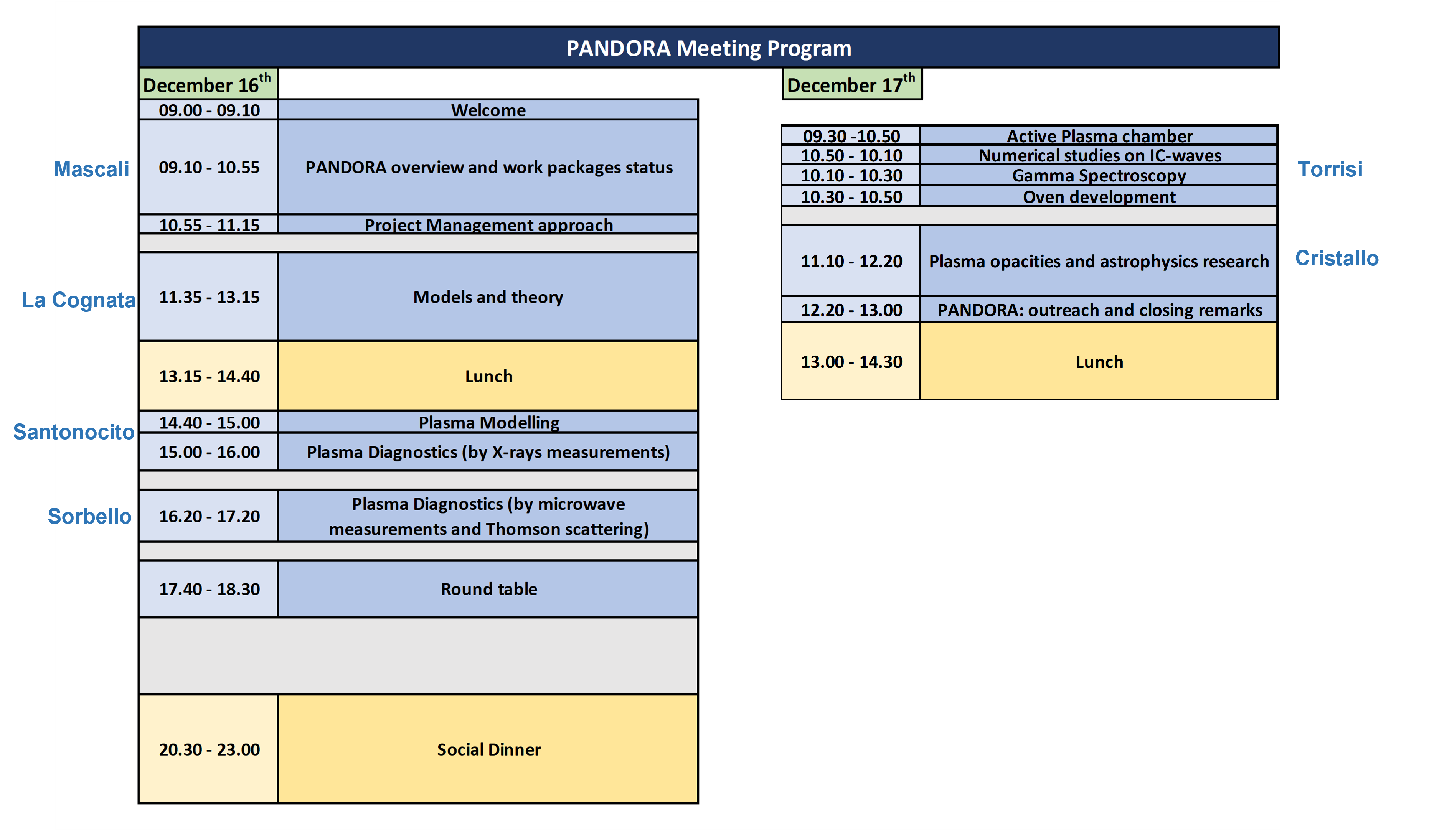
Meeting at a glance
David Mascali - PANDORA Collaboration Meeting – 16-17 Dec 2021
Project Milestones
Oct.2019 – Progr. Meeting Perugia: CDR ready
Jan. 2020 – official start of the project in the frame of INFN-CSN3
Mar—Jun. 2020: TDR release from 3.0 to 5.0. PBS, WBS, RBS done
Sept. 2020: CSN3 allocates 400k€: start of procurement phase for (RF system + X-ray camera, Trap)
Nov. 2020: start interplay of PANDORA with DTT – Divertor Tokamak Test
Jan.2021: start adm. process for Trap procur.
+ submission of n.2 PRIN grants, not funded but some good eval. –> ready for next applications
May 2021: CSN3 approves final release of TDR
Oct 2021: Coll. Agreement PANDORA & GAMMA signed
Sept. 2021: CSN3 allocates around 1 M€ for supporting Trap construction
chair
Meeting agenda reflects more or less main subprojects and PBS structure

Slide 5
Final TDR release: render view of the setup
David Mascali - PANDORA Collaboration Meeting – 16-17 Dec 2021
The approved TDR is a 214 pages document including:
The executive summary (Goals and physics cases, Team and Partners, PBS - Proj. Breakdown Structure)
The detailed description, including:
  List of potential physics cases and shortlist of 3-cases (⁹⁴Nb, ¹⁷⁶Lu, ¹³⁴Cs) with motivations
  Experimental procedure and main items description (Trap, Detectors, Diagnostics)
  Risk Assessment and Decision Strategy
Annex A: Document of Requirements for the Magnetic Trap procurement
Annex B: Diagnostics tools and report of the feasibility study
Proposal: let’s publish the TDR on EPJ-Plus → to be discussed during Round Table

Slide 6
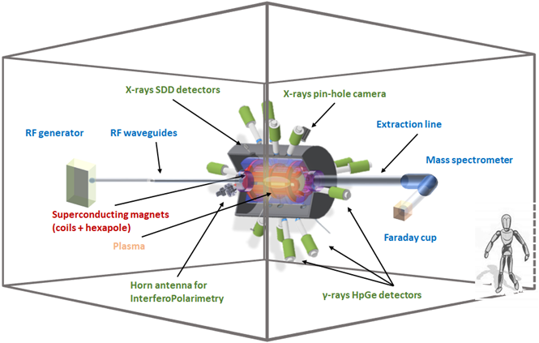
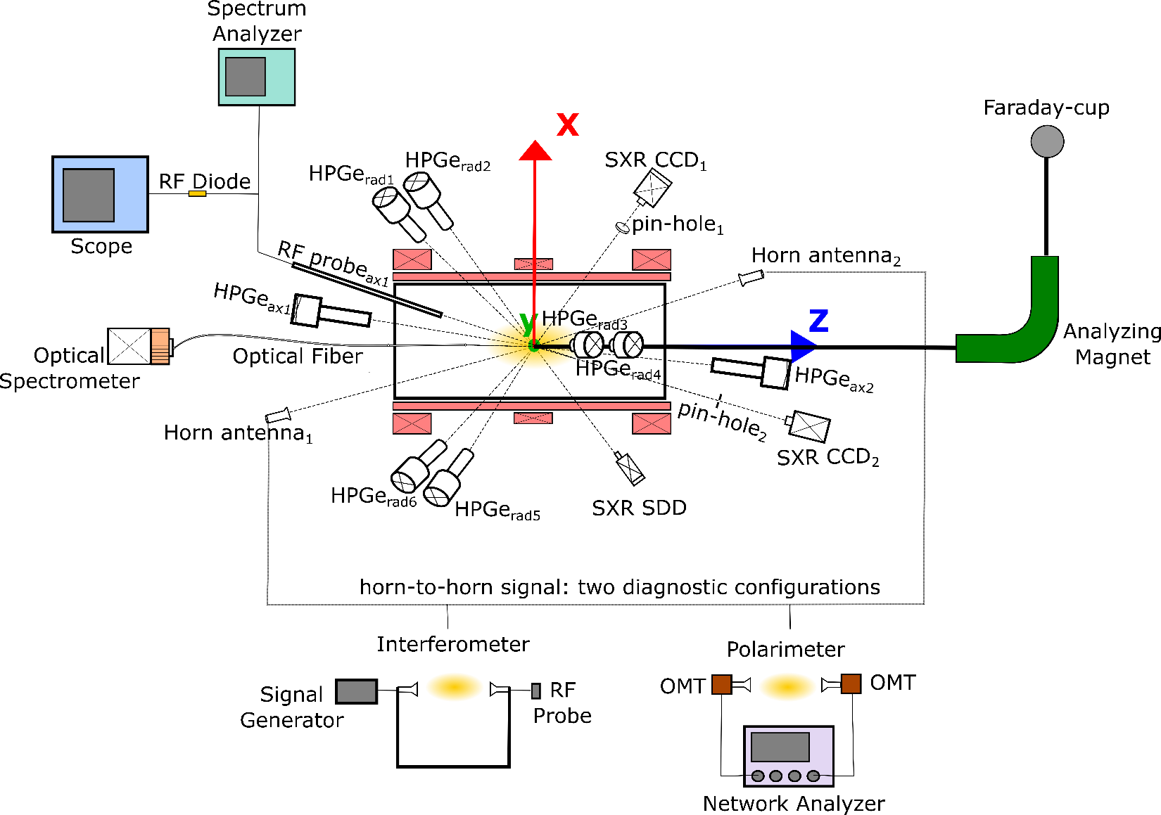
Final TDR release: render view of the setup
David Mascali - PANDORA Collaboration Meeting – 16-17 Dec 2021

Slide 7
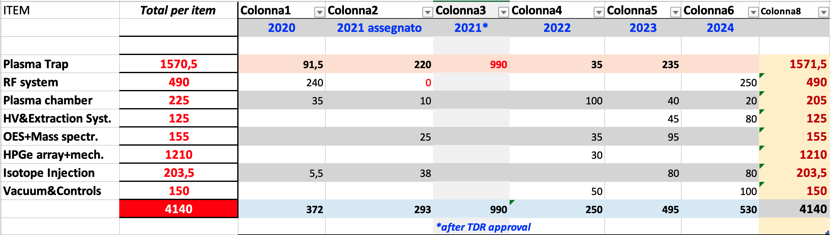
Budget table
David Mascali - PANDORA Collaboration Meeting – 16-17 Dec 2021
Already funded
expected
k€
k€
In-kind temporary (2022-2025) contribution from GAMMA collaboration
Diagnostics were supported by INFN during feasibility study (around 200 k€+80 k€ in 2020 → X-ray camera)
New diagnostics proposed by GANIL/CNRS → Thomson Scattering
GSI is already contributing with in-kind vaporization systems
INAF in-kind contribution by SARG spectrometer (installed in 2019)
ATOMKI made available the ECR lab setup for multidiagnostics experiments

Slide 8
PANDORA Timescale – GANTT “master”
David Mascali - PANDORA Collaboration Meeting – 16-17 Dec 2021
2020 2021 2022 2023 2024 2025
Trap’s design, procurement, installation and commissioning
X-ray and interferopolarimetry upgrades
OES → plasma opacity preliminary studies
GAMMA-PANDORA agreement:
HpGe det. @ LNS
Space-time characterization of the whole EEDF
PANDORA plasma characterization
PANDORA Phase-1 experimental run

Slide 9
David Mascali - PANDORA Collaboration Meeting – 16-17 Dec 2021
The Paper for MDPI-universe has been submitted
on December 5^{th,} 2021
It includes 70 co-authors from 34 departments/laboratories in Italy and Europe
The paper reports about the overall design and experimental strategy, including physics cases, expected run durations, etc
PANDORA is an interdisciplinary project. Up to now, papers about theory, plasma, technology, etc. have been published by individuals or groups according to their own field
BUT…
The collaboration is now established (but still open to new inputs) and maybe it is the time to discuss a formal and shared publication policy
Project Board has elaborated a proposal --> let’s discuss it together during the Round Table

Slide 10
Partnerships, Management, Organization: status and perspectives
(to be discussed during Round Table)
Workflow of actions and responsibilities have been provisionally defined at this level… let’s improve it for all the tasks

Slide 11
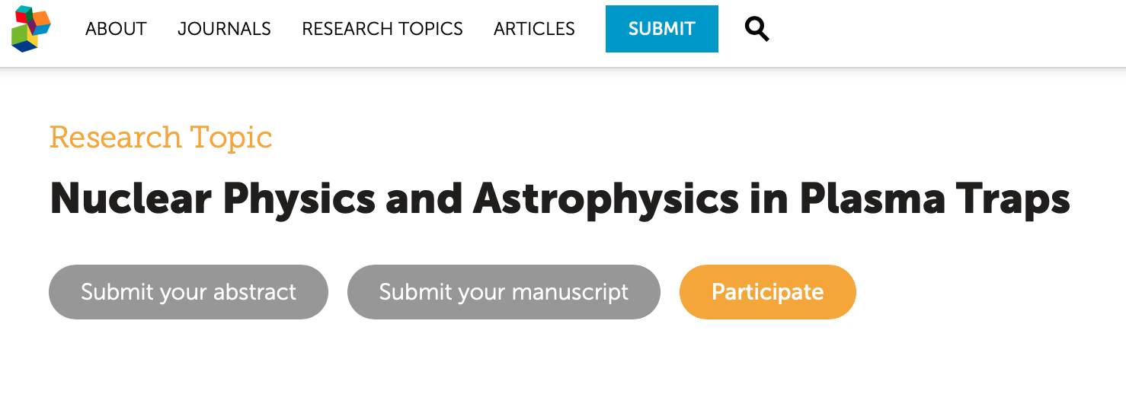
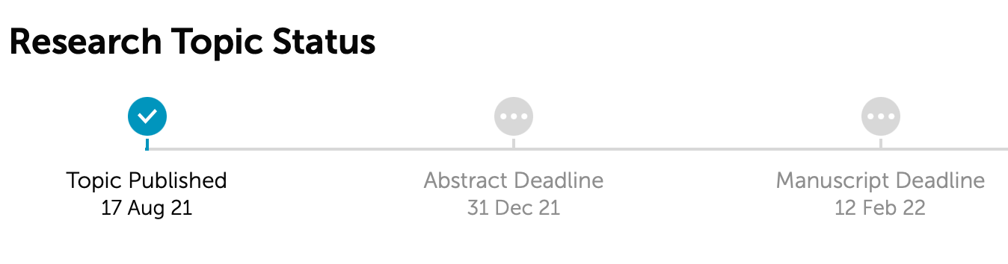

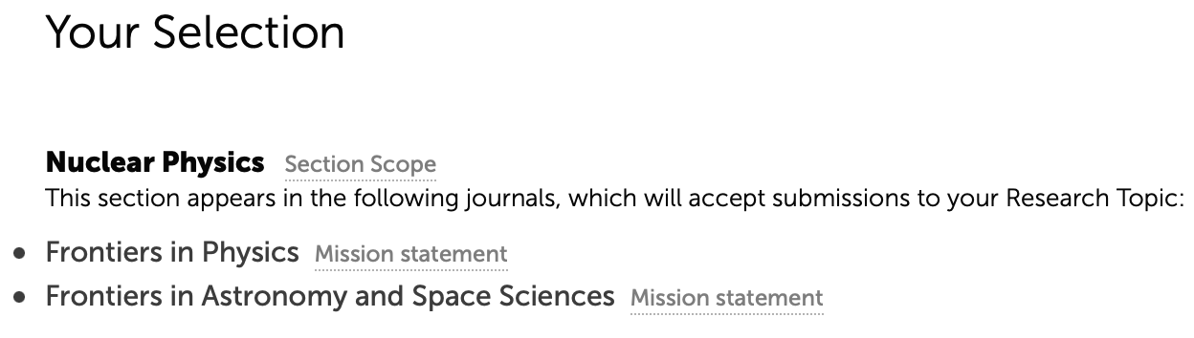
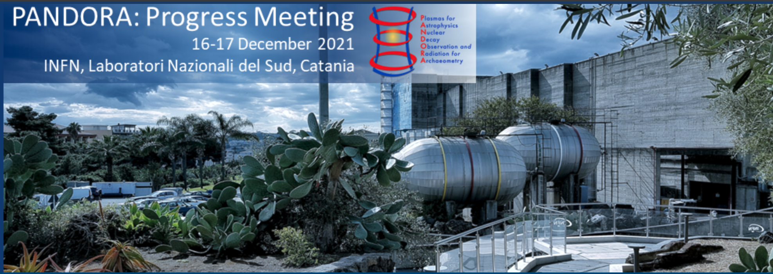
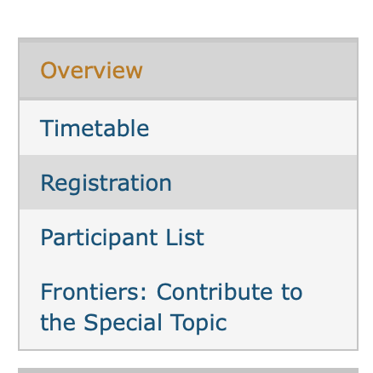
David Mascali - PANDORA Collaboration Meeting – 16-17 Dec 2021
We would organize the Research Topic according to the following sub-topics:
Physics and Technology of plasma traps for fundamental studies: the PANDORA project;
β-decay detection in plasmas: instruments and methods;
Nuclear and Atomic Physics of β-decays in plasmas;
Astrophysics Perspectives and Impact: nucleosynthesis of elements in the Universe
Authors are encouraged to submit contributions inherent to the single subtopics, or a merging of them, concerning the overall frame (the nuclear physics problem with fundamental and astrophysical implications) or specific issues and advances in the modelling, design, operations and diagnostics of the plasma-based setup.

Slide 12
Round Table possible topics
David Mascali - PANDORA Collaboration Meeting – 16-17 Dec 2021
Project outlooks: collaboration, funding, etc.
Publication policy
  Future Publications (e.g. about detailed way to make a measurement-Maurizio)
TDR publication (EPJ-Plus or something else)
Frontiers special issue
γ-spectroscopy perspectives (detectors shipment to LNS, hosting/maintenance lab, etc.)
Isotopes procurement
Tests about vaporization systems
Trap procurement follow-up
2022 rough Agenda, let’s organize meetings on:
    diagnostics,
    WP leaders,
    data acquisition system/architecture
    ….

Slide 13
Publication policy
Let’s take inspiration from similar size (even larger) collaboration: the n-TOF experience

Slide 14
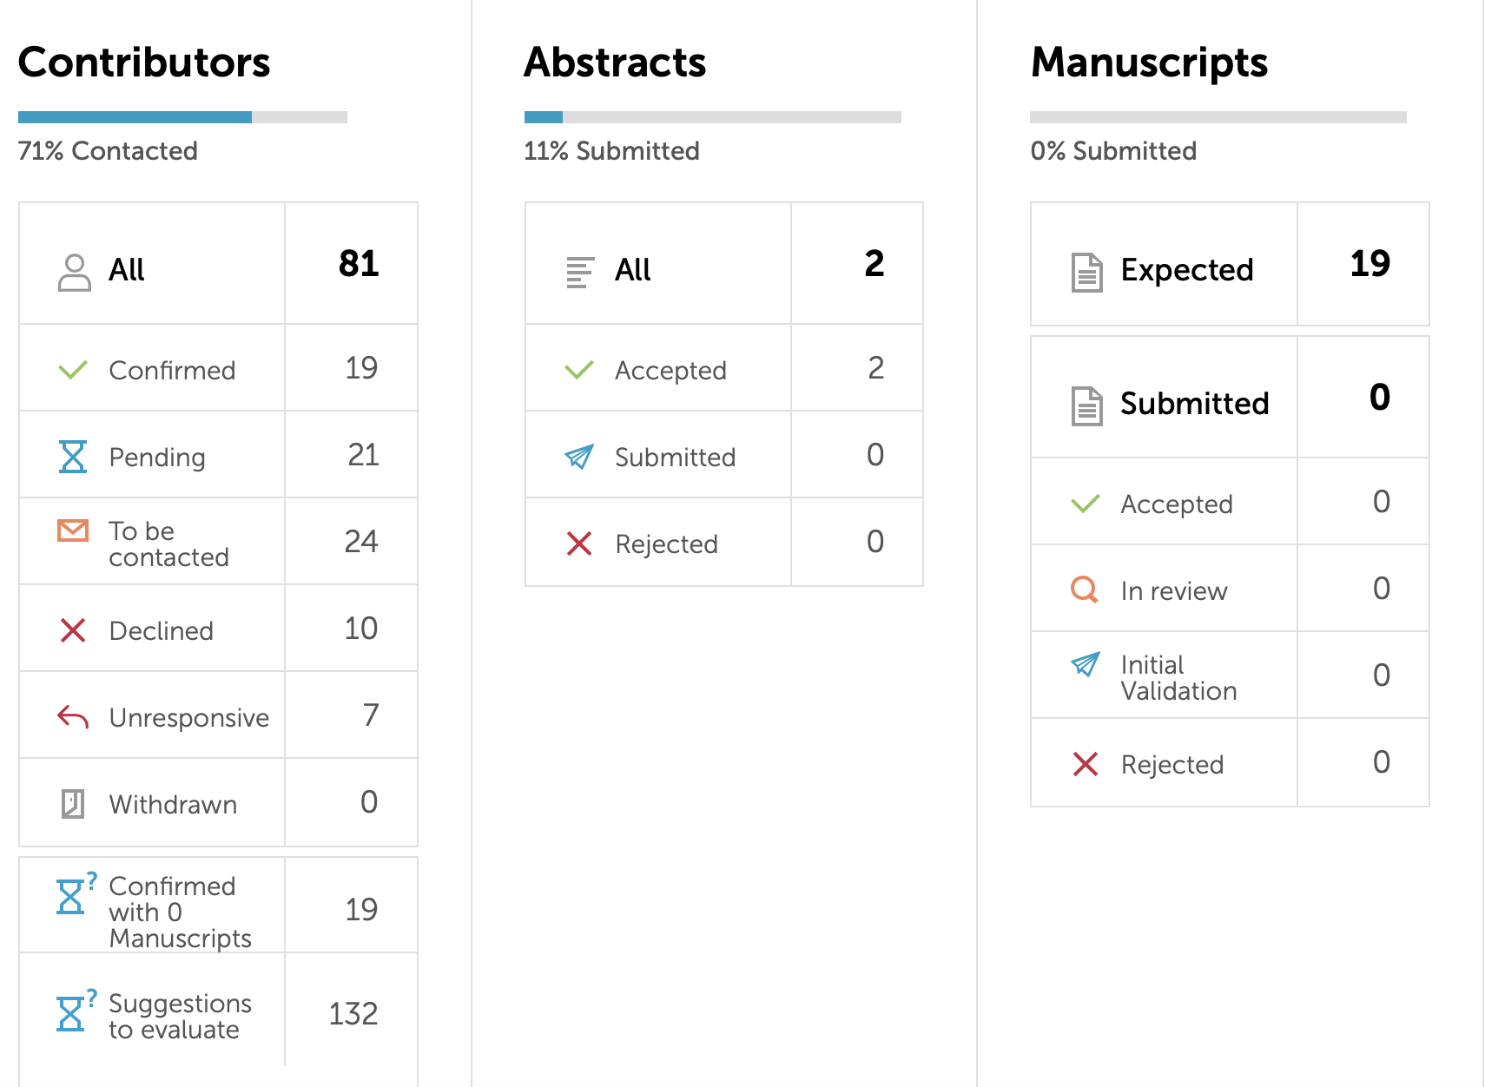
Manuscript deadline will be extended, but… not so much!!

Slide 15
2022 Agenda
2022 rough Agenda, let’s organize meetings on:
    Plasma diagnostics: let’s define technical needs (views, windows, acquisition system and integration, etc.)
    Organizational issues and management: Resp. Ass. Matrix to be completed
    Overall data acquisition system/architecture: data reading/writing, storage, etc.
    Joint paper according to Maurizio “trigger” of today morning
    Meeting on isotopes procurement and radioprotection

