Slide 1



L5 – 3G Gravitational wave lab
Amaldi Research Center
Ettore Majorana
Dipartimento di Fisica, Sapienza Università di Roma - 9 December 2021
A. Cruciani, A. D’Addabbo, S. Di Pace, V. Mangano, E. Majorana, L. Natacchioni,
M. Perciballi, S. Pirro, P. Puppo, P. Rapagnani, A. Rezaei and Fulvio Ricci

Slide 2
Plans for LIGO-KAGRA-Virgo runs

Slide 3

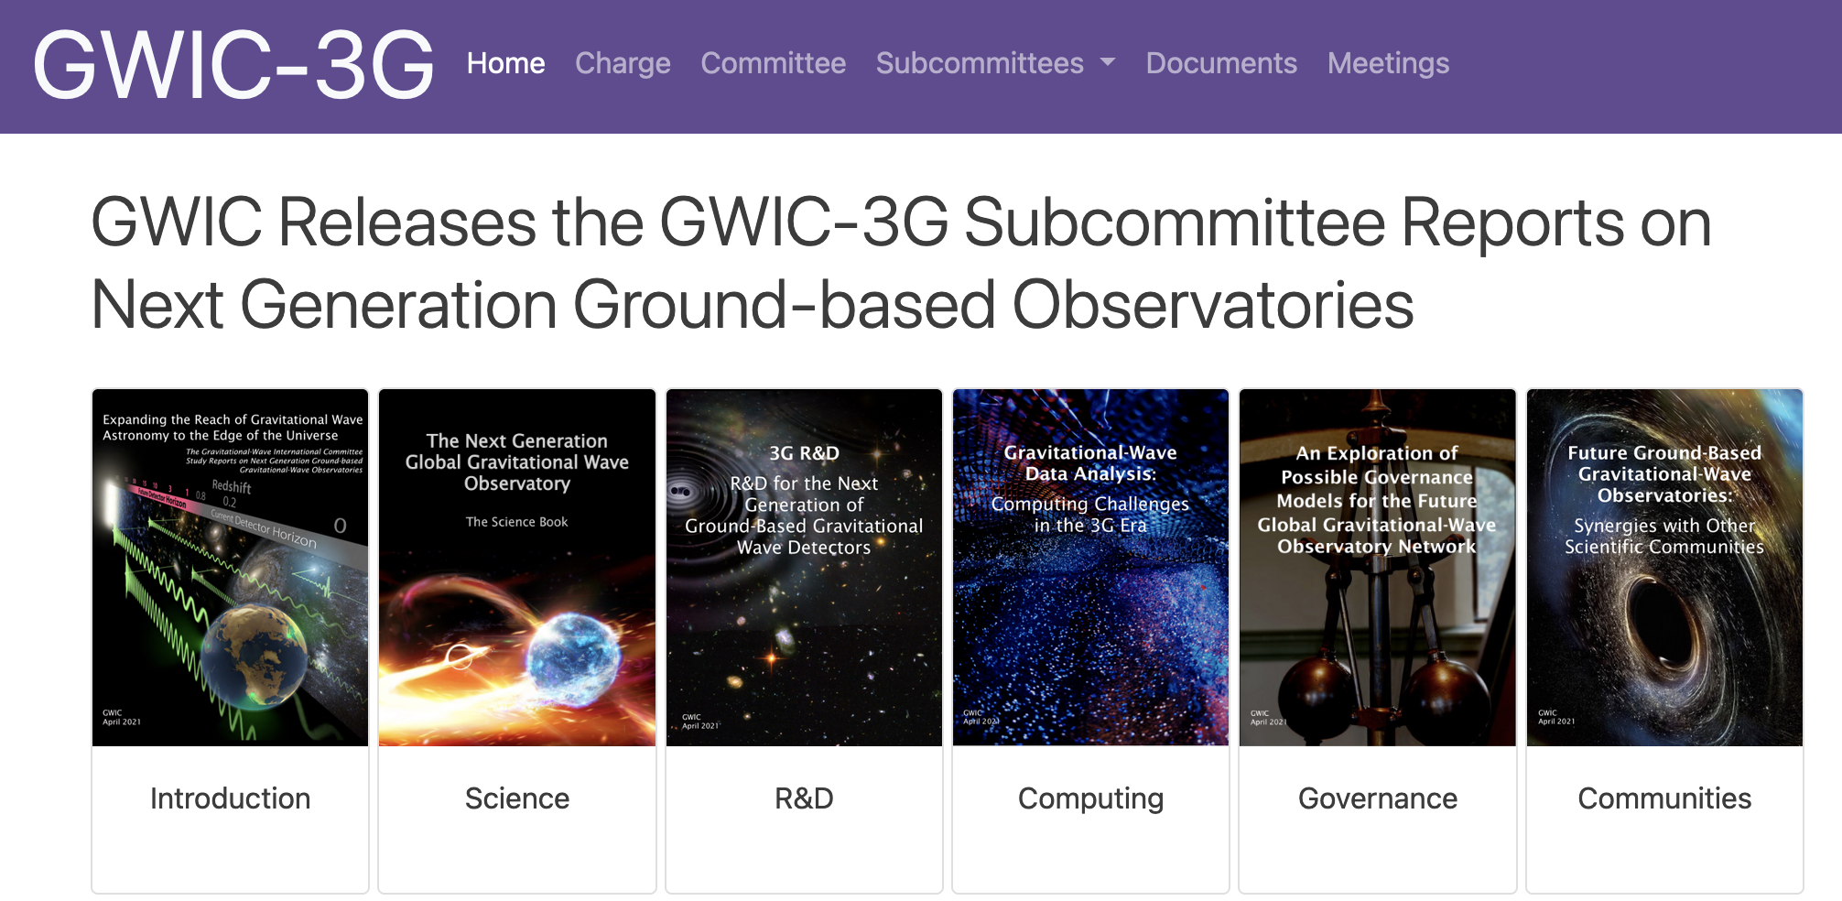
A worldwide community, a prosperous future, why ?
https://gwic.ligo.org/3Gsubcomm/

Slide 4
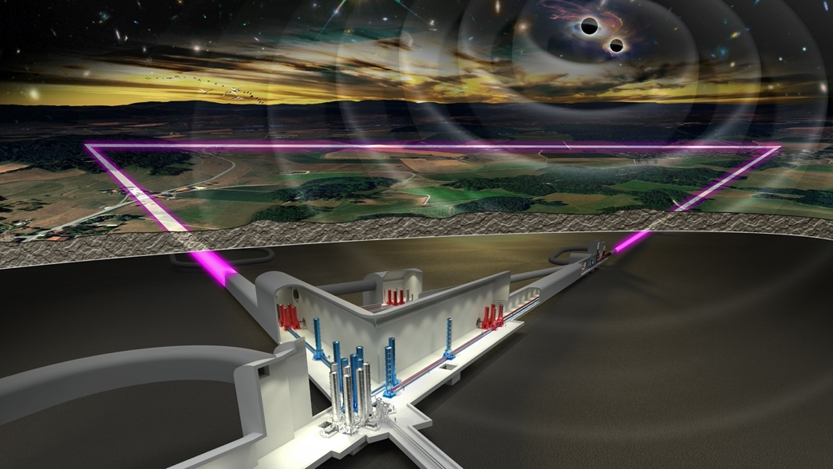
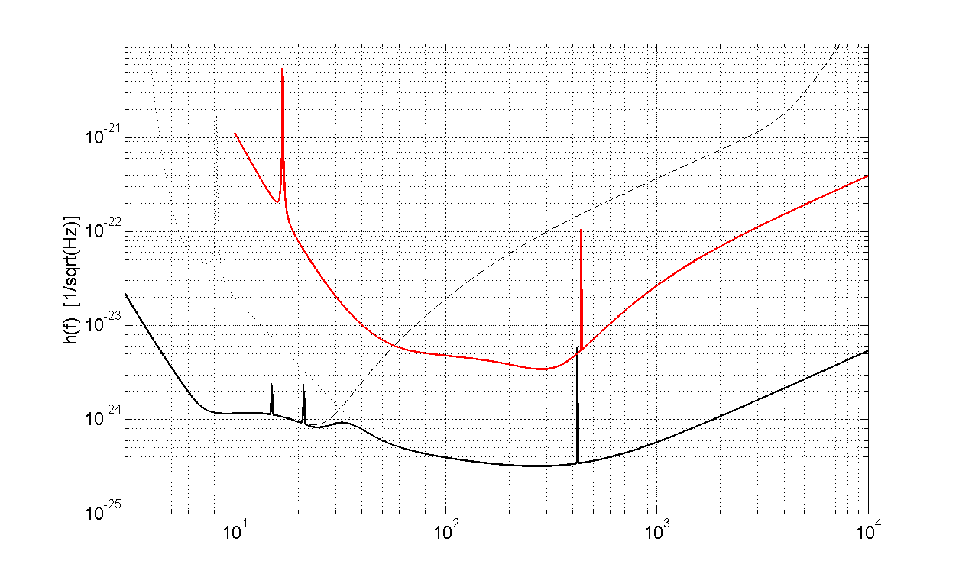
SENSITIVITY GOAL: ~×10-20 better
Advanced Virgo
Merging Black Holes throughout the whole universe and reconstruct BH demography
Explore new physics in gravity and fundamental properties of compact objects
Study the properties of the hottest matter in the universe
Investigate connection between high energy processes in radiation/particle VS gravitation
Investigate primeval universe and connections with particle physics
MASS ACCURACY
HIGH MASS/HIGH z
MERGER PHYSICS
LOCALIZATION
NUMBER of SOURCES
ET
Hz

Slide 5



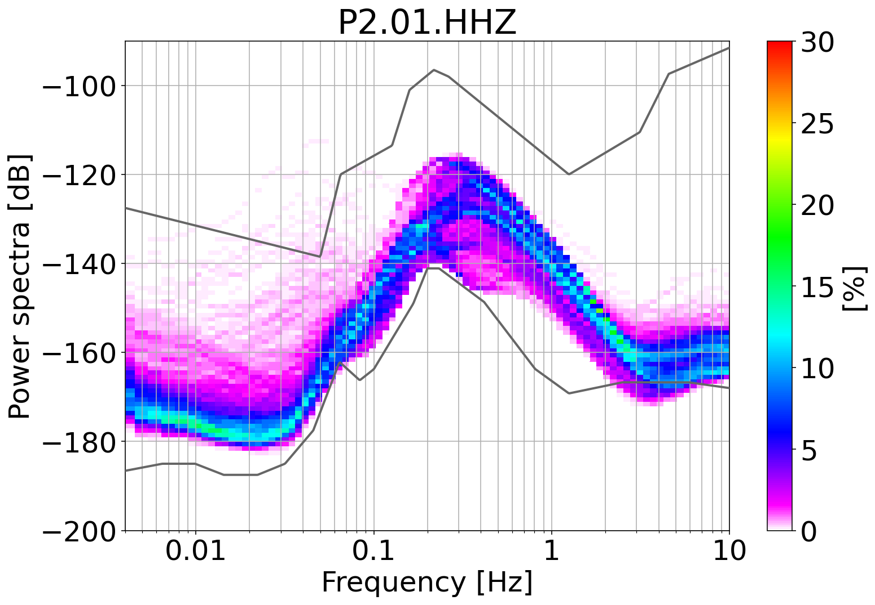
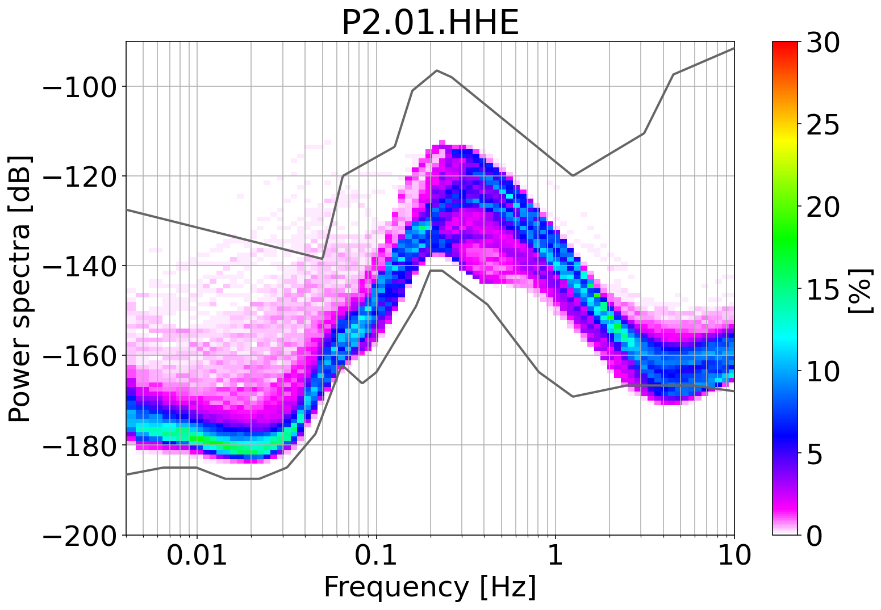
ET in Sardinia ? Who shows better locations ?
Vertical
Horizontal
October 2021
Underground (-264m)
L. Naticchioni et al., Characterization of the SosEnattos site for the Einstein Telescope, JPCS1468,2020
M. Di Giovanni et al., A seismological study of the SosEnattos Area - the Sardinia Candidate Site for the Einstein Telescope, SRL, 2020 https://doi.org/10.1785/0220200186
A. Allocca et al., Seismic glitchness at SosEnattos site: impact on intermediate black hole binaries detection efficiency, EPJP, 2021 https://doi.org/10.1140/epjp/s13360-021-01450-8
Another report in preparation…
L. Naticchioni – BH Preliminary Results – ET site studies and characterization – Nuoro, Nov. 8, 2021

Slide 6

Why R&D here ?
Narrow-band (~30 Hz) In Italy the experimental research on GW was born in Rome in the seventies, and later at INFN-LNL, following the experience of J. Weber and the first achievements in US, by Fairbank’s group in Stanford. Several historical achievements in the field of resonant bar detectors, from cryogenic long-term operation to advanced superconducting and parametric transducers.
GREAT PHYSICS BUT NO GW OBSERVATIONS !
Wide-band (~3 kHz) In 1994 we joined VIRGO, at room temperature, matured experience in test-mass payload, Thermal Noise, Vibration attenuation, alignment and control. In parallel, a vision on 3rd generation GW wide-band detectors using cryogenics (EC FP6, FP7) gre-up through a permanent collaboration with KAGRA.
GREAT ACHIEVEMENTS + OBSERVATIONS

Slide 7
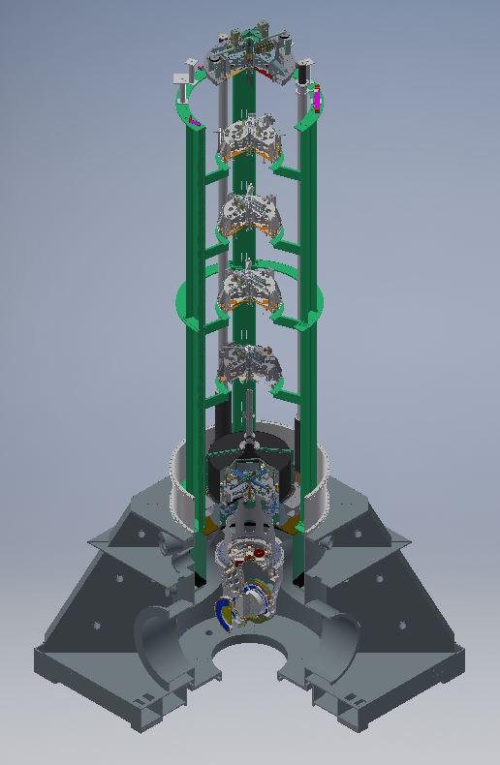
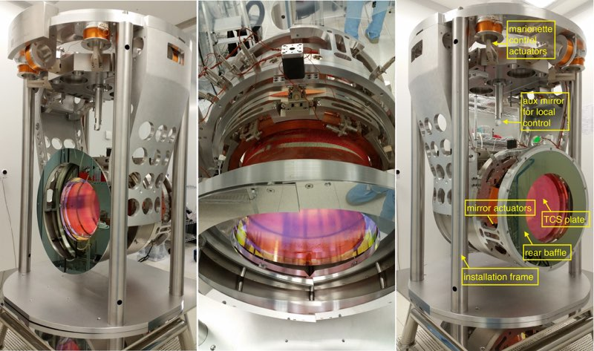
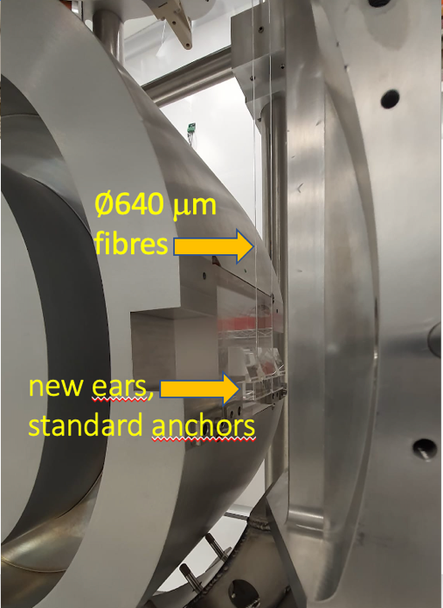
Test mass suspensions and seismic isolator in Virgo: overall system
In AdV the first 5 stages of the Super-attenuator (horizontal and vertical) are roughly the same designed 20 years ago !!
PAYLOAD
AdV+ in 2024 will adopts 105 kg mirrors to reduce coating Therma Noise
280 dB @ 10 Hz !!

Slide 8
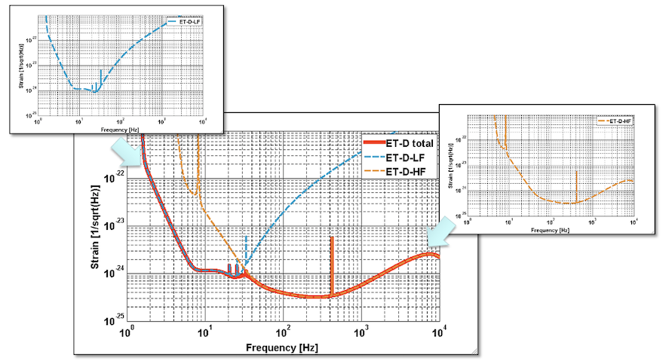
ARC-L5
Cryostats are meant to host payloads, seismic isolated systems meant to orientate the test masses and operate the detector
L5 - is dedicated to cryogenics feasibility of ET-LF, assumed in conceptual designs 2011/2021, but never modelled/demonstrated with a fully realistic configuration.
We plan to build a specifically designed cryostat around the concept of a reasonable 1:1 payload
ARC-L5
Cryostats are meant to host payloads, seismic isolated systems meant to orientate the test masses and operate the detector
L5 - is dedicated to cryogenics feasibility of ET-LF, assumed in conceptual designs 2011/2021, but never modelled/demonstrated with a fully realistic configuration.
Y
Cryogenics needed, to reduce thermal noise at LF
Much easier to tell it than to implement it !
seismic suspension
cryogenics
Test mass payload
TM
20 K

Slide 9
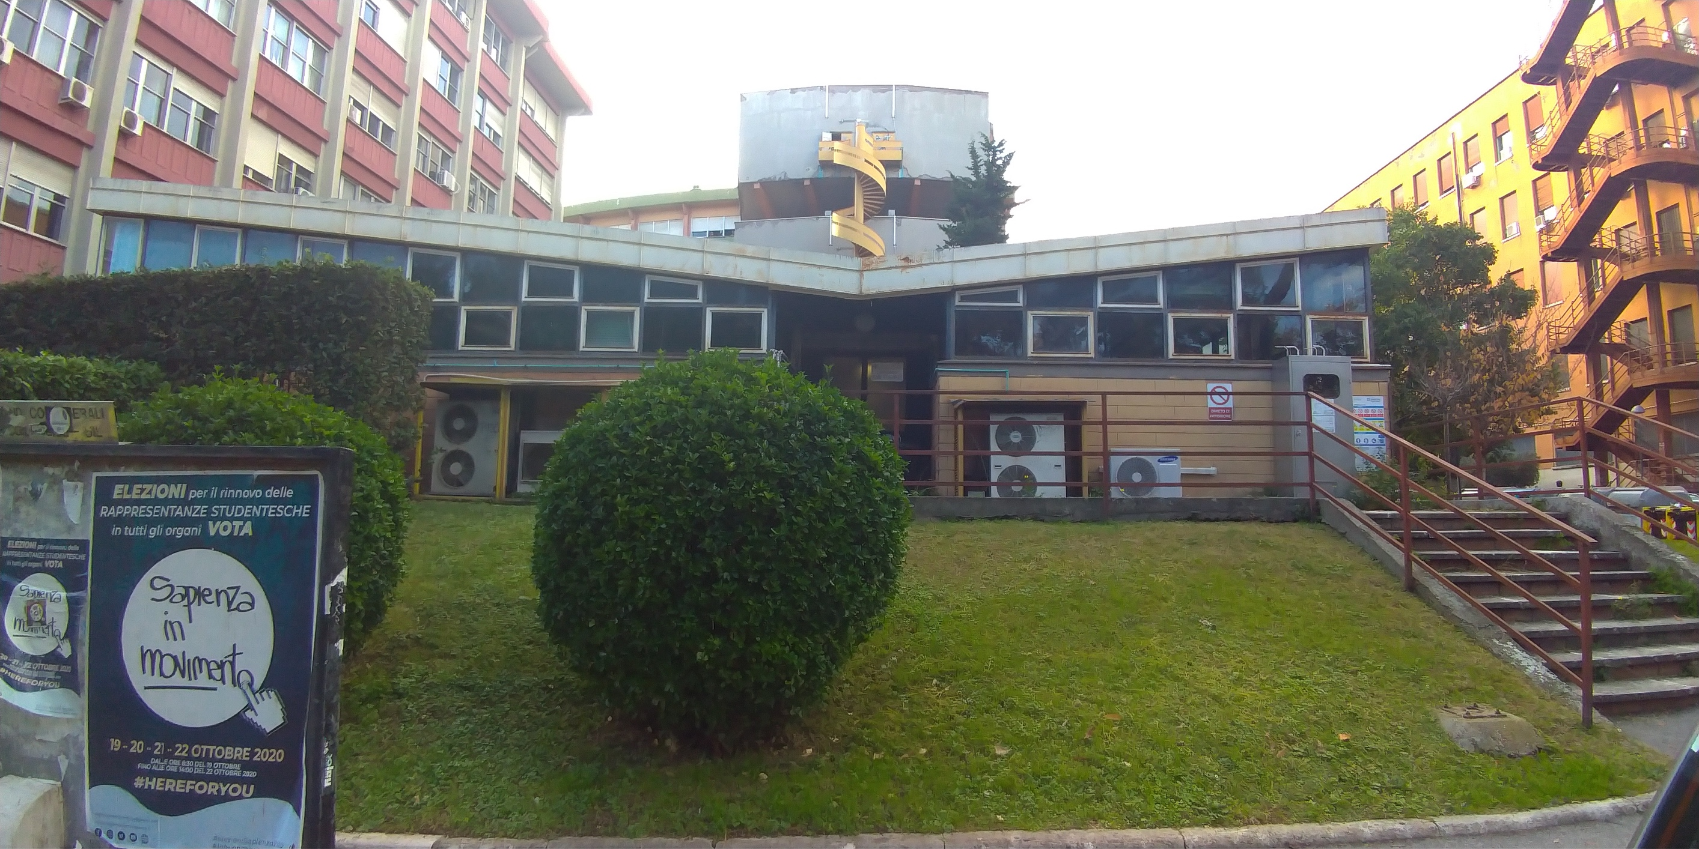
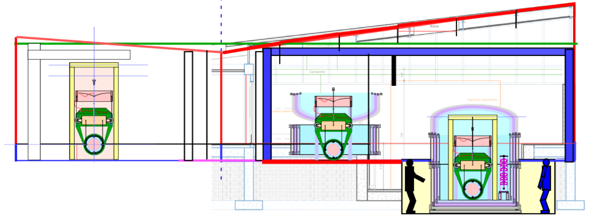
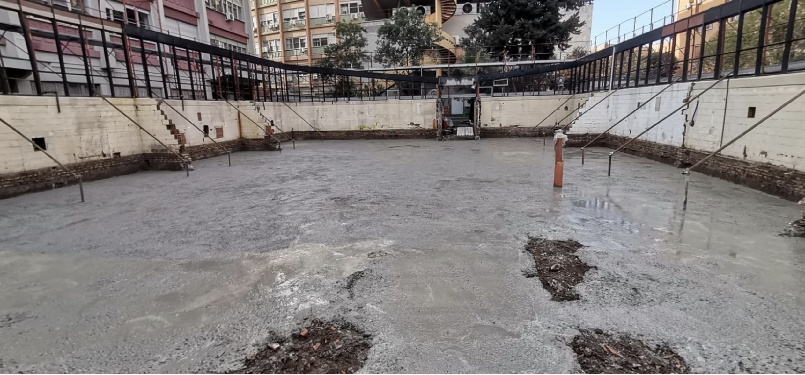
NOV 2021
Covid-19/logistics delays, works finally started, from scratch
2019-20 Preliminary evaluation of cryostat size upon ET-conceptual design and prototype payload modelling // Hardware Purchase (cryocoolers, thermometry, position sensing);
2019-21 Solid conduction cooling line, easily viable concept in underground developed. visitors: N. Kimura (ARC), A. Ueda (INFN grant), T. Yamada PhD (JSPS)
2022 Cryostat ¾ sized design starts. Dedicated to Initial tests of cryogenic payload prototype // reconstruction works (going on)
12/2022 Nominal End of ARC_L5 Dip Fisica of La Sapienza (tot. 750kE, committed)

Slide 10
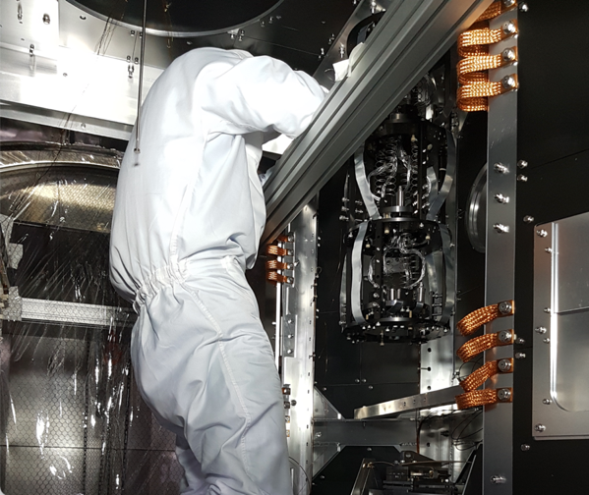
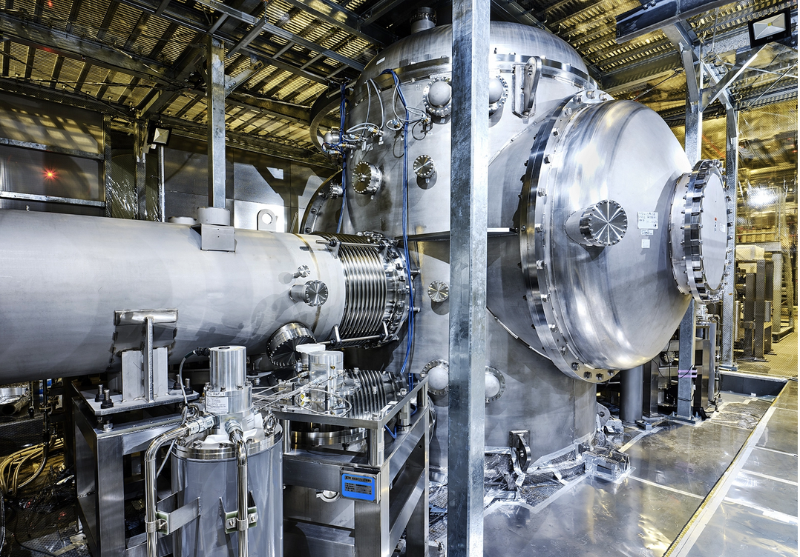
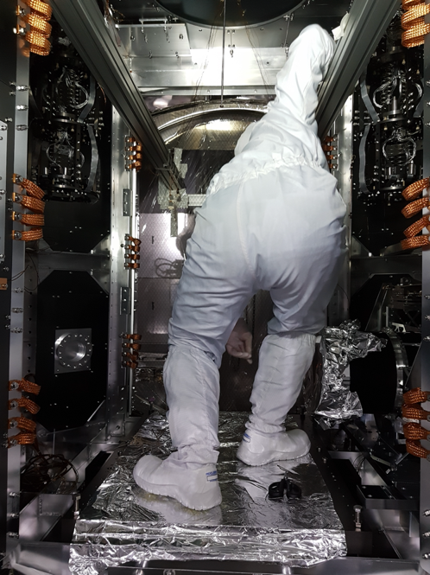
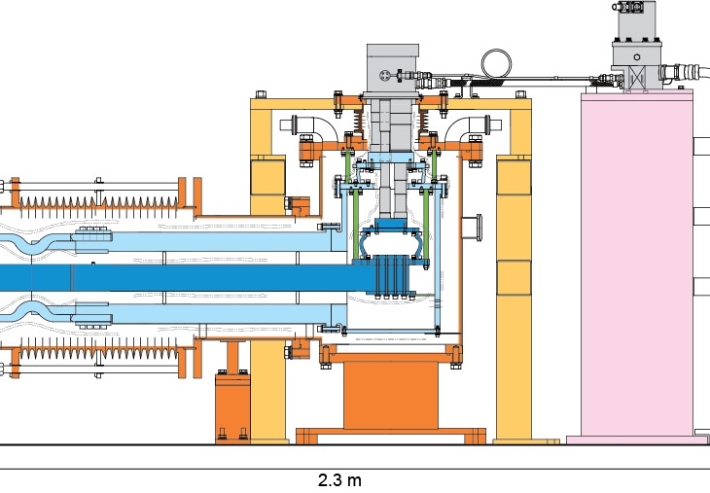
KAGRA cryostat and cooling units (at a glance)
ET-LF 4-5 m
2.5 m
Cryogenic vacuum duct
Access from bottom
Cooling line
A different concept developed at ARC, floating cooling bar

Slide 11
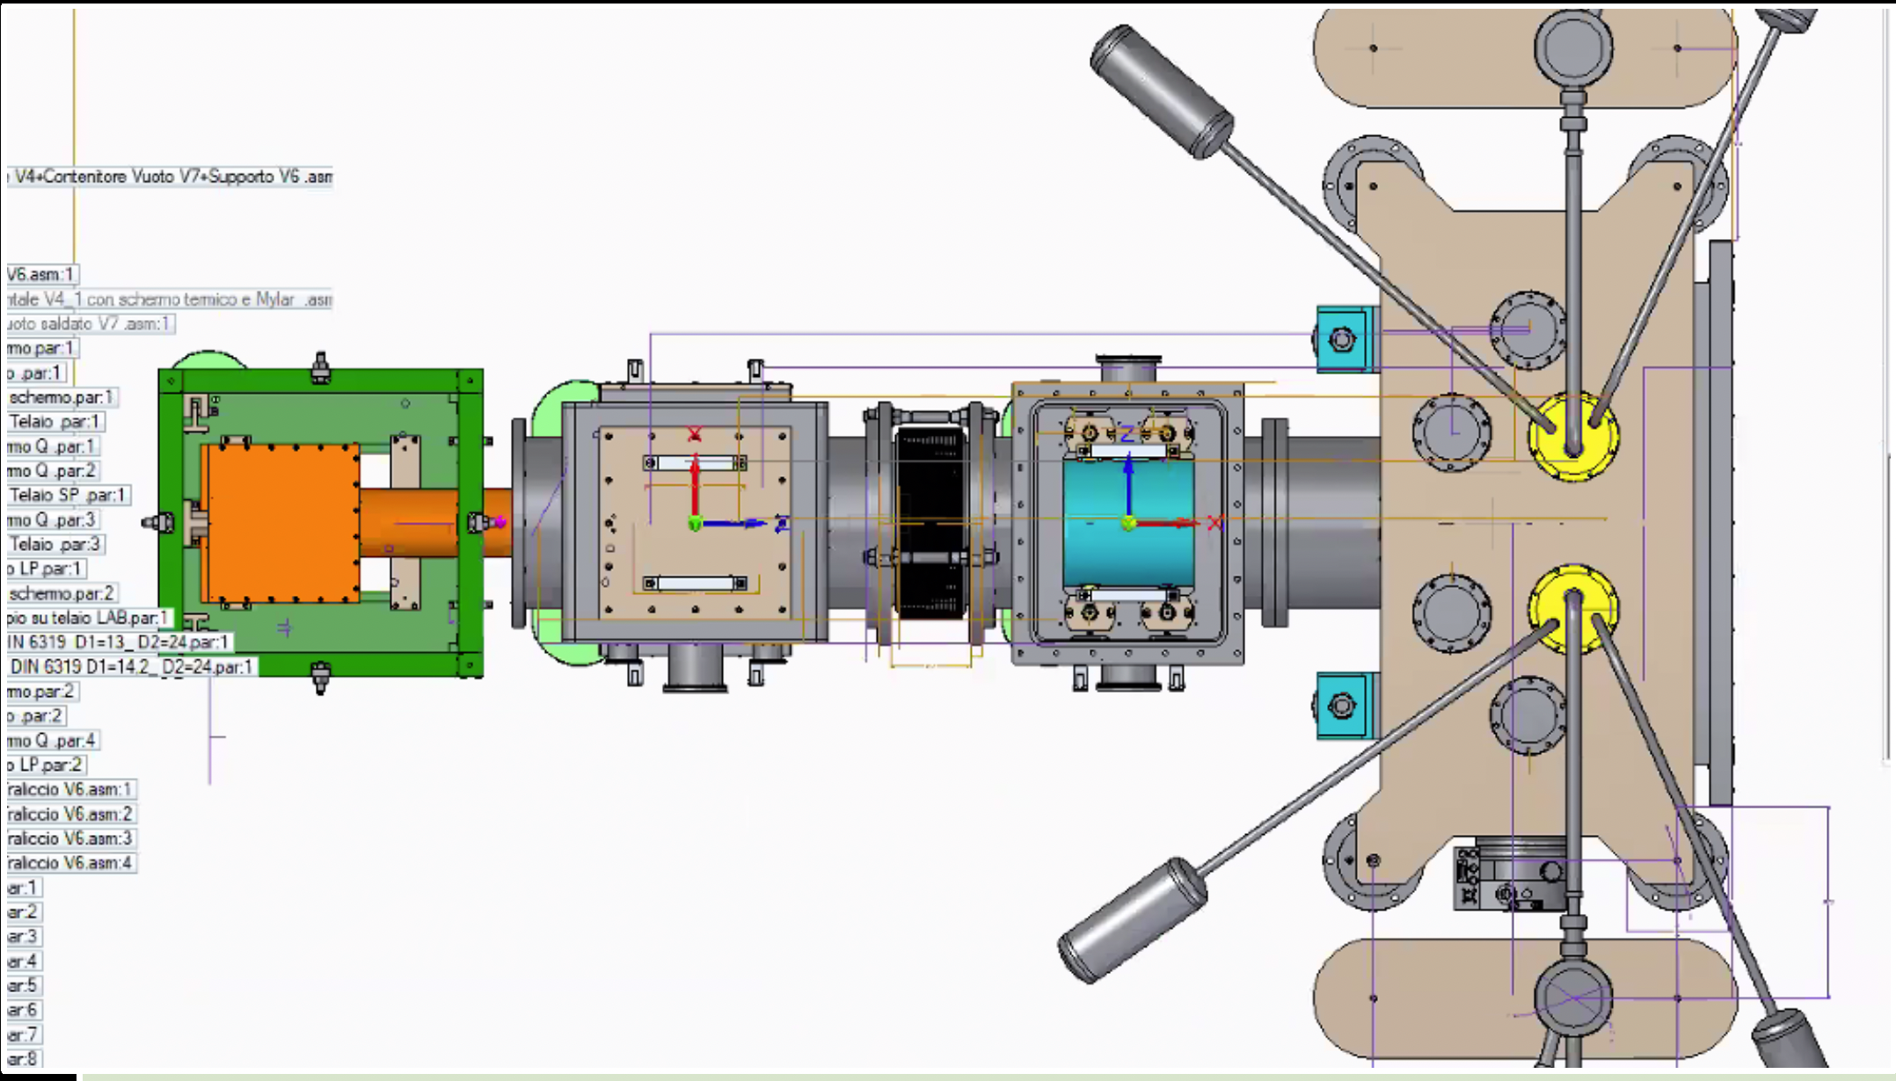
ARC cooling unit prototype (expected delivering by summer 2022)

Slide 12
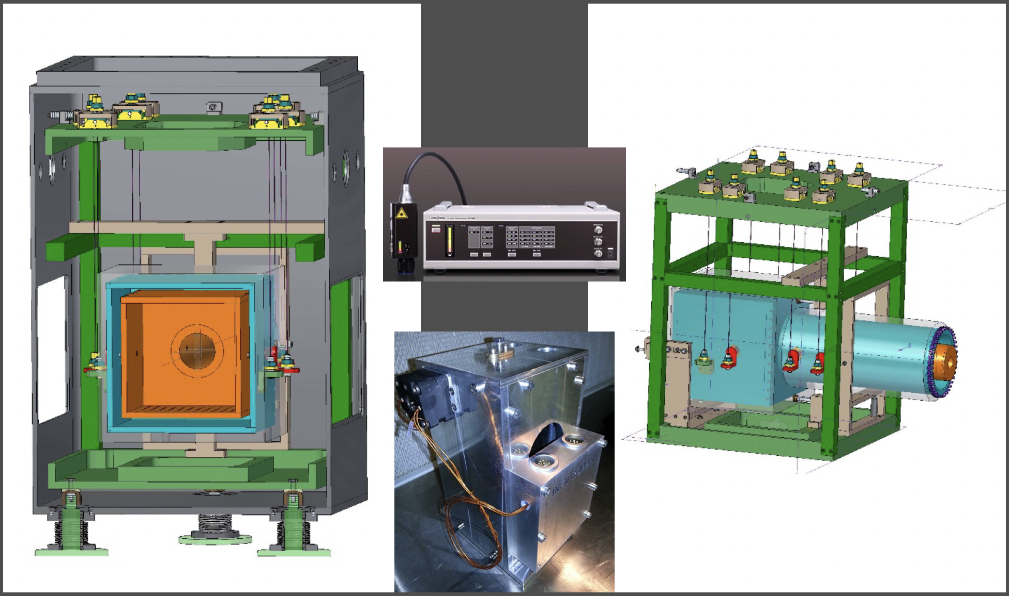
ARC cooling unit test jig (expected delivering by summer 2022)
Vibration sensors
(accel, position, room T and LowT)
Once tested using the test jig, the cooling line prototype will be connected to the cryostat.
Its design is included in ARC plans 2022

Slide 13
Conclusions
FUND APPLICATIONS, a proposal based on three pillars
A, CRYOSTAT75) 2022-24
completion of ¾ scaled Cryostat to be installed in La Sapienza Campus in the available room
B, CLARGELAB)
2022-24 Extension of ARC-L5 facility (inside or outside the campus)
C, CRYOSTAT100)
2023-26 Tests of payload prototype done => commitment for a larger cooling down of 1:1 cryostat
➔ Green light for a viable design towards ET-B

Slide 14
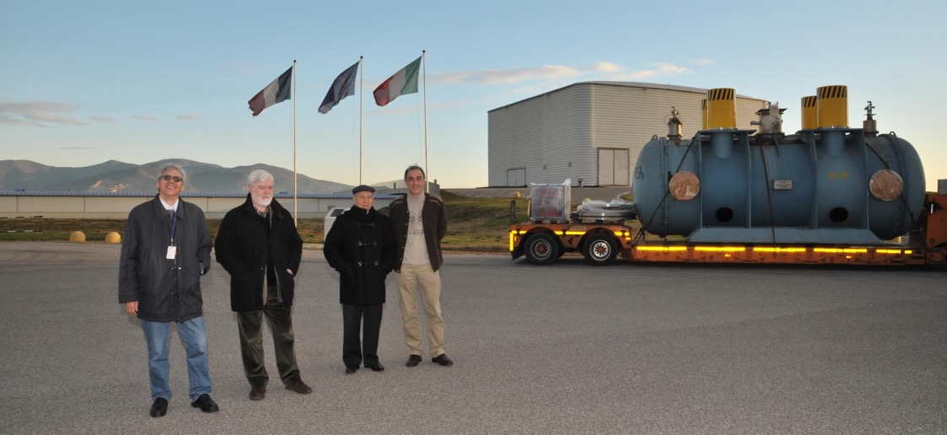
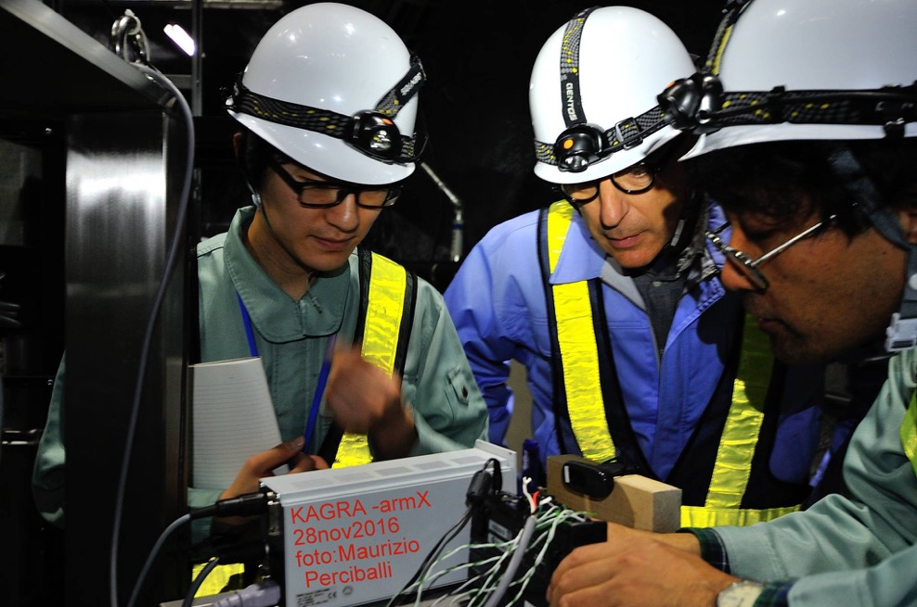
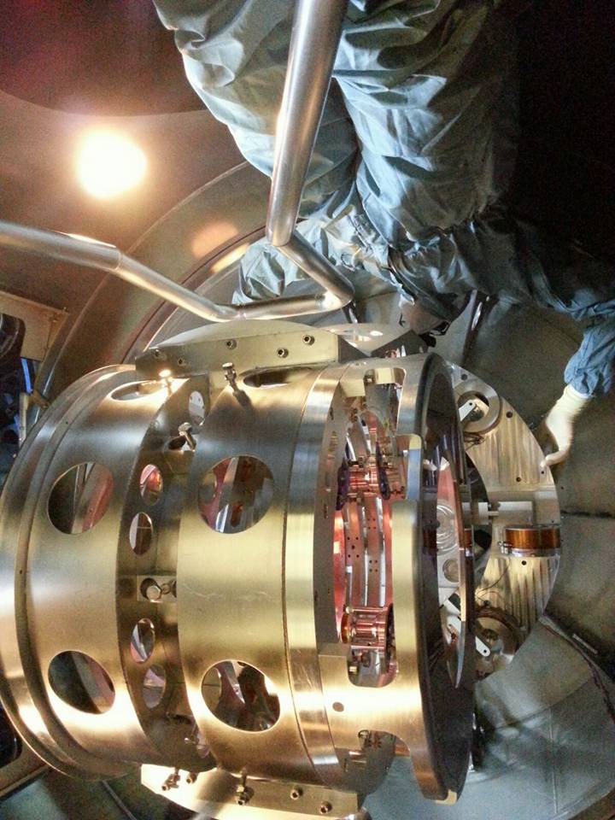
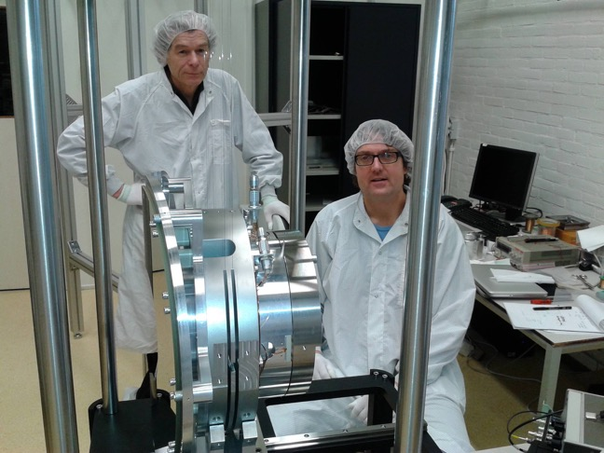
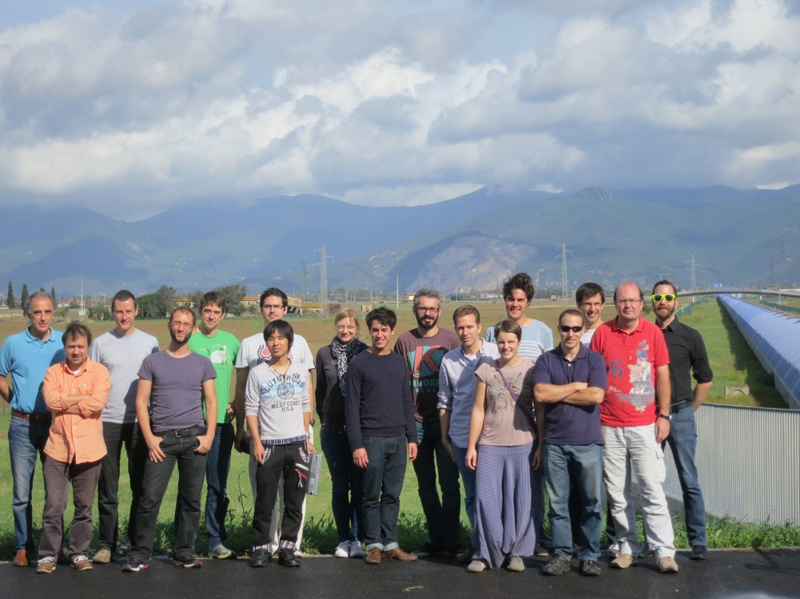
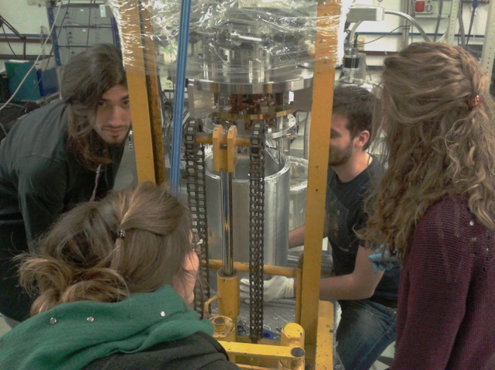
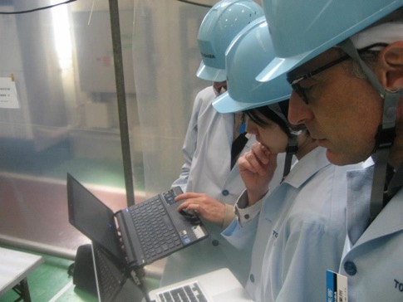
Thanks !

Slide 15
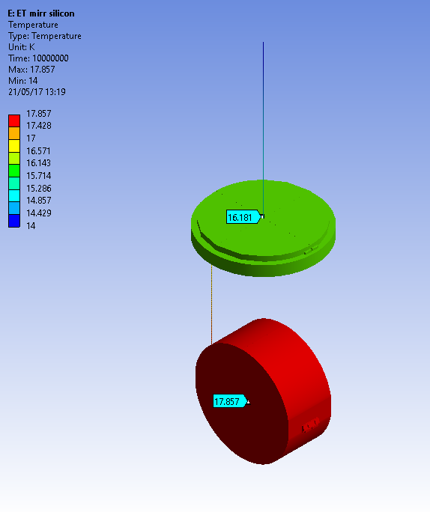
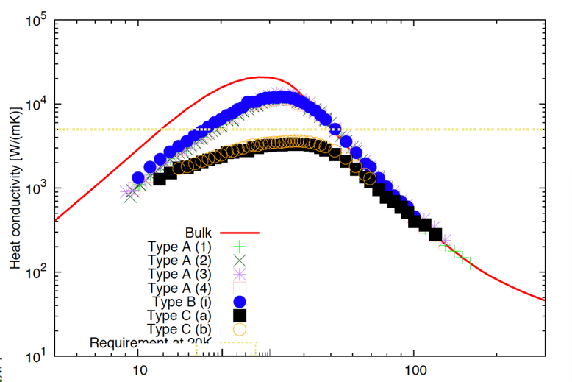
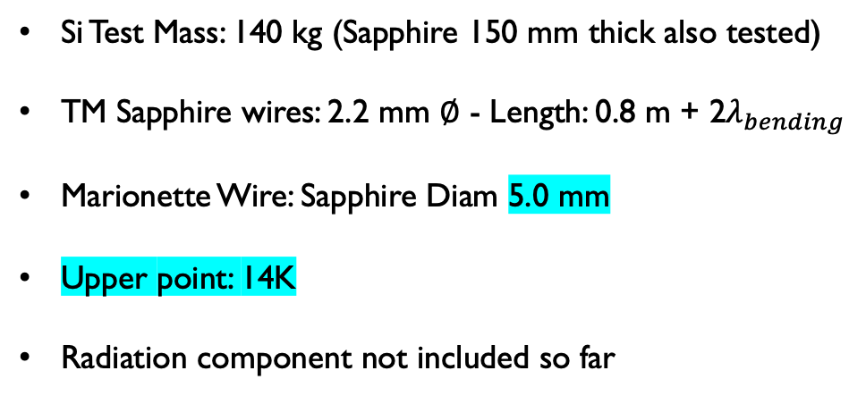
Using sapphire rods
Si Test Mass: 140 kg (Sapphire 150 mm thick also tested)
TM Sapphire wires: 2.2 mm $∅$ - Length: 0.8 m + 2$λ_{bending}$
Marionette Wire: Sapphire Diam 5.0 mm
Upper point: 14K
Radiation component not included so far
The system can be cooled down.
Notice the realtively massive marionette
(for AdV+ we adopt 180 kg).
Consistent with the cryostat room
The system works for both Si and Sapphire
Al6N HL, capability of building 80-90-cm-long Al₂O₃
Dan Chen et al 2014
No HL included
No radiation included, so far

Slide 16
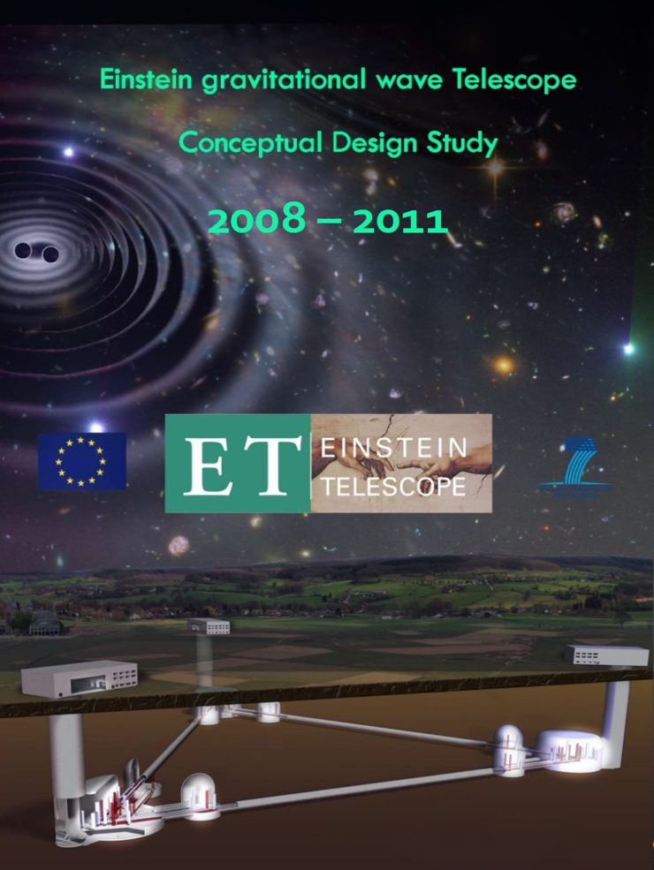
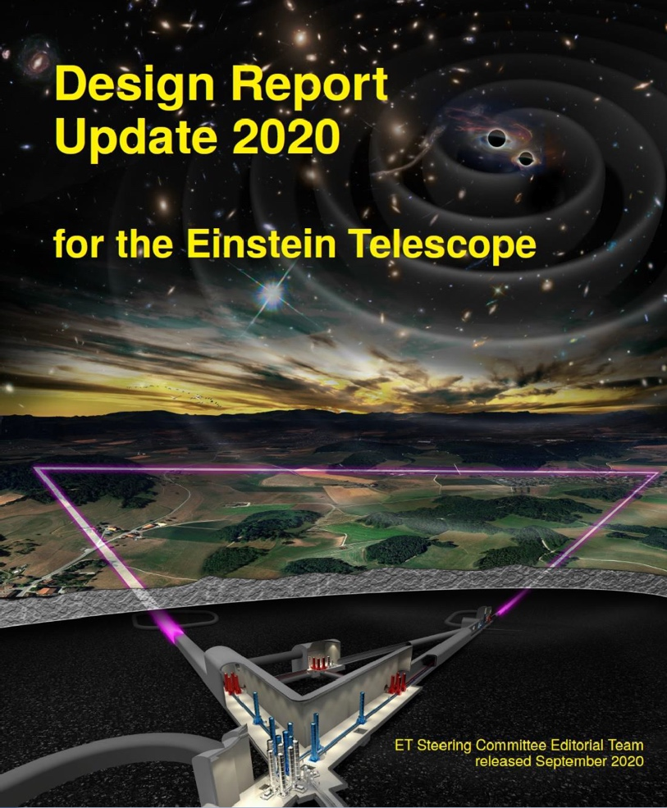
Conceptual Design Studies
https://tds.virgo-gw.eu/?call_file=ET-0106C-10.pdf
https://apps.et-gw.eu/tds/?content=3&r=17245
In 2020 governments of 5 EU countries (Italy, the Netherlands, Belgium, Spain and Poland) submitted the ET application to ESFRI (European Strategy Forum on Research Infrastructure).
July 2021 ET obtained ESFRI status, as the highest value project ever to feature on an ESFRI roadmap.
Constitution of the ET collaboration
Site definition (2024)
ESFRI

Slide 17



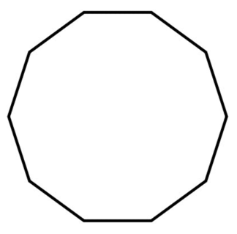

Virgo + KAGRA experiences
Side entries, 2 sets of doors, horizontal dimension.
Inner shield separation (two shields + superinsulation)
Inner shield room, once the payload is integrated it is suitable to work on a small payload standing outside
(very clean, two set of doors needed !)
Schematic Exercise :
case study rescaling internal shield
of KAGRA upon AdV+LM/ET seed parameters
150-200 kg mirror payload with cage
auxiliary attenuators for HL
side doors VS manholes (one per shield)
1 flange VAC rectangular (if circular, 1.2-1.3 m dia enough)
2 manholes (entering from bottom)
50 cm all around the payload (feet clearance)
Inner thermal shield diameter not smaller than 2.5 m
Minimum outer dia of VAC chamber 4.2 m

Slide 18
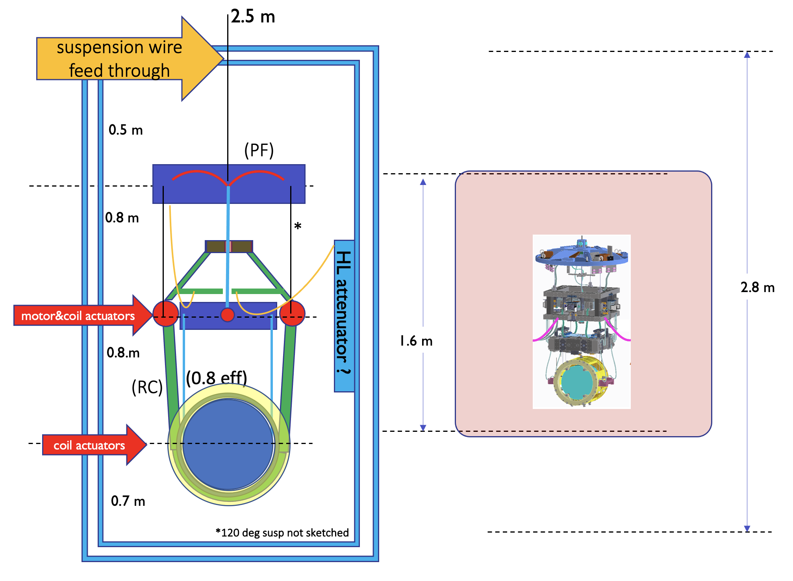
HEIGHT: minimum
3 m inside the inner radiation shield
SIZE STUDIES 2020
proper design of a viable payload, which starts from sensitivity demand, ensures also the minimum requirements for the cryostat
a possible, significant, difference envisaged (WRT KAGRA):
“cage” reaction mass

