Slide 1


L3 – Quantum Technologies for GW detection
Amaldi Research Center
Nicolò Spagnolo
Dipartimento di Fisica, Sapienza Università di Roma

Slide 2
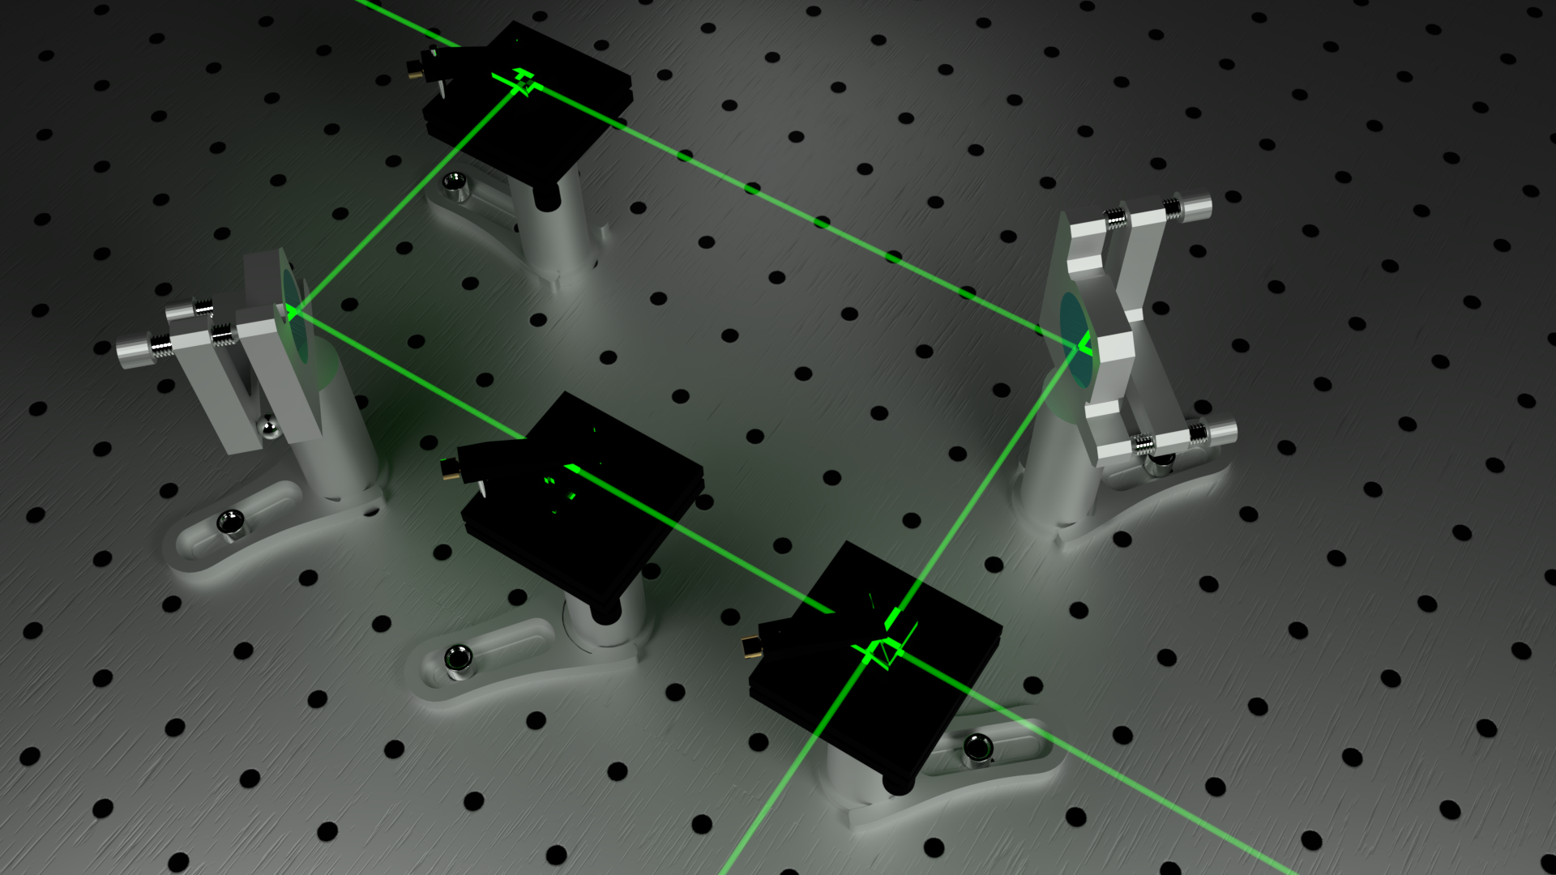
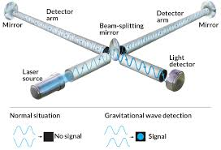
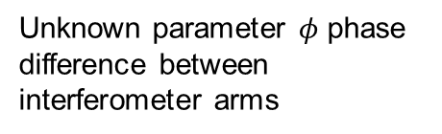
Quantum technologies for quantum sensing
Aim: improved precision in the estimation of an unknown physical quantity by adopting quantum resources
Unknown parameter $φ$ phase difference between interferometer arms
Optical phase estimation:
Applications:
-) Gravitational wave detection
-) Imaging
-) Quantum communications
-) Biological systems measurements
E. Polino, M. Valeri, N. Spagnolo, F. Sciarrino, AVS Quantum Science 2, 024703 (2020)

Slide 3


Quantum metrology
General quantum framework for estimation problems
Key element: preparation of the probe state
Ultimate limits for optical phase estimation
$$Δφ≥\frac{1}{\sqrt{νN}}$$
Standard quantum limit (SQL), achievable with classical resources
$$Δφ≥\frac{1}{ν\sqrt{N}}$$
Heisenberg limit (HL), achievable with quantum resources (entangled states, squeezed states)

Slide 4
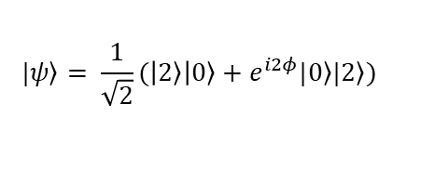
Optical phase estimation and quantum approach
Maximally entangled states
Squeezed light
$$|\left.ψ\right\rangle = \frac{1}{\sqrt{2}}(\left|\left.2\right\rangle \right|\left.0\right\rangle +e^{i2φ}|\left.0\right\rangle |\left.2\right\rangle )$$
Reduced noise in one phase quadrature
Higher sensitivity than classical light
Application for GW detection
First unconditional violation of the standard quantum limit:
S. Slussarenko, et al., Nature Photonics 11, 700-703 (2017)
Recent review:
L. Barsotti, et al., Rep. Prog. Phys. 82, 016905 (2019)

Slide 5
Quantum estimation: open issues
1. Estimation with limited data
Can we improve convergence rate to SQL or HL with limited data?
Sensitivity may depend on the parameters value
Robustness to noise in the estimation process?
Same precision is required
2. Calibration of large scale quantum sensors
Precise calibration of the system response function
can we reduce the number of measurements?
can we soften the need for system modeling?
our approach: devising algorithms based on machine learning

Slide 6

Adaptive estimation with limited data
Single probe
Measurement
Feedback phase change
-) Online approaches: feedback phase is evaluated at each run by the processing unit
-) Offline approaches: feedback phase is changed from a list of pre-calculated rules
Machine learning techniques can be employed

Slide 7
Adaptive estimation with limited data
OFFLINE APPROACHES
Genetic Algorithm
Particle Swarm Optimization
maps the problem to particle evolution
inspired by the principles of natural selection
ONLINE APPROACHES
A. Lumino, et al., Phys. Rev. Applied 10, 064028 (2018)
K. Rambhatla, et al., Phys. Rev. Research 2, 033078 (2020)
Optimized adaptive Bayesian approach
At each step the feedback is applied to minimize the variance of the posterior distribution
A. Lumino, et al., Phys. Rev. Applied 10, 064028 (2018)
M. Valeri, at al., npj Quantum Information 6, 92 (2020)

Slide 8
Extension to multiparameter estimation
Optimized adaptive Bayesian approach
Requires multiple feedback phases:
M. Valeri, et al., npj Quantum Information 6, 92 (2020)

Slide 9
Calibration of quantum sensors via neural networks
New approach for calibration - machine learning for quantum sensors
Advantage: Neural networks do not rely on knowledge of the device model
Neural networks learns the model directly from training data
(very limited a priori knowledge is required)
V. Cimini, et al., Phys. Rev. Lett. 123, 230502 (2019)
V. Cimini, et al., Phys. Rev. Appl. 15, 044003 (2020)

Slide 10
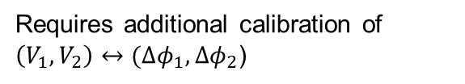
Calibration of quantum sensors via neural networks
Concept of the approach
(1) A series of input-output data are generated from the apparatus
input parameters tuned by the user
output probabilities
V. Cimini, et al., Phys. Rev. Lett. 123, 230502 (2019)
V. Cimini, et al., Phys. Rev. Appl. 15, 044003 (2020)
Requires additional calibration of $\left(V_{1},V_{2}\right)↔(∆φ_{1},∆φ_{2}$)

Slide 11
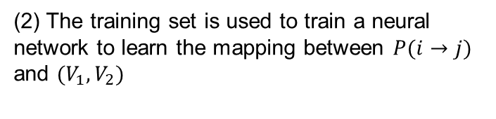
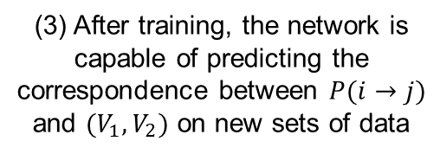
Calibration of quantum sensors via neural networks
Concept of the approach
(2) The training set is used to train a neural network to learn the mapping between $P(i→j)$ and $(V_{1},V_{2})$
No a priori knowledge on the functional form of the model/mapping is generally required, including noise
(3) After training, the network is capable of predicting the correspondence between $P(i→j)$ and $(V_{1},V_{2})$ on new sets of data
V. Cimini, et al., Phys. Rev. Lett. 123, 230502 (2019)
V. Cimini, et al., Phys. Rev. Appl. 15, 044003 (2020)

Slide 12
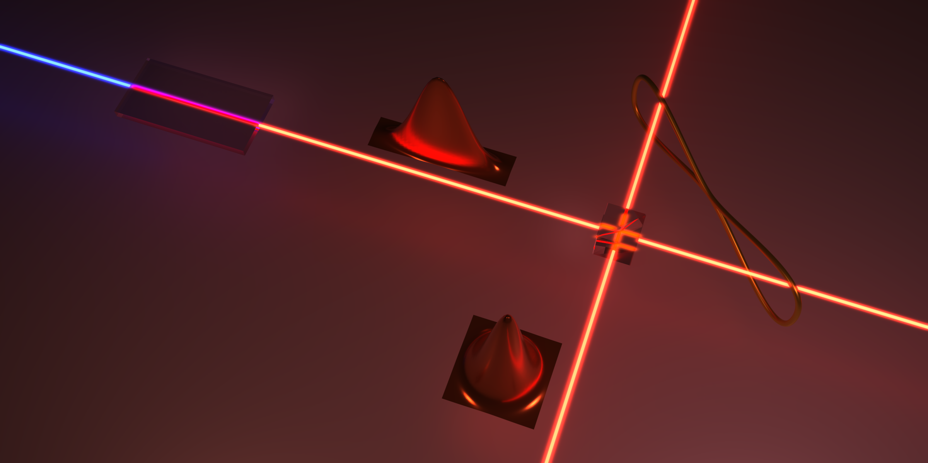
Results and Perspectives
Other results
A. Z. Goldberg, et al., Phys. Rev. A 102, 022230 (2020)
V. Cimini, et al., Phys. Rev. Applied 13, 024048 (2020)
V. Cimini, at al., arXiv:2110.02908 (2021)
ML for adaptive estimation
ML for sensors calibration
ongoing and future work
Quantum phase estimation with squeezed light
Development in progress of a squeezing apparatus
Testing of protocols for phase estimation with squeezed light for GW detection

Slide 13
Results and Perspectives
Development of a squeezed single-mode light source
Laser already purchased with ARC funding
local oscillator
balanced homodyne
1064 nm
Laser
Squeezed source
pump, 532 nm
Testing protocols for phase noise reduction in GW interferometers
(to be completed by the end of 2022)
Future extension to EPR entanglement
local oscillator
1064 nm
EPR entanglement
Laser
Squeezed source
pump, 532 nm
double balanced homodyne
Testing different schemes exploiting entagled states
Squeezed source
Beam
splitter

Slide 14




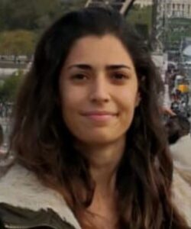
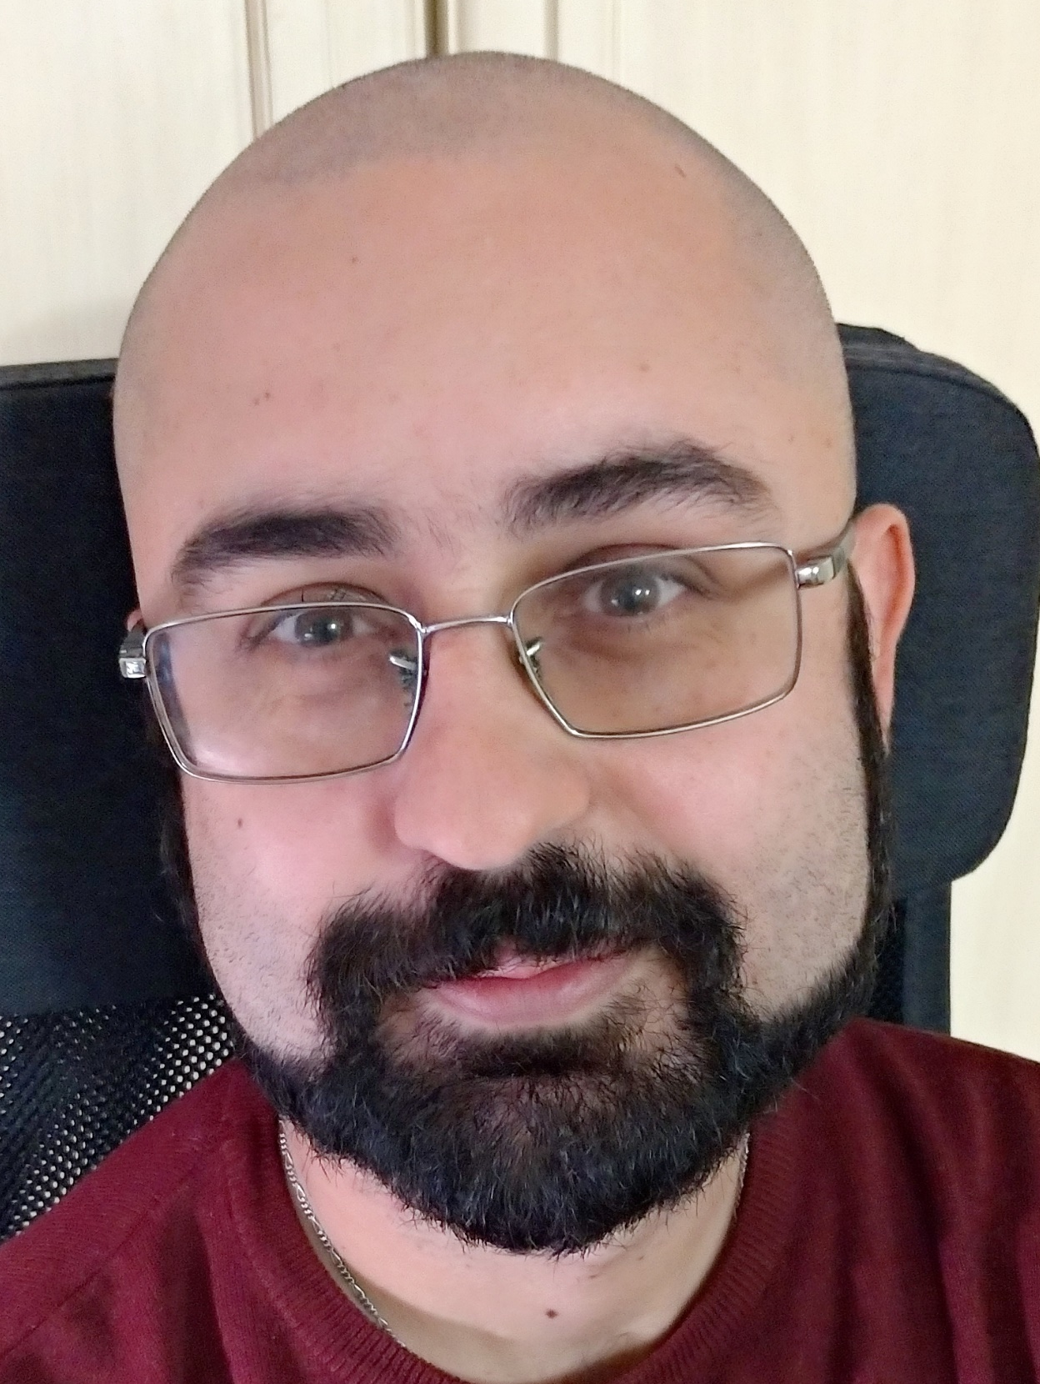





People
Marco Barbieri
Ilaria Gianani
Fabio Sciarrino
Nicolò Spagnolo
Valeria Cimini
Roberto Osellame
Andrea Crespi
Giacomo Corrielli
ARC fellow
Emanuele Polino
Mauro Valeri
Davide Poderini
Francesco Hoch
Alessandro Lumino
Simone Evaldo D’Aurelio
Adil S. Rab
Karthikeya Rambhatla
Vittorio Giovannetti
Federico Beliardo
Marco G. Genoni
Aaron Goldberg
Aephraim Steinberg
Nathan Wiebe

