Slide 1
SuperB Today M.A.Giorgi INFN & Universita’ di Pisa
XV SuperB General Meeting
Caltech Dicember 14 -17, 2010

Slide 2
Outline
Progress Reports before TDR have been published.
Machine parameters fixed.
Better understanding of Physics with Polarization.
Detector requirements for full exploitation of the collider potential.
Site requirements and evaluation process
Process:
Completion together with partners of MOU ‘s for the project.
Definition of partnership with IIT and its contribution to the construction
Toward the start

Slide 3
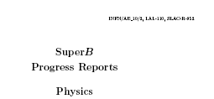
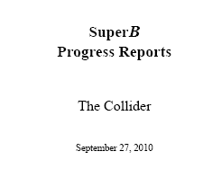
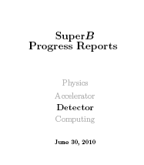
In Preparation of TDR
Since September 2010 the three SuperB Progress Reports have been published, it was an important step forward to the completion of the TDR , in time during 2011.
Machine parameters are fixed including the tunnel length , a Physics update after the 2008 Valencia document, the Detector is almost frozen.
arXiv:1008.1541v1
arXiv:1007.4241
arXiv:1009.6178v1

Slide 4
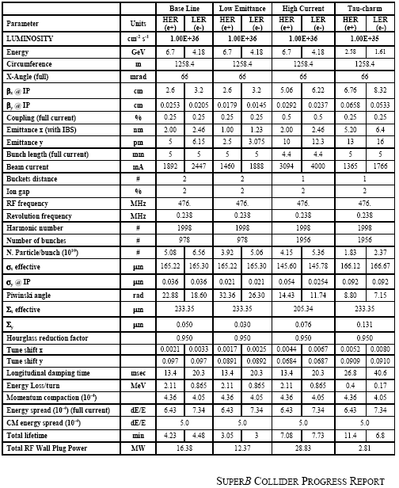
Collider Parameters are “stable”
LER
arc
HER
arc
HER Energy:
6.7 GeV
RF
FF
Polarization
80% for e⁻
l *~ 0.5m
I.P.
LER Energy:
4.2 GeV
e+
FF
e-
LER
arc
HER
arc

Slide 5
Recently: 88th Plenary ECFA Meeting CERN November 25, 2010
SuperB presentation before BELLEII by Peter Krizan.
The emphasis of Belle II was on B Physics and CKM constraints, our was focusing attention on the physics reach with polarization and charm threshold runs.
The value added by such possibilities was remarked by many people during the discussion.
The advantages of SuperB were evident.

Slide 6
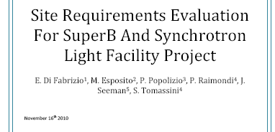
Toward fixing the site requirements.
An ad hoc committee has been set up to prepare the document on requirements for the site choice , preliminary to the infrastructure design.
Requirements and design will be reviewed by an International Review Committee

Slide 7
Goals for this 15th meeting
Discuss site document in the Project Board
Define strategy toward the completion of the TDR
Prepare for set up of Review Committees

Slide 8
Goals for this 15th meeting
Discuss site document in the Project Board
Define strategy toward the completion of the TDR
Prepare for set up of Review Committees
ALL DRIVEN BY THE ASSUMPTION OF HAVING BEEN APPROVED

Slide 9
BUT WHY ?

Slide 10
A bit of history
One year ago we expected the approval and funding!
WE MISSED!

Slide 11
A bit of history
Italian Minister of science prepared the PNR with flagship Projects and SuperB was there. We prepared together with the Management of INFN a spending profile, starting with ~20M€ in the first year. There was expectation of the approval and funding by the end of the summer.

Slide 12
A bit of history
Italian Minister of science prepared the PNR with flagship Projects and SuperB was there. We prepared together with the Management of INFN a spending profile, starting with ~20M€ in the first year. There was expectation of the approval and funding by the end of the summer.
WE MISSED AGAIN!

Slide 13
NOW
Minister of Science and University is to proceed to the subdivision of the national fund for research (FFO) between the science agencies and to the Flagship Projects . Money flow will start immediately and it is expected to follow the defined profile.

Slide 14
NOW
Minister of Science and University is to proceed to the subdivision of the national fund for research (FFO) between the science agencies and to the Flagship Projects . Money flow will start immediately and it is expected to follow to follow the defined profile.
The Minister will give the formal announcement!

