Slide 1
FTOF-Counter
for SuperB
Nicolas Arnaud, Dominique Breton, Leonid Burmistrov,
Jihane Maalmi, Veronique Puill, Achille Stocchi
LAL Orsay (CNRS-IN2P3)
Jerry Va’vra
SLAC National Accelerator Laboratory
Not many news since last presentation. Main effort put
on the CRT tests. See next presentations

Slide 2
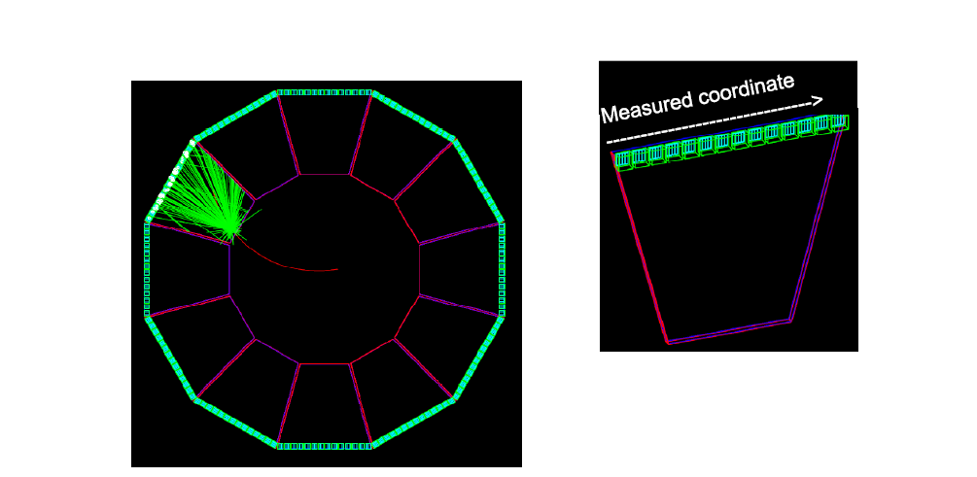
The detector is actually located close to the DCH – see next slides
• The detector is made of 1.2 cm thick (10% X₀) quartz sectors
• There are 12 sectors (30 degrees in φ) covering the polar range 15<θ<25 degrees
• The PMTs (14 per sector) are located on the sector outer radius

Slide 3
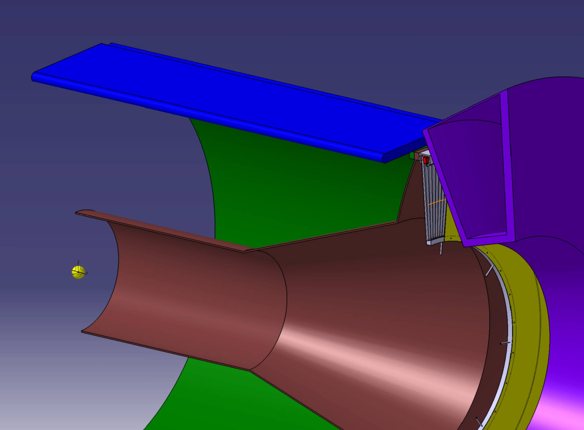
F. Bogard & S. Wallon, LAL, September 2010 design
FDIRC barbox
Forward EMC
FPID
Interaction point

Slide 4
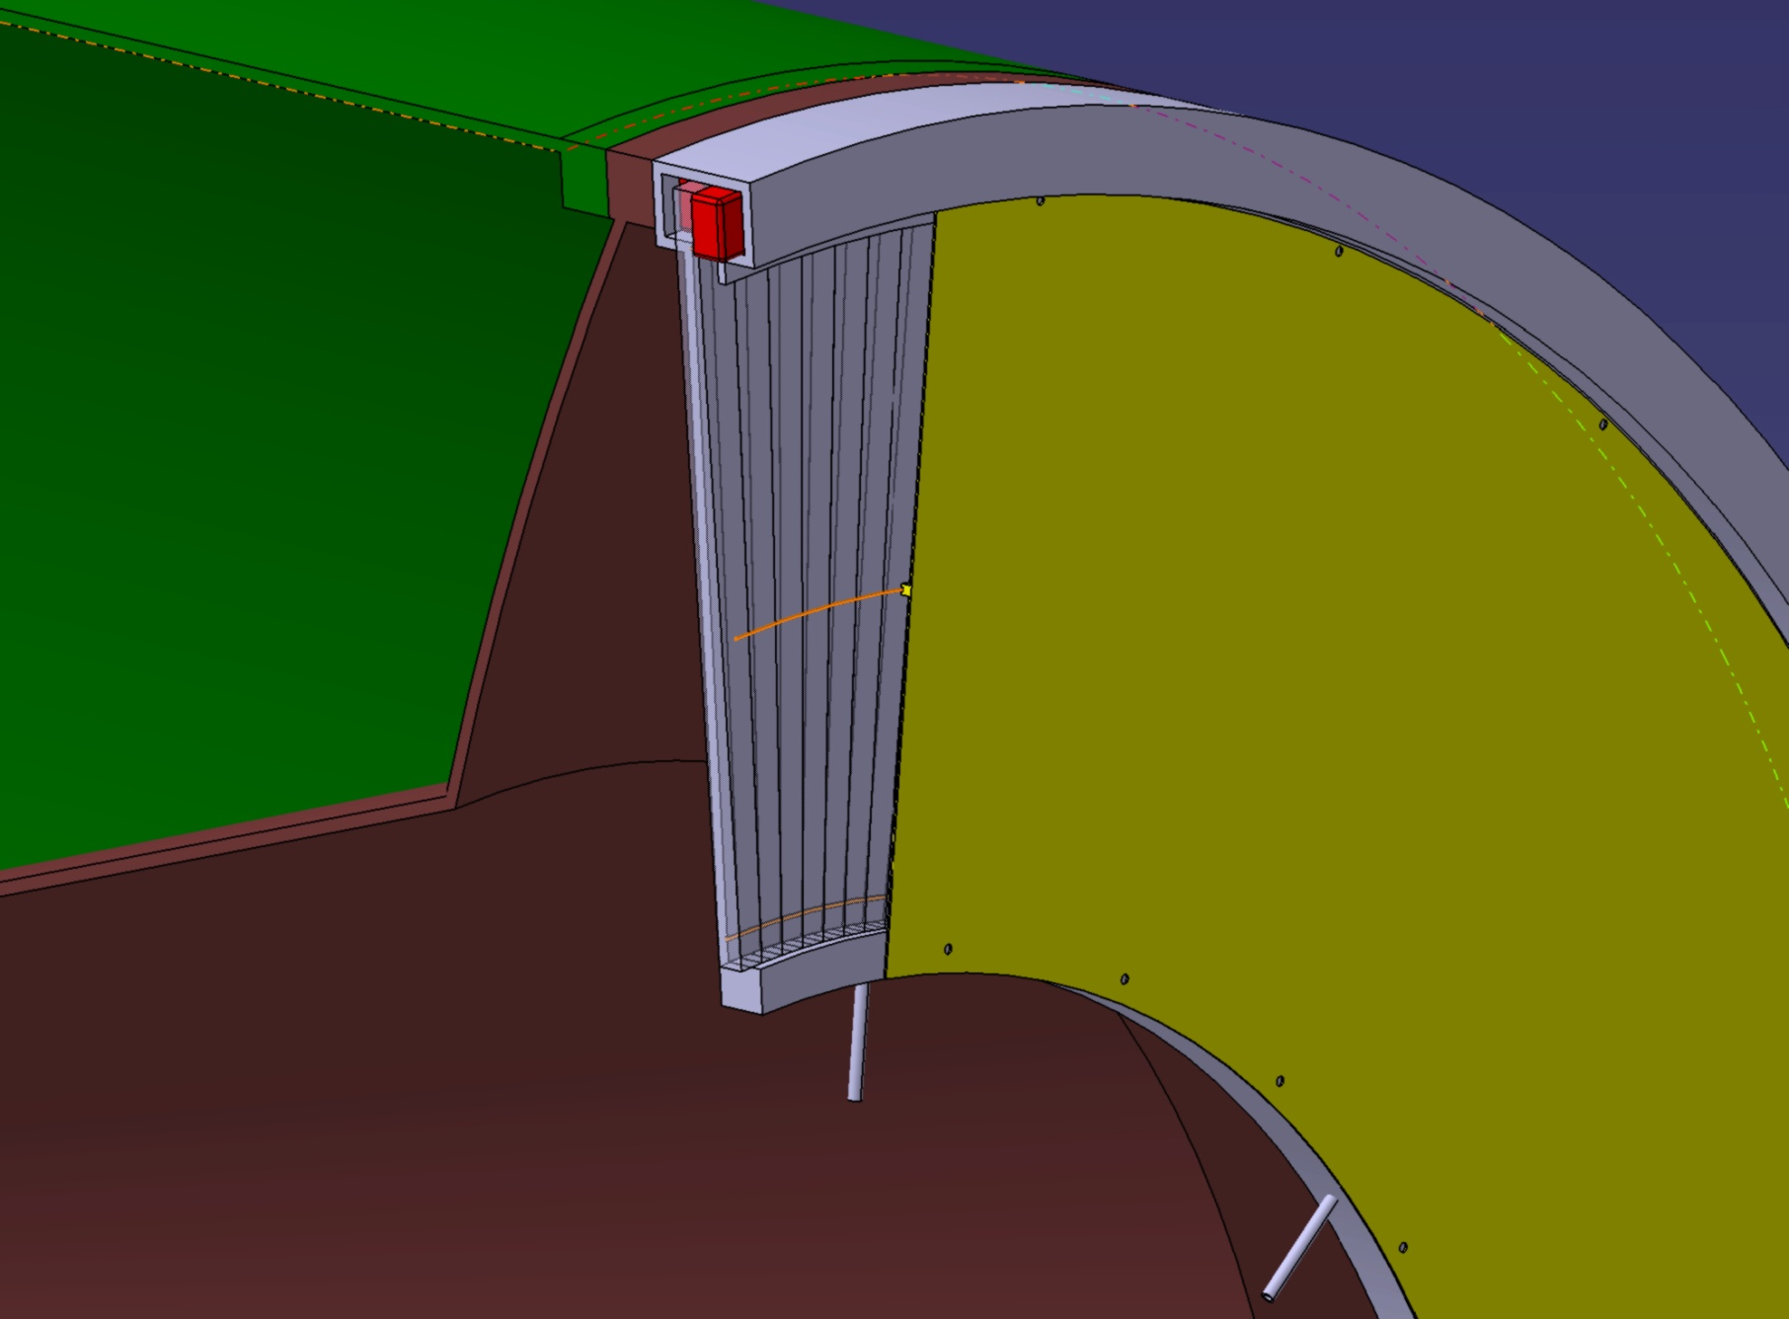
F. Bogard & S. Wallon, LAL, September 2010 design
DCH (outer shell)
Quartz plate & PMT holder
PMTs
Quartz plates (conical bar)
DCH (inner shell)
Cover plate

Slide 5

F. Bogard & S. Wallon, LAL, September 2010 design
DCH (outer shell)
Quartz plate & PMT holder
5 mm thick aluminum alloy
Cover plate -1 mm thick aluminum alloy
Inlet / outlet for N₂ flushing

Slide 6
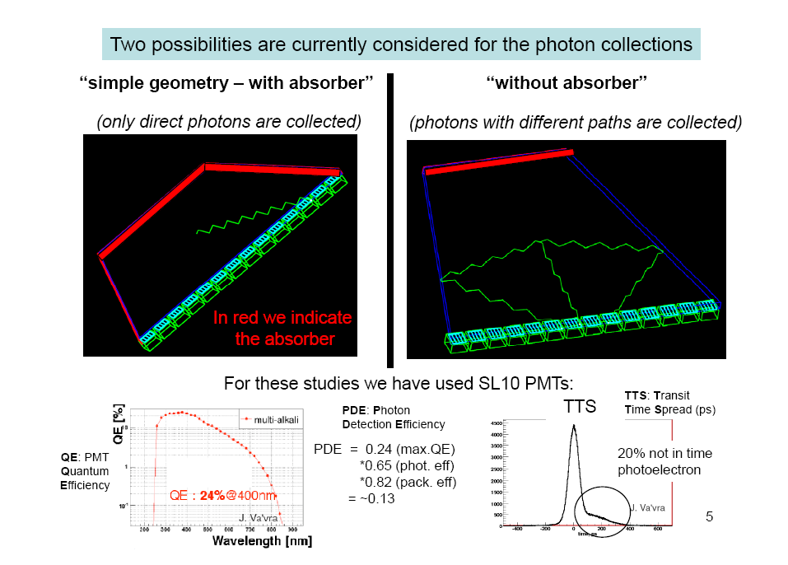
have been considered

Slide 7
Taking tracks with p = 900 MeV/c (less favourable case)
and looking at the (phi, theta) dependence of N_{phe}
With absorber
Without absorber
It can be noted the there is a lack
of phe.in the phi-border of the detector
The FTOF device for PID in the forward region located near to the DCH seems to meet the requirements of the minimum number of collected photoelectrons, if we work without absorber (all faces reflecting photons).
In this configuration we collect at least 10 photoelectrons in all theta range and for p>0.9 GeV/c

Slide 8
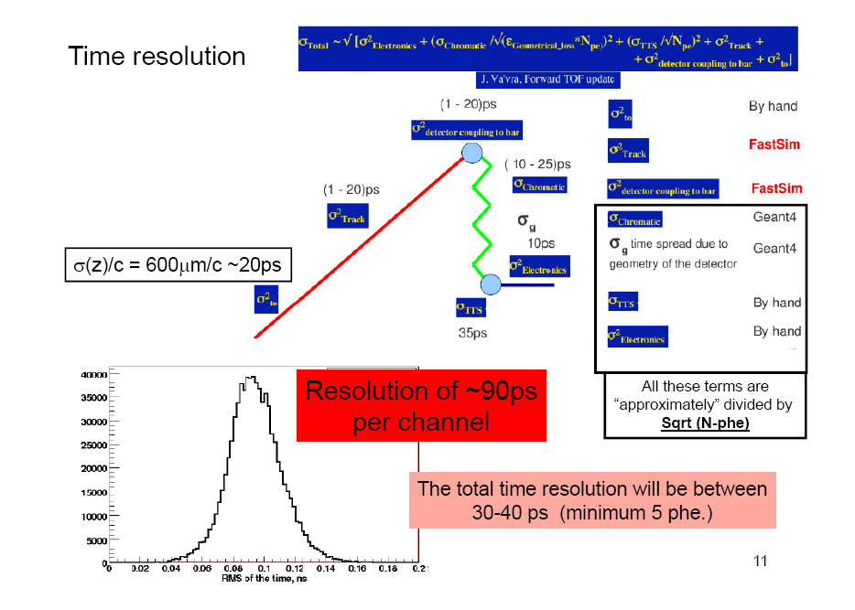

Slide 9
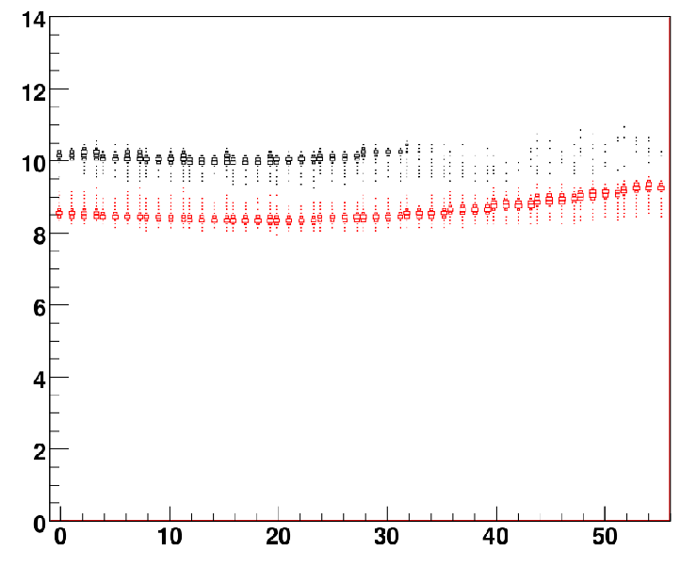
Photoelectron timing using tracks with
P=900Mev , theta=17, phi=0
“simple geometry – with absorber”
“without absorber”
Time (ns)
Red : pions
Black : kaon
This map is given
For the PID algorithm
(bin in momentum,theta,phi,x)
T=0 beam crossing
Channel number
of the PMT hit
More photons collected but time
algorithm more difficult. Under study
FTOF is a 2D device because it measures time vs position

Slide 10
First look at reconstruction
(PID with FTOF)
• Main idea: use 2D information (channel and time) for all recorded hits
• Apply a maximum likelihood method to
▪ separate signal hits from background hits
▪ decide whether the signal hits come from a kaon or a pion
• All tests so far based on a FTOF fast standalone simulation written by Leonid
▪ Half of the simulated tracks used to compute 2D maps;
the other half to simulate the reco performances
▪ Need to understand how accurate this simulation is
→ Integration in official simulation framework ?
→ But it should be fast enough to produce enough simulated data
▪ No real progress since Summer – manpower focused on CRT experiment
• Proper background distribution is a key input (currently missing) to the simulation
▪ How many hits per event? How are they distributed in the 2D plane?
• Another issue which remains to be solved: how to deal with the large track parameter space?
→ The track 2D map depends on its mass, on its momentum vector
and on the point where it hits the FTOF

Slide 11
FTOF updated cost estimation
• Electronics [Dominique, 2010/12]
▪ 250 kEuros for 672 channels [12 sectors * 14 PMTs / sector * 4 channels / PMT]
→ Includes everything: HV, LV, boards, cables, installation, etc.
• Quartz Plates [Jerry, 2009]
▪ Material: 210 k$ [12 + 2 plates, unit cost 15 k$]
▪ Manpower: 200 k$
▪ QC: 160 k$
• Mechanical integration [LAL engineers, 2010/03]
▪ Support structure: 80 kEuros
▪ Utilities: 20 kEuros
▪ Integration: 30 kEuros
• PMTs [Veronique, 2010/12] : 1.2 MEuros
▪ 200 PMTs (168 for the 12 sectors + ~2.5 sectors of spares]
Quote for SL10 Hamamatsu is ~6 kEuros/PMT
(→ Burle PMTs may be cheaper; no quote yet)
The total cost is ~2 MEuros. Largely dominated by the PMTs.
Total: 570 k$
~ 450 kEuros
(1.3 $ / euro)
Total: 130 kEuros

