Slide 1
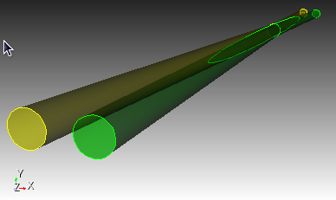
Supercomputing IR wakes
My adventures in super computing: first results
Introduce SLAC Advanced Computing Department parallel Finite Element Method electromagnetic time domain solver (t3p) as a tool for IR wakefield computation.
Compare with gdfidl** finite integration techniques (MAFIA)
Consider simple intersecting tubes as a generic model for an IP
* http://www.slac.stanford.edu/grp/acd/ace3p.html
** http://www.gdfidl.de/

Slide 2
wake potential basics
bunch particles are a rigid relativistic line charge of gaussian intensity distribution
at the pipe boundaries image charges move with the bunch
electromagnetic “wake” fields are generated by the image charges as they move along changing boundaries.
wake fields

Slide 3
wake potential basics
following particles within the bunch feel the wake fields caused by the previous particles
wake potential is the accumulated voltage seen by particles as the bunch traverses the structures
bunch
longitudinal
wake potential

Slide 4
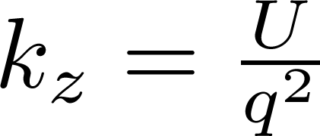
energy loss and loss factor
energy lost by the bunch to the structure is given by
with longitudinal loss factor [V/pC]:
bunch λ(s)
longitudinal
wake potential W(s)
Power loss by the beam currents I and bunch spacing τ :

Slide 5
software features
gdfidl
FIT
Napoly
serial to small cluster
loss factors
absorbing boundaries
t3p
FEM
direct
massively parallel NERSC
not yet implemented
absorbing boundaries
visualization: CUBIT, Paraview

Slide 6
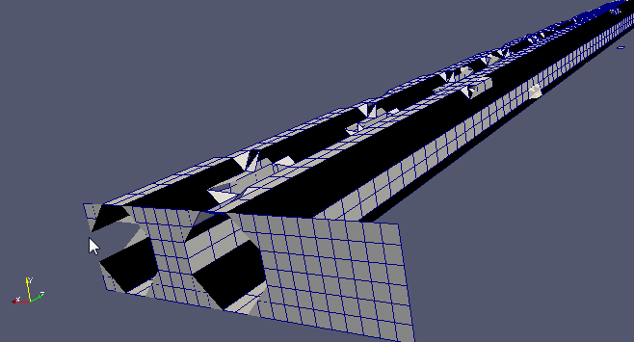
mesh
radius 10 mm
angle 66 mR
length 1 m
conformal vs staircase
loss factor vs mesh size
8mm bunch length
gdfidl
cubit

Slide 7
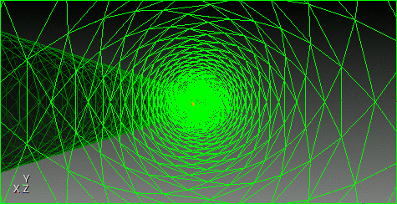
beam’s eye view
Notes:
CUBIT animation.

Slide 8
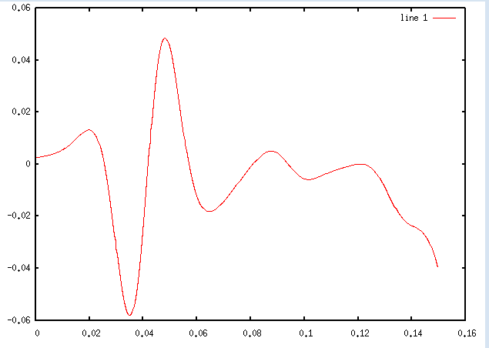
stability
both programs exhibit numerical instability for certain mesh and time step parameters
these runs are not considered
t3p sensitivity to internal surface meshing. Many ways to make bad triangles

Slide 9
stability
solver | Mesh [mm] | dt[ps] | kz | loss | Bunch length[mm] | order | solver |  | stability
t3p | 2 | 0.5 | -5.43E-05 | -5.43E-17 | 8 | 2 |  |  | stable
t3p | 2 | 0.3 | -1.02E-04 | -1.02E-16 |  | 2 |  |  | stable
t3p | 3 | 0.5 | -2.54E-04 | -2.54E-16 | 8 | 2 | CG |  | stable
t3p | 2 | 1 | -3.81E-04 | -3.81E-16 | 8 | 2 | CG |  | stable
t3p | 1 | 1 | 2.69E-04 | 2.69E-16 | 8 | 2 | CG |  | unstable
t3p | 3 | 1 | -1.93E-05 | -1.93E-17 | 8 | 2 | CG |  | stable
t3p | 4.2 | 1 | -6.49E-04 | -6.49E-16 | 8 | 2 | CG |  | stable
gdfidl | 1 | 1 | -1.10E-03 | -1.10E-15 | 8 |  |  | napoly | stable
gdfidl | 1 | 1 | -1.88E-03 | -1.88E-15 | 8 |  |  | no | stable
gdfidl | 2 | 1 | -3.35E-03 | -3.35E-15 | 8 |  |  |  | unstable
gdfidl | 2 | 2 | -7.36E-03 | -7.36E-15 | 8 |  |  | no | unstable
gdfidl | 2 | 3.6 | -5.26E-03 | -5.26E-15 | 8 |  |  | no | unstable
gdfidl | 1 | 0.9 | -7.53E-04 | -7.53E-16 | 8 | NA | NA | napoly | stable
gdfidl | 2 | 0.5 | -2.80E-03 | -2.80E-15 | 8 |  |  | napoly | unstable
gdfidl | 0.5 | 0.9 | 1.24E-03 | 1.24E-15 | 8 |  |  | napoly | stable
gdfidl | 0.5 | 0.4 | -5.50E-04 | -5.50E-16 | 8 | NA | NA |  | stable
gdfidl | 0.5 | 0.25 | -7.88E-04 | -7.88E-16 | 8 |  |  | no | stable
gdfidl | 1 | 1 | -1.75E-03 | -1.75E-15 | 8 | NA | NA |  | stable
gdfidl | 2 | 1 | -3.45E-03 | -3.45E-15 | 8 | NA | NA |  | unstable

Slide 10
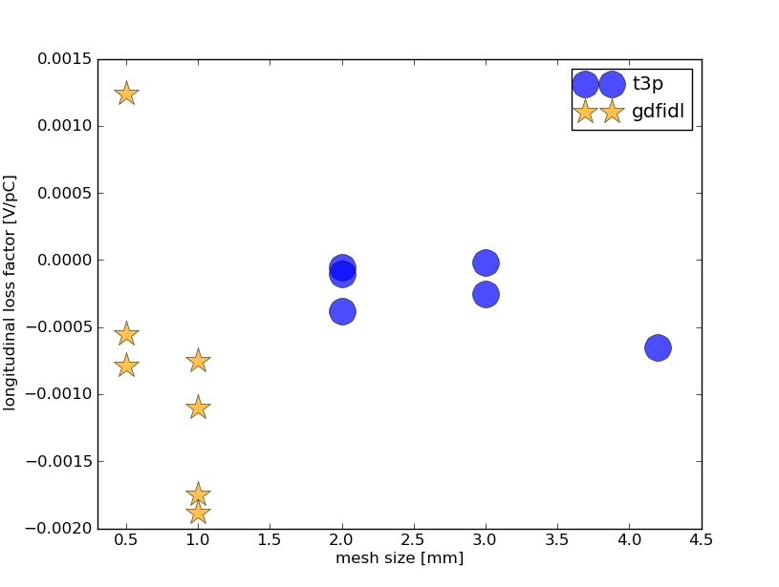
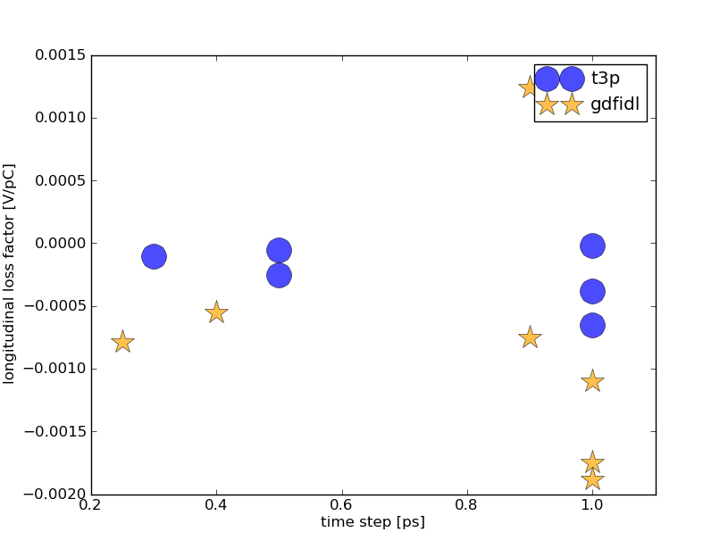
longitudinal loss factors
vs mesh size
vs time

Slide 11
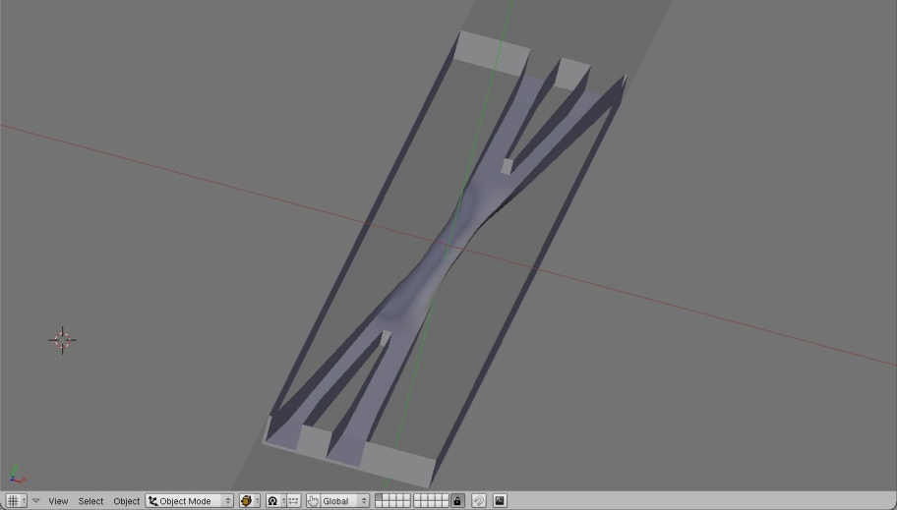
discussion
comparison with Super B IR model for σ = 8 mm with gdfidl:
k_{z}^{SuperB}~-10.8σ ^{-2.6} = -0.048 V/pC
speed up with supercomputing?
gdfidl 0.5 mm/1ps: 1 hr 1-2 CPU
t3p 1 mm/1ps: 9 hrs + queue time 128 nodes, 4 CPU/node
Longitudinal wake intensity for gdfidl changes with mesh size

Slide 12
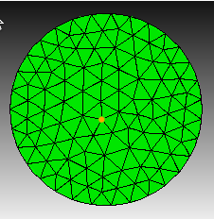
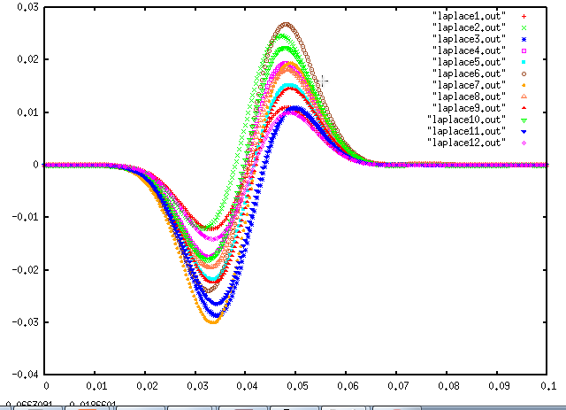
transverse wakes
implemented in gdfidl but not t3p

Slide 13
next steps
More exhaustive study
Napoly integration
Automatic calculation of important parameters
transverse wakes
loss factors
Beam offset
import SuperB geometry (stl)
Bunch length studies
beam pipe size and IP angles
optimize loads. More nodes for dense mesh

Slide 14
Conclusion
loss factor for round tubes is small compared to model of the Super B IR
Convergence is slightly better with t3p for this study
More exhaustive study needed

