Slide 1
Super-B: Second order of momentum compaction.
Sasha Novokhatski
SLAC National Accelerator Laboratory
XV Super B General Meeting
December 14 – December 17, 2010
California Institute of Technology, USA

Slide 2
Super-B parameters. March 3, 2010
(Bold: computed values) |  | Base Line |  | Low Emittance |  | High Current |  | Tau/Charm (prelim.)
Parameter | Units | HER (e+) | LER (e-) | HER (e+) | LER (e-) | HER (e+) | LER (e-) | HER (e+) | LER (e-)
Energy | GeV | 6.7 | 4.18 | 6.7 | 4.18 | 6.7 | 4.18 | 2.58 | 1.61
Circumference | m | 1258.4 |  | 1258.4 |  | 1258.4 |  | 1258.4
Bunch length (zero current) | mm | 4.69 | 4.29 | 4.73 | 4.34 | 4.03 | 3.65 | 4.75 | 4.36
Bunch length (full current) | mm | 5 | 5 | 5 | 5 | 4.4 | 4.4 | 5 | 5
Beam current | mA | 1892 | 2447 | 1460 | 1888 | 3094 | 4000 | 1365 | 1766
N. Buckets distance |  | 2 | 2 | 2 | 2 | 1 | 1 | 1 | 1
Ion gap | % | 2 | 2 | 2 | 2 | 2 | 2 | 2 | 2
RF frequency | Hz | 4.76E+08 | 4.76E+08 | 4.76E+08 | 4.76E+08 | 4.76E+08 | 4.76E+08 | 4.76E+08 | 4.76E+08
Revolution frequency | Hz | 2.38E+05 |  | 2.38E+05 |  | 2.38E+05 |  | 2.38E+05
Harmonic number | # | 1998 |  | 1998 |  | 1998 |  | 1998
Number of bunches | # | 978 |  | 978 |  | 1956 |  | 1956
N. Particle/bunch | # | 5.08E+10 | 6.56E+10 | 3.92E+10 | 5.06E+10 | 4.15E+10 | 5.36E+10 | 1.83E+10 | 2.37E+10
Bunch current | mA | 1.935 | 2.502 | 1.493 | 1.930 | 1.582 | 2.045 | 0.698 | 0.903
Energy Loss/turn | MeV | 2.11 | 0.865 | 2.11 | 0.865 | 2.11 | 0.865 | 0.4 | 0.166
Momentum compaction |  | 4.36E-04 | 4.05E-04 | 4.36E-04 | 4.05E-04 | 4.36E-04 | 4.05E-04 | 4.36E-04 | 4.05E-04
Energy spread (zero current) | dE/E | 6.31E-04 | 6.68E-04 | 6.31E-04 | 6.68E-04 | 6.31E-04 | 6.68E-04 | 6.31E-04 | 6.68E-04
Energy spread (full current) | dE/E | 6.43E-04 | 7.34E-04 | 6.43E-04 | 7.34E-04 | 6.43E-04 | 7.34E-04 | 6.94E-04 | 7.34E-04
CM energy spread | dE/E | 5.00E-04 |  | 5.00E-04 |  | 5.00E-04 |  | 5.26E-04
Energy acceptance |  | 0.01 | 0.01 | 0.01 | 0.01 | 0.01 | 0.01 | 0.01 | 0.01
Synchrotron frequency | kHz | 3.01 | 2.8 | 2.97 | 2.77 | 3.54 | 3.26 | 2.96 | 2.77
Synchrotron tune |  | 0.0126 | 0.0118 | 0.0125 | 0.0116 | 0.0148 | 0.0137 | 0.0124 | 0.0116
SR power loss | MW | 3.99 | 2.12 | 3.08 | 1.63 | 6.53 | 3.46 | 0.55 | 0.29
RF Wall Plug Power (SR only) | MW | 12.22 |  | 9.43 |  | 19.98 |  | 1.68
Total RF Wall Plug Power | MW | 17.08 |  | 12.72 |  | 30.48 |  | 3.11
Number of cavities |  | 12 | 8 | 12 | 8 | 20 | 12 | 6 | 4
Number of Klystrons |  | 6 | 4 | 6 | 4 | 10 | 6 | 3 | 2
Total Number of klystrons |  | 10 |  | 10 |  | 16 |  | 5
RF Voltage | MV | 7.01 | 5.25 | 6.88 | 5.13 | 9.3 | 7.2 | 2.54 | 1.94
R_{s} | MΩ
Q₀
β

Slide 3
Momentum compaction
Small momentum compaction means small
Quasi-isochronous ring

Slide 4
Example of a quasi-isochronous lattice
Yuri Nosochkov

Slide 5
When it is small?
Consider only first and second order
or

Slide 6
Two stable fixed points
without wake fields

Slide 7
Head-tail growth rate
If energy loss decreases with a bunch length,
than we have instability without any threshold for a positive sign of

Slide 8
Strong Heat –Tail Instability

Slide 9
Linear feedback. Bunch position.

Slide 10
Bunch length and energy spread

Slide 11
Super B. Wake potential of a 5 mm bunch (Base line).
Loss factor = 11 V/pC

Slide 12
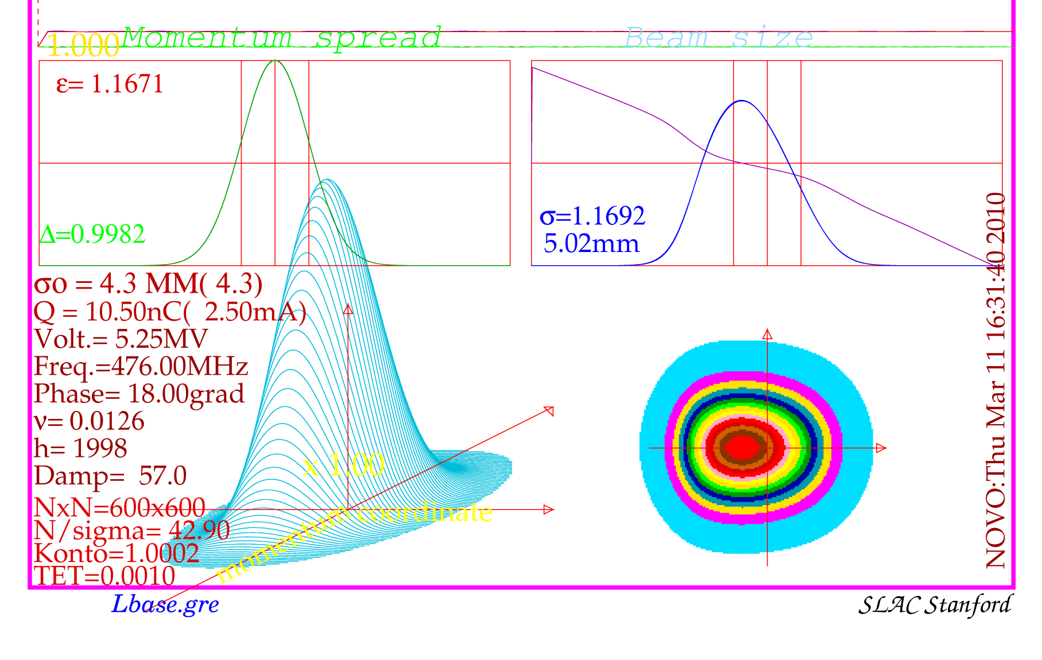
Bunch lengthening in Super-B. Base line

Slide 13
Bunch lengthening in Super-B.
LER

Slide 14
Adding second part of momentum compaction

Slide 15
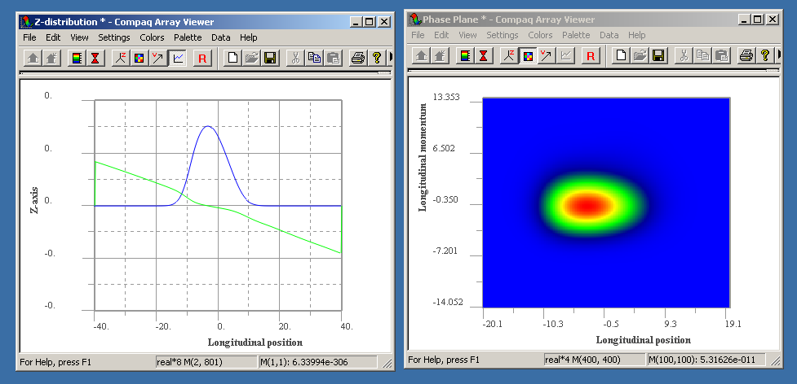
Adding second part of momentum compaction
Check for a negative value -0.05. It is stable.

Slide 16
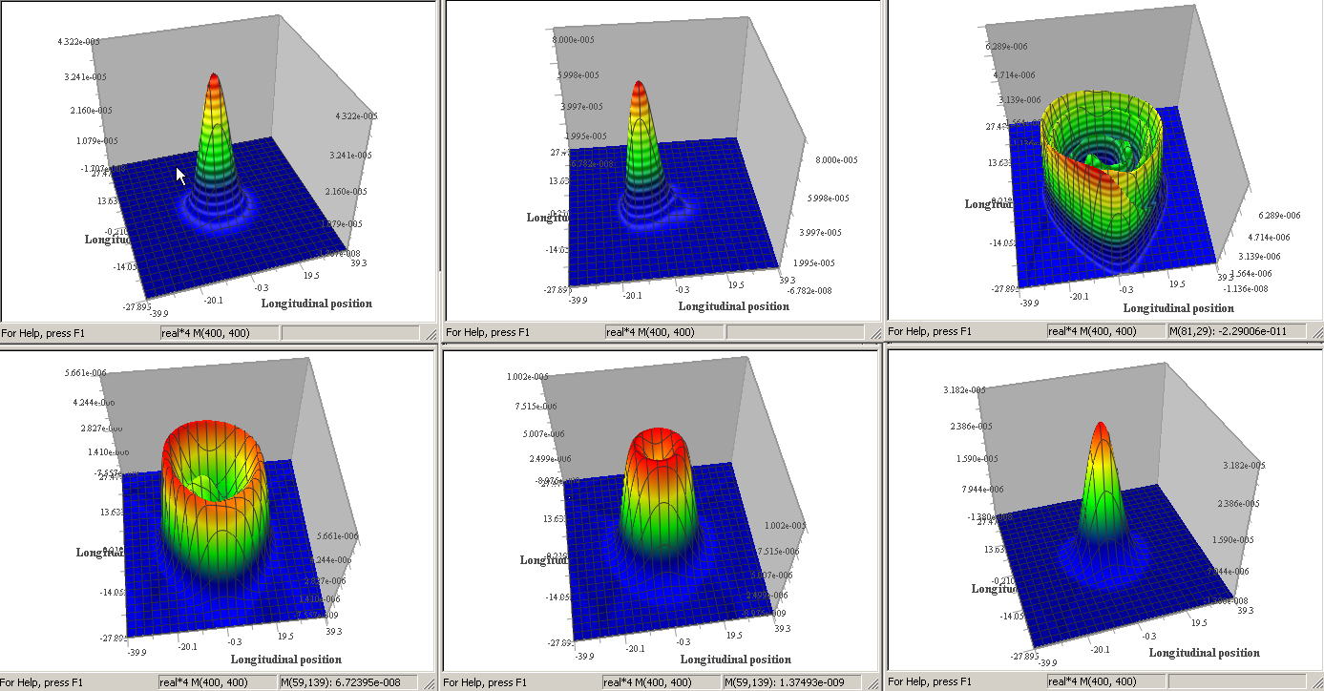
Saw-tooth type instability
Check for a positive value +0.05. It is unstable.

Slide 17
Summary
Second part of momentum compaction may play important role in the longitudinal beam dynamics for low compaction machines.
There is no instability threshold for a positive value of
It is necessary to check that second part of the momentum compaction of the Super-B lattice has the right sign, or at least less than 0.05, if it is positive.

