Slide 1
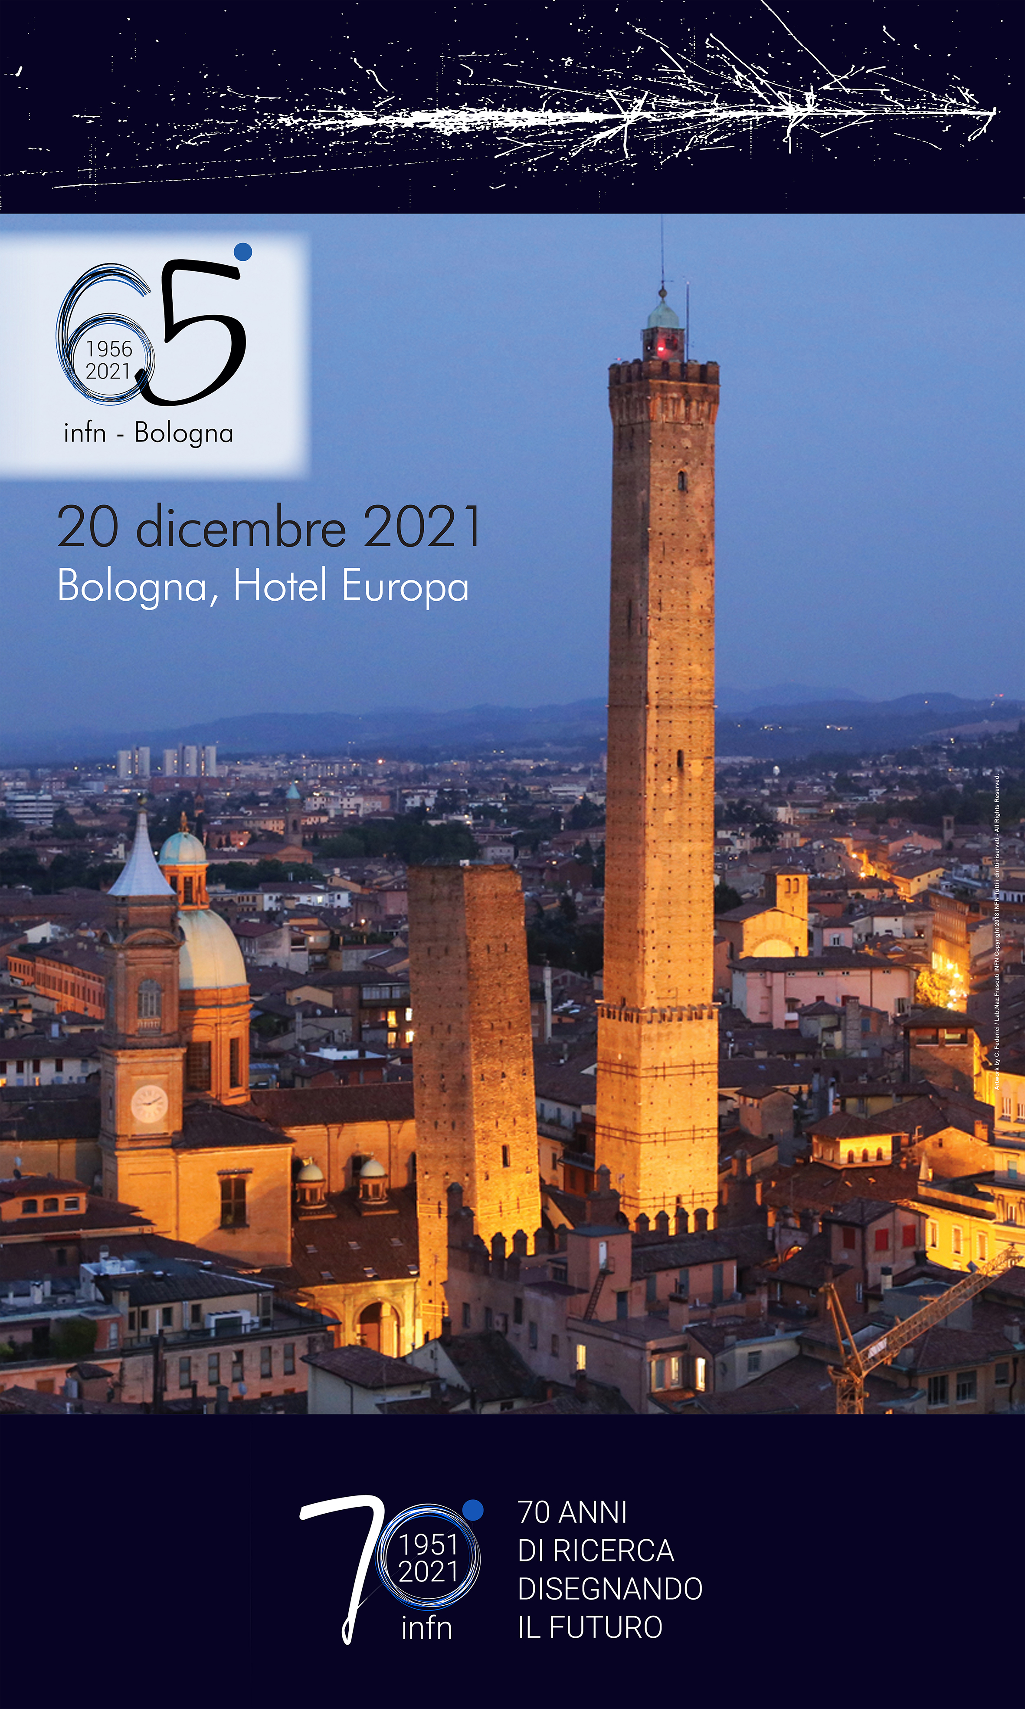

I primi 70 anni dell'INFN: una storia di successo
Antonio Zoccoli
Presidente INFN
Prof. Antonio Zoccoli
INFN - Università degli Studi di Bologna

Slide 2
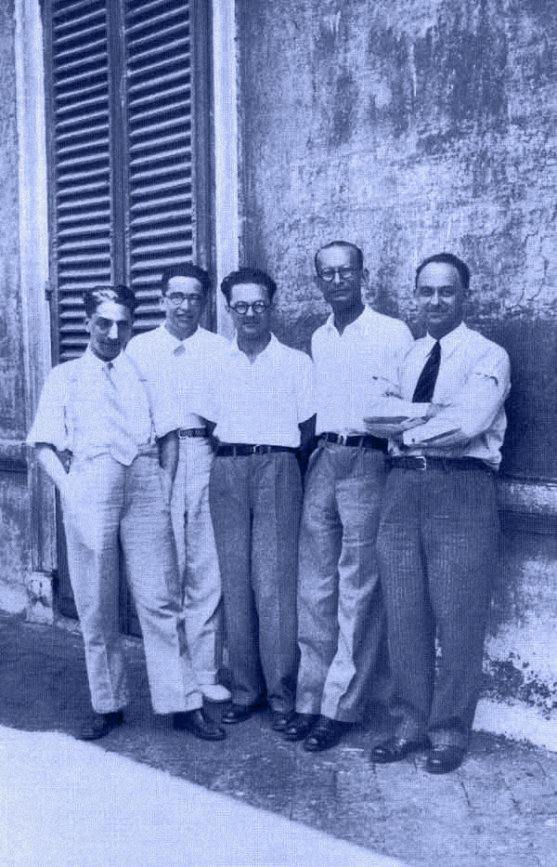
L’INFN è stato fondato
nel 1951 e ha una
lunga e prestigiosa
storia che discende
da Enrico Fermi
e i ragazzi
di via Panisperna

Slide 3





Pushing the frontiers of knowledge.
The secrets of the Big Bang
Developing
new frontier technologies
The
mission
Working together
with young researchers
and with researchers coming from all over the world
Train
the next generation of scientists and engineers

Slide 4
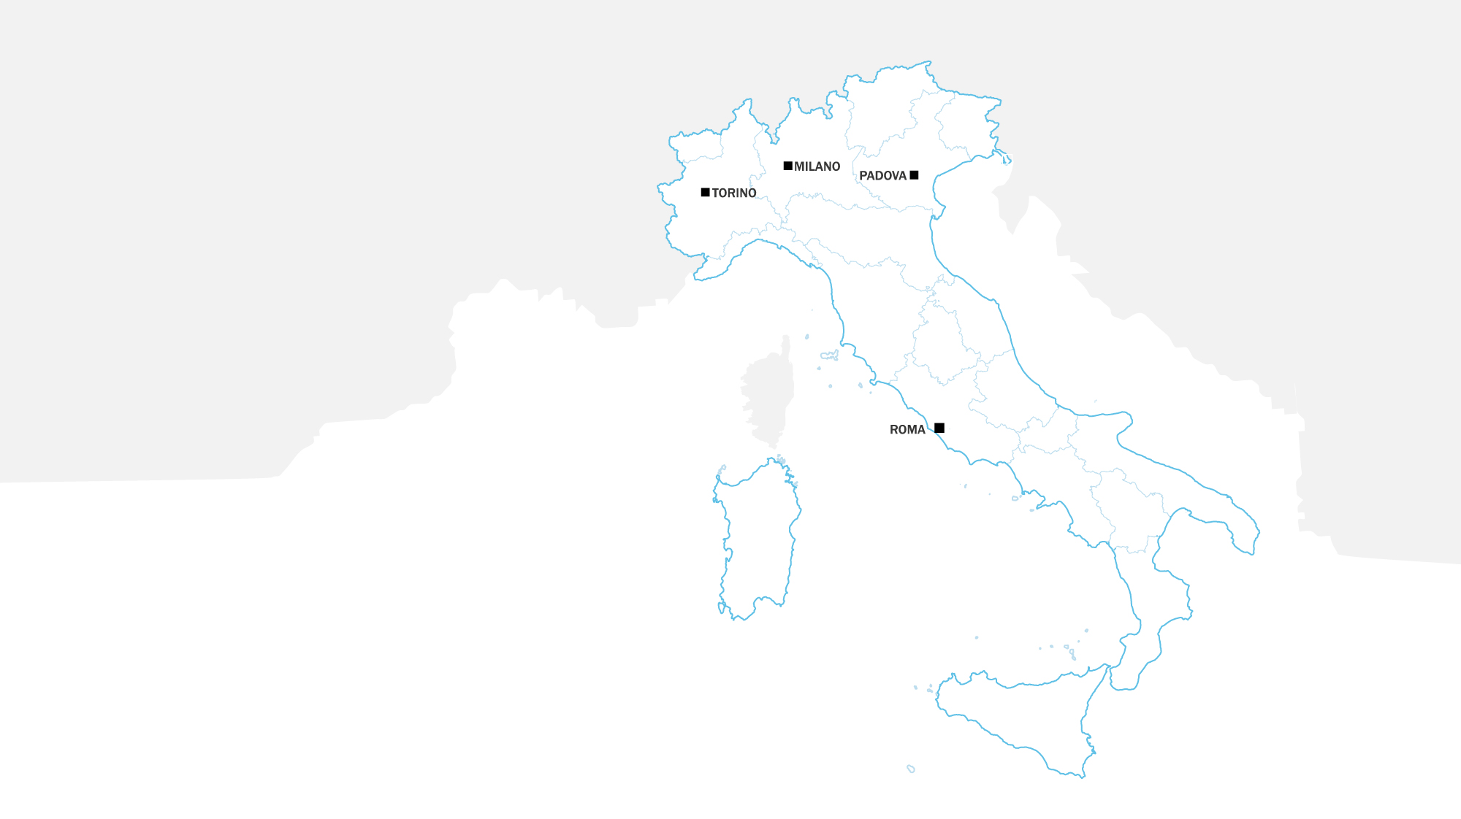
Centro di di Fisica Teorica
Centro Sperimentale e Teorico
di Fisica Nucleare
Centro di Studio degli Ioni Veloci
Centro di Studio per la Fisica Nucleare
INFN in 1951

Slide 5
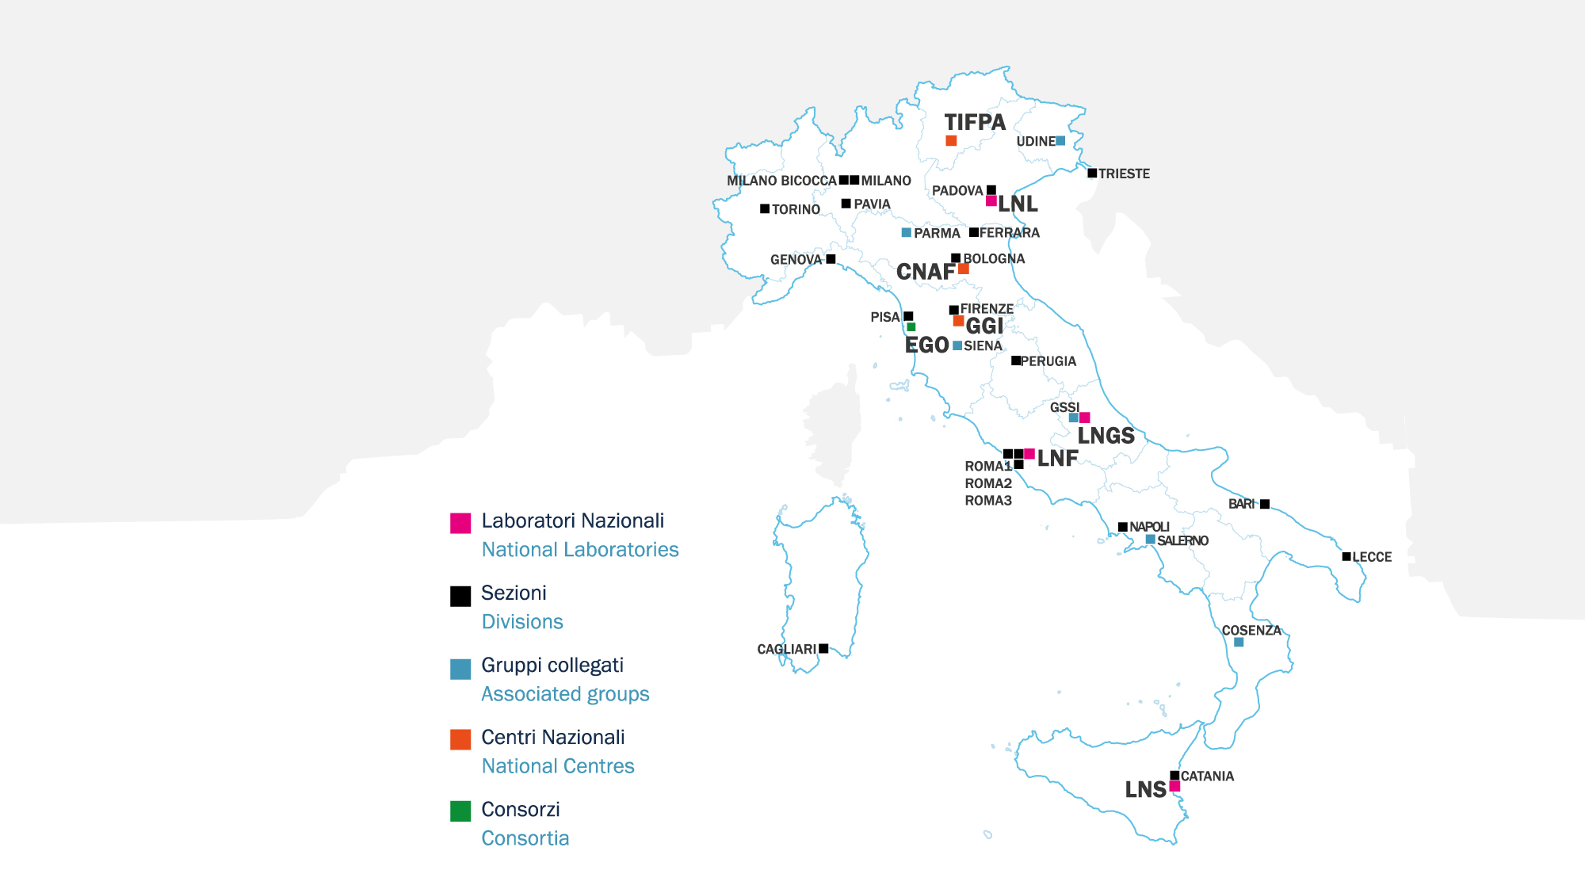
INFN Today

Slide 6
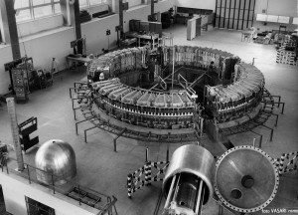
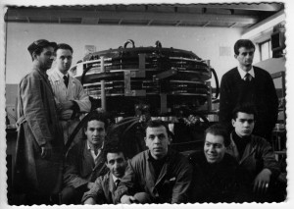
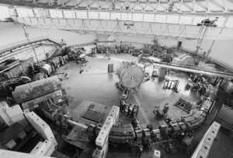
1954 Frascati National Laboratories
Main mission: construction and operation of particle accelerators
1959
The Synchrotron
1961
AdA
1969
ADONE

Slide 7
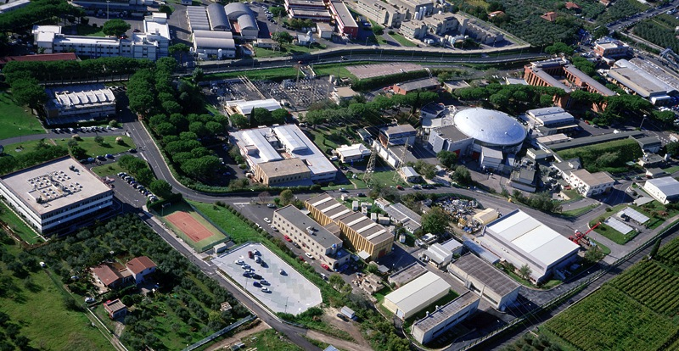
LNF Today
Fundamental Particle
and Nuclear Physics
DAΦNE-light
LINAC
Accelerator Physics
DAΦNE
Support to large scale
projects at other labs
BTF
FLAME
SPARC

Slide 8
EUPRAXIA
Italian branch of a multinational
project aimed at building two
plasma driven FELs,
one exploting the beam-driven
(in Frascati) and one the
laser-driven technique
(site yet to be decided)

Slide 9
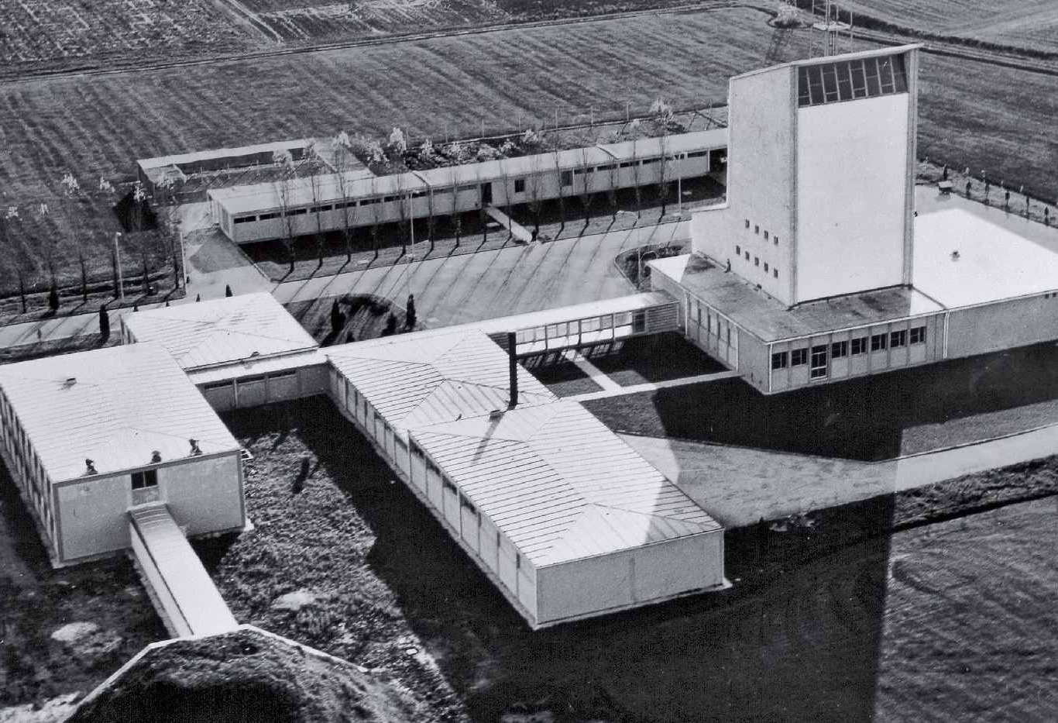
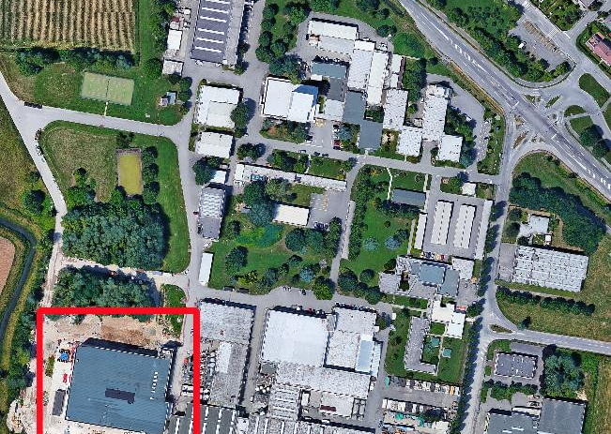
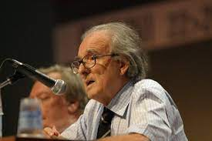
1961 Legnaro National Laboratories
Mission:
Nuclear physics and nuclear astrophysics:
  nuclear spectroscopy
  reaction dynamics
Advanced technologies for applications to nuclear physics and other fields
Technology transfer
Strengths:
Development of accelerators (e.g. RFQ)
Radiation detectors
Surface technology

Slide 10
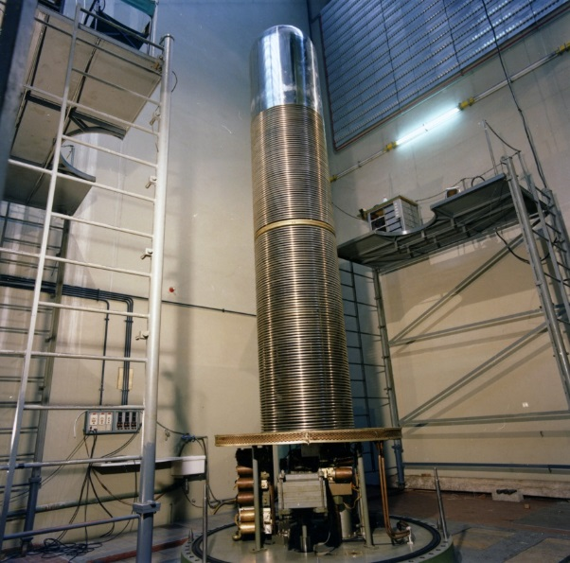
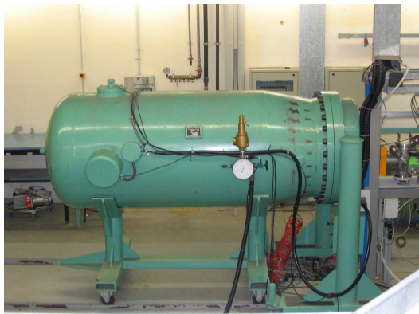
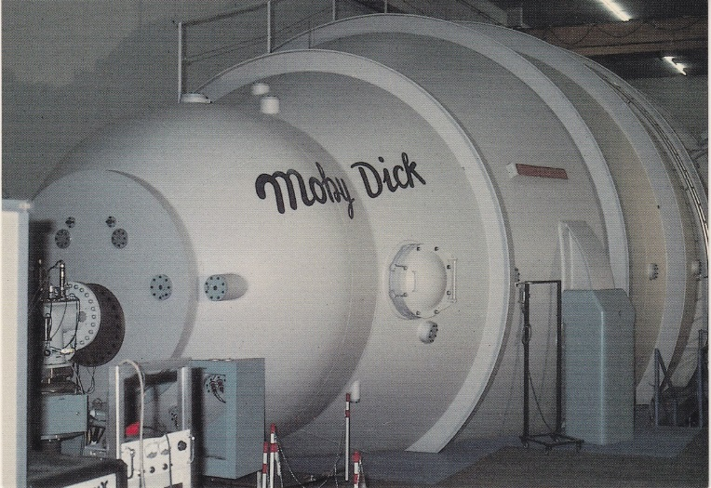
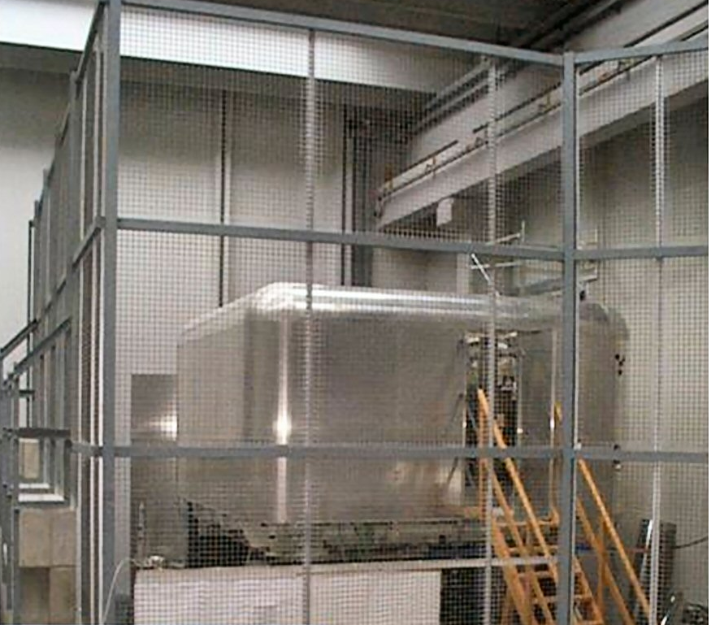
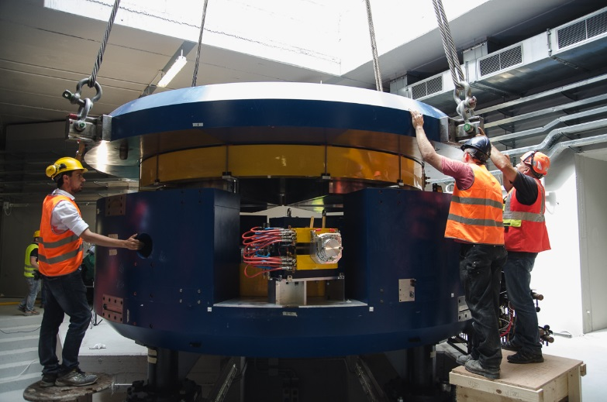
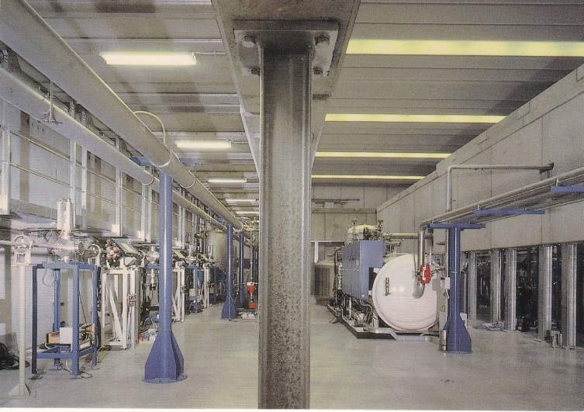
LNL Accelerators
CN (1961)
TANDEM (1981)
AN2000 (1971)
Ciclotrone SPES (2016)
ALPI (1995)
PIAVE (2005)

Slide 11
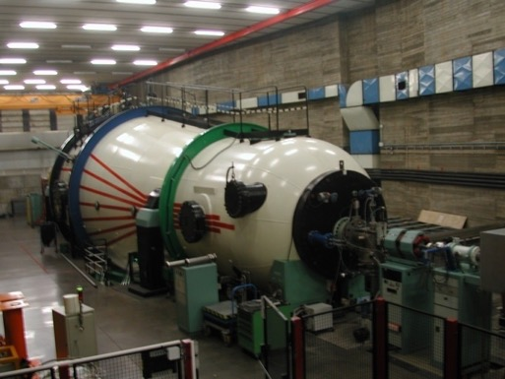
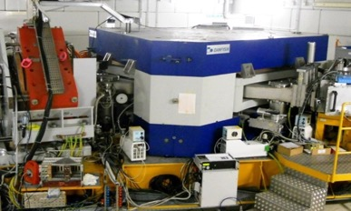
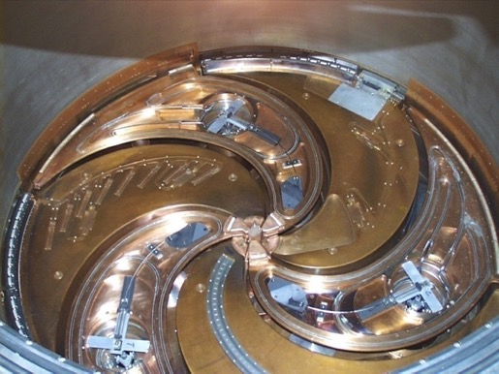
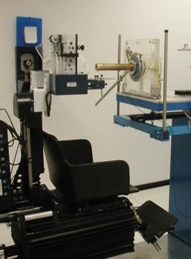
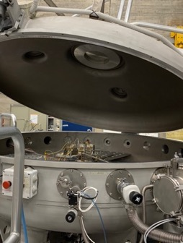
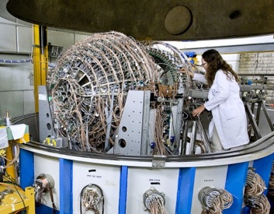
1976 Southern National Laboratories
Nuclear astrophysics
Nuclear structure and dynamics
Plasma physics
Medical physics and biophysics
Astroparticle physics
MAGNEX
Study of charge-exchange reactions
The 15 MV tandem accelerator
The K800 superconductive cyclotron
Medical physics
The CATANA irradiation hall
Nuclear astrophysics
Nuclear reactions at extra low energies
CHIMERA
Study of nuclear matter in extreme conditions

Slide 12


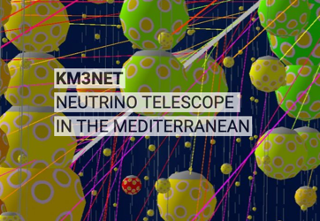
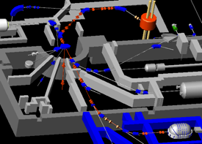
LNS Infrastructures
The POTLNS project aims
at upgrading the LNS CS and
beam lines to increase the
the intensity by about 2 orders of magnitude for ion
beams with mass number <= 40 and energies
between 15 and 70 MeV / amu.
PANDORA aims at
building an innovative
magnetic plasma trap,
for interdisciplinary
and fundamental
physics research, especially the study
of β-decays under astrophysical
conditions
Extraction by stripping
KM3NeT is a research infrastructure housing the next generation neutrino telescopes. KM3NeT will open a new window on our Universe, but also contribute to the research of the properties of the elusive neutrino particles.
Applications:
In flight production of RIBs @ FRAISE
High intensity beams for the study of 0ν2β decay (NMEs)
Not only NP : as outlined in an interview in occasion of the 45° anniversary of the foundation LNS is playing a role in Astroparticle Physics, Applied physics, Theoretical physics and is heavily involved in Societal challenges, according to UE guidelines and to UNO Agenda 2030

Slide 13
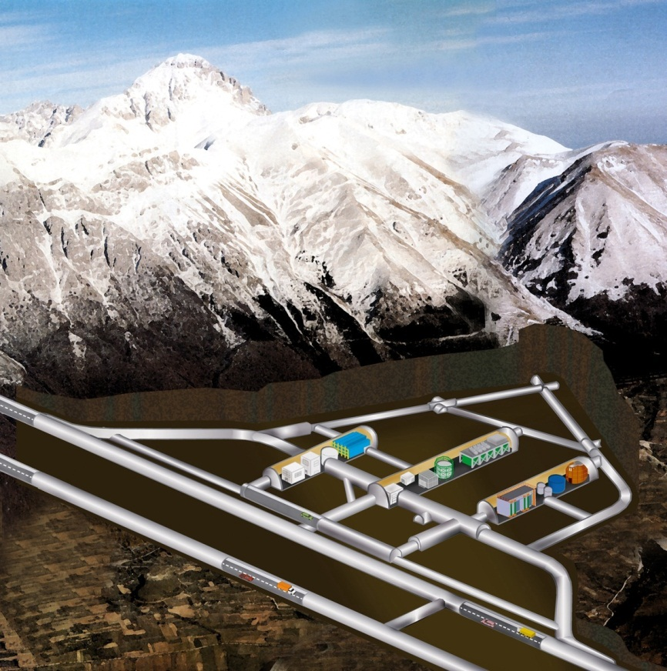
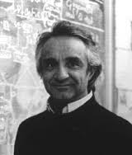
1987 Gran Sasso National Laboratories
3400 m.w.e.
1.1 μ / (m² h)

Slide 14
Science at LNGS

Slide 15
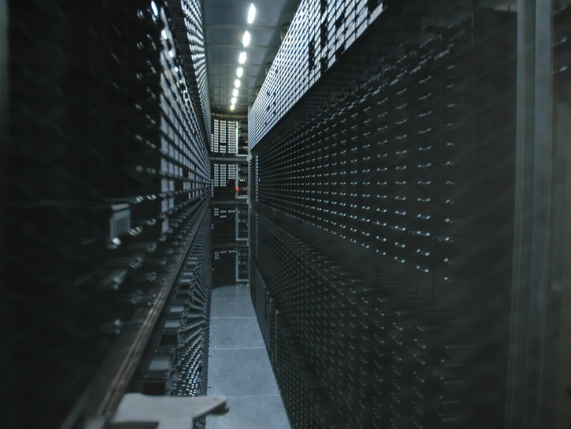
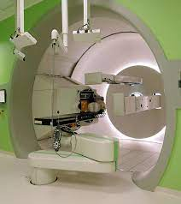

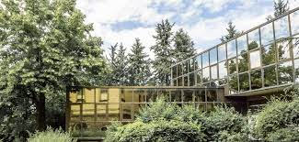
The National Centres
1962 CNAF
INFN Technological Center initially dedicated to the
analysis and high precision measurement of bubble chamber
photographic films.
Today CNAF is devoted to Research and Development in INFN
Information and Communication Technologies and supports the
INFN computing infrastructure
2014 TIFPA Trento Institute for Fundamental Physics and Applications
Science and Technology National Center for research in fundamental
physics and state-of-the-art development of related technologies.
It is embedded in the fertile substrate offered by the Trento Province
research and technology context, and capitalizes on the collaborations
already established across the past 20 years with UNITN and FBK.
2018 GGI Galileo Galilei Institute
Institute dedicated to organizing and hosting long-term
workshops dedicated to theoretical physics of fundamental
interactions. reference point for the international scientific
community and as a site dedicated to high-level training
of young Italian and foreign researchers.

Slide 16
INFN Computing infrastructure

Slide 17
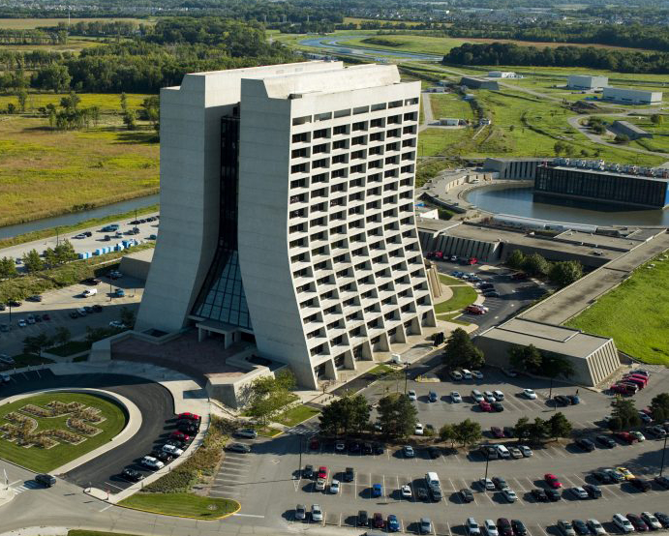
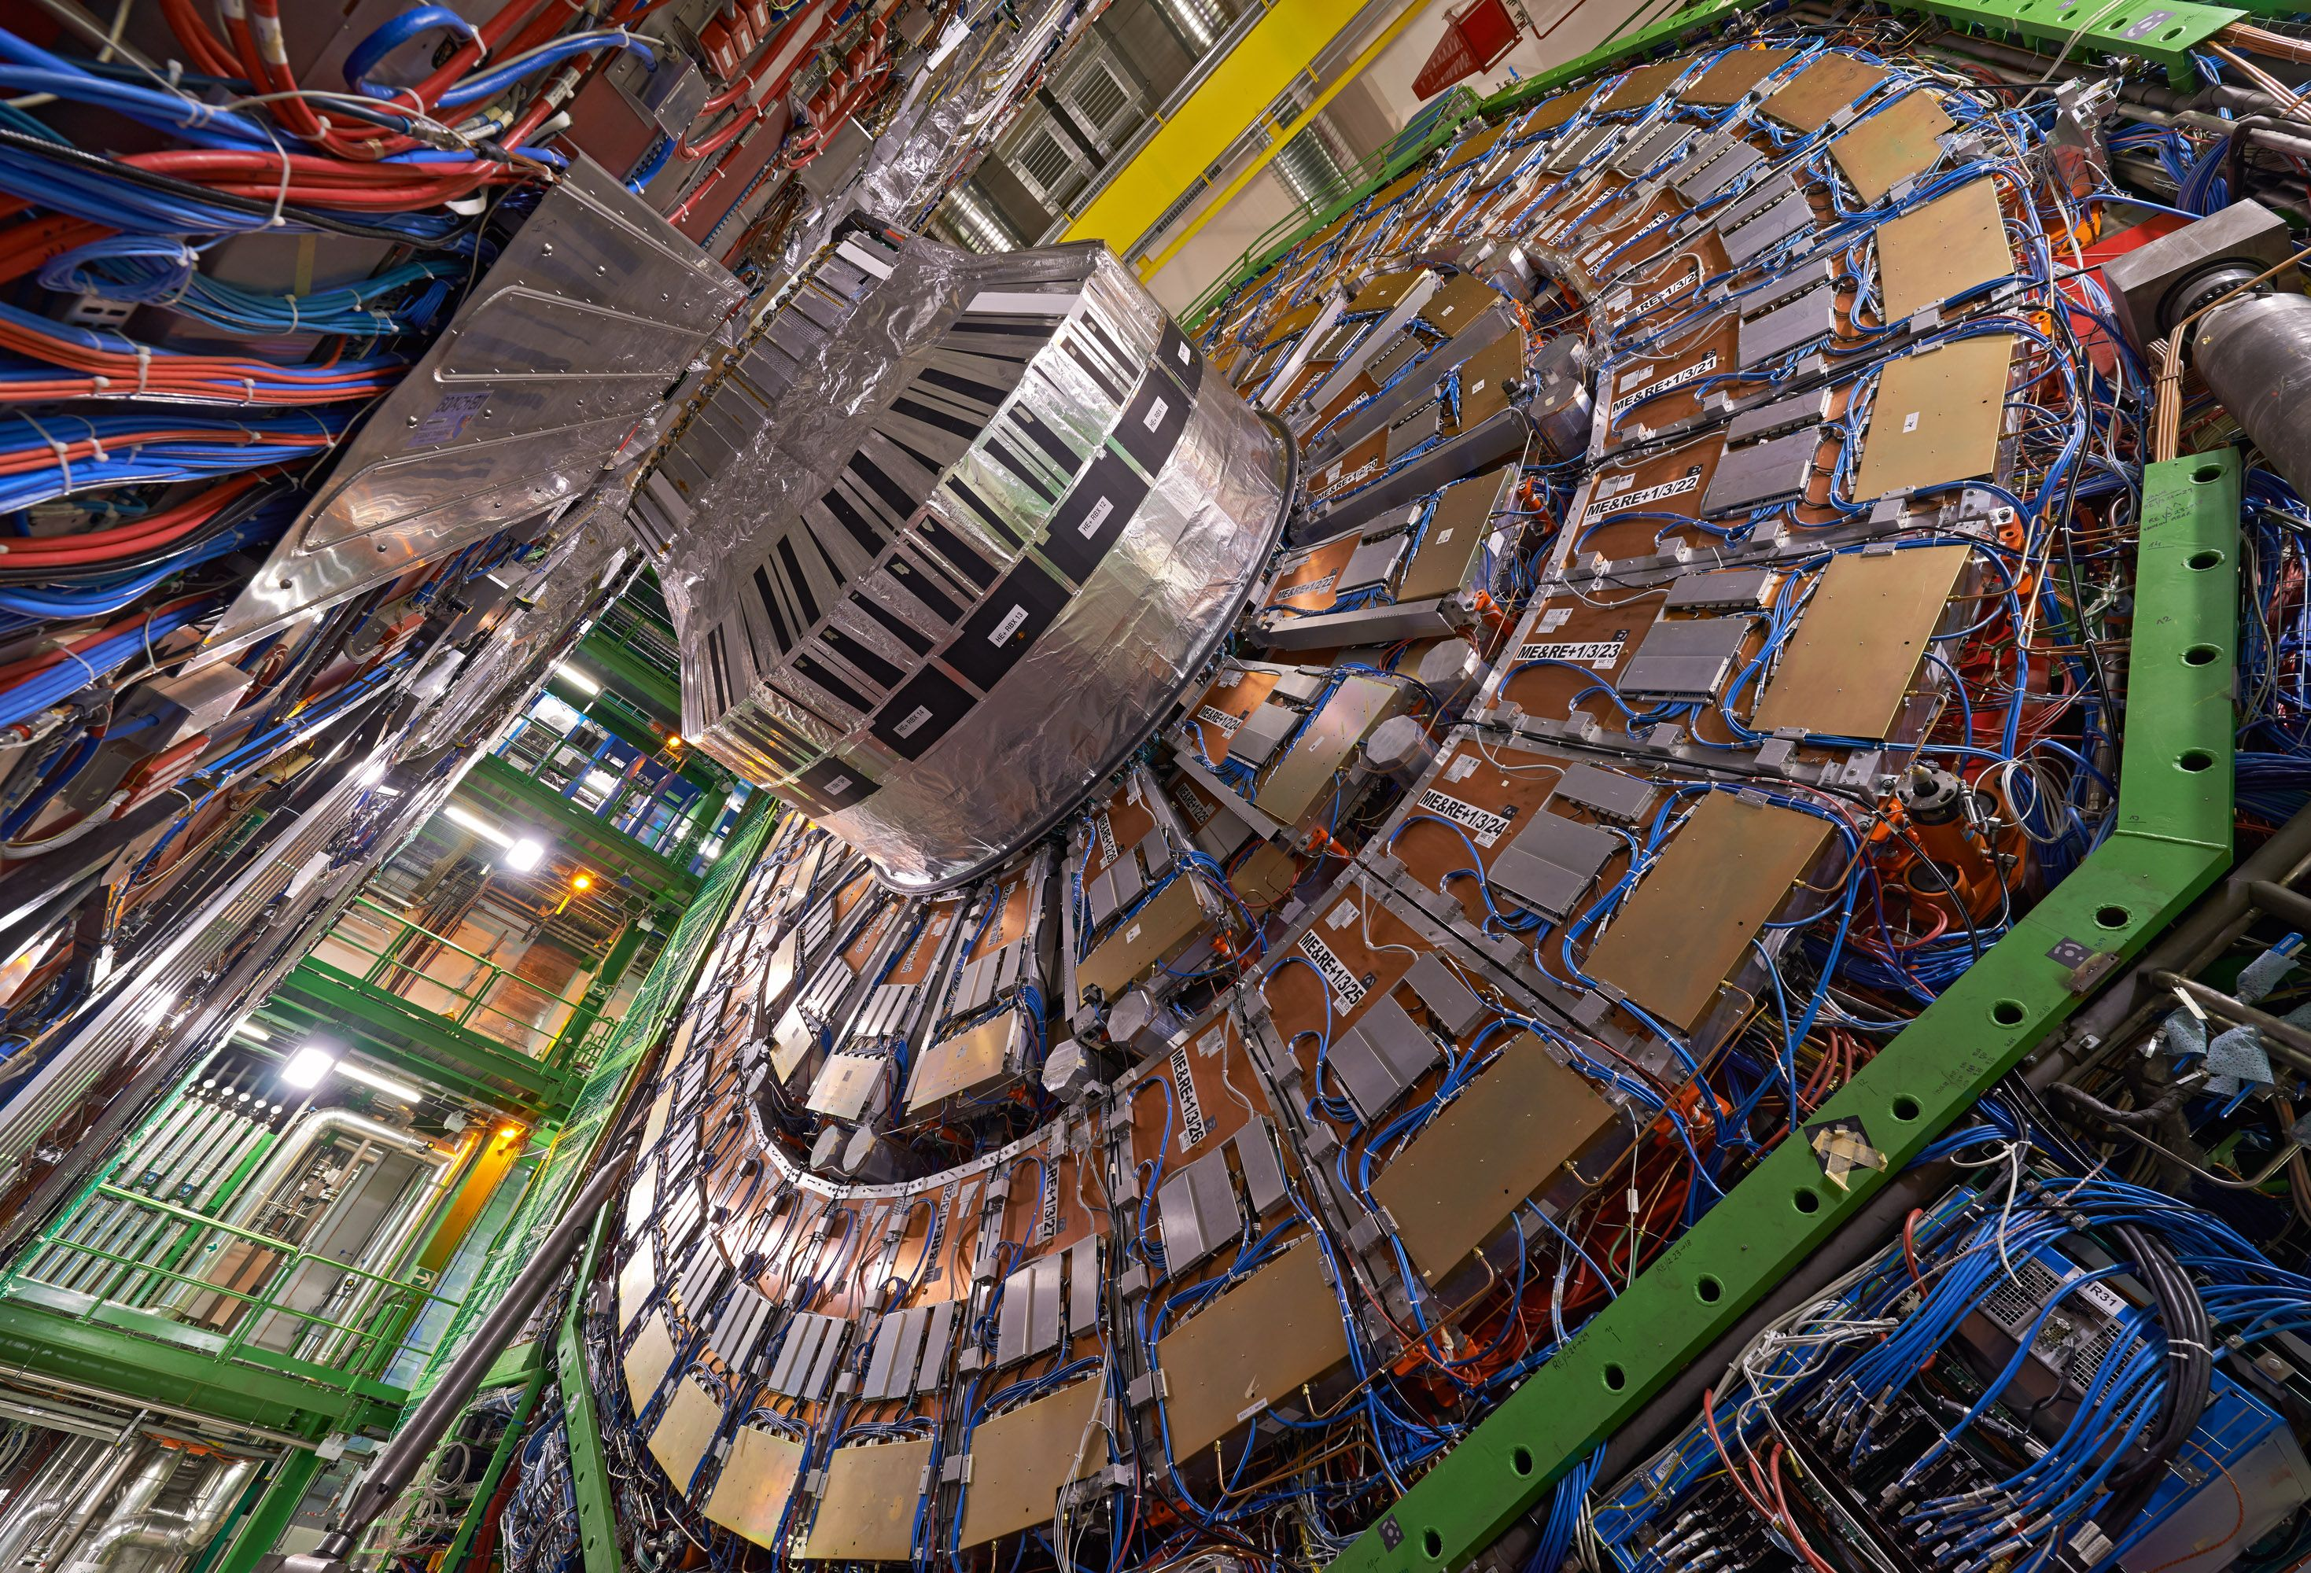
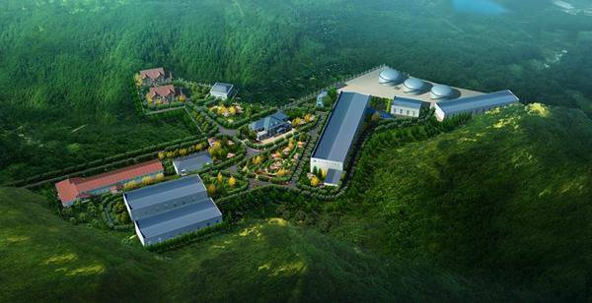
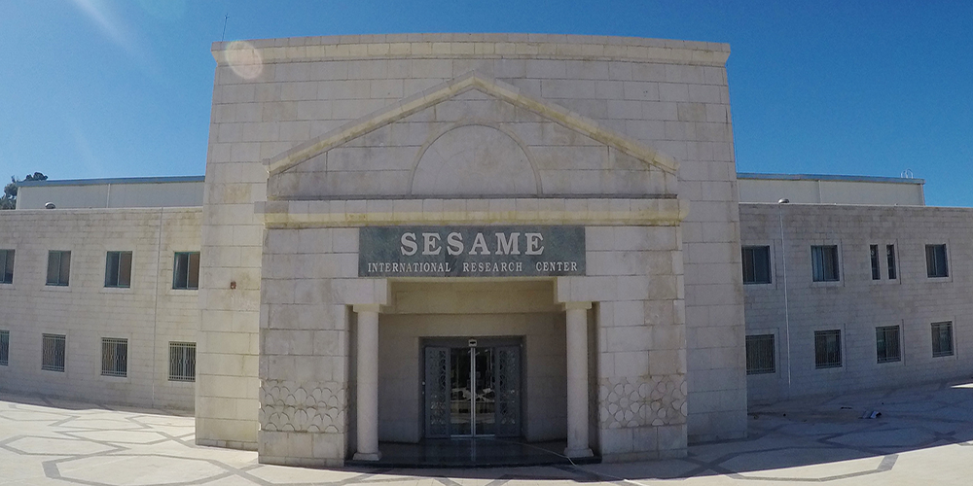
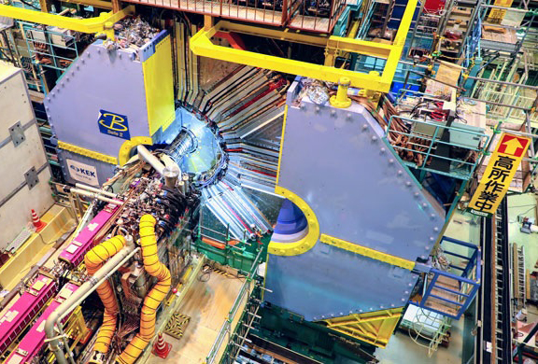
An
international DNA

Slide 18
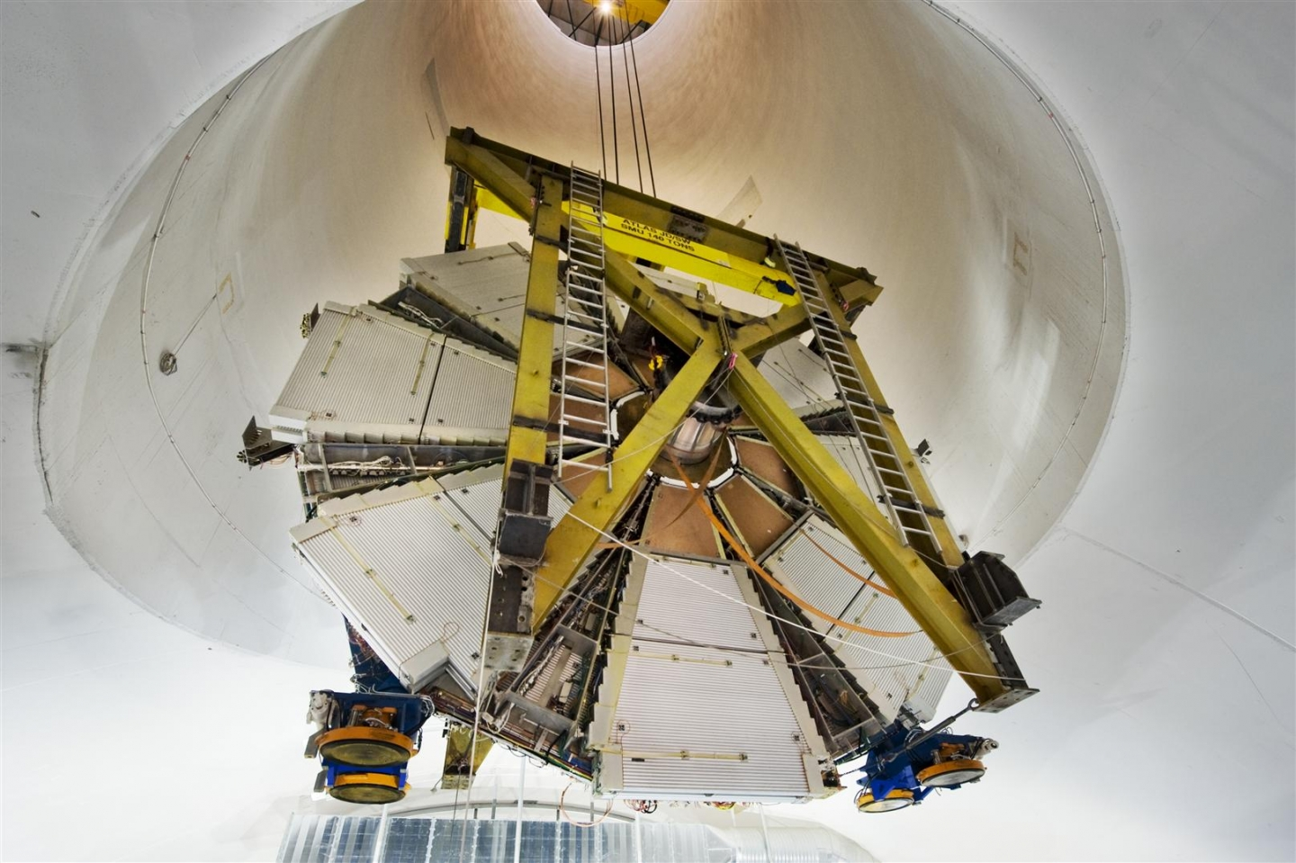
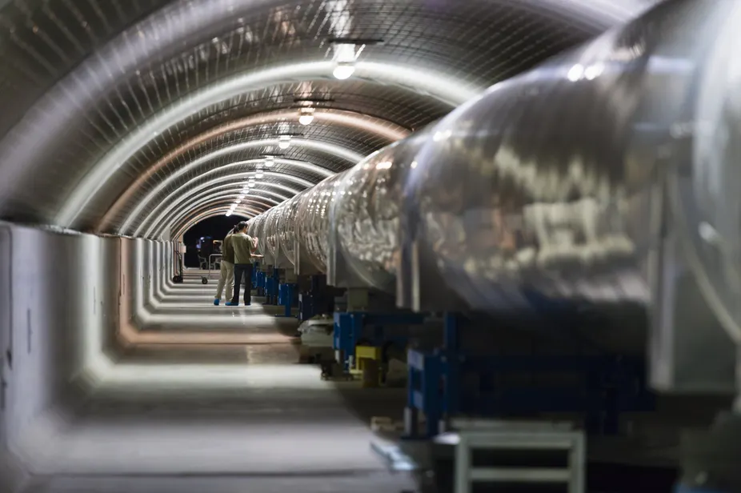
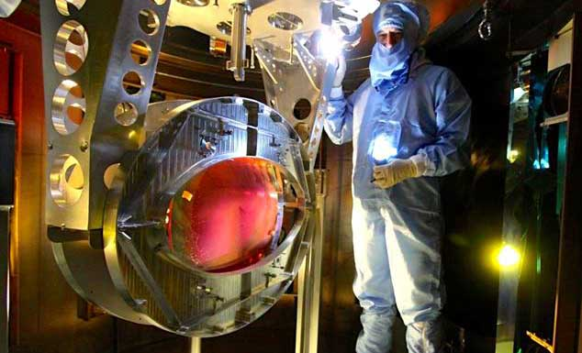
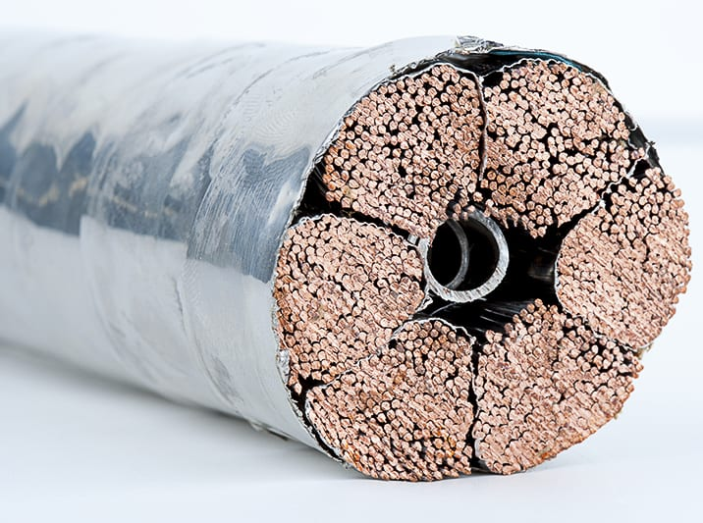
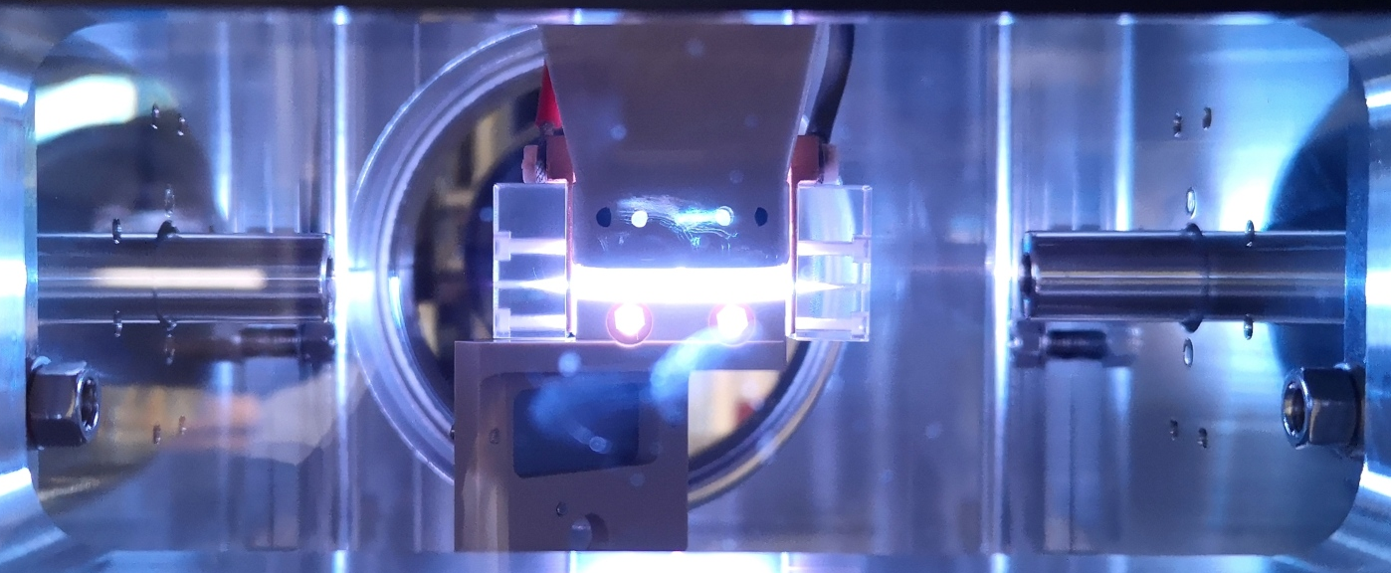

Due Premi Nobel
From the discovery of the Higgs boson
to the quest for a new particle world
Near future: High-luminosity LHC and beyond:
Future Circular Collider, Linear Collider, Muon Collider, …
New technologies:
High-field superconducting magnets, HTS
Plasma wakefield acceleration
From first detection to a new astronomy: Gravitational Waves and multi-messenger
VIRGO (EGO consortium)
Near future: Einstein Telescope
and beyond: LISA interferometer in space

Slide 19
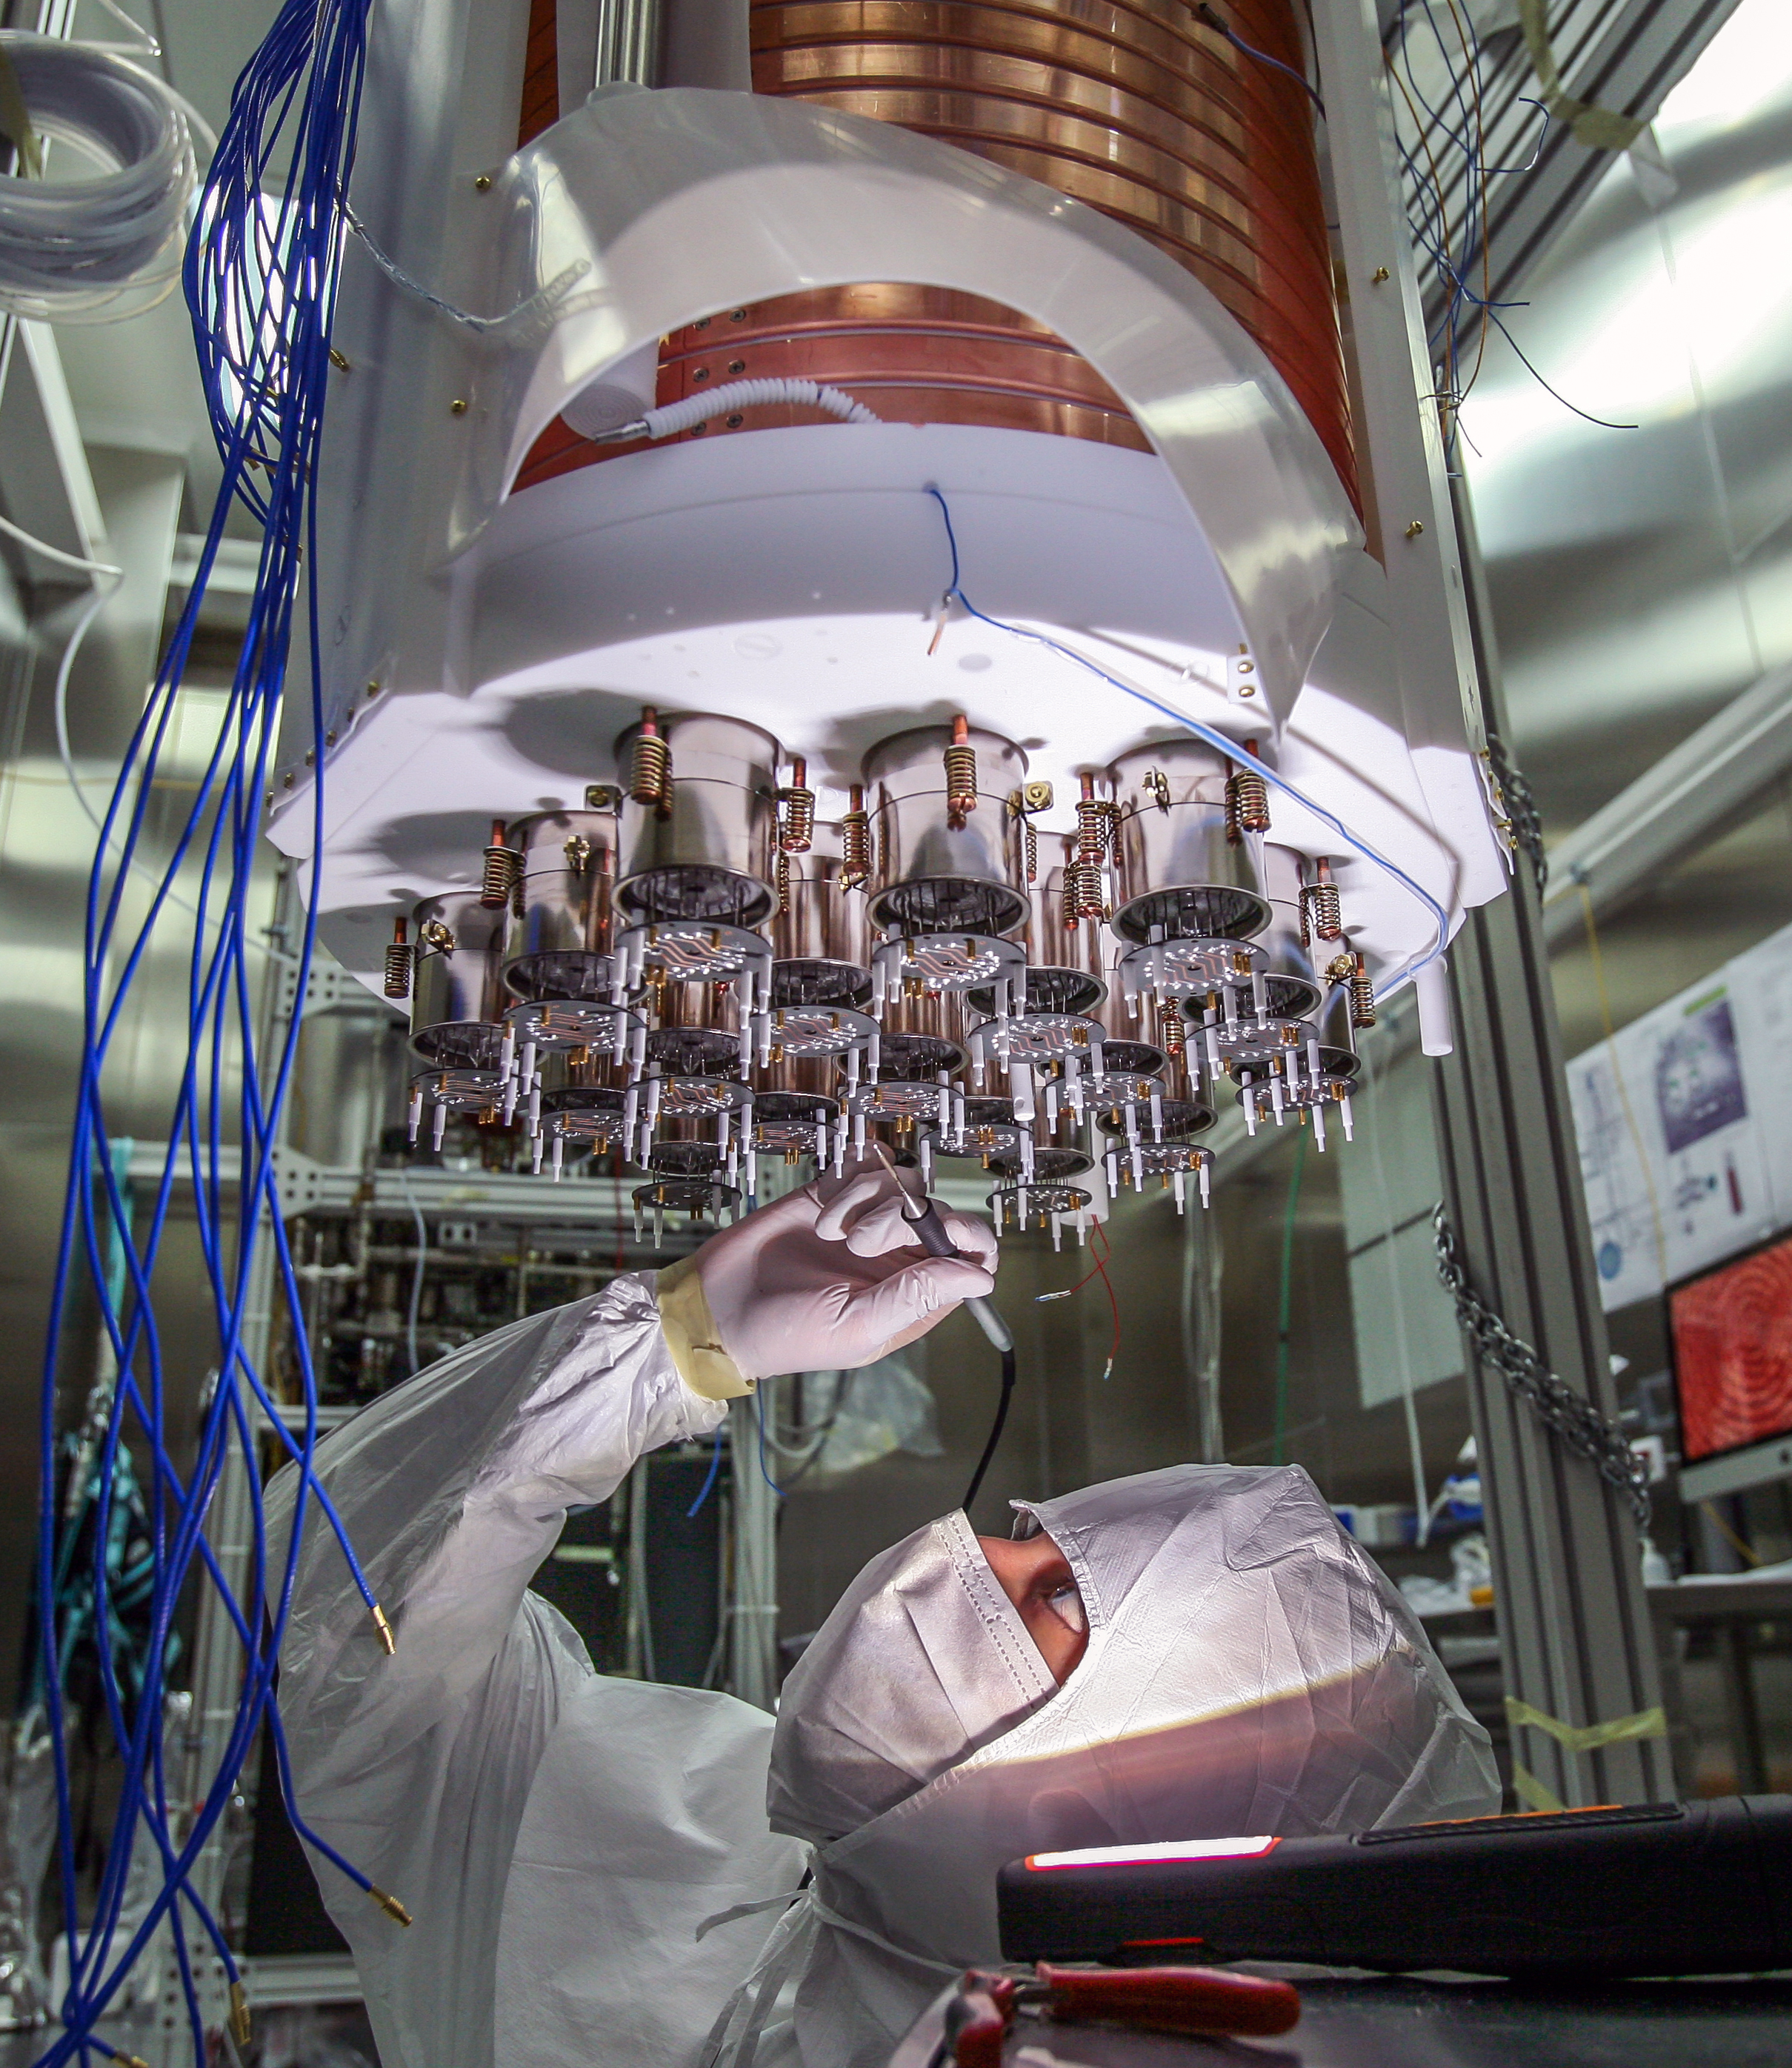

The INFN is …
a community of over 6,000 people
~ 25% of them have PhD grants,
post-doc scholarships and research grants

Slide 20

INFN people
Number of employees with
Permanent contract / Fixed-term contract
PERMANENT CONTRACT 1991
TI
men 1474
women 517
FIXED-TERM CONTRACT 216
TD
men 147
women 69
Up to 31/12/2020

Slide 21

INFN people
Breakdown of
Permament staff
Researchers 663
Technologists 353
Technicians 657
Administrative staff 316
Total staff TI 1991
Administrative manager 2
Up to 31/12/2020

Slide 22

INFN people
Breakdown of
Associates
Associates 4353
Research grants
558
Post-doc scholarships
148
PhD students
1011
Research assignments
802
Other
1656
Technical associates
179
Up to 31/12/2020

Slide 23
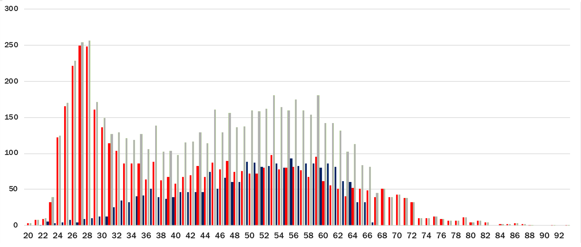
Frequency distribution of employees/associates according to age
associates
Staff INFN
Total
anni
Up to 31/12/2020

Slide 24

People
… in training
INFN
associates
Research grant
258
299
Post-doc scholarships
105
45
PhD students
1011
Up to 31/12/2020

Slide 25

Budget 2020
332 mln di euro
Financial resources
excluding funds allocated
to specific projects
253,8
mln di euro
Funds allocated to
specific projects
99,2
mln di euro

Slide 26
Financial report 2020
Profile of expenditure for
research, personnel, operations and equipment
operations
and
equipment
personell
research
48,1%
34.0 %
17.9%

Slide 27
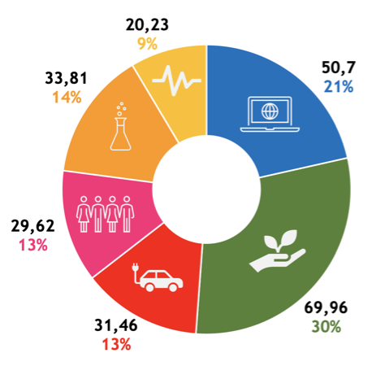
The future: PNRR
Recovery & Resilience Plan
Recovery and Resilience Plan
Next Generation EU: 191.5 b€ + 30.6 b€ Complementary Fund + 26 b€ Development and Cohesion + 13 b€ React EU
Mission 4 ‘Education and Research’:
Investments: 30.88 b€
About 6 b€ for approximately 60 new projects
National R&D networks
in selected key enabling technologies
1.6 b€
Research Infrastructures
1.58 b€
Innovation Ecosystems
around local R&D systems
1.3 b€
Extended Partnerships
for fundamental research projects including universities, research institutes and private businesses
1.61 b€

Slide 28


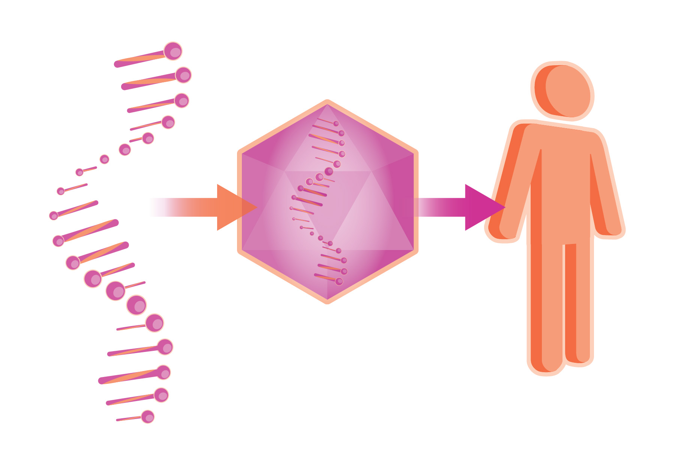


Simulations,
high-performance computing
and data analysis
Agriculture technologies
Gene therapy and RNA drugs
National R&D networks
in selected key enabling technologies
1.6 b€
Sustainable Mobility
Starting with 5 new centres
Biodiversity

Slide 29



Research Infrastructures
1.58 b€ for up to 30 new or upgraded RI
Included in the national plan of RI
or
in the European Strategy Forum Roadmap
Super
condictivity
Einstein Telescope
KM3NET

Slide 30
Conclusion
Happy 65° Birthday Bologna !!!!
INFN made a long path in frontier research based on Laboratories and Research Infrastructures
Today we celebrate the great achievements of the Bologna Section!
Thank you to all the researchers, the technologists, the technicians and the administratives that made it possible !!!
Now we have look forward to the future, a bright future is in front of you, in front of us !

